Slide 1
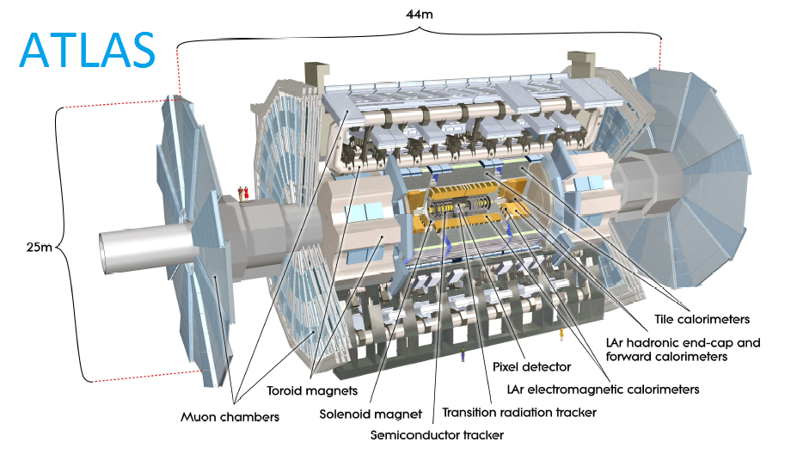
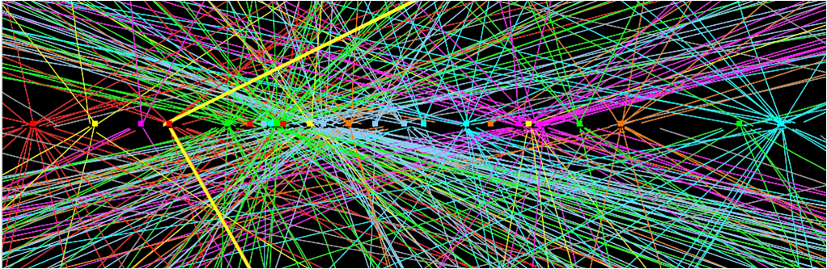
An online silicon detector tracker for the ATLAS upgrade
- FTK reconstructs charged particle trajectories in the silicon tracker (Pixel & SCT) at “1.5” trigger level.
- Extremely difficult task
100 kHz event rate
~70 pile-up events at top
luminosity.

Slide 2
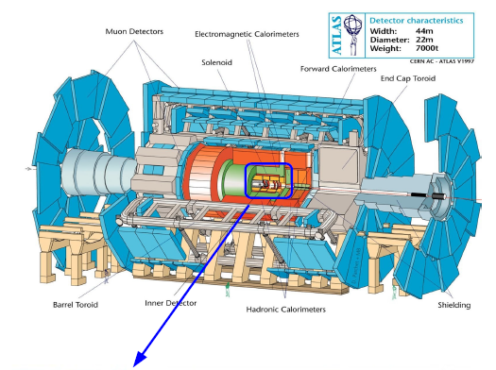
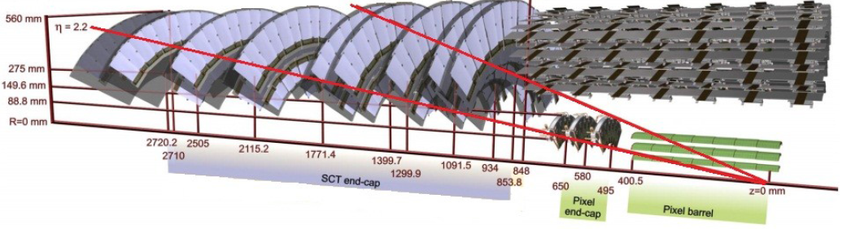
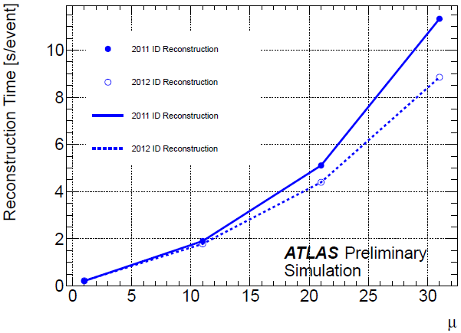
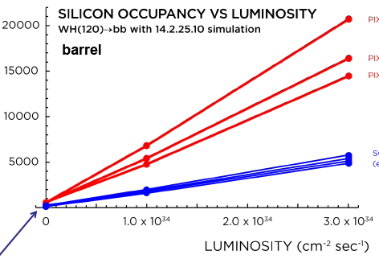
The Tracker: the most computing demanding
reconstruction
ATLAS
ATLAS Silicon Tracker
Pix2
Pix1
Pix0
SCTs
Hard scattering!

Slide 3
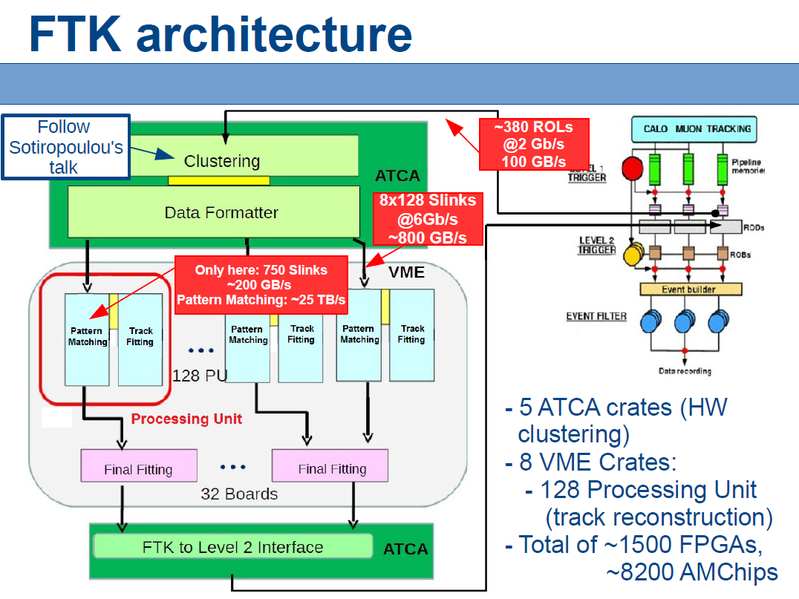

Slide 4
FTK: Full event tracking in 2 steps
  Find coarse Roads first (Pattern Matching with Associative Memory, AM)
  From those Roads extract the full resolution Hits
  Combine the Hits to form Tracks, calculate χ² and parameters (Track Fitter)
_{SSIDs}
Data Organizer
(DO)
Pattern matching
(Associative
Memory - AM)
Hits
Roads
Roads + hits
Track
Fitter
(TF)
Super
Strip (SS)
Tracks parameters
(d, p_{T}, φ, η, z)
Track fitting
  using full resolution of the detector

Slide 5
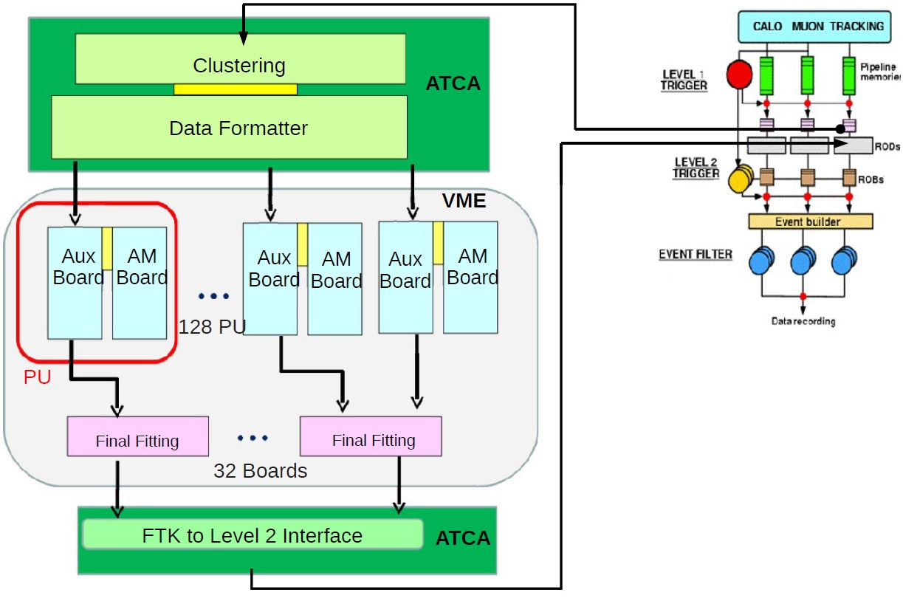
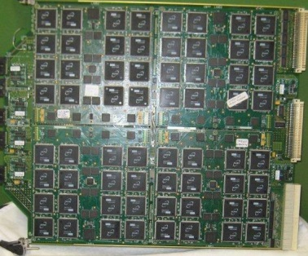
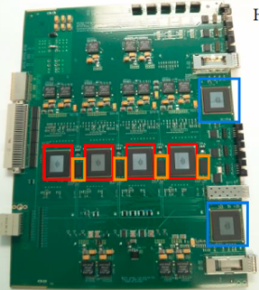
FTK architecture
~380 ROLs
@2 Gb/s
100 GB/s
8x128 Slinks
@6Gb/s
~800 GB/s
8x128 Slinks
@6Gb/s
~800 GB/s
Only one AMB: 750 Slinks
~200 GB/s
Only AMBs: ~25 TB/s

Slide 6
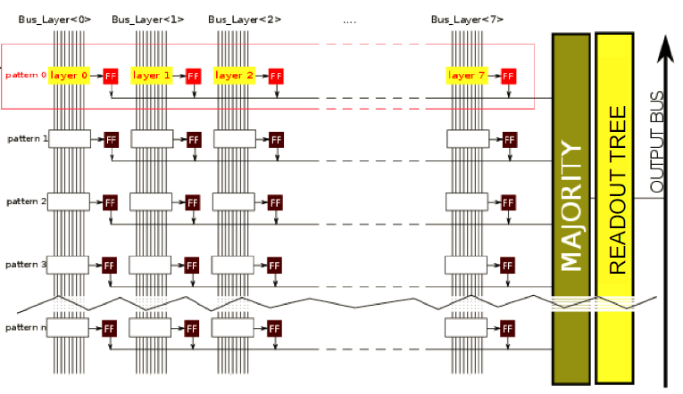
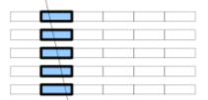
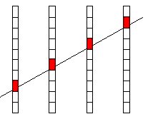
AM chip working principle
1 COMPARATOR
Between the
BUS & 1 stored
16-bits-WORD
Pattern
AM chip consumption:
~ 2.5 W for
128 kpatterns
AMchip computing power:
Each pattern, each 10 ns :
4x32 bits comparisons
128 kpat x4 = 500 K comparisons
→ 500 K x 100 M/s = 50x10⁶ MIPs/CHIP
Only comparisons! 8000 Amchips 4x10¹¹ MIPs
+ 128 k coincidences w majority/chip
+ readout logic
HIT
HIT
HIT
HIT
AM Memory Accesses:
128 k x 4x32 bits x 100 M/s=
1.6x10¹⁵ accesses/s per chip

Slide 7
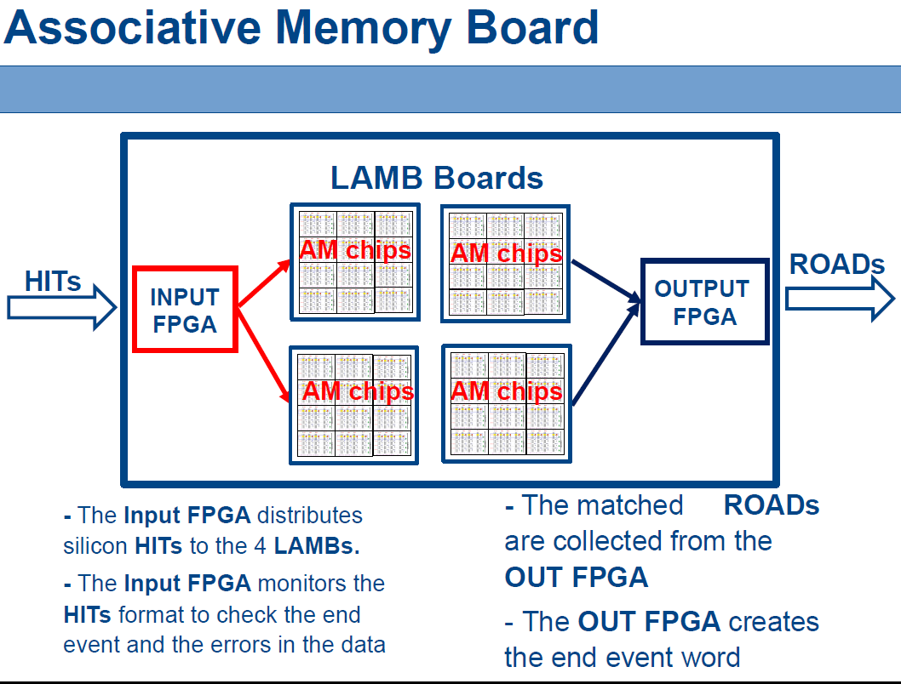

Slide 8
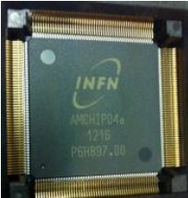
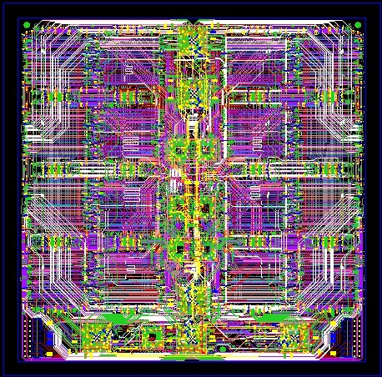
Recent developments of the Associative Memory chip
AM chip 04:
- Package: PQ208
- Parallel I/O interface
- 8k patterns
- Crazy routing of LAMB
More performance needed with the new AMChip06
- Increase the number of pads.
- Use BGA package for more pins
- Simplify LAMB routing
Idea: serial link to transmit the data

Slide 9
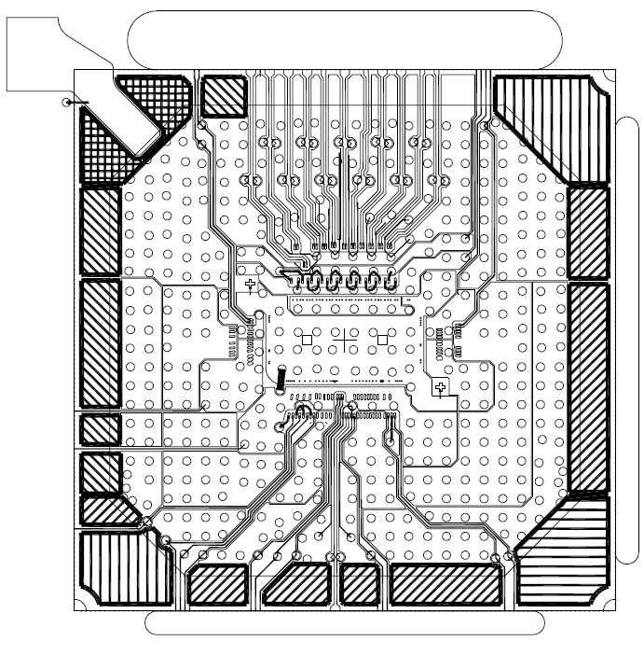
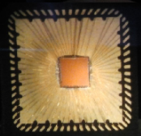
Associative Memory Chip - Family 05
We bought a IP-CORE to provide the chip with serialisers and deserialisers.
MiniAMChip05
AMChip05
Package: QFN 64
Die: 3.7 mm^2
Board: MiniLAMB-SLP
Status: under test
Package: BGA 23 x 23 mm
Die: 12 mm^2
Board: LAMB-SLP
Status: submitted

Slide 10
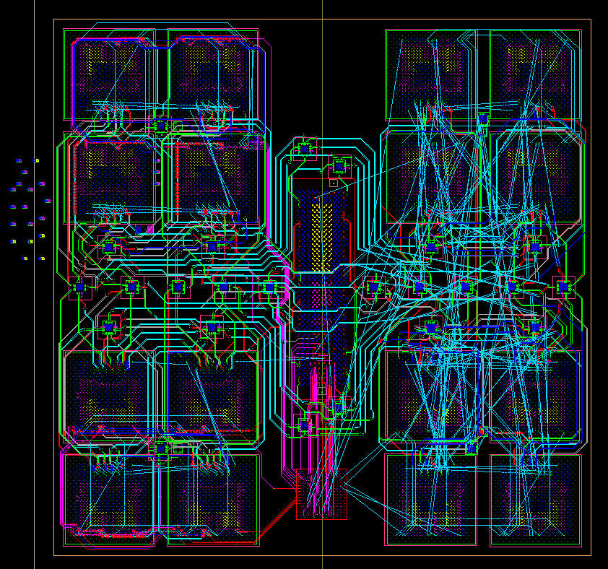
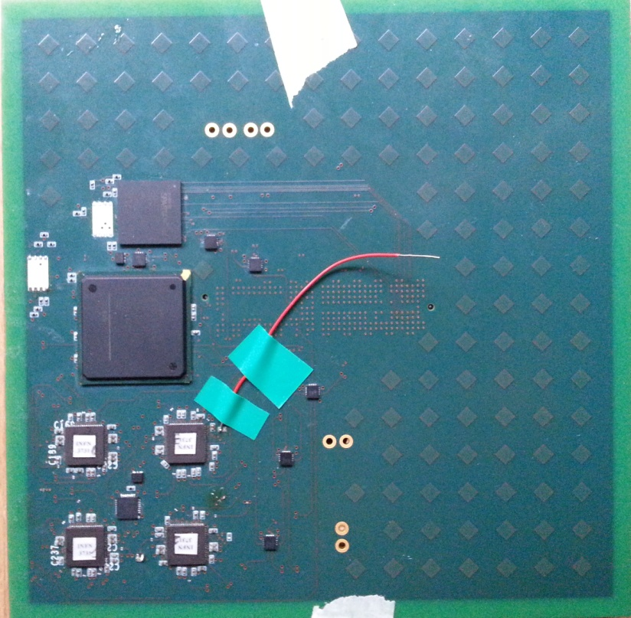
LAMB-SLP
- The final LAMB-SLP board will be ready in short time.
- In one LAMB-SLP board will have 16 Amchips.
→ for a total of ~2 M of patterns
- The routing is simplified.
- This is a prototype of LAMB-SLP
board with 4 MiniAM chips.
→ This board is important to confirm
our idea and our solution on
Serial Link.

Slide 11
MiniLAMB-SLP & LAMB-SLP
- The final LAMB-SLP board will be ready in short time.
- In one LAMB-SLP board will have 16 Amchips.
→ for a total of ~2 M of patterns
- The routing is simplified.
- This is a prototype of LAMB-SLP
board with 4 MiniAM chips.
→ This board is important to confirm
our idea and our solution on
Serial Link.

Slide 12
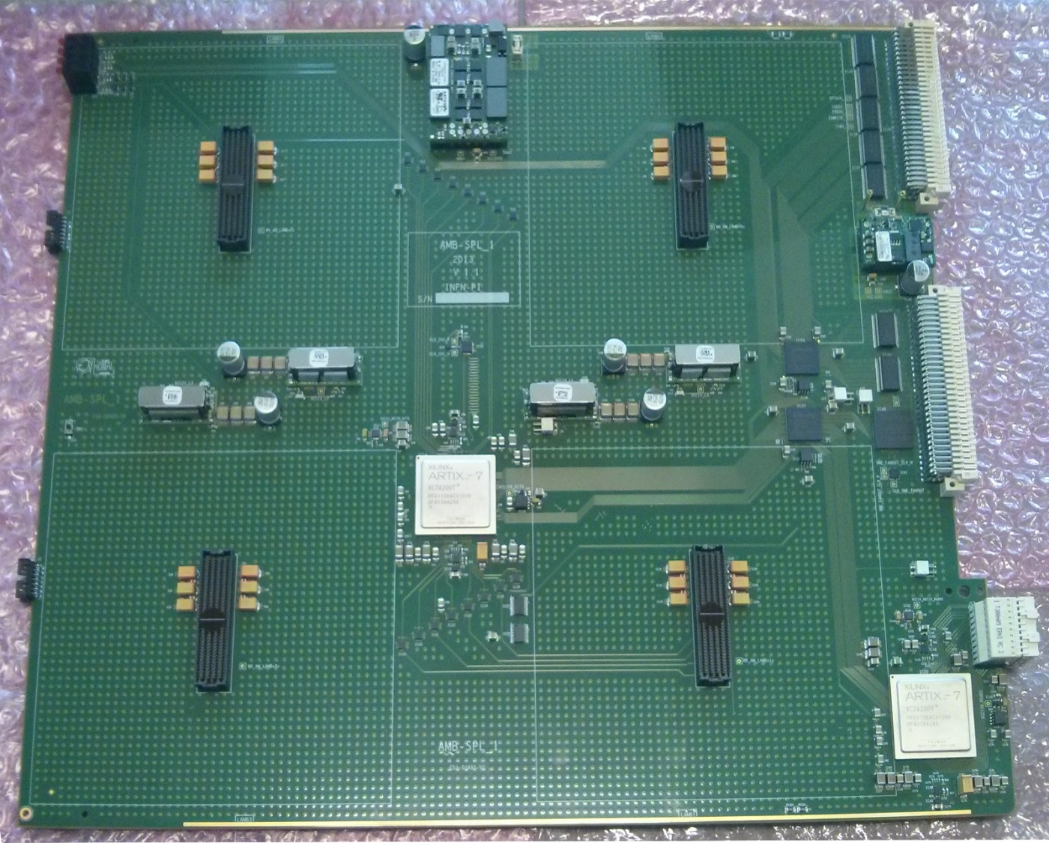
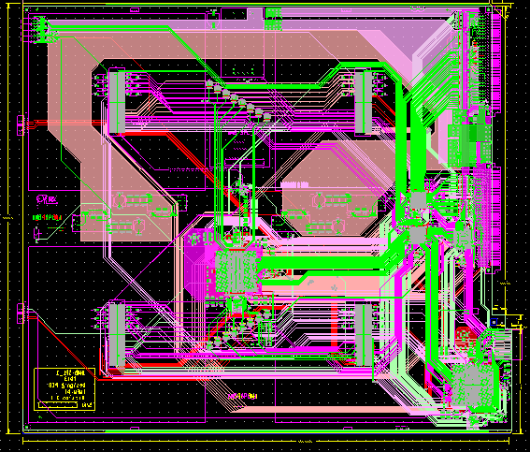
AMB-SLP board
The AMBSLP (Serial Link Processor) board design:
Interface:
- 12 input buses @ 24Gbps
- 16 output buses @ 32Gpbs
Three FPGA:
- 1 for the input data distribution (ARTIX-7)
- 1 for the output data distribution (ARTIX-7)
- 1 FPGA for the data control logic
(SPARTAN 6)
We used only serial standard for data distribution to and from the AM chips

Slide 13
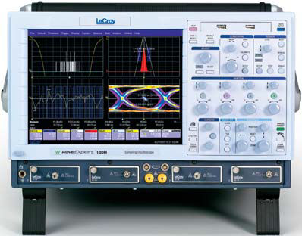
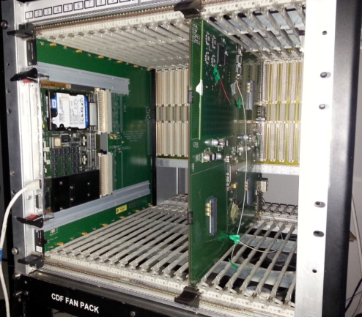
Test Stand
Complete test with:
AMB-SLP board.
MiniLAMB-SLP board.
Crate VME.
CPU TDAQ 4.
Strobe
- We perform a Serial Link's test with a PRBS Generator.
- We used a IBERT core in Xilinx's ISE.

Slide 14
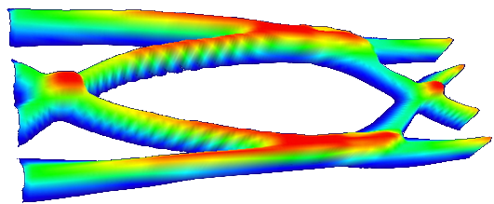
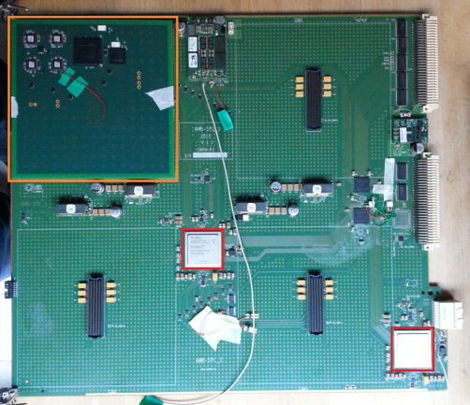
Serial Links
Both input and output serial links characterized for signal integrity.
AM CHIP
- Serial Link @ 2 Gb/s
→ Input path
FPGA to FANOUT to AM Chip
Intermediate buffers
→ Output path
AM Chip to FPGA
Intermediate repeater
IN
OUT

Slide 15
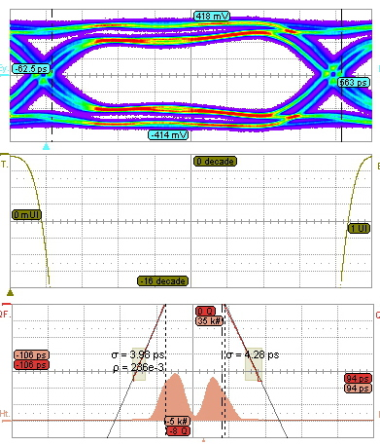
Result
- Types of measure:
.Jitter Analysis
.BER
.Eye diagram
- Send PRBS data:
PRBS checker
BER < 10⁻¹⁴

Slide 16
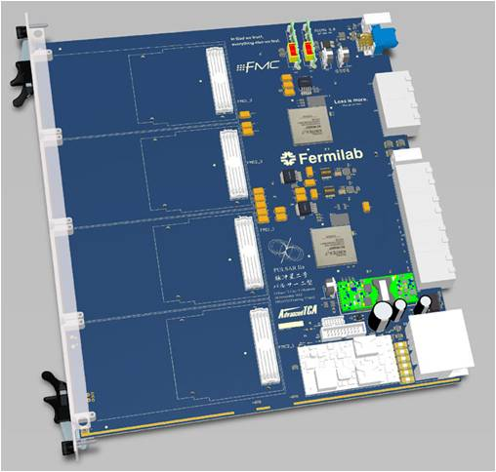
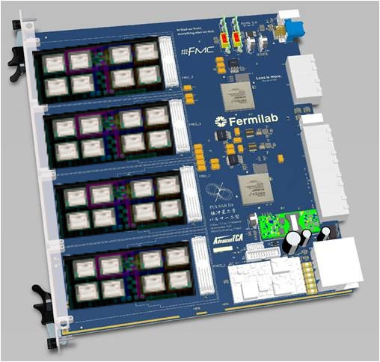
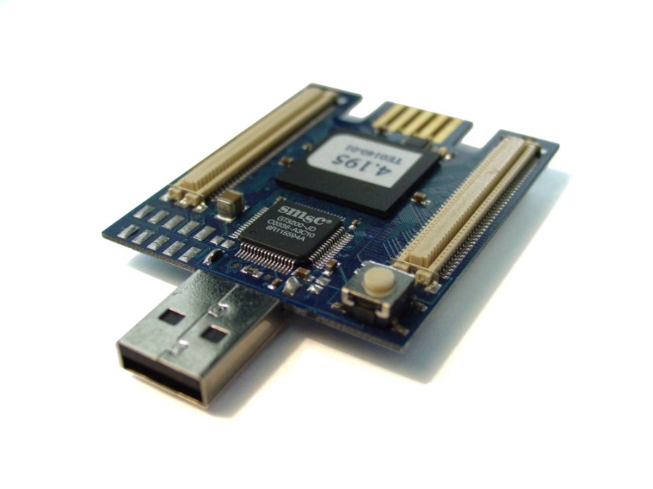
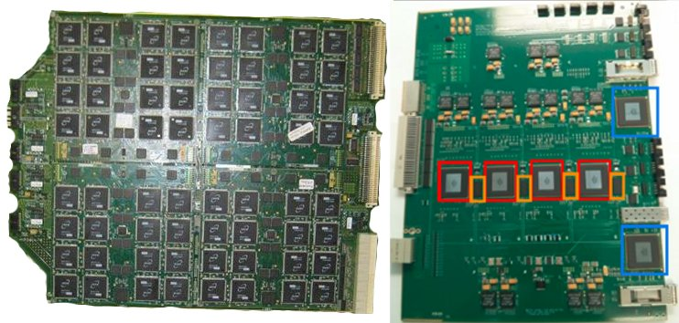
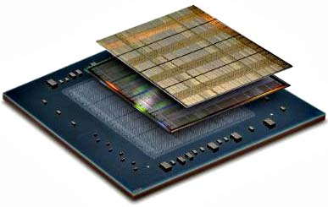
Future Evolution: integration of many FTK functions in a small form factor
Main goal is to integrate the FTK system in a more compact form
First step will be to connect an AMChip, an FPGA and a RAM in a prototype board
In the future the devices could be merged in a single package (AMSiP)
That AMSiP will be the building block of the new processing unit, to be assembled in an ATCA board with new mezzanines
AMSiP

Slide 17
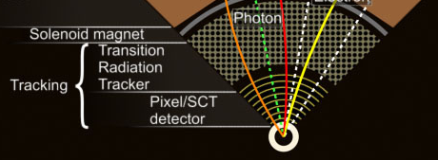
Project goals: flexibility
The main target will be the ATLAS detector L1 trigger (for the PhaseII upgrade), but for that development phase we will keep the FTK detector layout, that is 5 SCT and 3 pixel layers
The end architecture should be flexible, and the resulting system easy to reprogram to target other applications (to be studied in the IAPP project) such as:
  Machine vision for embedded systems: low power edge detection, object detection
  Medical imaging applications
  Coprocessor for various High Performance Computing applications

Slide 18
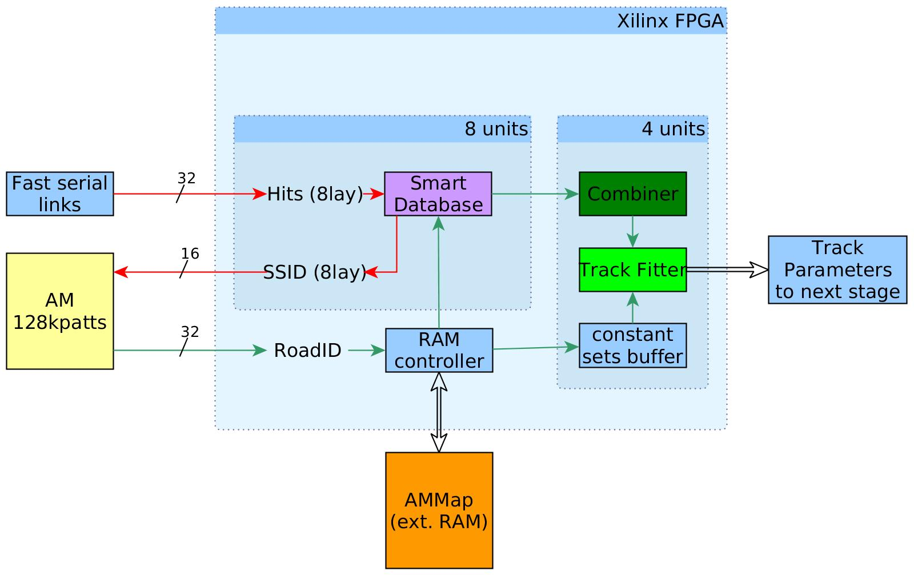
FPGA firmware - overview
Full resolution stored in a smart DB, while SSID of each hit is sent to the AM
Database retreives all hits for each SSID of the detected Roads
A very fast full resolution fit it is done for each possible track, fits are accepted or rejected according to x² value
AM performs pattern recognition and the ID value for each road (RoadID)
Combiner unit computes all possible permutations of the hits to form tracks
The RoadIDs get decoded in SSIDs for each layer, using an external RAM

Slide 19
Data Organizer
Data Organizer

Slide 20
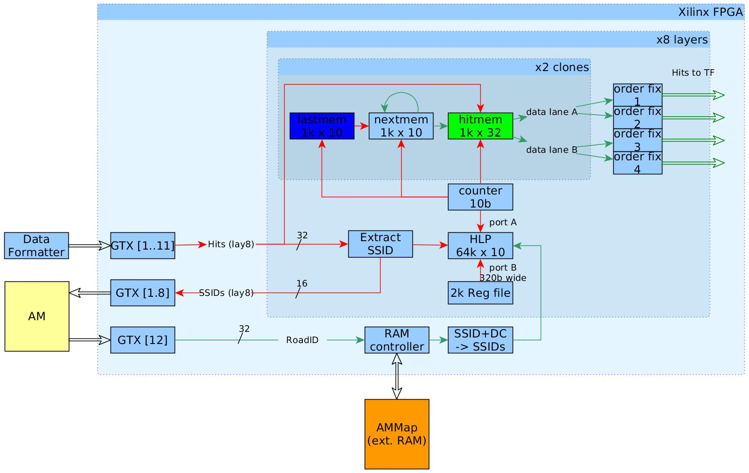
Data Organizer
The hits are stored, in the order in which they arrive, in the hitmem
The HLP keeps track of the address of the first hit of each SSID
The nextmem holds, for each hit address, the location of the next hit of the same SSID
Hits are cloned in two dual-port memories, reading uses 4 memory ports
Max. No of Hits per event, no other restrictions on the input

Slide 21
Track Fitting
Track Fitting

Slide 22
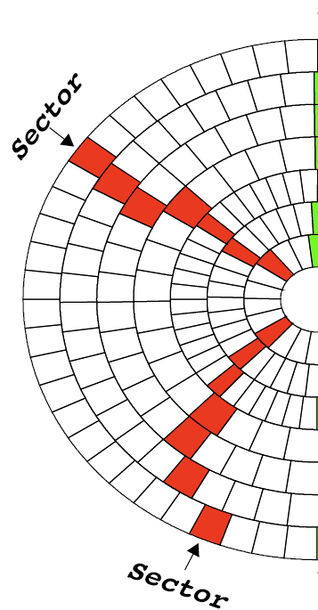
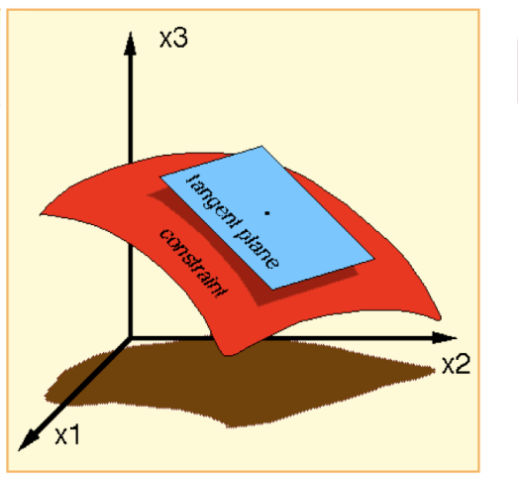
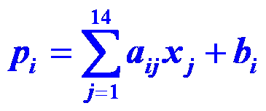
Track Fitting
    Track helix parameters and χ² can be extracted from linear equations in the local silicon hit coordinates
    The resolution of the linear fit is close to that of the full helical fit in a narrow region (sector) of the detector
    p_{i}’s are the helix parameters and χ² components.
    x_{j}’s are the hit coordinates in the silicon layers.
    a_{ij} & b_{i} are stored constants from full simulation or real data tracks.
    The range of the linear fit is a “sector” which consists of a single silicon module in each detector layer.
    Using FPGA DSPs, very good performance can be achieved
5sct+3pix*2=11
11 coordinate Space
to 5 dimensional surface

Slide 23
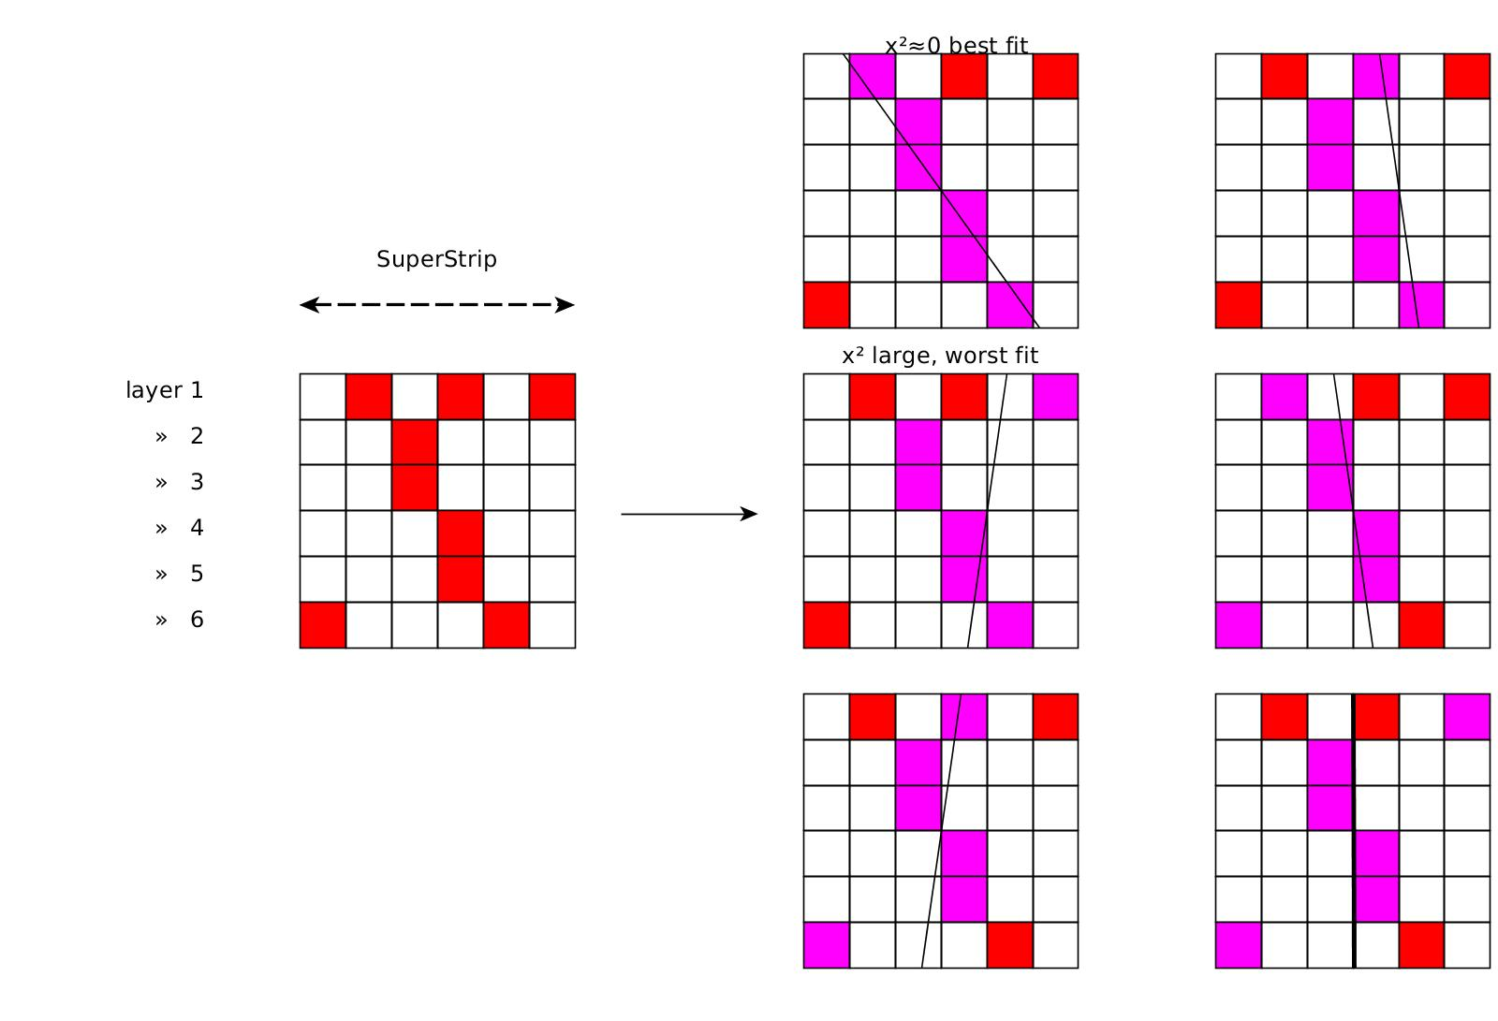
Track Fitting - Combiner
Best fit is selected, others are discarded
Visualization of the combiner function on an example Road

Slide 24
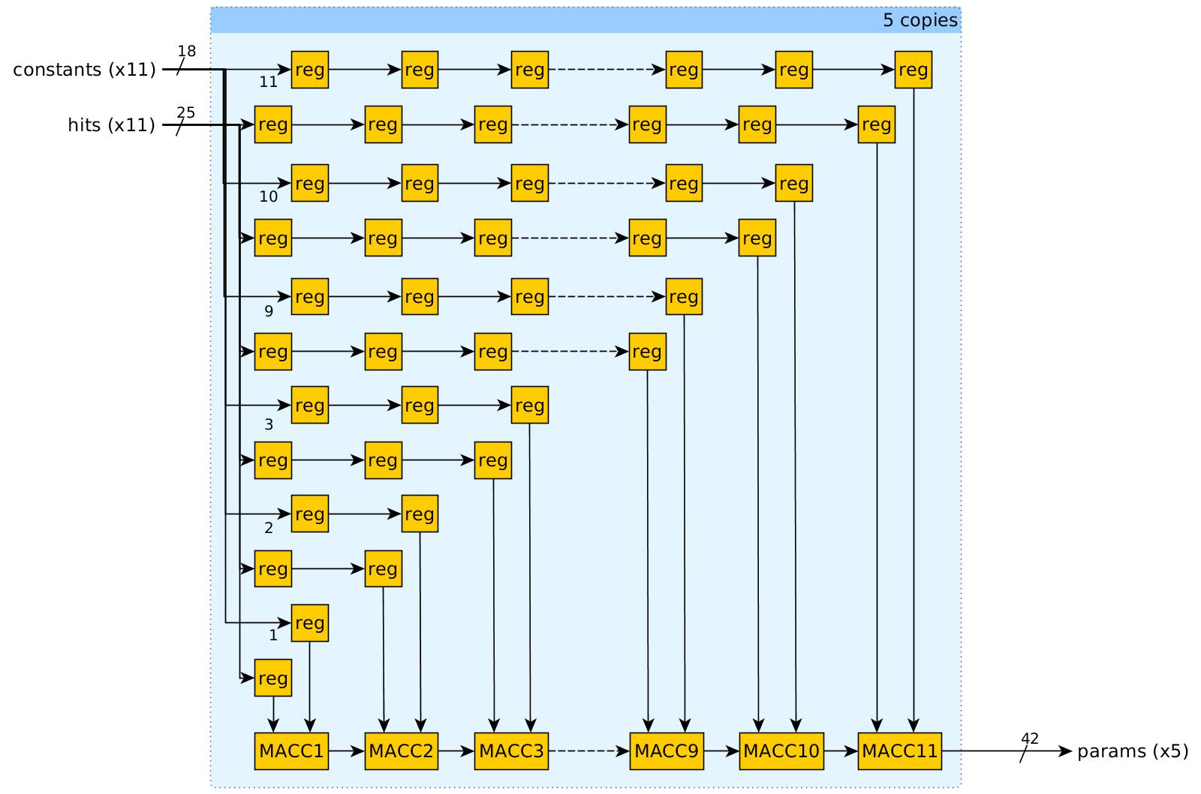
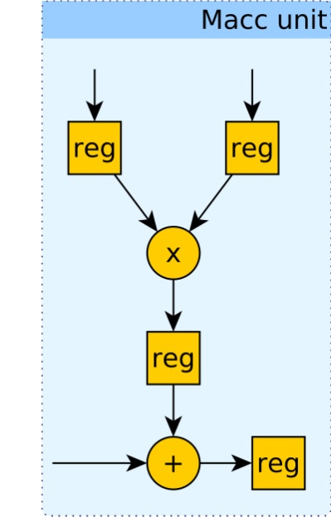
Track Fitting - Core
Very fast FPGA implementation was developed for the fitter
All multiplications are executed in parallel, giving 1 fit per clock
Using dedicated DSP resources, the frequency of the fitter is 550MHz
4 such fitters run in parallel in the device

Slide 25
FPGA implementation
The main components of the design are already implemented
Placement on the device was made for estimating true achievable clock rates and the power dissipation
Target device is XC7K325T-900ffg-3
To achieve high clock rates, careful RTL coding and advanced design techniques must be followed
  Pipelining of control signals and memory buses
  Careful fan-out control for many signals
  Manual CLB resource instantiation
  Manual floorplanning of key components
  Utilization of dedicated routing wherever possible
  Local clock buffers for 550MHz areas

Slide 26
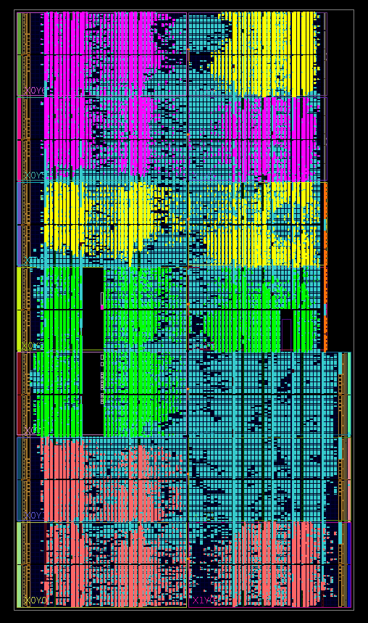
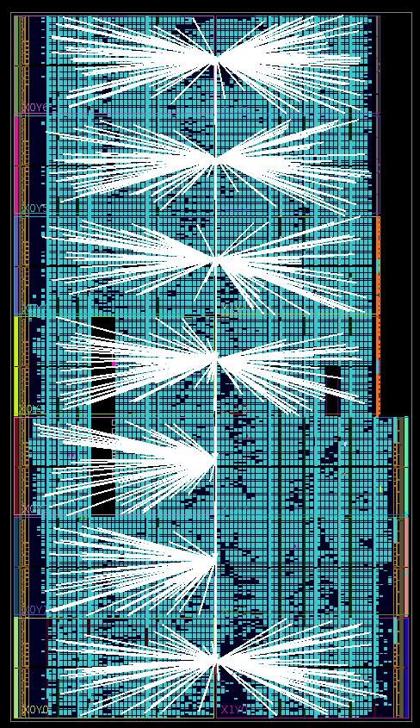
FPGA implementation (device floorplanning view)
Track Fitter instances
Local clock routing for the Track Fitters

Slide 27
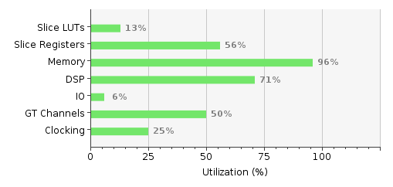
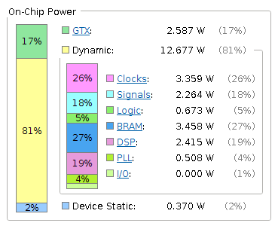
Device utilization & power
Power estimation of 15.5W is the absolute worst-case figure
Simple improvements to the design are expected to reduce this by 15%
If the design is migrated to a newer Xilinx UltraScale device an additional 10-15% reduction is expected

Slide 28
Speed and latency
450-1800 Mhits per layer
@550MHz
@450MHz
225MHitsper layer
2200Mfits
50MRoads
576MBit RLDRAM3
57.6Gb/s
10ns ^{t}RC
Units are per second

Slide 29
Speed and minimum latency
~10ns
~70ns
~50ns
System latency (from last hit to first computed parameters) <0.3us
Figures represent latency from last incoming hit to first output track
~40ns
There are ideas to further improve performance, if needed
Speed and latency are data dependent, further system simulation needed for precision

Slide 30
Sample event processing time
In a typical event there are 500 hits/layer
50 roads are assumed to be produced by the AM
4 layers are assumed to have 1 hit/road, the rest 4 to have 2hits/road each
Event processing time with current AMChip
5us (SSIDs to AM)
1us (roads from AM) > 0.36us (processing time for all the roads)
0.17us (latency from RAM, DO, Combiner, TF)
Total: 6.17us, which is close to 6us which is the limit for L1 tracking
Event processing time after a reasonable AMChip upgrade
2.5us (SSIDs to AM)
0.25us (roads from AM) < 0.36us (processing time for all the roads)
0.17us (latency from RAM, DO, Combiner, TF)
Total: 3us, which is half the L1 limit, lots of headroom for bigger events

Slide 31
Conclusions
Main functions already implemented in the FPGA device
Speed and latency figures of the system are promising
Simulation data for the L1 tracker is essential in proper testing and evaluation of system speed
Versatility of the design allows for quick modifications to upgrade performance in case the speed is not enough

Slide 32
Thank you!

