Slide 1
Backgrounds simulations (*), SVD radiation protection system and environmental monitoring L.Lanceri Univ. Trieste & INFN Belle2 – Italia Meeting, Roma, June 9 - 10, 2014 (*) Summary from B2GM and BPAC presentations

Slide 2
Backgrounds simulations
From B2GM, BPAC summary talks

Slide 3
Backgrounds: SuperB TDR
SuperB TDR, detailed simulations:
radiative Bhabha (BBBREM):
pairs production (BDK, DIAG36, GP++):
Touschek (STAR, MAD)
beam-gas (Coulomb, inelastic)
synchrotron radiation: smaller contributions
Sub-detectors: rates, occupancy, doses (Bruno)
SVT (pairs production dominates)
DCH (radiative Bhabha, pairs)
FTOF, FDIRC (radiative Bhabha)
EMC (radiative Bhabha)
IFR (radiative Bhabha; neutrons)

Slide 4
Backgrounds: Belle2 TDR
Qualitative statements on bkgd sources
radiative Bhabha: new IR, expect 1/40 x KEKB (?);
pairs production: 45 - 670 MHz in PXD
Touschek: HER dominates, 20-30 x KEKB expected
beam-gas: depending on beam currents (x2), vacuum, magnets…
synchrotron radiation
Subdetectors: rates, occupancy, doses…
PXD (pairs production: BDK, KoralB, Racoon; occupancy < 0.5%)
SVD (specs: bkgd up to 30x KEKB, dose up to 10 Mrad)
CDC, TOP (…)
ECL (endcap upgrades: pure CsI, BSO, etc.)
KLM (extrapolations from KEKB: endcap scintillators upgrade)

Slide 5
Backgrounds: on-going simulations
New working group (simulations + BEAST)
Hiroyuki Nakayama (KEK) + Sven Vahsen (Hawai’i)
Subsystems reps., in particular for simulations:
SVD: Peter Kvasnicka, ECL: Sam de Jong, TOP: Marko Petric
Simulation “campaigns”
6th- 8th: reported at the February B2GM & BPAC
9th: in preparation for the June B2GM;
HN, private communication: 9th should also include updates on Touscheck and beam-gas from the accelerator group
Slides from Sven (B2GM) & Hiro (BPAC):
Latest IR loss distributions of each BG source
Full detector simulation (6th – 8th campaigns)
NB: problem with rates, in particular pair production ??

Slide 6
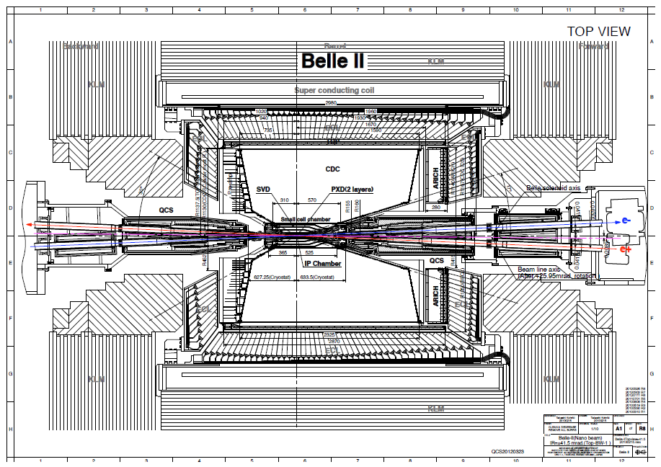
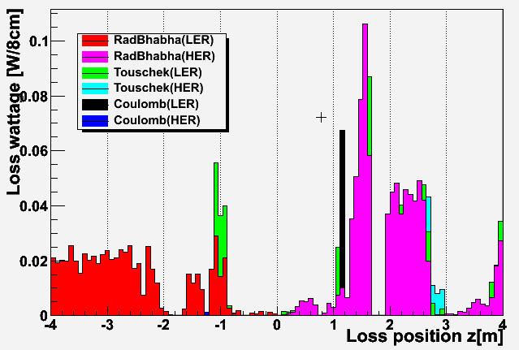
Background picture
Ver. 2013.6.12
←RBB LER
RBB HER→
Touschek HER→
SR
Neutrons (rad. Bhabha)
HER
LER
Coulomb HER→
←Touschek LER

Slide 7
Beam BG simulation
 | Touschek | Beam-gas Brems | Beam-gas Coulomb | Radiative Bhabha
Phase 1 No QCS Vacuum baking | READY | READY | READY | No collision
Phase 2 Detuned optics | READY | Not ready | Not ready | READY (x1/80 of phase 3)
Phase 3 Full luminosity | READY | READY | READY | READY
Y.Funakoshi, Y.Ohnishi (KEKB)
Loss distribution
Geant4
Belle II+ Beam Pipe + Shielding
Belle II / BEAST II detector digitization

Slide 8
8th background MC campaign
Nakayama
~nakayama/basf2_output/release_201312_8th/Work_Mcgen/output/output_*.root
New in 8th campaign:
Spent e+/e- from 2-photon process
included for the first time for sub-det except PXD
QCS cryostat design update: type 1 or type 2?
More tungsten structure on QCS-R head?
Quick study shows more tungsten increase CDC rate but decrease TOP PMT rate
Conclusions: Tungsten on QCS-R head preferred from BG point of view

Slide 9
Summary for 6th campaign
FIXME: not updated for 8th campaign - yet!
SF=Safety Factor
 | (5th→) 6th campaign result | limit | SF
PXD occupancy | 2photon:0.8%, SR:1.1+-0.3% | < 2~3% | 1
CDC wire hit rate | (200→)120kHz | <200kHz | 2
CDC Elec.Borad n-flux* | (2.6→)2.1 | <1 | 0.4
CDC Elec.Board dose | 30Gy/yr | <100 Gy/yr | 3
TOP PMT rate | 2MHz/PMT | <1 MHz/PMT | 0.5
TOP PCB n-flux* | 0.5 | <1 | 2
ARICH HAPD n-flux* | (2.0→)1.4 | <1 | 0.7
ECL crystal dose | (12→)6 Gy/yr | <10 Gy/yr | 2
ECL diode n-flux* | (2.2→)0.9 | <1 | 1
ECL pile-up noise | 4/1MeV | 0.8/0.2MeV at Belle-I | ?
With “combined” shield inside ECL
KLMs are not included
showing SF<5 only
*neutron flux in unit of
10¹¹ neutrons/cm2/yr,
NIEL-damage weighted
All sub-detectors groups except KLM delivered results from 8th campaign

Slide 10
Sub-detector BG summary
PXD occupancy close to limit
CDC FPGA
>1x10¹¹ neutrons/cm2/year, but SEU rate is still acceptable
TOP PMT lifetime
New PMTs has super-long lifetime (~x10 improvement)
Low-gain operation could help old PMTs
TTS is OK, need to check timing resolution with readout electronics
Last resort: replace PMTs every few years

Slide 11
VXD Radiation Monitoring and Beam Abort
(Trieste)

Slide 12
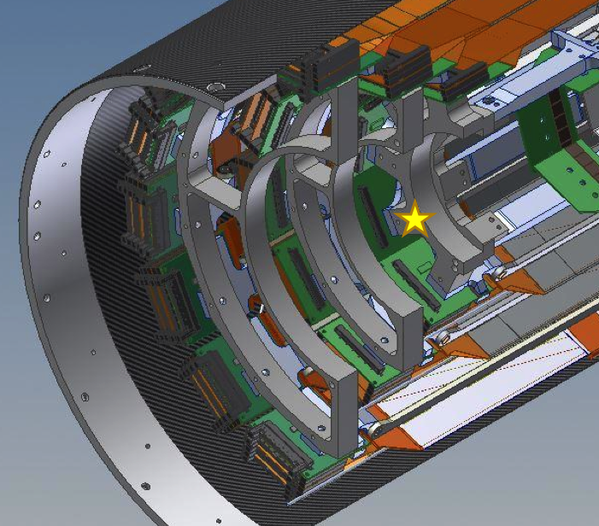
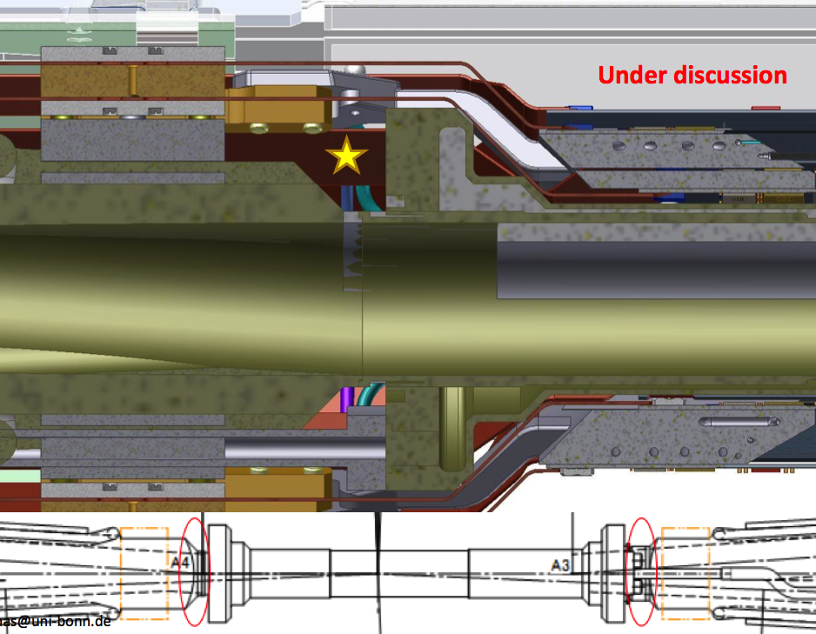
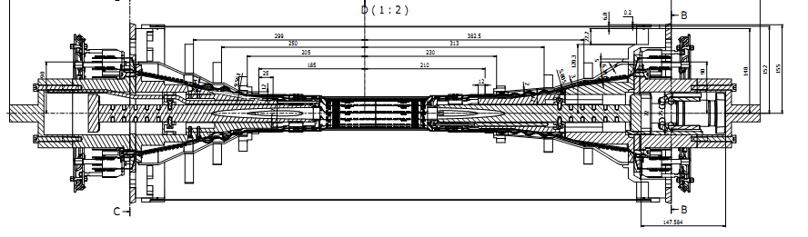
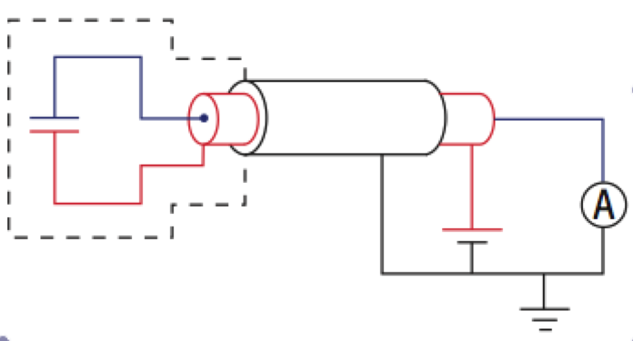
Conceptual Design
4 + 4 sensors
PXD-beam pipe
8 + 8 sensors
on SVD L3
support rings
Shielded
diamond
sensors
3+15 m (3+40 m) triax cables
Voltage sources (150÷500 V)
picoAmmeters

Slide 13
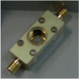
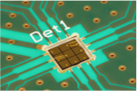
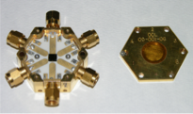
Diamond sensors and metallization
Offers and working prototypes from:
Micron (UK): sensors from E6 + metallization
Cividec (Austria): sensors from E6 + metallization
Other options under investigation:
Bare sensors directly from E6
Metallization by Elettra/Trieste (or ZM Fraunhofer ?)
EDP (Japan):
beginning to produce electronic grade diamond crystals
To be investigated if time constraints are more relaxed

Slide 14
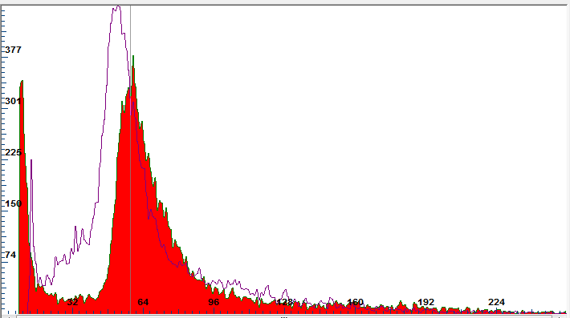
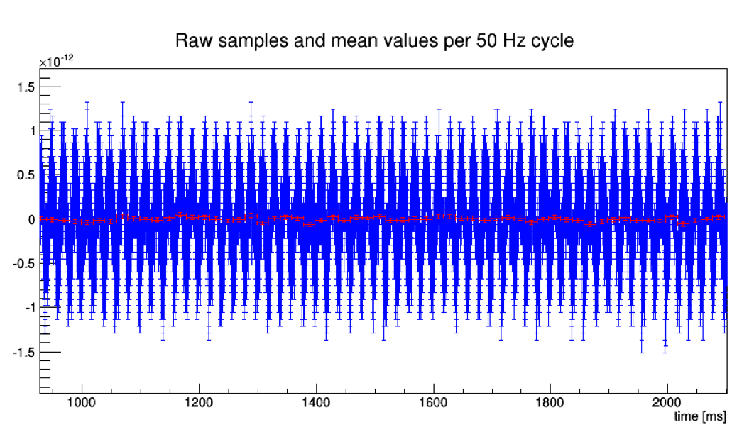
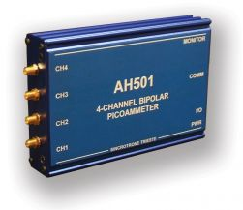
Measurements
Single particles (MIPs)
Tests on 9 p/scCVD sensors
Charge collection efficiency
Beta source + beam test
Currents measurements for dosimetry and beam abort
collaboration with Elettra, Electronics Division
AH501 fast picoammeter
Noise measurements and optimization(see next slide)
Digital filtering studies (see next slide)
DESY e- beam, 3 GeV
Sr90 e-, “2 MeV” selection

Slide 15
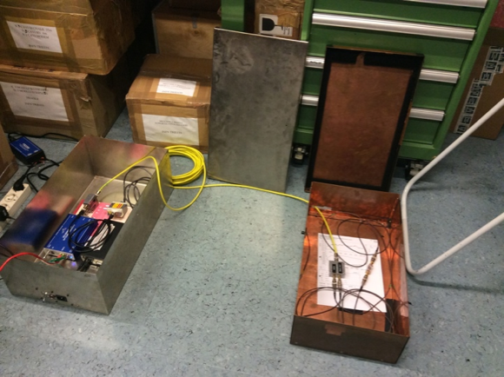
Grounding, cabling, digital filtering tests (TS)
Noise measured in different configurations, with AH501 picoammeter
grounding scheme
Cables types and layout: optimized
3 m two small coaxial (HS SM47LSFH)
15 m two coaxial HS S_04162-B60, double shield
Or 15m one tri-axial (HS BNT-50-3-1)
Noise characterization and filtering, results:
Noise dominated by 50Hz and multiples
Down to few pA level, with 3+15m cables
Digital filtering algorithms can further reduce noise (5-10x)
Moving average (or “sliding sums”), CIC sum (sum of sums)
Good compromise on bandwidth: reachable by further waveform subtraction
Next:
dosimetry tests, with
⁹⁰Sr beta source:
mechanics in preparation

Slide 16
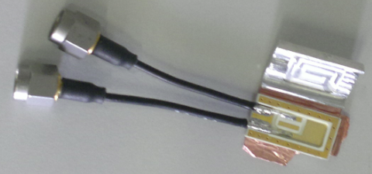
Mechanics: compact package
very small multi-layer package in Rogers laminate
12 x 20 x 3.1 mm³ with copper extra shielding
Designed and produced, now under test

Slide 17
Electronics: preliminary specs
Modules with 4 input channels, for monitoring and abort
Evolution of AH501 front-end + Altera Cyclone IV FPGA
Functionality similar to the FermiLab BLM system
http://beamdocs.fnal.gov/AD-public/DocDB/ShowDocument?docid=1410
Common logics: features
Timing synchronized to SuperKEKB revolution period (10 μs)
“SuperKEKB status” register, to select appropriate thresholds
Programmable masks and majority logics: abort signal (output)
Circular buffer for timing information, in parallel with data buffers
Circular data buffers “freeze” upon external or internal abort
Ethernet interface for programming and data read-out
“slow” readout of averaged radiation dose monitoring data (< 100 Hz, typical 1 Hz)
Full data buffers readout for post-abort diagnostics

Slide 18
Rad.Mon+Abort, 4-channel module
ADC + 3 Sums
+ 4 Abort Levels
4 Circular
Buffers
(for each
input channel)
Ethernet I/O
Timing
Control
Abort
HV
Timing (100 kHz)
Machine status
Timing buffer
Thresholds
etc

Slide 19
Electronics: preliminary specs
For each of the 4 input channels (diamond sensors)
Individual HV supply
Effective bandwidth: 100 kHz (revolution period = 10 μs)
Selectable current range: 0-50 μA or 0-2 mA
16 (24?) - bit ADC; over-sampling possible
4 circular data buffers, updated every 10 μs:
“Raw data” and 3 levels of "sliding sums” over programmable numbers of cycles
➔ different digital filtering levels and time responses, from "immediate" (10 us) to "very slow" (typically 1 s)
4 levels of abort signals
from the comparison of raw data and sliding sums with the programmable thresholds, selected according to the “SuperKEKB status”
In collaboration with G.Cautero, D.Giuressi, and R.H.Menk from Elettra - Sincrotrone Trieste S.C.p.A.

Slide 20
Temperature & Humidity Monitoring
(Trieste)

Slide 21
Temperature and humidity
System characteristics
PXD+SVD Front End power dissipation: 360+700 W
CO₂ cooling pipes (-20ºC); dry air / nitrogen flow (20ºC)
Requirements
Temperature monitoring:
near heat sources and at the inlets/outlets of cooling pipes
about 1ºC (0.1ºC) absolute (relative) accuracy
Interlocks on temperature and humidity (stand-alone, VXD)
Temperature above threshold, or dew point approaching -30ºC
Current activities and preliminary design
Conventional NTC thermistors for cross-calibration and interlocks
Fiber Optical Sensors (FOS) and laser interrogators
Based on Bragg grating reflection of specific wavelengths
Can monitor stress, temperature, humidity (with humidity-sensitive coating) at several points
Humidity interlock: “sniffers” plus chilled mirror hygrometer outside

Slide 22
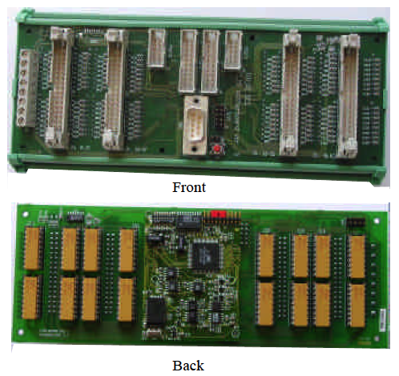
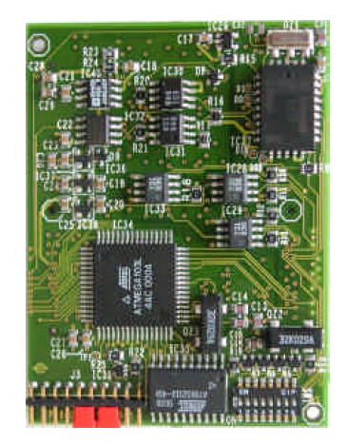
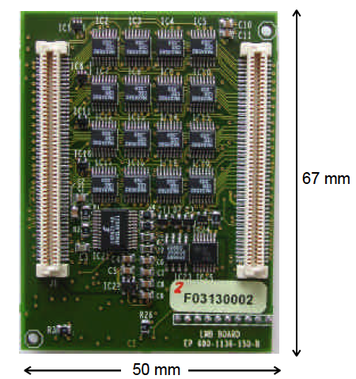
NTC temperature sensors
At least 28 x 2 = 56 NTC thermistors
12 sensor pairs attached to the 12 half-rings supporting the SVD ladders
16 sensor pairs on the inlets and outlets of the CO₂ cooling pipes
A few positioned near fibers for cross-calibration
We adopted rad-hard sensors and readout, largely used by LHC experiments
One ELMB board + Betatherm NTC thermistors: borrowed from CMS
2 motherboards and 10 adapter mini-cards procured (public CERN design)
Procurement of more Betatherm thermistors
Read-out via CAN bus interface, implemented

Slide 23
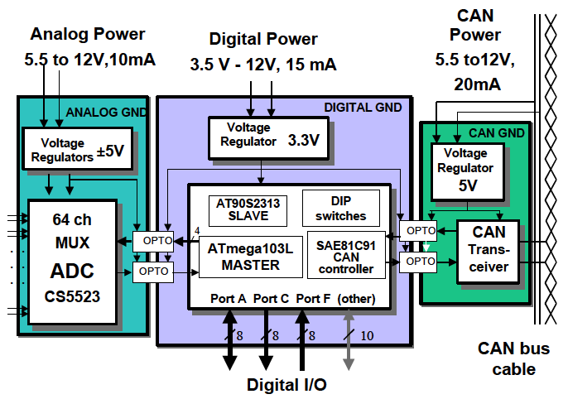
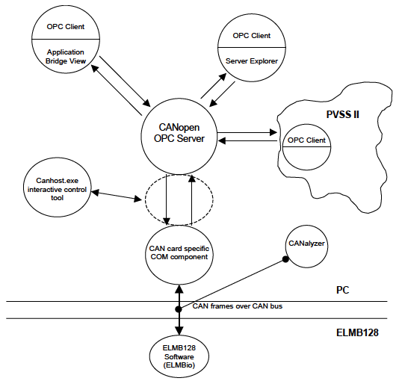
ELMB boards, CAN bus read-out
hardware
software
Installed and working
in our lab !
Embedded Local Monitor Board
CAN node, CANopen protocol
ATmega128 processor
128k flash, 4k SRAM, 4k EEPROM
64 chan. MUX, 16 bit ADC
General purpose motherboard
Interconnections, signal adapters
PC – CAN bus interface
CAN interface drivers
CANopen OPC Server
OPC Clients
Server Explorer
N.I. LabVIEW DSC
(Data Logging & Supervision Control)

Slide 24
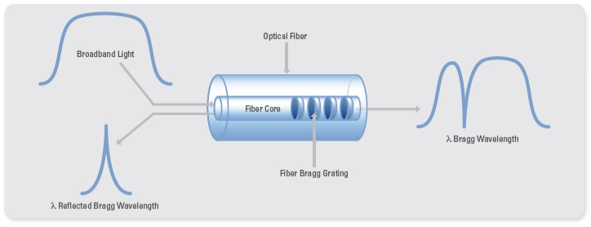
FOS Technique
TEMPERATURE CHANGE
Thermal expansion for
Thermo-optic effect for
STRESS
Where:
n_{eff} is the effective refractive index of the fiber,
Λ is the grating pitch and
λ_{B} is the reflected Bragg wavelength.
Elasto-optic effect for
Direct Strain for

Slide 25
FOS set-up, preliminary design
45 fibers, one fiber per ladder (layers 3-6)
Embedded in Airex, with several measurement spots (at each wafer)
Preliminary design: result of discussions with
PXD FOS monitoring experts (D.Moya, I.Vila / IFIC)
Rappresentanza italiana di Micron Optics (B.Griffoni / GHT Photonics)
Option A
SM225-800 interrogator, 16 channels (Micron Optics)
3 SM041-008 4x8 couplers/multiplexers (8 dB attenuation)
1 SM041-016 4x16 coupler/multiplexer (16 dB attenuation)
Option B
SM225-800 interrogator, 16 channels
10 1x4 passive couplers (5-6 dB att.)

Slide 26
Initial plan for humidity
Humidity interlock: “sniffing pipes” plus Chilled Mirror Hygrometer outside the detector
See CMS developments for their tracker upgrade: 3-fold approach
“sacrificial” expendable radiation-soft sensors for initial calibrations
Combination of FOS fibers measuring temperature and humidity
26 sniffer lines and Vaisala hygrometers in accessible positions
To start: lab tests using an hygrometer purchased with committed dot.1 funds
Mechanics, pipes, valves, etc: to be understood !
Some FOS fibers sharing the same interrogator with temperature FOS fibers

Slide 27
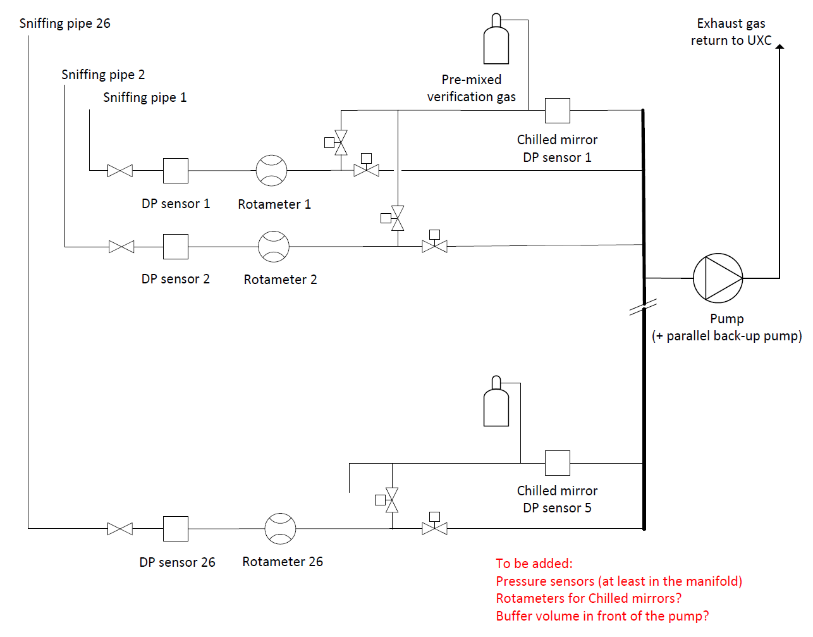
Humidity: CMS “sniffer” approach

Slide 28
Timeline, first guess (Feb. 2014)
Radiation | 2014 |  |  |  | 2015 |  |  |  | 2016
What | 1 | 2 | 3 | 4 | 1 | 2 | 3 | 4 | 1 | 2
Specifications, sign up
Simulations
Dosimetry, characterization
Diamond sensors choice
Mechanics & cabling design
Electronics specifications
Electronics design & proto.
Overall design, sign up
Components, procurement
"final" prototypes (4 ch.)
BEAST, 1 preliminary tests
BEAST, 2 complete test (4 ch)
electronics production & test
sensors installation & cabling
electronics installation
Temperature & humidity | 2014 |  |  |  | 2015 |  |  |  | 2016
What | 1 | 2 | 3 | 4 | 1 | 2 | 3 | 4 | 1 | 2
T&H Specifications, sign up
Fibers, mechanical layout
Fibers, assembly tests (SVD)
Fibers, multiplexing scheme
Fibers design sign up
Procurement, assembly
installation (PXD & SVD)
Thermistors, lab tests
Mechanics & cabling design
Procurement
assembly, installation

Slide 29
Back-up

Slide 30
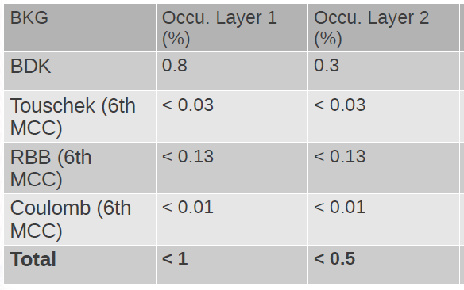
PXD
Pit Vanhoefer
SR LER: 0.1% at one half ladder in #1 layer
SR HER: Should be updated with the latest optics,
but it was 0.5%+-0.3% with previous optics
Yuri Soloviev
😐
Close to limit (2~3%)

Slide 31
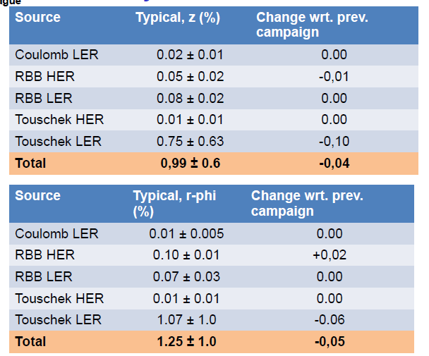
SVD
Peter Kvasnicka
☺
Well below 10%. OK

Slide 32
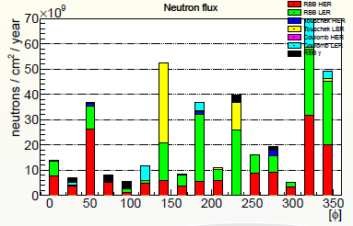
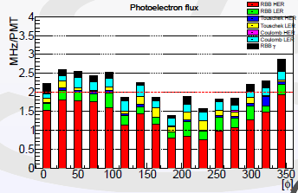
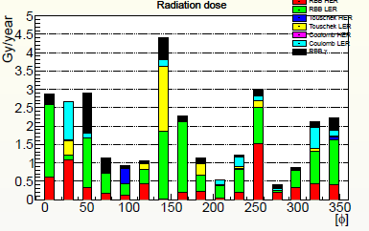
TOP
Marko Petric
☺
☹
☺
half gain, old PMTs
full gain, old PMTs
- New PMTs has good lifetime (>10C/cm2) but we still need to use old PMTs (~1C/cm2)
- Charge on PMTs can be 1/2 with half-gain operation
(timing resolution with half-gain operation should be checked)
* Note that TOP assumes 50/ab, while the other detectors assume80/ab(=full luminosityx10year)
Notes:
“TOPSimHits” = “detected photon” = photon * QE * CE = photoelectron * CE Marko’s MHz/PMT number counts “detected photon”. Is QE*CE in BASF2 is realistic? for new PMT, old PMT, respectively. (2MHz, full gain) 2MHz/PMT, 2.25cmx2.25cm,10^6 gain, 1.6e-19C, 10^7sec/year --> 0.63C/cm2/year 2e6/(2.25*2.25) * 1e6 *1.6e-19 * 1e7 = 0.63C/cm2/year 80/ab (full luminosity*10year) --> 6.3C/cm2 50/ab-> 4.0C/cm2 (2MHz, half gain) 80/ab -> 3.2C/cm2
50/ab -> 2.0C/cm2

Slide 33
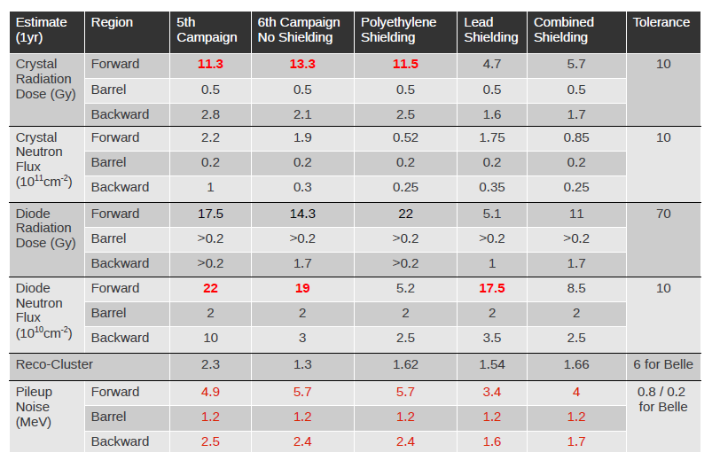
ECL
Sam de Jong
☺
☺
☺
😐
☺
😐
Crystal radiation dose/ diode Neutron flux becomes OK,
with “combined” shielding option.

Slide 34
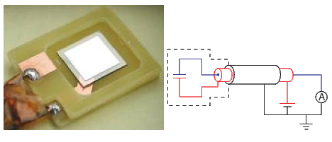
Radiation Monitoring and Beam Abort
Requirements
Measurement of instantaneous dose rates & integrated doses
sensitivity O(1 mrad/s = 10 μGy/s), sampling rate O(10 KHz)
Beam Abort for excessive beam losses affecting PXD, SVD
“Fast” (10-100 μs) and “slow” (minutes) Beam Abort triggers
Programmable “intelligent” thresholds, depending on accelerator conditions
Conceptual design
Based on experience from Belle, BaBar, CDF…
Diamond sensors, measurement of currents
Typical pCVD sensor (10 × 10 × 0.5) mm³: 1 nA = 7 mrad/s = 70 μGy/s
Noise should be limited to a few pA, in current measurements
up to 4 + 4 sensors near PXD
up to 8 + 8 sensors near SVD

Slide 35
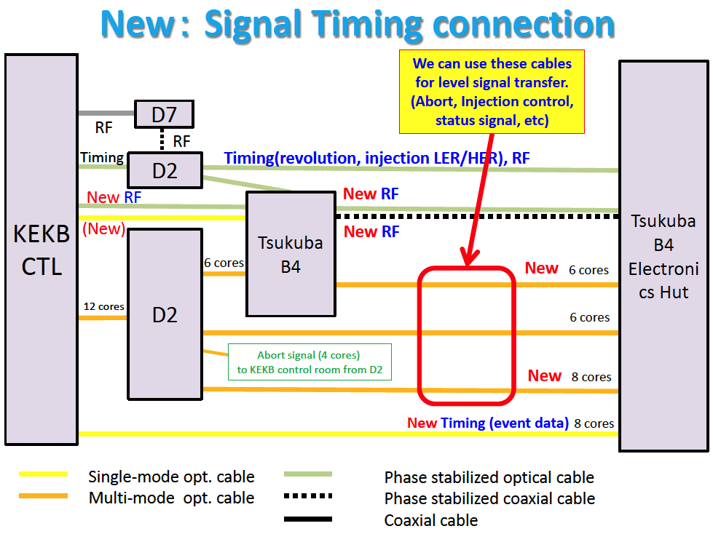
From M.Iwasaki (KEK), 2014-05-23: KEKB – Belle2 cables

Slide 36
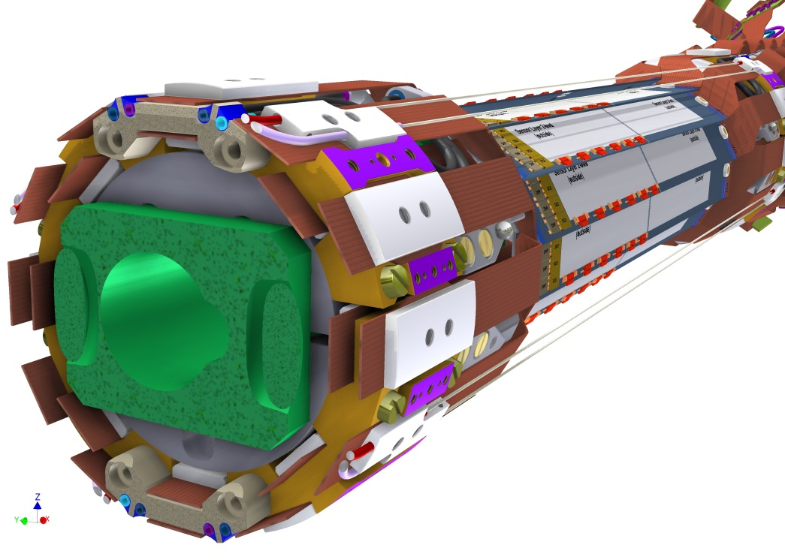
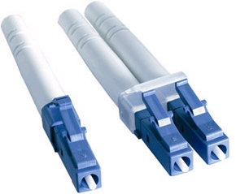
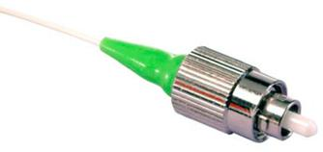
Reminder: FOS Monitor proposal
FC vs. LC connectors
R&D completed,
successfully tested
at the DESY beam test
Recent idea, under discussion:
1 fiber per ladder (45 ladders),
inserted in the Airex foam

