Slide 1
Consiglio di sezione
15-05-2014
Decadimento beta di nuclei prodotti con fasci radioattivi:
Attivita’ GAMMA e prospettive per SPES
Menu:
Exotic nuclei and beta –decay studies:
  Shell structure
  Stellar nucleosynthesis
Experimental techniques:
  Fast fragmentation ➔ GSI (D) e Riken (J)
  ISOL ➔ CERN
  Future project: tape station @ SPES-LNL
Gamma collaboration in CSN III:
Universita’: Angela Bracco, Franco Camera, Silvia Leoni, Fabio Crespi
INFN : G.B., Nives Blasi,, Benedicte Million, Oliver Wieland
Post-doc: A.I. Morales-Lopez, Luna Pellegri, Agnese Giaz

Slide 2
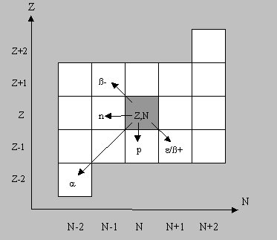
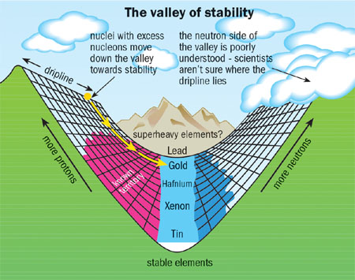
Beta decay: survey of general properties
β⁻ decay is the most common type of radioactive decay
  β⁻ decay
  β⁺ decay
  Electron capture (EC)
reasons to study beta decay:
Access to gross information on the decay, Half-life, Pn etc.
First information on excited states far from stability
Spin assignments owing to selection rules
Access to non-yrast states
Definition of shapes of daughter nuclei
Connection to mass measurements
Input for astrophysics and reactor heat calculation….
  ……many more…

Slide 3
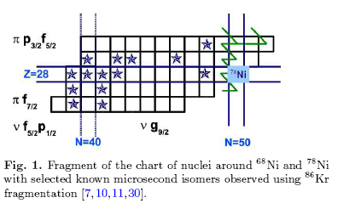
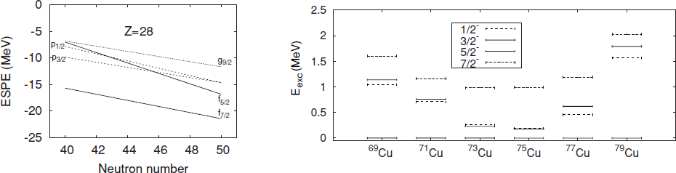
Exotic nuclei exotic properties
Proximity of doubly magic ⁷⁸Ni N=40 sub-shell closure {HO}
Many new effects arising at small changes in nuclear configuration:
- deformations
- change in levels sequence
- collectivity
- isomerism and loss of isomerism
- monopole drift
- proton core excitations
- proton intruder isomers
      …
g_{9/2}
Shell model calculations need to include a large valence space to describe all effects
K.Sieja and F. Nowacki, PRC 81, 061303 R (2010)
R. Grzywacz et al., Eur. Phys. J. 25, 89 (2005).

Slide 4
Nucleosynthesis
Most of the heavy elements (Z>30) are formed in neutron capture processes, either the slow (s) or rapid (r) process
p process
Mass known
Half-life known
nothing known
r process
rp process
np process
Light element primary process
LEPP
stellar burning
s process
Big Bang
protons
Cosmic Rays
neutrons
Notes:
Update slightly with EC

Slide 5
R-process basics
Element formation beyond iron involving rapid neutron capture and radioactive decay
β-decay
High neutron density
Seed
Waiting point
(n,γ)−(γ-n) equilibrium
β-decay half-lives (progenitor abundances, process speed)
β-delayed n-emission branchings
(final abundances)
n-capture rates (Smoothing progenitor abundances during freezeout)

Slide 6
Beta spectroscopy: experimental technique
Mother
¹⁴⁸Cs
β⁻
T_{1/2}= 146 ms
¹⁴⁸Ba
Daughter
Basic principle:
Detect Mother nucleus implantation
Correlate succeeding beta emission
➔ measure HALF-LIFE (T_{1/2})
➔ measure delayed GAMMA EMISSION,
spectroscopy of daughter nucleus
2 ways to produce exotic nuclei ➔
2 different techniques to study beta spectroscopy
IN-FLIGHT:Stack of Si stripped detectors for implant/beta det.
ISOL:Tape system + Plastic/Si
Both surrounded by HPGe + additional detectors (LaBr3, Neutron det.)
Notes:
0.25)→14.5
Sequence

Slide 7
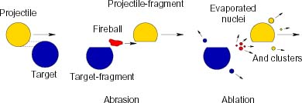
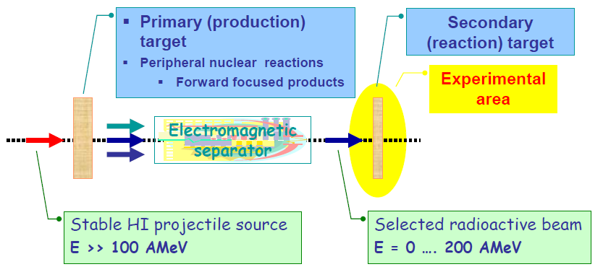
IN-FLIGHT fragmentation reactions
Fragmentation reactions:
Fragmentation of heavy ion beams (up to ²³⁸U) using thin targets
Cocktail beam ➔ many nuclei at once
both short-living (ms ) and long living (100s ) nuclei
Get information already with few particles
Low production rates (μb-> fb)
Need to run at low rate to distinguish contributions from each nucleus
* Active, position sensitive, pixelated stopper to correlate implanted ions (mother) with β-decay (daughter).
➔ stack of several DSSSD to ensure implantation and detect electrons
Typical Trigger conditions
Implantation: Signal coming from separator
Decay: OR signal coming from Si detectors
γ rays are usually acquired as SLAVE
Notes:
0.25)→14.5
Sequence

Slide 8
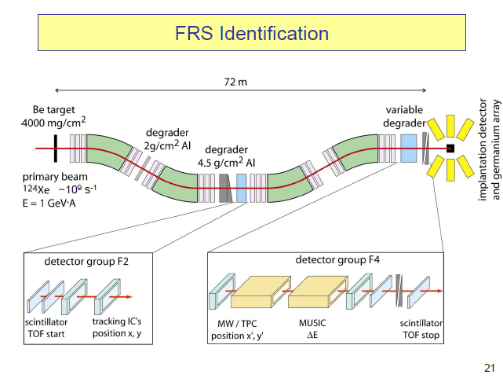
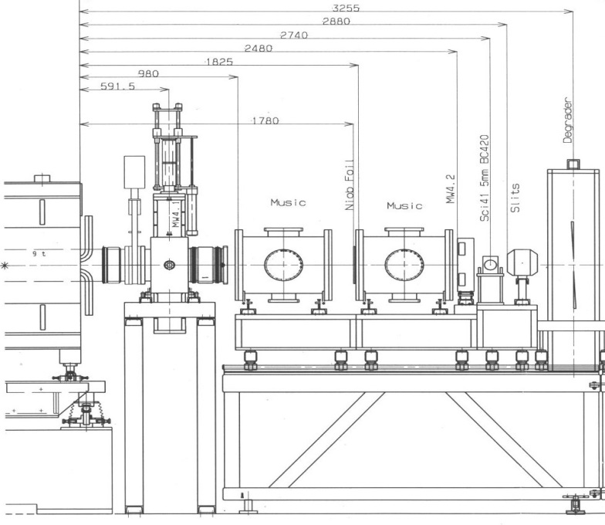
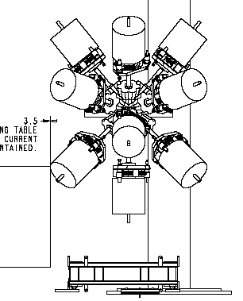
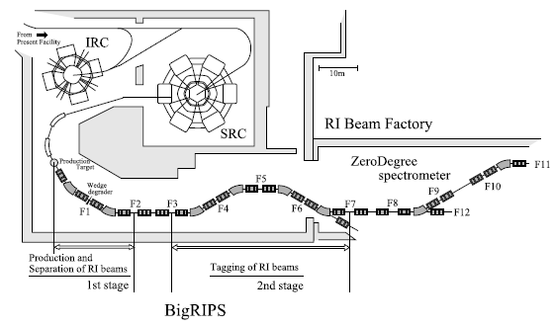
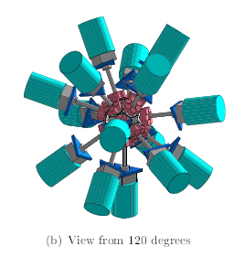
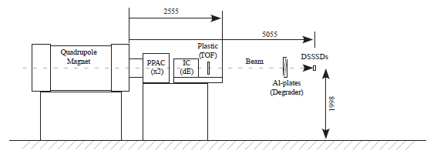
Fragmentation facilities
RISING
beam
GSI (Darmstadt- Germany)
EURICA
RIKEN (Wako-shi, Japan)

Slide 9
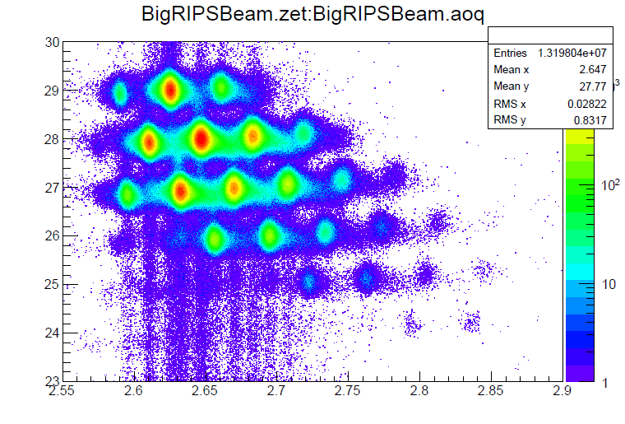
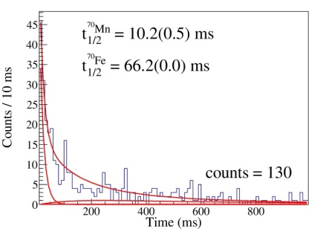
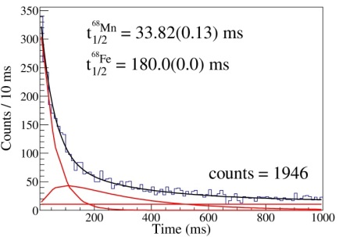
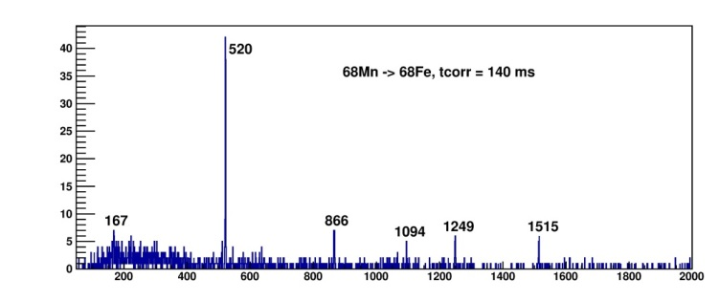
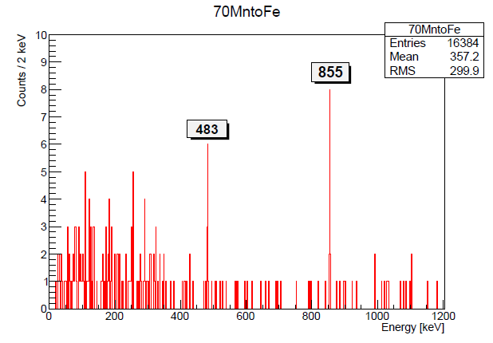
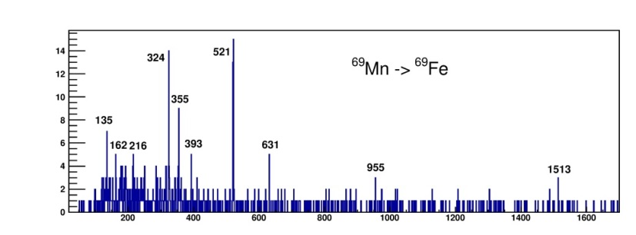
Fragmentation facilities: results from a recent exp. @ RIKEN
New half-lives
Delayed spectroscopy:
  Transitions measured for first time
  Extension of level schemes
Ni
Co
Fe
Mn
⁷⁰Mn->⁷⁰Fe
⁶⁸Mn->⁶⁸Fe
New isotopes:
No previous info available
⁶⁸Mn->⁶⁸Fe
⁷⁰Mn->⁷⁰Fe
⁷⁰Mn : 130
Implant-beta events
⁶⁹Mn-> ⁶⁹Fe
⁶⁸⁻⁷⁰Mn T_{1/2} measured
Tranisitions in ⁶⁸⁻⁶⁹⁻⁷⁰Fe seen

Slide 10
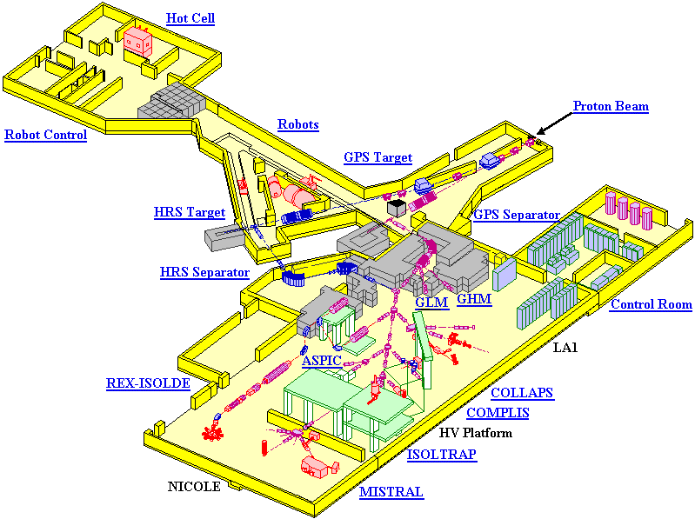
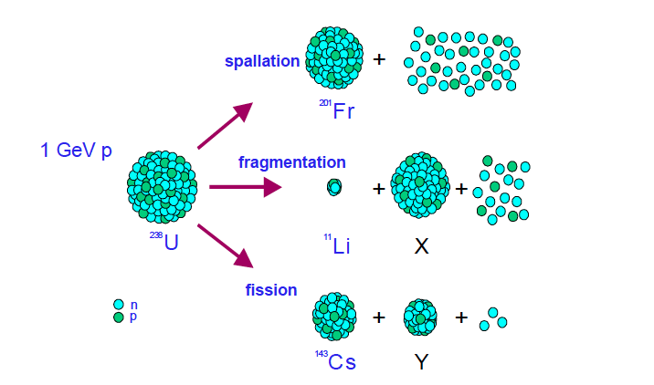
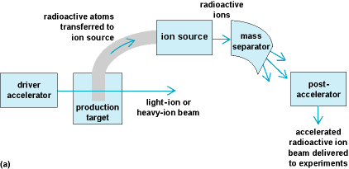
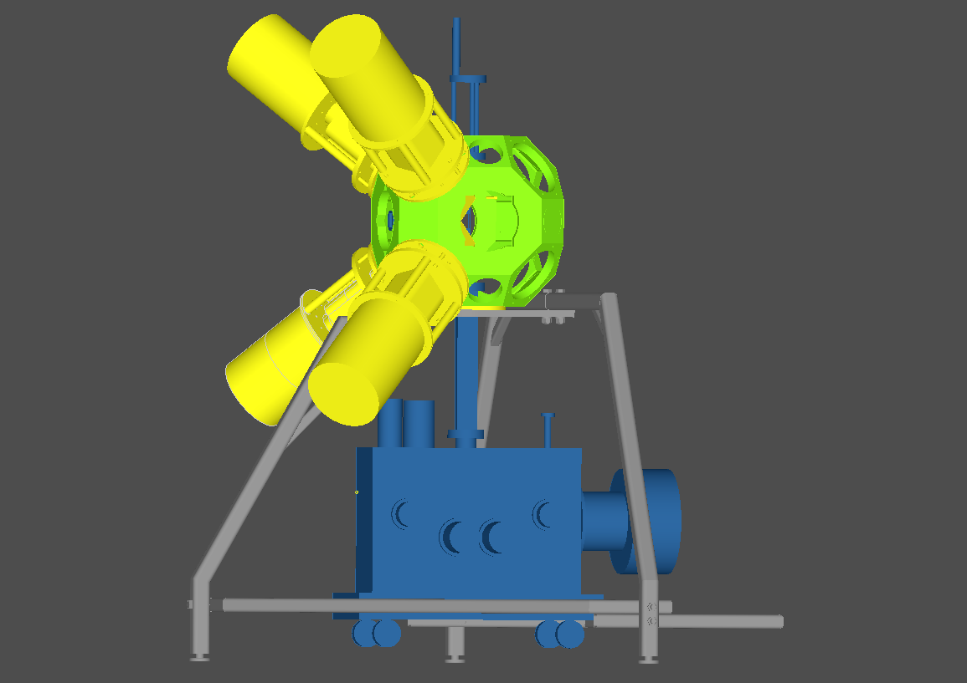
ISOL (Isotopic Separation On-Line) method
spallation/fission/fragmentation on thick targets, followed by chemical/physical processes to extract desired nuclei
ISOLDE@CERN
high cross sections ➔ high rates
Nearly mono-isotopical beams
Not all nuclei can be successfully extracted
long-living nuclei (> 100ms) owing to intermediate processes of effusion and diffusion
Decay station
TAPE Station systems
Each “point” is a measuring point and can be equipped with egs. Ge detectors and Plastic or Si detectors for β particles
Trigger given by implantation signal and β signal
Long-living activity is removed by moving away the tape
RI beam
Implantation point
Decay point
Notes:
0.25)→14.5
Sequence

Slide 11
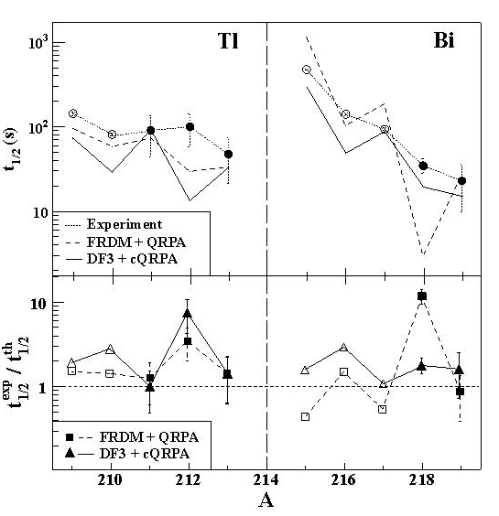

Beta decay spectroscopy in Milano
Recent past: RISING @GSI
“Spectroscopy of n-rich Pb nuclei”, G.Benzoni et al.
G.Benzoni et al., PLB 715 (2012) 293
A.I.Morales et al., PRC 89 (2014) 014324
+ conf. proceedings
Present:
* EURICA campaign @ RIKEN
“Structural changes btw N=40 and N=50 next to Ni isotopes”, G.Benzoni et al.
➔ under analysis. ARIS2014 -Tokyo,
* ISOLDE @CERN
“Study of octupole deformation in n-rich Ba
isotopes populated via β decay”,
G.Benzoni et al.
To run 7-12 August
Existence of octupole static/dynamic deformations is a long standing quest attracting much attention
Strong octupole correlations show up due to interaction of orbitals with ΔJ=ΔI=3
Two predicted regions for octupole def. are around Ba and Th-Ra
Possibility of having dynamic and static correlations ➔ Theoretical models do not agree on onset of static deformations

Slide 12

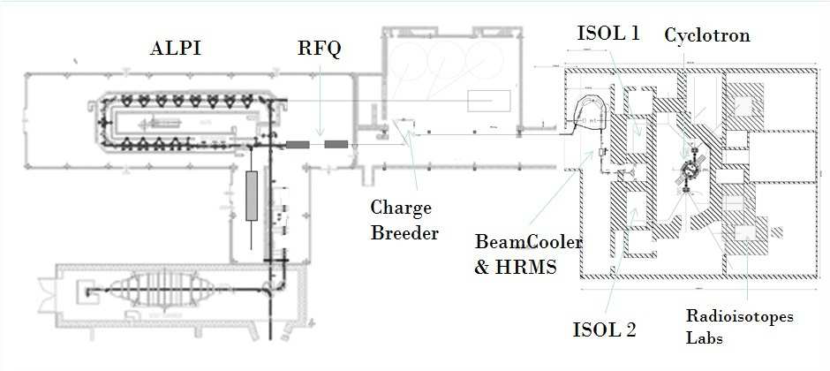
Beta decay spectroscopy in Milano
Future: SPES (Selective Production of Exotic Species) @ LNL
“A Letter of Intent for Beta-Decay Spectroscopy at SPES”, G.Benzoni et al.
Construction of a decay station (tape system) @ LNL to use beams of SPES
high performance cyclotron with high output current (~0.7 mA) and high energy (up to 70 MeV), together with the related infrastructure for the accelerator and experimental stations.
The beams will be dedicated to the nuclear physics facility producing neutron-rich ions by collisions of protons onto a UCx target
Beta counting station is being developed together with
HRIBF (Oak Ridge, USA), Bordeaux (France), ISOLDE (CERN)
Timeline:
Cyclotron installation 2015
First beams available 2016
Moving tape system
Plastic detectors surrounding measuring point
HPGe detectors (GALILEO-Clover), neutron detectors (NEDA),
LaBr3 detectors: - fast timing for half-lives meas.
        - total absorption spectrometer

Slide 13
Conclusions
Beta decay studies in exotic nuclei:
A good tool to access first info on nuclei
Strong correlation with nuclear astrophysics (nucleosynthesis)
Can be applied to nuclei produced both with IN-FLIGHT and ISOL methods
Gamma spectroscopy group in Milano has a lively program to study beta decays with both techniques
Recently published analysis on n-rich Tl-Pb-Bi
Current analysis of nuclei around doubly-magic ⁷⁸Ni
Scheduled exp. @ CERN on ¹⁵⁰⁻¹⁵²Ba
Future: construction and setup of a tape decay station @ SPES,LNL

Slide 14






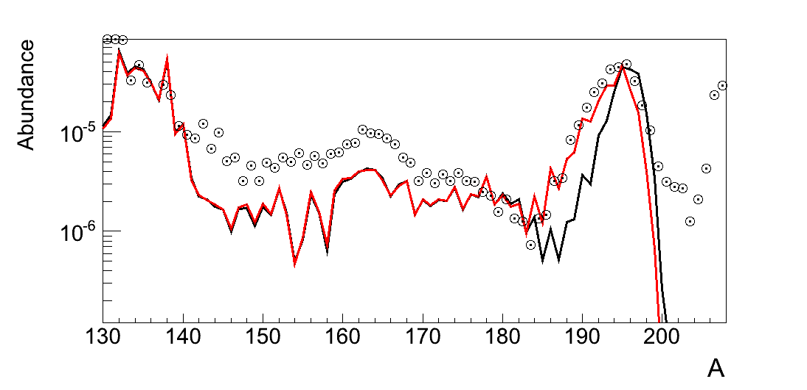
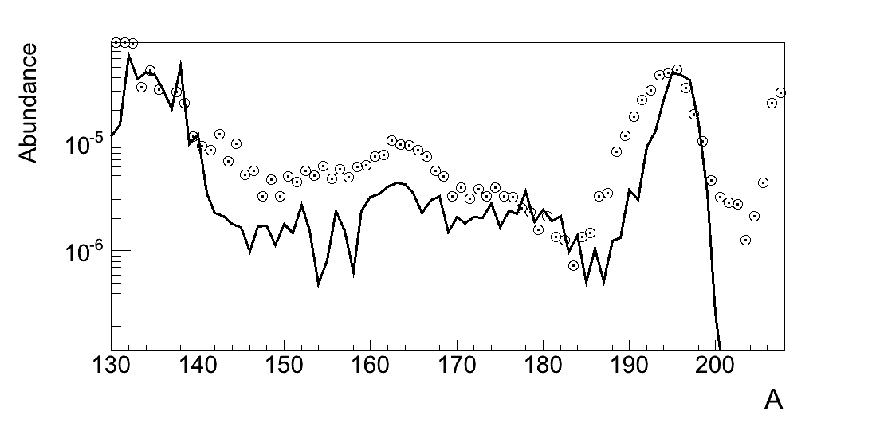
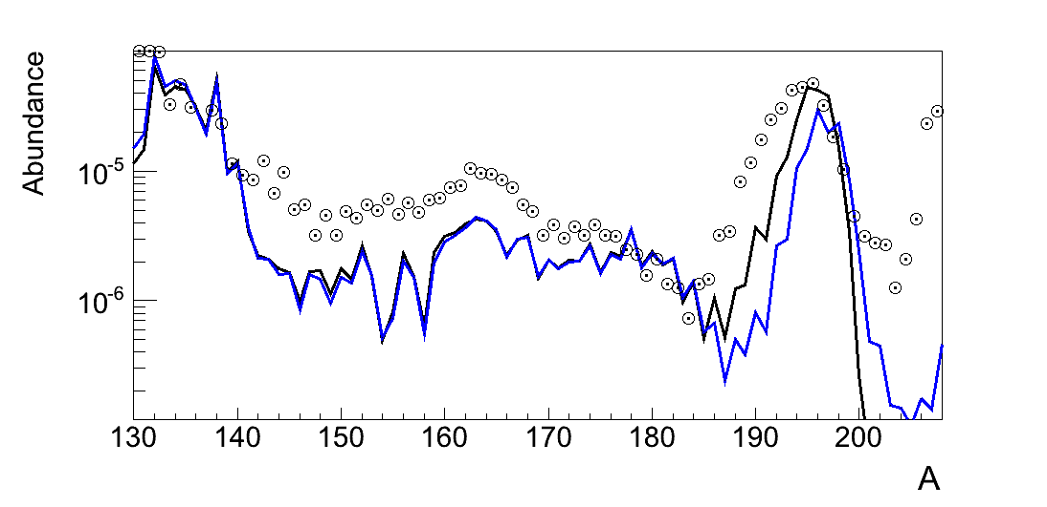
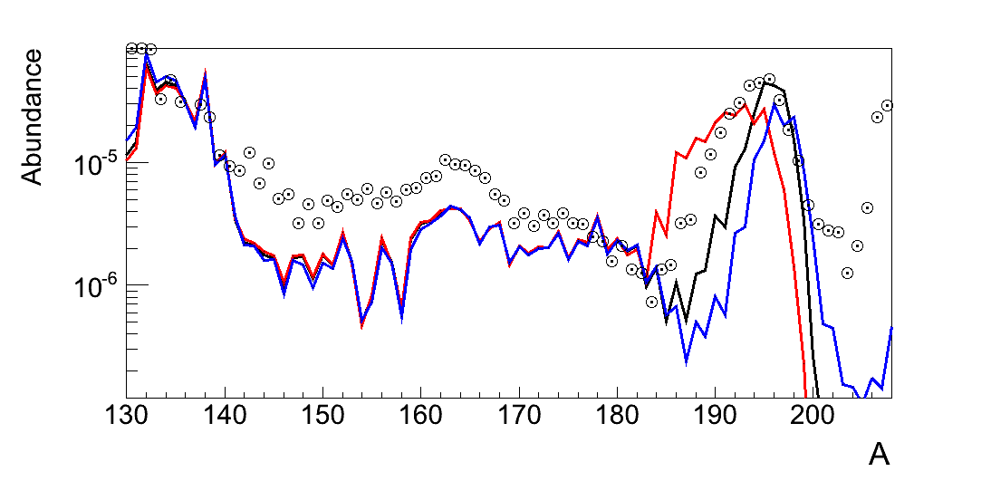





















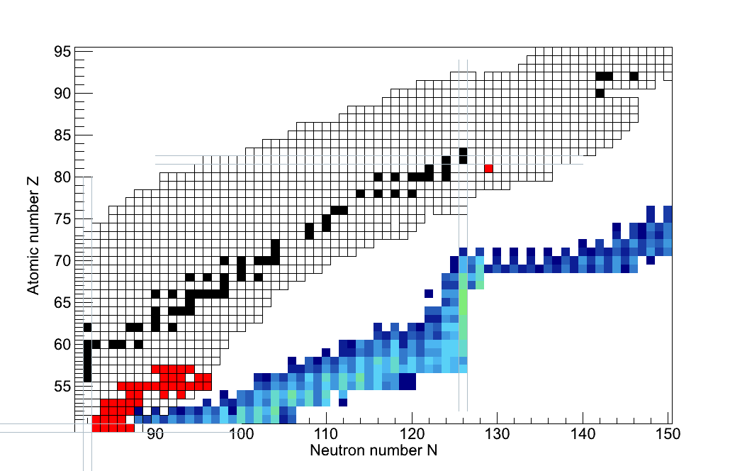









Impact on r-process abundances
During „Freeze-out“:
detour of β-decay chains
⇨ r-abundance changes
During „Freeze-out“:
enhancement of neutron flux
⇨ r-abundance changes
Pn x 0.4
Pn / 10
Pn x 10
Pn x 10
In 134
138 ms
βn, β2n
N=126

Slide 15
In-beam vs TAPE Station systems: figures
In-beam | Tape station
Low production rates Require little statistics can be used to study both short-living ( ms ) and long living (100s ) nuclei Get informations already with few particles | Can focus on single case Clean signal Usually higher cross-sections Only nuclei T1/2> 100 ms Naturally eliminating bg activity
ε_{implant} ~ 70 % ε_{β} < 50% ε_{γ} ~ 15 % (in best case) (**) | Ε_{implantjj,} ~ 100%(*) ε_{β} ~ 50-60% ε_{γ} ~ 10 % (**)
(*) provided T1/2 is large otherwise we have losses due to decays “on the way”
(**) of course it depends on many parameters: number of detectors, distance from implantation point, other reactions (prompt-flash in case of in-beam)

