Slide 1
RD at RM3
RM3 setup
Preliminary results
APD UV extended
Roma3 and I. Sarra

Slide 2
RM3 setup
two copper faraday cages for our PhotoPentode
Voltage divider received and tested
Big (unfortunately) dark faraday cage
Setup overview

Slide 3
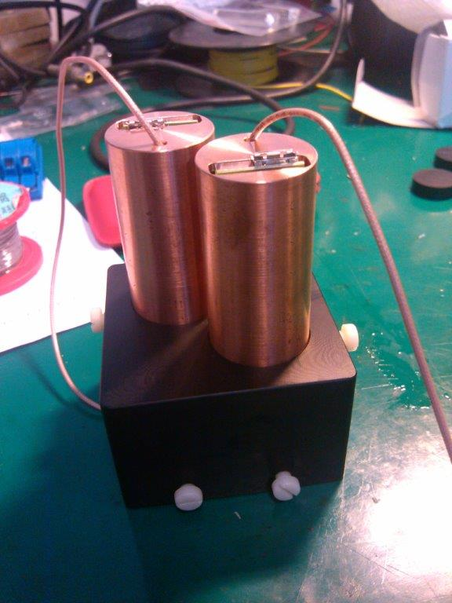
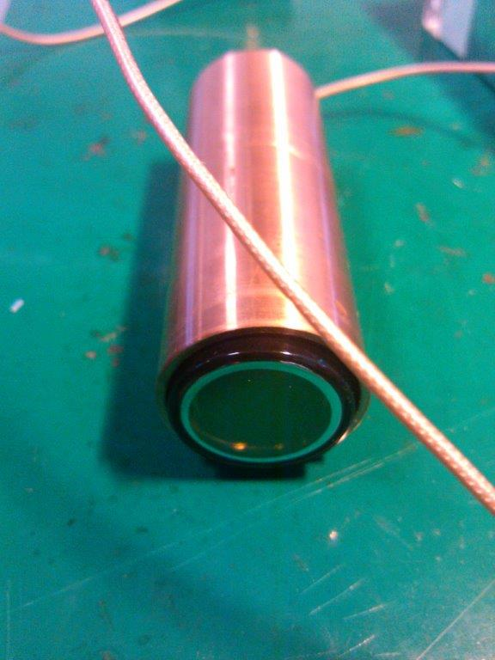
Photopentode cages
Photopentode Faraday cage
Faraday cage mounted on the mechanics which
Hosts the photopentode

Slide 4
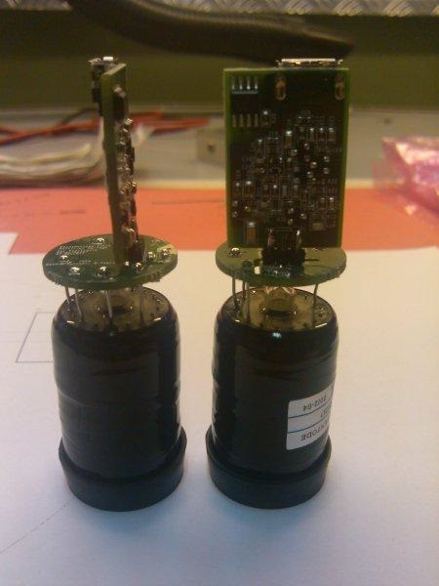
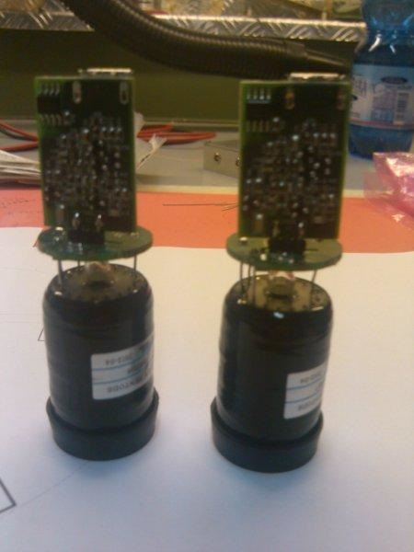
Voltage Divider and pre-amp
Voltage divider
pre-amp

Slide 5
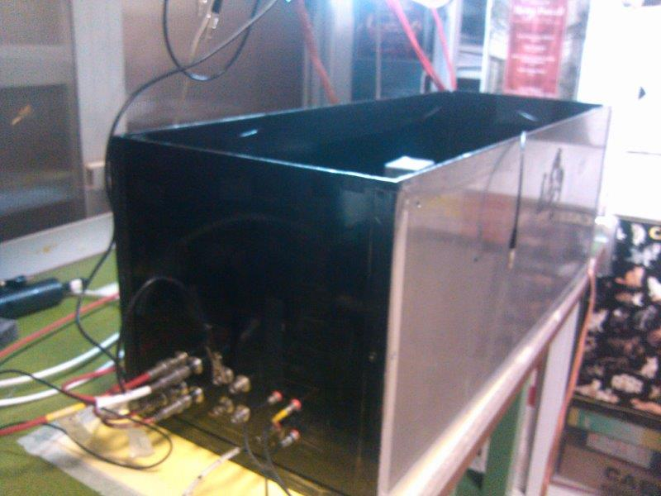
Dark box&setup
HV & signal cable
connections

Slide 6
Trigger Setup for 2PP 2inch
VIEW
Electronics System
Finger UP
TOP VIEW
Pb
5cm
CsI Pure
Finger UP
Finger DOWN
Finger DOWN
SCOPE
Finger UP
Finger DOWN
Pb
CsI Pure
Trigger Finger UP & Finger DOWN
Threshold: -200mV

Slide 7
Trigger Setup for 2PP 1inch
VIEW
Electronics System
Finger UP
TOP VIEW
Pb
5cm
CsI Pure
Finger UP
Finger DOWN
Finger DOWN
SCOPE
Finger UP
Finger DOWN
Pb
CsI Pure
Trigger Finger UP & Finger DOWN
Threshold: -200mV

Slide 8
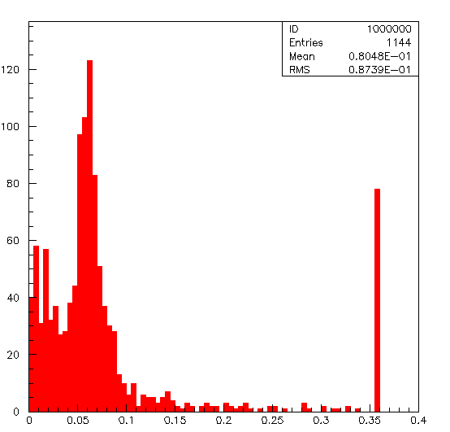
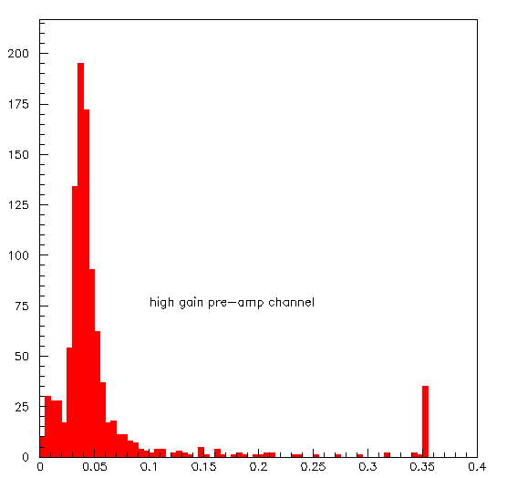
Comparison on 2 inches pp with/wo lead absorber
No Lead absorber
With lead absorber

Slide 9
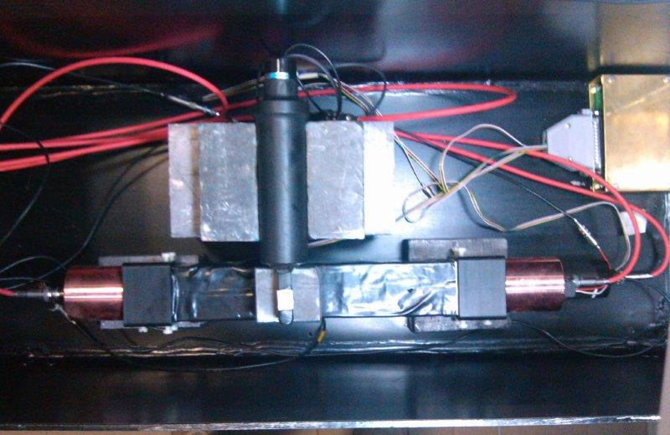
Setup topview

Slide 10
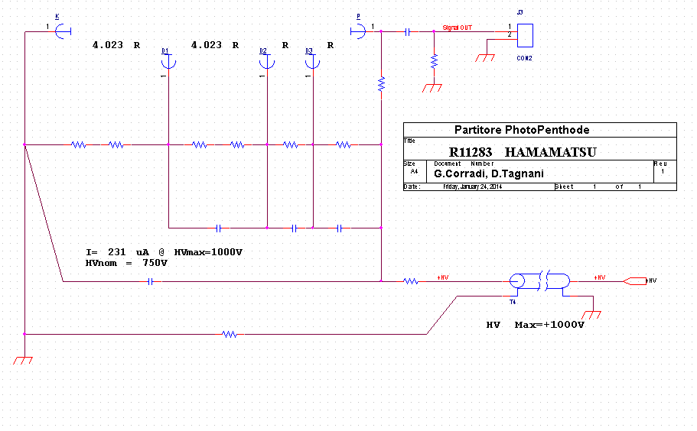
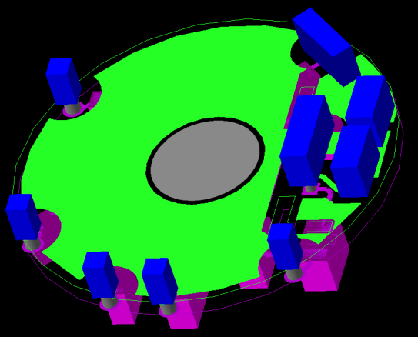
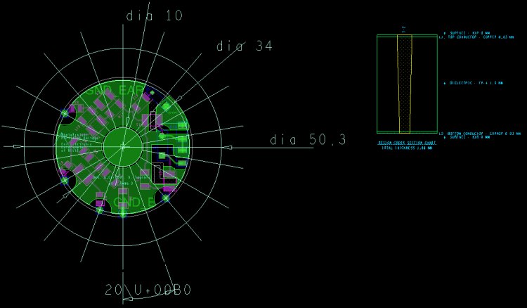
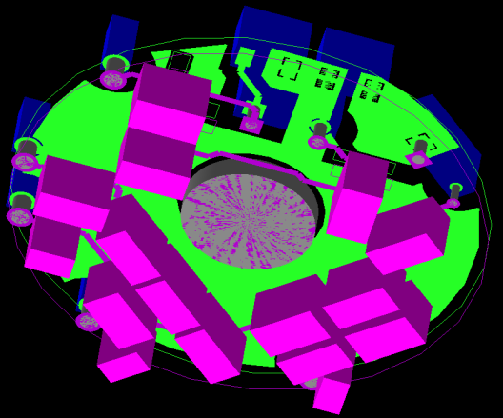
Voltage divider
LV PW
Pre Charge Amplifier
HV PW

Slide 11
Pre Charge Amplifier
Charge - Preamplifier
Gain = 1.4V/pC
Single power = 6V - GND
Power dissipation = 16mW 6V
Dynamic Range 2.2V su 50R
Tau = 150ns

Slide 12
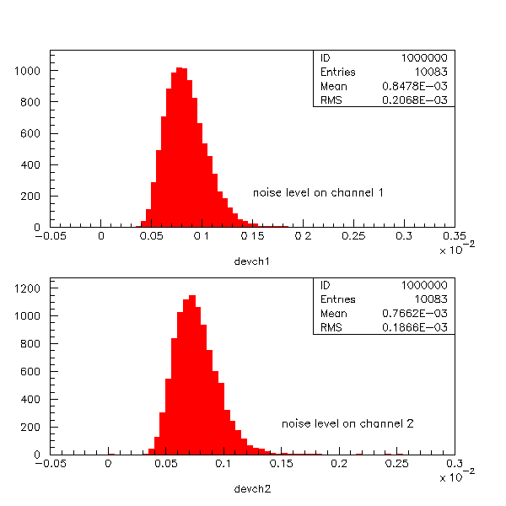
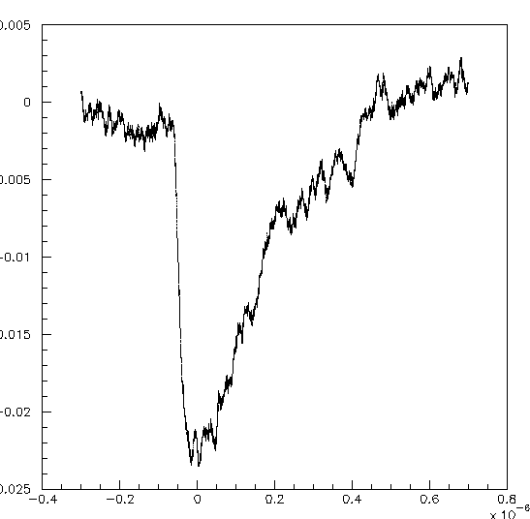
A typical signal
noise
The standard deviation of the noise distributon is 700-800 uV.

Slide 13
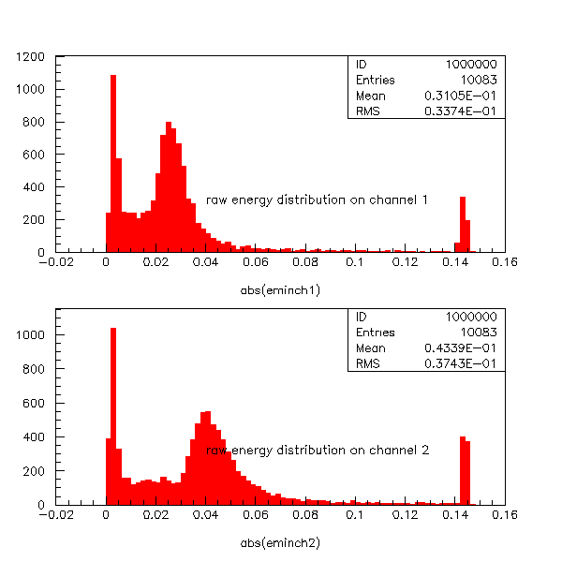
Raw energy distributions
The 2 channels are not equalized

Slide 14
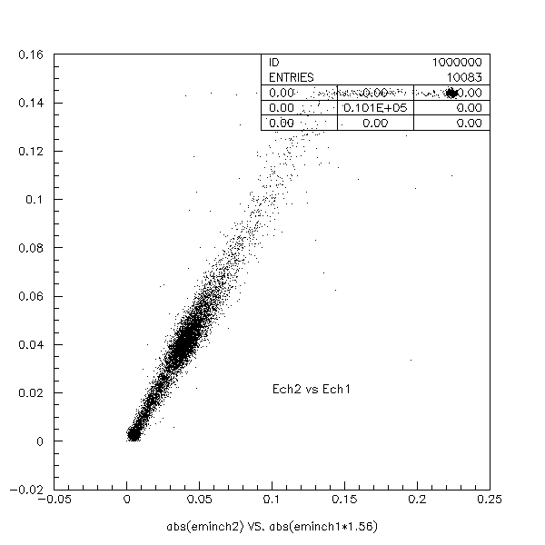
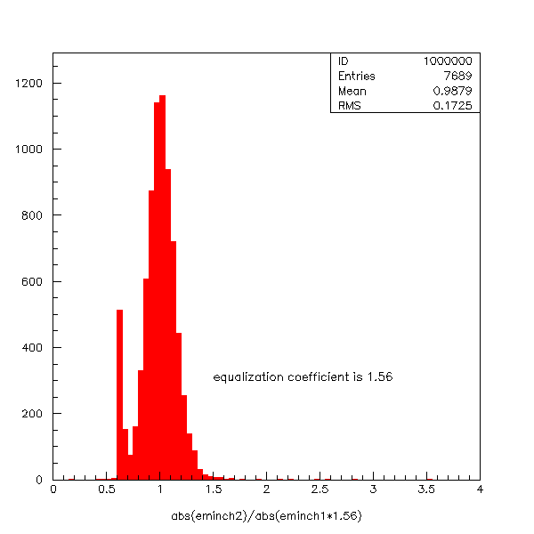
Channel equalization
saturation
Ch1 Ch2 correlation after equalization

Slide 15
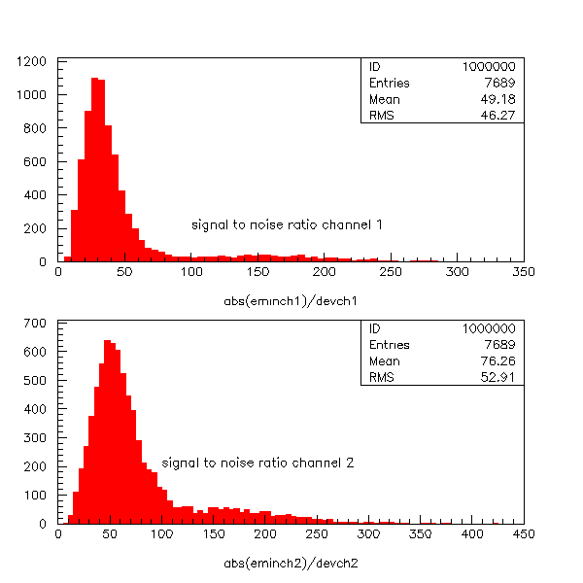
Signal to noise ratio
Signal/noise on ch1 = 49.
Assuming a that muon delivers
30 MeV noise level is about 650 KeV
Signal to noise ratio on ch2 = 76
under the same assumption
We estiate a noise level of about 400 KeV
No shaping has ever been applied to
This analysis

Slide 16
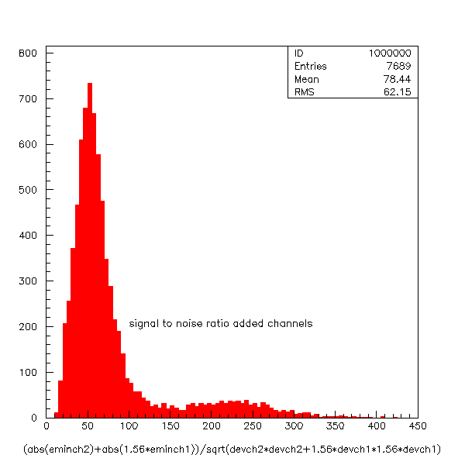
Signal to noise channels combined
Signal to noise ratio
Is 78.
We do not gaim much from
channells combination.
It is maybe due to the huge
difference between the
2 photopentode

