Slide 1
g-2 Calorimeter test beam
“ T-519 has been assigned beam time is from Thursday July 17 to Monday morning July 27 at ESTB”
LCLS is operating lower beam energies during the night shift, which should allow us to produce the low energy electrons
Setup at SLAC several days in advance
Cleanup will take Monday 27th, about a shift, including time for radiation safety to clear us

Slide 2
Il test beam sara’ preceduto da un periodo a SEATTLE per l’installazione con in seguente schedule
June 2 - 6 : Crystal and SiPM preparations
Transmission measurements for each crystals, wrap, assemble housing
SiPMs and boards tested in stand-alone setup at CENPA or Muon Lab
June 9 – 13: Installation of SiPMs with Bias and Crystals
SiPMs mounted to crystals; tested with a standard light source setup
Mount units inside mechanical housing.
UVa Group at Seattle; install and debug Bias and it’s control. Cable and mount to SiPMs.
June 16 – 19 (or just before CD2 review); Calibration Installation
Italian team in Seattle. Setup laser, distribution, monitoring; test it locally (train locals);
Attaches front plate to housing and does pe calibration exercises.
arrives and is used together with local readout electronics to practice pulsing the detectors. Italian groups here.
June 23 – 27: Digitizer Installation / Software Coordination
Cornell group arrives with digitizers and does basic setup (trains locals).
Kentucky group arrives and works on MIDAS readout of Digitizers
UW group continues to test stand-alone installation and perform calibrations
June 30 – July 3 (short). System Tests Continue on WFDs, DAQ, Detectors
By now need enough on-site experts to keep system running. Who will be here then?
July 7 – 11. Reserved for any slippage; Pack up at end of week
July 14th: Drive equipment to SLAC (full day); others fly
RUN: July 17 to 28TH (morning); Packup on 28th, return to Seattle

Slide 3
Valutazione della potenza del laser necessario per il test beam
In base alle seguenti ipotesi:
To simulate calorimeter signals:
pulse energy E ~ 2 GeV, 350 < λ < 450 nm ; assume: y=2. p.e./MeV and ε_{SiPM}=20%. Then: and
per channel. And the total laser energy/pulse must be
where Att is the total attenuation. For N_{ch} = 25, we can calculate Att for a given
:
(pJ) | @ 40 MHz (mW) | Att
25 | 1 | 100
250 | 10 | 1000

Slide 4
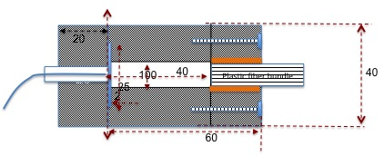
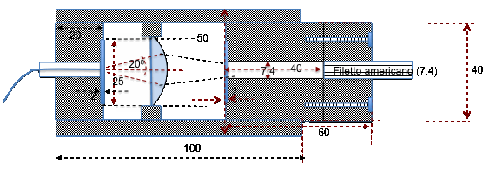
For the integrating sphere, we have measured attenuations of the order of ~ 10⁻²
This OK with the lase we have acquired.
For our prototype beam_expander-diffuser-mixing chamber distributors
we measure attenuations of ~ 20 - 10^{2.} This should be OK for the laser we we have purcahsed.
We plan to test both distributors at test beam
This should also settle whther the broadening of the laser pulse produced by the integrating sphere will be a problem.

Slide 5
Our custom monitor electronics for stable low - noise amplification and inte gration of the monitor signals should also be ready in time for test beam.
The output signals will be digitized by the standard Cornell electronics.
Our custom laser control electronics are not essential for test beam but we will test whatever version is ready.
In conclusion:
we will be ready for test beam and the tests will be essential for the resolution of design issues

