Slide 1




The FP7-IAPP-FTK project: real-time image reconstruction for Hadron Collider experiments & a possible application to the
Artificial Intelligence field
Paola Giannetti
INFN Pisa
Pisa Seminar, May 6 2014

Slide 2
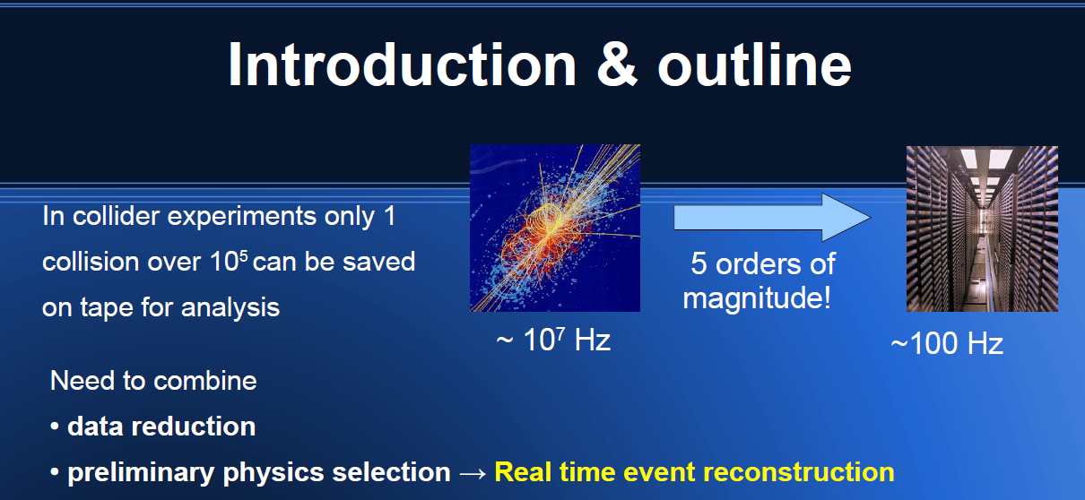
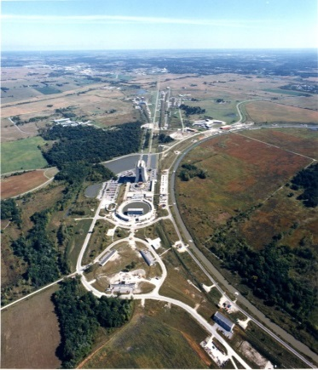
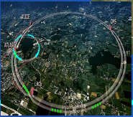
In this talk:
Highly parallelized, pipelined electronics for Hadron colliders
the technology was born in CDF, exported to LHC
Spinoff of the FTK – IAPP project
Comparison with other technologies when possible

Slide 3
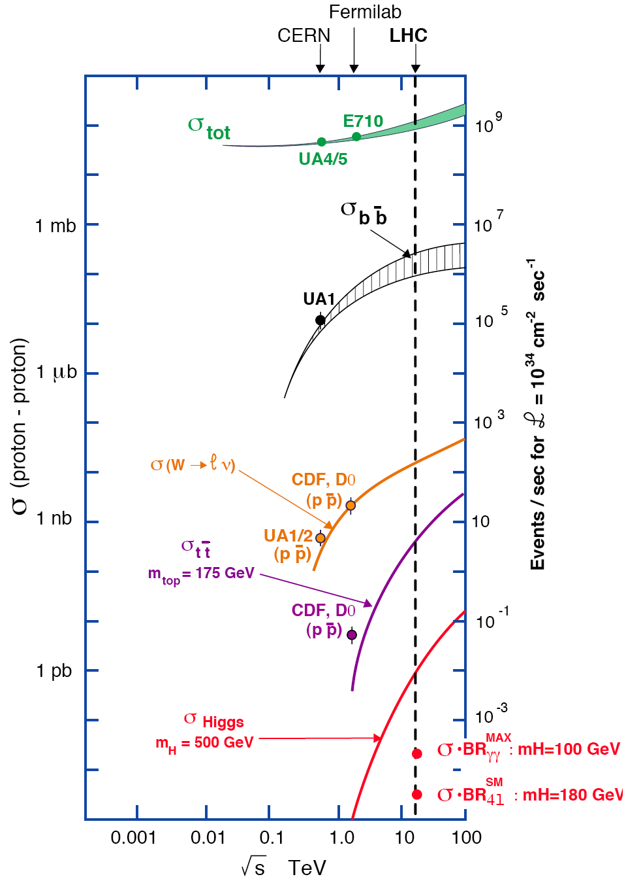
Hadron Colliders
HARD LIFE
Common
EVENTS
10⁹
10⁷
p
p
Event & Underlying event
10⁵
Events at L = 10³⁴ cm⁻²s⁻¹
10³
Bunch Crossing
10
Pile-up:
25 eventi @10³⁴ cm⁻²s⁻¹
40 MHz coll. Rate
500 eventi @10³⁵ cm⁻²s⁻¹
20 MHz coll. Rate SLHC
Pile-up:
25 events @10³⁴ cm⁻²s⁻¹
40 MHz coll. Rate
Hundreds of events
@10³⁵ cm⁻²s⁻¹
40 MHz coll. Rate HL-LHC
High Luminosity →
high P density in the Bunch
10⁻¹
RARE
EVENTS
10⁻³
H
S^{1/2} (TeV)

Slide 4
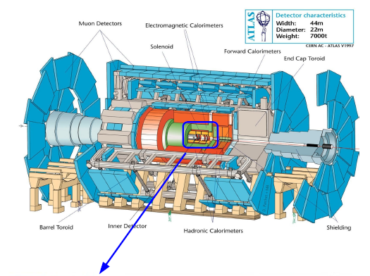
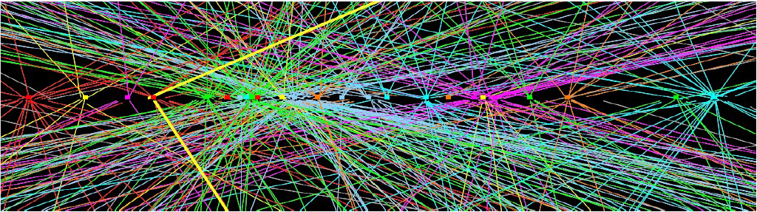
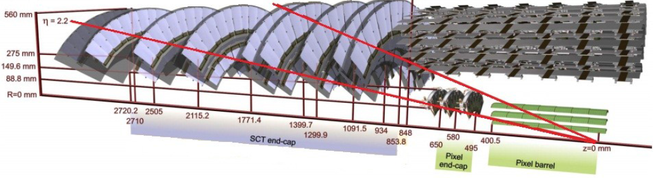
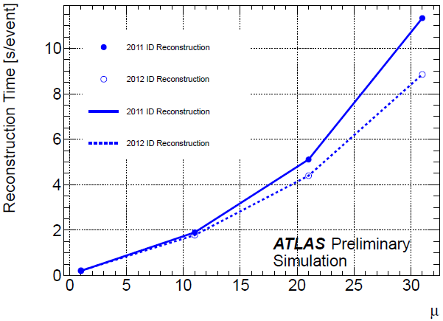
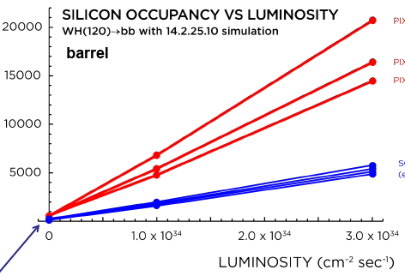
Role of the a high precision Tracker, the most computing power reconstruction
ATLAS
P
P
ATLAS Silicon Tracker
Pix2
Pix1
Pix0
Pile-up
SCTs
Hard scattering!

Slide 5
The Trigger at ATLAS
40 MHz Crossing rate
ATLAS
7.6 MHz Crossing rate
CDF
L1 pipeline 100 clock cycles
L1 pipeline
42 clock cycles
L1
L1
L1
7.6 MHz Synchromous
Pipeline
5.5 μs Latency
30 kHz accept rate
Level 1
40 MHz Synchromous
Pipeline
2.5 μs Latency
75 kHz accept rate
L2 buffer
4 events
L 2 buffer many events
L2
L2
L2
Asynchronous 2 Stage Pipeline
20 μs Latency
1 kHz accept rate
Level 2
Asynchromous
10 ms Latency
6-4 kHz accept rate
DAQ buffers
DAQ buffers
L3 Farm
L3: CPU farm
Full event reconstruction
with speed optimized offline code
L3 Farm
Mass Storage
(~100 Hz)
Mass Storage
(~800-300 Hz)

Slide 6
CDF vs ATLAS TDAQ Architecture
40 MHz Crossing rate
ATLAS
7.6 MHz Crossing rate
CDF
L1 pipeline 100 clock cycles
L1 pipeline
42 clock cycles
L1
L1
L1
7.6 MHz Synchromous
Pipeline
5.5 μs Latency
30 kHz accept rate
Level 1
40 MHz Synchromous
Pipeline
2.5 μs Latency
75 kHz accept rate
L2 buffer
4 events
Highly parallelized
Dedicated hardware
L 2 buffer many events
L2
L2
L2
Asynchronous 2 Stage Pipeline
20 μs Latency
1 kHz accept rate
Level 2
Asynchromous
10 ms Latency
6-4 kHz accept rate
DAQ buffers
DAQ buffers
L3: CPU farm
Full event reconstruction
with speed optimized offline code
L3 Farm
CPUs FARMs
L3 Farm
Mass Storage
(~100 Hz)
Mass Storage
(~800-300 Hz)

Slide 7
CDF vs ATLAS TDAQ Architecture
40 MHz Crossing rate
ATLAS
7.6 MHz Crossing rate
CDF
XFT here
L1 pipeline 100 clock cycles
No
Tracking
L1 pipeline
42 clock cycles
L1
L1
L1
7.6 MHz Synchromous
Pipeline
5.5 μs Latency
30 kHz accept rate
Level 1
40 MHz Synchromous
Pipeline
2.5 μs Latency
75 kHz accept rate
SVX read out after L1
L2 buffer
4 events
L 2 buffer many events
L2
Late
Tracking
L2
SVT here
L2
Asynchronous 2 Stage Pipeline
20 μs Latency
1 kHz accept rate
Level 2
Asynchromous
10 ms Latency
6-4 kHz accept rate
DAQ buffers
DAQ buffers
L3: CPU farm
Full event reconstruction
with speed optimized offline code
L3 Farm
CPUs FARMs
L3 Farm
Mass Storage
(~100 Hz)
Mass Storage
(~800-300 Hz)

Slide 8
SVT, The FTK predecessor @ CDF &
Its upgrades (~2000-04)
XFT : 3D Tracks at L1
SVT: Tracks in the silicon at L2
in a average time of 20 μs
with enough precision to see b quarks decays – Exceptional CDF B-physics results
π
π
B
200 μm
p
p

Slide 9
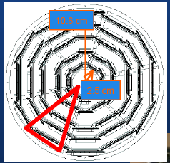
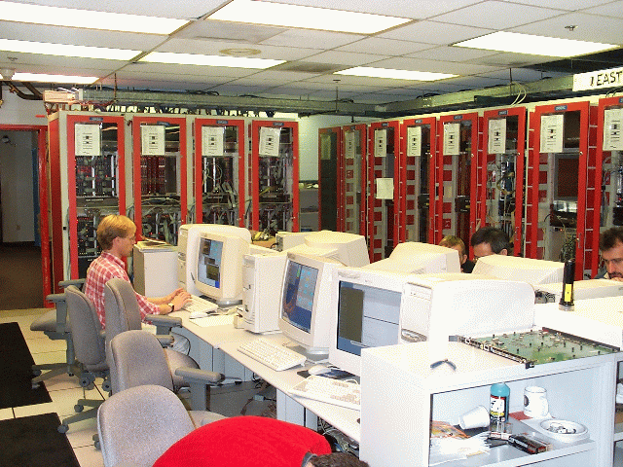
SVT was installed in 2000.
It was made of 12 processors (one per wedge) made of 5 different 9U VME boards each, for a tot of ~72 boards
2 Wedges
per crate
CDF Trigger ROOM
SVT

Slide 10
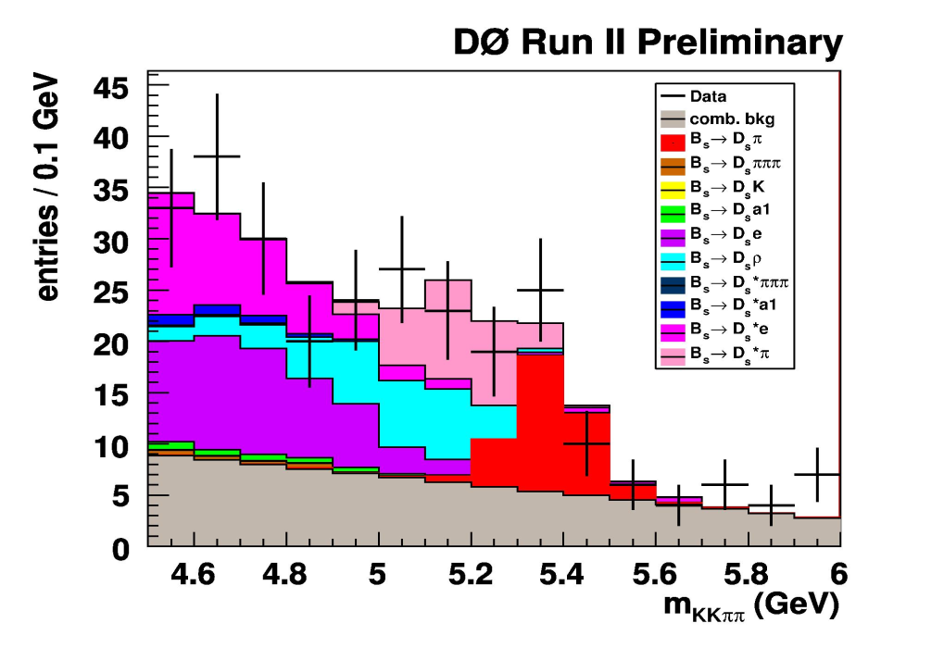
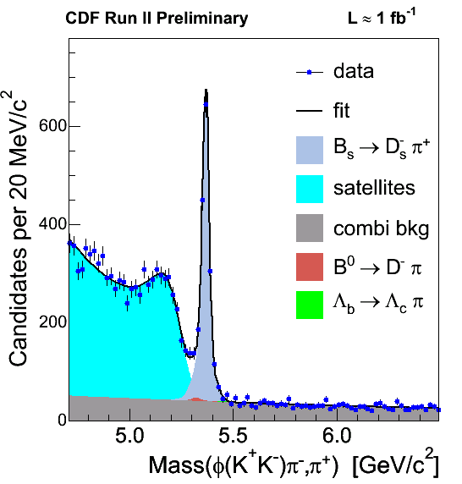
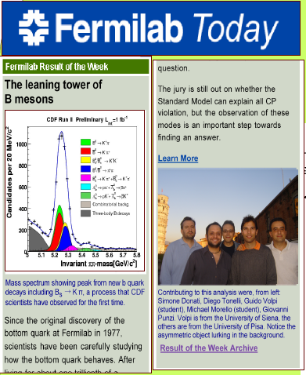
The sample for the Bs Mixing at CDF
wo SVT
w SVT
M^{kkππ}
Efficient collection of
B’s purely-hadronic decays
Panofsky Price 2009

Slide 11
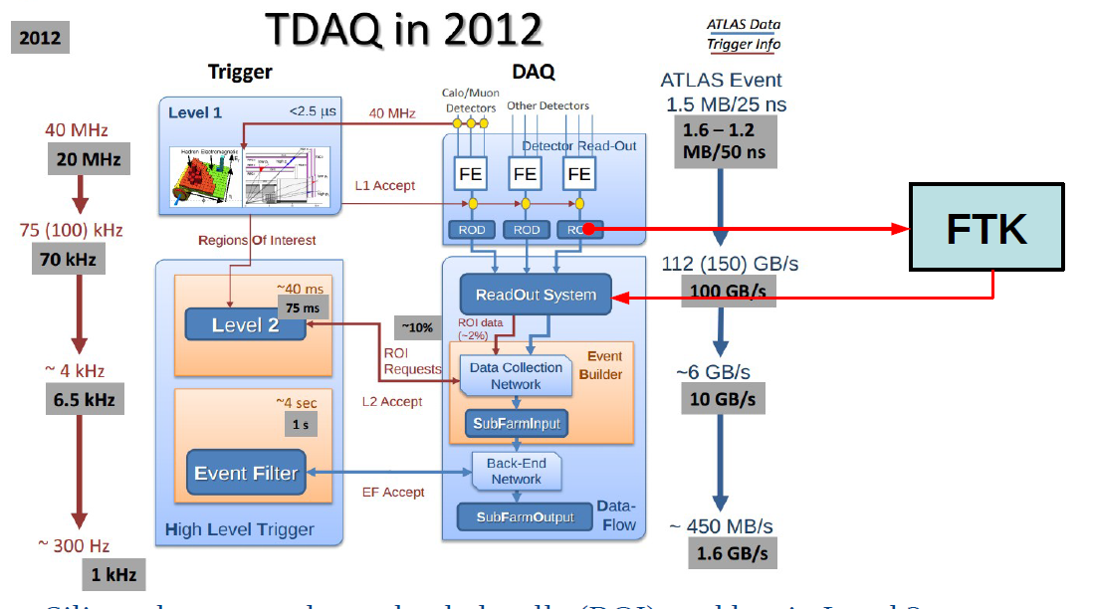
But AM survives at LHC inside FTK an exception
to the LHC strategy
Very limited space
For dedicated HW
After 15 years
of discussions &
studies a new addition, a second generation
TRACKER
has been approved

Slide 12
HOW FTK WORKS
30 minimum bias events + H->ZZ->4μ
30 minimum bias events + H->ZZ->4μ
@LHC (both CMS & Atlas) tracking
is missing @L1 and late @L2
FTK
Where is the Higgs?
μ
μ
Where is the Higgs?
μ
μ
Help!
μ
μ
μ
Tracks with P_{t}>2 GeV
μ
Tracks with P_{t}>2 GeV

Slide 13
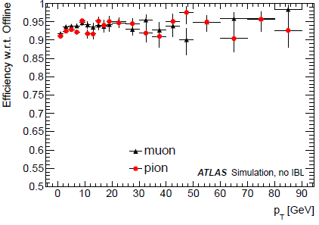
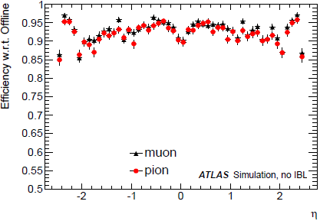
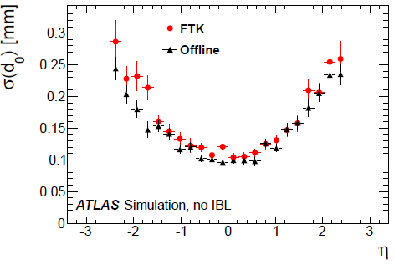
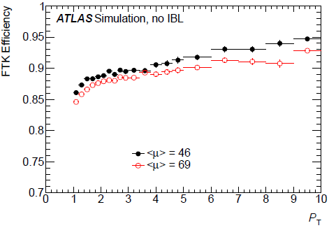
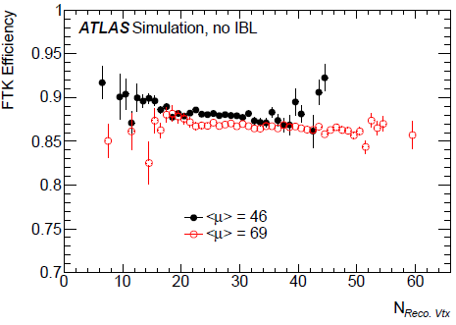
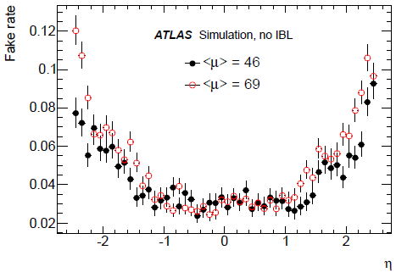
FTK: a second generation processor
High efficiency
Large η coverage
Good
d0 resolution for low pt tracks
P_{T}
η
No pile-up
Performances are mantained at high luminosity
High pile-up
Low Fakes
P_{T}
N_{Reco Vtx}
η

Slide 14
FTK Physics case: collect high statistics samples of
Higgs purely hadronic decays (but also standard decays)
R_{SIG}
P
P
R_{I}
R_{ISO}
leading P_{T}
track
Hadornic
TAU decay
High efficiency and short execution time to
Identify the primary vertex & hard scattering
Tag b-jets & tau-jets
………
Online track-corrections for MET & jets
track-based isolation algorithm, not only for leptons…isolated hadrons (one-prong τ or highly ionizing particles)
Benchmark channels:
– ZH→ννbb, bbbb, bb ττ ; bbH, ttH → bbbb, bbττ ; X → hh → bbbb, bb ττ .
– VBF Hqq → ττqq; boosted H → ττ
– Calibration channels: Boosted Z → bb & Z → ττ
Jet axis

Slide 15
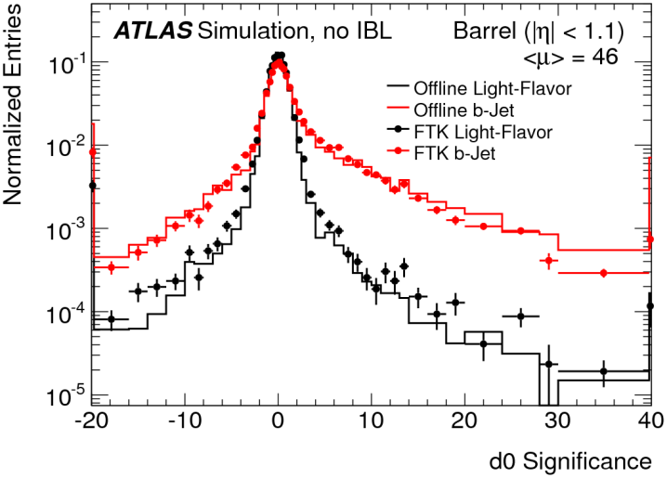
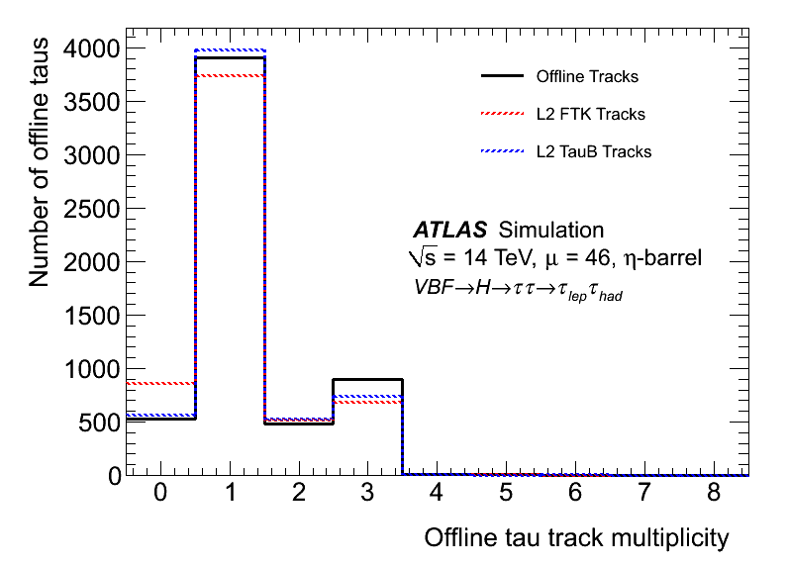
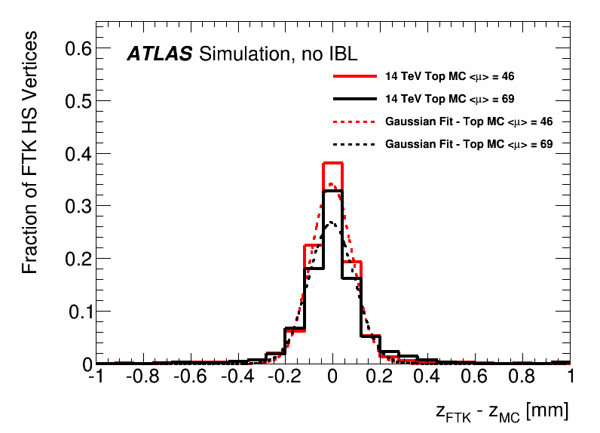
Tau signal
cone
Jet b-tagging
Jet tau-tagging
Primary Vertex reconstruction;
right PV identification 98% efficient
PV Z
Resolution
~100 um

Slide 16
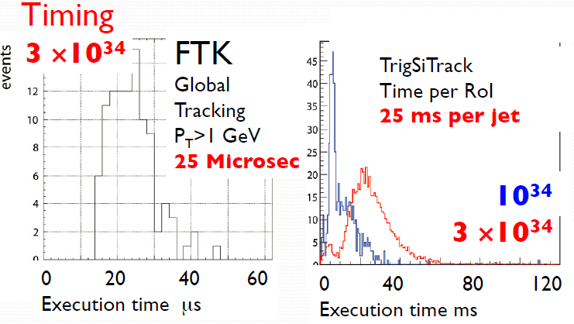
HOW much FAST it is
WH events @3×10³⁴ average of 40 jets (ROIs) > 70 Gev per event
CPU: 25 ms * 40 = 1 sec → 1 Hz
FTK : ~ latenza 25 μsec, event rate 100 kHz → 100 k times faster !
GPU : ~4 times faster than a CPU → 25 k times slower than FTK!
HOW CAN FTK DO IT?

Slide 17
FTK: Full event tracking in 2 steps
  Find coarse Roads first (Pattern Matching with Associative Memory, AM)
  From those Roads extract the full resolution Hits
  Combine the Hits to form Tracks, calculate χ² and parameters (Track Fitter)
_{SSIDs}
Data Organizer
(DO)
Pattern matching
(Associative
Memory - AM)
Hits
Roads
Roads + hits
Track
Fitter
(TF)
Super
Strip (SS)
Tracks parameters
(d, p_{T}, φ, η, z)
Track fitting
  using full resolution of the detector

Slide 18
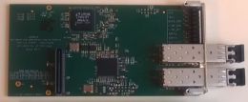
Only one AMB
750 Slinks
~200 GB/s
Only AMBs ~25 TB/s
1860 large FPGAs
8200 AM-Chips (ASICs)
Thousands of 2Gb/s Serial Links
RODS
8x128 Slinks@6Gb/s
~800 GB/s
AMBoard
8 VME core crates
SSB: Final Fit-HW
ATCA
ATCA
8
4 DOs
4 TFs
4 HWs
~80 FTK_IM: Clustering in parallel
32 DF: cross-point for clusters -
ROS
AMBoard
4 DOs
4 TFs
4 HWs
32
boards
~380
ROLs
@2 Gb/s
100 GB/s
FLIC: FTK-to-Level-2 Interface Crate
128 PUs =
512 pipelines
ROS
SSB: Final Fit-HW
AMBoard
PU
4 DOs
4 TFs
4 HWs
To
TDAQ
ROS
Board-board
Connector
AUX CARD
fibers

Slide 19
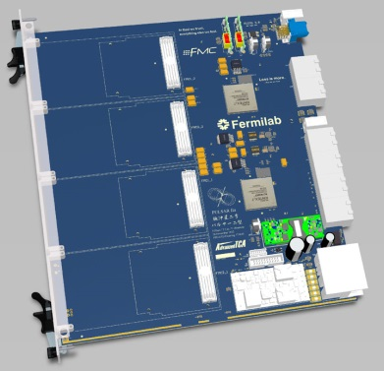
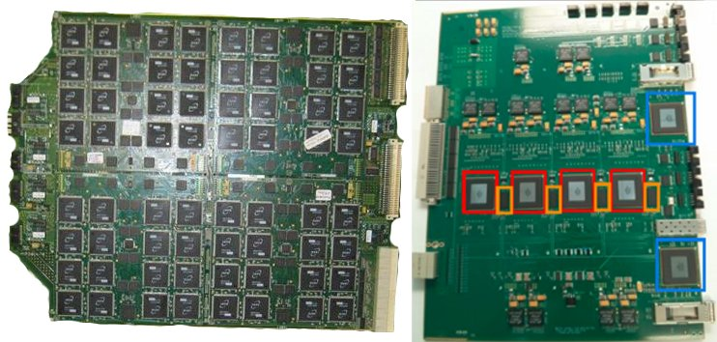

RODS
AMBoard
PU
SSB: Final Fit-HW
ATCA
ATCA
4 DOs
4 TFs
4 HWs
~80 FTK_IM: Clustering in parallel
32 DF: cross-point for clusters -
ROS
AMBoard
AUX CARD
4 DOs
4 TFs
4 HWs
32
boards
FLIC: FTK-to-Level-2 Interface Crate
128 PUs =
512 pipelines
ROS
SSB: Final Fit-HW
AMBoard
4 DOs
4 TFs
4 HWs
To
TDAQ
ROS
Board-board
Connector
fibers

Slide 20
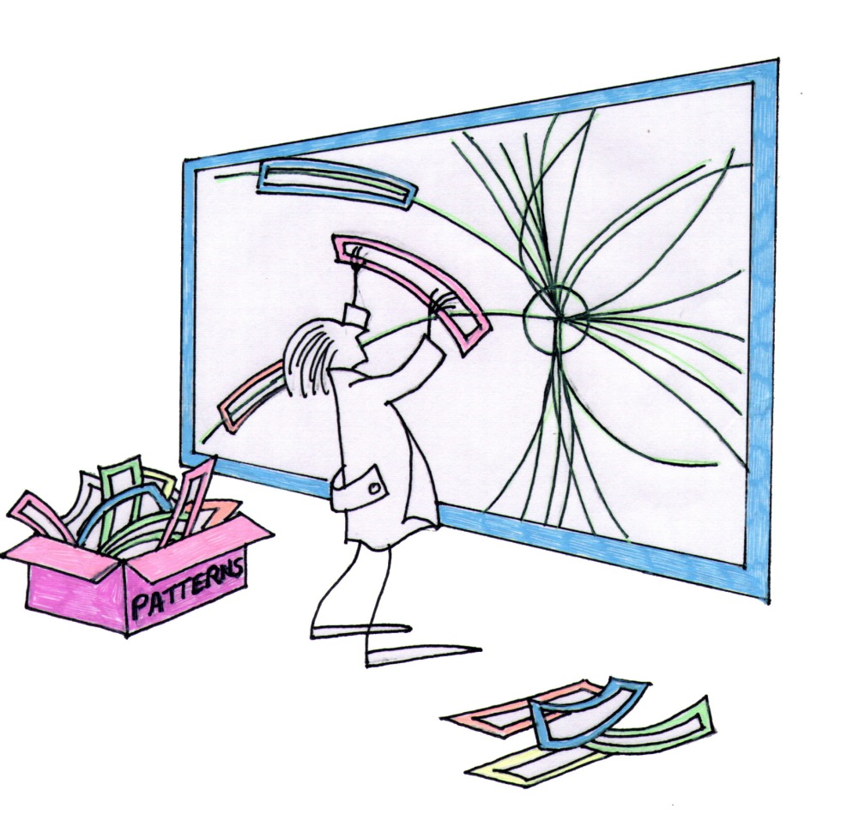
AM: ACE in the Hole
TRACKING WITH
PATTERN MATCHING
We need a Highly
Parallelized Comparison
The Event
The Pattern
Bank
...

Slide 21
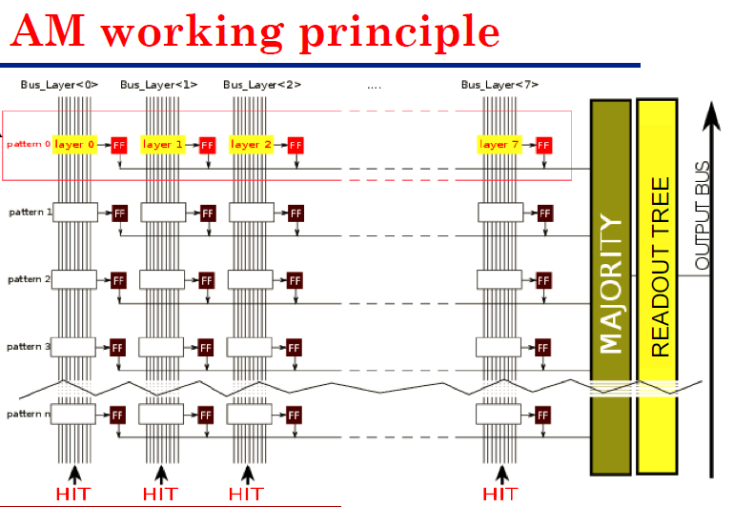
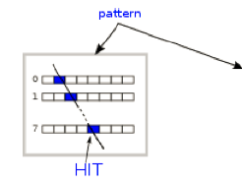
1 COMPARATOR between
the BUS & 1 stored
16-bits-WORD
- very parallelized ASIC x pattern matching
Bus_layer0 Bus_layer1 Bus_layer2 …….. Bus_layer7
pattern
layer0
layer1
layer2
pattern0
layer7
layer0
layer1
layer2
pattern1
layer7
AM CONSUMPTION:
~ 2.5 W for
128 kpatterns
pattern2
pattern3
AM COMPUTING
POWER
Each pattern:
4 32 bits comparators
128 kpat *4 = 500 K comparisons
→ 500 K * 100 M/s = 50 10⁶ MIPS/chip
MIPS → note: only comparisons!
+ readout tree
+ 128 k *100 M/s 8-bits-coincidences w majority= 1 10¹⁵ bit-coincidences/s
AM Memory Accesses:
128 k * 4 * 32 bits *100 M/s=
1.6 * 10¹⁵ accesses/s
….

Slide 22
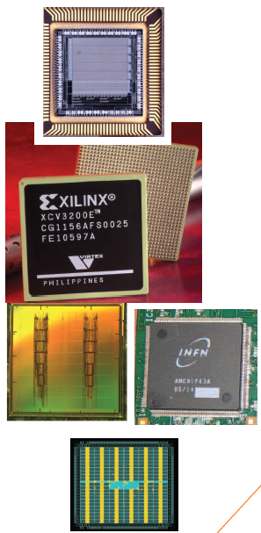
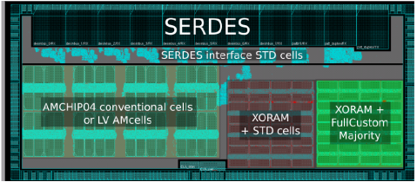
History
Associative Memory (AM)
90’s Full custom VLSI chip – 0,7 mm AMS (INFN-Pisa) 128 patterns, 6x12 bit words each (F. Morsani et al., The AM chip: a Full-custom MOS VLSI Associative memory for Pattern Recognition, IEEE Trans. on Nucl. Sci.,vol. 39, pp. 795-797 (1992).) 25 MHz clock
1998 FPGA (Xilinx 5000) for the same AMchip (P. Giannetti et al., A Programmable Associative Memory for Track Finding, Nucl. Intsr. and Meth., vol. A 413/2-3, pp.367-373, (1998) ).
1999 first standard cell project presented at LHCC
2006 AMChip 03 Standard Cell UMC 0,18 mm, 5k patterns in 100 mm² for CDF SVT upgrade total: AM patterns (L. Sartori, A. Annovi et al., A VLSI Processor for Fast Track Finding Based on Content Addressable Memories, IEEE TNS, Vol 53, Issue 4, Part 2, Aug. 2006). 50 MHz clock
2012 AMchip04 (Full custom/Std cell) TSMC 65 nm LP technology, 8k patterns in 14mm² Pattern density x12. First variable resolution implementation. (F. Alberti et al, 2013 JINST & C01040, doi:10.1088/1748-0221/8/01/C01040) 100 MHz
2013 AMchip05, 4k patterns in 12 mm² a further step towards final AMchip version. Serialized I/O buses at 2 Gbs, further power reduction approach. BGA 23x23 package.
2014 AMchip06: 128k patterns in 180 mm². Final version of the AMchip for the ATLAS experiment.
CDF
ATLAS

Slide 23
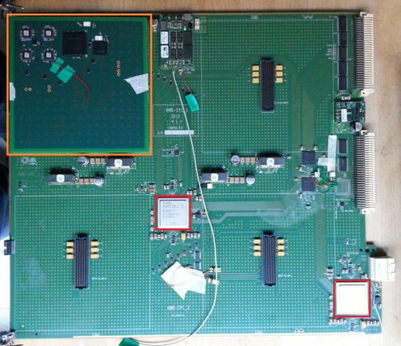
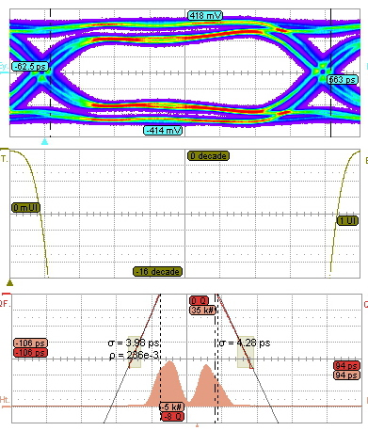
  Measures:
  Jitter Analysis
  BER
  Eye diagram
  Good results
AMBSLP: Tests
Input Measure
Output Measure
Notes:
We went to the National Lab of Frascati to check the quality of the serial links. We performed measures of the jitter, we checked the bit error rate and the quality of the signals with the eye diagram.
We did this analysis in different point of the data path, the most important result that I want to show you are on the input of the miniASIC and at the output. The result show that we have a very good input data path but no so good output links.

Slide 24
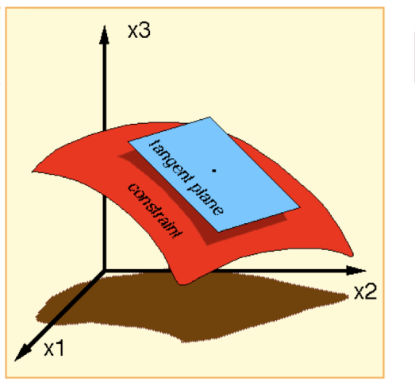
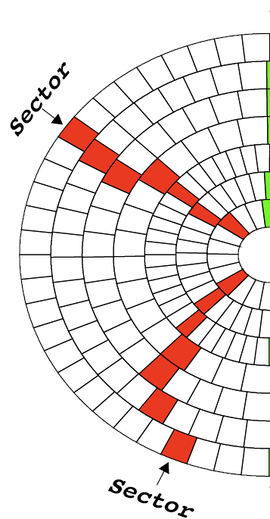
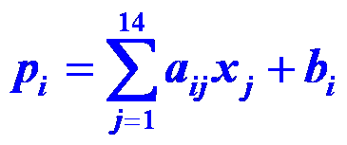
Track fitting – high quality helix parameters and χ²
  Over a narrow region in the detector, equations linear in the local silicon hit coordinates give resolution nearly as good as a time-consuming helical fit.
      p_{i}’s are the helix parameters and χ² components.
      x_{j}’s are the hit coordinates in the silicon layers.
      a_{ij} & b_{i} are prestored constants from full simulation or real data tracks.
        The range of the linear fit is a “sector” which consists of a single silicon module in each detector layer.
      This is VERY fast in FPGA DSPs.
14D coord. space
5D surface
8 TMACs/chip top line
~625 GBs/chip top line
Nucl.Instrum.Meth.A623:540-542,2010
doi:10.1016/j.nima.2010.03.063

Slide 25
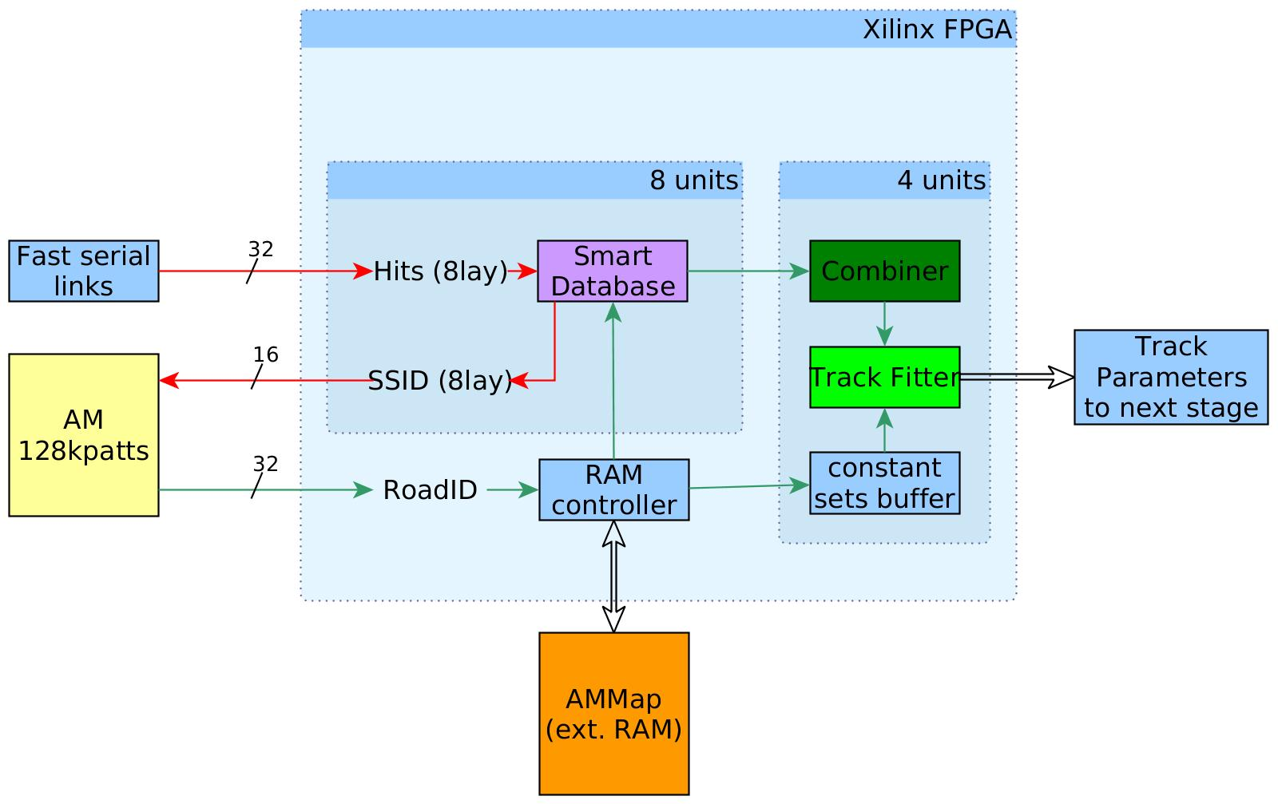
DO+TF: FPGA firmware - overview
Full resolution stored in a smart DB, while SSID of each hit is sent to the AM
XC7K325T-900ffg-3
Database retreives all hits for each SSID of the detected Roads
DO
TF
A very fast full resolution fit it is done for each possible track, fits are accepted or rejected according to x² value
AM performs pattern recognition and provides the ID value for each road (RoadID)
Combiner unit computes all possible permutations of the hits to form tracks
The RoadIDs get decoded in SSIDs for each layer, using an external RAM

Slide 26
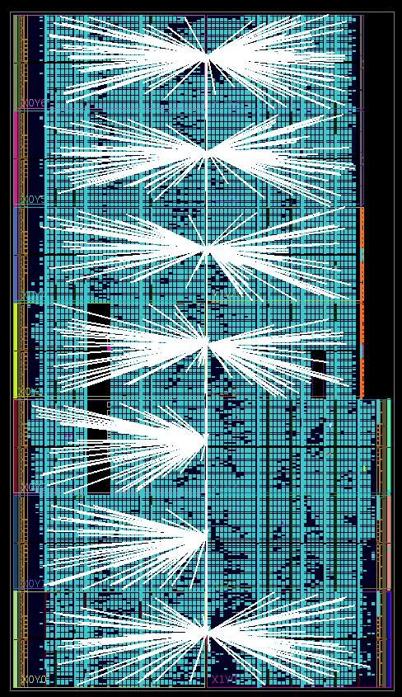
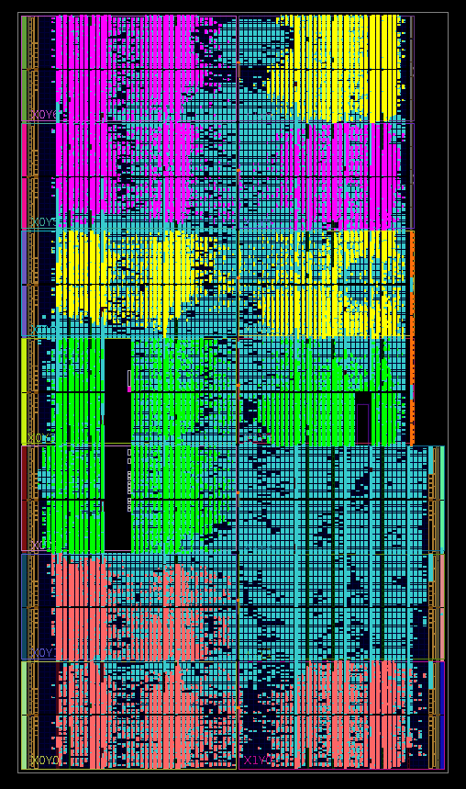
FPGA implementation (device floorplanning view)
4 Track Fitter instances
Local clock routing for the Track Fitters

Slide 27
Speed and latency
450-1800 Mhits per layer/event
@550MHz
@450MHz
225MHitsper layer
2200Mfits
50MRoads
576MBit RLDRAM3
57.6Gb/s 10ns ^{t}RC
Units are per second

Slide 28
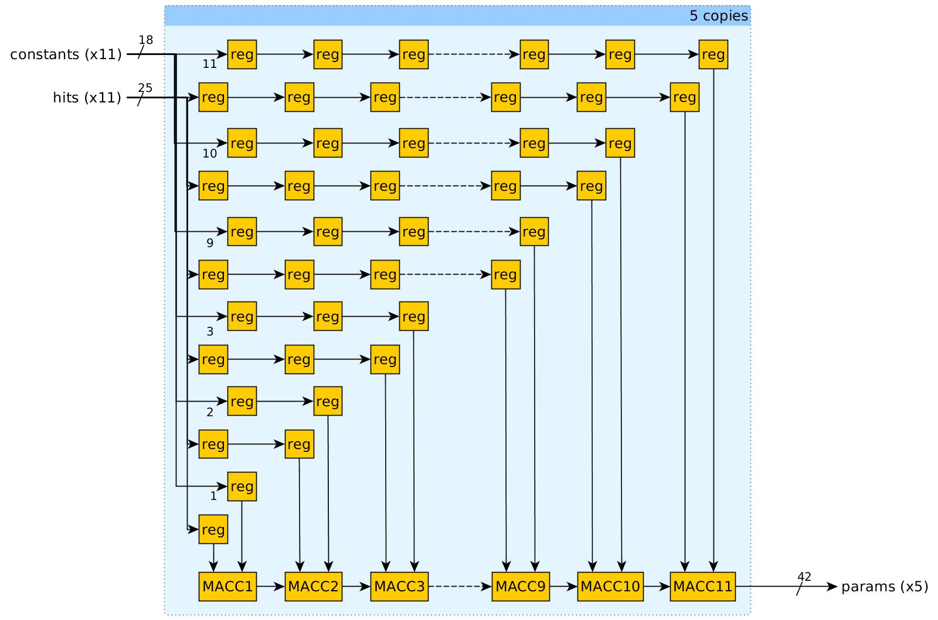
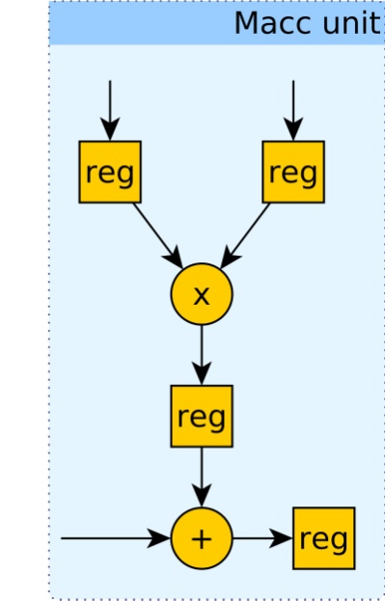
Track Fitting: 5 scalar products
Set of 14 Constants
Set of 14 hits
One DSP
Pipeline
of
DSPs
Very fast FPGA implementation was developed for the fitter
4 such fitters run in parallel in the device →2 fits/1 ns
All multiplications are executed in parallel, giving 1 fit per clock
With dedicated DSPs, the frequency of the fitter is 550MHz→1 fit/2 ns

Slide 29
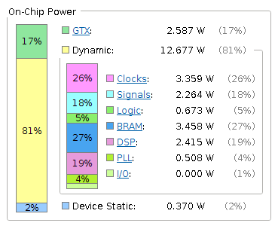
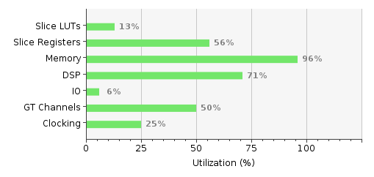
Device utilization & power
Power estimation of 15.5W is the absolute worst-case figure
Simple improvements to the design and use of Xilinx UltraScale new devices are expected to reduce this by 30% or more.
96%

Slide 30
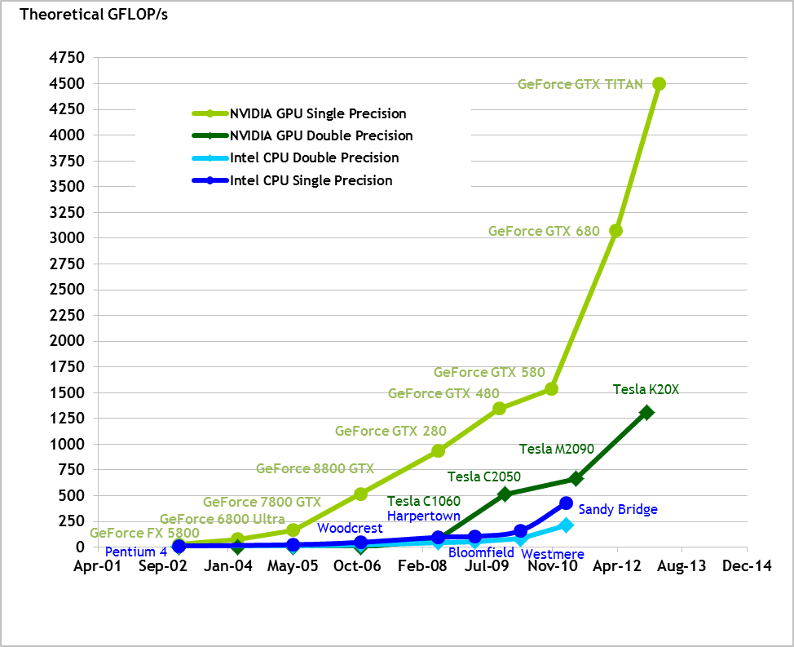
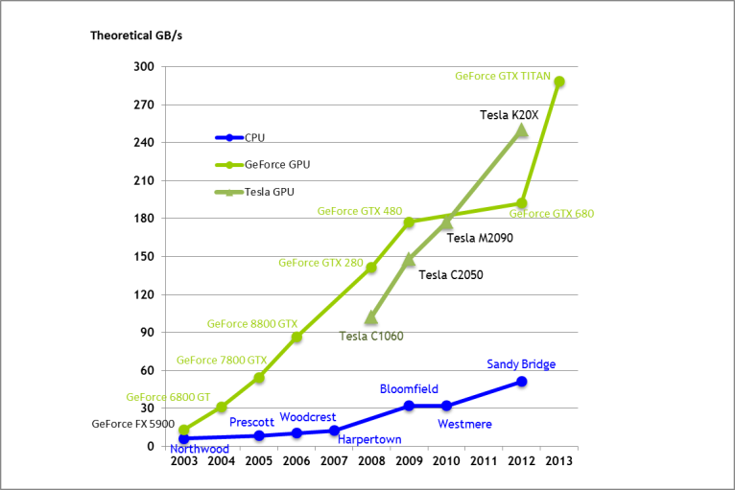
Theoretical GFLOP/s
4500 GF/s
In HEP there
is preference for CPUs/GPUs
Theoretical GB/s
300 GB/s

Slide 31
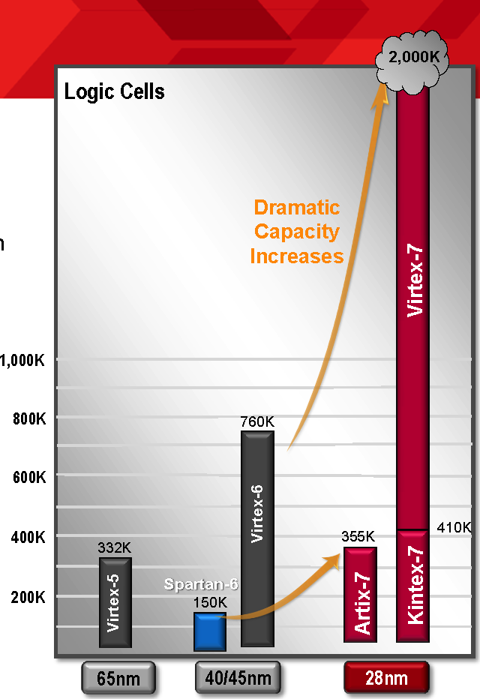
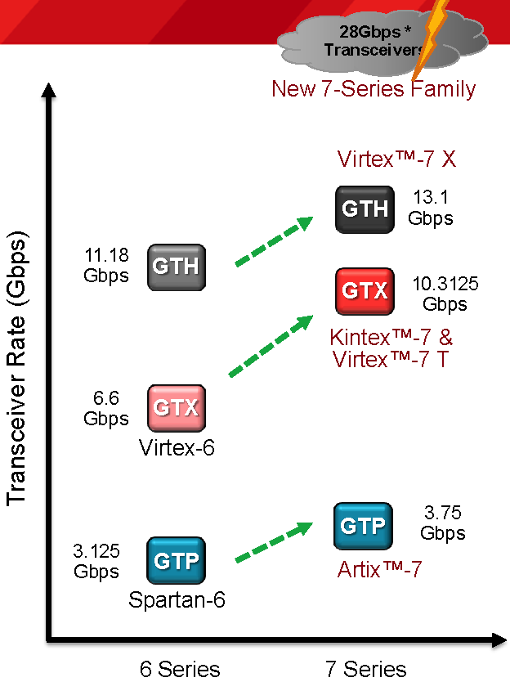
BUT FPGA and Asic’s advancement is also
impressive ….. and they
are more flexible
Up to 96
in the top
line Virtex7
~150 GB/s

Slide 32
 | Spartan-6 | Artix-7 ~150 € | Kintex-7 | Virtex-7 | Kintex UltraScale | Virtex UltraScale
Logic Cells | 147,443 | 215,360 | 477, 760 | 1,954,560 | 1,160,880 | 4,407,480
BlockRAM | 4.8Mb | 13Mb | 34Mb | 68Mb | 76Mb | 115Mb
DSP Slices | 180 | 740 | 1,920 | 3,600 | 5,520 | 2,880
DSP Performance (symmetric FIR) | 140 GMACs | 930 GMACs | 2,845 GMACs | 5,335 GMACs | 8,180 GMACs | 4,268 GMACs
Transceiver Count | 8 | 16 | 32 | 96 | 64 | 104
Transceiver Speed | 3.2 Gb/s | 6.6 Gb/s | 12.5 Gb/s | 28.05 Gb/s | 16.3 Gb/s | 32.75 Gb/s
Total Transceiver Bandwidth (full duplex) | 50 Gb/s | 211 Gb/s | 800 Gb/s | 2,784 Gb/s | 2,086 Gb/s | 5,101 Gb/s ~635 GB/s
Memory Interface (DDR3) | 800 | 1,066 | 1,866 | 1,866 | 2,400 | 2,400
PCI Express® Interface | x1 Gen1 | x4 Gen2 | x8 Gen2 | x8 Gen3 | x8 Gen3 | x8 Gen3
Analog Mixed Signal (AMS)/XADC | - | XADC | XADC | XADC | System Monitor | System Monitor
Configuration AES | Yes | Yes | Yes | Yes | Yes | Yes
I/O Pins | 576 | 500 | 500 | 1,200 | 832 | 1,456
I/O Voltage | 1.2V - 3.3V | 1.2V - 3.3V | 1.2V - 3.3V | 1.2V - 3.3V | 1.0 – 3.3V | 1.0 – 3.3V
Please refer to the device data sheets for the latest product information.
45 nm
28 nm
20-16 nm

Slide 33
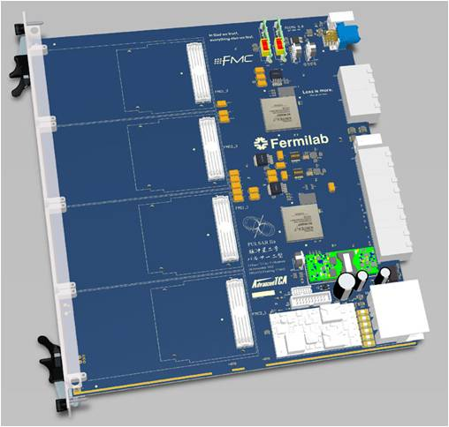



PU evolution: integration of many FTK functions in a small form factor
Main goal is to integrate the FTK system in a more compact form
First step will be to connect an AMChip, an FPGA and a RAM in a prototype board
In the future the devices could be merged in a single package (AMSiP)
That AMSiP will be the building block of the new processing unit, to be assembled in an ATCA board with new mezzanines
AMSiP

Slide 34



FTK SPINOFF
/www.plosone.org/article/info%3Adoi%2F10.1371%2Fjournal.pone.0069154
M. Del Viva, G. Punzi
AM: a filter to detect the IMAGE relevant features
HEP
FILTERING NATURAL IMAGES: edge detector
→ AM as neurons?
Filtered images are clear to
human eyes

Slide 35








HOW we use the AM to filter images?
We build small arrays of pixels (3x3 for static images or 3x3x3 for movies) that are AM patterns - M. Del Viva, G. Punzi
B/W ... 2⁹=512 patterns: 101-010-100, ……. , 111-011-001
4 gray level ... 2¹⁸= 256 Kpatterns: 00,00,01-00,01,00-11,00,10 …..
B/W + time 2²⁷= 128 Mpatterns: 111,000,000 - 000,111,000 - 000,000,000 …
Training: Calculate the frequency of each pattern in the image
SELECT the RELEVANTs
to be PUT in the AM BANK
4 grey level:
2¹⁸ patterns
Stored N=2000
= 1/64 di 1 chip
= 50 mW
Accepting only
these 50 patterns
Accepting only
these 16 patterns
9.8%
5.5%

Slide 36










How we select the relevant patterns to be
stored in the AM bank?
under real constraints
Patterns that are
efficient carriers
of information
given the bandwidth (W)
&memory limits (N),
All 512 patterns
W=0.5, N=50
W=0.5, N=16
Low p
M. Del Viva e G. Punzi (Universita’ di Firenze e Universita’ di Pisa)

Slide 37

Michela Del Viva e Giovanni Punzi (Universita’ di Firenze e Universita’ di Pisa)

Slide 38


Possible applications: smart cameras
DreamCam is a modular smart camera built with the use of an FPGA like main processing board. The core of the camera is an Altera Cyclone-III EP3C120 associated with a CMOS imager and six private Ram blocks.
The main novel feature of our work consists in proposing a new smart camera architecture and several modules (IP)
to efficiently extract and sort the visual features in real time.
2000 patterns ~ 1/64 Amchip~50 MW

Slide 39

AM-based Coprocessor a unit with PCI-express and ethernet
~ 8 chips = 1 Mpatterns → good for Movie filtering

Slide 40
Conclusions
Optimal partitioning of complex algorithms on a variety of computing technologies (ASICs - FPGAs – CPUs) demonstrated to be a very powerful strategy.
Hardware dedicated highly parallelized systems offer extremely powerful computing power and I/O and have been demonstrated to be necessary for tasks like tracking in very high occupancy detectors at LHC.
Expertise in the ASIC and FPGA field is extremely important and should be kept alive to be able to achieve extreme performances, when necessary.

Slide 41
COFUND application
SMART SYSTEM Integration (SSI): Real Time Image and Sensor Data processing – large interest argument into our Institute:
ATLAS, CMS, LHCB, NA62… (trigger @GR1), fisica medica, gruppo 2….
Ditte che potrebbero essere interessate:
EMC (Ponsacco) avrebbe gia' detto di si' per una smart camera che incorpori la AM
Alkeria (polo tecnologico): ha dei bellissimi sistemi embedded con FPGA attaccati a videocamerine ad altassima risoluzione, dove gli FPGA eseguono trasformate di Fourier per fare tomografia all'occhio (OCT)
CAEN (Viareggio) potrebbe entrare con i suoi sistemi di monitoring di Aeroporti e porti per ricerca di sostanze radiattive.
Microtest (Altopascio): lavora con noi per tests dei chip di memoria associativa
Kaiser (Livorno): fa tanti progetti, specialmente per lo spazio, potrebbe partecipare sul tema di sistemi embedded per processamento di immagini o dati da sensori. Antonio Bardi lavora li’
Prisma Electronics (Grecia) ha un sistema embedded per monitoraggio di sensori nelle sale macchine di navi.

Slide 42
1 COMPARATOR between
the BUS & 1 stored
16-bits-WORD
- very parallelized ASIC x pattern matching
Bus_layer0 Bus_layer1 Bus_layer2 …….. Bus_layer7
pattern
layer0
layer1
layer2
pattern0
layer7
layer0
layer1
layer2
pattern1
layer7
AM CONSUMPTION:
~ 2.5 W for
128 kpatterns
pattern2
pattern3
AM COMPUTING
POWER
Each pattern:
4 32 bits comparators
Each 10 ns
128 kpat *4 = 500 K comparisons
→ 500 K * 100 M/s = 50 10⁶ MIPS/chip
MIPS → note: only comparisons!
+ readout tree
+ 128 k *100 M/s 8-bits-coincidences w majority= 1 10¹⁵ bit-coincidences/s
AM Memory Accesses:
128 k * 4 * 32 bits *100 M/s=
1.6 * 10¹⁵ accesses/s
….

Slide 43
Speed and minimum latency
System latency (from last hit to first computed parameters) <0.3us
~10ns
~70ns
~50ns
Figures represent latency from last incoming hit to first output track
~40ns
There are ideas to further improve performance, if needed
Speed and latency are data dependent, further system simulation needed for precision

Slide 44

VIRTEX 5: 65 nm- 550 MHz devices
XC5VSX95T: 160 x 46 CLB Array (Row x Col)
244 39kbits BlockRams or Fifos+ 640 DSP Slices (organized in columns)
160
Each Slice:
4 6-input Luts or RAM or SR
4 FFs
Wide MUXs
Carry logic
46

Slide 45
DSP SliCEs
5 CLBs (like Block RAM): 32 into each column x 20 colonne

Slide 46

Michela Del Viva e Giovanni Punzi (Universita’ di Firenze e Universita’ di Pisa)

