Slide 1

Cancer: A Medical Challenge for Physics
Ken Peach
Particle Therapy Cancer Research Institute)
&
John Adams Institute for Accelerator Science, University of Oxford
and
Okinawa Institute of Science and Technology (OIST)
LNGS, April 14th 2014

Slide 2
Outline
Cancer and radiotherapy
Charged Particle Therapy
Research
Summary and Conclusions

Slide 3
Disclaimer
I am a physicist, and this is a physicist’s view of cancer and cancer therapy.
However, I do have associates who are oncologists, radiobiologists, biophysicists and accelerator scientists.
These are my own views of cancer and its challenges.

Slide 4
Cancer & Radiotherapy

Slide 5
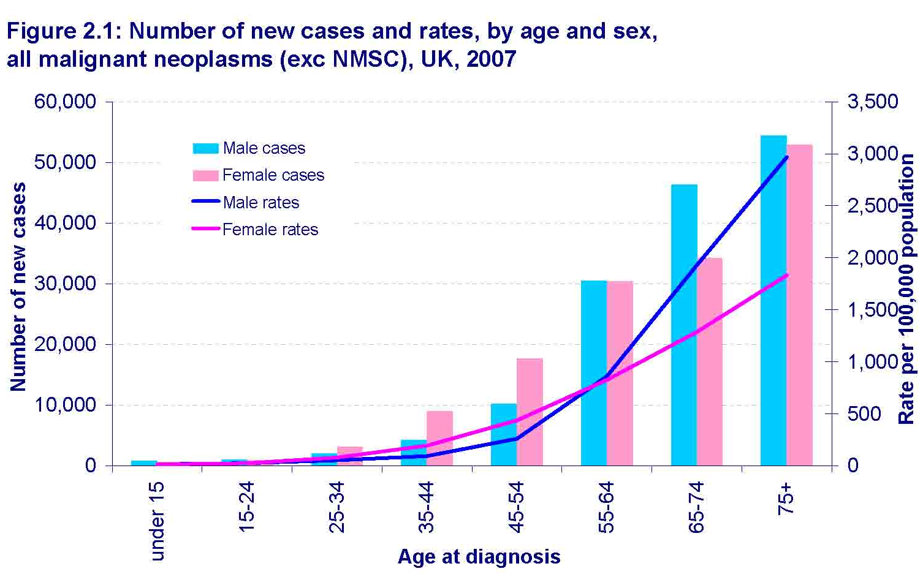
Cancer Statistics & therapies
About one third of us will have cancer
About two thirds of cancers are in people over 65
Environmental factors & lifestyle choices can increase risk
Baseline risk of cancer remains that cannot be eliminated
Source CRUK
Cancer is a terrible condition
but there have been great advances in therapy
Contributions to successful treatment of cancer
  45-50% surgery, 40-50% radiotherapy, 10-15% chemotherapy
Radiotherapy is an important weapon in the battle against cancer

Slide 6


Radiation-induced DNA damage
Sparsely ionising radiation (low-LET)
e.g. γ-rays, β-particles
Low concentration
of ionisation events
electron tracks
Densely ionising radiation (high-LET)
e.g. α-particles
C⁶⁺ ions
High concentration
of ionisation events
Kills tumour cells
Damages normal tissues
DNA

Slide 7
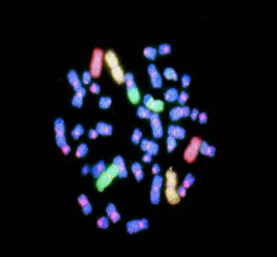
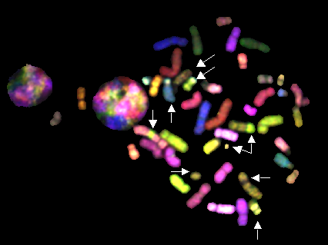

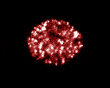
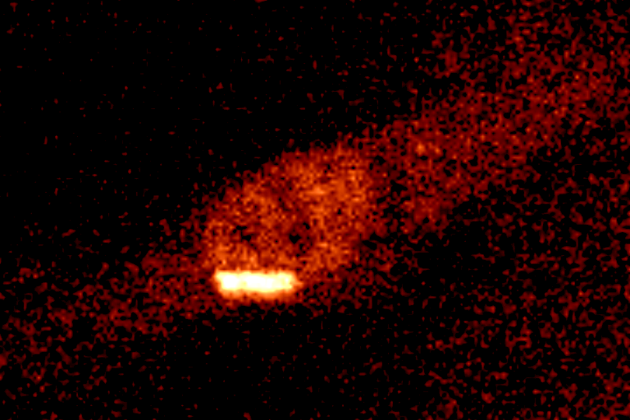
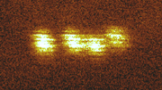
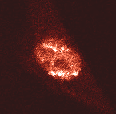
Nuclear / Cellular scale damage
Simple aberrations
γH2AX
RAD51
FISH image
Low-LET (e.g. γ-rays)
1 Gy corresponds to:
~1000 electron tracks
~20-40 DSB
Relatively homogeneous
Induction of double strand breaks (DSB)
Repair
High-LET (e.g. α-particles)
γH2AX
RAD51
1 Gy corresponds to:
~2 alpha tracks
~20-40 DSB
α-particle
α-particle
Very non-homogeneous
M-FISH
Complex aberrations
Chromosome aberrations
Mark Hill, Gray Institute

Slide 8
Depth Dose curves – x-rays & electrons
100
80
Dose (%)
60
MV x-rays
40
⁶⁰Co x-rays
20MV electron
20
200kV x-rays
50
100
150
Depth (mm)

Slide 9
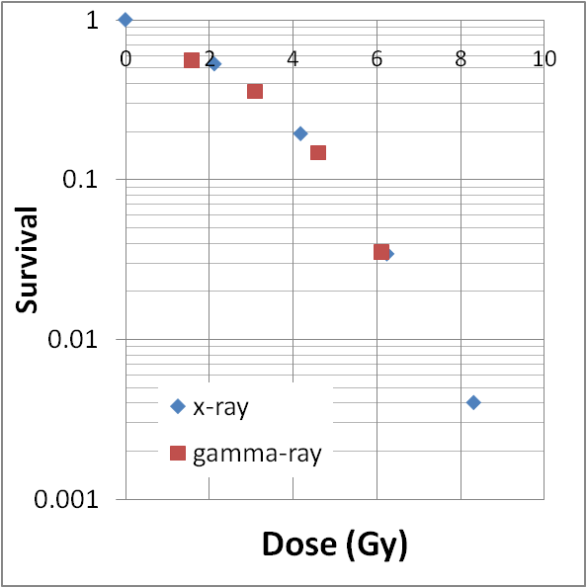
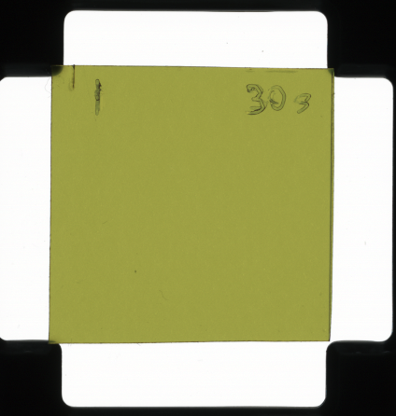
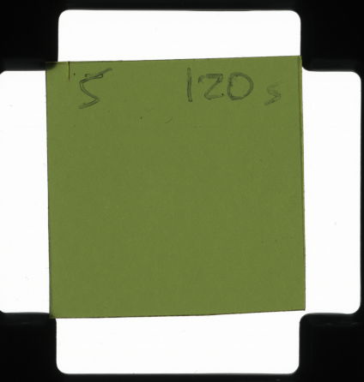
Materials and Methods
- Gamma-ray irradiation
Gamma-ray irradiation system
  Cesium irradiator
  Dose rate of ~1.7 Gy/min
  Dose correction factor was obtained from EBT film dosimetry based on the data of cobolt irradiator at Harwell
Comparison with x-ray
  To confirm the correction factor,
  →Gamma-ray survival curve was compared with x-ray(from X-ray tube) curve
  Both plots agree well
1Gy
4Gy
AI Nagano (PTCRi, private communication)

Slide 10
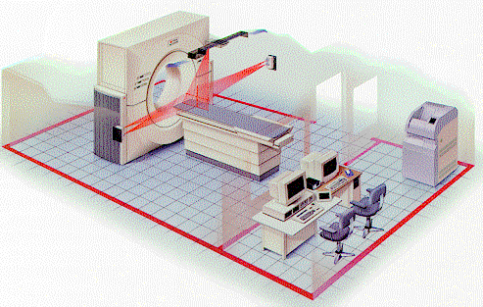
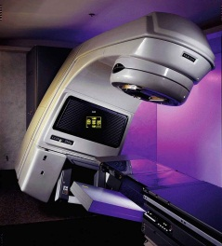
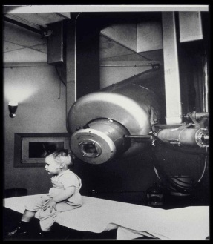
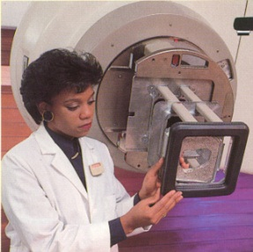
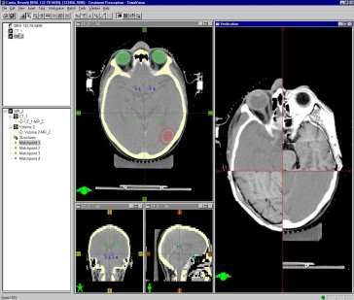
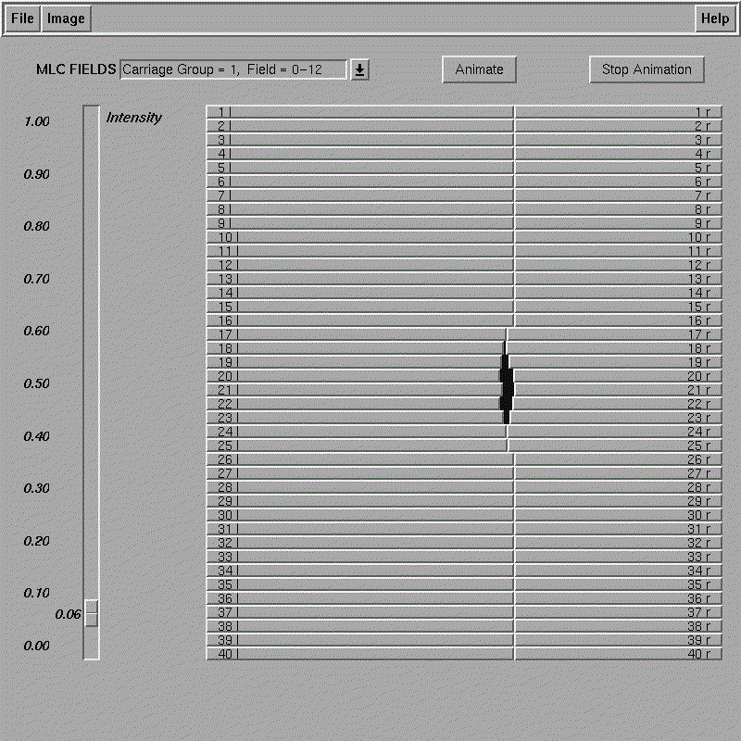
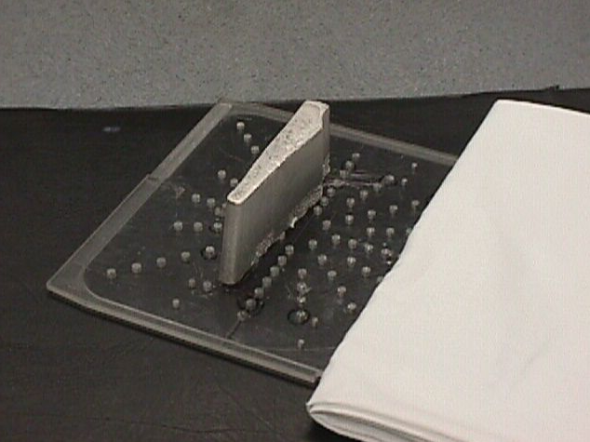
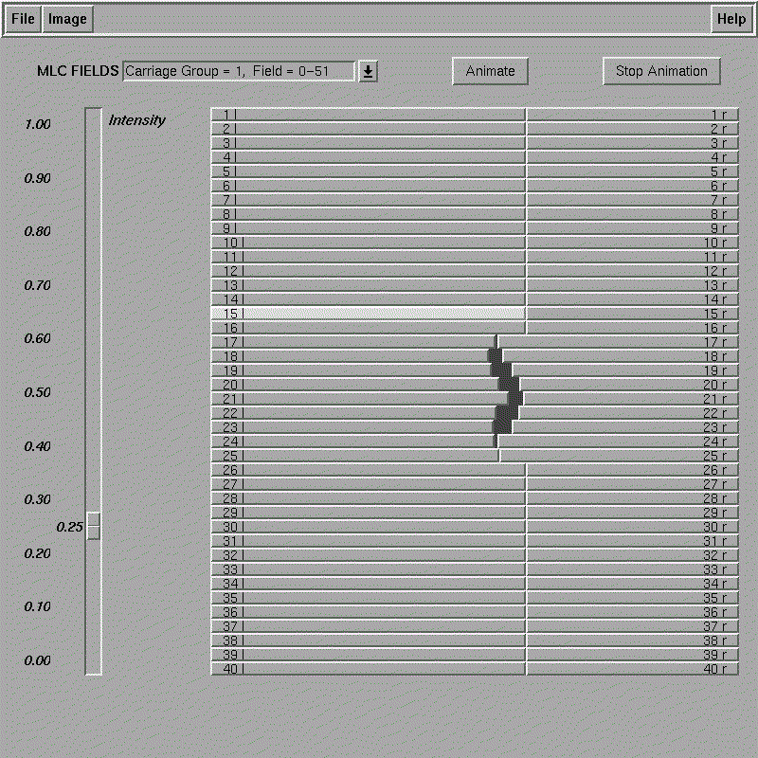
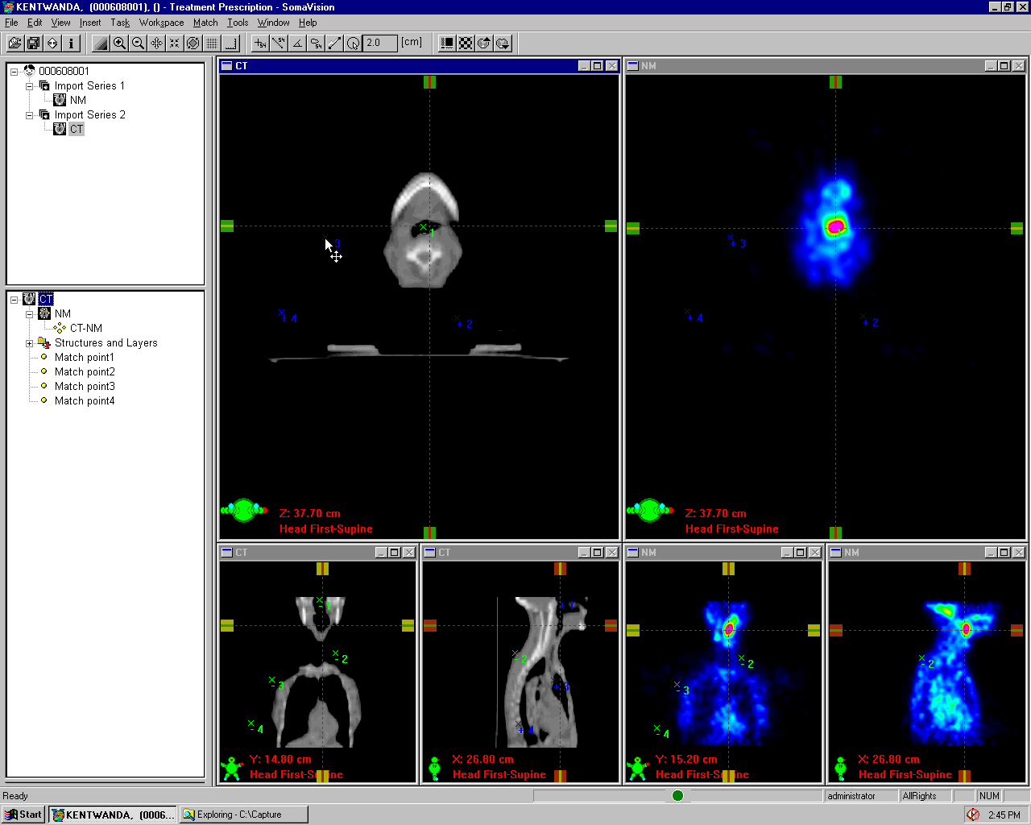
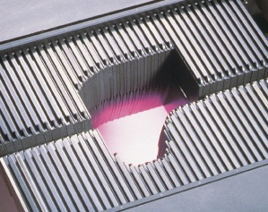
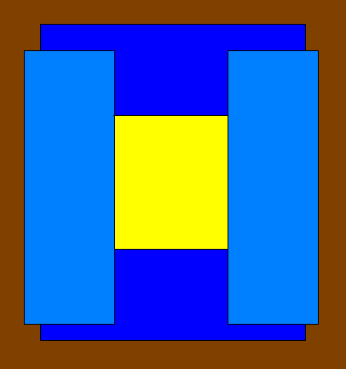
The Evolution of Radiation Therapy
1980’s
Computerized 3D CT Treatment Planning
1990’s
2000’s?
1960’s
1970’s
The First Clinac
Functional
Imaging
Cerrobend Blocks
Electron Blocks
Multileaf Collimator
Standard Collimator
Dynamic MLC
and IMRT
High resolution IGRT
After Gillies McKenna
Notes:
Key points to make:
Completely new carriage and leaf design to
Other improvements made:
Reduced Head Diameter by 10 cm from previous “Standard” MLC

Slide 11
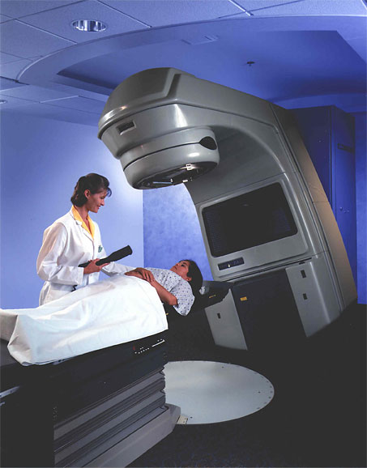

Curing Cancer with MV X-rays
Dose
Linac
Linac
Linac
Linac
Linac
Linac
Linac
Linac
Linac
Linac
Linac

Slide 12
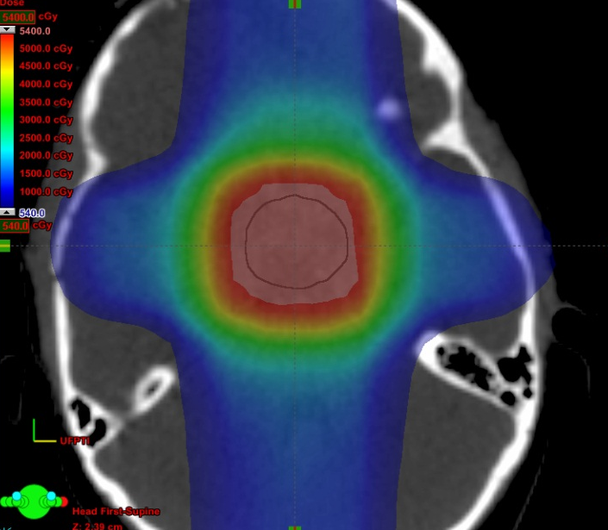
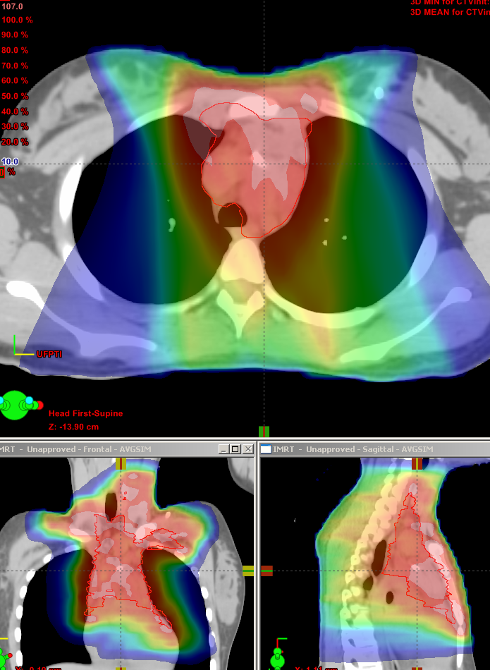
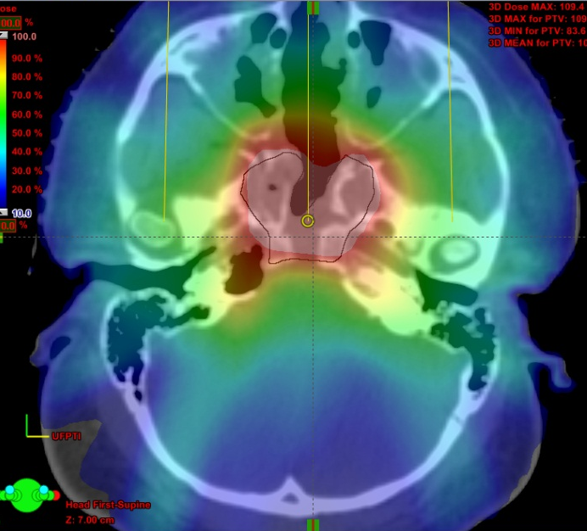
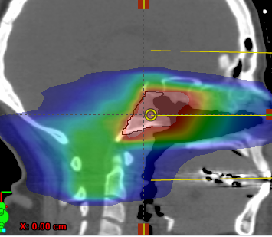
MV x-ray treatment plans
Craniopharyngioma
Hodgkin’s Lymphoma
Base of Skull Sarcoma

Slide 13
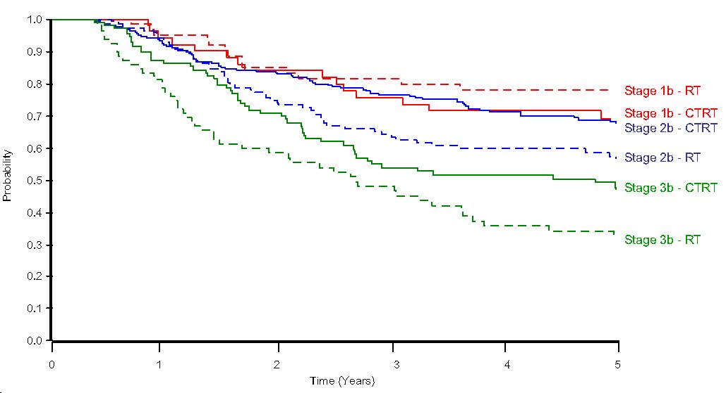
Conventional Radiotherapy
Millions of people have benefited from x-radiation therapy
From Vale et al, Clinical Oncology 22 (2010) 590e601
Survival curves for Radiotherapy (RT) and chemo+radiotherapy (CTRT)
(locally advanced cervical cancer)

Slide 14
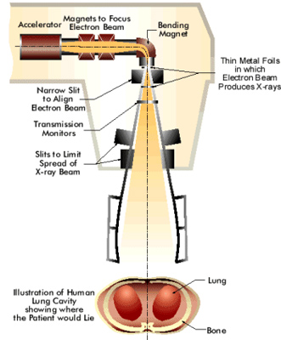
Inside the Linac
The conceptual design of the radiotherapy linac is relatively simple
  but performance is crucial
    Accuracy
      Position, dose
    Reliability
      Interrupting treatment is very bad
    Maintainability
      Simple set-up and diagnostics
  and affordability
challenges for physics

Slide 15
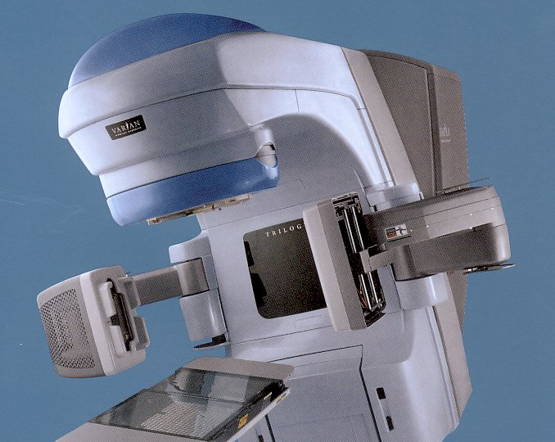
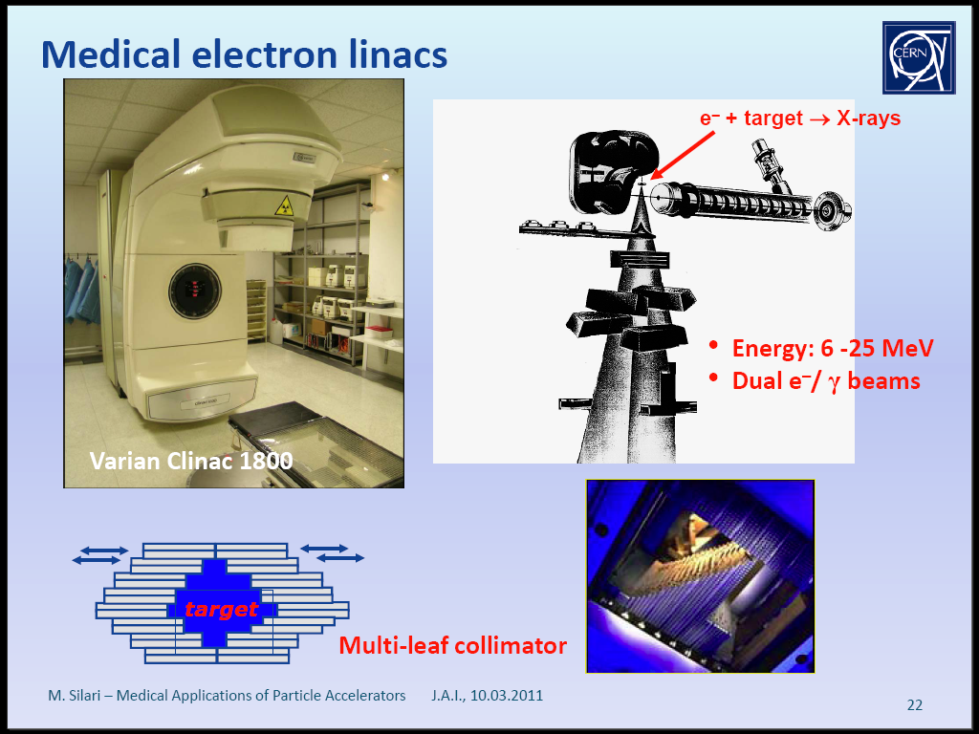
Linacs with on-Board Imaging
MLC
MV Beam
kV imager
kV X-ray tube
Remote
couch
control
MV EPID
Liz Macauley/ORHT

Slide 16
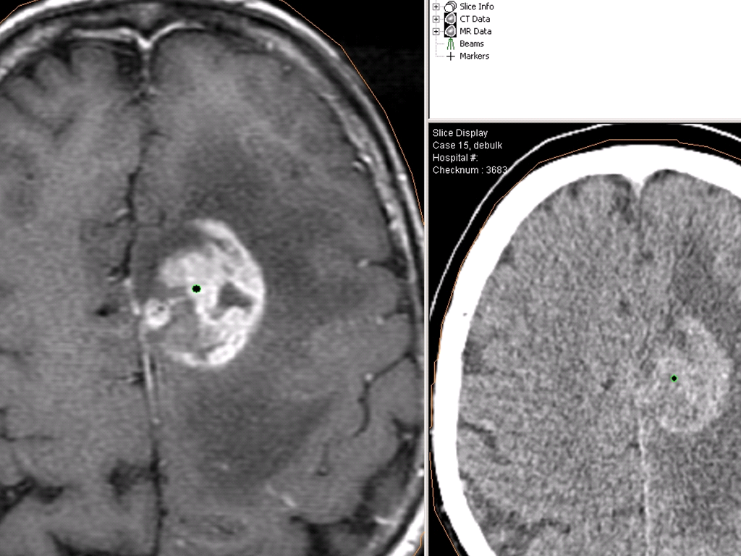
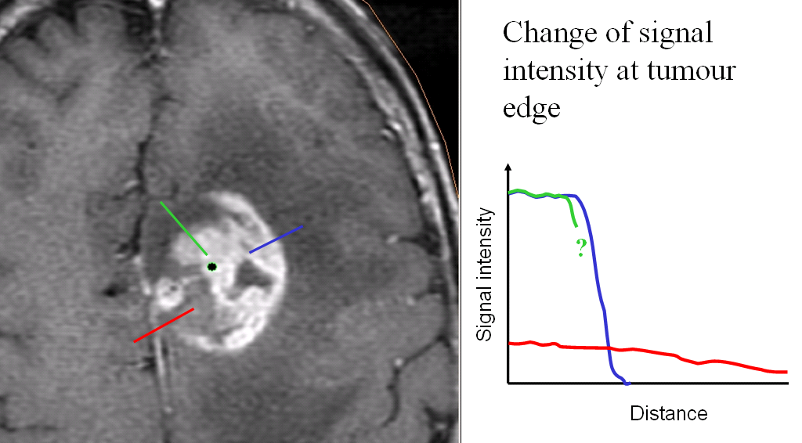
Imaging & Tumour Definition
Imaging is crucial to better diagnosis
  and treatment
Credit: Neil Burnet

Slide 17
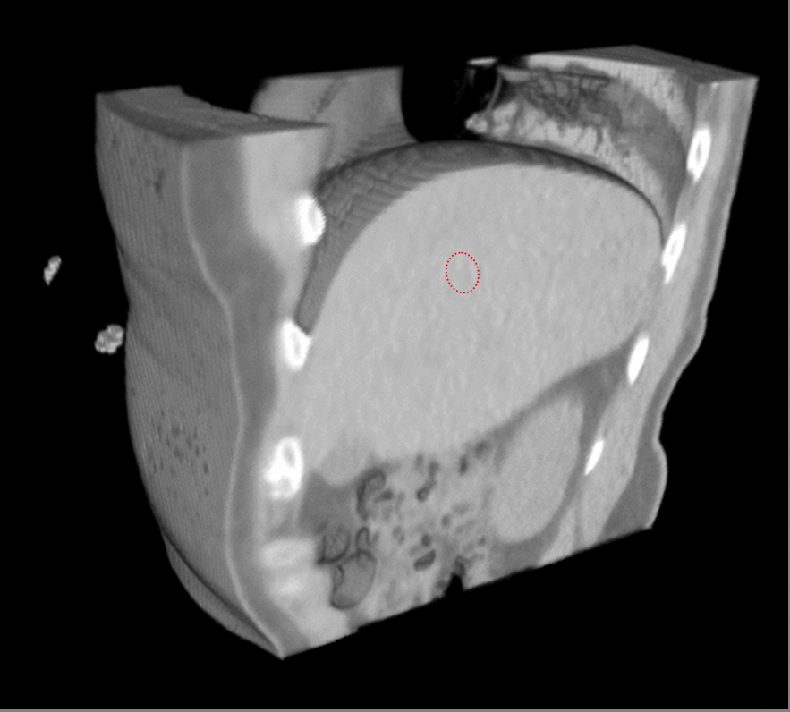
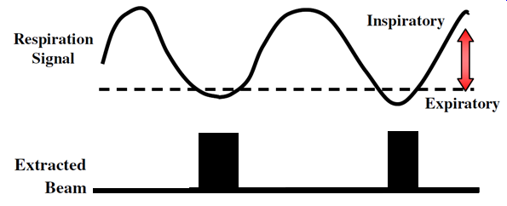
Organ motion: the problem
Patients breathe!
Solutions?
  Motion tracking
    Complicated
  Active breathing
    May be difficult
  Gating
    Long treatment
4D-CT derived from 4D-MRI
After Martin von Siebenthal, Phillipe Cattin, Gabor Szekely, Tony Lomax, ETH, Zurich and PSI, Villigen

Slide 18
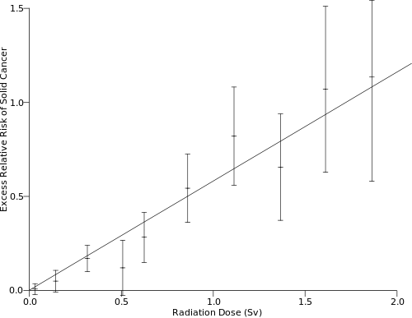
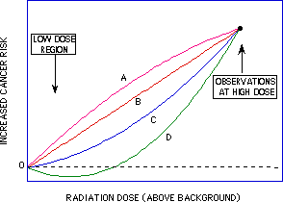
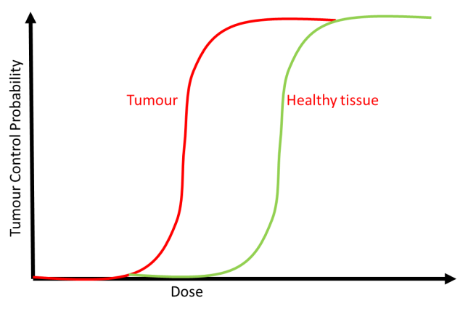
Cancer risk versus dose
The Data: Survivors of the Nuclear Weapons attacks – Hiroshima and Nagasaki
… but what happens at low dose?
Important because

Slide 19
… and much more
Diagnosis
  Early diagnosis leads to better outcomes
Tumour (and Organs At Risk)
  identification and delineation
Treatment planning
  Optimising the therapeutic ratio
  Fractionation strategies
Calibration and dosimetry
  Deliver the prescribed dose – no more, no less
Follow-up

Slide 20
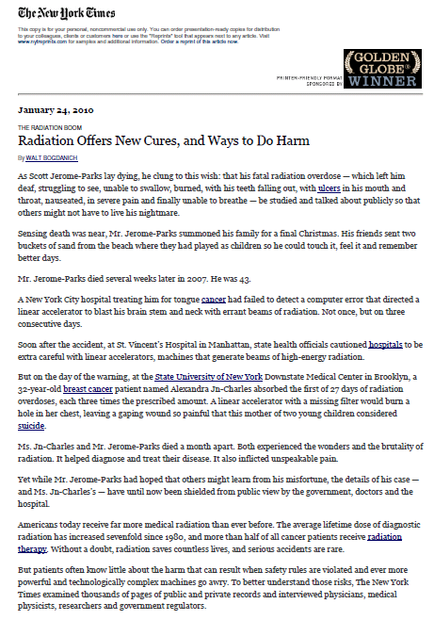
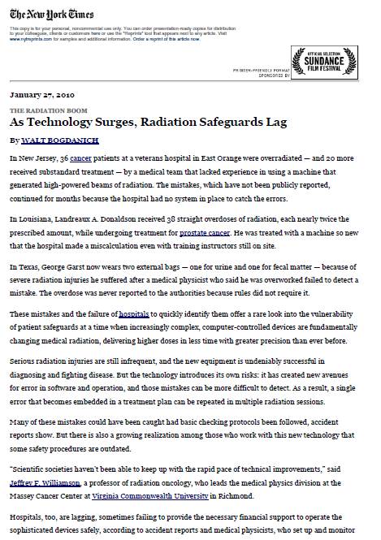
The need for caution: Calibration & Dosimetry

Slide 21

Therapeutic Ratio: A Juggling Act
The goal is:
the highest therapeutic ratio
  the greatest chance of cure
  the least chance of serious toxicity
Oftentimes radiation doses are limited to avoid toxicity.
Sometimes the price of cure is a complication.
Mendenhall

Slide 22
What do the clinicians want?
Technology can provide many things
  but clinical practice is conservative
New ideas must satisfy clinical need
  and be effective, reliable and affordable
If we are lucky
  we make life better for thousands
    or millions
If we get it wrong
  we do damage, perhaps only to a few
Remember the Hippocratic Corpus
  “επι δηλησει δε και αδικιηι ειρξειν”
    “First, do no harm”

Slide 23
Charged Particle Therapy
Using protons and other light ions (e.g. carbon) to treat cancer

Slide 24
Depth Dose curves – photon and proton
100
tumour
80
SOBP
Dose (%)
60
MV x-rays
40
Pristine peak
20
50
100
150
Depth (mm)

Slide 25
History of Proton Therapy
1946:
  Therapy proposed by Robert R. Wilson, Harvard Physics
1955:
  1st Proton Therapy at Lawrence Tobias University of California, Berkeley
1955-73:
  Single dose irradiation of benign CNS lesions
2010:
  > 75 000 patients had been treated with protons worldwide
  > 30 proton therapy centres operating worldwide
  ~ 20 more planned or under construction
Proton Therapy Centres Worldwide
http://www.uhb.nhs.uk/ProtonsBirmingham/background/facilities.htm

Slide 26
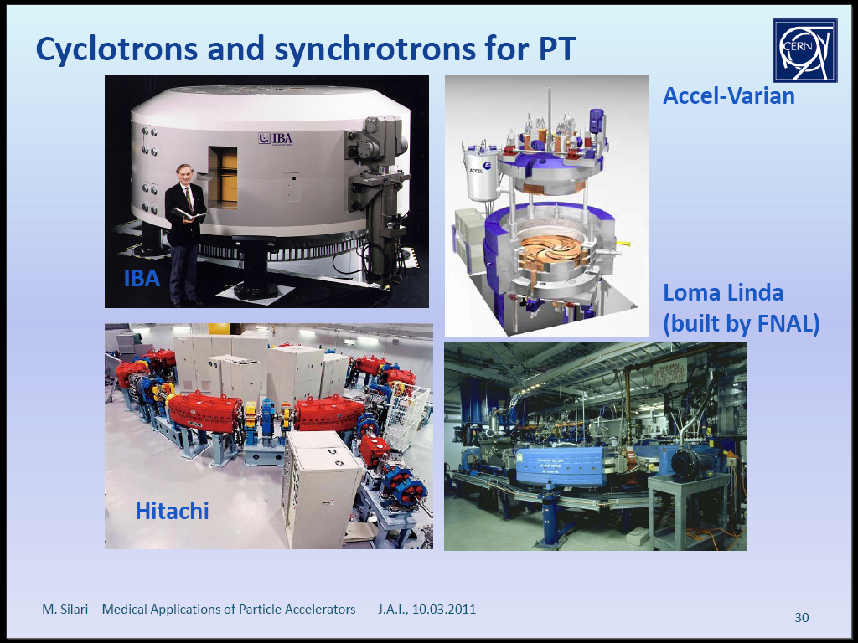
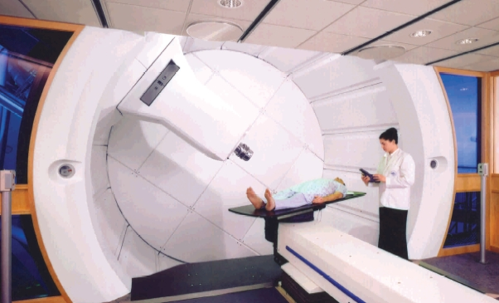
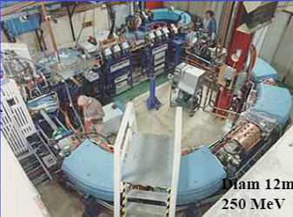
Can we do better?
Dose
The Bragg Peak
Proton
Proton

Slide 27
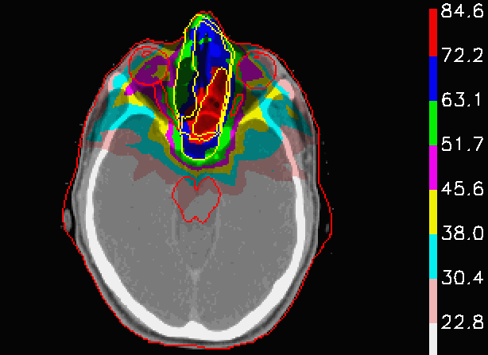
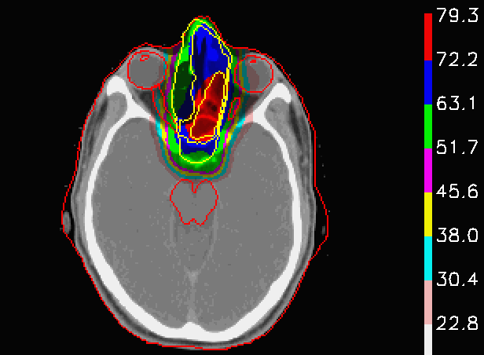
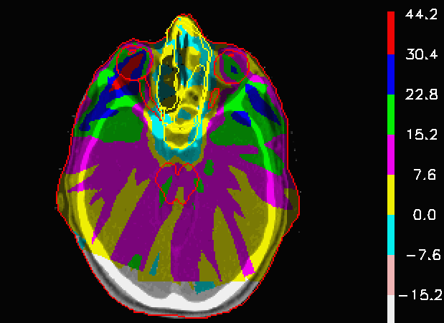
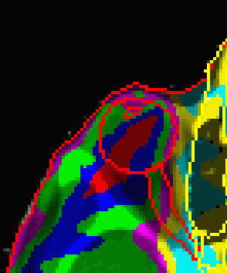
Paranasal Sinus
IMXT (X rays)
Protons
Studies at UF and MMSKCC have demonstrated either high blindess rates with moderate cure rates or low blindness rates with low cure rates, however MGH studies with PT and early experience at UF with PT suggests both low blindness rates and high cure rates.
Dose Difference
Lomax et al, PSI
Mendenhall

Slide 28
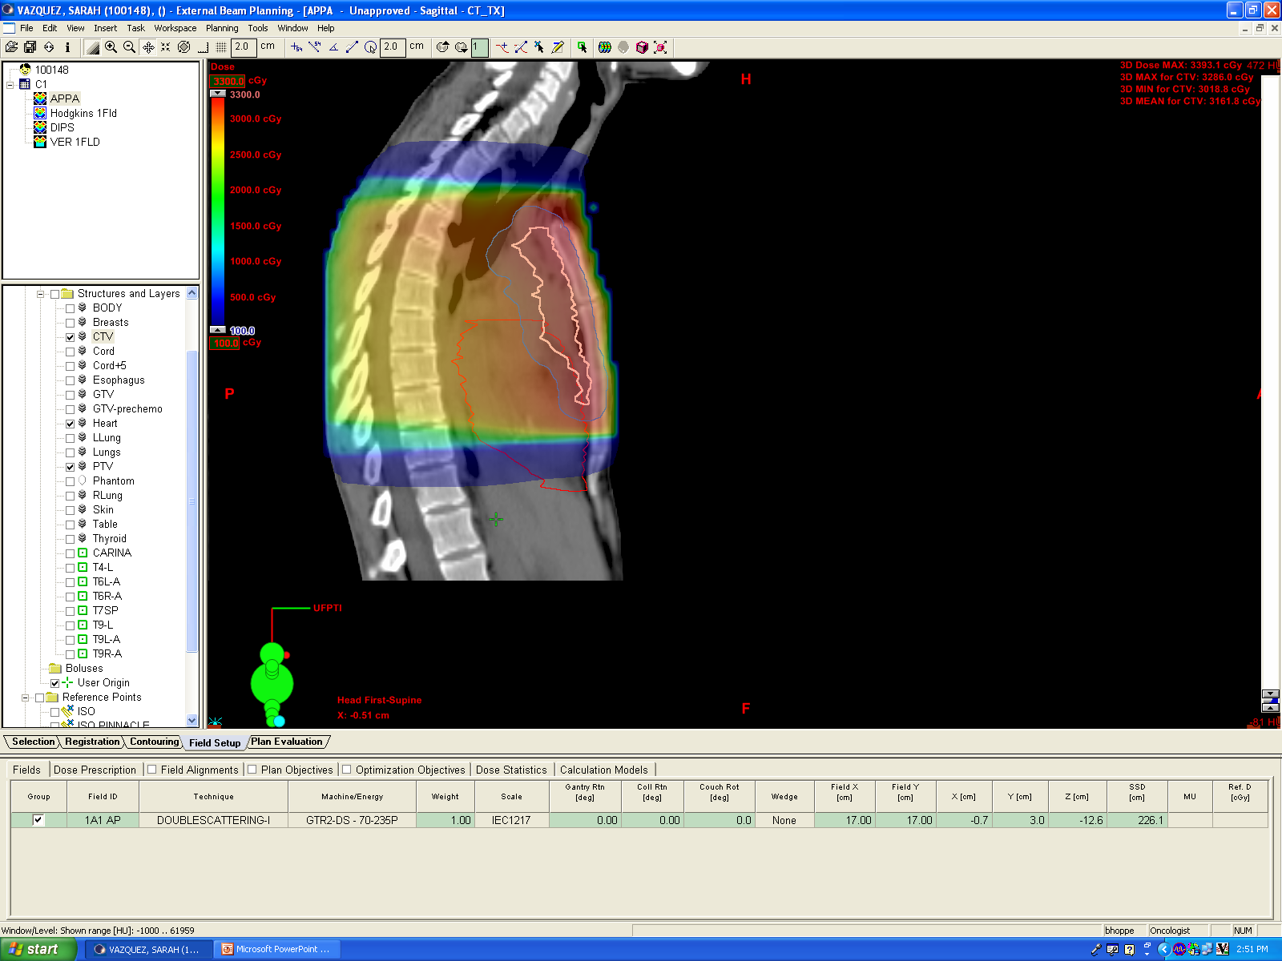
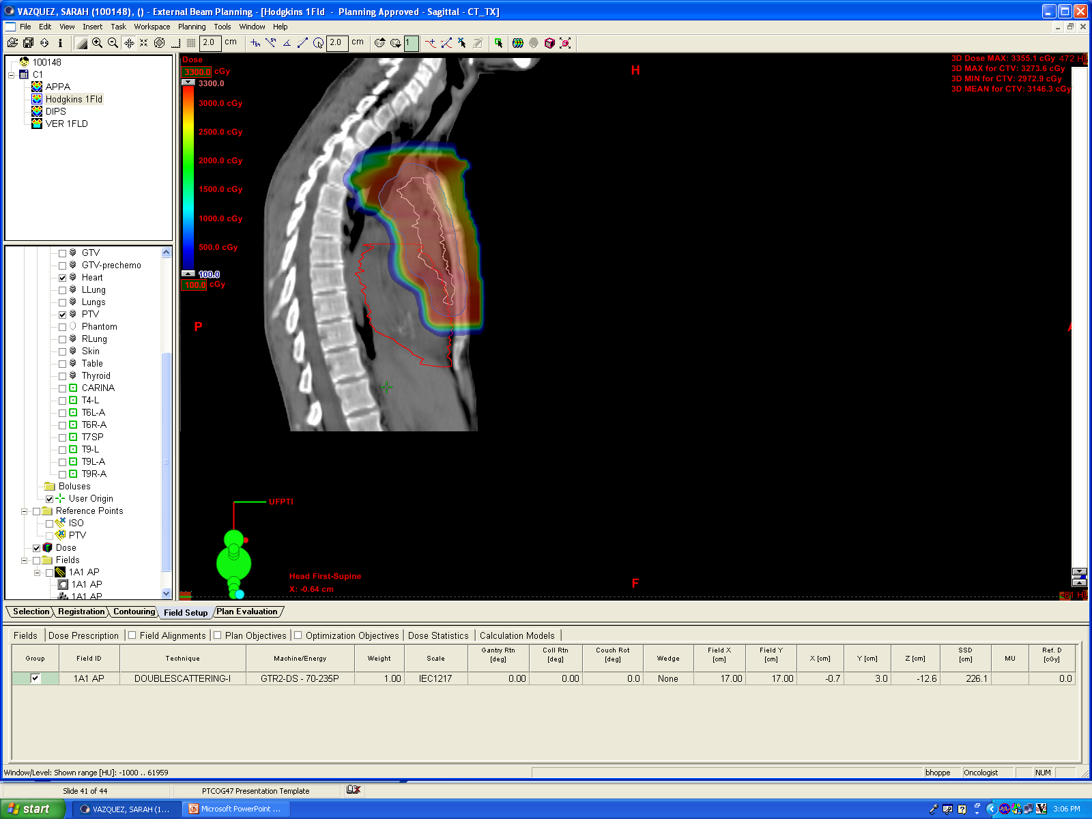
Hodgkin’s Lymphoma; Heart & Spine Sparing
Photons
Protons
After Mendenhall

Slide 29
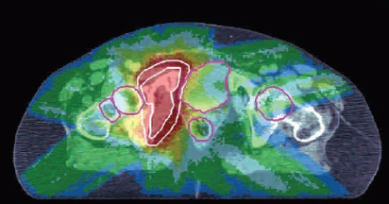
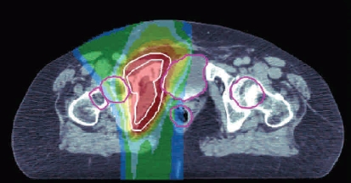

X-rays compared with protons
X-rays
protons

Slide 30




Medulloblastoma in a child
X-rays
100
60
10
With Protons

Slide 31
Beam Delivery - Scattering
Courtesy of T. Lomax, PSI, Switzerland.

Slide 32
Beam Delivery - Scanning
Beam direction
Target
Patient
Beam direction
Target
Patient
Notes:
parallel proton pencil beams are used (~3mm σ )
position and dose of each spot is chosen by the computer in the treatment planning system, individually for each spot
sweeper magnets are used to scan the target volume in transverse plane (steps of 4mm)
scanning depth is controlled by changing beam energies.
for one litre target volume typically 10000 spots are deposited in less than 5min.
dose distributions of complex shapes can be constructed with less entrance dose

Slide 33

CPT worldwide
Number of centres
Number of patients
In Physics Laboratories
In Hospitals (mostly)
83,667 protons, 96,537 total (Dec 2011)
After Janet Sisterson, MGH

Slide 34
What remains to be done?
Particle Therapy has moved from laboratory to hospital
  where it belongs
But there is still much to do
  Improved accelerator technology
    improved patient experience, better control
  Improved beam delivery & instrumentation
    Improved accuracy, lower healthy tissue dose, better control
  Improved understanding of the evidence
    better treatment planning, domains of applicability
  Improved treatment regimes
    better ways of delivering the lethal tumour dose
  Improved understanding of mechanisms
    better treatment planning, more effective outcomes
Improve patient experience
Increase effectiveness
Decrease cost

Slide 35

Parameters

Slide 36

RBE & LET
Relative Biological Effectiveness
Linear Energy Transfer
LET is related to dE/dx (Bethe Bloch)
but is the energy transferred to the medium,
not the energy lost by the particle

Slide 37


More on RBE
The recommended value of RBE for protons is 1.1

Slide 38



Result –proton irradiation-
Averaged survival fractions over 3 repeated experiments.
After AI Nagano (PTCRi, private communication)

Slide 39
Accelerator Technology

Slide 40


Cyclotrons
Yu. G.Alenitsky, Proceedings of RuPAC 2008, Zvenigorod, Russia

Slide 41

IBA & Varian cyclotrons
Cyclotrons are essentially fixed energy extraction

Slide 42



PSI
Courtesy PSI

Slide 43



IBA
Courtesy Robert Proton Therapy Center, Penn
Courtesy IBA

Slide 44

Synchrotrons
Ramp down
acceleration
“flat top”
B(t)
Set-up
t

Slide 45
The Loma Linda Synchrotron
Loma Linda

Slide 46

Heidelberger Ionenstrahl-Therapiezentrum (HIT)
First patient treated November 2009
Courtesy HIT

Slide 47





HIT in action
Courtesy HIT

Slide 48

Centro Nazionale di Adroterapia Oncologica
CNAO (Pavia)
Courtesy Amaldi

Slide 49


PIMMS (CERN/TERA) Synchrotron Hall @ CNAO
2012
Courtesy Amaldi
Ugo Amaldi/TERA

Slide 50
Physics Challenges
Better conventional technologies

Slide 51
Conventional Accelerator Technology
Cyclotrons
  Fixed energy extraction, difficult for Carbon at full energy (equivalent to 1.2 GeV/c protons)
Synchrotrons
  Flexible, but too slow?
FFAG
  Flexible, rapid cycling (fixed field), variable energy … but … new technology
    Scaling (Mori) & non-Scaling (Johnstone, PAMELA)

Slide 52

Main requirements on the accelerator
Question
  What would clinicians ideally like?
    i.e. without taking into account current limitations
  Could technology deliver this?

Slide 53
Photons, Protons and Carbon

Slide 54

Some Accelerator Ideas; Novel technologies
Cyclinac (Italy)

Slide 55






Fast active energy modulation
Active Energy
Modulation
+
3D feedback
system
Treatment of
MOVING
ORGANS
18 mod ON
17 mod ON
18 mod ON
16 mod ON
17 mod ON
15 mod ON
16 mod ON
14 mod ON
Notes:
By switching off the 18 klystrons, the cyclotron-linac complex produces - in eighteen 15-16 MeV/u steps – beams with energies in the range 120 - 400 MeV/u, without using an Energy Selection System.
55

Slide 56


Compact Cyclotron: Mevion
Compact s/c
  Cyclotron (10 Tesla)
    Mounted on gantry (25T)
Single Room system
  Expensive to operate
  Neutron Background?
ne Still River

Slide 57

Compact Cyclotron
After Silari
Still River

Slide 58

The IBA 400 MeV/u cyclotron
After Silari

Slide 59

BNL RCS Design
Peggs/BNL

Slide 60

Rapid Cycling Synchrotrons
Peggs/BNL

Slide 61



Compact Synchrotron
5 meter diameter Synchrotron
Lebedev Physics Institute
Commercialized
by the Company PRO-TOM
In collaboration with MIT/Bates
Protons have been accelerated
Bragg peak
Pro-Tom
61
Notes:
New equipment and new technology for the mass treatment of the oncological diseases by the proton beam
Primary author: Prof. BALAKIN*, Vladimir (Protom)
* e-mail: balakin@protom.ru
Co-authors: Mr. ALEXANDROV, Victor (Protom); Mr. BAZHAN, Anatoly (Protom); Mr. LUNEV, Pavel (Protom); VALYAEV, Yury (Protom)
The proton radiation of the oncological diseases will be always more preferable in comparison with the Υ-rays therapy on electron accelerators (even in the case of IMRT), if the proton radiation technology is similar to the IMRT technology. In other words, the proton radiation should be carried out from many directions and it intensity should be modulated (IMPT). In order that the proton therapy becomes as mass applicable as the Υ-rays therapy on electron accelerators, its installation and operation cost should be comparable with the cost of the equipment based on the electron accelerators, which are basically using for the treatment of human cancer diseases now. We have designed and created the proton therapy facility, which solves this problem. Its cost and operating expenses are lower than all worldwide operating centers have. The irradiation is carrying out from many directions (multi-field irradiation) and the dose distribution and the beam energy can be fitted for each irradiation field, according to the algorithm, provided by the special optimization program. In present time several samples of installation are creating. One of them is installed in the municipal hospital of Protvino city for the clinical testing which is scheduled on 2010. Another one will be installed in Pushino (Moscow region) in 2010. In 2009 the accelerator has been delivered to MIT (Boston, USA) for the testing and receiving of the FDA approval, and another one is assembling now in the hospital of Ruzomberok (Slovakia) for the medical certification according to the European Union rules.

Slide 62
The FFAG
Should combine the advantages of FFAGs
  Fixed Field
    Fast cycling (limited essentially by RF)
    Simpler, cheaper power supplies
    No eddy-currents
    High intensity (pulsed, ~continuous)
    Low beam losses
    Easier maintenance and operation
    Lower stresses
  Strong Focussing
    Magnetic ring
    Variable energy extraction
    Higher energies (than cyclotrons)
    Different ion species possible
with relative ease of construction
Declaration of
Interest
This is what I do

Slide 63

Does it work?
Yes!
S. Machida et al, Nature Physics Nature Physics, 8:243–247(2012) doi:10.1038/nphys2179

Slide 64

EMMA
The World’s First non-Scaling FFAG
S Machida et al

Slide 65

EMMA lattice
After Rob Edgecock

Slide 66
PAMELA

Slide 67

EMMA-like ns-FFAG machine
Keil, Sessler & Trbojevic
Issues
  Injection & extraction
  Acceleration
  Alignment

Slide 68

Application to Cancer?

Slide 69
From EMMA to PAMELA
From Doublet to Triplet
From EMMA to PAMELA
The EMMA lattice
Doublet structure
  Focus and Defocus
Dense lattice
  Little space between magnets
Lots of RF Acceleration
  Almost every other cell
The PAMELA lattice
Triplet structure
  Focus, Defocus, Focus
Less Dense lattice
  Long straight sections
Less of RF Acceleration
  Larger cavities
  Lower frequencies
Larger radius
F
D
D
F
F
Ken Peach (PTCRi, Oxford) Physics, Accelerators and Cancer 69

Slide 70

Overview
Carbon ring
~12m
Proton ring
Carbon source & injection
Proton source & injection
Extraction
Transfer line

Slide 71
From scaling to PAMELA
C

Slide 72






Scaling restoration
Rectangular
& parallel
Scaling
Rectangular

Slide 73


PAMELA Layout

Slide 74



Double-Helix Principle
Current density:
Helix 1
Helix 2
Double-Helix
+
Double-helix coil:
Smart way of creating a cosine-theta magnet
Main advantage for PAMELA: No coil end problem
Notes:
74

Slide 75



High field quality
Patent GB 0920299.5

Slide 76







Kicker Magnets

Slide 77




Septum Magnets

Slide 78

Ring-to-Ring transfer line

Slide 79




Ion sources
Carbon RFQ Parameters
E-field frequency 200MHz
E_{I} 8 keV/u
E_{f} 382 keV/u
Transmission 75%
RFQ length 2.4m
Electrode potential 80 kV

Slide 80




FFAG Beam Transport
D
F
F
D
0.2m
0.2m
3.6m
5m
$$B_{y}\left(x,z\right)=B_{y.0}{\left({\left(x+x_{0}\right)}/{x_{0}}\right)}^{k} F\left(z\right)$$
$$B_{y}\left(r,θ\right)=B_{y.0}{\left(r/{r_{0}}\right)}^{k} F\left(θ\right)$$
$$B_{y}\left(x,z\right)=B_{y.0}{\left(n/ρ\right)}^{k} F\left(z\right)$$
$$n=\left(ρ/{B_{y}}\right){dB_{y}}/{dx} , ρ is radius of curvature$$

Slide 81

Beam Transport
Horizontal
Vertical

Slide 82




Gantry Design

Slide 83


How does PAMELA work?
Protons
Carbon

Slide 84

PAMELA: ring overview
Injector(c): RFQ+LINAC
 | Ring #1 (p, c) | Ring #2 (c)
Energy | 30~250MeV (p) 8~68MeV/u (c) | 68~400MeV/u
# of Cell | 12 | 12
Diameter | 12.5m | 18.4m
K-value | 38 | 41
Orbit excursion | 18cm | 21cm
Rev. freq | 1.94~4.62MHz(p) 0.98~2.69MHz(c) | 1.92~3.91MHz
Magnet | Triplet(FDF), SC | Triplet(FDF), SC
length | 57cm | 113cm
aperture | 25cm | 33cm
Long Drift | 1.3m | 1.2m
Packing factor | 0.48 | 0.65
Inj./Ext | 1turn inj/ext 2 LD (each) | 1turn inj/ext 2 LD (each
RF | Max 8 LD | Max 8 LD
Injector(p): cyclotron
Proron ring
Carbon ring
scaling
PAMELA
Stable betatron tune ∆ν<0.1
Long straight section (~1.3m)
Small beam excursion(<20cm)
Strong field (max 3.5T) ⇒ SC magnet
High repetition rate(~1kHz) is a big challenge

Slide 85
PAMELA
Particle Accelerator for MEdicaL Applications
There are obvious potential benefits from proton/light ion therapy
  Need to maximise the benefits
Requirements
  Rapid variable energy extraction
  Rapid variable transverse spot scanning
  Variable ion species
  Accurate dose measurements

Slide 86
Summary and conclusions

Slide 87
Radiation Therapy: Benefits and Challenges
Radiation Therapy Cures Cancer
  More than 50% of patients cured have RT
Radiation Therapy is High Technology
  It is not traditional medicine
    Needs highly trained personnel
      To commission, operate and maintain the equipment
      To identify and delineate the tumour volume
        and associated treatment volumes
      To define the treatment plan
      To verify that the treatment plan was implemented
        and to modify it as necessary
  and still requires biomedical research

Slide 88
Conclusions
Cancer is a terrible condition
  but millions are cured every year
Radiation therapy uses “physics”
  high technology, many challenges
  already good, but can be improved
    in many ways
Great opportunities to contribute
  and reap the rewards, treating cancer

Slide 89
Summary
PAMELA Conceptual Design
  “Proof of Principle”
    on paper
  Main weaknesses
    ion source (can be fixed … known technology)
    RF (common problem for low E ions)
    Gantry (sketch solution, but needs work)
    Lattice (two rings – expensive, esp. carbon)
  Possible new lattice
    “Racetrack” configuration
      matching from arcs to long straights?
      alignment sensitivity?
      orbit excursion?

