Slide 1
Progress of CsI(Na) Dark Matter Searches Experiment
Xilei Sun
IHEP
On behalf of CINDMS group
Roma, IHEP-INFN Meeting 2014

Slide 2
Contents
Introduction
Concept Design
Challenge
Progress
Plan
Summary

Slide 3
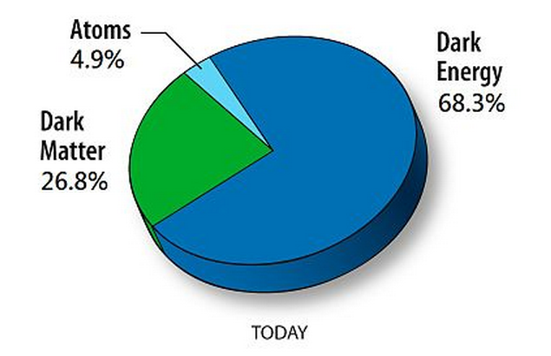
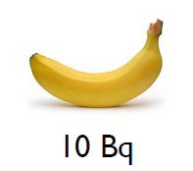
What to look for？
Signal：nuclear recoil events <0.01events/kg.day @0-100keV
background：e α μ γ n（U Th K cosmic rays）
bg suppress：
Underground \shielding\n/γ separation
Challenge:
Background rejection at ~10keVee

Slide 4
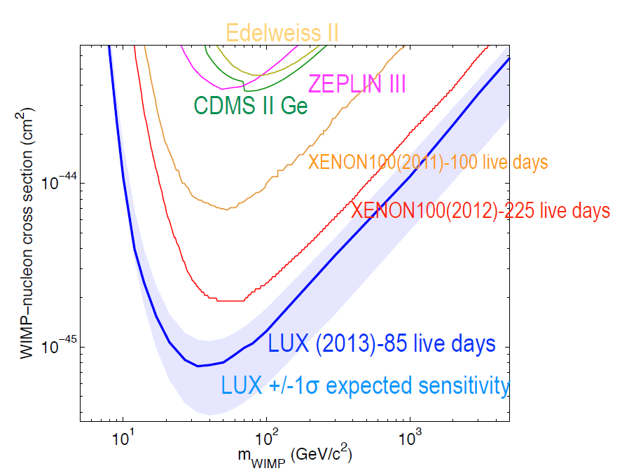
Status

Slide 5
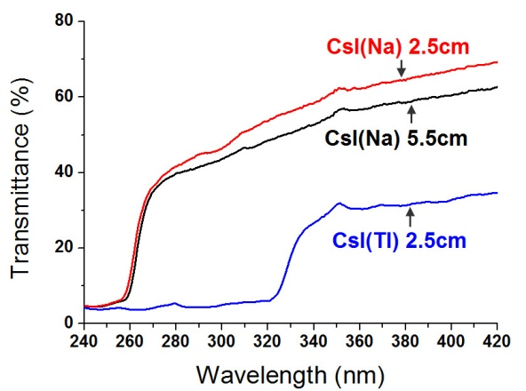
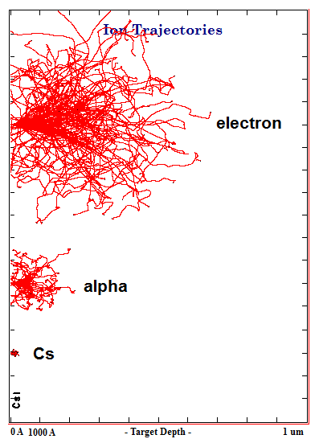
Why CsI(Na)?
CsI(Na) crystal is transparent for the scintillation of pure CsI
Nuclear recoil
has higher dE/dx, small range, scintillation dominant by pureCsI,
Wavelength 310nm,
decay time 15ns
Electron recoil
has lower dE/dx, large rang,
Scintillation dominant by Na⁺,
Wavelength 420nm,
decay time 600ns
Ranges of different
Particles in CsI(Na)
Waveforms of CsI(Na) for
different particles

Slide 6
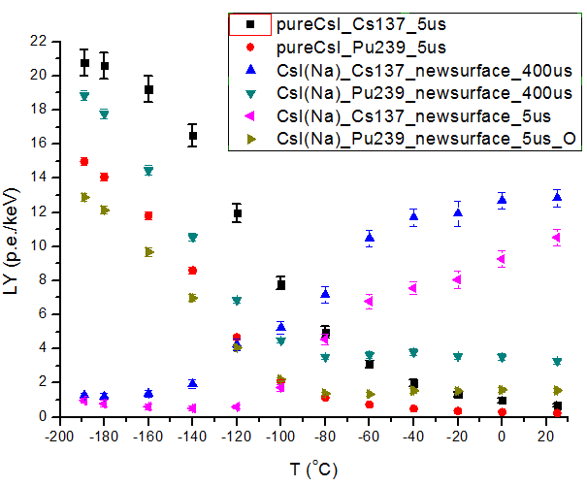
The Light Yield
2.5x2.5x2.5cm CsI(Na)
Test by PMT R8778
~30% QE @ 300-400nm
-120C
Balance of alpha and gamma LY 4 p.e./keVee 36%
QF: 10%
Light collection: 25% ~0.28p.e./keVnr
Threshold is
10p.e. /35keVnr with
10⁻⁶ rejection power
light yield as a function of temperature for gamma and alpha

Slide 7
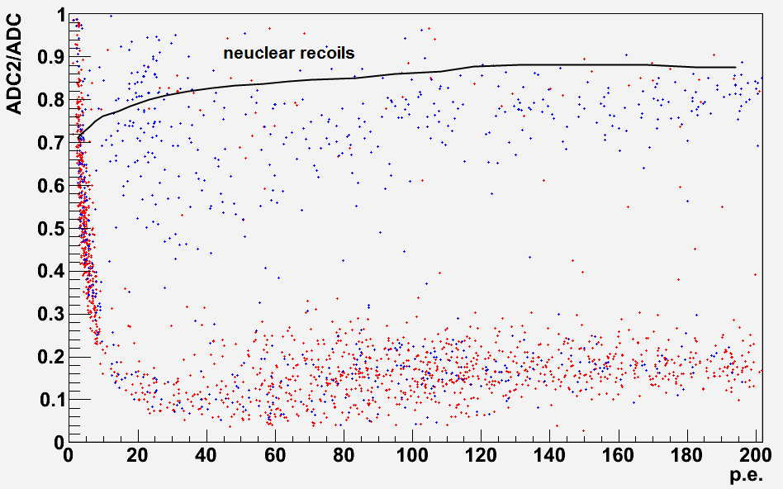
Separation @-120C
1.26µs/40µs separation for gamma /alpha

Slide 8
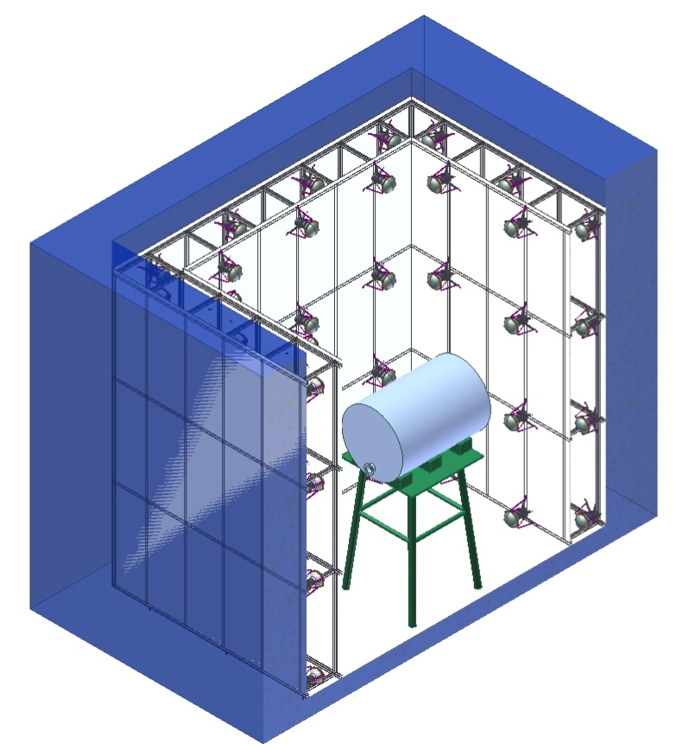
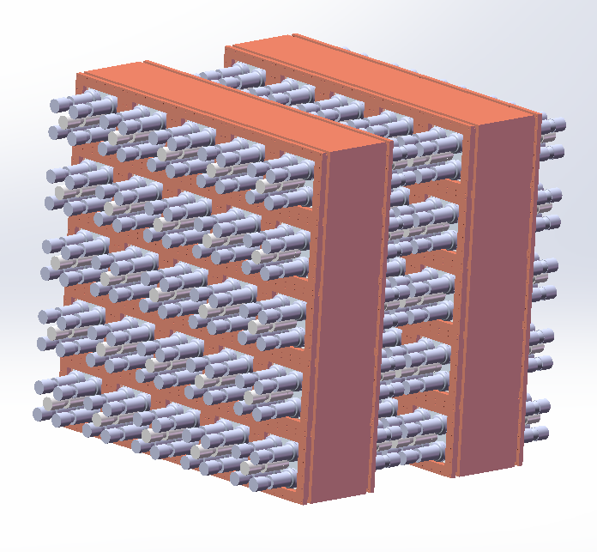
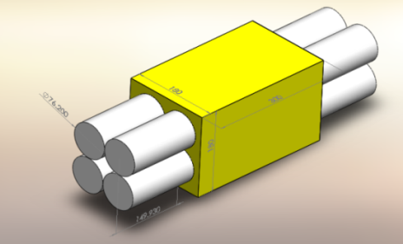
CINDMS Program
First Stage 1 module
Next stage Ton scale
Water tank:
To shield environment neutrons
trace cosmic ray by Cherenkov light
Copper low-temperature box:
To provide a low-temperature environment -120℃
Shield environment gamma
Background rejection:
PSD
Funded by IHEP 2013-2014
One module 43 kg
Daya Bay laboratory
Hall 5 ~100 m overburden
Water tank 5 m x 5 m x 6 m
Ton scale proposal 2015
50 modules 2000 kg
Gran Sasso or Jingping
50 modules 2T scale
End read out

Slide 9
CsI(Na) vs LXe
CsI(Na) Advantages：
Good n/γ separation by PSD;
Cheap，price is 1/5 of LXe，CsI(Na) 850 USD/kg，Lxe 4200 USD/kg;
Stable，suitable for long-term operation to observe the annual modulation effect;
Modular，Easy to build large-scale detector;
CsI(Na) Disadvantages：
Cs137 not easy purification (2mBq/kg is best) ;
Doping uniformity is difficult to measure, depends on the quality of the crystal growth;
Volume is limited, Single crystal difficult to achieve 3D measurement;
Surface deliquescence, assembling and testing complex;
LXe Advantages：
Continuous purification , Kr85 can purify from 5-20ppm to 1ppb;
Easy to implement 3D measurements (TPC/4π);
LXe Disadvantages：
Expensive;
Complex (precise temperature/pressure control, purification and recovery system);
Scale limited by high drift voltage

Slide 10
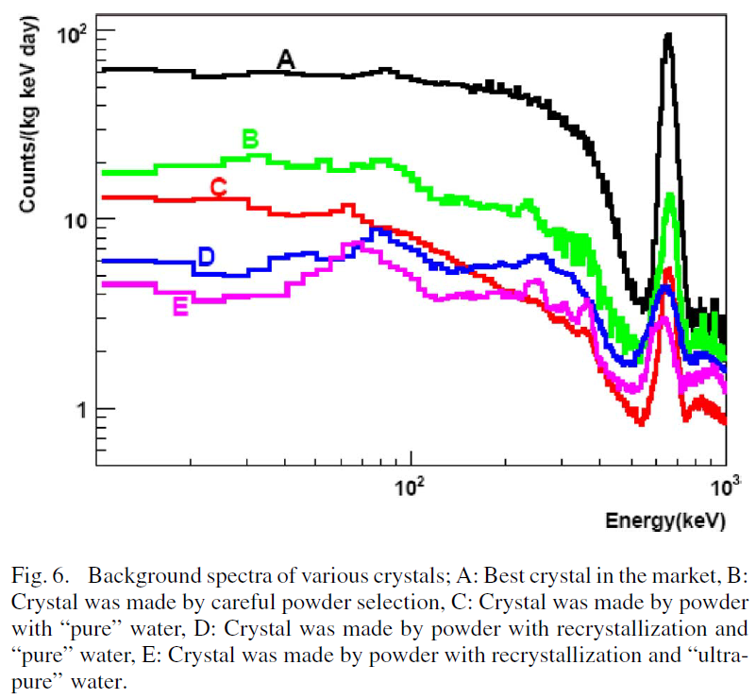
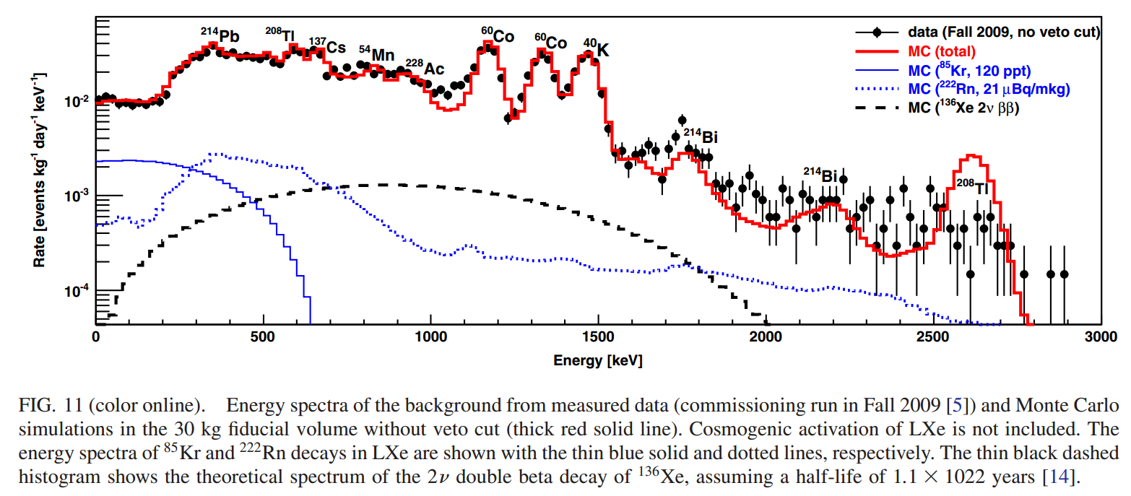
backgrounds
IEEE TRANSACTIONS ON NUCLEAR SCIENCE, VOL. 55, NO. 3, JUNE 2008
PHYSICAL REVIEW D 83, 082001 (2011)

Slide 11
Key Technical and Physics Challenges
Ultra-low controlled background
Surface deliquescence remove
Uniform of Na doped in crystal
QF measurement
Understanding of detector response
Calibrate energy scales
Efficiency calibration (background, signal)

Slide 12
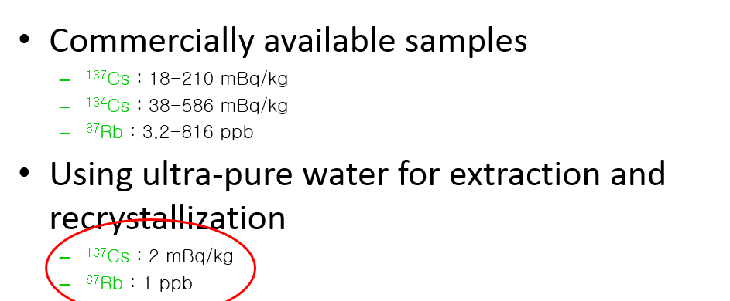
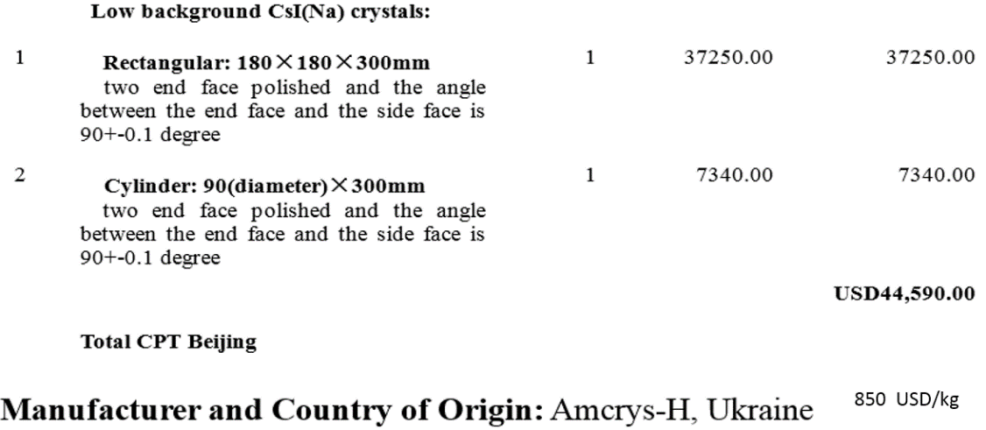
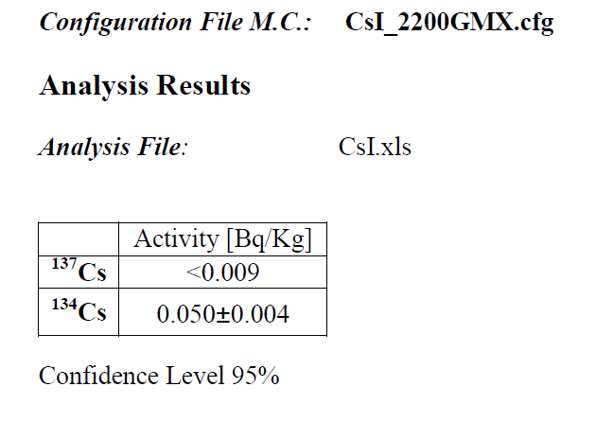
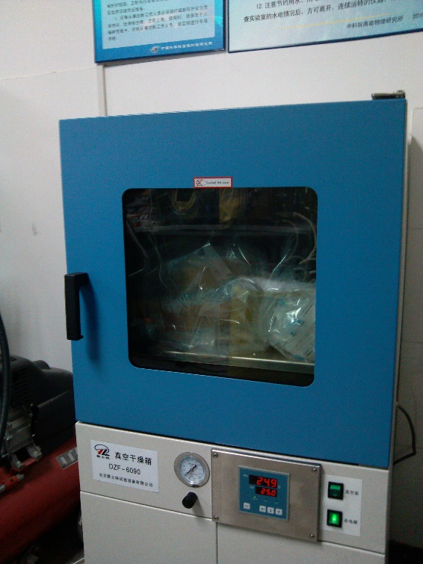
The Low background Crystals
850 USD/kg
Close to the best level radioactive content
Crystals have been received, Stored in the vacuum oven
Dr. Ezio Previtali from University of Milano Bicocca

Slide 13
Crystal Package
Crystal size：180x180x300 mm 43.8kg
Shell size：270x270x360 thick 40 118kg
Oxygen-free copper shielding shell,
quartz-glass window,
silicone coupling,
TEFL reflecting layer,
each side 5 PMT,
positive seal against deliquescence.
LC1011 from LUOYANG COPPER CO.,LTD
Ingredient: Cu+Ag >99.98
Order has been completed, delivery in late May.
Line cutting, a period of about 1.5 months
Expected to be completed in July.

Slide 14
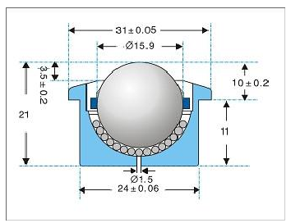
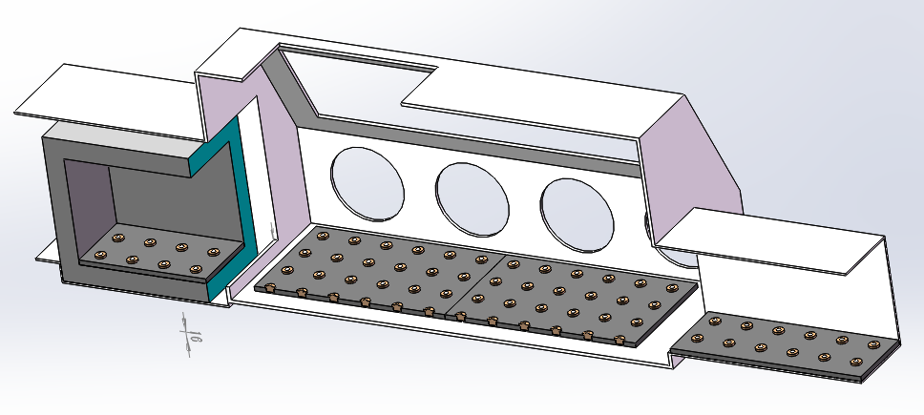
Glove box
Deliquescent crystals, 160kg, assembly is a challenge.
Vacuum glove box:
4 stations, heating chamber, transition chamber, Ball transfer, lifting hatch,
Electrode and the vacuum channel interface reserved
Moisture meter monitoring inside moisture content, Liquid nitrogen cold well for removing water vapor
Assembly and testing completely isolated
Moisture meter, furnace, transfer ball has arrived. Expected to complete construction by the end of May.

Slide 15
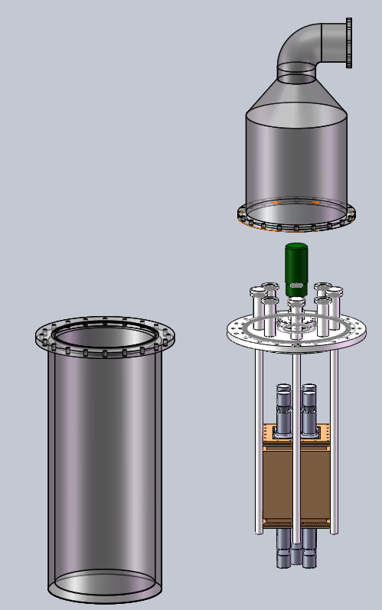
Cryostat
Temperature control system:
Vacuum insulation structure,
GM refrigerator,
PT100 temperature sensors,
ceramic heater,
lakeshore temperature controller,
Detector using lifting structure,
the upper is waterproof cover,
Cable through the pipe to the surface.
Delivery is expected in June.
Refrigerator have been delivered,
Temperature controller, feedthroug, vacuum pump has completed research, upcoming orders.

Slide 16
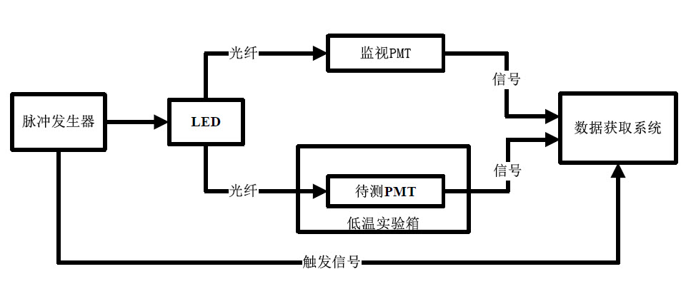
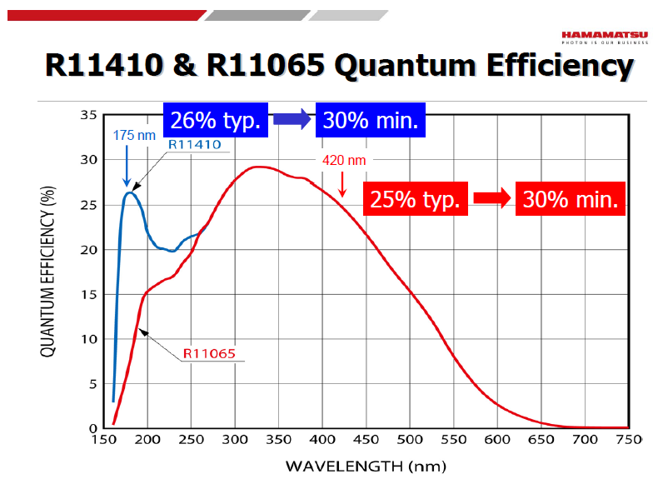
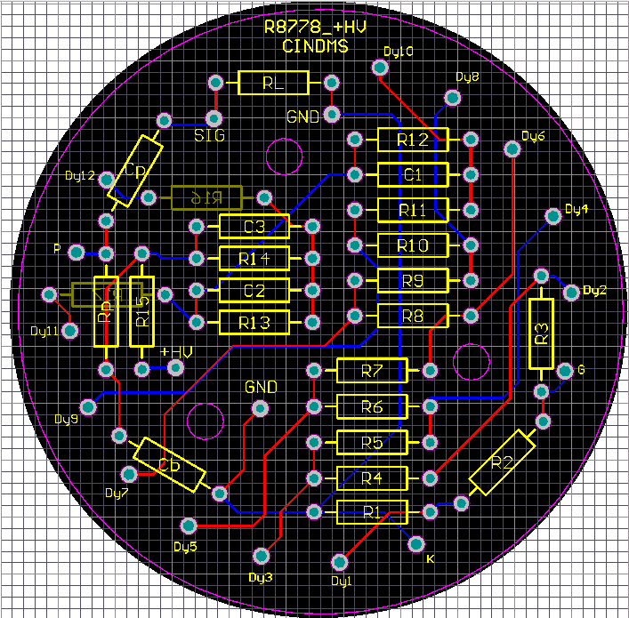
PMT
HAMAMATSU PMT have been delivered
R11065MOD, R8778 70-100mBq/PMT
PMT voltage divider has been designed, Positive high voltage, Voltage and signal separation,
Calibration System is ready, Test work carried out in June

Slide 17
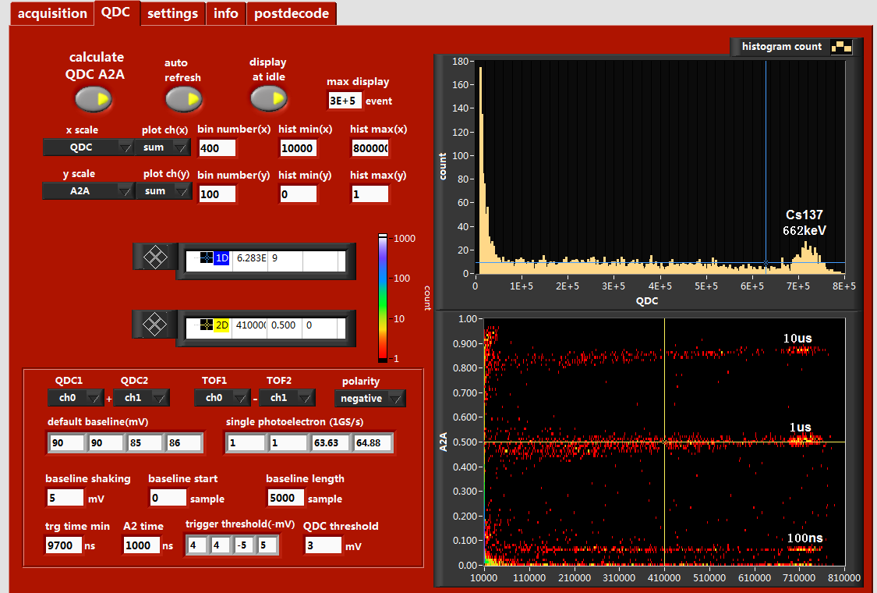
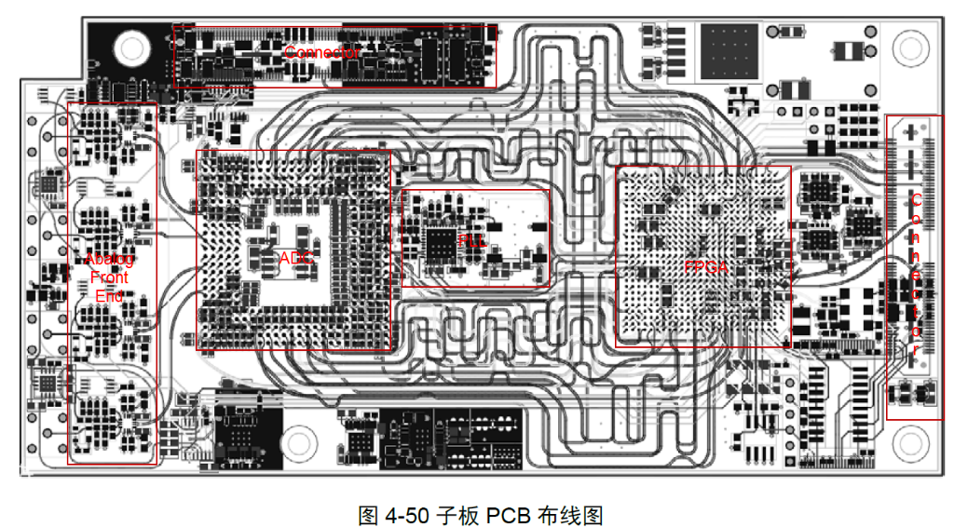
Electronics
Hardware:
CAEN commercial plug-ins
V1751 8channels FADC 1GS/s,
N625 FIFO,
N844 Discriminator,
have been ordered.
Software:
Real-time waveform analysis software is ready
Disc.
Gate
Logic
Signal
FIFO
FADC
FADC and trigger system developed by IHEP is expected in JUNE debug

Slide 18
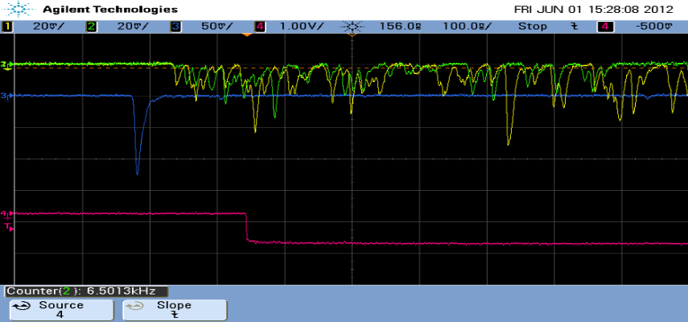
Mechanical structure, calibration
Detector support structure has completed the design, surface platform and related work will be carried out.
PMT Calibration：
LED+Optical fiber for PMTs
Gamma/neutorn：
Cs137 gamma, Cf252 neutron,
Rejection power calibration:
Am241 plastic scintillator source for gamma rejection power calibration.
Cu
PS
SiPMT
Am241
X
CsI(Na)

Slide 19
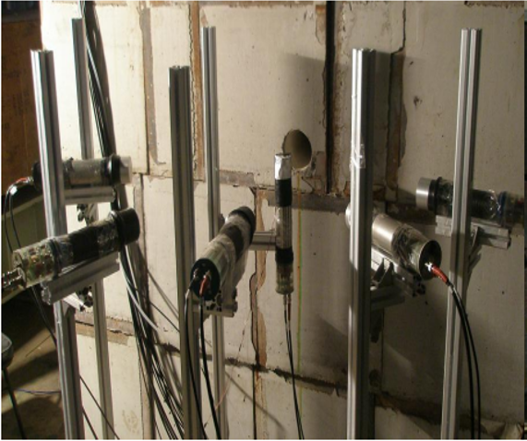
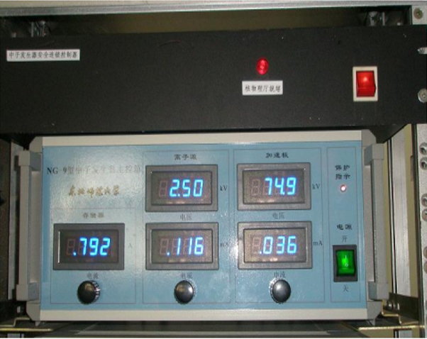
QF measurement
IHEP neutron experiment setup:
DT, DD neutron tube, BC501A liquid scintillation have been installed and tested,
Cryostat has arrived, is being assembled.
Low temperature neutron scattering experiments condition is ready.
￥1 million funds
Supported by National Natural Science Foundation of China 2014
QF measurements for CsI(Na), CsI(Tl), NaI(Tl) will be carried out.

Slide 20
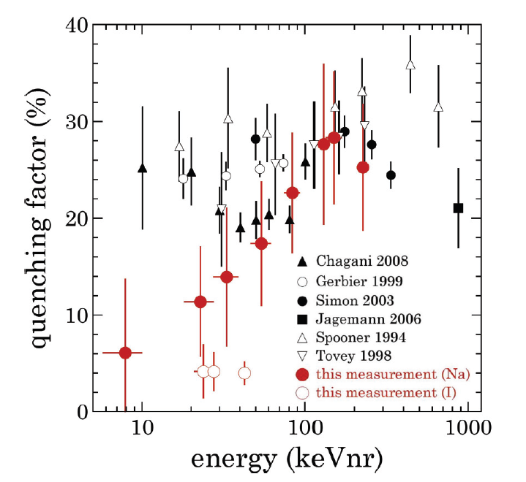
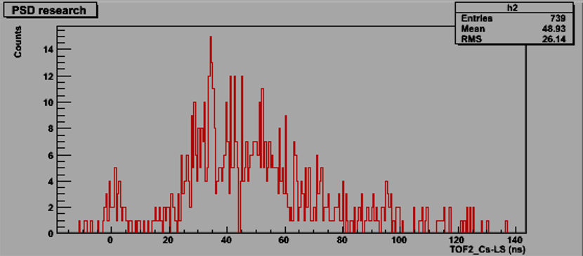
QF new results
PHYSICAL REVIEW C 88, 035806 (2013)
NaI(Tl)
CsI(Na)
neutron
expected
gamma
preliminary
QF is 4% for I recoil, consistent with our expectations.
CsI(Tl)??
Flight time peaks delayed than expected, indicating a small QF at room temperature.

Slide 21
G2 Concept Design
If G1 successful, G2 will be proposed 2015
8 m
2 m
Detector array: 5x5x2 50 modules 2.15T
water tank: Φ 8x8 m
Cryostat: Φ 2x2 m
8 m
2 m
The budget
PMT: ￥20 million 500x40000/PMT
CsI(Na): ￥10 million 2000kg x5000/kg
Electronics: ￥5 million 500x10000/ch
Others: ￥5 million
Total ~￥40 million

Slide 22
Plan
March.2015
G2 proposal
November-February.2015
Run 4 months
October
To complete the installation and commissioning at Daya Bay
September
completed the assembly and commissioning at IHEP, the Daya Bay site ready
August
all the hardware is ready at IHEP, Daya Bay site installation of auxiliary equipment
July
Completion of the crystal package, PMT, cryostat, data acquisition, calibration related hardware and software testing
June
Crystal package, cryostat assembly, temperature scale, PMT scale, crystal scale research

Slide 23
Summary
CsI ​​(Na) has cheap, modular, easy to scale advantages, But facing the purification, doping uniformity, surface deliquescence difficulties.
One R&D module funds in October 2013, crystal, PMTs, electronics, refrigerator and other key components have been delivery or ordering.
The packaging problems has been solved, oxygen-free copper, glove box, cryostat has been designed, is about to begin construction.
Expected in November 2014, Hall 5 at Daya Bay, Installation and commissioning
G2 will be proposed 2015, scale to 2T, at GS or Jinping

Slide 24
Cooperation
Crystals bg measurement
QF measurement
Detector construction and test
Shift Duty at Daya Bay
G2 experiment design
…….
Interested persons are welcome to participate in this project.

