Slide 1
uSOP
A. Aloisio – R Giordano

Slide 2
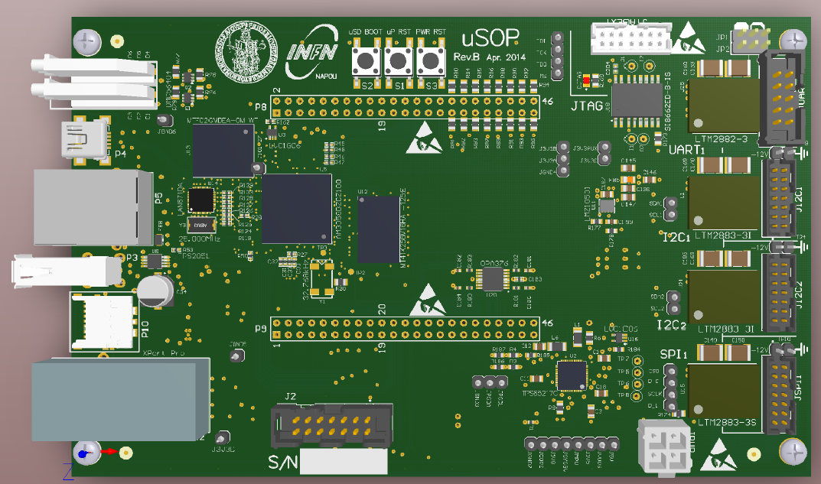
uSOP – Ver. B
Cortex A8 uP – 1GHz
Linux OS (Debian)
2 GB Flash
2 GB RAM
General platform for slow-control
Designed for reliability

Slide 3
Project Status @ Apr. 2014
Design of first version completed
PCB manufacturing started today
Software for ADC read-out via I2C in progress
Software for JTAG programming of Xilinx FPGA tested successfully
Integration in EPICS to be started soon

Slide 4
Front Side
2x USB device + host
Supply via USB (device)
Board management via an IPMI-like interface
LEDs
USB device
Ethernet
uSD
USB device
IPMI

Slide 5
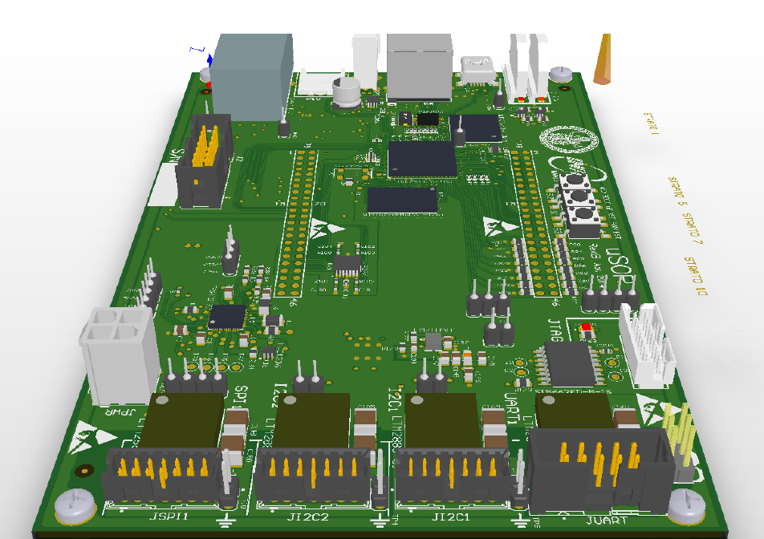
Rear Side
Fully Isolated I/O:
I2C
SPI
RS232
JTAG
All IOs fail proof
Non Isolated I/O:
Parallel
On-chip ADCs
On chip ADC
RS232
SPI
2x I2C
RS232

Slide 6
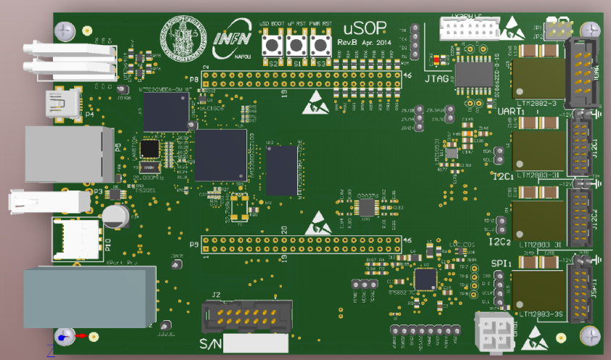
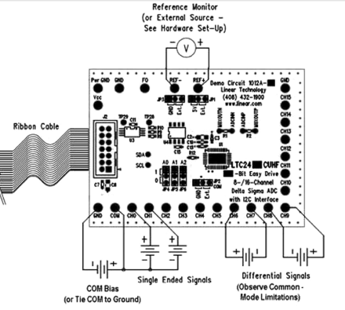
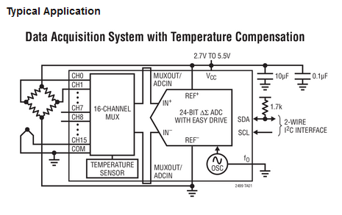
ADCs
ADC LTC2499 – 24 bit
Sigma/Delta Architecture
7.5 Hz sampling Rate
VERY high performance

