Slide 1
KM3NeT-IT
The Capo Passero Infrastructure
M. Anghinolfi – site manager

Slide 2
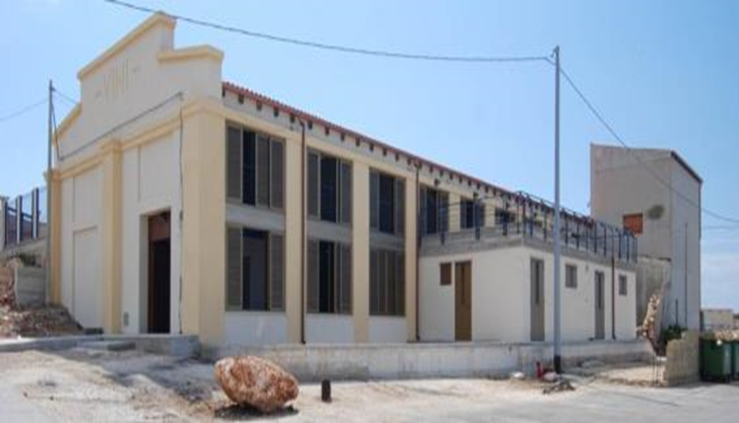
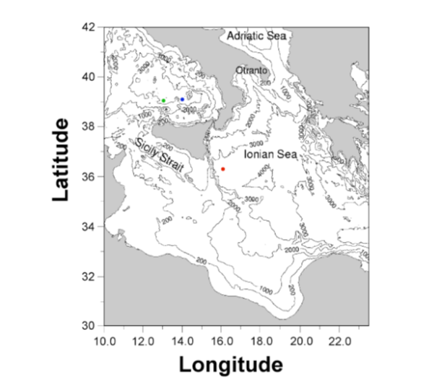
The present status : on-shore
Power Supply
Output voltage: 0-10 kV DC
Output current: 0 -5 A
Shore station:
Harbor of Porto Palo
100 km from Catania
electrical supply up to 800 kVA
UPS up to up t 159 kVA
Adequate for system expansion
fibre connection at 1 Gbps to LNS
communication is inserted inside the GARR-X network
Site:
36° 16’ N, 16° 06’ E,
about 40 NM from shore
depth of 3350 m;

Slide 3

... and off-shore
Tower prototype
8 Floor 8m length , 40 m spacing
4 10” PMTs per floor
Main cable:
Length (Km): 100
Max Voltage: 10 kV DC
Max Current: 8 Amp
Number of fibres: 20
Cable termination frame
Unfolds the main cable to 3 ROV mateable output ports
converts the supplied voltage (-10 kV DC) to 375V DC up to 10kW
8 out of the 20 optic fibres of the main cable are available at the 3 outputs
8 floor tower connected to one output on march 2013

Slide 4
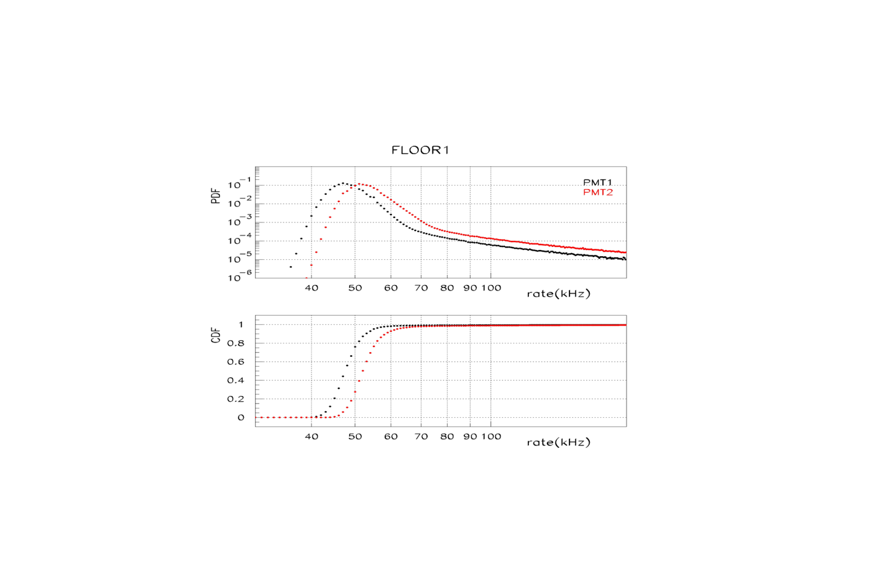
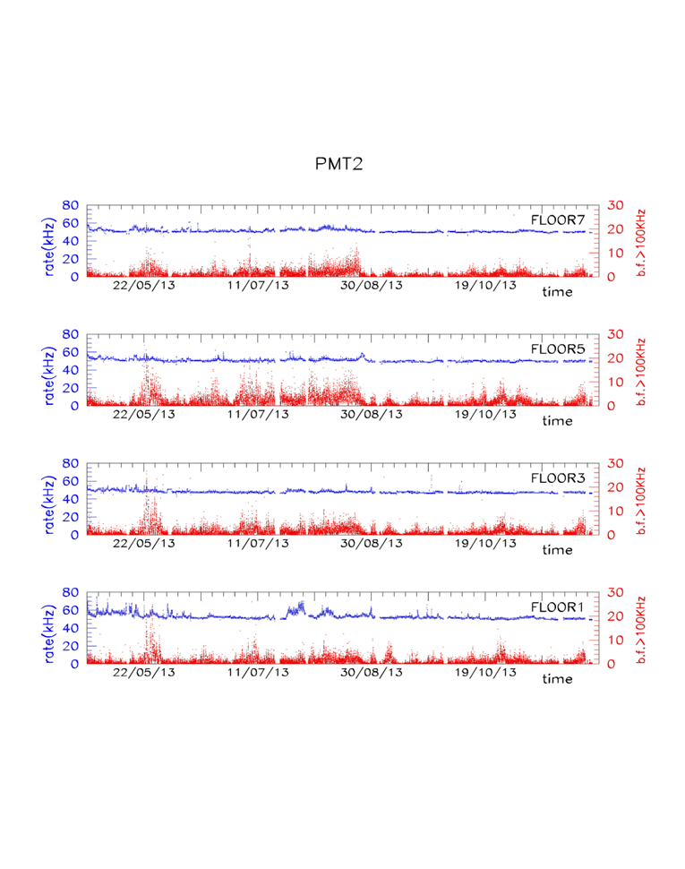
Bioluminescence activity in the site from the tower prototype
Continuous monitoring since March 2013
Mean 1 pe counting rate on 10”PMTs: ~ 50/65 kHz (⁴⁰K)
Burst fraction (>100kHz): 1-2 %
bio sound continuous monitoring
Sea current velocity: low to moderate (average 2-3 cm/s)
Single rate on a couple of 10’’ PMTs in floor 1: average values from a 9 months continuous monitoring
PDF evaluate in 1 kHz bin
Low (<10%) probability to have average rate higher than 70 kHz
Very low bioluminescence activity during the 9 month period of operation
Blue: median of rate distribution in 15’
Red: burst fraction %

Slide 5
KM3-IT PHASE 1.
PON Poject:
Funded by 20 MEuro to be spent before November 2014
Aimed at the realization of a seabed infrastructure and a first DU block in the site
  compatible to the available 8.5 kW power and exploiting the 20 optic fibres
  composed by:
    8 towers “a la NEMO” (14 floors with 6 10” PMTs per foor)
    24 strings with 18 DOMs
    Sea bed network to connect to the DUs composed by:
      NEW Cable Termination with 5 outputs
      Interlink cables
      4 Secondary Junction Boxes :
        1 SJB for the 8 towers
        2 SJBs for 12 + 12 strings
        1 SJB for EMSO

Slide 6
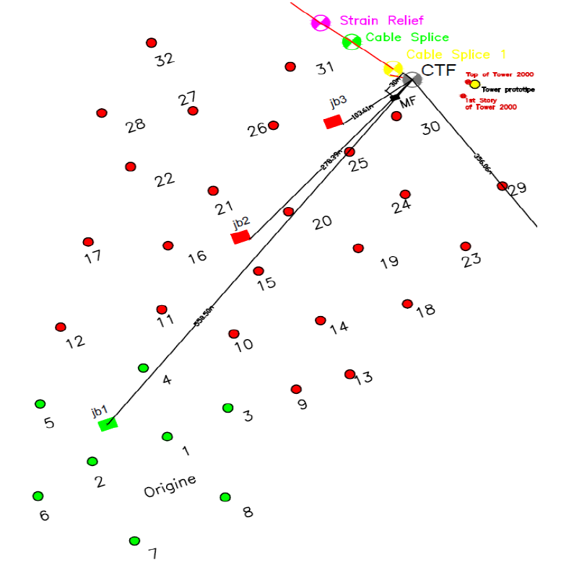
The Layout
CTF: Cable Termination (Frame)
: Secondary Junction boxes
: Tower DU
: String DU
EMSO node
Result from various compromises:
Sea deployment operations constraints
Optimized detection efficiency
DC/DC converter power limitation (8.5 kWt)
Uncertainty on the schedule of the
NEW Cable Termination

Slide 7
Some news on tenders &P.O.
Sea operations
Public tender end of January: assigned to MTS-FUGRO ~ 2.5 M€
Grand total of: 50 days of sea operations including
DRY electro and optical cables
Public tender 18/02: assigned to SEACON ~ 2.5 M€
Backbone for towers, cabling for towers and JBs
Interlink and jumpers for DUs
Public tender completed & proposed assignement to ODI on 04/03. ~ 3.5 M€

Slide 8
Mechanical srtucture of towers
Public tender for full structure of the towers including buoy, story and anchor:
assigned end of February 0.6 M€
Long interlink cables from CTF to JBs
Purcease order to ODI . Quote almost ready . Will be
finalized during OCEANOLOGY 2014 this week in London
LASERS
Purchease order for full equipement of 8 towers and 30 strings to TALLGRASS
TALLGRASS is available for both Oesolution and Eoptolink
Total amount of 0.6M€
Tender should be approved in April
and in addition…
Tender are on going for CLB, DOM, SUPPORT SYSTEM (see Marco C.)

Slide 9
MINUTE DALL’ULTIMO SC di km3-IT del 20/03
Papaleo riassume brevemente lo stato degli ordini e gare. Ad oggi risultano già impegnati circa 17.3 M€. A breve partiranno ancora due ordini, quello dei laser ( circa 0.55M€) e quello alla ODI sui cavi lunghi di interlink e connettori del nuovo CTF (circa 1.3M€).

Slide 10
Integration
OMs:
effettuato nei locali del laboratorio INFN al porto
02/04: inizia saldatura 550 basette alimentazione – PMT
30/04: arrivano FEM, mu metal e sfere
01/05: inizia assemblaggio MO; rate previsto : 4 MO/die
FCM:
FCM vessel: produzione terminata
FCM schede: consegna primi di giugno (ordine arrivato venerdi scorso)
PSS: consegna metà maggio
Transceiver: in poco tempo consegnino solo x fare 2 torri. I restanti a novembre.
Connettori: ordinati
Le sezioni di PI e LNS faranno l’integrazione e i test. Rate previsto: 2 moduli/die/sezione.
TOWERS…
Meccanica: in fase di produzione, primo prototipo del piano prossima settimana. Ritmo di produzione previsto non meno di due piani al giorno.
Cavi , connettori, sensori: ordinati. Sono state fornite alle ditte liste di priorità congruenti con l'integrazione di almeno una torre ed una JB prima dell'estate.
Siti integrazione: LNS, Frascati: l'integrazione della prima torre è programmata con inizio nella seconda metà di giugno e termine entro 15 gg. dall'inizio

Slide 11
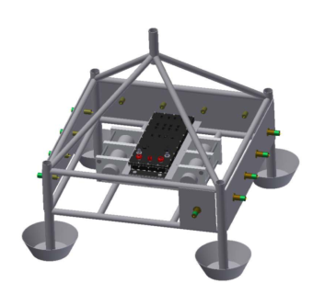

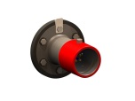
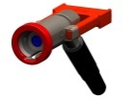
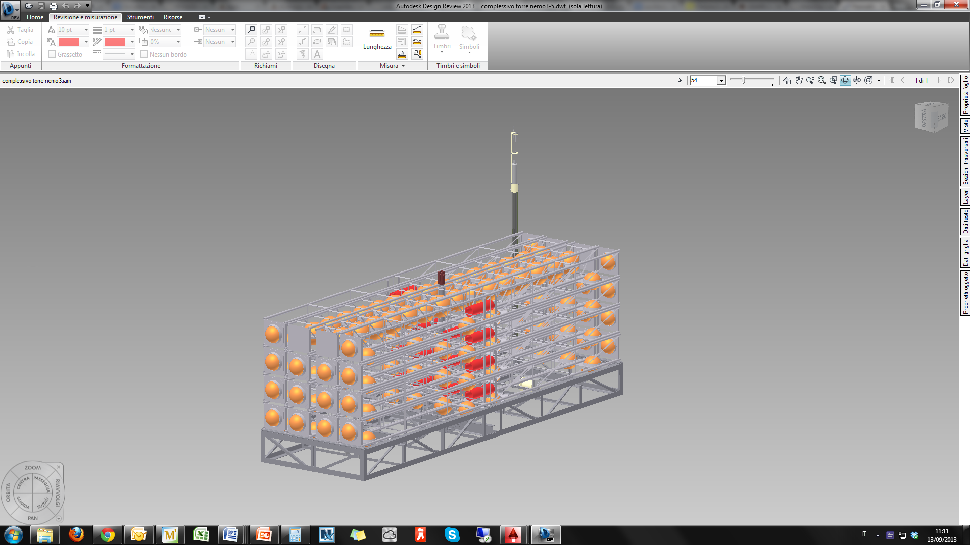
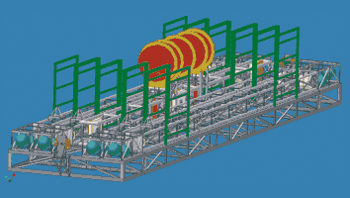
Possible scenario (end 2014)
With 3 fibers will be possible only to install 8 strings
3 O + 2 E
3 O + 2 E
With 3 fibers will be possible only to install 4 towers
MVC
2 O + 2 E
OR

Slide 12

Final configuration with New CTF (end 2015)
It will be possible to install all the towers (8)
4O + 2 E
4O + 2 E
New CTF
4O + 2 E
4O + 2 E
It will be possibile to install until 12 strings
4O + 2 E
It will be possibile to install until 12 strings

Slide 13
Major Milestones
PPM DU deployment & connection: May 2014
Deployment & installation of manifold: fall 2014
Recovery of the PPM DU and tower : fall 2014
Deployment & installation of 2 SJBs: fall 2014
Procurement of interlink cables (before November 2014,
contractual clause)
Tower installation: end 2014
One DU string ready for deployment : end 2014
Part of DU string installation: spring 2015
New Cable termination: mid 2015

Slide 14
Summary
Capo Passero: shore station in operation and suitable for system expansion
Site: clean & calm during 11 months monitoring
Phase 1: install network for 8+24 DUs
Severe constraints on:
  Expenditure time profile
  procurement of cable termination

