Slide 1
XLIV International Symposium on multiparticle dynamics
8-12 September 2014, Bologna
Cosmic-ray world
with gamma-ray astronomy:
a wealth of information,
an ever more open issue
Martina Cardillo
INAF-Osservatorio Astrofisico di Arcetri
September 9, 2014

Slide 2
Index
SNR/CR context and gamma-rays
Main Issue: can we resolve the problem of the origin of hadronic cosmic-rays?
The breakthrough:
The SNR W44 and the first direct proof
Challenges:
data vs theory
Prospects for the future

Slide 3
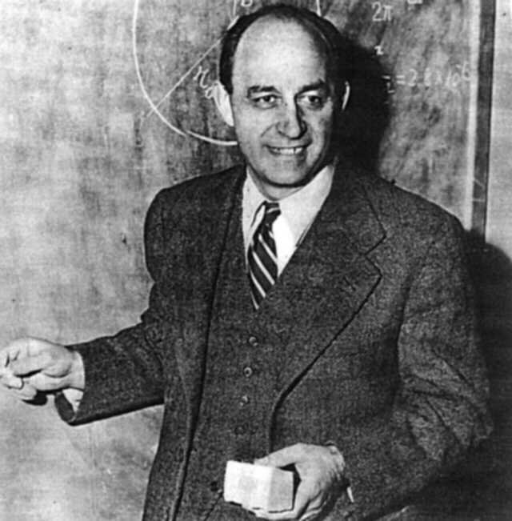
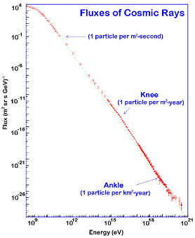
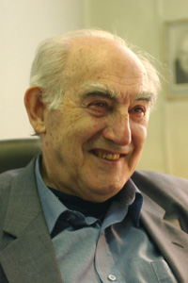
Context
1949 E. Fermi
(Fermi acceleration)
Galactic Origin
α=2.7
1959. V.Ginzburg
(SNRs hypothesis)
Supernova
Remnants
Energetic shock waves
Possibility of energy gains by repeated shock crossing
Protons (85 %)
Nuclei (13%)
Electrons/Positrons (2%)
Diffusive Fermi Acceleration
(magnetic turbulence)

Slide 4
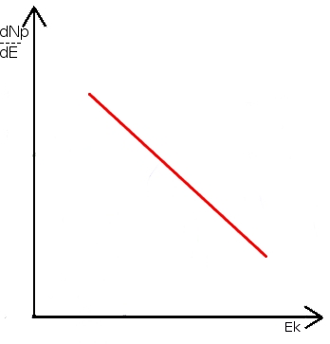
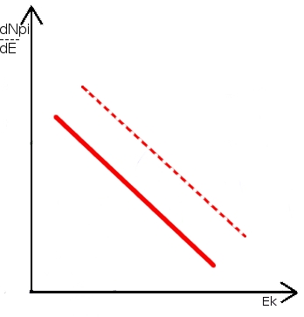
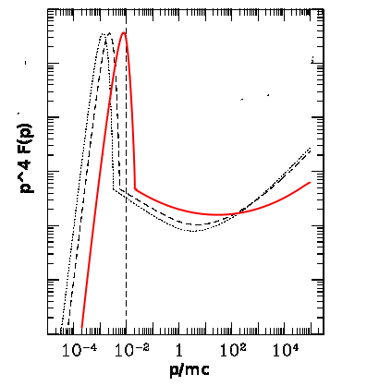
Context
Linear DSA
STRONG SHOCK → r=4
Concavity
Non Linear DSA
Notes:
Massa primo protone=gamma m c^2
Massa secondo protone (a riposo)= m c^2

Slide 5
Context
Accelerated
protons
Balmer line emission by
charge-exchange
INDIRECT
DOWNSTREAM
UPSTREAM
Gamma-ray
from pion emission
DIRECT
Pevatrons
Notes:
Dal livello 3 al 2- information electron/ion temperature - Halpha=656 nm (visibile) – 10^-17 tempo decadimento pi0

Slide 6
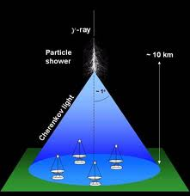
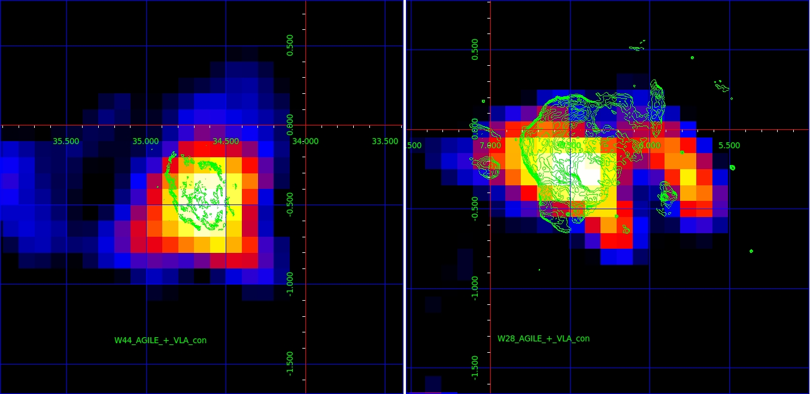
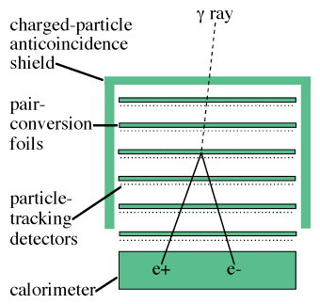
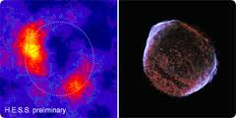
Gamma-rays
Earth
(GeV-TeV)
Space
(MeV-GeV)
AGILE
MAGIC
VERITAS
Fermi-LAT
HESS

Slide 7
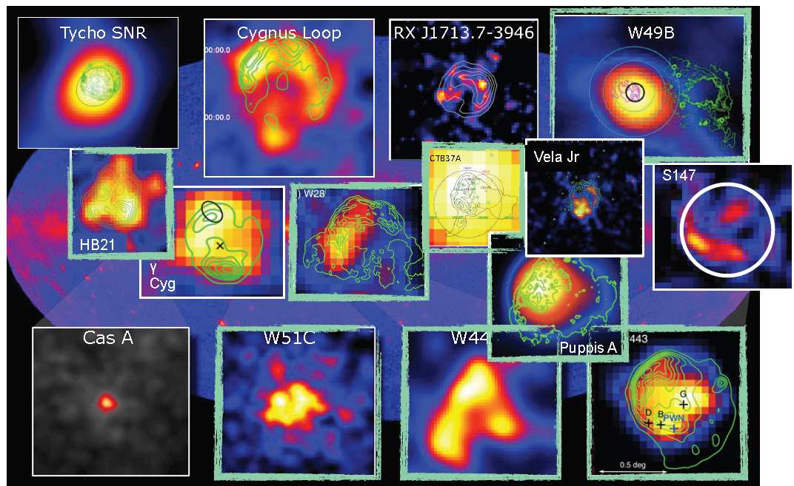
Gamma-ray SNRs
Several SNRs detected in gamma-rays,
but finding a clear proof is very difficult!

Slide 8
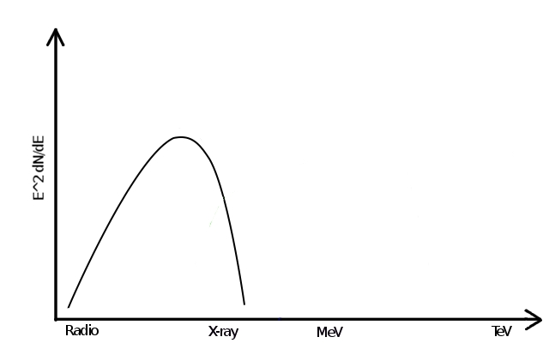
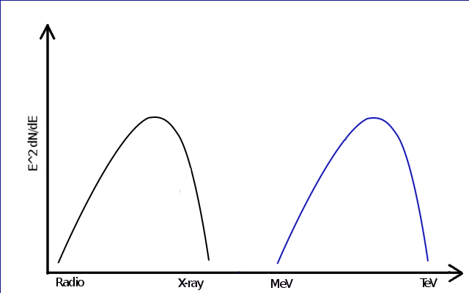
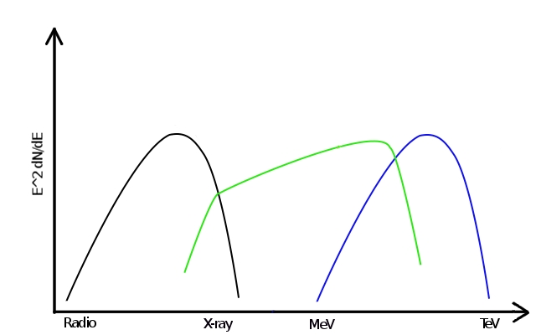
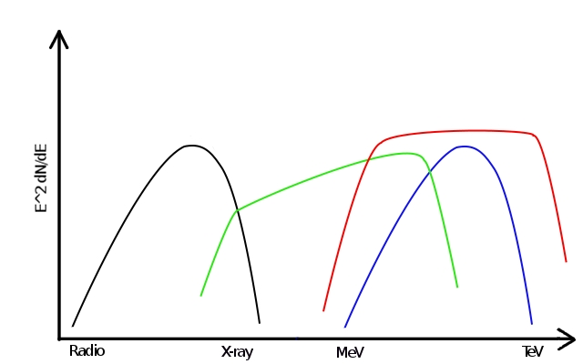
Gamma-ray detection: problem
PROBLEM
unique signature!

Slide 9
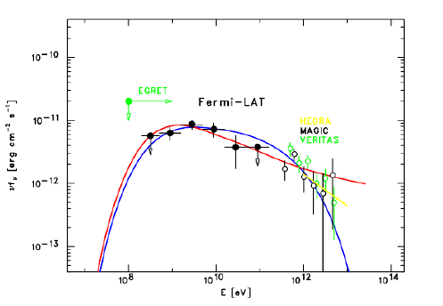
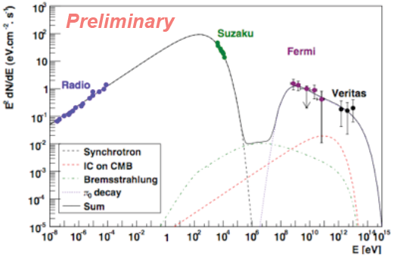
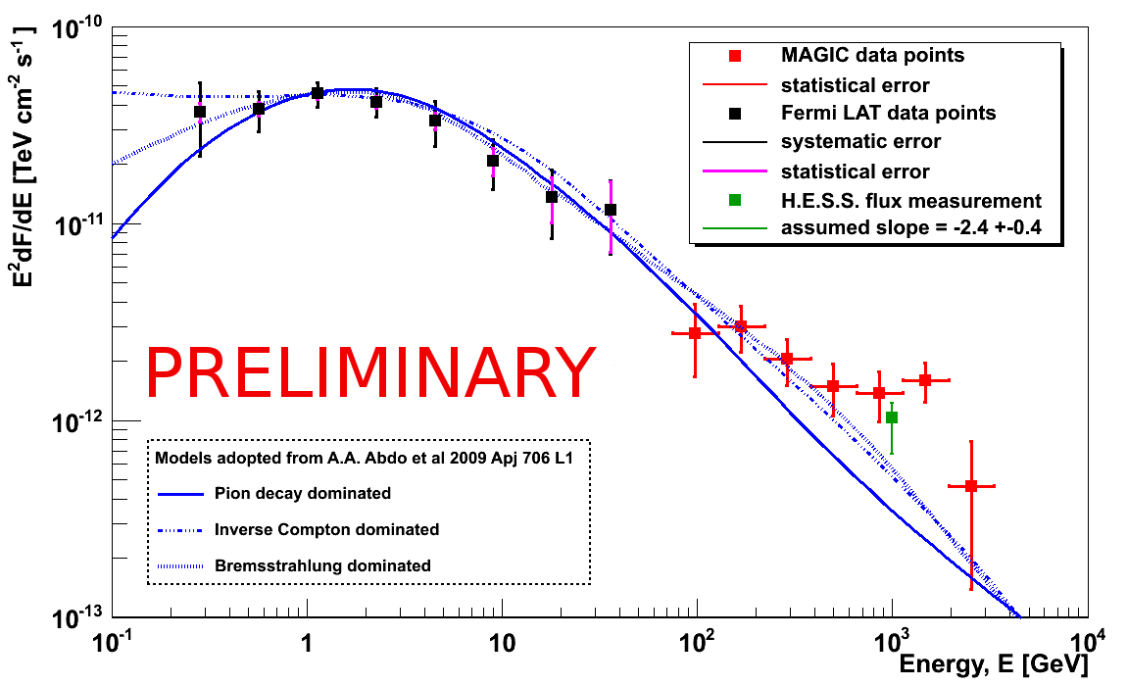
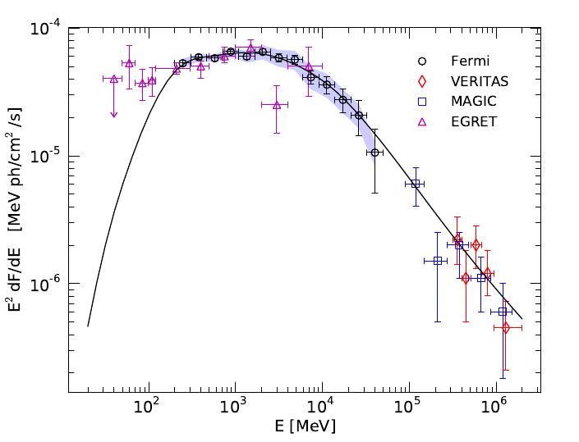
CAS A
W51c
IC443
Gamma-ray detection: problem
Tycho
Giordano et al. 2012
Abdo et al. 2010
CAS A
Abdo et al. 2010
Krause et al. 2011
Abdo et al. 2010
Tavani et al. 2010
Notes:
Sensibilità: naturalmente ogni strumento è ottimizzato per un certo range di energie. Comunque andando sotto ai 100 MeV
la soglia per ditinguerli dal rumore è veramente bassissima
PSF: dipende dalla deviazione tra direzione ricostruita e direzione reale del fotone. E’ ovvio che a più basse E, i fotoni interagiscono
Maggiormente e quindi è più difficile la ricostruzione
Area Efficace: quella di AGILE non dipende quasi per niente dall’angolo da cui provengono i fotoni. Devo capire bene il motivo per cui dipende dall’energia.

Slide 10
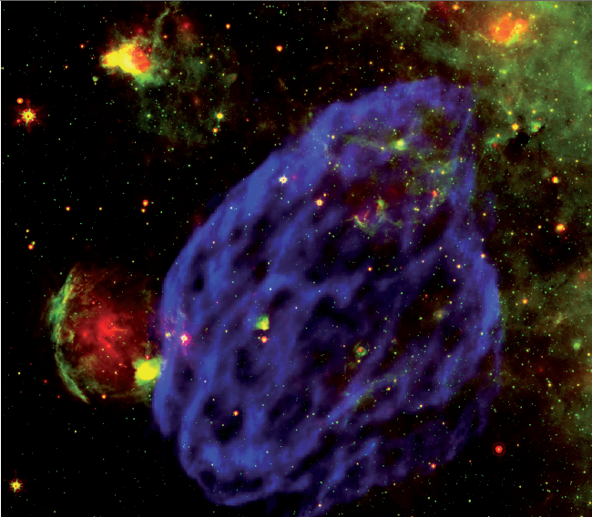
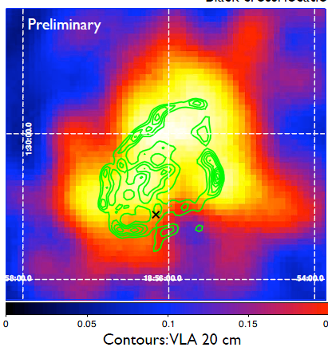
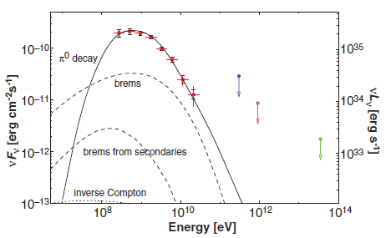
The breakthrough: the SNR W44
Fermi-LAT
(Abdo et al 2010)
W44: gamma-ray emission (Fermi)
(Abdo et al. 2010)

Slide 11
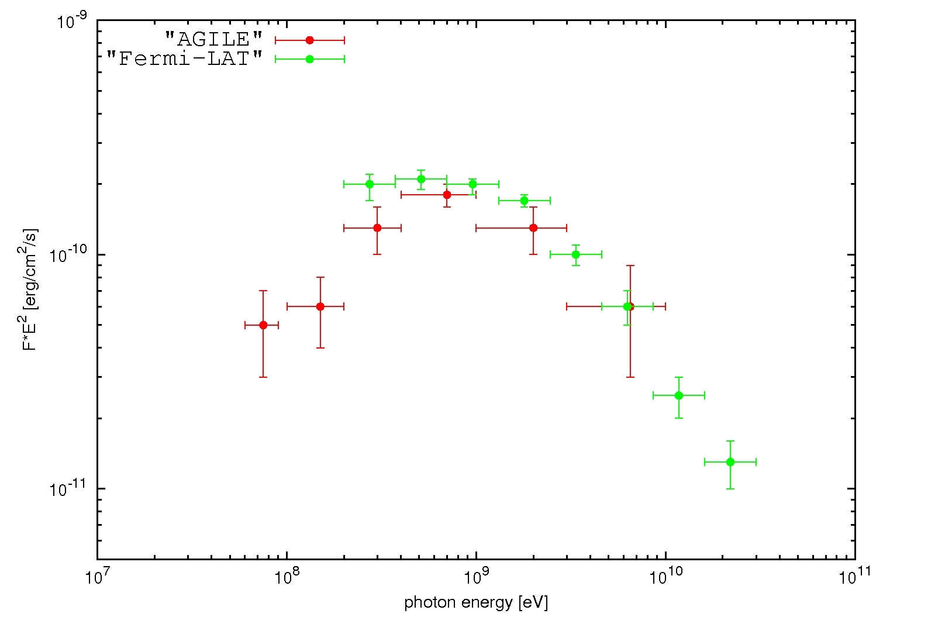
The breakthrough: the SNR W44
Giuliani, Cardillo, Tavani et al .(2011)
Pion bump: direct proof
AGILE

Slide 12
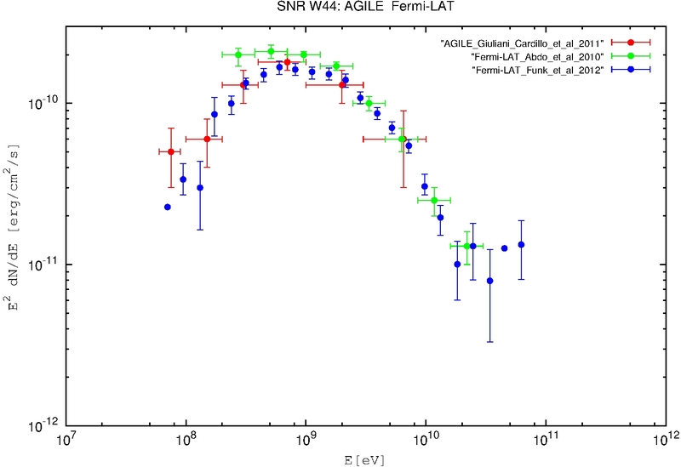
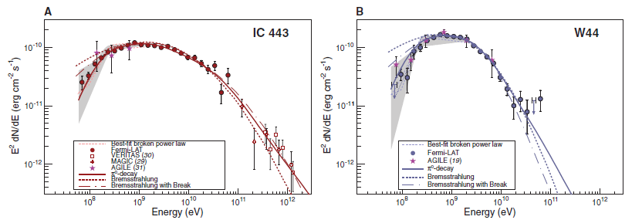
The breakthrough: the SNR W44
Fermi confirms
AGILE data
Ackermann et al. (2013)

Slide 13
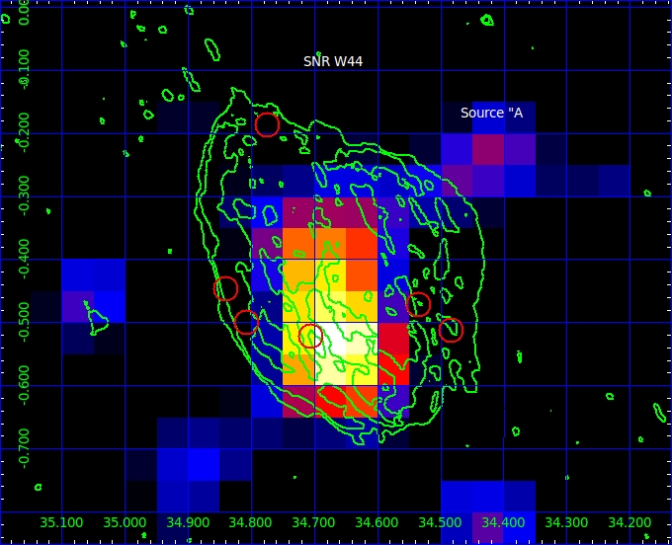
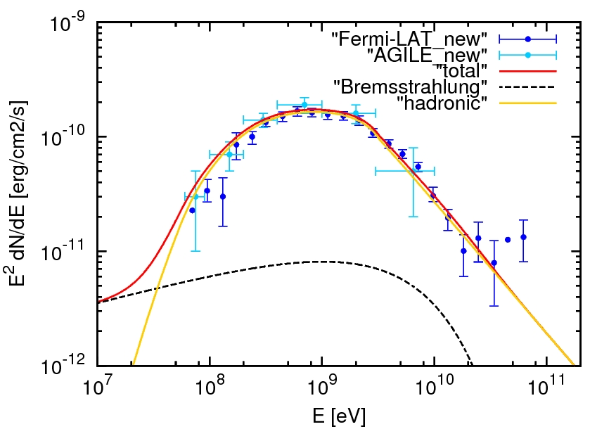
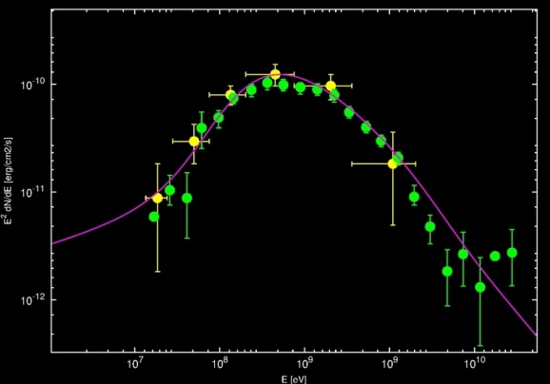
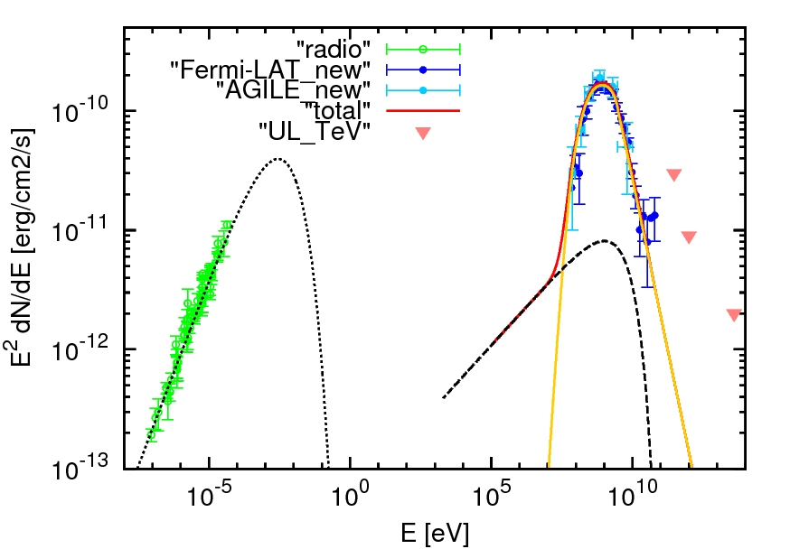
The challenge: the SNR W44
Cardillo et al. 2014

Slide 14
The challenge: from W44 to all the others
First pion bump signature:
* low-E index p₁ ~ 2.2 → as like as the young SNRs
High density: n ≈ 300 cm⁻³
* In all the middle-aged SNRs → related to high magnetic field
High magnetic field: B ≈ 200 μG
* in the most of the SNRs → amplification
* differences between young and old
Steepness:
* p₂ ≥ 3 → Why?
Cardillo et al., 2014

Slide 15
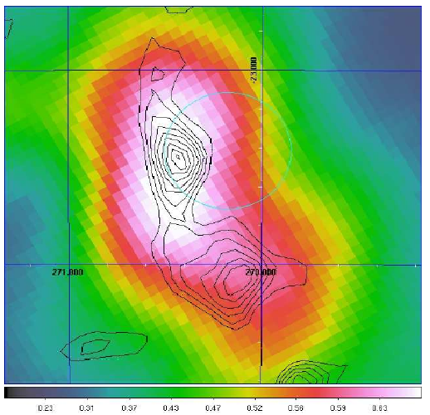
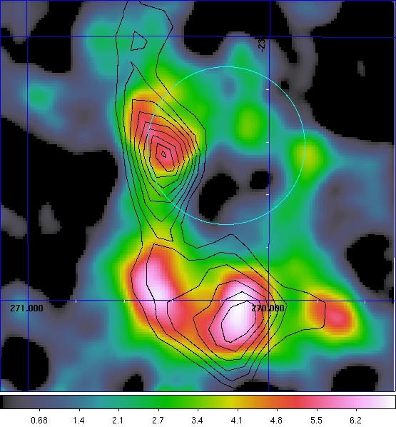
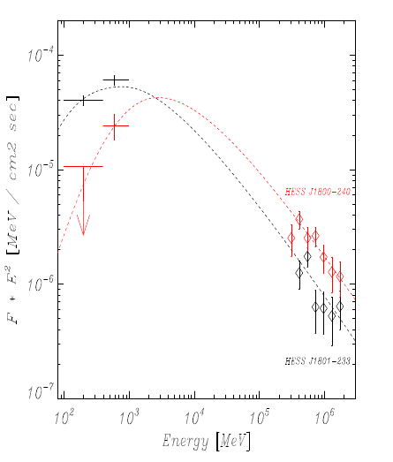
The SNR W28
HESS
(TeV)
Giuliani et al., 2010
AGILE
E>400 MeV
- Spectral index for E>1 GeV → α=2.7
- Linear DSA model

Slide 16
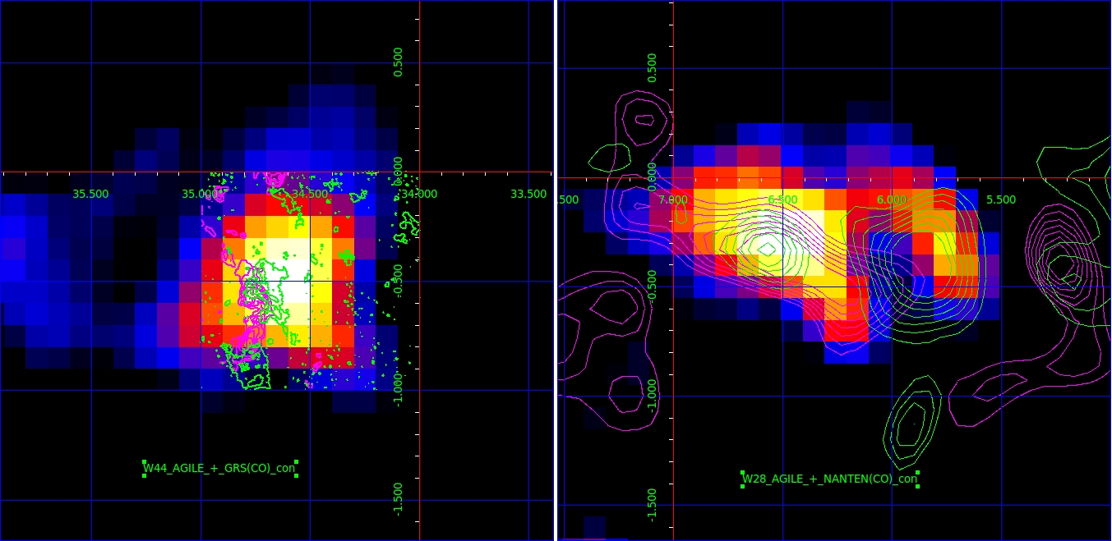
W28 and W44
AGILE E>400 MeV (bin=0.1)
Cardillo et al. 2014b
VLA radio contours (324 MHz)
VLA radio contours (30 cm)
NANTEN CO contours 0-17/18-27 km/s
GRS CO contours (40-43 Km/s)

Slide 17
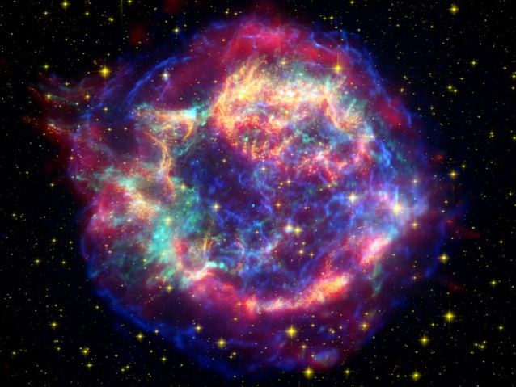
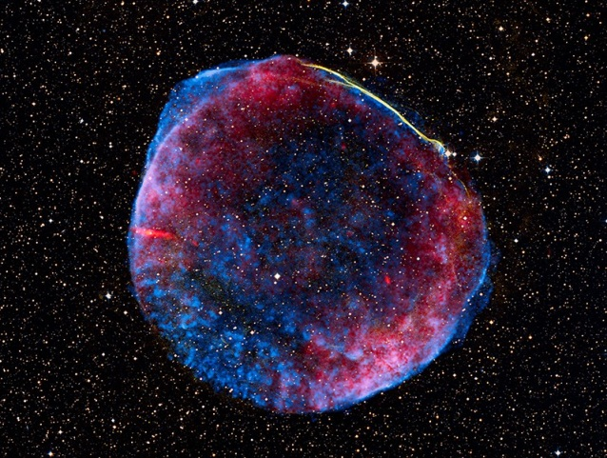
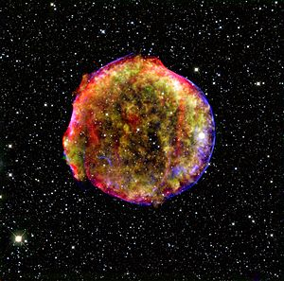
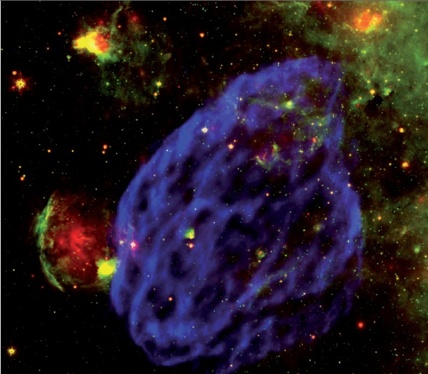
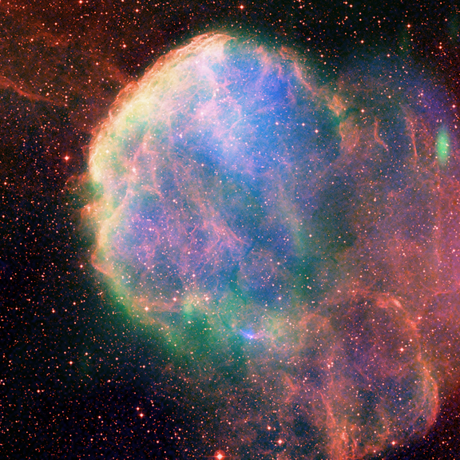
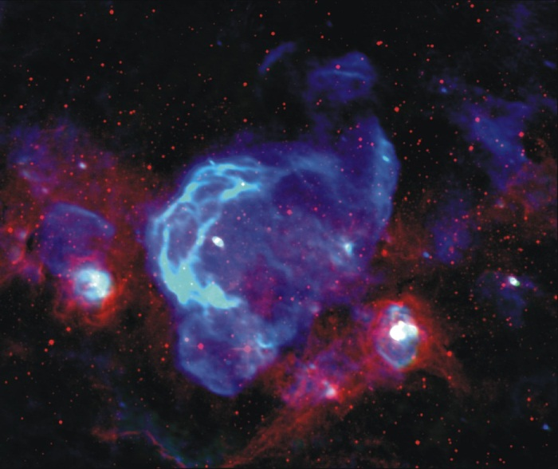
Young SNRs
t < 1000-2000 yrs
Cas A
Primary spectrum
1006
W44
Environment
(ISM, molecular clouds))
Tycho
Middle-aged SNRs
t > 1000-2000 yrs
Secondary spectrum
IC443
W28

Slide 18
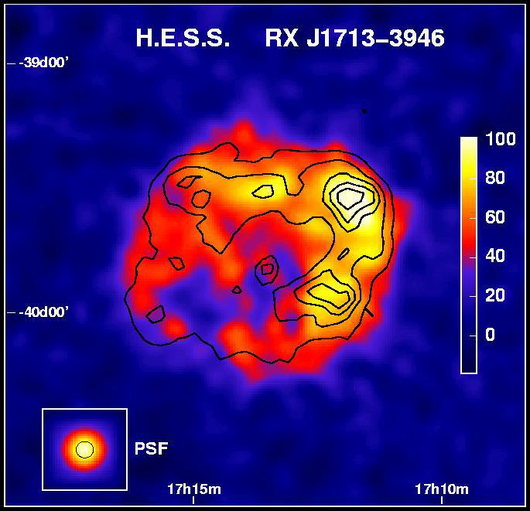
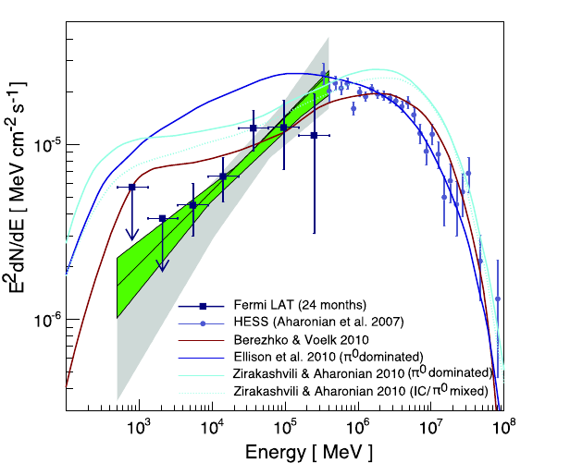
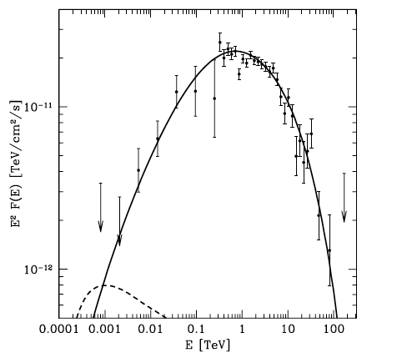
Environment importance: the SNR RX J1713-3946
HADRONS
LEPTONS
Aharonian et al. 2007
Abdo et al. 2011
HADRONS
…even if the leptons maybe could…
Fukui et al.2013
Gabici & Aharonian 2014

Slide 19
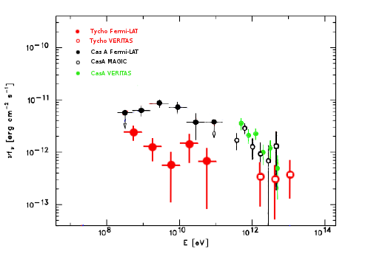
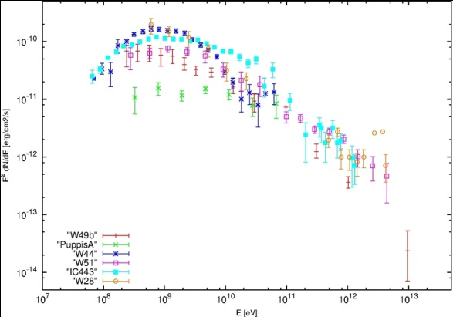
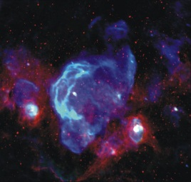
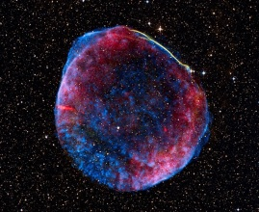
Summary: a great confusion
Cardillo et al. 2014b
Middle-aged
Giordano et al. 2012
Acciari et al. 2009
Abdo et al. 2010
Albert et al 2007
Acciari et al. 2010
Young SNRs
Abdo et al.2009
Hewitt et al. 2012
Giuliani et al. 2011
Aleksic et al 2012
Aleksic et al. 2012
Abdo et al.2010
Young:
Low-density medium
p= 2,2-2,4 → No concavity!!
No obvious Pevatrons
Middle-aged:
High-density medium
2,6 < p < 3
No hope for Pevatrons !

Slide 20
Optimistic point of view:looking for an explanation
Alfvén Damping
(Malkov et al.)
Neutrals leakage
(Blasi et al.)
How can we explain
experimental features
of observed SNRs
in the context of
CR acceleration?
Lower acceleration efficiency
Lower compression ratio
Free Escape boundary
Slower diffusion
Scattering Center
Velocity
(Caprioli et al.)
Reacceleration
(Blasi et al.)

Slide 21
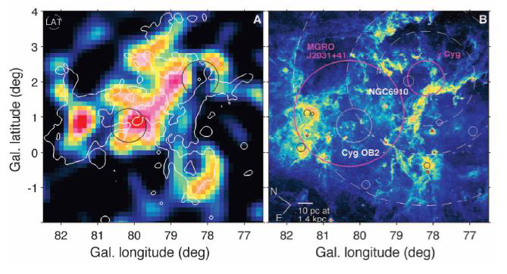
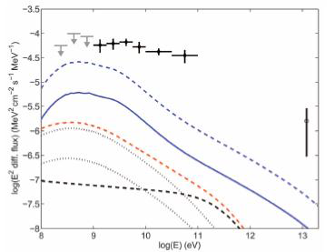
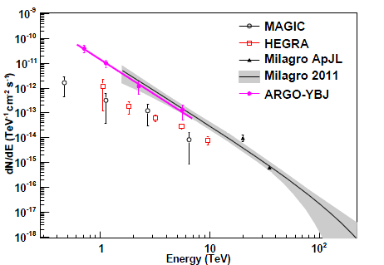
Pessimistic point of view: no SNRs, other sources
Cygnus region: GeV emission
from Fermi-LAT (Ackermann et al.2011)
Superbubbles
MGRO2031+41: TeV emission
from ARGO (Bartoli et al. 2012)

Slide 22
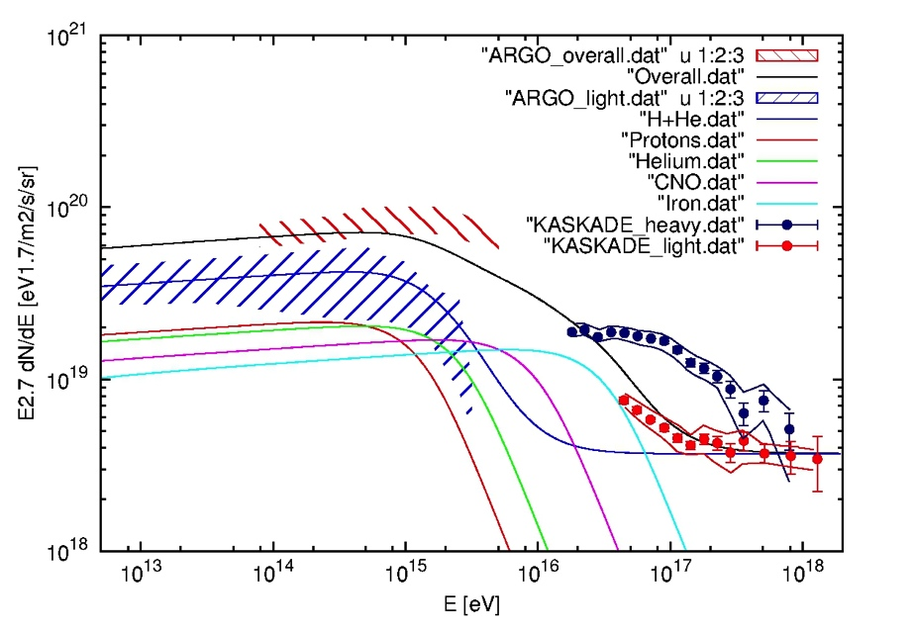
And particle spectrum?
Cardillo, Amato, Blasi, in preparation
Non resonant instability and CR current (Bell 2004)
Preliminary
k=9
E_{SN}= 4 x 10⁵¹ erg
R= 1/60 yrs
Uncertainty on the data?
Additional component?
E_{M} ≅ 1.2 x 10¹⁵ eV
ξ_{CR} ≅ 4.5 %
t₀ ≅ 42 yrs
v₀ ≅23.700 km/s

Slide 23
Future for gamma-ray astronomy
Gamma
400
(Galper et al.)
CTA

Slide 24
G-400 and CTA sensitivity (extragal. pointing) Fermi-LAT (blue), G-400 (red), CTA (cyan)
Future for gamma-ray astronomy
G-400 48 hr, CTA 5 hr
G-400 1 yr, CTA 50 hr
G-400
CTA
G-400
CTA
We need to improve detection at energy below 100 MeV → several proposals, never materialized yet (Gamma-Light ?)

Slide 25
Conclusions
Gamma-ray astronomy is fundamental for the understanding of Galactic CR origin
→ we need to enhance the number of SNRs detected in the critical energy range, after the breakthrough of W44 and IC443
Evidence a power-law index steeper than the one provided by theoretical models in the most of gamma-ray detected SNRs
inconsistency between data and theories
In spite of the amount of data, CR origin is still an opening issue
new generation of gamma-ray instruments
multiwavelength analysis
deeper understanding of acceleration and transport mechanisms

Slide 26
Thank you
very much!

Slide 27
Context
Uchiyama et al. 2011
Notes:
Sensibilità: naturalmente ogni strumento è ottimizzato per un certo range di energie. Comunque andando sotto ai 100 MeV
la soglia per ditinguerli dal rumore è veramente bassissima
PSF: dipende dalla deviazione tra direzione ricostruita e direzione reale del fotone. E’ ovvio che a più basse E, i fotoni interagiscono
Maggiormente e quindi è più difficile la ricostruzione
Area Efficace: quella di AGILE non dipende quasi per niente dall’angolo da cui provengono i fotoni. Devo capire bene il motivo per cui dipende dall’energia.

Slide 28
Young SNRs without dense nearby clouds: ‘‘shell’’ emission
It needs improvements of the GeV and TeV spectra
Pion bump is needed !
Are young SNRs accelerating up to the knee ?
With the right numbers/energetics ?

Slide 29
New data analysis
Cardillo et al. 2014
AGILE 400-10000 MeV
Radio(VLA), Masers

Slide 30
New data analysis
Cardillo et al. 2014
AGILE 400-10000 MeV
Radio(VLA), CO(NANTEN2)
Infrared (HERSCHEL)
Gamma-ray(AGILE),CO(GRS)

Slide 31
New modeling: hadrons
Cardillo et al. 2014
H3

Slide 32
New modeling: leptonic-only
Cardillo et al. 2014, accepted by A&A

Slide 33
Discussions
Cardillo PhD thesis

Slide 34
KASKADE Grande (Apel,2013)
k=9
E_{SN}= 10⁵² erg
R= 1/950 yrs
E_{M} ≅ 9.4 x 10¹⁵ eV
ξ_{CR} ≅ 13 %
t₀ ≅ 27 yrs
v₀ ≅37.500 km/s

Slide 35
KASKADE Grande + ARGO (Di Sciascio, 2014)
k=9
E_{SN}= 10⁵² erg
R= 1/950 yrs
E_{M} ≅ 9.4 x 10¹⁵ eV
ξ_{CR} ≅ 13 %
t₀ ≅ 27 yrs
v₀ ≅37.500 km/s

Slide 36
ARGO
k=9
E_{SN}= 10⁵¹ erg
R= 1/30 yrs
E_{M} ≅ 6.3 x 10¹⁴ eV
ξ_{CR} ≅ 8.5 %
t₀ ≅ 84 yrs
v₀ ≅11.800 km/s

Slide 37
a future after Fermi and AGILE for MeV-GeV astrophysics ?
Silicon technology can be pushed to the limits.
Substantial PSF improvement expected by a combination of thin converter + analog readout.
GAMMA-400, a new space mission concept (at the moment under study by groups in Russia, Italy, …).
Much improved Gamma-Ray Tracker, very deep calorimeter; a new gamma-ray and charged CR exploration.

Slide 38
0.5 – 100 MeV range !
several proposals, never materialized yet.
maybe we should improve the Compton telescope concept (e.g., GRIPS, other being considered now) and reach larger energies (e.g., GAMMA-LIGHT).
a very important window, sensitivity needs to be good to compete and do better than Fermi-LAT

Slide 39
a future after Fermi and AGILE for MeV-GeV astrophysics ?
Silicon technology can be pushed to the limits.
Substantial PSF improvement expected by a combination of thin converter + analog readout.
GAMMA-400, a new space mission concept (at the moment under study by groups in Russia, Italy, …).
Much improved Gamma-Ray Tracker, very deep calorimeter; a new gamma-ray and charged CR exploration.

Slide 40
Conclusions
Direct proofs: the first direct proof of hadronic acceleration in SNRs (the pion bump in W44)
→ we need to enhance the number of SNRs detected in the critical energy range
Evidence in W44 of a power-law index steeper than the one provided by theoretical models
→ as like as in the most of other gamma-ray detected SNRs
Data and theorie inconsistencies
In spite of the amount of data, CR origin is still an opening issue
→ new generation of gamma-ray and particle instruments

