Slide 1
Fisica all’ Exploratorium:
Scienza, Arte e Percezione
9 Ottobre, 2014
Tom Rockwell, Director Exhibit & Media Studio

Slide 2
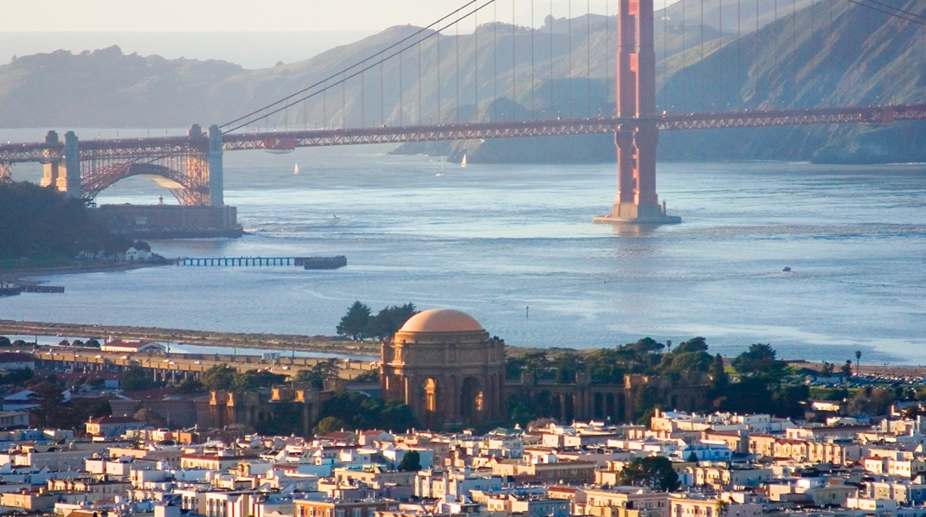
Notes:
From one dramatic location...

Slide 3
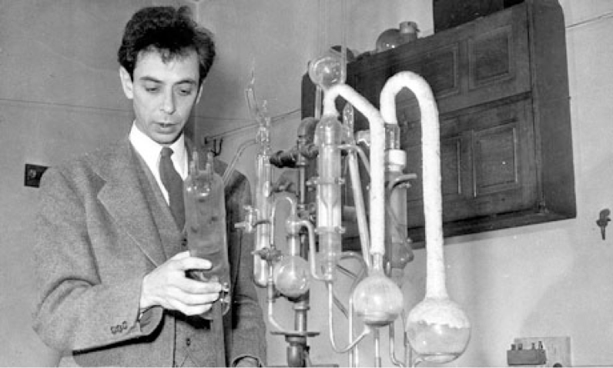
Notes:
From one dramatic location...

Slide 4
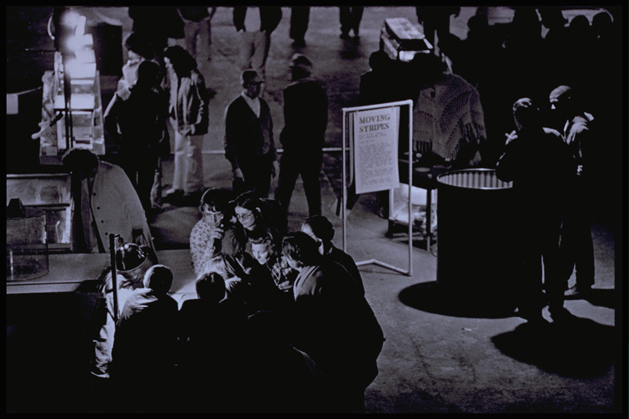

Slide 5
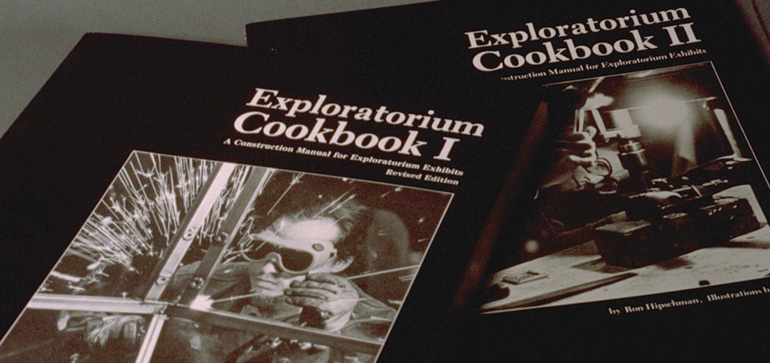

Slide 6
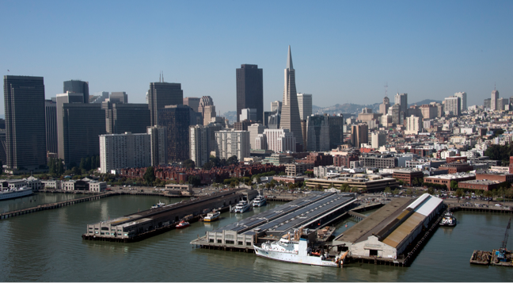
Notes:
...to another.

Slide 7
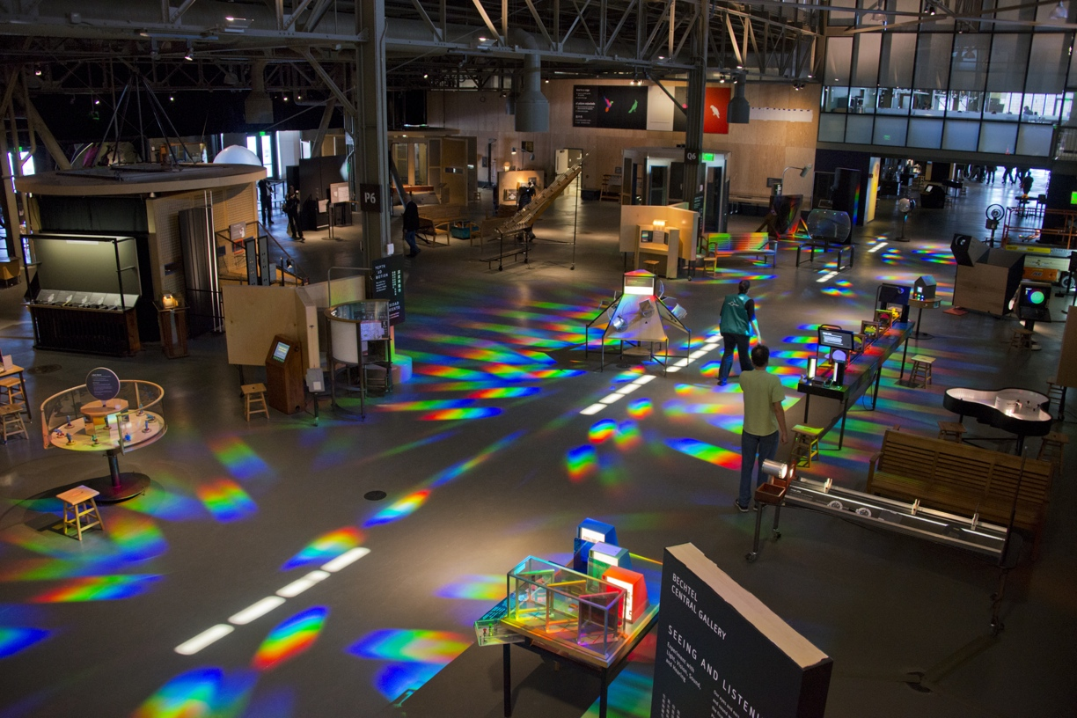
Notes:
...to another.

Slide 8
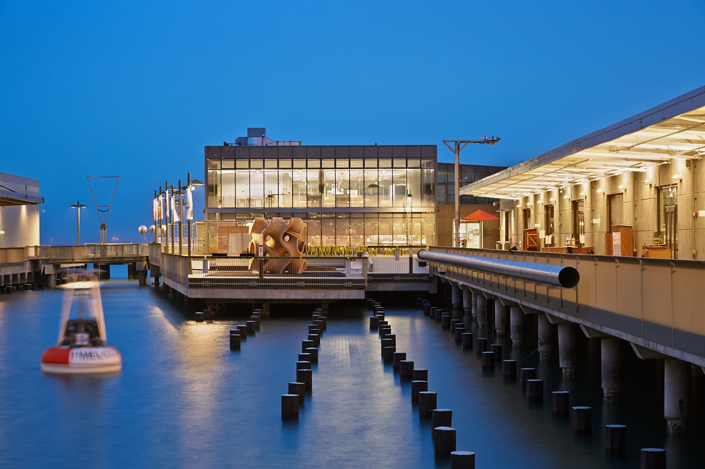

Slide 9
Fenomeni Dinamici

Slide 10
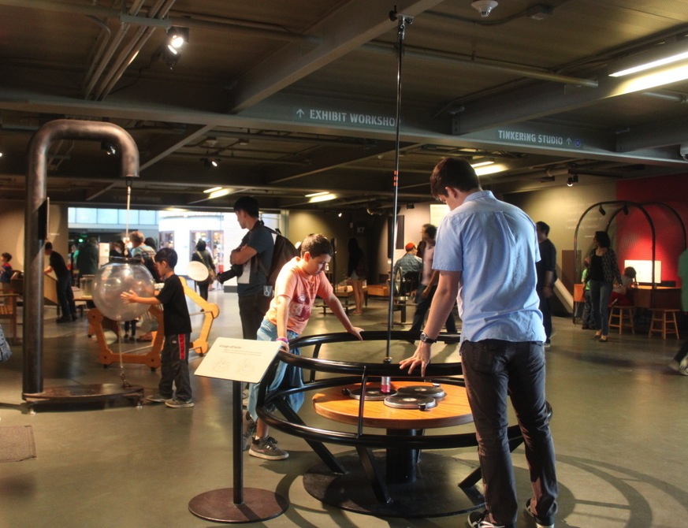
Notes:
Modeling Landscapes groups a series of exhibits about granular materials, water flow and pattern formation to allow visitors to experiment with the forces that shape the land.

Slide 11
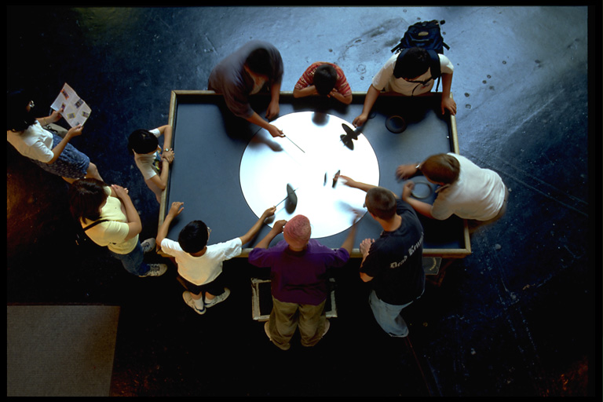
Notes:
Classic exhibits promote group inquiry allowing visitors to learn from each other’s behavior.

Slide 12
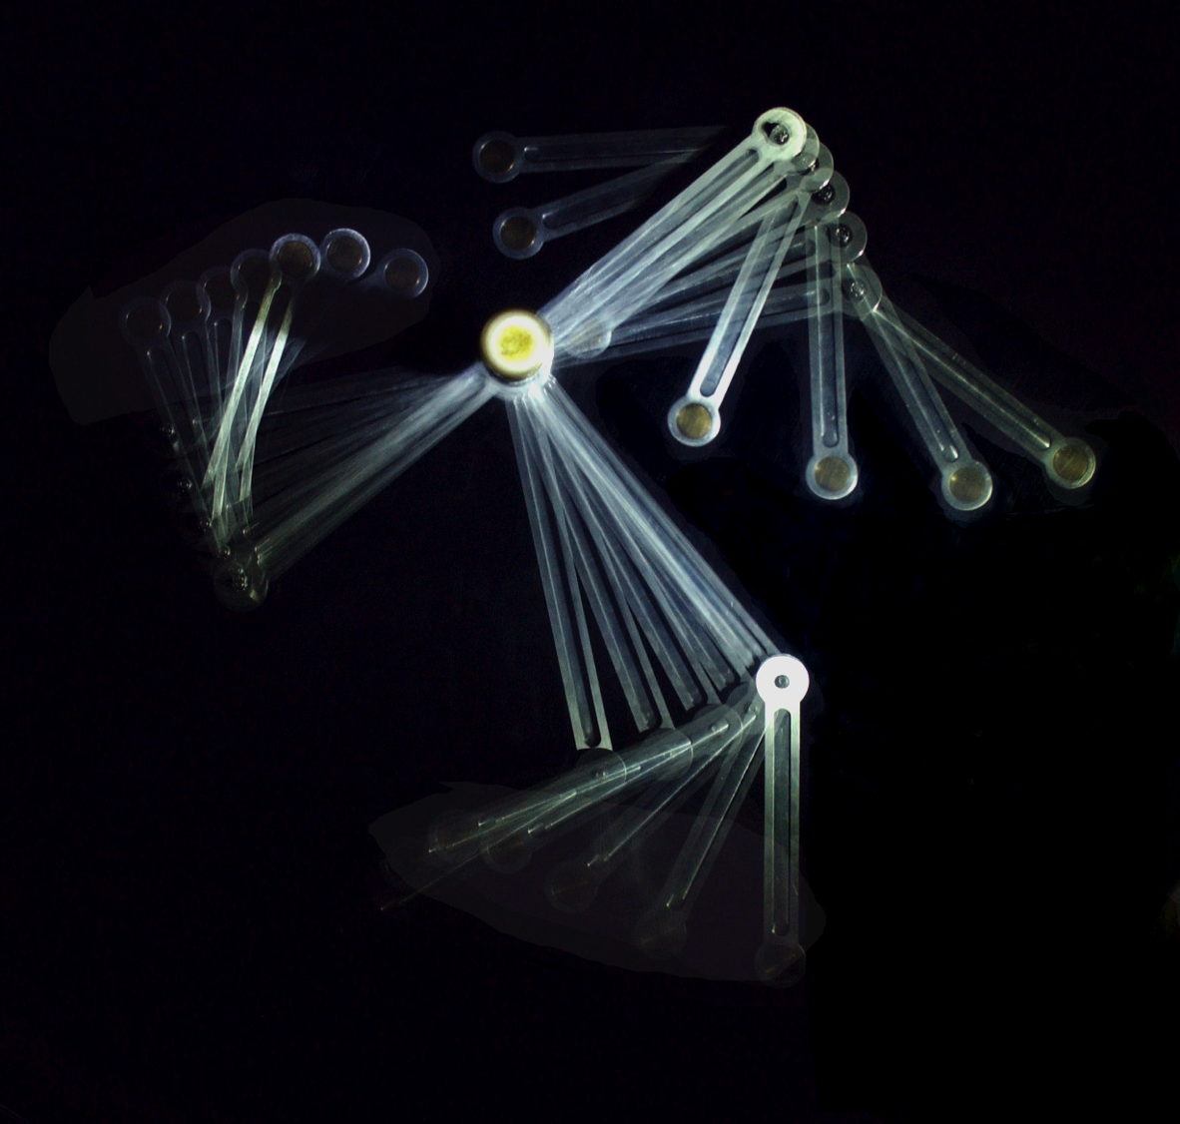

Slide 13
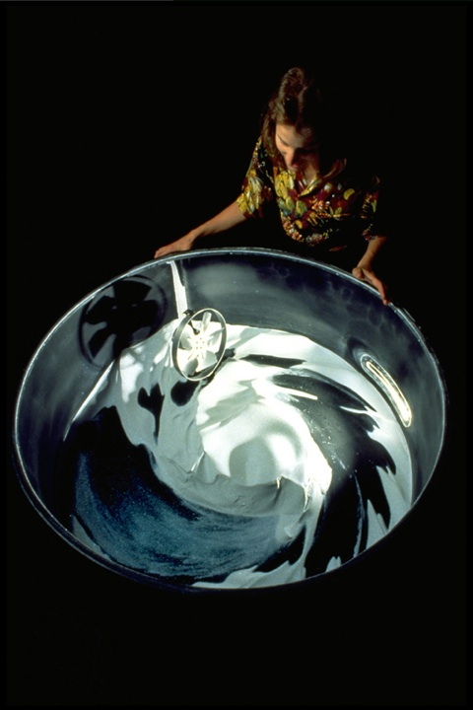
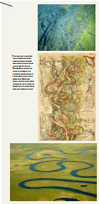
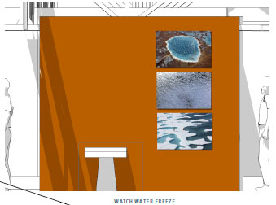
Notes:
Modeling Landscapes groups a series of exhibits about granular materials, water flow and pattern formation to allow visitors to experiment with the forces that shape the land.

Slide 14
Fenomeni Ottici

Slide 15
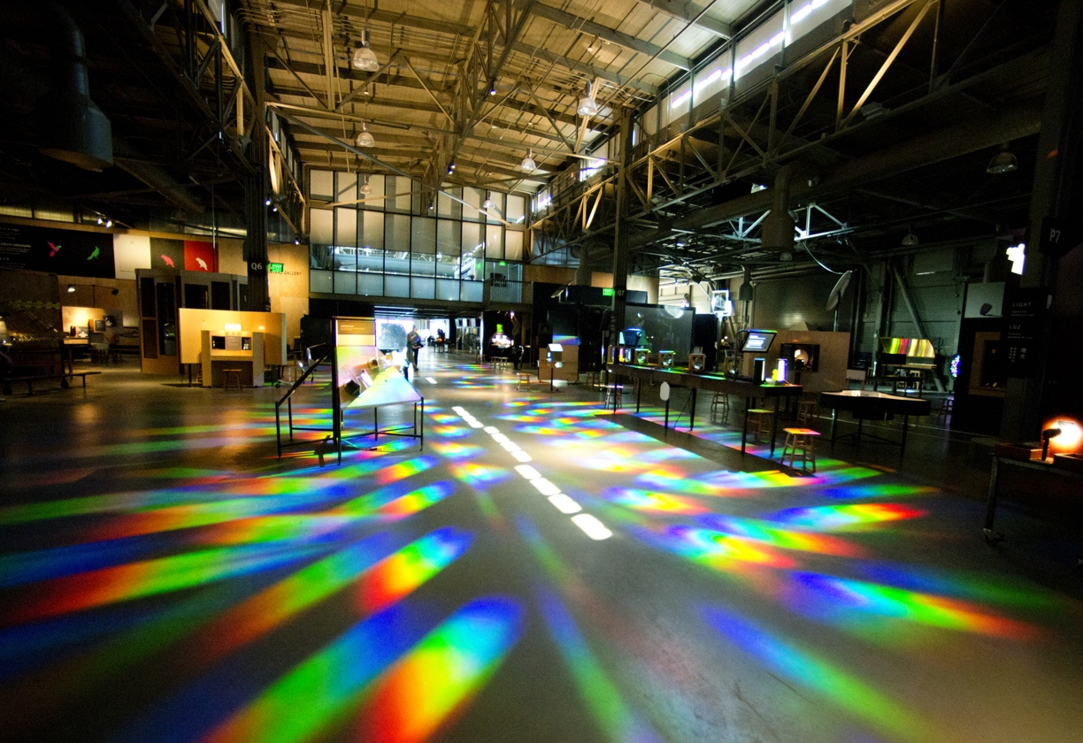
Notes:
It is a large open space punctuated with smaller enclosed buildings for light or sound control.

Slide 16
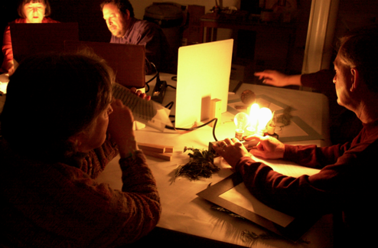
Notes:
...attentive inquiry...

Slide 17
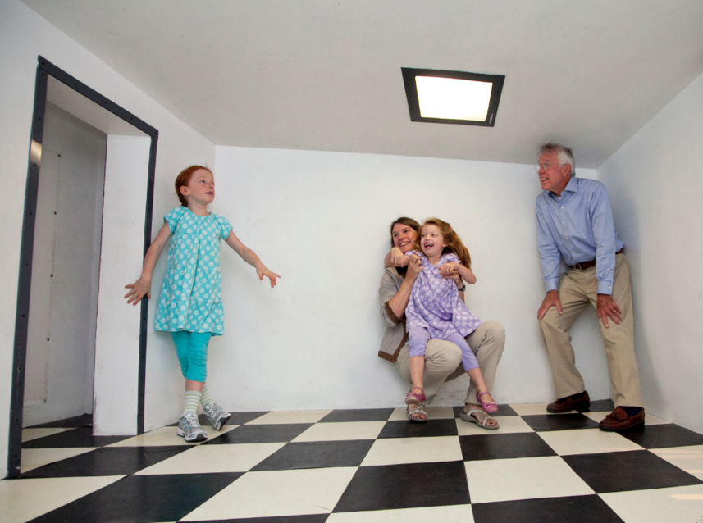
Notes:
Other classics include the Distorted Room...

Slide 18
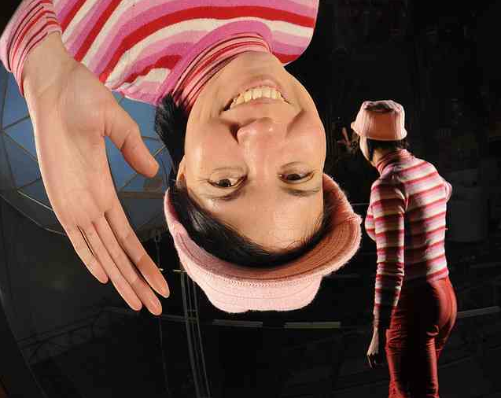
Notes:
...whereas new exhibits include a spectacular parabolic mirror that was prototyped in the old building but will be permanently revealed at opening.

Slide 19
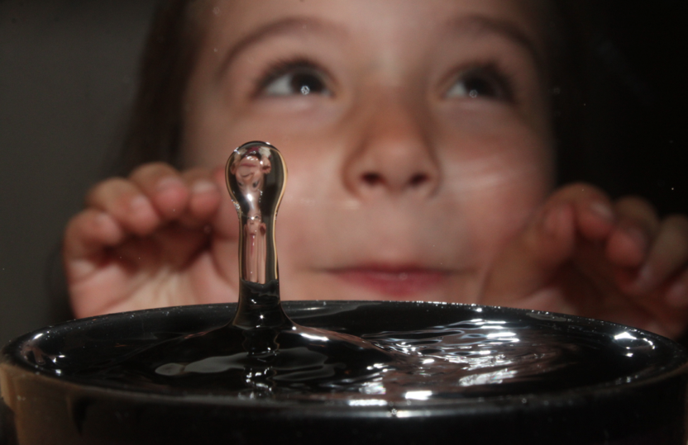
Notes:
This exhibit combines high-speed photography of a water drop hitting a full cup of water with the ability for visitors to see themselves in the exhibit.

Slide 20
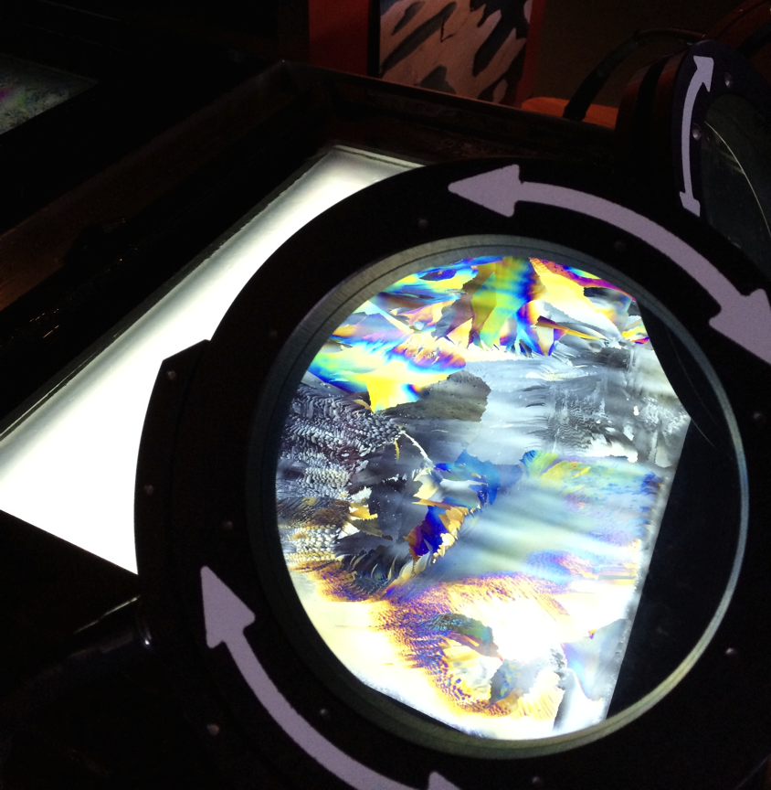
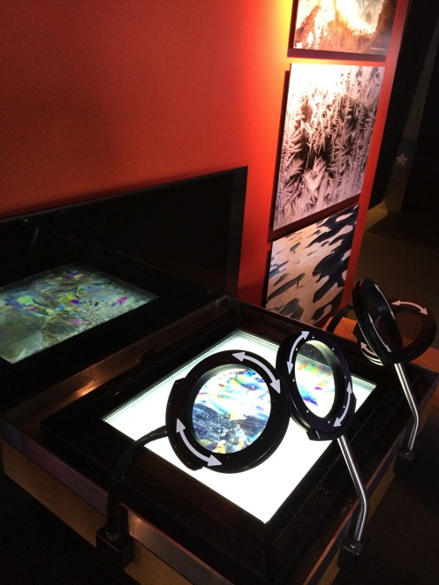

Slide 21
Fenomeni Atmosferici
e dell’ Ambiente

Slide 22
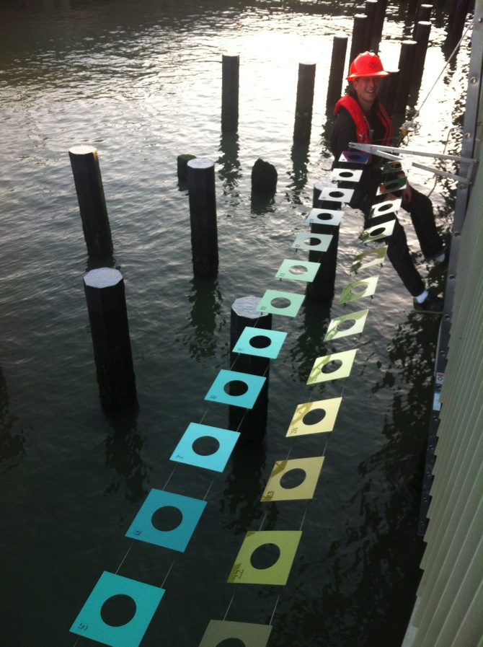
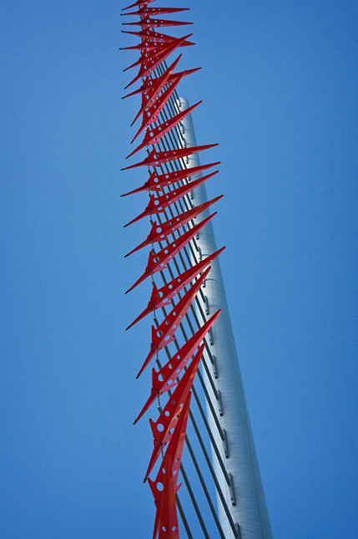
Notes:
A series of exhibits instrument the landscape, helping visitors read the changing dynamics in the Bay. Indicators in the water and the air show the directions of the changing tides and stratification of the wind currents. Visitors can lower a large scale “Secchi Disk” into the bay water giving them a way to measure the turbidity of the waters as the white disks disappear from view at a given depth.

Slide 23
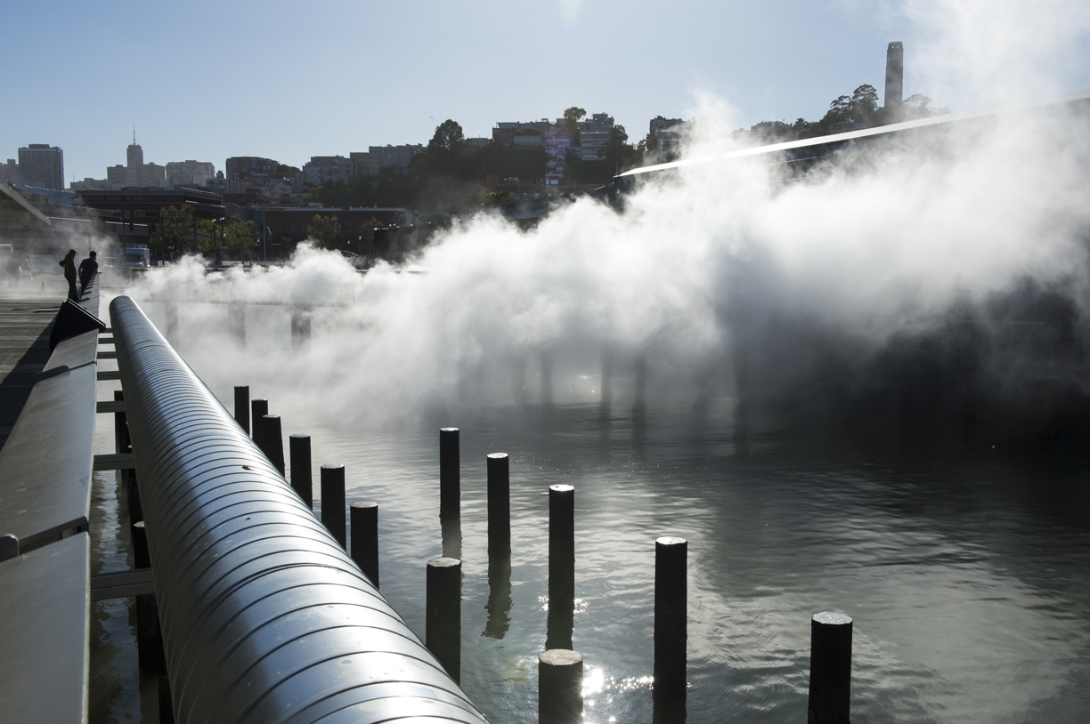
Notes:
At opening, the large bridge connecting Piers 15 and 17 will be enveloped twice an hour by a fog installation by Japanese artist Fujiko Nakaya, transforming the space and highlighting the wind dynamics between the piers.

Slide 24
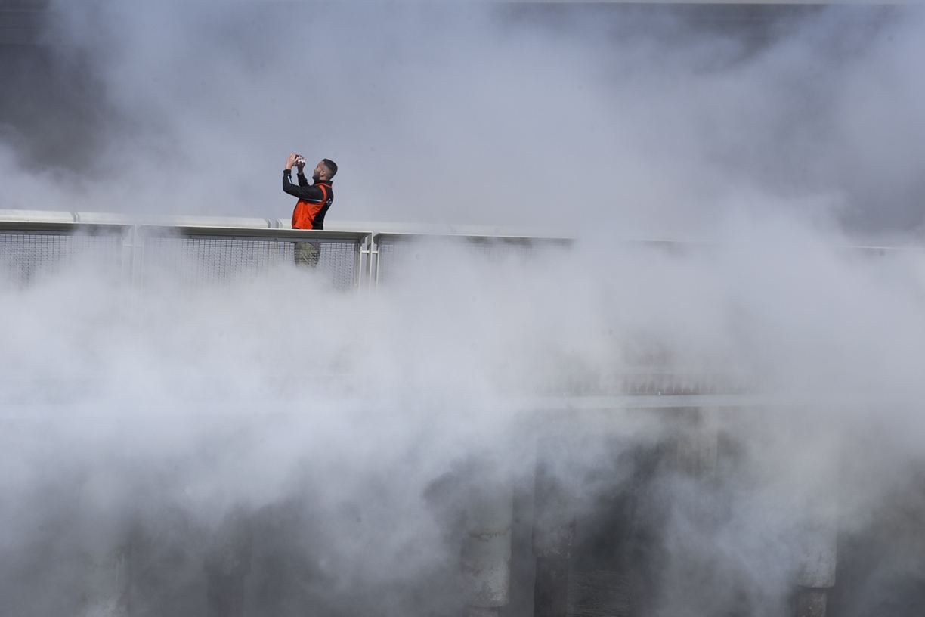
Notes:
...to another.

Slide 25
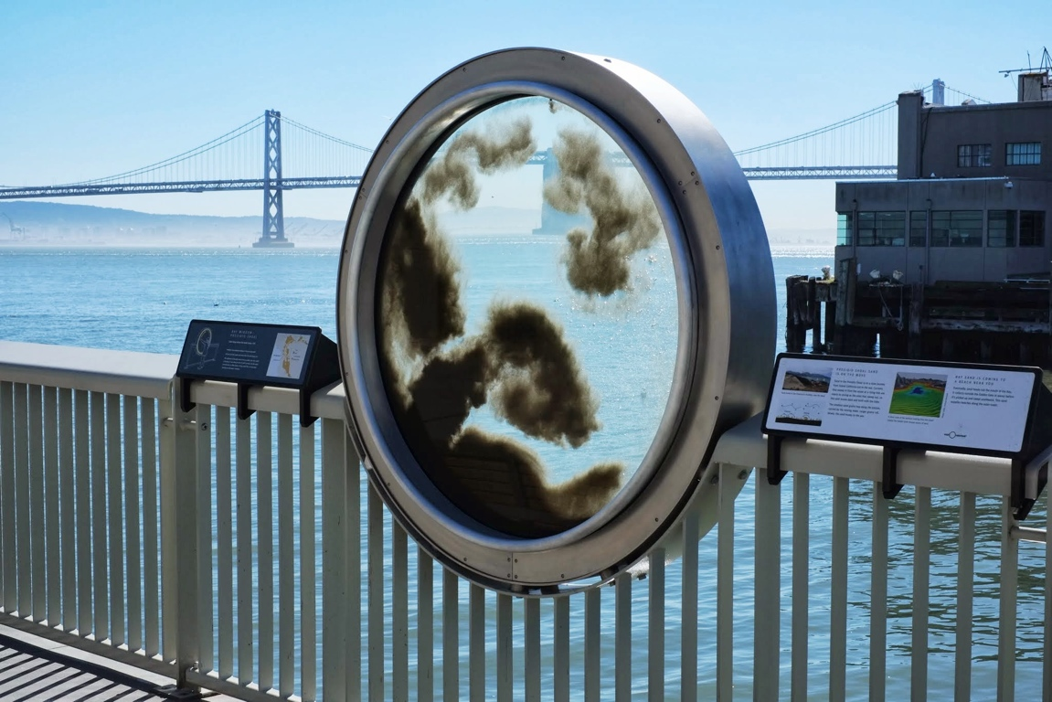

Slide 26
Fenomeni di
Fisica Moderna

Slide 30
In Conclusione

Slide 31
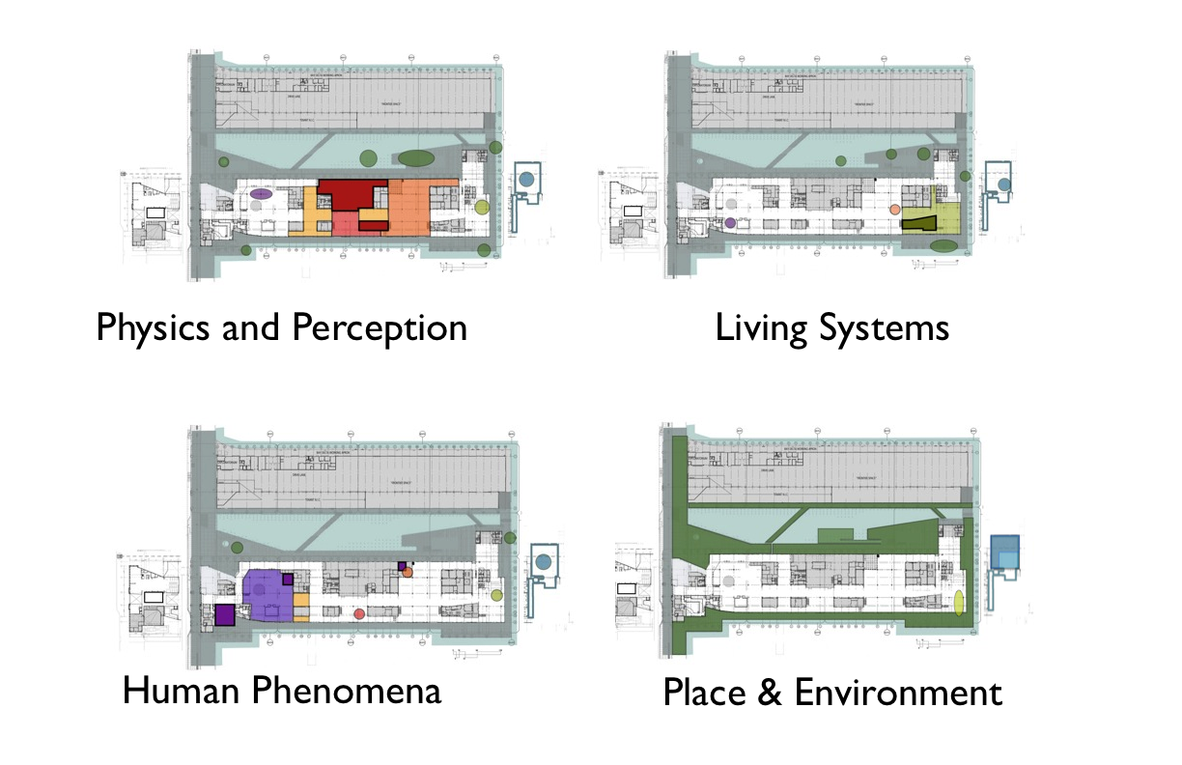

Slide 32
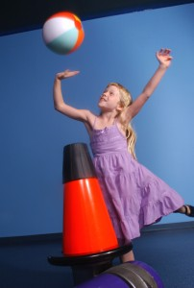

Slide 33
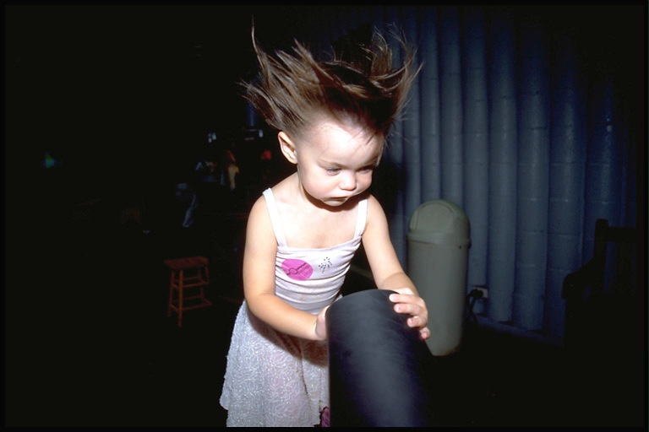

Slide 34
