Slide 1
Tracker “front-end” board
Mauro Citterio

Slide 2
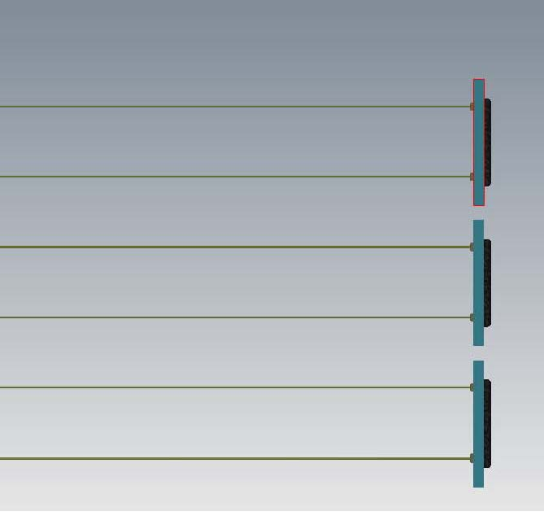
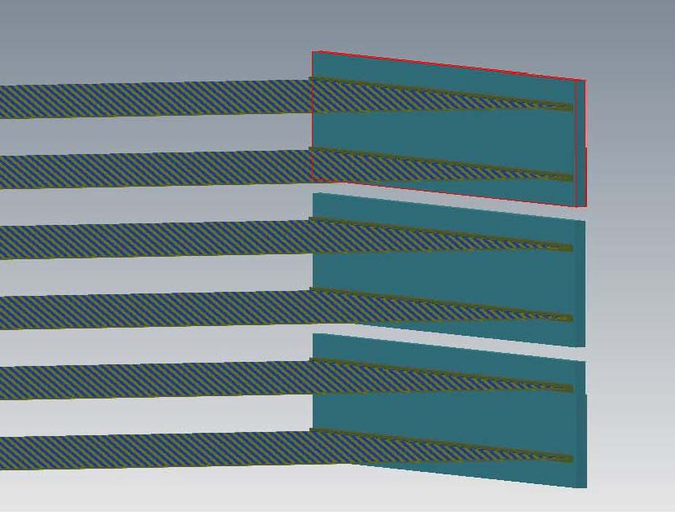
One PCB for two fiber planes
Fibers connected to SIPM
SIPMs read-out via BASIC 32
To take advantage of the BASIC input channel layout , one PCb every two fiber planes
6 planes
3 PCBs (SIPM on the TOP face, BASIC 32 on the BOTTOM face)

Slide 3
Cartoon of the PCB
TOP View
Overall PCB dimensions to be optimized against mechanical constraints.
One board will contains
96 x 2 SIPMs
6 BASIC32 ICs
Distance between SIPM and IC INPUTs minimized (“vias” through the board)
BOTTOM View (only three ICs shown)
Data Flow: traces embedded in the PCB
In/out connector(s) area

Slide 4
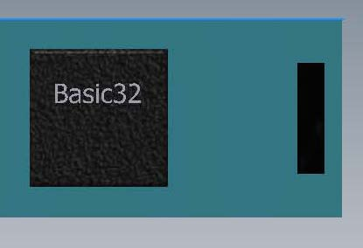
Prototype Test Board
Subset of the final board
Same use of TOP and BOTTOM layers
Additional components included to perform BASIC32 tests
Injection circuit
External ADC
Learn from prototype the criticality of the final board
HV – LV distribution to be defined on the test-board
Design is ongoing:
Schematic to be reviewed soon
Help from Cristoforo and Adalberto
Layout by first week of April
Board in house by end of April
Testing lab in preparation
External interface for test board: CAEN V1495 board
BASIC32 controlled via onboard FPGA

