Slide 1
Elettronica e DAQ: status e prospettiva
Sviluppo dell’ASIC di front-end per i SiPM (Cristoforo)
PET system update and CNAO test beam results (Maria Antonietta)
Sviluppo del DAQ: motherboard, RX board, interfaccia con TX board (Giancarlo)
DAQ: proposte per lo sviluppo della TX board (Richard)
Elettronica del tracker (Michela)
Meeting INSIDE, 24-25 marzo 2014, Milano
Notes:
This is the outline of the presentation.
Fist of all, we needed an accurat model of the detector in order to perform reliable simulations at circuit level. So, the classical model of the SiPM has been modified by adding some relevant features which gives remarkable contributions to the electrical behaviour of the detector itself and, moreover we set up a suitable extraction procedure to evaluate the paramenters involved in the model.
After that, different front-end circuit solutions have been compared to find out the most suitable one, considering the SiPM characteristics. Some prototypes of the very first front-end have been realized and some results fromt their characterization will be shown.
The very first version of the f.e. has been equipped with more building blocks and a first version of the complete analog channel has been designed, realized and characterized. Also in this case some measurements results wil be provided.
Next, the design of an 8 channel test chip has been carried out, togheter with the architecture of the digital read-out section. The chip has been submitted to a MPW for fabrication at the end of July and we expect the delivery of the prototypes by the first part of October.
Eventually some possible future work will be described

Slide 2
Sviluppo dell’ASIC
Struttura del front-end
Architettura del canale analogico: blocchi base disponibili e modifiche necessarie
Architettura ASIC e modi di lettura previsti
Convertitore A/D
Meeting INSIDE, 24-25 marzo 2014, Milano

Slide 3
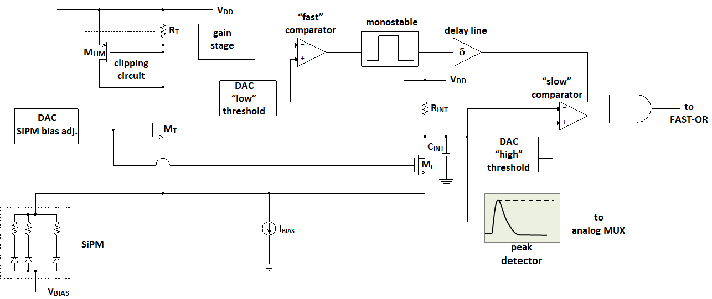
Struttura del FE
Non risulta indispensabile realizzare FE con resistenza di ingresso estremamente piccola e larghezza di banda molto ampia
Preferibile adottare la struttura del FE più semplice possibile: consumi contenuti, larghezza di banda limitata, ottimizzazione delle prestazioni di rumore
Meeting INSIDE, 24-25 marzo 2014, Milano

Slide 4
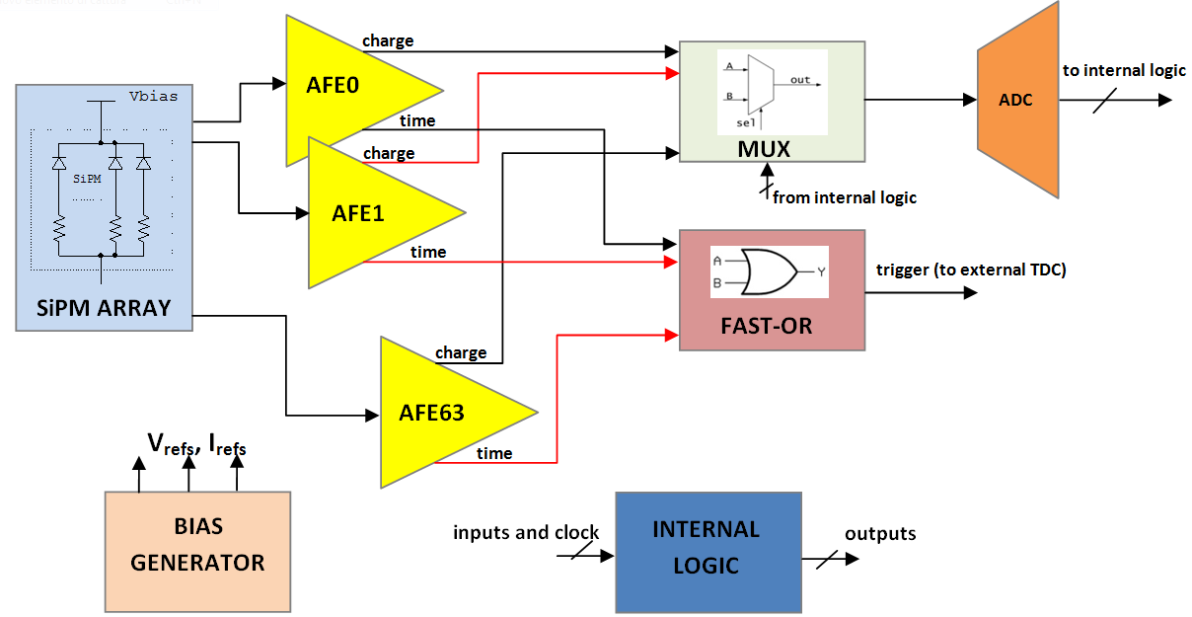
Architettura dell’ASIC
Meeting INSIDE, 24-25 marzo 2014, Milano
Notes:
4

Slide 5
Discussione e decisioni prese
Modalità di lettura ASIC
Sparse read-out:
il MUX viene pilotato dalla logica interna e si leggono tutti e soli i canali che vengono trovati sopra soglia
Serial read-out: tutti i canali vengono letti, siano essi sopra o sotto soglia
Counting mode read-out: si inibisce il controllo sulla seconda soglia e si contano tutti i trigger ricevuti da ciascun canale
Sparse e serial read-out possono essere fatti partire anche da un segnale di trigger esterno
Previsione di un segnale di “VETO” per inibire l’acquisizione
Stima della rate di eventi sull’ASIC (fatta sulla base dei risultati del test beam a CNAO): 16kHz (da incrementare di un fattore 10 in previsione di un eventuale upgrade di CNAO)
Meeting INSIDE, 24-25 marzo 2014, Milano
Notes:
5

Slide 6
Blocchi base
Già disponibili
DAC a 8 e 10 bit per il bias del SiPM e le soglie
Comparatori
Gain stage
Circuiti per il biasing degli stadi e per la generazione dei riferimenti di tensione necessari
Da progettare e/o upgradare
Monostabile
Delay line
FAST-OR e MUX a 64 bit (partendo dalla versione a 32 bit)
ADC a 10 bit (realizzato partendo dalla versione a 8 bit già disponibile, con applicazione di oversampling e decimazione)
Obiettivo: versione definitiva dell’architettura e progetto esecutivo ASIC per fine anno
Meeting INSIDE, 24-25 marzo 2014, Milano
Notes:
6

Slide 7
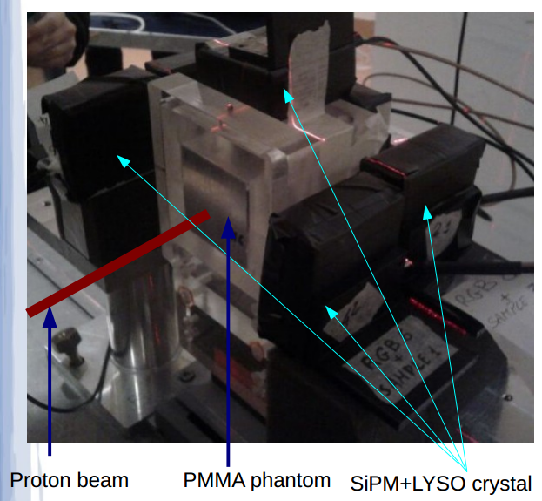
PET system update and CNAO test beam results
Descrizione del setup di misura, basato su fantoccio PMMA, SiPM 3mmx3mm AdvanSid, cristalli LYSO 3x3x10mm³ ed elettronica basata su ASIC TOFPET
Presentazione succesiva di Maria Antonietta
Discussione sulla rate degli eventi per ASIC
Meeting INSIDE, 24-25 marzo 2014, Milano
Notes:
This is the outline of the presentation.
Fist of all, we needed an accurat model of the detector in order to perform reliable simulations at circuit level. So, the classical model of the SiPM has been modified by adding some relevant features which gives remarkable contributions to the electrical behaviour of the detector itself and, moreover we set up a suitable extraction procedure to evaluate the paramenters involved in the model.
After that, different front-end circuit solutions have been compared to find out the most suitable one, considering the SiPM characteristics. Some prototypes of the very first front-end have been realized and some results fromt their characterization will be shown.
The very first version of the f.e. has been equipped with more building blocks and a first version of the complete analog channel has been designed, realized and characterized. Also in this case some measurements results wil be provided.
Next, the design of an 8 channel test chip has been carried out, togheter with the architecture of the digital read-out section. The chip has been submitted to a MPW for fabrication at the end of July and we expect the delivery of the prototypes by the first part of October.
Eventually some possible future work will be described

Slide 8
DAQ: From the last meetings
Each SiPM/ASIC pair can handle single rates at 180 kHZ (confirmed and slightly relaxed, i.e. 160kHz)
Data collected by two FPGAs
TX, coupled to the ASIC
RX, plugged on the mainboard
TX-RX link realized by means of HSMC connectors
Meeting INSIDE, 24-25 marzo 2014, Milano

Slide 9
Updates: Motherboard HW development
Functional design ✔
Schematic design ✔
Mechanical design ✔
PCB design (in progress) (some delays due to obsolescence of the selected memory chips)
Construction and assembly ✖
Initial delivery 12/2013, expected delivery 4/2014
Meeting INSIDE, 24-25 marzo 2014, Milano

Slide 10
Motherboard development
F/W
Functional architecture design ✔
USB interface (imported from DoPET)
RX interface (under development)
Coincidence sorter and processor ✖
Expected first version delivery 12/2014 (depending on HW status)
S/W
Largely imported from DoPET
No specific developments are being made at the moment
Meeting INSIDE, 24-25 marzo 2014, Milano

Slide 11
RX board development
Initial FW development with the SoCKit board, equipped with Cyclone V SX 5CSXFC6D6 FPGA and ARM processor
Customizing and producing a new board based on the same technology
The HSMC connector is kept to communicate with the TX board
Possibly the RX board can be used to emulate the motherboard
+ Motherboard
connector

Slide 12
RX board development
The RX F/W architecture is relatively simple
SPI slave component
FIFO buffers
SERDES
RX S/W board development
The RX does not require S/W development
However, the ARM processors offer simple and flexible solutions to processing problems
This is a new aspect of SoC FPGA that is under investigation
Meeting INSIDE, 24-25 marzo 2014, Milano

Slide 13
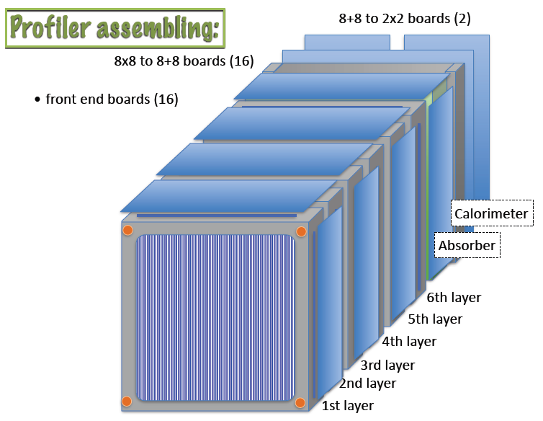
Elettronica del profiler
Tracker:384 fibre per layer
16 FE boards con 192 canali di lettura, cioè 6 BASIC32_ADC
Calorimetro: 16 MAPMT H8500
Ogni PMT letto da una scheda (8x8 to 8+8) (16 schede in tutto)
Infine abbiamo 2 schede (8+8 to 2x2), ciascuna con un BASIC32_ADC a bordo
Meeting INSIDE, 24-25 marzo 2014, Milano

Slide 14
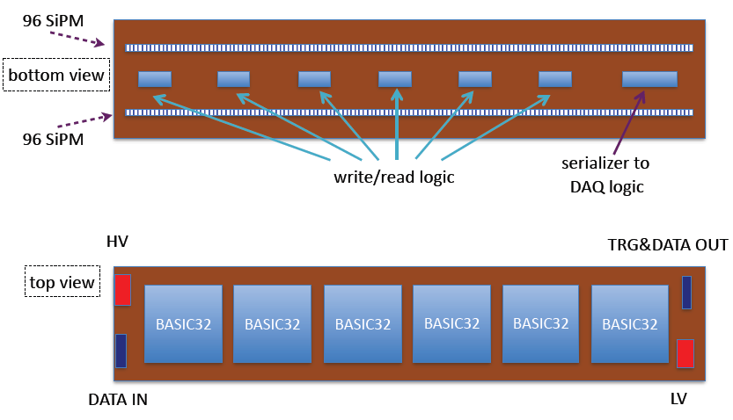
Scheda di lettura del tracker
Meeting INSIDE, 24-25 marzo 2014, Milano

Slide 15
Status dello sviluppo dell’elettronica del profiler
Frascati (Ciambrone) sta sviluppando le schede per il calorimetro
Milano (Citterio) sta sviluppando una demo-board per BASIC32_ADC, per il tracker
Necessario lo studio preliminare per verificare la funzionalità del BASIC32_ADC nell’applicazione specifica (min 10, max 400 fotoelettroni previsti): disponibile scheda sviluppata a Torino per BASIC32
Meeting INSIDE, 24-25 marzo 2014, Milano
Notes:
15

