Slide 1
Km3 Collaboration Meeting
Catania, 21 March 2014
NEMO-Fase II - Tower data analysis, atmospheric muon tracks reconstruction
Carla Distefano
LNS-INFN

Slide 2
Post-Trigger Data
Sub0:
mysql pt_phase2 -e "select FileName from pt_files where Comments is null and FileSize>1900;" --user=Km3NeT -h fasserver.lns.infn.it --password=Km3NeTuser
Sub1:
mysql pt_phase2 -e "select FileName from pt_files where Comments is null and FileSize>100 and FileSize<=1900;" --user=Km3NeT -h fasserver.lns.infn.it --password=Km3NeTuser
Sub2:
mysql pt_phase2 -e "select FileName from pt_files where Comments is not null and FileSize>100;" --user=Km3NeT -h fasserver.lns.infn.it --password=Km3NeTuser
Runs 412-421: Comments is not null but the files do not have problems (Wrong Data Format and Number of Events reported in the PT file)

Slide 3
Post-Trigger Data
Data Set | Runs | Period | HV | Trigger L1 | Trigger L2
Set1 | 412-498 | 2013-04-27 - 2013-05-08 | SetUp0 (on-shore values) | SC: 5 ns FC: 5 ns (old definition + bug) Q: 1E6 | -
Set2 | 499-675 | 2013-05-08 - 2013-05-30 | SetUp1 (2013-05-08) | SC: 5 ns FC: 5 ns (old definition + bug) Q: 1E6 | -
Set2to3 | 676-703 | 2013-05-30 - 2013-05-31 | SetUp1 -> SetUp2 | SC: 5 ns FC: 5 ns (old definition + bug) Q: 1E5 (1E6 for 676, 677) | -
Set3 | 704-846 | 2013-05-31 - 2013-06-22 | SetUp2 (2013-05-30) | SC: 20 ns FC: 100 ns (old definition + bug) Q: 1E5 | FC 1:10, SC 1:100
Set4 | 847-873 | 2013-06-22 - 2013-06-28 | SetUp2 (2013-05-30) | SC: 20 ns FC: 100 ns (old definition + bug) Q: 500 (first 10 samples) | FC 1:1, SC 1:100 or 1:1 if SC≥2, Q && SC (differ. PMTs)
Set5 | 874-1325 | 2013-06-28 - 2013-07-16 | SetUp3 (2013-06-28) | SC: 20 ns FC: 100 ns (old definition + bug) Q: 500 (first 10 samples) | FC 1:1, SC 1:100 or 1:1 if SC≥2, Q && SC (differ. PMTs)
Set6 | 1326-1718 | 2013-09-16 – 2013-12-05 | SetUp3 (2013-06-28) | SC: 20 ns FC: 100 ns (new definition) Q: 500 (first 10 samples) | FC 1:1, SC 1:100 or 1:1 if SC≥2, Q && SC (differ. PMTs) At this level, FC condition is equivalent to the old L1 FC condition
2013-12-05: L1 Seq Hits Trigger was implemented, not yet analysed

Slide 4
Monte Carlo simulations and DATA analysis
Simulations
Atmoph. Muon Generator
MuPage
* using tables from gen+hit codes
** + SwitchPmtOff: no PMTs off (from PT DB)
*** + SelOnLine: on line trigger conditions
Propagator and Light Simulator
km3*
Background Simulator
GenBkg
Electronics Simulator
FemSim**
PT Data
OnLine Trigger Simulator
TriggerSim
On-Line***
HitDeco2
TriggerSim
Off-Line
OffLine Trigger Seeds
Evt Selector (OffLine Trigger Condition + Causality Filter)
SelectionPois
Antares
Track reconstructor
reco
Our codes

Slide 5
Hit decompression and calibration
The code HitDeco2:
parses the PT file;
decompresses the Fem Hits and evaluates the hit total charge in p.e.;
evaluates the hit time from the decompressed hit wave form;
applies the time calibration offsets;
finds the mechanical floor id from the eFCM id;
writes the output file in the ANTARES evt format (input for reco).
See http://wiki.infn.it/cn/csn2/km3/analysis_tools/hitdeco2 for details
See C.D.’s talk, analysis meeting in Rome, Nov. 2014
Code Update:
Giulia found a bug in parsing multi-fragmented hits: the bug has been fixed
All PT files were re-calibrated

Slide 6
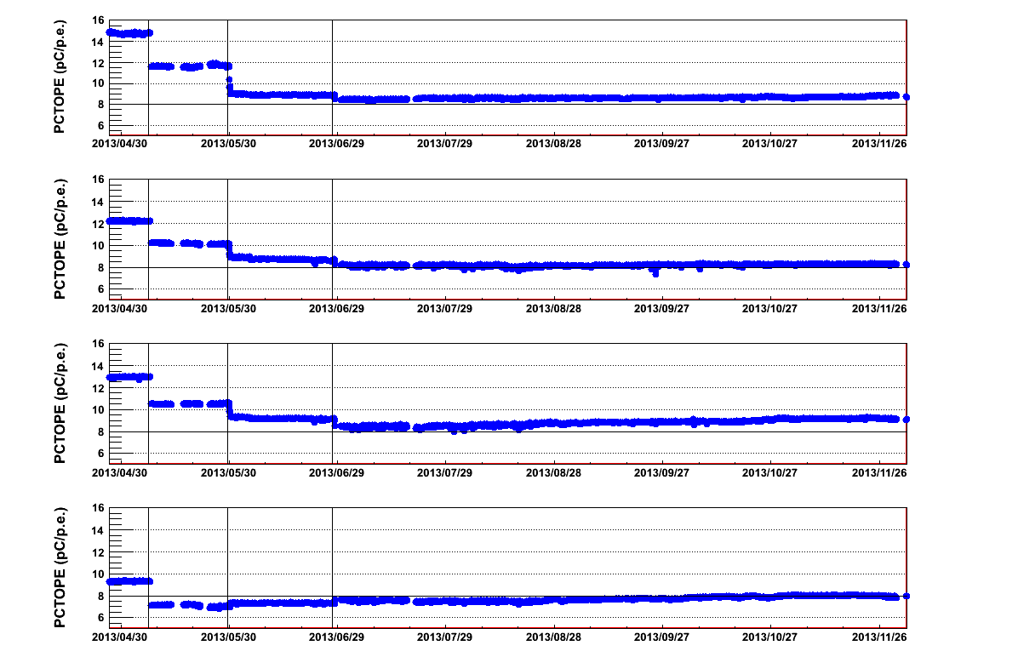
Single photo-electron peak
s.p.e. peak changes in time
PCTOPE tables computed for each PT file (using HitDeco2)
eFCM5
PMT0
PMT1
PMT2
PMT3

Slide 7
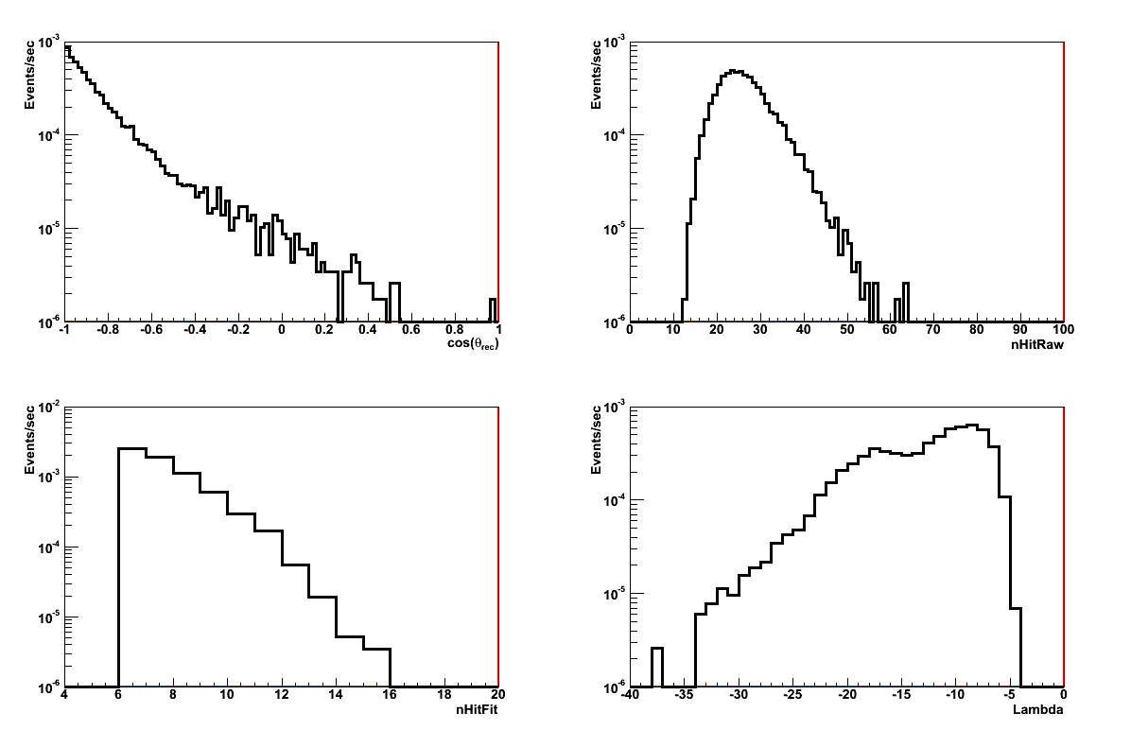
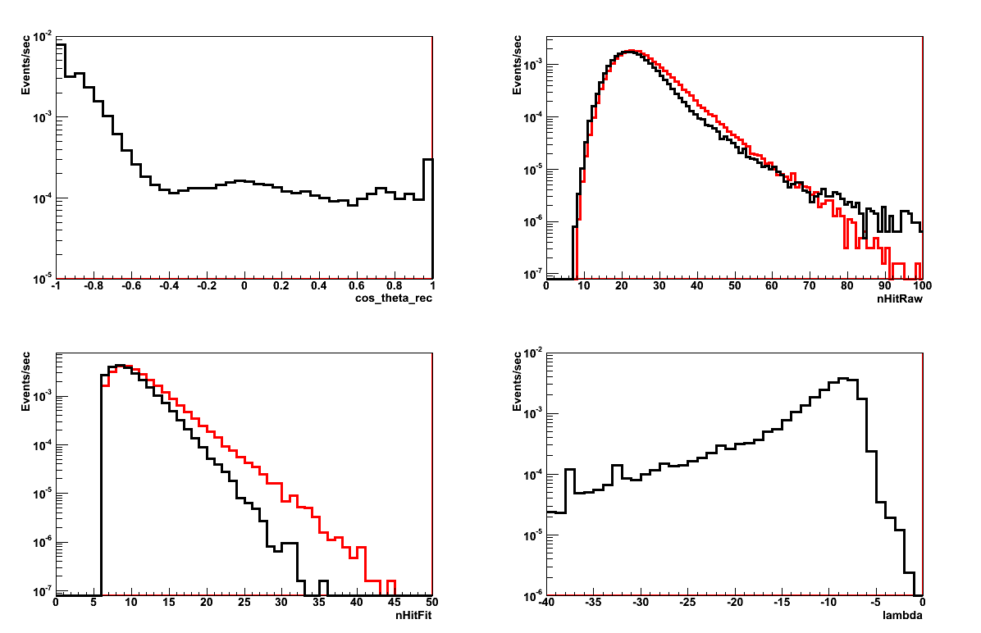
Reconstruction
reco code: old version used for Phase-1
Reco rate increased by a factor ≈3, different angular distribution and lambda spectrum
Differences in present results (DATA-MC comparison) are mainly due to the reco version
Nov 2013
Now

Slide 8
Monte Carlo simulations and DATA analysis
km3*
Propagator and Light Simulator
using tables from gen+hit codes: Absorption length profile measured at the Capo Passero (AC9 + ANTARES), Scattering: partic model, Gel:Thickness: 1.0 cm, Absorption length measured by Catania group
Glass:Thickness: 1.2 cm, Absorption length quoted by Vitrovex; Angular acceptance: “Clancy” truncated at cos(_{C})=-0.5
Background Simulator (Rate: 52 kHz)
Electronics Simulator (new release by F. Ameli):
SpeCharge = 1 pC, ChargeSD = 0.3, TimeSD = 2 ns, IntWindow = 75 ns
** + SwitchPmtOff: no PMTs off (list from PT DB)
OnLine Trigger Simulator
TriggerSim (on-line mode): 5ns flag added to hit time -> possibility to compute coincidences with 5ns delay
*** + SelOnLine (fixed some bugs): on line trigger conditions (plgs and FC bug)
Input depend on the data set to be simulated.
GenBkg
FemSim**
TriggerSim
On-Line***

Slide 9
Rbr simulation
To take into account the different trigger conditions.
To take into account PMTs don’t take data.
Possibility to use the whole data set to compute the transfer function and then the DIR.
For each analysed PT file:
- We generate a corresponding MuPage file with the same live time
- After FemSim, we switch off the PMTs which didn’t take data in
that PT file (list from PT DB)

Slide 10
Data Set | N File | Live Time (days) | Reco Evt | Reco Rate (mHz) | Reco Rate MC (mHz)
Set1 | 118 | 9.8 | 6531 | 7.70 | 7.48
Set2 | 138 | 11.9 | 7930 | 7.70 | 8.38
Set2to3 | 6 | 0.2 | 123 | 7.42 | 8.43
Set3 | 118 | 19.9 | 5371 | 3.12 | ??????
Set4 | 32 | 4.9 | 10353 | 25.04 | 24.62
Set5 | 435 | 71.6 | 152767 | 24.68 | 24.03
Set6 | 449 | 72.5 | 154415 | 24.64 ????? | 27.63
When the FC bug was fixed, the data trigger rate increased by 10%
Mean Trigger Rate (Set4+Set5) = 94.16 Hz
Mean Trigger Rate (Set6) = 103.68 Hz
At reconstruction level:
Data mean rate doesn’t change
MC mean rate increases by 15%

Slide 11
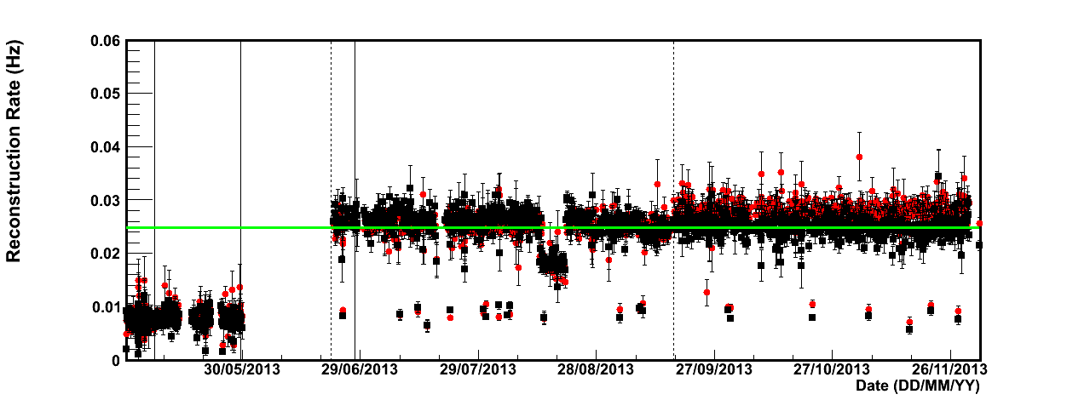
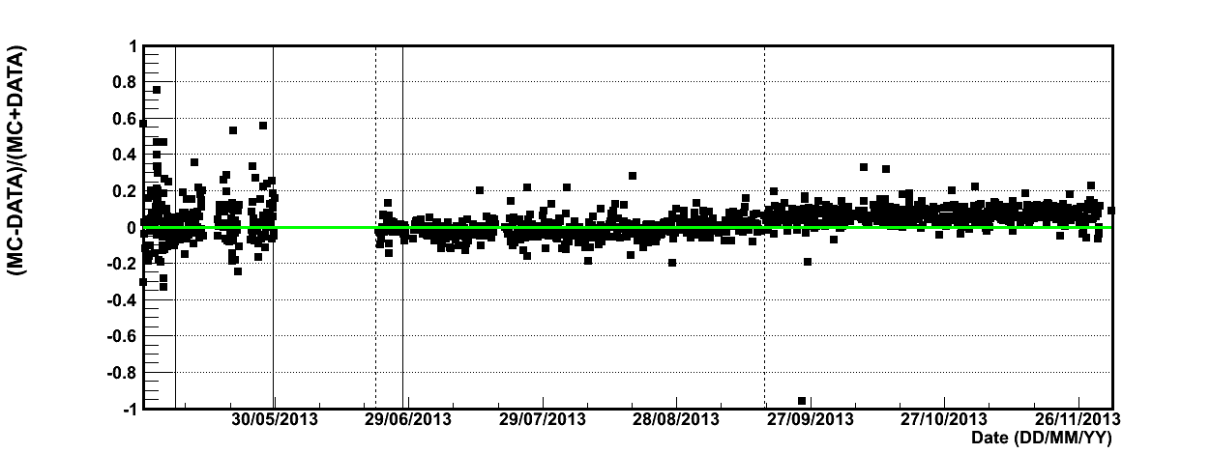
Run by run analysis
1
2
3
4
5
6
0.0248

Slide 12
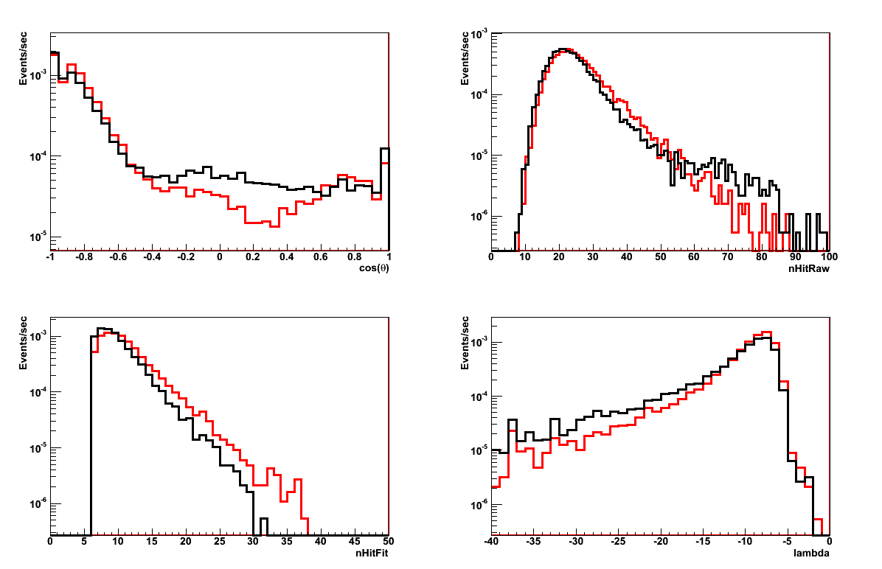
Runs: 412-672 (Set1+Set2)
DATA
MC
Ratio=1.03

Slide 13
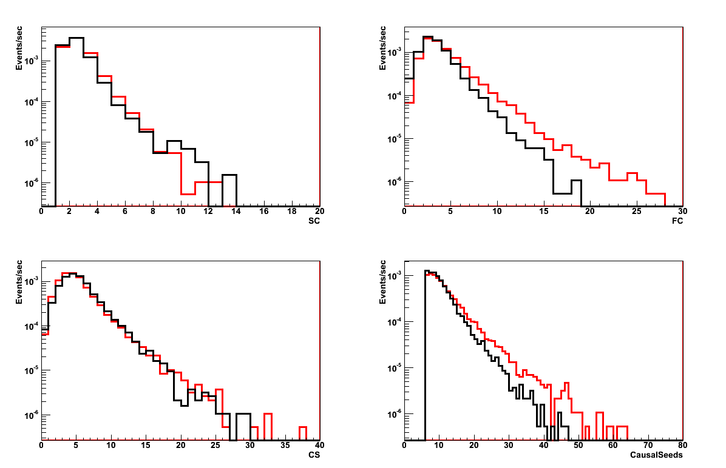
Runs: 412-672 (Set1+Set2)
DATA
MC
Ratio=1.03

Slide 14
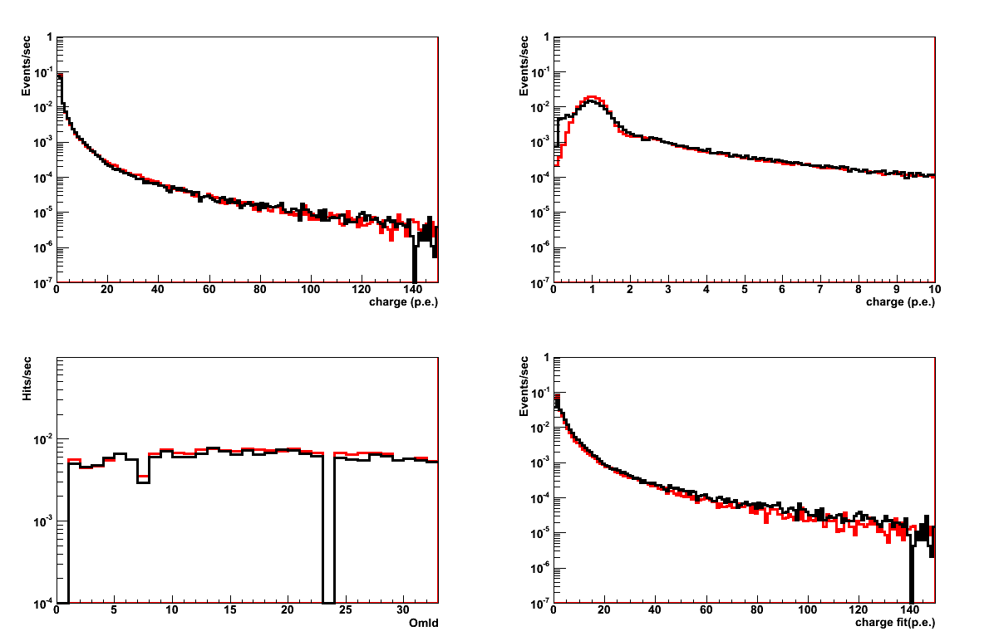
Runs: 412-672 (Set1+Set2)
DATA
MC
Ratio=1.03

Slide 15
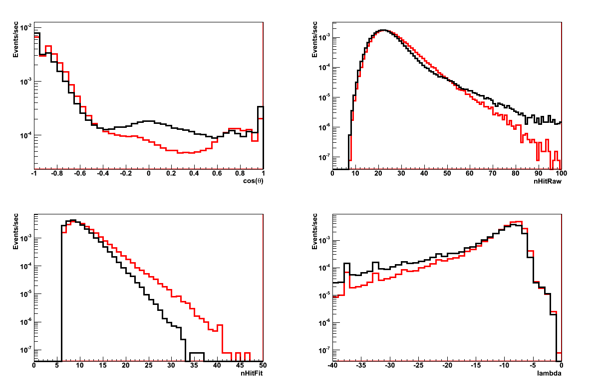
Runs: 847-1718 (Set4+Set5+Set6)
DATA
MC
Ratio=1.05

Slide 16
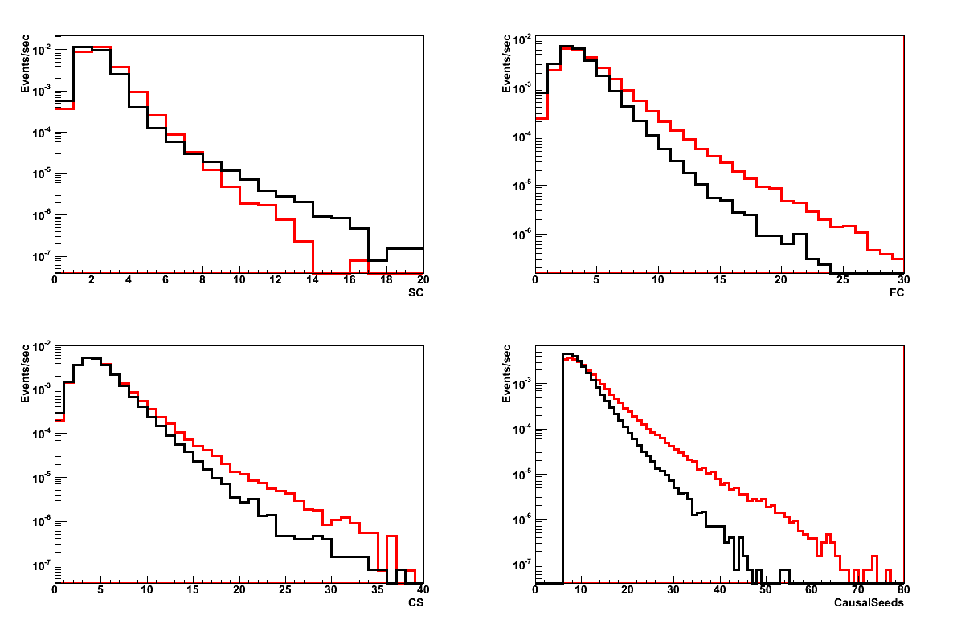
Runs: 847-1718 (Set4+Set5+Set6)
DATA
MC
Ratio=1.05

Slide 17
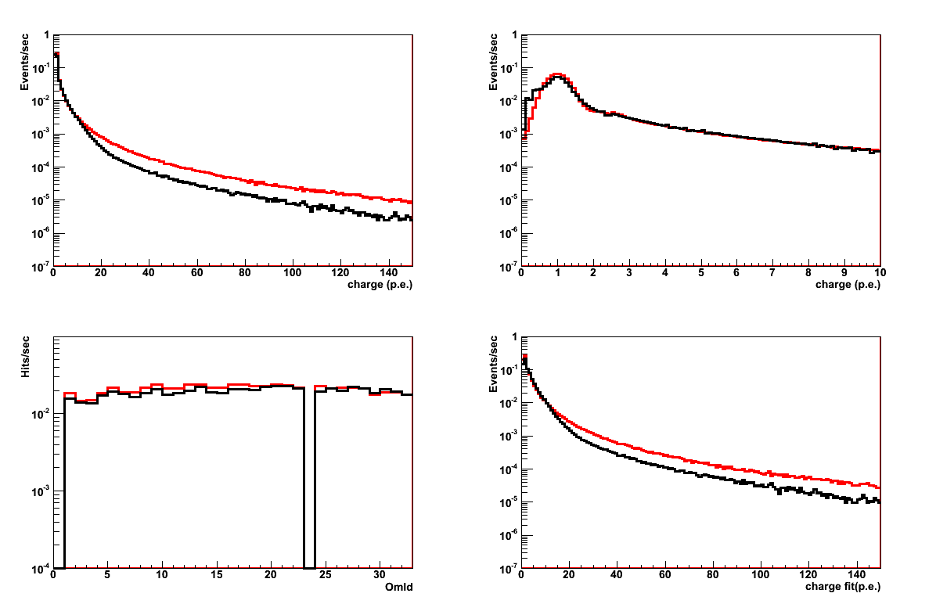
Runs: 847-1718 (Set4+Set5+Set6)
DATA
MC
Ratio=1.05

Slide 18
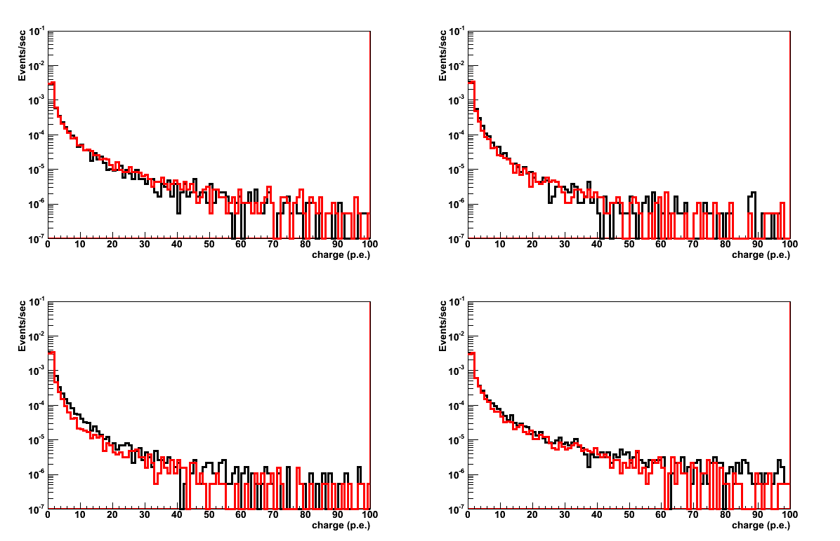
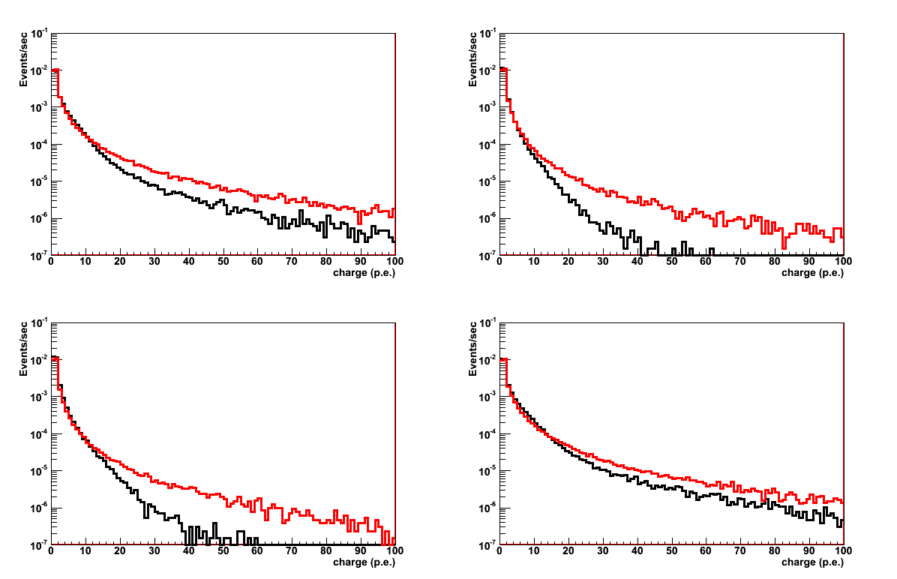
eFCM5
Runs: 412-672 (Set1+Set2)
PMT0
DATA
MC
PMT1
Runs: 847-1718 (Set4+Set5+Set6)
PMT0
PMT1

Slide 19
eFCM5
Runs: 412-672 (Set1+Set2)
PMT2
PMT3
Runs: 847-1718 (Set4+Set5+Set6)
PMT2
PMT3

Slide 20
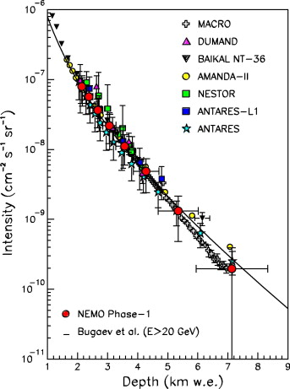

Depth Intensity Relation: DIR
h
θ
D
h
h=D/cosθ
Vertical Muon Intensity as a function of Depth

Slide 21
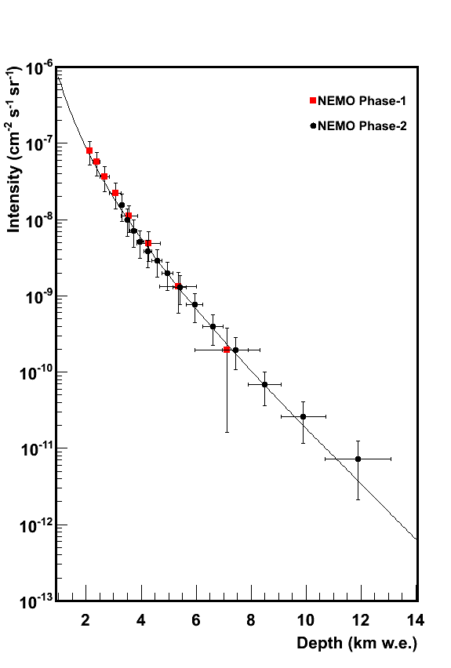
Depth Intensity Relation: DIR
Live Time = 170.6 days
Code CalcDir (NEMO Phase-1)
Vertical Flux:
I(h = D/cosθ) = I (θ)⋅cosθ⋅c_{corr}
Flux Angular Dependence:
I (θ) = N_{μ}(θ) m(θ) /T ΔΩ A^{eff}(θ)
N_{μ}(θ): number of detected muons (deconvolution)
T: livetime
ΔΩ: solid angle
A^{eff}(θ): effective area*
m(θ): multiplicity*
* From Monte Carlo simulations
_ Bugaev (E_{μ}≥20 GeV)

Slide 23
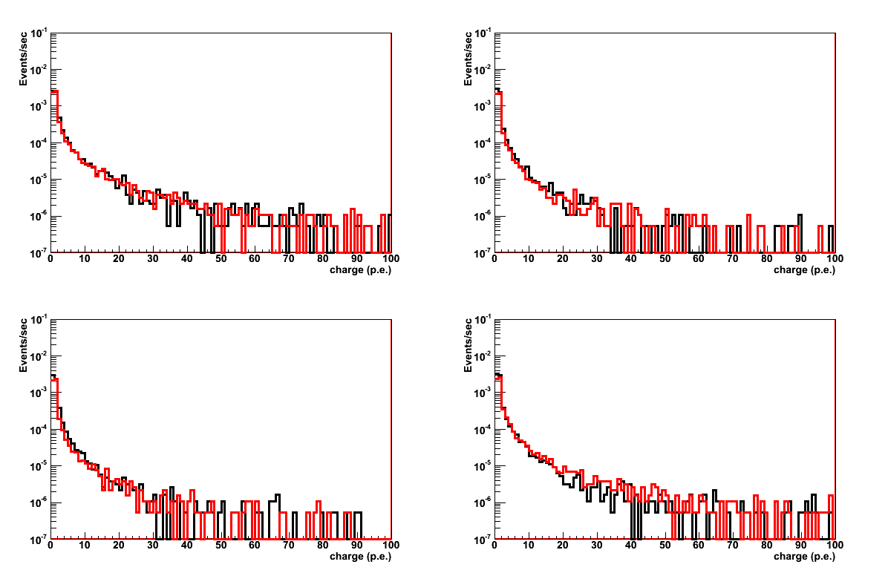
eFCM1
Runs: 412-672 (Set1+Set2)
DATA
MC
Ratio=1.02

Slide 24
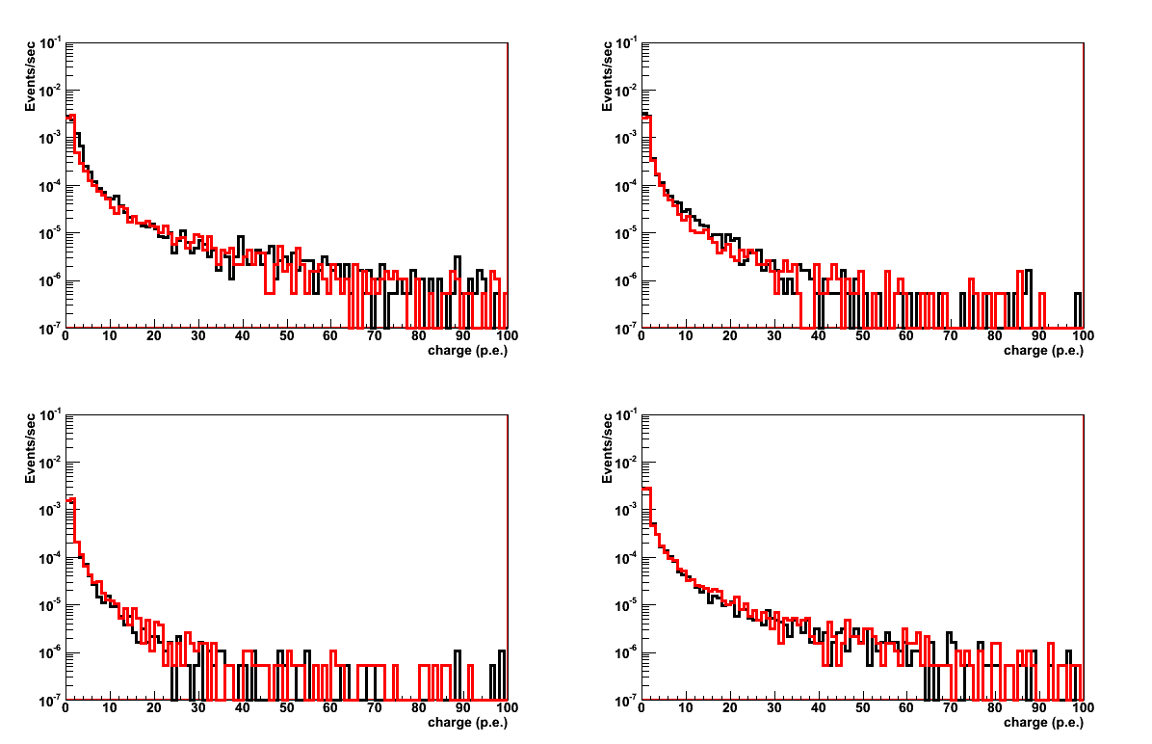
eFCM2
Runs: 412-672 (Set1+Set2)
DATA
MC
Ratio=1.02

Slide 25
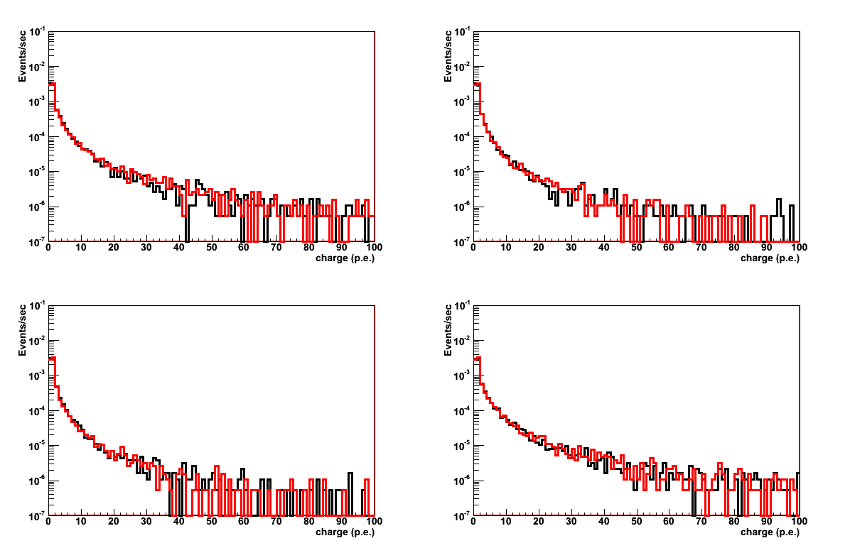
eFCM3
Runs: 412-672 (Set1+Set2)
DATA
MC
Ratio=1.02

Slide 26
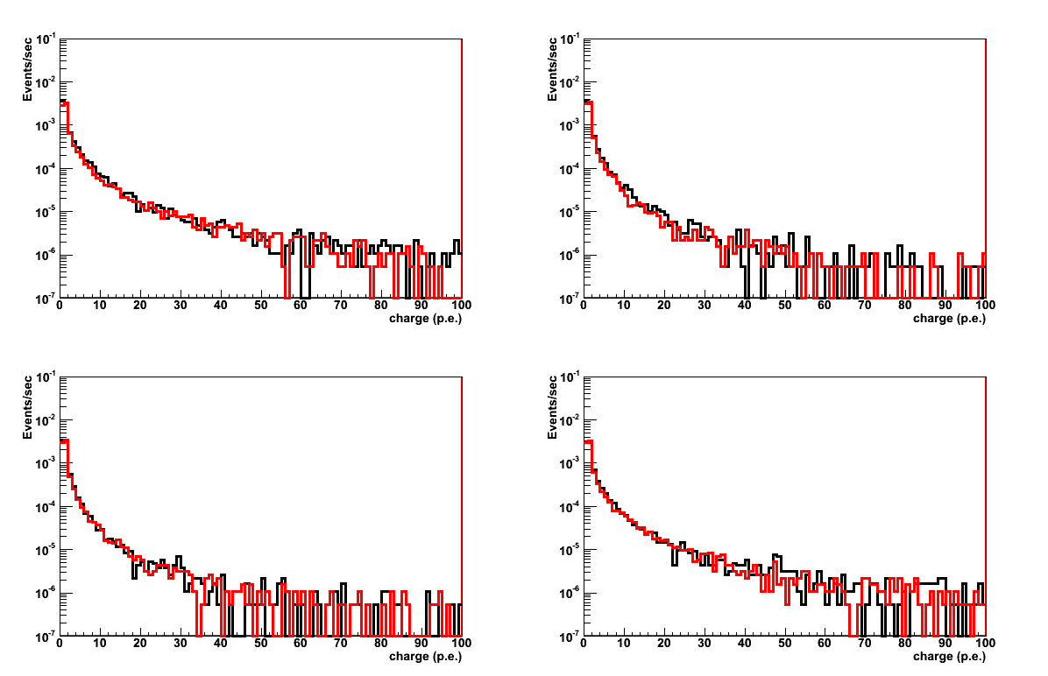
eFCM4
Runs: 412-672 (Set1+Set2)
DATA
MC
Ratio=1.02

Slide 27
eFCM5
Runs: 412-672 (Set1+Set2)
DATA
MC
Ratio=1.02

Slide 28
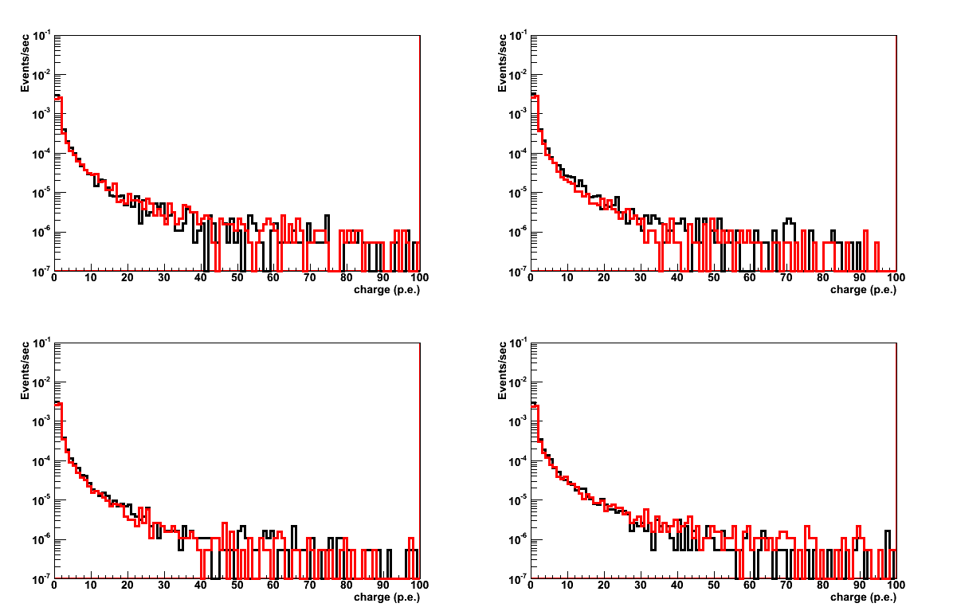
eFCM6
Runs: 412-672 (Set1+Set2)
DATA
MC
Ratio=1.02

Slide 29
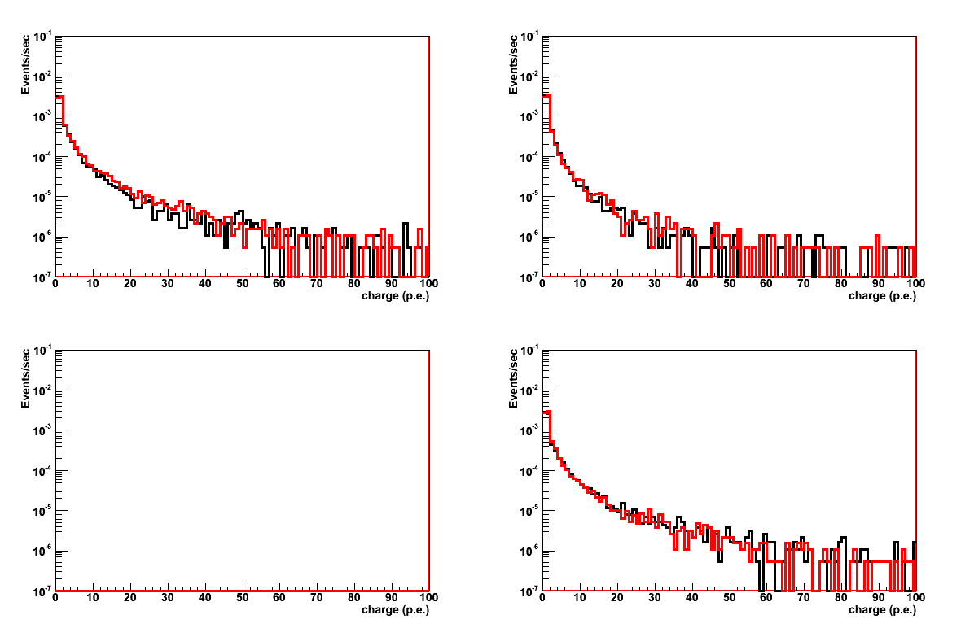
eFCM7
Runs: 412-672 (Set1+Set2)
DATA
MC
Ratio=1.02

Slide 30
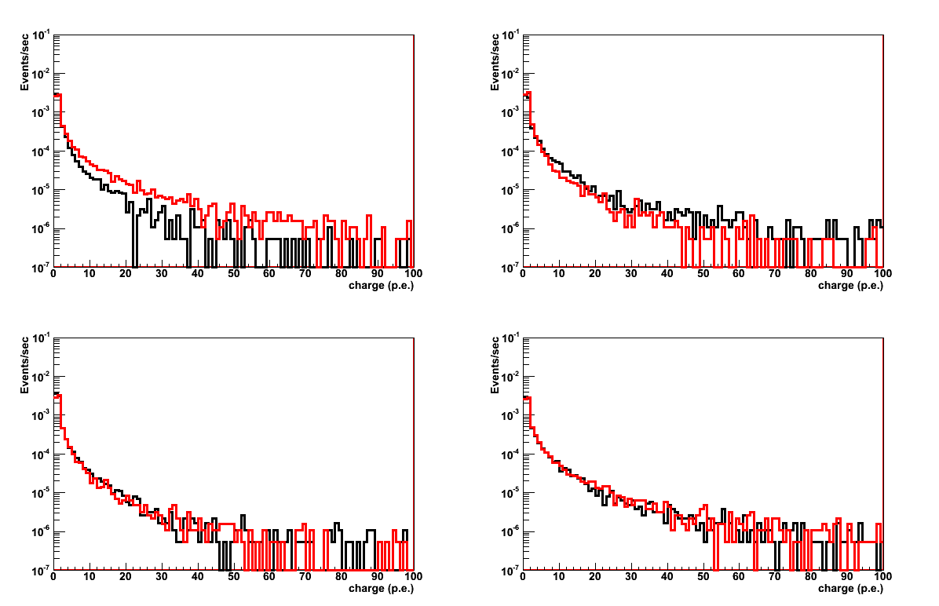
eFCM8
Runs: 412-672 (Set1+Set2)
DATA
MC
Ratio=1.02

Slide 31
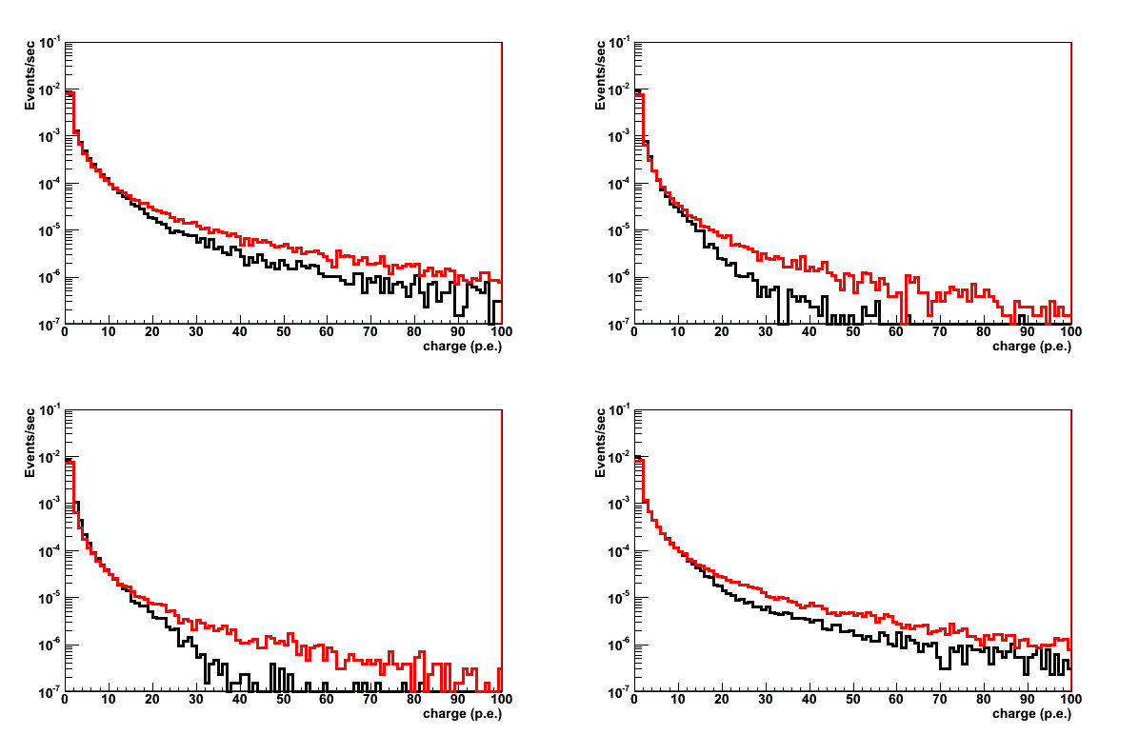
eFCM1
Runs: 847-1718 (Set4+Set5+Set6)
DATA
MC
Ratio=1.05

Slide 32
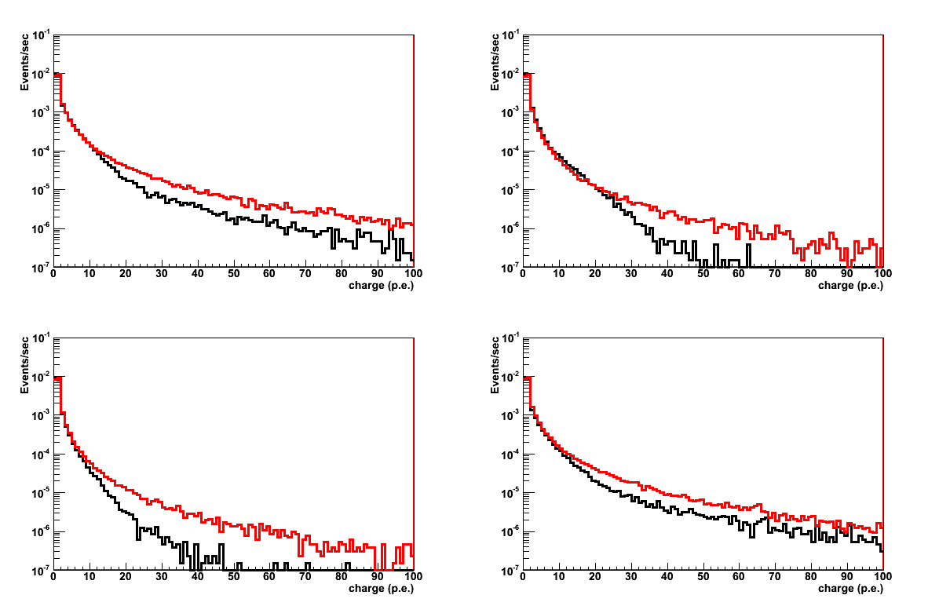
eFCM2
Runs: 847-1718 (Set4+Set5+Set6)
DATA
MC
Ratio=1.05

Slide 33
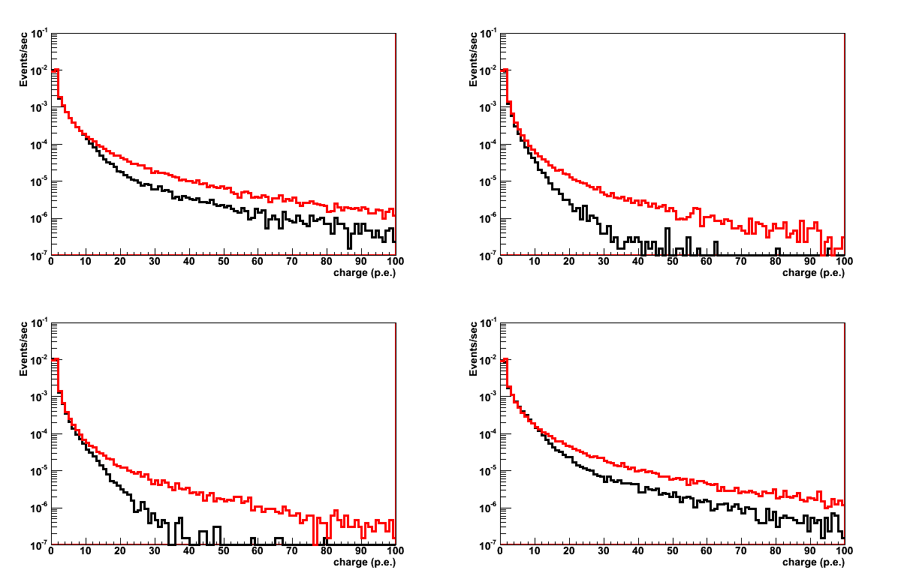
eFCM3
Runs: 847-1718 (Set4+Set5+Set6)
DATA
MC
Ratio=1.05

Slide 34
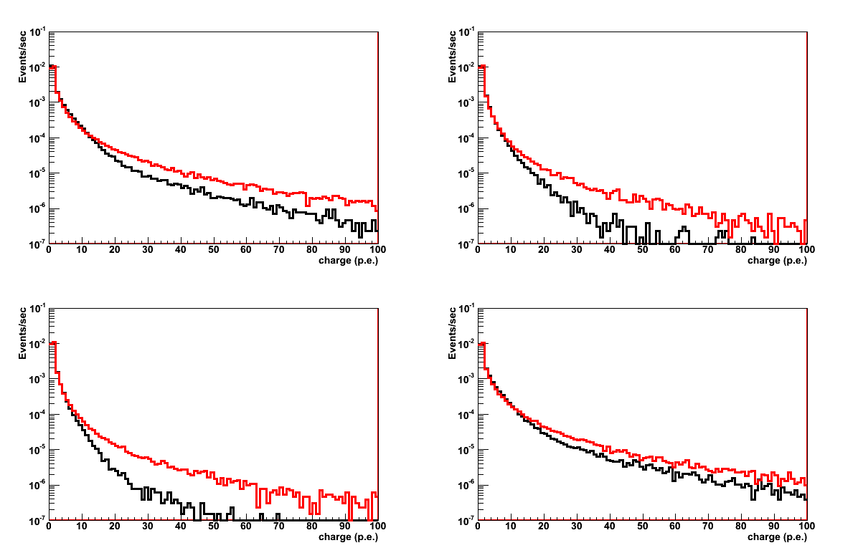
eFCM4
Runs: 847-1718 (Set4+Set5+Set6)
DATA
MC
Ratio=1.05

Slide 35
eFCM5
Runs: 847-1718 (Set4+Set5+Set6)
DATA
MC
Ratio=1.05

Slide 36
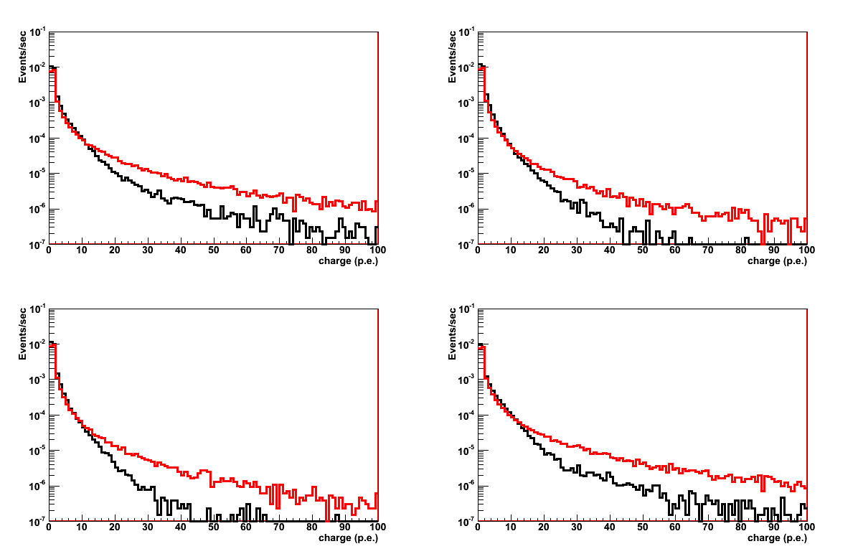
eFCM6
Runs: 847-1718 (Set4+Set5+Set6)
DATA
MC
Ratio=1.05

Slide 37
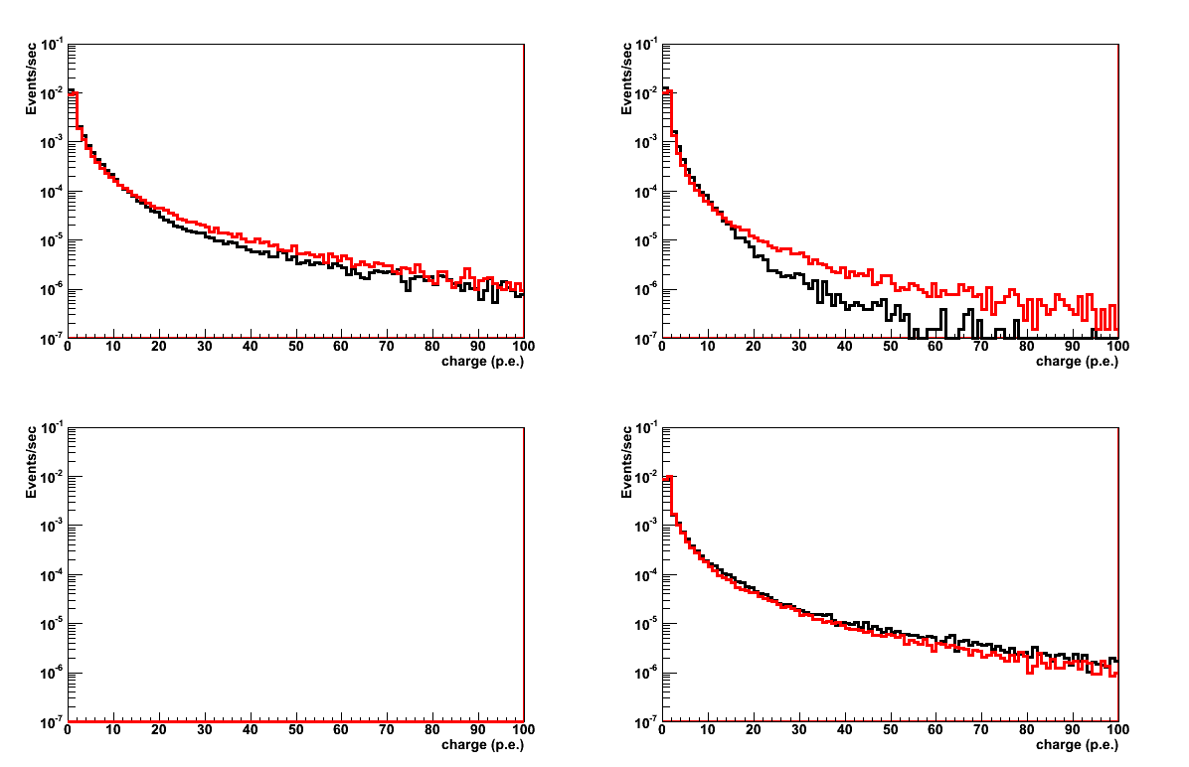
eFCM7
Runs: 847-1718 (Set4+Set5+Set6)
DATA
MC
Ratio=1.05

Slide 38
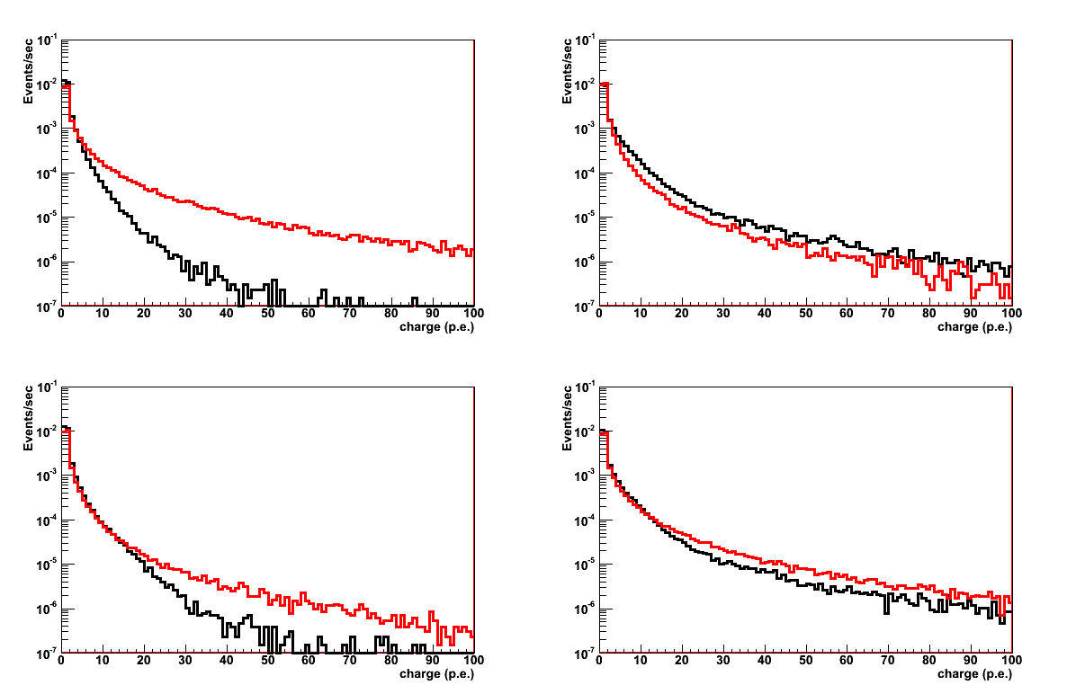
eFCM8
Runs: 847-1718 (Set4+Set5+Set6)
DATA
MC
Ratio=1.05

Slide 40
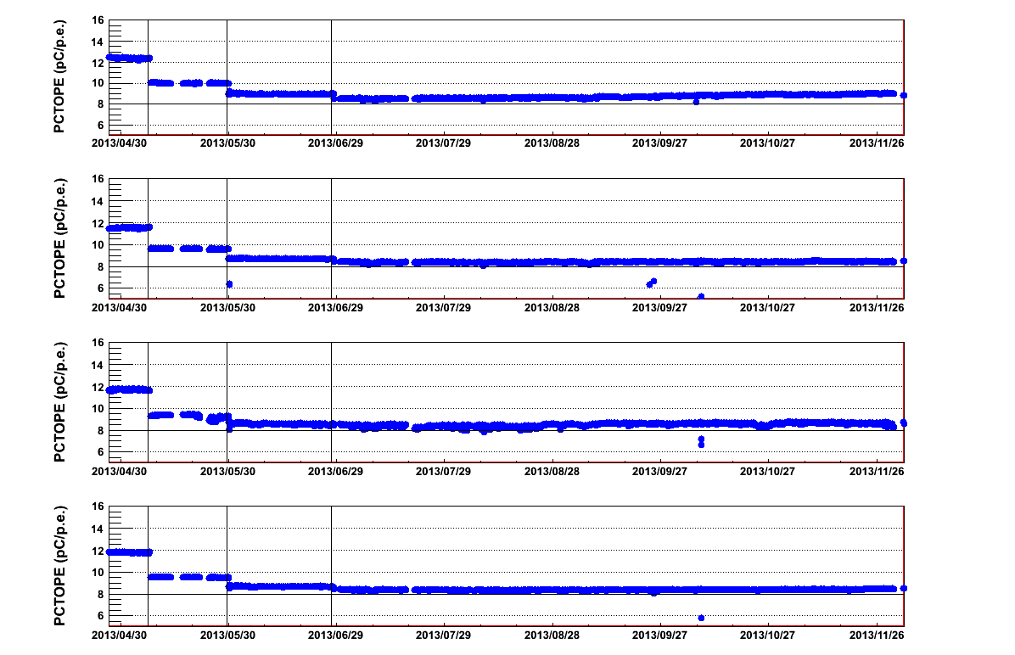
eFCM1

Slide 41
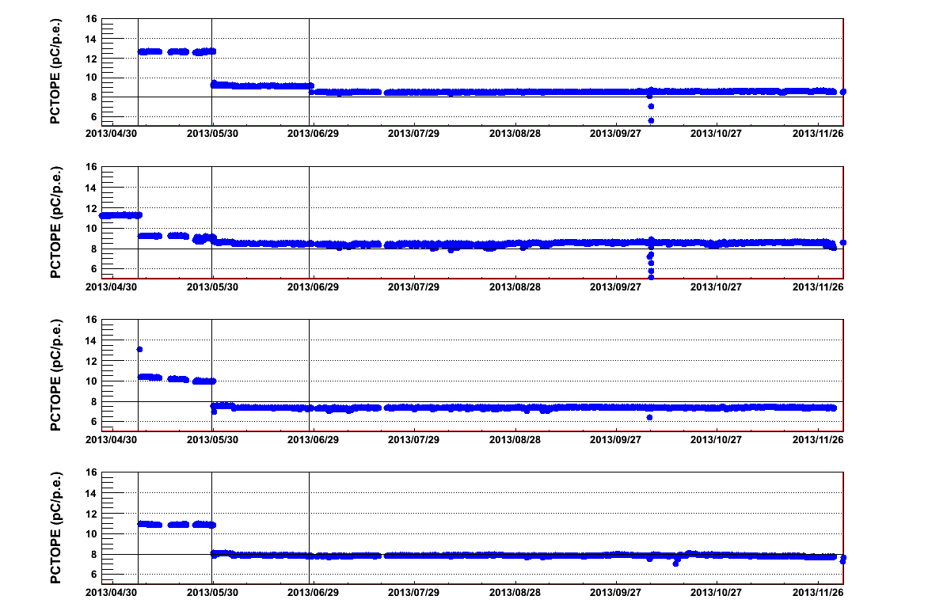
eFCM2

Slide 42
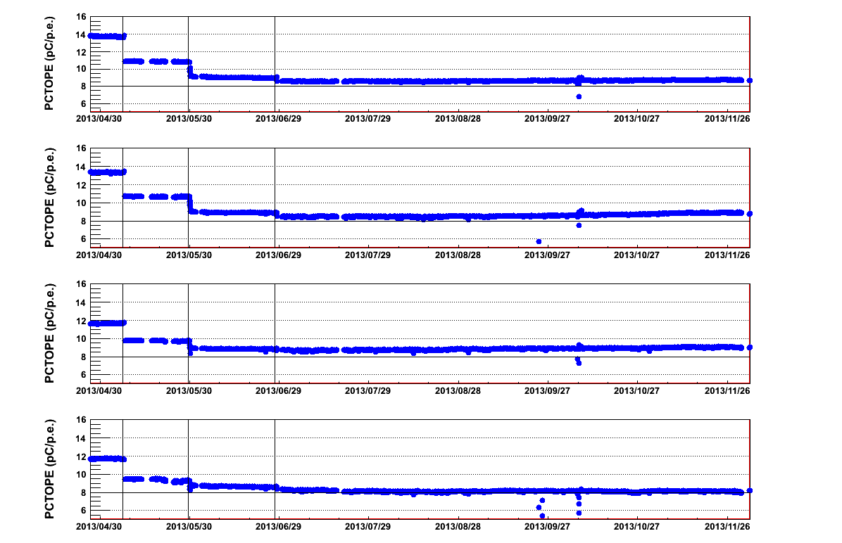
eFCM3

Slide 43
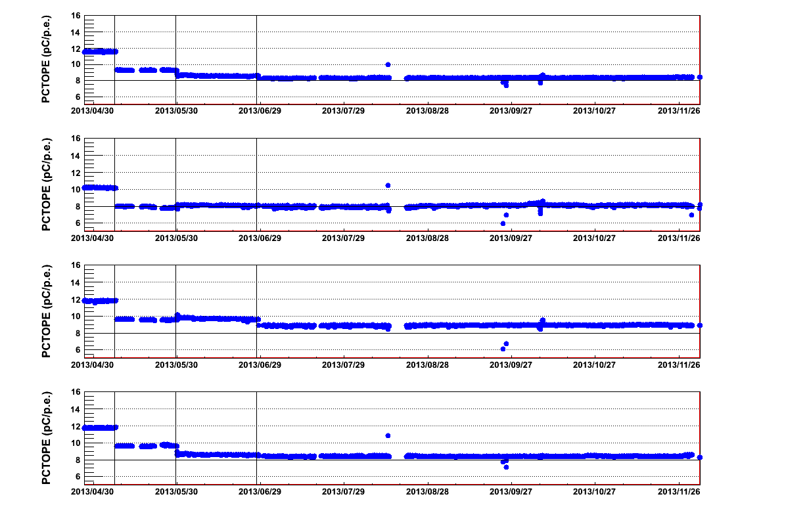
eFCM4

Slide 44
eFCM5

Slide 45
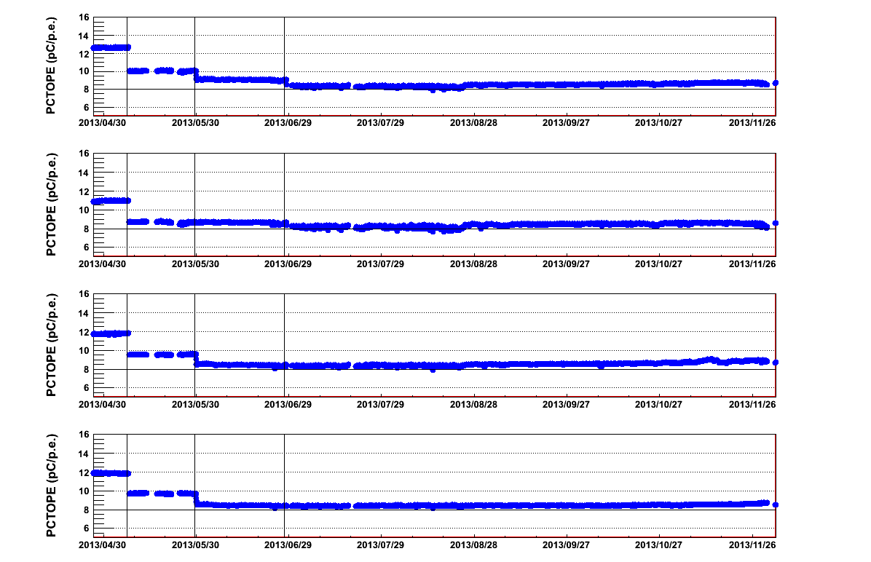
eFCM6

Slide 46
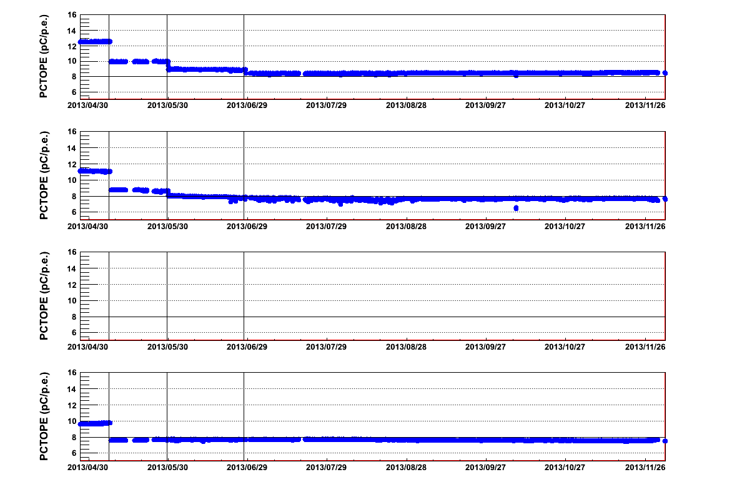
eFCM7

Slide 47
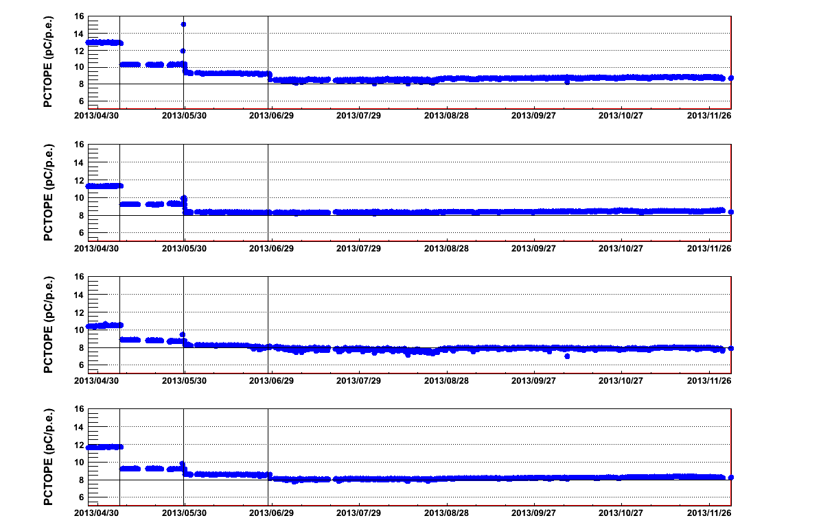
eFCM8

