Slide 1
ONE YEAR rate MONITORING, burst analysis and ENVIRONMENTAL parameters
M.G. Pellegriti – INFN - LNS
KM3 Collaboration Meeting – Catania 21 March 2014
1

Slide 2
Outlook
Long term rate monitoring
Burst analysis
CTD Monitoring
Correlations between PMT’s
2

Slide 3
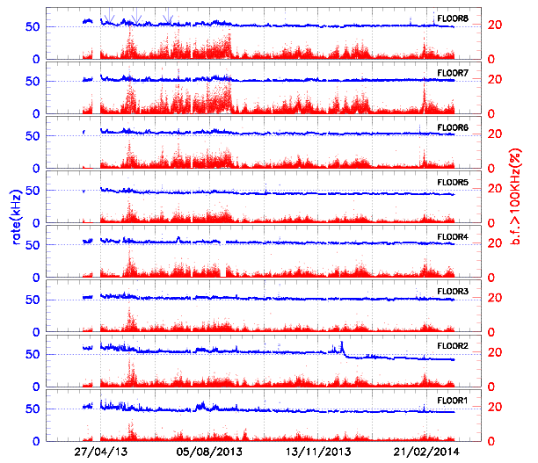
PMT1 Rate – march 2013 / March 2004
Median
Rates and
burst fractions
over 15 min
Old D.B.
HV changes
Drastic change
in b.f. activity
10 days
3

Slide 4
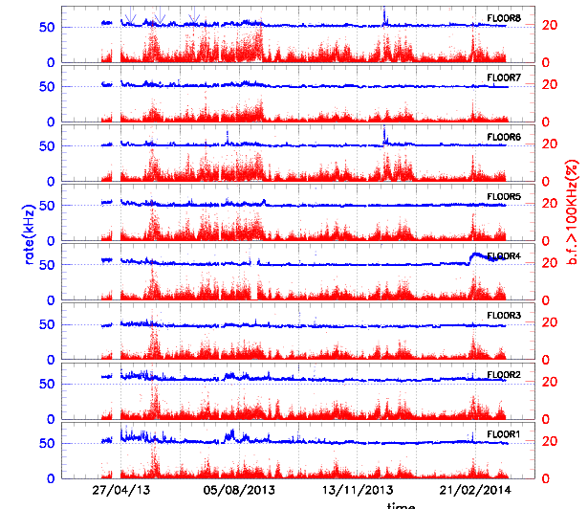
PMT2 Rate – march 2013 / March 2004
4

Slide 5
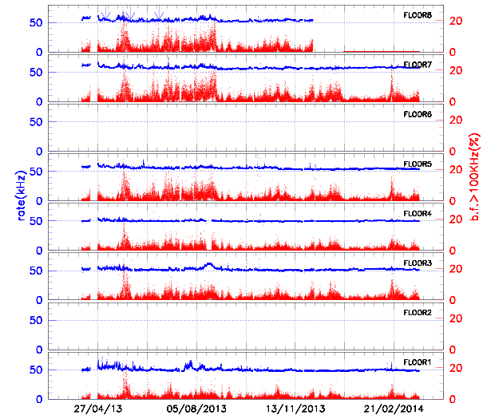
PMT3 Rate – march 2013 / March 2004
Not working PMT
5

Slide 6
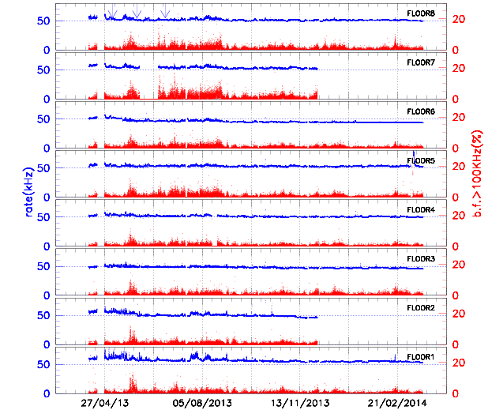
PMT4 Rate – march 2013 / March 2004
Not working PMT
Last week monitoring
in Porto Palo
6

Slide 7
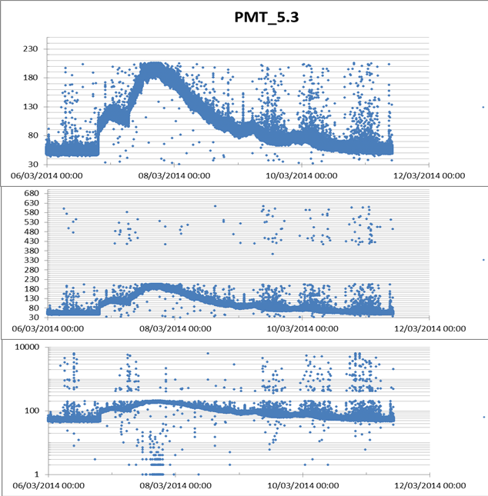
PM Saturation effect
@ about 200 kHz
No data between
200 -300 kHz
→Overflow at low
rate values
→Fifo-full normal
below 104/105 kHz
7

Slide 8
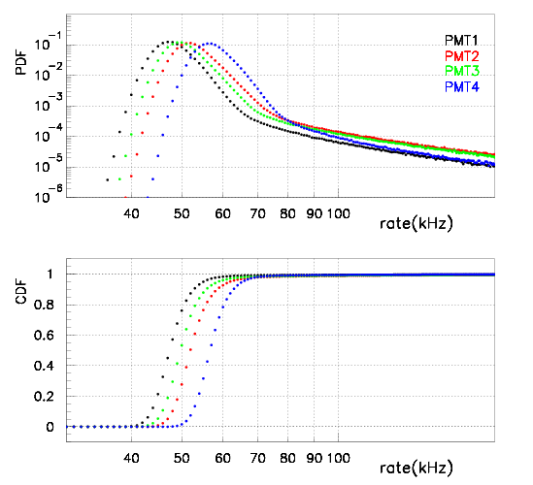
Rate probability distributions
Different high rate shape
for PMT4
CUMULATIVE
27/04/2013 to 04/12/2013
8

Slide 9
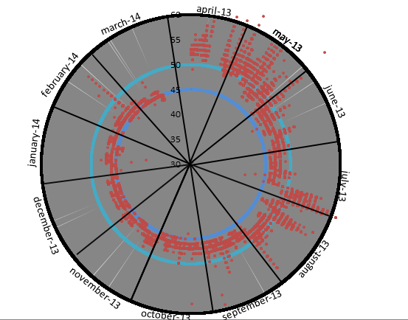
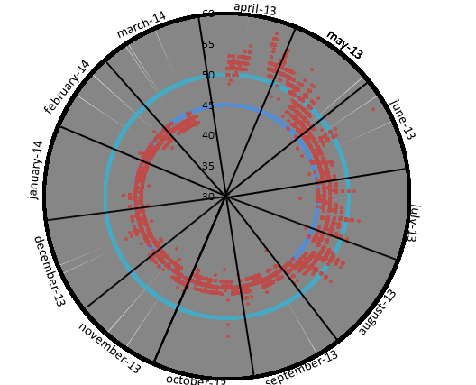
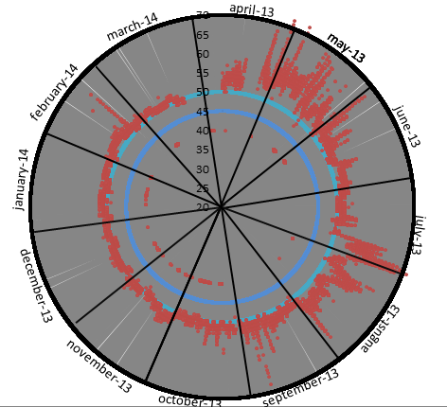
ROSE PLOT 10/03/2013– 19/04/2013
PMT1-F1
PMT4-F7
to check the seasonal
changes in bioluminescence
waiting for a superposition
region
PMT2-F1
August drastic
changes in b.f.
activity
High Voltage
changes
9

Slide 10
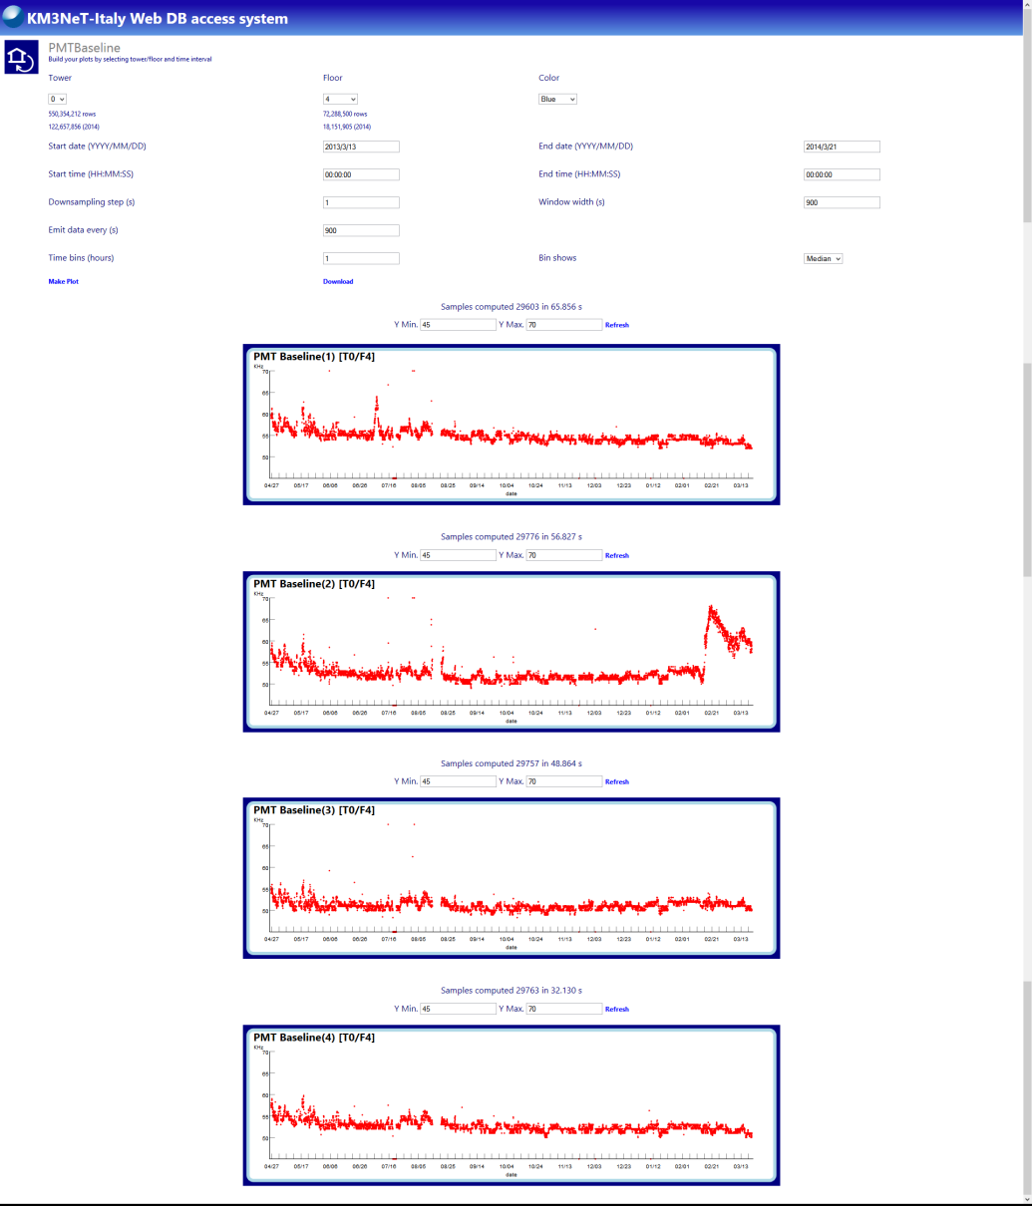
KM3NET-Italy web db
Implementation of the median calculation
performed by
Cristiano Bozza & Natalia Deniskina
Cross checks and comparison with
the previous calculations to be done
preliminary
10

Slide 11
Burst analysis
In collaboration with T. Chiarusi
11

Slide 12
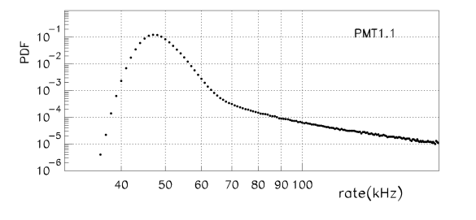
Sample
Burst > 100 kHz
12

Slide 13
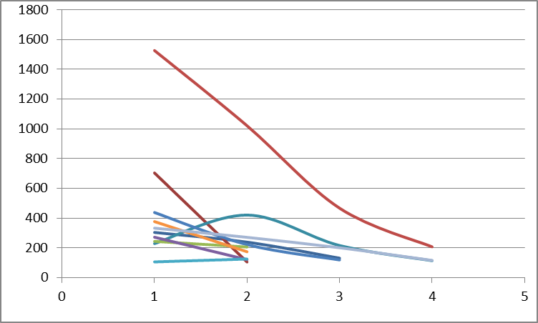
Example of burst behaviour
the threshold of 100 kHz is considered
the duration of the burst is the time the rate is above the threshold
Amplitude (kHz)
Duration (sec)
→Evidence of exponential decay of the bursts
→Maybe some superposition of subsequent burst is present
13

Slide 14
Statistics
Initial sample composed by 12099866 events (seconds)
Corrected sample composed by 19219712 events (seconds) (stops included)
(we are including the not-recordered events)
If we remove 6.3 % of events due to acq stop→ Sample will be composed by 18008870 (sec)
N. of events (seconds) with rate above 100 kHz: 96867 (0.5%)
N. of «bursts» (consecutive seconds in which the rate is above 100kHz): 40112
Note on the 6.3% acq stops:
the acq stops are the 0’s recordered by the database
and time intervals with no records > 700 sec which have been set to zero
14

Slide 15
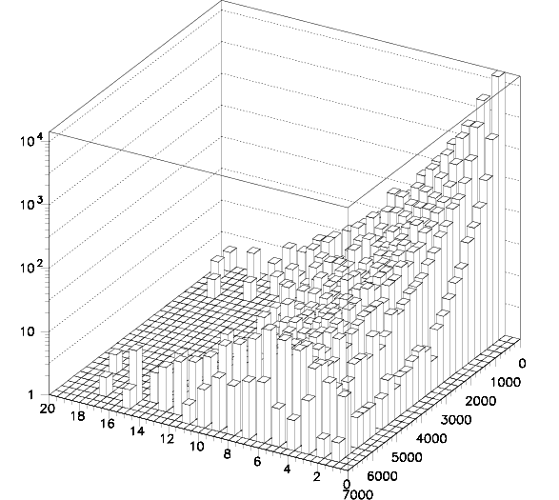
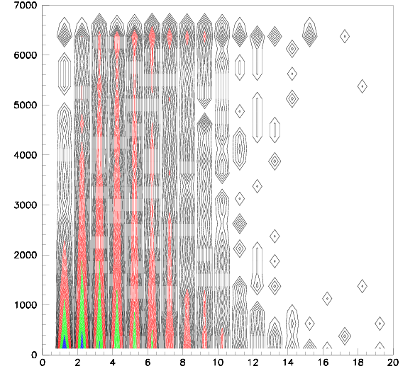
Initial burst amplitude vs burst duration
Initial rate (kHz)
n. of detected bursts
Burst duration (s)
Burst duration (s)
Initial rate (kHz)
15

Slide 16
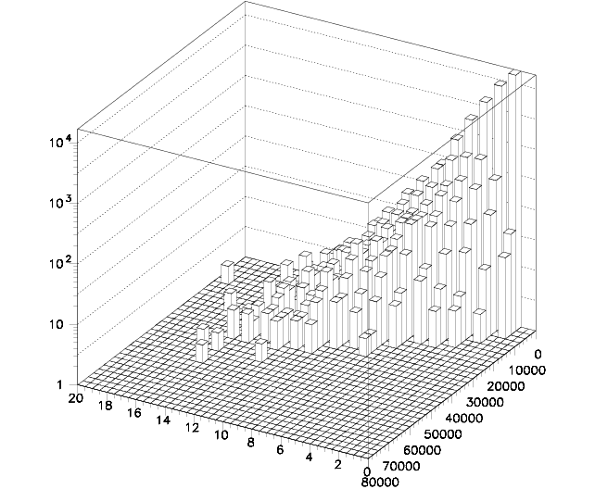
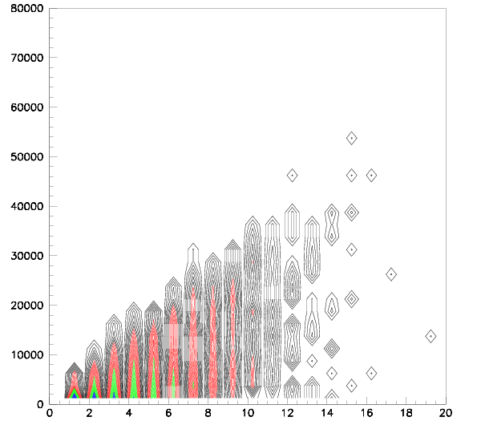
Integral of the rate amplitude during the burst vs duration
Integral of the rate
n. of detected bursts
Burst duration (s)
Integral of the rate
Burst duration (s)
16

Slide 17
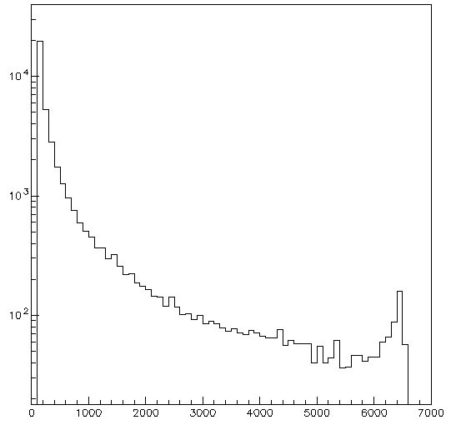
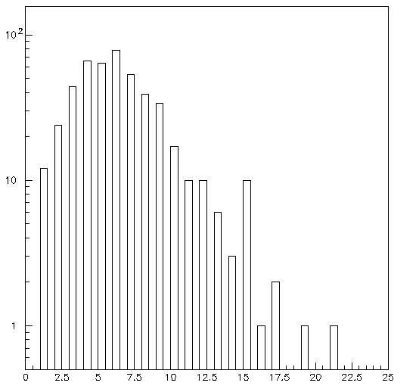
Initial rate amplitude (no selection in the duration interval)
Tot = 40112 bursts
Number of Burst
Duration distribution for burst which have an initial rate amplitude >6000kHz
Number of Burst
475 bursts
Initial rate Amplitude (kHz)
Burst duration (s)
17

Slide 18
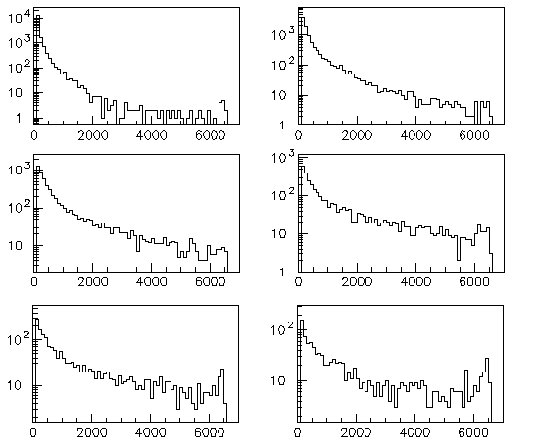
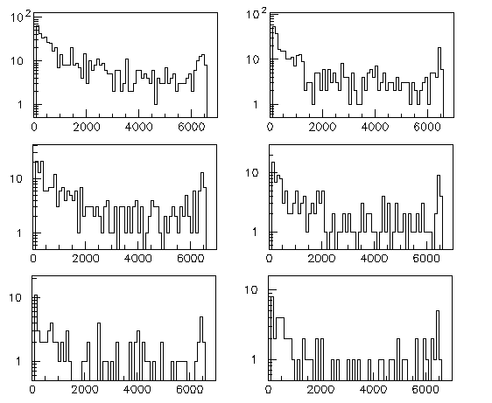
delta=1s
delta=2s
Initial rate Amplitude
with a selection in
duration window
delta=3s
delta=4s
delta=5s
delta=6s
Number of Burst
delta=7s
delta=8s
delta=9s
delta=10s
delta=11s
delta=12s
Initial rate (kHz)
18

Slide 19
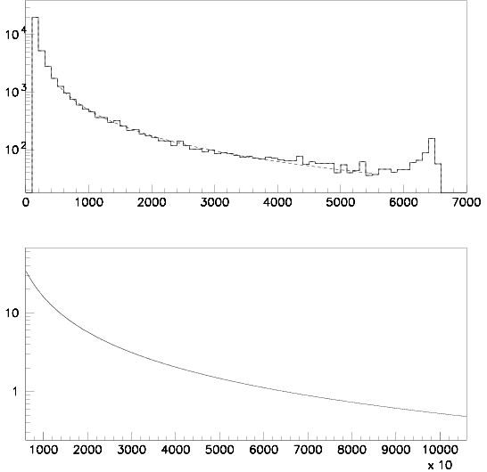
Fit with a power low
y=0.14123E+08*x**(-1.4862)
Fit range:
from 500kHz to 5500kHz
16 bit → 2^16=65536
Total burst 39640
Data wrapping above
6553.6 kHz
(kHz)
Phase III 24 bit
Percentage of lost burst: 8%
Try to recover data
above 6553.6 kHz
to cross- check the fit
Extrapolated burst 3154
(kHz)
19

Slide 20
CTD – Analysis
20

Slide 21
CTD
d.b. writing changes
CTD1
P del ctd1 era già scritto correttamente
CTD8
21

Slide 22
DIFFERENZE IN TEMPO NELLA SCRITTURA DI DUE VALORI CONSECUTIVI
CONFRONTI TRA PRIMA E DOPO IL CAMBIAMENTO DELLE COND: DI SCRITTURA NEL D:B:
CTD1
PRIMA
DOPO
CTD8
PRIMA
DOPO
22
I valori arrivano con maggiore frequenza ogni 10 min e non arrivano piu’ contemporaneamente

Slide 23
Two days zoom after changes in D.B. writing
resolution=FWHM=σ*2,35
☻☻Resolution = 0.0001°C
Initial accuracy = 0.002°C
Stability (per month)= 0.0002°C
☻Resolution = 0.14 dbar
Initial accuracy = 6.98 dbar (7 m)
Stability (per month) = 0.27dbar (0.28 m)
☺Resolution = 0.00001 S/m
Initial accuracy = 0.0003 S/m
Stability (per month) =0.0003 S/m
☺Resolution = 0.0001 mS/cm
Initial accuracy = 0.003 mS/cm
Stability (per month) =0.003 mS/cm
☻☻Resolution = 0.0001°C
Initial accuracy = 0.002°C
Stability (per month)= 0.0002°C
☺Resolution = 0.069db (0.07 m)
Initial accuracy = 3.4 db (3.5 m)
Stability (per month)= 0.14dbar (0.14m)
☺Resolution = 0.00001 S/m
Initial accuracy = 0.0003 S/m
Stability (per month) =0.0003 S/m
☺Resolution = 0.0001 mS/cm
Initial accuracy = 0.003 mS/cm
Stability (per month) =0.003 mS/cm
23

Slide 24
Long series observations - temperature
24

Slide 25
Long series observations - pressure
25

Slide 26
Long series observations - conductivity
26

Slide 27
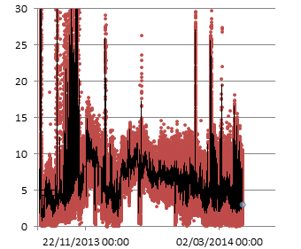
Current-meter
PRELIMINARY
Qualitative representation
--- media mobile
Speed(cm/s)
27

Slide 28
Correlation file
28

Slide 29
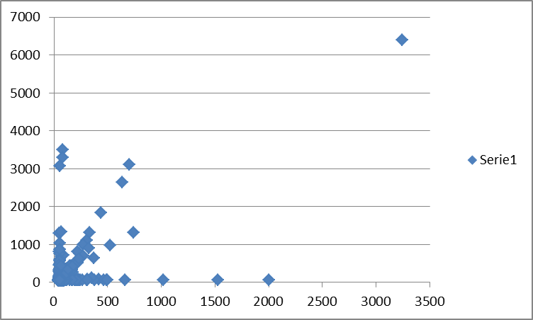
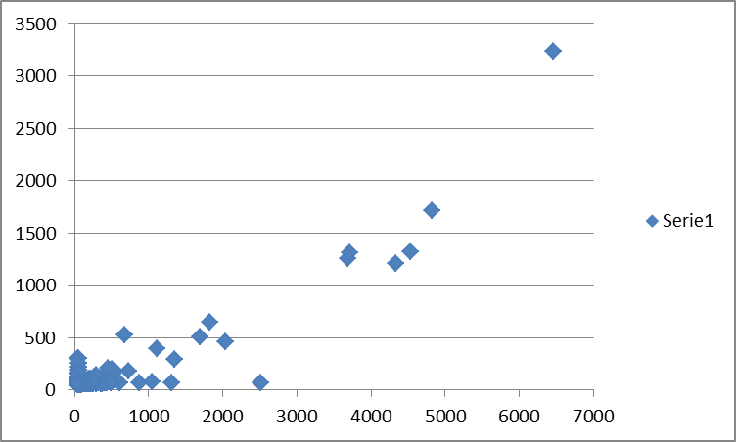
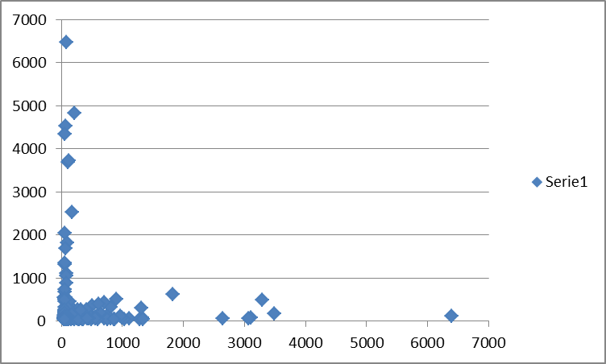
PMT-PMT Correlations (same floor)
PMT2
PMT4
VERY PRELIMINARY
PMT1
PMT3
PMT3
PMT vicini
PMT lontani
2-h measurement
PMT2
29

