Slide 1


Review of Instabilities Issues for Low Emittance Rings and Summary of TWIICE Workshop
R. Nagaoka
Synchrotron SOLEIL, Gif-sur-Yvette, France
Low Emittance Ring Workshop 2014
17-19 September 2014, Frascati, Italy

Slide 2
Content:
I. What are the Instability Issues for Low Emittance Rings?
Summary of TWIICE Workshop
Conclusions
R. Nagaoka
Review of Instabilities Issues for Low Emittance Rings …
LER2014, Frascati, 17-19 September 2014 2/21

Slide 3
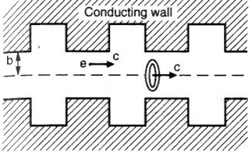
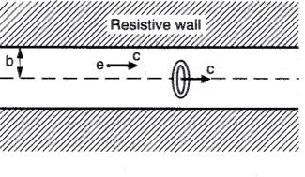
1. What are the Instability Issues for Low Emittance Rings?
◊ Reduced vacuum chamber aperture due to stronger magnetic focusing
(from AW Chao, “Physics of collective beam instabilities…”)
Increased geometric and resistive-wall wake fields
Enhanced single bunch instabilities (microwave, TMCI, head-tail, …)
Enhanced resistive-wall instability in multibunch
◊ Enhanced sensitivity against collective effects due to lower emittance
• Low dispersion → low alpha → shorter bunch → wider bunch spectrum
➔ Impedance-induced single & multibunch instabilities
➔ CSR instability
➔ Two-beam instabilities (e-cloud, ion, …)
➔ IBS, Touschek scattering
➔ Space-charge effects
R. Nagaoka
Review of Instabilities Issues for Low Emittance Rings …
LER2014, Frascati, 17-19 September 2014 3/21

Slide 4
◊ Impedance studies (in addition to instabilities and particle scatterings)
• Geometric impedance calculations/minimizations
Tapers, trapped-modes, 3D objects with fine structures, short-range wakes, surface roughness, power losses, power propagation,
• Resistive-wall studies
Coating materials, high frequency properties, secondary-electron desorption, …
• Shield-CSR wakes (parallel plates, pillbox, rectangular chamber, general cross section, …)
Two-beam wakes
Beam-based impedance measurement
◊ Instability mitigations
• Chromaticity shifting
• Diagnostics (bunch profile observations/turn-by-turn)
• Bunch-by-bunch feedback
• Bunch lengthening with harmonic cavities
• Suppression of secondary electron desorptions
R. Nagaoka
Review of Instabilities Issues for Low Emittance Rings …
LER2014, Frascati, 17-19 September 2014 4/21

Slide 5
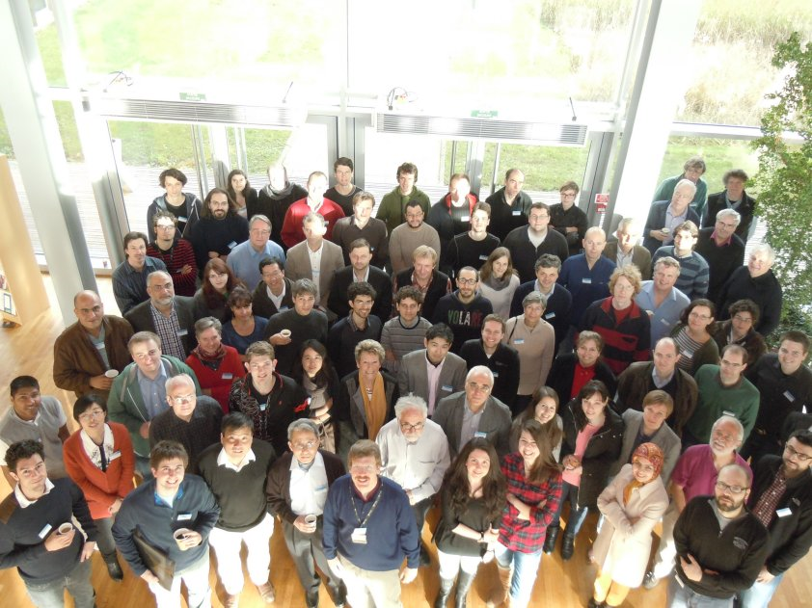
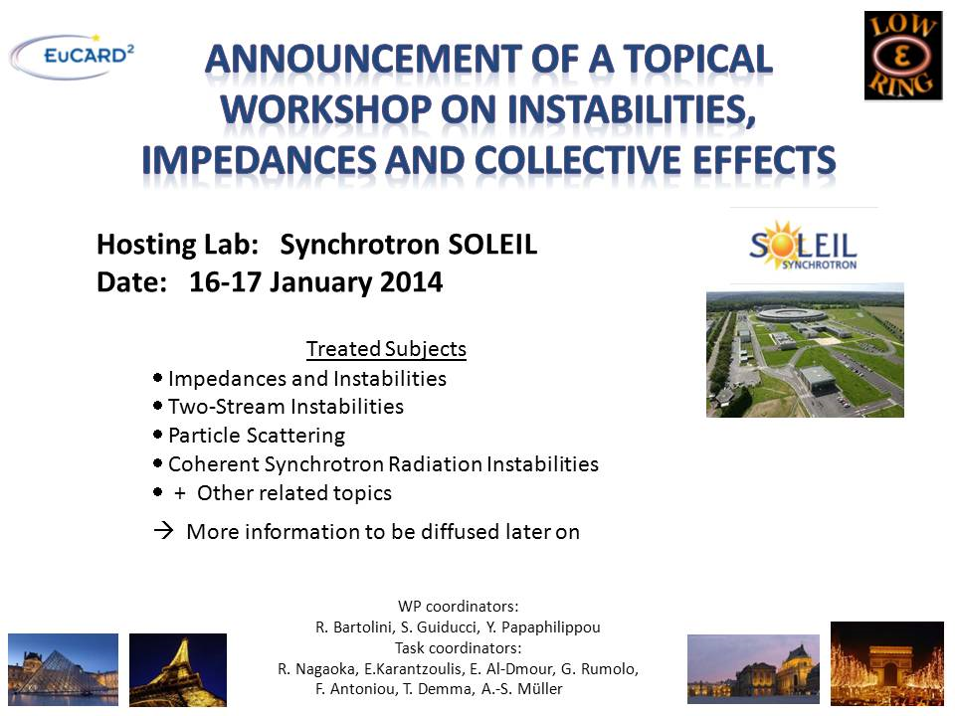
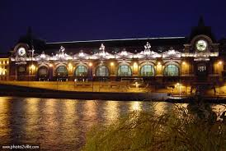

2. Summary of TWIICE Workshop
2.1. General Features
Workshop photo
Workshop dinner at the Musée d’Orsay
R. Nagaoka
Review of Instabilities Issues for Low Emittance Rings …
LER2014, Frascati, 17-19 September 2014 5/21

Slide 6
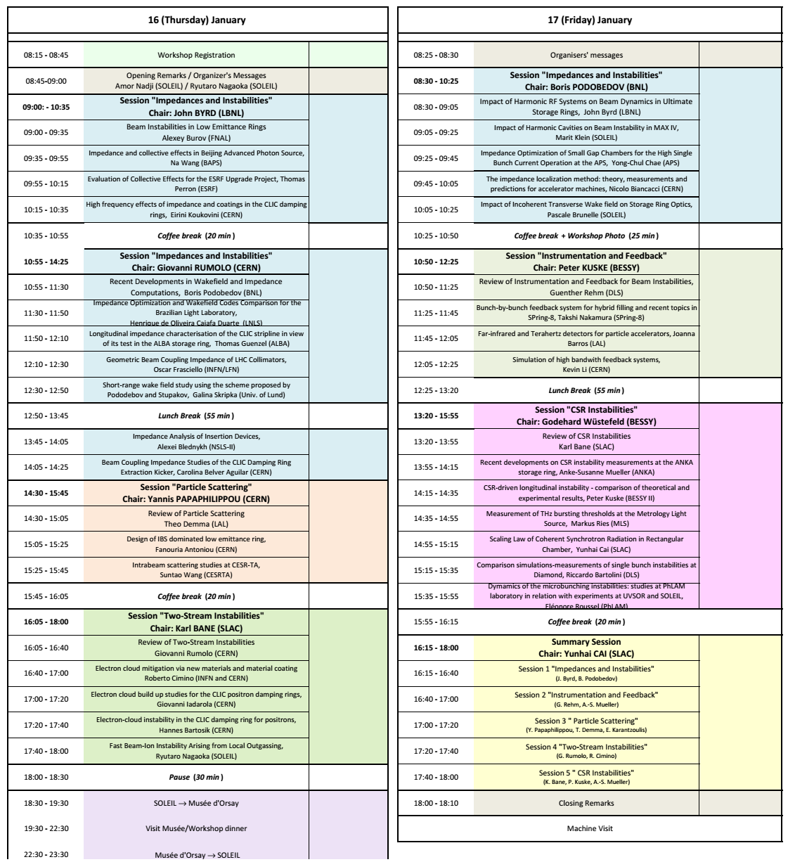
More than 70 participants from 26 institutes and universities from around the world:
Europe: 19, USA: 5, Asia: 2
accelerator physicists and engineers from the community of light sources, colliders and damping rings.
Altogether 35 talks (among which 7 reviews) in 5 sessions:
• Impedance/instabilities
• Particle scattering
• Two-stream instabilities
• Beam diagnostics/feedback
• CSR instabilities
R. Nagaoka
Review of Instabilities Issues for Low Emittance Rings …
LER2014, Frascati, 17-19 September 2014 6/21

Slide 7
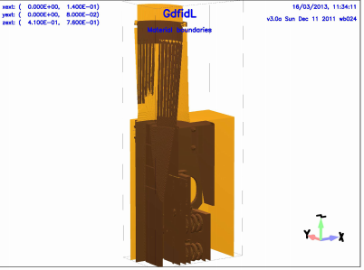
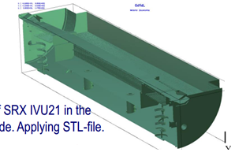
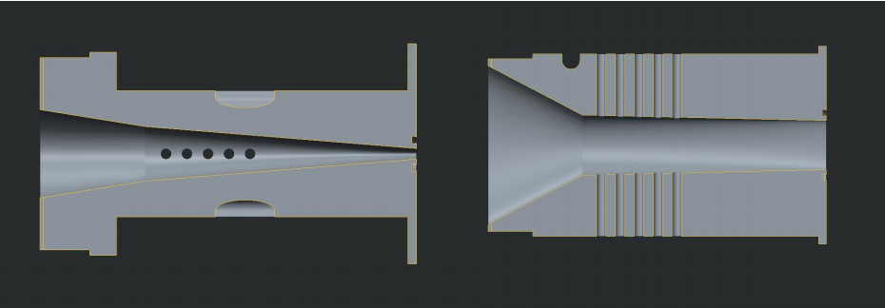
2.2. Specific Features
2.2.1. Impedance/Instabilities
16 presentations (3 reviews + 13 contributions)
◊ Impedance calculations/optimizations/measurements
• Numerical optimization (minimization) of the coupling impedance of various vacuum components were presented:
- Insertion device and cavity tapers (A. Blednykh, NSLS-II; Y.-C. Chae, APS; N. Wang, BAPS; M. Klein, MAXIV; …)
- BPM buttons (H. de Oliveira Caiafa Duarte, LNLS)
- LHC collimators (O. Frasciello, INFN, Frascati)
- CLIC stripline (T. Günzel, ALBA)
- CLIC damping ring extraction kicker (C. Belver Aguilar, CERN)
- Longitudinal kicker (H. de Oliveira Caiafa Duarte, LNLS)
LHC collimator, O. Frasciello, INFN, Frascati
A newly optimized (5 mm) gap insertion device chamber, Y.-C. Chae, APS
NSLS-II in-vacuum undulator, A. Blednykh
R. Nagaoka
Review of Instabilities Issues for Low Emittance Rings …
LER2014, Frascati, 17-19 September 2014 7/21

Slide 8
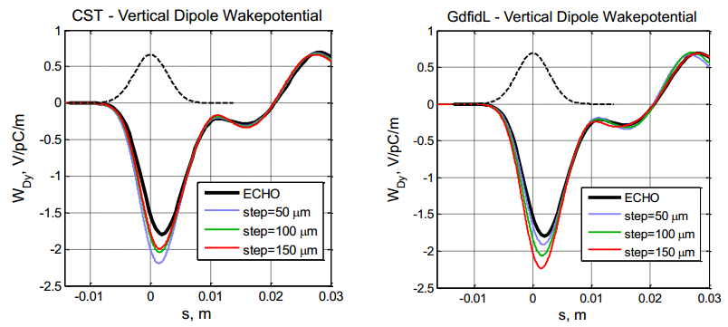
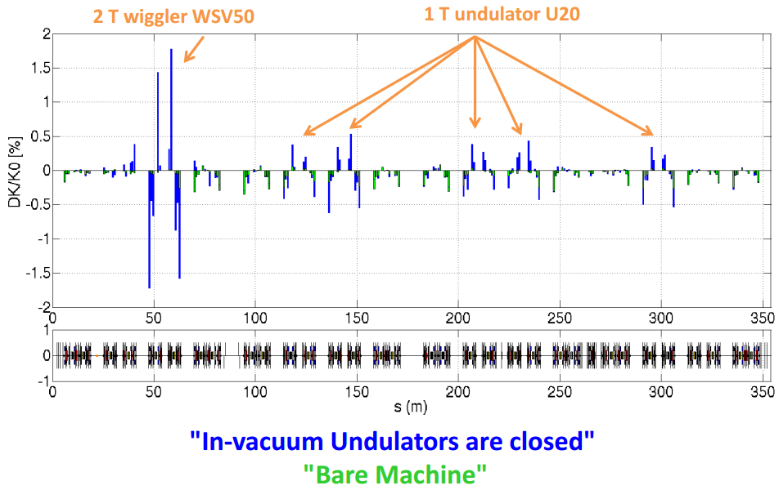
Comparison of EM solvers:
(CST, ECHO, GdfidL, ACE3P, …) in the impedance evaluation of standard ring vacuum components
(H. de Oliveira Caiafa Duarte, LNLS; A. Blednykh, NSLS-II)
Comparison of CST, GdfidL and ECHO on a tapered cavity (H. de Oliveira Caiafa Duarte, LNLS)
Beam-based transverse impedance measurement and localization:
Review of the theory and measurement of transverse dipolar impedance (N. Biancacci, Universita e INFN, Roma I (IT) )
Measurement of incoherent focusing due to non-circular cross-section chambers (P. Brunelle, SOLEIL)
Beam-based identification of intensity-dependent quadrupole focusing (P. Brunelle, SOLEIL)
R. Nagaoka
Review of Instabilities Issues for Low Emittance Rings …
LER2014, Frascati, 17-19 September 2014 8/21

Slide 9
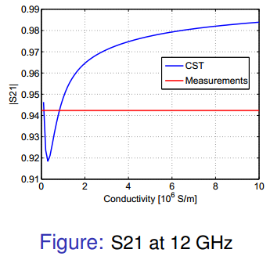
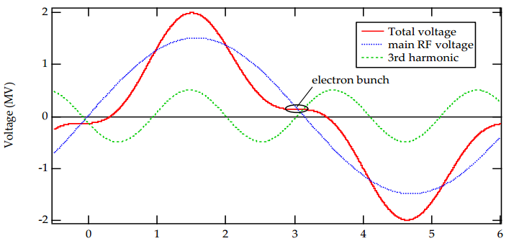
◊ Impedance studies
Review of several recently developed geometric wake field computations (short-bunch asymptotic models/scaling laws/new method for a point-charge wake from an EM solver, B. Podobedov, NSLS-II)
Application of Podobedov-Stupakov scheme to a multi-cell cavity (G. Skripka, Univ. Lund)
Experimental and numerical studies of the high frequency conductivity of NEG coating (E. Koukovini Platia, Ecole Polytech., Lausanne)
(E. Koukovini Platia, Ecole Polytech., Lausanne )
◊ Reviews on beam instability/harmonic cavities
Theory of transverse instability (single bunch/multibunch/dampers/Landau damping/electron-cloud) reviewed by A. Burov (FNAL)
Harmonic RF systems and their impact on beam overviewed by J. Byrd (LBNL)
In the review talk by J. Byrd (LBNL)
R. Nagaoka
Review of Instabilities Issues for Low Emittance Rings …
LER2014, Frascati, 17-19 September 2014 9/21

Slide 10
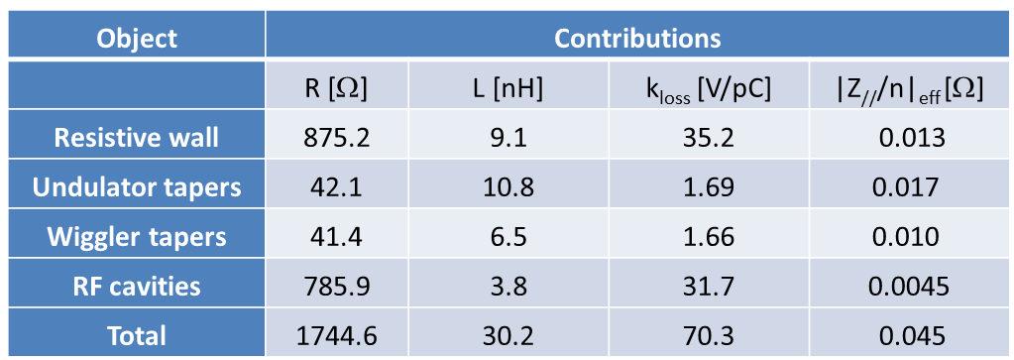
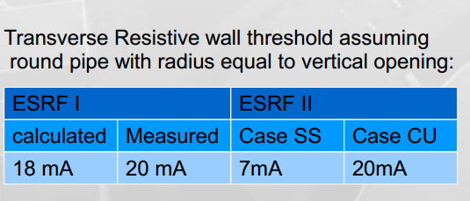
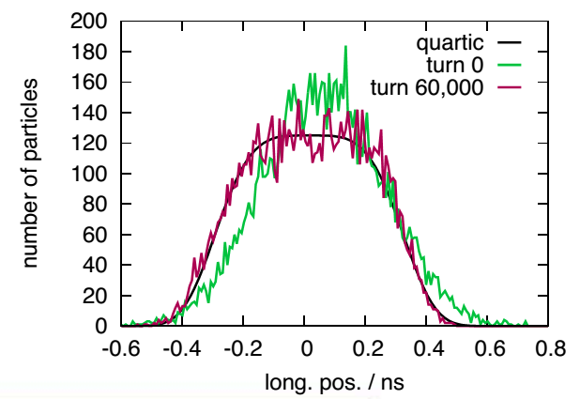
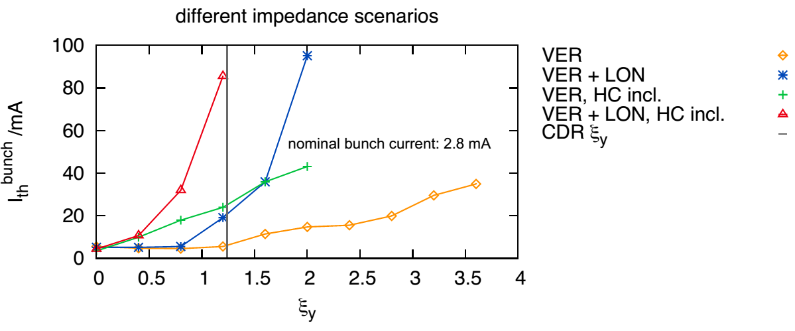
◊ Estimates of impedance/instabilities for future machines
• Studies presented for Beijing APS / ESRF-II / Sirius / NSLS-II / MAXIV
(N. Wang, BAPS)
(T. Perron, ESRF)
• For MAXIV, passive harmonic cavities are treated dynamically in mbtrack to follow their impact on instabilities (M. Klein, SOLEIL)
Evolution of longitudinal bunch profile
Vertical single bunch instability as a function of chromaticity
R. Nagaoka
Review of Instabilities Issues for Low Emittance Rings …
LER2014, Frascati, 17-19 September 2014 10/21

Slide 11
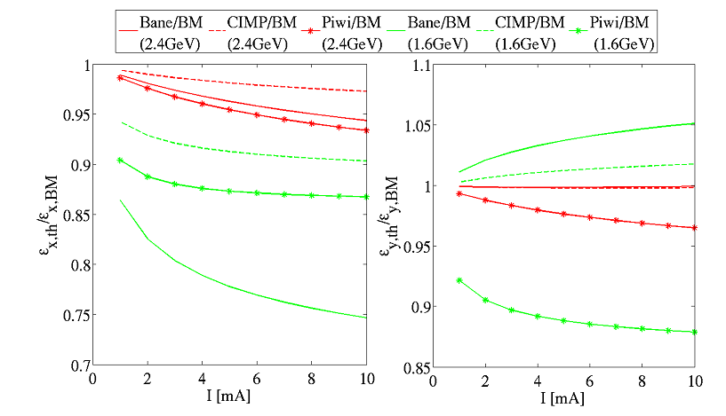
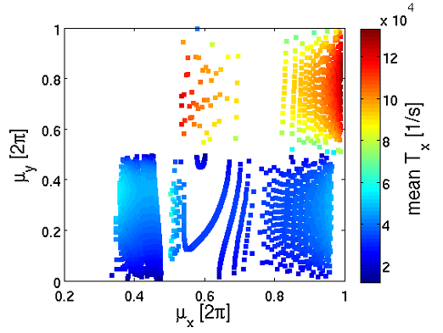
2.2.2. Particle Scatterings
◊ Review of IBS studies (theory/measurement/simulations/outlook) given by T. Demma (LAL)
◊ Studies made at CERN (F. Antoniou et al.):
Good agreement of different theoretical models at weak IBS regimes
Discrepancies grow at strong IBS regimes
Bench-marking of theoretical models and MC computations with measurement is essential
Comparisons of different models for SLS (H. Bartosik for F. Antoniou, CERN)
Optimization of CLIC damping ring parameters (energy, linear optics (TME lattice), …) w.r.t. IBS effects
➔ Optimal phase advances can be found where chromaticity, IBS growth rates and space charge detuning are minimized
(H. Bartosik for F. Antoniou, CERN)
R. Nagaoka
Review of Instabilities Issues for Low Emittance Rings …
LER2014, Frascati, 17-19 September 2014 11/21

Slide 12
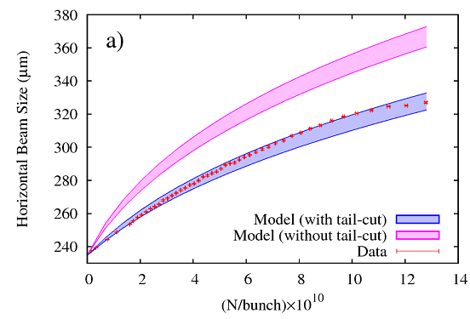
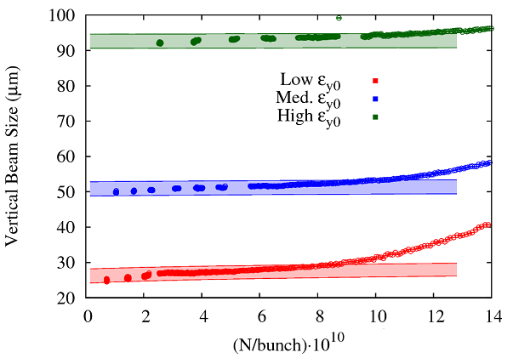
◊ Studies (theoretical/experimental) made at Cornell (S. Wang, Cornell)
• Importance of “tail-cut” in the numerical estimation, without which, a large over-estimation of experimental data results
Measured horizontal beam size versus current (S. Wang)
• Anomalous vertical beam size blowup measured at Cornell cannot be explained by the present models
Importance of;
Incorporating vertical coupling into the models
Extended particle tracking schemes
Distinguishing different collective effects
Anomalous vertical beam size blow up measured at Cornell (S. Wang)
R. Nagaoka
Review of Instabilities Issues for Low Emittance Rings …
LER2014, Frascati, 17-19 September 2014 12/21

Slide 13
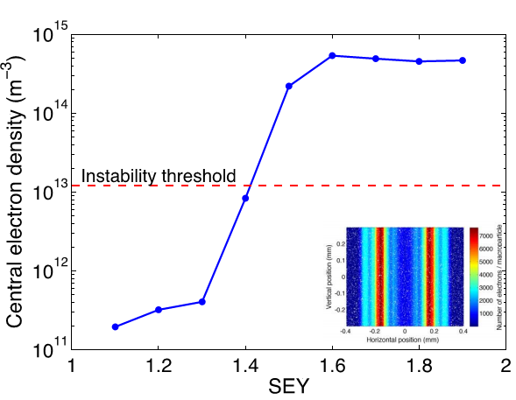
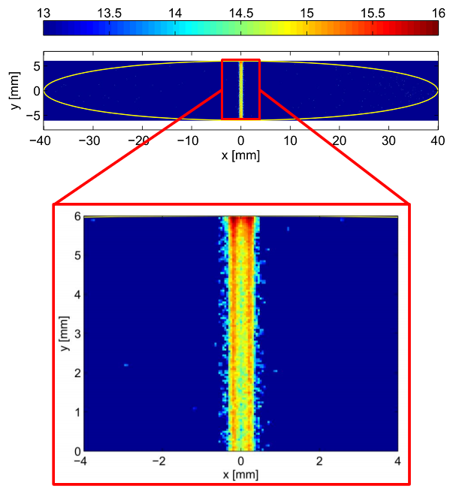
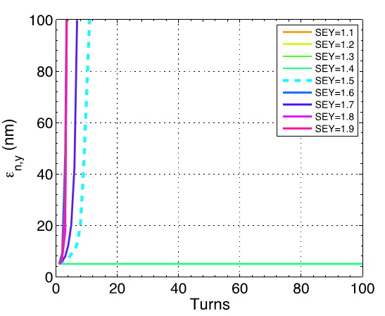
2.2.3. Two Stream Instabilities
◊ Advanced simulations of e-cloud driven single bunch instability at CERN
Simulation of e-cloud formation in a wiggler using the code PyCLOUD developed at CERN (G. Iadarola et al.)
➔ Results indicate strong instability with weak dependence on bunch intensity and chromaticity. E-cloud buildup itself must be suppressed
Simulation of transverse single bunch instability using HEADTAIL with e-cloud distributions from PyCLOUD (H. Bartosik et al.)
R. Nagaoka
Review of Instabilities Issues for Low Emittance Rings …
LER2014, Frascati, 17-19 September 2014 13/21

Slide 14
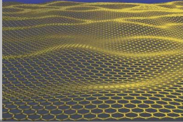
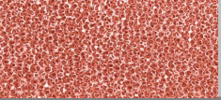
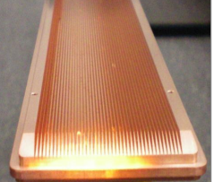
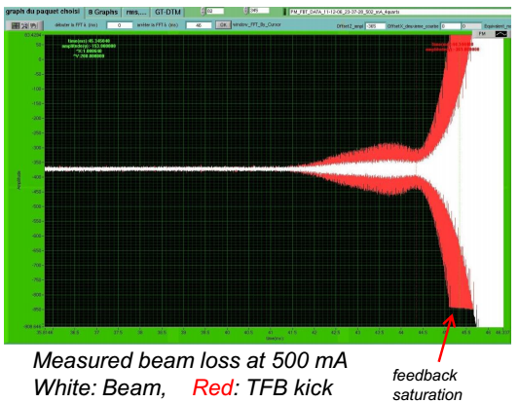
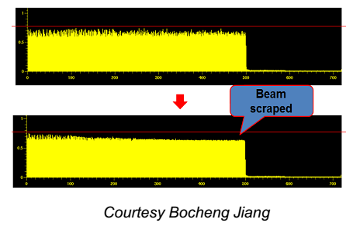
◊ On-going E-cloud mitigation studies using new materials and material coating (R. Cimino et al., INFN/CERN)
Thin graphite coating on a metallic surface
Sponges
Geometric mitigation by grooves
➔ Solutions getting matured, but there is still a lot to learn
◊ Observation of FBIIs arising from local outgassing in SOLEIL and SSRF (R. Nagaoka et al., SOLEIL)
Simulations with mbtrack suggest a combined effect of resistive-wall, FBII and transverse feedback as a likely explanation of beam losses
Courtesy Bocheng Jiang, SSRF
R. Nagaoka
Review of Instabilities Issues for Low Emittance Rings …
LER2014, Frascati, 17-19 September 2014 14/21

Slide 15
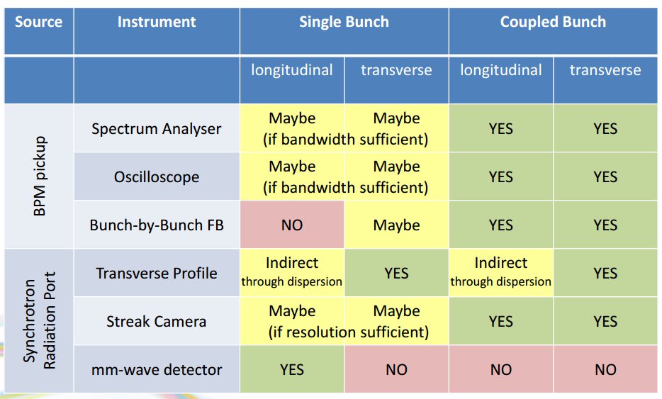
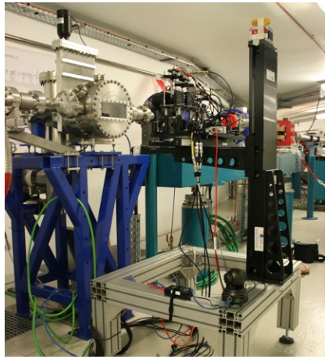
2.2.4. Beam Diagnostics/Feedback
◊ Review of beam instruments and feedback for beam instabilities (G. Rehm, DIAMOND)
Some of the future directions discussed:
• Better turn-by-turn profile diagnostics, both transversely and longitudinally would be beneficial
Table summarizing the possible tools for beam instability diagnostics (G. Rehm, DIAMOND)
• Record beam data synchronously at highest possible rate, and stream to storage to compare with simulations.
• Wider feedback kicker bandwidth (if we want to go towards intrabunch FB), while keeping loss factor manageable
Smith-Purcell bunch length monitor in development at SOLEIL (J. Barros, LAL)
R. Nagaoka
Review of Instabilities Issues for Low Emittance Rings …
LER2014, Frascati, 17-19 September 2014 15/21

Slide 16
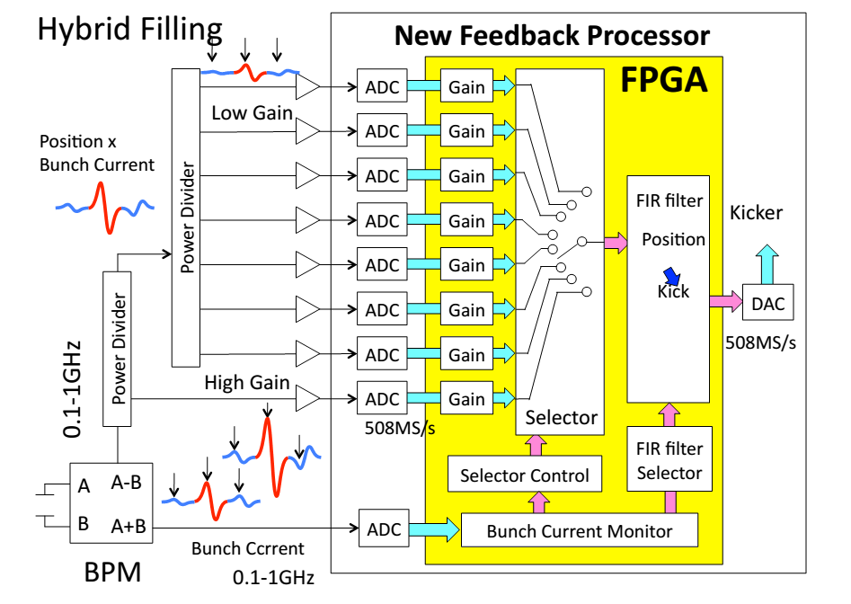
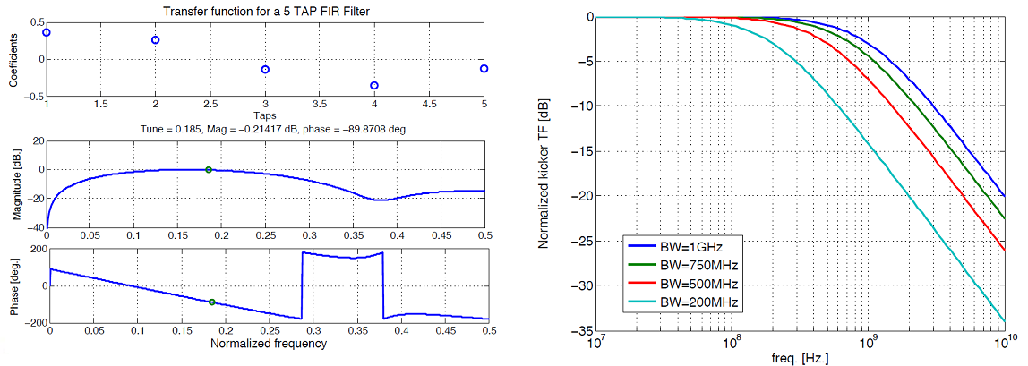
◊ Development at SPring-8 (T. Nakamura):
New bunch-by-bunch feedback processor capable of differentiating the gain to cope with the hybrid beam filling
50 kV variable fast kicker for 2 ns bucket-by-bucket injection/extraction
◊ Realistic bunch-by-bunch transverse feedback in beam instability simulations by taking into account FIR filters and components bandwidth limitations (K. Li et al., CERN)
New bunch-by-bunch feedback processor developed at SPring-8 (T. Nakamura)
5-tap FIR (left) and horizontal kicker transfer function (right) used in the simulation (K. Li et al., CERN)
R. Nagaoka
Review of Instabilities Issues for Low Emittance Rings …
LER2014, Frascati, 17-19 September 2014 16/21

Slide 17
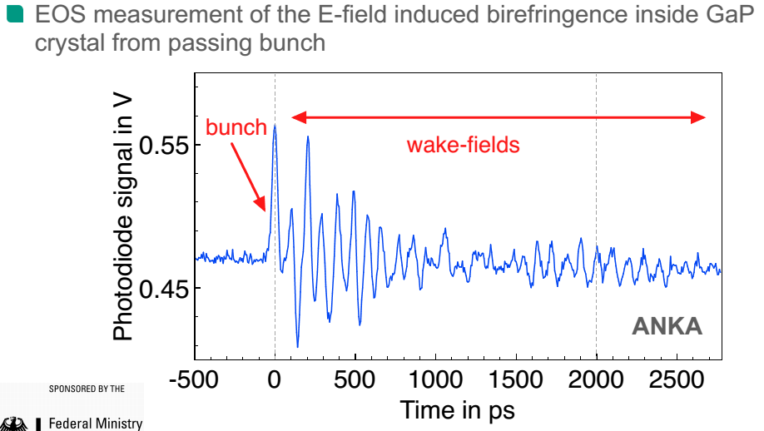
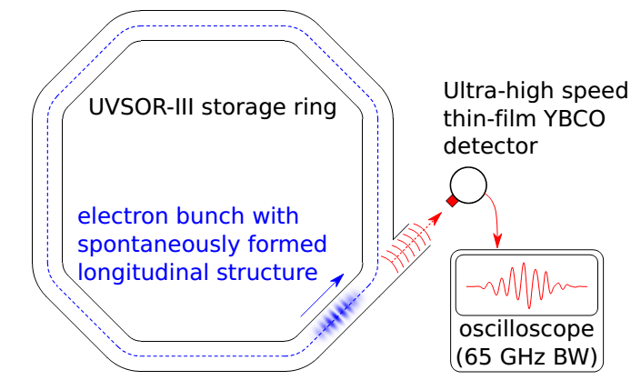
2.2.5. CSR Instabilities
7 presentations (2 reviews + 5 contributions)
• Experimental studies (2)/Simulations and measurement (3)/Theoretical studies (1)
Implementation of fast detectors and fast data acquisition systems (LNB/YBCO superconducting/NbN hot electron bolometer/Schottky diode/Electro-optic sampling…)
• Single shot/turn-by-turn/bunch-by-bunch measurement
• Measurement of longitudinal bunch profile, short-range wakes, microbunching, …
(A-.S. Müller, ANKA / E. Roussel, PhLAM)
(A-.S. Müller, ANKA )
(E. Roussel, PhLAM )
R. Nagaoka
Review of Instabilities Issues for Low Emittance Rings …
LER2014, Frascati, 17-19 September 2014 17/21

Slide 18
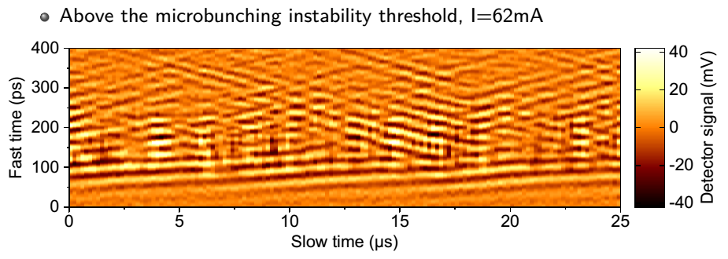
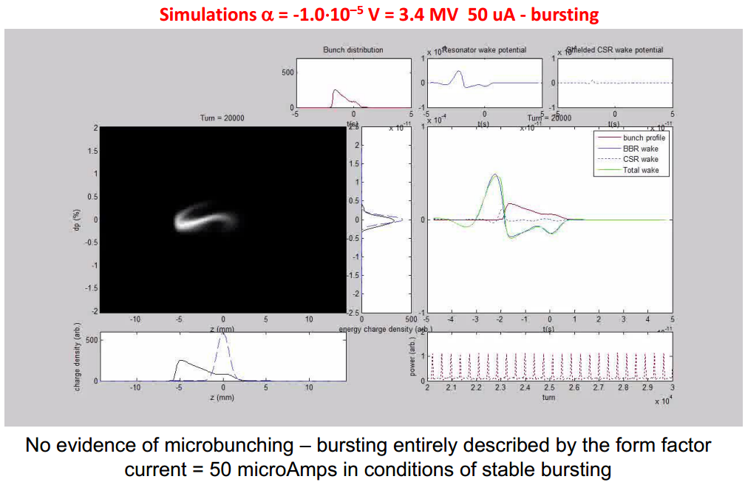
YBCO detector + 65 GHz BW oscilloscope setup in UVSOR (Japan) allowed measuring the temporal evolution of microbunching in the bursting regime, and refine the wake model (CSR + L + R)
(E. Roussel et al., PRL 113,094801 (2014))
◊ Study in α < 0 regime:
(R. Bartolini, DIAMOND)
Comparison between tracking and measurement
Tracking with shielded CSR and (fitted) BBR wakes
Good reproduction of experimental characteristics
No clear evidence of microbunching instability in the bursting regime
R. Nagaoka
Review of Instabilities Issues for Low Emittance Rings …
LER2014, Frascati, 17-19 September 2014 18/21

Slide 19
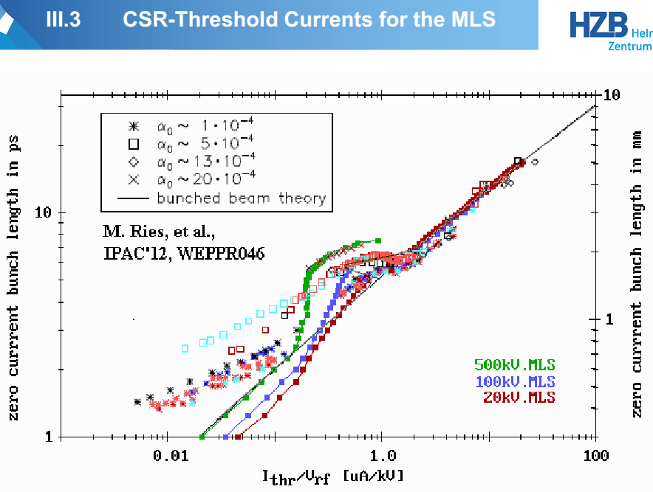
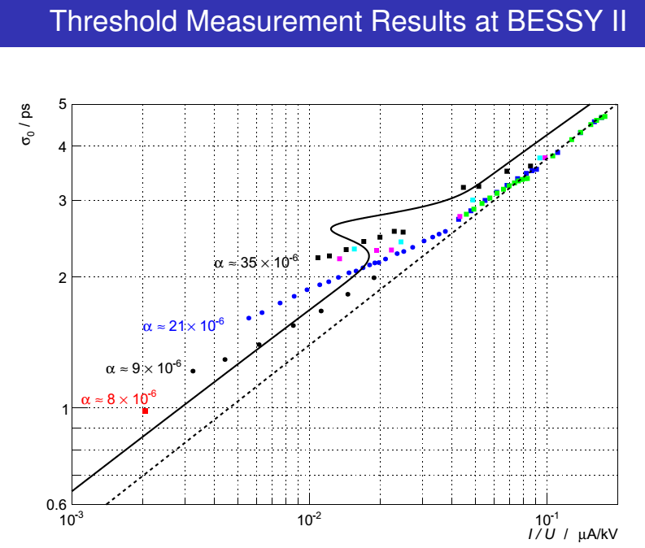
Comparison of measurement, simulation (VFP) and theory at MLS and BESSY II:
(P. Kuske, BESSY II / M. Ries, MLS)
Anomalous dip observable in MLS at around the bunch length of 5~6 ps.
While at long bunches, the agreement between the theory and measurement is good, at short bunches (some ps range), the measured threshold is significantly lower than expected → Impact on BESSY VSR
Prediction with the parallel-plate model is impressively good for MLS, BESSY-II and ANKA.
(from P. Kuske, BESSY II)
(from M. Ries, MLS)
R. Nagaoka
Review of Instabilities Issues for Low Emittance Rings …
LER2014, Frascati, 17-19 September 2014 19/21

Slide 20
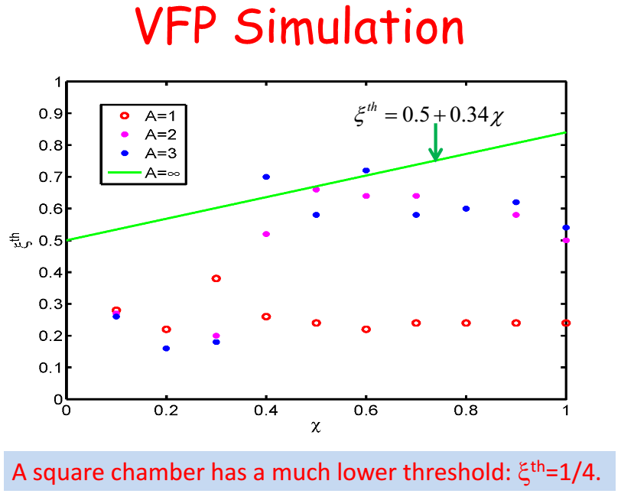
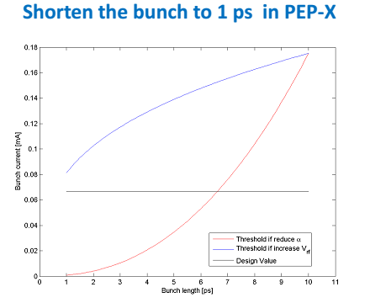
◊ Extension of the scaling law obtained for free-space and parallel-plates CSR wakes to a rectangular chamber: (Y. Cai, SLAC)
Use of the aspect ratio A = w/h of the chamber
VFP simulation finds lower thresholds than for parallel plates (A = ∞)
◊ Mitigation of CSR effects: (Y. Cai, SLAC)
• Bunch shortening with high RF voltage is helpful in keeping the CSR threshold high, as compared to lowering the momentum compaction α
(Y. Cai, SLAC)
R. Nagaoka
Review of Instabilities Issues for Low Emittance Rings …
LER2014, Frascati, 17-19 September 2014 20/21

Slide 21
3. Conclusions
• Efforts to lower the beam emittance generally tend to enhance beam instability and collective effects, both in terms of impedance and beam sensitivity.
• Therefore, if the beam intensity is to be used as a knob to attain higher brilliance in future low emittance rings, the coupling impedance, as well as all concerned beam instabilities and collective effects must be well studied and mastered in advance.
• The high quantity and quality of studies presented at TWIICE workshop demonstrate the enormous efforts actively being made by the colleagues in the low emittance ring community (and also of hadron ring community) in all directions.
• For more details of the presentations made at TWIICE, please visit the workshop site at
http://www.synchrotron-soleil.fr/Workshops/2014/TWIICE
where all the contributions are accessible. The 2nd TWIICE is to be organized in 2016.
R. Nagaoka
Review of Instabilities Issues for Low Emittance Rings …
LER2014, Frascati, 17-19 September 2014 21/21

