Slide 1
4th Low Emittance Rings Workshop (LOWεRING 2014)
Frascati, INFN-LNF
17-19 September 2014
The Round Beam Project at SOLEIL
R. Nagaoka, on behalf of the project team

Slide 2
Outline
Introduction: theoretical background on the subject
Stream of the project development at SOLEIL
Feasibility study made at SOLEIL so far
Summary and Outlook

Slide 3
I. Introduction
Background Situation
Application of the round ⇔ flat beam conversion studied by Y. Derbenev et al. in light source rings was proposed by A. Chao and P. Raimondi:
cf. SLAC-PUB-14808 / Presentation (by A. Franchi) in FLS 2012, Jefferson lab
◊ The scheme consists in a local exchange of apparent horizontal and vertical emittance using skew quadrupoles and a solenoid;
◊ As the SOLEIL ring possesses four 12 m long straight sections, application of the scheme is of great interest in lowering the horizontal emittance locally

Slide 4
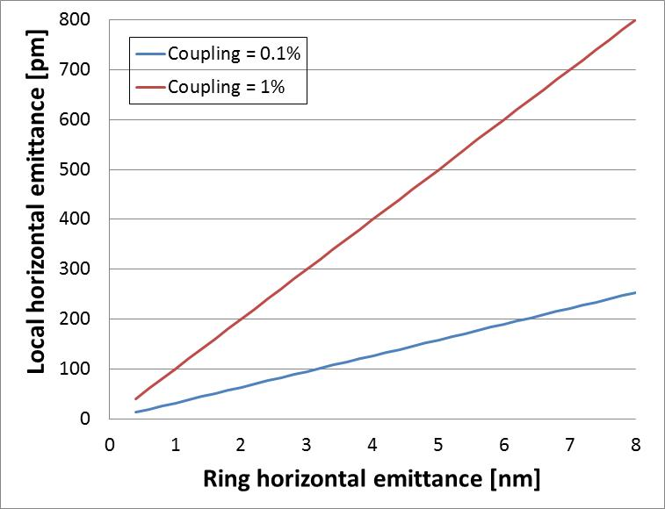
I. Introduction
Range of local horizontal emittance potentially reachable with this scheme
⇒ A. Chao and P. Raimondi claim that a conventional 3rd generation light source ring could become locally a DLSR* (as we know how to make the vertical emittance ε_{z} very small)
◊ Typically crystallography beamlines such as PX1, PX2 and Nanoscopium at SOLEIL are already very much interested in such beams
(* Diffraction Limited Storage Ring)

Slide 5
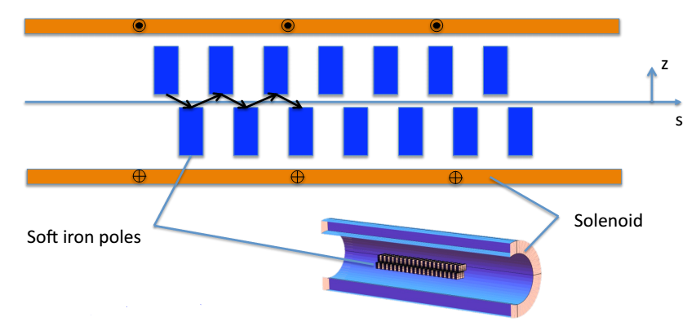
I. Introduction
Practical steps given in A. Chao - P. Raimondi Scheme in realizing a local DLSR:
Use of a pair of skew quadrupole triplets and a solenoid in between them
β_{x} = β_{z}, α_{x} = α_{z} at the entrance of the Flat to Round (F2R) skew Q triplet
β_{x} = β_{z}, α_{x} = α_{z} = 0 at the entrance of the solenoid
• Δφ_{x} = Δφ_{z} + π/2 over the skew Q-triplet to the entrance of the solenoid in the unrotated frame
Solenoid strength k_{s} = 2/β_{x} (matching condition)
Round to Flat (R2F) skew Q triplet is mirrored to the F2R one
Possible undulator scheme: Staggered undulator
(J. Chavanne, ESRF)
… taken from A. Chao and P. Raimondi at FLS 2012

Slide 6
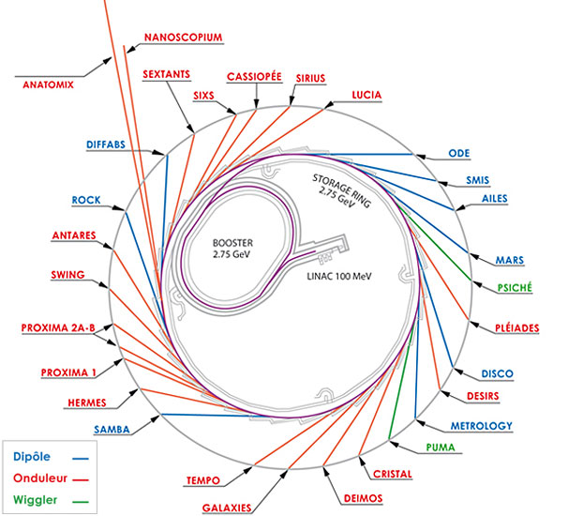
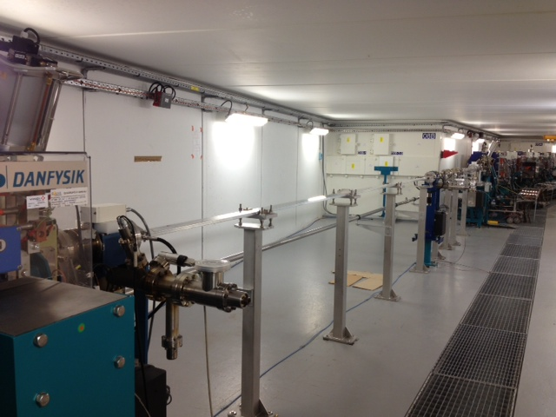
II. Stream of the Project Development at SOLEIL
Possibility of Applying the Emittance Adapter to a Long Straight Section at SOLEIL
Injection
SDL13
2 canted in-vacuum undulators
SDL05
10 m long HU640 undulator
SDL09 is free

Slide 7
II. Stream of the Project Development at SOLEIL
Idea of Project at SOLEIL presented for the 1st time at the Workshop on Accelerator R&D for USR (A. Nadji, Beijing, China, Oct. 30 – Nov. 1, 2012)
◊ Since 2013, discussions between the ESRF and SOLEIL for a collaboration for the feasibility of principle of a local F2R and R2F conversion without affecting the rest of the machine, and the creation of a round beam.
ESRF could lend some materials (quads, ID, power supplies, …)
◊ Project is split into 2 phases (steps):
Phase 1: Demonstration of
• Local F2R (flat to round) and R2F (round to flat) conversions without affecting the rest of the machine
• Round beam (ID + diagnostics)
Phase 2: Demonstration of a ultra low emittance beam (F2R + solenoid-ID + R2F)
→ Organization of a local working team (composed of physicists and engineers) at SOLEIL to study the feasibility of Phase 1 using the SDL09 long straight section. Coordination and beam dynamics studies are performed by P. Brunelle.

Slide 8
III. Feasibility Study made at SOLEIL so far
Phase 1 : Introduction of F2R and R2F converters in SDL09 without a solenoid
Adopted guidelines
Possibility of switching back immediately to the nominal machine with no injection and lifetime problems
No modification of the magnetic lattice except for SDL09
Introduction of skew quadrupoles in SDL09 only
Skew quadrupoles are existing quadrupoles coming from ESRF or SOLEIL
Keep free space for an existing Apple-II type insertion device
Use of existing equipment as far as possible, in order to lower the cost

Slide 9
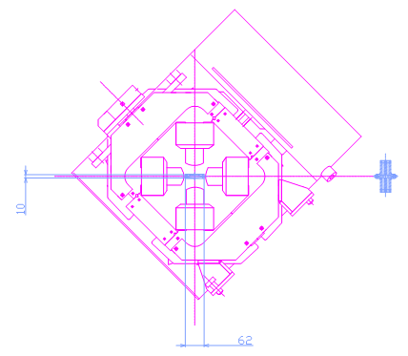
III. Feasibility Study made at SOLEIL so far
The photon beam will be created by a 60 mm period Apple-II type undulator available at SOLEIL
SDL09 Layout
1.73 m
3.9 m
3.9 m
QT1
QT2
QT3
QT3
QT2
QT1
2 BPMs
Old quadrupoles from ESRF
rotated in a frame
Gmax = 17 T/m
L = 0.40 m
An imaging system based on an X-ray pinhole camera can be installed in the tunnel.

Slide 10
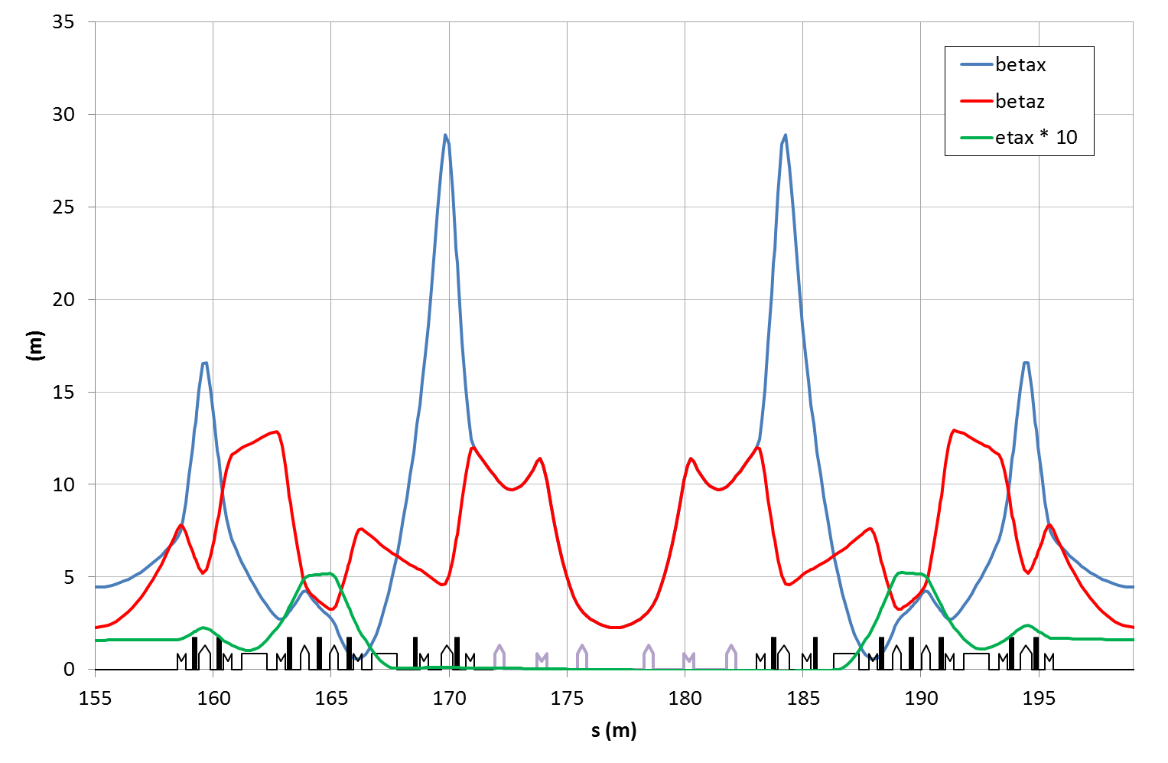
III. Feasibility Study made at SOLEIL so far
SDL09 Optics Due to the Dispersion cancellation in SDL09, ex is increased from 3.9 to 15.1 nm.rad
betax = betaz = 2.3 m
sigmax = sigmaz = 186 µm
Adaptation
to the nominal optics
nux = 18.176
nuz = 10.234
QT maximum gradient = 17 T/m, L = 0.40 m

Slide 11
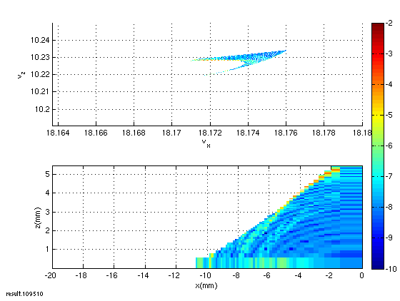
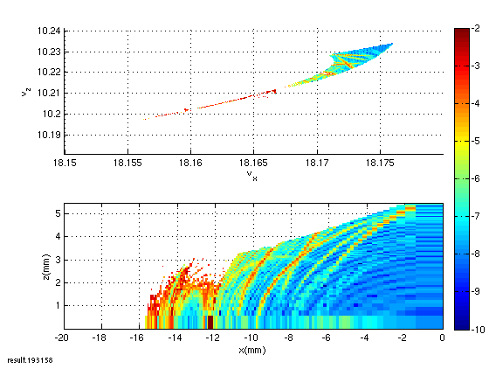
III. Feasibility Study made at SOLEIL so far
Beam dynamics
The vacuum chamber height has to be enlarged to ensure good injection efficiency
→ The minimum gap of the undulator is 19.5 mm
The Touschek lifetime is sufficient: 45 h for 1 mA/bunch
No significant effect of the multipolar components* of the skew quadrupoles
The photon flux emitted by the HU60 undulator is sufficient to obtain performant imaging
Standard chamber 56 (H) x 14 (V) mm
Enlarged QT chamber 56 (H) x 24 (V) mm
* Courtesy of Joel Chavanne (ESRF)
Beam coming from the booster (100% of the electrons)

Slide 12
III. Feasibility Study made at SOLEIL so far
Estimation of the cost
A rough estimate of the budget was made for the equipment only taking into account the possible contributions of ESRF
→ ~400 k€
(Vacuum chambers, tapers, fixation of rotated quadrupoles, power supplies for skew quadrupoles,
BPMs, Pinhole camera based imaging system, control system)
It turned out that this project could not be achieved at a low cost (even without solenoid) and that such an amount of money cannot be wasted only for the proof of principle.
It follows that the demonstration phase, performed at SOLEIL, must be compatible with Phase 2 that includes the emittance adapter (solenoid)
→ Available length for the solenoid should be enlarged to 4 ~ 5 m

Slide 13
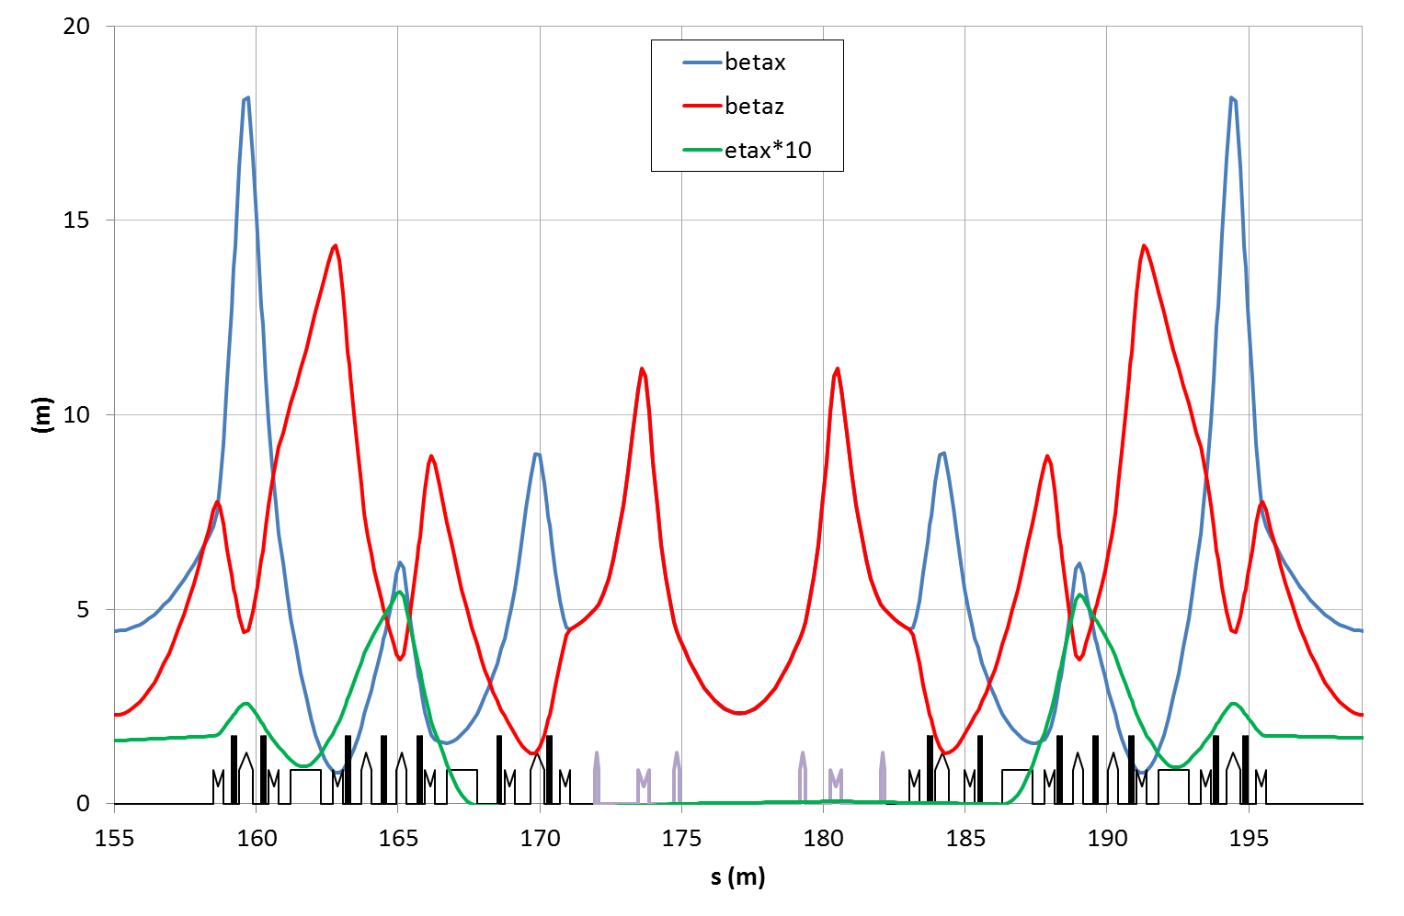
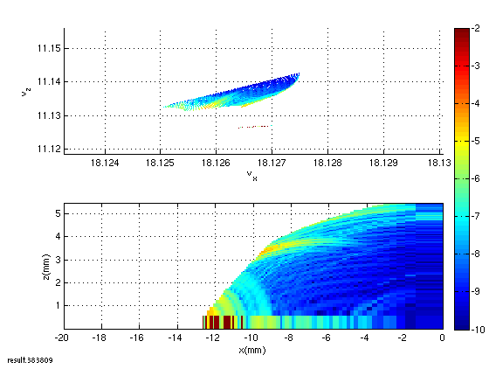
III. Feasibility Study made at SOLEIL so far
New optics with 4.2 m available for the solenoid (preliminary studies)
New magnet setup:
skew quadrupoles reach 40 T/m gradient, L = 0.14 / 0.39 / 0.20 m
1 quadrupoles of the ring reach gradient > 20 T/m
Required solenoid strength < 4 T
nux = 18.127, nuz = 11.142
ε_{x} = 9.6 nm.rad
betax = betaz = 2.3 m (@ ID centre)
sigmax = sigmaz = 149 µm

Slide 14
IV. Summary and Outlook
Demonstration of a Round Beam using the SDL09 long straight section at SOLEIL appears to be feasible.
Magnet setup of Phase 1 must be compatible with the installation of a solenoid for the emittance adaptation in Phase 2.
This new scheme will require studies in many areas :
Beam dynamics without and with solenoid containing an undulator,
Magnets, undulators, solenoids,
Vacuum chamber, tapers (impedance),
Imaging system,
Diagnostics,
…

Slide 15
IV. Summary and Outlook
We then proposed to extend the collaboration to an international collaboration including other partners in order to realize a more ambitious project:
“ Having the possibility to answer more efficiently the specific demands of users such as the imaging beamlines that are demanding small, round and high brilliant beams. “
Phase 1 and 2, performed at SOLEIL, could then lead to the phase of using a round and extremely low emittance beam by a photon beamline.
For the future, the application of such an idea to shorter straight section (~6-8 m) will make the collaboration between these partners essential in order to reach more challenging requirements especially for the engineering of strong skew quadrupoles and undulators inside solenoids.
The ESRF and SLAC have expressed interest to participate in this experiment. We are in the process of exploring the interest of MAX-IV, SPRING-8, APS, PETRA III and other interested labs. Financial participation shall be requested to all of the collaborators.

Slide 16
Thank you for your attention!

Slide 17
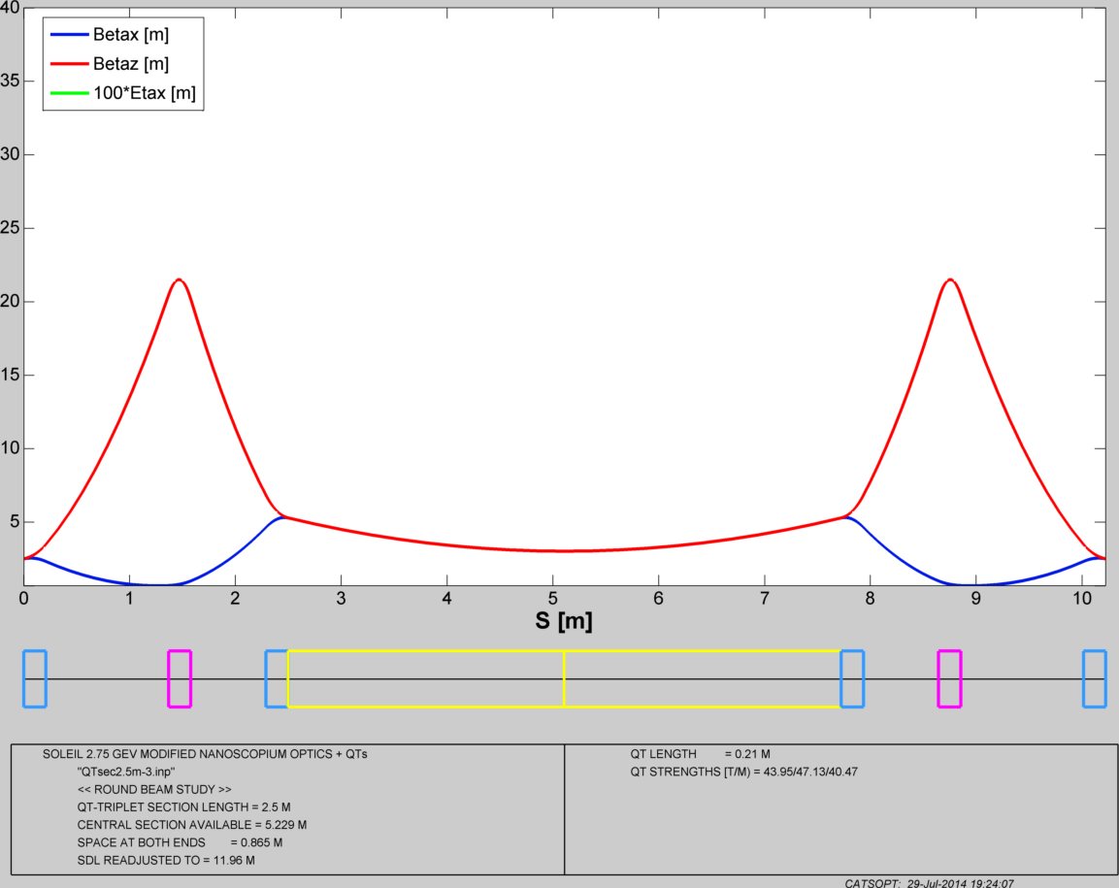

Slide 18
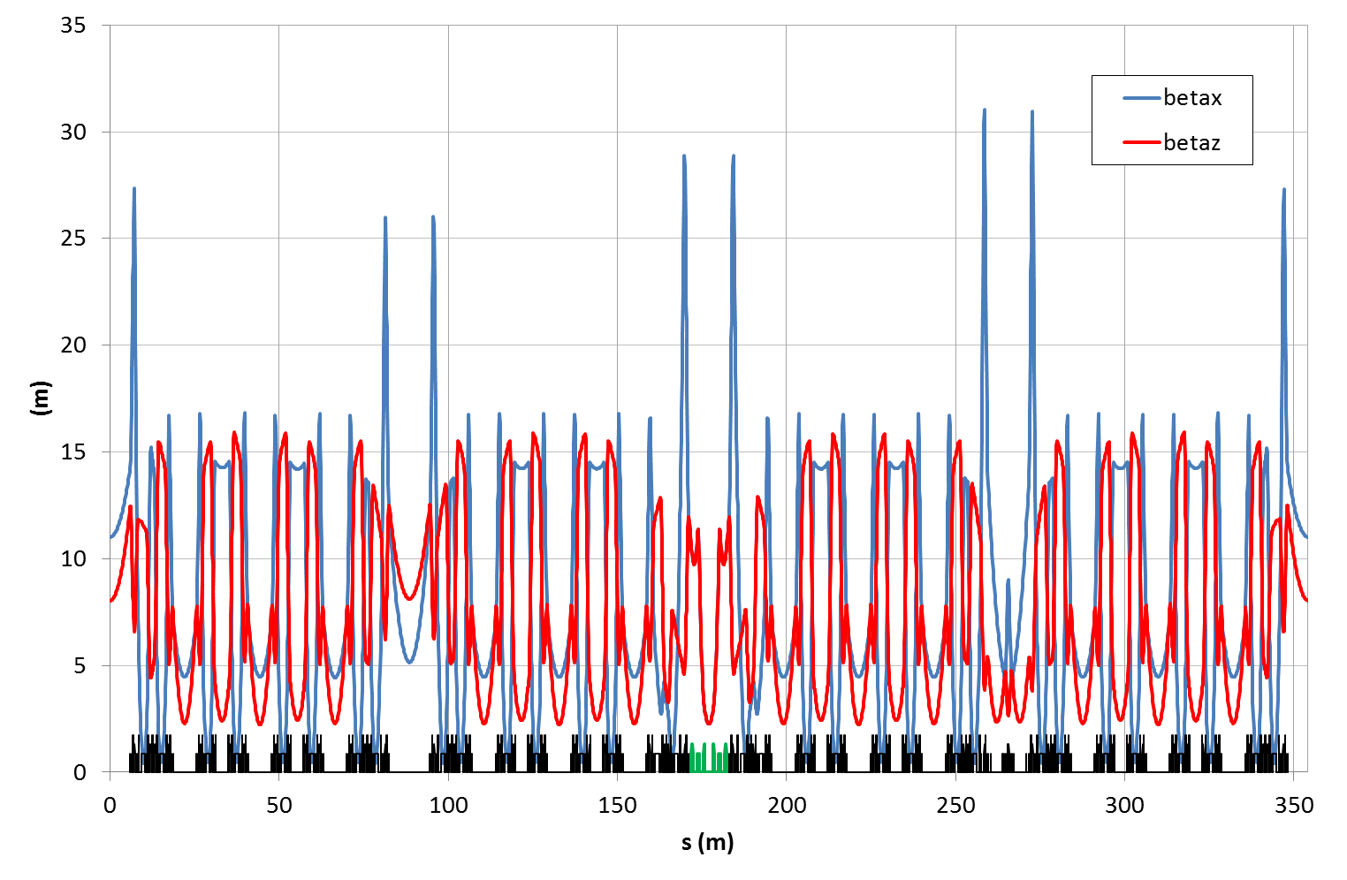
III. Feasibility Study made at SOLEIL so far
Storage Ring Optics The optical functions are modified only in SDL09
nux = 18.176 nuz = 10.234
QT maximum gradient = 17 T/m, L = 0.40 m

Slide 19
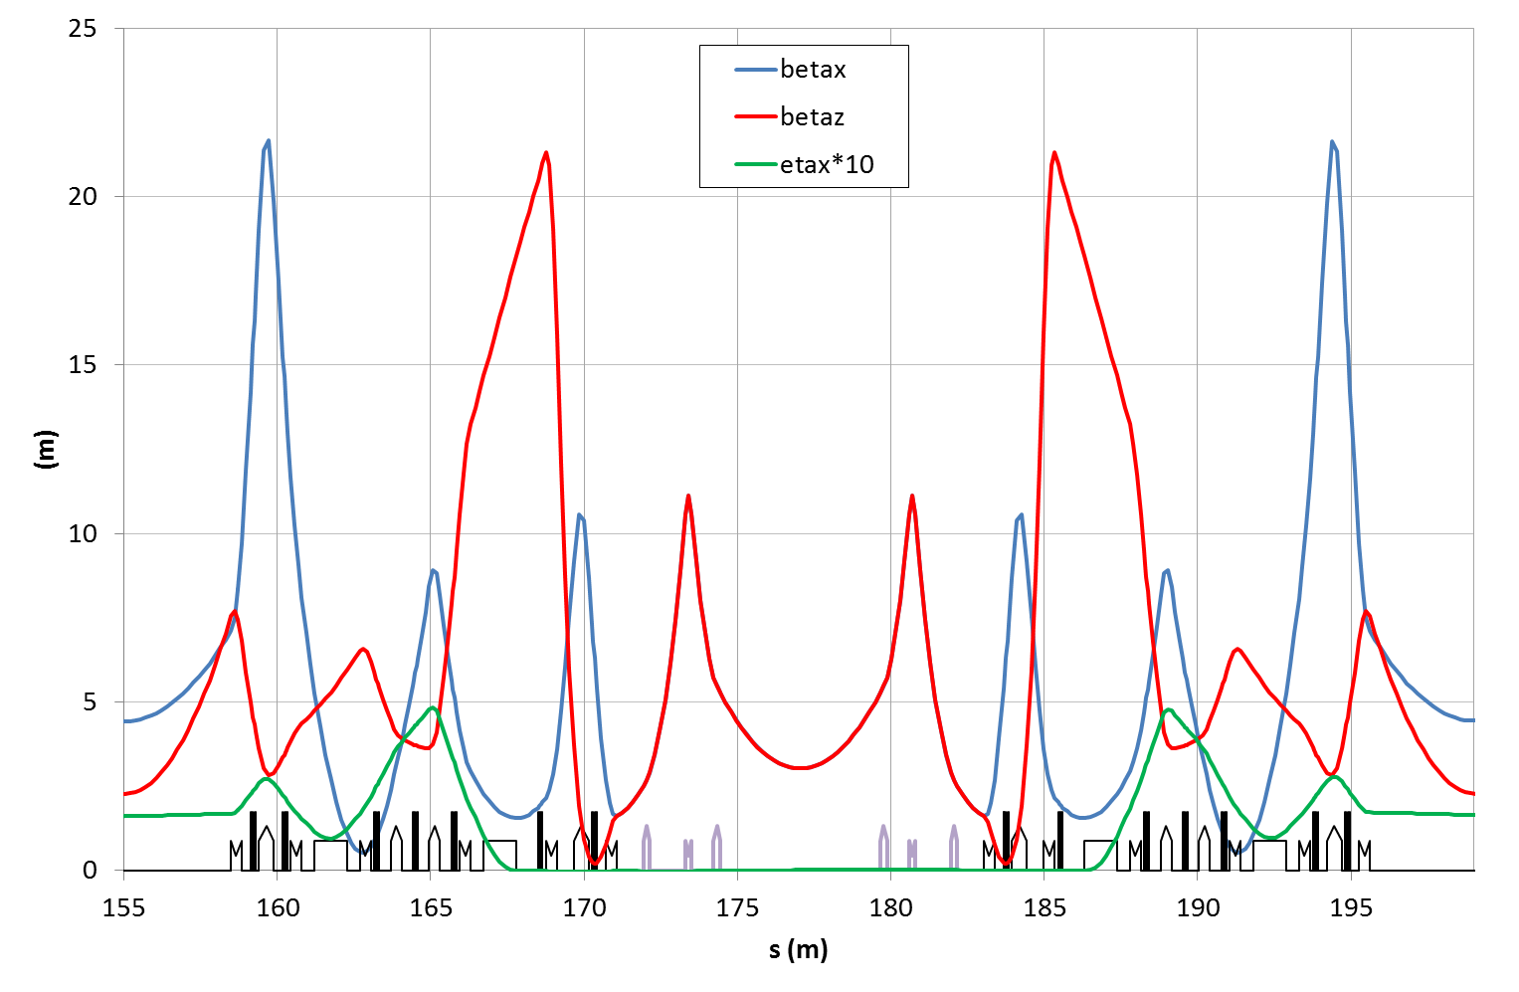
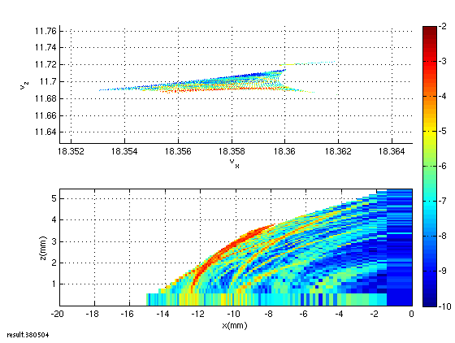
III. Feasibility Study made at SOLEIL so far
New optics with 5.2 m available for the solenoid (preliminary studies)
New magnet setup :
skew quadrupoles reach 47 T/m gradient, L = 0.21 m
3 quadrupoles of the ring reach gradient > 20 T/m
Required solenoid strength < 4 T
nux = 18.360, nuz = 11.714
ex = 9.4 nm.rad
betax = betaz = 3 m (@ ID centre)
sigmax = sigmaz = 168 µm

Slide 20
Evaluation of the cost of the main equipment
Equipment | Amount of money (k€) | Spending profile (year)
Vacuum chambers*, Tapers | 135 | 2015
Skew quadrupoles and their girders or frames to rotate existing quadrupoles** | 120 (50) | 2015
Design and engineering | 20 | 2015
Power supplies for quadrupoles | 60 | 2015
BPMs | 20 | 2015
Pinhole Camera based Imaging system | 75 | 2015
Solenoid | Provided by ESRF | 2015
Control system | 10 | 2016
Total | 440 (370)
*: NEG at SOLEIL or ESRF
**: option of using existing quadrupoles (ESRF and SOLEIL) and rotate them.

