Slide 1

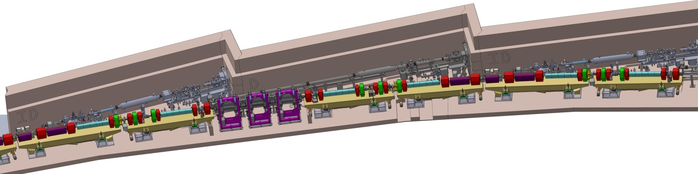

Low Emittance Rings 2014 Workshop
Frascati, 17 & 19 September 2014
Status of ESRF Upgrade Phase II
The Accelerator Project – J.L. Revol
On behalf of the Accelerator Project Phase II Team

Slide 2
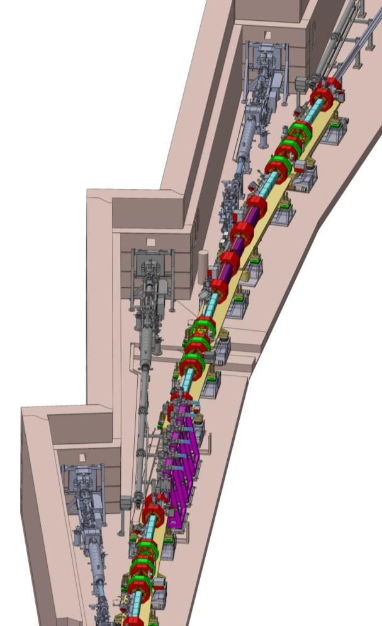
Objectives
Design, procurement, preassembly, construction and commissioning
of a new low emittance storage ring
to reduce the horizontal equilibrium emittance
from 4 nm down to 150 pm
Re-use the same tunnel and infrastructure
Maintain the existing insertion device and bending magnets
beamlines
Preserve the time structure operation
and a multibunch current of 200 mA
Keep the present injector complex
Reuse, as much as possible, existing hardware
Minimize the energy lost in synchrotron radiation
Minimize operation costs and maintain operation reliability
Minimize the impact on User Operations due to the downtime
for installation and commissioning

Slide 3
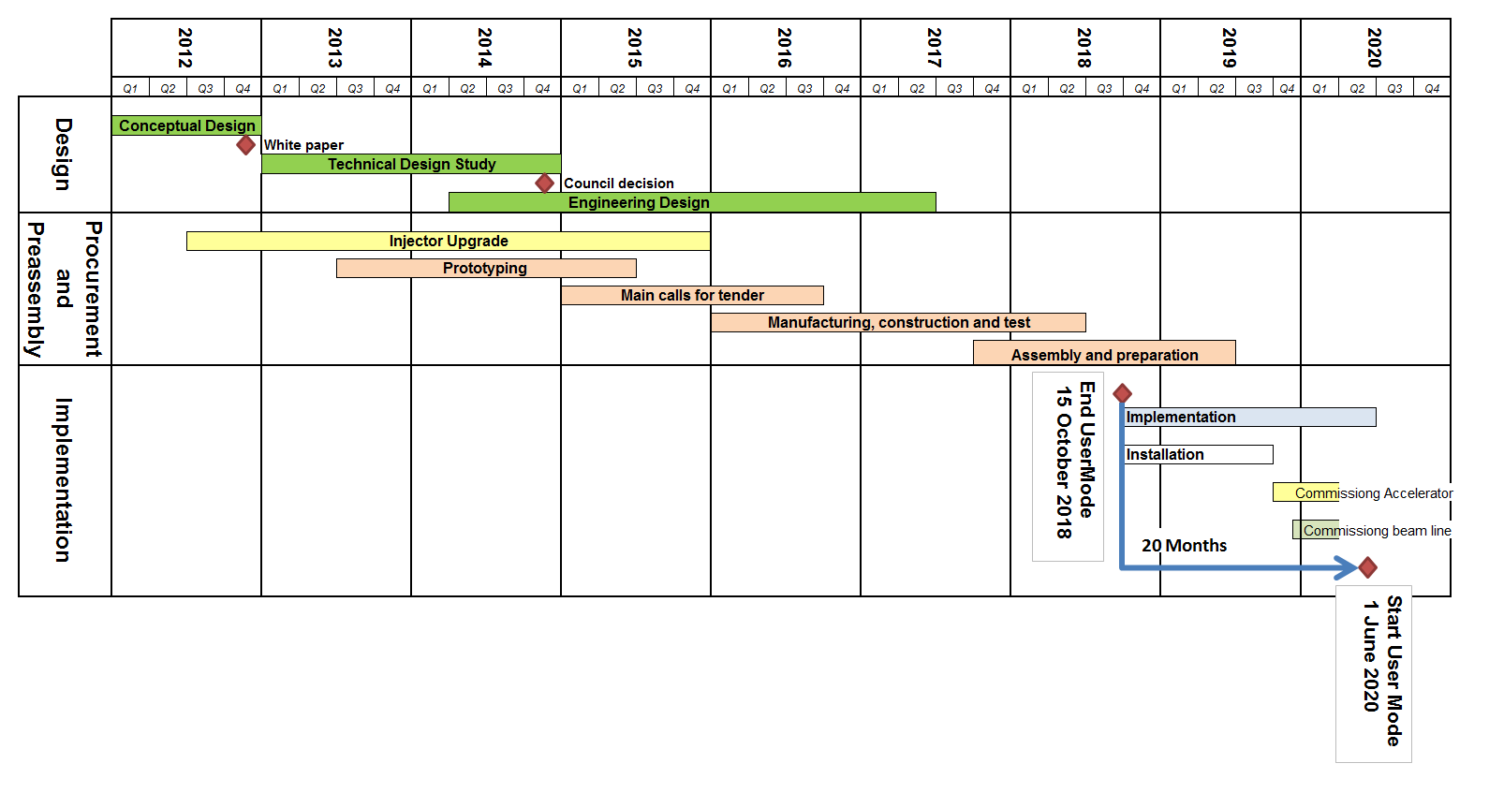
Time scale
  Operation 2013: Accelerator and Source
4 years
Nov 2012 White paper (conceptual design)
Nov 2012- Dec 2014 Technical Design Study
June 2014 Project approved by the Council
Jan 2015 – Oct 2018 Detailed design and procurement
Oct 2018 – Sep 2019 Shutdown for installation
Sep 2019 – Jun 2020 Commissioning
June 2020 User Mode Operation
Start shutdown:
October 2018
Notes:
3

Slide 4
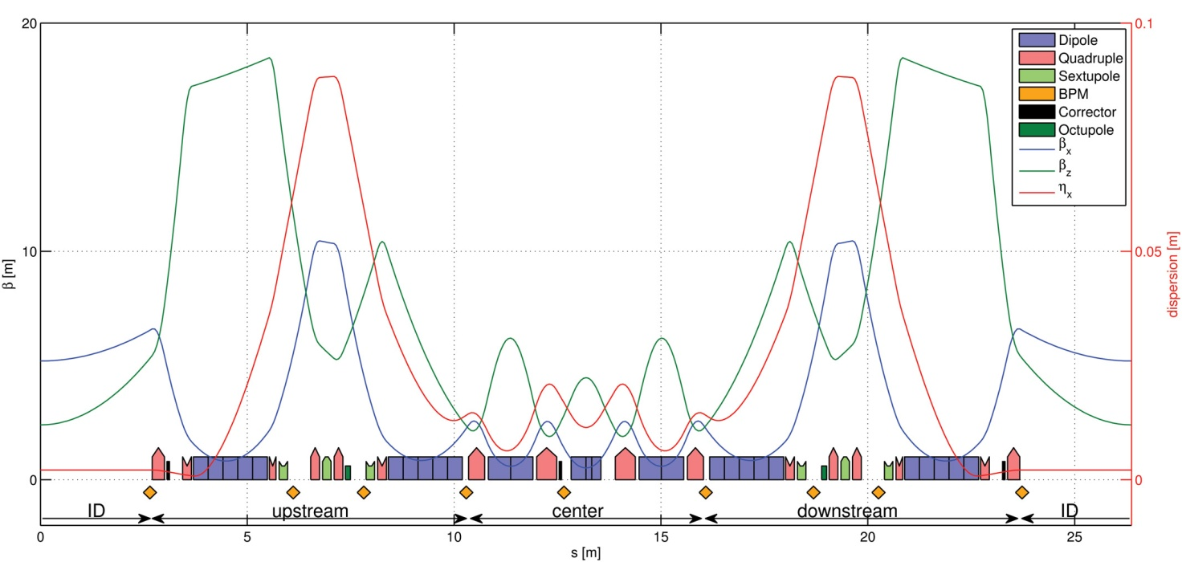
Optical functions of a standard cell
7 bends hybrid achromats to replace the existing DBA
Space between dipoles 1&2 and 6&7 ➔ beta-functions and dispersion grow to high values ➔sextupoles more efficient.
Central part, four high-gradient horizontally-focusing quadrupoles and three high-gradient bending magnets providing also vertical focusing.
At each side of the cell, two dipoles with longitudinally varying bending field
➔ reduce emittance and increase dispersion.

Slide 5
Main parameters
Lattice parameters | Present | New
Lattice type | DBA | HMBA
Circumference [m] | 844.390 | 843.979
Beam energy [GeV] | 6.04 | 6.00
Natural emittance [pm•rad] | 4000 | 147
Vertical emittance [pm•rad] | 4 | 5
Energy spread [%] | 0.106 | 0.095
Damping times H/V/L[ms] | 7/7/3.5 | 8.5/13/8.8
Energy loss /turn [MeV] | 4.88 | 2.60
Tunes (H/V) | 36.44/13.39 | 75.58/27.62
Chromaticity (H/V) | -130/-58 | -100/-84
Momentum compaction | 1.78 10⁻⁴ | 0.87 10⁻⁴

Slide 6
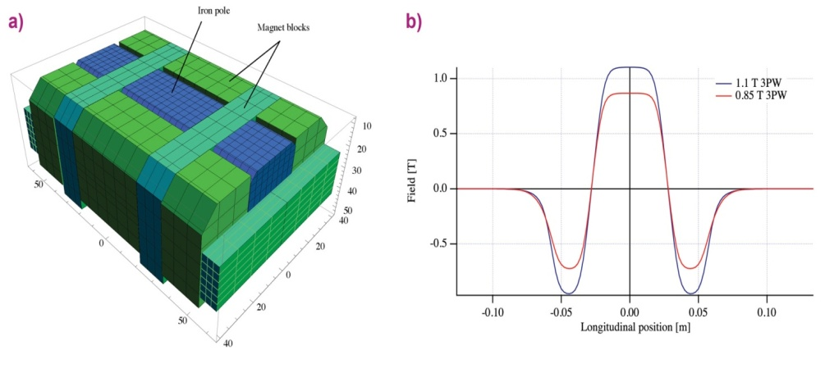
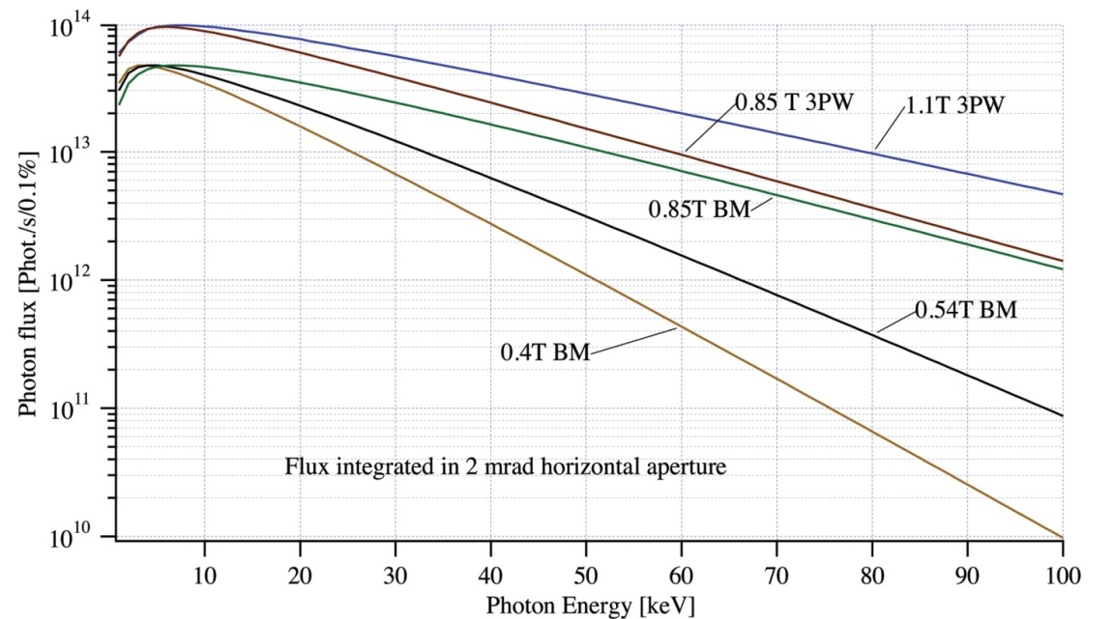
Bending magnets source: 3-Pole wiggler
All new projects of diffraction limited storage rings have to deal with:
Increased number of bending magnets / cell => BM field reduction.
Conflict with hard X-ray demand from BM beamlines.
ESRF will go from 0.85 T BM to 0.54 T BM.
The BM Source can be replaced by a dedicated 3-Pole Wiggler:
Half
assembly
Field Customized
Large fan with flat top field
2 mrad feasible for 1.1 T 3PW
2 mrad difficult for 0.85 T version
Mechanical length ≤ 150 mm

Slide 7
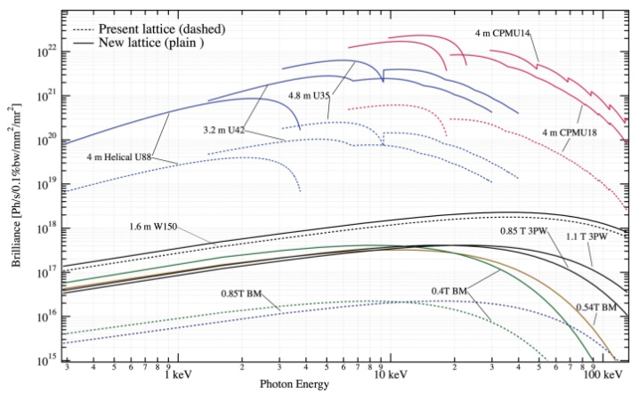
Brilliance from various sources
x 30
I = 200 mA

Slide 8
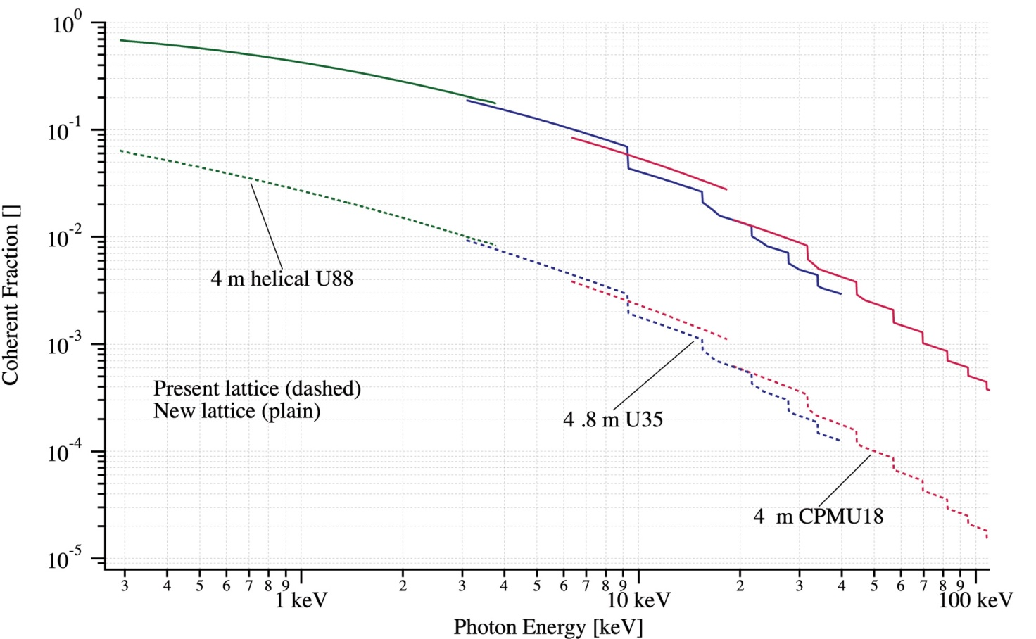
Coherent fraction of the photon flux
I = 200 mA
x 30

Slide 9
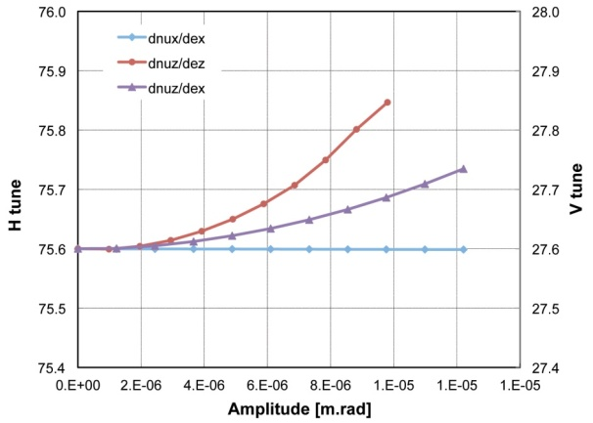
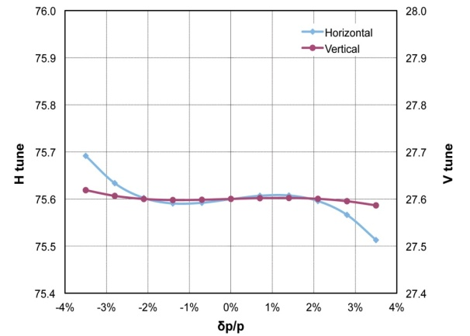
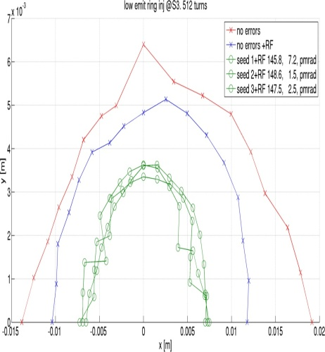
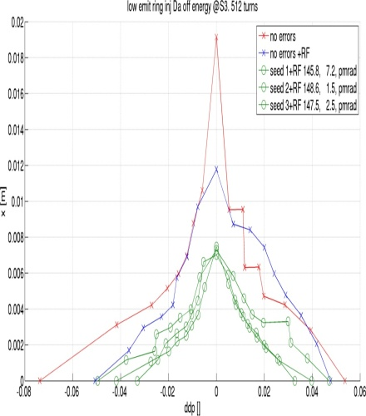
Non Linear dynamics
Tune shift with amplitude and momentum are minimized by:
-Identity phase advance transform
between sextupoles
sextupole tuning
introduction of octupoles.
Amplitude-dependent tune shifts
Momentum-dependent tune shifts
Transverse and longitudinal acceptance at injection, compatible with a conventional injection scheme and the present injector complex.
Multibunch lifetime in the order of 5-10 hours according to the error seed.
Transverse acceptance at injection
Longitudinal acceptance at injection

Slide 10
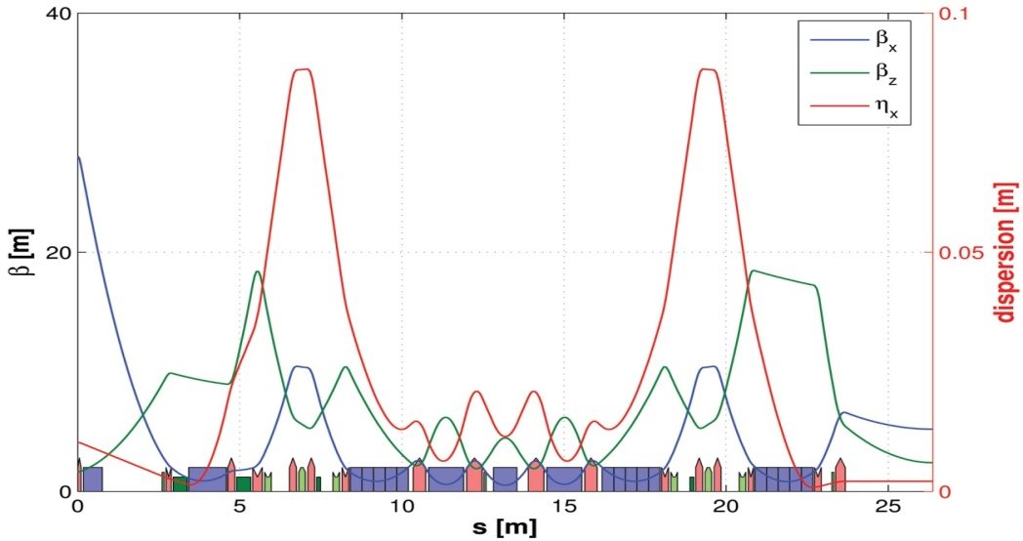
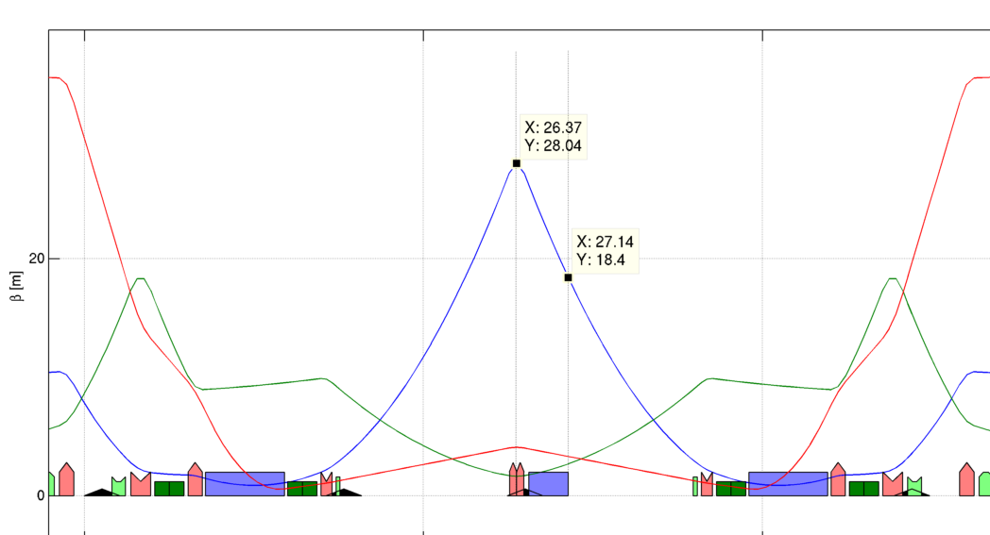
Special Injection cell
High horizontal beta at septum 18.4 m
Phase advance identical to the standard cell
Optical function identical in most of the cell
Slight local chromaticity differences
Geometry and requirements close to the present injection scheme
(4 kickers, 2 in-air septa, 1 in-vacuum septum)
No sextupoles within the injection kicker bump
 | Present Booster | Upgraded Booster
Injected beam emittance [nm] | 120 | 60
Booster RF voltage [mV] | 7.3 | 11
Bunch length [mm] | 23 | 17
Septum thickness [mm] | 2 | 1.5
Beam distance from septum [mm] | 1 | 0.5
Max. efficiency [%] | 70 | 95
S1-S2
S3 septum
K1
K2
K3
K4

Slide 11
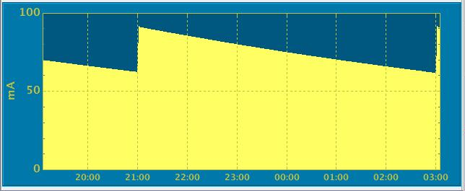
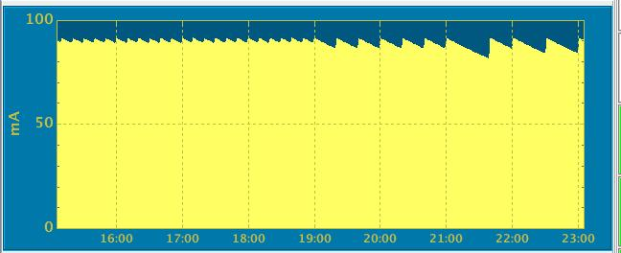
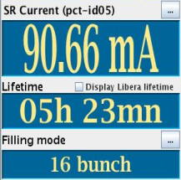
Injector Upgrade
16 Bunch mode
Injector upgrade for Top-up operation is a deliverable of Phase I (End2015)
Test with users are on going during machine time
Improvements for reliability are ongoing
  New ramped power supply (4Hz)
  Two additional cavities in the booster
  Linac
Bunch cleaning in the booster under development
Emittance reduction under study
Specific requirement for the new storage ring
Slight reduction of the circumference to compensate the shorter length of the SR (+171 kHz RF frequency)
New injection layout
Nominal decay
with vertical beam blowup to increase lifetime

Slide 12
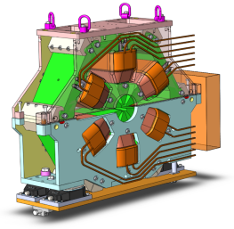
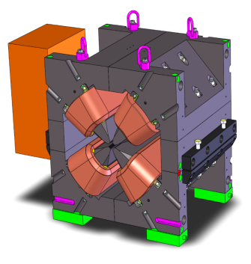
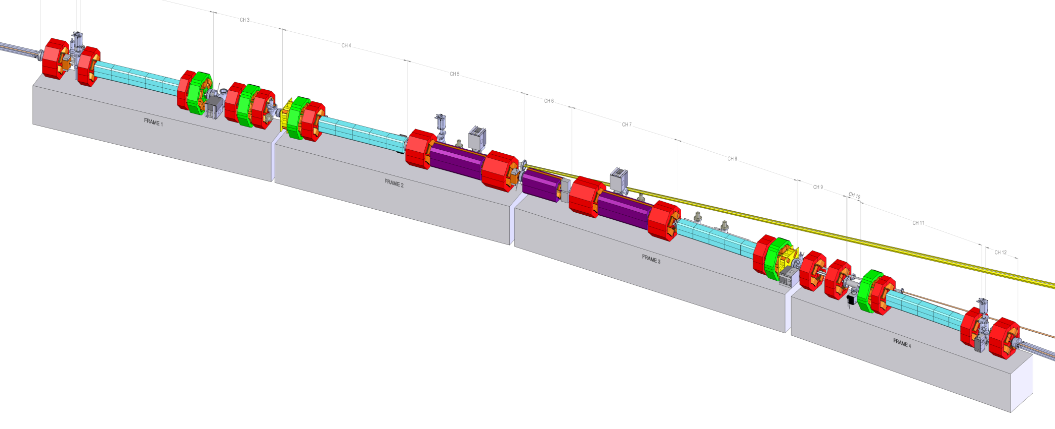
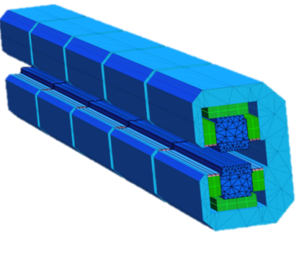
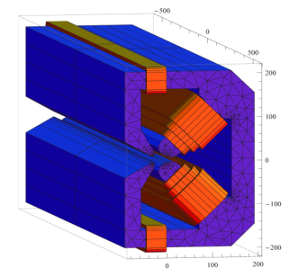
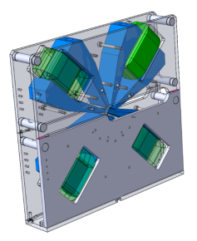
Magnets (more details in Gael’s talk)
192 Sextupoles
Length 200mm
900-2200 Tm⁻²
Also used as dipole and skew quad correctors
128 High gradient Quadrupoles
Gradient: 85 T/m
Bore radius: 12.5 mm
Length: 390/490 mm
Power: 1-2 kW
96 Correctors (H/V)
Length 120mm
0.08 T
384 Moderate gradient quadrupoles
Gradient: 51 T/m
Bore radius: 15.5 mm
Length: 160/300 mm
Power: 0.7-1 kW
All magnets individually powered
128 Permanent magnet dipoles
longitudinal gradient 0.16 − 0.65 T, magnetic gap 26 mm
1.8 meters long, 5 modules
Hybrid Sm2Co17 / Strontium Ferrite
96 Combined
Dipole-Quadrupoles
0.54 T / 34 Tm⁻¹
& 0.43 T / 34 Tm⁻¹
64 Octupoles
51.2 10³ T/m³

Slide 13
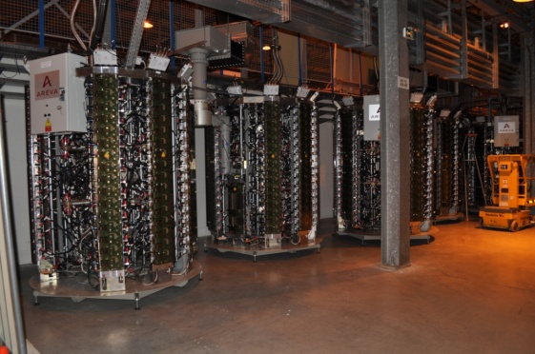
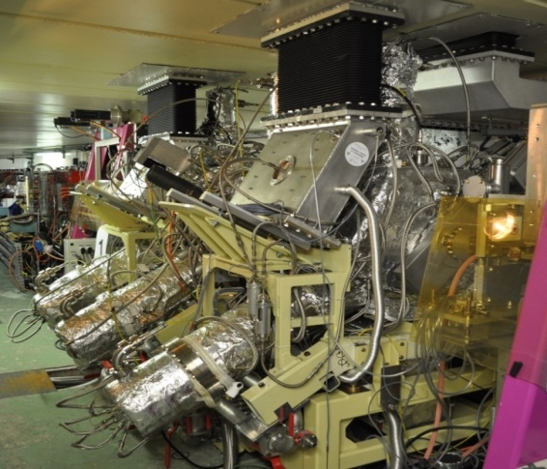
Radiofrequency
RF parameters | Present | New
Energy loss (incl 0.5 MeV/turn for IDs) | 5.4 MeV/turn | 3.1 MeV/turn
Longitudinal damping time | 3.5 ms | 8.86 ms
RF frequency | 352.200 MHz | 352.371 MHz
Harmonic number | 992 | 992
Nominal RF voltage | 8 MV | 6 MV
RF energy acceptance | 2.9% | 4.9%
Number of cavities | 5 five-cell cav’s | 14 mono-cells HOM damped
3 cavity prototypes installed in the SR, powered by SSA
12 cavities ordered

Slide 14
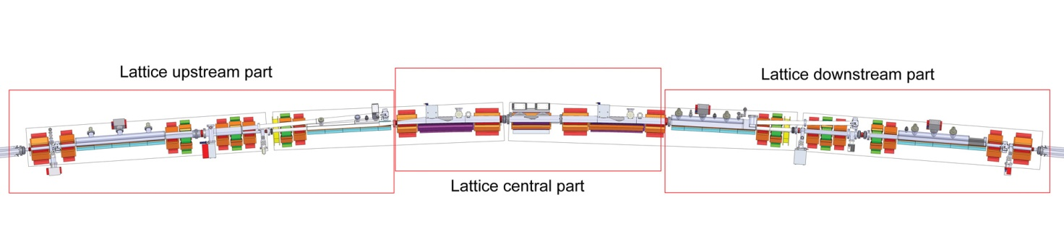
Vacuum chamber layout
Layout with 12 chambers with aperture defined in 3 regions adapted to the beta functions.

Slide 15
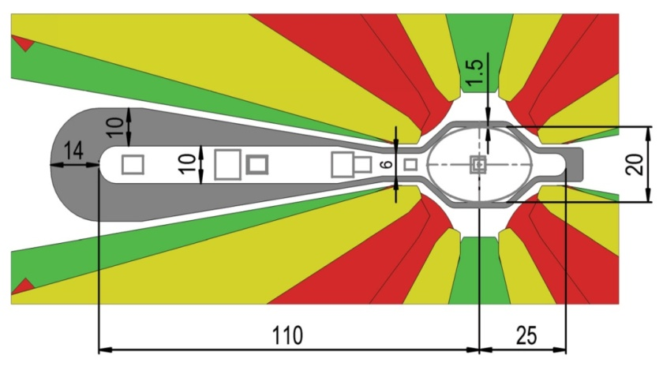
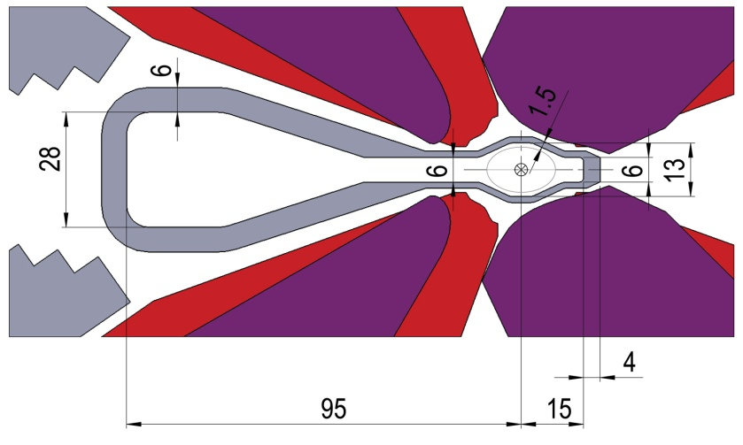
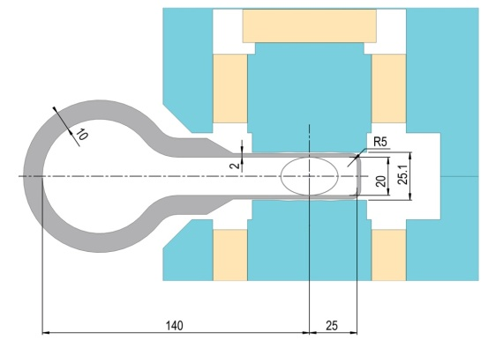
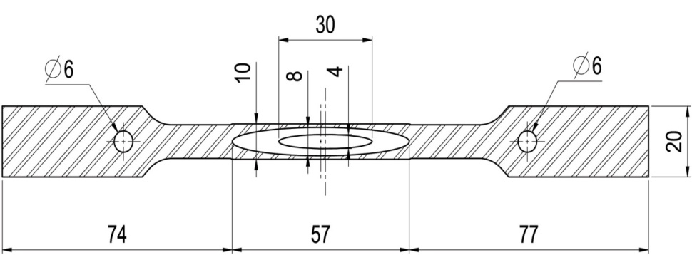
Vacuum system
Upstream & downstream
Centre
30*13 mm
(50*13 under design)
50*20 mm
ID
(reuse of existing ID chambers)

Slide 16
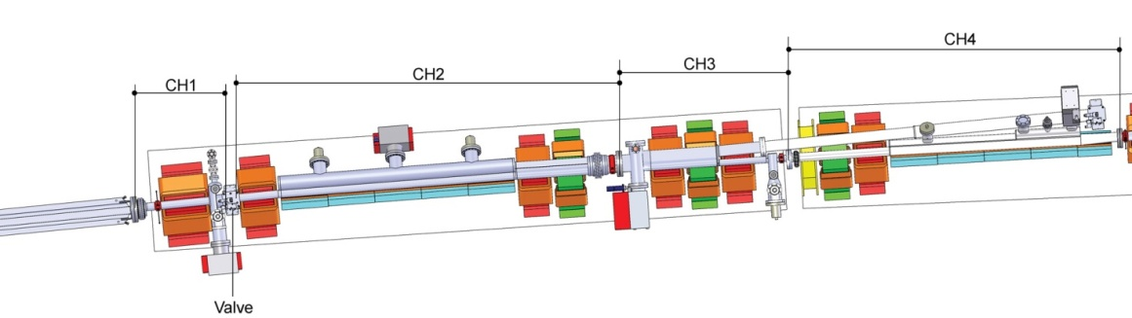
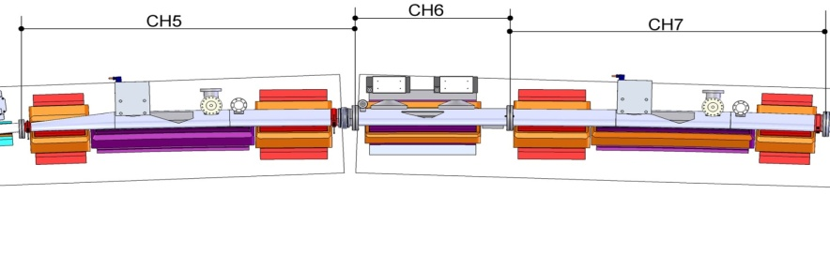
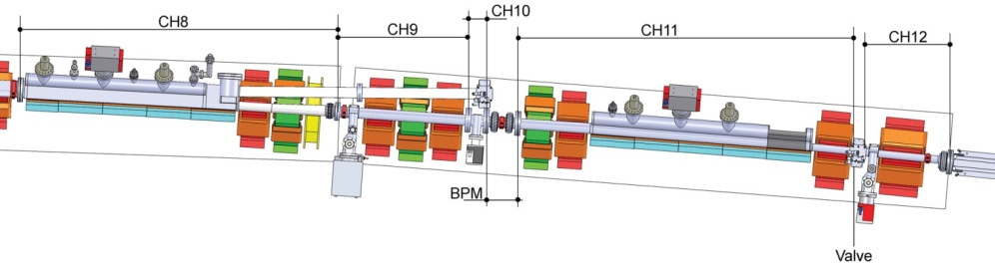
Vacuum system
3 pole wiggler location
Upstream
Vacuum system:
Split in12 chambers
Discreet conventional pumping system using antechambers
Additional NEG coating for chambers 1 and 12
Most probably stainless steel material
Lump and crotch copper absorbers
Impedance and beam losses management under study
Centre
Downstream

Slide 17
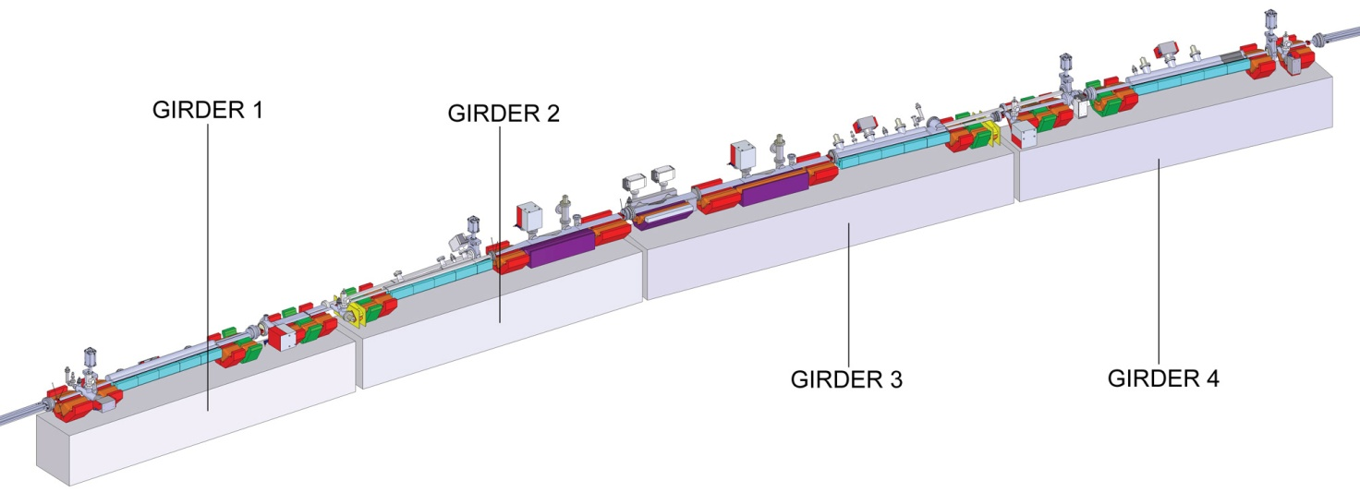
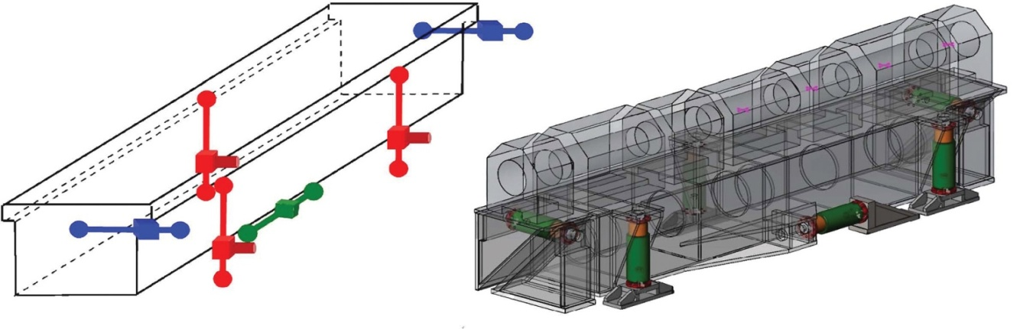
Girders and stability
3 or 4 vertical leg concept under evaluation
Preparation and installation strategy under study
(total weight of girder + magnets larger than the capacity crane)
Z legs motorised, X and Y legs are manually adjustable

Slide 18
Prototyping mid 2013-mid2015
No new technologies to be validated,
  No R&D foreseen.
Prototypes needed to:
  Validate the components design.
  Finalise the engineering design of the fully assembled elements.
  Verify required tolerances achievable at industrial level.

Slide 19
Prototyping mid 2013-mid2015
Magnet
  Prototyping started fall 2013.
  Majority of prototypes ordered by end 2014 and validated by summer 2015.
Vacuum chamber
  Prototyping started at the beginning 2014 (Chamber with 3 new BPMs under test with beam, prototypes launched summer 2014 to validate the realisation of profiles, first central part profile available this month).
  Prototyping will allow validating the design of all components, including bellow shields, absorbers....
Girder
  Prototype ordered before end 2014, girder design finalised by end 2015 in order to validate the stability and tolerances requirements.

Slide 20

Preparing the Upgrade phase II
Technical Design Study (TDS)
completed and submitted to:
Science Advisory Committee (SAC)
Accelerator Project Advisory Committee (APAC)
Cost Review Panel (CRP)
ESRF Council
All committees
very positive to go ahead

Slide 21
Organisation and project management
10 Work Packages defined in the TDS:
WP0: Logistics and installation
WP1: Beam dynamics
WP2: Magnets
WP3: Mechanical and Vacuum Engineering
WP4: Power supplies
WP5: Radiofrequency
WP6: Control System
WP7: Diagnostics and feedbacks
WP8: Photon source
WP9: Injector upgrade
ESRF is now preparing the organisation
to be in a position to start from 2015
the execution phase of the project.
Accelerator Project Budget:
103.5 M€ Construction and commissioning of the new storage ring
including infrastructure adaptations and logistics for storage and pre-assembly.
In addition, the ESRF Upgrade Phase II also includes the upgrade of 4 beamlines and the implementation of an aggressive scientific instrumentation roadmap.

Slide 22
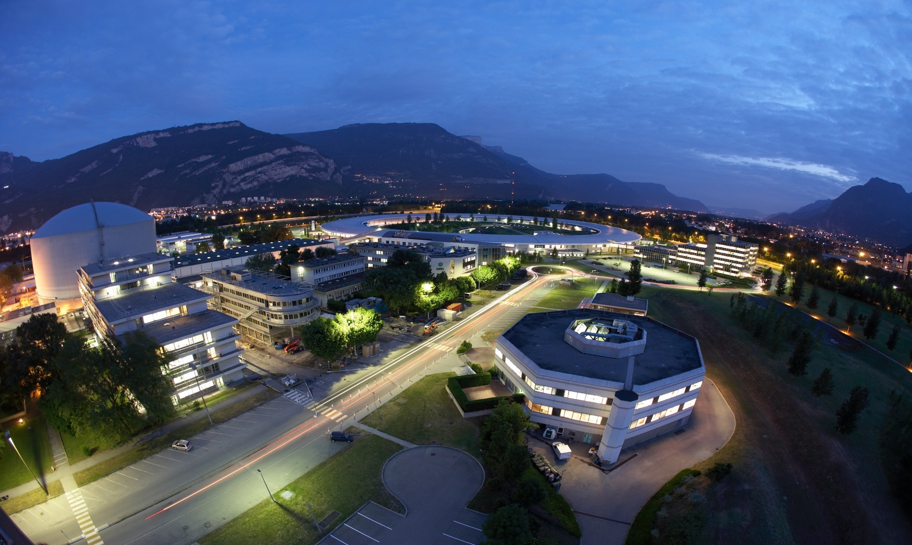
Many thanks for your attention

