Slide 1
Vertical Emittance at the Quantum Limit
Rohan Dowd
Senior Accelerator Physicist, Australian Synchrotron

Slide 2
Overview
Vertical emittance minimisation method
Early results from lifetime analysis
Vertical Undulator results
Refinements:
Beam based magnet alignment
Additional Skew quads
Low chromaticity lattice
Latest results
Refined lifetime analysis
Quantum limit determination
Conclusions

Slide 3
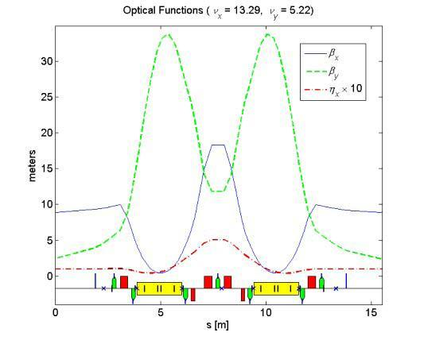
Lattice
3 GeV Light Source (3.013 GeV),
Double bend achromat lattice design
Operates at 0.1 m dispersion in straights – 10.4 nm Hor. ε
28 Skew quads for coupling control, located on sextupole windings. 28 additional unpowered windings.
Storage Ring Parameters
Energy 3 GeV
Circumference 216 m
RF Frequency 499.654 MHz
Peak RF Voltage 3.0 MV
Current 200 mA
Betatron Tune (h/v) 13.3/5.2
Momentum Compaction 0.002
ε_{x} (nominal) 10.4 nm∙rad

Slide 4
Vertical emittance minimisation method
Measure orbit response matrix and dispersion. Analyse with LOCO, fit skew quad components to every multipole in the ring.
Use LOCO calibrated lattice to calculate equilibrium beam envelope in AT, using Ohmi method (K.Ohmi et al. Phys.Rev.E. Vol.49. (1994)). Calculate Vertical emittance from this.
Feed calculated emittance into minimisation algorithm which adjusts the skew quadrupole currents in the model to minimise it (or set it to an arbitrary value)
Apply skew quadrupole settings onto machine and re-do LOCO analysis. Calculate vertical emittance from calibrated lattice.
Calculated emittance incorporates coupling and vertical dispersion effects only, not Quantum limit.

Slide 5
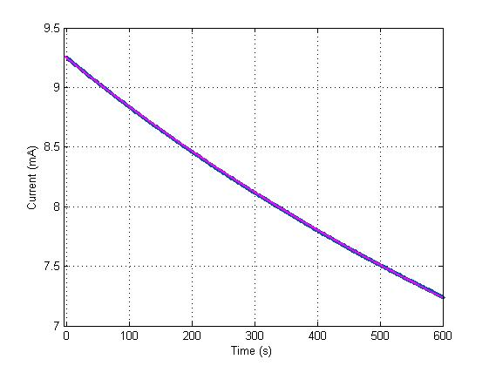
Touschek Lifetime Fitting
By taking single bunch lifetime over extended period the Touschek component of the lifetime can be extracted.

Slide 6
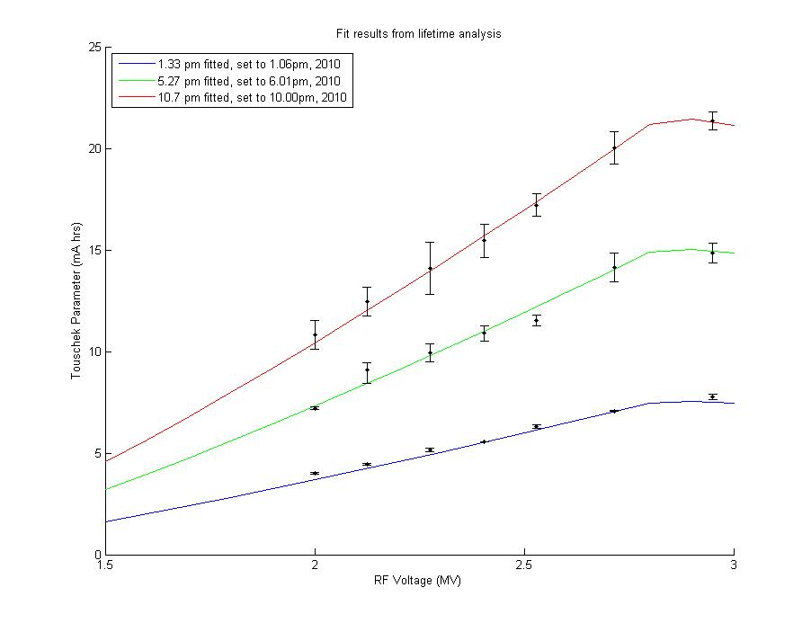
Touschek Lifetime Analysis
Touschek lifetime parameter depends on beam sizes and RF energy acceptance
If we know our horizontal and longitudinal beam sizes well and our RF voltage and beam energy, then we can calculate the Touschek parameter for a given vertical beam size and hence deduce an vertical emittance.
Extracting the Touschek parameter at various RF voltages allows us to fit a curve to the results by varying the vertical emittance.
R. Dowd, et al, PRST:AB, 14, 012804, (2011)

Slide 7
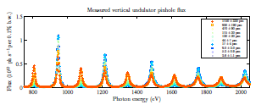
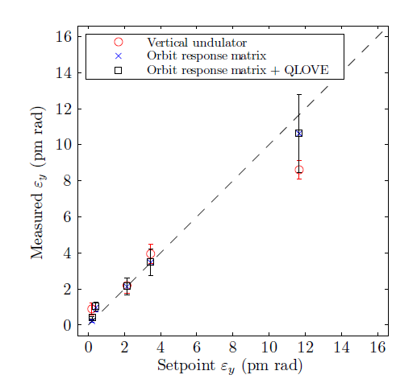
Vertical Undulator Measurements
An APPLE 2 undulator was set up as a vertical undulator for use in direct beam emittance measurements on a user beamline.
Photon flux ratios between odd and even harmonics can be used to determine vertical spatial coherence and therefore emittance.
Agrees very well with LOCO analysis down to ~1pm, where uncertainties start to dominate. Main uncertainties arise from limited magnetic model of ID (especially in vertical polarisation mode) and uncertainty in pinhole vertical size and position.
Reference: K. Wootton, et al, Submitted to PRST:AB
also in Thesis of K. Wootton at http://hdl.handle.net/11343/39616

Slide 8
Beam Based Magnet Alignment
Coupling terms rise from quadrupole rolls and sextupole vertical offsets.
Alignment surveys often made coupling worse
Alignment survey positioning doesn’t tell you what is happening at the magnetic centre.
The beam will tell you where the magnetic centre really is
Orbit response analysis using LOCO should allow you to find the sextupole offsets. (Eg. V. Sajaev, A Xiao, IPAC10)
Need to take care with the LOCO fitting. Simultaneous measurements found not to work due to ‘smearing’ of fitted coupling.
Separate, family by family measurements taken.

Slide 9
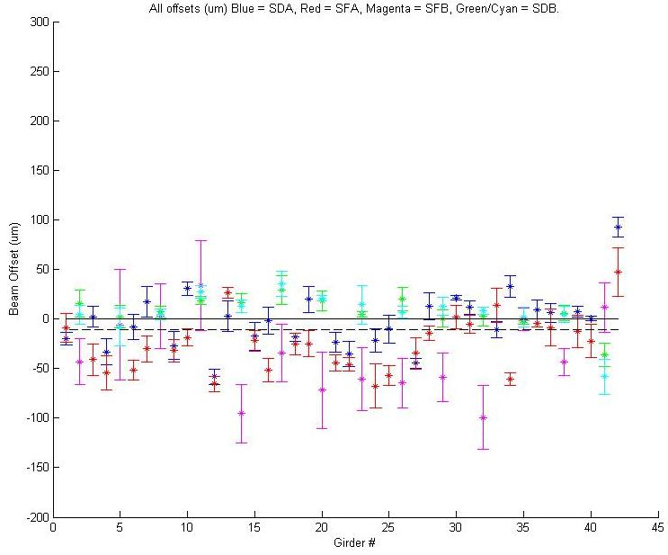
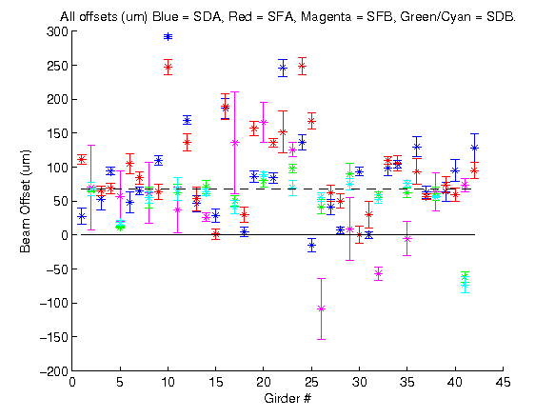
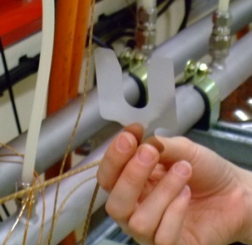
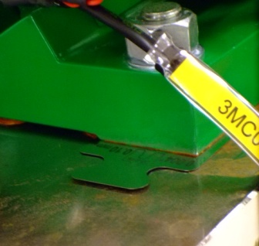
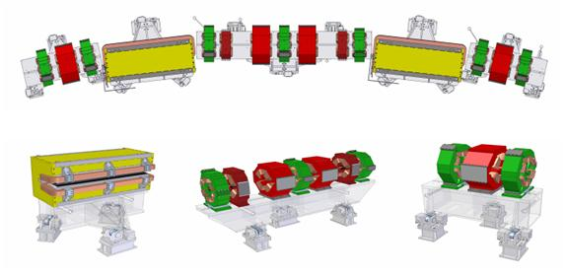
Sextupole offsets
Shunt each sextupole magnet family to different strengths and take a response matrix at each point
Perform LOCO analysis and fit skew quadrupole terms to each sextupole.
Gradient of skew field vs sextupole field gives vertical offset.
Shim Magnets to reduce offsets
Notes:
Note – I found an error in the calculations for the SFA family last week. We have over-shimmed those magnets by about 75%, so these will be redone shortly. This probably explains the next slide result, where the shimming of the sextupoles didn’t have a huge effect on the coupling.
As mentioned, each family was shunted separately. Its not possible with LOCO to do all sextupoles at once, as the fits don’t work (the smearing effect causes all the offsets to come out the same).

Slide 10
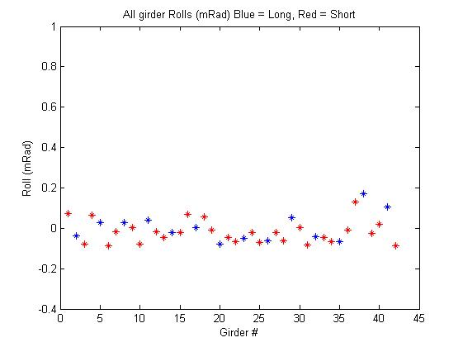
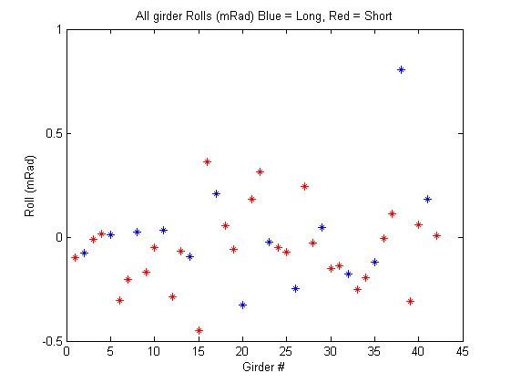
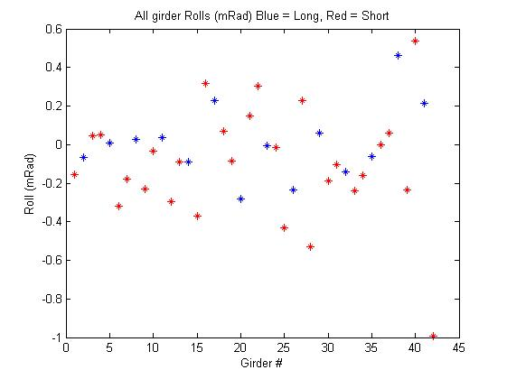
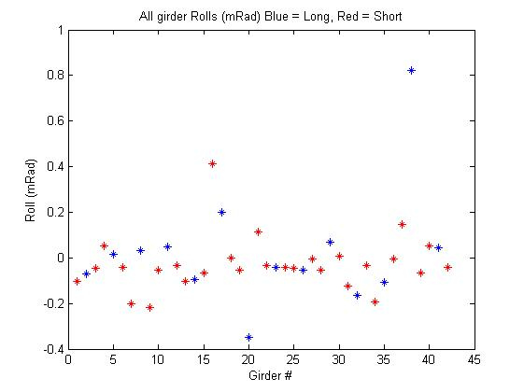
Emittance coupling – Quadrupole rolls
Turn off Sextupoles and perform LOCO analysis.
Fit skew quadrupole terms to each Quadrupole only
Roll Girders by the amount indicated in the LOCO analysis and re-measure.
Method was found to be accurate to ±0.05 mRad. Mechanical precision of setting the girders ±0.1 mRad. Rolls now reduced to < 0.2 mRad.
Girder roll (mRad) progression over several alignment iterations
Notes:
The

Slide 11
What did Magnet re-alignment achieve?
Sextupole shimming didn’t have much effect on the uncorrected coupling, but allowed for better minimisation
Quadrupole Rolls had a strong effect
Effort required was not especially high – but we did get lucky with the sextupole offsets.
Lattice Condition | Uncorrected ε_{y} (pm) | Minimised ε_{y} (pm)
Uncorrected | 36.8 ± 5.9 | 8.3 ± 2.3
Sextupoles Shimmed | 35.8 ± 6.2 | 5.4 ± 1.9
Sextupoles off | 30.4 ± 4.8 | 6.0 ± 1.4
Sextupoles and Quads corrected | 12.8 ± 2.4 | 0.8 ± 0.1

Slide 12
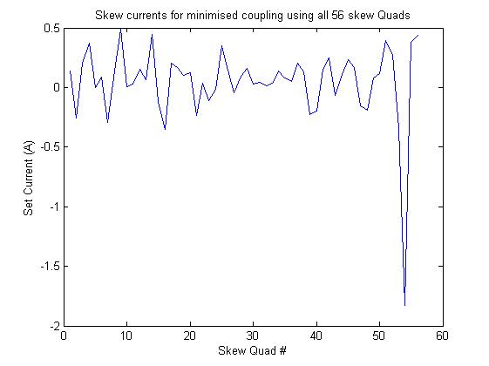
Skew magnet re-positioning.
Only 28 of 56 possible skew quadrupole coils normally are powered in the storage ring.
A simulation using all 56 skew quadrupole coils as skew correctors found the ring was best minimised with a very high skew correction in one particular sextupole
Purchased 4 additional power supplies and powered all skew coils around this area. Storage ring sectors 1-12 have 2 skew quads in each, 13 and 14 now have 4 skew quads.

Slide 13
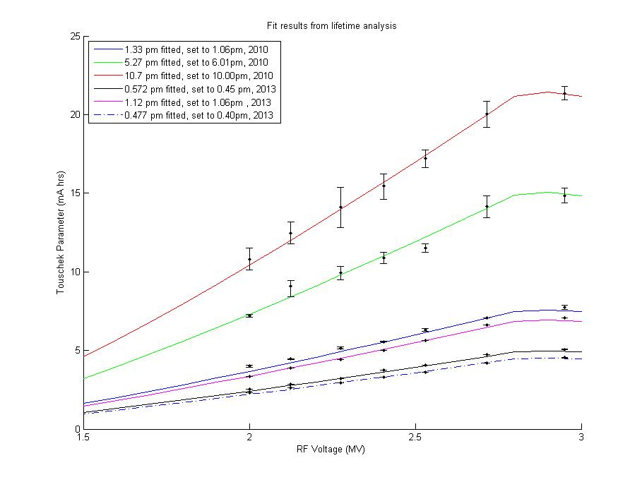
Results after alignment and skews

Slide 14
Change to low chromaticity lattice
Touschek lifetime analysis sensitive to the momentum acceptance of the lattice. Low chromaticity lattice was found to have slightly higher momentum acceptance, which raised it above the RF acceptance.
Measurements of our lattice momentum acceptance are not very accurate - would prefer it to not be a factor -> Go to low chromaticity lattice, where lattice acceptance is always higher than RF acceptance.
Results are theoretically better anyway as the sextupoles are at lower strength, therefore less induced coupling from them.
.

Slide 15
Other refinements to the lifetime analysis
Updated Touscheck scattering equation
Updated to Piwinski derivation for flat beams A. Piwinski, DESY 98-179
Incorporated PWD in beamsize better for lower RF voltages
use impedance model to determine single bunch lengthening for different RF voltages
confirmed with streak camera measurements
Extra care when collecting data
Avoid spin polarisation effects by shortening the lifetime data collection time (10 min → 2 min) and always using freshly injected beam
Multiple Iterations of minimisation algorithm (usually 2-3)
No orbit corrections between setting the coupling and data collection

Slide 16
Spin Polarisation Effect
Allowing the beam to polarise can affect the lifetime measurement by ~ 10%. Polarisation time at ASLS is ~ 14 minutes. K.P.Wootton, et al., PRST:AB, 16, 074001, (2013)

Slide 17
Touschek Lifetime Analysis - low chromaticity lattice

Slide 18
Reaching the Quantum Limit
Quantum Limit of vertical emittance, calculated from the Raubenheimer equation, QL = 0.346 pm
Touschek parameter is dependent on beam volume and energy acceptance. We know β_{x,y}, ε_{x}, η_{acc} and γ < 1%. Dominant uncertainty is from bunch length, σ_{z}, which has been previously estimated in low-α studies as 3.6%. A total error in beam volume ± 5% was applied and results re-fit to determine error of the emittance determined by the lifetime analysis.
Error in the ‘Coupling + Vertical dispersion’ emittance from the LOCO analysis is determined in the beam envelope calculation.

Slide 19
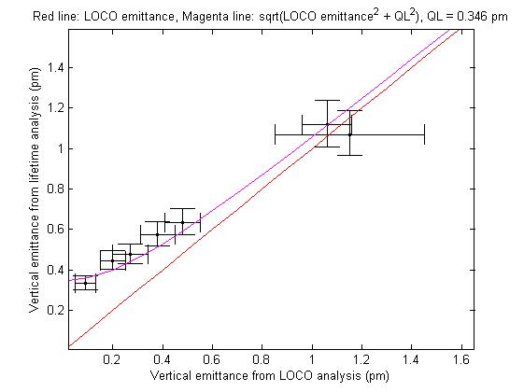
Comparison with expected curves
We would expect the Quantum limit to add in quadrature to the emittance from coupling and vertical dispersion
Clear deviation from straight line as emittance approaches the Quantum Limit

Slide 20
Experimental determination of Quantum Limit
Fit using y = sqrt(QL^2 + x^2).
Result: Experimental QL = 0.37 ± 0.06 pm,

Slide 21
Conclusions
Observations
Beam based magnet alignment is effective in eliminating sources of coupling in our storage ring
Targeted positioning of skew quads is more effective than global correction
With care in data collection and good knowledge of machine parameters, lifetime analysis technique is very effective
Achievements
We have measured a vertical emittance of 0.33 ± 0.03 pm, within error of the calculated quantum limit of 0.346 pm.
For the first time, we have experimentally determined the quantum limit of vertical emittance for our storage ring and found it to be 0.37 ± 0.06 pm

Slide 22
Additional Slides
Additional Slides

Slide 23
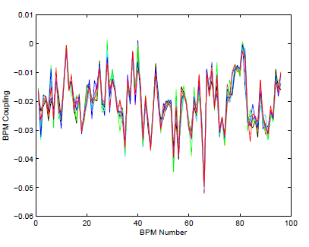
Robustness of LOCO fit results – BPM coupling
LOCO Fitted BPM coupling for a range of different coupling settings
LOCO Fitted BPM coupling for the same machine setting
R. Dowd, et al Phys. Rev. ST Accel. Beams,14, 012804 (2011)

Slide 24
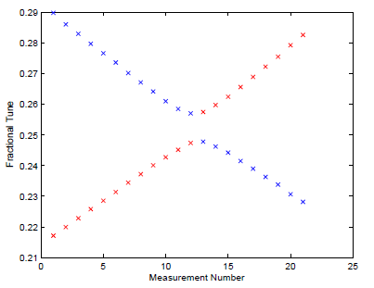
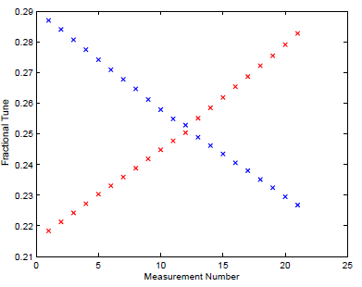
Robustness of LOCO fit results - Tune crossing measurements
Loco analysis result (pm) | Measured (pm) | Difference
92.31 ± 2.77 | 89.55 ± 2.65 | 2.76 ± 3.68
76.30 ± 2.23 | 78.64 ± 2.14 | 2.34 ± 3.09
41.41 ± 1.24 | 42.23 ± 1.84 | 0.82 ± 2.22
22.75 ± 0.68 | 21.72 ± 1.33 | 1.03 ± 1.49
12.75 ± 0.38 | 12.85 ± 1.02 | 0.10 ± 1.09
7.55 ± 0.23 | 7.14 ± 0.71 | 0.41 ± 0.75
1.05 ± 0.03 | 1.32 ± 0.30 | 0.27 ± 0.30

