Slide 1
CLIC DR RF system
Baseline and Alternatives
A.Grudiev
19/09/2014
Acknowledgements for useful discussions to:
K.Akai, S.Belomestnykh, W.Hofle, E.Jensen

Slide 2
Outline
Introduction
Beam loading effect
Baseline
1 GHz alternatives
  SC option
  Option with RF frequency mismatch
  Option with strong input power modulations
2 GHz alternatives (will not be presented in details due to lack of time)
Summary

Slide 3
CLIC DR RF system design evolution
2008,
  CLIC08, (Oct. 2008), 2 GHz RF system issues were raised for the first time, recommendations were given, 1 GHz was proposed as possible alternative.
2009,
  ACE (May 2009), Issues were presented to ACE and partially addressed. ACE recommended to develop concept for RF system.
2010,
  ACE (Feb. 2010), progress was reported.
  CLIC meting (March 2010) 1 GHz RF system with 2 bunch trains adopted for CLIC baseline
  Real work on the DR RF system conceptual design started
  IWLC (Oct. 2010), new DR parameters were presented (more favorable for RF system), several options for conceptual design of 2 GHz RF system were presented
2011,
  New parameter set for the DR: even more favorable for RF
  Conceptual design for the baseline at 1 GHz and several alternatives at 1 and 2 GHz are proposed for the CDR.
  Baseline published in CLIC CDR, alternatives in CLIC-Note-879
Basically, nothing happened since CDR is published

Slide 4
CLIC DR parameters
CLIC DR
RF frequency: f [GHz] | 1 | 2
Circumference: C [m] | 427.5
Energy : E [GeV] | 2.86
Momentum compaction: α_{p} | 1.28 x 10⁻⁴
Bunch population: N_{e} | 4.1 x 10⁹
Number of bunches: N_{B} | 312
Number of trains: N_{T} | 2 | 1
Energy loss per turn: eV_{A} [MeV] | 3.98
Energy spread in the bunch: σ_{E}/E [%] | 0.12
Bunch length: σ_{Z} [mm] | 1.8 | 1.6
RF voltage: V_{C} [MV] | 5.1 | 4.5
Calculated RF parameters
Harmonic number: h | 1426 | 2852
Synchronous phase : φ [º] (0º on crest) | 38.7 | 27.8
Synchrotron frequency: f_{s} [kHz] | 3.45 | 4.58
Energy acceptance: ΔE/E [%] | 2.34 | 1.01
Bucket length 2ΔZ [mm] | 70 | 35
F. Antoniou and Y. Papaphilippou
Last update on 18 Jan. 2011
Synchrotron motion: small amplitude harmonic oscillation in longitudinal phase space

Slide 5
Specifications from RTML
Specification on the bunch-to-bunch spacing variation along the train:
0.1 degree at 1 GHz corresponds to 280 fs; or 84 μm;
Specification on the bunch-to-bunch variation of the bunch length (σ_{Z}) along the train:
RMS{σ_{Z}}/σ_{Z} < 2%
These are very tight specs for the DR RF system itself to meet
It is also a challenge for beam diagnostics in the DR to measure it. Isn’t it?
N.B. At the equilibrium, mean energy and the energy spread are the same for all bunches. Only the bunch spacing and the bunch length are significantly affected by the beam loading transient within each revolution period. It is the scope of this presentation to address this effect.
Slow (compared to the revolution period) variations are outside of the scope of this presentation. Slow feedback system should take care of this.

Slide 6
Beam loading effect (1/3)
2GHz case
1GHz case
Variation of the stored energy and rf voltage due to beam loading (δV_{C}/V_{C} << 1):
I_{B}
T_{B}
T_{R}
t
V_{C}
1GHz case
δV_{C}
V_{A}
Condition to keep RF voltage variation small in an RF system with constant input rf power:

Slide 7
Beam loading effect (2/3)
Variation of the bunch phase due to rf voltage variation (δV_{C}/V_{C} << 1):
Im{V}
δV_{B}
V_{C}
δV₁
δV_{C}
δV₂
δφ₁
δφ₂
φ
Re{V}
V_{A}

Slide 8
Beam loading effect (3/3)
Variation of the bunch length due to rf voltage variation (σ_{E}<< ΔE):
σ_{E}
σ_{Z}
σ_{Z} + δσ_{Z}

Slide 9
Baseline solution (basic parameter chose)
RF frequency is 1 GHz
It is designed in a way that the stored energy is so high that the RF voltage variation is kept small to minimize the transient effect on the beam phase to be below the specifications
ARES-type cavity developed for the KEK B-factory RF system is used after scaling from 0.5 to 1 GHz and some modifications
δφ_{b} = 0.1 degree RMS correspond to 0.3 degree peak-to-peak variation
δV_{C}/V_{C} = δφ_{b} cosφ sinφ = 0.26 %
δU/U = 2δV_{C}/V_{C} = 0.52 %
δU = N_{b}N_{e}eV_{A}(1-N_{b}/h)/N_{T} = 0.318 J
U = δU/(δU/U) = 0.318 / 0.0052 = 61.2 J;
R/Q = V_{C}²/2ωU = 33.8 Ω

Slide 10
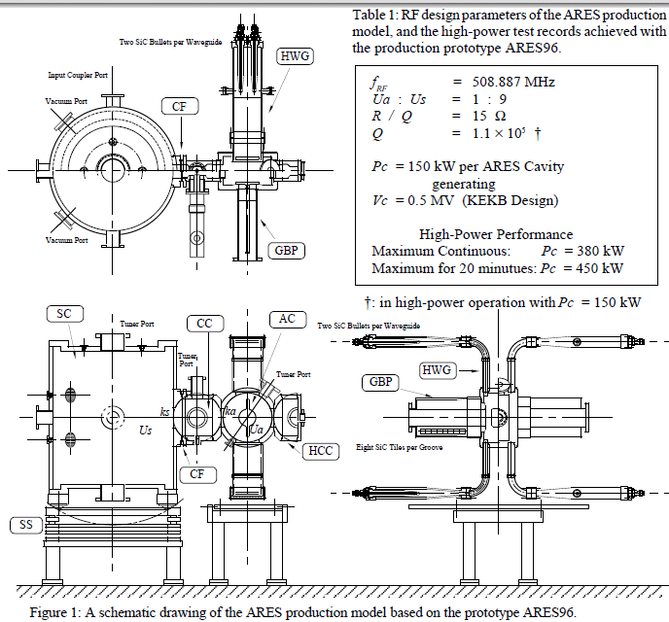
Baseline solution (cavity parameter chose)
Proposed in 1993 by Shintake, cavities of this type (ARES-type utilizing TE015 mode in storage cavity) are used in KEK B-factory in both low and high energy rings. It is equipped with tuning and HOM damping features.
Frequency: f[GHz] | 0.509
Normalized shunt impedance (circuit): R_{g}/Q [Ω] | 7.4
Unloaded Q-factor: Q | 110000
Aperture radius: r [mm] | 80
Power range: P_{g}=V_{g}²/2R_{g} [MW] Nominal – Maximum tested | 0.15 – 0.45
Gap voltage range: V_{g} [MV] Nominal – Maximum tested | 0.5 – 0.866
~2.5 m
Kageyama et al, APAC98

Slide 11
Baseline solution (cavity parameter chose)
Cavity scaling from 0.5 to 1 GHz
1 GHz cavity modification to reduce R/Q
Storage Cavity
TE015
Storage Cavity
TE~0 2 10
R/Q=V²/2ω(U_{a}+U_{s})
in ARES U_{s}=9U_{a}
R/Q ~ 1/f³
Q ~ v/s ~ f
0.5 – 1 GHz
TE 015
AC
Scaling V_{g} to keep EM field amplitude constant : V_{g} ~ f ⁻¹
V_{g} ~ f ⁰
Frequency: f[GHz] | 0.509 | 1 |  | 1
Normalized shunt impedance (circuit): R_{g}/Q [Ω] (~f⁰) | 7.4 | 7.4 | (~f⁻³) x 1/8 | 0.925
Unloaded Q-factor: Q (~f^{-1/2}) | 110000 | 78000 | (~f¹) x 2 | 156000
Aperture radius: r [mm] | 80 | 40 |  | 40
Gap voltage range: V_{g} [kV] Nominal – Maximum tested | 500 – 866 | 250 – 433 | same | 250 – 433
In our case, an intermediate modification of the cavity is chosen to have comfortable voltage per cavity V_{g} = 5100 kV / 16 = 319 kV and the reduced R_{g}/Q = 33.8 Ω / 16 = 2.11 Ω

Slide 12
Baseline solution (final parameter table)
No issues
Constant input rf power matched to the average beam power and power loss in the cavity walls
Only standard feedback system, for example, like in KEK-B LER
Remaining (minor) R&D is the rf design of the modified ARES-type cavity with reduced R/Q of 2.1 Ω.
Parameters of CLIC DR rf system at 1 GHz (baseline) |  | KEK-B LER
Rf frequency [GHz] | 1 | 0.509
Total stored energy [J] | 61.2 | 106
Total R/Q: [Ω] | 33.8 | 148
Cavity voltage: V_{g} [kV] | 319 | 500
Number of cavities | 16 | 20
R_{g}/Q per Cavity: [Ω] | 2.1 | 7.4
Q-factor | 120000 | 110000
Total wall loss power [MW] | 3.2 | 3.1
Average beam power [MW] | 0.6 | 4.5
Total rf power [MW] | 3.8 | 7.6
Number of klystrons | 8 | 10
Required klystron power [MW] | > 0.5 | > 0.8
Total length of the rf system [m] | 16 x 2 = 32 | 20 x 2.5 = 50
Bunch phase modulation p-p [deg] | 0.3 (train 22%) | 3.5 (gap 5%)
K.Akai, et.al, EPAC98

Slide 13
Alternative solutions (motivations)
Alternative solutions at 1 GHz
  Improve efficiency
  Reduce size/cost
Alternative solutions at 2 GHz
  No train interleaving after the DR
  Improve efficiency
  Reduce size/cost

Slide 14
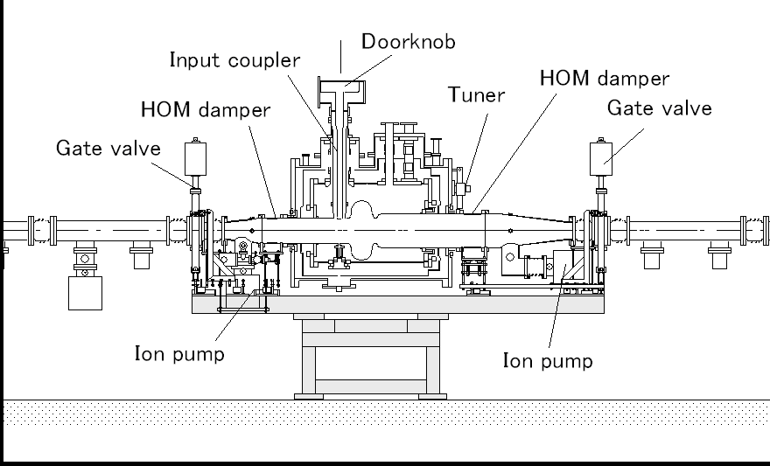
Alternative solutions 1.1
(superconducting cavity at 1 GHz)
Superconductive RF system will be more efficient but not smaller or cheaper. Two options :
Superconducting ARES-type cavity. Since it is beyond present state-of-the-art in the SC RF technology an extensive R&D and prototyping will be necessary. It is not considered further.
Elliptical cavity. An example, is SCC used in KEK-B HER. It is equipped with tuners and HOM dampers. Must be scaled and modified to reduce R/Q.
Frequency: f[GHz] | 0.509
Normalized shunt impedance (circuit): R_{g}/Q [Ω] | 46.5
Unloaded Q-factor: Q | ~1e9
Aperture radius: r [mm] | 110
Beam loading Power range: [MW] Nominal – Maximum tested | 0.25 – 0.4
Gap voltage range: V_{g} [MV] Nominal – Maximum tested | 1.5 – 2
Stored energy range: U_{g} [J] Nominal – Maximum tested | 7.7-13.7
~3 m
Y. Morita et al, IPAC10

Slide 15
Alternative solutions 1.1
(superconducting cavity at 1 GHz)
Elliptical cavity. Must be scaled and modified to reduce R/Q. This is done in two steps similar to ARES-type cavity scaling and modification:
Scaling by frequency ratio and keeping the same EM field amplitude: V~1/f, U~1/f³.
Increasing aperture to reduce the R/Q from 46.5 to 0.94 Ω but assuming that the stored energy is constant. This is the main issue for this alternative. It is not obvious that the solution exists …
Parameters of CLIC DR rf system at 1 GHz (baseline) |  | Alternative 1.1
Rf frequency [GHz] | 1
Total stored energy [J] | 61.2
Stored energy per cavity [J] | 3.8 | 1.7
Number of cavities | 16 | 36
Total R/Q: [Ω] | 33.8
R_{g}/Q per gap: [Ω] | 2.1 | 0.94
Gap voltage: V_{g} [kV] | 319 | 142
Q-factor | 120000 | ~1e9
Total wall loss power [MW] | 3.2 | ~0
Average beam power [MW] | 0.6
Total rf power [MW] | 3.8 | 0.6
Number of klystrons | 8 | 9
Required klystron power [MW] | > 0.5 | > 0.07 (IOT?)
Total length of the rf system [m] | 16 x 2 = 32 | 36 x 3 = 108

Slide 16
Alternative solutions 1.2
(mismatch of rf frequency and 1 GHz)
RF frequency is close to 1 GHz
It is designed in a way that the stored energy is intermediately high, so that the rf voltage variation is kept small to minimize the transient effect to be below the specifications for the bunch length only
The remaining variation of the bunch phase is above the specification but it is linear and is compensated by reducing the rf frequency
V_{C}
V_{A}
T_{rf}
dT_{b} < T_{rf}

Slide 17
Alternative solutions 1.2
(mismatch of rf frequency and 1 GHz)
Basic parameters chose based on the bunch length specs
Alternative 1.2
δσ_{Z}/σ_{Z} = 2% RMS correspond to
  6% degree peak-to-peak variation
δV_{C}/V_{C} = -2δσ_{Z}/σ_{Z} sin²φ = 2·6% ·sin²38.7º = 4.7 %
δU/U = 2δV_{C}/V_{C} = 9.4 %
δU = N_{b}N_{e}eV_{A}(1-N_{b}/h)/N_{T} = 0.318 J
U = δU/(δU/U) = 0.318 / 0.094 = 3.4 J;
R/Q = V_{C}²/2ωU = 608 Ω
Baseline
δφ_{b} = 0.1 degree RMS 0.3 degree peak-to-peak
δV_{C}/V_{C} = 0.26 %
δU/U = 0.52 %
δU = 0.318 J
U = 61.2 J;
R/Q = 33.8 Ω

Slide 18
Alternative solutions 1.2(parameter table)
rf system with rf frequency is slightly lower than bunch rep. frequency to correct the bunch spacing to be exactly 1 ns.
This frequency mismatch is bunch intensity dependent
Remaining R&D:
the cavity design (conventional)
Accommodate the MRP change
an MD to demonstrate this compensation in an existing ring. (unless it is already done ?)
Advantages:
More efficient
More compact
Less expensive
Parameters of CLIC DR rf system at 1 GHz (baseline) |  | Alternative 1.2
Rf frequency [GHz] | 1
Total stored energy [J] | 61.2 | 3.4
Total R/Q: [Ω] | 33.8 | 608
Gap voltage: V_{g} [kV] | 319 | 319
Number of cavities | 16 | 16
R_{g}/Q per gap: [Ω] | 2.1 | 38
Q-factor | 120000 | ~30000
Total wall loss power [MW] | 3.2 | ~0.7
Average beam power [MW] | 0.6
Total rf power [MW] | 3.8 | 1.3
Number of klystrons | 8 | 4
Required klystron power [MW] | > 0.5 | > 0.35
Total length of the rf system [m] | 16 x 2 = 32 | 16 x 1 = 16
Bunch phase modulation p-p [deg] uncompensated | 0.3 | 5.5
Relative frequency mismatch δf/(1GHz) |  | 1e-4
Corresponding MRP (ρ=50m) shift [mm] |  | 5

Slide 19
Alternative solutions 1.2
(mismatch of rf frequency and 1 GHz)
Bunch phase variation due to second order effects
Q_{l} = 10700
0.012º RMS

Slide 20
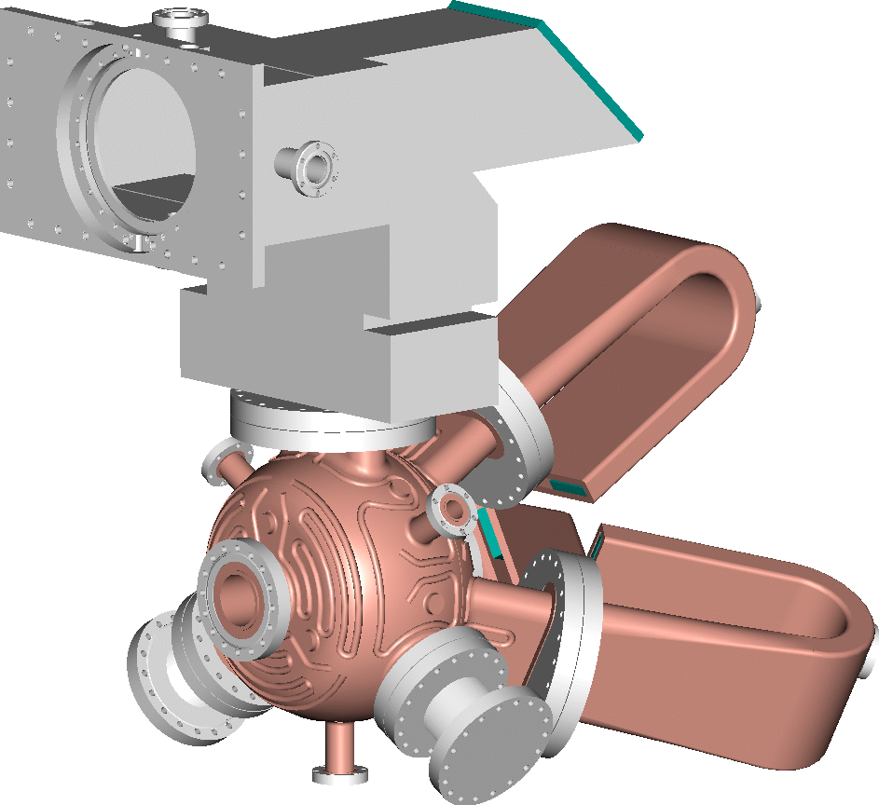
Alternative solutions 1.3
(Input RF power modulation at 1 GHz)
RF frequency is 1 GHz
It is designed in a way that the stored energy is low.
The variation of the RF voltage are compensated by the modulation of the input RF power which is matched not to the average beam power but to the peak beam power, like in a linac
AN RF CAVITY FOR THE NLC DAMPING RINGS, R.A. Rimmer, et al., PAC01.
NLC DR RF cavity parameters |  | CLIC DR RF
Frequency: f[GHz] | 0.714 | 1
R_{g} /Q [Ω] (~ f ⁰) | 120 | 120
Unloaded Q-factor: Q₀ (~ f ^{-1/2}) | 25000 | 21000
Aperture radius: r [mm] (~ f ⁻¹) | 31 | 22
Gap voltage: V_{g} [MV] (~ f ⁻¹) Nominal - | 0.5 - | 0.35 -
The same voltage per cavity and so the same number cavities as for the baseline solution is assumed: 16.

Slide 21
Alternative solutions 1.3(parameter table)
An rf system similar to the linac rf system with repetition rate equivalent to the revolution frequency.
Strong input power modulations are essential
This requires an RF power source with larger bandwidth ~1% which is OK.
This requires more sophisticated fast feedback and/or feed-forward systems
A lots of R&D culminating in building a prototype and testing it in a ring are probably necessary:
Advantages:
Slightly more efficient
More compact
Maybe less expensive
Parameters of CLIC DR rf system at 1 GHz (baseline) |  | Alternative 1.3
Rf frequency [GHz] | 1
Number of cavities | 16
Gap voltage: V_{g} [kV] | 319
R_{g}/Q per gap: [Ω] | 2.1 | 120
Total R/Q: [Ω] | 33.8 | 1920
Total stored energy [J] | 61.2 | 1.1
Q-factor | 120000 | 21000
Total wall loss power [MW] | 3.2 | 0.3
Reflected power [MW] | 0 | 0.4
Average beam power [MW] | 0.6
Peak beam power [MW] | 2.6
Total rf power [MW] | 3.2+0.6=3.8 | 0.3+0.4+2.6=3.3
Number of klystrons | 8 | 8
Required klystron power [MW] | > 0.5 | > 0.4
Total length of the rf system [m] | 16 x 2 = 32 | 16 x 0.5 = 8

Slide 22
Alternative solutions 1.3 (transients)
Klystron bandwidth: 0
Klystron bandwidth: ∞
Klystron bandwidth: 1%
Matched to average beam power. Q_{l} = 5570
No input power modulations.
Matched to peak beam power.
Q_{l} = 2080
Input power modulations.
Q_{l} = 2080
Q_{l} = 2080
Q_{l} = 5570

Slide 23
2 GHz alternatives
Huge advantage for all these alternatives is no train interleaving after the DR

Slide 24
Summary table
 | 1 GHz | 2 GHz, no train interleaving after DR
Classical RF system based on the NC ARES-type cavities | Baseline P_{RF} = 3.8 MW; L = 32 m; Cavity design: OK | Alternative 2.0 P_{RF} = 5.9 MW; L = 48 m; Cavity design: ok?
Classical RF system based on the SCC cavities | Alternative 1.1 P_{RF} = 0.6 MW; L = 108 m; Cavity design: ok? | Alternative 2.1 P_{RF} = 0.6 MW; L = 800 m; Cavity design: NOT OK
RF system with RF-to-bunch frequency mismatch | Alternative 1.2 P_{RF} = 1.3 MW; L = 16 m; Cavity design: OK | Alternative 2.2 P_{RF} = 2.1 MW; L = 24 m; Cavity design: OK
“A-la-linac” RF system with strong input power modulations | Alternative 1.3 P_{RF} = 3.3 MW; L = 8 m; Cavity design: OK | Alternative 2.3 P_{RF} = 5.8 MW; L = 12 m; Cavity design: OK
Baseline solution is safe
Alternative with an RF-to-bunch frequency mismatch is very attractive both at 1 GHz and 2 GHz.

Slide 25
Spare slides

Slide 26
Synchrotron motion
Hamiltonian equations for longitudinal beam dynamics :
Separatrix , Bucket length 2ΔZ and Bucket height ΔE :
ΔE
σ_{E}
ΔZ
σ_{Z}
Small amplitude synchrotron oscillation (σ_{E}<< ΔE):

Slide 27
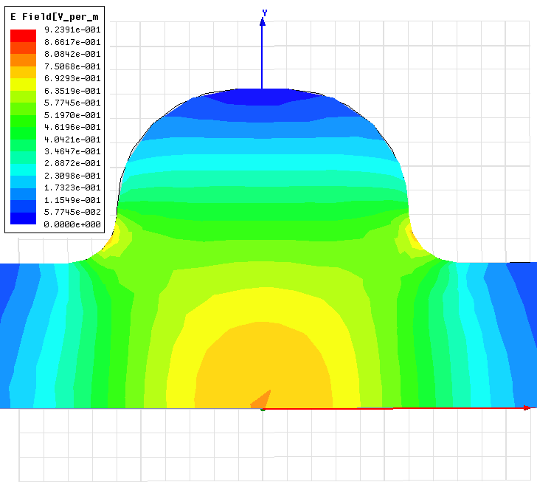
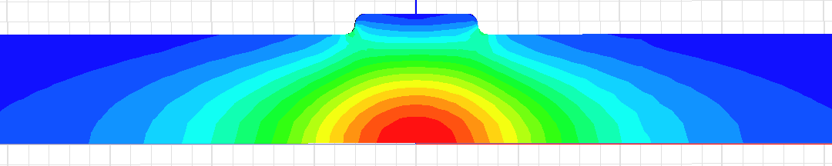
Alternative solutions 1.1
(superconducting cavity at 1 GHz)
Elliptical cavity at 1 GHz with reduced R/Q from 46.5 to 0.94 Ω.
R_{bp}[mm] | R/Q [Ω] | f₁ [GHz]
60 | 42.5 | 1.17
70 | 33 | 1.08
80 | 22.5 | 1.00
90 | 13.8 | 0.91
100 | 6.3 | 0.84
105 | 2.84 | 0.81
106 | 2.47
107 | 1.80
108 | 1.13
109 | 0.59
110 | 0.16 | 0.79
Issues:
Longer cavity
More sensitive to the dimensional errors
Dipole mode frequency is lower than the fundamental (SOM-damping)
All these may make this solution unusable in practice, t.b.s.

Slide 28
Alternative solution 2.0 (basic parameter chose)
RF frequency is 2 GHz
It is designed in a way that the stored energy is so high that the RF voltage variation is kept small to minimize the transient effect on the beam phase to be below the specifications
ARES-type cavity developed for the KEK B-factory RF system is used after scaling to 2 GHz and some modifications
Alternative 2.0
δφ_{b} = 0.2 degree at 2 GHz RMS correspond to
0.6 degree peak-to-peak variation
δV_{C}/V_{C} = δφ_{b} cosφ sinφ = 0.43 %
δU/U = 2δV_{C}/V_{C} = 0.86 %
δU = N_{b}N_{e}eV_{A}(1-N_{b}/h)/N_{T} = 0.725 J
U = δU/(δU/U) = 0.725 / 0.0086 = 84.3 J;
R/Q = V_{C}²/2ωU = 9.6 Ω
Baseline
δφ_{b} = 0.1 degree RMS 0.3 degree peak-to-peak
δV_{C}/V_{C} = 0.26 %
δU/U = 0.52 %
δU = 0.318 J
U = 61.2 J;
R/Q = 33.8 Ω

Slide 29
Alternative solution 2.0 (cavity parameter chose)
Cavity scaling from 0.5 to 2 GHz
2 GHz cavity modification to reduce R/Q
Storage Cavity
TE015
Storage Cavity
TE~0 2 10
R/Q=V²/2ω(U_{a}+U_{s})
in ARES U_{s}=9U_{a}
R/Q ~ 1/f³
Q ~ v/s ~ f
0.5 – 2 GHz
AC
TE 015
Scaling V_{g} to keep EM field amplitude constant : V_{g} ~ f ⁻¹
V_{g} ~ f ⁰
Frequency: f[GHz] | 0.509 | 2 |  | 1
Normalized shunt impedance (circuit): R_{g}/Q [Ω] (~f⁰) | 7.4 | 7.4 | (~f⁻³) x 1/64 | 0.116
Unloaded Q-factor: Q (~f^{-1/2}) | 110000 | 55000 | (~f¹) x 4 | 220000
Aperture radius: r [mm] | 80 | 20 |  | 20
Gap voltage range: V_{g} [kV] Nominal – Maximum tested | 500 – 866 | 125 – 216 | same | 125 – 216
In our case, an intermediate modification of the cavity is chosen to have comfortable voltage per cavity V_{g} = 4500 kV / 24 = 188 kV and the reduced R_{g}/Q = 9.6 Ω / 24 = 0.4 Ω

Slide 30
Alternative solution 2.0 (final parameter table)
Classical rf system similar to 1 GHz baseline
No showstoppers
Few issues remains:
RF design of the low R/Q = 0.4 Ω cavity of ARES-type
Total rf power is 1.5 times higher than in the Baseline
Total length is 1.5 times bigger
…
Parameters of CLIC DR rf system at 2 GHz alternative 2.0 |  | Baseline pars
Rf frequency [GHz] | 2 | 1
Total stored energy [J] | 84.3 | 61.2
Total R/Q: [Ω] | 9.6 | 33.8
Cavity voltage: V_{g} [kV] | 188 | 319
Number of cavities | 24 | 16
R_{g}/Q per Cavity: [Ω] | 0.4 | 2.1
Q-factor | 200000 | 120000
Total wall loss power [MW] | 5.3 | 3.2
Average beam power [MW] | 0.6 | 0.6
Total rf power [MW] | 5.9 | 3.8
Number of klystrons | 12 | 8
Required klystron power [MW] | > 0.5 | > 0.5
Total length of the rf system [m] | 24 x 2 = 48 | 16 x 2 = 32

Slide 31
Alternative solutions 2.1
(superconducting cavity at 2 GHz)
Elliptical cavity. Must be scaled and modified to reduce R/Q. This is done in two steps similar to ARES-type cavity scaling and modification:
Scaling by frequency ratio and keeping the same EM field amplitude: V~1/f, U~1/f³.
Increasing aperture to reduce the R/Q from 46.5 to 0.024 Ω but assuming that the stored energy is constant. This is the main issue for this alternative. It is not obvious that the solution exists …
Total length of the system is HUGE. Here multiple cell cavity could be considered.
Parameters of CLIC DR rf system at 1 GHz (baseline) |  | Alternative 2.1
Rf frequency [GHz] | 1 | 2
Total stored energy [J] | 61.2 | 84.3
Stored energy per cavity [J] | 3.8 | 0.21
Number of cavities | 16 | 400
Total R/Q: [Ω] | 33.8 | 9.6
R_{g}/Q per gap: [Ω] | 2.1 | 0.024
Gap voltage: V_{g} [kV] | 319 | 11.3
Q-factor | 120000 | 1e9
Total wall loss power [MW] | 3.2 | ~0
Average beam power [MW] | 0.6
Total rf power [MW] | 3.8 | 0.6
Number of klystrons | 8 | 10
Required klystron power [MW] | > 0.5 | > 0.06 (IOT?)
Total length of the rf system [m] | 16 x 2 = 32 | 400 x 2 = 800

Slide 32
Alternative solutions 2.2
(mismatch of rf frequency and 2 GHz)
Basic parameters chose based on the bunch length specs
δσ_{Z}/σ_{Z} = 2% RMS correspond to 6% degree peak-to-peak variation
δV_{C}/V_{C} = -2δσ_{Z}/σ_{Z} sin²φ = 2·6% ·sin²27.8º = 2.6 %
δU/U = 2δV_{C}/V_{C} = 5.2 %
δU = N_{b}N_{e}eV_{A}(1-N_{b}/h)/N_{T} = 312·4.1e9·1.6e-19·3.98e6·(1-312/2850)/1 = 0.725 J
U = δU/(δU/U) = 0.725 / 0.052 = 14 J;
R/Q = V_{C}²/2ωU = 58 Ω

Slide 33
Alternative solutions 2.2(parameter table)
Classical rf system with one exception: the rf frequency is slightly reduced to correct the bunch spacing to be exactly 1 ns.
This frequency mismatch is bunch intensity dependent
Remaining R&D:
the cavity redesign ARES-type (minor)
an MD to demonstrate this compensation in an existing ring. (unless it is already done ?)
Advantages:
More efficient
More compact
Less expensive
No train interleaving after DR
Parameters of CLIC DR rf system at 1 GHz (baseline) |  | Alternative 2.2
Rf frequency [GHz] | 1 | 2
Total stored energy [J] | 61.2 | 14
Total R/Q: [Ω] | 33.8 | 58
Gap voltage: V_{g} [kV] | 319 | 188
Number of cavities | 16 | 24
R_{g}/Q per gap: [Ω] | 2.1 | 2.4
Q-factor | 120000 | ~120000
Total wall loss power [MW] | 3.2 | ~1.5
Average beam power [MW] | 0.6
Total rf power [MW] | 3.8 | 2.1
Number of klystrons | 8 | 6
Required klystron power [MW] | > 0.5 | > 0.35
Total length of the rf system [m] | 16 x 2 = 32 | 24 x 1 = 24
Bunch phase modulation p-p [deg] uncompensated | 0.3 | 3.6
Relative frequency mismatch δf/(1GHz) |  | 3e-5
Corresponding MRP (ρ=50m) shift [mm] |  | 1.5

Slide 34
Alternative solutions 2.3(parameter table)
An rf system similar to the linac rf system with repetition rate equivalent to the revolution frequency.
Strong input power modulations are essential
This requires an rf power source with larger bandwidth ~1%, which is OK.
This requires more sophisticated fast feedback and/or feed-forward systems
A lots of R&D culminating in building a prototype and testing it in a ring are probably necessary:
Advantages:
More compact
Maybe less expensive
No train interleaving after DR
Parameters of CLIC DR rf system at 1 GHz (baseline) |  | Alternative 1.3
Rf frequency [GHz] | 1 | 2
Number of cavities | 16 | 24
Gap voltage: V_{g} [kV] | 319 | 188
R_{g}/Q per gap: [Ω] | 2.1 | 120
Total R/Q: [Ω] | 33.8 | 2880
Total stored energy [J] | 61.2 | 0.28
Q-factor | 120000 | 15000
Total wall loss power [MW] | 3.2 | 0.2
Reflected power [MW] | 0 | 0.4
Average beam power [MW] | 0.6
Peak beam power [MW] | 5.2
Total rf power [MW] | 3.2+0.6=3.8 | 0.2+0.4+5.2=5.8
Number of klystrons | 8 | 12
Required klystron power [MW] | > 0.5 | > 0.5
Total length of the rf system [m] | 16 x 2 = 32 | 24 x 0.5 = 12

Slide 35
Alternative solutions 2.3 (transients)
Klystron bandwidth: 0
Klystron bandwidth: ∞
Klystron bandwidth: 1%
Matched to average beam power. Q_{l} = 3720
No input power modulations.
Matched to peak beam power.
Q_{l} = 729
Input power modulations.
Q_{l} = 3720
Q_{l} = 729
Q_{l} = 729
Imaginary !!!

Slide 36
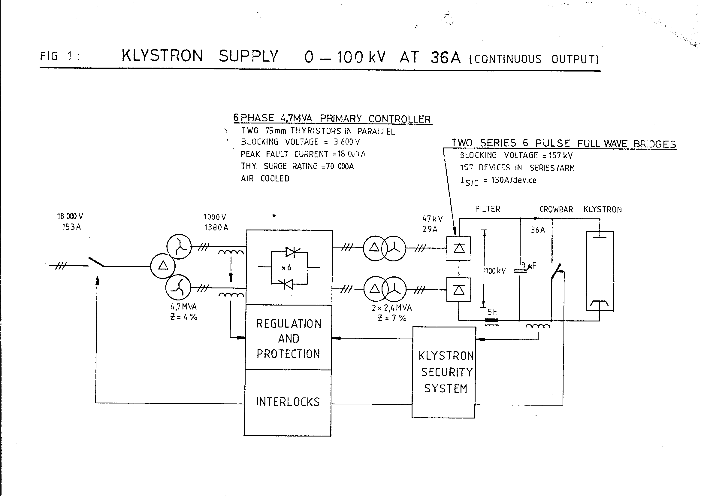
CW klystron power supply
LEP klystron power supply
Information provided by D. Siemaszko
Feedback stabilizes high voltage at lower frequencies to the level of 1-0.1%.
Limited mainly by the HV measurement accuracy
Filter reduce 600 Hz ripples down to
0.04*0.0045 = 2*10⁻⁴
3 phases main
12 phases – 600 Hz ripples
filter
4%
f
t
t
600 Hz
-40 dB

Slide 37
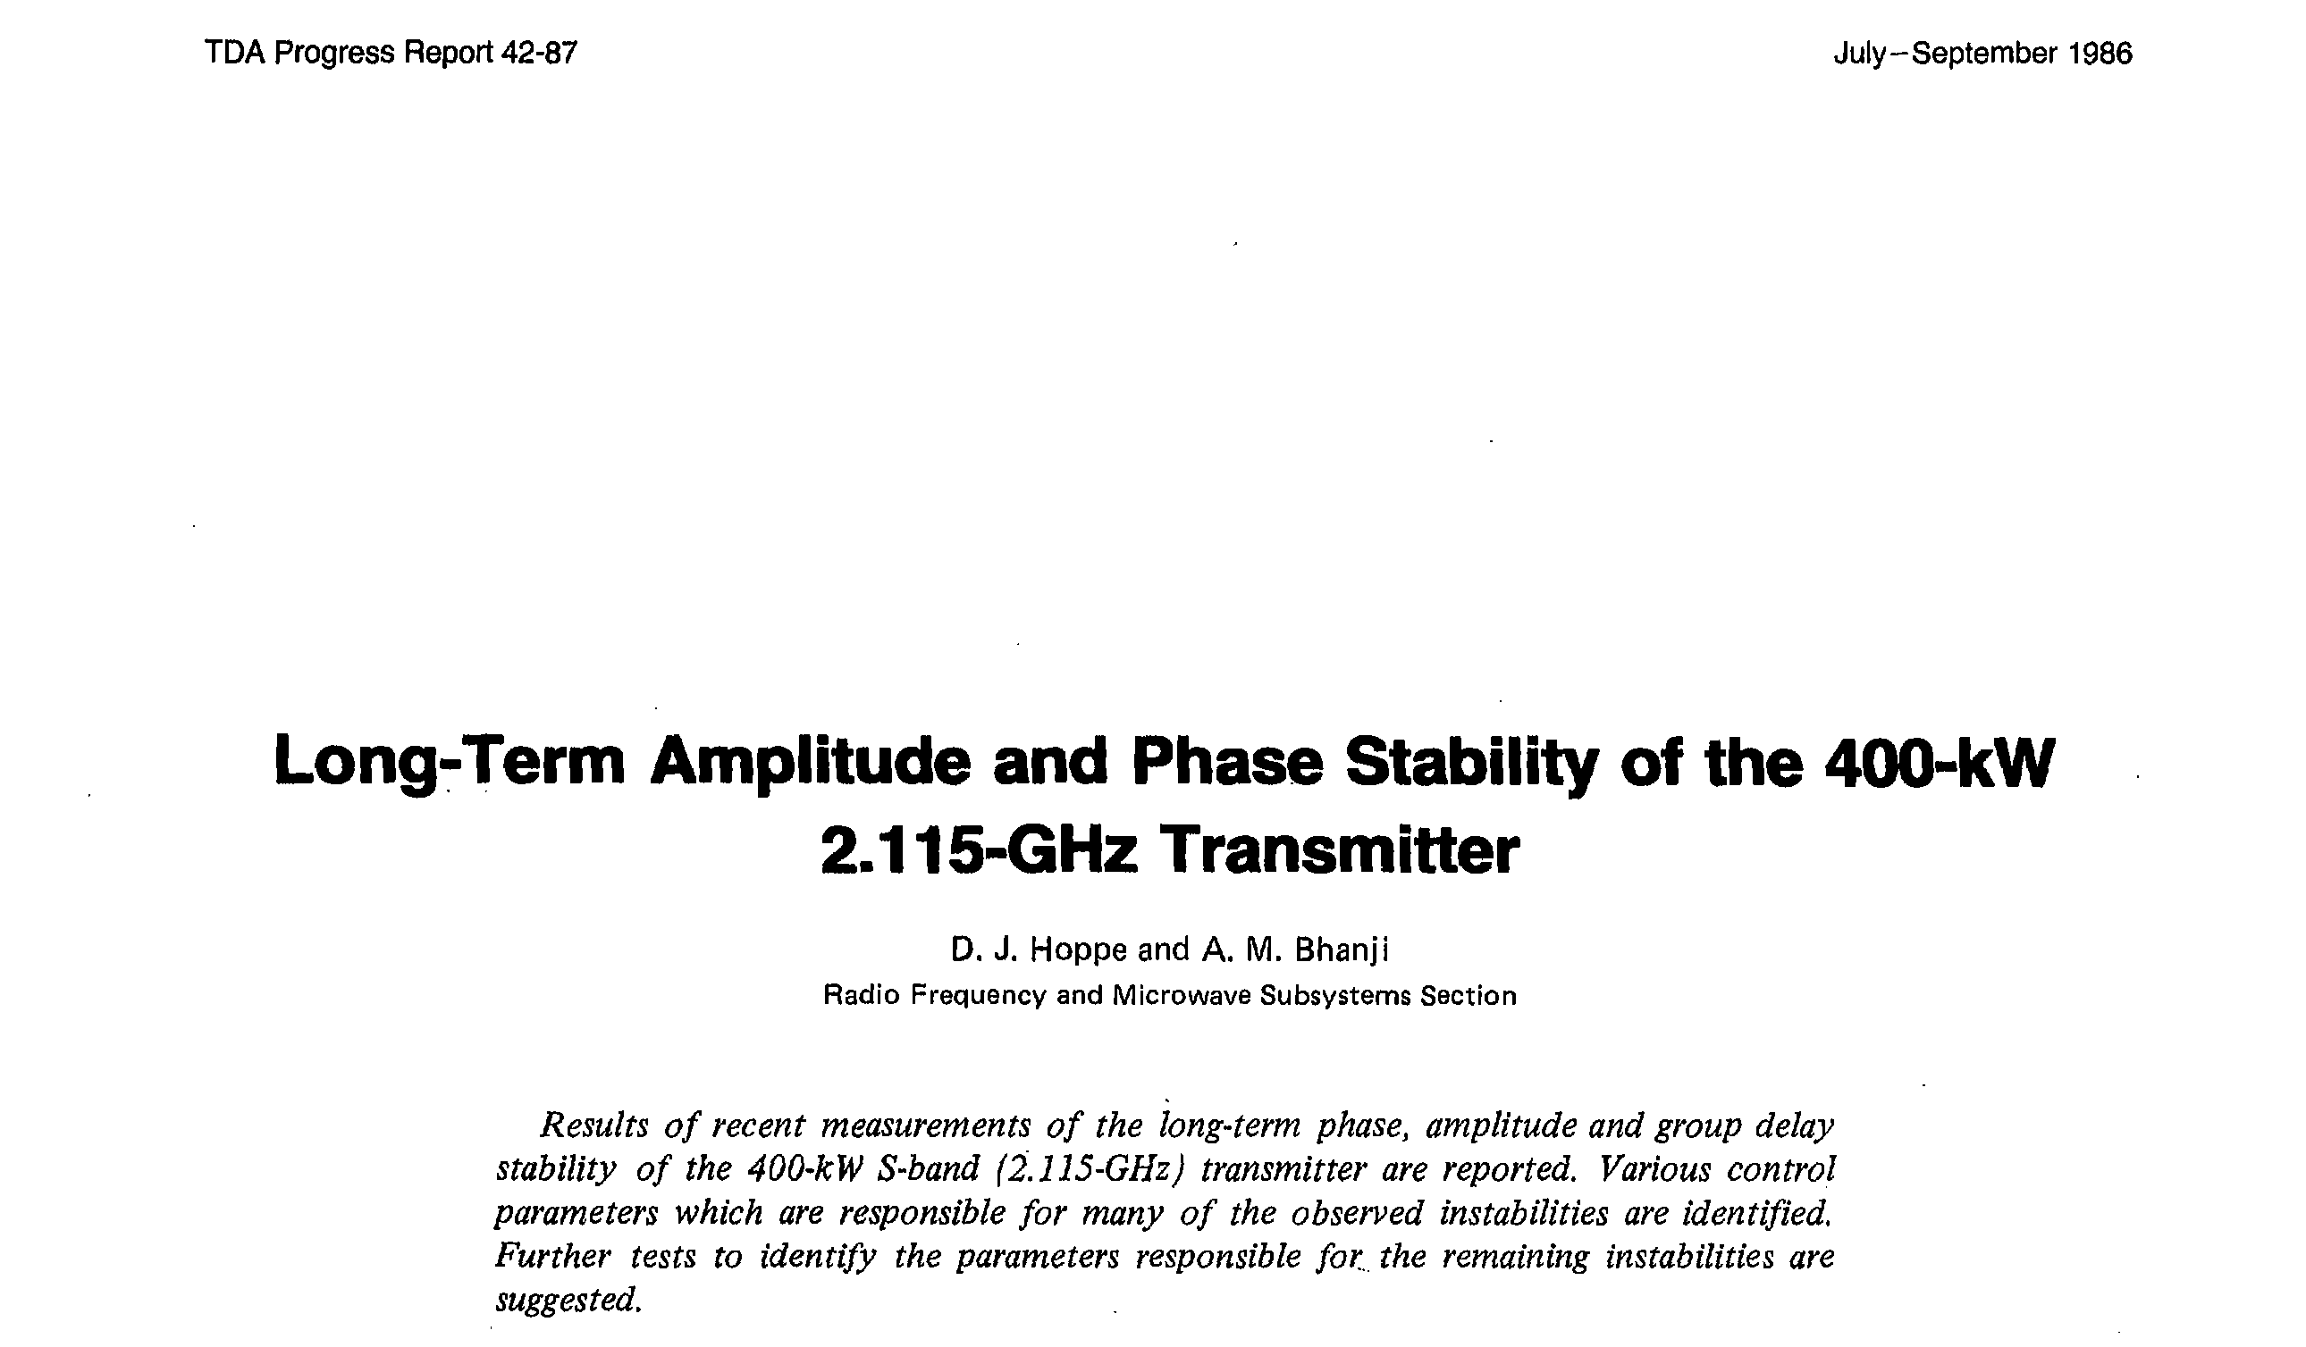
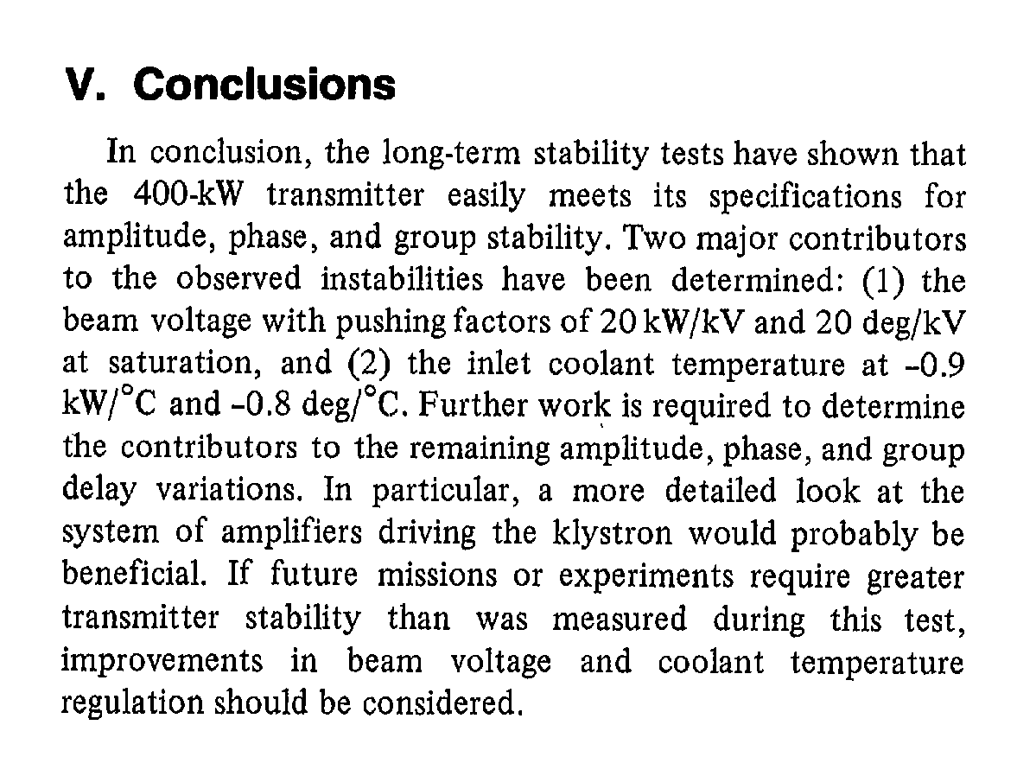
Klystron amplitude and phase stability
Beam voltage ~60 kV
Low frequency
high voltage stability: 0.1 %
(0.3 % achieved in Tristan (KEK) DC power supply for 1MW CW klystron, PAC87)
-> 60V -> 1.2 kW rf output power stability
~ 0.3 % power stability
~ 0.15 % amplitude stability
Or
~ 1.2 degree phase stability
This is not sufficient (see RTML specs). Slow RF feedback loop around the klystron is necessary

Slide 38
Klystron bandwidth
NLC DR RF system:
http://www-project.slac.stanford.edu/lc/local/Reviews/cd1%20nov98/RF%20HighPwr_Schwarz.pdf
Klystron
High power CW klystrons of 1 MW output power and -3 MHz 1 dB bandwidth at 700 MHz were developed by industry for APT.
New requirement for Damping Ring klystron is order of magnitude wider bandwidth: 65 nano-seconds gap in between bunch trains cause variations in accelerating field level during bunch train, resulting in bunch extraction phase variation. This effect can be counteracted by a fast direct feedback loop with about 30 MHz bandwidth.
A klystron bandwidth of 20 - 30 MHz is within technical know-how for a 1 MW hiqh power klvstron but will result in lower efficiency.
Klystron Dept. Microwave Engineering, H. Schwarz, 1998
http://ieeexplore.ieee.org/stamp/stamp.jsp?arnumber=01476034
A BROADBAND 500 KW CW KLYSTRON AT S-BAND,
Robert H. Giebeler and Jerry Nishida, Varian Associates, Palo Alto, Calif. 1969
klystron amplifier designed for installation ‘on the 210 foot steerable antenna. This paper will describe the development of a 500 kilowatt CW S-band at the JPL/NASA deep space instrumentation facility a€ Goldstone, California. This tube is an improved version of the 450 kilowatt unit developed in 1967. Its features include 1-1/2 percent instantaneous bandwidth, 58 dB nominal gain and 53 percent nominal efficiency.
Few percent bandwidth is feasible for 0.5 MW CW klystron

Slide 39
Impedance estimate in DR, PDR
Calculated RF cavity parameters HOM | NLC DR | CLIC DR |  | CLIC PDR
Frequency: f[GHz] | 0.714 | 1 | 2 | 1 | 2
Number of cavities: N = V_{rf}/V_{g} | 2 (3) | 16 | 20 | 40 | 48
Total HOM loss factor: k||_{l} * N [V/pC] | 2.2 | 24.6 | 61.6 | 61.6 | 148
Long. HOM energy loss per turn per bunch [μJ]: ΔU = k||_{l} * N * eN_{e}² | 2.8 | 10 | 25 | 32 | 77
Incoherent long. HOM loss power [kW]: P||_{incoh}= ΔU * N_{b}f/h | 2 | 2.2 | 5.6 | 7.7 | 19
Coherent long. HOM loss power [kW]: P||_{coh}~ P||_{incoh}*Q_{HOM} *f/f_{HOM} (if the mode frequency f_{HOM} is a harmonic of 2 GHz) | Careful Design of HOM damping is needed
Total HOM kick factor: k^{T}_{t} * N [V/pC/m] | 78.8 | 1240 | 6160 | 3100 | 14800
Tran. HOM energy loss per turn per bunch [μJ]: ΔU = k^{T}_{t} * 2πf/c * N * eN_{e}² * d² (d – orbit deviation , 10mm assumed) | 0.15 | 1.1 | 10.5 | 3.3 | 32
Tran. HOM loss power is not an issue: < [kW]

