Slide 1

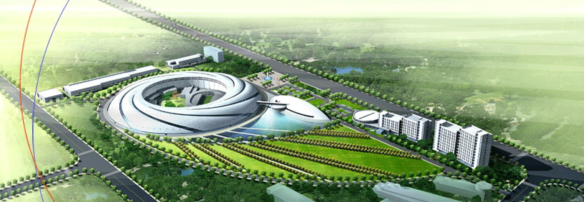
Injection scheme for ultimate storage ring with double RF system
LOWεRING 2014
Bocheng Jiang
SSRF AP group
SINAP. CAS
2014.9.18

Slide 2
Outline
USR dynamic aperture
Overview of injection scheme
Twin RF buckets generation
Injection beam dynamics
Conclusions

Slide 3
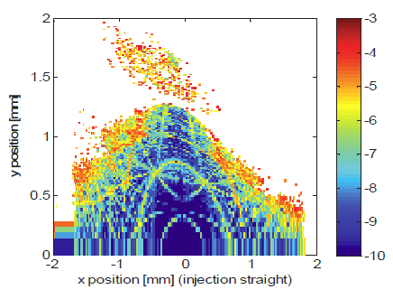
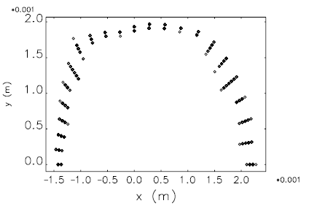
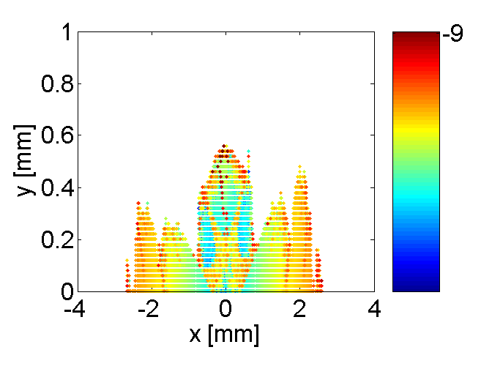
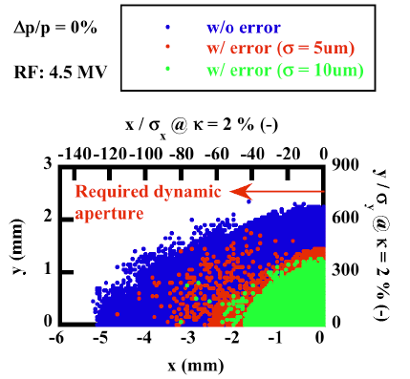
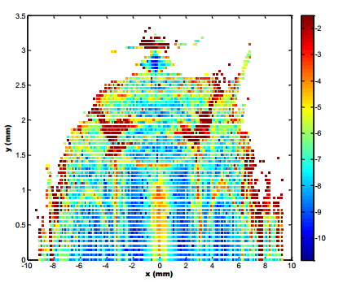
USR DA
ALS-II
H. Tarawneh, C. Steier, R. Falcone, D. Robin, et al.
SSRF-UR, S. Q. Tian
To be optimized
APS MBA lattice
Yipeng Sun, Michael Borland, PAC 13
Spring-8 II
Y. Shimosaki, K. Soutome, J. Schimizu, et al. IPAC 11
Beijing Advance photon source
Xu gang, et al.

Slide 4
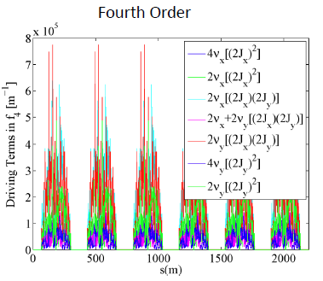
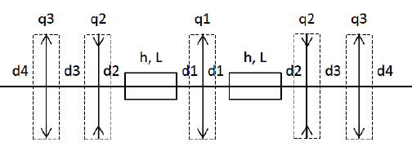
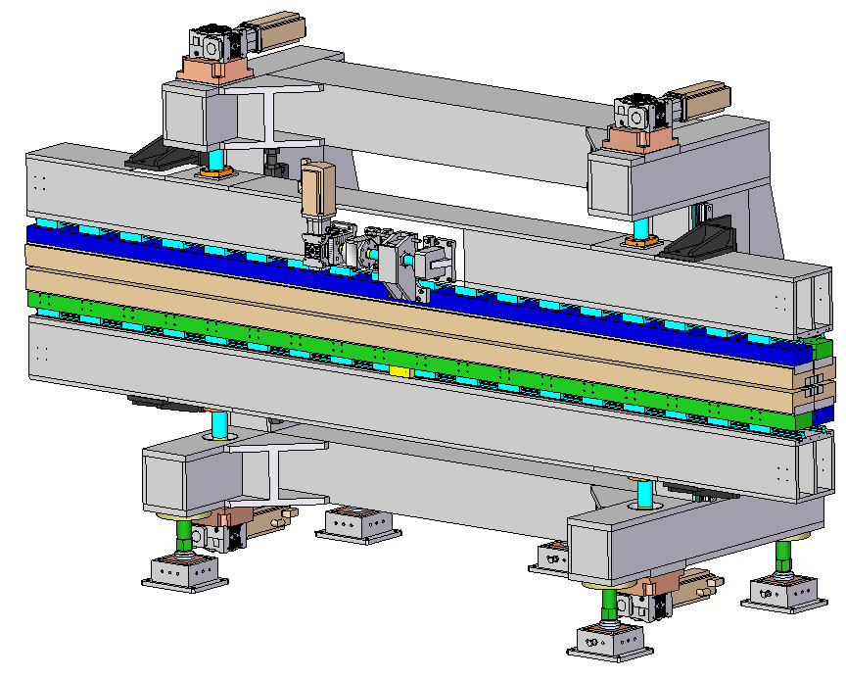
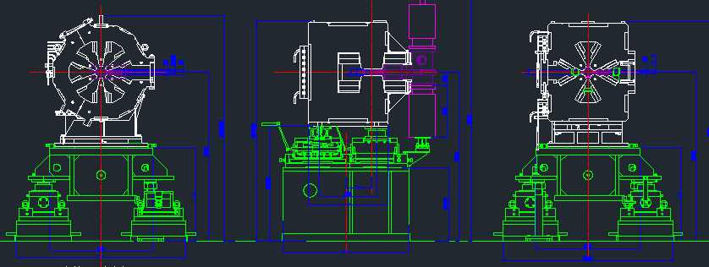
USR DA
Cancelation resonance driving term up to 4th order
Yunhai Cai, et al.
A Split Magnet TME (SM-TME) cell .
A. Bogomyagkov ,
E. Levichev , P. Piminov
IDs
Alignment and Field errors

Slide 5
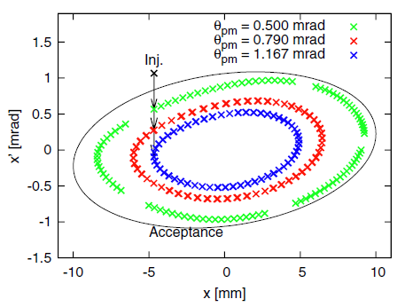
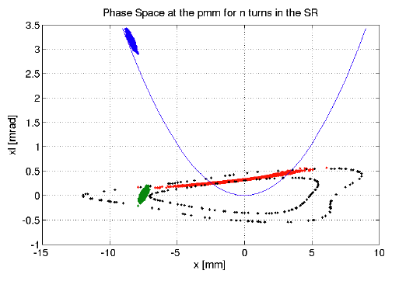
Injection schemes
Septum
Stored beam
Injected beam
1mm
~5~9mm
3mm
MAX IV
S. C. Leemann, PR-STAB, 15, 050705 (2012)
Sirius
Sirius Detailed Design Report, 2014
Local bump injection, DA>~10mm
Pulsed Multipole, DA>~5mm

Slide 6
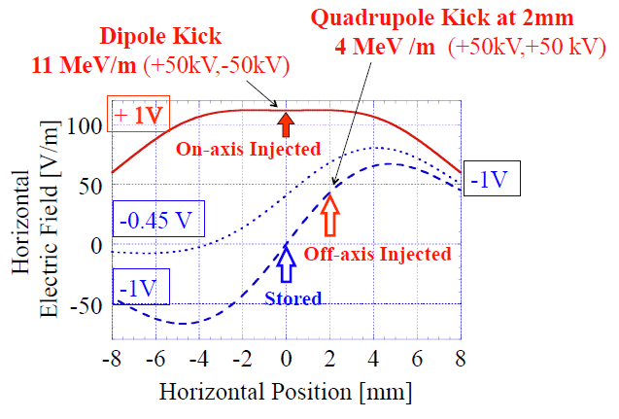
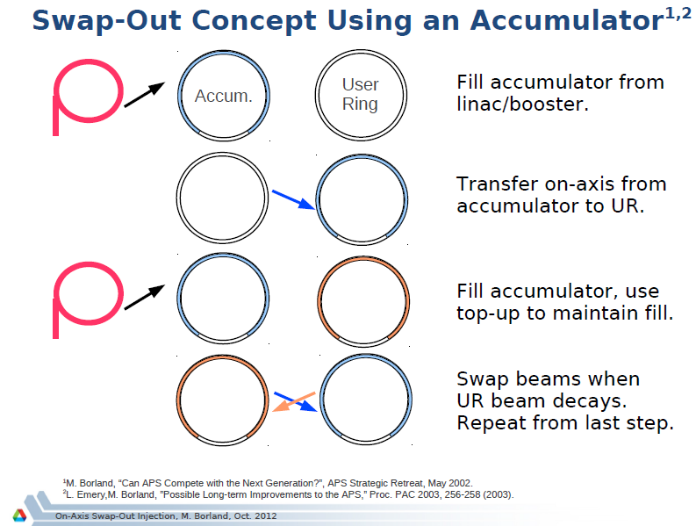
Injection schemes
T. Nakamura
M. Borland
Fast TEM mode Kicker off axis injection
DA ~2mm
On axis injection
DA < ~2mm

Slide 7
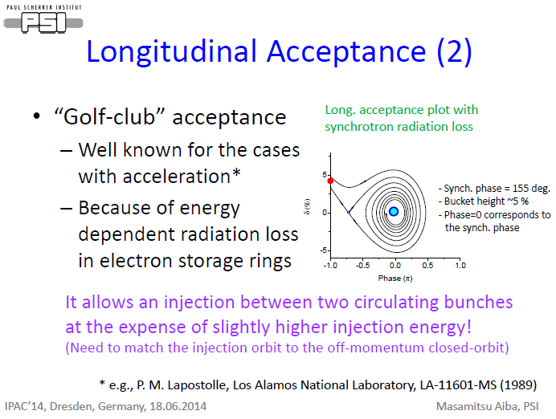
Injection schemes
M. Aiba, M. Böge, Á. Saá Hernández, et al.
IPAC14
Longitudinal inject without swap out
DA < ~2mm

Slide 8
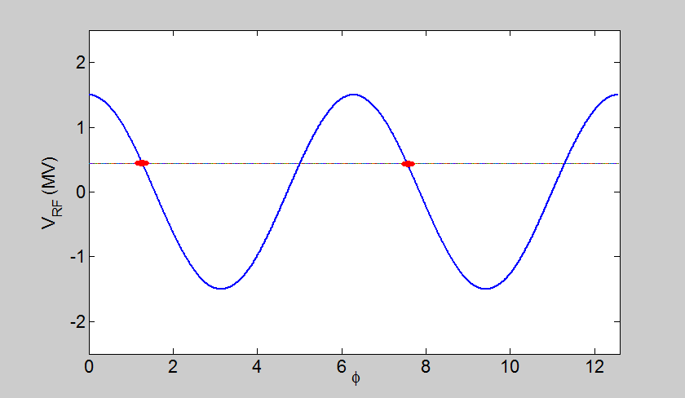
Twin RF buckets generation
Movie
RF system: 250MHz（V_{m}） + 500MHz （V₂）
Voltage of both systems modulated.
step | 1 | 2 | 3 | 4 | 5 | 6 | 7 | 8 | 9 | 10 | 11 | 12 | 13 | 14 | 15
$$V_{h}\left(st\right)/V_{m}(0)$$ | 0 | 0.1 | 0.2 | 0.3 | 0.4 | 0.5 | 0.6 | 0.7 | 0.8 | 0.9 | 1 | 1 | 1 | 1 | 1
$$V_{m}(st)/V_{m}(0)$$ | 1 | 1 | 0.95 | 0.9 | 0.85 | 0.8 | 0.75 | 0.7 | 0.6 | 0.5 | 0.4 | 0.3 | 0.2 | 0.1 | 0

Slide 9
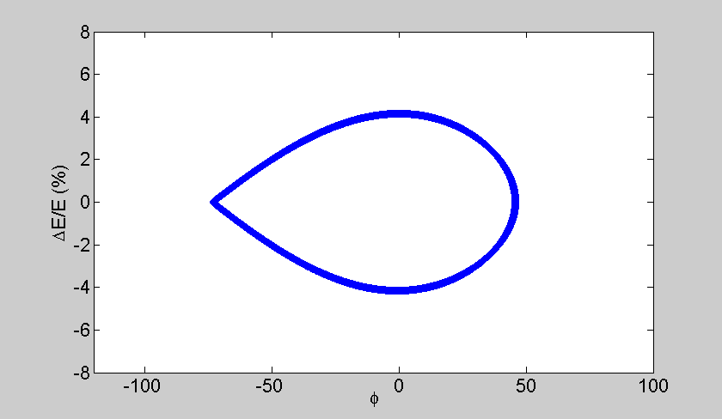
Twin RF buckets generation
Movie
Longitudinal acceptance evolution. Blue for stored beam, green for injection.

Slide 10



Twin RF buckets generation
‘Knot’ should apart from synchrotron phase.
$∆θ$ > 2*RMS(stored bunch length)+2*RF phase jitter
(2*RMS = 95% of particles are pushed ahead)
$V_{m}=\hat{V_{m}}(st)cos(ω_{m}t$)
$V_{h}=\hat{V_{h}}\left(st\right)cos\left(2(ω_{m}t−φ_{s}\right)−\frac{π}{2}+∆θ)$.
Step ‘magenta’ is crucial. Forward process new RF buckets are created. Backward process, inject bunch is dumped to main RF bucket.

Slide 11
Beam dynamics
Energy acceptance evolution.
Energy acceptance 0.67%
Quantum lifetime >10Hours
Touschek lifetime ~ 5 min
Assume the step takes 1 second,
0.5% charge lost. Will captured by the created bucket, will be swap-out when injection occur, appears like an injection efficiency drop.

Slide 12
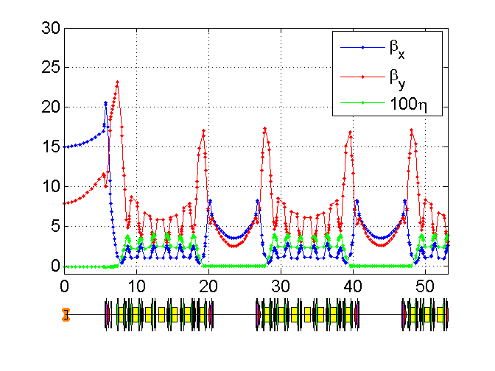
Beam dynamics
Main parameters of SSRF-UR (preliminary) for beam dynamic study
Lattice | 7BA
E₀ (GeV) | 3.0
C (m) | 432
ν_{x/y} | 47.19/12.13
Vrf (MV) | 1.5
Emittance (pm) | 205pm
Transverse coupling | 10%
Damping time (x,y,z) (ms) | 11.1,19.7,16.2
Bunch charge | 0.4mA/bunch (3.6e9 electrons)
Slip factor | 2.2e-4
Energy spread | 0.08%
U₀ (MeV) | 0.438
Bunch length (mm) | 4.9
Main RF frequency (MHz) | 250
2nd RF frequency (MHz) | 500
Twiss parameters of a quarter of SSRF-UR (preliminary)

Slide 13
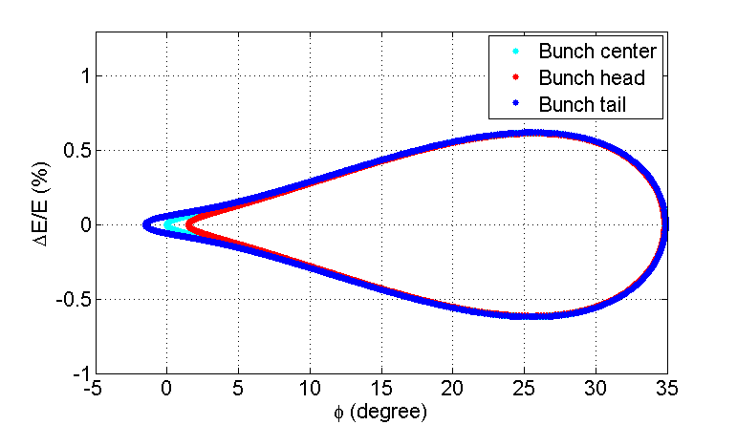
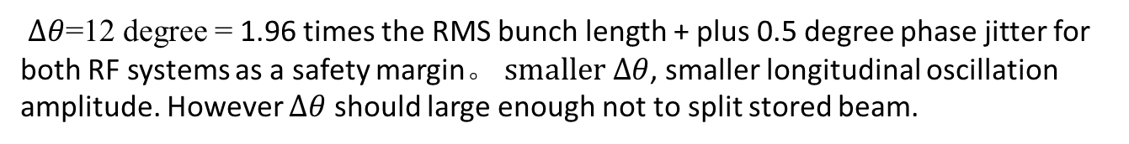
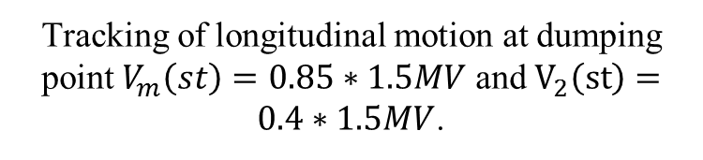
Beam dynamics
Longitudinal and transverse oscillation of injected bunch at dumping step.
Tracking of longitudinal motion at dumping point $V_{m}\left(st\right)=0.85∗1.5MV$ and $V_{2}\left(st\right)=0.4∗1.5MV$.
Tracking of transverse motion of injected bunch(snapshot at maximum dispersion point)
$∆θ$=12 degree = 1.96 times the RMS bunch length + plus 0.5 degree phase jitter for both RF systems as a safety margin。 $smaller ∆θ$, smaller longitudinal oscillation amplitude. However $∆θ$ should large enough not to split stored beam.

Slide 14
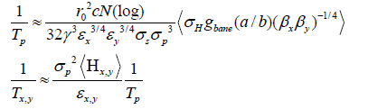
Beam dynamics
Bunch length evolution
IBS induce emittance growth
ZAP result
~20%
Bunch length evolution of stored bunch.
Solution: Gating the light at injection

Slide 15
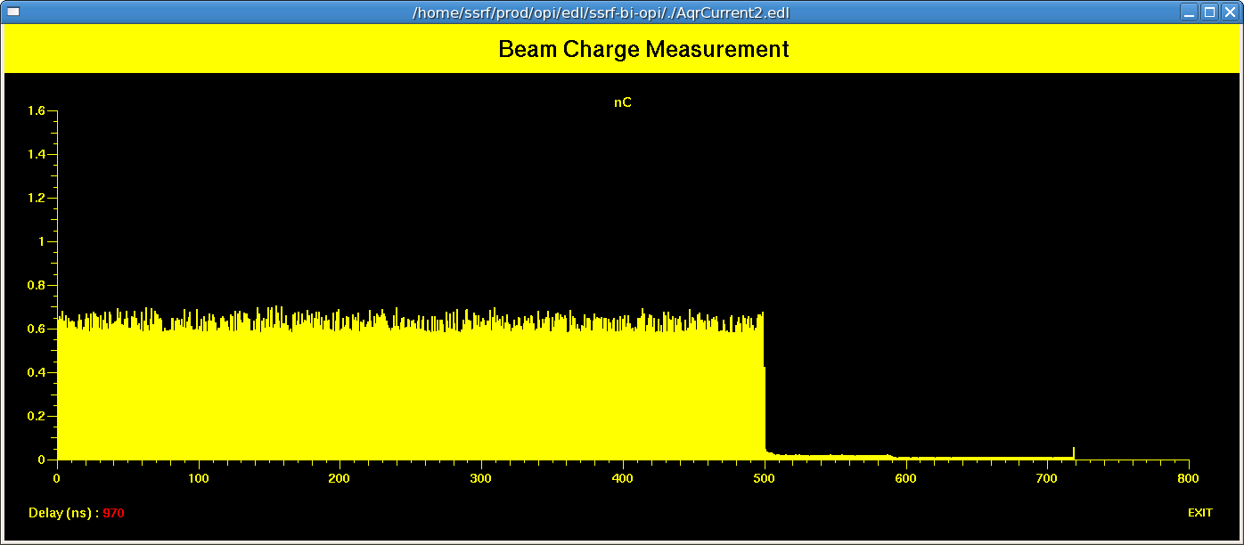
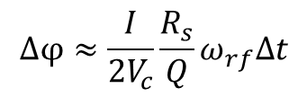
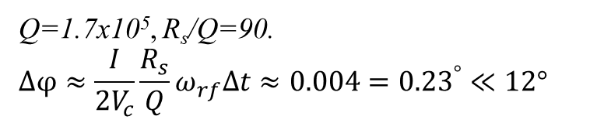
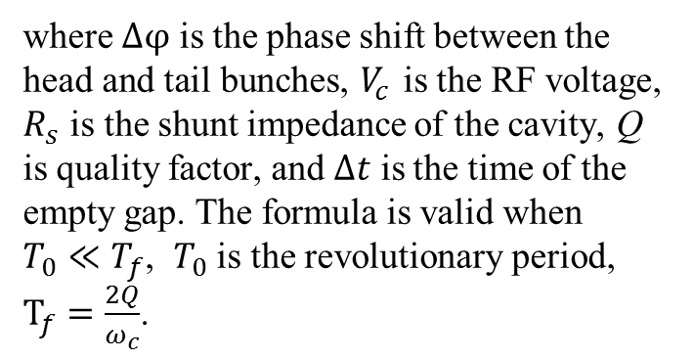
Beam dynamics
Asymmetric filling pattern results transient beam loading, which will cause phase shift between bunch train head and tail. The effect can be evaluated by following formula
$$∆φ≈\frac{I}{2V_{c}}\frac{R_{s}}{Q}ω_{rf}∆t$$
A typical filling patter for SSRF (500-bunch train +220 empty buckets
where $∆φ$ is the phase shift between the head and tail bunches, $V_{c}$ is the RF voltage, $R_{s}$ is the shunt impedance of the cavity, Q is quality factor, and $∆t$ is the time of the empty gap. The formula is valid when $T_{0}≪T_{f}$, $T_{0}$ is the revolutionary period, $T_{f}=\frac{2Q}{ω_{c}}$.
Q=1.7x10⁵, R_{s}/Q=90.
$$∆φ≈\frac{I}{2V_{c}}\frac{R_{s}}{Q}ω_{rf}∆t≈0.004={0.23}^{°}≪12°$$

Slide 16
Beam dynamics
Initial injection
RF modulation
RF modulation
One cycle of injection
One cycle of injection
~ 15m
~ 20s
~ 15m
~ 10s
Top up injection
RF modulation
RF modulation
Decay
Top up injection
Decay
Top up injection
~ 10m
~ 10s
~ 10m
~ 10s
~ 10s
~ 10s
~ 10s
~ 10s
10s of RF modulation time long enough for RF adjustment and longer enough for beam to catch up synchrotron phase
+20s extra RF modulation time, Injection duty ratio is acceptable.

Slide 17
Conclusions
A alternative choice on axis injection scheme.
All the perturbations are acceptable expect IBS
RF voltage change duration around 10s, which is not a large cost comparing to several minutes of decay time for top up injection.

Slide 18
Thanks for Attentions!

