Slide 1
METU in Belle II
Mehmet Zeyrek
Middle East Technical University
Belle II RISE Meeting
March 10, 2014

Slide 2
Belle II Activity Plan
Hardware: METU is non-CDC member, but helped CDC wiring and tension check in October and November 2013.
METU is in contact with Shoji Uno-San about CDC tasks.
METU would like to participate CDC cosmic ray testing at the beginning of 2015, and be more active in CDC activities afterwards.
Software: one of our group members (Hulya Atmacan) is in “generators” group, and our group would also like to be a part of tracking software validation activities in future.

Slide 3
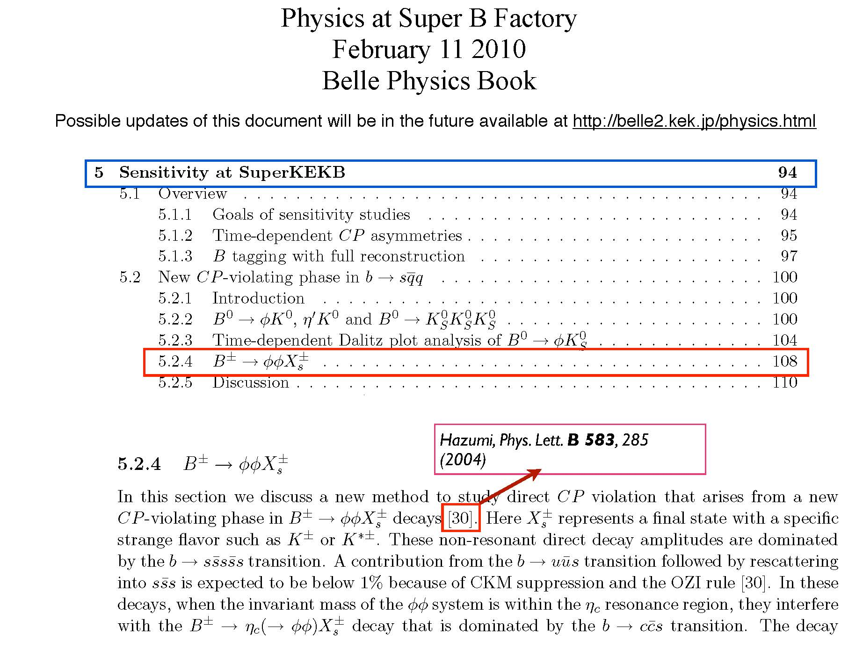
Current Physics Analysis Plans in Belle II
Charmless B decays. B→ϕϕK and B→ρK* (currently studying in BELLE)

