Slide 1
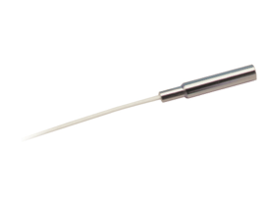
Calibration system of the iTOP detector
~ 1.5 m Multimode.
9 / Module
~ 20/40 m Single mode. fiber
Electronics hut
Quartz
Bar Box
Pico laser
Fiber coupled with gradient index micro lens
Belle Backward
iTOP
Electronics
hut
From outside
7
Notes:
1

