Slide 1

HIGGS BOSON, DARK MATTER and LHC: la grande sfida della Nuova Fisica
Univ. di Napoli, Dipt. Di Fisica, 15 giugno 2012
Antonio Masiero
Univ. di Padova e INFN

Slide 2
I L C
TEVATRON
LHC
NEW
PHYSICS AT
THE ELW
SCALE
DARK MATTER
"LOW ENERGY"
PRECISION PHYSICS
DARK ENERGY
m_{χ} n_{χ} σ_{χ}…
LINKED TO COSMOLOGICAL EVOLUTION
FCNC, CP ≠, (g-2), (ββ)_{0νν}
LEPTOGENESIS
LFV, CPV B PHYSICS
GW
INFLATION
NEUTRINO PHYSICS

Slide 3
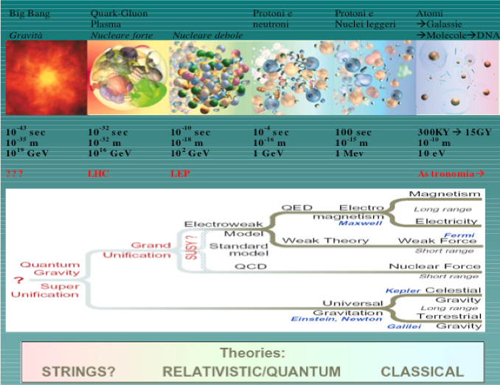
LEP,…:HIGGS MECHANISM
HIGGS MECHANISM?

Slide 4
SOMETHING is needed at the TeV scale to enforce the unitarity of the electroweak theory

Slide 5
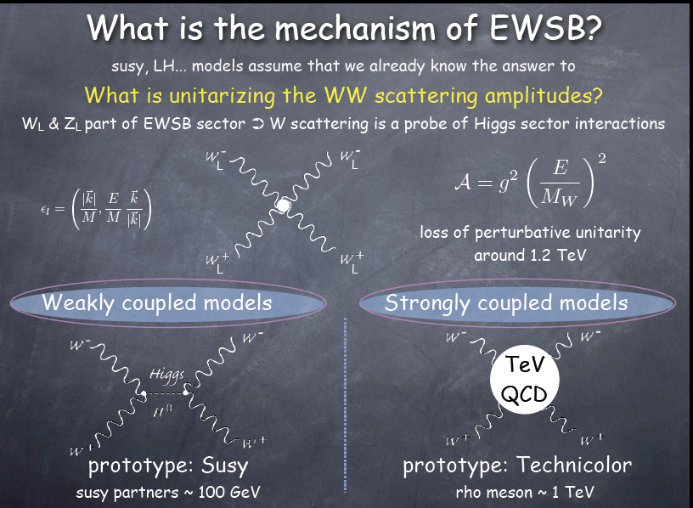
Different
signatures
at the LHC!
Grojean

Slide 6
Altarelli LP09

Slide 7
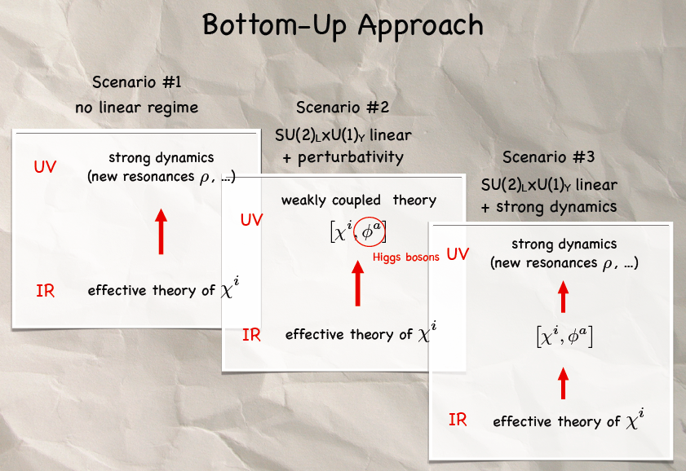
EWSB: WITH OR WITHOUT A HIGGS BOSON
R. CONTINO PLANCK2012
CAN LHC TELL US WHAT NATURE HAS CHOSEN TO BREAK THE ELW SYMMETRY?

Slide 8
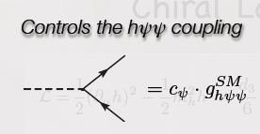
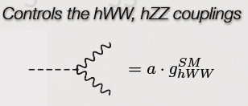
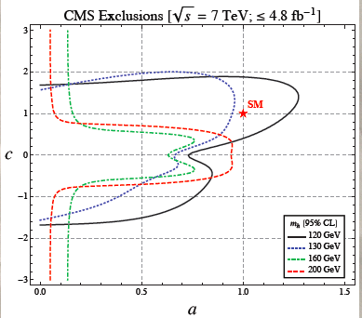
AZATOV, CONTINO,
GALLOWAY

Slide 9
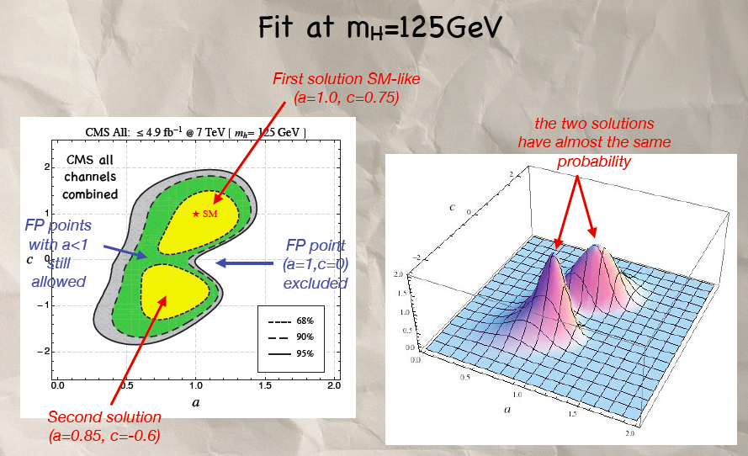
AZATOV, CONTINO, GALLOWAY

Slide 10
a light higgs (or something mimicking it) is definitely favored
the big desert between the TeV and the GUT scales only if the higgs is a narrow band between 130 and 180
Ellis, Espinosa, Giudice, Hoecker, Riotto

Slide 11
GENERAL FEATURES OF NEW PHYSICS AT THE ELW. SCALE
Some amount of fine-tuning ( typically at the % level) is required to pass unscathed the elw. precision tests, the higgs mass bound and the direct search for new particles at accelerators.
The higgs is typically rather light ( <200 GeV) apart from the extreme case of the “Higgsless proposal”
All models provide signatures which are (more or less) accessible to LHC physics ( including the higgsless case where new KK states are needed to provide the unitarity of the theory)

Slide 12
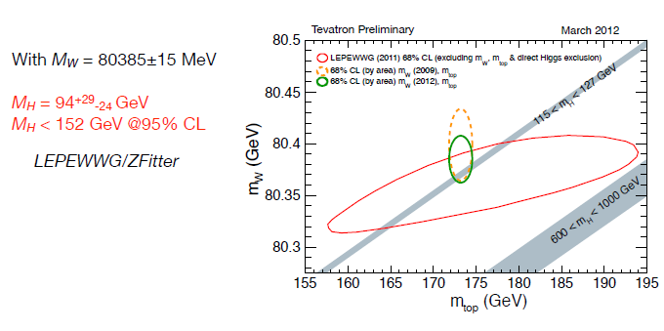

Slide 13
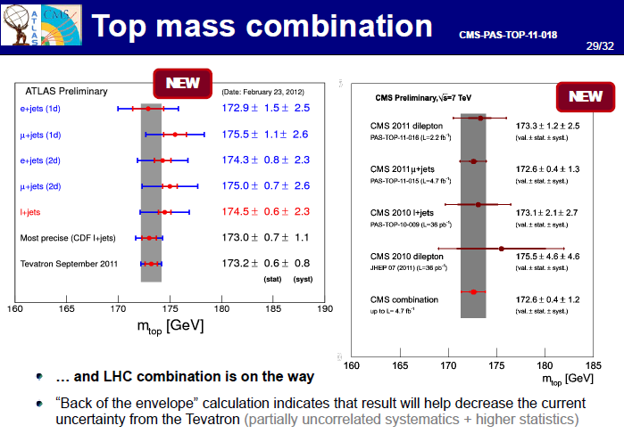

Slide 14
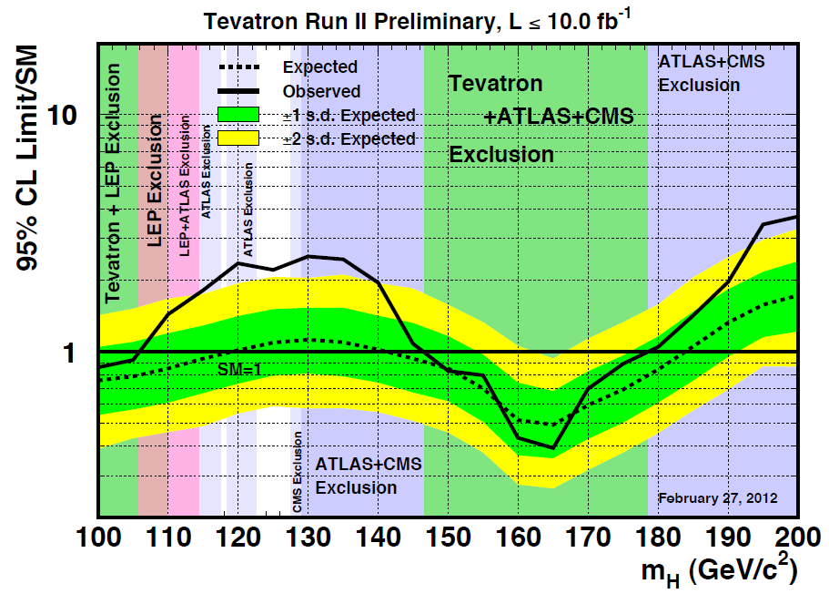
From M. Kirby
Fermilab users meeting – June 12-13, 2012
Higgs limits:
Tevatron combined

Slide 15
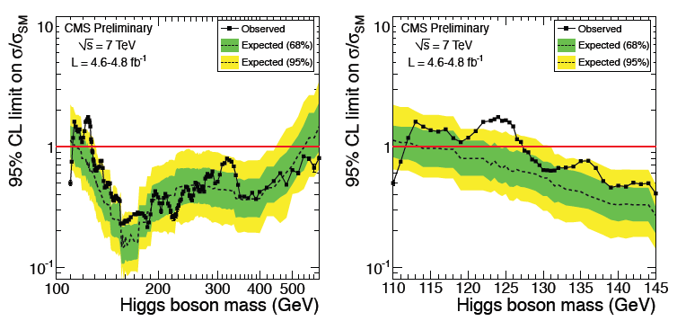
New combination
PLHC June 4-9, 2012 - Vancouver
Higgs limits:
CMS 2011 data

Slide 16
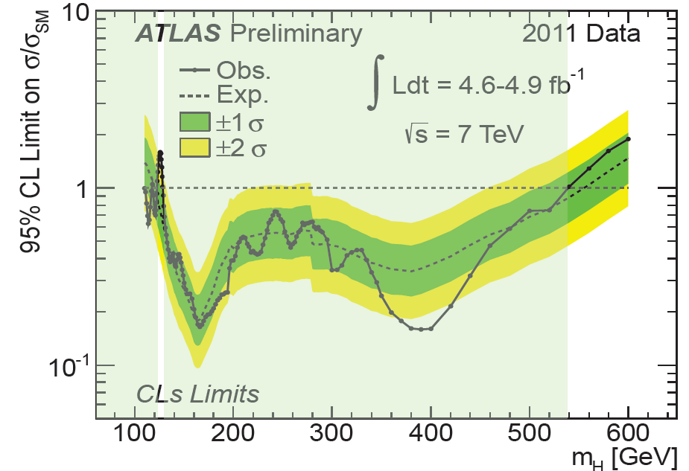
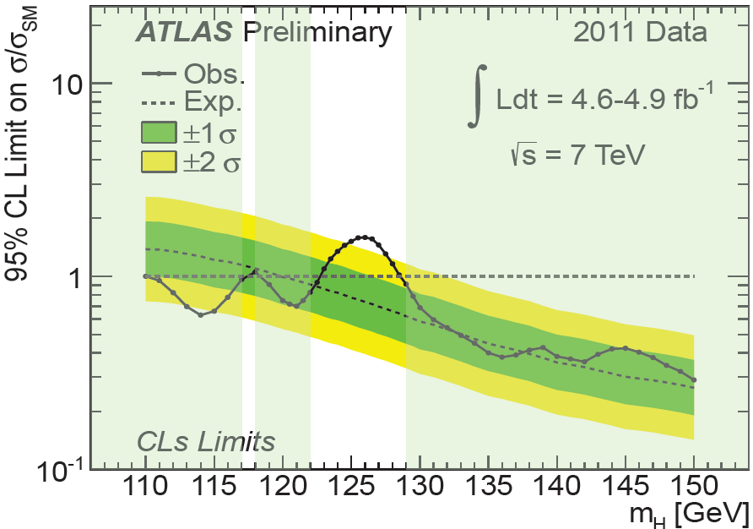
New combination
PLHC June 4-9, 2012 –
Vancouver
Higgs limits:
ATLAS 2011 data

Slide 17
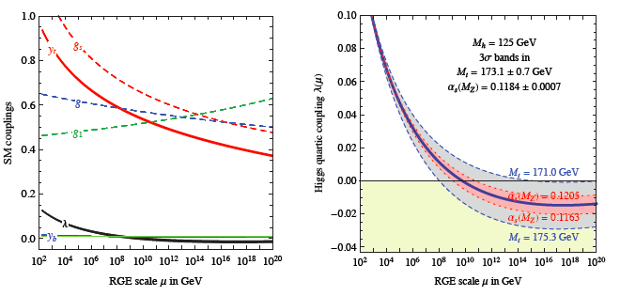
STABILITY vs. INSTABILITY OF OUR VACUUM
Giuseppe Degrassi, Stefano Di Vita, Joan Elias-Miro, Jose R. Espinosa,
Gian F. Giudice, Gino Isidori, Alessandro Strumia
1205.6497v1 [hep-ph]

Slide 18
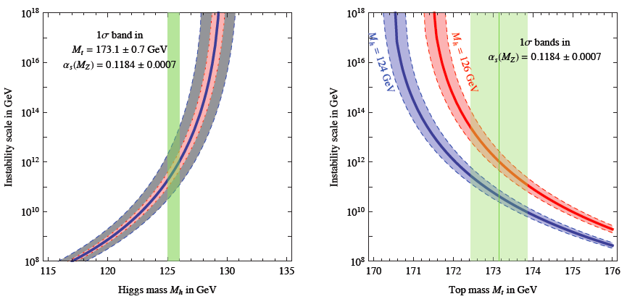
ELW VACUUM INSTABILITY SCALE
Degrassi et al

Slide 19

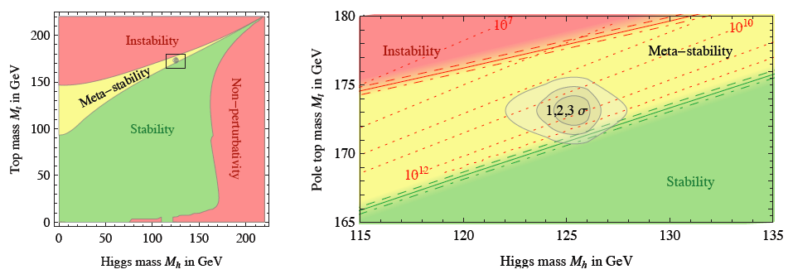
VITA SPERICOLATA IN UN “PROBABILE” UNIVERSO METASTABILE
DEGRASSI ET AL

Slide 20
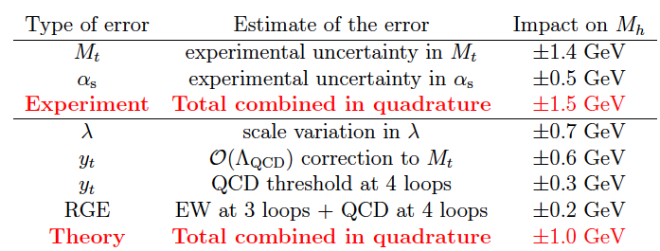
L’IMPORTANZA DI AVERE UNA MISURA PRECISA DELLE MASSE DI TOP E HIGGS
SE ALLA FINE DI QUESTO RUN DI LHC SI TROVA UN “HIGGS STANDARD” CON ACCOPPIAMENTI –pur misurati con modesta precisione - “STANDARD”, cioe’ in sintonia con quanto previsto nel SM, ACQUISTA INTERESSE UN LINEAR COLLIDER TOP- E HIGGS- FACTORY!

Slide 21
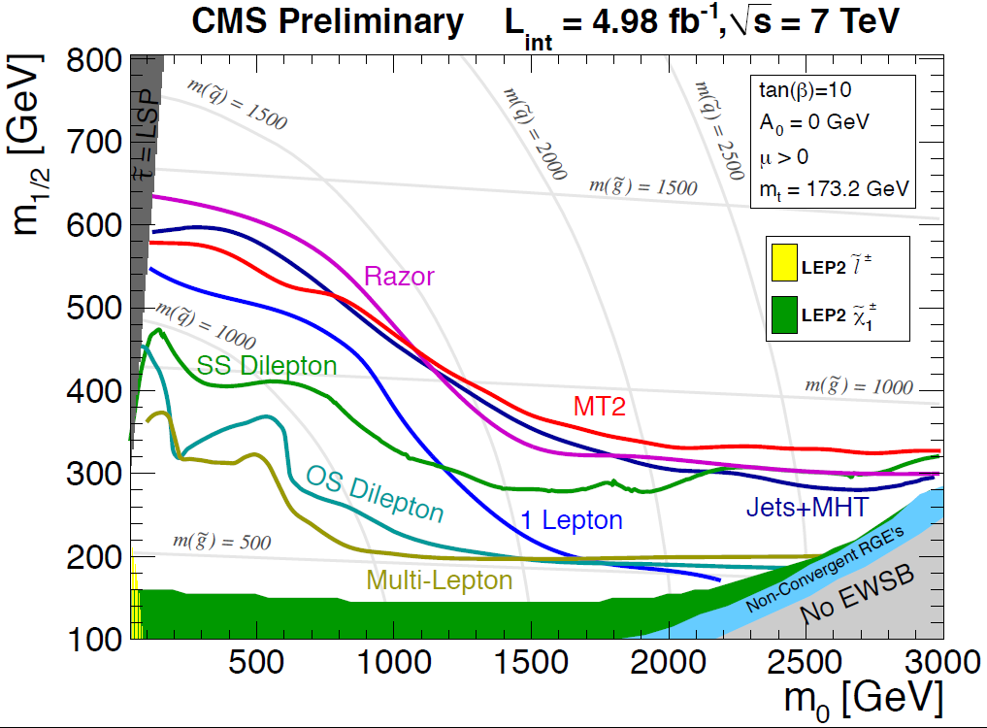
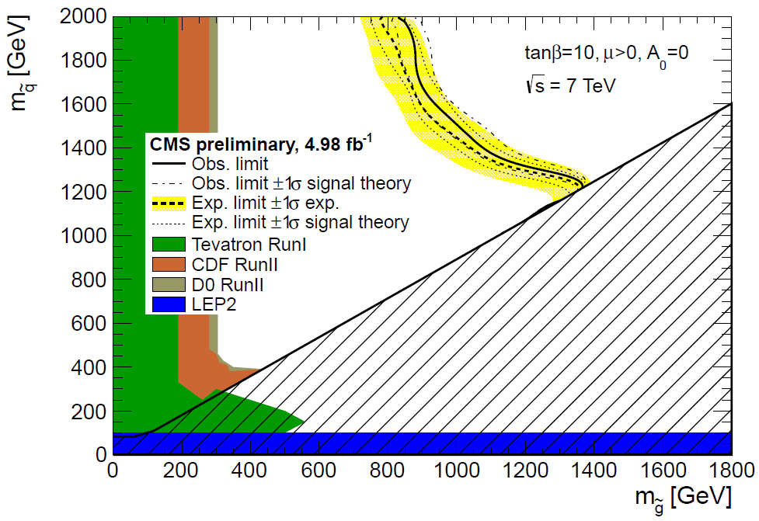
VITA DURA PER SUSY
SUSY limits
PLHC June 4-9, 2012 – Vancouver CMS 2011 data

Slide 22
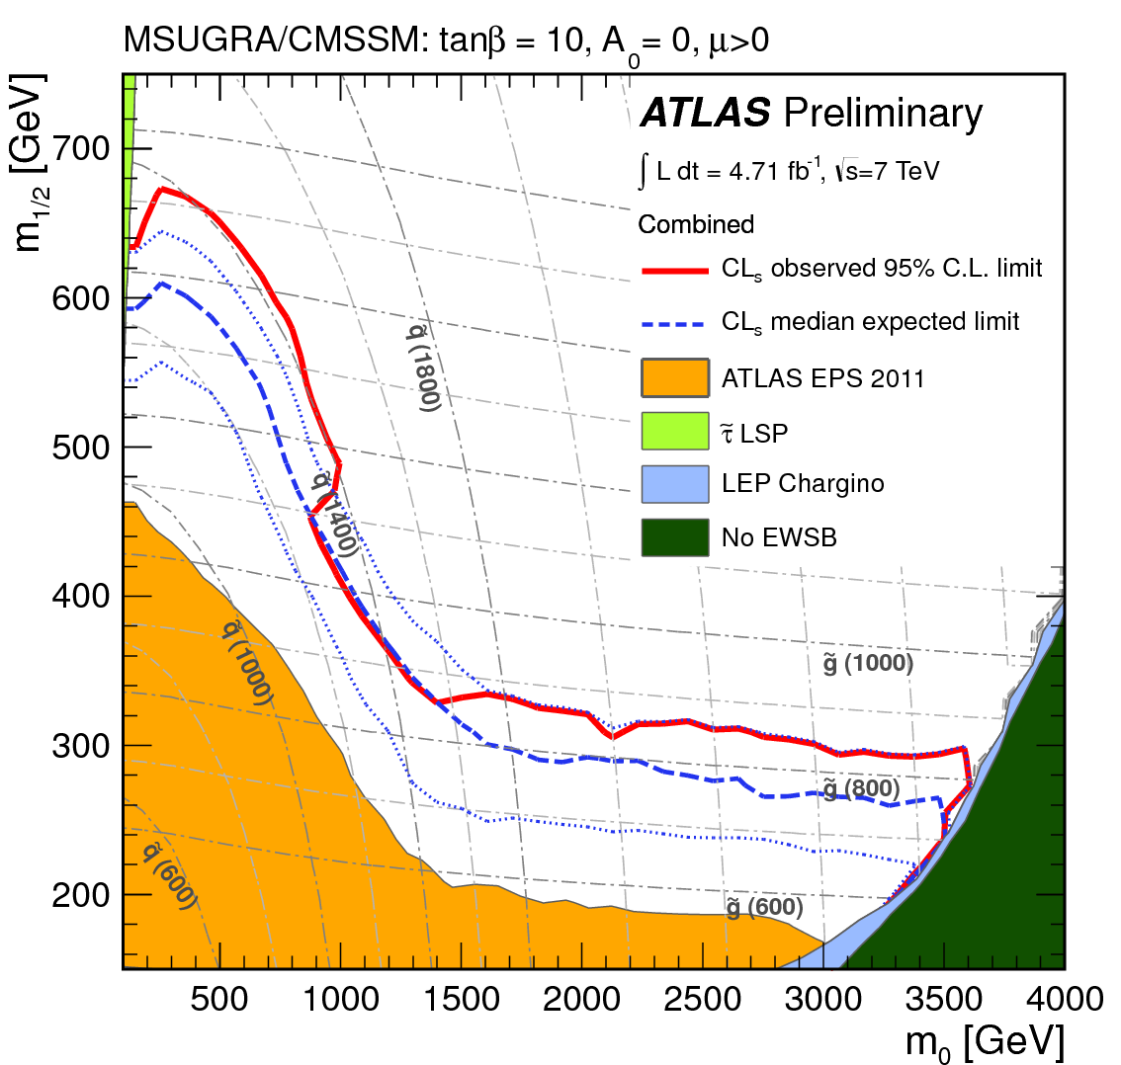
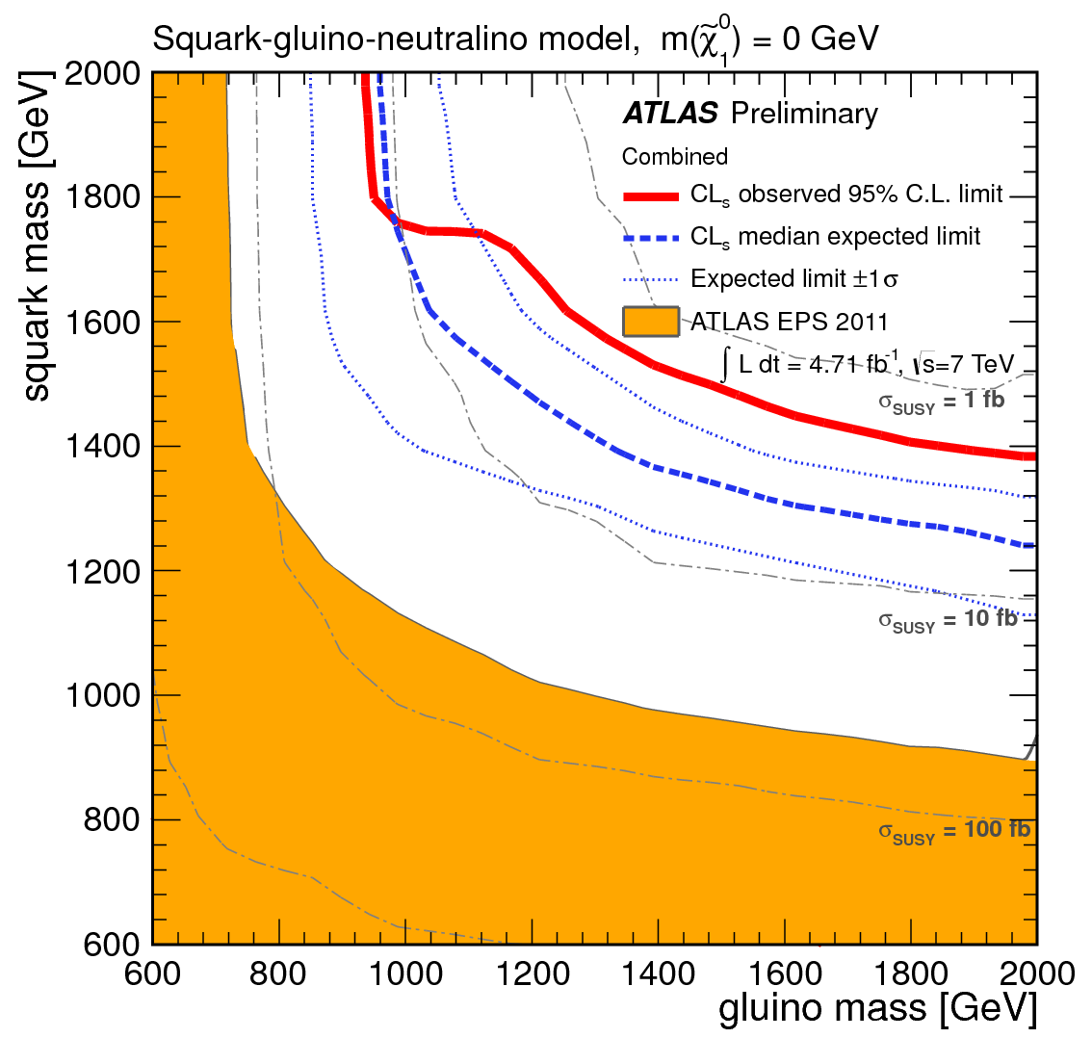
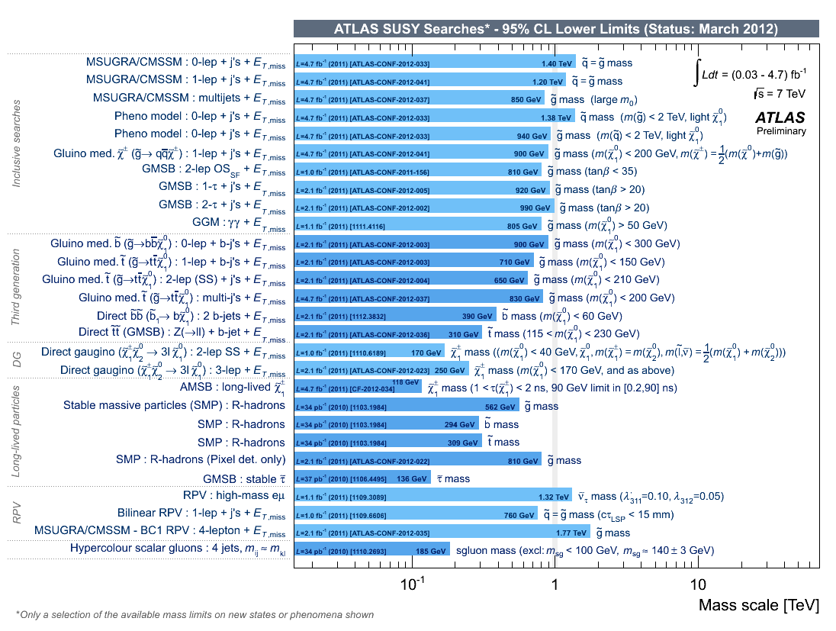
SUSY limits
CIPAMP May 29-June 2, 2012 - Florida
ATLAS 2011 data

Slide 23
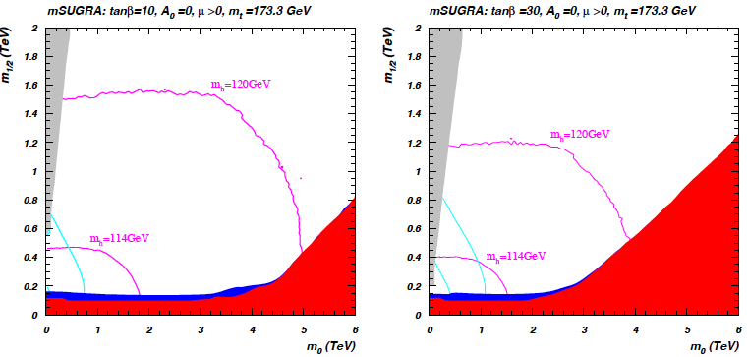
Hard times for the most constrained minimal SUSY extension of the SM
BAER, BARGER MUSTAFAYEV

Slide 24
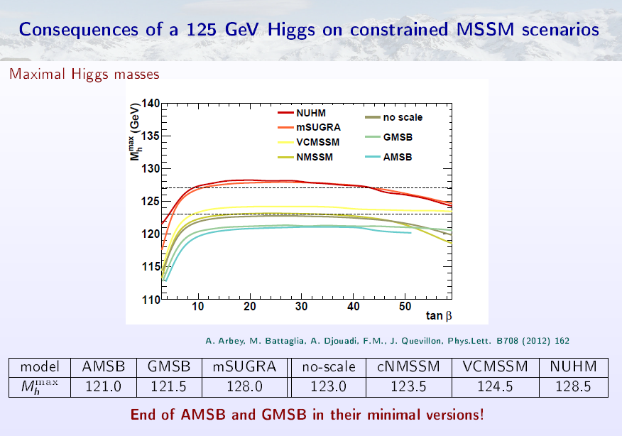

Slide 25
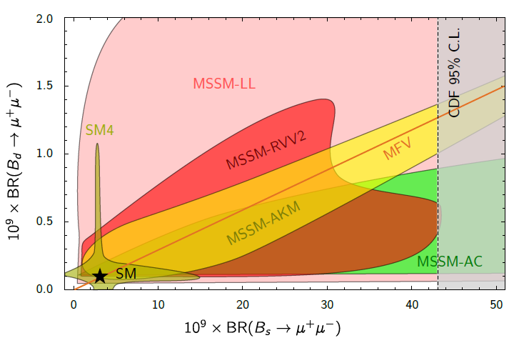
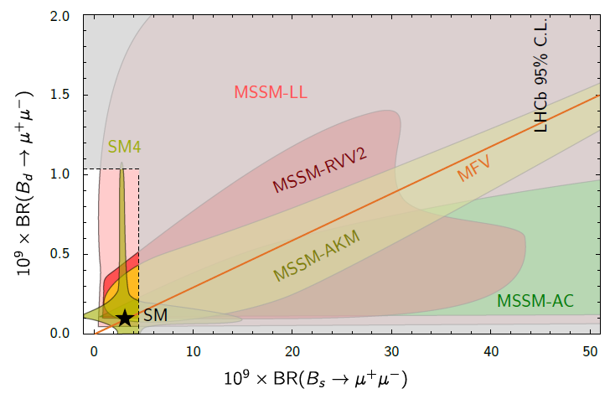
2012
ATLAS, CMS and LHCb results combined:
BPH-12-009, ATLAS-CONF-2012-061, LHCb‐CONF-2012-017
David Straub: arXiv:1205.6094
2011

Slide 26
WHY TO GO BEYOND THE SM
“OBSERVATIONAL” REASONS
THEORETICAL REASONS
HIGH ENERGY PHYSICS
(but A_{FB}…… )
FCNC, CP≠
NO (but CPV in Bs, sin2β tension…)
HIGH PRECISION LOW-EN.
NO (but (g-2)_{μ} …)
NEUTRINO PHYSICS
YE m_{ν} ≠0, θ_{ν}≠0
COSMO - PARTICLE PHYSICS
YE (DM, ∆B _{cosm}, INFLAT., DE)
INTRINSIC INCONSISTENCY OF SM AS QFT
(spont. broken gauge theory
without anomalies)
NO ANSWER TO QUESTIONS THAT “WE” CONSIDER “FUNDAMENTAL” QUESTIONS TO BE ANSWERED BY “FUNDAMENTAL” THEORY
  (hierarchy, unification, flavor)
NO
_{Z bb}
NO
NO
NO
YES
YES
YES

Slide 27
EVIDENCE OF NP ALONG
THE HIGH INTENSITY ROAD?
“FLAVOR COLDS for the SM:
Like-sign dimuon
charge asymmetry

Slide 28
But tension in the UT fit even neglecting CPV in the B_{s} mixing

Slide 29

Direct CPV in D⁰ → π⁺π–, K⁺K⁻:
CPV in mixing (indirect) can be related to direct CPV via the relation:
<t>/τ = 1 at B factories,
~2.5 at CDF (displaced trigger)
Considering ππ or KK final states we
can build the difference:
Independent of the final state
A_{CP}(K⁺K⁻) – A_{CP}(π+π-) = Δa_{CP} (direct) + Δ<t>/τ a_{CP} ^{ind}
HCP 2011: LHCb, 620 pb⁻¹ : first evidence (3.5 σ) of CPV in charm:
Moriond 2012: CDF, 9.6 fb⁻¹, confirms this result
(- 0.62 ± 0.21 ± 0.10) %
Combination of LHCb and CDF results in a 3.8 σ deviations from zero.

Slide 30
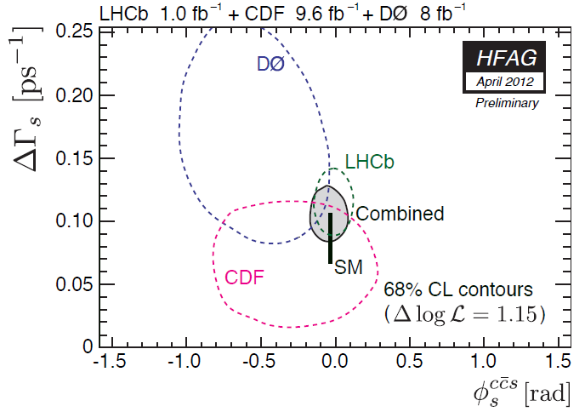
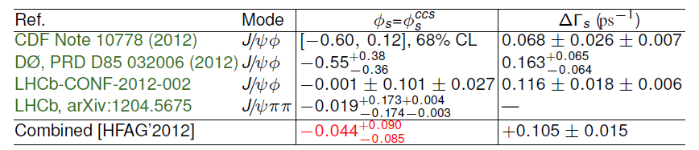

Slide 31
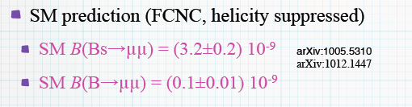
LHCb: Search for B_{s}(B_{d})→ μ⁺μ⁻
Expected limits
assuming bck+SM
arXiv 1203.4493
CMS expected limit with 4.9 fb⁻¹ only 15% worse wrt LHCb
Observed limit BR < 7.7 × 10⁻⁹ CMS-PAS-BPH-11-020
arXiv: 1110.3568
ATLAS preliminary limit with 2.4 fb⁻¹ BR < 2.2 × 10⁻⁸ ATLAS-CONF 2011-145

Slide 32
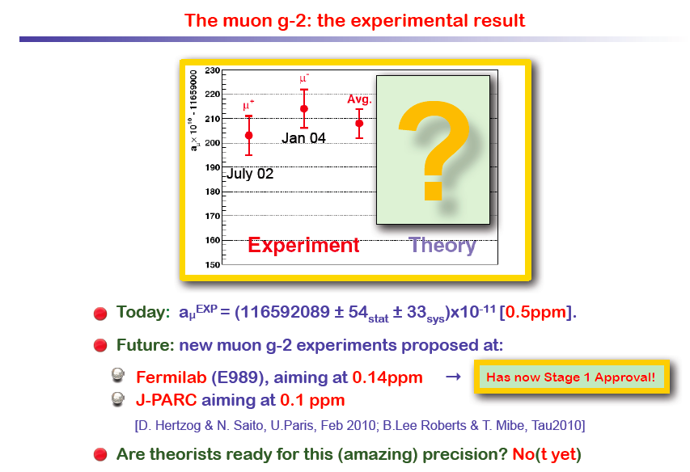

Slide 33
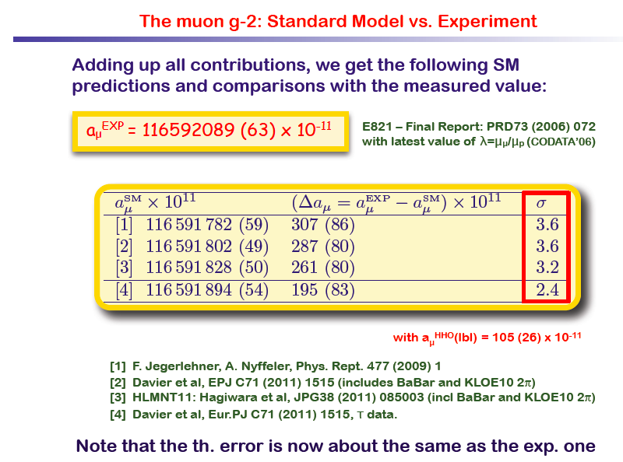

Slide 34
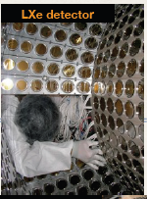
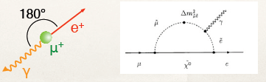

MEG expt @ PSI
3 10⁷ μ/s
Liq Xe calorimeter
DE/E =4% at 50 MeV
New upper limit: B (μ→eγ) < 2.4×10⁻¹² (90%C.L.)
Upgrade?
Will continue run and upgrade detector towards 10⁻¹⁴ sensitivity
Also: mu2e at FNAL, COMET at KEK, mu3e LOI at PSI…

Slide 35
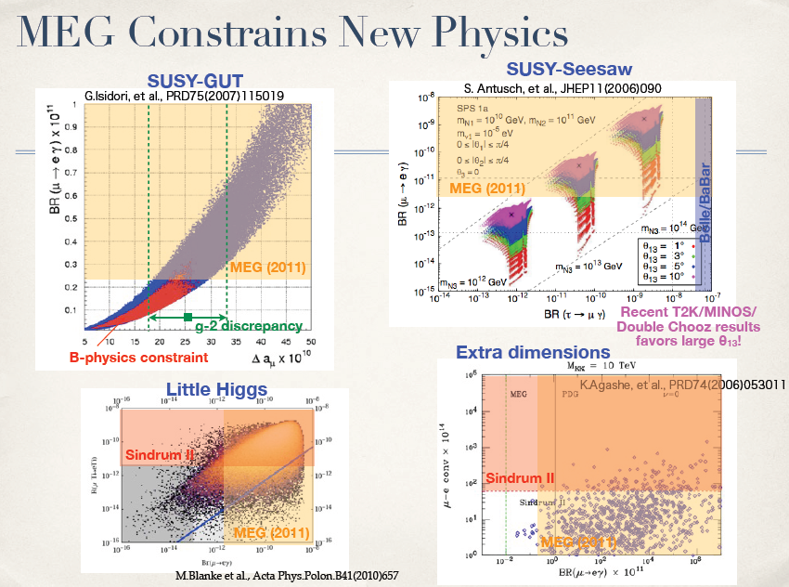

Slide 36
MICRO
MACRO
PARTICLE PHYSICS
COSMOLOGY
GWS STANDARD MODEL
HOT BIG BANG STANDARD MODEL
HAPPY MARRIAGE
Ex: NUCLEOSYNTHESIS
NUCLEAR ASTROPHYSICS
POINTS OF
FRICTION
BUT ALSO
NEW SOURCE OF CP VIOLATION
- COSMIC MATTER-ANTIMATTER ASYMMETRY
- INFLATION
- DARK MATTER + DARK ENERGY
NEW SCALAR POTENTIAL
NEW PARTICLES AND INTERACTIONS
“OBSERVATIONAL” EVIDENCE FOR NEW PHYSICS BEYOND THE (PARTICLE PHYSICS) STANDARD MODEL

Slide 37
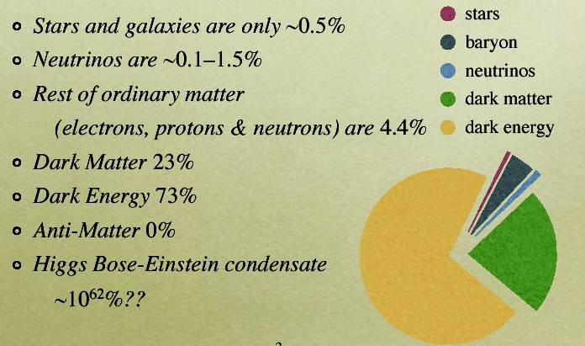
THE ENERGY BUDGET
OF THE UNIVERSE

Slide 38
COULD (AT LEAST SOME OF) THE “OBSERVATIONAL” NEW PHYSICS BE LINKED TO THE ULTRAVIOLET COMPLETION OF THE SM AT THE ELW. SCALE ?

Slide 39
The Energy Scale from the
“Observational” New Physics
neutrino masses
dark matter
baryogenesis
inflation
NO NEED FOR THE NP SCALE TO BE CLOSE TO THE ELW. SCALE
The Energy Scale from the
“Theoretical” New Physics
Stabilization of the electroweak symmetry breaking at M_{W} calls for an ULTRAVIOLET COMPLETION of the SM already at the TeV scale +
CORRECT GRAND UNIFICATION “CALLS” FOR NEW PARTICLES AT THE ELW. SCALE

Slide 40
THE COSMIC MATTER-ANTIMATTER ASYMMETRY PUZZLE:
-why only baryons
-why N_{baryons}/N_{photon} ~ 10⁻¹⁰
NO EVIDENCE OF ANTIMATTER WITHIN THE SOLAR SYSTEM
ANTIPROTONS IN COSMIC RAYS: IN AGREEMENT WITH PRODUCTION AS SECONDARIES IN COLLISIONS
IF IN CLUSTER OF GALAXIES WE HAD AN ADMIXTURE OF GALAXIES MADE OF MATTER AND ANTIMATTER THE PHOTON FLUX PRODUCED BY MATTER-ANTIMATTER ANNIHILATION IN THE CLUSTER WOULD EXCEED THE OBSERVED GAMMA FLUX
IF N_{ba .} = N_{antibar} AND NO SEPARATION WELL BEFORE THEY DECOUPLE . WE WOULD BE LEFT WITH N_{bar.}/N_{photon} << 10⁻¹⁰
IF BARYONS-ANTIBARYONS ARE SEPARATED EARLIER DOMAINS OF BARYONS AND ANTIBARYONS ARE TOO SMALL SMALL TODAY TO EXPLAIN SEPARATIONS LARGER THAN THE SUPERCLUSTER SIZE
ONLY MATTER IS PRESENT
HOW TO DYNAMICALLY PRODUCE A BARYON-ANTIBARYON ASYMMETRY STARTING FROM A SYMMETRIC SITUATION

Slide 41
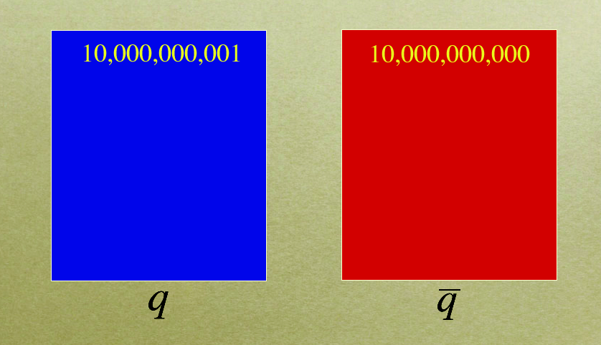
COSMIC MATTER-ANTIMATTER ASYMMETRY
Murayama

Slide 42
SM FAILS TO GIVE RISE TO A SUITABLE COSMIC MATTER-ANTIMATTER ASYMMETRY
:
NOT ENOUGH CP VIOLATION IN THE SM
NEED FOR NEW SOURCES OF CPV IN ADDITION TO THE PHASE PRESENT IN THE CKM MIXING MATRIX
FOR M_{HIGGS} > 80 GeV THE ELW. PHASE TRANSITION OF THE SM IS A SMOOTH CROSSOVER
NEED NEW PHYSICS BEYOND SM. IN PARTICULAR, FASCINATING POSSIBILITY: THE ENTIRE MATTER IN THE UNIVERSE ORIGINATES FROM THE SAME MECHANISM RESPONSIBLE FOR THE EXTREME SMALLNESS OF NEUTRINO MASSES

Slide 43

MATTER-ANTIMATTER ASYMMETRY NEUTRINO MASSES CONNECTION: BARYOGENESIS THROUGH LEPTOGENESIS. Connection to LFV, too?
Key-ingredient of the SEE-SAW mechanism for neutrino masses: large Majorana mass for RIGHT-HANDED neutrino
In the early Universe the heavy RH neutrino decays with Lepton Number violatiion; if these decays are accompanied by a new source of CP violation in the leptonic sector, then
it is possible to create a lepton-antilepton asymmetry at the moment RH neutrinos decay. Since SM interactions preserve Baryon and Lepton numbers at all orders in perturbation theory, but violate them at the quantum level, such LEPTON ASYMMETRY can be converted by these purely quantum effects into a BARYON-ANTIBARYON ASYMMETRY ( Fukugita-Yanagida mechanism for leptogenesis )

Slide 44
INFLATION
CAUSALITY
(isotropy of CMBR)
FLATNESS
(Ω close to 1 today)
AGE OF THE UNIV.
PRIMORDIAL MONOPOLES
SEVERE COSMOGICAL PROBLEMS
COMMON SOLUTION FOR THESE PROBLEMS
VERY FAST (EXPONENTIAL) EXPANSION IN THE UNIV.
φ
V(φ)
VACUUM ENERGY
Ω dominated by vacuum en.
TRUE VACUUM
NO WAY TO GET AN “INFLATIONARY SCALAR POTENTIAL” IN THE STANDARD MODEL

Slide 45
NO ROOM IN THE PARTICLE PHYSICS STANDARD MODEL FOR INFLATION
V=μ² φ² + λφ⁴ no inflation
Need to extend the SM scalar potential
Ex: GUT’s, SUSY GUT’s,…
ENERGY SCALE OF “INFLATIONARY PHYSICS”:
LIKELY TO BE » Mw
DIFFICULT BUT NOT IMPOSSIBLE TO OBTAIN ELECTROWEAK INFLATION IN SM EXTENSIONS
For some inflationary models → large amount of primordial gravitational waves
Notes:
μφλ

Slide 46
HOW TO COPE WITH THE
HIERARCHY PROBLEM
LOW-ENERGY SUSY
LARGE EXTRA DIMENSIONS
DYNAMICAL SYMMETRY BREAKING OF THE ELW. SYMMETRY
LANDSCAPE APPROACH (ANTHROPIC PRINCIPLE)

Slide 47
ROADS TO GO BEYOND
THE STANDARD MODEL (I)
1) THERE EXISTS NO NEW PHYSICAL ENERGY SCALE ABOVE THE ELW. SCALE: gravity is an extremely weak force not because of the enormous value of the Planck scale, but because of the existence of NEW DIMENSIONS beyond the usual 3+1 space-time where (most of) the gravity flux lines get “dispersed”
VISIBILITY AT LHC: there exist “excited” states of the ordinary particles ( Kaluza-Klein states) and some of them are accessible at LHC (the lightest KK state may be a stable particle and it can constitute the DM)

Slide 48
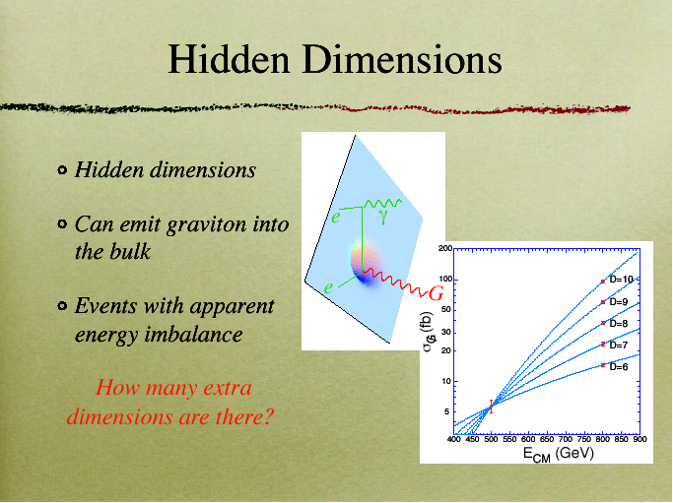

Slide 49
ROADS TO GO BEYOND
THE STANDARD MODEL (II)
2) NO NEED TO “PROTECT” THE HIGGS MASS AT THE ELW. SCALE: THE HIGGS IS A COMPOSITE OBJECT (for instance, a fermion condensate) WHOSE COMPOSITENESS SCALE IS THE ELW. SCALE (cfr. the pion mass case)
VISIBILITY AT LHC: THERE EXIST NEW (STRONG) INTERACTIONS AT THE ELW. SCALE WHICH PRODUCE THE HIGGS CONDENSATE ( new resonances,, new bound states, a new rescaled QCD at 1 TeV)

Slide 50
ROADS TO GO BEYOND
THE STANDARD MODEL (III)
3) THE MASS OF THE ELEMENTARY HIGGS BOSON IS “PROTECTED” AT THE ELW. SCALE BECAUSE OF THE PRESENCE AT THAT ENERGY OF A NEW SYMMETRY, THE SUPERSYMMETRY (SUSY)
VISIBILITY AT LHC: WE’LL SEE (SOME OF) THE SUSY PARTICLES AND THEIR INTERACTIONS. THE LIGHTEST SUSY PARTCILE (LSP) IS LIKELY TO BE STABLE AND PROVIDE THE DM. AT THE SAME TIME, WE COULD DISCOVER SUSY AND THE SOURCE OF 90% OF THE ENTIRE MATTER PRESENT IN THE UNIVERSE.

Slide 51
DM: the most impressive evidence at the “quantitative” and “qualitative” levels of New Physics beyond SM
QUANTITATIVE: Taking into account the latest WMAP data which in combination with LSS data provide stringent bounds on Ω_{DM} and Ω_{B} EVIDENCE FOR NON-BARYONIC DM AT MORE THAN 10 STANDARD DEVIATIONS!! THE SM DOES NOT PROVIDE ANY CANDIDATE FOR SUCH NON-BARYONIC DM
QUALITATIVE: it is NOT enough to provide a mass to neutrinos to obtain a valid DM candidate; LSS formation requires DM to be COLD NEW PARTICLES NOT INCLUDED IN THE SPECTRUM OF THE FUNDAMENTAL BUILDING BLOCKS OF THE SM !

Slide 52
DM → NEW PHYSICS BEYOND THE
( PARTICLE PHYSICS ) SM - if Newton is right at scales>size of the Solar System
Ω_{DM} = 0.233 ± 0.013 *
Ωbaryons = 0.0462 ± 0.0015 **
*from CMB ( 5 yrs. of WMAP) + Type I Supernovae + Baryon Acoustic Oscillations (BAO)
**CMB + TypeI SN + BAO in agreement with Nucleosynthesis (BBN)

Slide 53
THE RISE AND FALL OF NEUTRINOS AS DARK MATTER
Massive neutrinos: only candidates in the SM to account for DM. From here the “prejudice” of neutrinos of a few eV to correctly account for DM
Neutrinos decouple at ~1 MeV ; being their mass<<decoupling temperature, neutrinos remain relativistic for a long time. Being very fast, they smooth out any possible growth of density fluctuation forbidding the formation of proto-structures.
The “weight” of neutrinos in the DM budget is severely limited by the observations disfavoring scenarios where first superlarge structures arise and then galaxies originate from their fragmentation

Slide 54
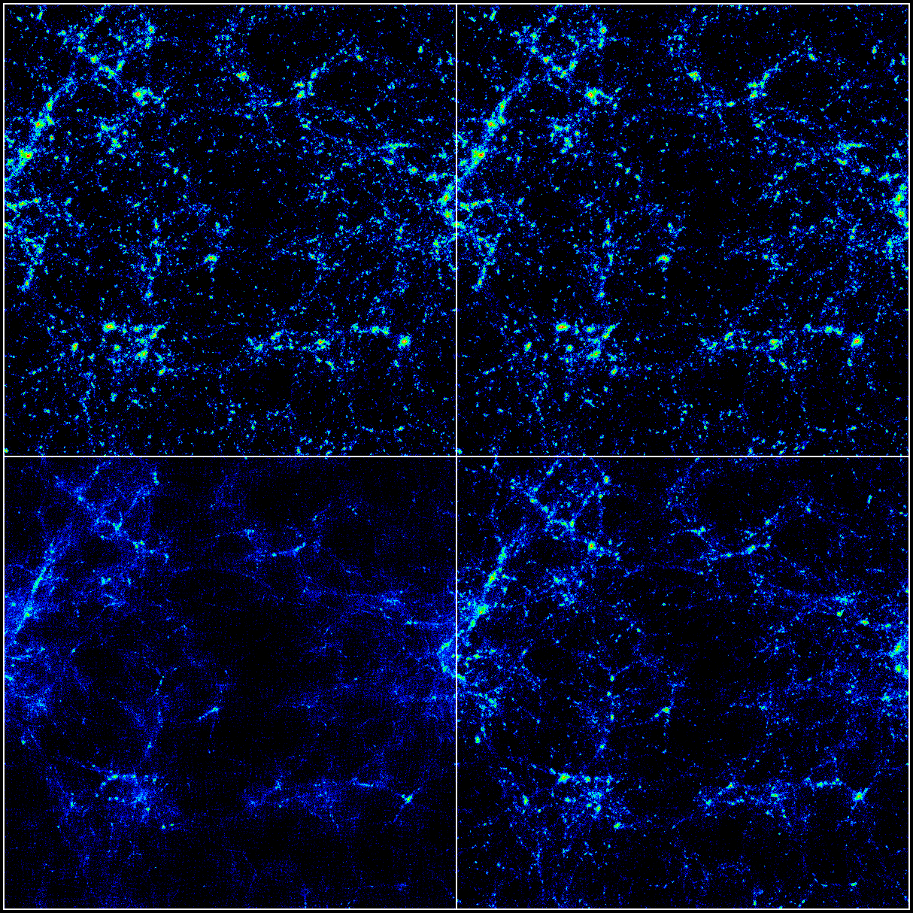
LSS PATTERN AND NEUTRINO MASSES
m_{ν} = 0 eV
m_{ν} = 1 eV
m_{ν} = 7 eV
m_{ν} = 4 eV
(E..g., Ma 1996)

Slide 55
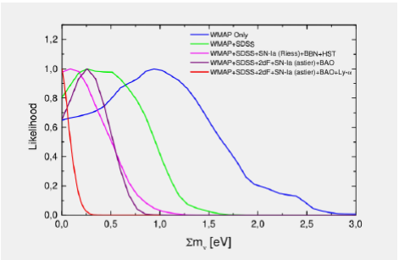
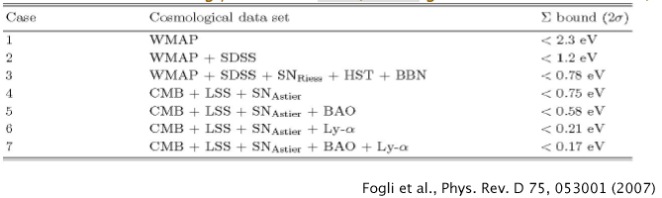
Cosmological Bounds on the sum of the masses of the 3 neutrinos from increasingly rich samples of data sets

Slide 56
TEN COMMANDMENTS TO BE A “GOOD” DM CANDIDATE
BERTONE, A.M., TAOSO
TO MATCH THE APPROPRIATE RELIC DENSITY
TO BE COLD
TO BE NEUTRAL
TO BE CONSISTENT WITH BBN
TO LEAVE STELLAR EVOLUTION UNCHANGED
TO BE COMPATIBLE WITH CONSTRAINTS ON SELF – INTERACTIONS
TO BE CONSISTENT WITH DIRECT DM SEARCHES
TO BE COMPATIBLE WITH GAMMA – RAY CONSTRAINTS
TO BE COMPATIBLE WITH OTHER ASTROPHYSICAL BOUNDS
“TO BE PROBED EXPERIMENTALLY”

Slide 57
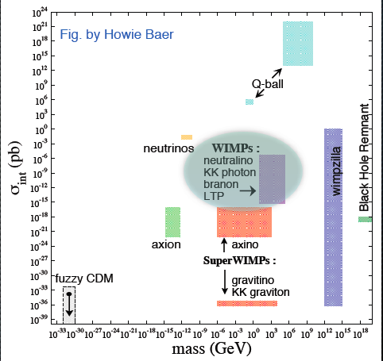

Slide 58
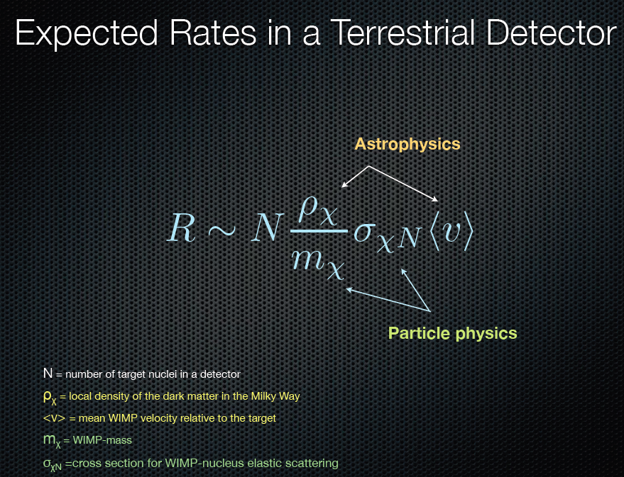

Slide 59
THE DM ROAD TO NEW PHYSICS BEYOND THE SM:
IS DM A PARTICLE OF THE NEW PHYSICS AT THE ELECTROWEAK ENERGY SCALE ?

Slide 60
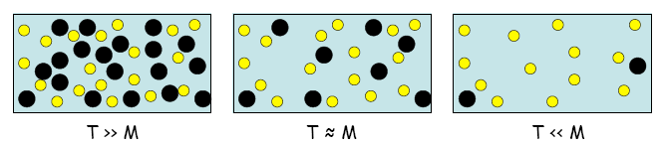
WIMPS (Weakly Interacting Massive Particles)
_{χ}
#χ exp(-mχ/T)
#χ does not change any more
#χ~#γ
m_{χ}
T_{decoupl.} typically ~ m_{χ} /20
_{χ}
Ω _{χ} depends on particle physics (σ_{annih.}) and “cosmological” quantities (H, T₀, …
10⁻³
Ωχ h²_
COSMO – PARTICLE
CONSPIRACY
~
<(σ_{annih.}) V χ > TeV²
~ α² / M²χ
From T⁰ M_{Planck}
Ωχh² in the range 10⁻² -10⁻¹ to be cosmologically interesting (for DM)
mχ ~ 10² - 10³ GeV (weak interaction) Ωχh² ~ 10⁻² -10⁻¹ !!!
THERMAL RELICS (WIMP in thermodyn.equilibrium with the plasma until T_{decoupl})
Notes:
χ

Slide 61
CONNECTION DM – ELW. SCALE
THE WIMP MIRACLE :STABLE ELW. SCALE WIMPs
SUSY EXTRA DIM. LITTLE HIGGS.
1) ENLARGEMENT OF THE SM
(x^{μ}, θ) (x^{μ,} j^{i)} SM part + new part
Anticomm. New bosonic to cancel Λ²
Coord. Coord. at 1-Loop
2) SELECTION RULE
DISCRETE SYMM.
STABLE NEW PART.
R-PARITY LSP KK-PARITY LKP T-PARITY LTP
Neutralino spin 1/2 spin1 spin0
3) FIND REGION (S) PARAM. SPACE WHERE THE “L” NEW PART. IS NEUTRAL + Ω_{L} h² OK
m_{LSP}
~100 - 200 GeV *
m_{LKP}
~600 - 800
GeV
m_{LTP}
~400 - 800
GeV
* But abandoning gaugino-masss unif. Possible to have m_{LSP} down to 7 GeV
Bottino, Donato, Fornengo, Scopel

Slide 62

SUSY & DM : a successful marriage
Supersymmetrizing the SM does not lead necessarily to a stable SUSY particle to be a DM candidate.
However, the mere SUSY version of the SM is known to lead to a too fast p-decay. Hence, necessarily, the SUSY version of the SM has to be supplemented with some additional ( ad hoc?) symmetry to prevent the p-decay catastrophe.
Certainly the simplest and maybe also the most attractive solution is to impose the discrete R-parity symmetry
MSSM + R PARITY LIGHTEST SUSY PARTICLE (LSP) IS STABLE .
The LSP can constitute an interesting DM candidate in several interesting realizations of the MSSM ( i.e., with different SUSY breaking mechanisms including gravity, gaugino, gauge, anomaly mediations, and in various regions of the parameter space).

Slide 63
WHO IS THE LSP?
SUPERGRAVITY ( transmission of the SUSY breaking from the hidden to the obsevable sector occurring via gravitational interactions): best candidate to play the role of LSP:
NEUTRALINO ( i.e., the lightest of the four eigenstates of the 4x4 neutralino mass matrix)
In CMSSM: the LSP neutralino is almost entirely a BINO

Slide 64
DM THE ORIGIN OF THE SUSY BREAKING
HIDDEN
SECTOR SUSY
BREAKING AT
SCALE √F
DM NEUTRALINO
DM GRAVITINO
F = M_{W} M_{Pl}
F = (10⁵ - 10⁶) GeV
GRAVITY
MESSENGERS
GAUGE INTERACTIONS
M_{gravitino} ~ F/M_{Pl} ~
(10² -10³) GeV
M_{gravitino} ~ F/M_{Pl} ~
(10² - 10³) eV
OBSERVABLE
SECTOR
SM + superpartners
MSSM : minimal content
of superfields

Slide 65
GRAVITINO LSP?
GAUGE MEDIATED SUSY BREAKING
(GMSB) : LSP likely to be the GRAVITINO ( it can be so light that it is more a warm DM than a cold DM candidate )
Although we cannot directly detect the
gravitino, there could be interesting signatures
from the next to the LSP ( NLSP) : for instance
the s-tau could decay into tau and gravitino,
Possibly with a very long life time, even of the order of
days or months

Slide 66
Cerdeno ‘09

Slide 67
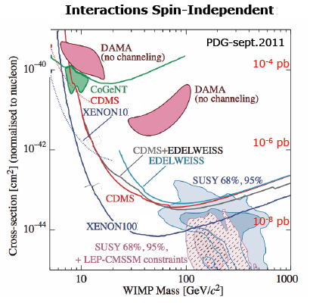
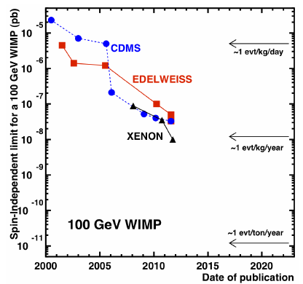
Direct searches: results
Status of the search
Most competitive limits (@ 50-100 GeV):
⇒ Xe: XENON100 (7x10⁻⁹ pb) and Zeplin (4x10⁻⁸ pb)
⇒ Ge: bolometers: CDMS and EDELWEISS (3x10⁻⁸ pb)
Sensitivity at 5x10⁻⁹ pb (@ 100 GeV) will be reached soon (by XENON 100)
Future: XENON 1 ton - 5x10⁻¹¹ pb (2013-2015: installations)
Prospects for bolometers: 1 t experiment in US (GEODM) and Europe (EURECA) < x10⁻¹⁰ pb
Hints for signals at low WIMP masses (< 10 GeV): DAMA modulation signal, CoGeNT, CRESST:
Situation not clear at the moment.

Slide 68
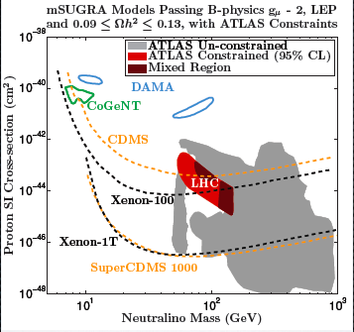
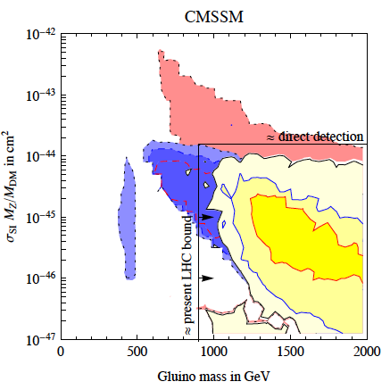

Slide 69
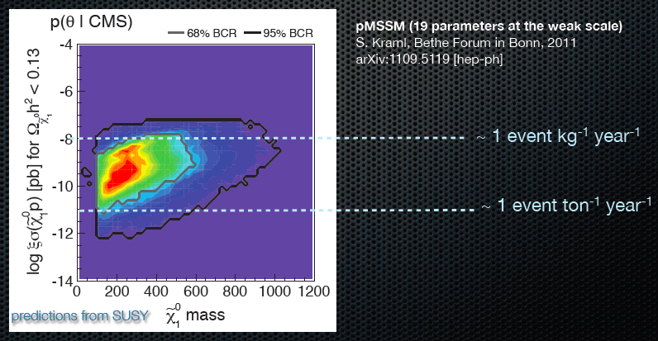
SPOTTING THE NEUTRALINO WITH DM 1-TON DETECTORS

Slide 70
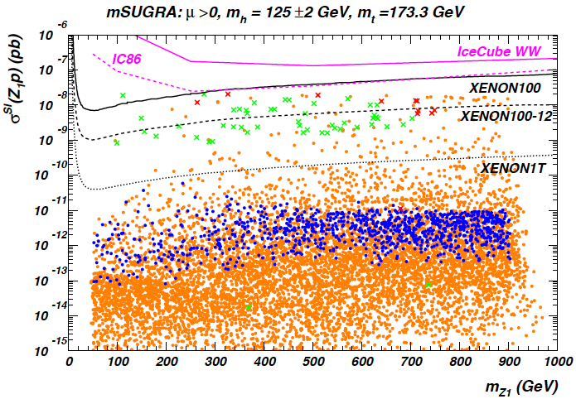

Slide 71
DM and NON-STANDARD COSMOLOGIES BEFORE NUCLEOSYNTHESIS
NEUTRALINO RELIC DENSITY MAY DIFFER FROM ITS STANDARD VALUE, i.e. the value it gets when the expansion rate of the Universe is what is expected in Standard Cosmology (EX.: SCALAR-TENSOR THEORIES OF GRAVITY, KINATION, EXTRA-DIM. RANDALL-SUNDRUM TYPE II MODEL, ETC.)
WIMPS MAY BE “COLDER”, i.e. they may have smaller typical velocities and, hence, they may lead to smaller masses for the first structures which form
GELMINI, GONDOLO

Slide 72
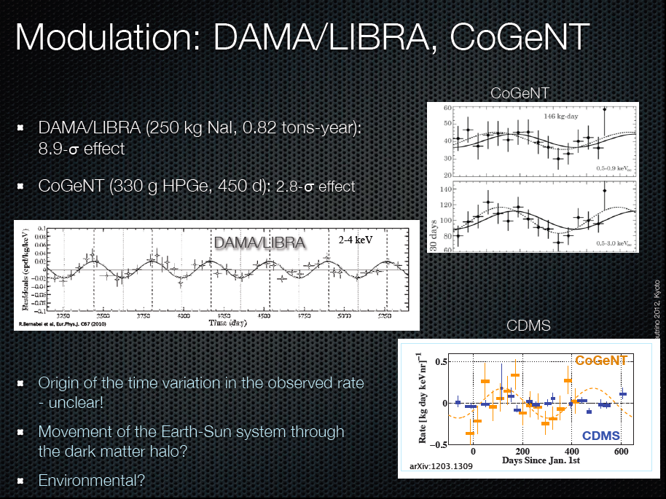

Slide 73

However KIMS is making use of CsI instead of NaI !!!
Kim, KIMS DM

Slide 74
DM INDIRECT DETECTION

Slide 75

INDIRECT SEARCHES OF DM
WIMPs collected inside celestial bodies ( Earth, Sun): their annihilations produce energetic neutrinos
WIMPs in the DM halo: WIMP annihilations can take place ( in particular, their rate can be enhanced with there exists a CLUMPY distribution of DM as computer simulations of the DM distribution in the galaxies seem to suggest. From the WIMP annihilation:
-- energetic neutrinos ( under-ice, under-water exps Amanda, Antares, Nemo, Nestor, …)
--photons in tens of GeV range ( gamma astronomy on ground Magic, Hess, … or in space Agile, FERMI-Glast…)
--antimatter: look for an excess of antimatter w.r.t. what is expected in cosmic rays ( space exps. Pamela, AMS, …)

Slide 77

NO COVINCING SIGNAL OF DM ANNIHALATION
FROM PHOTONS, NEUTRINOS AND ANTIMATTER
Charged particles (PAMELA, FERMI, ATIC-2, PPB-BETS, HESS)
Positron fraction
Antiprotons
Electrons+positrons
PAMELA e+ effect
SOURCE OF ASTROPHYSICAL NATURE?

Slide 78
A FINAL CONSIDERATION
HALF-EMPTY GLASS: hints only for a “standard” higgs ( standard couplings, standard mass…) ; no signal for new physics at LHC; no signal for DM in direct or indirect searches ; no signal for LFV, anomalous FCNC, anomalous CPV; …

Slide 79
A FINAL CONSIDERATION
HALF-FULL GLASS: close to the discovery of the mechanism for electroweak breaking, the higgs boson; the value of its mass could be “peculiar”, i.e. it could hint at relevant new possibilities for our understanding of the hierarchy problem and … of the future of the Universe; impressive prospects for DM searches, deeper comprehension for neutrino physics, possible breakthroughs for our understanding of the flavor physics etc.

Slide 80

..\Desktop\LHC_rough-draft.gif
..\Desktop\._LHC_rough-draft.pdf
Drawing by G. Martinelli
I keep telling my students that they are lucky that they happen to work in the moment when finally we’ll have ANSWERS from Nature through our experiments!

