Slide 1
Design and Test
AMBSLP
Saverio Citraro
PhD Student University of Pisa & I.N.F.N. Pisa
Notes:
Hi to everybody, I’m going to talk about the design and test of the board named AMBSLP

Slide 2
Outline
  AMBSLP: Associative Memory Board Serial Link Processor
    PCB Design
  Measures
  Tests
    Serial links
    miniASIC configuration
  Next steps
Notes:
In this presentation we will see some details of the Associative Memory Board Serial Link Processor, how are the principles feature;
Next ill show you the electronic measures that we did
After that we will see the tests that we made on the board, on serial link connection and the configuration of the new miniASIC
In conclusion ill tell you the strategies of the electronic group for the future

Slide 3
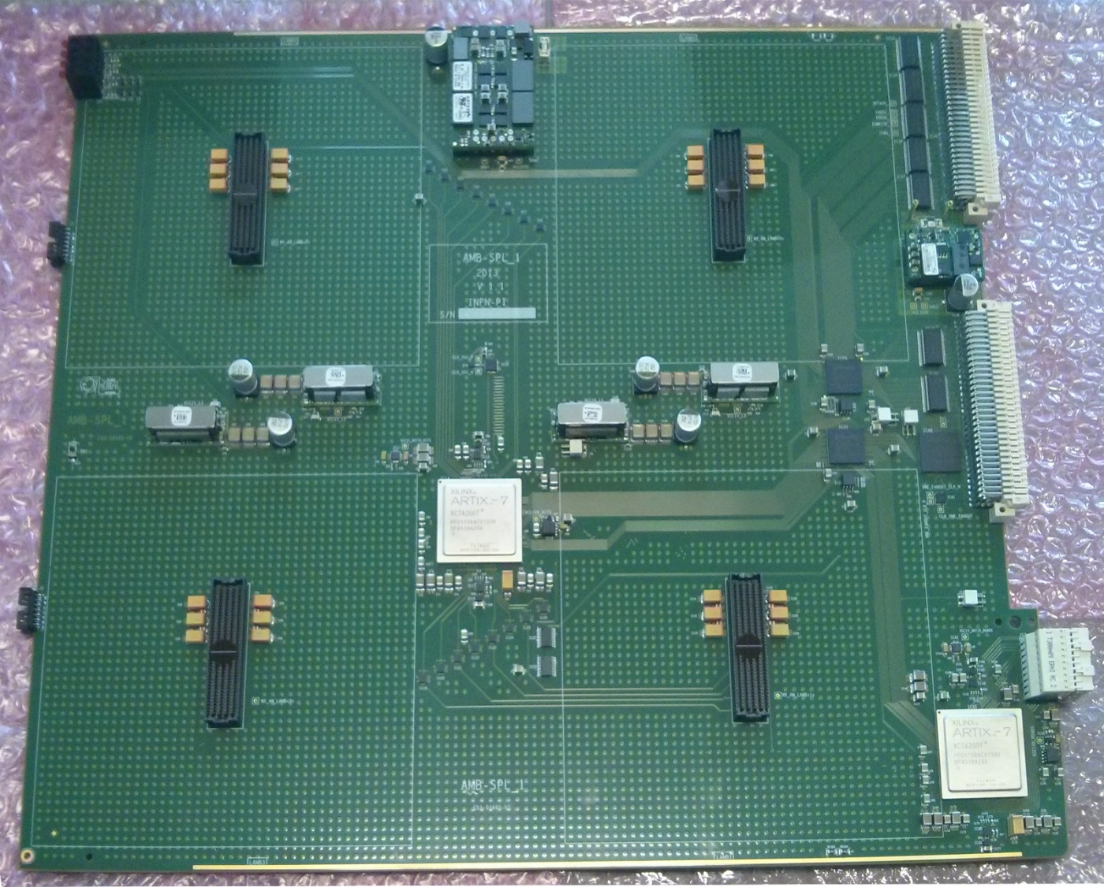
AMBSLP
  VME 9 U
  Serial Links
  @ 2Gb/s
  Clock
  @100MHz
  Supply
  Voltages:
    2,5V
    1,2V
    1V
  Power consumption:
  ~ 250 Watt
Notes:
Let’s start with a little description of the board:
Here is shown a picture of the ambslp

Slide 4
AMBSLP
  VME 9 U
  Serial Links
  @ 2Gb/s
  Clock
  @100MHz
  Supply
  Voltages:
    2,5V
    1,2V
    1V
  Power consumption:
  ~ 250 Watt
Notes:
It is a VME 9 units standard board, that communicates with the back plane with this 2 connectors, there are chips that provide the VME interfacement: here we is shown the transceiver and two fpga that do this.

Slide 5
AMBSLP
  VME 9 U
  Serial Links
  @ 2Gb/s
  Clock
  @100MHz
  Supply
  Voltages:
    2,5V
    1,2V
    1V
  Power consumption:
  ~ 250 Watt
Notes:
The data path is completely routed on serial links at two gigabit per second : the input data path came from the Aux card through the interface connector to the input FPGA, an Artix 7. This FPGA split the input data bus in two. There are also sixteen fanout buffers that split each bus in four and send it to the connector. On this connectors we will plug the Little board with the chips. The output data paths, in red, come from each connectors to the output FPGA, that collect all the informations (Roads) and send it to the Auxcard through the P3 connector.

Slide 6
AMBSLP
  VME 9 U
  Serial Links
  @ 2Gb/s
  Clock
  @100MHz
  Supply
  Voltages:
    2,5V
    1,2V
    1V
  Power consumption:
  ~ 250 Watt
Notes:
On the board we have a system clock at one hundred mega herz and it is distributed on all devices, we have also dedicated clocks (in red squares) for the serial interfaces of the FPGA.

Slide 7
AMBSLP
  VME 9 U
  Serial Links
  @ 2Gb/s
  Clock
  @100MHz
  Supply
  Voltages:
    2,5V
    1,2V
    1V
  Power consumption:
  ~ 250 Watt
Notes:
Let’s see now the strategy of the power supply of the board, we take forty-eight volts and twelve volts from the back plane and make on board three differ voltages: the dc-dc in red square, the big-one generates the two point five volts for all the i/o, the dc-dc in purple square make the one point two for the serial interface, and these four generate the one volt for the AMchip core.

Slide 8

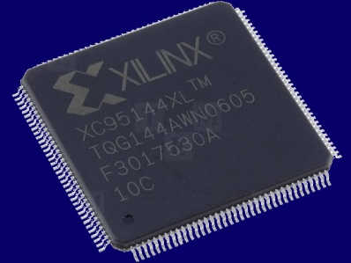
AMBSLP: First step Test
  PCB arrived in Αλεξανδρούπολη in August:
    Power Supply
    Clock Distribution
    JTAG chain
    VME access
    The Problem: Heavy humidity in Pisa…
    CPLD was broken after the mounting phase
Notes:
Now ill tell you the story of the test that we did in this months:
The PCB is arrived in Alessandroupolis in august . here me, Marco and Daniel have provided the preliminary check on the board. Like power supply, clock distributions Jtag chain and so on. We have found a big problem on the CPLD that send and receive data to and from the data bus. This CPLD was totally broken, it was impossible to access in jtag mode to configure it. So we can’t use the vme and we had to bypass it in the Jtag chain in order to be able to configure the other FPGAs. The reason of this problem was that the CPLD tokes a lot of humidity because we opened the packing box mouths before. So after in the mounting phase, in the oven the chip died.

Slide 9
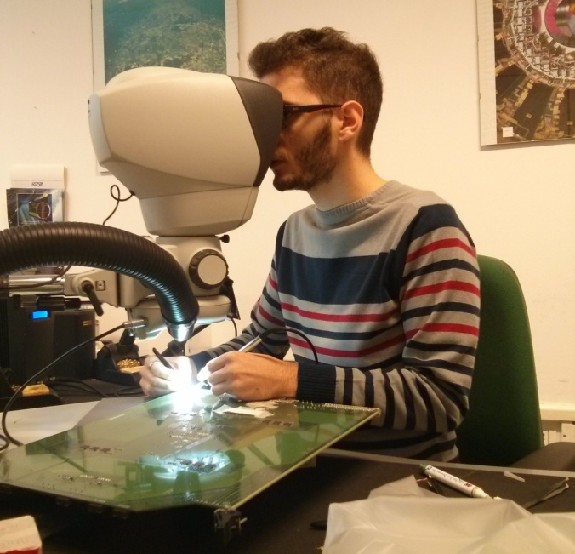
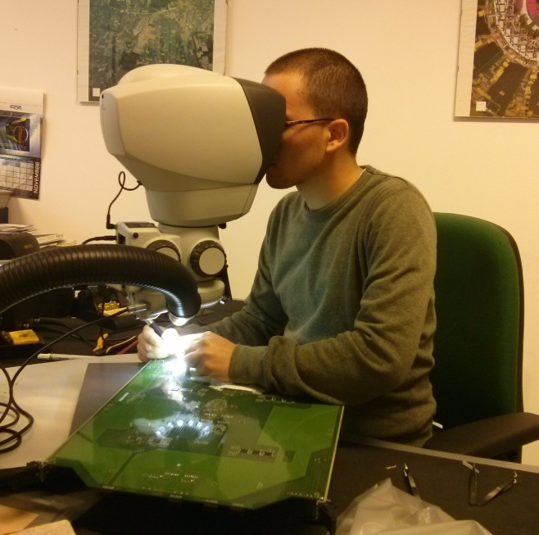
AMBSLP: Fix problem
    CPLD was dried, 5 days of brake OK!
    Some other little fix
    Power Supply
    Clock Distribution
    JTAG chain
    VME access
Notes:
So, We asked to the company to dry it with a brake process, after that CPLD is working well.
We did also some hardware fix, here in the two photo me and Gigi are working on the board like a surgeons.

Slide 10
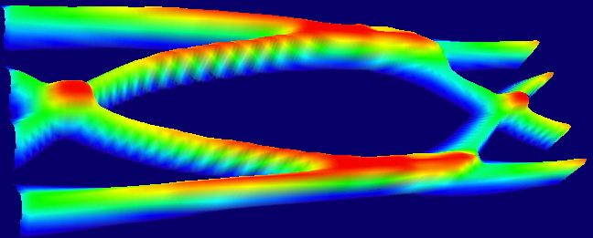
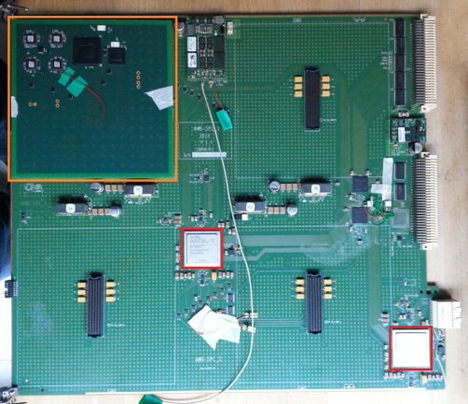
AMBSLP: Measures
Input Measure
  Measures in Frascati:
  Jitter Analysis
  BER
  Eye diagram
  Good results input path
  No Good results output
Output Measure
Notes:
We went to the National Lab of Frascati to check the quality of the serial links. We performed measures of the jitter, we checked the bit error rate and the quality of the signals with the eye diagram.
We did this analysis in different point of the data path, the most important result that I want to show you are on the input of the miniASIC and at the output. The result show that we have a very good input data path but no so good output links.

Slide 11
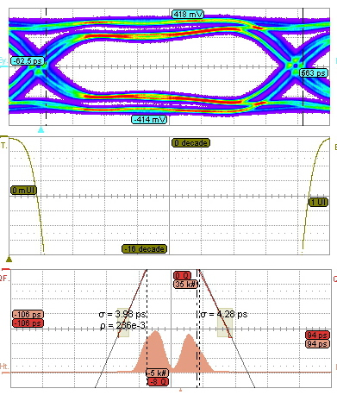
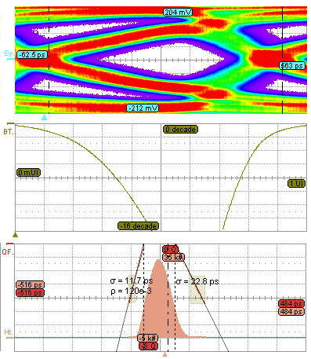
AMBSLP: Measures Result
Notes:
Here is clear what I said, on the left I reported the results of input links. The eye diagram is open, this means that the quality of the signal is good, the rising and falling edge are fast enough and the low and high voltage level are good. The second plot named bath tube shows the quality of the discrimination between logical levels zero and one. Both plots show a very good signal quality. In the third plot is shown the jitter histogram, we have two components with a little standard deviation.
On the right is shown the measure result made on the output path. The eye diagram is more closed than the other one, this means that the signal is distorted. The bath tube shows that we have a poor discriminations between logical one and zero. The jitter histogram shows a standard deviation ten times greater then the input path.
After in next slides I will show you that the functional test on serial links was good, for both situations, this means that the result aren’t so good but are good enough to send and receive data correctly.

Slide 12
miniASIC Configuration Test
  Config Procedure:
    CPU VME
    Conversion JTAG
  Problem on SerDes:
  No answer from the
  miniASIC
VME
Notes:
Now I want to talk about another important test that we made on AMBSLP. We tried to configure the miniASIC by VME bus. The configuration instructions are converted from VME in Jtag format by this two Fpgas, the first one is the VME interface and the second one produce the jtag stimulus for the miniASICs chian.

Slide 13
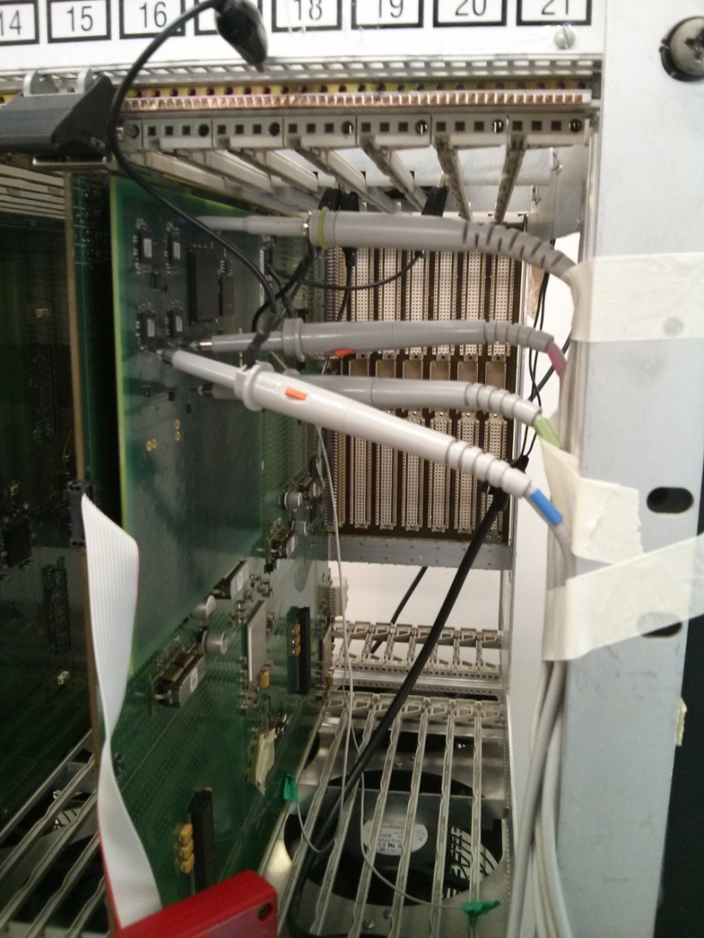
miniASIC Configuration
  After Hardware Debug
  We discovered the Problem:
  A control signal from AMBSLP
  held in reset the SerDes module
  inside miniASIC
Notes:
We had a problem on this procedure, there was a control signal, that is connected to the reset of the serial links interface inside the miniASICs. Discovered e fix this issue, now we are able to configure without problem all the miniAsic cy the cpu in the vme crate.

Slide 14
AMBSLP: Second step Test
  Serial Link @ 2 Gb/s
    Input path
    Output path
  Send PRBS data
  PRBS checker
    BER < 10⁻¹⁴
  Known data stream
Notes:
The most important test provided on the AMBSLP boad is the functional tests of the serial links at 2Gb/s.
We sent pseudorandomic pattern from the input FPGA and checked it in the receiver with a prbs checker.
We did the same on the output path, and in this way we have an estimation of the Bit error Rate, running this test for few days we have this estimation.
We sent also known data without errors.

Slide 15
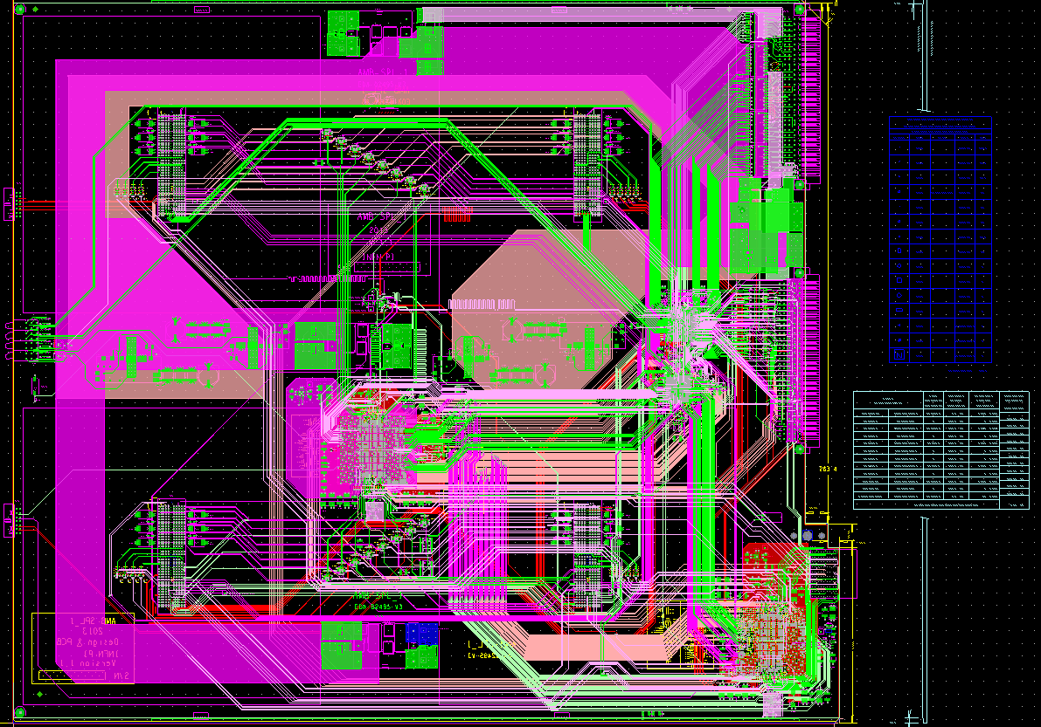
Next steps: New AMBLS version
Only one FPGA for VME interface
Add buffers on
Output Links
Split a bigger
DC-DC @2.5V
in 3 smaller
Notes:
Ok now ill show you the ideas for the next version of the ambslp. We fix all the bug that we found. The three most important changes are these: We merge the CPLD and the FPGA the make the VME interface into a big one FPGA. We add a buffer for each output data path, to avoid the signal quality problem saw in the measures. And we will slpit the biggest dc-dc converter in the board. In three smalle dc-dc.
This is the new layout made by electronic group at cern. They finished last week.

Slide 16
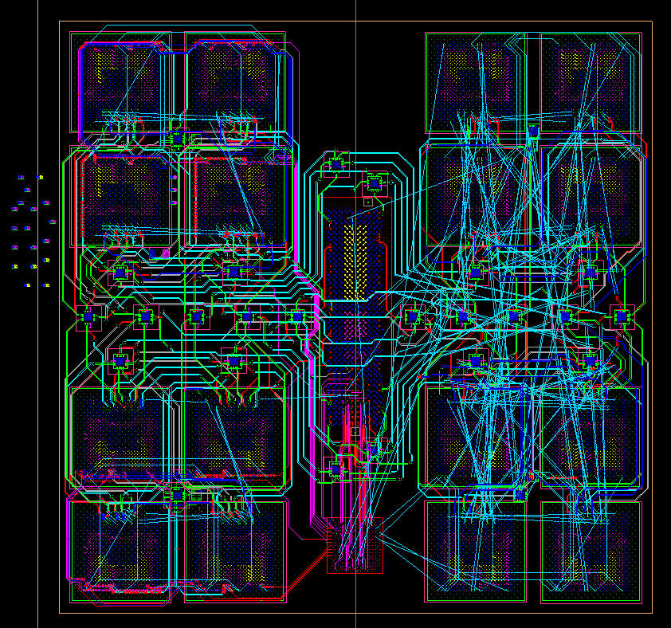
Next steps: Design of the LAMBSLP
Notes:
About next steps, we are waiting the final submission of the chip AMchip zero five, to complete the LAMB layout, here is shown the work in progress of it.

Slide 17
Conclusions
  AMBSLP tested successfully:
    VME
    miniASIC configuration
    Serial Links
  Measurements:
    Very good result on input data path
    No so good on Output data path
  Next steps
    New AMBSLP version
    LAMBSLP design work in progress
    Integration AMBSLP with AUXBoard
Notes:
In conclusion: We tested successfully the VME, the miniASIC configuration and the serial links on the AMBSLP. We did Measures and we had a good results, and we learned that we have to make attention on output data path. For the future we are waiting the new ambslp to test it, we will design the lamb and we will do the integration test with the AUX board.

Slide 18


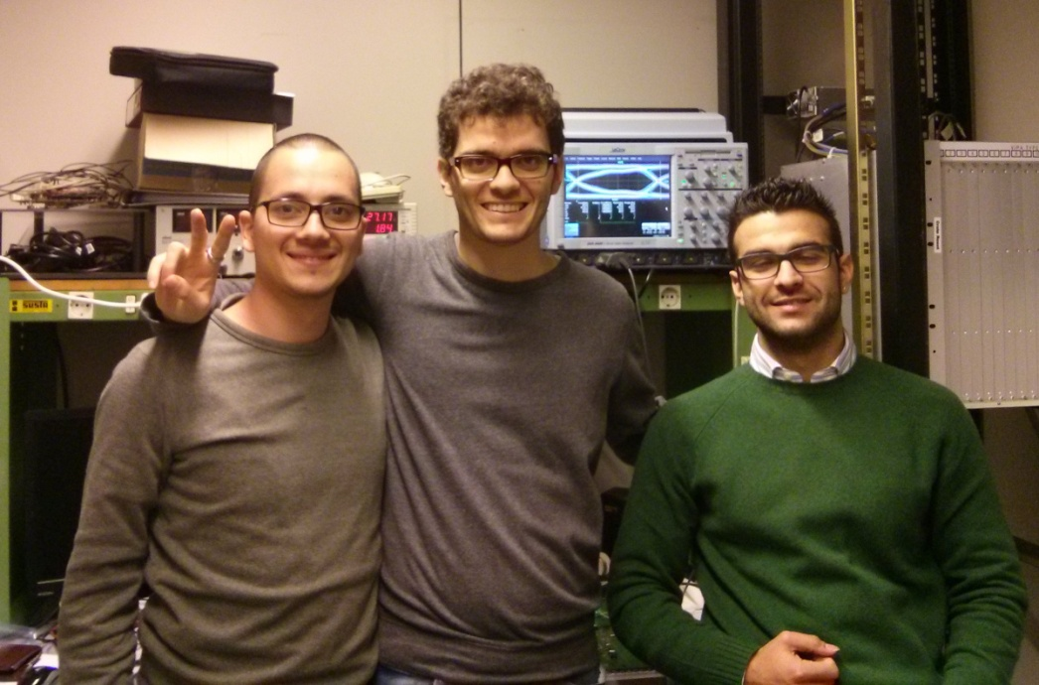
Thanks!
    The Pisa FTK Electronic team
    Saverio, Gigi, Enrico and the two Guardian Angels from Skype: Marco and Daniel
Notes:
Thanks for the attentions!

