Slide 1
Management:
(1) Next GA, EB and trainings
(2) Summary 2013 – Planning 2014
(3) AUTH recruitment

Slide 2
OUTREACH - FTK workshops - Trainings SCHEDULE
YEAR 1
YEAR 2
YEAR 3
ALL DONE IN PISA first year
Where we do it
The second year?
CERN Training!
This is going to happen now in AUTH
Very nice organization – congratulation to AUTH!
Training in the LAB with FPGA evaluation boards and VIVADO!
Very nice workshop
Participation with a talk also at the school on trigger!
NEXT year
at LPNHE!
What do you
Plan to offer?

Slide 3
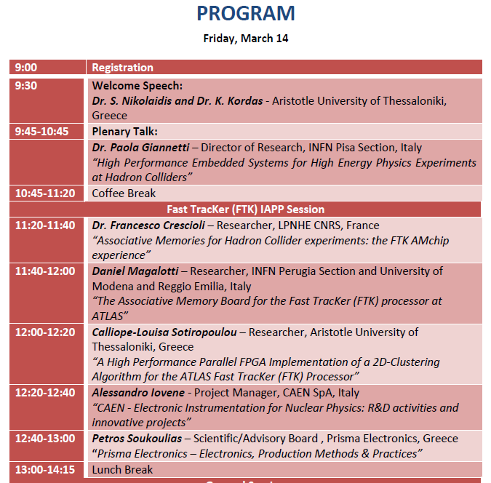
Very nice
session
on FTK!
Next Friday
At AUTH

Slide 4
SLP1 task – the good occasion with Thales did not work
It looks like Thales is now very little interested
We are looking for different contacts
Cadence -- IMEC

Slide 5
Recruitments
GA approved for the AUTH recruitment
Having a a short list of the follwoing three: Dr. Naoki Kimura, Dr. Daniela Paredes and Dr. Antonio Branca
Arranging interview with them, with the selection comittee:
- Calliope-Louisa Sotiropoulou (gender officer) , Simone Donati (UNIPI), Kostas Kordas
Who has to answer for the GA:
Mauro Dell’ Orso –UNIPI, Chair
Kostas Kordas – AUTH, Member
Alessandro Iovene – CAEN, Member
Betty Magnin – CERN, Member -- missing answer
Giovanni Calderini – CNRS, Member
Petros Soukoulias – PRIELE, Member
Simone Donati – UNIPI, Member

Slide 6
Recruitments
Who has to answer for the EB:
Dell’Orso UNIPI, Project Coordinator,
Kostas Kordas, AUTH, WP 7
Dimitrios Sampsonidis, AUTH, WP 8
Paola Garosi, CAEN, WP 2
Francesco Crescioli, CNRS, WP 6
Andreas Sakellariou, PRIELE, WP 1
Marco Piendibene UNIPI, WP 5 Coordinator, Member
Chiara Roda UNIPI, WP 4
Betty Magnin CERN, WP 3

Slide 7
Mid Term Review
Has to be done preferably on months 20-22 September-November
I propose September
Report should be delivered one month before: end of July

Slide 8
Management – Meetings (1/2)
ANNEX 1:
The GA will meet twice per year (M5 & M11 each year)
to deal with administrative issues of the project.
The EB will meet every 4 months (M3, M7, M11 each year)
to assess the progress in research and training aspects.
CONSORTIUM AGREEMENT:
General Assembly At least once a year
Executive Board At least quarterly
PROPOSAL June 2013:
approve an “amendment” to CA by EB and GA.
- Unless otherwise required by practice, EB will meet 4-monthly

Slide 9
NEXT EB, GA meetings proposal
Today-tomorrow meeting is the first GA, EB of the year.
Next EB can be in July
The last GA, EB can be in September-October depending when we will have the Mid-term review

Slide 10
Summary 2013
The “progress report” has been submitted in time with a lot of work on my side.
Little interaction from the collaboration
Deliverables and reports sent in very preliminary form, needed my work to ne finalized.
The web site is still “almost empty”
Let’s see what will be the EU analysis of the project
I hope to have more collaboration in the future, also because the next step (Mid term review) is much more complex.

Slide 11
However the scientific work has advanced significantly
We could declare that the milestones were reached
We had a lot of contributions to conferences (see next slide)
The AMBSLP2 was produced and seems ok
The cooling tests seems promising
We already have the CAEN PS
The integration with the AUX card is ok on our side (much work has to be done on AUX side)

Slide 12
S. Citraro et al. “The Associative Memory system for the FTK processor at ATLAS”,
11th International Conference on Large Scale Applications and Radiation Hardness of Semiconductor Detectors, Florence, Italy, 3 - 5 Jul 2013 http://cds.ce,rn.ch/record/1601039/files/ATL-DAQ-PROC-2013-013.pdf
C.-L. Sotiropoulou at al., “A Multi-Core FPGA-based 2D-Clustering Algorithm for High-Throughput Data Intensive Applications”,
14th ICATPP Conference on Astroparticle, Particle, Space Physics and Detectors for Physics Applications, Como, Italy, 23 - 27 Sep 2013
http://cds.cern.ch/record/1612184/files/ATL-DAQ-PROC-2013-023.pdf
G. Volpi et al. “Design of a hardware track finder (Fast TracKer) for the ATLAS trigger”,
Journal of Instrumentation (Impact Factor: 1.66). 01/2014; 9(01):C01045. DOI:10.1088/1748-0221/9/01/C01045; Topical Workshop on Electronics for Particle Physics, Perugia, Italy, 23 - 27 Sep 2013 http://cds.cern.ch/record/1626623?ln=it
C.-L. Sotiropoulou at al., “A Multi-Core FPGA-based Clustering Algorithm for Real-Time Image Processing”, 2013 IEEE NSS and MIC, Seoul, Korea, Kor, 26 Oct - 2 Nov 2013 http://cds.cern.ch/record/1615402/files/ATL-DAQ-SLIDE-2013-850.pdf
A. Lanza et al, “The Associative Memory Boards for the FTK Processor at ATLAS”, 2013 IEEE NSS and MIC, Seoul, Korea, Kor, 26 Oct - 2 Nov 2013
https://cds.cern.ch/record/1629311/files/ATL-DAQ-PROC-2013-041.pdf
D. Magalotti et al., “THE ASSOCIATIVE MEMORY SYSTEM FOR THE FTK PROCESSOR AT ATLAS”,
14th ICATPP Conference on Astroparticle, Particle, Space Physics and Detectors for Physics Applications, Como, Italy, 23 - 27 Sep 2013, http://cds.cern.ch/record/1620237?ln=it

Slide 13
2014 Program - Milestones
M.2.2. Slp2 ok at Caen CAEN M20 SLP2 runs flawlessly at CAEN
M.2.3. Infrastructure ok at CAEN CAEN M20 Infrastructure validated
M.2.4 Compare_technologies CAEN M20 Compare and choose technology
M.3.1. Demonstrator ok at Atlas CERN M24 Demonstrator runs flawlessly in Atlas

Slide 14
2014 Program - Deliverables
D.4.3. Test Vectors for the SLP2 based FTK R RE M16 Guido/Daniel
D.2.3. CAEN power supply ready for integration R RE M18
Marco/Alex
D.2.4. FTK cooling and mechanical tests completed R RE M20
Paola/Ago
D.2.5 SLP2 fully integrated Pub PU M20
paper Pierluigi/Albe
D.3.1. FTK demonstrator commissioned Pub PU M22
paper NSS
D.6.2. Standard characterization R RE M24
Giovanni

Slide 16
OUTREACH MILESTONES & Deliverables
M.7.1.-M.7.3. Open Days results verification AUTH M8, M20,M32 Sept.
M.7.4. –M.7.6. WorkS. days results verification AUTH M6, M18,M30 JULY
M.7.7. –M.7.9. Summer schools results AUTH M7, M19,M31 August
D.7.1. IAPP project open days R PU M7, M19, M31, M43 August
D.7.2. Workshop days (at AUTH next week) R PU M5, M17,M29, M41 June
D.7.3. Summer school weeks (boot camp?more?)R PU M6, M18,M30, M42 July
D.7.4 D.8.3 World wide web site for dissemination R PU M6, M18, M30, M48 July
Status of Web site
D.8.1. FTK Workshops (@Aless. Now) R RE M1, M13, M30, M46 February
D.8.2. Trainings (next is CERN) R RE M1, M5, M9, M19, August M29, M47

Slide 17
CONCLUSIONS
Interesting work developments
Our recruitment – secondment plan is going ahead with changes but all approved by PO
We wait comments from the first progress report submission

