Slide 1

Loss of Synchronization Module
MARIE CURIE IAPP PROGRAMME
FTK-FAST TRACKER FOR HADRON COLLIDER EXPERIMENTS
SYNCHRONIZATION MODULE
March 2014
Panos Neroutsos
MSc Student/Early Stage Researcher
Aristotle University of Thessaloniki,
Greece

Slide 2
Contents
    Introduction and Specifications
    Technical Design Report of the Loss of Sync module
        Block Diagrams
        Signal Explanations
    Future Plans

Slide 3
Loss of Synchronization module specifications
This work regards a module for the detection of the Synchronization Loss at the Hit Chip.
The module gets the 12 Hit Bus data input and indicates several information to the output as the End Event reference word, and whether the end event word on each bus is equal with the reference. In case of inequality this bus is considered to have lost synchronization. A switch has been implemented to process 8 buses for the AM chip.
One counter has been implemented on each Hit Bus to monitor how many Losses of Synchronization the bus had compared to the Reference End Event Word.
The module assumes that the 1st bus (Hit Bus 0) has always the valid data.

Slide 4
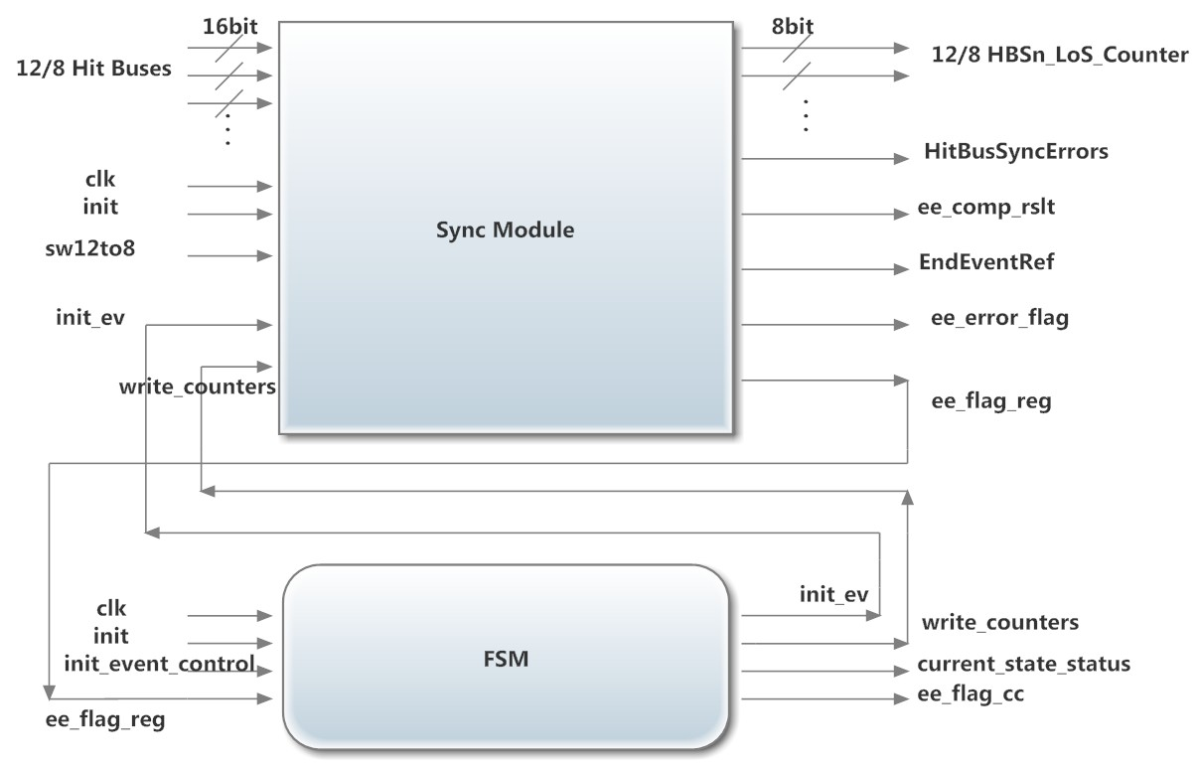
Block diagram Loss of Sync Module

Slide 5
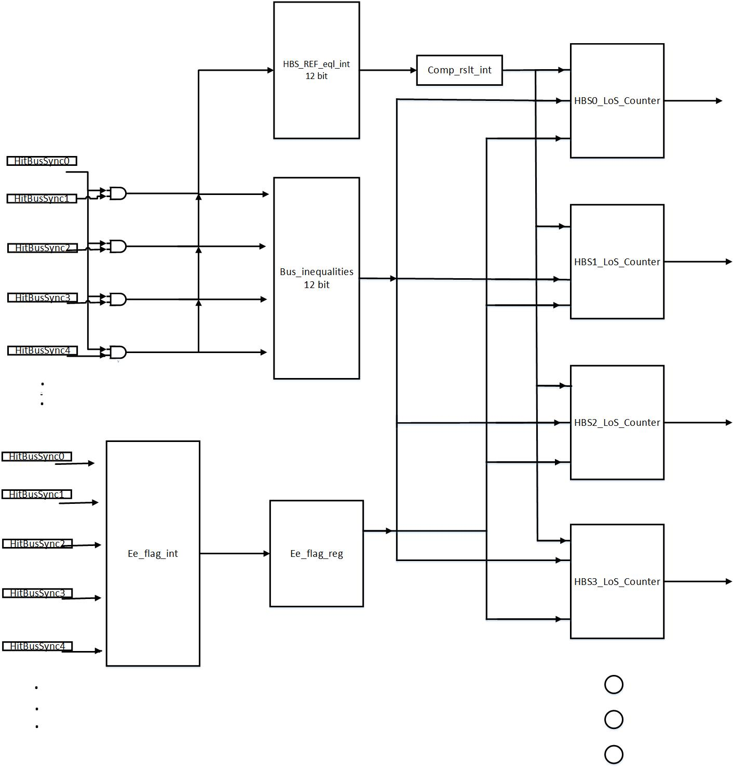
Block diagram of Sync Module

Slide 6
Sync Module : Input Signals Explanation
init : Master reset.
sw12to8 : ‘0’ for 12 Hit Bus input, ‘1’ for 8 Hit Bus Input.
init_ev: Initialization signal that comes from the FSM (see FSM Dataflow).
write_counters : Write enable signal for the counters (see FSM Dataflow).
HitBusSyncN (where N from 0 to 11) 16-bit bus width : Input Data.

Slide 7
Sync Module : Output Signals Explanation
EndEventRef : End Event Reference value (currently equal to HitBusSync0)
HitBusSyncErrors (12-bit) : Indicates the equality of each pair (HitBusN with End Event Reference). ‘1’ when the same, ‘0’ when not.
HBSn_LoS_Counter (where n from 0 to 11) : Counts the losses of synchronization on each bus respectively.
ee_comp_rslt : Registered signal that indicates whether all the End Event Words have the same value. ‘1’ if I have end event and equal values of the HitBuses.
ee_flag_reg : Shows that I have end event on all buses (value ‘1’ in the HitBus MSB).
ee_error_flag : The signal arises if only the end event has arrived in all HitBuses and at least one comparison is not equal.

Slide 8
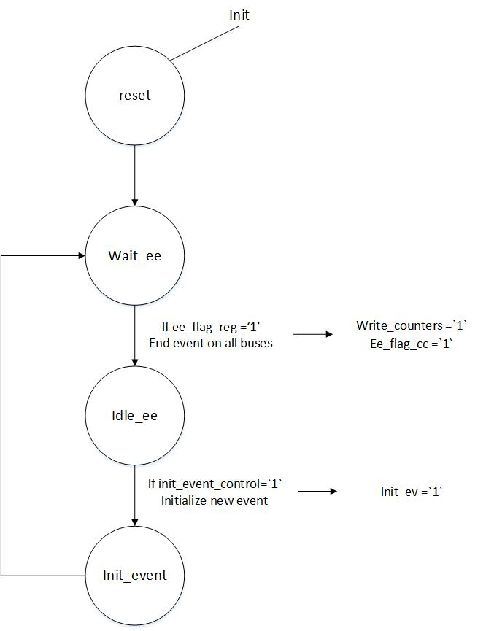
FSM Dataflow

Slide 9
FSM : Input Signal Explanation
init : Master reset.
init_event_control : Initialization signal that comes from the Control Chip. Initializes a new event.
ee_flag_reg : Shows that an end event has arrived on all buses (Produced by the sync_module)

Slide 10
FSM : Output Signal Explanation
write_counters : Signal that arises when an end event has occurred. It works as a write enable pulse of the counter registers.
init_ev : It is produced by the init_event_control signal. It is ‘1’ when the FSM is in the init_event state. It goes to the sync_module to initialize all the registers apart from the counters.
ee_flag_cc : Signal that indicates an end event. It goes to the Control Chip.
current_state_status : Signal that is monitoring the FSM state cycle.

Slide 11

Future plans
The current EndEventRef signal is not reliable. The 1st bus (HitBus0) does not always contain the valid data.
Majority Vote implementation.
    The buses with the most common word (end event) will create the EndEventRef signal that will compare with the others.
    Counters will increment with these differences.
    Speed evaluation.
Implementation of the loss of sync module in the
Hit Chip.

Slide 12
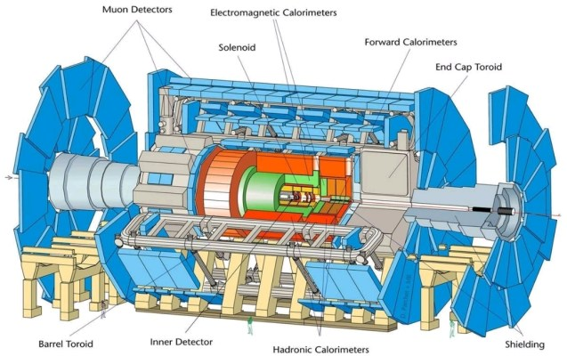
Thank you for your attention.

