Slide 1
Simulation for the AMB-AUX combined tests
G. Volpi

Slide 2
Outline
Overall simulation status and difference w.r.t. hardware
Offline and hardware formats differences
Extracting test vectors from the emulation
Required development
Ongoing actions on the code
Bank and data
Conclusions

Slide 3
FTK simulation status
FTK simulation is a complex framework with a main package and other auxiliary packages
TrigFTKSim contains the core emulation software
FastTrackSimWrap converts RDO/RAW ATLAS data for the emulation
TrigFTKLib contains the software used for the training, preparing the largest configuration files (fit constants and pattern banks)
FTK simulation currently describe the logic of all the components of the system
It is generally flexible and can support different architecture
Number and definition of the towers can be changed
Layers used in the system can changed
Many flags to change the internal behavior of the algorithm and to decide the granularity of the output

Slide 4
FTK emulation flow
RDO/RAW
Reco
NTUP_FTKIP
TrigFTKMergeReco
TrigFTKSM4
NTUP_FTKTMP
DESD_FTK
All the simulation can be controlled by Athena transforms
RDO/RAW files are converted using the default Reco_trf.py
Good: minimal configuration
Not everything can be disabled, not negligible time
FTK main emulation step runs partitioning the detector in 256 parts
64 eta-phi towers with 4 internal partitions each

Slide 5
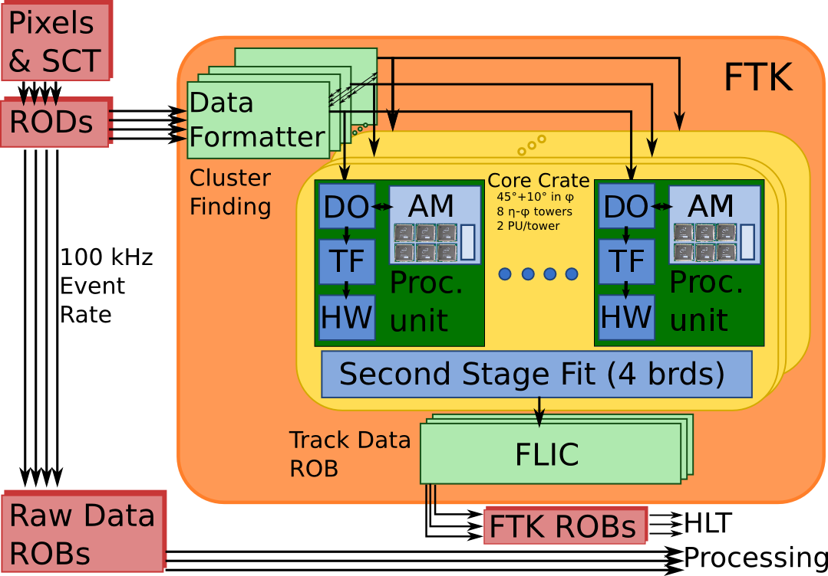
Differences w.r.t. the hardware
AM Emulation controlled features
The AM emulation control the whole initial stage of the HW:
Read the hits and control the clustering
Convert the clusters in SS and make the match
Store the input to be read by the TF
This code embeds the features of different boards/cards.
A more HW-like code organization can be achieved or the difference between boards and hi-level code has to be considered in the output creation.

Slide 6
Data types difference
FTK emulation mostly uses high level data formats
C++ classes represent most of the boards i/o objects
Clusters are 32b floating points to represent the cluster position
Patterns are described by vectors of 32b integers (more than 16 bits are used)
Fit constants and track parameters are 32b floats
Large effort in converting the representation is required
Changing all the formats overnight is impossible
Need to support a scenario in which both high- and low-level formats coexist
Fitter low-level formats mostly require scaling and truncation of values
No impact in the training. Under implementation.
Pattern/Road representation require changes in the SSID calculation model
Require to redo the training, DC calculation method requires technical changes
HW-like SSID format under deployment

Slide 7
How to produce test vectors
The current emulation can produce test vectors for the AMB+AUX
Input can be either simulation or RAW data, conversion through the wrapper is required in both cases
Simulation outputs is in the format of a ROOT ntuple readable having the FTK software setup
Output composed by a map of SSs, with the hits in them, and a list of roads
Roads don’t have the associated hits, library function to make the association provided
Code to convert the ROOT format in HW-like formats to be written
Some efforts ongoing in different institutes (e.g. Chicago), need to uniform the effort to avoid work duplication
Complete test vectors with DC cannot be produced
Preparation of the code that assigns the DC bits not started yet, final SSID format required to avoid work duplication
Some other changes required (next slide)

Slide 8
Current DC implementation
Current code makes a TSP emulation
SS for hits are calculated at “coarse” resolution
Truncating all the DC bits, like assuming all pattern have all the DC set to 1
SSs in good roads are then partitioned the real DC value confirmed
Hits are stored in a 2 levels structure: SS and sub-SS
Hits to SS conversion
Using 32 bit words
Done using worst resolution
SS splitting
SS in good roads are partioned and the hits distributed properly
Roads DC verification
Using internal SS hits distribution roads can be rejected
Roads and SS saving
Each road can be related to a cluster of fine SS

Slide 9
DC test vector preparation road-map
To have a real DC emulation variable precision match has to be implemented
Full resolution SS calculated
Compared to patterns emulating the variable resolution
Need to apply tricks to avoid linear scan, preliminary ideas exist
Extend the road definition to recover hits from multiple SS
A fair amount work also on the bank preparation code
Starts from a realistic SS definition
Almost ready for the barrel
Endcap implementation may come later
HW SSID definition
New TSP preparation code
DC bank preparation update
DC match code
New fit preparation code
Bit limited SS representation has to be defined
Code that prepare the TSP structure adapted to the new format
New code able to extract the DC configuration for a given working point
Define mechanisms to match SS without the current 2 step process
New code able to retrieve hits from multiple SSs in a layer of a given pattern

Slide 10

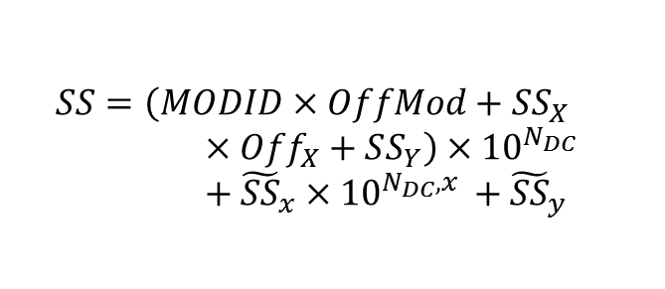
Ongoing change in the code
HW-like SS implementation almost done
Local SS calculation done according two modes
Bit aligned or compressed
Need to be tested
Local module ID based on simple counting, implemented fro the barrel
EC issue postponed
Once the new SS encoding is defined other code can be adapted
Bank preparation code changes is expected to be a minor issue
Implementation of the code for variable resolution match will require important effort
Core part of the whole emulation code
Resource consuming, need to be kept under control to avoid performance issue
$$SS=\left(MODID×OffMod+SS_{X}×Off_{X}+SS_{Y}\right)×{10}_{}^{N_{DC}}+{\tilde{SS}}_{x}×{10}_{}^{N_{DC},x }+{\tilde{SS}}_{y}$$
Gray code used to describe the last section(or the whole local SS part?)

Slide 11
Bank and data for tests
Pattern bank production using the new SSID can start just after the code is considered “good”, probably 1-2 weeks
This would bring to a TSP bank (fine precision, as having all DC=0) in 1-2 days
Only a small patch is required to introduce the limitation to the number of sectors related to AUX limitation
The DC pattern bank production can start few days after
DC-bank preparation code can be prepared while the bank is prepared but some days of testing would be required
Banks will not be really useful until new matching code is ready
Bank and data generally need conversion scripts
Under the described conditions the offline emulation can produce data compatible with the HW functionalities
To perform direct conversion few conversion scripts/programs are still required

Slide 12
Conclusions
FTK simulation currently can produce test vectors in a specific scenario: no DC bits enabled
This feature still need some improvements
SSID finalization, scripts to extract, load and compare information with the hardware are required
The SS size is known, first bank can be created soon
Supporting the full DC feature still requires many steps
Full implementation has a major impact on many core parts
First development requires several weeks counting bank generation time and code development
Performance of the offline emulation always need to be taken into account

