Slide 1
FTK WORKSHOP, ALEXANDROUPOLI: 10/03/2014
FTK_IM: Pixel Clustering, Integration and Tests
Calliope-Louisa Sotiropoulou
Aristotle University of Thessaloniki

Slide 2
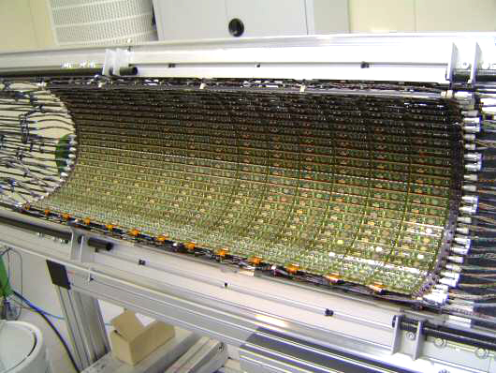
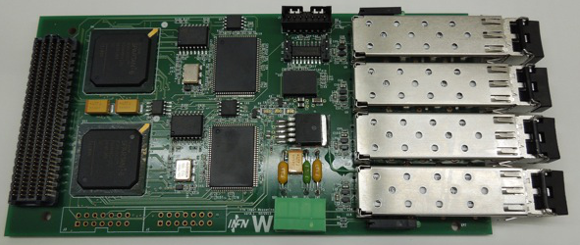
2D-Clustering for the ATLAS FastTracKer Processor
Main challenge: input rate 308Gbits
256 S-link fibers from all pixel RODs
Running at 1.2 Gbits (total 308Gbits)
32bit words at 40MHz, 1 hit/word
PixelDetector
Detector
interface
Fast TracKer
input stage
50~100 kHz
event rate
clustering
device
132
S-links
Level-2
Event buffers
ATLAS Pixel Layer 2
FTK Input Mezzanine Board

Slide 3
2D-Clustering for the ATLAS FastTracKer Processor
Main challenge: input rate 308Gbits
256 S-link fibers from all pixel RODs
Running at 1.2 Gbits (total 308Gbits)
32bit words at 40MHz, 1 hit/word
PixelDetector
Detector
interface
Fast TracKer
input stage
50~100 kHz
event rate
clustering
device
Target:
A system which clusters data on the fly
132
S-links
Level-2
Event buffers
ATLAS Pixel Layer 2
FTK Input Mezzanine Board

Slide 4
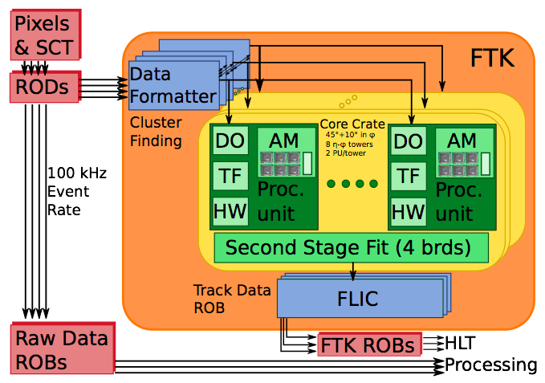
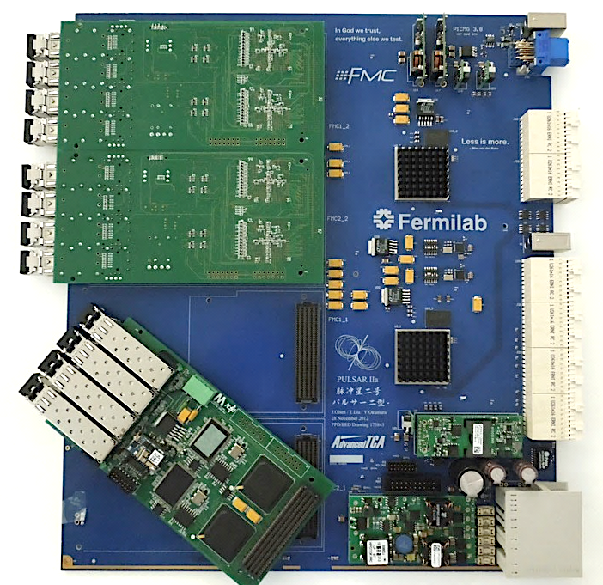
FTK_IM (input mezzanine board)
Receive SCT, Pixel and IBL hit information form ROD
IM performs the hits clustering
Send clustered hits to DF with FTK data format.
4 S-Links(2 SCT and 2 Pixel) / IM, 4IM / DF.
FTK IM
DF

Slide 5
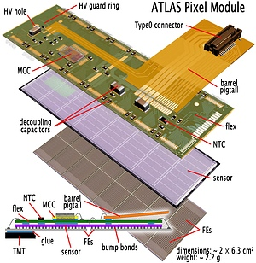
The ATLAS Pixel Module
328x144 pixels readout by 16 Front End (FE) chips
Each module is comprised of 2 rows of 8 FE
Each FE reads out pixel hits by double column
The hits in the double column are scrambled
The pixels are 50um x 400um
Pixels with larger occupancy (column 0 and 17 of each FE chip) are 600um wide

Slide 6
The Clustering Problem
 | 3 | 9 | 7
 | 1 |  |  |  |  | 13 | 15
 | 4 | 8 | 6 | 11
 |  |  |  |  |  |  | 12
2 | 5 | 10 |  |  |  |  | 14
The work on Pixel Clustering started last April
Associate hits from same cluster
Loop over hit list
Time increases with occupancy & instantaneous luminosity
Non linear execution time
Goal: Keep up with 40Mhz hit input rate
The Cluster Hits arrive scrambled→
Loop over the list of hits
1
2
3
4
5
6
7
8
9
10

Slide 7
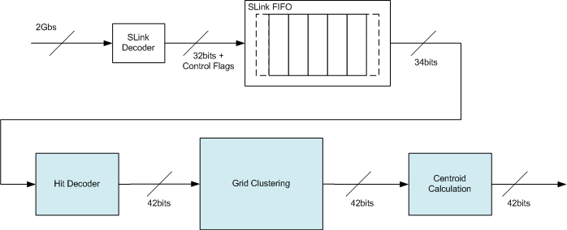
2D-Pixel Clustering

Slide 8
Clustering Modules

Slide 9
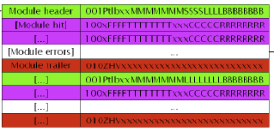
Hit Decoder – Issues addressed
Transform the input data to the format needed, dropping all unnecessary information (bits)
← The pixel coordinates need to be calculated as a function of the FE chip number
Trace and fix errors of missing trailer words (end module, end event)
Drop hits from unidentified events and modules
ATLAS Pixel Byte Stream Format

Slide 10
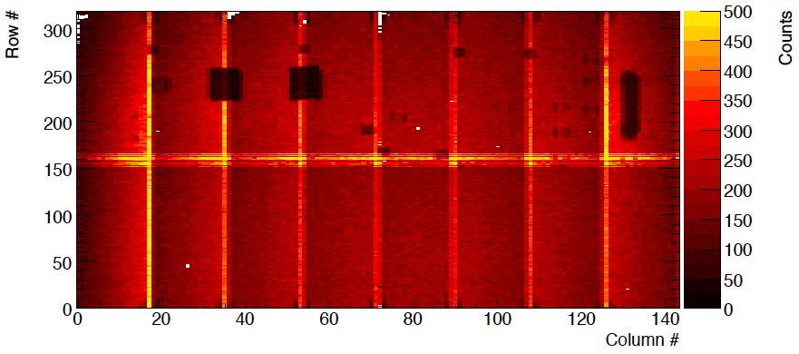
Hit Decoder – Issues addressed
ATLAS Pixel Module
8 | 9 | 10 | 11 | 12 | 13 | 14 | 15
7 | 6 | 5 | 4 | 3 | 2 | 1 | 0
FE chip numbering is circular
FE chips are readout in the order of their numbering →
Incoming data is not in sequence:
Hits from FE <8 come in the reverse column order
Hits from FE>=8 come in the correct column order

Slide 11
Hit Decoder – Block Diagram
Hits from FE<8 are stored in a LIFO
When a hit from FE>=8 arrives it is stored in a register
The column value is compared with the last LIFO word
The hit with the smallest column value is propagated to the output FIFO
FIFOs are used to separate functions and simplify control logic
Input and Output FIFOs could be used for possible Clock Domain crossing

Slide 12
Clustering Modules

Slide 13
Grid Clustering – Generate Window
 | 3 | 9 | 7
 | 1 |  |  |  |  | 13 | 15
 | 4 | 8 | 6 | 11
 |  |  |  |  |  |  | 12
0 | 1 | 2 | 3 | 4 | 5 | 6 | 7 | 8 | 9
Generate a cluster window (e.g. 4x5 pixels) around a reference hit
The reference hit is located on the middle row of the window and
Column 1 of the window if it belongs to an odd column

Slide 14

Grid Clustering – Generate Window
 | 3 | 9 | 7
 | 1 |  |  |  |  | 13 | 15
 | 4 | 8 | 6 | 11
 |  |  |  |  |  |  | 12
1 | 2 | 3 | 4 | 5 | 6 | 7 | 8 | 9 | 10
Generate a cluster window (e.g. 4x5 pixels) around a reference hit
The reference hit is located on the middle row of the window and
Column 1 of the window if it belongs to an odd column
Column 0 of the window if it belongs to an even column
Hits are read from the input until a hit which belongs to a column beyond the cluster window is identified
The hits that belong to the same columns as the cluster window are stored in a separate circular buffer

Slide 15
Grid Clustering – Select and Readout
 | 3 | 9 | 7
 | 1 |  |  |  |  | 13 | 15
 | 4 | 8 | 6 | 11
 |  |  |  |  |  |  | 12
0 | 1 | 2 | 3 | 4 | 5 | 6 | 7 | 8 | 9
Two cells in the cluster window are selected as “seeds” (0, mid-row) and (1, mid-row)
Selected grid cells

Slide 16
Grid Clustering – Select and Readout
 | 3 | 9 | 7
 | 1 |  |  |  |  | 13 | 15
 | 4 | 8 | 6 | 11
 |  |  |  |  |  |  | 12
0 | 1 | 2 | 3 | 4 | 5 | 6 | 7 | 8 | 9
Two cells in the cluster window are selected as “seeds” (0, mid-row) and (1, mid-row)
The “selected” state is propagated to the neighboring hits

Slide 17
Grid Clustering – Select and Readout
 | 3 | 9 | 7
 | 1 |  |  |  |  | 13 | 15
 | 4 | 8 | 6 | 11
 |  |  |  |  |  |  | 12
0 | 1 | 2 | 3 | 4 | 5 | 6 | 7 | 8 | 9
Two cells in the cluster window are selected as “seeds” (0, mid-row) and (1, mid-row)
The “selected” state is propagated to the neighboring hits
The previous hit is now readout

Slide 18
Grid Clustering – Select and Readout
 | 3 | 9 | 7
 | 1 |  |  |  |  | 13 | 15
 | 4 | 8 | 6 | 11
 |  |  |  |  |  |  | 12
0 | 1 | 2 | 3 | 4 | 5 | 6 | 7 | 8 | 9
Two cells in the cluster window are selected as “seeds” (0, mid-row) and (1, mid-row)
The “selected” state is propagated to the neighboring hits
The previous hit is now readout
Selecting and reading out the cluster is executed in parallel
The hits are sent out in their local coordinates with regards to the reference hit
Less bits for calculation in the next processing element
The reference hit is sent out in absolute coordinates in the end cluster word
The hits that do not belong to the cluster are recovered and written to the circular buffer in their absolute coordinates

Slide 19
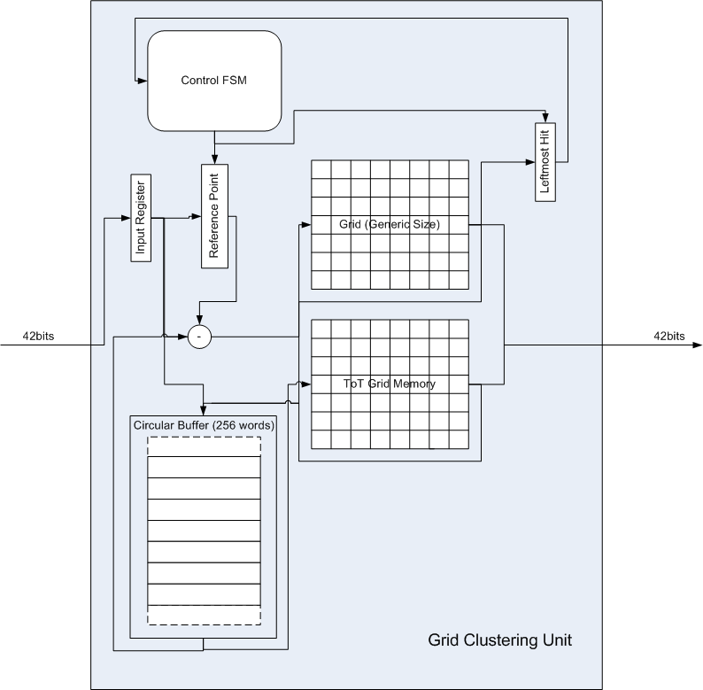
Grid Clustering – Block Diagram
The Grid Clustering Module’s main components are:
The Grid
The ToT memory
The Circular Buffer
It is fundamentally a control intensive data manipulation module
The current Grid size chosen is 8x21 pixels
Pixels exceeding this size will be split at the boundary and activate a “split flag” at the end_cluster word

Slide 20
Grid Clustering - Operation
The first time of the operation the reference hit is the first to arrive from the input buffer
For every other execution the reference hit is the leftmost hit stored in the circular buffer (where the recovered hits are stored)
The pixel data is moved from the grid to the circular buffer and back to the grid until all clusters are identified
This is why execution time is data dependent

Slide 21
Clustering Modules

Slide 22
Clustering Modules – Centroid Calculation
A calculation of the average coordinate without using ToT was the baseline for the FTK TDR
A correction based on ToT (linear interpolation) and pixel absolute position will be implemented
This is beyond baseline FTK
FW to be planned and written
The Centroid Calculation step will output the cluster centroid and also the cluster size in two coordinates

Slide 23
Clustering – Parallel Version
The fundamental characteristic of the 2D-Pixel Clustering implementation is that different clustering engines can work independently on different data →
Increase performance with greater FPGA resource usage
A parallelization strategy was chosen:
Instantiate multiple clustering engines (grid clustering modules) that work independently on data from separate pixel modules
To achieve this data parallelizing (demultiplexing) and data serializing (multiplexing) modules are necessary

Slide 24
Clustering – Parallel Version
Parallel Distributor (Data Demultiplexing)
It distributes the data to the different pixel modules to different clustering engines by choosing always the “less busy engine”
The less busy engine is decided by the number of data words each engine has queued at its input
There is a LVL1ID FIFO which stores the LVL1IDs of the processed events in the arrived sequence so that they are recovered in the same sequence from the Data Multiplexing module

Slide 25
Clustering – Parallel Version
Data Merger (Data Multiplexing)
It begins operation as soon as the LVL1ID FIFO and a parallel engine have valid output
It identifies the parallel engines that have the same event and propagates data out from the engine with the smallest index number
The other engines continue working and storing data at their output FIFOs until they are almost full. Then backpressure is applied at the clustering modules.
The parallel engines are buffered with FIFOs at input and output to avoid backpressure as much as possible

Slide 26
Clustering – Parallel Version
Distributes pixel module data to different engines
Merges the modules of each event
Stores the LVL1ID sequence

Slide 27
Clustering – Implementation Results
Single Flow Implementation Results (Spartan 6 lx150t)
 | FF | LUT | BRAM (18Kbit) | BRAM (9Kbit) | Maximum Frequency (MHz)
Hit Decoder | 306 | 486 | 1 | 3 | 120.0
Grid Clustering | 700 | 2257 | - | 2 | 81.5
Total System | 1137 (0.6%) | 2647 (2.4%) | 1 (0.4%) | 6 (1.8%) | 81.5
FF: Flip Flops, LUT: Look-Up-Tables, BRAM: 18Kbit Block RAM blocks and 9Kbit Block RAM blocks
Parallel Flow (4 Engines) Implementation Results (Spartan 6 lx150t)
 | FF | LUT | BRAM (18Kbit) | BRAM (9Kbit) | Maximum Frequency (MHz)
Parallel Data Distributor | 51 | 79 | - | - | 270.0
Binary Tree Comparator | 84 | 51 | - | - | 334.8
Data Merger | 70 | 113 | - | - | 247.5
Total System | 5272 (2.8%) | 10250 (11.1%) | 15 (5.6%) | 19 (3.5%) | 80.5
Extra buffering added (explained later)

Slide 28
Clustering – Testing Results Single Flow
Successful integration with the rest of the FTK_IM firmware
Testing with ZH → nunubb files (80pu)
Small event files (3 events: 2 modules per event) multiple times
Big event files (50 events: 7 modules per event) multiple times – this is what each pixel clustering module will receive from the RODs
Output was compared with the bit-accurate simulation (prepared by Akis – more details in his presentation)
Some very small differences exist (less than ~0.4%) which are due to the backpressure applied by the DF and the slower than anticipated input rate ← Currently being debugged

Slide 29
Clustering – Testing Results Parallel Flow
Successful integration with the rest of the FTK_IM firmware of a 4 Engine Parallel Flow
Tests with the same input files
Output same quality as the single input flow ← Currently debugged

Slide 30
Clustering - Performance Results (Single Flow)
For the Single Flow we have a processing time per word of 84.15ns
At worst case one word is read every 25ns (40MHz)
84.15/25 = 3.36 clock cycles of 40MHz are required for one data word processing
Therefore it was anticipated that 4 engines would be sufficient for Pixel (B Layer) worst case
The latency presented at the plot is not realistic because it the end_event words at the input are delayed due to the backpressure applied by both grid clustering and hit decoder modules

Slide 31
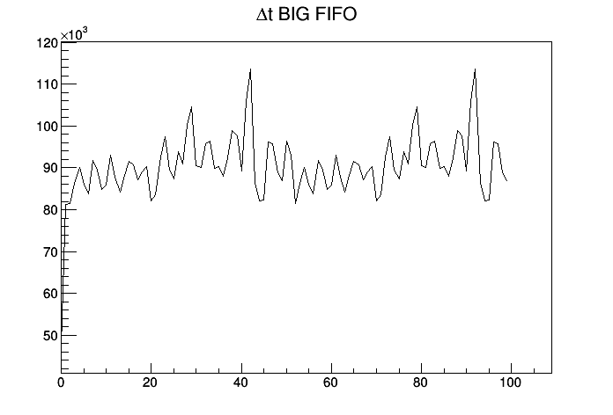
Clustering - Performance Results (Single Flow)
Single Flow Event Processing Latency (end_event output – end_event input time)
Time (ns)
Event number
End_event input time delayed by backpressure
The actual delay is bigger and increasing with event number

Slide 32
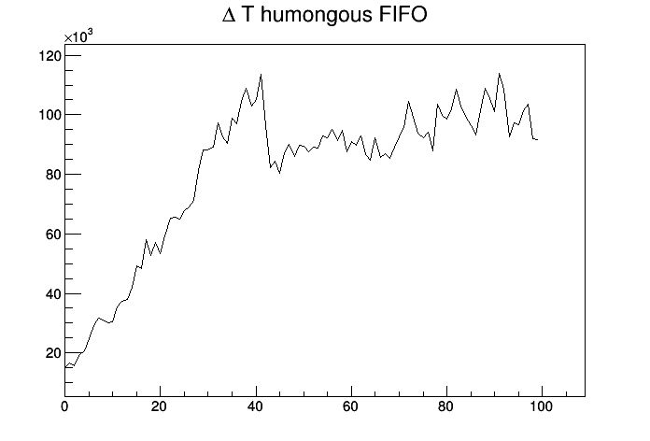
Clustering - Performance Results (Parallel Flow)
4 Parallel Engine Flow Event Processing Latency (end_event output – end_event input time)
Time (ns)
Event number
End_event input time delayed by backpressure
The actual delay is bigger and increasing with event number

Slide 33
Clustering - Performance Results (Parallel Flow)
The 4 Parallel Engine Flow saturates after 30 events
This is because of the back pressure applied by the Data Merger
We increased the buffering before the Data Merger to reduce this effect
Bigger buffering → processing time per word reduced to 25.24 ns which is the 8 Parallel Engine Flow performance without the extra buffering (next slides)
(0.24ns is due to simulation time artifacts)

Slide 34
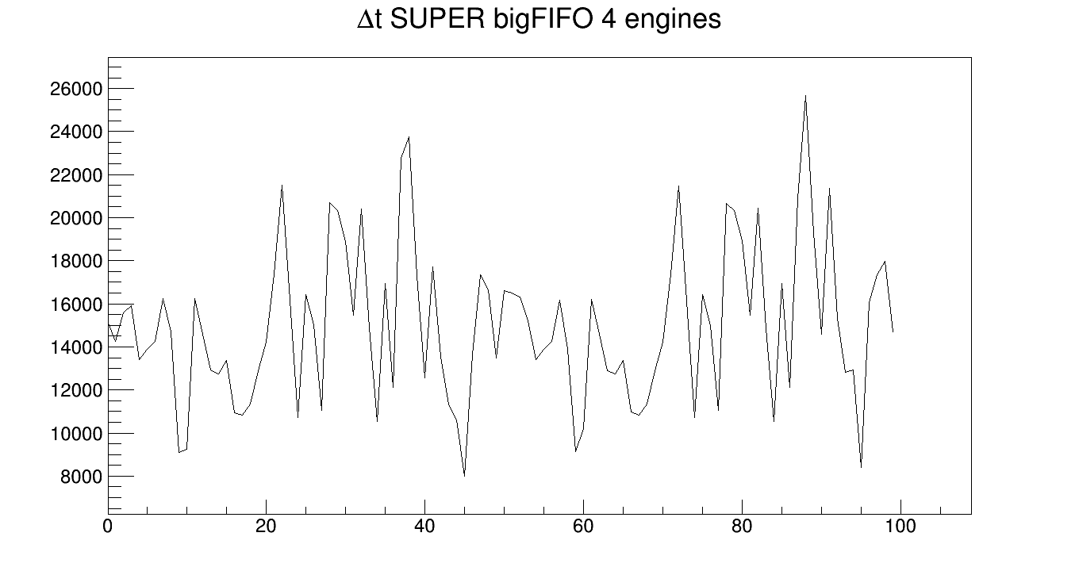
Clustering - Performance Results (Parallel Flow)
4 Parallel Engine Flow Event Processing Latency (end_event output – end_event input time) ← No saturation and no backpressure seen at the input
Time (ns)
Event number

Slide 35
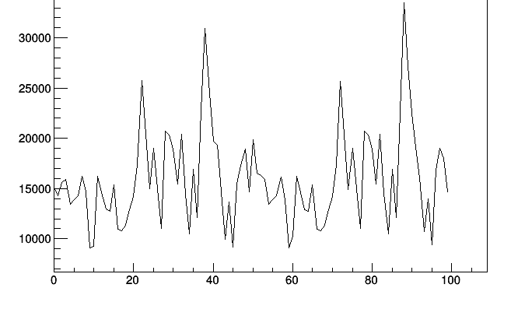
Clustering - Performance Results (Parallel Flow)
8 Parallel Engine Flow Event Processing Latency (end_event output – end_event input time) ← No saturation and no backpressure seen at the input
Time (ns)
Event number

Slide 36
Clustering - Performance Results (Parallel Flow)
The 8 Parallel Engine Flow fully covers pixel specifications for 80pu events even without the big buffering (data from 7 pixel modules are easily distributed over 8 engines)
A 25.24 ns processing time was calculated per data word as a worst case (0.24ns is due to simulation time artifacts)
Target: Make a 8 Parallel Engine version with an 80MHz “fast” clock (not tested yet)

Slide 37
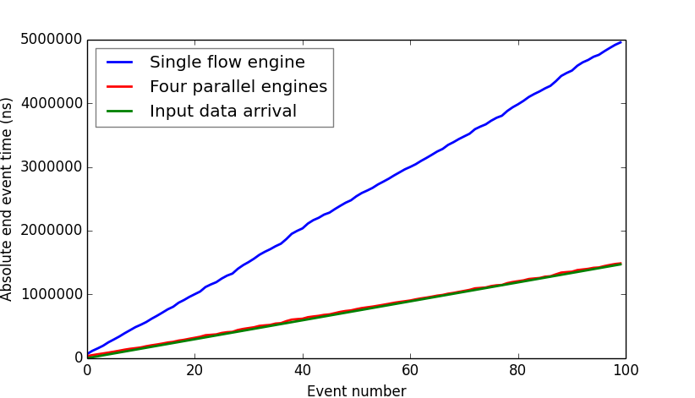
2D-Pixel Clustering Performance Plot
Nice match! ☺

Slide 38
2D-Pixel Clustering Dissemination
Presented in:
ICATPP 2013
IEEE NSS 2013
In the merged presentation of TWEPP 2013
A paper for IEEE TNS currently written (first draft finished, under review by the authors)
Three (3) more abstracts submitted

Slide 39
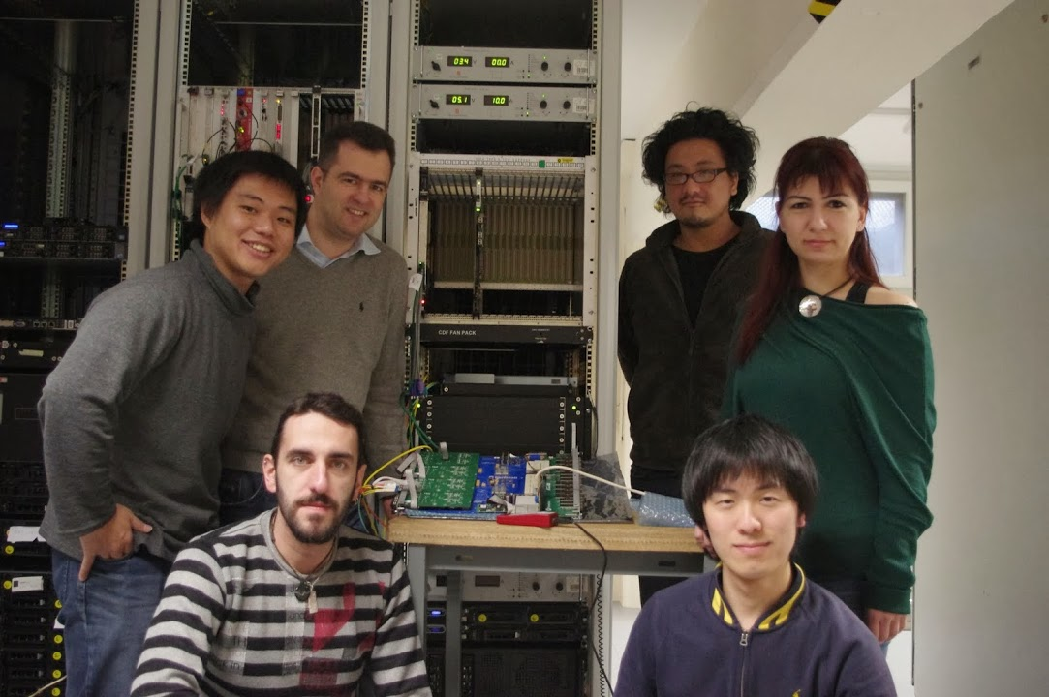
Lab 4 FTK_IM Testing Team
Alberto, INFN- CERN
Naoki, Waseda Un.
Yasu, Fermilab
Calliope, AUTH
Akis, AUTH
Tomoya, Waseda Un.

Slide 40
Clustering – Next Steps
Finalize parallel FW (debugging etc.)
Finalize integrated version (issues with the wrapper, error words, monitoring etc.)
Prepare simplified centroid calculator
Implement final output format
Then ready for tests with AUX card
Study IBL data flow (and implement IBL FW)
Maximum input hit rate from IBL : 100MHz
Higher occupancy
IBL data flow not trivial & not solved yet
A lot happened with pixel clustering in the last year…

Slide 41
BackUp

Slide 42
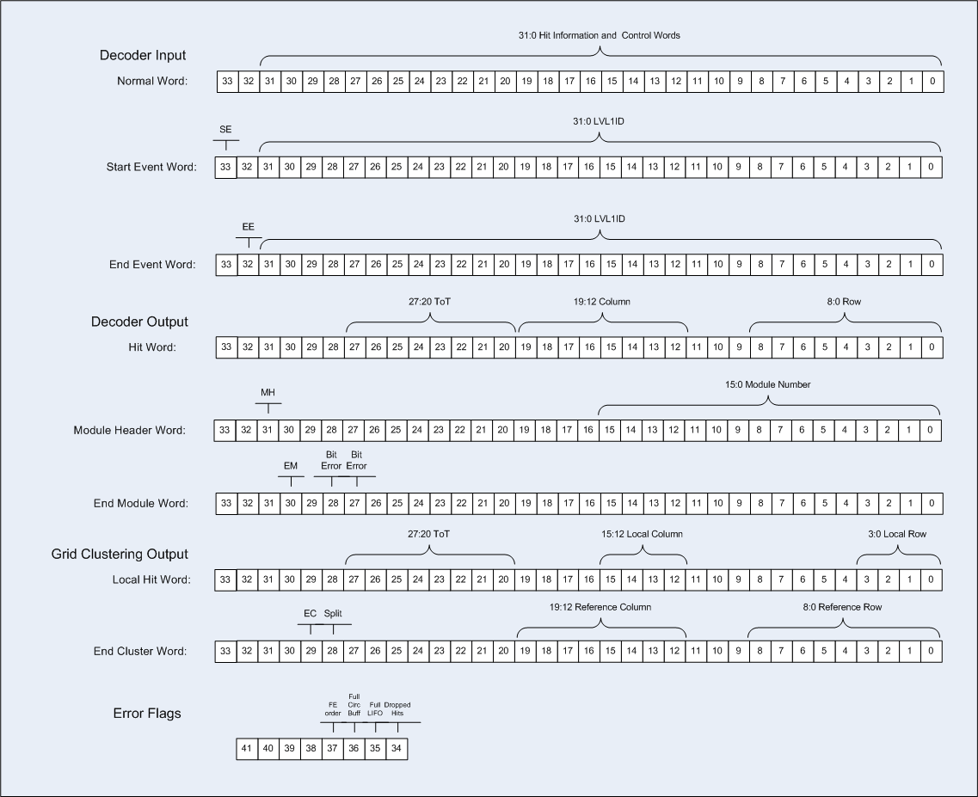
Data Format

Slide 43
Clustering Modules – Centroid Calculation
0
1
2 | 30 | 70 | 80
3 | 40 | 75 | 60
4
 | 0 | 1 | 2 | 3 | 4
Centroid
Correction
Constant a is a function of pixel position
Calculate the charge imbalance between the two sides of the cluster (left-right for y, top-bottom for x)
Apply a correction with respect to the centroid
For the above 3x2 cluster the centroid coordinates would be (1.15, 2.5)

Slide 44
Clustering - Performance Results (Parallel Flow)
4 Parallel Engine Flow Event Processing Latency (end_event output – end_event input time) ← No saturation and no backpressure seen at the input
Time (ns)
Event number

Slide 45
Clustering - Performance Results (Parallel Flow)
4 Parallel Engine Flow Event Processing Latency (end_event output – end_event input time) ← No saturation and no backpressure seen at the input
25000ns delay → 1000 words from Slink
This also means 1000 words being distributed/processed by different engines
The parallel distributor and data merger work on one module at a time
Enough buffering before/after each engine is needed to ensure that all engines can work at full speed without waiting for data from parallel distributor and without backpressure from data merger

