Slide 1
FTK WORKSHOP, ALEXANDROUPOLI: 10/03/2014
FTK: Error Detection and Monitoring
Calliope-Louisa Sotiropoulou
Aristotle University of Thessaloniki

Slide 2
FTK Tools for Monitoring
Two front approach:
Tools for error detection
  CRC, Invalid Input, Lost Sync, FIFO overflow, Truncated output
Tools for performance monitoring
  Execution cycles measurement

Slide 3
FTK HW Tools for Monitoring
Synchronization Logic Module
Spy Buffers and their “freeze” logic
Error Registers and Flags
VME (and not only) Error Registers
Time measurements (execution cycles)

Slide 4
Synchronization Logic Module (Sync Module)
Input FIFOs
An End Event (EE) word, which includes the event tag, separates hits belonging to different events. Data in different streams have to be synchronized to guarantee that hits belonging to the same event are being processed by the AM patterns.
It also applies to boards with multiple-parallel data streams.
FPGA logic
As soon as the first EE word arrives in one stream it is stopped and waits for all streams to receive an EE word.
EE words must match or → Lost Sync

Slide 5
Synchronization Logic Module (Sync Module)
Issues to be addressed/decided:
Report only “Lost Sync” or which streams have “Lost Sync”?
  First case: Just compare all EE words and report if they don’t match
  Second case: Compare with a reference EE word and report which streams don’t match together with the reference EE word
How do we decide which is the “valid” (reference) EE word?
  Internal counter: Increment LVL1ID by one for each event
    Must make sure even empty events are received and take into account the LVL1ID reset after overflow (how?)
  Majority vote: Identify which is the EE word in the majority of streams and consider this one to be the “valid”
    More complex logic but error proof, not as fast? (to be looked into)

Slide 6
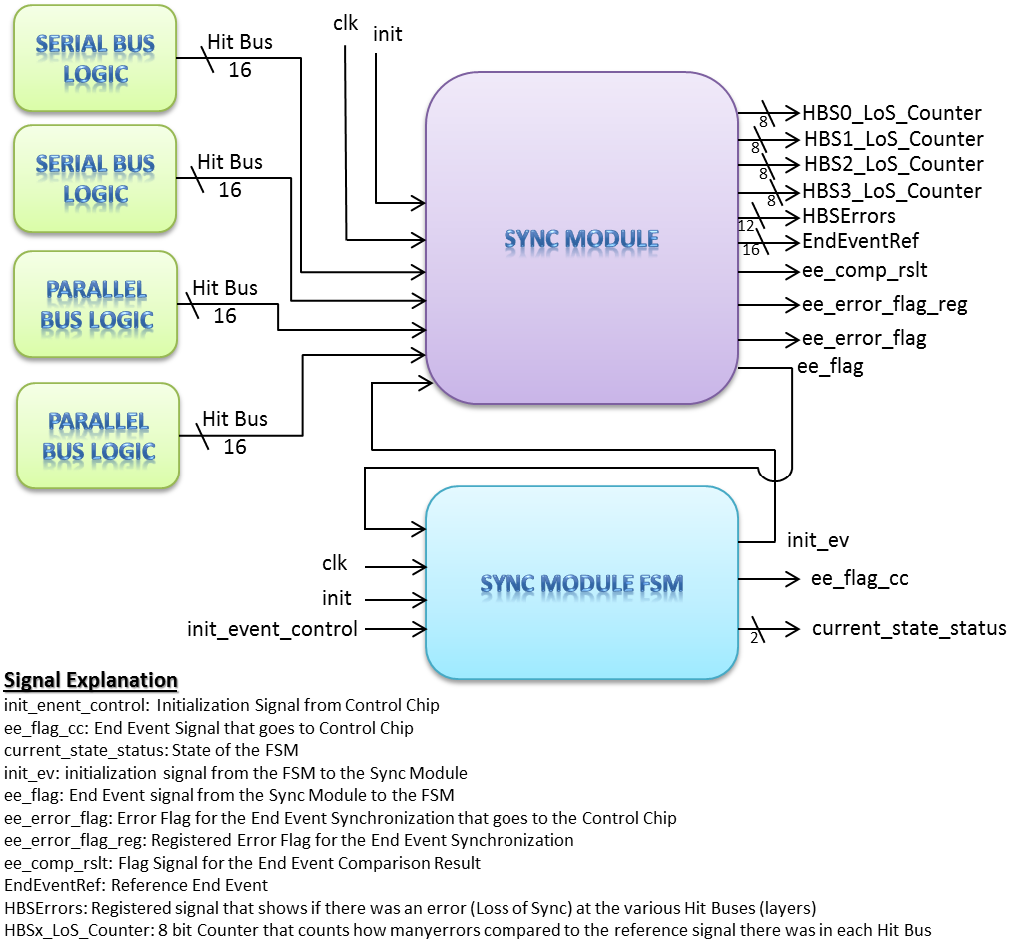
Sync Module – Old Version
First version for the AMBFTK during summer by Dimitris
Currently under development for the AMBSLP – Panos presentation next

Slide 7


INPUT FIFOs
as derandomizers
Spy Buffers:
what are they?
Hold
Pointer: incremented each time a word is popped from FIFO or sent to output.
When it overflows it wraps around and an ‘overflow flag’ is set → circular memory
TWO MODES:
SPY or FREEZE
Hold
Hold
To be read
by VME
Copying data
during run

Slide 8
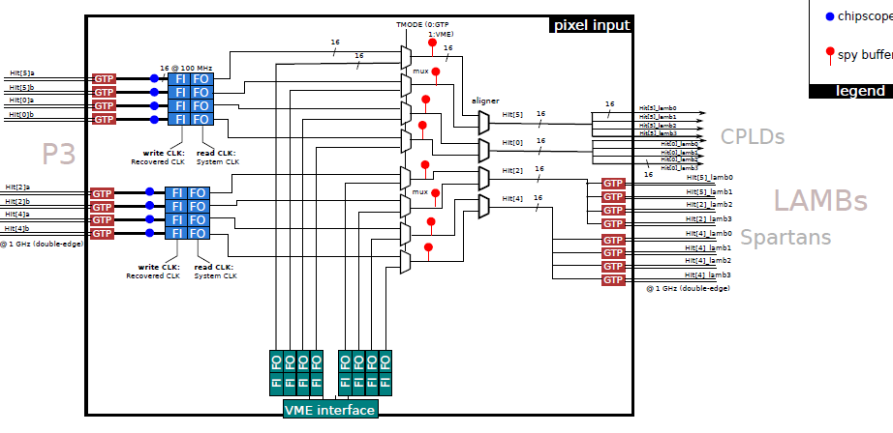
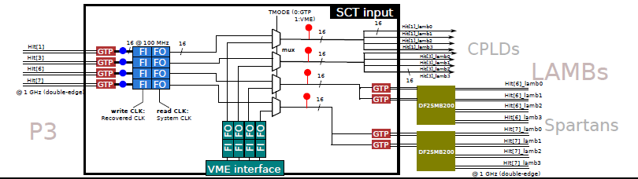
INPUT FPGAs
(AMBFTK)
Spy Buffer Location

Slide 9
Spy Buffers
Issues to be addressed/decided:
Size
  In the Input chip (“HIT”) we have 12 streams: 12 Input FIFOs + 12 VME FIFOS + 12 Spy buffers ← quite a lot of buffering
  Replace the VME FIFOs with the Spy Buffers?
Format
  Word size is different for the Input and different for the Output of the AMB. If storing of extra information is decided (e.g. timing information) then an extra info word per data word could be added
Behavior
  When should we freeze the Spy Buffers?

Slide 10
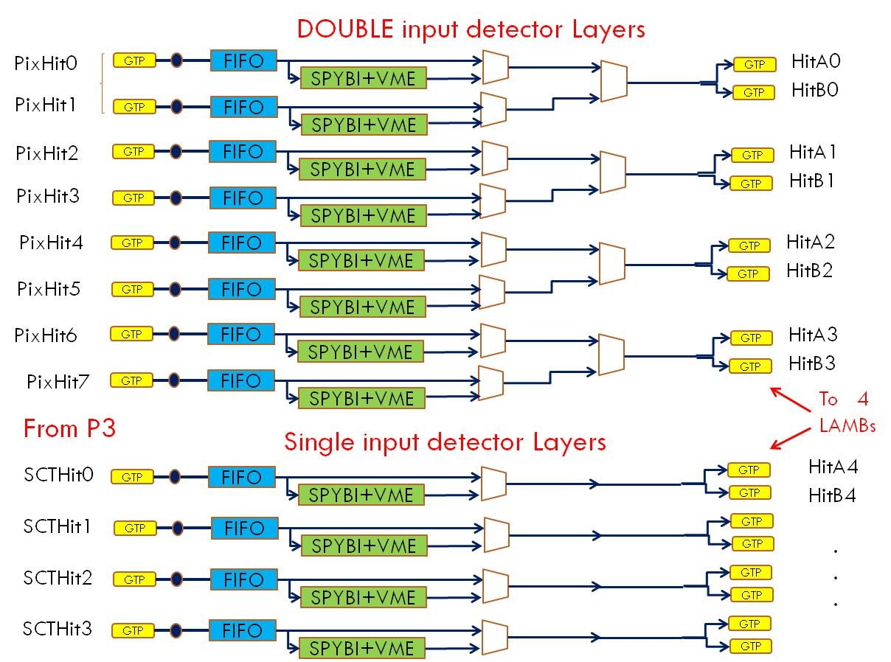

Slide 11
Spy Buffer Freeze
Two cases
  One bit in the EE word received on input stream means “freeze immediately after you have finished to process the current event”. The event to be monitored will be chosen by DF that will set the EE bit into all FTK streams
  In case of a severe error :
  Freeze is sent immediately to the previous board together with the event tag meaning “Freeze after processing current event”.
  Or freeze as soon as the freeze is received.

Slide 12
FTK Monitoring Requirements (AMB examples)
CRC error : for each link (12 streams) ‘checksum’ could be monitored (not currently supported). Error detection should be registered in a 12 bit word
FIFO Overflow : each FIFO full flag should produce error if set. Again 12 bit word.
Invalid Input data : for example invalid HIT from ROD (?)
Lost Synchronization : event tags in different streams do not match – 12 bit word
Truncated output : too many roads in output – 16 bit word

Slide 13
FTK: Common Error Word Proposal
In the FTK Monitoring Kick Off Meeting it was proposed to use a common error word format in the whole FTK system
This word should be propagated from one board to the next, being updated by every board’s error status
32bits available for error identification in the EE word
  Use 16 bits for the error bits
  Use 16 bits for the board encoding (Identifying the board that caused the error)

Slide 14
FTK: Common Error Word Proposal
Error bits format
  Use the 8 least significant bits (LSBs) for General Errors (Common to all boards)
  Use the 8 most significant bits (MSBs) for Board Specific Errors
General (Common) Error bits (bits 0 – 7)
    CRC Error
    FIFO Overflow
    Loss of Sync
    Truncated Output
    Invalid Input Data
    Internal Overflow
    (Two bits still available)

Slide 15
FTK: Common Error Word Proposal
Board Specific Error Bits (bits 8 – 15)
Some of the Board Specific Error Flags could trigger a General (Common) Error Flag
  (e.g. FTK_IM Pixel Clustering Error Flags)
    Dropped Hits → Set Common Invalid Input Data
    Full LIFO → Set Common Internal Overflow
    Full Circ Buff → Set Common Internal Overflow
    FE order → Set Common Invalid Input Data
    Loss of Sync → Set Common Loss of Sync

Slide 16
FTK: Common Error Word Proposal
Board Encoding (Board Identification)
  Use 16 bits to identify the board causing the error
  Use the 8 least significant bits to encode the boards using one bit per board. Each Board in the pipeline will use an “OR” to add its bit in the error word.
    FTK_IM
    DF (for errors received from another DF board)
    DF (for errors caused by the current DF board)
    AUX
    AMB
    pSSB
    fSSB
    FLIC
Will the 2 types of SSB boards have separate monitoring or not?

Slide 17
FTK: Common Error Word Proposal
Tower Encoding (Tower Identification)
  Use the 8 most significant bits to identify the tower
  Starting from the AUX board the identifier will be “tower_number mod 8” which will return a number from 0 up to 7. This will be transformed to a single bit:
    0→bit 8
    1→bit 9
    2→bit 10
    3→ bit 11 etc.
  So each tower from an 8 tower group will have one specific bit

Slide 18
FTK: Common Error Word Proposal
Tower Encoding (Tower Identification)
  In the FLIC 8 channels are received and each channel propagates the information of 8 towers
  Therefore if one bit is assigned to each tower and an “OR” is used to propagate the tower identifier in the error word to the FLIC we will be able to trace how many and which towers produced an error by reading the tower identifier

Slide 19
FTK: Common Error Word Proposal
Error Bits:
Board/Tower Identifier

Slide 20
FTK: Common Error Word Proposal
Example:
There was a Loss of Sync in an AMB and an AUX on Tower 2 and/or Tower 5. (This could mean there was Loss of Sync in an AUX and an AMB on both towers, or in an AUX on Tower 2 and an AMB on Tower 5 etc. By reading the spy buffers or the VME error registers this will be clear.)

Slide 21
32bit Error Word
Example from FTK_IM:
A Loss of Sync occurred in the Pixel Clustering Module of the FTK_IM

Slide 22
Time measurements (Local vs. Global)
Local (per board)
  Implement a counter on each chip together with each Spy Buffer: Same size, same operating frequency
  Initialize on “Init_event”, start on first word received, stop on EE, store the value in the Spy Buffer ← Execution time per event/per processing element and execution time per event/per board
Extra local time measurements (if necessary)
  Time of empty FIFOs (initialize on “FIFO_empty”)
  Time of full/HOLD FIFOs (initialize on “FIFO_full”)
  Could be stored periodically in the Spy Buffer with a dedicated word

Slide 23
Time measurements (Local vs. Global)
Global (System) Processing Time
Do we want to have Global (System) Processing Time?
  Yes...
Do we want to measure the data delay from the detector?
  Then we need the L1 accept at least for the DF board
At this point we can only add up the processing time per event from each board (without interconnection delays etc.) just to get a very rough estimate
AMBoard
DF
4 DOs
4 TFs
4 HWs
Final Fit-HW
FLIC
ROS

Slide 24
Conclusions
FTK Monitoring Tools are somewhat defined and development has been initialized for most of the boards
Questions that need addressing
  How extensive and strict should monitoring be (e.g. Loss of Sync reporting)
  Define an error word format→ which are the error flags we actually need ← Presented in last FTK weekly meeting
  The Error Word is currently being defined for the FTK_IM
  Define time measurements requirements

