Slide 1
The 6 GeV TMD Program at JLab
Andrew Puckett
University of Connecticut
4th International Workshop on Transverse Polarisation Phenomena in Hard Processes
June 12, 2014

Slide 2
Outline
Introduction:
  SIDIS and TMD formalism
  Accessible phase space in fixed target electron scattering with a 6 GeV electron beam
The Continuous Electron Beam Accelerator Facility (CEBAF) at Jefferson Lab
  Accelerator
  Experimental Halls @6 GeV
SIDIS/TMD published results from JLab 6 GeV
  Hall C cross section data
  Hall B unpolarized target data
  Hall B polarized beam and/or target data
  Hall A polarized ³He target data
Ongoing analyses and forthcoming results from completed 6 GeV experiments
Summary—what have we learned from JLab @6 GeV?
Conclusions

Slide 3
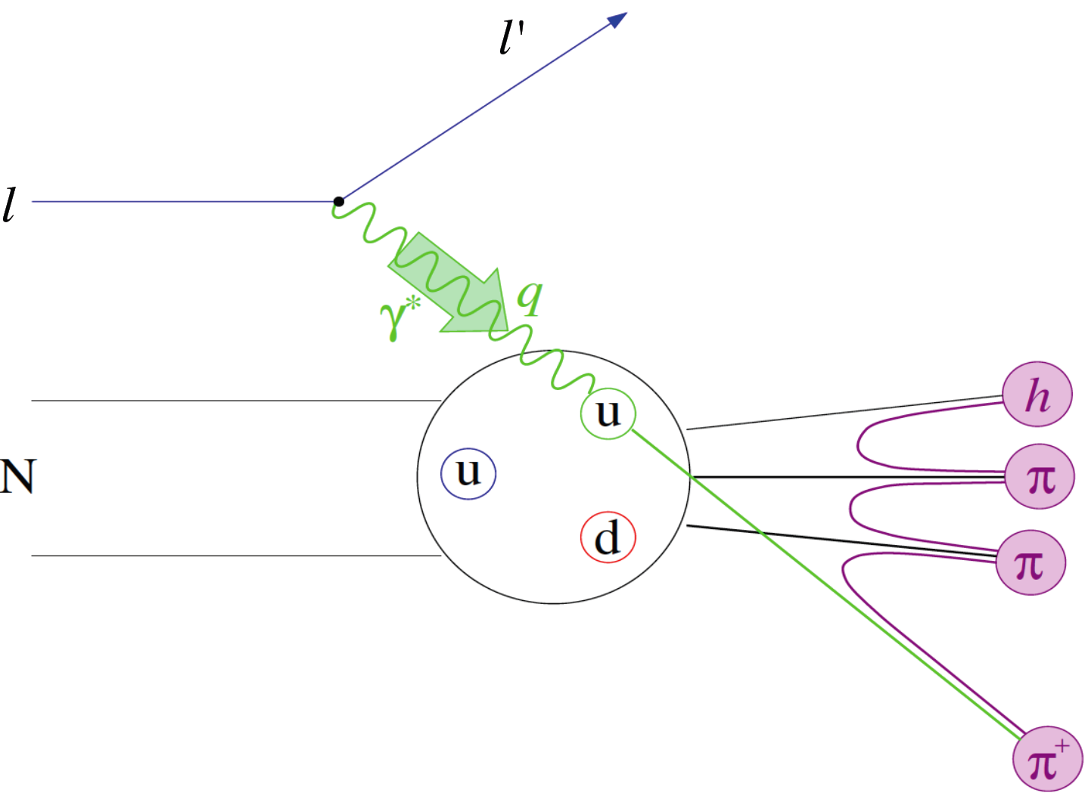
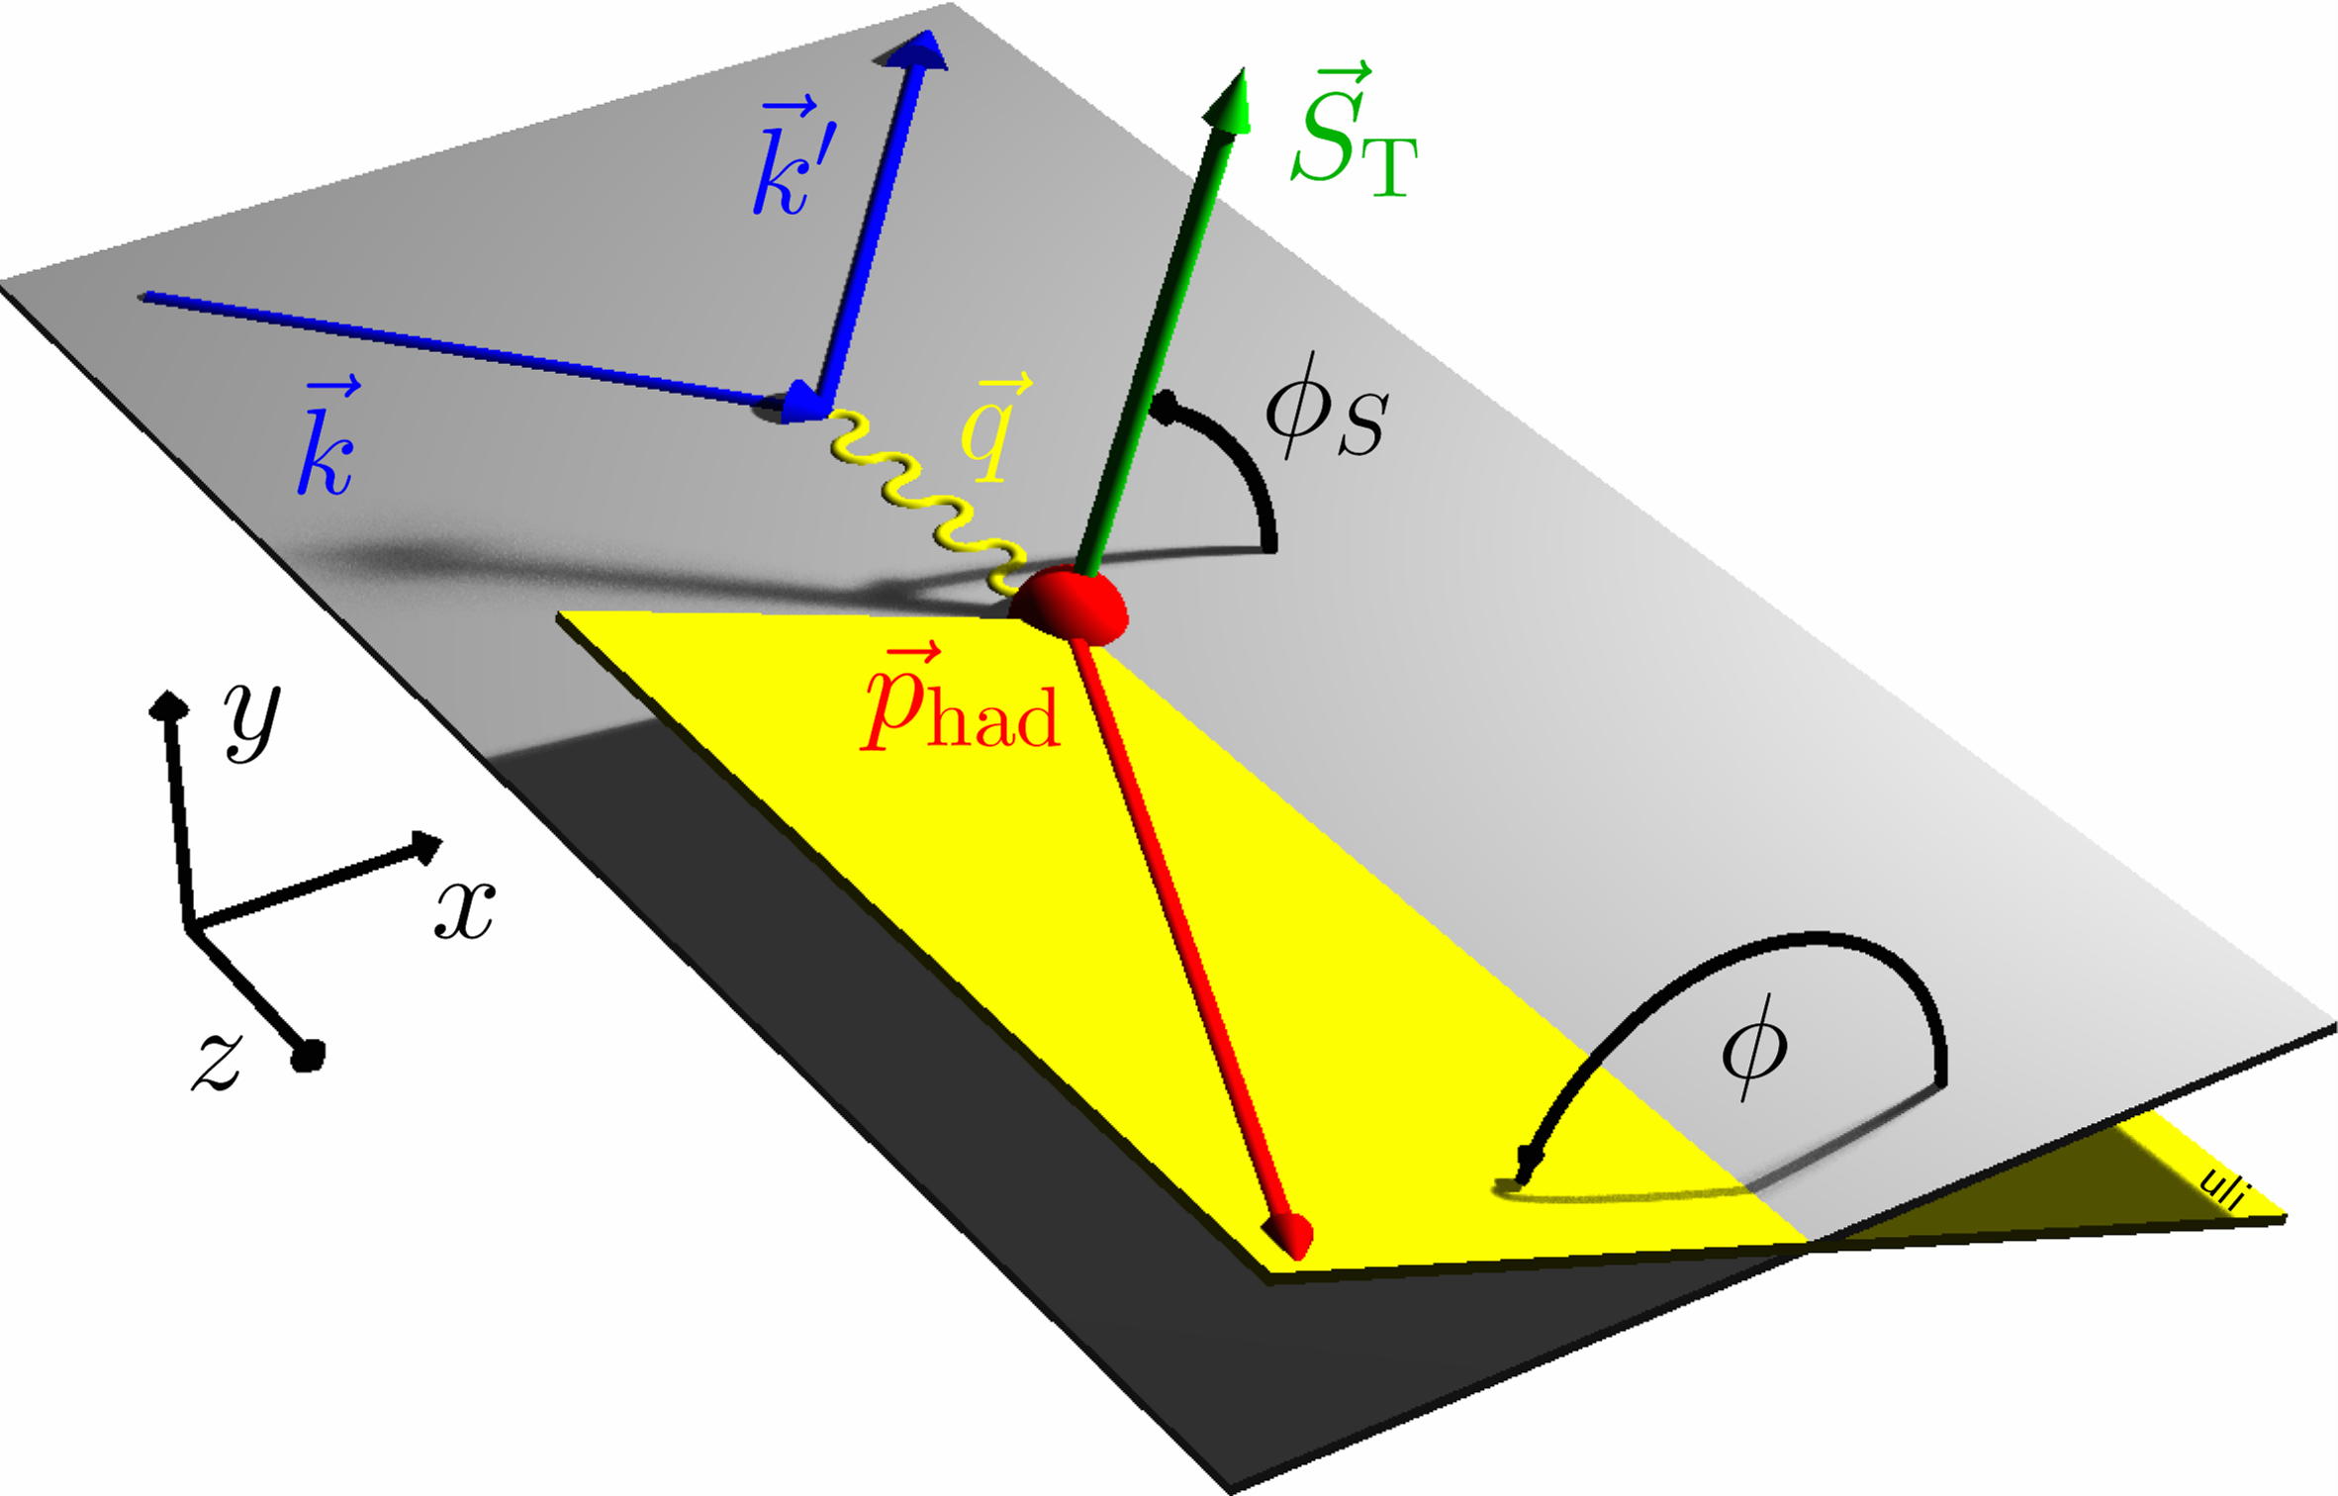
Semi-Inclusive Deep Inelastic Scattering
Detecting leading (high-energy) hadrons in DIS, N(e,e’h)X provides sensitivity to additional aspects of the nucleon’s partonic structure not accessible in inclusive DIS:
  quark flavor
  quark transverse motion
  quark transverse spin
Goal of SIDIS studies is (spin-correlated) 3D imaging of nucleon’s quark structure in momentum space.
Transverse Momentum Dependent (TMD) PDF formalism: Bacchetta et al. JHEP 02 (2007) 093, Boer and Mulders, PRD 57, 5780 (1998), etc, etc...

Slide 4
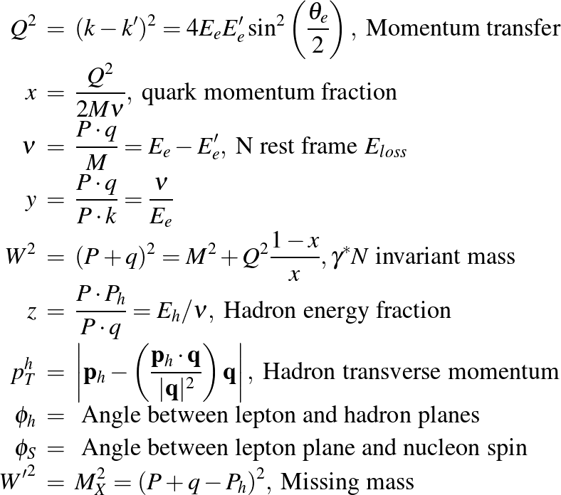
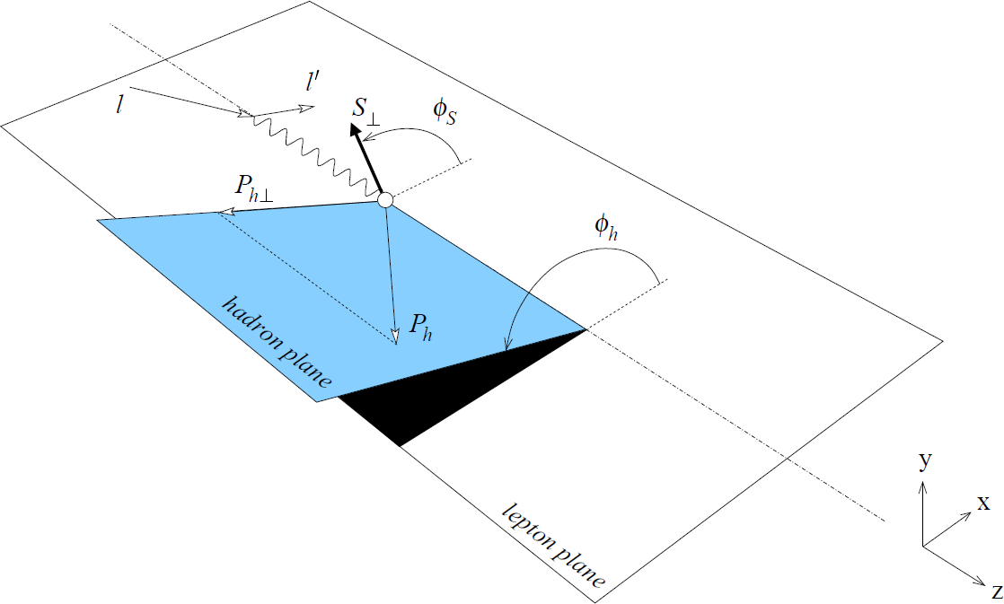
SIDIS Kinematics—Notation and Definitions

Slide 5
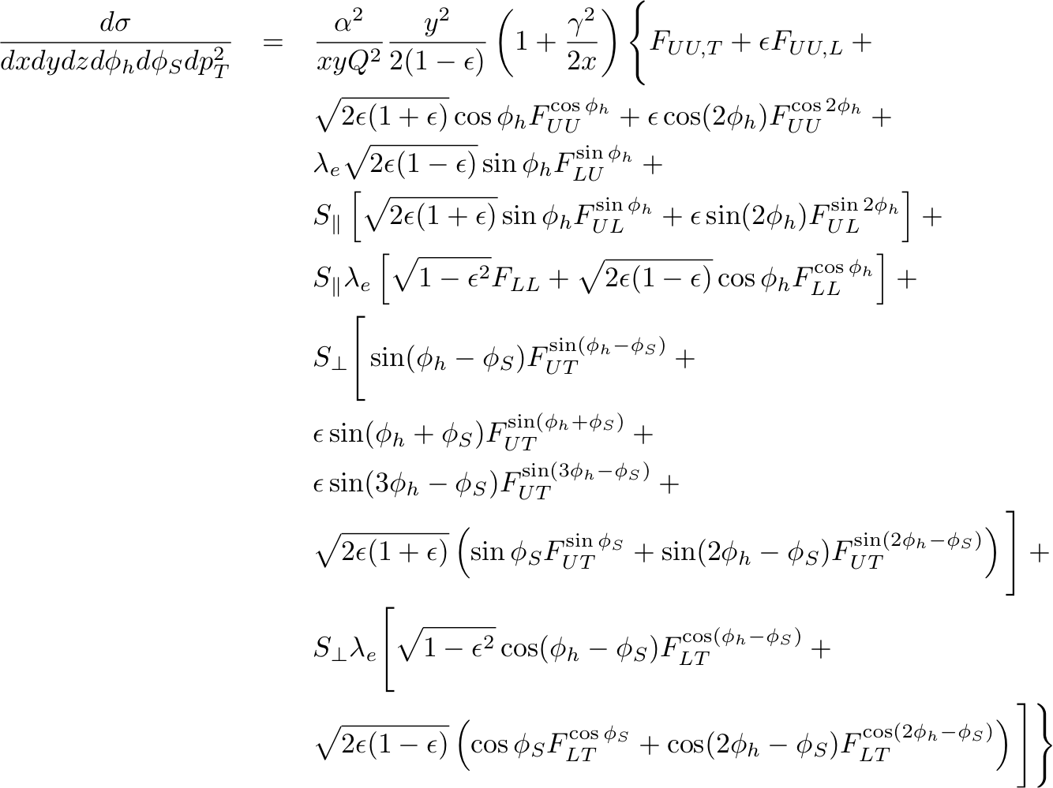
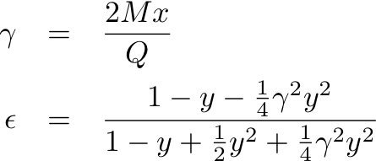
General Expression for SIDIS Cross Section: Bacchetta et al., JHEP 02, 093 (2007)
SIDIS structure functions F depend on x, Q², z, p_{T}
U, L, T subscripts indicate unpolarized, longitudinally and transversely polarized beam, target, respectively
S = nucleon spin
λ = lepton helicity
Eight terms survive at leading twist; the rest are M/Q suppressed
Sivers
Collins
“Pretzelosity”

Slide 6




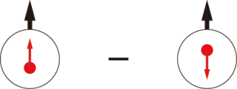
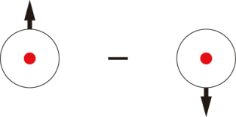
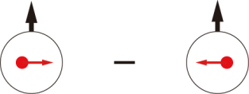
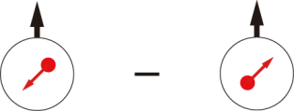
Quark-parton Model Interpretation of SIDIS: Transverse Momentum Dependent PDFs (TMDs)
 |  | Quark polarization
 |  | Unpolarized (U) | Longitudinally Polarized (L) | Transversely Polarized (T)
Nucleon Polarization | U
 | L
 | T

Slide 7

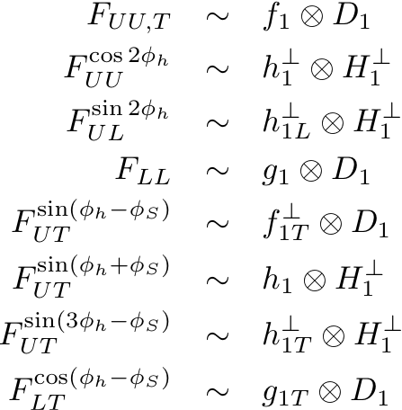
SIDIS Structure Functions in Terms of TMDs
Only f₁, g₁, h₁ survive integration over quark k_{T}
All eight leading-twist TMDs are accessible in SIDIS with polarized beams/targets via azimuthal angular dependence of the SIDIS cross section
Physical observables are convolutions over two (unobserved) transverse momenta:
  Initial quark k_{T}
  Hadron p_{T} relative to recoiling quark, generated during fragmentation

Slide 8
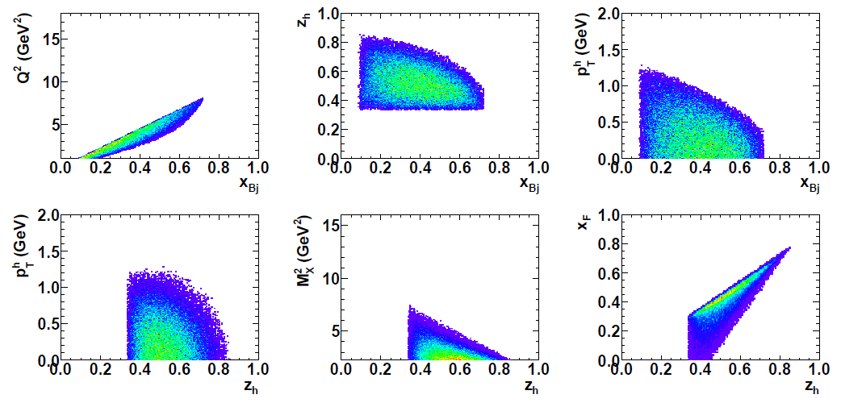
Accessible phase space in fixed-target at 6 GeV
Above: phase space with SIDIS cuts (before considering any detector acceptances), E=6 GeV

Slide 9
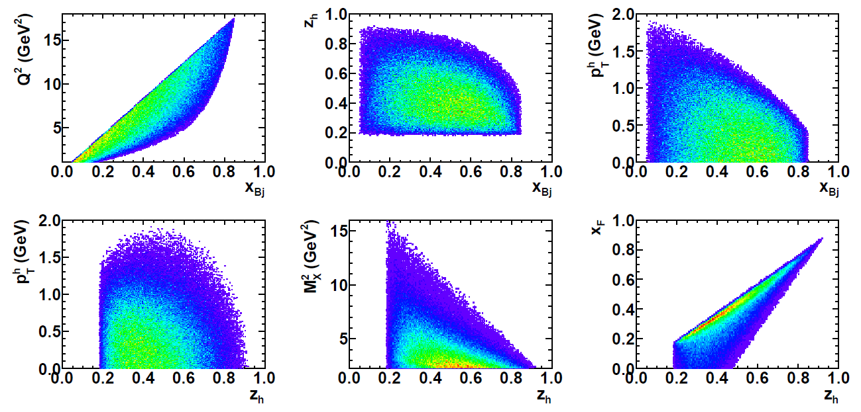
Accessible phase space in fixed-target at 11 GeV
Above: phase space with SIDIS cuts (before considering any detector acceptances), E=11 GeV

Slide 10
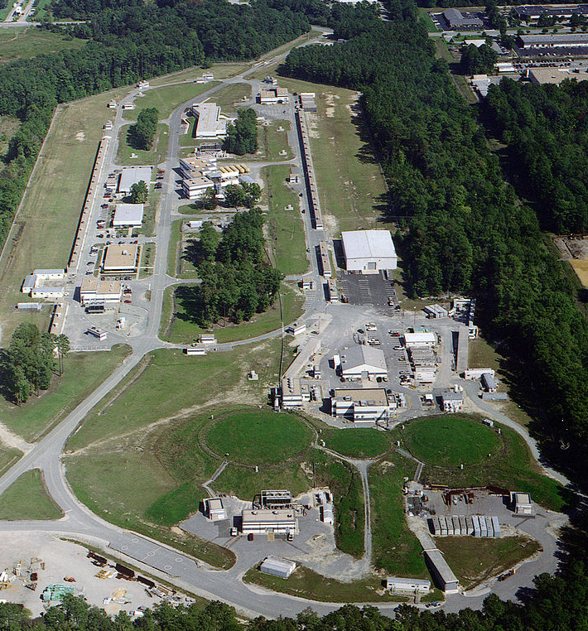
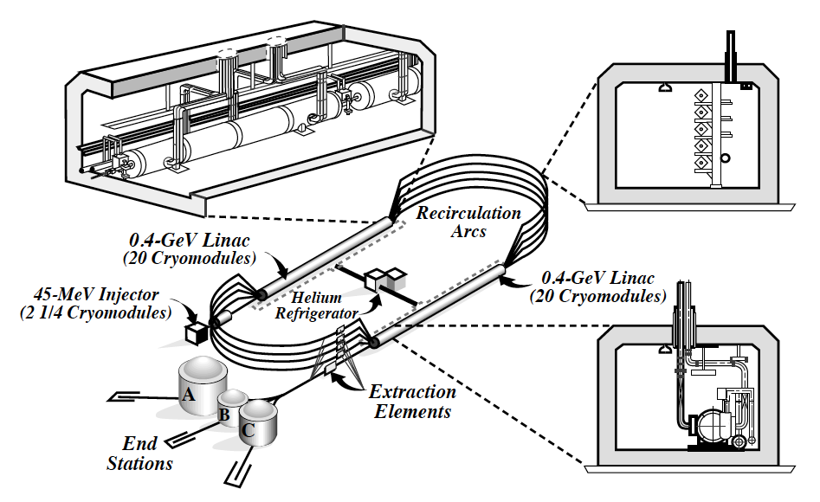
CEBAF @ Jefferson Lab
Superconducting RF electron linacs with up to 5X recirculation
CW (“100%” duty factor) operation (2 ns bunch period, ~0.3 ps bunch length)
Polarized source: up to 85-90% polarization
Three experimental Halls
Energy up to 6 GeV (upgrade will increase to 11(12) GeV to Halls A/B/C (D))
Current (up to 180 μA CW)
A
B
C
JLab Aerial View

Slide 11

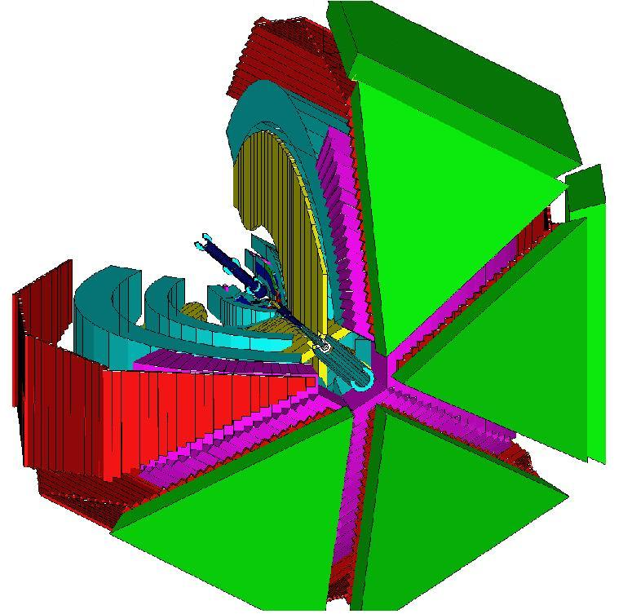
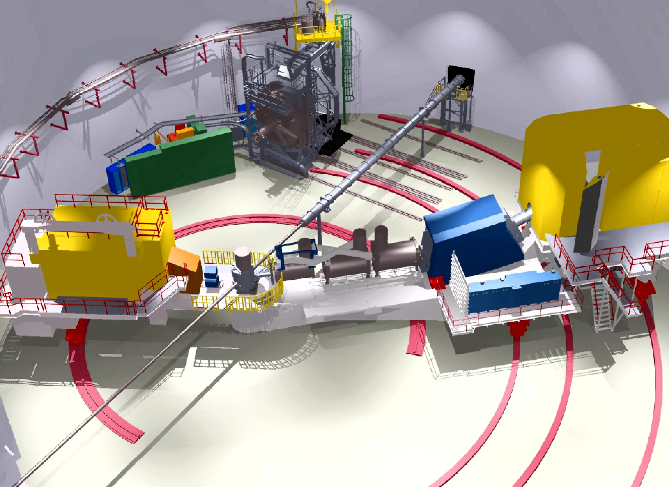
CEBAF Experimental Halls @6 GeV
CLAS in Hall B
Hall A: Two identical HRSs
Hall A: High resolution (dp/p ~ 10⁻⁴) spectrometers, small acceptance for targeted measurements w/ well-controlled systematics, well-defined kinematics at high luminosities. NIM A 522, 294 (2004)
Hall B: Large acceptance, moderate resolution/luminosity for measurement of multi-particle final states with broad kinematic coverage: NIM A 503, 513 (2003)
Hall C: High momentum spectromer and Short Orbit Spectrometer—well-controlled acceptance for precise cross section measurements: PRC 78, 045202 (2008)
Hall C: HMS + SOS

Slide 12
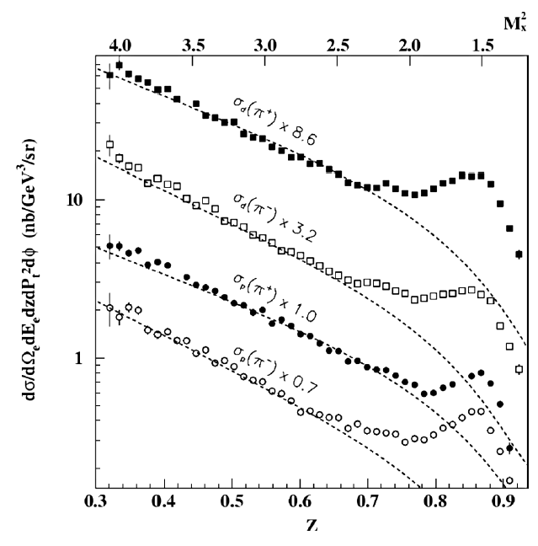
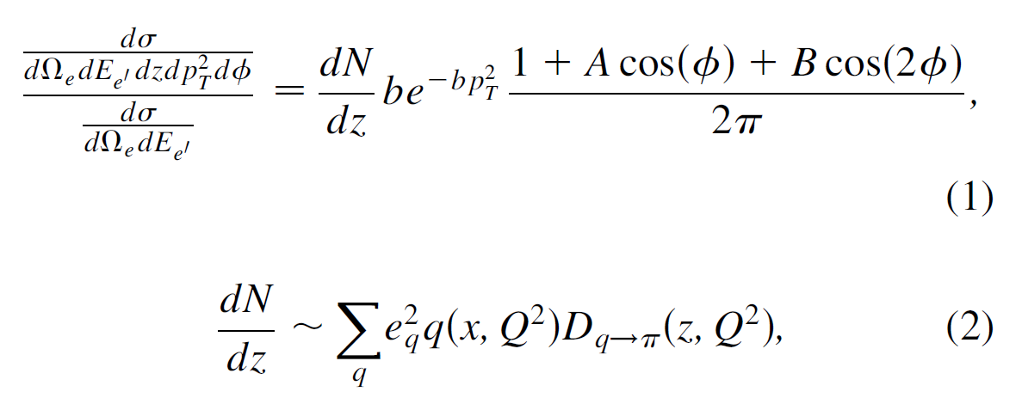
Hall C SIDIS Cross Section Data
First dedicated SIDIS experiment at JLab:
  T. Navasardyan et al. PRL 98, 022001 (2007)
  R. Asaturyan et al. PRC 85, 015202 (2012)
E ~= 5.5 GeV
Cross section measurements with three sets of targeted kinematic variations:
  z-scan (0.3<z<1) at fixed (x,Q²) = (0.32,2.3 GeV² ), p_{T} ~ 0
  x-scan (0.2<x<0.6, 1.5 < Q² < 4.6 GeV²) at fixed z = 0.55, p_{T} ~ 0
  p_{T}-scan (0 < p_{T} < 0.4 GeV) at fixed (x,z,Q²)=(0.32, 0.55, 2.3 GeV²)
  All measurements: fixed ν = 3.8 GeV
Measurements of π⁺/π⁻ on liquid H₂ and D₂ targets
Hall C SIDIS cross section data are in reasonable agreement with simple, LO, naive partonic picture, provided M_{X}² >~ 2.5 GeV²

Slide 13
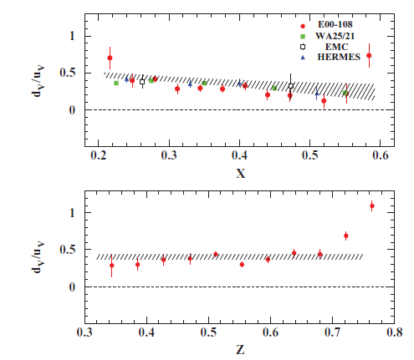
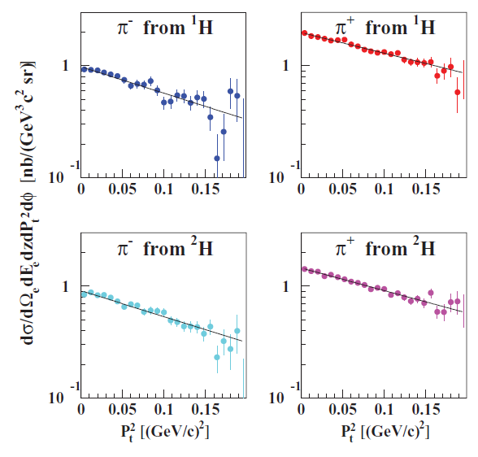
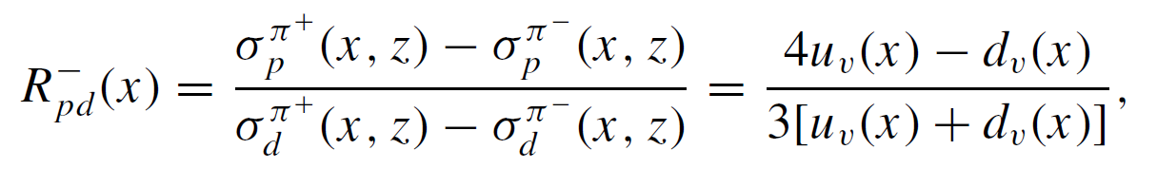
Hall C data, Continued
  R. Asaturyan et al. PRC 85, 015202 (2012)
p_{T} dependence at (x,z,Q²) = (0.32, 0.55, 2.30 GeV²) up to p_{T} < 0.4 GeV
Data compatible with Gaussian p_{T} distribution, similar (but not identical) widths for p, d, π⁺, π⁻
Small p_{T} range, strongly correlated with ϕ—not venturing far from collinearity!
p/d ratios of π⁺ - π⁻ cross section difference depends only on d_{v}/u_{v} at leading order
Data for z < 0.7 in reasonable agreement with CTEQ6 LO PDFs

Slide 14
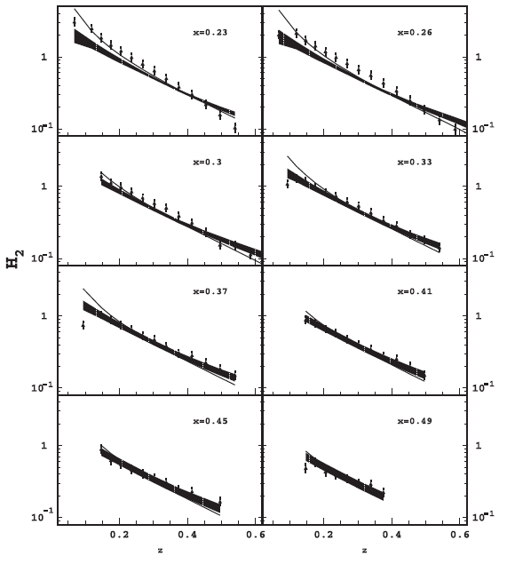
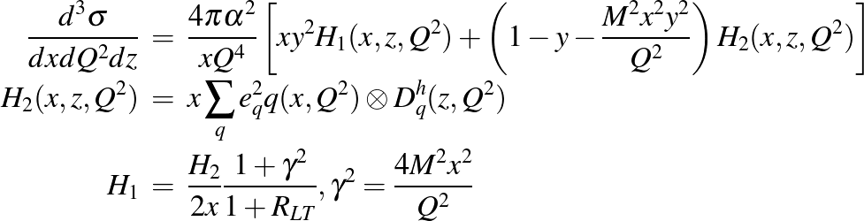
Hall B Unpolarized Data
Osipenko et al. (CLAS Collaboration), PRD 80, 032004 (2009)
E = 5.75 GeV, liquid hydrogen target, CLAS detector, luminosity 10³⁴ cm⁻² s⁻¹
October 2001-2002 data set
Only p(e,e’π⁺)X data were analyzed
Large acceptance for wide, multi-dimensional phase-space coverage.
Usual “DIS” cut W > 2 GeV not explicitly included, but most of the data are in the DIS regime.
Exclusive enπ⁺ suppressed with M_{X}² > 1.08 GeV² (more relaxed compared to M_{X}² > 2.5 GeV² cut suggested by Hall C data).
(p_{T}, ϕ)-integrated data described to within ~20% by NLO pQCD predictions using standard PDFs and FFs.
z-dependence of p_{T}, ϕ-integrated SIDIS structure function H₂, compared to LO/NLO pQCD expectation

Slide 15
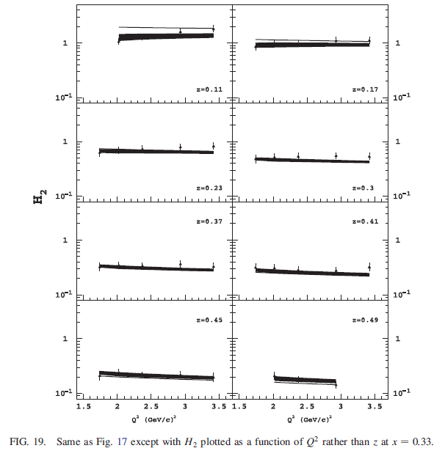
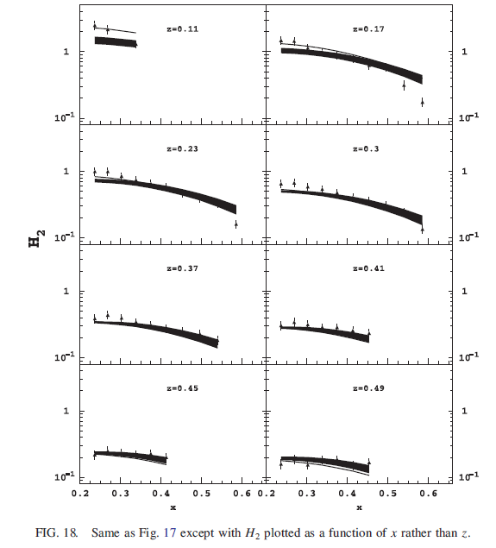
Hall B Unpolarized Data, Continued
H₂ vs. Q² at fixed x = 0.33 in different z bins
H₂ vs. x in different z bins

Slide 16
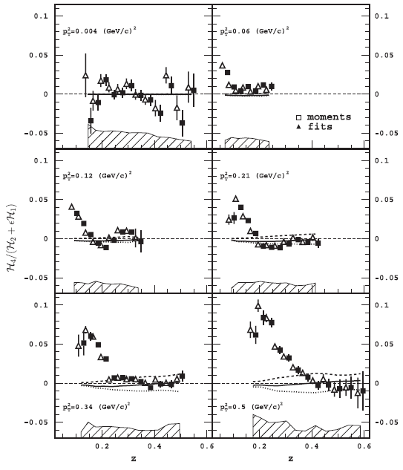
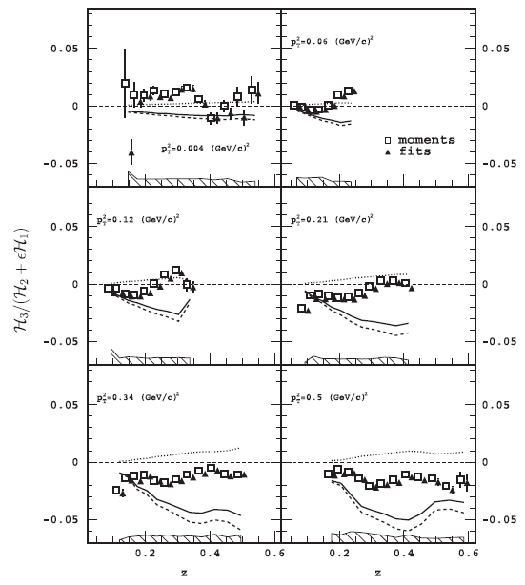
Hall B Unpolarized Data, Continued
<cos(ϕ)> moments smaller than prediction based on Cahn+Berger effects
<cos(2ϕ)> moments small, except at low z, high p_{T}

Slide 17
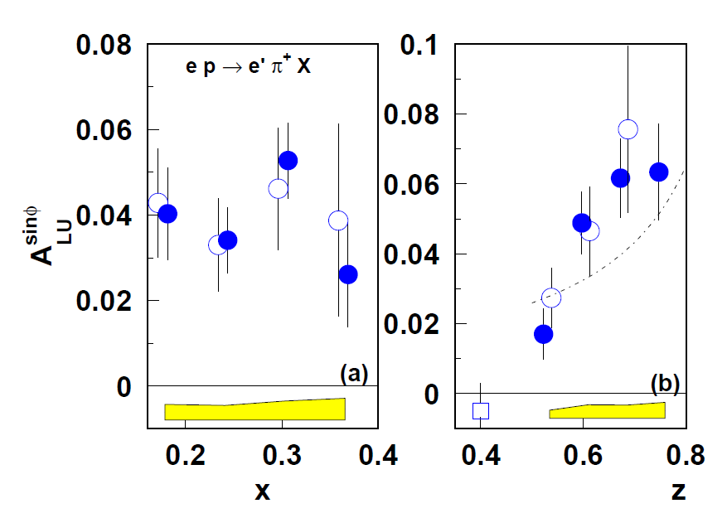
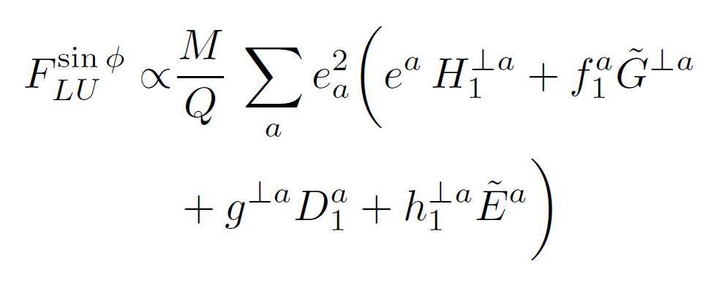
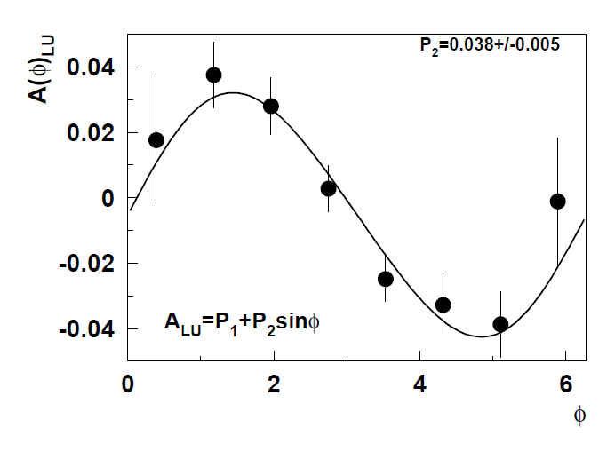
CLAS SIDIS Beam Spin Asymmetries A_{LU}^{sin(ϕ)}
A_{LU}^{sin(ϕ)} is a twist-3 asymmetry sensitive to qgq correlations
Is sensitive in principle to leading-twist TMDs and FFs including Collins and B-M functions, but convoluted with twist-3 objects.
Little is currently known about the contribution of each term.
Phys. Rev. D 69, 112004 (2004): BSA from CLAS data with E = 4.3 GeV, P_{e} ~ 70%
First clear evidence for non-zero BSA in SIDIS.

Slide 18
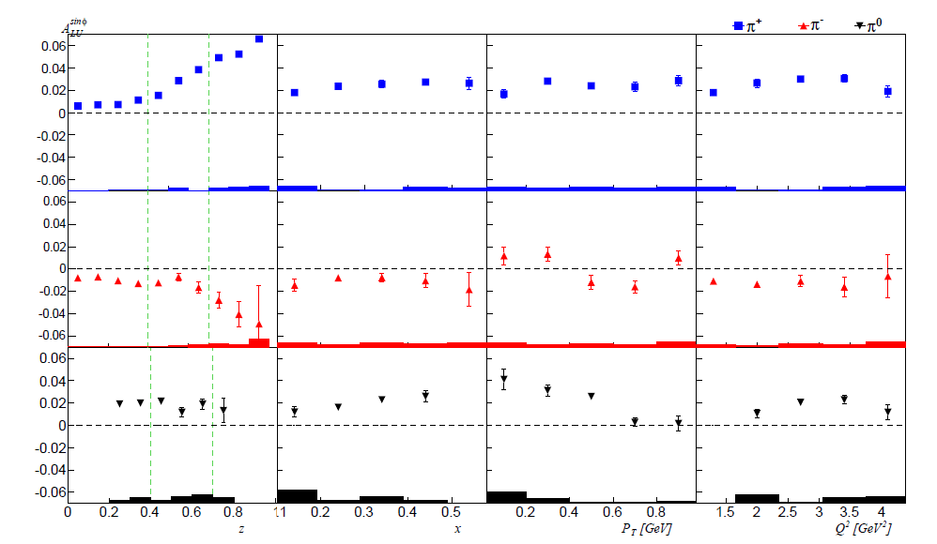
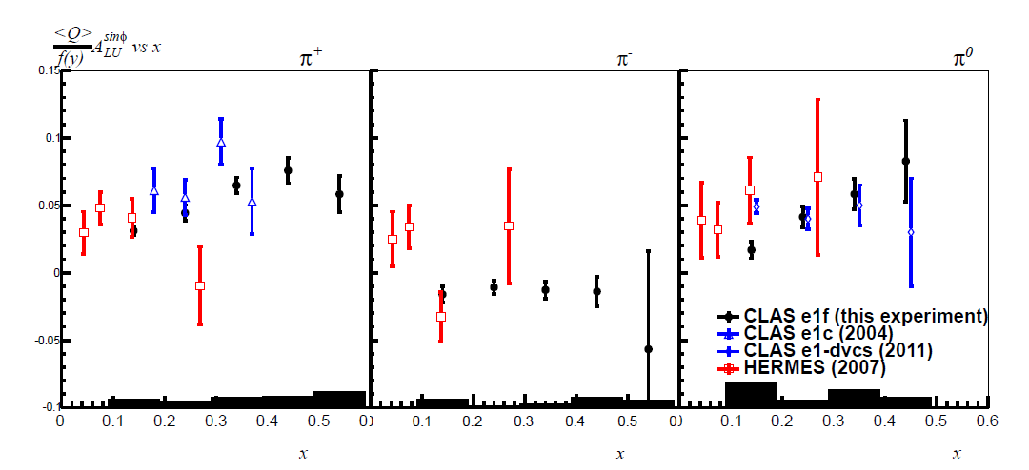
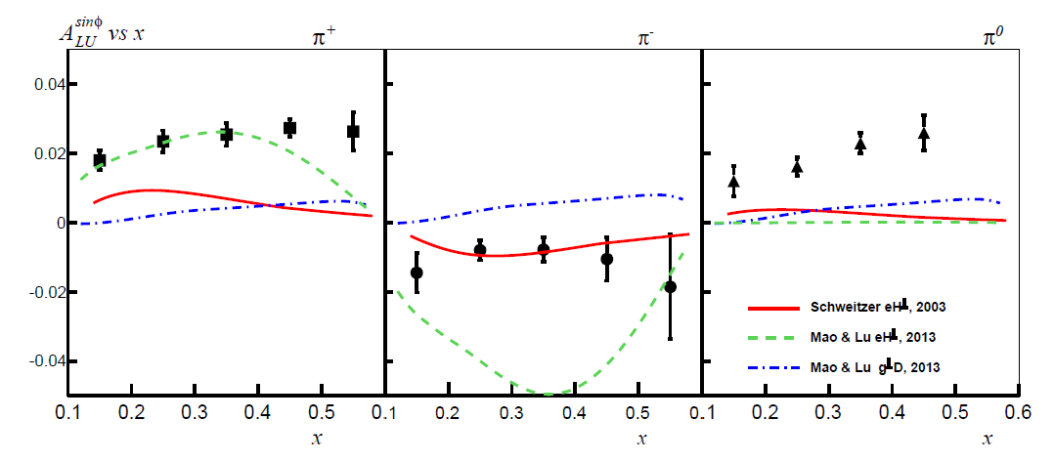
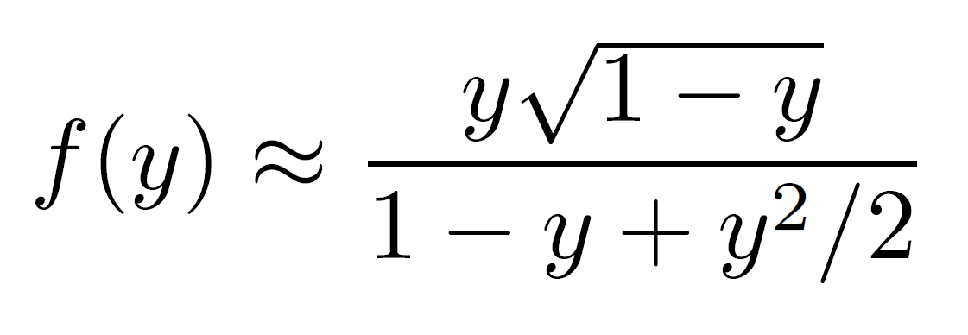
CLAS SIDIS Beam Spin Asymmetries A_{LU}^{sin(ϕ)}
PRD 89 (2014) 072011: High-statistics data @5.5 GeV for π⁺, π⁻, π⁰
See also π⁰ data from CLAS e1-dvcs: PLB 704 (2011) 397
Bottom left: comparison with existing data, after kinematic re-scaling by f(y)
Comparison to model predictions—significant discriminating power

Slide 19
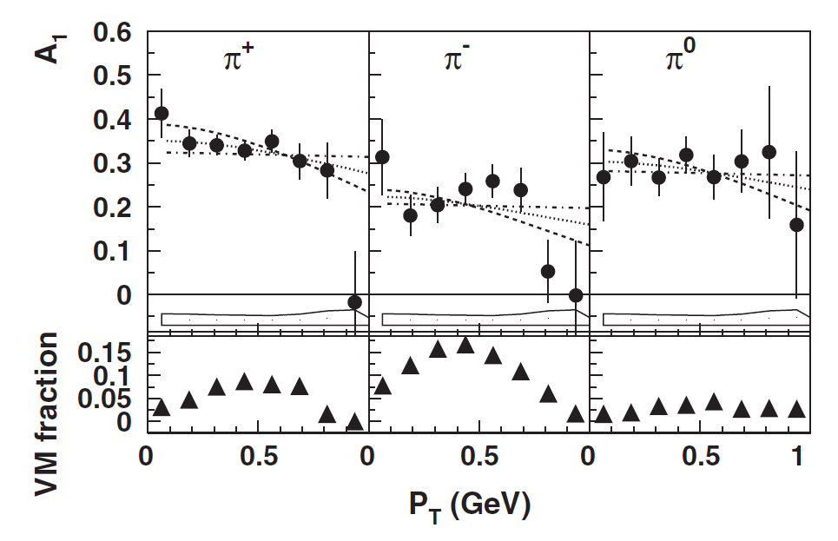
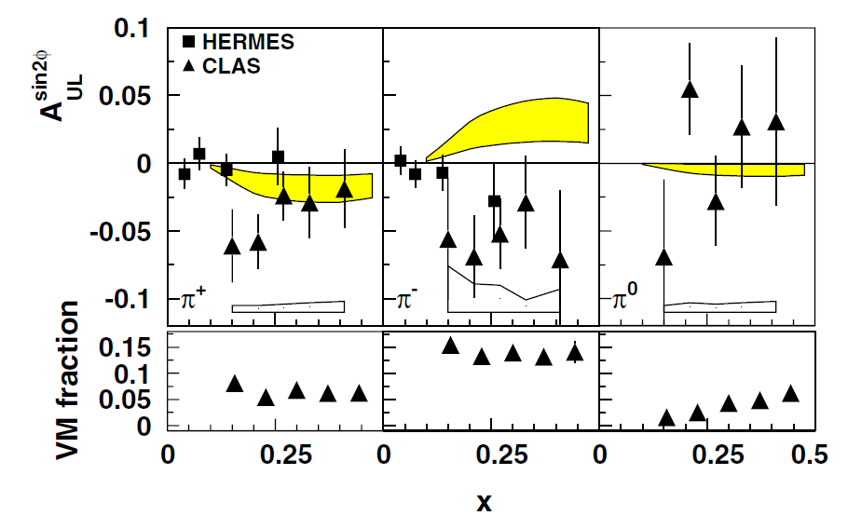

CLAS SIDIS A₁, A_{UL}
PRL 105, 262002 (2010)
E = 5.7 GeV, I_{beam} = 5 nA, P_{B} ~ 0.7
NH₃ polarized target (DNP method), P_{T} ~ 0.75.
Average dilution from unpolarized N, f_{D} ~ 0.14
First measurement of transverse momentum dependence of A₁ asymmetry in SIDIS
  Hints at possible helicity-dependence of quark k_{T} distributions.
First measurement of non-zero A_{UL}^{sin(2ϕ)}, indicating potentially significant quark spin-orbit correlations

Slide 20
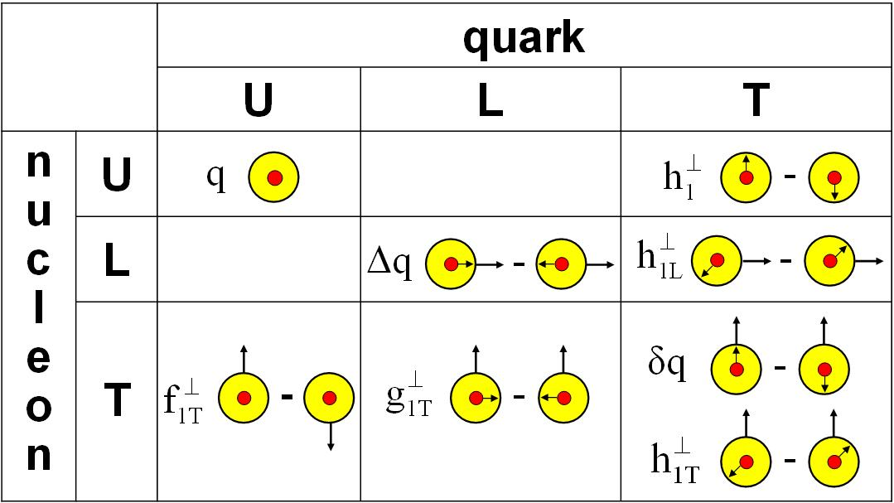
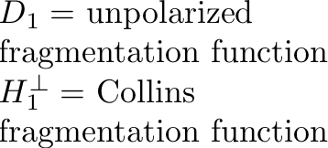
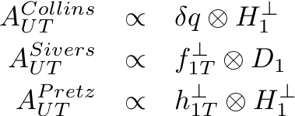
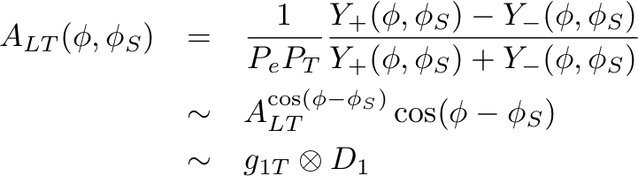
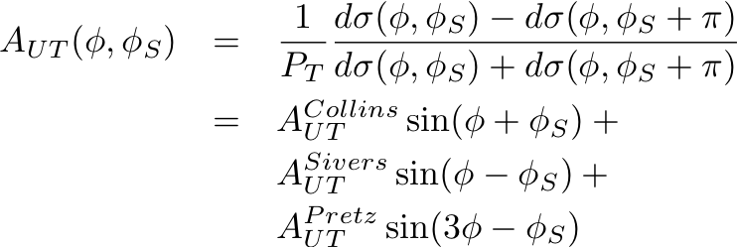
Transverse target spin asymmetries in SIDIS
Transverse target spin-dependent cross section for SIDIS
Collins effect—chiral-odd quark transversity DF; chiral-odd Collins FF
Sivers effect—access to quark OAM and QCD FSI effects
“Transversal helicity” g_{1T}—real part of S wave-P wave interference (Sivers = imaginary part)
“Pretzelosity” or Mulders-Tangerman function—access to wavefunction components differing by 2 units of OAM

Slide 21
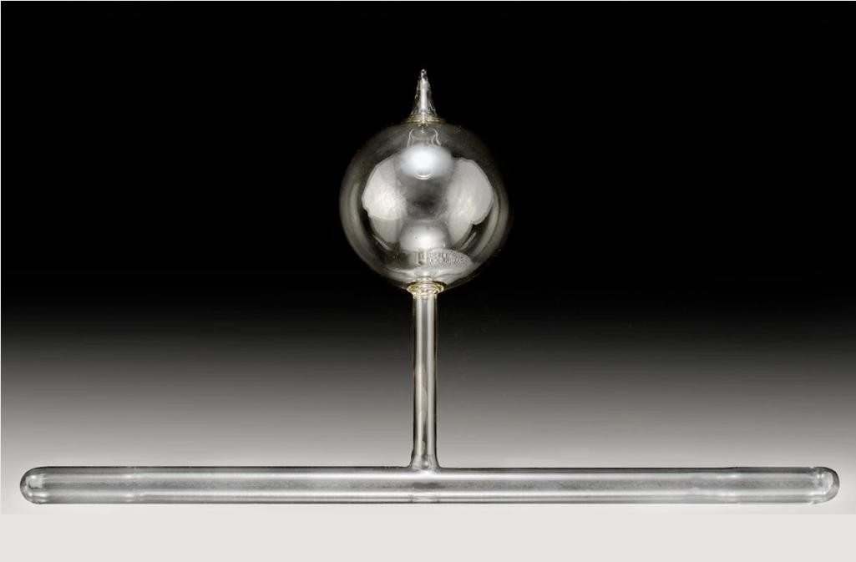
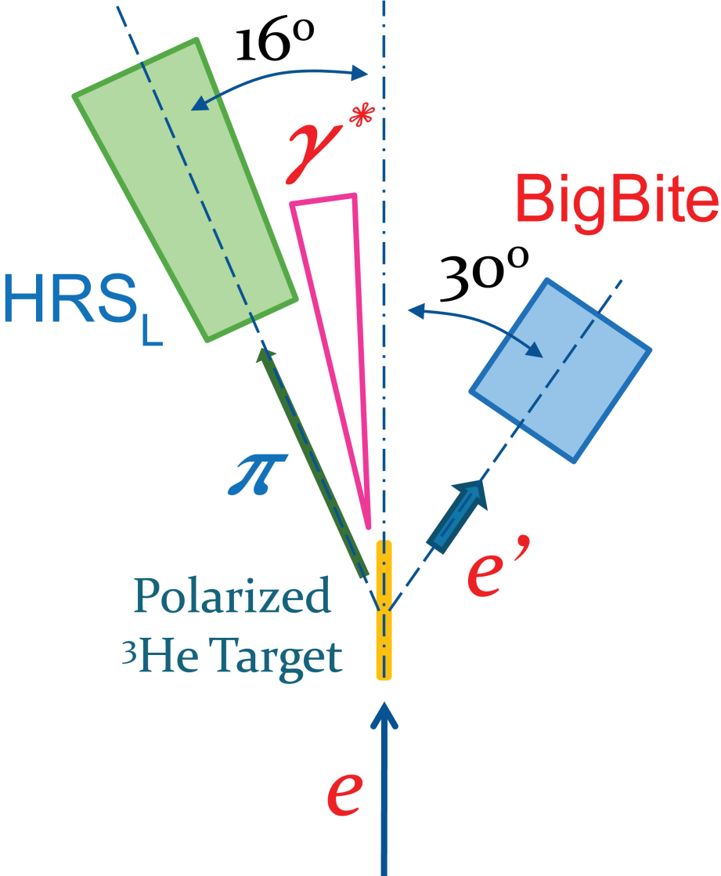
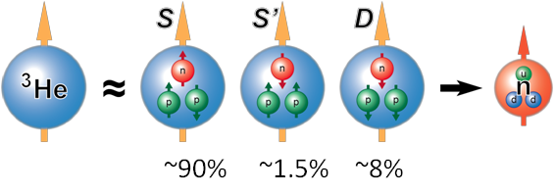
Transverse Spin Asymmetries from Hall A: E06-010
Polarized Laser
795 nm
Oven @ 230 ºC
Luminosity
Monitor
10 atm ³He
Some N₂, Rb, K
Pumping Chamber 3” diameter
25 G Holding Field
40 cm Target Chamber
5.9 GeV beam, ~85% polarized
Helium-3 target, <P_{T}> = 55% transverse (vertical and horizontal directions), flip every ~20 minutes.
Average beam current ~12 μA
Two-month run in Hall A in 2008/2009, expt. E06-010
Beam Polarimetry
(Møller + Compton)

Slide 22
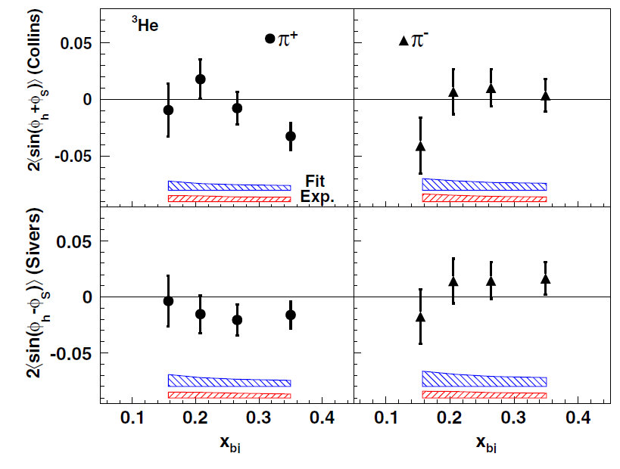
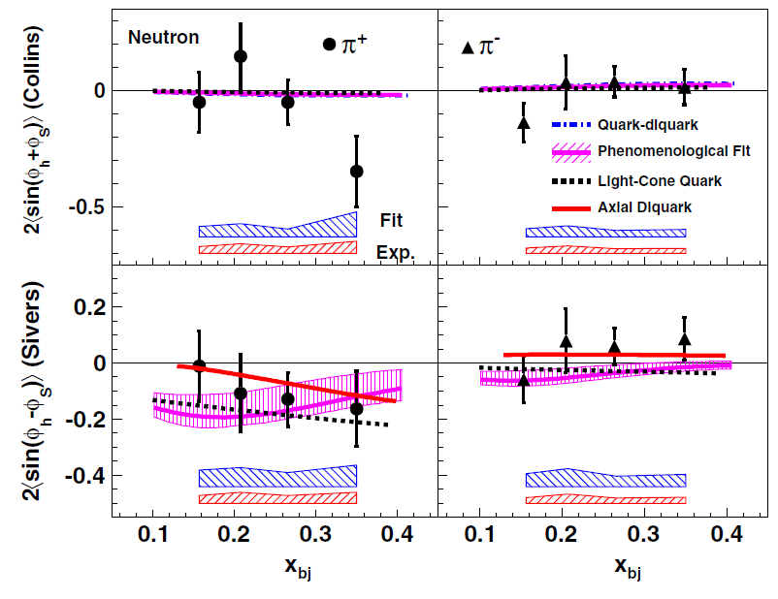
Collins and Sivers effects: PRL 107, 072003 (2011)
Observed ³He Collins and Sivers asymmetries <5% in magnitude
Extracted neutron C/S moments consistent w/model predictions available at time of publication
In the valence region, despite relatively low statistics, E06-010 has best sensitivity to neutron Sivers moments, and comparable precision to COMPASS d-p for Collins moments, after correction for quark depolarization factor D_{NN} = (1-y)/(1-y + y²/2)
Impact of E06-010 data from a short-duration run with small-acceptance spectrometers demonstrates power of ³He target and lays foundation for high statistical FOM @11 GeV

Slide 23
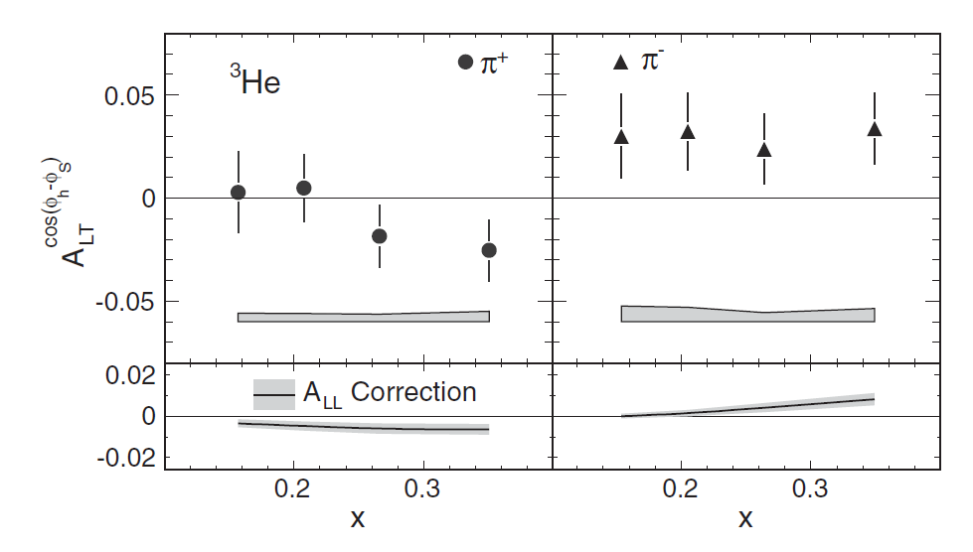
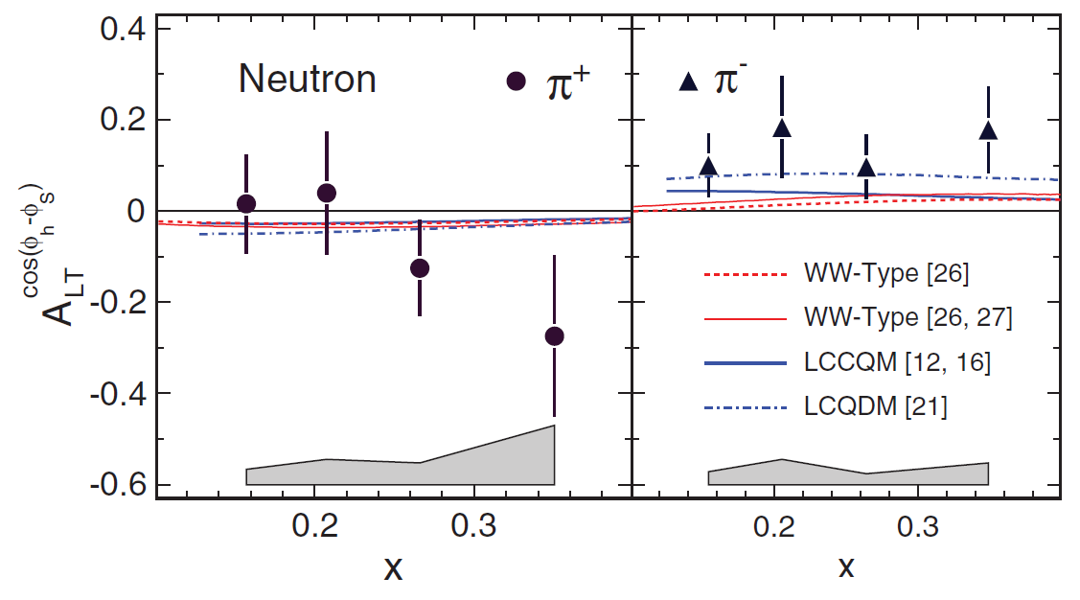

“Trans-helicity” (A_{LT}^{cos(ϕh–ϕS)}): PRL 108, 052001 (2012)
Above right: Helium-3 asymmetries:
  π⁺ asymmetries compatible with zero
  π⁻ asymmetries: 2.8σ positive signal for 4 x bins combined
First neutron data for A_{LT}
First clear non-zero A_{LT} observation
Data suggest:
  g_{1T}^{d} is small at low x, favors negative values at larger x
  g_{1T}^{u} is positive, significantly non-zero→expect noticeable signal for proton target!
Related to real part of L=0, L=1 interference (Sivers→imaginary part)

Slide 24
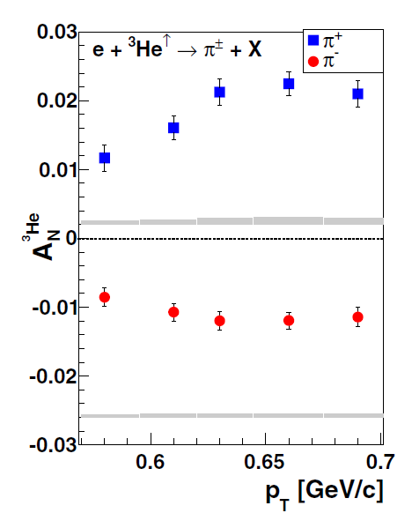


Inclusive Hadron SSAs: PRC 89, 042201(R) (2014)
No explicit prediction for JLab kinematics on a neutron available at time of publication, but:
See Anselmino et al., arXiv:0911.1744

Slide 25

Inclusive DIS A_{y}: arxiv:1311.0197
Inclusive DIS A_{y} strictly zero in Born approximation; non-zero is a clear signal for multi-photon-exchange effects.
Combined asymmetry for all W > 2 GeV data is negative, non-zero by 2.8σ.
Consistent in sign w/model calculation based on twist-3 qgq correlators with input from Sivers function measured in SIDIS (Metz et al., http://arxiv.org/abs/1209.3138v2).
Submitted to PRL, under review, second round

Slide 26

³He(e,e’K)X Collins/Sivers: arxiv:1404.7204v1
With rather low statistics, K⁺ Collins/Sivers consistent with zero, K⁻ Collins/Sivers both large, negative (but with large errors)
Submitted to Phys. Rev. C, under review

Slide 27


Pretzelosity for n(e,e’π^{+/-})X: arXiv:1312.3047v3
Observed asymmetries consistent with zero and with model predictions.
Status: Submitted to PRC, under review

Slide 28
Other forthcoming results from JLab 6 GeV
The long shutdown of CEBAF for the upgrade to 12 GeV has halted the flow of new data for the last ~2 years.
Substantial volume of additional SIDIS data “in the can” with analysis ongoing, mainly from CLAS:
  SIDIS multiplicity ratios A/D for C, Fe, Pb targets from CLAS eg2 data (Ph. D. thesis of T. Mineeva, U.Conn, advisor K. Joo)
  SIDIS unpolarized cross sections and azimuthal moments cos(ϕ), cos(2ϕ) from CLAS e1f data (Ph. D. thesis of N. Harrison, U.Conn, advisor K. Joo).
  Higher-statistics A_{LL} and A_{UL} SIDIS asymmetries from recent CLAS eg1-dvcs data, NH₃ and ND₃ targets (Ph.D. thesis of S. Jawalkar, W&M, advisor K. Griffioen)
Potential for SIDIS “data-mining” from CLAS experiments not primarily dedicated to SIDIS
Probably other results and/or ongoing analyses I’ve left out...

Slide 29
Summary
What have we learned from studies of SIDIS and TMDs in the 6 GeV era of CEBAF (from my perspective)?
  Partonic interpretation of SIDIS data appears to be accessible even at the relatively low energy of CEBAF, albeit in a limited slice of phase space: M_{X}² >~ 2.5 GeV², 0.4 <~ z <~ 0.7.
  SIDIS/TMDs have emerged as one of the major physics motivations of the 12 GeV upgrade.
  SIDIS BSA data conclusively demonstrate the importance of understanding the SIDIS reaction mechanism beyond leading twist TMDs and FFs
  Longitudinally polarized SIDIS data from CLAS suggest non-trivial p_{T} dependence of polarized quark distributions
  Transverse SSA data from Hall A demonstrate the potential of high-luminosity polarized ³He targets, lay foundation for neutron SIDIS studies with high statistical FOM (and also show the importance of large acceptance!).
  Inclusive DIS A_{y} measurement may shed light on twist-3 qgq correlations and reaction mechanism for generation of A_{N} in pp collisions
  Large SSAs observed in inclusive pion production at E = 5.9 GeV, p_{T} ~ 0.65 GeV—waiting for theoretical interpretation!

Slide 30


Conclusions
CEBAF at 6 GeV has already made significant contributions to our global knowledge of TMDs. More exciting results from the accumulated 6 GeV data forthcoming...
Andrey Kim (Friday morning)→for overview on CEBAF 6 GeV data for exclusive processes
12 GeV era is officially underway!
Silvia Pisano (Friday morning)→overview of 12 GeV GPD+TMD programs
JLab 12 GeV Upgrade

Slide 31



SIDIS w/BB 30 deg, SBS 14 deg.
60 cm polarized ³He
10.5 atm
I_{beam} ≥ 40 μA

Slide 32
Backup Slides

Slide 33



E06-010 Phase Space

Slide 34




Polarized ³He Target
~87% ~8% ~1.5%
Polarized ³He as effective polarized neutron target
~10 atm ³He = ~10³⁶ cm⁻²s⁻¹ en luminosity
Final target chamber
<P> = (55.4 ± 2.8)%
Effective nucleon polarization approach:
Scopetta, PRD 75, 054005 (2007)

Slide 35

BigBite Spectrometer
1.2 Tesla dipole magnet in front of detector stack
Positioned to subtend ~64 msr solid angle
Large out-of-plane angle acceptance (~±240 mrad), essential to maximize ϕ coverage, separate Collins/Sivers effects
Three drift chambers for tracking
Shower+Preshower for electron PID
Scintillator for timing
BigBite Spectrometer

Slide 36

High Resolution Spectrometer
Detector
Package
Detector Hut
Gas Cherenkov+Lead-glass for e/π separation
Coincidence Vertex + TOF w/ Bigbite suppress random coinc.
Aerogel+RICH+TOF: π/K separation >10:1 K rejection factor
Q1
Q2
D1
Q3

Slide 37




Kinematic and Azimuthal Coverage
z
p_{T}
π⁺
π⁻
z, p_{T} for different x bins, π±
Collins
Sivers
Q², W, z, W’ vs. x
Collins/Sivers angle coverage, x bins 1-4, different target spin states

Slide 38


Analysis: Target Single-Spin Asymmetry
Target single-spin asymmetry from normalized yields, need to consider :
beam charge, target density, DAQ life time, detector efficiency etc.
2845 target spin
“local pairs”
Automatic target spin flip once every 20 minutes.
Beam Charge + vs
Beam Charge -
Beam charges are well-balanced
between the pairs

Slide 39






SSA check: HRS single-arm ³He SSA
(Witness channels on ³He, not corrected for target polarization and dilution)
K. Allada
Univ. of Kentucky
2010.
False asymmetry < 0.1%

