Slide 1


Transverse Spin Physics with an Electron Ion Collider
Oleg Eyser
4th International Workshop on Transverse Polarisation Phenomena in Hard Processes
Chia, Cagliari, 2014

Slide 2

The Path Forward
Nucleon Structure 2020
Collider Kinematics
  Semi-inclusive Deep Inelastic Scattering
  Deeply Virtual Compton Scattering
Possible Scenarios for an EIC
  eRHIC
  MEIC
arxiv.org/abs/1212.1701
https://indico.bnl.gov/conferenceDisplay.py?confId=727

Slide 3
Open Questions
How are sea quarks and gluons and their spin distributed in space and momentum inside the nucleon?
How are these quark and gluon distributions correlated with the over all nucleon properties, such as spin direction?
What is the role of the motion of sea quarks and gluons in building the nucleon spin?
How does the nuclear environment affect the distribution of quarks and gluons and their interaction in nuclei?
How does the transverse spatial distribution of gluons compare to that in the nucleon?
How does matter respond to fast moving color charge passing through it?
Is this response different for light and heavy quarks?
Where does the saturation of gluon densities set in?
Is there a simple boundary that separates the region from the more dilute quark gluon matter?
How do the distributions of quarks and gluons change as one crosses the boundary?
Does this saturation produce matter of universal properties in the nucleon and all nuclei viewed at nearly the speed of light?

Slide 4
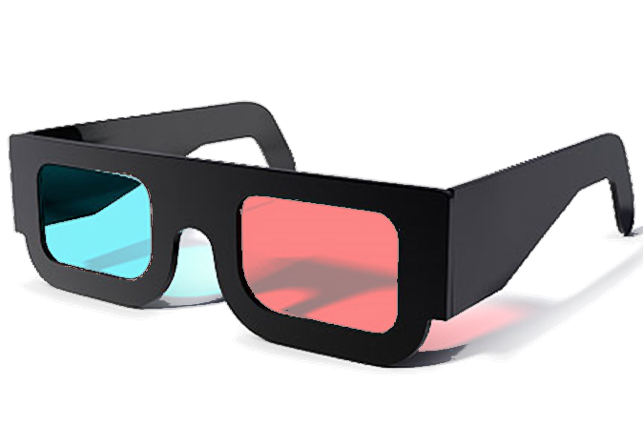
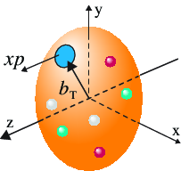
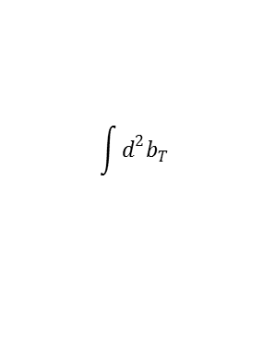

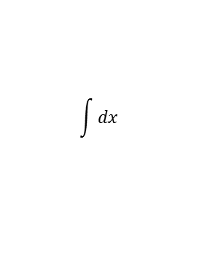
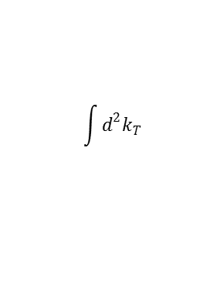

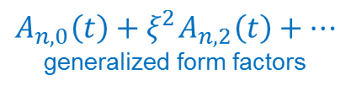

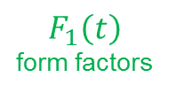


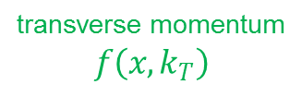

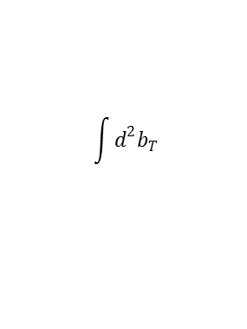
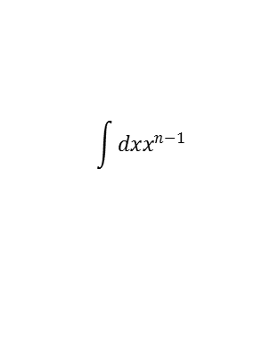
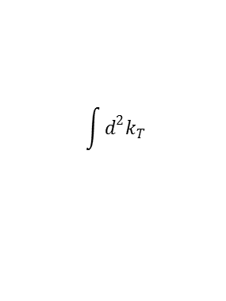

The Partonic Picture of the Nucleon
5D
Wigner distributions
$$W\left(x,b_{T},k_{T}\right)$$
3D
$$\int{d^{2}b_{T}}$$
$$\int{d^{2}k_{T}}$$
generalized parton
distributions
$$H\left(x,ξ,t\right)$$
transverse momentum
$$f\left(x,k_{T}\right)$$
impact parameter
$$f\left(x,b_{T}\right)$$
Fourier trans.
$$b_{T}⟷Δ$$
$$t=−Δ^{2}$$
$$H\left(x,0,t\right)$$
$$ξ=0$$
1D
$$\int{d^{2}k_{T}}$$
$$\int{d^{2}b_{T}}$$
$$\int{dx}$$
$$\int{dxx^{n−1}}$$
$$f\left(x\right)$$
parton densities
$$F_{1}\left(t\right)$$
form factors
$$A_{n,0}\left(t\right)+ξ^{2}A_{n,2}\left(t\right)+⋯$$
generalized form factors
TMDs: confined partonic motion inside the nucleon
GPDs: spatial imaging of quarks and gluons

Slide 5
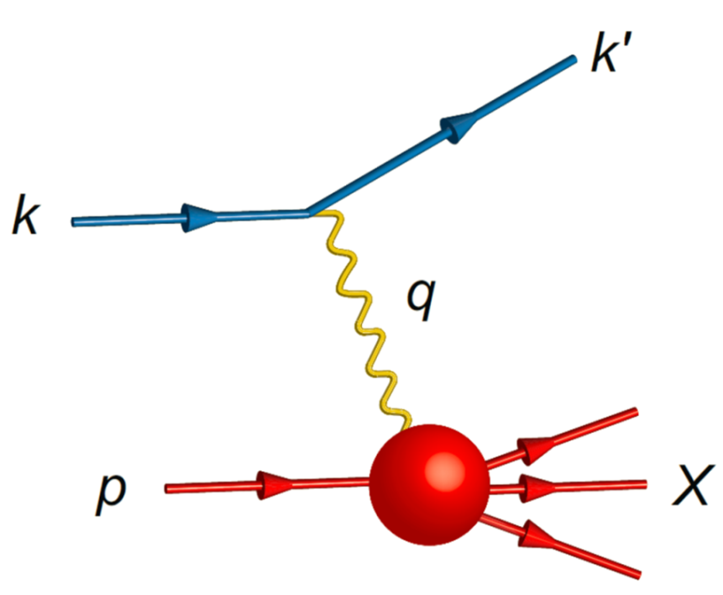

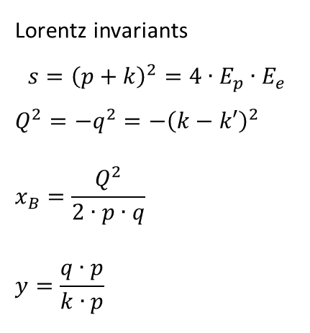

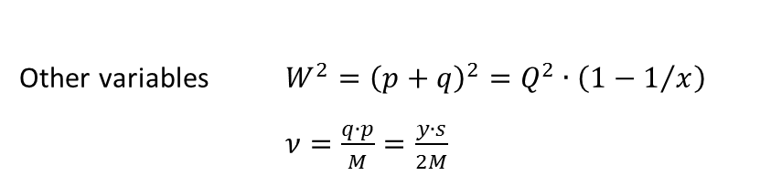

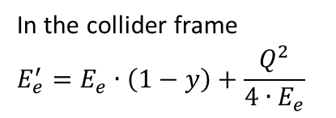
Deep Inelastic Scattering
Lorentz invariants
$$s={\left(p+k\right)}^{2}=4∙E_{p}∙E_{e}$$
$$Q^{2}=−q^{2}=−{\left(k−k′\right)}^{2}$$
$$x_{B}=\frac{Q^{2}}{2∙p∙q}$$
$$y=\frac{q∙p}{k∙p}$$
$$Q^{2}=x∙y∙s$$
Other variables $W^{2}={\left(p+q\right)}^{2}=Q^{2}∙\left(1−1/x\right)$
$ν=\frac{q∙p}{M}=\frac{y∙s}{2M}$
In the collider frame
$$E_{e}^{′}=E_{e}∙\left(1−y\right)+\frac{Q^{2}}{4∙E_{e}}$$
Electron Ion Collider
$$E_{e}=10−30 \text{GeV}$$
$$E_{p}=50−250 \text{GeV}$$

Slide 6









Lepton Kinematics
$$E_{e} = 10 \text{GeV}$$
$$E_{e} = 15 \text{GeV}$$
$$E_{e} =20 \text{GeV}$$
$$E_{p} =250 \text{GeV}$$
$$Q2>0.1 \text{GeV}$$
$$0.01<y<0.95$$
$$E_{p} =50 \text{GeV}$$
$$E_{p} =100 \text{GeV}$$
$$E_{p} =250 \text{GeV}$$
$$E_{e} = 15 \text{GeV}$$
Notes:
Low Q2 tagger, Rosenbluth separation

Slide 7
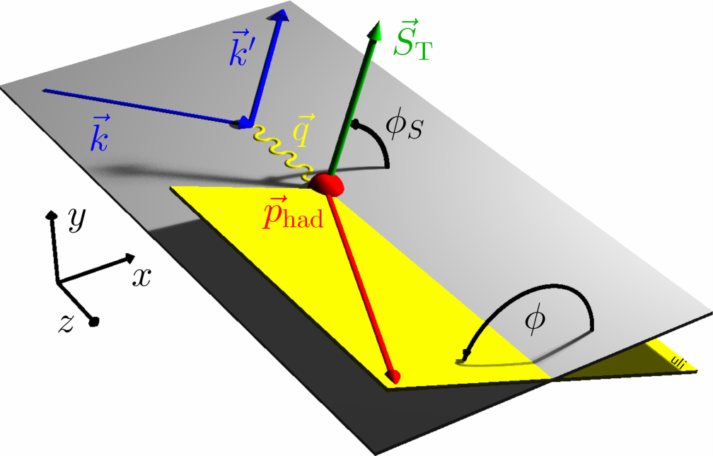
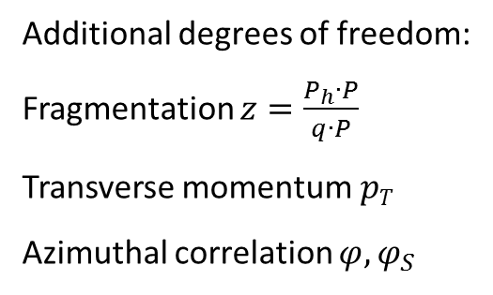
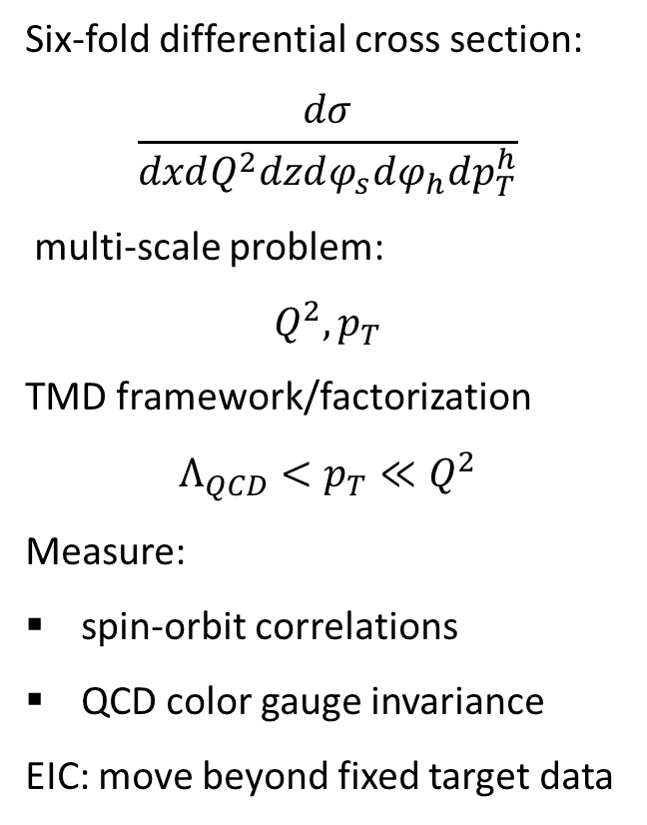
Semi-Inclusive DIS
Six-fold differential cross section:
$$\frac{dσ}{dxdQ^{2}dzdφ_{s}dφ_{h}dp_{T}^{h}}$$
multi-scale problem:
$$Q^{2},p_{T}$$
TMD framework/factorization
$$Λ_{QCD}<p_{T}≪Q^{2}$$
Measure:
spin-orbit correlations
QCD color gauge invariance
EIC: move beyond fixed target data
Additional degrees of freedom:
Fragmentation $z=\frac{P_{h}∙P}{q∙P}$
Transverse momentum$pT$
Azimuthal correlation $φ, φ_{S}$

Slide 8
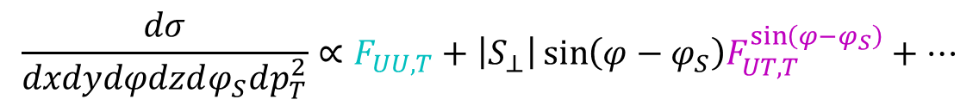

$$\frac{dσ}{dxdydφdzdφ_{S}dp_{T}^{2}}∝F_{UU,T}+\left|S_{⊥}\right|\sin\left(φ−φ_{S}\right)F_{UT,T}^{\sin\left(φ−φ_{S}\right)}+⋯$$
$$f_{1T}^{⊥q}\left(x,k_{T}\right)$$

Slide 9

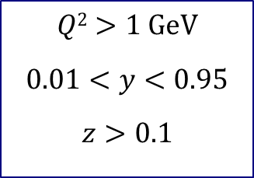







SIDIS: Hadron Kinematics
$$E_{e} = 10 \text{GeV}$$
$$E_{e} = 15 \text{GeV}$$
$$E_{e} =20 \text{GeV}$$
$$E_{p} =250 \text{GeV}$$
$$Q2>1 \text{GeV}$$
$$0.01<y<0.95$$
$$z>0.1$$
$$E_{p} =50 \text{GeV}$$
$$E_{p} =100 \text{GeV}$$
$$E_{p} =250 \text{GeV}$$
$$\vec{p_{p}}$$
$$E_{e} = 15 \text{GeV}$$
$$\vec{e_{p}}$$
Notes:
Same for pi, K, p; requirements for hadron and lepton particle identification

Slide 10
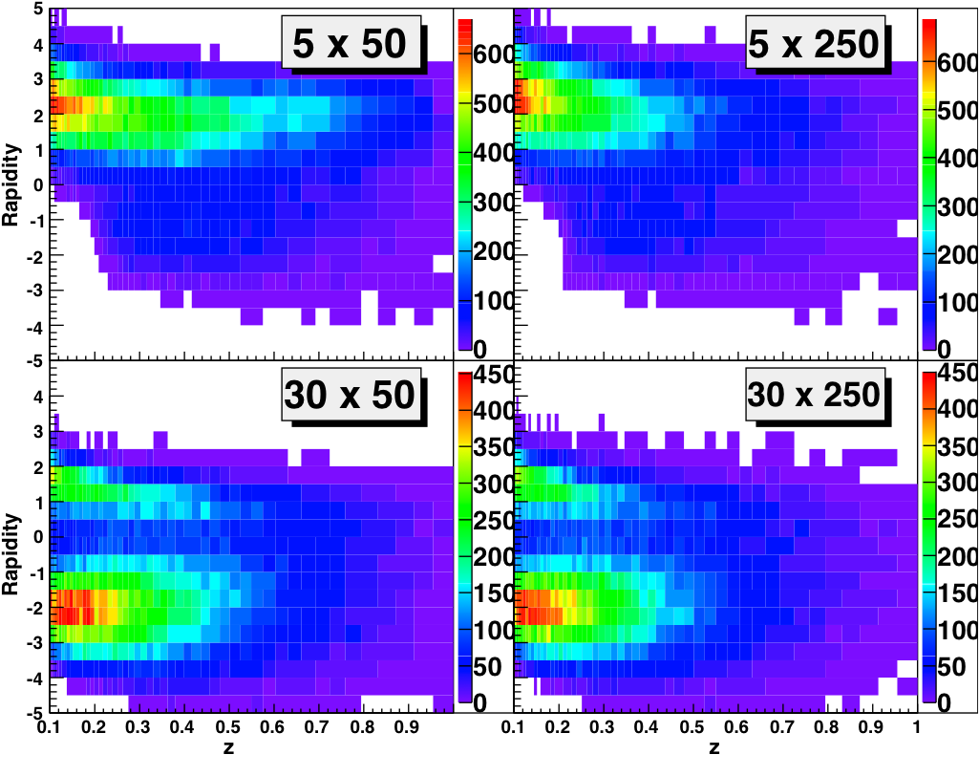
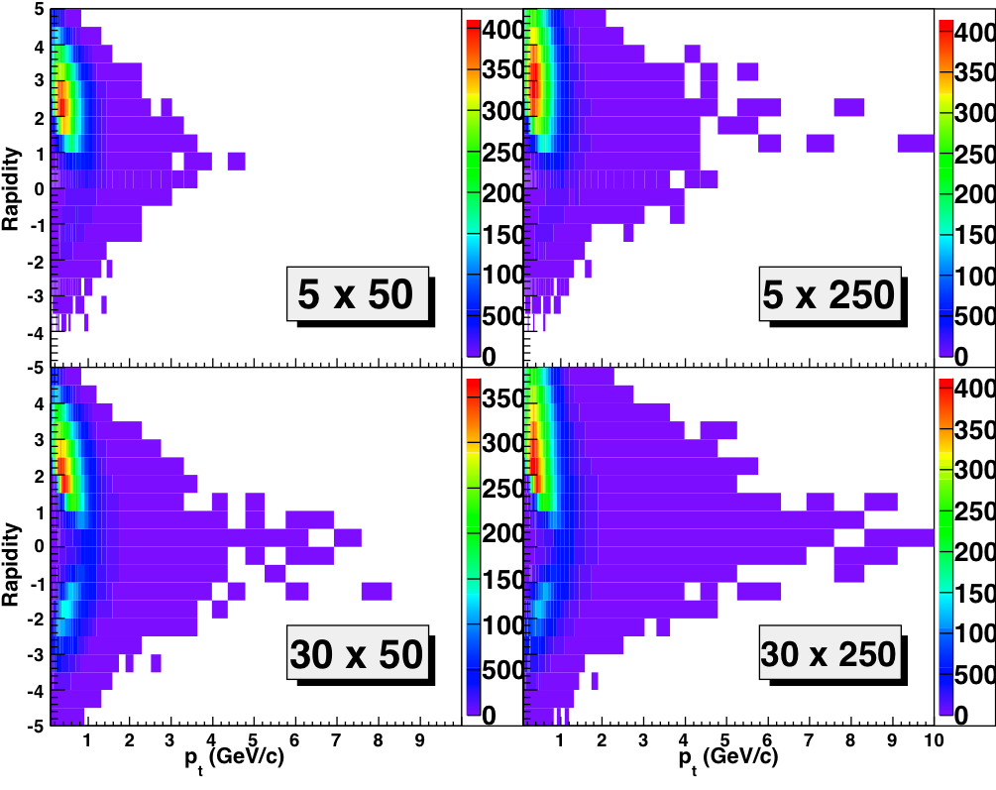
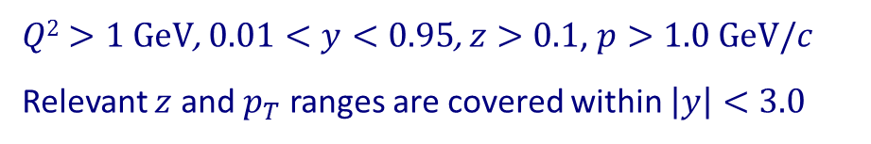


SIDIS: Hadron Coverage
$Q2>1 \text{GeV}$, $0.01<y<0.95$, $z>0.1$, $p>1.0 \text{GeV}/c$
Relevant $z$ and $p_{T}$ ranges are covered within $\left|y\right|<3.0$
(for pions here)
$$z$$
$$p_{T}$$

Slide 11

Particle Distribution
Lepton
Photon
Hadron
$$E_{e} = 15 \text{GeV}$$
$$E_{p} =250 \text{GeV}$$
Pion
Kaon
Proton

Slide 12
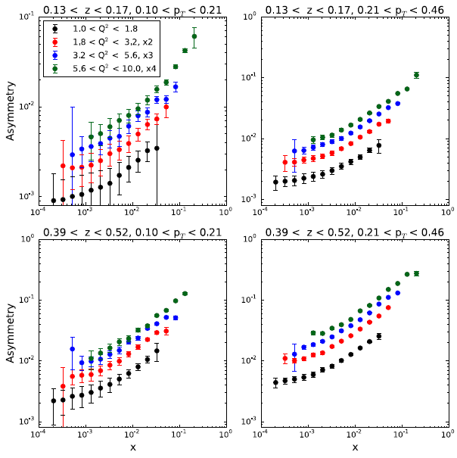
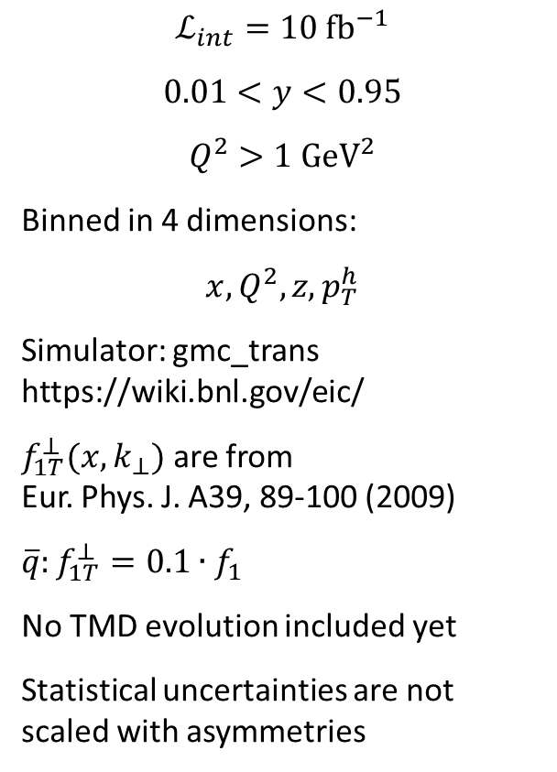
Pseudodata
$$ℒ_{int}=10 {\text{fb}}^{−1}$$
$$0.01<y<0.95$$
$$Q^{2}>1 {\text{GeV}}^{2}$$
Binned in 4 dimensions:
$$x, Q^{2}, z, p_{T}^{h}$$
Simulator: gmc_trans
https://wiki.bnl.gov/eic/
$f_{1T}^{⊥}(x,k_{⊥})$ are from
Eur. Phys. J. A39, 89-100 (2009)
$$\overline{q}:f_{1T}^{⊥}=0.1∙f_{1}$$
No TMD evolution included yet
Statistical uncertainties are not scaled with asymmetries
https://indico.bnl.gov/conferenceDisplay.py?confId=727

Slide 13
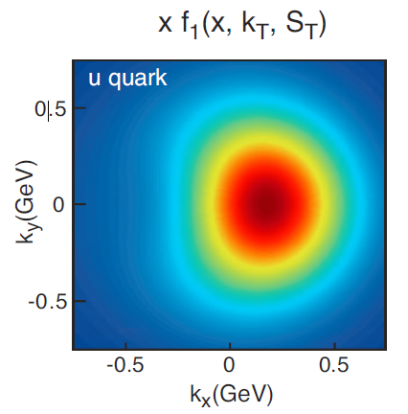




Projection for Quark Sivers TMD
QCD dynamics in the hard process
Evolution
Resummation
Matching of factorization - TMD vs. collinear
EIC pseudo data
$$\sqrt{s}=45 \text{GeV}$$
$$L_{int}=10 \text{f}{\text{b}}^{−1}$$
$$x=0.1$$
$$S_{T}$$
$${\vec{p}}_{z}$$
Anselmino et al.
J. Phys. Conf. Ser. 295, 012062 (2011)

Slide 14
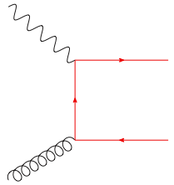

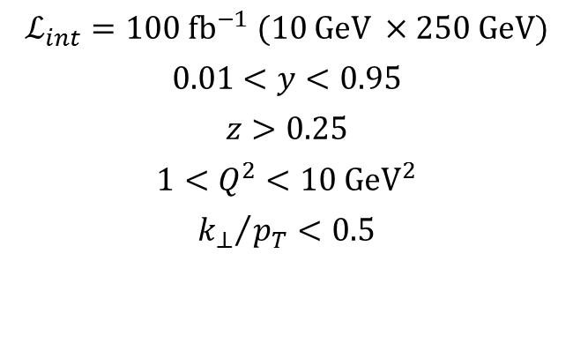
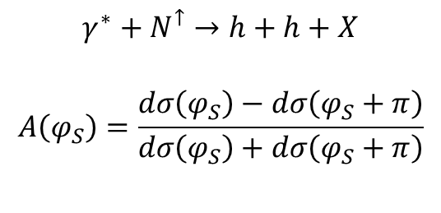
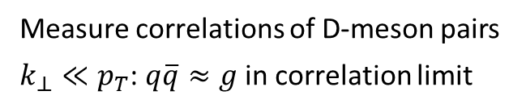
Gluon Sivers from Charm
Measure correlations of D-meson pairs
$k_{⊥}≪p_{T}$: $q\overline{q}≈g$ in correlation limit
$$γ^{∗}+N^{↑}→h+h+X$$
$$A\left(φ_{S}\right)=\frac{dσ\left(φ_{S}\right)−dσ\left(φ_{S}+π\right)}{dσ\left(φ_{S}\right)+dσ\left(φ_{S}+π\right)}$$
e
$$A(k_{⊥}^{′},φ_{S})$$
N⇑
$$ℒ_{int}=100 {\text{fb}}^{−1} (10 \text{GeV} ×250 \text{GeV}\text{)}$$
$$0.01<y<0.95$$
$$z>0.25$$
$$1<Q^{2}<10 {\text{GeV}}^{2}$$
$${k_{⊥}}/{p_{T}}<0.5$$

Slide 15
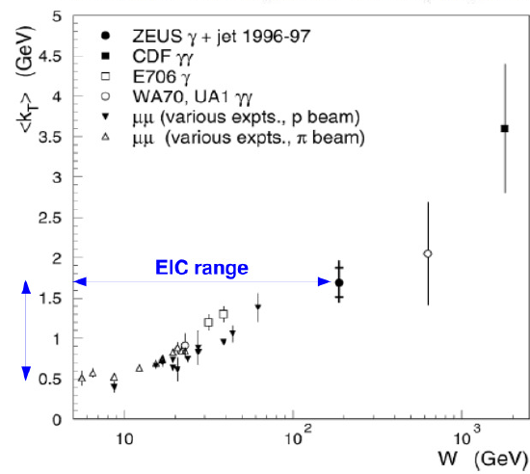
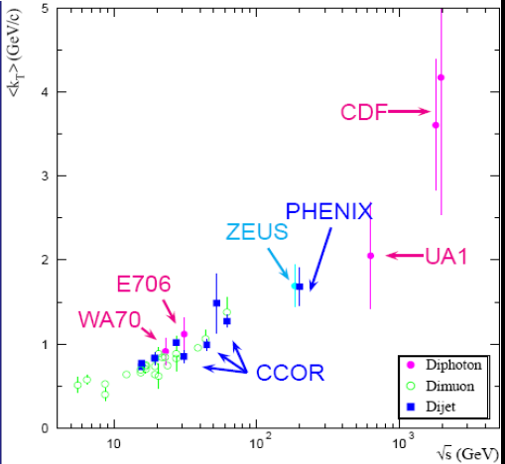
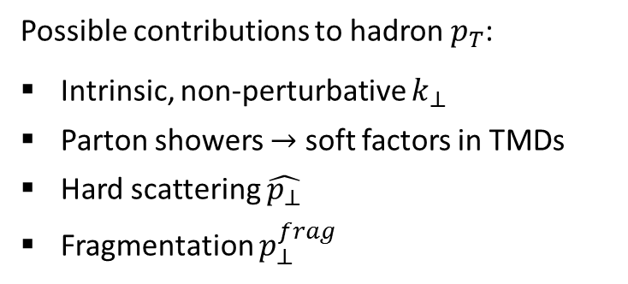
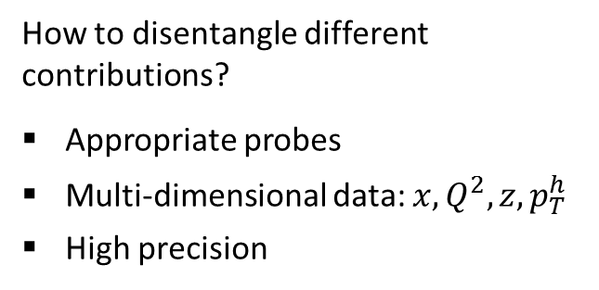

Transverse Momenta of Hadrons
Possible contributions to hadron $p_{T}$:
Intrinsic, non-perturbative $k_{⊥}$
Parton showers $→$ soft factors in TMDs
Hard scattering $\hat{p_{⊥}}$
Fragmentation $p_{⊥}^{frag}$
How to disentangle different contributions?
Appropriate probes
Multi-dimensional data: $x, Q^{2}, z, p_{T}^{h}$
High precision
$$k_{T}$$

Slide 16
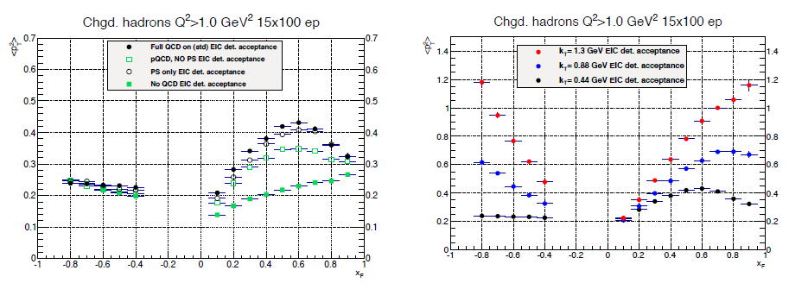

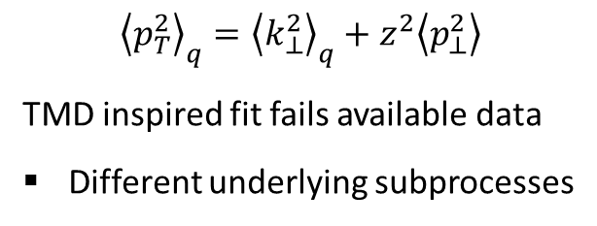
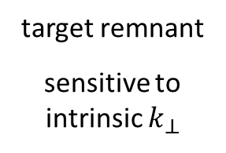
Primordial $k_{⊥}$
target remnant
sensitive to intrinsic $k_{⊥}$
scattered parton
$${\left\langle p_{T}^{2}\right\rangle }_{q}={\left\langle k_{⊥}^{2}\right\rangle }_{q}+z^{2}\left\langle p_{⊥}^{2}\right\rangle$$
TMD inspired fit fails available data
Different underlying subprocesses

Slide 17
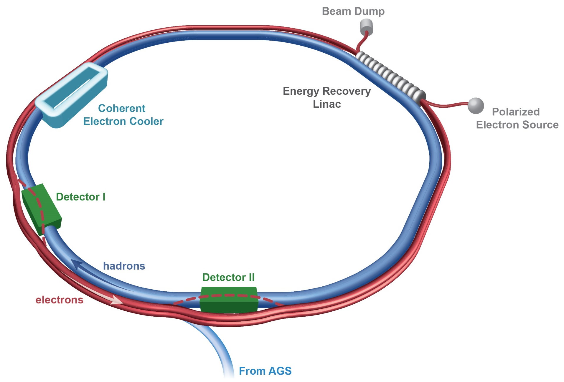
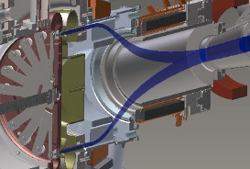
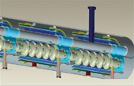
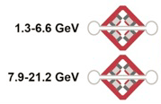

eRHIC @ BNL
https://indico.bnl.gov/conferenceDisplay.py?confId=727
$I_{e}=50 \text{mA}$ per bunch
$$P_{e}=80\%$$
$$P_{p}=70\%$$
$$L_{max}=1.5∙{10}^{33} {\text{cm}}^{−2}{\text{s}}^{−1}$$

Slide 18
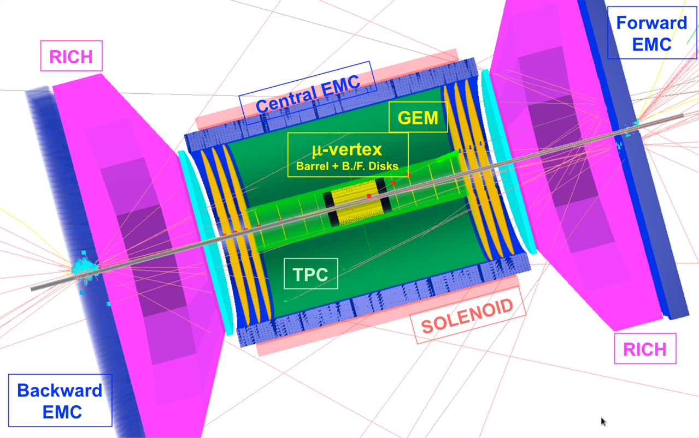
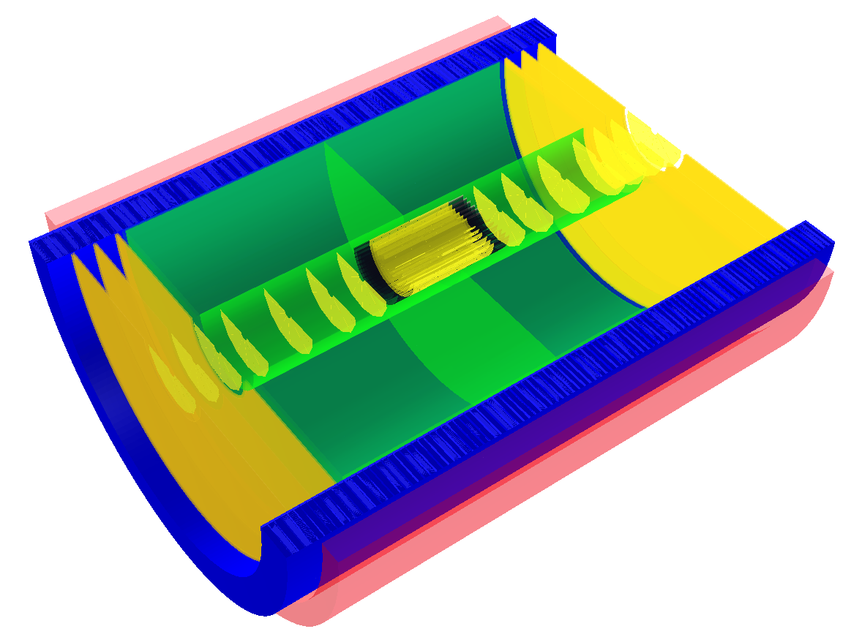

A Model Detector for eRHIC
ROMAN
POTS
LOW-Q²
TAGGER
TPC
SILICON VTX
TRACKER
GEM
TRACKER

Slide 19







Particle Rates
$$E_{e}=10 \text{GeV}$$
$$E_{p} =100 \text{GeV}$$
$$L≈{10}^{33} cm^{−2}s^{−1}$$
$$σ_{ep}≈0.03−0.06 \text{mb}$$
$$f_{coll}≈30−60 \text{kHz}$$
$$E_{e}=20 \text{GeV}$$
$$E_{p} =250 \text{GeV}$$

Slide 20


ePHENIX / eSTAR
www.phenix.bnl.gov/plans.html
arxiv.org/abs/1402.1209
https://drupal.star.bnl.gov/STAR/future

Slide 21


MEIC @ JLAB
arxiv:1209.0757
Ion
source
Warm large booster
(3 to 25 GeV/c)
Three Figure-8 rings
stacked vertically
SRF linac
Pre-booster
Cold ion collider ring (25 -100 GeV)
Warm electron collider ring (3-12 GeV)
Medium-energy IPs with
horizontal beam crossing
Injector
12 GeV CEBAF
$$f_{cross}=750 \text{MHz}$$
$$E_{e}=3−12 \text{GeV}$$
$$E_{p}=25−100 \text{GeV}$$
$$L_{max}={10}^{34} {\text{cm}}^{−2}{\text{s}}^{−1}$$

Slide 22


MEIC Detector
Bunch spacing: $1.3 \text{ns}$
${10}^{−3}$ collisions per bunch crossing
$$f_{L1}≈200 \text{kH}\text{z}$$
Asynchronous trigger with L2 tracking to suppress background

Slide 23








Summary
An electron ion collider will combine:
Kinematic reach into the gluon dominated region
Precision from electromagnetic interaction
Accuracy from high luminosity
Polarized nucleons and light/heavy ions
This will provide decisive measurements to answer many open questions in QCD.
Electroweak
$${10}^{34}$$
Tomography of the nucleon
Luminosity $({\text{cm}}^{−2}{\text{s}}^{−1})$
$${10}^{33}$$
Spin and flavor structure
of the nucleon
Internal landscape
of the nucleus
QCD at extreme
parton densities
$${10}^{32}$$
arxiv:1212.1701
$$50$$
$$100$$
$$150$$
$\sqrt{s} (\text{GeV})$

Slide 24


Slide 26










Spatial Imaging of Nucleons
$$f^{⇑}\left(x,b_{T} \right)=f\left(x,b_{T}^{2}\right)+\frac{{\left(S_{T}×b_{T}\right)}^{z}}{M}\frac{∂}{∂b_{T}^{2}}e\left(x,b_{T}^{2}\right)$$
$$f\left(x,b_{T}^{2}\right)$$
$$H\left(x,ξ,t\right)$$
Fourier transform of at
$$ξ=0$$
$$e\left(x,b_{T}^{2}\right)$$
$$E\left(x,ξ,t\right)$$
Exclusive processes to measure generalized parton distribution functions:
$$V$$
Resolution scale
$$Q^{2}$$
$${M_{V}^{2}+Q}^{2}$$

Slide 28







DVCS Kinematics
$$η>4.5$$
$$E_{γ}>1 \text{GeV}$$
$$Q^{2}>1 \text{GeV}$$
$$0.01<y<0.85$$
$$E_{p} =50 \text{GeV}$$
$$E_{p} =100 \text{GeV}$$
$$E_{p} =250 \text{GeV}$$
$$E_{e} = 15 \text{GeV}$$

Slide 29

Pseudodata Single Spin Asymmetries
http://arxiv.org/abs/1304.0077

Slide 30


GPDs & Spatial Imaging
Arxiv:1304.0077

Slide 31


Gluon Distributions
$$x_{V}=x_{B}\left(1+M_{Jψ}^{2}/Q^{2}\right)$$
$$15.8 \text{Ge}{\text{V}}^{2}<Q^{2}+M_{Jψ}^{2}<25.1\text{Ge}{\text{V}}^{2}$$
Requires high luminosities at different energies to map out the spatial distribution

