Slide 1
TMDs and spin asymmetries in SIDIS

Slide 2
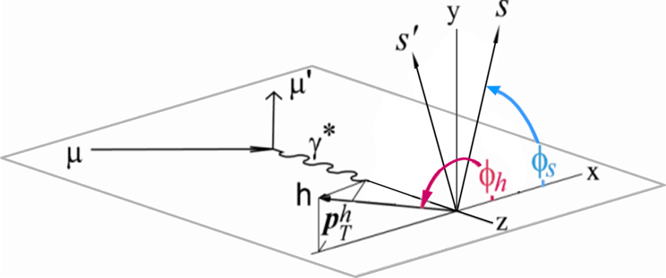
SIDIS 1h x-section

Slide 3
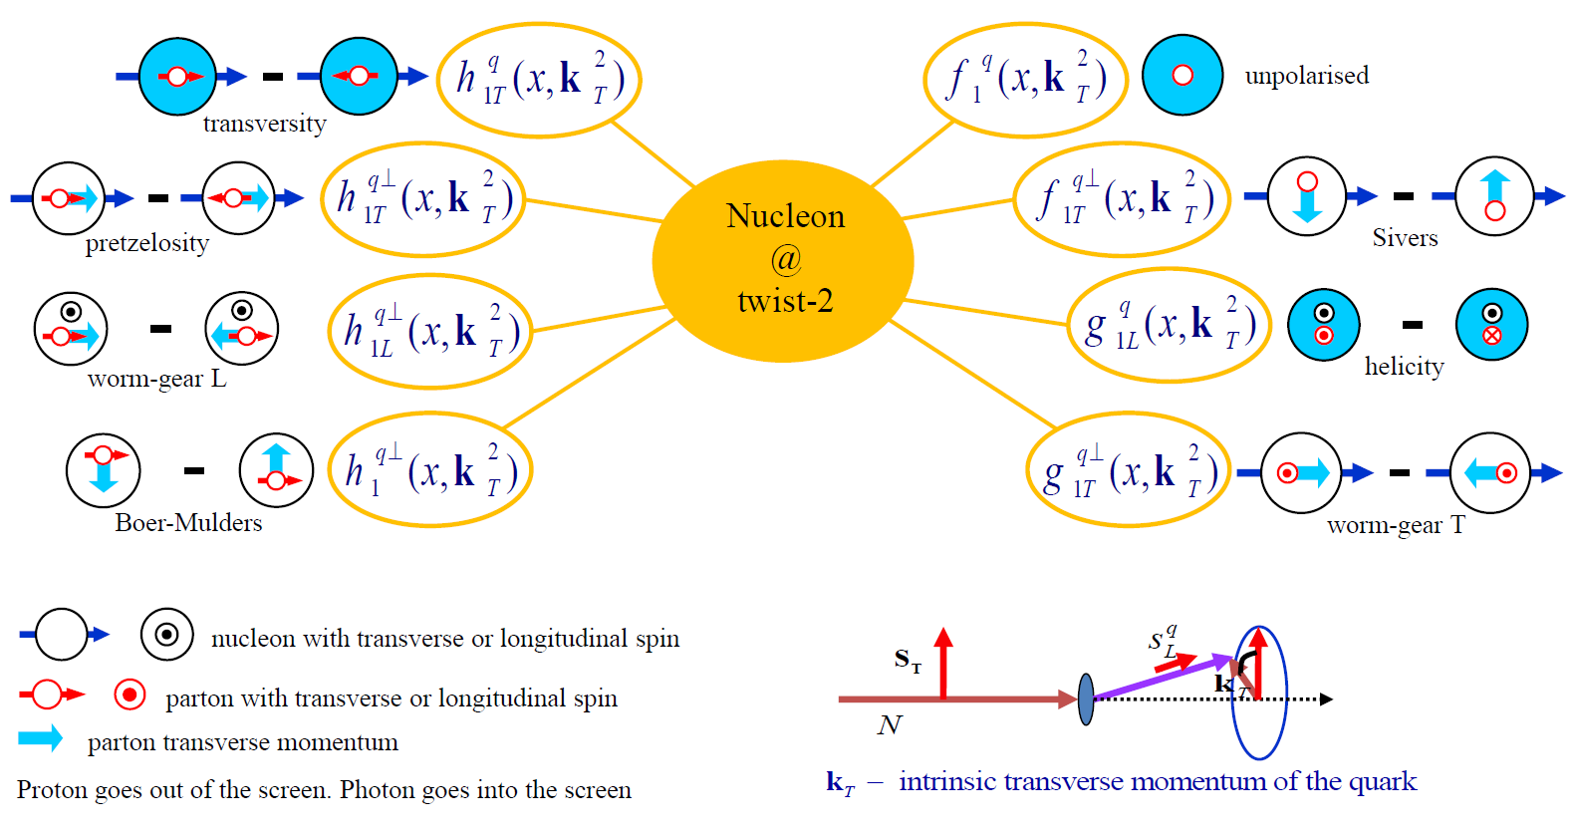
TMD Distribution Functions

Slide 4
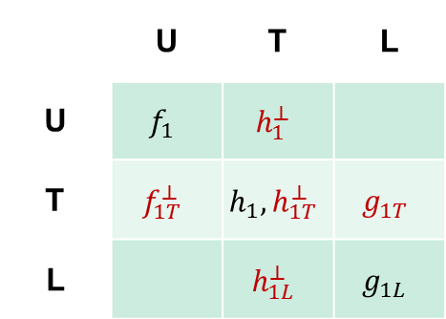
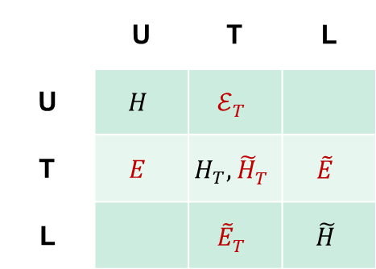
Top→Bottom
GTMDs
TMDs
GPDs
Nucleon polarization
Nucleon polarization
 | U | T | L
U | $$f_{1}$$ | $$h_{1}^{⊥}$$
T | $$f_{1T}^{⊥}$$ | $$h_{1}, h_{1T}^{⊥}$$ | $$g_{1T}$$
L |  | $$h_{1L}^{⊥}$$ | $$g_{1L}$$
 | U | T | L
U | $$H$$ | $$ℰ_{T}^{}$$
T | $$E$$ | $$H_{T}, {\tilde{H}}_{T}^{}$$ | $$\tilde{E}$$
L |  | $${\tilde{E}}_{T}^{}$$ | $$\tilde{H}$$
Parton polarization
Parton polarization
distributions in red vanish if there is no quark orbital angular momentum
quark GPDs (at ξ=0) and TMDs given by the same overlap of LCWFs but in different kinematics
  each distribution contains unique information
  no model-independent relations between GPDs and TMDs

Slide 5
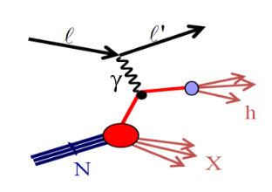
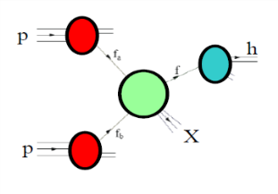
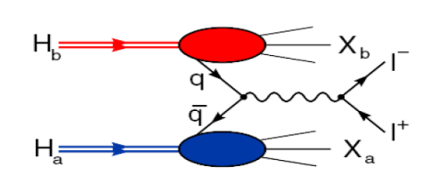
Accessing TMD PDFs
SIDIS off polarized p, d, n targets
hard polarised pp scattering
polarised Drell-Yan
HERMES
COMPASS
JLab
future: eN colliders?
RHIC
COMPASS
RHIC
FNAL
future: FAIR, JPark, NICA

Slide 6
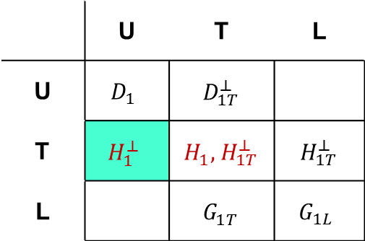
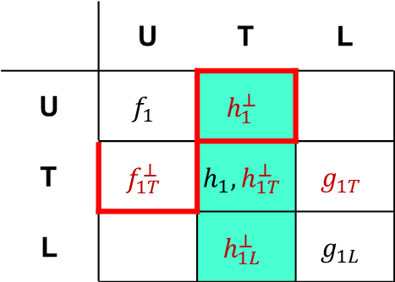
SIDIS access to TMDs
TMDs
FFs
Nucleon polarization
Hadron polarization
 | U | T | L
U | $$f_{1}$$ | $$h_{1}^{⊥}$$
T | $$f_{1T}^{⊥}$$ | $$h_{1}, h_{1T}^{⊥}$$ | $$g_{1T}$$
L |  | $$h_{1L}^{⊥}$$ | $$g_{1L}$$
 | U | T | L
U | $$D_{1}$$ | $${ D}_{1T}^{⊥}$$
T | $$H_{1}^{⊥}$$ | $H_{1}^{}, { H}_{1T}^{⊥}$ | $${ H}_{1T}^{⊥}$$
L |  | $${ G}_{1T}^{}$$ | $$G_{1L}$$
Parton polarization
Parton polarization
T odd
chiral odd
Factorisation (Collins & Soper, Ji, Ma, Yuan,
Qiu & Vogelsang, Collins & Metz...)

Slide 7
LO content
SIDIS
DY

Slide 8
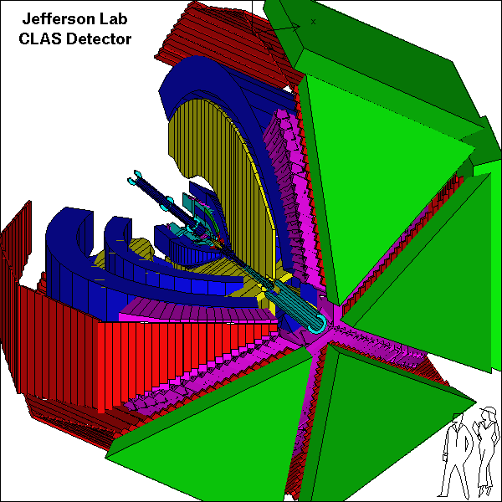

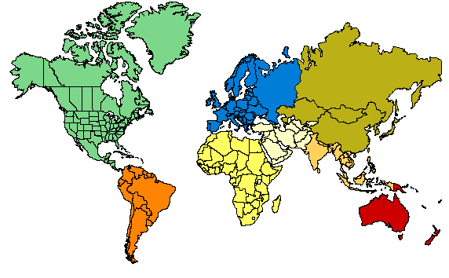
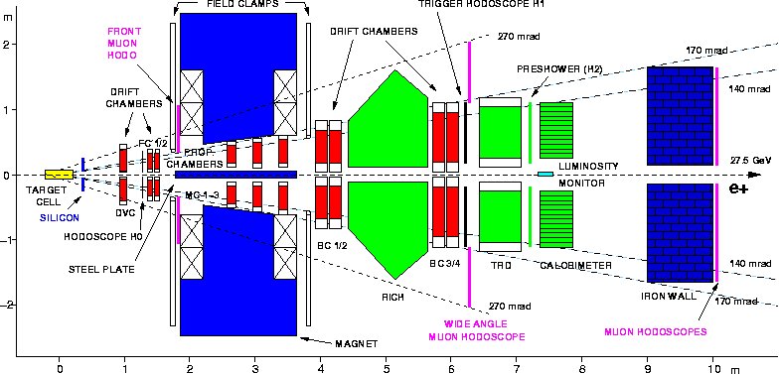
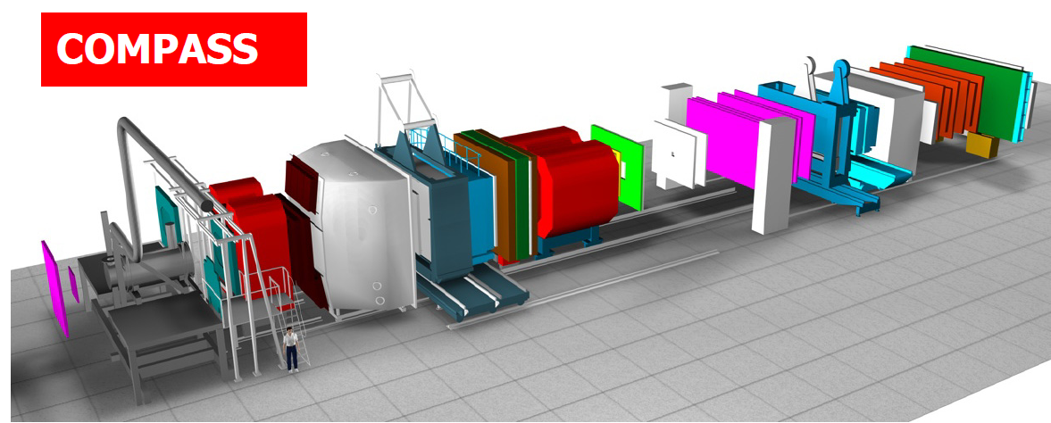
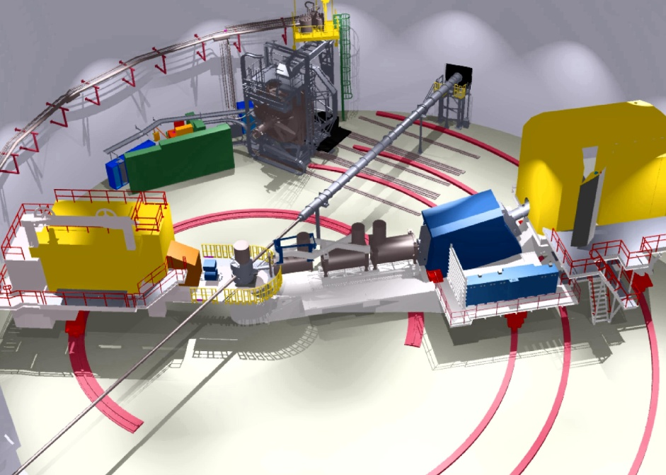



Players on SIDIS playground
Hall B
Beam: ≤6 GeV e⁻; 85% polarization
Target: polarized targets ³He, ⁶LiD, NH₃
Large acceptance spect. electron/photon beams
Hall C
Hall A
Beam: 160 GeV μ; 75% polarization
Target: ⁶LiD; 50% polarization
NH_{3;} 90%
Beam: 27.5 GeV e±; <50>% polarization
Target: polarized p gas targets; $\left\langle 85\%\right\rangle$ polarization
7 GeV spectrometer,
1.8 GeV spectrometer,
large installation experiments
Two high-resolution
4 GeV spectrometers

Slide 9
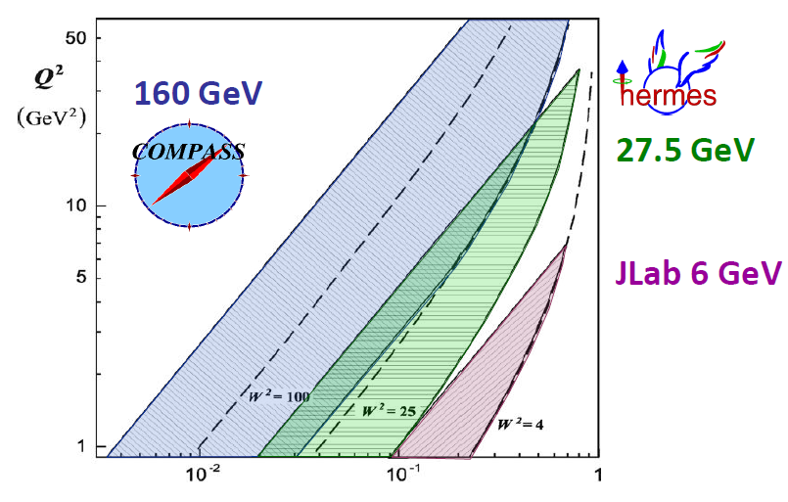
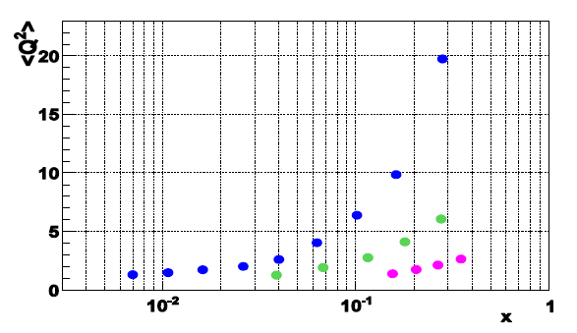
Phase space of different SIDIS -experiments
0.004 < x < 0.3, 25<W²<200GeV²
0.023 < x < 0.4, 10<W²< 50GeV²
0.14 < x < 0.5, 4<W²< 10GeV²

Slide 10
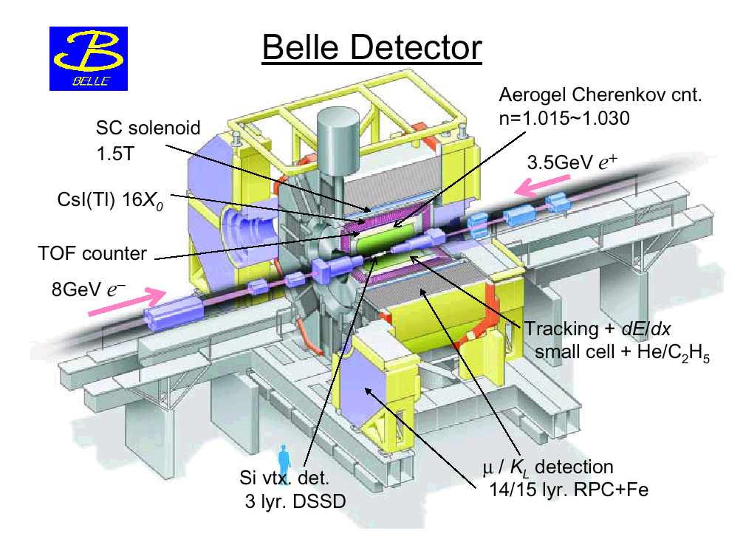
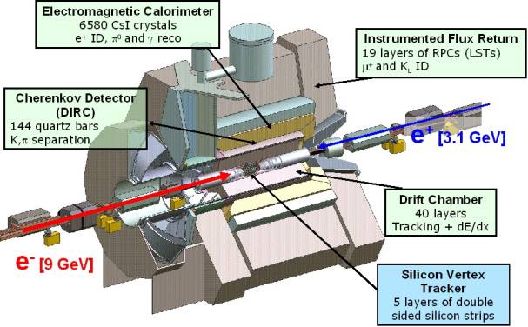


Players on FF playground

Slide 11
Specific experimental talks by:
    Christopher Braun,
    Isabella Garzia,
    Francesca Giordano,
    Charlotte van Hulse,
    Bakur Parsamyan,
    Matthias Perdekamp
    Andrew Puckett
    Adam Szabelski

Slide 12
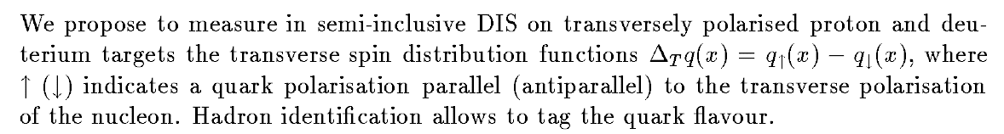
Few facts:
The measurement of transversity was in the COMPASS 1996 proposal
The measurement of the Sivers PDF was added to the program soon after … the other TMD with the developments over the years
Measurements started in 2002 by HERMES (p) and COMPASS (d)
This field has grown considerably in the last years and comes one of high priority measurements for the JLab12 program

Slide 13


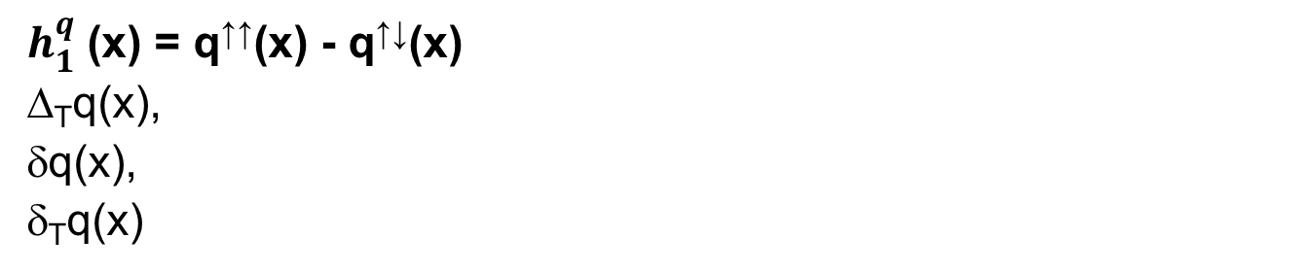
Transversity PDF
$h_{1}^{q}$ (x) = q↑↑(x) - q↑↓(x)
Δ_{T}q(x),
δq(x),
δ_{T}q(x)
q=u_{v}, d_{v}, q_{sea}
quark with spin parallel to the nucleon spin in a transversely polarised nucleon
probes the relativistic nature of quark dynamics
no contribution from the gluons  simple Q² evolution
Positivity: Soffer bound……………..
first moments: tensor charge……….
sum rule for transverse spin in PM…
it is related to GPD’s
is chiral-odd: decouples from inclusive DIS
Soffer, PRL 74 (1995)
Bakker, Leader, Trueman, PRD 70 (04)

Slide 14
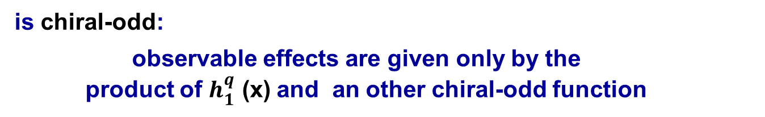
Transversity
is chiral-odd:
observable effects are given only by the
product of $h_{1}^{q}$ (x) and an other chiral-odd function
can be measured in SIDIS on a transversely polarised target
via “quark polarimetry”
“Collins” asymmetry “Collins” Fragmentation Function
“two-hadron” asymmetry “Interference” Fragmentation Function
Λ polarisation Fragmentation Function of q↑Λ

Slide 15
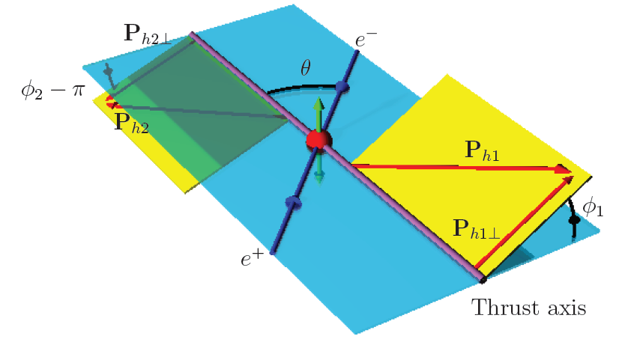
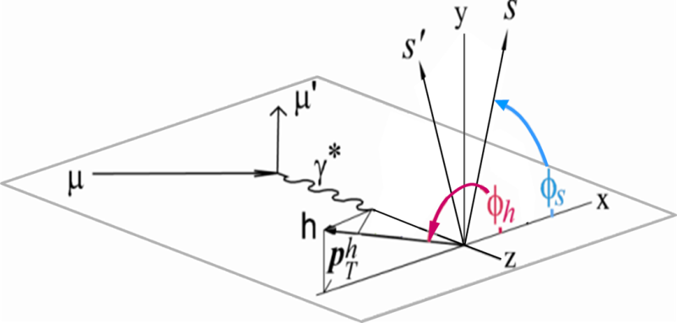
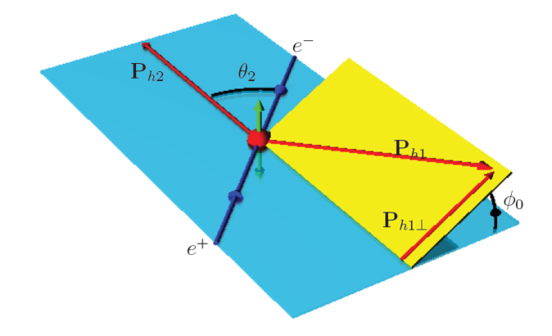
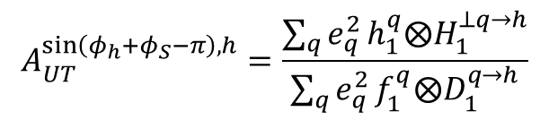
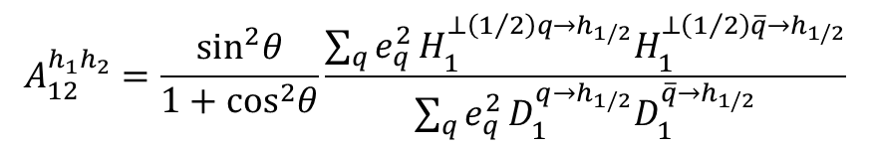
Transversity from Collins SSA and Collins FF
$$A_{UT}^{\sin\left(φ_{h}+φ_{S}−π\right), h}=\frac{\sum_{q}{e_{q}^{2}}h_{1}^{q}⨂H_{1}^{⊥q→h}}{\sum_{q}{e_{q}^{2}}f_{1}^{q}⨂D_{1}^{q→h}}$$
$$A_{12}^{h_{1}h_{2}}=\frac{\sin^{2}θ}{1+\cos^{2}θ}\frac{\sum_{q}{e_{q}^{2}}H_{1}^{⊥\left(1/2\right)q→h_{1/2}}H_{1}^{⊥\left(1/2\right)\overline{q}→h_{1/2}}}{\sum_{q}{e_{q}^{2}}D_{1}^{q→h_{1/2}}D_{1}^{\overline{q}→h_{1/2}}}$$

Slide 16
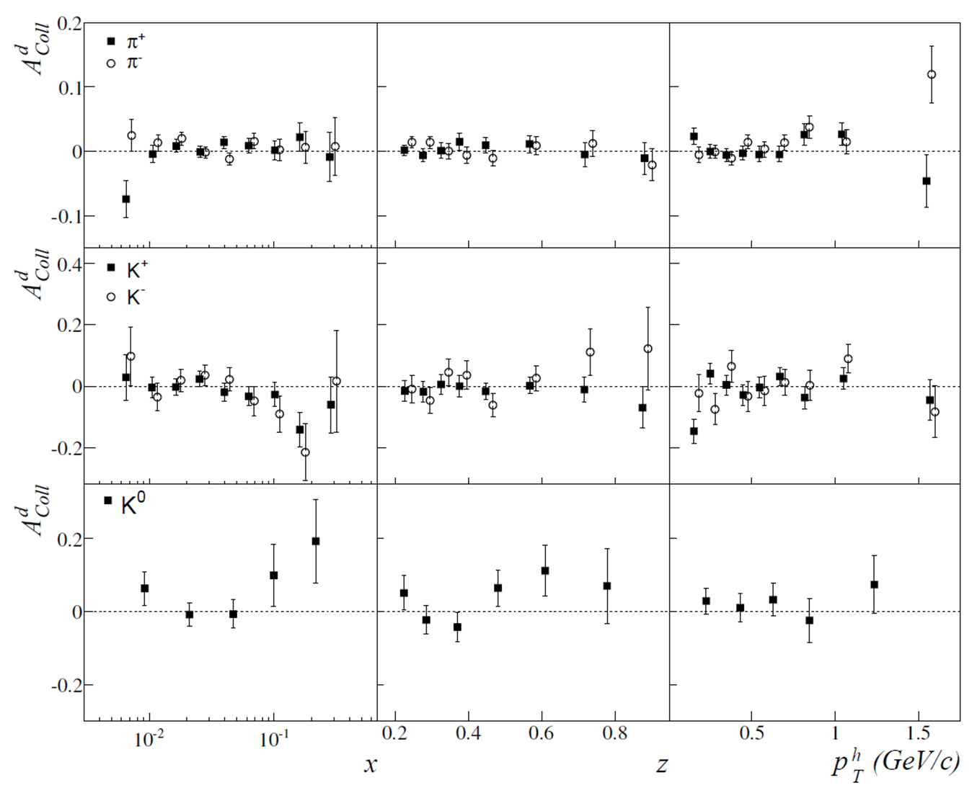

Collins asymmetry on deuteron
π-
π+
K-
K+
K⁰

Slide 17
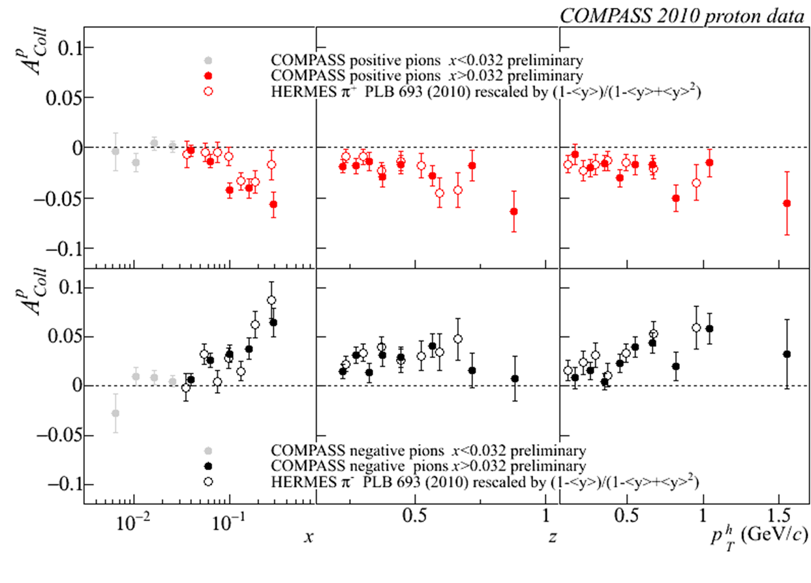
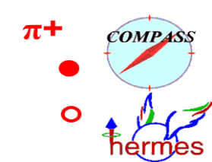
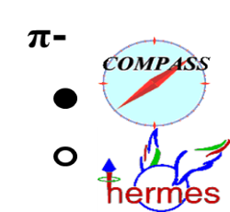
Collins asymmetry on proton
x > 0.032 region
charged pions
COMPASS and HERMES results
Notes:
17

Slide 18
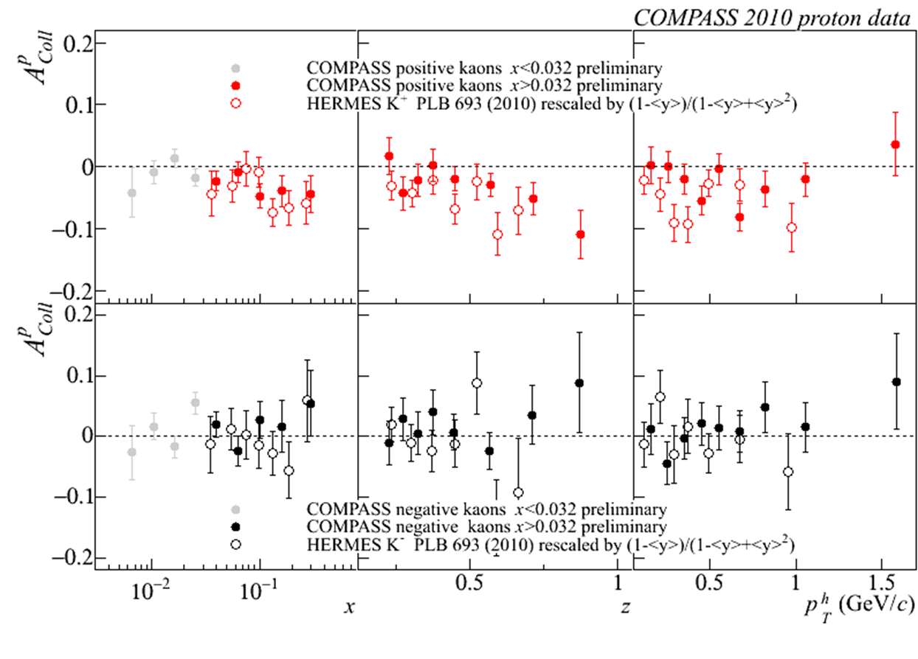


Collins asymmetry on proton
x > 0.032 region
charged kaons
COMPASS and HERMES results
K+
K-
Notes:
18

Slide 19
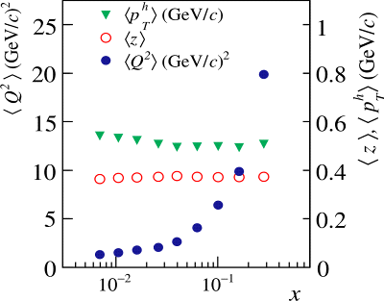


Collins asymmetry on proton
x > 0.032 region
same strength:
a very important, not obvious result!
~12
~ 4
no strong Q² dependence
Notes:
19
\

Slide 20
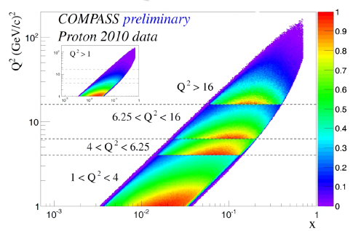
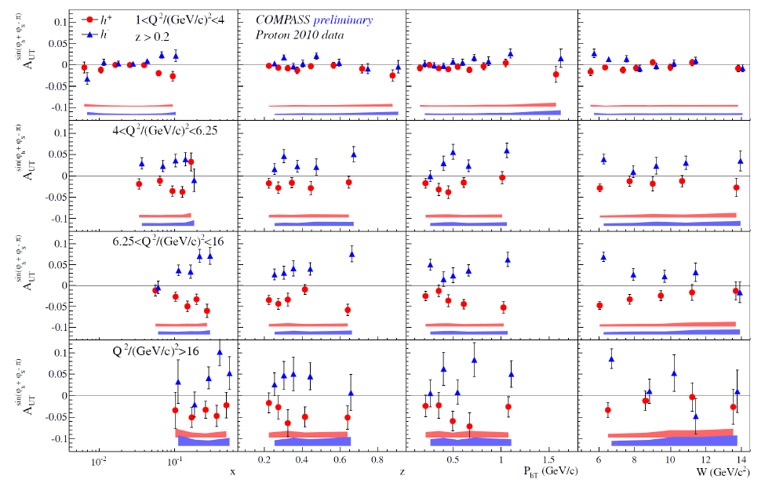
Collins asymmetry on proton
π-
Notes:
20

Slide 21
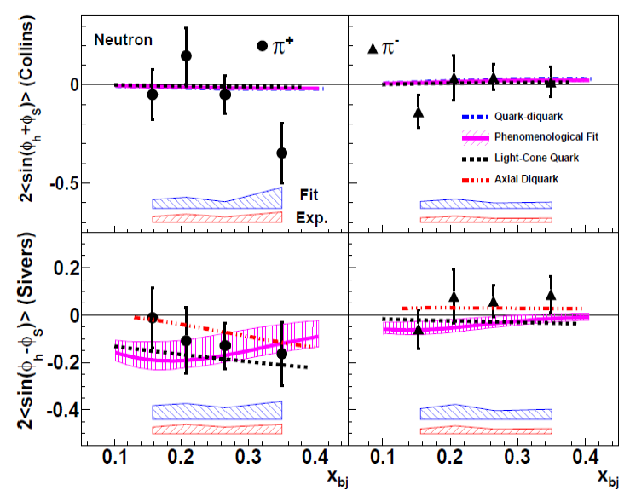
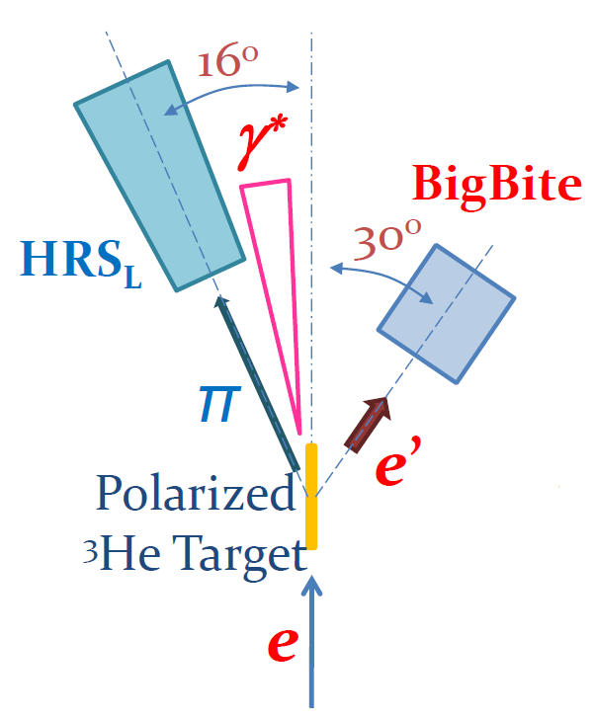
Collins asymmetry on neutron
JLab Hall A

Slide 22
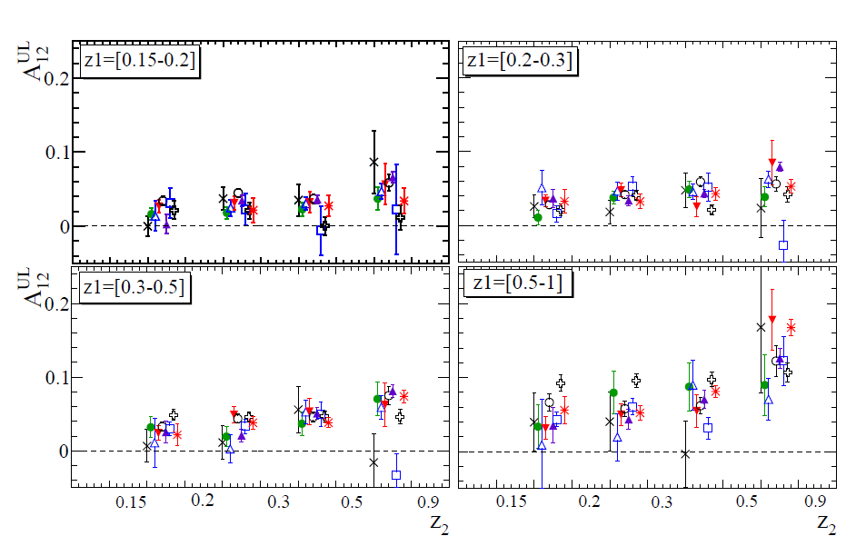
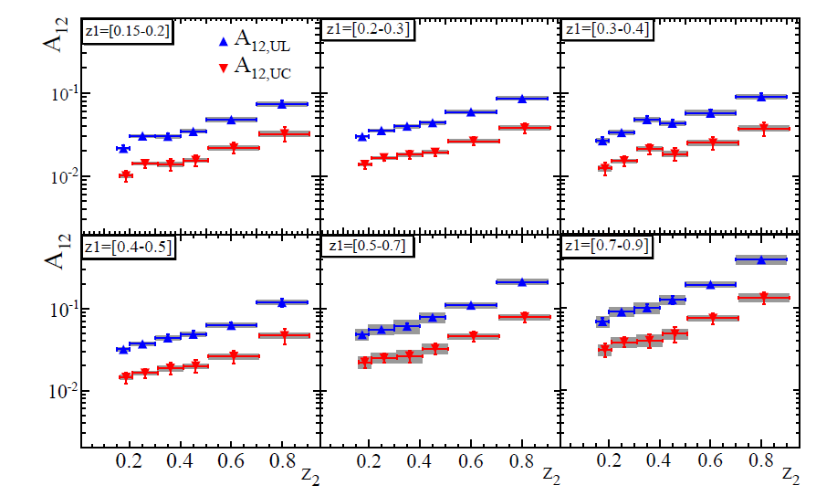
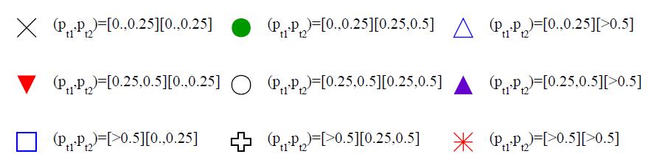
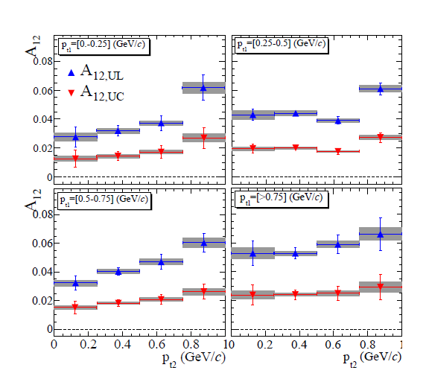
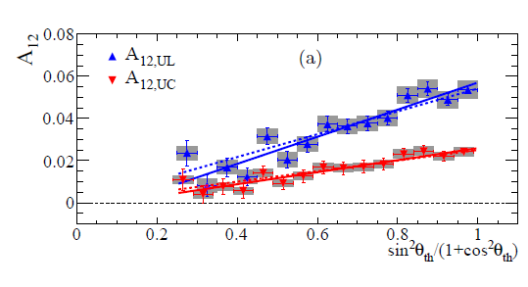

Collins asymmetry on $e^{+}e^{−}$

Slide 23
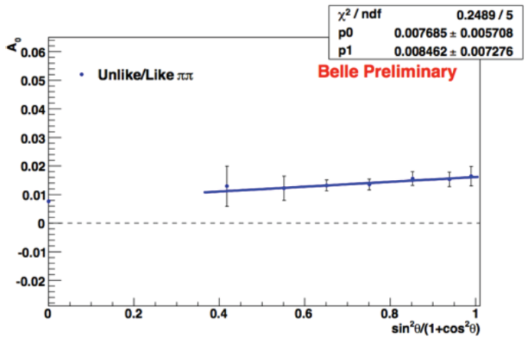
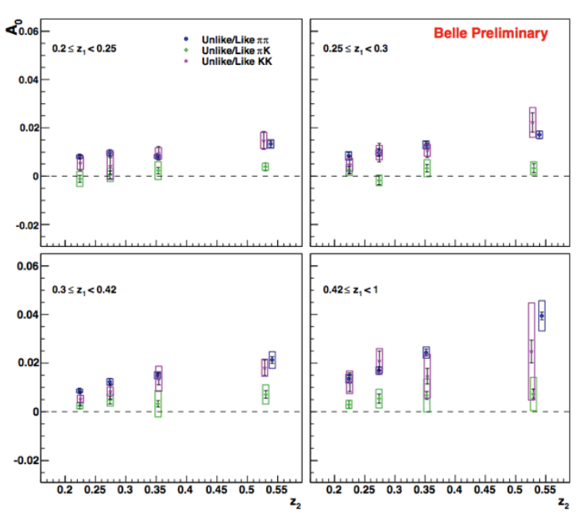
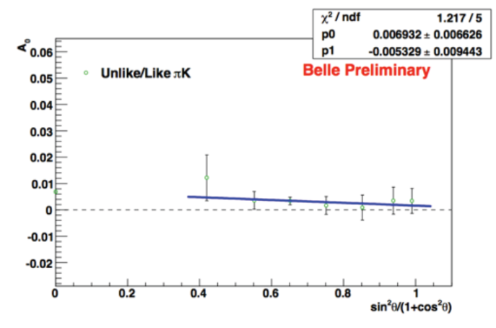
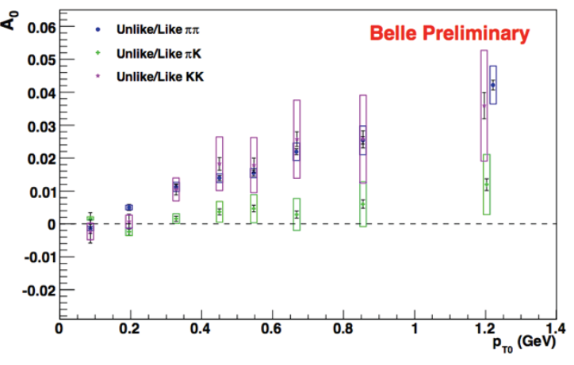
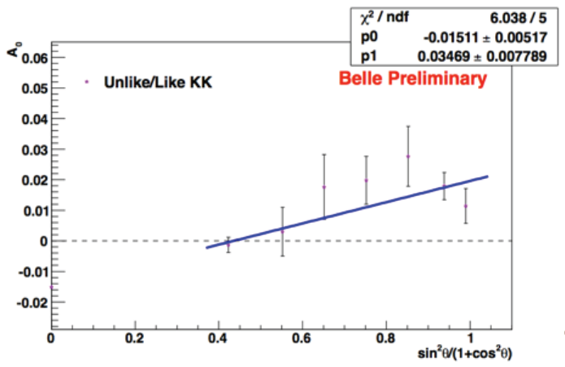
Collins asymmetry on $e^{+}e^{−}$
𝜋𝜋 => non-zero asymmetries, increase with z₁, z₂
𝜋K => asymmetries compatible, with zero
KK => non-zero asymmetries, increase with z₁,z₂

Slide 24
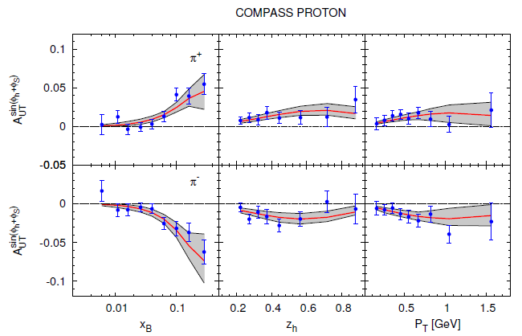
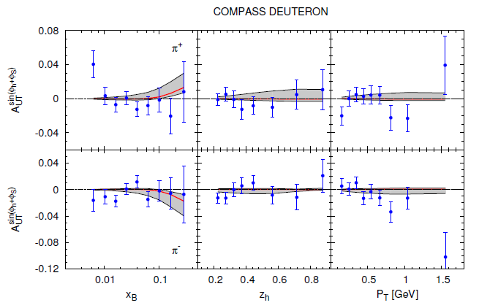

Collins asymmetry fits
M. Anselmino et al., arXiv:1303.3822
fit to HERMES p, COMPASS p and d, Belle $e^{+}e^{−}$ data
2010 p data
d data
Notes:
24

Slide 25
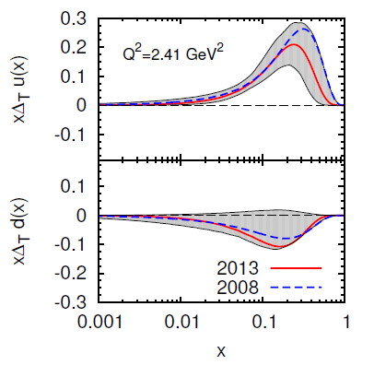
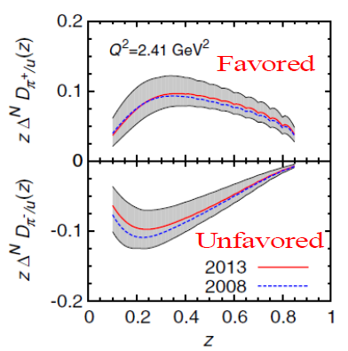
Transversity from Collins
Combined analyses of HERMES, COMPASS and BELLE fragm.fct. data
Anselmino et al. arXiv: 1303.3822

Slide 26



statistical correlations
Collins (Sivers, …) asymmetries measured vs x, z, p_{T}^{h}
correlation coefficients
correlation coefficients
x
x
z
p_{T}^{h}
correlation coefficients
charged pions
also available for
charged hadrons
charged kaons
have to be taken into account
z
p_{T}^{h}

Slide 27

The other way to
YTISREVSNART

Slide 28



2h asymmetries on d
$$A_{UT}^{\sin\left(φ_{R}+φ_{S}−π\right)}=\frac{\sum_{q}{e_{q}^{2}h_{1}^{q}\left(x\right)H_{q→h_{1}h_{2}}^{∡}\left(z, ℳ_{h_{1}h_{2}}^{2}\right)}}{\sum_{q}{e_{q}^{2}q\left(x\right)D_{q}^{h_{1}h_{2}}\left(z, ℳ_{h_{1}h_{2}}^{2}\right)}}$$

Slide 29




2h asymmetries on p
$$A_{UT}^{\sin\left(φ_{R}+φ_{S}−π\right)}=\frac{\sum_{q}{e_{q}^{2}h_{1}^{q}\left(x\right)H_{q→h_{1}h_{2}}^{∡}\left(z, ℳ_{h_{1}h_{2}}^{2}\right)}}{\sum_{q}{e_{q}^{2}q\left(x\right)D_{q}^{h_{1}h_{2}}\left(z, ℳ_{h_{1}h_{2}}^{2}\right)}}$$

Slide 30






2h asymmetry
Lund/Artru string fragmentation model predicts sign change in the Collins
function between single hadron and the corresponding transversely polarized
vector meson.
Functions entirely identified by the polarization states of the quarks, $χ$ and $χ′$
Any final-state polarization, i.e.$\left|ℓ_{1},\right.\left.m_{1}\right\rangle$ $\left|ℓ_{2},\right.\left.m_{2}\right\rangle$contained within partial wave expansion of FF
Partial waves analysis using direct sum basis $\left|ℓ,\right.\left.m\right\rangle$
$$H_{1}^{⊥}=\sum_{ℓ=0}^{∞}{\sum_{m=−ℓ}^{ℓ}{P_{ℓ,m}\left(\cos{θ}\right)e^{im\left(φ_{R}−φ_{k}\right)}H_{1}^{⊥\left|ℓ,\right.\left.m\right\rangle }\left(z,M_{h},p_{⊥}\right)}}$$
the usual IFF, related to $H_{1}^{⊥\left|1,\right.\left.1\right\rangle }$ (not pure sp, but also includes pp interference).
Models predict dihadron $H_{1}^{⊥\left|2,\right.\left.±2\right\rangle }$ has opposite sign as pseudo-scalar $H_{1}^{⊥}$
$\left|2,\right.\left.2\right\rangle$ suggests negative moments for $ρ^{±}$, very small $ρ^{0}$ moments

Slide 31




Interplay between Collins and IFF asymmetries
common hadron sample for Collins and 2h analysis

Slide 32



IFF asymmetry on $e^{+}e^{−}$

Slide 33



Transversity from 2h p and d results
use the same coefficients evaluated by A. Bacchetta et al. from Belle data [JHEP1303 (2013)119]

Slide 34




Transversity from Collins and 2h p and d results
For 2$π$, directly use the Belle data following Bacchetta et al., PRL107(2011)012001
For Collins, analysing power from Belle data
A=$\frac{\left\langle H_{1}^{⊥,fav}\right\rangle }{\left\langle D_{1}^{fav}\right\rangle }$
Bradamante, Martin, Barone
QCD Evolution, Santa Fe

Slide 35


Sivers Asymmetry
Sivers: correlates nucleon spin & quark transverse momentum k_{T} /T-ODD
at LO:
$$μp^{↑}→μXh^{±}$$
The Sivers PDF
1992 | Sivers proposes $f_{1T}^{⊥}$
1993 | J. Collins proofs $f_{1T}^{⊥}=0$ for T invariance
2002 | S. Brodsky, Hwang and Schmidt demonstrate that $f_{1Tq}^{⊥}$ may be $≠0$ due to FSI
2002 | J. Collins shows that${\left(f_{1T}^{⊥}\right)}_{DY}=−{\left(f_{1T}^{⊥}\right)}_{SIDIS}$
2004 | HERMES on p: $A_{Siv}^{π^{+}}≠0$ and $A_{Siv}^{π^{−}}=0$
2004 | COMPASS on d: $A_{Siv}^{π^{+}}=0$ and $A_{Siv}^{π^{−}}=0$
2008 | COMPASS on p: $A_{Siv}^{π^{+}}≠0$ and $A_{Siv}^{π^{−}}=0$

Slide 36



Sivers asymmetry on deuteron
PLB 673 (2009) 127
understood as
u – d cancellation
$$f_{1T,u}^{⊥}≈−f_{1T,d}^{⊥}$$

Slide 37



Sivers asymmetry on deuteron for Gluons
Based on deuteron COMPASS data, Brodsky and Gardner foresaw gluon Sivers $f_{1T,g}^{⊥}=0$

Slide 38



Sivers asymmetry on p
charged pions (and kaons), HERMES and COMPASS
smaller values measured by COMPASS with respect to HERMES;
same indication for K+

Slide 39



Sivers asymmetry on proton
charged hadrons, 2010 data - Q² evolution
comparison with
S. M. Aybat, A. Prokudin and T. C. Rogers calculations PRL 108 (2012) 242003
x > 0.032
<Q²> = 8.7 GeV/c²
No TMD
evolution
with TMD
evolution
all x
<Q²> = 3.8 GeV/c²
Notes:
39

Slide 40
Sivers asymmetry on neutron
JLab Hall A

Slide 41





HERMES inclusive SSAs
Relevant kinematic:
  Feynman $x_{F}={p_{long}^{h}}/{p_{long,max}^{h}}$ (in ep CMS)
  Transverse hadron momentum $p_{T}$(w.r.t $ℓ$ direction)
  Azimuthal hadron angle (vs target spin) $φ_{h}−φ_{S}$
$$ℓp^{↑}⟶hX$$
$π^{+}$ nearly linear rise with $x_{F}$ (up to ~ 10%)
$π^{−}$ similar trend, smaller magnitude (up to ~ 4%)
$K^{+}$ about constant at (~ 7%)
$K^{−}≈0$
Different behaviour of kaons
Asymmetries also separated
for different regions⇒

Slide 42


Test of universality
T-odd character of the Boer-Mulders and Sivers functions
In order not vanish by time-reversal invariance T-odd SSA require an interaction phase generated by a rescattering of the struck parton in the field of the hadron remnant
Time reversal
SIDIS
these functions are process dependent, they change sign to provide the gauge invariance
Boer-Mulders
Sivers

Slide 43


Q² vs x phase space at COMPASS
The phase spaces of the two processes overlap at COMPASS
➔ Consistent extraction of TMD DPFs in the same region

Slide 44

Sivers in DY range

Slide 45


Other SSAs - Deuteron data
two twist-2 asymmetries can be interpreted in QCD parton
“pretzelosity” ⊗ Collins FF
In some models $h_{1T}^{⊥}=g_{1}−h_{1}$
on deuteron asymmetries compatible with zero: again cancellation between proton and neutron?

Slide 46

Other SSAs - proton data
“pretzelosity” ⊗ Collins FF

Slide 47

Other SSAs - proton data
“pretzelosity” ⊗ Collins FF

Slide 48

Other SSAs - neutron data
“pretzelosity” ⊗ Collins FF

Slide 49

Other Transverse Target spin asymmetries on d

Slide 50

Other Transverse Target spin asymmetries on p

Slide 51

Other Transverse Target spin asymmetries on p

Slide 52

Other Transverse Target spin asymmetries on n

Slide 53
Conclusions (?)
A lot of data on the shelf being used;
SIDIS results will continue to come in the future both from COMPASS and from JLAB12;
In the near future COMPASS will provide first polarized DY (see talk of Chiosso)
  Whats NEXT?

Slide 54
Nucleon Structure Outlook
This is a defining period for the future, which can be bright
Next decade gets important input from HL-LHC, COMPASS, JLab-12 GeV
LHeC (and FCC-he) utilizes an envisioned 60-GeV ERL off the LHC (or its upgrade). They will be the ultimate tools to study high-energy DIS, and allow unprecedented measurements of
  parton distributions of gluons in nucleons and nuclei, down to the region of the highest-density matter
  precision Higgs characterization
  resolving proton (and LQ) structure down to a few times 10⁻⁵ fm
EIC science requires polarization & luminosity & detection capability. EIC allows a unique opportunity to make a (textbook) breakthrough in nucleon structure and QCD dynamics
  explore and image the 3D (spin) structure of the nucleon
  discover the role of gluons in structure and dynamics
  understand the emergence of hadrons from color charge
Rolf Ent: Workshop on the Long Term Strategy of INFN CSN1
Elba, May 22 – May 24, 2014
Lepton scattering has proven its science value over the last 5 decades!
These projects deserve the strongest support – they can be on your horizon!

Slide 55
Electron Ion Colliders
Past
Possible Future
Europe
US
China
Europe
EIC
CEIC
 | HERA@DESY | LHeC@CERN | eRHIC@BNL | MEIC@JLab | HIAF@CAS | ENC@GSI
E_{CM} (GeV) | 320 | 800-1300 | 70-150 | 12-70 → 140 | 12 → 65 | 14
proton x_{min} | 1 x 10⁻⁵ | 5 x 10⁻⁷ | 4 x 10⁻⁵ | 5 x 10⁻⁵ | 7 x10⁻³ →3x10⁻⁴ | 5 x 10⁻³
ion | p | p to Pb | p to U | p to Pb | p to U | p to ~⁴⁰Ca
polarization | - | - | p, ³He | p, d, ³He (⁶Li) | p, d, ³He | p,d
L [cm⁻² s⁻¹] | 2 x 10³¹ | 10³³⁻³⁴ | 10³³ → 10³⁴ | 10³⁴⁻³⁵ | 10³²⁻³³ → 10³⁵ | 10³²
IP | 2 | 1 | 2+ | 2+ | 1 | 1
Year | 1992-2007 | 2025 | 2025 | Post-12 GeV | 2019 → 2030 | upgrade to FAIR
Followed by FCC-he?
Figure-8
Figure-8
Dormant
High-Energy Physics
Hadron Physics
Note: x_{min} ~ x @ Q² = 1 GeV²

Slide 56
EIC: the MACHINE to image quarks and gluons
All of us dreams of

Slide 57


Thank You

Slide 58

Collins Asymmetry on p - π, K id.
Correlation between outgoing hadron & quark transverse spin
→ $h_{1}^{u} \& h_{1}^{d}$
π-
combined 2007 – 2010 results
π+
preliminary
Agreement HERMES/COMPASS → no Q² dependence seen
(factor of ~3 inQ²)
Now also produced in bins of z and y

Slide 59

COMPASS
high energy beam
large angular acceptance
broad kinematical range
two stages spectrometer
  Large Angle Spectrometer (SM1)
  Small Angle Spectrometer (SM2)
radiator C₄F₁₀
threshold: π ~2 GeV/c
K ~ 10 GeV/c
SM2
MuonWall
E/HCAL
SM1
RICH
MuonWall
Target
E/HCAL
variety of tracking detectors to cope with different particle flux from θ = 0 to θ ≈ 200 mrad
Notes:
59

Slide 60


the polarized target system (>2005)
³He – ⁴He dilution refrigerator (T~50mK)
solenoid 2.5T
dipole magnet 0.6T
acceptance > ± 180 mrad
3 target cells
30, 60, and 30 cm long
μ
opposite polarisation
d (⁶LiD) p (NH₃)
polarization 50% 90%
dilution factor 40% 16%
no evidence for relevant
nuclear effects (160 GeV)

Slide 61

Importance of unpolarized
SIDIS for TMDs
The cross-section dependence from $p_{T}^{h}$ results from:
  intrinsic k_{T} of the quarks
  $p_{⊥}$ generated in the quark fragmentation
The azimuthal modulations in the unpolarized cross-sections comes from:
  Intrinsic k_{T} of the quarks
  The Boer-Mulders PDF
These are difficult measurements requiring to take into account apparatus acceptance
COMPASS and HERMES have
  results on ${}_{}^{6}{LiD} \left(\sim d\right)$ and $d$ from
  No measurements on $p$ since on $NH_{3} \left(\sim p\right)$ nuclear effects may be important
$⇒$COMPASS-II, measurements on LH₂ in parallel with DVCS

Slide 62


Collins asymmetry on proton
charged pions and kaons
combined 2007 – 2010 results
π-
~ h+ / h-
π+
preliminary
K-
compatible
with π+ / π-
K+
preliminary
Notes:
62

Slide 63

SIDIS 1h x-section

Slide 64

Results:
Year
2005 | $$A_{Siv, d}^{h}, A_{Col, d}^{h}$$ | First ⁶LiD data
2006 | $$A_{Siv, d}^{h}, A_{Col, d}^{h}$$ | Full ⁶LiD statistics
2009 | $$A_{Siv, d}^{π^{±},{ K}^{±}, K_{s}^{0}}, A_{Col, d}^{π^{±},{ K}^{±}, K_{s}^{0}}$$ | Full ⁶LiD statistics
2010 | $$A_{Siv, p}^{h}, A_{Col, p}^{h}$$ | 2007 NH₃ data
2012 | $$A_{UT,d}^{sinφ_{RS}},A_{UT,p}^{sinφ_{RS}}$$ | $$\text{Full} \text{6}\text{LiD} \text{and} \text{NH}\text{3}\text{statistics}$$
2012 | $$A_{Siv, p}^{h}, A_{Col, p}^{h}$$ | $$\text{Full} \text{NH}\text{3}\text{statistics}$$
2012 | $A_{UT,d}^{sin\left(φ_{ρ}−φ_{S}\right)}$, $A_{UT,p }^{sin\left(φ_{ρ}−φ_{S}\right)}$ | Exclusive${ ρ}^{0} \text{production}\text{− }\text{Full} \text{6}\text{LiD} \text{and} \text{NH}\text{3}\text{statistics}$
2013 | $${{dn}^{h}}/{\left({dN}^{μ}dz dp_{T}^{2}\right)}$$ | Unpolarized multiplicities on d
2014 | $A_{UU,d}^{\sin{φ_{h}}}$, $A_{UU,d}^{\cos{φ_{h}}},A_{UU,d}^{\cos{{2φ}_{h}}}$ $A_{UT,p }^{sinφ_{S}}$, $A_{LT,p }^{cosφ_{S}},A_{UT,p }^{sin\left({2φ}_{ρ}−φ_{S}\right)}$… $$A_{Siv, d}^{g}$$ | Unpol. azimuthal asymm.s Excl$.{ ρ}^{0} \text{production}$ on $\text{NH}\text{3}$ preliminary

Slide 65




Transversity from Collins and 2h p and d results –
$$A_{UT,p, h^{+}}^{sin\left(φ_{h^{+}}+φ_{S}−π\right)}=\frac{\left\langle H_{1}^{⊥,fav}\right\rangle }{\left\langle D_{1}^{fav}\right\rangle }∙\frac{4\left(xh_{1}^{u}+αxh_{1}^{\overline{u}}\right)+\left(xh_{1}^{d}+αxh_{1}^{\overline{d}}\right)}{4\left(xf_{}^{u}+\frac{\left\langle D_{1}^{unfav}\right\rangle }{\left\langle D_{1}^{fav}\right\rangle }xf_{}^{\overline{u}}\right)+\left(xf_{}^{d}+\frac{\left\langle D_{1}^{unfav}\right\rangle }{\left\langle D_{1}^{fav}\right\rangle }xf_{}^{\overline{d}}\right)}$$
$$A_{UT,p, h^{+}}^{sin\left(φ_{h^{+}}+φ_{S}−π\right)}=\frac{\left\langle H_{1}^{⊥,fav}\right\rangle }{\left\langle D_{1}^{fav}\right\rangle }∙\frac{4\left(xh_{1}^{u}+αxh_{1}^{\overline{u}}\right)+\left(xh_{1}^{d}+αxh_{1}^{\overline{d}}\right)}{4\left(xf_{}^{u}+\frac{\left\langle D_{1}^{unfav}\right\rangle }{\left\langle D_{1}^{fav}\right\rangle }xf_{}^{\overline{u}}\right)+\left(xf_{}^{d}+\frac{\left\langle D_{1}^{unfav}\right\rangle }{\left\langle D_{1}^{fav}\right\rangle }xf_{}^{\overline{d}}\right)}$$
+ equivalent for $h^{−}$ and for deuteron
$$α=\frac{\left\langle H_{1}^{⊥,unfav}\right\rangle }{\left\langle H_{1}^{⊥,fav}\right\rangle }=\left\{\begin{matrix}\begin{aligned}−1; A1 \\ \end{aligned} \\ \frac{\left\langle D_{1}^{unfav}\right\rangle }{\left\langle D_{1}^{fav}\right\rangle }; A2\end{matrix}\right.$$
Bradamante, Martin, Barone
QCD Evolution, Santa Fe

Slide 66

Interplay between Collins and IFF asymmetries
common hadron sample for Collins and 2h analysis, i.e.
  events which contain at least one positive hadron and at least one negative hadron
  for each event the number of hadrons is the number of $h^{+}h^{−}$ pairs, as defined in the $2h$ analysis
  $p_{T}^{h_{1,2}}>0.1$ GeV/c and $R_{T}>0.07$ GeV/c; two sets of data, with $z_{h_{1,2}}>0.1$ and $z_{h_{1,2}}>0.2$

