Slide 1
Perspectives on Fragmentation Functions from BESIII
Yinghui Guan ^{a*}, Isabella Garzia ^{b}, Haibo Li ª,
Xiao-Rui Lyu ^{c} , Wenbiao Yan ^{d}
a. Institute of High Energy Physics
b. Ferrara University, INFN
c. University of Chinese Academy of Sciences(UCAS)
d. University of Science and Technology of China(USTC)
* guanyh@ihep.ac.cn
The Fourth International Workshop on Transverse Polarization Phenomena in Hard Processes (Transversity 2014)
Chia (CA), Italy, 9−13th June 2014

Slide 2
Outline
Motivation
BEPCII and BESIII
Physics topics about FF at BESIII:
Inclusive hadron(π/π⁰/K/K_{S}…) production
Double Collins Asymmetries(DCA) measurement
Summary and Outlook

Slide 3
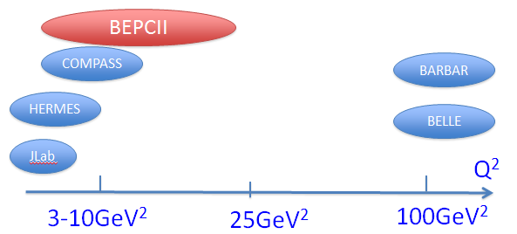
Motivation
e+e-
SIDIS
SIDIS experiments: HERMES, JLab, low Q², to extract PDFs, need FFs from e+e- annihilations.
Existing information of FFs: BARBAR, Belle etc., high Q², need energy evolution for SIDIS.
BEPCII: similar energy coverage with SIDIS. Input for extracting the parton distribution without energy evolution! Proposed by PRD 88. 034016 (2013)
It will be interesting if BEPCII can do something
Experiences and technique from Belle and BABAR

Slide 4
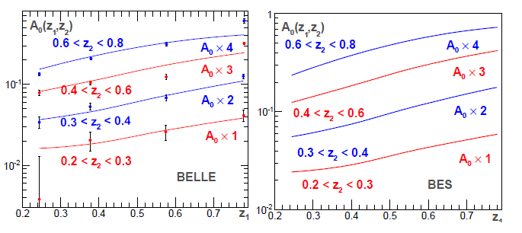
Motivation --Test the evolution at BEPCII
PRD 88. 034016 (2013) P. Sun, F. Yuan
The Collins asymmetries in di-pion azimuthal angular distributions in e+e− annihilation processes, Ec.m. =4.6GeV,
Because of energy evolution effect, it will be larger than that at Belle by a factor 2
The experimental results from BEPCII will provide an important test for TMD factorization.

Slide 5
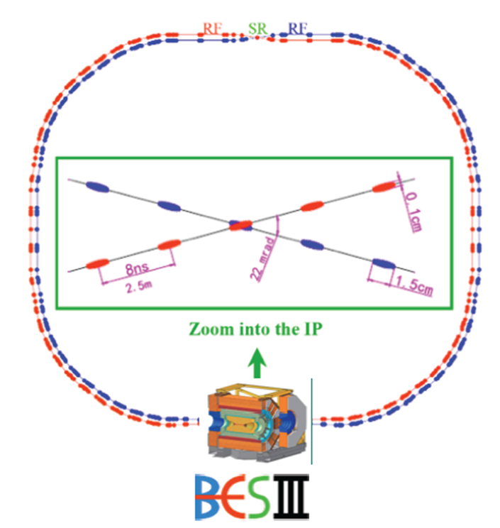
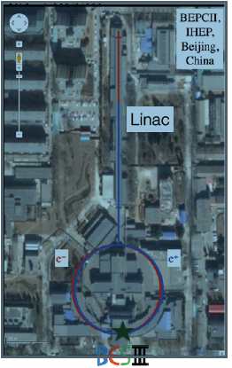
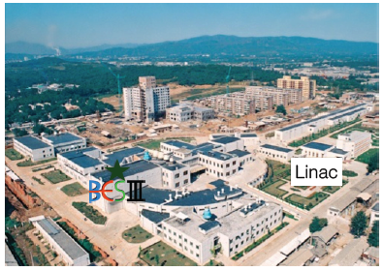
Beijing Electron Positron Collider‐II (BEPCII)
e+e- annihilation , unpolarized beams, symmetric collider,
beam energy: 1.0-2.3GeV (Q: ~2.0-4.6GeV)
Achieved luminosity: 0.7×10³³ cm^{‐2}s^{‐1}@3.770GeV

Slide 6
The BESIII Detector
NIM A614, 345 (2010)
Large acceptance: 93% *4π
Tracking
PID
PID
muon PID
Neutral showers reconstruction

Slide 7
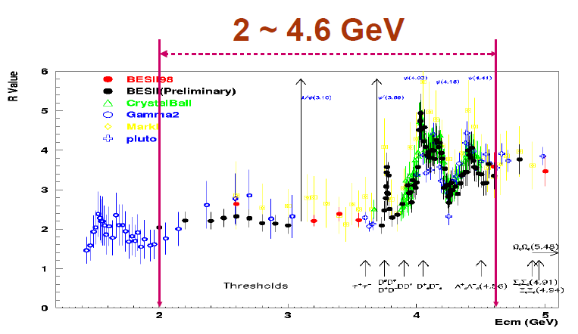
Energies of BEPCII
Data samples we (will) have
0.7fb⁻¹@ψ’
2.9fb⁻¹@ψ’’
0.3fp⁻¹@J/ψ
~65 pb ⁻¹@3.65
~5fb⁻¹@4.*GeV
2015/2016
0.36fp⁻¹@3.5GeV

Slide 8
Inclusive Hadron Production

Slide 9
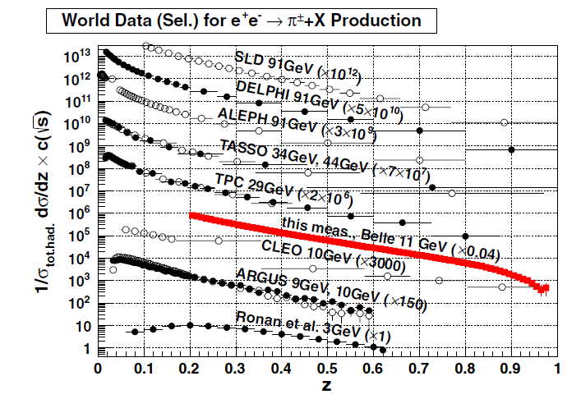
e+e- → π/K + X
π + X
K + X
Lack of low energy scale, high z
BESIII can contribute
PID problem at high z
High error rate of PID for the charged tracks with high momentum.

Slide 10
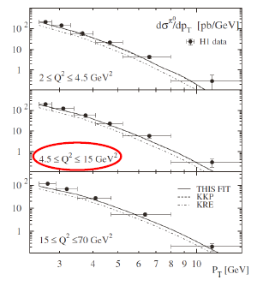
PID is not needed (crucial issue for charged π/K, especially at high z)
At BESIII, good performance of EMC on measuring neutral showers

Slide 11
(in progress)
Ks + X: clean process, low backgrounds level
Second vertex to suppress backgrounds

Slide 12
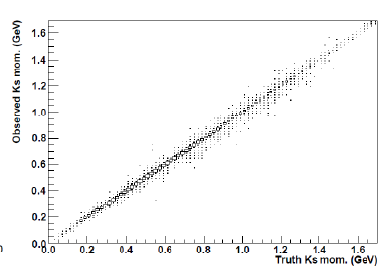
(in progress)
Rec. Ks mom.(GeV)
Truth Ks mom.(GeV)
Binning to get the cross section depending on the momentum of Ks
The resolution of Ks momentum is good
Preliminary data results are not shown

Slide 13
Collins Effect Measurement
We only focus on the di-pion currently

Slide 14
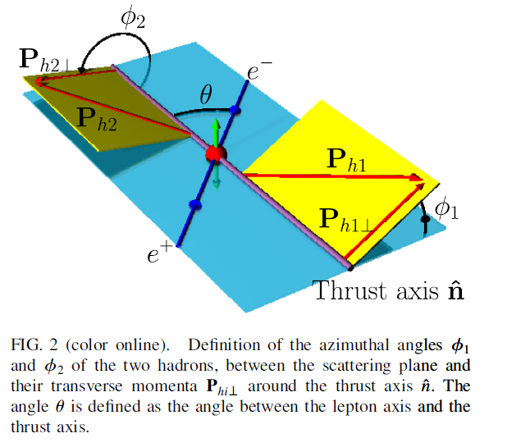
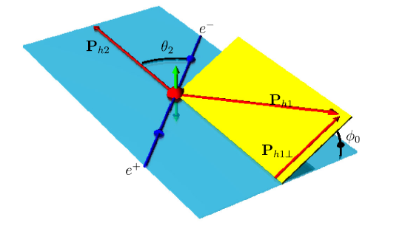
Double Collins Asymmetries(DCA)
PRD 78, 032011
The Thrust frame
The second hadron frame
√
The correlation of quark and anti-quark Collins Functions
By looking the two hadrons in opposite jets
Only the second method could be performed at BESIII

Slide 15
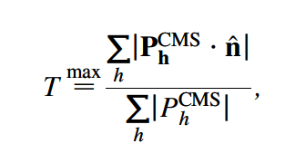
Event Shape
BEPCII energy
High energy scale
At Belle/BABAR, with tow-jets events
High Thrust value is useful to suppress backgrounds.
Thrust axis is used to separate the hadrons from opposite jets (h1 and h2)
At BESIII, different situation
low energy, low multiplicity, $q q ̅$ event shape is almost isotropic, not jetty!
mis-combination problem: $h1h^{′}1$ or $h2h^{′}2$ combination from same quark which are not of interest. Dilute the measured asymmetries.
require large Open Angle(OA) of π-pair to suppress mis-combination
choosing the leading hadrons
Mis.com. could be suppressed, but still be a problem

Slide 16
Event Selection
Charged tracks :
|V_{r}|<1.0cm, |V_{z}|<10.0cm
|cosθ|<0.93
nGood>=3
Further requirements:
N_{electron} ==0 to suppress Bhabha
The total visible energy E_{vis}>1.5GeV to suppress ττ
PID of π
de/dx, TOF1, TOF2
Prob(π)>0&&Prob(π)>Prob(K)
Nπ >= 2
open angle of the π-pair: OA>120$o$

Slide 17
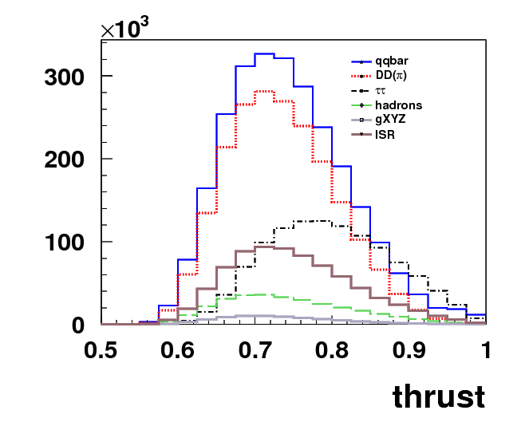
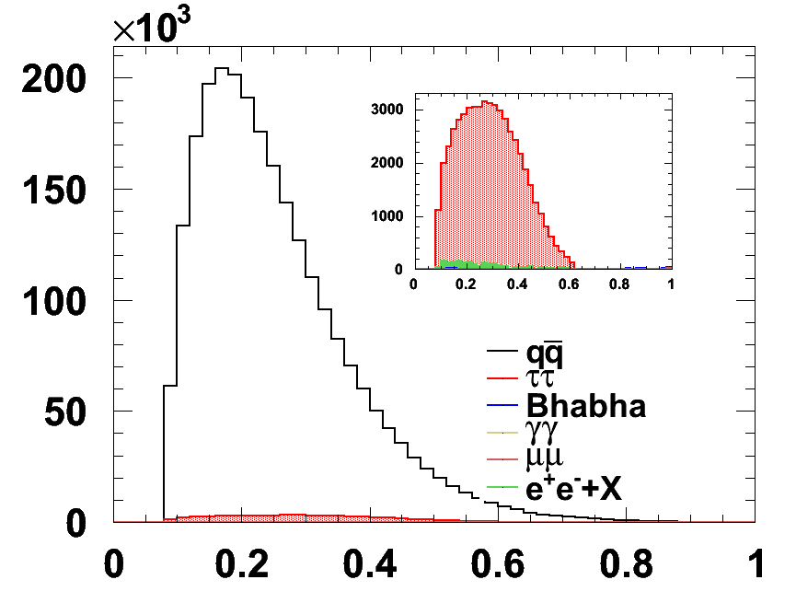
Possible Backgrounds
BESIII@3.65GeV
BESIII@4.2GeV
z
Thrust value is not a good cut to suppress backgrounds
Only data @3.65GeV is used currently

Slide 18
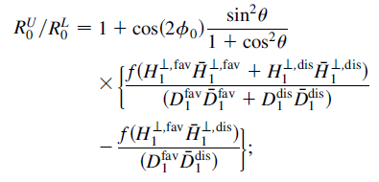
Double Ratio
Favored fragmentation process describes the fragmentation of a quark of flavor q into a hadron with a valence quark of the same flavor: i.e.: u→π+, d→π-
Disfavored for d→π⁺, u→π⁻
Unlike-sign pion pair = U:
π∓π±: (fav x fav)+(dis x dis)
Like-sign pion pair = L:
π±π±: (fav x dis)+(dis x fav)
Normalized Ratio R
Double Ratio(DR) ( R^{U}/R^{L} )to cancel detector effects and QCD radiative effects which are charged independently

Slide 19
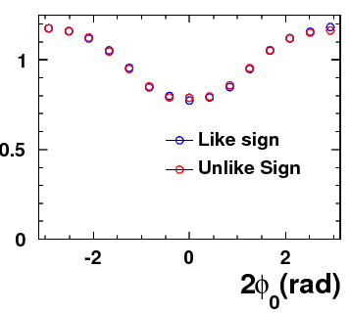
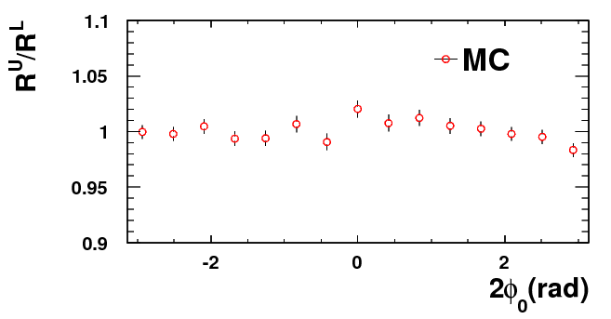
2φ₀ Distributions (MC)
Normalized Raw distribution:
Double Ratio:
uds MC

Slide 20
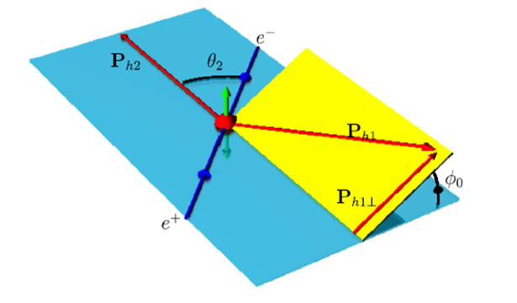
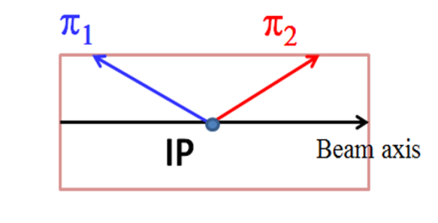
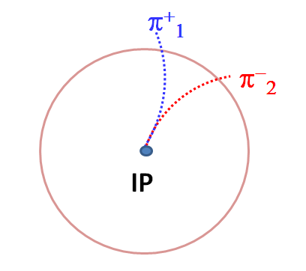
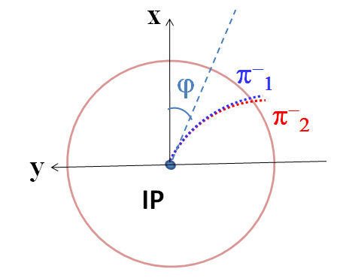
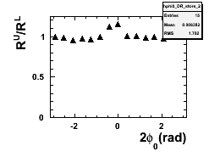
Detector Effects(1)
From MC, we confirmed two kinds of detector effects which can not be cancelled out in Double Ratio:
Case 1. when the azimuthal angle in the detector (ϕ) of two 𝝅 are very close, opposite-charged $π^{+}π^{−}$ have higher efficiencies than same-charged $π^{−}π^{−}$(or $π^{+}π^{+}$)
$$>$$
wire
①
②
Note that , φ₀ is calculated in C.M.S frame. ϕ is defined in lab. frame.

Slide 21
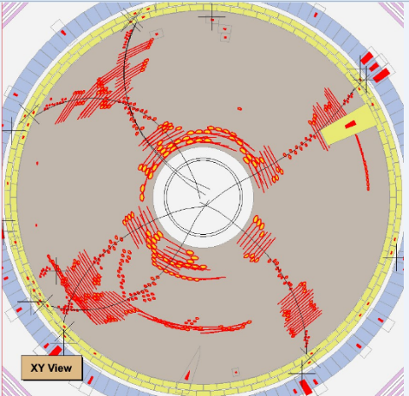
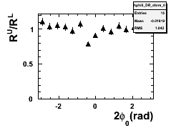
Detector Effects(2)
Case 2. Ghost tracks produce extra same-charged $π$pairs ($π^{−}π^{−}$or $π^{+}π^{+}$)
These two detectors effects:
contaminate the $2φ0$ distribution, especially in small open angle
require large open angle of the two π
these effects can be suppressed, but still there, assumed as systematic errors
Ghost tracks

Slide 22
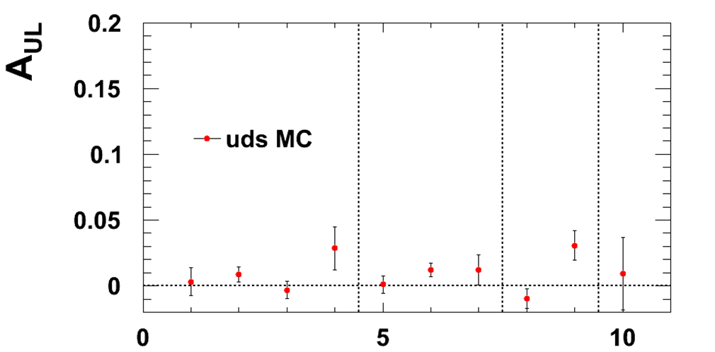
MC Validation
1
2
3
4
5
6
7
8
9
10
0.15-0.2
0.2-0.3
0.3-0.5
0.5-0.9
z₁
0.15-0.2
0.2-0.3
0.3-0.5
0.5-0.9
0.2-0.3
0.3-0.5
0.5-0.9
0.3-0.5
0.5-0.9
0.5-0.9
z₂
In most of bins, consistent with zero as expected

Slide 23
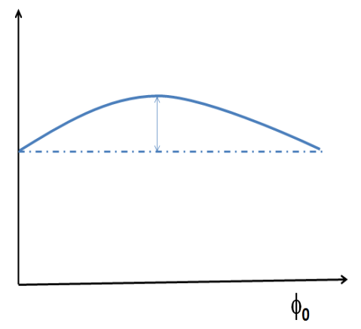
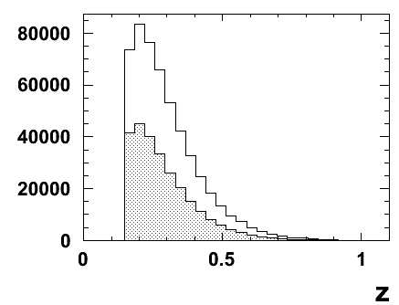
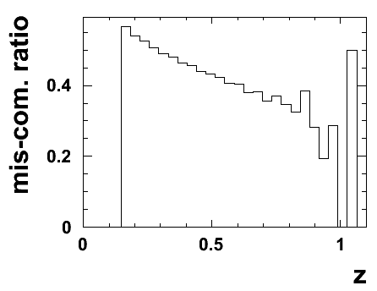
Estimation of Mis-combination Rate
The rate of the mis-combination(R_{mis.}) need to be known
N_{event}
This estimation relies on MC
We trace the final hadrons back to the initial parton in Pythia to find π-pair that come from the same quark .
Need more check and will be used to correct asymmetries measured in data
2
all
mis-com.

Slide 24
Summary and Outlook
BESIII data@[2.0-4.6]GeV can provide:
Data at low energy scale
Test energy evolution effect
What we are working on currently:
Ks + X cross section
Double Collins asymmetries in inclusive charged π production
Outlook
Spin 2014 Conference
the feasibility of extending this analysis to our large data sample @ 4.* GeV
~ 0.36fb⁻¹ off-resonance data, 2015/2016
Thanks!

Slide 25
Backup

Slide 26
Truth q-qbar axis
Truth q-qbar axis

Slide 27
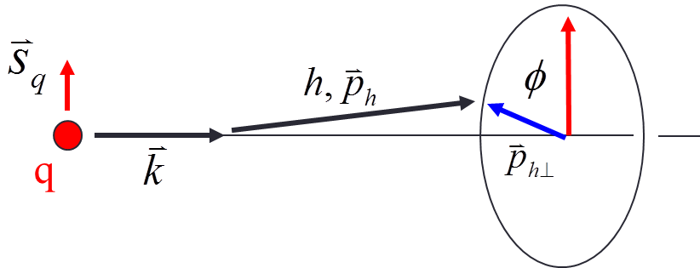
Collins Fragmentation Function
J. Collins, Nucl. Phys. B396, (1993) 161
Spin of quark correlates with hadron transverse momentum
translates into azimuthal anisotropy of final state hadrons
The possibilities for finding a hadron produced from a transversely polarized quark:
D₁: the unpolarized Fragmention Function
H: Collins Fragmentation Function
z: fractional energy of hadron
:transverse momentum of the hadron
Notes:
Fragmentation Functions (FFs) describe the probability for a parton to fragment into a hadron carrying a certain fraction z of the parton momentum

Slide 28
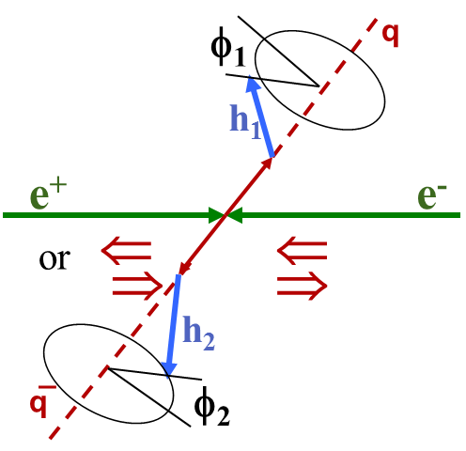
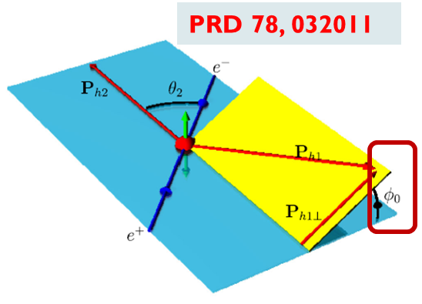
Collins Effect in e⁺e⁻ Annihilation
In e⁺e⁻ annihilation, γ* (spin-1) → spin-1/2 q and q̅
In a given event, the spin directions are unknown, but they must be parallel
Exploit this correlation by using hadrons in opposite jets
The correlation of quark and anti-quark Collins Functions give a product of cos(2φ₀) modulation
e⁺e⁻→qq̅→h₁h₂X (q=u, d, s) ==>
σ∝cos(2φ₀)H₁⊥(z₁) ⊗ H₂⊥(z₂),

Slide 29
Motivation

Slide 30
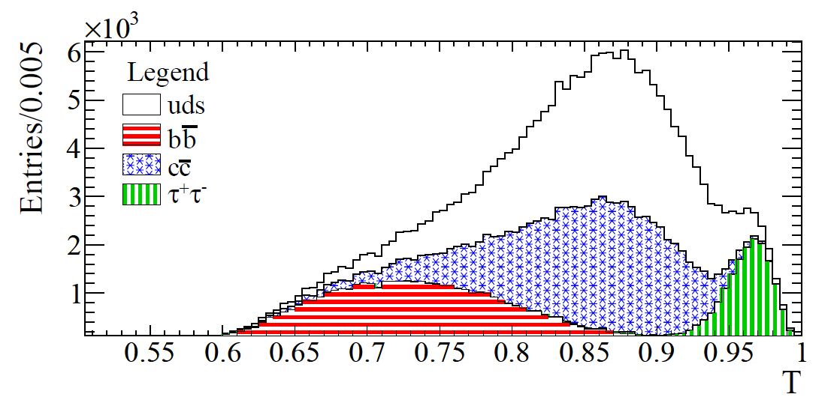
Possible Backgrounds
BESIII@4.2GeV
BABAR@10.6GeV
arXiv:1309.5278
Thrust value is used to suppress backgrounds at Belle/BaBar.

Slide 31
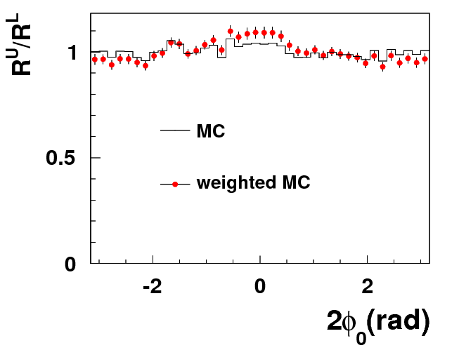
MC Validation
MC Sample:
MC@3.65GeV
event generator: Pythia
Event Selection
Good charged tracks: N_{charged}>=3
At least two π
weighted MC samples mimic azimuthal asymmetries of di-hadron
Input azimuthal asymmetries could be reproduced after reconstruction

Slide 32
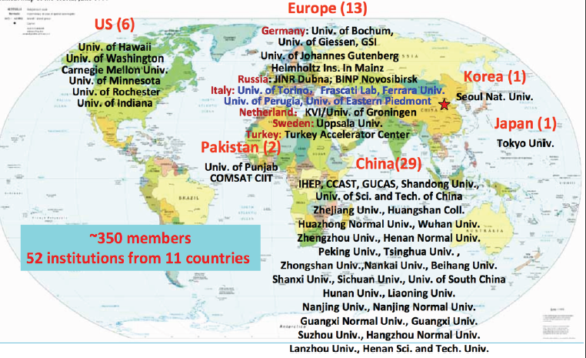
The collaboration

Slide 33
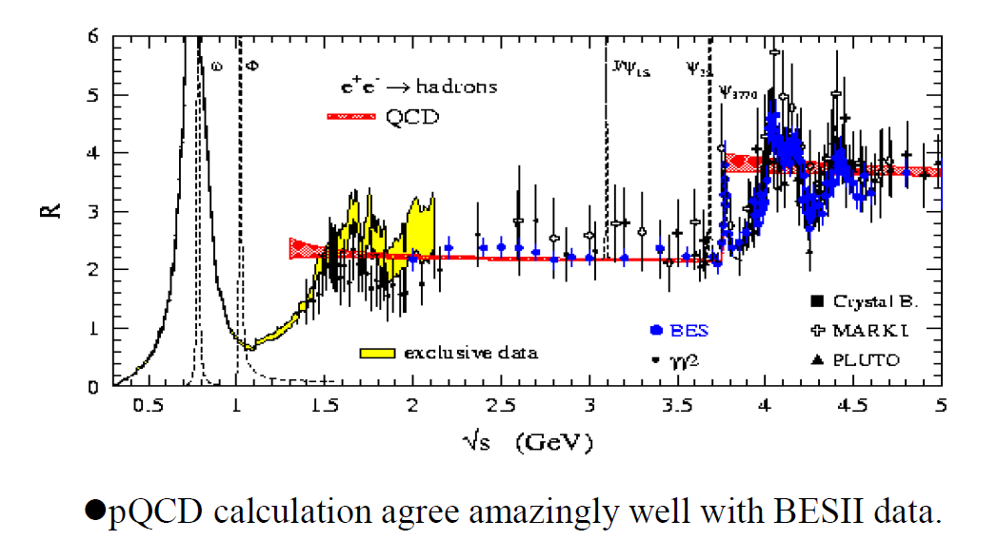
BESIII data samples
0.7fb⁻¹@ψ’
2.9fb⁻¹@ψ’’
0.3fp⁻¹@J/ψ
~65 pb ⁻¹@3.65
~5fb⁻¹@4.*GeV
25pb⁻¹@2.2-3.4

