Slide 1



ANTARES constraints to a Galactic component of the IceCube cosmic signal
Maurizio Spurio
Noto, SR, 1/10/2014

Slide 2
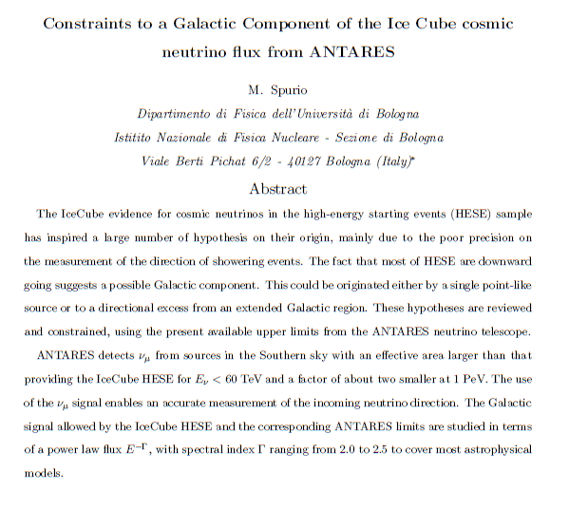
Details: see arXiv 1409.4552

Slide 3
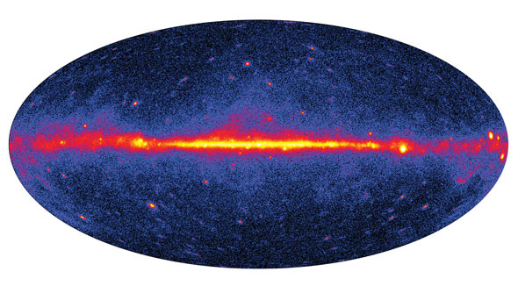
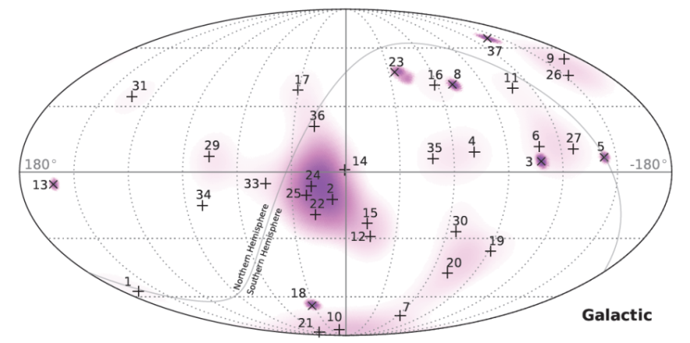
The High Energy Starting Events (HESE) ν sky
From IceCube
PRL113(2014)101101
Southern Hemisphere
Northern Hemisphere

Slide 4
Hypotheses on the HESE origin
(non-exhaustive list)
E. Waxman. The Beginning of Extra-Galactic Neutrino Astronomy. Physics 7 (2014) 88
F.W. Stecker. Phys. Rev. D 88 (2013) 047301;
P. Padovani and E. Resconi. arXiv:1406.0376
…
Extragalactic
Dark Matter
Unidentified
Galactic
A. Esmaili and P. D. Serpico, JCAP 1311, 054 (2013)
J. Zavala. arXiv:1404.2932
…
D. B. Fox, K. Kashiyama, P. Meszaros. ApJ, 774, 74;
….
J. Joshi, W. Winter, N. Gupta. MNRAS 439 (2014) 3414
Y. Bai, R. Lu, and J. Salvado, (2013); arXiv:1311.5864
L. A. Anchordoqui et al., Phys.Rev. D89 (2014) 083003;
M. Kachelriess, S. Ostapchenko. arXiv:1405.3797
M. Ahlers, K. Murase. Phys. Rev. D 90, (2014) 023010;
S. Razzaque. Phys. Rev. D 88 (2013) 081302;
A. D. Supanitsky. Phys. Rev. D 89 (2014) 023501;
A.Neronov, D.V.Semikoz, C.Tchernin. PRD89(2014) 103002
….

Slide 5
A galactic component in HESE
A correlation with the Galactic plane/center is quoted statistically non-significant in the IceCube paper;
The measured signal from the Northern hemisphere =3.6 evts (~purely extragalactic) is ~ 50% expected;
Assuming: 3.6 from North + symmetric extragalactic flux →expected 6.2 HESE events of extragalactic origin from South
Galactic contribution= 13.7 - 6.2 ≅ 7.5 events
This holds for any source energy spectrum E^{−Γ}.
E_{dep}>60 TeV

Slide 6
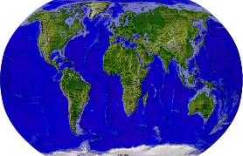
IceCube ANTARES
Recent Results from the IceCube Neutrino Observatory
Speaker:
ANTARES and Baikal: recent results from underwater neutrino telescopes
Speaker: Fabian Schüssler, this morning

Slide 7
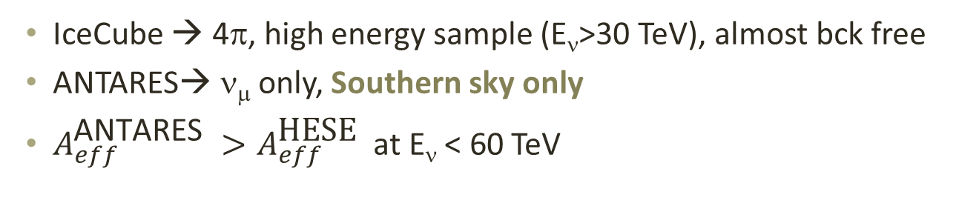
Comparison between IC-HESE and ANTARES effective areas A_{eff}
IceCube → 4π, high energy sample (E_{ν}>30 TeV), almost bck free
ANTARES→ ν_{μ} only, Southern sky only
$A_{eff}^{\text{ANTARES} }>A_{eff}^{\text{HESE} }$ at E_{ν} < 60 TeV

Slide 8

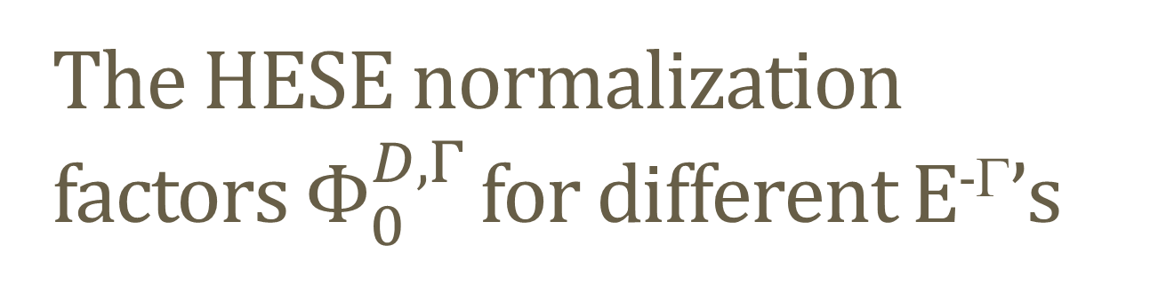
The HESE normalization factors $Φ_{0}^{D,Γ}$ for different E^{-Γ}’s
The normalization factors for a generic E^{−Γ} spectrum can be derived from the IC effective areas $A_{eff}^{ν}$
observed events
livetime
Diffuse flux
Effective Areas
Detector response, computed numerically

Slide 9

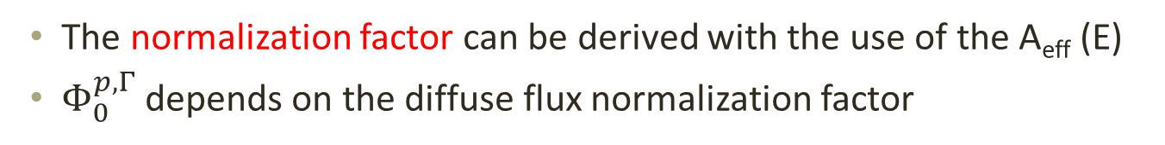
I) A point-like Galactic source
n_{p} = from a point-like source
N_{IC} =total IC-HESE sample
The Galactic component can have a generic E^{−Γ} spectrum:
The normalization factor can be derived with the use of the A_{eff} (E)
$Φ_{0}^{p,Γ}$depends on the diffuse flux normalization factor
Same formula as in:

Slide 10
ANTARES has upper bounds
For different energy spectra E^{−Γ}: (similar method using the A_{eff})

Slide 11

Results
The ANTARES 90% C.L. upper limit excludes that a single point-like source produces n_{p}>5 HESE, assuming Γ=2.0.
A single point-like source yielding n_{p}>2 is excluded for Γ=2.3
A clusters made of n_{p}≥ 2 is excluded for Γ> 2.3.

Slide 12
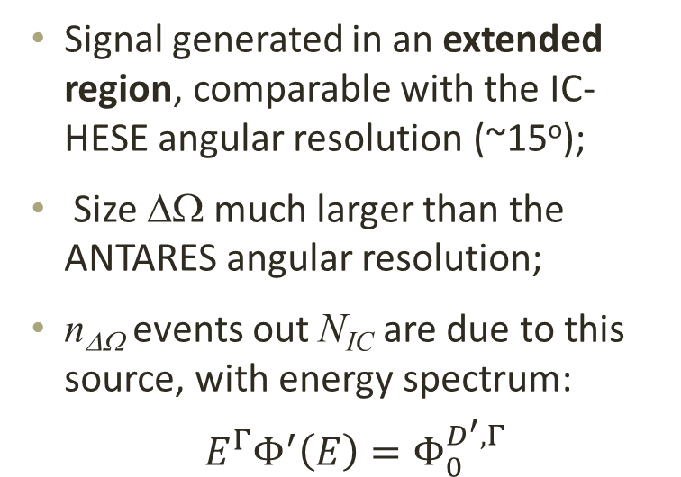
II) Enhanced diffuse Galactic flux
Signal generated in an extended region, comparable with the IC-HESE angular resolution (~15º);
Size ΔΩ much larger than the ANTARES angular resolution;
n_{ΔΩ} events out N_{IC} are due to this source, with energy spectrum:
$${ E}^{Γ}Φ^{′}\left(E\right)=Φ_{0}^{D^{′},Γ}$$
ΔΩ

Slide 13
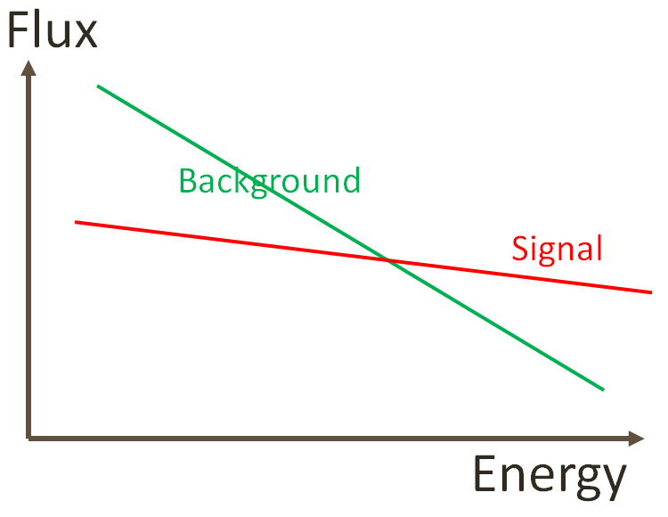
The ANTARES sensitivity
Problem: for an extended source, large background of atmospheric neutrinos → bck for ANTARES∼200 events/(y· sr);
Strategy: suppress the atmospheric ν_{μ} using the muon estimated energy
Compare background in ON/OFF regions
Method already used by ANTARES in the search for ν from the Fermi Bubbles → bck reduced to ∼5 events/(y· sr);
Sensitivity for E⁻² (using 3 y data)
Analysis from IC hot spot in progress

Slide 14

Fermi Bubbles

Slide 15
Predictions for an enhanced flux vs. (n_{ΔΩ}, ΔΩ) and Γ
ΔΩ
8°
ΔΩ
20°
Model yielding n_{ΔΩ}>2 events within ΔΩ = 0.06 sr (= 8º) can be confirmed or excluded by ANTARES for any E^{-Γ} spectrum with an analysis similar to that already done on Fermi Bubbles

Slide 16
Conclusions
HESE counting rate different from South/North hemispheres;
The excess from the South sky can be interpreted as an over-fluctuation or due to the presence of a galactic component;
This galactic component (> 60 TeV) estimated in ~ 2.5 HESE/yr;
ANTARES has an effective area for ν_{μ} comparable with IC-HESE and angular resolution of about 0.4°;
Astrophysical models predict different energy spectra E^{−Γ};
The present ANTARES bounds refer to:
  A point-like source. Published ANTARES upper limits constrain the hypothesis of a single galactic source, in particular for energy spectra E^{−Γ} with Γ>2.2
  Extended source (based on extrapolated sensitivities) Models yielding >2 events within a radius of 10º can be confirmed or excluded by ANTARES for any value of the spectral index Γ;
A key-role can be played also by KM3NeT- Phase 1

Slide 17
Spares

Slide 18
HESE effective area for:
Downgoing
Upgoing
Effective area(cm²)
Energy (GeV)
Effective area(cm²)
Energy (GeV)

Slide 19
The HESE signal
From IceCube
PRL113(2014)101101
It is possible, using the effective area, to obtain the normalization factor Φ^{D,Γ} for any spectral index Γ;
This extend the possible range of astrophysical models for the signal
In particular, we are interested on a possible Galactic component

Slide 20
The HESE normalization factors for different Γ’s (2)
By imposing the same N_{IC} from the previous formula:

Slide 21
I) A point-like Galactic source
Thus:

Slide 22
ANTARES sensitivities on an enhanced cosmic ν flux
I assume an ANTARES analysis similar to that on FB;
Sensitivity extrapolated to a region with different size and assuming a generic spectral index Γ;
Effective area, before the cut on the energy estimator E_{obs}, equal to A_{eff} used for the point-like source;
1
3.5
11.6
36.3
116
343
  Optimization on the cut on E_{obs} has an effect on the number of accepted background events (reduces the effective area);
  This effect increases the ratios for softer Γ w.r.t. E⁻² by a multiplicative factor
  No (first-order) effects for changing the size Δω;
    Signal: events/Δω ; events/Δω

