Slide 1
PADME project at DAΦNE BTF
Mauro Raggi, Venelin Kozhuharov
Riunione commissione nazionale I
La Biodola, May 20th 2014

Slide 2
Outline
The dark sector basic model
Motivation for dark photon searches
Positron Annihilation into Dark Matter Experiment PADME proposal
  DAΦNE Beam Test Facility (BTF)
  Beam conditions and the Target
  The dipole magnet
  The decay chamber
  The electromagnetic calorimeter
  The spectrometer
MC simulation
Analysis technique for annihilation production
  Signal selection criteria
  Positron flux measurement
  Limit evaluation
Experimental technique for bremsstrahlung production
  Decay in e+e- pair in thin target experiment
  The Dump experiment
Conclusion and prospects

Slide 3
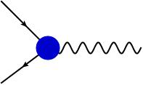
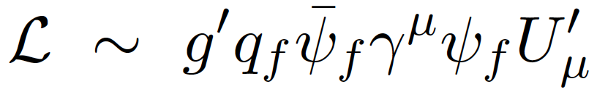


The simplest dark sector model
The simplest hidden sector model just introduces one extra U(1) gauge symmetry and a corresponding gauge boson: the “dark photon" or U boson.
  Two type of interactions with SM particles should be considered
As in QED, this will generate interactions of the type:
  Not all the SM particles need to be charged under this new symmetry
  In the most general case q_{f} is different in between leptons and quarks and can even be 0 for quarks. (P. Fayet, Phys. Lett. B 675, 267 (2009).)
The coupling constant and the charges can be generated effectively through the kinetic mixing between the QED and the new U(1) gauge bosons
  In this case q_{f} is just proportional to electric charge and it is equal for both quarks and leptons.
e⁻
U
e⁺
γ
U

Slide 4
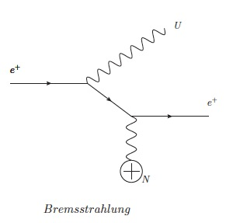
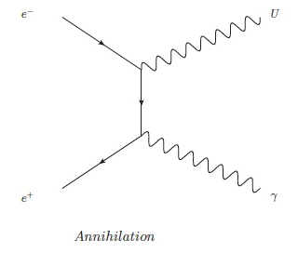
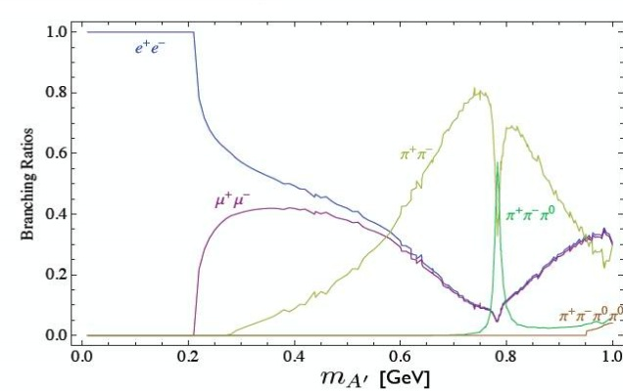
U boson production and decays
U boson can be produced in e⁺ collision on target by:
  Bremsstrahlung: e⁺A →e⁺AU
  Annihilation : e⁺e⁻→ γU
If no dark matter candidate lighter than the U boson exist:
  U→e⁺e⁻,μ⁺μ⁻,π⁺π⁻ the so called “Visible” decays
  For M_{U}<210 MeV U only decay to e⁺e⁻ BR(e+e-)=1
If any dark matter χ with 2M_{χ}<M_{U} exist
  U will dominantly decay into pure dark
  matter and BR(l+l-) becomes small suppressed by ε²
  U→χχ ~ 1 so called “Invisible” decays”

Slide 5
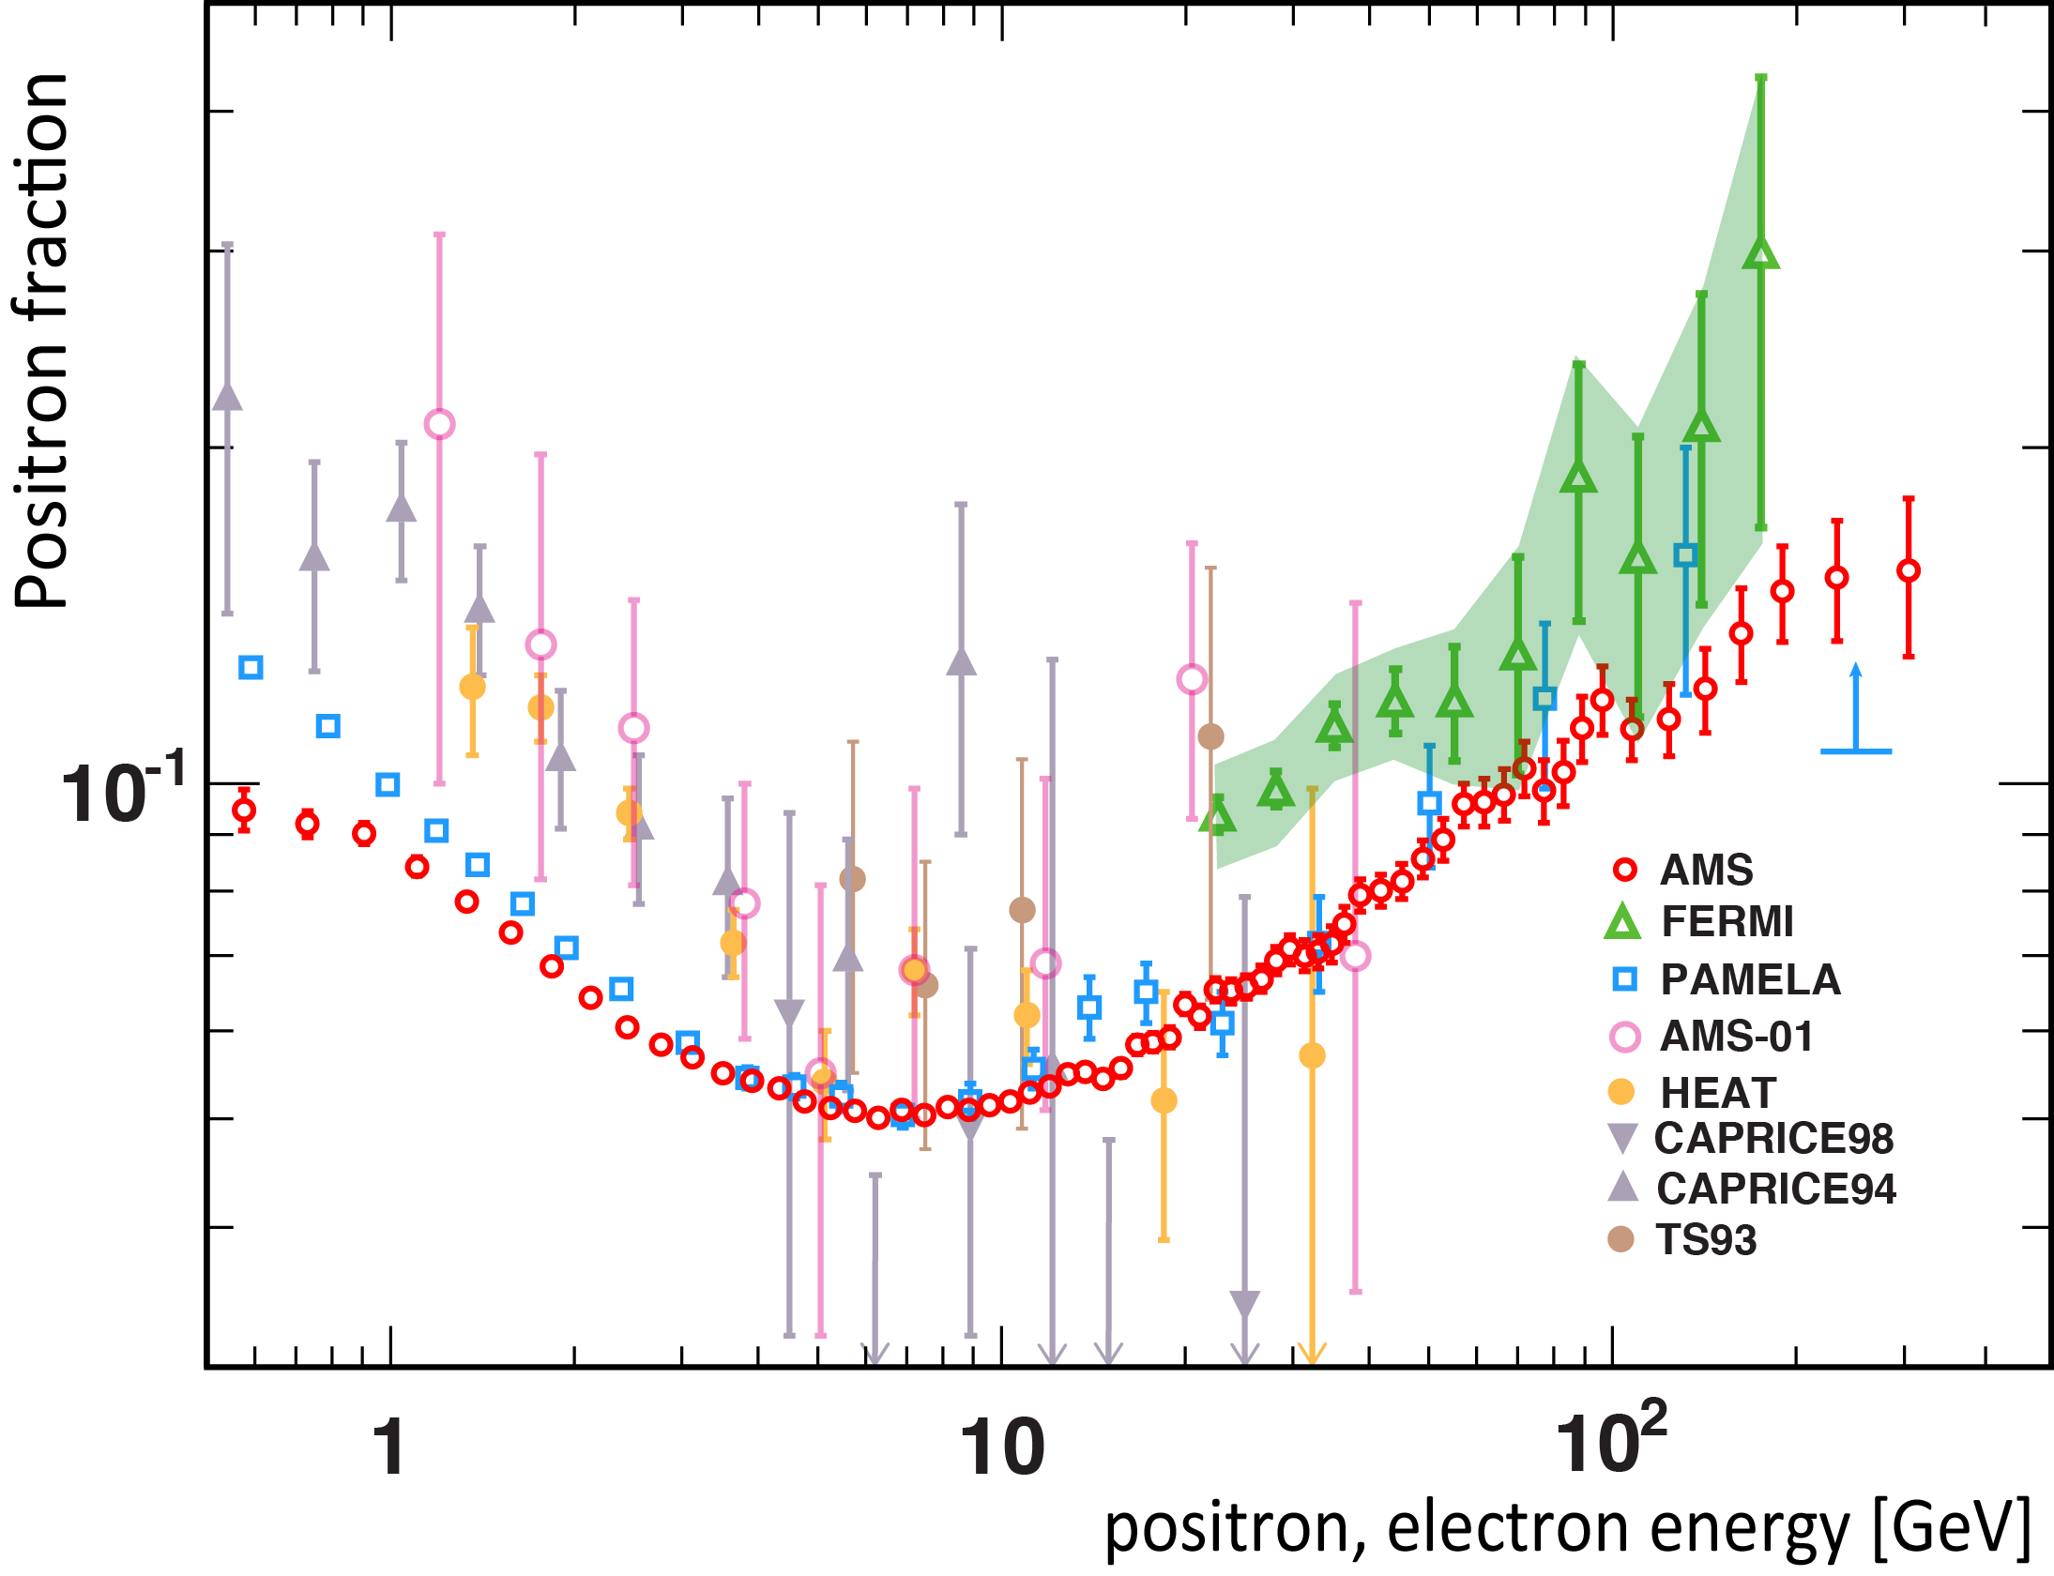
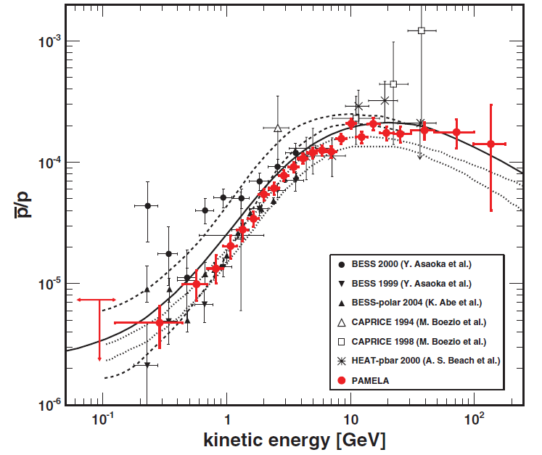
Particle astrophysics PAMELA AMS
Positron excess: PAMELA, FERMI, AMS02
No significant excess in antiprotons
  Consistent with pure secondary production
Leptofilic dark matter annihilation?

Slide 6

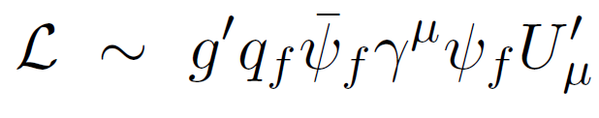
Hints for dark matter annihilation?
χ
U
е⁺
е⁻
е⁻
g'
U, A', ....
U
е⁺
е⁺
χ
е⁻
If Dark Matter is the explanation to the positron excess, then the mediator should be light ( < 2*M_{proton})
Coupling constant to DM could be arbitrary (even О(1))
The Lagrangian term can arise through
  Fermions being charged (mili) under this new gauge symmetry (q_{f}  0 for some flavours)
  Kinetic mixing between ordinary photon and DM one
  Using simply an effective description:

Slide 7
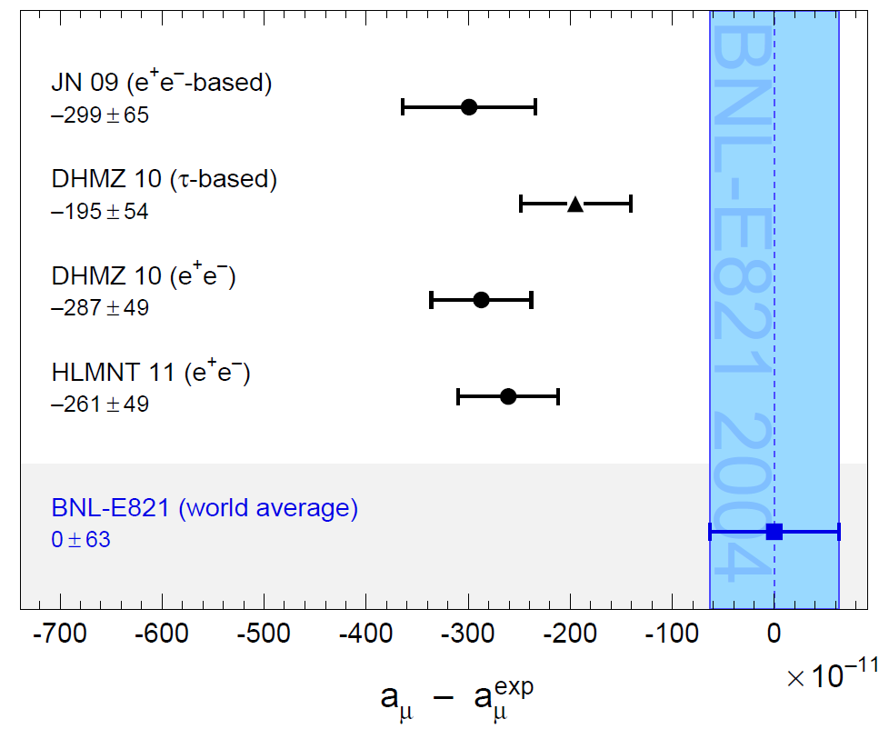
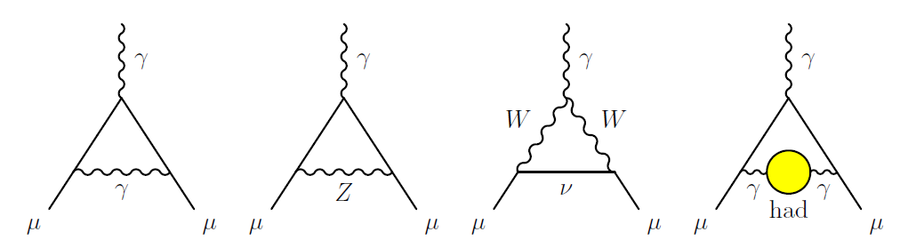
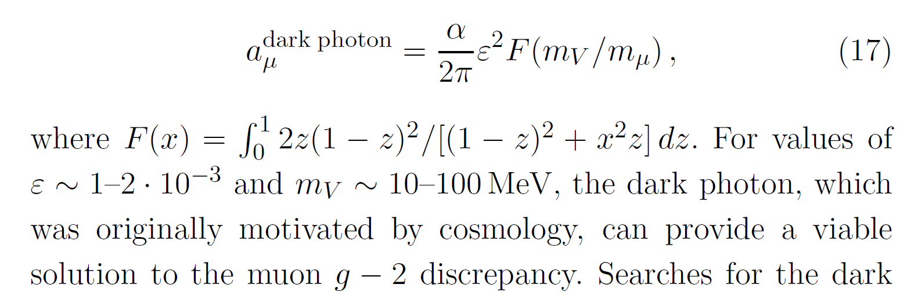
Muon g-2 SM discrepancy
About 3σ discrepancy between theory and experiment (3.6σ, if taking into account only e⁺e⁻hadrons)
Contribution to g-2 from dark photon

Slide 8
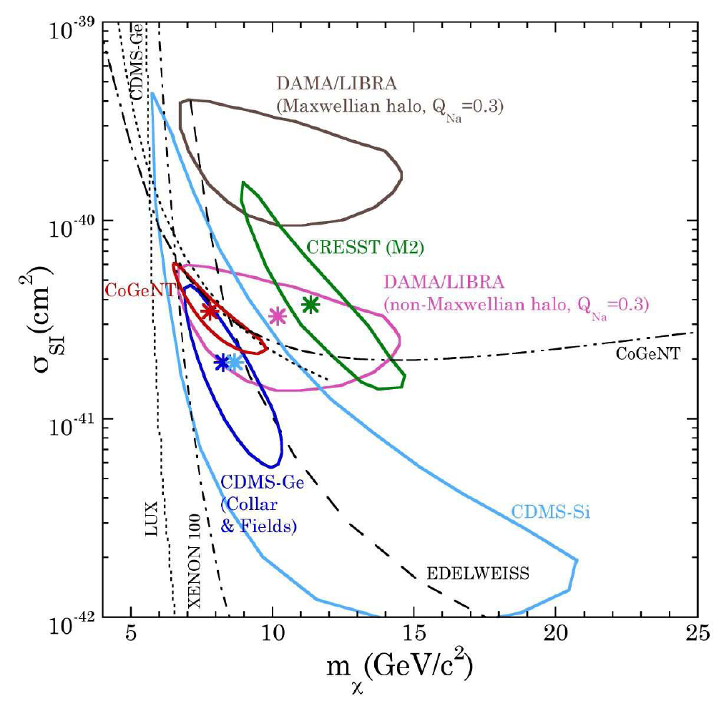
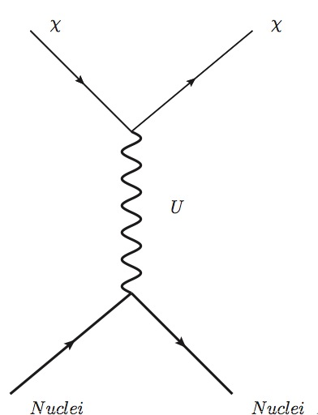
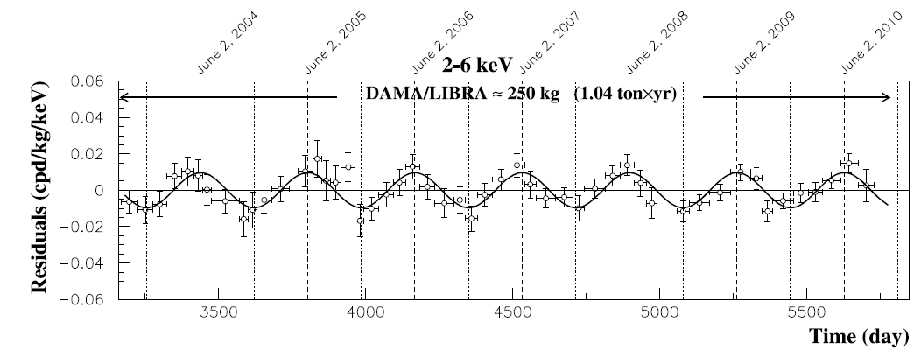
The DAMA-Libra effect
arXiv:1401.3295v1
Nuclear recoil by the exchange of a dark photon
Independent of χ mass value
radiopure NaI (Tl)

Slide 9
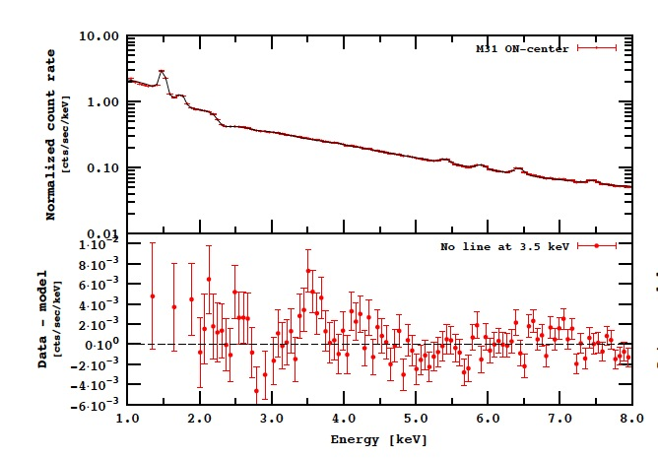
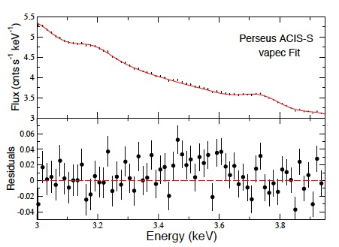
Observation of 3.5KeV X-ray line
Recently a 3.55 KeV X-ray line (~3σ) has been reported in the stacks analysis of 73 galaxy clusters from the XMM-Newton telescope arXiv:1402.2301v1
A similar analysis finds an evidence at the 4.4σ level for a 3.52 KeV line from the analysis of the X-ray spectrum of the Andromeda galaxy (M31) and the Perseus Cluster arXiv:1402.4119
arXiv:1402.2301v1
arXiv:1402.4119

Slide 10
U(1) symmetry explanation
Many models have been developed to explain such a line based on sterile neutrinos
A possible explanation of such a line in term of the U(1) gauge theory with an Higgs mechanism is proposed in arXiv:1404.2220v1
  A single new scalar dark matter field φ of mass 7.1 KeV is introduced
  φ couples to SM Higgs through U boson
  Due to the very small mass φ can only decay into γγ or νν creating the Xray line at 3.5 KeV
  After spontaneous symmetry breaking of the U(1) symmetry the U boson becomes massive
  Due to constraints coming from the relic abundance a mass interval has been identified by authors for the U boson mass
    7KeV<M_{U}<10MeV

Slide 11
Dark sector with dark Higgs
Model assumes the existence of an elementary dark Higgs h’ boson, which spontaneously breaks the U(1) symmetry.
PRD 79, 115008 (2009)
U boson can be produced together with a dark Higgs h’ through a Higgs-strahlung e⁺e⁻→Uh’
  Cross section =20fb x (α/α_{D})(ε²/10⁻⁴)(10GeV)²/s
  For light h’ and U (M_{U,h’}<2Mμ) final state with 3(e+e- pair) are predicted
  Background events with 6 leptons are very rare at this low energies
  Due to U,h’being very narrow resonances strong kinematical constraints are available on lepton pair masses
Experimental search by BaBar and KLOE
for U masses above 200 MeV

Slide 12
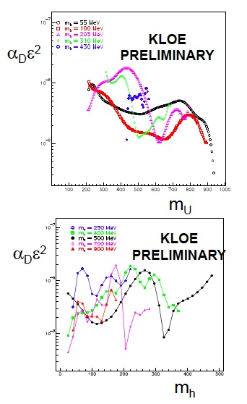
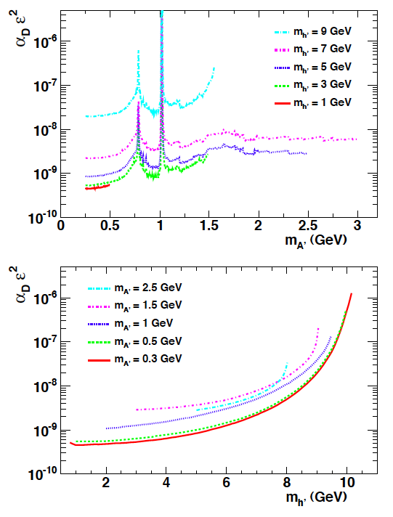
Experimental status U(1) + dark higgs
BaBar Phys. Rev. Lett. 108, 211801 (2012)
Production mechanism being bremsstrahlung allows PADME to reach >100MeV U masses
No data available below 200 MeV in M_{U}
PADME can provide sensitivity in unexplored parameter region.

Slide 13
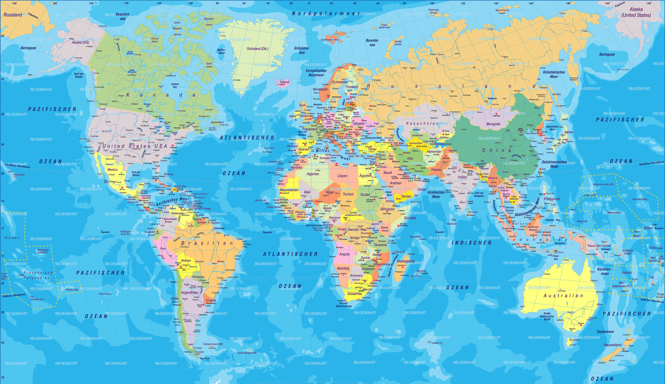






U boson searches at 1GeV scale
MAMI & MESA: A1
COSY: WASA
GSI: HADES
VEPP3
PEPII:
BaBar
SuperKEKB
BelleII
JLAB:
APEX
DarkLight
HPS
CERN SPS
spsc-p348
SHIP
ATLAS
CMS
DAΦNE
KLOE2, PADME
Status: Already publishing results, planned , proposals

Slide 14
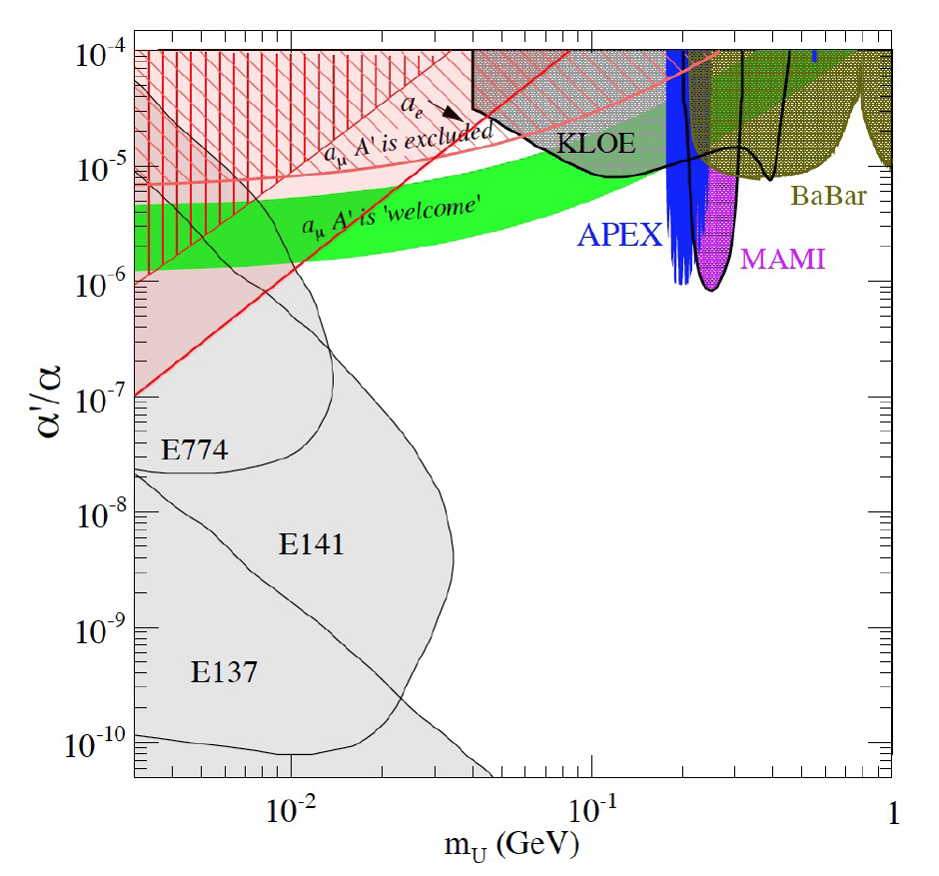
Dark photon searches status
Favored parameters values explaining g-2 (green band)
  the U-boson, it should be sufficiently light 10-100 MeV
Status of dark photon searches
  Beam dump experiments (grey)
    U-strahlung production
    Every observed event is a signal
  Fixed target (APEX A1@MAMI)
    U-strahlung production
    peaks in the e⁺e⁻ invariant mass spectrum
  Meson decays (KLOE BaBar)
    Peaks in M(e+e-) or M(μ+μ−)
Inderect exclusion from g_{e}-2 gμ-2
  Recent tight limit in red filled area
Include only published results coming form electron facilities

Slide 15
The PADME approach
At present all experimental results rely on at least one of the following assumptions:
  U decays to e⁺e⁻ (visible decay assumption BR(U→e⁺e⁻ = 1)
  U couples with the same strength to all fermions (ε_{q}= ε_{l}) (kinetic mixing)
In the most general scenario (PADME)
  U can decay to dark sector particles lighter than the U
    BR(U→e⁺e⁻ <<1)
    Dump and meson decay experiment only limit ε²BR(U→e⁺e⁻ <<1)
  U can couple to quark with a coupling constant smaller ε_{l} or even 0
    Production at hadronic machines suppressed or forbidden
    Production in meson decays suppressed or forbidden
PADME aims to detect U boson produced in e⁺e⁻ annihilation and decaying into invisible
  No assumption on the U decays products and coupling to quarks
  Only minimal assumption: U bosons couples to leptons

Slide 16
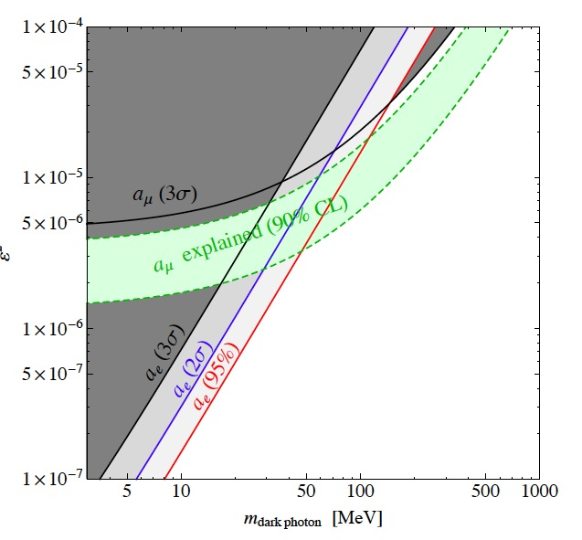
Why dark photon invisible decays?
In this scenario U boson keeps all the necessary characteristics to explain positron excess, g-2 and 3.5 KeV line
The invisible search technique remove any assumption except coupling to leptons
U boson increase its capability of having escaped detection so far
W. J. Marciano et al.
arXiv:1402.3620v2
At present there is no experimental limit for the Uinvisible decay
  Just a never published ArXiv 0808.0017 by Babar ‘08 with very limited sensitivity on ε² (Υ_{3S}γU assumes coupling to quarks!)
  Indirect limit from K⁺→π⁺νν (assumes coupling to quarks!) arXiv:1309.5084v1

Slide 17
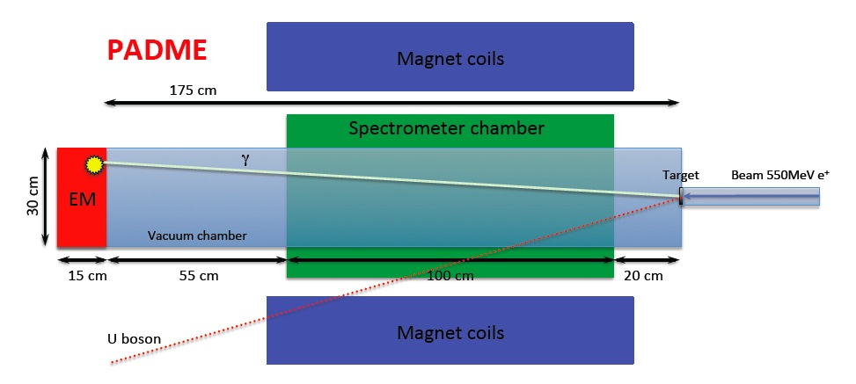
The PADME experiment proposal
1.75 m

Slide 18
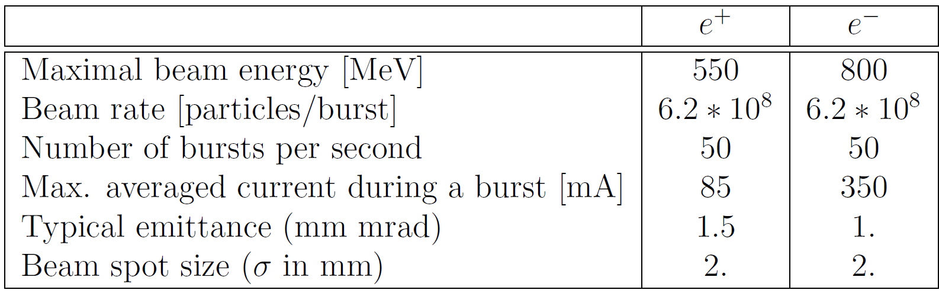
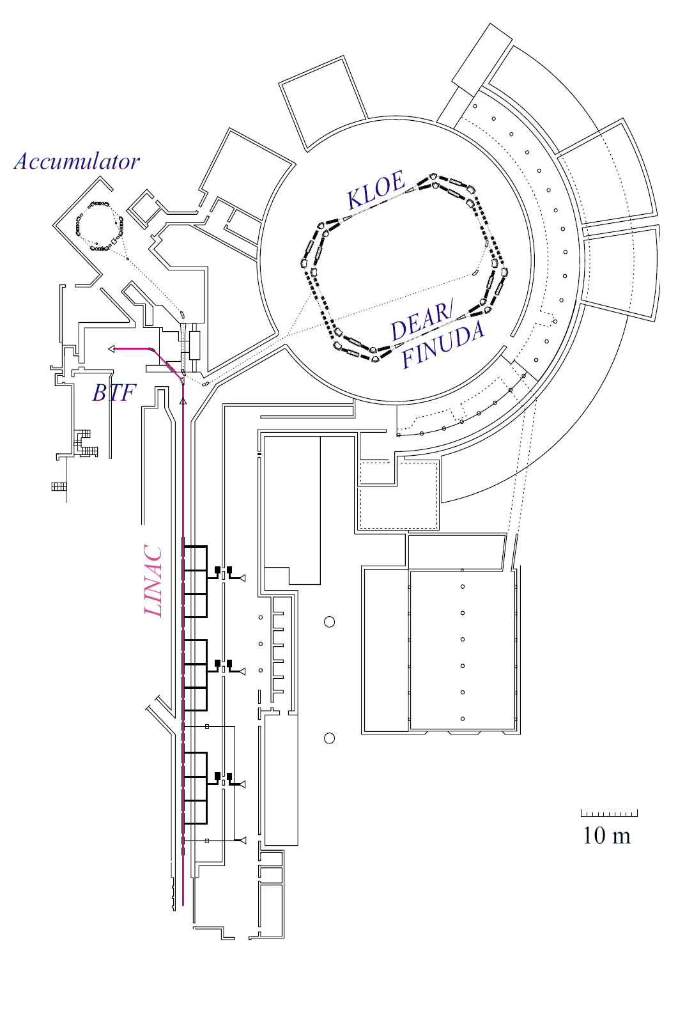
DAΦNE Beam Test Facility (BTF)
NIM A 515 (2003) 524–542
Variable beam energy
  From minimum of ~100MeV
  Maximum to 800MeV electron only
Possibility for single particle beam to 10⁸
  However we need statistics...
The accessible M_{U} region is limited by beam energy
  Around 22 MeV for 550 MeV e⁺ beam

Slide 19
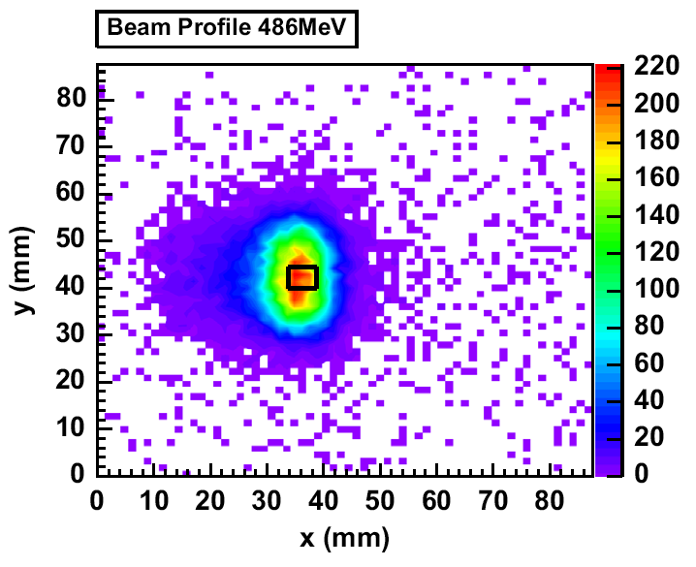
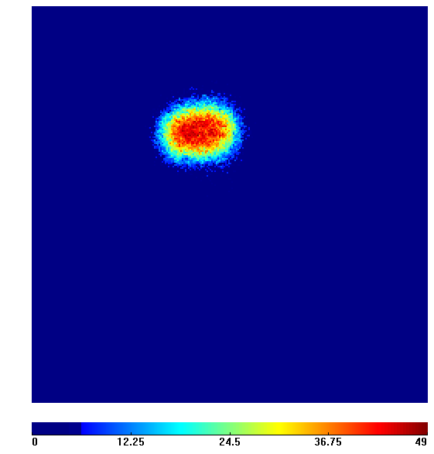
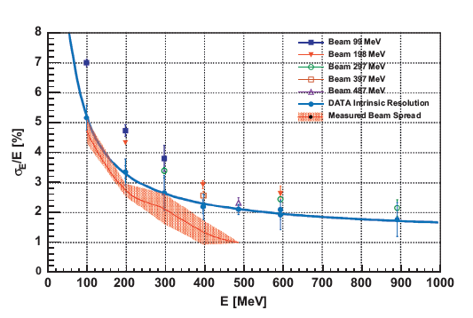
Beam conditions
In the present study we assume that the BTF will be able to deliver
  1E4 positrons of energy 550 MeV per bunch in 50 bunch/s over 1 year
  Total e⁺ on target being: 50*1E4*3.15E7 = 1.6E13 (we use 1E13)
  Beam energy spread ~1% (BTF can do much better)
  RMS of beam position 2mm and emittance 1mm*mrad
  Bunch duration 10 ns (can already go up to 40ns)
Medipix detectors
Beam E spread
FWHM 2.4 × 1.8 mm
  [NIM A 718 (2013) 107–109]
Single bunch beam spot
Measurement of the beam spread
Integrated beam spot

Slide 20
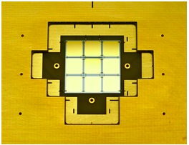
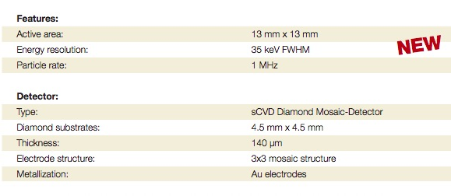
PADME active target
Diamond 50μm thick target
  Most probably strip detector
Active area 2x2cm²
Position resolution ~2mm in both X and Y
Sensitive from few particle to 10⁹ particle
Real time beam imaging
Time resolution below 1ns
Readout with QDC.
R&D can start from CIVIDEC diamond mosaic detector
CIVIDEC
Diamond Mosaic Detector

Slide 21
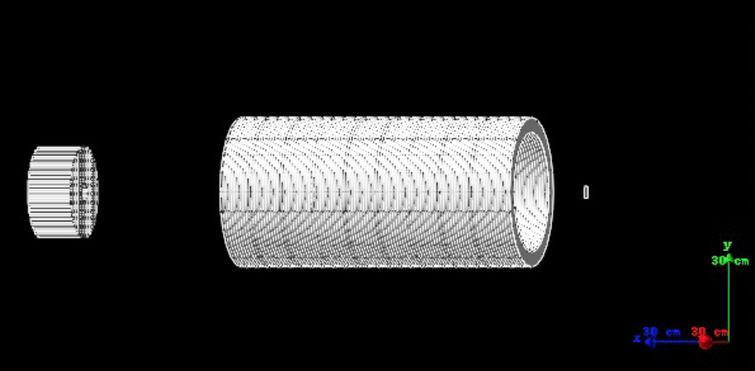
PADME spectrometer & Magnet
1m
0.2 m
Conventional magnet with B=0.6 Tesla
Generic cylindrical chamber filled with gas
  Inner radius 20 cm outer radius 25 cm length 100 cm
  5 cylindrical layers of 1cm each
Expected to measure track crossing position with 300μm resolution
Used in the experiment to veto positron and to reconstruct mass of lepton pairs.

Slide 22
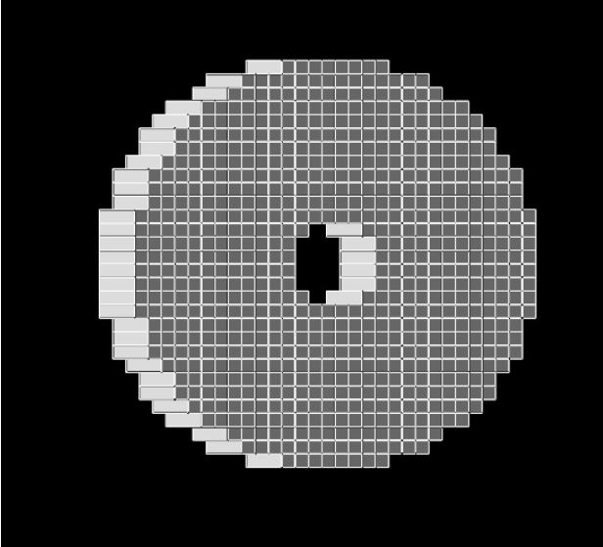
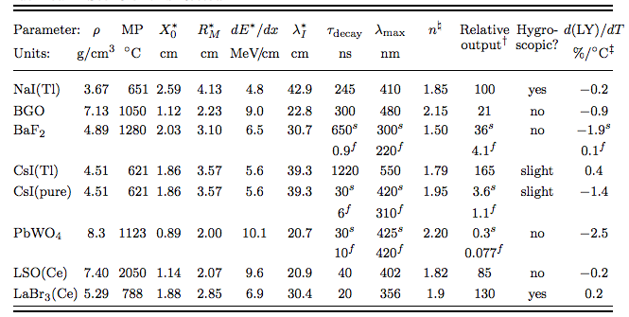
The electromagnetic calorimeter
30 cm
Cylindrical shape: radius 15 cm, depth of 15-20 cm
  Inner hole 4 cm radius
  Active volume 9840 cm³ total of 656 crystals 1x1x15-20 cm³
Material LSO(Ce): high LY, high ρ, small X₀ and R_{M}, short τ_{decay}
Expected performance:
  σ(E)/E =1.1%/√E ⨁ 0.4%/E ⨁1.2% superB calorimeter test at BTF [NIM A 718 (2013) 107–109]
  σ(θ) = 3 mm/1.75 m < 2 mrad
  Angular acceptance 1.5-5 degrees

Slide 23
Geant4 MC status
GEANT4 simulation using low energy electromagnetic library
Realistic beam line simulation
  Energy spread 1%
  Beam spot size 2mm rms
  10⁴ particle per bunch with their own energy and position
  Vacuum pressure equal to P=0.1mbar
Uniform field 0.6 tesla dipole magnet (field only)
Fully simulated EM LYSO calorimeter
  Starting from energy deposit a cluster reconstruction algorithm applied
  Produces reconstructed angle and cluster energy
Dummy gas spectrometer
  Get the momentum of track inside the volume no reconstruction.
Still missing:
  Dumping of primary beam, passive material in the magnet, decay chamber passive material, beam pipe material.

Slide 24
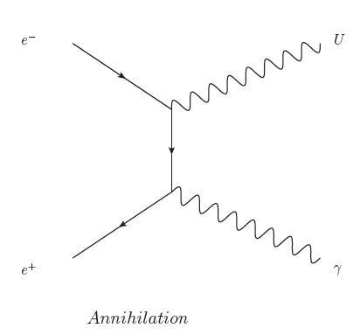
Search in annihilation production

Slide 25
Experimental technique
Spectrometer
ECal
γ
550 MeV e⁺
Target
P⁴_{beam}
U boson
Mmiss²
Search for the process: e⁺e⁻ → γU
550 MeV positron beam on a 50 μm diamond target
Measure in the ECal the Eγ and θγ angle wrt to beam direction
Compute the Mmiss² = (P⁴_{e−} + P⁴_{beam} − P⁴_{γ})²
  P⁴_{e−} =(0,0,0,m_{e}) and P⁴_{beam} =(0,0,550,sqrt(550² + m_{e}²))

Slide 26
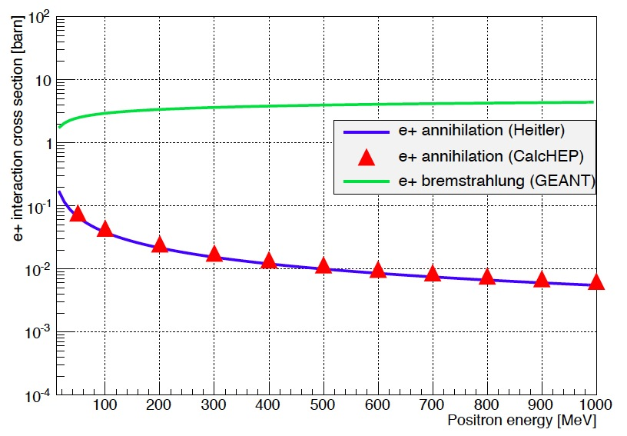
Main background sources
γ
E_{γ} >1 MeV
γ
Bremsstrahlung is the main BG σ_{brem}~400*σ_{γγ}
  Dominant at high Mmiss² due to inefficient veto
  Rejected by minimum gamma energy cut.
Annihilation is important at low m_{γγ}
  Rejected by number of cluster=1
  Rejected by Mmiss² condition
Pile up background negligible

Slide 27
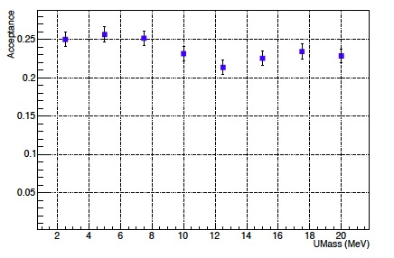
Signal selection
Selection cuts (all decay modes)
Only one cluster in EM calo
  Rejects γγ final state
5 cm < R_{Cl} < 13 cm
  Improve shower containment
Cluster energy within: E_{min}(M_{U}) < E_{Cl} < 400 MeV
  Removes low energy bremsstrahlung photons and pile up clusters
Positron veto in the spectrometer
  E_{e+}< 500 MeV then (E_{beam} - E_{e+} - E_{cl}) > 50 MeV
  Reject BG from bremsstrahlung identifying primary positrons
Missing mass the region: Mmiss²_{U}±σMmiss²_{U}

Slide 28
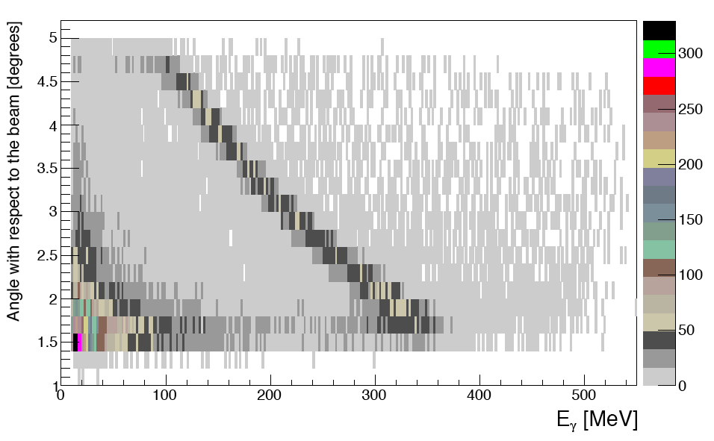
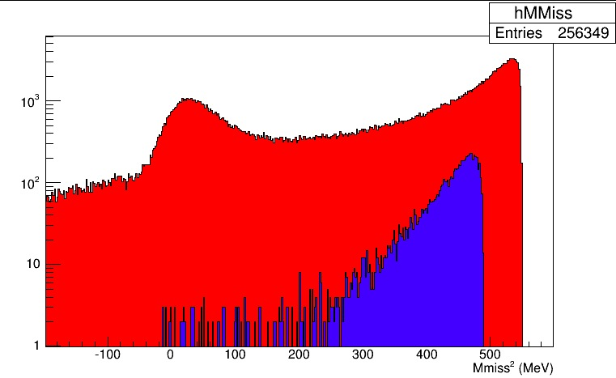
Background estimates
Data Mmiss²
e⁺e⁻→ γγ
e⁺N→e⁺Nγ
e⁺e⁻→ γγ
Pile up
e⁺N→e⁺Nγ
Even with 10⁴ e⁺ per bunch kinematics is preserved
Pile up contribution is important but rejected by the maximum cluster energy cut and MMiss².
Veto inefficiency at high missing mass (E(e⁺)≃ E(e⁺)_{beam})
  New Veto detector introduced to reject residual BG
  New sensitivity estimate ongoing

Slide 29
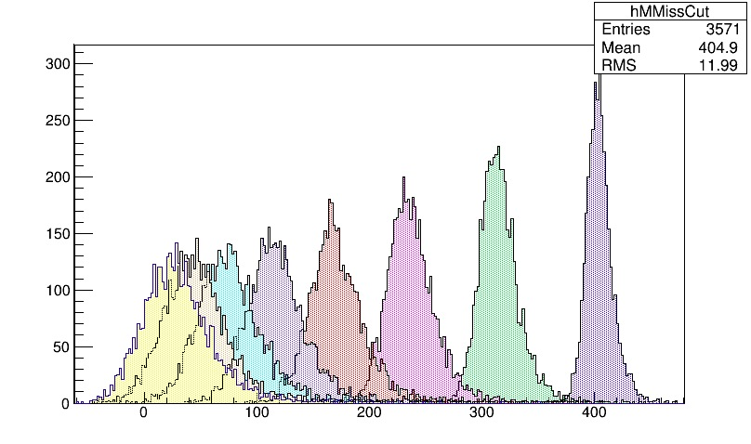
Background estimates II
U mass | N BG events (1E11)
2.5 MeV | 23
5 MeV | 20
7.5 MeV | 19
10 MeV | 37
12.5 MeV | 48
15 MeV | 41
17.5 MeV | 138
20. MeV | 844
U boson Mmiss²
Cut the missing mass of data in slices of 1σ and count the number of events inside.
High background into 20MeV U boson mass region compensated by enhanced cross section due to resonant production

Slide 30
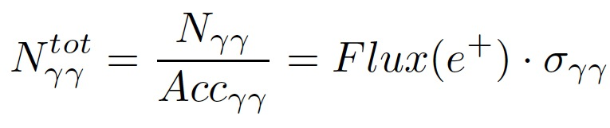
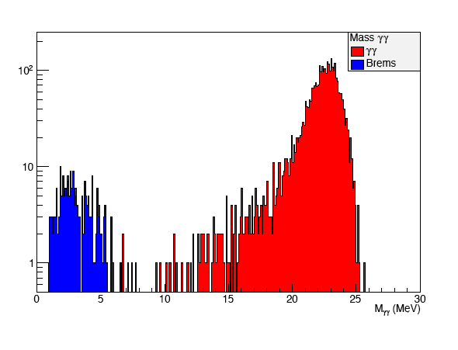
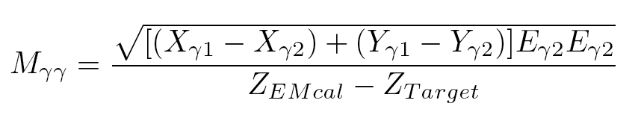
The γγ normalization selection
Number of calorimeter clusters = 2
Cluster energy: 100MeV<E_{cl}<400 MeV
Cluster radial position 5 cm <R_{Cl}< 13 cm
γγ invariant mass 20 MeV < M_{γγ} < 26 MeV
Acc_{γγ} = 7%
Contamination from bremsstrahlung < 1‰

Slide 31
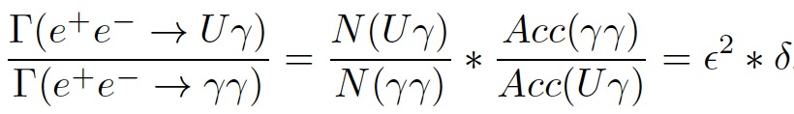
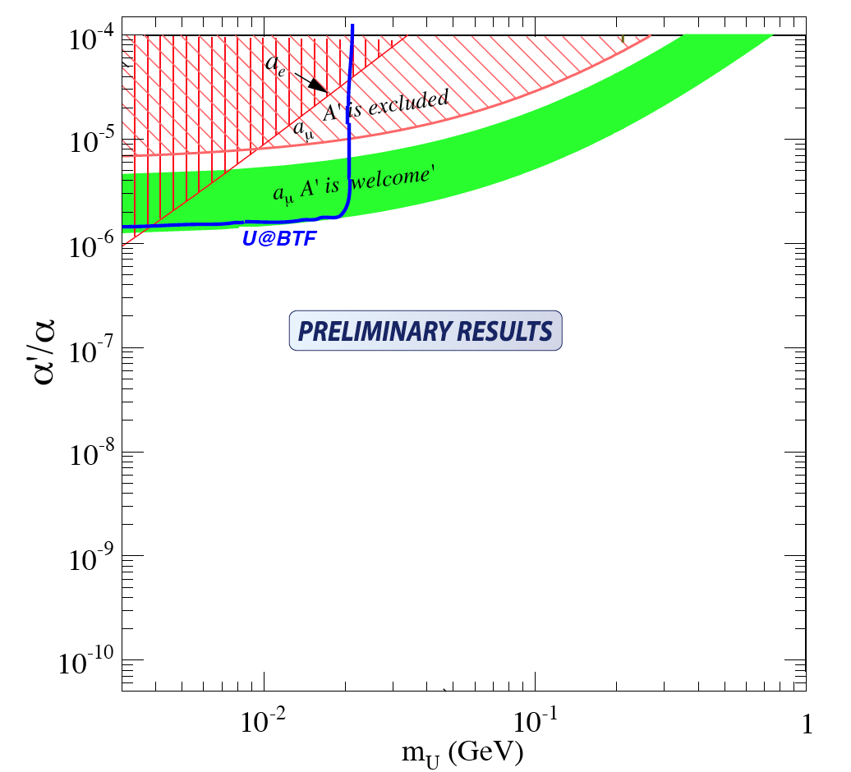
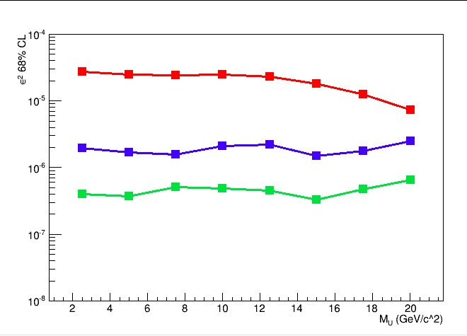
Sensitivity estimate
Based on 1E11 fully GEANT4 simulated e⁺ on target events
Number of BG events is extrapolated to 1E13
  Using N(Uγ)=σ(N_{BG})
  δ enhancement factor δ(M_{U}) = σ(U)/σ(γγ) with ε=1
ArXiv1403.3041
No e+ veto
U→χχ or U→e⁺e⁻
U→e⁺e⁻

Slide 32
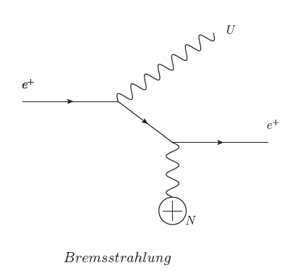
Search in bremsstrahlung production

Slide 33
Visible analysis strategy
Spectrometer
ECal
e⁺
e⁺ Beam
550 MeV e⁺
Target
P⁴_{beam}
e⁻
Search for the process: e⁺N → Ne⁺U →Ne⁺e⁺e⁻
550 MeV positron beam on a 50 μm diamond target
Measure in the spectrometer the P⁴_{e−} P⁴_{e+}
Compute the M_{U}² = (P⁴_{e−} + P⁴_{e+})²

Slide 34
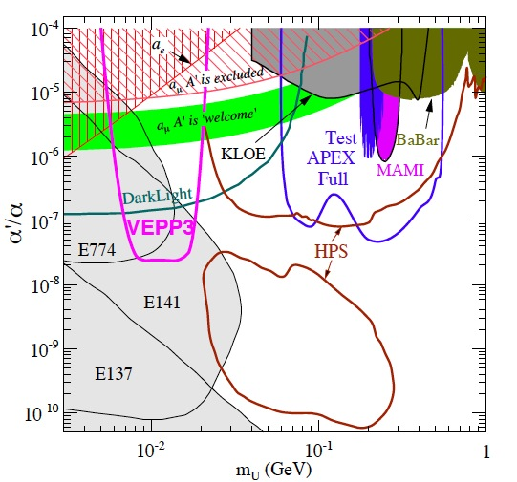
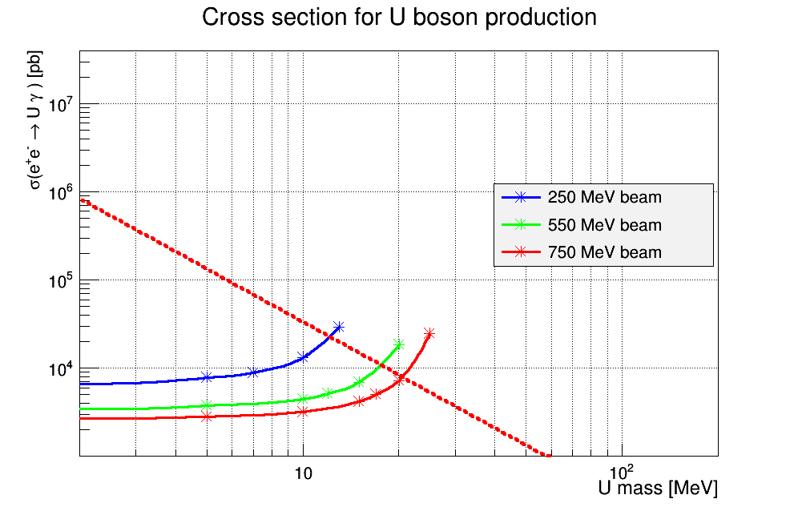
Indication on visible decay sensitivity
with ε=1・10⁻³
??PADME??
Ratio of bremsstrahlung wrt to annihilation at 1MeV ~ 400
Scaling low of the U-strahlung is 1/M_{U}²
Final state is more constrained by invariant mass of the ee pair
Naively a limit for ε²<10⁻⁵ is expected up to 100 MeV

Slide 35
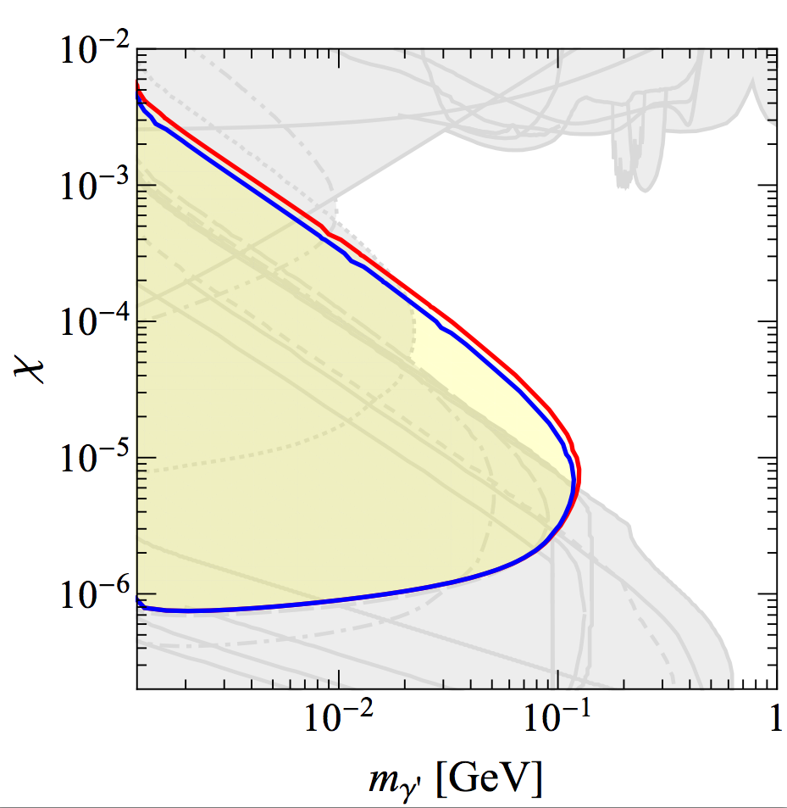
Visible decay: dump experiment
Same detectors of the previous phase
  Change the target with 5-7.5 cm W one
  Build a W collimator
  Remove the EM calorimeter
By Sarah Andreas
1E16 750 MeV e-
50 cm
W target
5cm
Magnet
W collimator
Vacuum pipe
Spectrometer
Beam
Hole 10 cm
1 m
1 m
Magnet
Early study for a beam dump experiment (Sarah Andreas)
  1E7 electrons of energy 750 MeV per bunch in 50 bunch/s over 1 year
  Total e⁻ on target being: 50*1E7*3.15E7 = 1.6E16 (we use 1E16)
  Study based on 0 events observed after the dump. (not easy to achieve)
  Much better sensitivity can be achieved using 10¹⁰ e⁻/bunch (total 1E19)

Slide 36
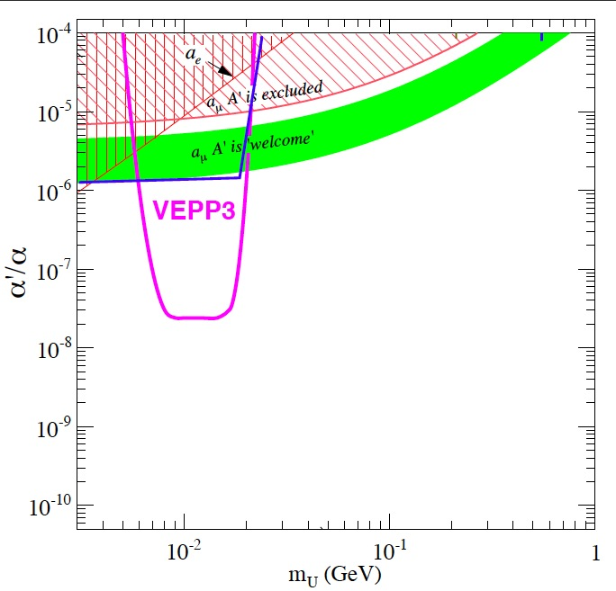
Competitors
Decays to lepton pairs
Decays to invisible
PADME
??PAMDE??
??PADME DUMP??
Expected results for PADME are shown for annihilation production only
  Accessible regions in the decays to lepton pairs are shown
Many competitors in e⁺e⁻ decay scenario, APEX, HPS, MAMI A1
Only VEPP3 proposal in the invisible searches (exclusion is a naïve estimate)

Slide 37
Possible BTF upgrades
Energy upgrades up to 1 GeV electrons
  Proposal to reach >800MeV energy for positrons (see V. Buonomo BTF user workshop)
Longer Duty Cycle
  Standard BTF duty cycle = 50*10 ns = 5x10⁻⁷ s
  Already obtained upgrade 50*40ns= 20x10⁻⁷ s (Thanks to BTF team)
  Any increase of duty cycle increase linearly experiment statistics
Collimation system
  Assure better beam definition for positrons beam
Maximum current in BTF hall
  Limited by radio protection to 6.2x10⁸ per bunch for long term operation
  Can reach >3x10¹⁰ particle per bunch after proper screening
See recent BTF user workshop for details at:
https://agenda.infn.it/conferenceOtherViews.py?view=standard&confId=7359

Slide 38
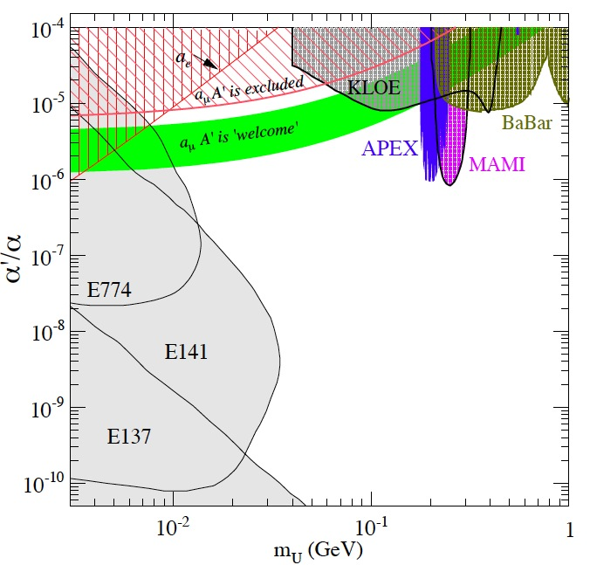

Improvement in case of BTF upgrades
Decays to lepton pairs
Decays to invisible
Energy ~√E
??PAMDE??
Energy
Duty cycle
e⁺ 750 MeV
e⁺ 1 GeV
Energy
Duty cycle
Duty cycle
??PADME DUMP??
Energy
Duty cycle
The PADME experiments profits of every upgrade of the BTF beam
  Energy gives access to higher masses both in visible and invisible decays
  Duty cycle gives access to lower ε²
  In case of Bremsstrahlung production duty cycle helps also in the mass ranges

Slide 39
The PADME path so far
9/2013: Idea born during phipsi conference in Rome
25/02/2014: LNF seminar “U boson searches at BTF”
  https://agenda.infn.it/conferenceDisplay.py?confId=7604
12/03/2014: First sensitivity assessment with full G4 montecarlo
  Includes only invisible decay!
  Paper submitted to ArXiv: http://arxiv.org/abs/arXiv:1403.3041
Contact with LNF scientific committee chair G. Rolandi
  Full presentation foresee at next LNF Scientific Committee
21/03/2014: talk at what’s next DM WG
  https://agenda.infn.it/conferenceTimeTable.py?confId=7748#20140321
25/03/2014 ERC starting grant proposal by V. Kozhuharov
  2M euro requested for a 5 year project (short list results in July 2014)
7/05/2014: First BTF user Workshop
  https://agenda.infn.it/contributionDisplay.py?contribId=13&sessionId=2&confId=7359

Slide 40
Possible project development
2014 MC studies and financial support procurement
  ERC project submitted (P.I. V. Kozhuharov)
  Background studies at BTF for MC validation?
  Installation of radio protection screening (up to 10¹⁰ part/bunch)
2015-summer 2016 construction and commissioning
  Construction of calorimeter + active target
  Construction and commissioning of the spectrometer + magnet
  Short run to study beam background 1 month 10⁴ e⁺/bunch
  Summer 2016 Main run: 550 MeV 10⁴ e⁺/bunch
  Simultaneous measurement in the visible and invisible modes
2017 upgrade of the BTF to 1GeV electrons
2017-2018 Dump experiment: 1 GeV e⁻ at 10¹⁰ e⁻/bunch

Slide 41
Compatibility with DAΦNE operation
The PADME project is compatible with any activity at the DAΦNE ring limitation to the experiment being:
  Fixed positron beam energy to 510 MeV (instead of 550 MeV)
  10 ns bunch duration
  Efficiency of data taking limited to 50% due to time devoted to injection
  of electrons into the DAΦNE ring
The PADME project can be even compatible with usage of the BTF as test facility
  The PADME target has a probability interaction 5x10⁻⁶ (beam untouched)
  If beam is splitted if there is enough space in the BTF beam can be reused
  see talks at (BTF user workshop)
  Users intensity lower 10³10⁴

Slide 42
Why we are here?
Inform the INFN community
Scientific review of the project
Form a “proto team” to better assess the physics reach and start working on the detectors
Dedicated beam time at BTF in 2015 (order of 1 month)
Who we are (up to now)
  Raggi LNF, Kozhuharov LNF, Valente RM1, Dosselli LNF (ERC team)
  Interest from: F. Bossi LNF ,L. Foggetta LNF , Buonomo LNF

Slide 43

What next

Slide 44
Conclusions
An experiment running at BTF sensitive to both U→invisible and U→e⁺e⁻ decays was proposed
Sensitivity study for U boson produced into annihilation process e⁺e⁻ → γU was presented
  The detection through missing mass is independent of the U decay mode and never performed so far
Exclusion limit in ε² down to 1-2・10⁻⁶ can be achieved in invisible decays with the present BTF beam parameters in the region M_{U} 2-20 MeV
Possible accessible regions for a bremsstrahlung produced U→e⁺e⁻ were identified to reach 100MeV
  Detailed study of the sensitivity in this channel is planned
  Sensitivity for different dark sector models to be understood
ArXiv 1403.3041: PADME sensitivity to invisible decays with annihilation production

Slide 45

Calorimeter cluster reconstruction
E (MeV)
Seed defined as cell with maximum energy and E_{seed}>10MeV
  A cluster includes all the cell with center distance <4.6 cm and energy >0.1 MeV
  All the cell included are removed from seed search
Seed search is iterated on remaining cells.
Cluster returns reconstructed E_{Cl}, θ_{Cl} and Mmiss²_{Cl}

Slide 46


Indirect limits
Phys.Rev.Lett.106:080801,2011
Phys.Rev.D80:095002,2009
2σ limit from new α,
Phys Rev D 86, 095029 (2012)
|a_{e}^{th} – a_{e}^{exp}| = (1.06 ± 0.82) × 10⁻¹²
α⁻¹ = 137 .035 999 037 (91)
However this is based on a single measurement with drastically improved precision

Slide 47
MC calorimeter performance
Mmiss²(MeV)
Missing mass resolution in agreement with toy MC using
  σ(E)/E =1.1%/√E ⨁ 0.4%/E ⨁1.2% [NIM A 718 (2013) 107–109]
  Differences are ~ 10%
Resolution is the result of combination of angular resolution energy resolution and angle energy correlation due to production

Slide 48
Experimental status
Experiment | Extra assumptions | Results | Technique | Status
KLOE2 | Q_{q}≠0 & U→e⁺e⁻ | YES | φ→ηe⁺e⁻ | Running
KLOE2 | U→μ⁺μ⁻ | Prel. | e⁺e⁻→μ⁺μ⁻γ | Running
APEX | U→e⁺e⁻ | YES | e⁻ on target | Completed
HPS | U→e⁺e⁻ |  | e⁻ on target | Start running 2014
BABAR | Q_{q}≠0 & U→μ⁺μ⁻ | YES |  | Completed
A1 (MAMI) | U→e⁺e⁻ | YES | e⁻ on target | Completed
WASA (cosy) | Q_{q}≠0 & U→e⁺e⁻ | YES | π⁰→e⁺e⁻γ | Completed
SHIP | Q_{q}≠0 & U→e⁺e⁻ |  | p on dump | Proposal (2023)
DARK LIGHT | U→e⁺e⁻ |  | e⁻ on H target | Planned (2016?)
VEPP3 | NONE |  | e⁺ on H target | Proposal (unknown)
HADES | Q_{q}≠0 U→e⁺e⁻ + 5 | YES | P on nuclei | Completed
SINDRUM | Q_{q}≠0 U→e⁺e⁻ | YES | π⁰→e⁺e⁻γ | Completed
P348 (CERN) | U→e⁺e⁻ or NONE |  | e⁻ on target | Proposal (201?)
PADME | NONE |  | e⁺ on target | Proposal (2016?)

Slide 49

Padme work flow (from ERC)

Slide 50

PADME cost from ERC project

Slide 51
Target termal load and out gassing
The total energy deposit into the target will be
  Etot=E_{mip}・ρ・Targ_{Z}・Ne・N_{Bunch}=2MeV・2.62・0.005・Ne・50=13 GeV/s
  Converting to joule gives P=20・10⁻¹⁰ joule/s
  The total mass of the target will be M_{tar} = 2・2・0.005・2.62 = 0.05 g
  ΔT/dt = P/(M_{tar}・c) = 5.6x10⁻⁸ ºC/s
In the dump case
  E_{beam}・N_{e}・50 = 1GeV・10¹⁰・50 =
Outgassing of the target is very very low

Slide 52
Rates
Starting from the total cross section per atom in fig.
  σ_{Tot} = σ_{Atm} ・N_{atm}・Nele
  Natm = (Mass/MolarMass)・NAvog mass in g/cm²

