Slide 1


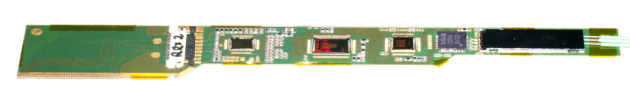
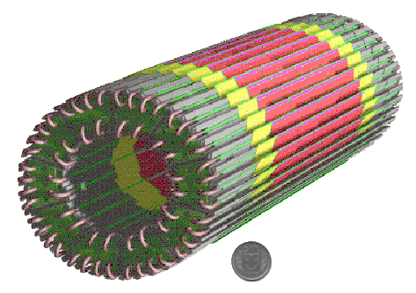
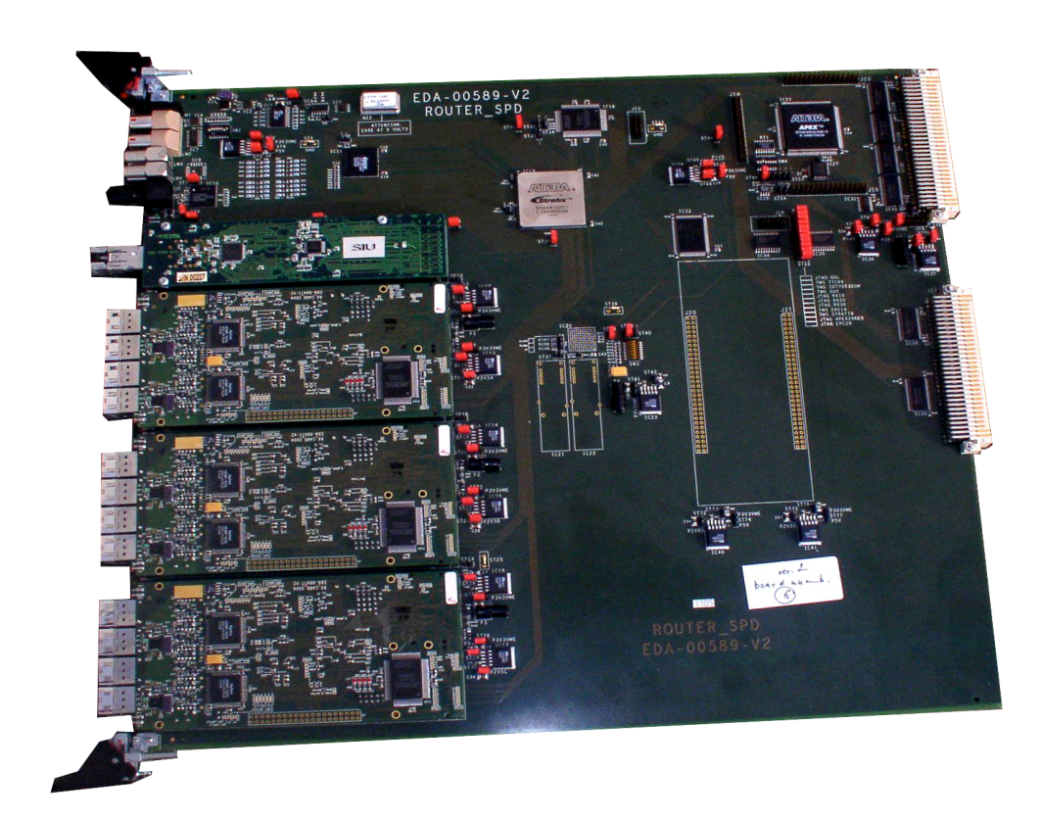

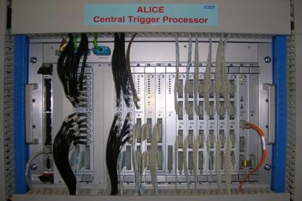
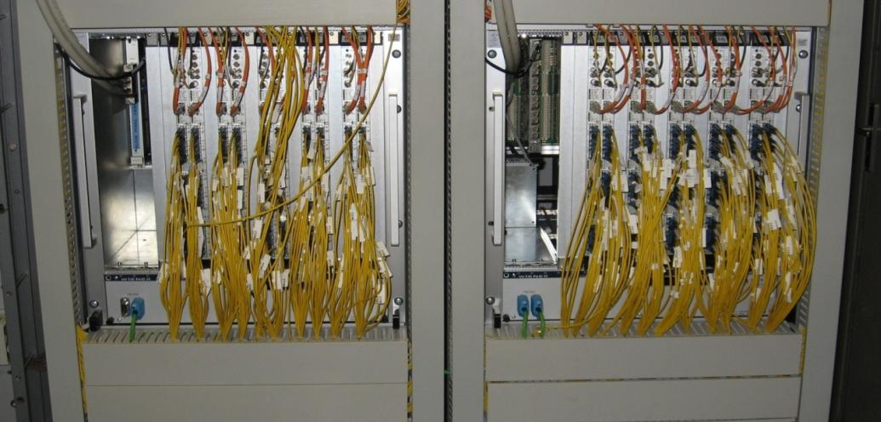
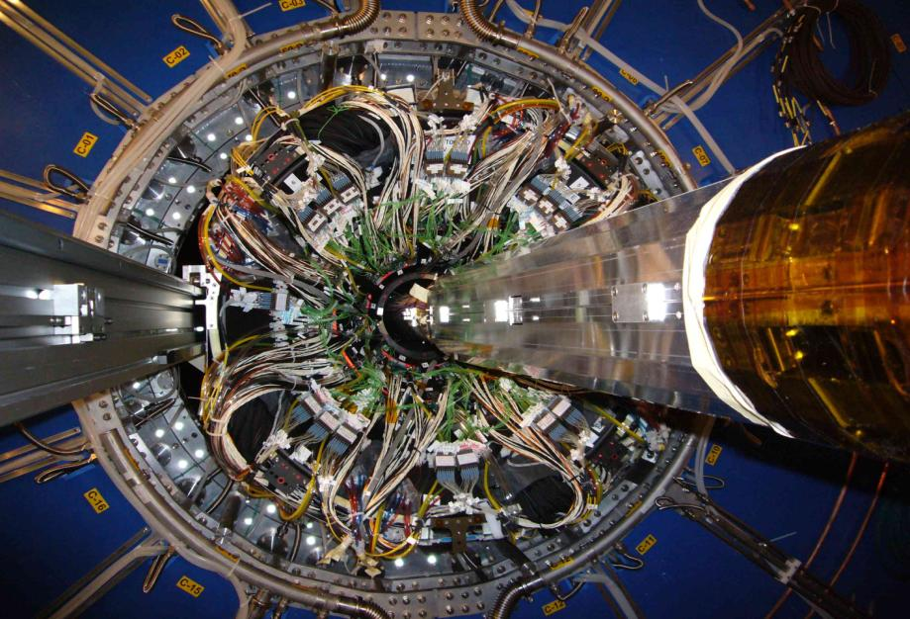

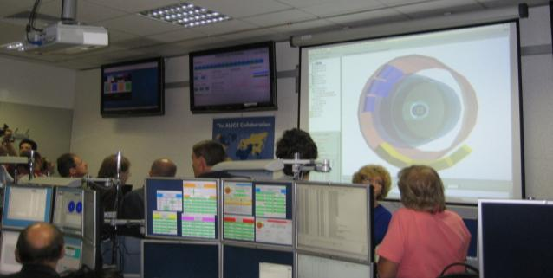
The ALICE SPD readout electronics
The ALICE Silicon Pixel Detector (SPD)
Multi Chip Module (MCM)
The ALICE SPD on-detector readout electronics (MCM) reads data from 10 pixel chips and stores binary hit information in a delay line during the L1 decision time. In case of a positive L1 decision the hit is stored in one out of four multi-event buffers where the data wait for the L2 decision to be read out or discarded.
ANALOG
PILOT
chip
DIGITAL
PILOT
chip
GOL
chip
RX40
chip
Optical
transceiver
Router
The ALICE SPD off-detector readout electronics (Router) controls, configures and reads out the detector via bidirectional optical links. The front-end data streams from the 120 half-staves are processed in 20 readout modules (Router), housed in the control room, based on FPGAs, each carrying three 2-channel link receiver daughter cards.
On the link receiver the pixel data stream from the detector is de-serialized, checked for format errors and stored in a FIFO buffer before being zero suppressed, encoded, re-formatted and written to a dual port memory. After reception of the positive L2 decision, the Router starts to check the event ready flag in the status register of the link receivers. When the event ready flag appears the router processor reads the data from the link receiver dual port memory. The processed data are sent to the ALICE-DAQ system on the ALICE detector data link (DDL) for permanent storage. The SPD control, configuration and data monitoring are performed using the VME interface of the routers.
The ALICE SPD constitutes the two innermost layers of the ALICE inner tracking system which contains 9.8x10⁶ pixels organized in 120 detector modules called half staves. Each half stave consists of two detector elements (ladders) read out using a multi-chip module (MCM).
1 read-out channel of the Router
Link Rx
processor
Event description
FIFO
(1000 x 32-b)
control + status bits
Router
processor
VME interface
DCS
HDMP
1034
FIFO
(1K x 16-b)
Zero
suppress
Encode + format
Dual-port RAM
(512K x 32-b)
DDL
FIFO
buffer
DDL
DAQ
81 920 bits
L1-L2
resolver
L1
FIFO
in average
4 000 bits
L1, L2 triggers
L2
FIFO
DAQ BUSY
Central Trigger Proce-ssor
TTCrx
chip
L2 trigger
L2 counter
(4 x L1)
& !L2Y
& L0
OR
L1 trigger
L1 counter
8 x (L1&L2)
& L0
BUSY
L0 trigger
BUSY logic
Ladder
ALICE Central Trigger
Processor
Each ladder is a linear array of 5 pixel readout chips bump bonded to a silicon sensor.
SPD off detector electronics (20 Routers)
ALICE DAQ
The Routers interface the on-detector readout electronics, the trigger system, the data acquisition system and the detector control system.
ALICE SPD installed
inside ITS and TPC
ALICE DCS
in the control room
M. Krivda for the ALICE SPD project, Institute of experimental physics, Košice, Slovakia

