Slide 1


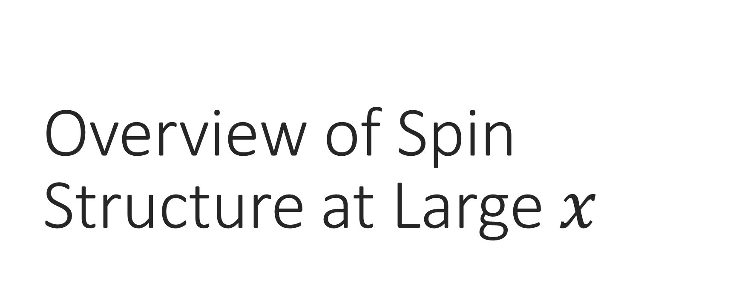
Overview of Spin Structure at Large $x$
Elena Long
HiX2014
Laboratori Nazionali di Frascati
November 17th, 2014

Slide 2
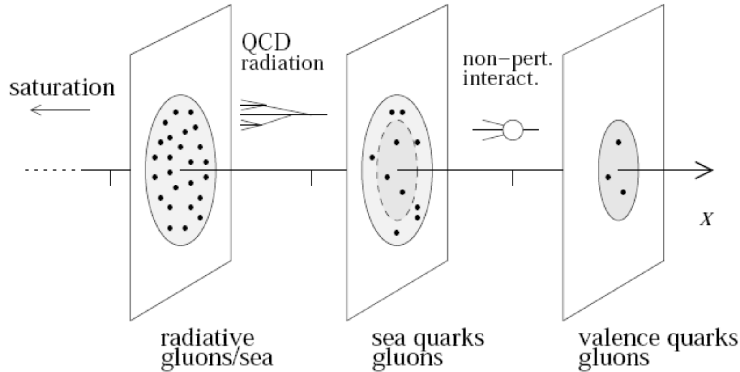
Picture of the Nucleon
Understanding spin structure allows us to access information regarding the structure of nucleons
A 3D picture of nucleons would give insights on the dynamics of how quarks and gluons form the nucleons
We can begin to access this information through spin observables

Slide 3
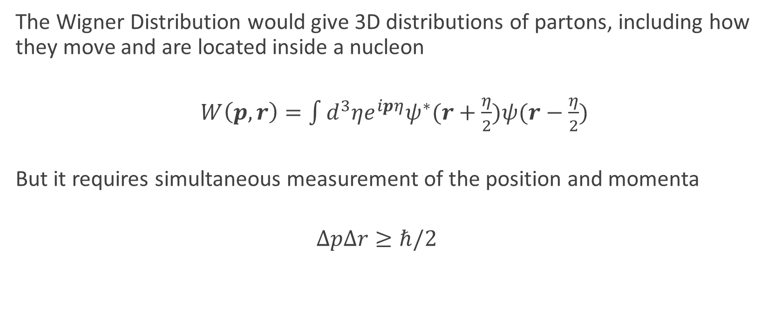
Wigner Distribution
  The Wigner Distribution would give 3D distributions of partons, including how they move and are located inside a nucleon
  $W\left(p,r\right)=\int{d^{3}ηe^{ipη}ψ^{∗}(r+\frac{η}{2})ψ(r−\frac{η}{2})}$
  But it requires simultaneous measurement of the position and momenta
  $$ΔpΔr≥ℏ/2$$

Slide 4
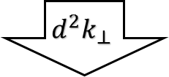

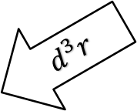



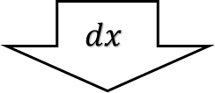

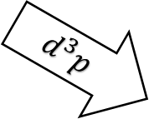
Wigner Distribution
$$W(p,r)$$
Transverse
Momentum
Distributions
Generalized
Parton
Distributions
$$d^{3}r$$
$$d^{3}p$$
$$f(x,k_{⊥})$$
$$H(x,ξ,t)$$
$$d^{2}k_{⊥}$$
$$dx$$
Patron
Distribution
Functions
$$f(x)$$
$$F(Q^{2})$$
Form
Factors

Slide 5

Parton Distribution Functions (PDFs)
R
L
Unpolarized
Helicity
Transversity
$f_{1}\left(x\right)= = +$
$= +$
$g_{1}\left(x\right)= −$
$h_{1}\left(x\right)= −$
R
L
* See previous talk, next 2 talks and Monday morning session
Nucleon Spin
Quark Spin

Slide 6








Transverse Momentum Distributions (TMDs)
q
 | Unpolarized (U) | Longitudinally Polarized (L) | Transversely Polarized (T)
U
L
T
N
Nucleon Spin
Quark Spin
$$f_{1}\left(x\right)=$$
$$h_{1}^{⊥}\left(x\right)= −$$
Boer-Mulders
$g_{1}\left(x\right)= −$
$$h_{1L}^{⊥}\left(x\right)= −$$
Helicity
Worm Gear
$h_{1}\left(x\right)= −$
$$f_{1T}^{⊥}\left(x\right)= −$$
$g_{1T}\left(x\right)= −$
Transversity
* See TMD Sessions, Tuesday and Thursday Afternoon
Sivers
Worm Gear
$$h_{1T}^{⊥}\left(x\right)= −$$
Pretzelosity

Slide 7
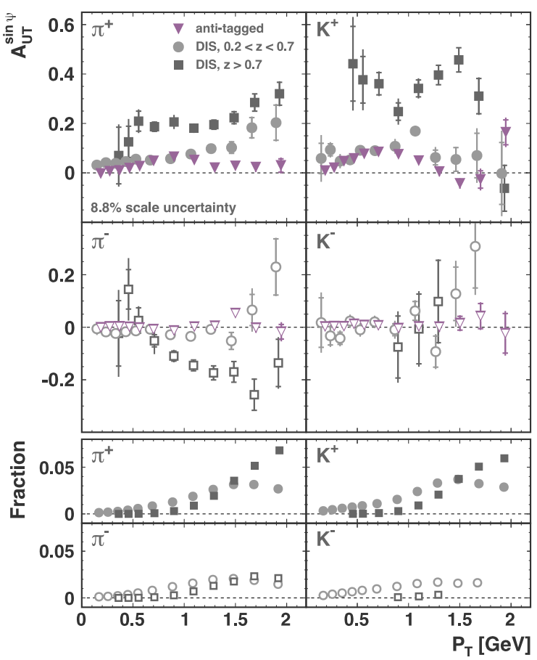
Transverse Asymmetries @ HERMES
Inclusive electroproduction of pions and kaons from transversely polarized protons
P_{T} dependence primarily caused by the Sivers effect
Very large asymmetries measured with high z
  Exclusive processes can contribute & effects from fragmentation of the struck quark dominate
Data can lead to better understanding of spin-orbit effects of partons in the nucleon
A. Airapetian et al., Phys. Lett. B 728, 183 (2014)

Slide 8
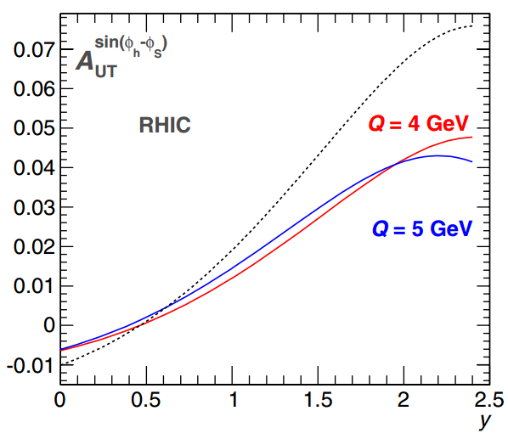
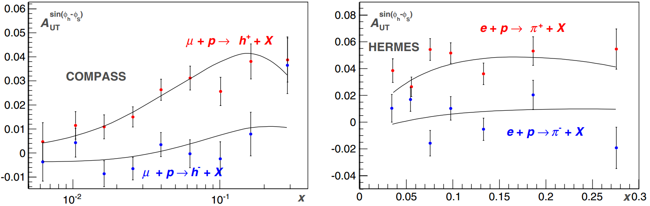
Transverse Asymmetries – Theory & Predictions
Recent Sivers theoretical fits for SIDIS and Drell-Yan
Include Q2 evolutions
Predictions for upcoming experiments
P. Sun, F. Yuan, Phys. Rev. D 88, 034016 (2013)

Slide 9
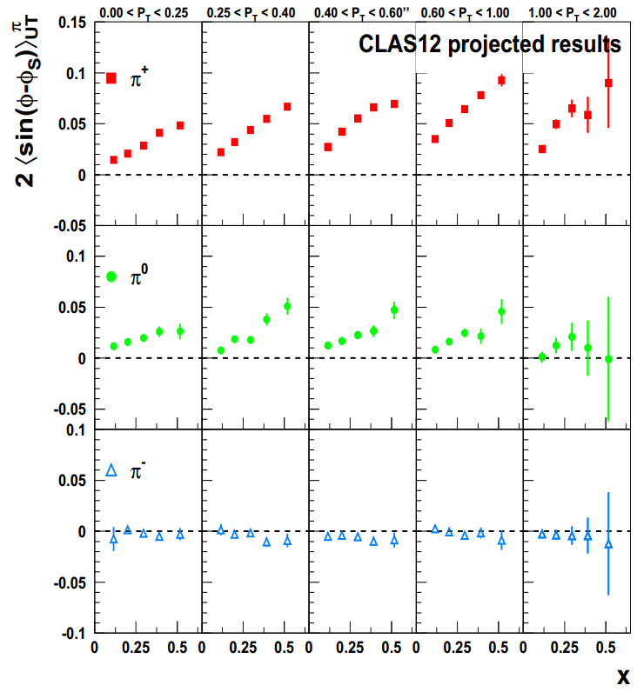
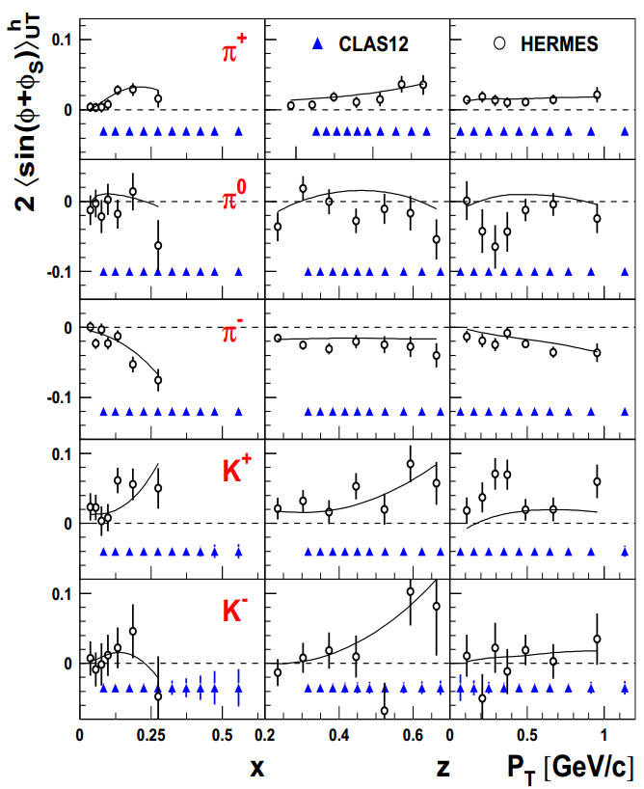
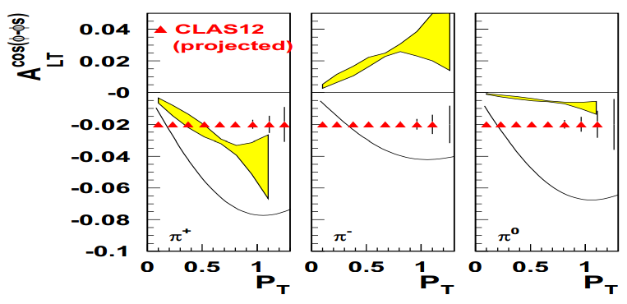
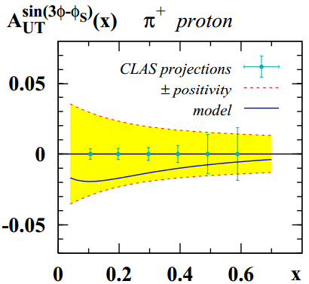

Future “High Impact” Transverse SIDIS @ JLab12 CLAS12
Sivers
Collins
Classified “master experiment with high impact” by JLab PAC41
Polarized electron beam on transversely polarized HD-Ice target
SSA provide access to Transversity ($h_{1}\left(x\right)$), Sivers ($f_{1T}^{⊥}\left(x\right)$), and Pretzelosity ($h_{1T}^{⊥}\left(x\right)$)
DSA provide access to Worm gear ($g_{1T}\left(x\right)$, $h_{1L}^{⊥}\left(x\right)$)
M. Contalbrigo et al., JLab E12-11-111
* See TMD Sessions, Tuesday and Thursday Afternoon

Slide 10
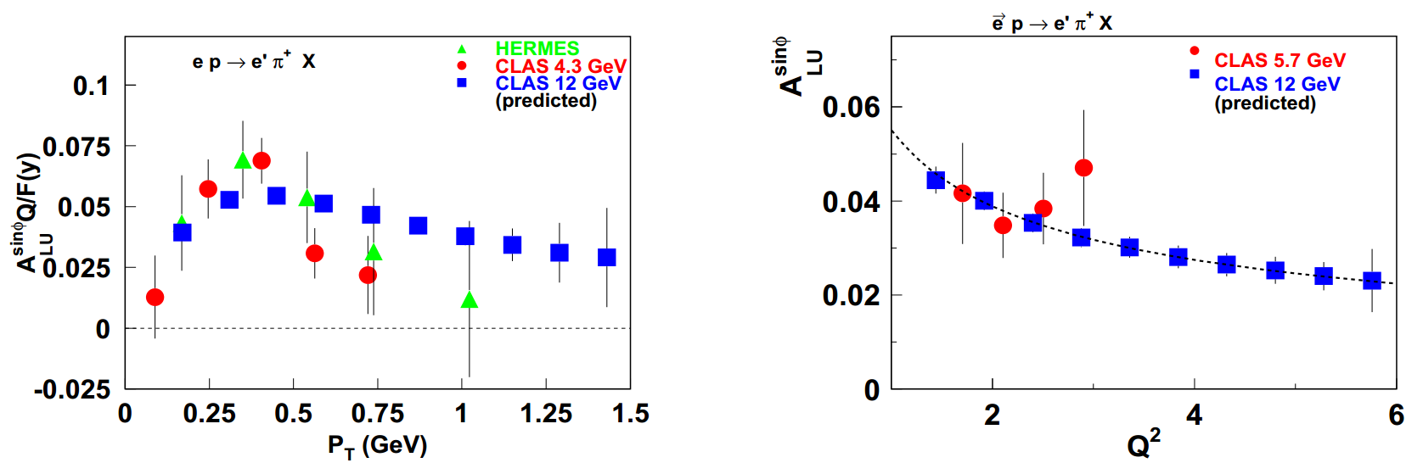
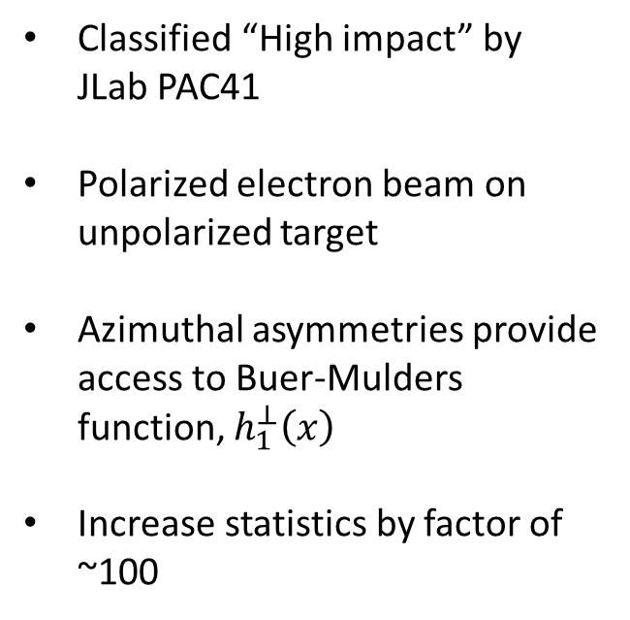
Future “High Impact” Boer-Mulders @ JLab12 CLAS12
Classified “High impact” by JLab PAC41
Polarized electron beam on unpolarized target
Azimuthal asymmetries provide access to Buer-Mulders function, $h_{1}^{⊥}\left(x\right)$
Increase statistics by factor of ~100
H. Avakian et al., JLab E12-06-112
* See TMD Sessions, Tuesday and Thursday Afternoon

Slide 11
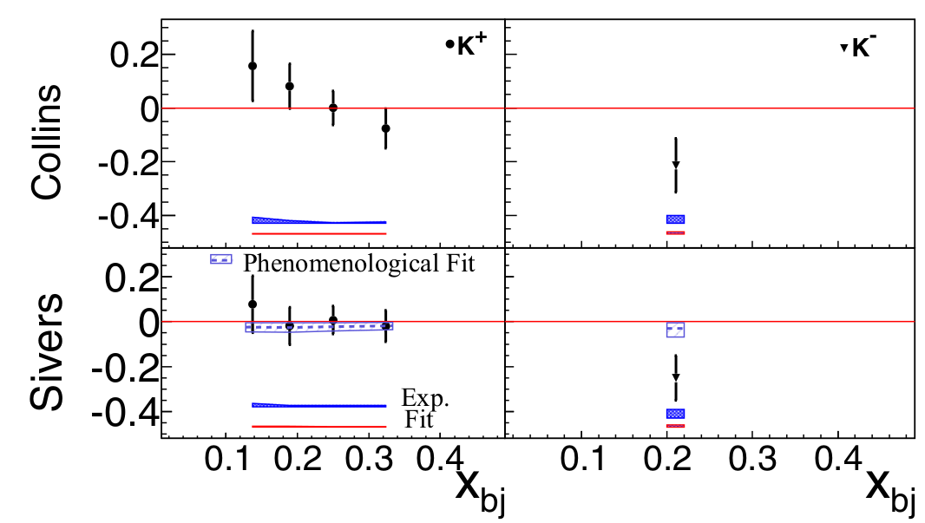
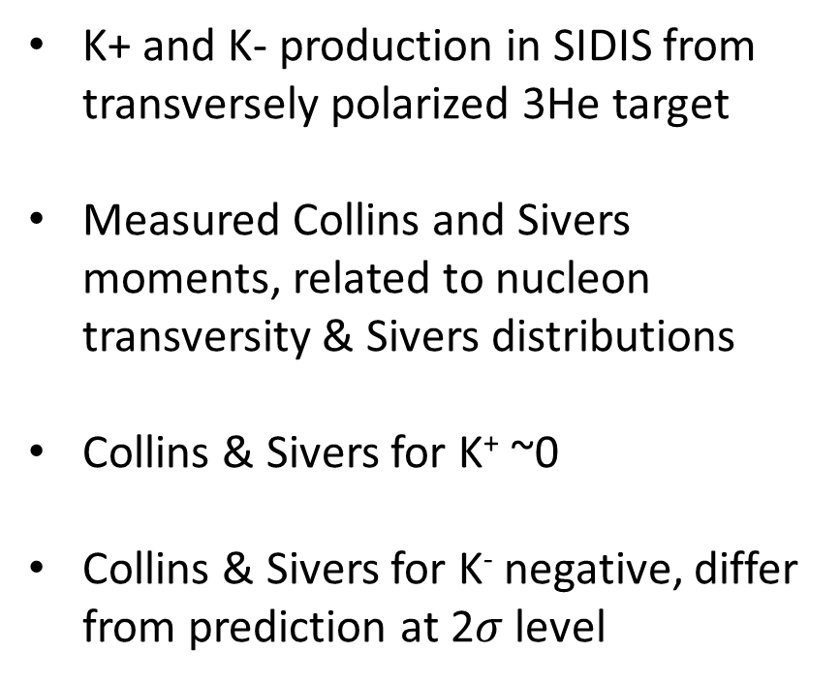
Transversity @ JLab
K+ and K- production in SIDIS from transversely polarized 3He target
Measured Collins and Sivers moments, related to nucleon transversity & Sivers distributions
Collins & Sivers for K⁺ ~0
Collins & Sivers for K⁻ negative, differ from prediction at 2$σ$ level
Y.X. Zhao et al., Phys. Rev. C 90, 055201 (2014)
* See TMD Sessions, Tuesday and Thursday Afternoon

Slide 12
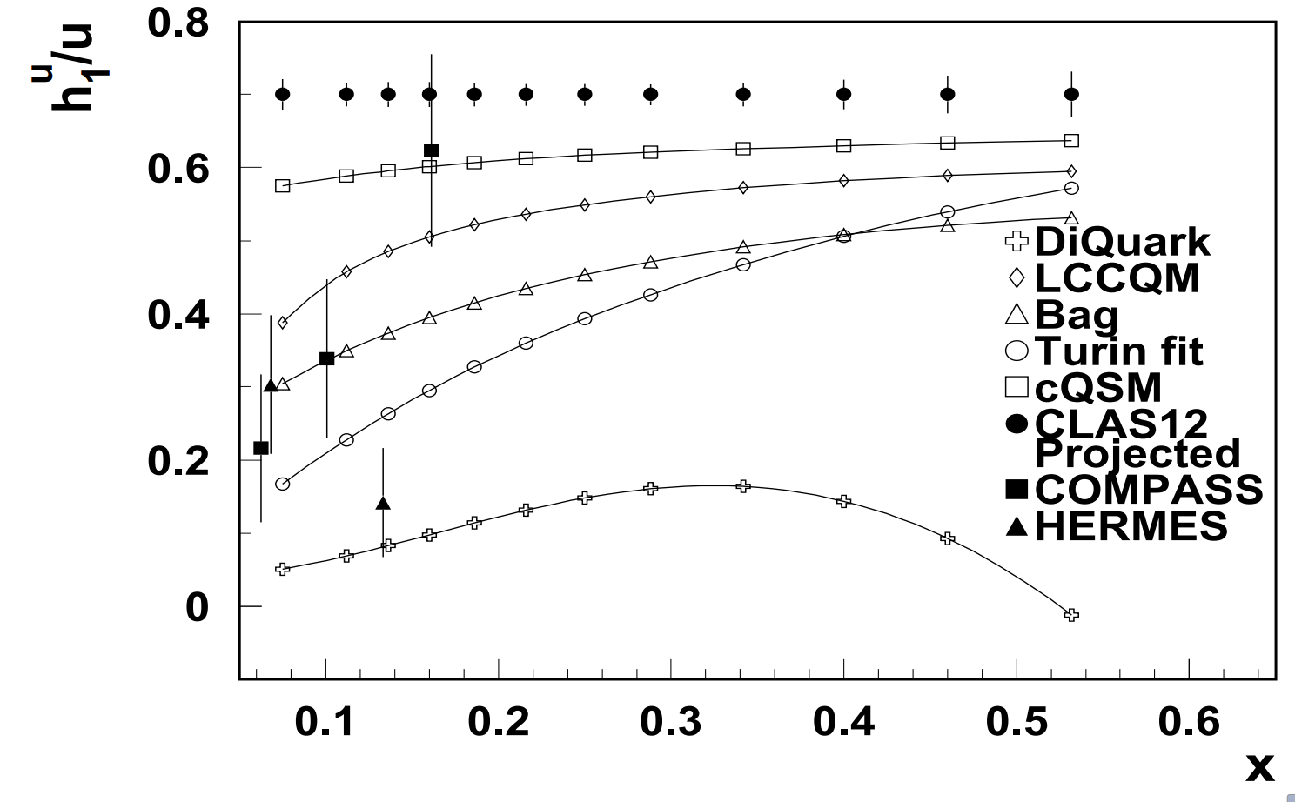
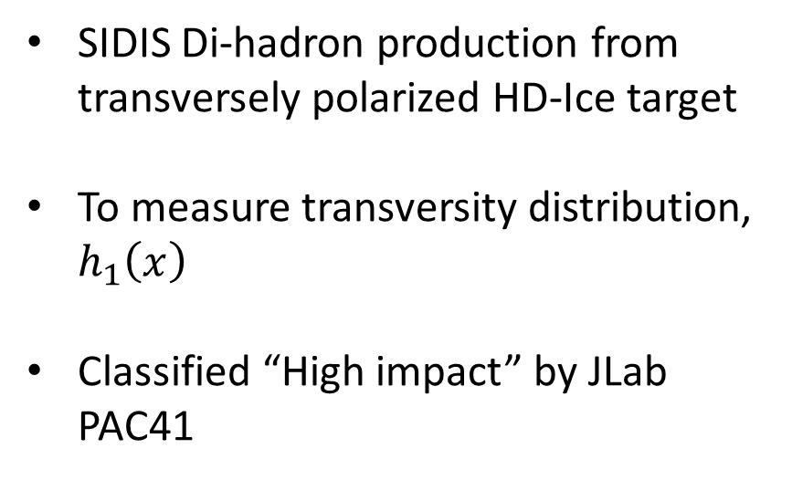
Future “High Impact” Transversity @ JLab12 CLAS12
SIDIS Di-hadron production from transversely polarized HD-Ice target
To measure transversity distribution, $h_{1}\left(x\right)$
Classified “High impact” by JLab PAC41
H. Avakian et al., JLab E12-12-009
* See TMD Sessions, Tuesday and Thursday Afternoon

Slide 13

Generalized Parton Distributions (GPDs)
GPDs give insight into nucleon spin crisis
  Quark OAM?
  Gluon polarization?
  Gluon OAM?
Measured through Deeply Virtual Compton Scattering (DVCS) and Meson Production (DVMP)
  “DVCS is the cleanest ‘golden’ channel to study GPDs” –JLab Pac41
$$H, E, \tilde{H},\tilde{E},H_{T},E_{T},\tilde{H_{T}},\tilde{E_{T}}$$

Slide 14
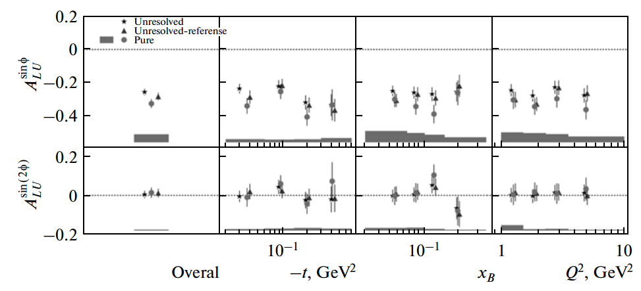
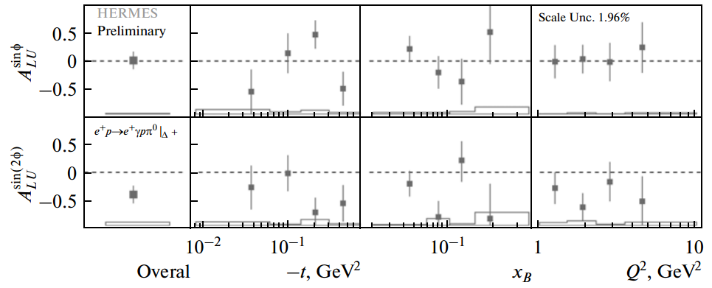
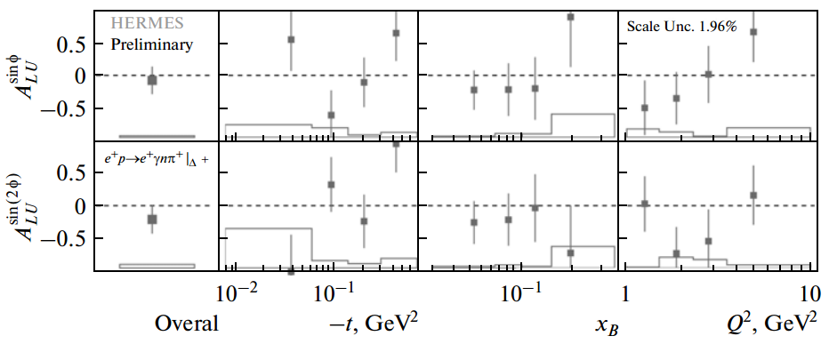
DVCS @ Hermes
ep → eγnπ+ .
DVCS results still in analysis
Longitudinally polarized electron beam on unpolarized hydrogen target
Data from recoil detector added in last 2 years of HERA running
Beam-helicity asymmetry amplitudes provide constraints to GPD models and fits
ep → eγpπ⁰
ep → epγ
S. Yaschenko, Phys. Part. Nucl. 45, 173 (2014)
* See TMD Sessions, Tuesday and Thursday Afternoon

Slide 15
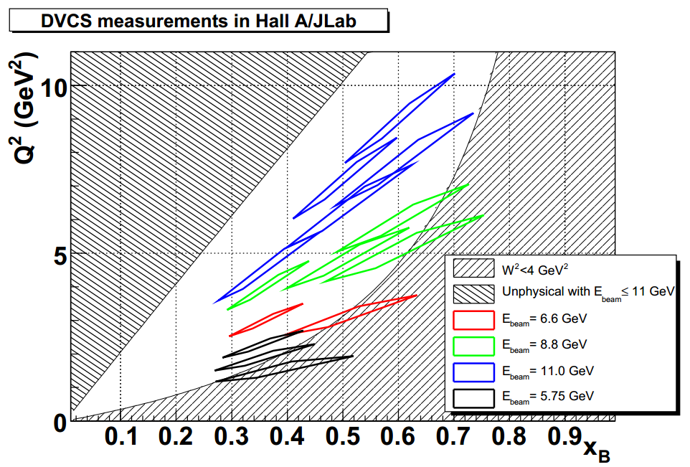
“High Impact” DVCS @ JLab12 Hall A
Classified “Major high-impact highlight” by JLab PAC41
Longitudinally polarized electron beam on unpolarized hydrogen target
Precision test of scaling through measurement of DVCS absolute cross section
Just starting to run!
A. Camsonne, et al, JLab E12-06-114
* See TMD Sessions, Tuesday and Thursday Afternoon

Slide 16
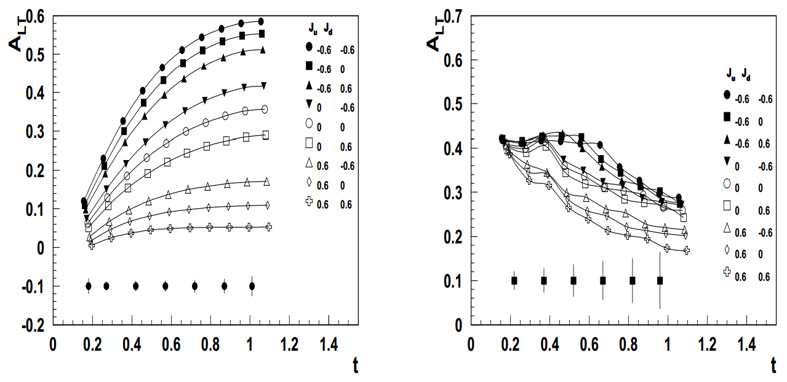
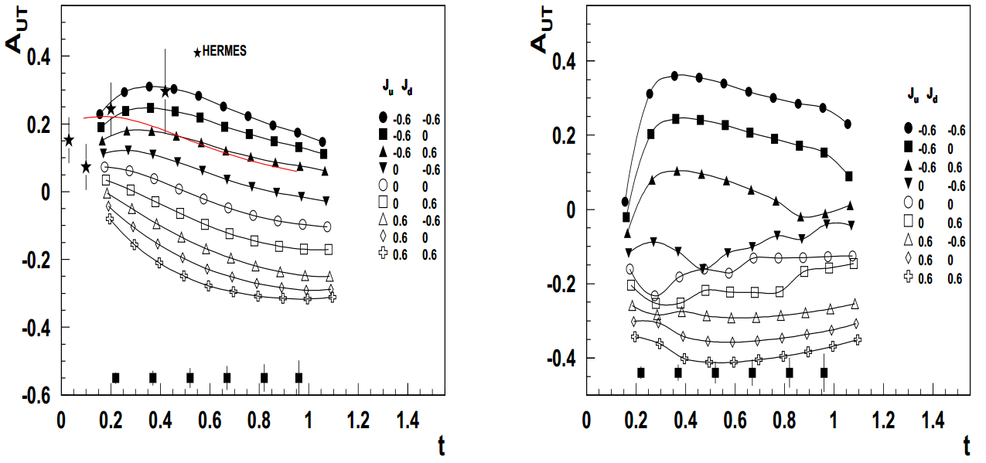
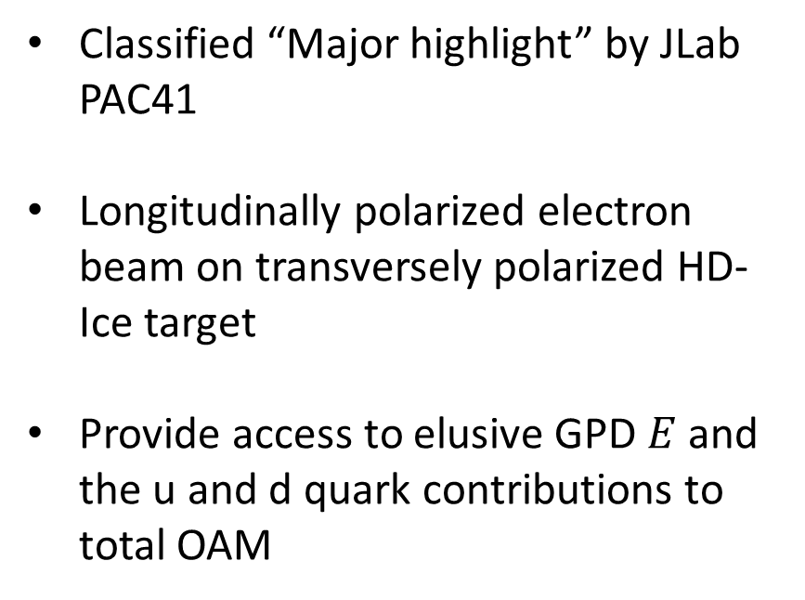
Future “High Impact” DVCS @ JLab12 CLAS12
Classified “Major highlight” by JLab PAC41
Longitudinally polarized electron beam on transversely polarized HD-Ice target
Provide access to elusive GPD $E$ and the u and d quark contributions to total OAM
A. Camsonne, et al, JLab E12-06-114
* See TMD Sessions, Tuesday and Thursday Afternoon

Slide 17

EM Form Factors
Describe the electromagnetic structure of nucleons
$G_{E}$, $G_{M}$

Slide 18
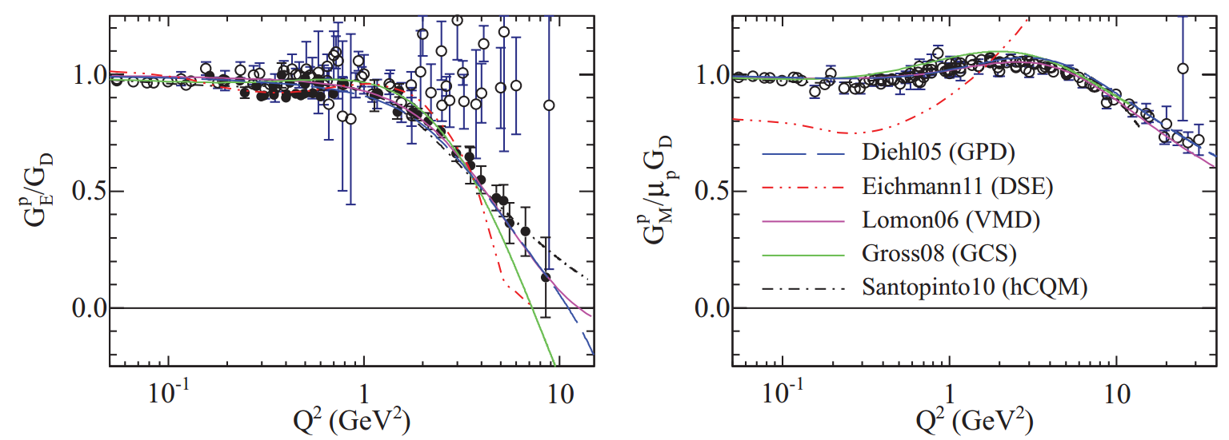
Proton Form Factors – World Data
A. Puckett, et al, Phys. Rev. C 85, 045203 (2012)

Slide 19
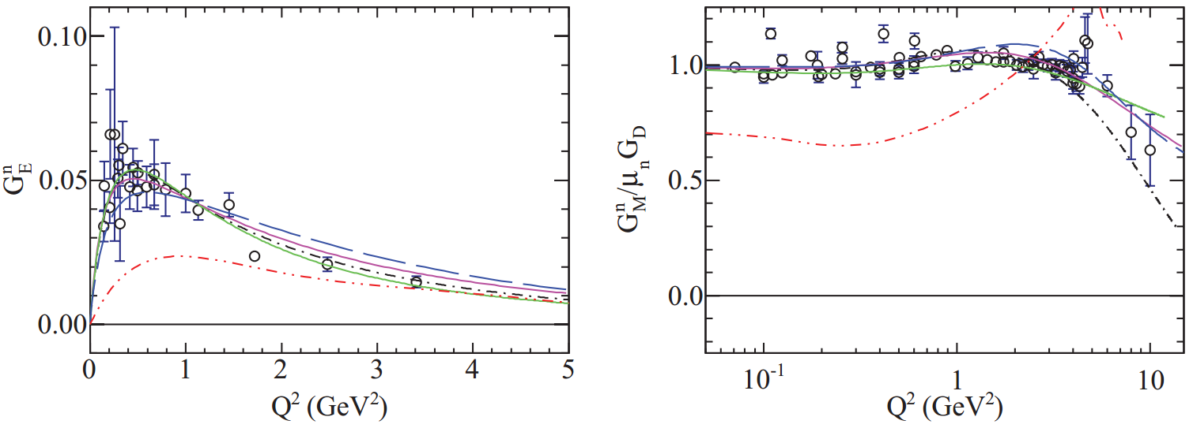
Neutron Form Factors – World Data
A. Puckett, et al, Phys. Rev. C 85, 045203 (2012)

Slide 20
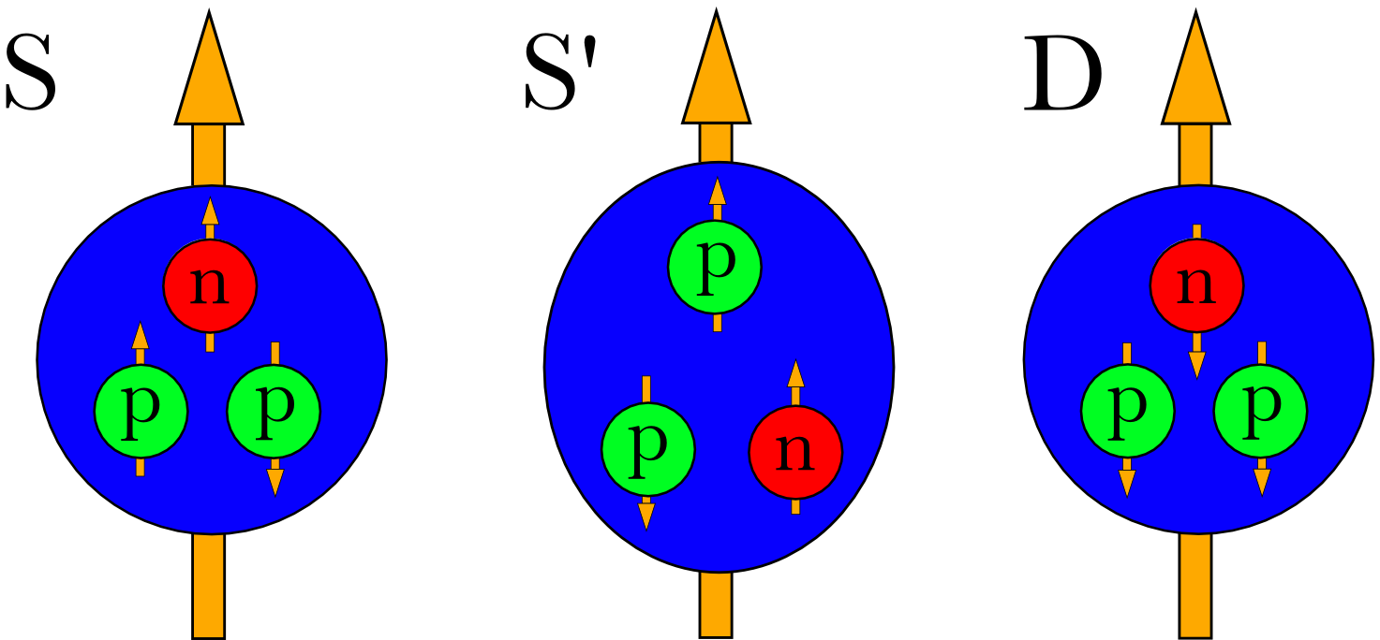
Using ³He as a Free Neutron Target – Spin Asymmetries
³He often used as a free neutron target due to its unique spin properties
Experimental uncertainties have matched or surpassed theoretical descriptions of the ³He nucleus
Recent studies have been done to better understand the effects on a neutron inside of a ³He nucleus
Necessary for extracting any neutron information from ³He
^{~90%}

Slide 21
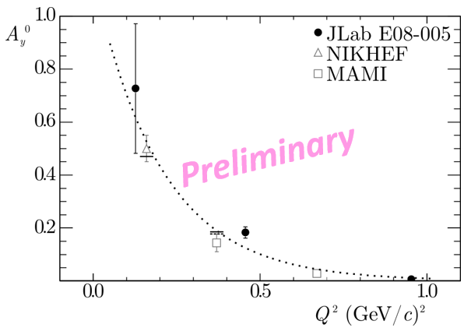
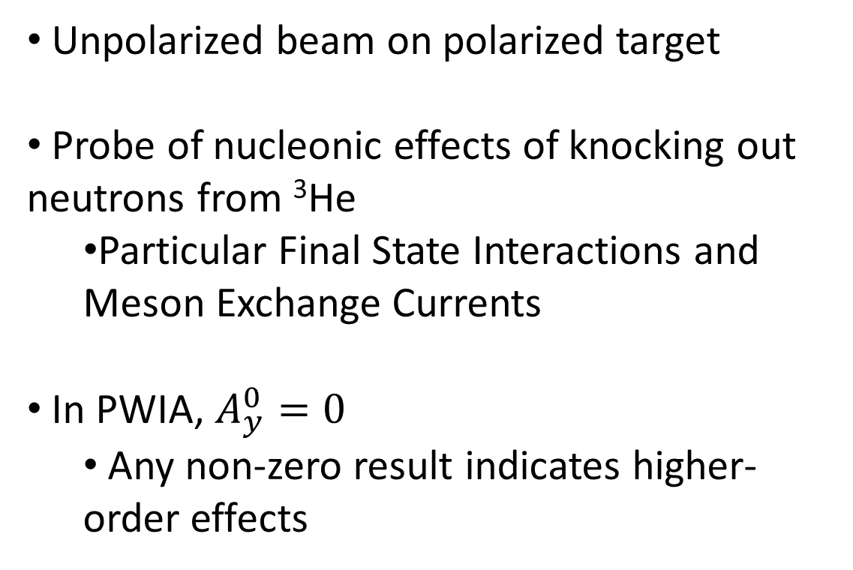
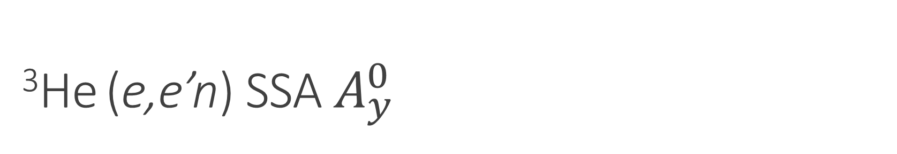
³He (e,e’n) SSA $A_{y}^{0}$
Unpolarized beam on polarized target
Probe of nucleonic effects of knocking out neutrons from ³He
  Particular Final State Interactions and Meson Exchange Currents
In PWIA, $A_{y}^{0}=0$
  Any non-zero result indicates higher-order effects

Slide 22
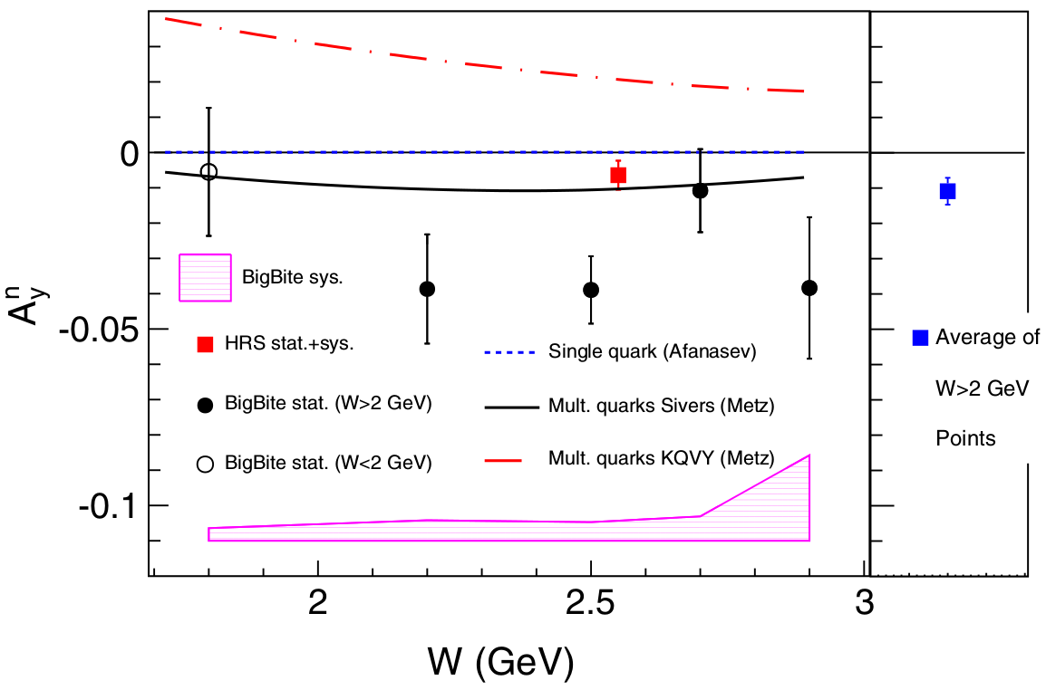
³He(e,e’)X SSA / 2-Photon Exchange
0.16 < x < 0.65
First measurement of A_{y} for neutron
In Born approximation, A_{y}^{n} = 0
  Unless 2-photon exchange effects included
Non-zero negative value found, 2.8σ level
Agrees with 2-photon-exchange using Sivers TMD input
J. Katich et al., Phys. Rev. Lett. 113, 022502 (2014)

Slide 23
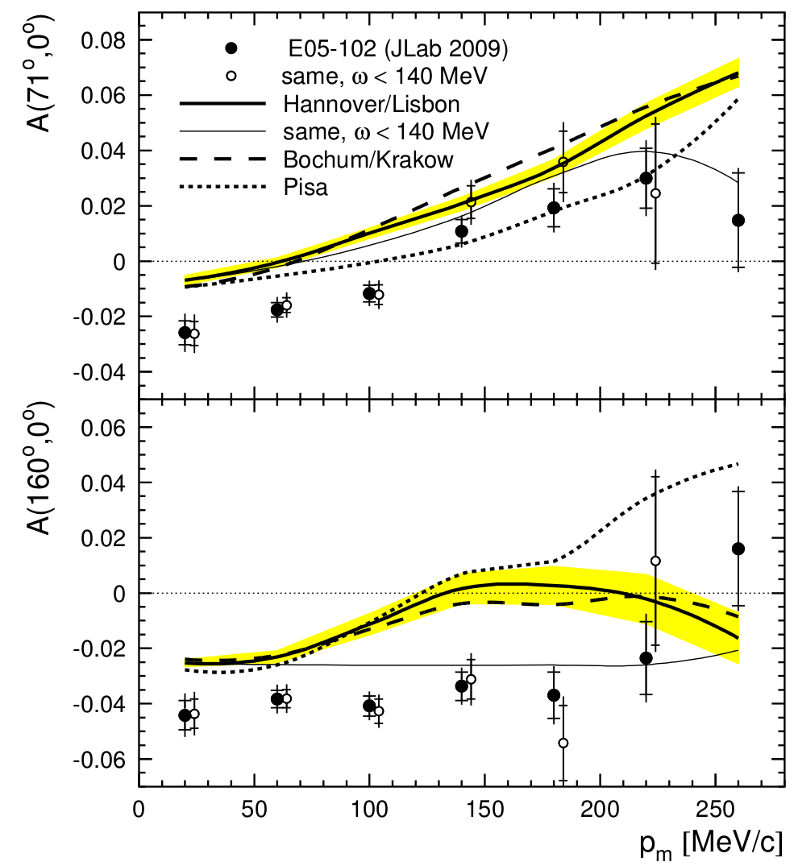
3He(e,e’d) DSA
Q²=0.25 GeV², p_{miss} < 270 MeV/c
Systematic discrepancy with state-of-the-art 3-body Fadeev calculations
First measurement of ³He(e,e’d)p DSA
Sensitive to 3He ground-state wavefunction and 3-nucleon forces
Extracted deuteron Pz and Pzz in ³He
M. Mihovilovic, G. Jin, E. Long, Y.W. Zhang, et al., arXiv:1409.2253

Slide 24
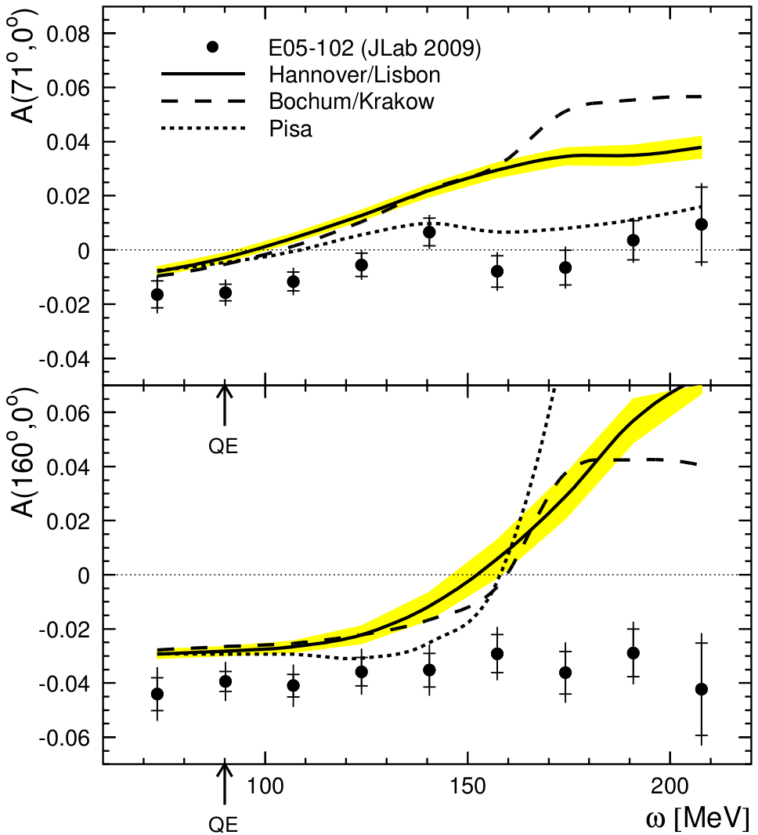
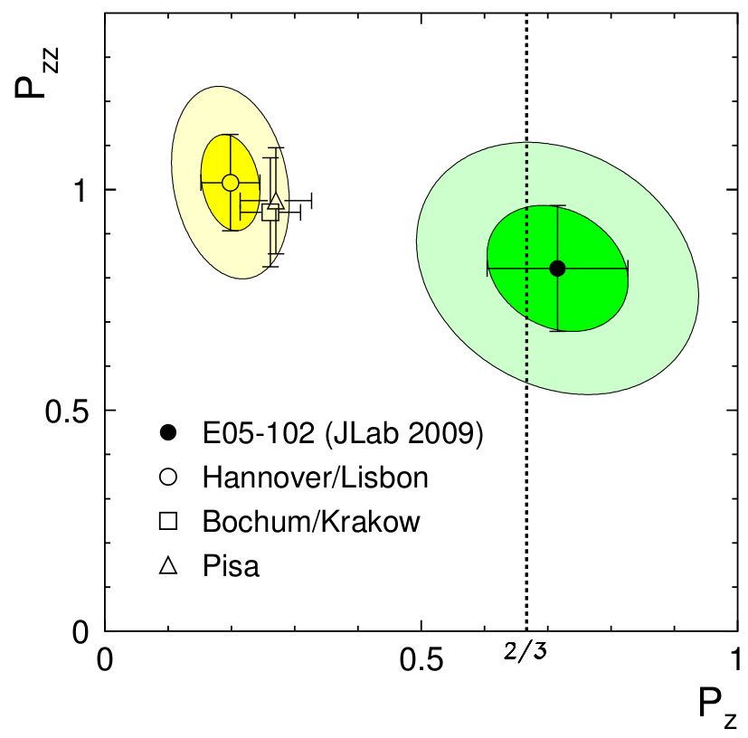
3He(e,e’d) DSA
Q²=0.25 GeV², p_{miss} < 270 MeV/c
Systematic discrepancy with state-of-the-art 3-body Fadeev calculations
First measurement of ³He(e,e’d)p DSA
Sensitive to 3He ground-state wavefunction and 3-nucleon forces
Extracted deuteron Pz and Pzz in ³He
M. Mihovilovic, G. Jin, E. Long, Y.W. Zhang, et al., arXiv:1409.2253

Slide 25



Structure Functions
Describe the longitudinal momentum distribution of quarks and gluons
$$W_{μν}=−{αF}_{1}+{βF}_{2}$$
Scattering on Unpolarized Targets
$$+iγg_{1}+iδg_{2}$$
Scattering on Polarized Targets
$$−εb_{1}+ζb_{2}+ηb_{3}+κb_{4}$$
Scattering on Tensor-Polarized Targets
(Save for later)

Slide 26
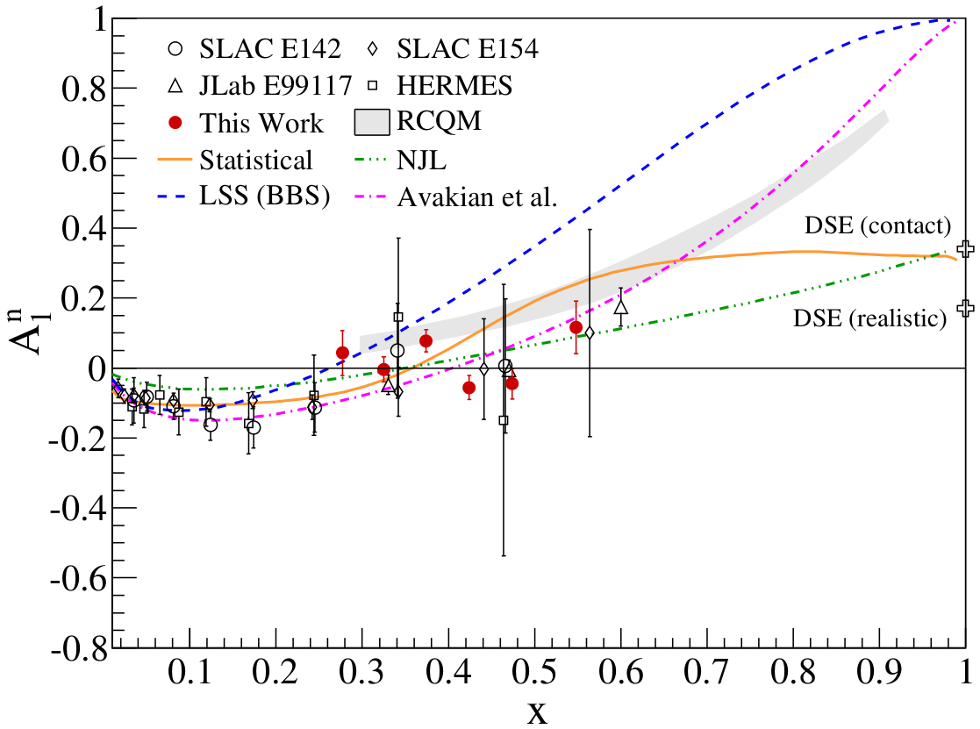
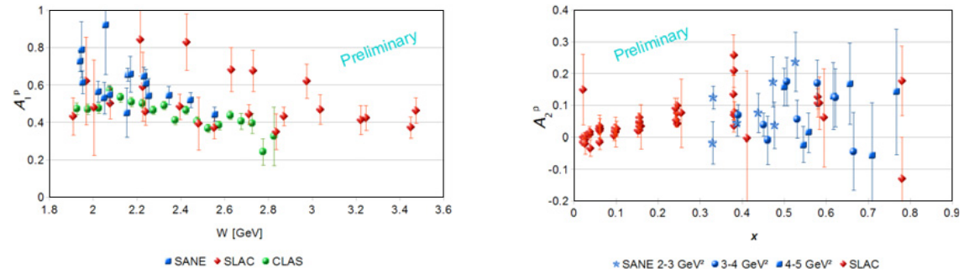
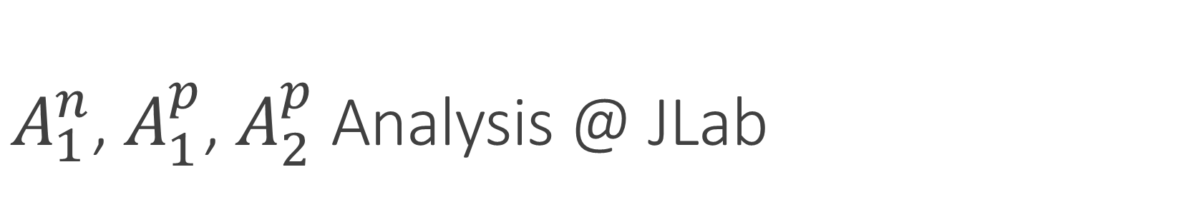
$A_{1}^{n}$, $A_{1}^{p}$, $A_{2}^{p}$ Analysis @ JLab
* See Mark Jones’s Talk, Wed. 11am
SANE
SANE
Hall A
D.S. Parno et al., arXiv:1406.1207
O.A. Rondon, EPJ WoC 73, 02001 (2014)

Slide 27
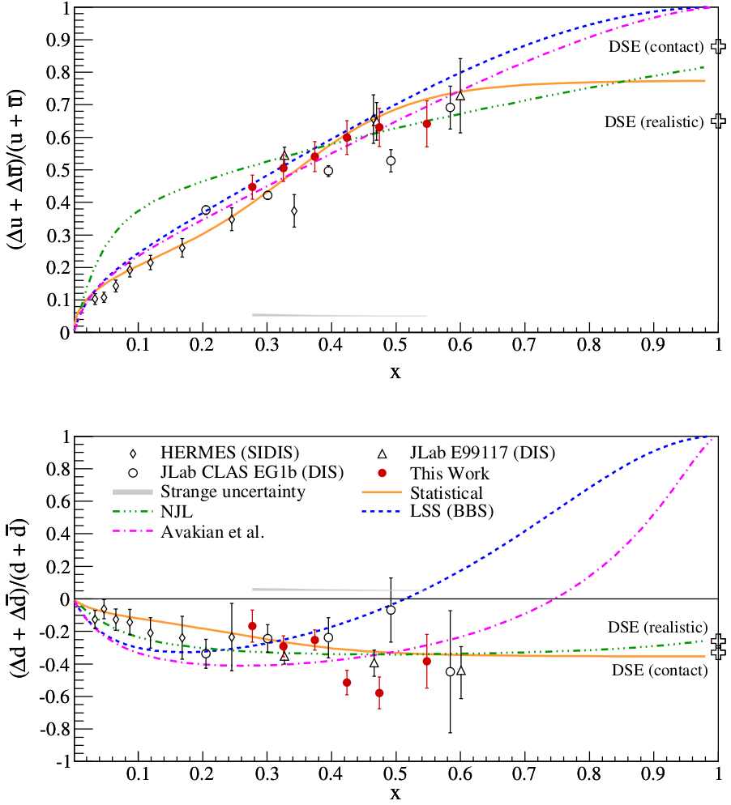
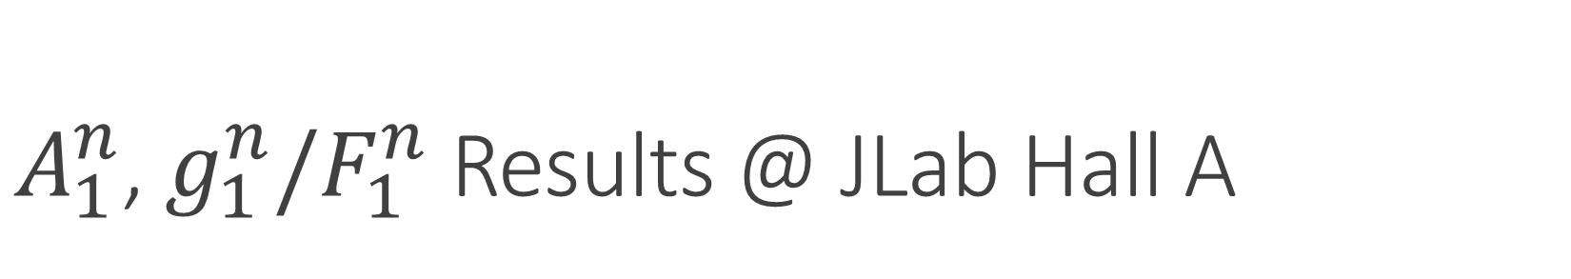
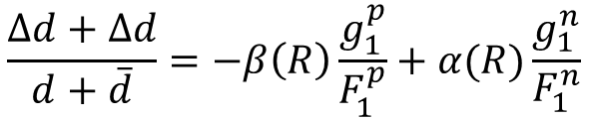
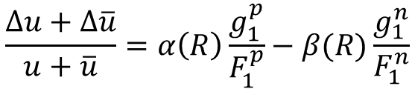
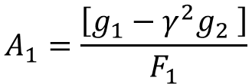
$A_{1}^{n}$, $g_{1}^{n}/F_{1}^{n}$ Results @ JLab Hall A
* See Mark Jones’s Talk, Wed. 11am
$$A_{1}=\frac{\left[g_{1}−γ^{2}g_{2} \right]}{F_{1}}$$
$$\frac{Δu+Δ\overline{u}}{u+\overline{u}}=α\left(R\right)\frac{g_{1}^{p}}{F_{1}^{p}}−β(R)\frac{g_{1}^{n}}{F_{1}^{n}}$$
$$\frac{Δd+Δd}{d+\overline{d}}=−β\left(R\right)\frac{g_{1}^{p}}{F_{1}^{p}}+α(R)\frac{g_{1}^{n}}{F_{1}^{n}}$$
D.S. Parno et al., arXiv:1406.1207

Slide 28
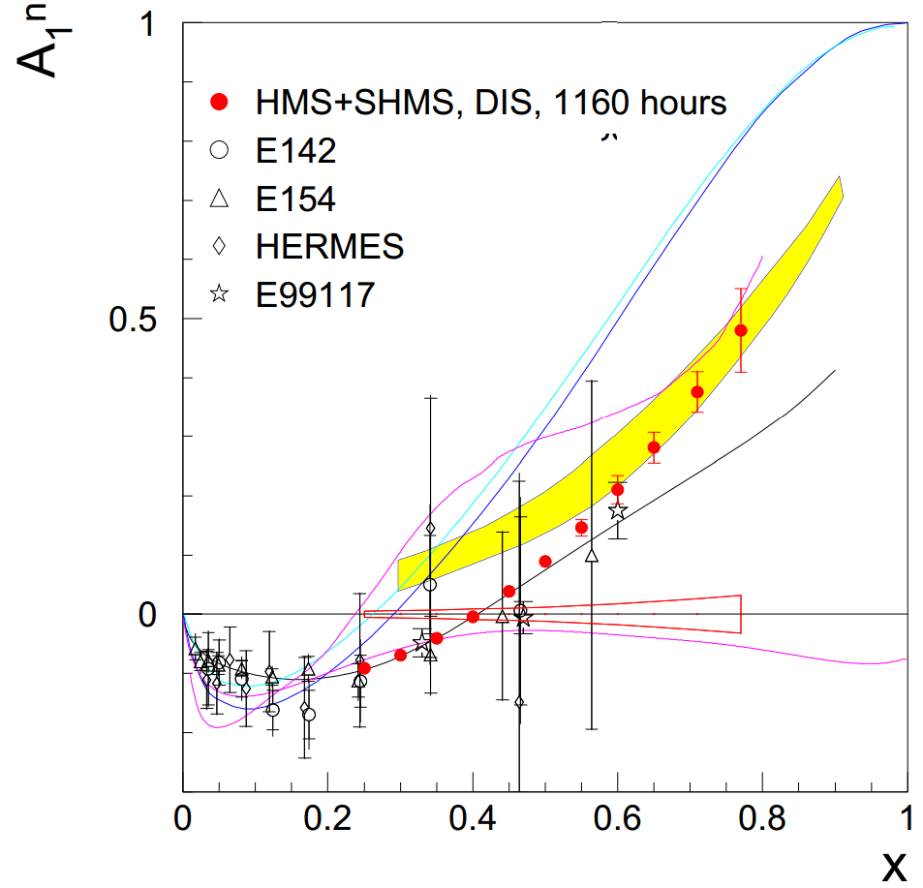

Future “High Impact” $A_{1}^{n}$ @ JLab12 Hall C
Identified as “High Impact” by JLab PAC41
Polarized electron beam on polarized ³He target
Extend Δq/q for u & d quarks up to large x
* See Mark Jones’s Talk, Wed. 11am
X. Zheng et al., JLab E12-06-110

Slide 29
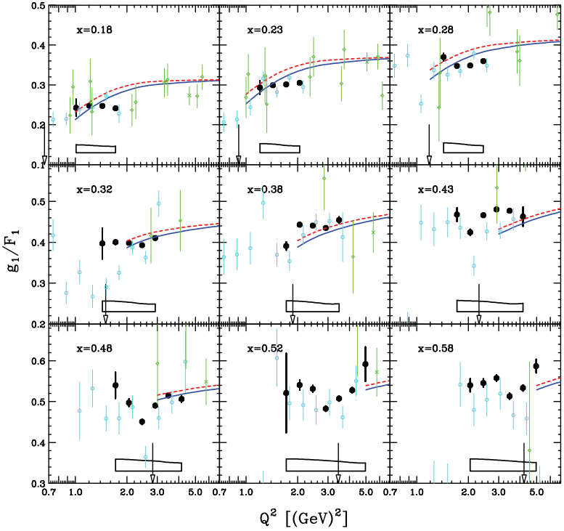


$g_{1}/F_{1}$ Results @ JLab CLAS
Proton
Deuteron
Y. Prok, et al, Phys. Rev. C 90, 025212 (2014)

Slide 30


Structure Functions from World Data Fits
P. Jimenez-Delgado et al., Phys. Rev. D 89, 034025 (2014)

Slide 31

Structure Functions from World Data Fits
P. Jimenez-Delgado et al., Phys. Rev. D 89, 034025 (2014)

Slide 32


$g_{2}^{3He}$ from $d_{2}^{n}$ @ JLab
M. Posik et al., Phys. Rev. Lett. 113, 022002 (2014)

Slide 33



Twist-3 Matrix Element $d_{2}^{n}$ @ JLab
Long. polarized electrons on trans. & long. polarized 3He target
${\overline{g}}_{2}\left(x,Q^{2}\right)=g_{2}\left(x,Q^{2}\right)−g_{2}^{WW}(x,Q^{2})$ $g_{2}^{WW}\left(x,Q^{2}\right)=−g_{1}\left(x,Q^{2}\right)+\int_{x}^{1}{\frac{g_{1}\left(y,Q^{2}\right)dy}{y}}$
$d_{2}=3\int_{0}^{1}{dxx^{2}{\overline{g}}_{2}(x)}$
Agree with QCD, resolve previous data disagreement at Q2=5 GeV^2
Neutron color E&M FF extracted, opposite sign ~30 MeV/fm
  Probes confinement forces
See Brad Sawatzky’s talk, Wed. 12pm
M. Posik et al., Phys. Rev. Lett. 113, 022002 (2014)

Slide 34






Tensor Structure Functions
$$W_{μν}=−{αF}_{1}+{βF}_{2}$$
Scattering on Unpolarized Targets
$$+iγg_{1}+iδg_{2}$$
Scattering on Vector Polarized Targets
$$−εb_{1}+ζb_{2}+ηb_{3}+κb_{4}$$
Scattering on Tensor-Polarized Targets
Vector $P_{z}=p_{+}−p_{−}$
Spin-1
System
-
Spin-½
System
m = +1
m = +½
m = 0
Tensor $P_{zz}={(p}_{+}+p_{−})−2p_{0}$
m = -½
( + )-2
m = -1
P Hoodbhoy et al, Nucl. Phys. B312, 571 (1989)

Slide 35



Tensor Structure Function, $b_{1}$
$b_{1}→$ Leading twist
$b_{1}$ is the measure of quark distributions when the nucleus is in a particular spin state
Looks at nuclear effects at the resolution of quarks!
If there are no nuclear effects, then $b_{1}$ vanishes.
Even with D-state admixture, it’s expected to be vanishingly small
Deuteron
=
n
+
p
$$b_{1}=0$$
Khan & Hoodbhoy, PRC 44 ,1219 (1991)
Umnikov, PLB 391, 177 (1997)

Slide 36





Tensor Structure Function, $b_{1}$
All conventional models predict small or vanishing values of b₁ in contrast with the HERMES data
All conventional models predict small or vanishing values of b₁ in contrast with the HERMES data
Any measurement of a b₁<0 indicates exotic physics
K. Slifer et al, JLab E12-13-011

Slide 37

Tensor Structure Function, $b_{1}$
Measured by ratio method

Slide 38

Tensor Structure Function, $b_{1}$
  Jefferson Lab’s Hall C
  Unpolarized beam, tensor polarized target (longitudinal alignment)
SHMS
SHMS
Slow
Raster
Faraday
Cup
Lumi
Unpolarized
Beam
Fast
Raster
Polarized
Target
HMS

Slide 39





Tensor Structure Function, $b_{1}$
* See Dustin Keller’s Talk, Wed. 12:30pm
  Dynamic Nuclear Polarization of ND₃
  $P_{zz} \sim 30\%$
  5 Tesla at 1 K
  3cm Target Length
  $p_{f} \sim 0.65$
  $f_{dil} \sim 0.27$

Slide 40

Tensor Structure Function, $b_{1}$
Measuring $b_{1}$ will give insight into:
Close-Kumano sum rule^{[1]}
6-quark hidden color^{[2]}
OAM and spin crisis^{[3]}
Pionic effects^{[2,4]}
Polarized sea quarks^{[4]}
Approved JLab Experiment E12-13-011
Spokespersons: K. Slifer, E. Long, D. Keller, P. Solvignon, J.P. Chen, O.R. Aramayo, N. Kalantarians
^{[1]} FE Close, S Kumano, Phys. Rev. D42, 2377 (1990)
^{[2]} G Miller, Phys. Rev. C89, 045203 (2014)
^{[3]} SK Taneja et al, Phys. Rev. D86, 036008 (2012)
^{[4]} S Kumano, Phys. Rev. D82, 017501 (2010)

Slide 41



High-x Tensor Structure
Repeat same experiment, only look at $A_{zz}$ in the quasi-elastic region
Can give insight to short range deuteron structure
Total
S-state
  $$A_{zz}∝\frac{\frac{1}{2}D^{2}−SD}{S^{2}+D^{2}}$$
D-state
L. Frankfurt, M. Strikman, Phys. Rept 160, 235 (1988)

Slide 42

High-x Tensor Structure
Repeat same experiment, only look at $A_{zz}$ in the quasi-elastic region
Can give insight to short range deuteron structure
AV18
AV18
  $$A_{zz}∝\frac{\frac{1}{2}D^{2}−SD}{S^{2}+D^{2}}$$
cdBonn
cdBonn
Sargsian, Strikman, J. Phys.: Conf. Ser. 543, 012099 (2014)
L. Frankfurt, M. Strikman, Phys. Rept 160, 235 (1988)

Slide 43


High-x Tensor Structure
Measuring high-x A_{zz} will give insight into:
SRCs & pn dominance^{[1]}
Differentiate light cone and VN models^{[2]}
Better understanding of s/d^{[3]}
Final state interaction models^{[4]}
^{[1]} J Arrington et al, Prog. Part. Nucl. Phys. 67, 898 (2012)
^{[2]} M. Sargsian, private communication
^{[3]} L Frankfurt, M Strikman, Phys. Rept. 160, 235
^{[4]} W Cosyn, M Sargsian, arXiv:1407.1653
E. Long, et al, JLab LOI12-14-002

Slide 44
High-x Tensor Structure
Encouraged for full submission by PAC42
“The measurement proposed here arises from a well-developed context, presents a clear objective, and enjoys strong theory support. It would further explore the nature of short-range pn correlations in nuclei, the discovery of which has been one of the most important results of the JLab 6 GeV nuclear program.”
-JLab PAC42 Theory Advisory Committee
E. Long, et al, JLab LOI12-14-002

Slide 45



Tensor Structure Function, $b_{4}$
Hadronic double helicity flip structure function, $Δ\left(x,Q^{2}\right)=b_{4}$
Unpolarized electron beam on transversely-aligned tensor polarized target
Insensitive to bound nucleons or pions
Any non-zero value indicates exotic gluonic components
Encouraged for full submission by PAC42
J. Maxwell, et al, JLab LOI-14-001
R Jaffe, A Manohar, Phys. Lett. B223, 218 (1989)

Slide 46

Conclusion – Recent results are exciting and the future is promising!
PDFs
TMDs
Structure Functions
Spin Asymmetries
DVCS at JLab12 just starting to turn on!

Slide 47
Thank you

