Slide 1

(High-x) physics at an Electron-Ion Collider (EIC)
Pawel Nadel-Turonski
Jefferson Lab
4th International Workshop on Nucleon Structure at Large Bjorken x
Rome, Italy, November 17-21, 2014

Slide 2


EIC physics program
A program for a generic EIC has been outlined in several documents
  White paper, INT report, etc
Both the proposed JLab and BNL implementations support the full generic program, although some unique capabilities are site-specific

Slide 3
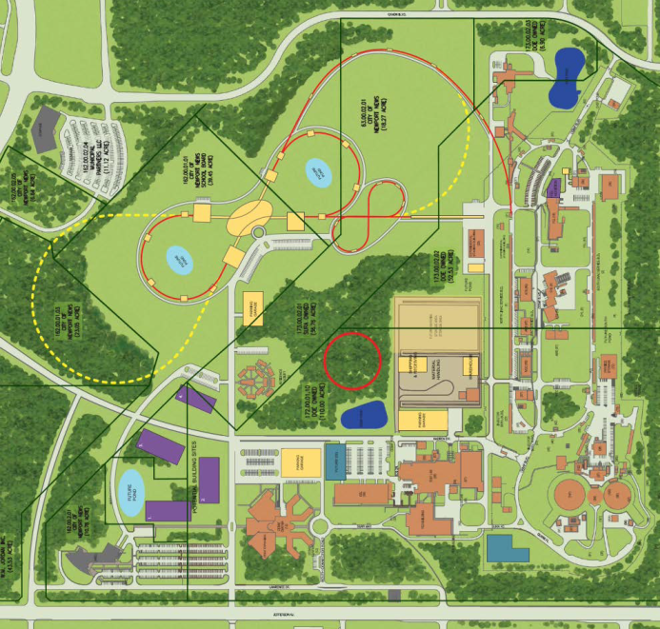
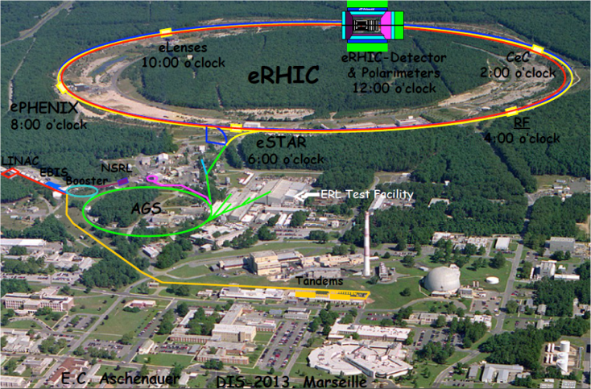
EIC implementations at JLab and BNL
MEIC
IP1
CEBAF
IP2
The MEIC will add 2.2 km storage rings for ions and electrons to 12 GeV CEBAF (which is 1.4 km in circumference)
eRHIC will replace one of the RHIC rings with a 3.8 km, recirculating, multi-pass linac with energy recovery
The fixed-target capability will be retained during construction and operation
  Interesting for for PVDIS, light meson spectroscopy, as well as high-x DIS
The remaining ion ring will be changed to include all snakes in order to meet the EIC polarization goal of 70%.

Slide 4
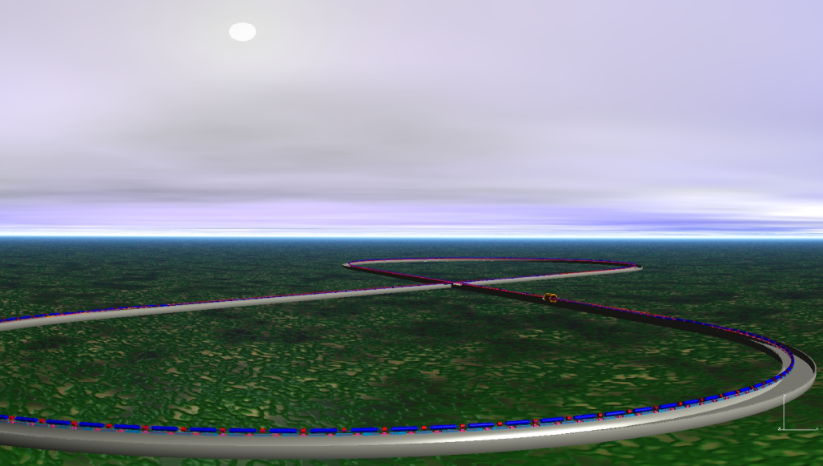
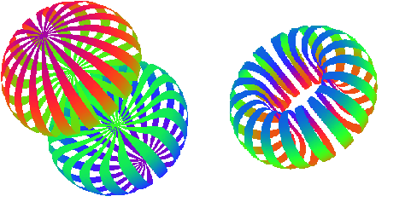
Polarized light ions at an EIC
The EIC will support a variety of light ions, including d, ³He, Li, etc
  Polarized ³He beams are relatively straightforward
The very small deuteron g-2 requires a figure-8 ring shape
  Both vector- and tensor polarization possible
-
Vector
From talk by E. Long
Tensor
( + )-2

Slide 5
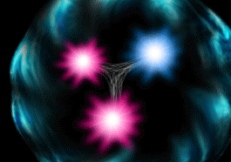
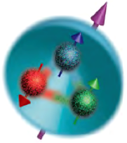
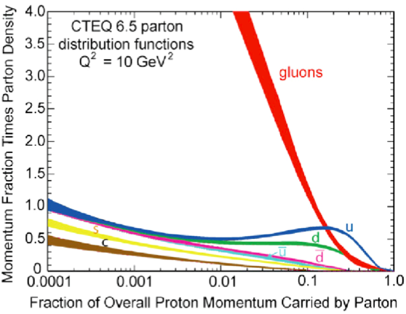
Some EIC physics highlights
3D structure of nucleons
How do gluons and quarks bind into 3D hadrons?
Role of orbital motion and gluon dynamics in the proton spin
Why do quarks contribute only ~30%?
Gluons in nuclei (light and heavy)
Example: spectator tagging with light polarized nuclei
Does the gluon density saturate at small x?

Slide 6

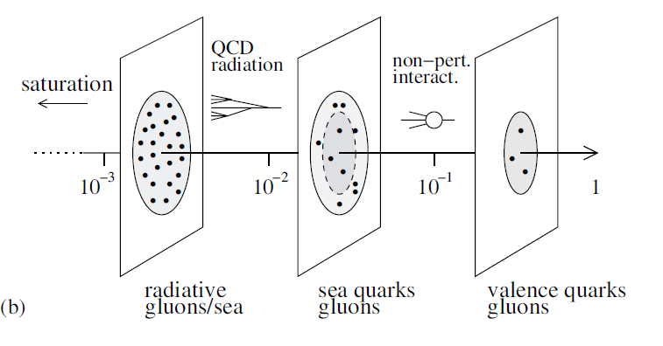
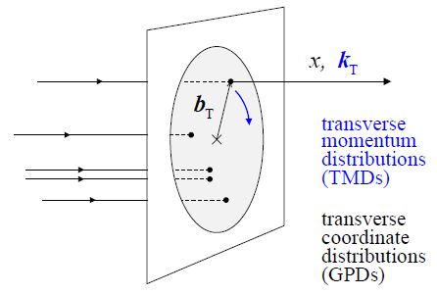
Kinematic coverage of an EIC
JLab 12 GeV: valence quarks
EIC stage I (MEIC): non-perturbabative sea quarks and gluons
  but also high x at high Q²: x_{max} = Q² / (s_{min} y_{min}), where s = 4E_{e}E_{p}
EIC stage II: extends coverage into radiation-dominated region
JLab
12 GeV
Stage I
Stage I+II
A stage I EIC (JLab MEIC) covers the x and Q² range between JLab 12 GeV and HERA (or a future LHeC)

Slide 7
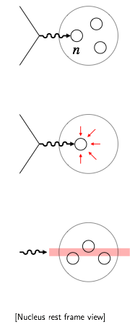
Physics opportunities with light ions
Neutron structure
  Flavor decomposition of quark spin, Δg, etc
  Binding, final-state interactions, polarization?
Bound nucleon in QCD
  Modification of quark/gluon structure by nuclear medium
  QCD origin of nuclear forces
  Understand nuclear environment?
Coherence and saturation
  Interaction of high-energy probe with coherent quark-gluon fields
    Onset of coherence, signature of saturation?
W. Cosyn, V. Guzey, D.W. Higinbotham, C. Hyde, S. Kuhn, W. Melnichouk, PNT, K. Park, M. Sargsian, M. Strikman, C. Weiss, JLab LDRD-funded project

Slide 8
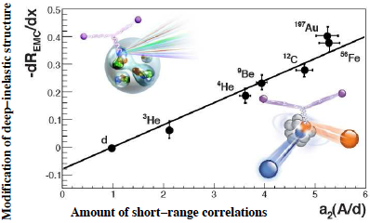
In-medium nucleon
EMC effect and Short-Range Correlations
Measurements at JLab 6 and 12 GeV presented at this workshop
At an EIC we can map out the recoil-momentum dependence in DIS on light nuclei
  Large p_{T} acceptance for spectators (~ 0-2 GeV/c)

Slide 9
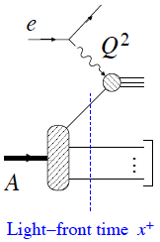
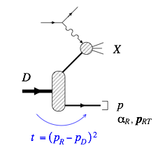
Measuring neutron structure
High-resolution spectator tagging
X
Polarized deuterium
  Needs to be theoretically understood also for ³He
  Light-cone wave function simple and known
  Limited possibilities for final-state interactions
  Coherent effects at N=2
  Complementary to saturation in heavy nuclei
Tagged spectators
Simplest case: tagged DIS on neutron
  Recoil-proton light-cone momentum
  Cross section in impulse approximation
Deuteron LCWF
Neutron SF
Frankfurt, Strikman 1981

Slide 10
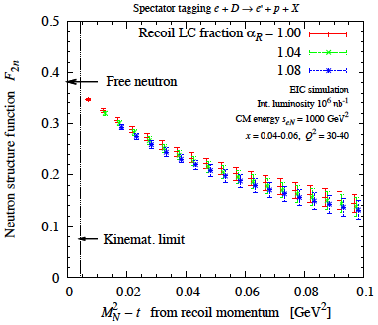
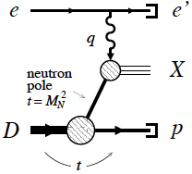
On-shell extrapolation t ➔ M_{N}
Only stat. errors
W. Cosyn et al., arXiv:1409.5768
Free neutron at pole
  Pole value not affected by final-state interactions
Sargsian, Strikman 2005: no-loop theorem
As Chew-Low extrapolation in πN, NN
  Model-independent method
  Also applicable to other observables and channels
➔ Talk by Vim Cosyn

Slide 11
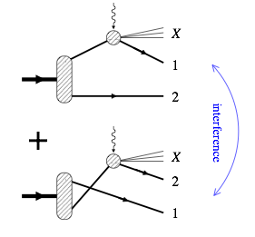
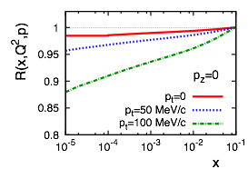
Shadowing
Shadowing at small x
  Interference between diffractive scattering on nucleons 1 and 2
  Nuclear effect calculable in terms of nucleon diffractive structure
  Determines approach to saturation in heavy nuclei
Gribov 70’s, Frankfurt, Strikman ’98, Frankfurt, Guzey, Strikman ‘02+
Shadowing in tagged DIS
  Strong p_{T} dependence
  Clean coherent effect with N=2
Frankfurt, Guzey, Strikman 2011

Slide 12
Polarized structure functions
As with unpolarized structure functions, on-shell extrapolation can also be performed in the polarized case
g₁^{n} accessible through longitudinal spin asymmetry A||
Only stat. errors
On-shell extrapolation of A|| is easier than for F₂^{n}
  Effects of FSI, etc, at higher values of M² – t are not included here
Note that A|| increases with Q² at fixed x
W. Cosyn et al., arXiv:1409.5768

Slide 13
CM-energy dependence of A||
At fixed x and Q², a lower cm-energy s increases the asymmetry
  A|| can be large compared with systematic uncertainties from polarimetry
FoM ~ event rate x (P_{e}P_{D}A||)²
Good low-s performance important!
FoM
x25
W. Cosyn et al., arXiv:1409.5768

Slide 14
Experimental considerations
Spectator tagging requires high-resolution forward hadron spectrometers
  Large-acceptance magnets required for good p_{T} coverage (e.g., SRC)
Inclusive measurements at low x and Q² are systematics limited
  Polarimetry is essential
  Radiative corrections and detector coverage important at extreme values of y
Exclusive- and semi-inclusive reactions pose a wide range of challenges
  Drive design of central detector
  Spectator tagging equally important as for inclusive (e.g., DVCS on neutron)!
High-x measurements possible at high Q² - extension of JLab 12 GeV
  Good performance at low s is essential
  At x = 0.7, and s_{eN} = 600 GeV² (e.g., 3 GeV e⁻ on 50 GeV/A N):
    Q² = 378 GeV² for y = 0.9
    Q² = 21 GeV² for y = 0.05
  These are deuteron kinematics for which the MEIC reaches its full luminosity

Slide 15
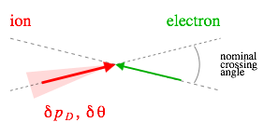
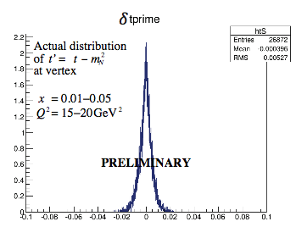
Uncertainty in spectator momentum
Two contributions to uncertainty in measured spectator momentum
  Resolution of detector
    Final-state resolution
  Momentum spread in the beam
    Initial-state resolution
50 GeV/A d beam
Ideal detector gives negligible contribution to uncertainty
  Can be achieved !
  Uncertainty entirely due to beam
    few x 10⁻⁴ longitudinal (dp/p)
    few x 10⁻⁴ rad angular (dθ/θ)
Simulation shows effect on resolution (binning) in t’
  Uncertainty increases with the ion beam energy

Slide 16
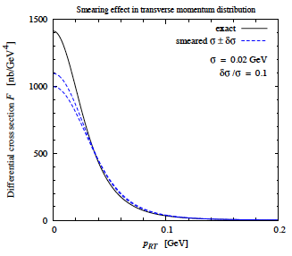
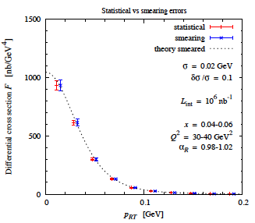
Systematic uncertainty on p_{T}
50 GeV/A d beam
Smearing in p_{T} (left) gives systematic affecting on-shell extrapolation (right)
The resolution σ ~ 0.02 GeV/c for a 50 GeV/A beam, is known to 10%
Can achieve systematic uncertainties for on-shell extrapolation comparable with the statistical uncertainties

Slide 17
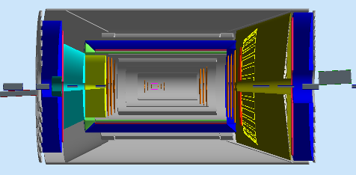
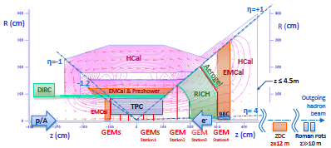
EIC central detectors
MEIC IP1 detector
The central detector concepts developed at JLab and BNL, exemplified by MEIC-IP1 and ePHENIX, are different in many details, but the impact on inclusive structure functions is limited
TOF
dual-solenoid in common cryostat
4 m inner coil
RICH
aerogel
+ CF₄
Forward
dipole
Coil wall
barrel DIRC + TOF
EM calorimeter
GEM/micromega central and forward
e/π HBD
π/K Cherenkov
Si-pixel vertex + Si disks
outer+inner EM cal
3 m
EM calorimeter
TOF
Coil wall
MEIC IP1
  Focus on exclusive processes and semi-inclusive DIS
  Several solenoid options available (CLEO or dual)
(top view)
3 m
5 m
(approximately to scale)
ePHENIX detector
(side view of top half)
ePHENIX
  Focus on jet-physics
  Possible to move sPHENIX to MEIC IP2

Slide 18
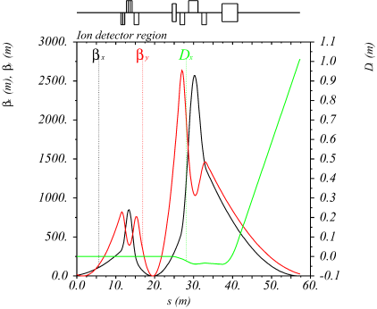
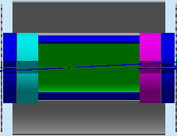
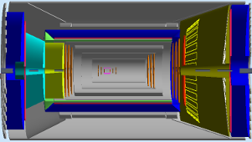
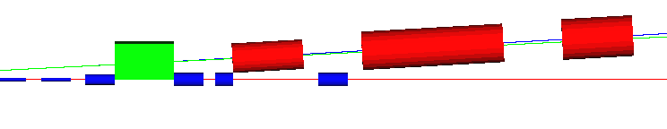
The MEIC full-acceptance detector
Design goals:
1. Detection/identification of complete final state
2. Spectator p_{T} resolution << Fermi momentum
3. Low-Q² electron tagger for photoproduction
4. Compton polarimeter with e⁻ and γ detection
(top view)
IP
FP
low-Q² electron detection
and Compton polarimeter
far forward
hadron detection
n, γ
e
large-aperture
electron quads
ion quads
~60 mrad bend
small-diameter
electron quads
p
50 mrad beam
(crab) crossing angle
central detector
with endcaps
Thin exit windows
Fixed trackers
Roman pots
dual-solenoid in common cryostat
4 m inner coil
barrel DIRC + TOF
RICH
Endcap
1 m
1 m
Ion quadrupoles
2 Tm dipole
EM calorimeter
EM calorimeter
Electron quadrupoles
e/π
Tracking
π/K
Trackers and “donut” calorimeter
EM calorimeter

Slide 19
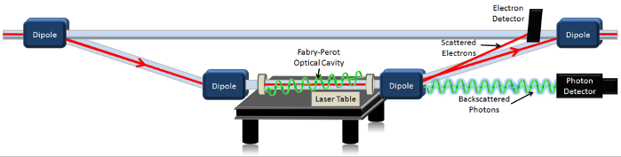
Compton polarimetry
Experience from HERA: uncertainty > 1%
  Limited to detection of Compton photon only
  Accelerator limitations (non-colliding bunches)
Experience from JLab and SLAC
  SLD at SLAC reached 0.5% detecting the Compton electron
  Compton polarimeters in Halls A and C at JLab reach ~1% detecting both the photon and the electron for cross check
  Laser at Chicane center ensures that polarization is identical to IP

Slide 20

MEIC polarimeters and low-Q² tagger
30 m
Compton polarimeter and low-Q² tagger in GEANT
Laser + Fabry Perot cavity
Compton photon
calorimeter
ν_{c}
Low-Q² tagger for low-energy electrons
Low-Q² tagger for high-energy electrons
Compton electron
tracking detector
Luminosity monitor
e⁻ beam to spin rotator
e⁻ beam from IP
Compton- and low-Q² electrons are kinematically separated!
Photons from IP
One IP will have much larger version of the JLab Compton chicane
  Detection of both electron and photon, the latter with low synchrotron background
Second IP will have a similar chicane optimized for electron detection
  Goal is to push the uncertainty of the polarimeter towards what SLAC achieved

Slide 21
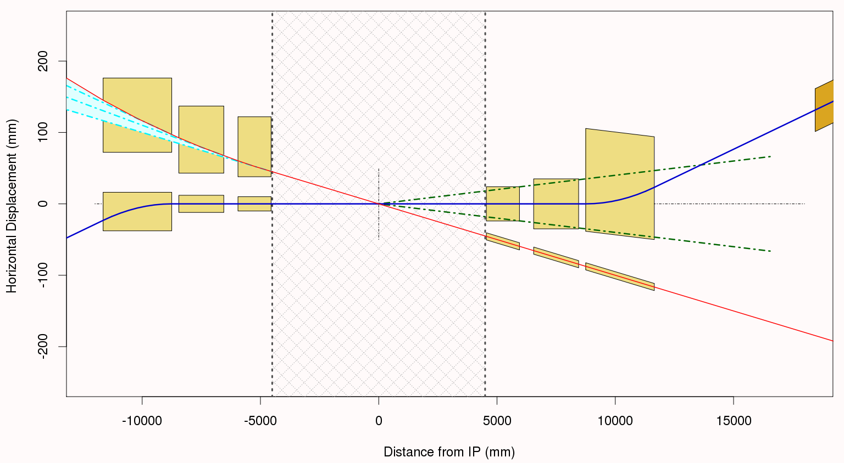
eRHIC: small-angle electron detection
e-beam gets extra 10 mrad deflection on the rear side
4.6 mrad
3.1
mrad
2.3
mrad
The detector is aligned with incoming e-beam.
photon
beam
line
10 mrad total crossing angle
Hadron beam is deflected 16 mrad on both rear and forward sides
E. Aschenauer, EIC detector R&D meeting, July 2014
The design of a Compton polarimeter and a low-Q² tagger for eRHIC is funded by the Generic detector R&D for an EIC program.

Slide 22
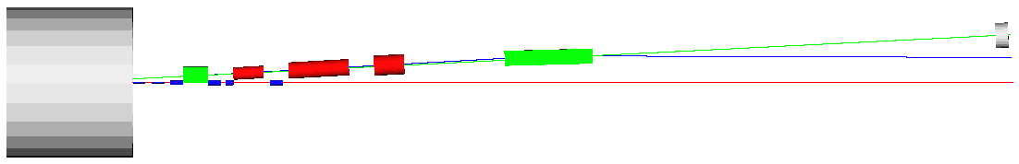
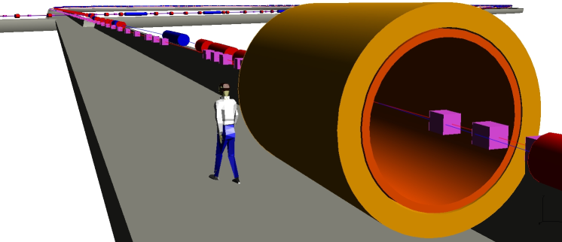
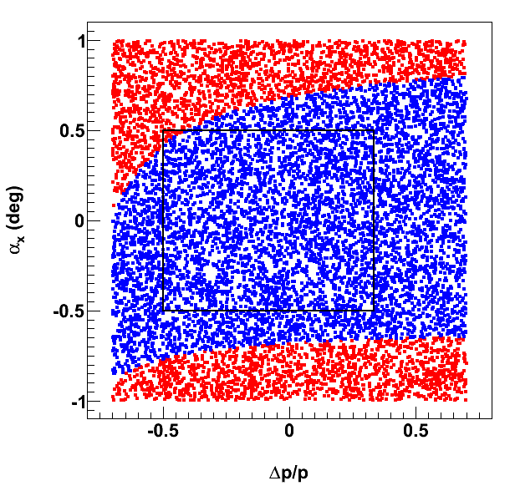
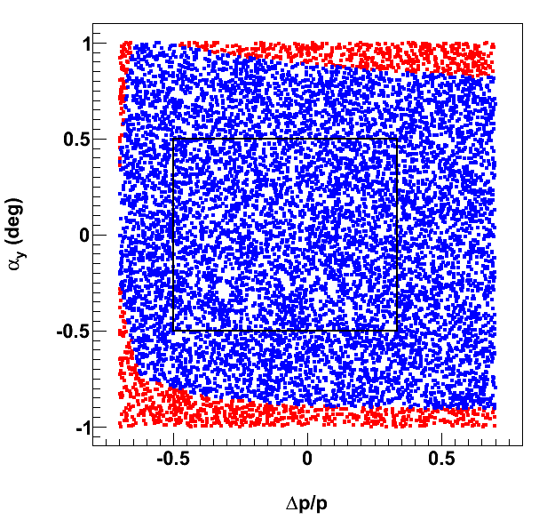
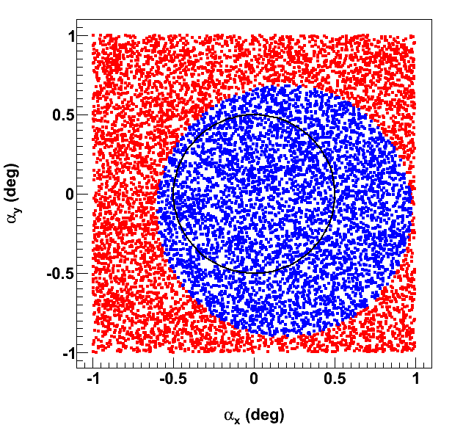
MEIC small-angle hadron detection
ZDC
(n, γ)
Aperture-free drift space
2 Tm dipole (out)
20 Tm dipole (in)
p
solenoid
far forward hadron detection
e
S-shaped dipole configuration optimizes acceptance and space (beam line separation > 1 m)
Spectator protons (exit windows)
Recoil protons (e.g. DVCS) (roman pots at focal point)
50 mrad crossing angle
(Belle II: 83 mrad)
Spectator angle after dipole is 75 mrad with respect to beam
ions
horizontal
vertical
neutrals
Red: detected before ion quadrupoles
Blue: detected after ion quadrupoles
Spectator protons from d: dp/p ~ -0.5

Slide 23
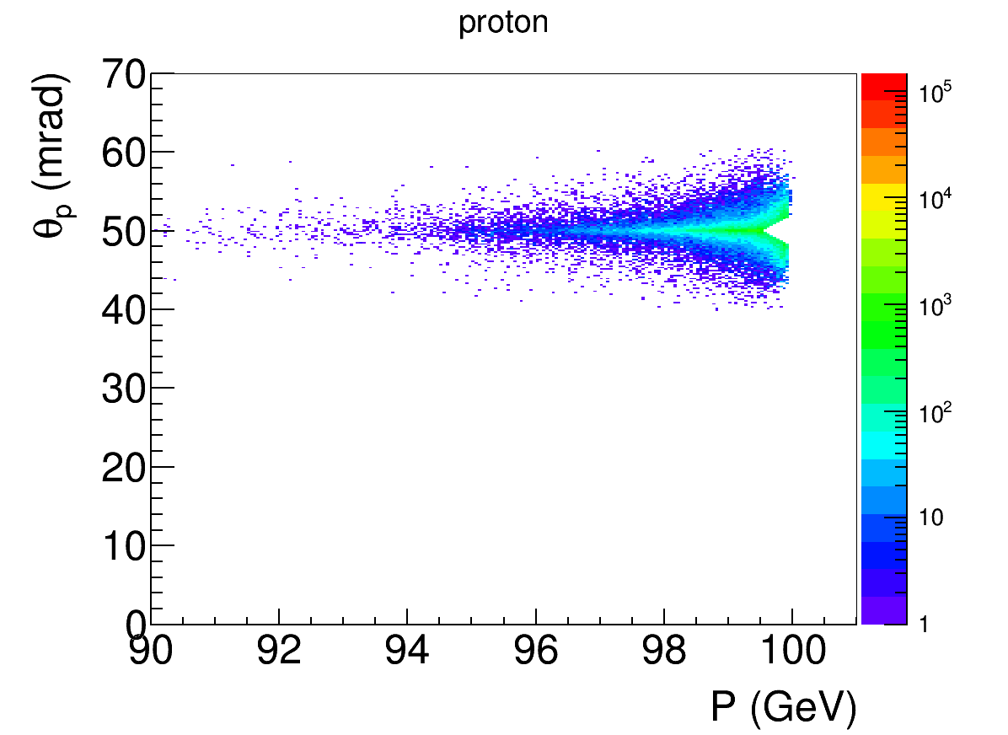
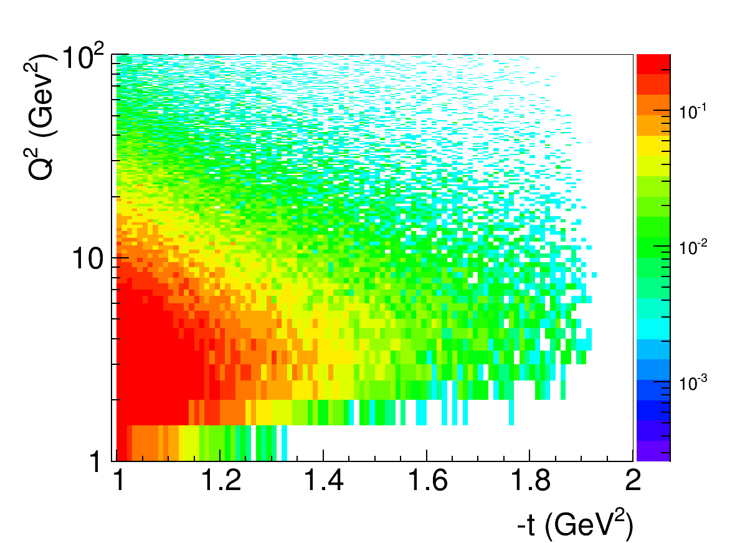
DVCS recoil proton acceptance
Kinematics: 5 GeV e⁻ on 100 GeV p at a crossing angle of 50 mrad.
  Cuts: Q² > 1 GeV², x < 0.1, E’_{e} > 1 GeV, recoil proton 10σ outside of beam
DVCS generator: MILOU (from HERA, courtesy of BNL)
GEANT4 simulation: tracking through all magnets done using the JLab GEMC package
low-t acceptance
high-t acceptance
p beam at 50 mrad
High-t acceptance limited by magnet apertures
10σ beam size cut:
  p < 99.5% of beam for all angles
  θ > 2 mrad for all momenta
-t = 1.9 GeV² ±14 mrad
Proton angle at IP
e⁻ beam at 0 mrad
Recoil proton angle is independent of electron beam energy: θ_{p} ≈ p_{T}/E_{p} ≈ √(-t)/E_{p}
A wider angular distribution at lower energies makes precise tracking easier

Slide 24
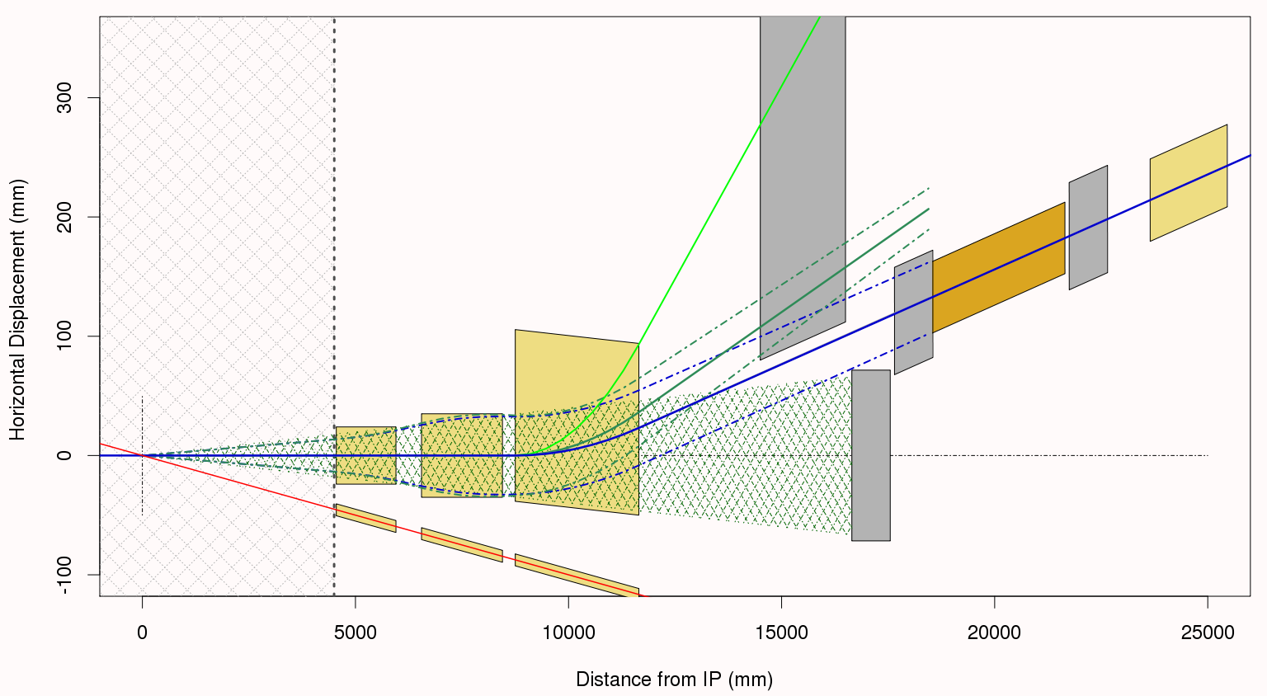
eRHIC: small-angle hadron detection
MDI Treaty Line
@ 4.5 m
p = 50%p_{o}
protons from Au decay
p = 80%p_{o}
Q2
B1
Q1
16 mrad deflection of the hadron beam
Q0
p = p_{o}
“ZDC”
Electrons pass
through essentially
zero B-field
Neutrons
E. Aschenauer, EIC detector R&D meeting, July 2014
New version of the eRHIC forward hadron detection has some similarities to the MEIC, but is smaller (16 vs 56 mrad bending angle, less drift space, no second focus on roman pot, no dipole before quads)

Slide 25
Summary
The EIC is the next-generation US QCD facility
Spectator tagging with polarized light ions offers many interesting opportunities
High-x physics is possible also at an EIC !

Slide 26
Backup

Slide 27
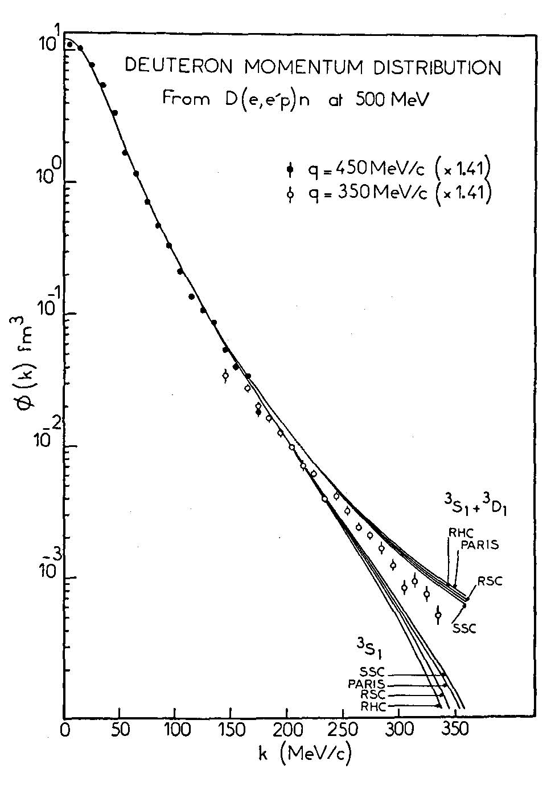
Forward detection – processes
Recoils in exclusive (diffractive) processes
  Recoil baryons
    Large t (p_{T}) range and good resolution desirable
  Coherent nuclear processes
    Good small-p_{T} acceptance extends detectable mass range
    Suppression of incoherent background for heaviest nuclei through detection of all fragments and photons
Partonic fragmentation in SIDIS
  Correlations of current and target jets
  Decays of strange and charmed baryons
Nuclear spectators and fragments
  Spectator tagging with polarized light ions
    p_{T} resolution < Fermi momentum
  Final state in heavy-ion reactions
    Centrality of collision (hadronization, shadowing, saturation, etc)
Heavy flavor photoproduction (low-Q² electron tagging)

Slide 28
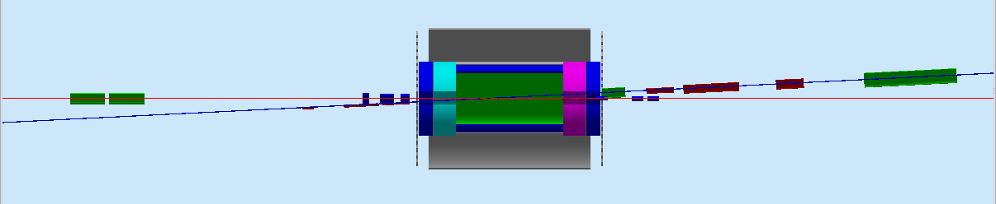
Forward detection before ion quads
7 m from IP to first ion quad
Ion quadrupoles: gradient, length
36 T/m, 1.2 m
Endcap detectors
1 m
1 m
89 T/m, 1.2 m
51 T/m, 2.4 m
Permanent magnets
2 T dipole
2 x 15 T/m
34 T/m
46 T/m
38 T/m
Electron quadrupoles
e
Tracking
Calorimeter
5 T, 4 m dipole
50 mrad crossing angle
  Moves spot of poor resolution along solenoid axis into the periphery
  Minimizes shadow from electron FFQs
Crossing angle
Dipole before quadrupoles further improves resolution in the few-degree range
Low-gradient quadrupoles allow large apertures for detection of all ion fragments
  Peak field = quad gradient x aperture radius

Slide 29
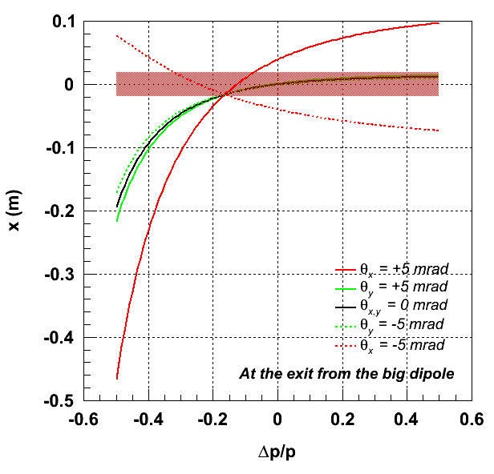
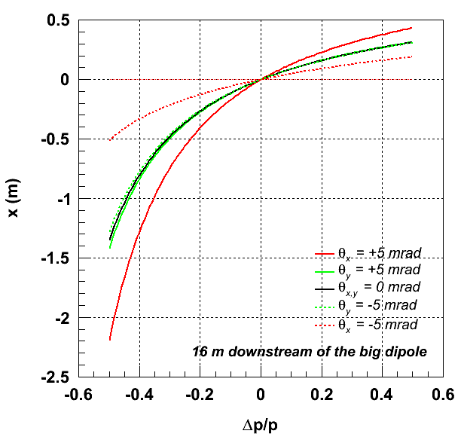
Spectator angles after dipole
True spectator fragments have very small scattering angles at the IP (black curve)
Spectator protons from deuterium have Δp/p = -0.5
After passing the large bending dipole, the spectator angle with respect to the ion beam is large
The angle in the magnet-free drift section after the dipole can be calculated from the displacement at the dipole exit and a point 16 m further downstream:
  θ = atan ((1.4- 0.2)/16) = 75 mrad (= 4.3°)

Slide 30
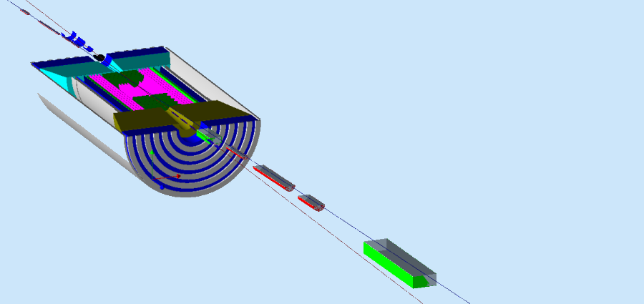
Far-forward detection summary
Neutrals detected in a 25 mrad (total) cone down to zero degrees
  ZDC with EMcal and high-res. Hcal (DREAM or particle flow).
Excellent acceptance for all ion fragments
Recoil baryon acceptance:
  up to 99.5% of beam energy for all angles
  down to 2 mrad for all momenta
Resolution limited only by beam
  Longitudinal (dp/p): 3x10⁻⁴
  Angular (θ, for all φ): 0.2 mrad
n, γ
2 Tm dipole
20 Tm dipole
p
solenoid
e
15 MeV/c resolution goal for a 50 GeV/A tagged deuteron beam

Slide 31
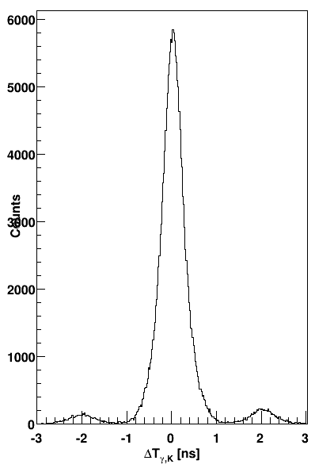
Bunch spacing and identification
Detectors (CLAS, BaBar, etc) at machines with high bunch crossing rates have not had problems in associating particle tracks with a specific bunch.
  Having more bunches lowers the average number of collisions per crossing
Example: CLAS detector at JLab 6 GeV
  2 ns bunch spacing (500 MHz rep. rate)
  0.2 ns TOF resolution (0.5 ns FWHM)
  The figure shows time matching of kaons in CLAS with electrons in the (low-Q²) tagger, in turn matched to the accelerator RF signal
    The 2 ns bunch structure is clearly resolved
  CLAS12 aims at a TOF resolution of 80 ps
K-e coincidence time in CLAS 6 GeV data
electron-kaon counts
The bunch spacing in the MEIC is similar to CLAS and most e⁺e⁻ colliders
  PEP-II/BaBar, KEKB/Belle: 8 ns
  Super KEKB/Belle II: 4 ns (2 ns with all RF buckets full)
  MEIC: 1.3 ns [750 MHz]
  CERN Linear Collider (CLIC): 0.5 ns [2 GHz]
Δt [ns]

Slide 32
Asynchronous triggering
The MEIC will use a “smart” asynchronous trigger and pipelined electronics
  The MEIC L1 rate is expected to be comparable to GlueX (200 kHz)
    Low-Q² (photoproduction) events will be pre-scaled
  Simple tracking at L2 will suppress random background (not from vertex)
    Already planned for CLAS12
Data-driven, asynchronous triggers are well-established
  If the number of collisions of interest per bunch crossing is << 1, synchronizing the trigger to each RF clock cycle becomes inefficient
  Sampling rate requirements for the pipelined electronics depend on signal properties and backgrounds, not the bunch crossing frequency
    JLab 12 GeV uses flash ADCs with 250 MHz (4 ns) sampling
  When a trigger condition is fulfilled (e.g., e⁻ found), memory buffers are written to disk or passed to L3 (at PANDA signals will go directly to L3)
  Correlations with the RF are made offline
  T0 is obtained from tracking high-β particles (e.g., electrons in CLAS)

Slide 33
Synchrotron radiation background
Initial electron beam pipe design for evaluating SR
Conclusion: diameter at the vertex tracker could be reduced to 25-30 mm
Surface: | 1 | 2 | 3 | 4 | 5 | 6
Power (W) @ 5 GeV | 3.0 | 5.7 | 0.2 | 0.8 | - | 0.03
γ >10 keV @ 5GeV | 5.6x10⁵ | 3.4x10⁵ | 1.4x10⁴ | 5.8x10⁴ | 167 | 3,538
Power (W) @ 11 GeV | 4.2 | 8.0 | 0.3 | 1.1 | - | 0.04
γ >10 keV @ 11 GeV | 5.6x10⁵ | 2.8x10⁵ | 9.0x10⁴ | 3.8x10⁵ | 271 | 13,323
Photon numbers are per bunch
Simulation by M. Sullivan (SLAC)

Slide 34
Hadronic backgrounds
Random hadronic background
  Assumed to be dominated by scattering of beam ions on residual gas (mainly ²H) in the beam pipe between the ion exit arc and the detector.
  Correlated background from photoproduction events is discussed separately
The conditions at the MEIC compare favorably with HERA
  Typical values of s are 4,000 GeV² at the MEIC and 100,000 GeV² at HERA
  Distance from arc to detector: 65 m / 120 m = 0.54
  p-p cross section ratio σ(100 GeV) / σ(920 GeV) < 0.8
  Average hadron multiplicity per collision (4000 / 100000)^{1/4} = 0.45
  Proton beam current ratio: 0.5 A / 0.1 A= 5
  At the same vacuum the MEIC background is 0.54 * 0.8 * 0.45 * 5 = 0.97 of HERA
  But MEIC vacuum should be closer to PEP-II (10⁻⁹ torr) than HERA (10⁻⁷ torr)
The signal-to-background ratio will be even better
  HERA luminosity reached ~ 5 x 10³¹ cm⁻²s⁻¹
  The EIC (and the MEIC in particular) aims to be close to 10³⁴ cm⁻²s⁻¹

