Slide 1
BSM at fixed target
Paolo Valente, INFN Roma
DM
DM
DM
DM
DM
DM
SM
SM
SM
SM
SM
SM
Direct detection
Production at accelerators
Indirect detection

Slide 2
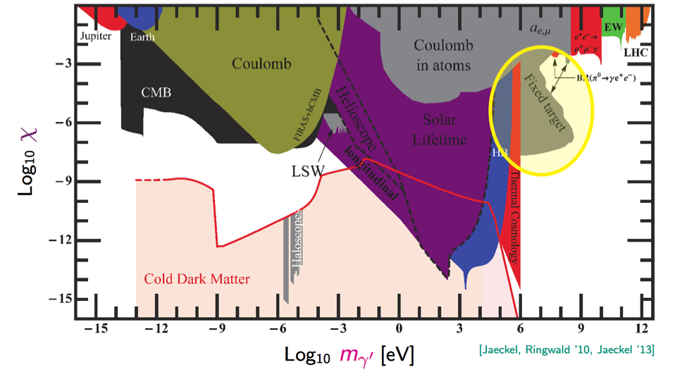
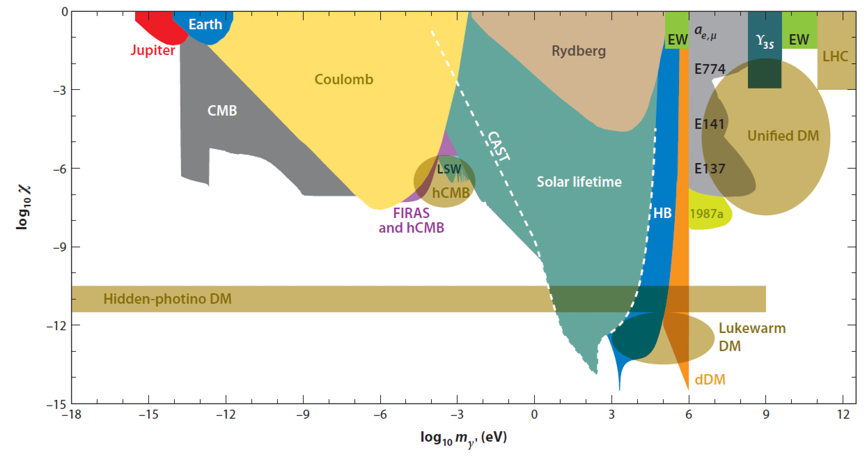
Where to look?
Accelerators
Light shining through wall
MeV
GeV
TeV

Slide 3
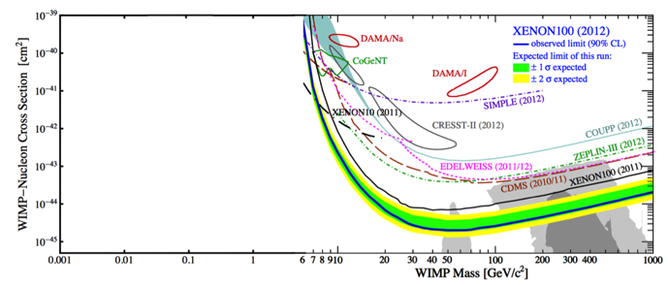
BSM: secluded DM
Problem: connect dark matter (e.g. WIMPs) to SM particles while being compatible with direct measurements:
Low elastic cross section on nuclei
Low production rates at colliders
Solution: DM not directly connected to the SM, but only through “mediator” particles
Hidden or secluded or dark sectors often present in string teories and supersymmetry
Simple model: add additional U(1)’ gauge group, but a vector boson is not the only possible mediator
Singlet scalar, right-handed neutrino, non-Abelian interactions in the secluded sector, arXiv:0711.4866 [hep-ph]
The mediator could be not the lightest dark particle and thus it is not itself a DM candidate
Nuclear recoil too weak
MeV
GeV
TeV

Slide 4
Portals to secluded sector
“portal”
vector
dark photon
Higgs
dark scalar
neutrino
sterile neutrino
axion
ALPs

Slide 5
Dark photon
The simplest hidden sector model just introduces one extra U(1) gauge symmetry and a corresponding gauge boson: the “dark photon" or U boson or heavy photon (γ’ or A’)
Two types of interactions with SM particles should be considered
As in QED, generates interactions of the type:
Not all the SM particles need to be charged under this new symmetry
In the most general case q_{f} is different in between leptons and quarks and can even be 0 for quarks. (P. Fayet, Phys. Lett. B 675, 267 (2009).)
Couples to SM hypercharge through kinetic mixing operator:
ε/2 F^{Y}_{μν}F’^{μν}, where F’^{μν}=∂_{μ}A’_{ν}
A_{μ} → A_{μ} + εa_{μ} ; α’ = ε²α
The dark photon acquires a (small) SM charge
e⁻
A’
e⁺
A’
A’
γ
e
εe

Slide 6
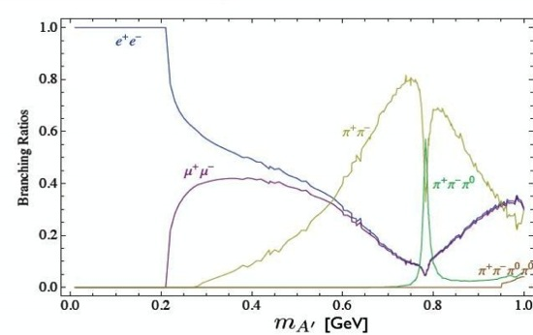
Decay to visibles
Assume that no additional lighter states exists in the dark sector with m_{χ}<m_{A’}/2
Dark photon couples to SM particles through kinetic mixing only (with same coupling εq)
For m_{A’}<2 m_{μ} only decays to e⁺e⁻
A portal to the hidden sector:

Slide 7
Decays to “invisibles”
If χ state with U(1) charge q_{U} and coupling constant g_{U} exists in the dark sector with m_{χ}<m_{A’}/2, the coupling to the A’ will be: q_{U}g_{U}
A’→χχ will be dominant wrt to visible decays for α_{D}>α, i.e. |q_{U}g_{U}|>εe
_
χ
SM
A’
_
A’
χ
SM

Slide 8
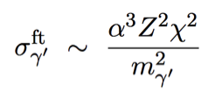
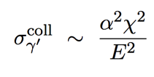
Why fixed target?
10¹¹ e⁻
10²³ atoms
ε
ε
Bremsstrahlung
Annihilation
Meson decay
γ
e⁻
e⁻
A’
γ
e⁺
π⁰,η
e⁻
A’
e⁻
e⁻
A’
e⁻
γ
e⁺
e⁺
e⁺

Slide 9
Fixed target experiments
Radiative background
e⁻
Main backgrounds: SM Bremsstrahlung + Bethe-Heitler
Kinematics:
A’ takes nearly all the beam energy E₀ (sharply peaked at x≈1)
Electron takes a small energy ≈ m_{A’}
A’ emission almost collinear to the beam: θ_{A’}=(m_{A’}/E₀)^{3/2}
Electron going at “wide” angle: θ_{e}=(m_{A’}/E₀)^{1/2}
A’ decay products open by θ ≈ m_{A’}/E₀
e⁺
e⁻
e⁻
γ
Bethe-Heitler background
e⁻
e⁻
e⁺
E₀
E’
Target
θ
e⁻
θ_{A’}
θ_{e}
E

Slide 10
Dark photon experiments
Thick target (beam-dump)
Thin target + decay of dark photon:
Decay to visible particles (e+ e−, μ+ μ−, …)
“Bump hunting”, looking for a peak in the invariant mass
Displaced vertices, looking for long-lived particles
Decay to invisible particles
Look for missing mass
DM particles recoil
[Meson decays]

Slide 11
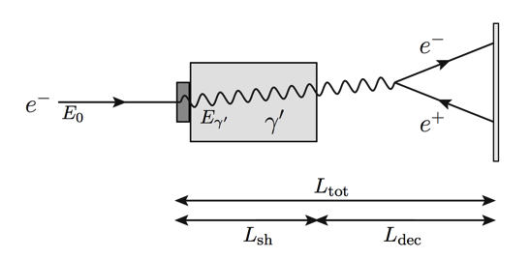
Electron beam-dump experiments
Shield
Target
Decay region
Detector
Luminosity:
At colliders:
Beam
section
In addition to cross section advantage

Slide 12
Electron beam-dump experiments
Electron energy distribution due to the interaction in target+shield
Decay probability of γ ’ after shield
dσ/dx for γ ’ production by Bremsstrahlung

Slide 13
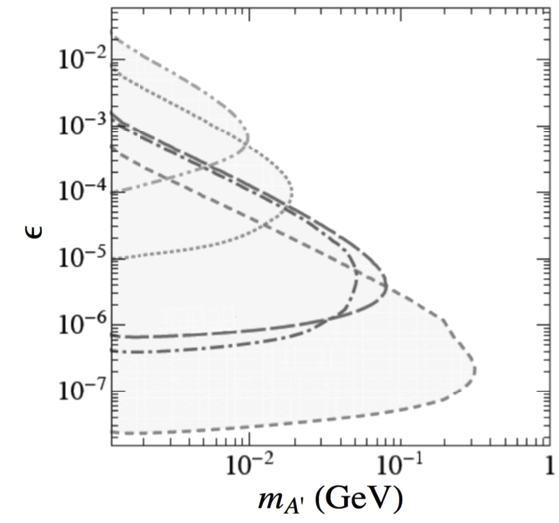
Limits from electron beam-dump experiments
decay in dump
L_{sh}
E₀
E₀
Not enough energy
N_{e}
L_{dec}
decay too far
rate too small

Slide 14
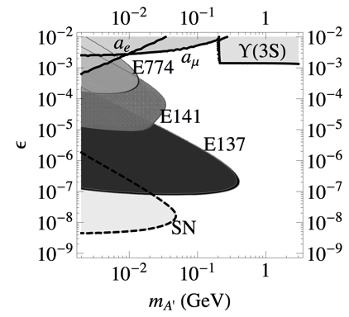
Limits from past experiments: electron beam-dump
Beam-dump experiments: looking for decay products of “rare penetrating particles” behind a stopped electron beam
SLAC E141 (1987) and E137 (1988), Fermilab E774 (1991)
5×10⁹
275 GeV
2×10¹⁵
9 GeV
2×10²⁰
20 GeV
μ⁺μ⁻
hadrons

Slide 15
Proton beam dump experiments
Use data of the search of ν_{H}→νe+e− for looking for P→γA’
Pseudoscalar decaying to spin 0 or ½ particles negligibly small
A’

Slide 16
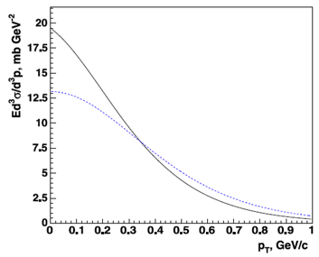
Limits from past experiments: proton beam dump
CHARM: ν_{H}→νe+e− from π,K, D decays
2.4⋅10¹⁸ POT
Look for η,η’→γA’
Parametrization of η,η’ production in pp collisions at 27.4 GeV
e⁺e⁻ reconstruction efficiency
Bourquin-Gaillard parametrization for the invariant cross section of hadron production in high energy hadronic collisions over the phase-space
π⁰:η:η’ yield=1 : 0.078 : 0.024
Phys. Rev. D85, 055027 (2012), Phys. Lett. B713, 244 (2012)

Slide 17
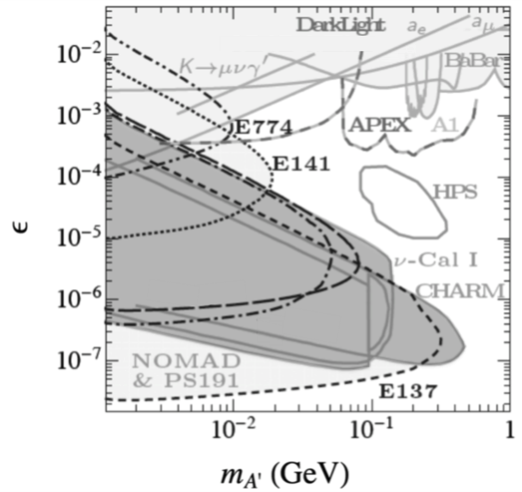
Limits from past experiments: proton beam dump
NOMAD and PS191 looked for decay of and heavy neutrino ν_{H}→νe+e−
Look for π⁰→γA’
NOMAD: 4.1⋅10¹⁹ POT
E>4 GeV, m_{ee}<95 MeV
PS191: 0.89⋅10¹⁹ POT

Slide 18
Thin target experiments
Running or coming soon:
APEX at JLAB Hall-A, test run done, full run coming
A1 at MAMI
HPS at JLAB Hall-B, test run done, full run coming
Proposed:
DarkLight at JLAB FEL (electron on gas jet target)
PADME at Frascati
P-348 at CERN SPS (thin-thick)
VEPP3 (electron on gas jet target)

Slide 19
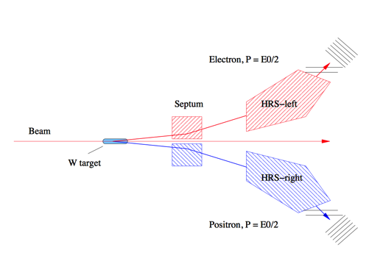
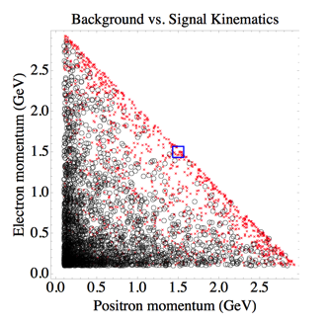
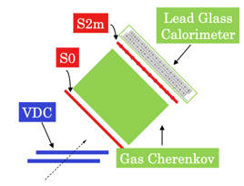
APEX
JLAb Hall-A High-Resolution Spectrometers
Background
m_{A’}=200 MeV
Spectrometer
acceptance
Opening angle ≈m_{A’}/E₀
0.3<p<4.0 GeV, θ₀=5°
Acceptance=4.5 msr
δp/p < 2×10⁻⁴
δφ=0.5 mrad, δθ=1 mrad

Slide 20
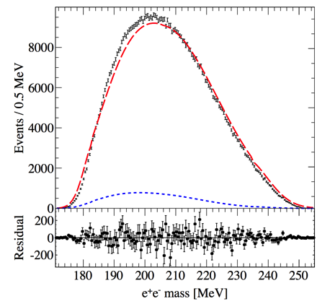
APEX test
QED
accidentals

Slide 21
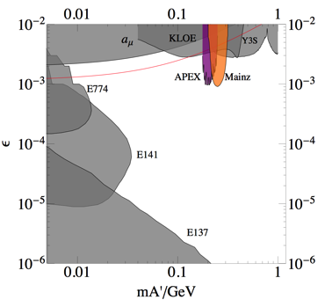
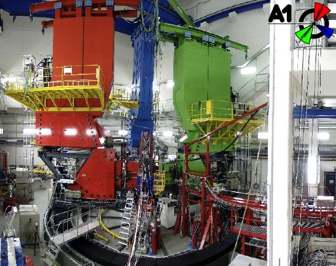
MAMI A1
JLAB Hall-A APEX
n×1.1 GeV, continuous, 200 μA beam
MAMI A1
855 MeV, continuous, 90 μA beam

Slide 22
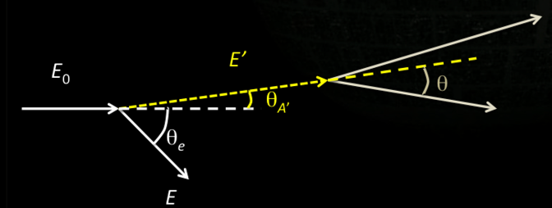
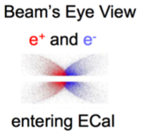
HPS
Increase acceptance wrt double arm spectrometer
Look for displaced vertex
θ of the decay is small:
put detectors as close as possible, good forward coverage
Aim at minimum θ_{A’} ≈ 15 mrad
Bump hunting needs good momentum/mass resolution
Good tracking and analyzing magnet
Aim at Δm/m ≈ 1% and Δz ≈ 1 mm
Trigger with a high rate ECAL
Magnet+ECAL to select e⁺ and e⁻
Magnet+muon detector to select μ⁺ and μ⁻

Slide 23
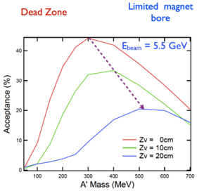
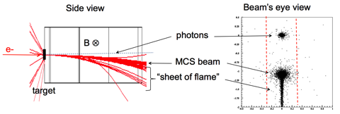
HPS
10⁻³ x₀
PbWO₄
Detectors split in two halves to let the beam pass through

Slide 24
HPS
<=2015
Test
1 week at 1.1 GeV
1 week at 2.2 GeV
>2015
3 months at 2.2 GeV
3 months at 6.6 GeV
APEX
HPS
(HPS test)

Slide 25
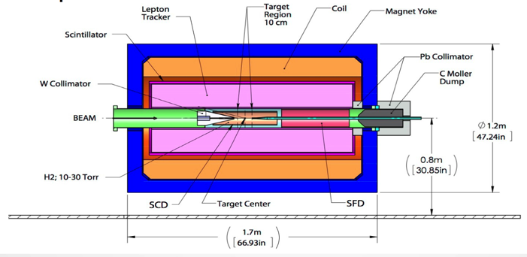
DarkLight
FEL electron beam, 100 MeV, continuous, 10 mA, sent onto 10¹⁹ H₂/cm² gas jet target
Proton recoil detector. Full reconstruction of the event for background rejection.
Vertex ing and low momentum lepton tracker: TPC
Outer trackers
- Test performed on prototype vacuum chamber to assess beam transport feasibility

Slide 26
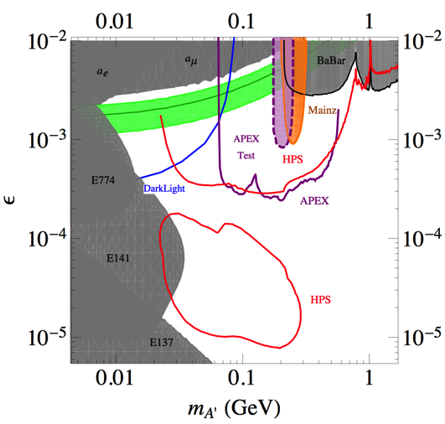
Dark photon at JLAB + MAinz

Slide 27
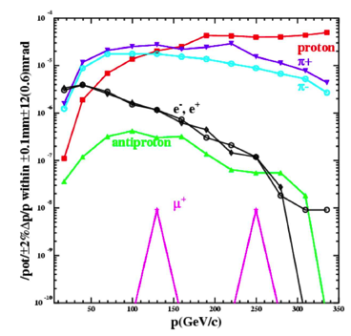
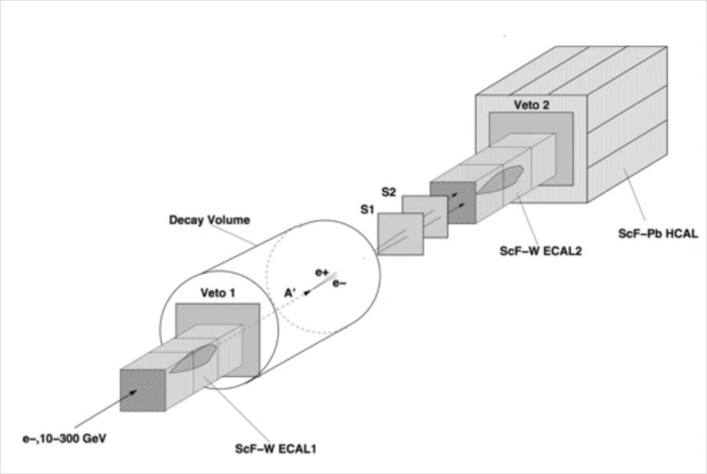
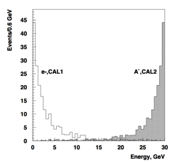
P-348 at CERN SPS
H4 high purity electron beam, <1% contamination required
(tertiary, from γ conversions)
SPSC-P-348
beam

Slide 28
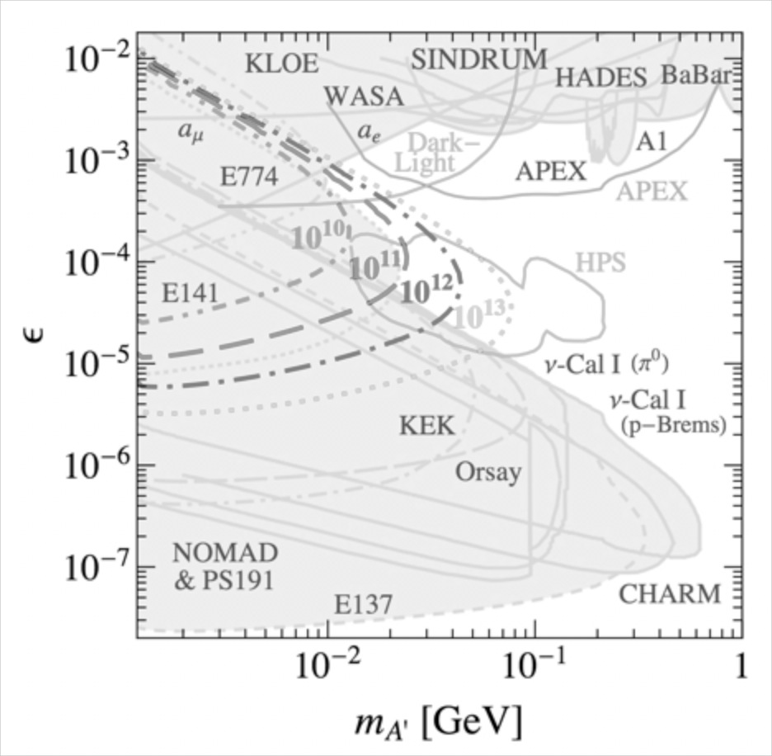
P-348 at CERN SPS
N_{e}=10¹² requested (3 months run)
Main backgrounds:
punch-through of primary energy into ECAL1
Beam-related background (mis-identified electrons): muon and hadronic events
10¹²

Slide 29
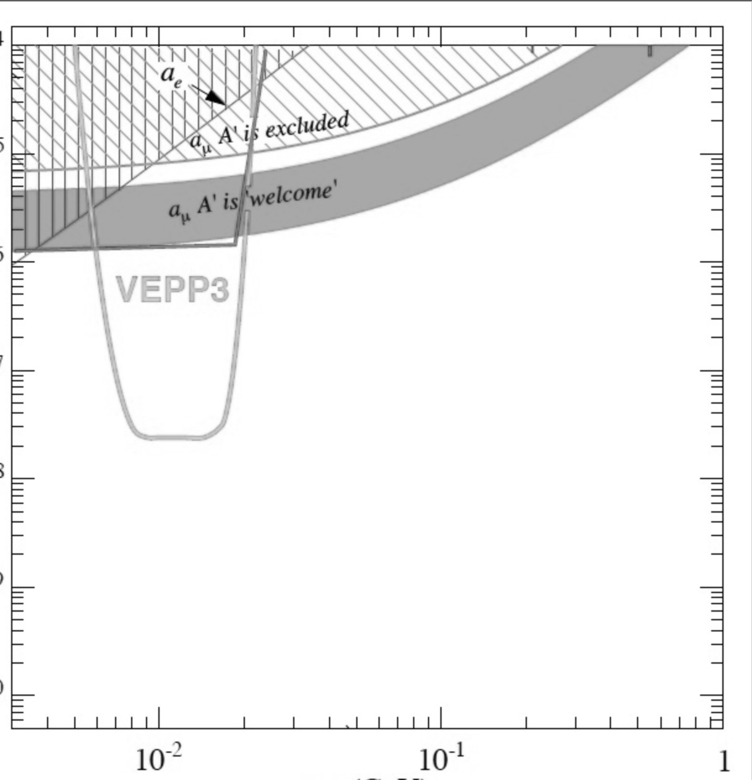
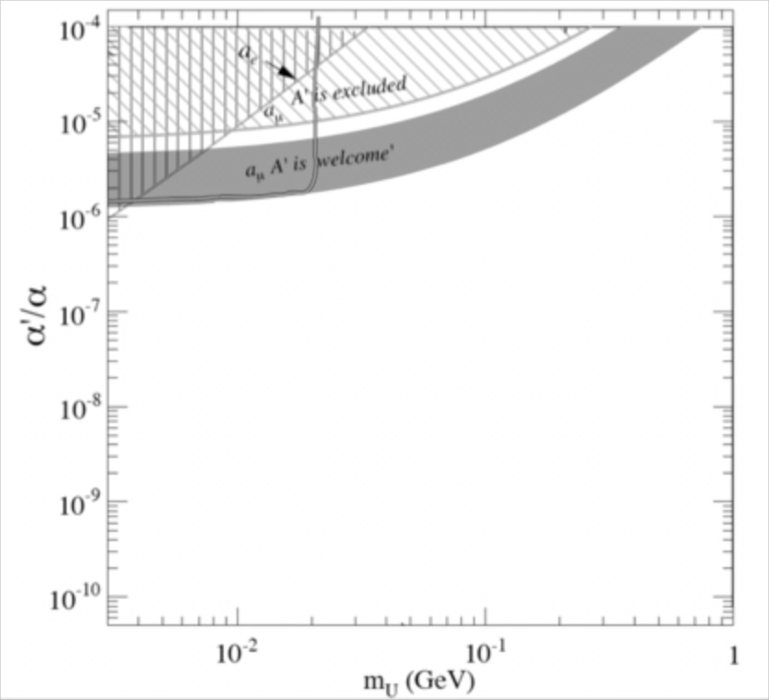
P-348 at CERN SPS
Also proposal for A’ →invisible search
N_{e}=10⁹
Main backgrounds:
punch-through of e⁻ or γ
Non-hermeticity of HCAL
Low energy tail of e⁻ beam
e⁻ induced photo-nuclear reactions
Muon events
Background free
Background assessment run requested for 2015, 10¹¹ electrons

Slide 30
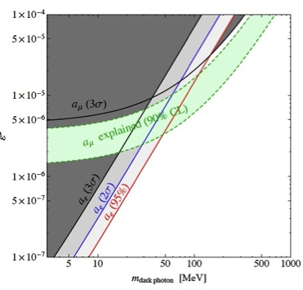
PADME at Frascati
PADME aims to detect U boson produced in e⁺e⁻ annihilation and decaying into invisibles
No assumption on the U decays products and coupling to quarks
Only minimal assumption: U bosons couples to leptons
No experimental results yet with this approach (VEPP3 planned experiment)
arXiv:1402.3620

Slide 31
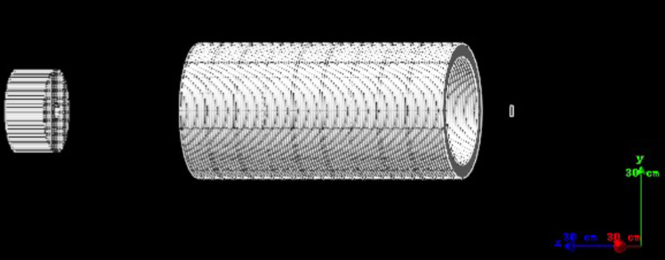
PADME at Frascati
Dipole
ECal
Tracker
γ
550 MeV e⁺
Target
10⁴/pulse
A’
M_{miss}²
1 m
Decay to invisibles
Decay to visibles
ECal
e⁺
e⁺
e⁺
A’
550 MeV e⁺
e⁺ Beam
Target
10⁴/pulse
Target
e⁻
e⁻

Slide 32
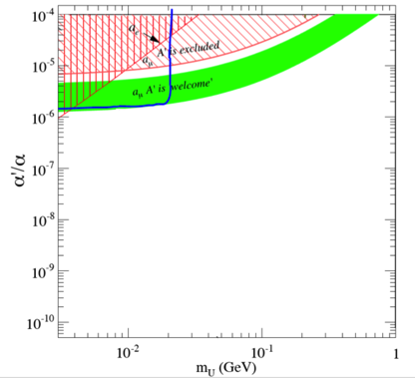
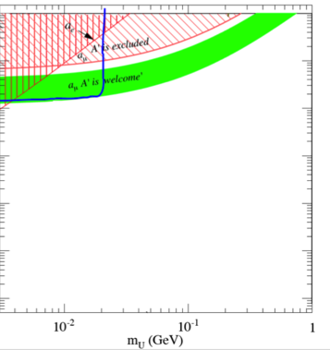
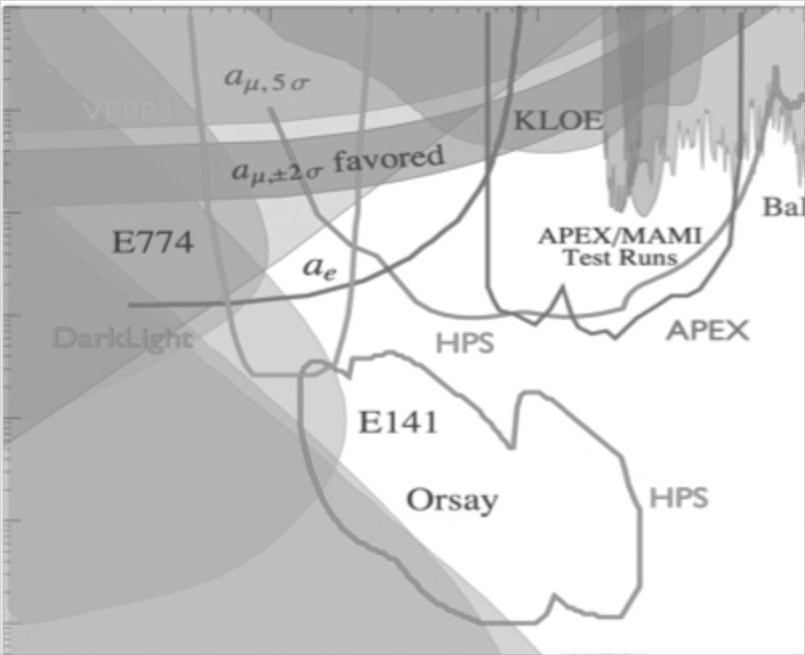
PADME at Frascati
Decay to invisibles
10¹³ e⁺ 550 MeV
Full simulation
Decay to e⁺e⁻
10¹³ e⁺ 550 MeV
First estimate
Dump experiment
10¹⁶ e⁻ 750 MeV
Positron annihilation experiments (decay to invisibles and e+e-): 10⁴ electrons/bunch × 50 Hz × 2⋅10⁷ seconds
Beam dump on thick target: 10¹⁶ electrons at 750 MeV dumped

Slide 33
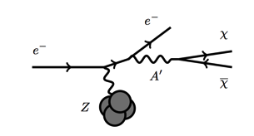
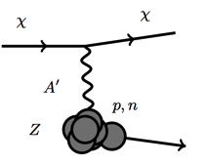
New ideas for dump experiment: BDX at JLAB
Scintillator 1 m³
1 MeV/10 MeV e⁺e⁻ detection threshold
Backgrounds:
Neutrino production
Cosmogenic muons and neutrons
LOI presented to PAC

Slide 34
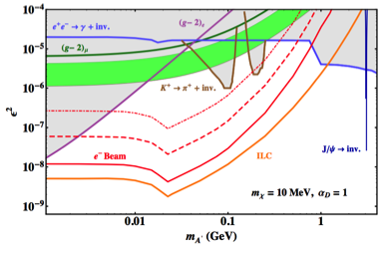
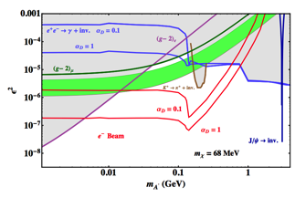
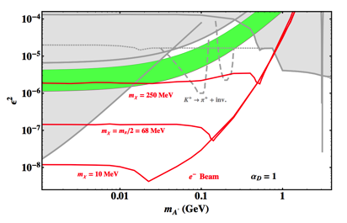
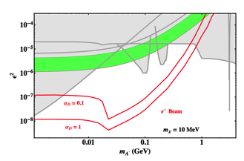
BDX experiment (Hall-A)
2√N_{bkg}= 2⋅ 10⁴
10³
10²² EOT = 1 beam-year at Hall-A
3 beam-years at Hall-C?
arXiv:1307.6554
40
2√N_{bkg}= 10
Pulsed beam

Slide 35
BDX at Frascati?

Slide 36
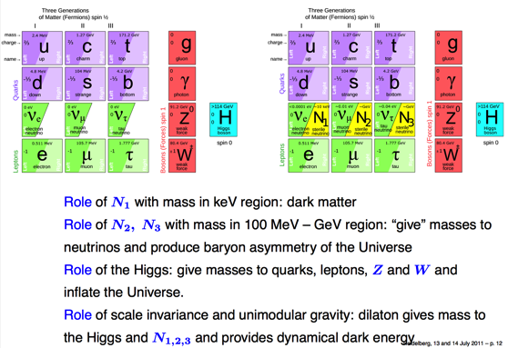
Heavy neutral lepton
Alternative to see-saw mechanism for neutrino masses: instead of a very heavy neutral lepton, new leptonic flavours with masses similar to those of known quarks and leptons. This gives the possibility of direct experimental search.
This can explain the missing of WIMP particles at LHC (DM particles are just too light)
Baryogenesis due to those new leptonic flavours
Shaposhnikov neutrino (νMSM) is a realization of this model

Slide 37
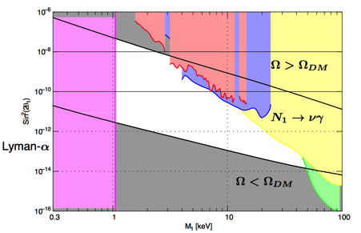
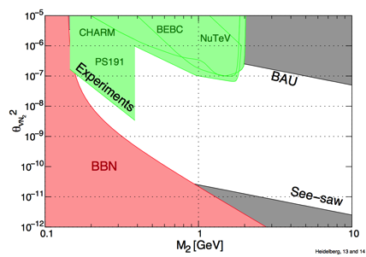
Heavy neutral lepton
N₁ limits from
Relic abundance, f f →νN₁
Radiative decays N₁→γν
Structure formation (light N₁ can erase fluctuations on small scale, check with Lyman-α)
_
N_{2,3} limits from
BAU requires out of equilibrium: mixing angle of N_{2,3} to active neutrinos not too large
Neutrino masses: mixing angle of N_{2,3} to active neutrinos cannot be too small
Nucleosynthesis should not be spoiled by N_{2,3} decays
No observation of N_{2,3}

Slide 38
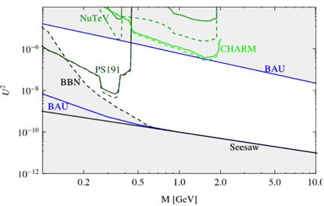
SHiP at CERN SPS
Look for HNL through the only possible interaction (Yukawa coupling to the Higgs) in the D mesons decay
μ
D_{S}
D_{S}
μ
π
ν_{μ}
U²
ν_{μ}
U²
N_{2,3}
N_{2,3}
H
H
Small couplings, long decay length (km!)
Decay channels in μ/e π, μ/e ρ, v μ e
Coupling
Mass

Slide 39
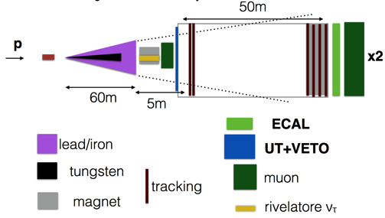
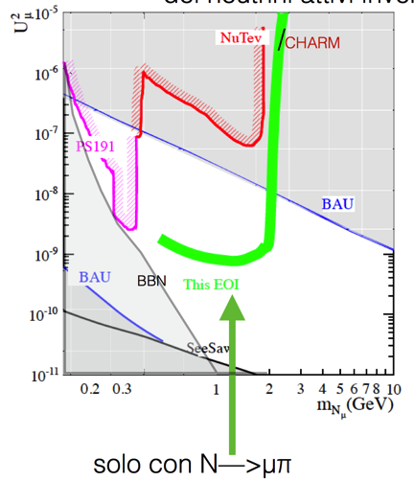
SHiP at CERN SPS
ν_{τ} detector
2×10²⁰ pot
Zero background

Slide 40
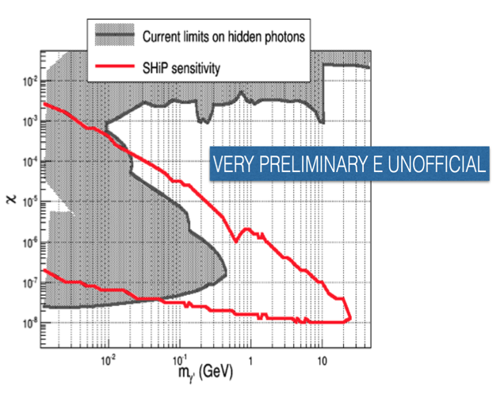
SHiP (dark photon search)
PADME
Visible decays
HPS

Slide 41
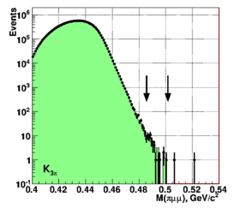
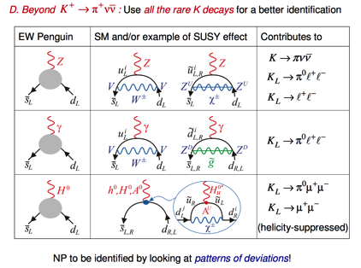
NA62
Of course NA62 main goal is already searching for BSM effects
What can be done with 10¹³ K decay and 2.5⋅ 10¹² π⁰ decays?
Search for LFV modes
Dark photon
Majorana neutrino
Right-handed neutrino

Slide 42
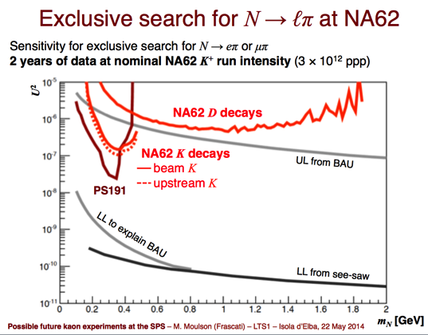
HNL at NA62
Exclusive search for N→eπ or μπ
Possible during K⁺→π⁺νν run
No substantial hardware modifications needed
May need some small hardware modifications to the NA62 level-0 trigger
Also possible during a neutral K run
K decays
Upstream: K decays in space between Be target and RP shield wall
Beam: K decays in 100 m downstream of KTAG, upstream of Straw 1
D decays
Fully analogous to SHiP experiment; lower intensity

Slide 43
HNL at NA62
Still a factor 10 below SHiP for D decays

Slide 44
Growing interest in the low mass DM/hidden sectors/portals
Careful with assumptions and model-dependent limits!
Lots of limits from old experiments re-analysis
CERN fixed target program alive and kicking
JLAB strong investment
Opportunities in Italy (Frascati electron/positron beam)

