Slide 1
New Magnet Technology
(for high field)
Lucio Rossi
CERN
INFN - CNS1 future strategy Elba 22 May 2014

Slide 2

Main parameter: energy
E_{beam} ≅ 0.3×R×B
L_{dipole field} ≅ 2/3 L_{tunnel}
LHC (R_{tunnel} = 4.25 km):
0.3×2.8km×8.33T= 7.0 (14)TeV
0.3×2.8km×4.76T= 4.0 (8) TeV
0.3×2.8km×7.74T= 6.5 (13)TeV
HE-LHC (same tunnel)
0.3×2.75km×20 T= 16.5 (33) TeV
0.3×2.75km×16 T= 13.2 (26) TeV
0.3×2.75km×11 T= 9.24 (18.5)TeV
0.3×2.75km×9.22=7.75 (15.5)TeV
(lattice 8.33+11+8.33 T)
The magnetic field is mainly determined by:
→ Superconductor (B_{c}, J_{c})
→ Coil thickness (∼Aturns)
→ Mechanics (ability to keep the huge e.m. forces)
However other parameters play a key role:
  Magnetic design (optimization)
  Stability and Protection
  Magnet aperture (SSC! )
  beyond 11 T one needs to change Injector (SPS→PS→ Booster)

Slide 3
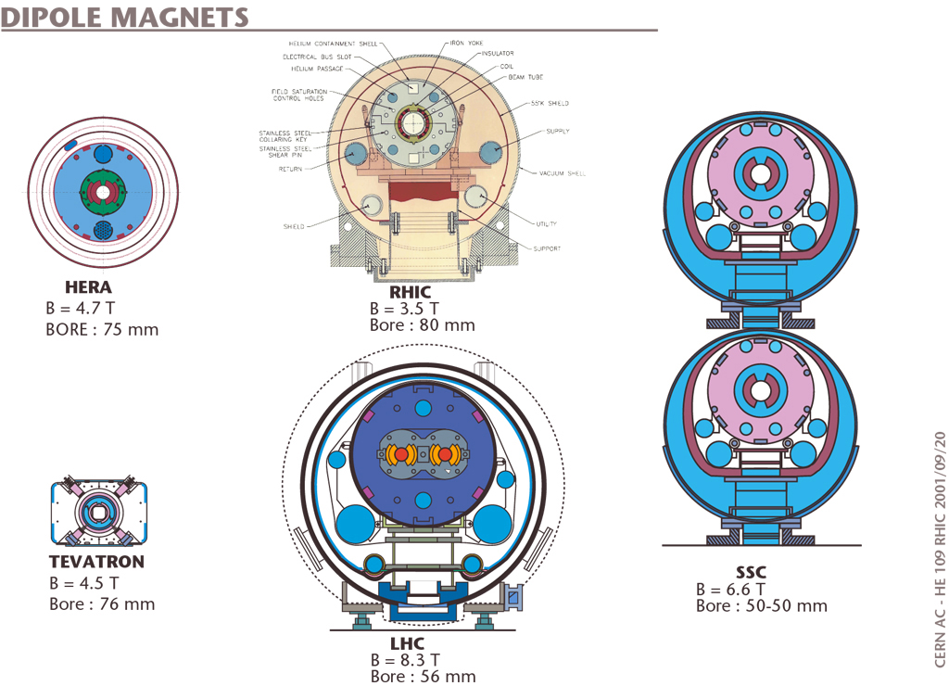
LHC is the summit of 30 years of SC magnets

Slide 4
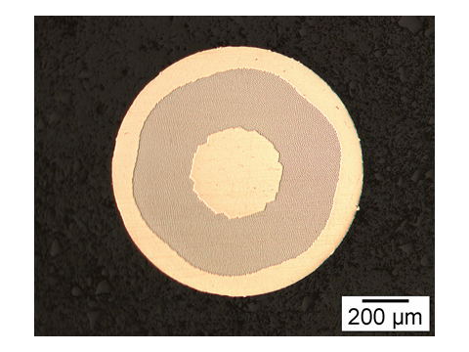
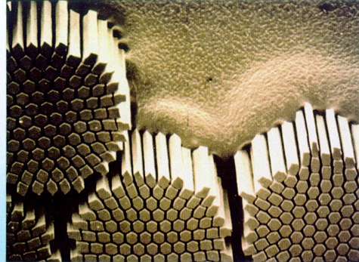
LHC: 300,000 km of SC wires
180,000,000 km of NbTi filaments
Developing SC is the key in SC accelerators.
The perfection of LHC superconductor (thanks also to SSC R&D) is such that we basically «forget» the SC effects
6-7 μm filament, to limit persisitent currents at injection

Slide 5
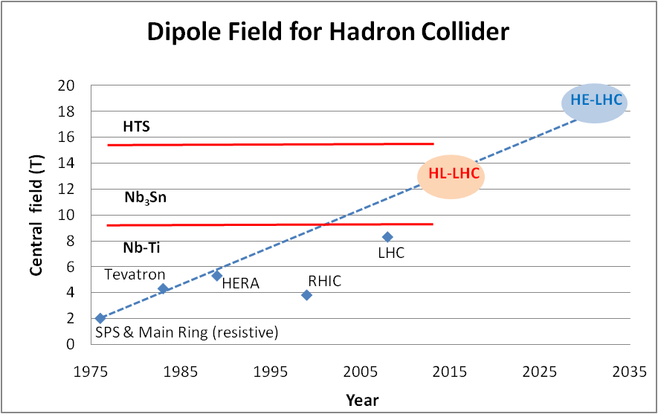
Main dipoles: what we can reach?
Looking at performance offered by practical SC, considering tunnel size and basic engineering (forces, stresses, energy) the practical limits is around 20 T. Such a challange is similar to a 40 T solenoid (μ-C)

Slide 6
Nb-Ti operating dipoles;
Nb3Sn cosϑ test dipoles
Nb3Sn block test dipoles
Nb3Sn cosϑ LARP QUADs

Slide 7
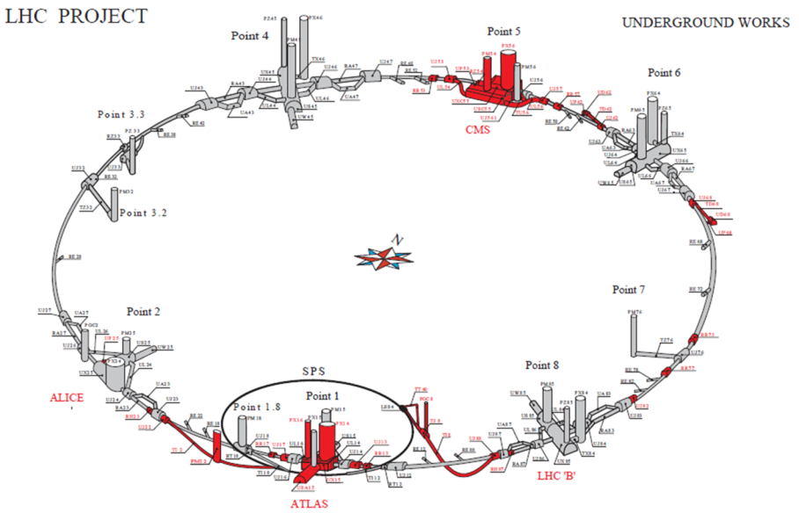
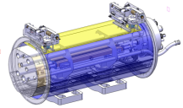
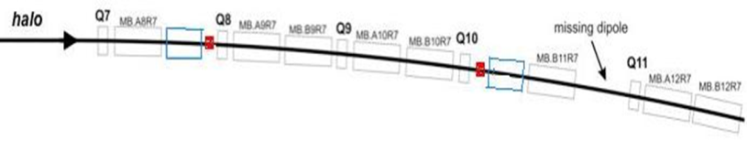
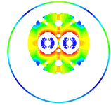

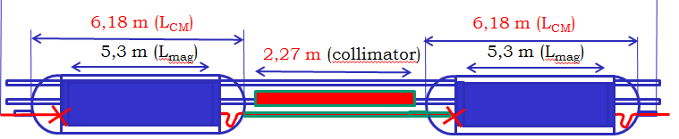
DS collimators ions – 11 T
Recommended by the Collimation Review
11 T Nb₃Sn

Slide 8

DS collimation 11 T – P7
Colimation review: preparare and then check real need during Run II
11 T Nb₃Sn

Slide 9
Milestones 11 T
Aug. 2010: seminar Rossi at FNAL, proposing the 11 T as part of their GARD
October 2010: start of 11 T project in FNAL
First test : June 2012
Third test : May 2014
CERN first test : Oct 2014
First twin magents by FNAL : end 2014
First long magnet (5.5 m) CERN: 2016/17

Slide 10
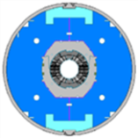
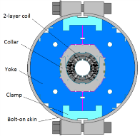
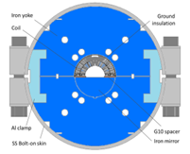
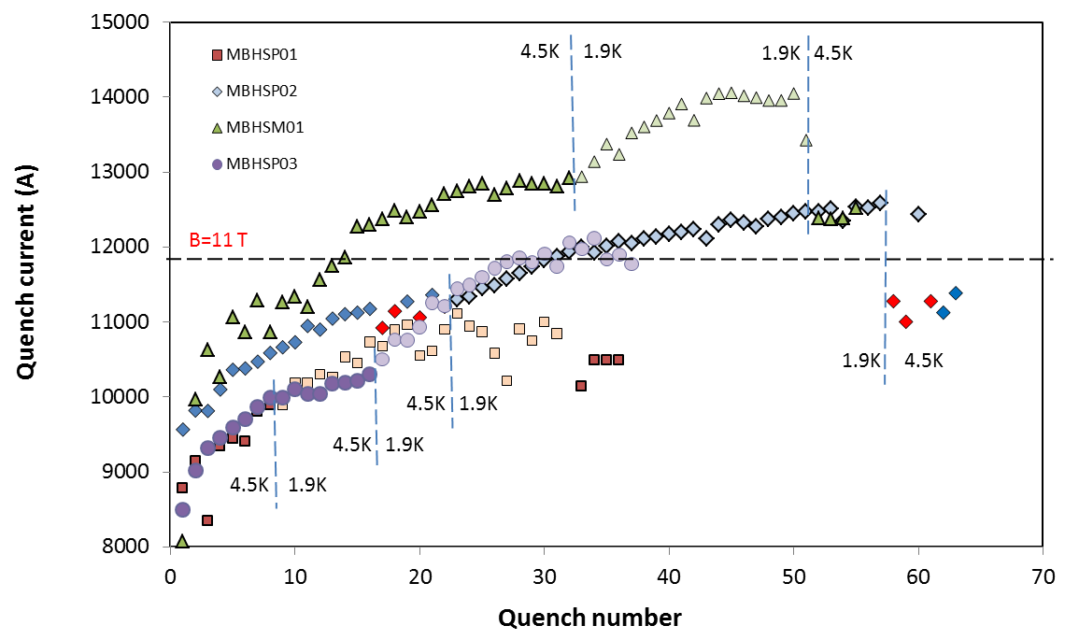
Quench perfomance 11 1T
MBHSP01:
  limited quench performance
  B_{max}=10.4 T at 1.9 K, 50A/s
  78% of SSL
  strong ramp rate sensitivity
  holding quenches
MBHSP02:
  improved quench performance
  B_{max}=11.7 T at 1.9 K
  97.5% of B_{des}=12 T
  low ramp rate sensitivity
  holding quenches
MBHSM01:
    B_{max}=12.5 T at 1.9 K
    ~100 (97)% at 4.5 (1.9) K of SSL
    low ramp rate sensitivity
    no holding quenches
MBHSP03: test in progress
MBHSP01
MBHSP02, 03
MBHSM01

Slide 11
The Superconductor « space »
Nb-Ti
Nb₃Sn
HTS

Slide 12
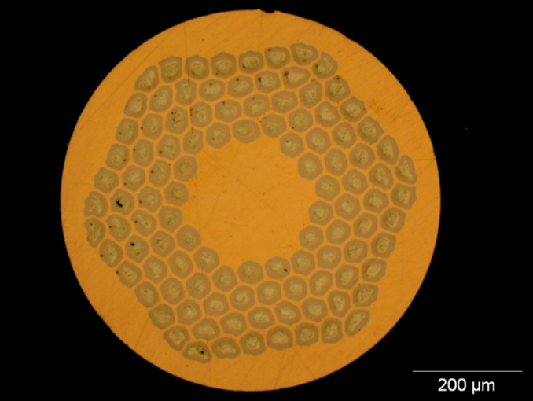
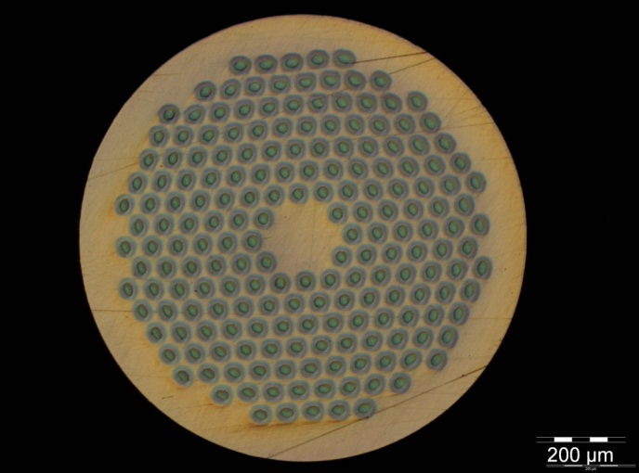
The « new » materials
1 – Nb3Sn
Recent 23.4 T (1 GHz) NMR Magnet for spectroscopy in Nb₃Sn (and Nb-Ti). 15-20 t/y for NMR and HF solenoids. Experimental MRI is taking off
ITER: 500 t in 2010-2015! It is comparable to LHC!
HEP ITD (Internal Tin Diffusion):
  High Jc., 3xJc ITER
  Large filament (50 µm), large coupling current...
  Cost is 5 times LHC Nb-Ti
0.7 mm, 108/127 stack RRP from Oxford OST
1 mm, 192 tubes PIT from Bruker EAS

Slide 13
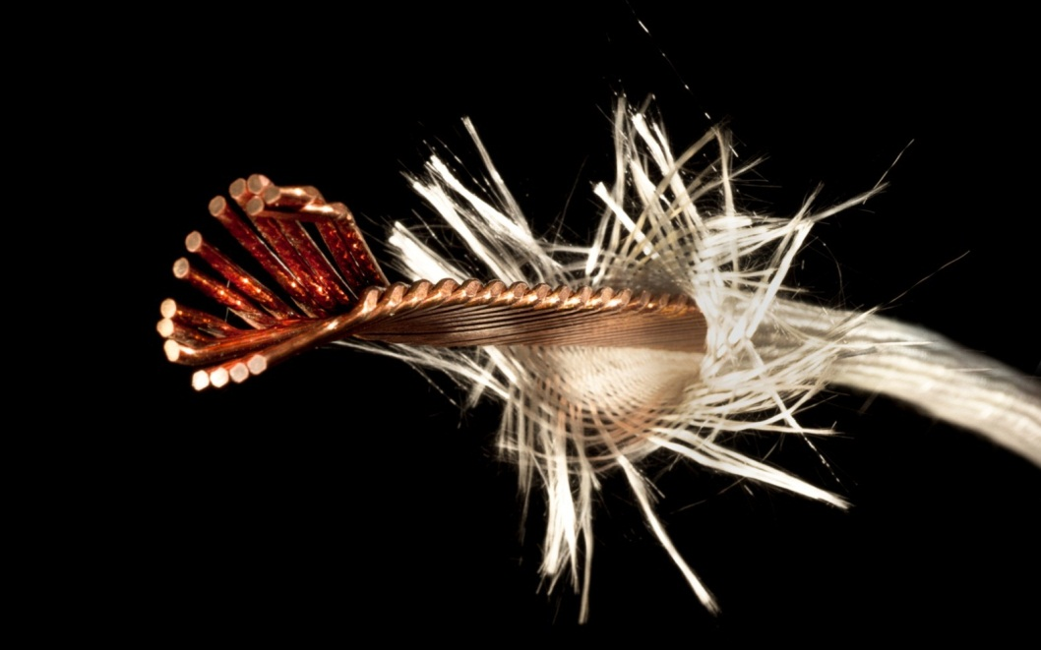
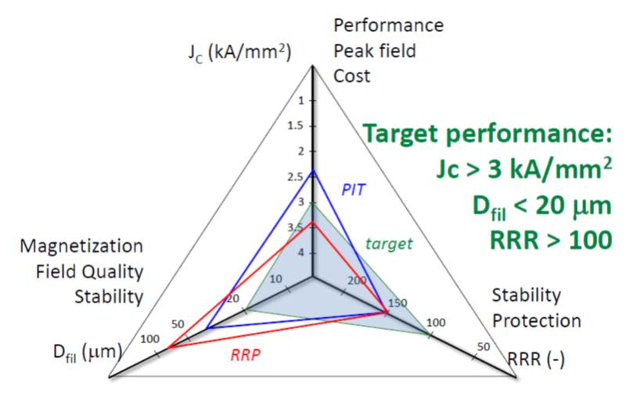
The successful cable as result of 5 –y R&D (FP6-CARE-NED)
1.25 mm PIT strand, 14 strands @ CERN 2011
Thermo-magnetic instability and FQ issues will continue to play a major role. However the route is traced and we can expect that in the next 5-6 years ,also thanks to HiLumi R&D and industrialization, Nb₃Sn for HEP will be consolidated.

Slide 14
CERN Program
Nb₃Sn
HiLumi: consolidate cable by 2014 and magnet desing – perfomance at 11-13 T by 2016
Hilumi magnets has high quality only at collision
FCC: launch conductor R&D now for new generation
Design 15-16 T dipole (small aperture) now, first model by 2018?
HTS
Started basic R&D (Eucard2)
Explore the parameter space
Demonstrate technical feasibility (the equivalent of LARP program for Nb3Sn) by 2018
Cost reduction program (2020)
Design and test accelerator magnets by 2020-2025
HTS will be needed for HE-LHC or FCC at least in some regions of the accelerator. Boost 20-25% in energy.

Slide 15
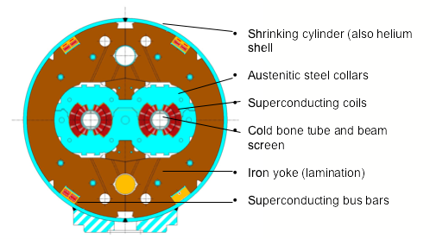
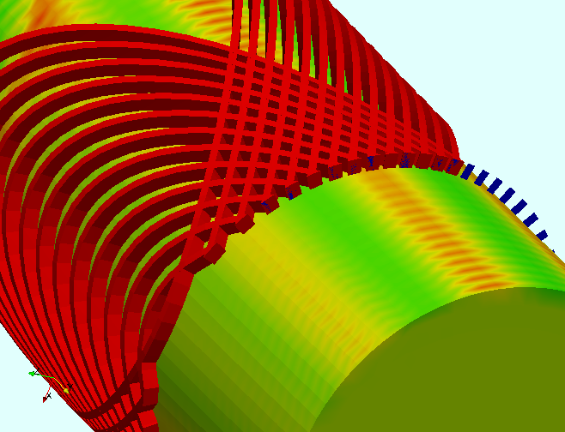
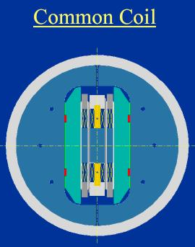
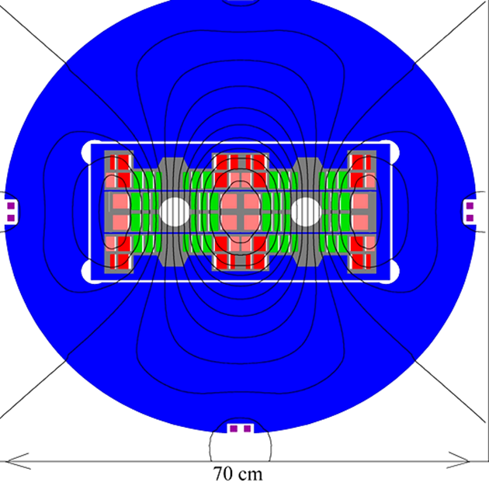
Defferent shapes (field optimization & structure)
Cosϑ Coil
Canted Solenoid Coil
Bloc Coil

Slide 16
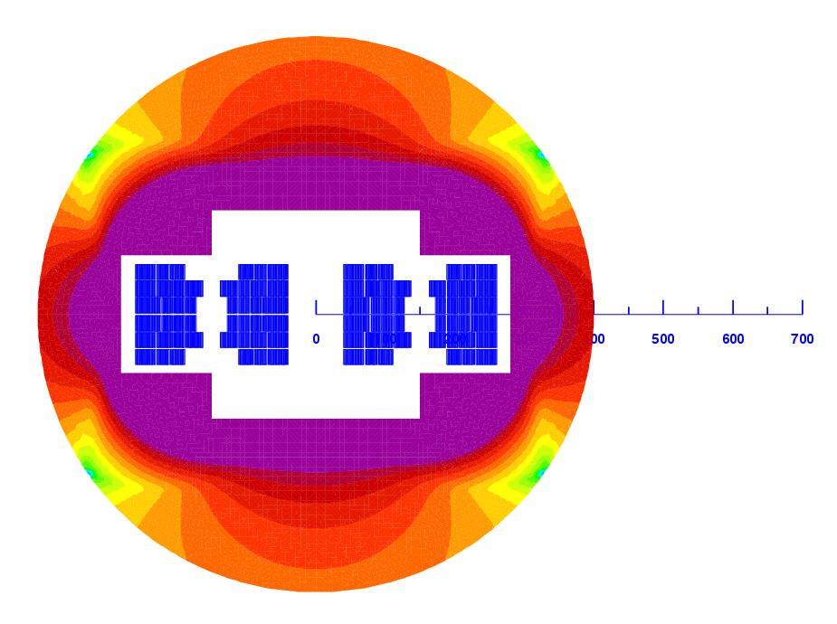
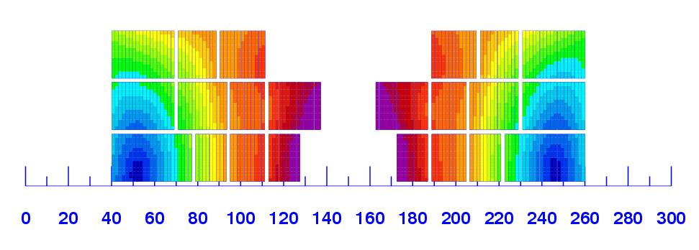
First consistent cross section, 2010 WG and Malta (fits our tunnel)
L. Rossi and E. Todesco
Magnet design: 40 mm bore (depends on injection energy: > 1 Tev)
Very challenging but feasable: 300 mm inter-beam; anticoils to reduce flux
Approximately 2.5 times more SC than LHC: 3000 tonnes!
Multiple powering in the same magnet for FQ (and more sectioning for energy)

Slide 17
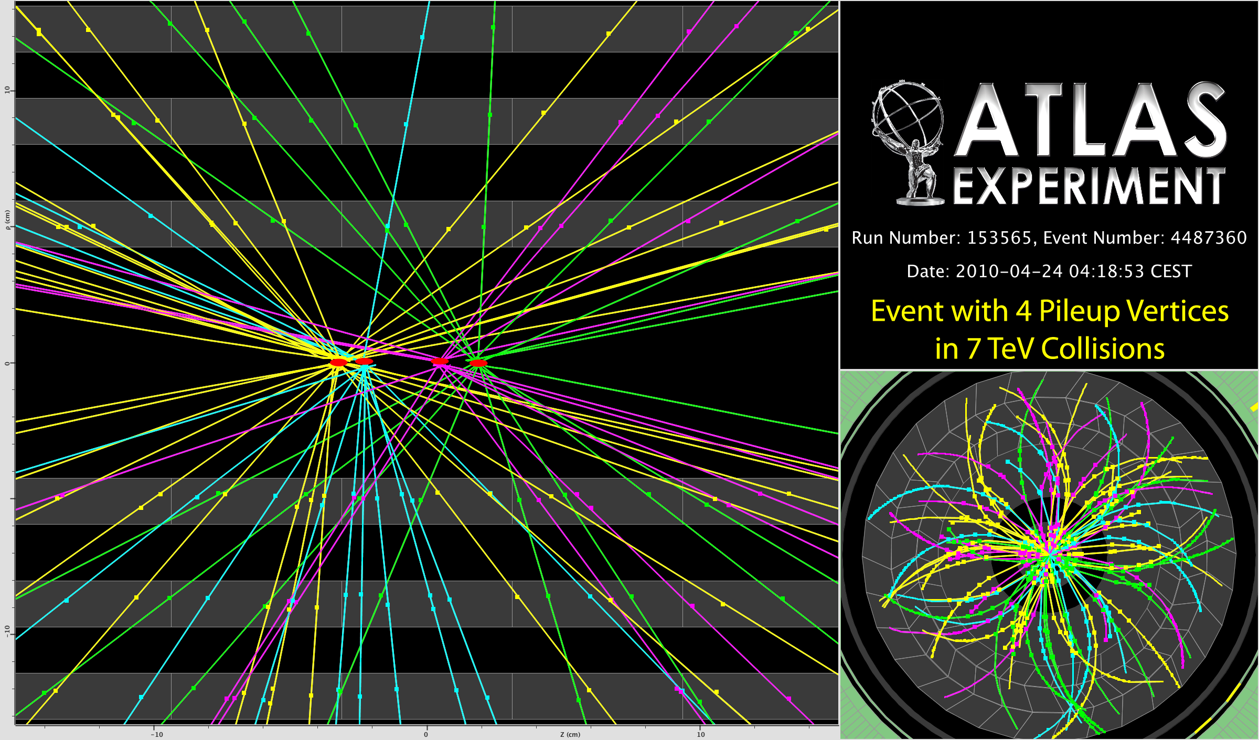
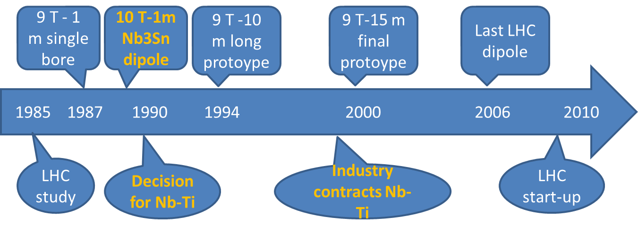
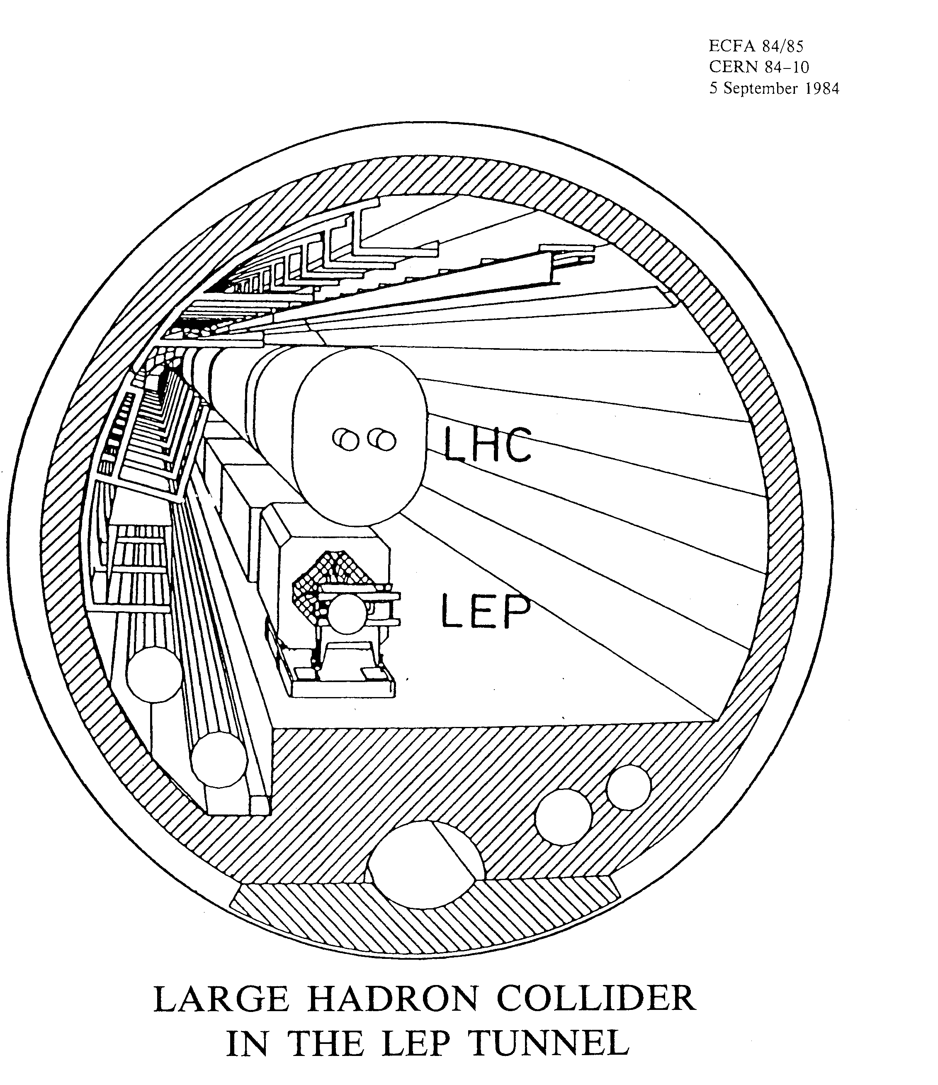
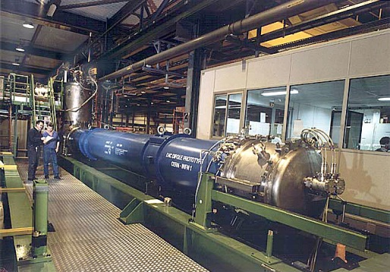
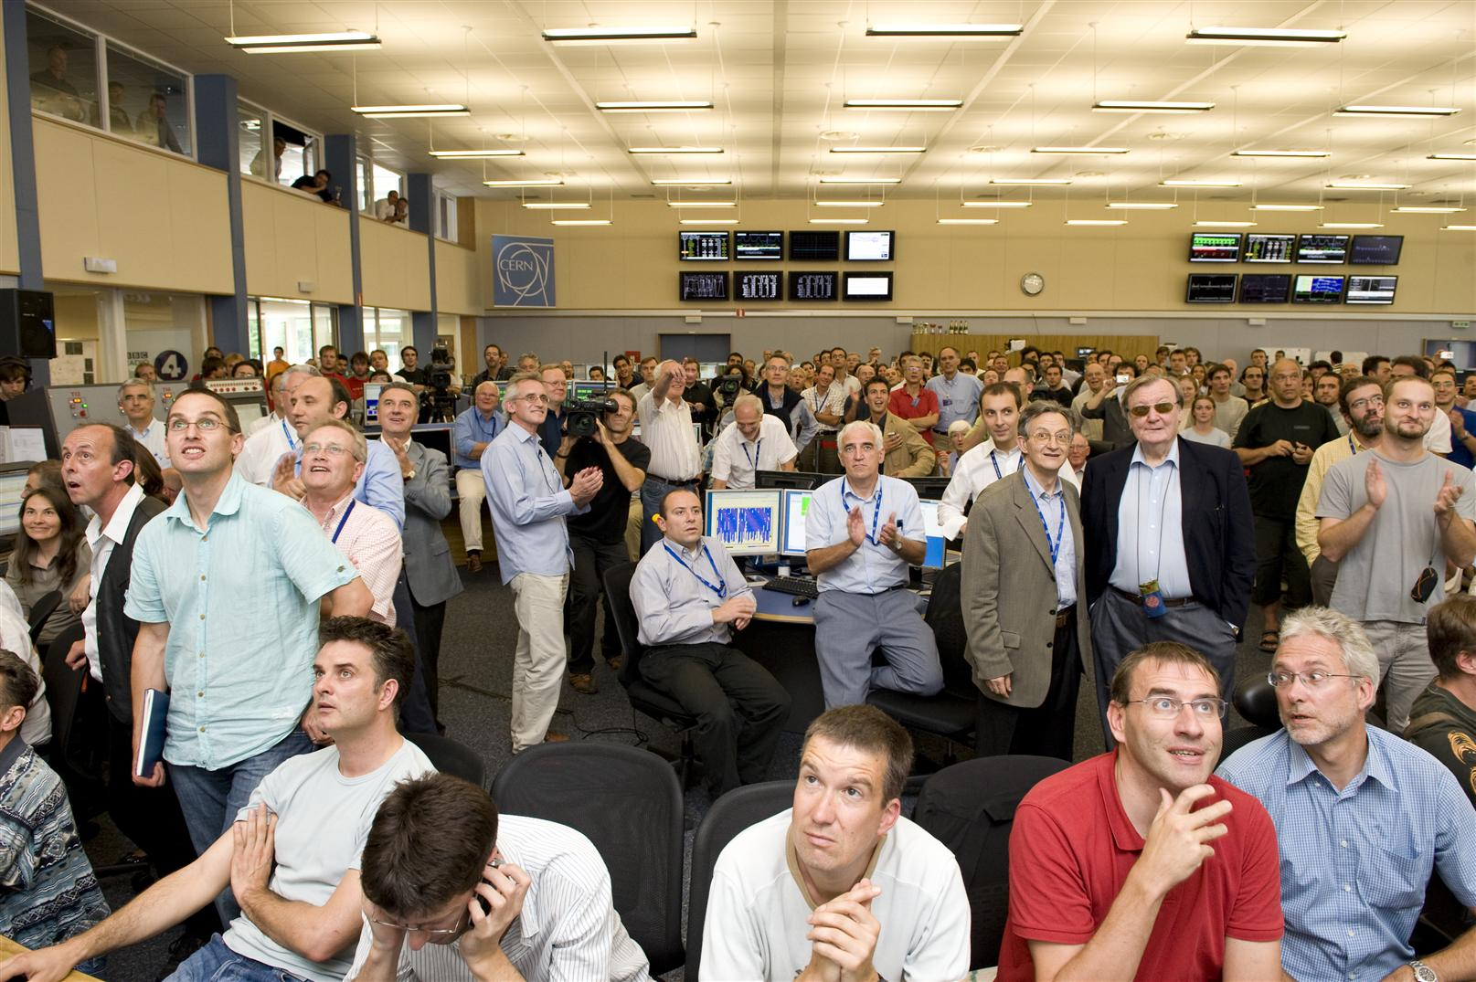
LHC, the construction timeline: a 25 year old project

Slide 18
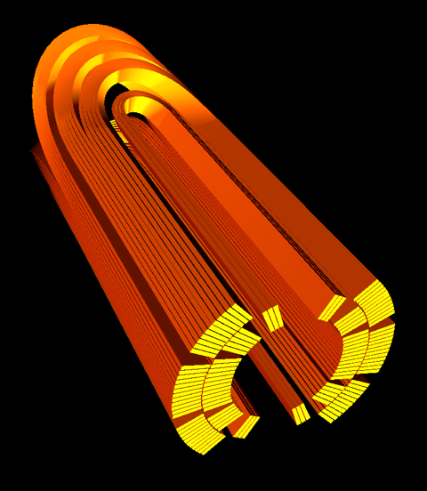
What is the possibile for HE-LHC? (done in 2011)
Full profit of the HiLumi program
US basic programs and LARP R&D
EU FP6-CARE-NED
EuCARD 13 T large dipole+ 18 T small insert
US 13 T Quads FP7-HiLumi
US NbSn-HTS development
US 16 T small dipole
LARP 11 T long quad
EuCARD R&D
15-20 T R&D dipole models and prototypes
15-20 T dip final proto & Industrialization
Final delivery Magnets HE-LHC
2005 2010 2015 2020 2025 2030 2035
EuCARD2 full bore dipole HTS
HE-LHC preliminary study
HTS for HE-LHC: yes.or.no
Industry contracts, start constrution
HE-LHC start-up

Slide 19
Rough cost rough evalution
(personal)
LHC (machine): about 3.2 BCHF, 1.7 BCHF for the magnet system,
HE-LHC: The non-magnet is ∼ same 1.4 BCHF
  Nb3Sn based (26 TeV c.o.m) : ∼ 3.5 BCHF ( for a total of 5-5.5 BCHF for th whole machine + inj renewal))
  Nb3Sn based (18 TeV c.om.): ∼ 2.7-3 BCH (for total of 4.5 BCHF for whole LHC ring+ inj. renewal).
  HTS based (33 TeV c.o.m) : ∼ 5 BCHF (for a total of 6.5-7 for the whole machine + inj renewal)
  Ecomomy could be made:Cryo and other system needs only renovation; however one should consider the cost of LHC removal)

Slide 20
Other important issues (among many …)
Synchrotron radiation
15 to 30 times!
The best is to use a window given by vacuum stability at around 50-60 K (gain a factor 15 in cryopower removal!)
First study on beam impedance seems positive but to be verified carefully
Use of HTS coating on beam screen?
Beam in & out
Both injection and beam dump region are constraints.
Ideally one would need twice stronger kickers
Beam dumps seems feasable by incresing rise time from 3 to 5μs
Injection would strongly benefit form stronger kckers otherwise a new lay-out is needed (different with or wihtout experiments)

Slide 21
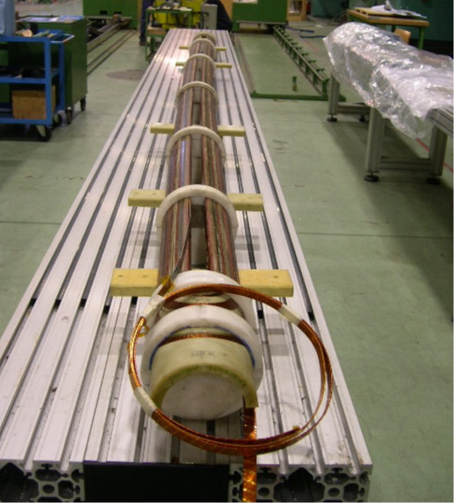
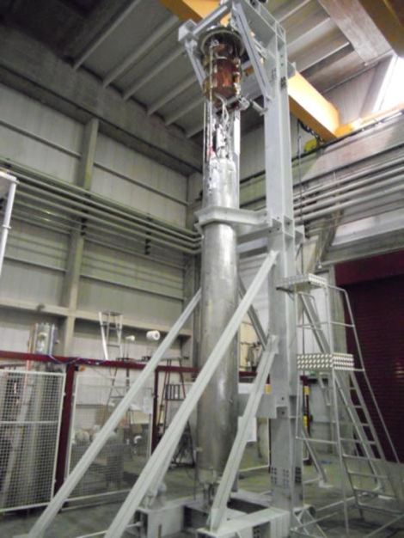
Injector chain
Various reason to renew
Age! PS 80 years old by 2039
SPS will have seen an amount of radiation well beyond its design
Chance to redign the chain in synergy with other programs
  Low energy physics
  Neutrino
SPS+ (1-1.2 TeV) R&D is progressing thanks to FAIR SIS300 design.
Discorap INFN magnet, 4.5 T pulsed at 1-2 T/s, test in July

Slide 22
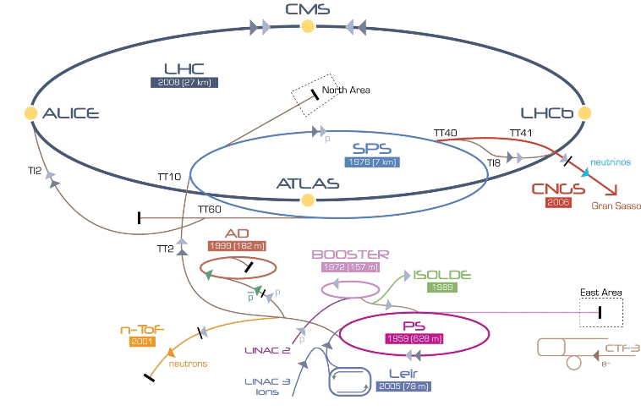
Between Linac4 and SPS+
HE-LHC
SPS+
New injectors optimization
Linac4

Slide 23
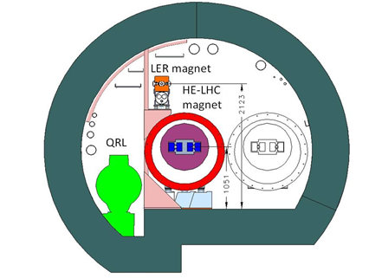
Alternate scenarios
Injectors
Avoid touching the SPS
Install a Low Energy Ring in the LHC tunnel using superferric Pipetron magnets (W. Foster). Possible with adequate logistic and change inthe experiment (workshop 2006 FP6-CARE-HHH network, revisited for LHeC ring-ring option).
Work done in colalbporation with Fermilab (H. Piekartz)

