Slide 1
GPGPU
for track finding
in High Energy Physics
L. Rinaldi, M. Belgiovine, R. Di Sipio, A. Gabrielli, M. Villa
(Bologna University and INFN)
M. Negrini, F. Semeria, A. Sidoti
(INFN Bologna)
S. A. Tupputi
(INFN CNAF)
GPU Computing in High Energy Physics
Pisa, 10-12/9/2014

Slide 2
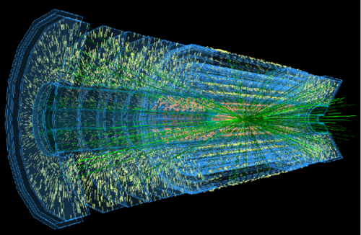
Outlook
A massive parallel approach based on GPGPU can be relevant for Tracking in High Energy Physics
Fast tracking is suitable for realtime data selection
In this contribution we will show a track finding algorithm based on the Hough Transform

Slide 3
Tracking in HEP experiments
Model based on a typical central track detector:
Multi-layer cylindrical shape, with axis on the beamline and centered on the nominal interaction point
Uniform magnetic field with field lines parallel to the beamline
Charged particles will have helix trajectories (circles in the transverse plane wrt z-axis)
Several approaches used to extract track parameters from experimental data (fitting, associative memories, etc.)
Hough Transform (HT) is yet another method
HT is a pattern recognition technique (60’s) for feature extraction in image processing
The advantage: very massive parallelisation could be applied

Slide 4
The Hough Transform
y
B
⬥
(x_{H},y_{H})
(0,0)
x
A
In real space there are ∞ circles passing for each hit (x_{H},y_{H}) and (0,0):
The point of coordinates (A,B)
is the center of the circle
In the A-B parameter space (Hough space), for each hit, all the ∞ circles are represented with straight lines:

Slide 5
The Hough Transform
y
(x₄,y₄)
Accumulation point
⬥
B
(x₃,y₃)
(x₂,y₂)
⬥
⬥
Hits lying on a circle → the corresponding lines in the Hough Space meet in a (accumulation) point
⬥
(x₁,y₁)
(0,0)
x
A
First step: discretize the Hough space with a N_{A}×N_{B} Hough Matrix (or Vote Matrix)
For each hit, all the matrix elements satisfying
are incremented by one unity (or weighted value).
Accumulation points with high vote will correspond to real tracks
10/09/14
L. Rinaldi - GPGPU for track finding and triggering in High Energy Physics
4

Slide 6
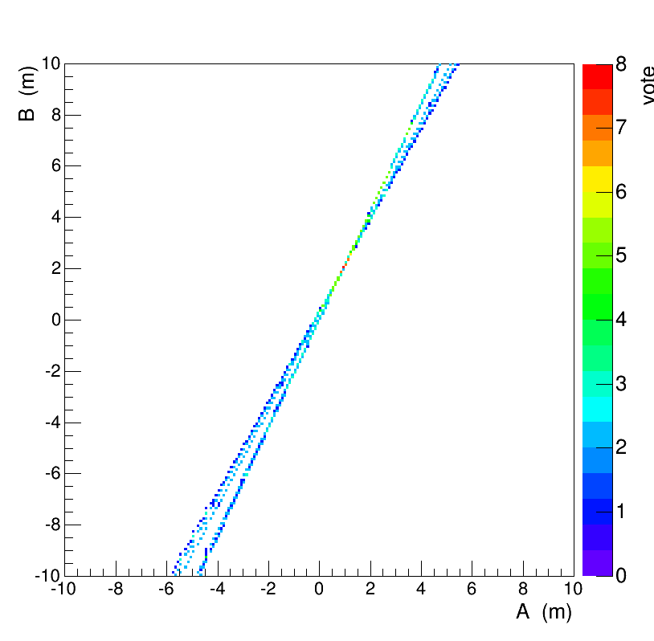
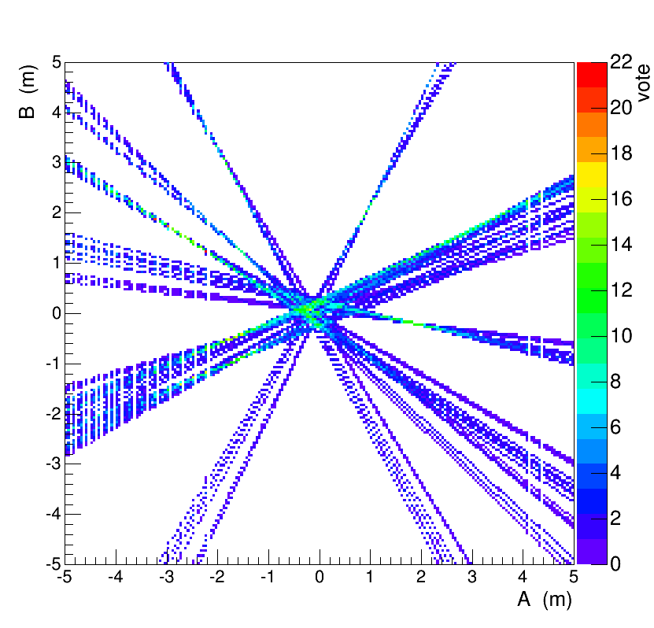
The Hough Transform
Second step: find local maxima of the Hough Matrix (each maximum corresponding to a real track)
Red=accumulation point
10 hits, 1 track
Very simple case
100 hits, 8 tracks, a little bit complex (some cuts needed)
10/09/14
L. Rinaldi - GPGPU for track finding and triggering in High Energy Physics
5

Slide 7
Test description
Stand-alone testbed, not (yet) interfaced to any experiment framework
Model based on a cylindrical 12-layer Si detector
  100 simulated events (pp collisions @ LHC energy, Minimum Bias sample with low p_T tracks)
  Each event contains up to 5000 hits and O(100) tracks
  Known quantities: x,y,z coord’s of the hits
  Hough-space divided in 4 iper-dimensions:
  the A and B parameters and the transverse (φ) and longitudinal (θ) planes
  4x16x1024x1024 M_{H}(φ,θ,A,B) Hough-matrix

Slide 8
Computing resources
Local resources
INFN-CNAF HPC-Cluster
Device specification | NVIDIA GeForce GTX770 | NVIDIA Tesla K20m (2x) | NVIDIA Tesla K40m (2x)
Performance (Gflops) | 3213 | 3524 | 4291
Mem. Bandwidth (GB/s) | 224.3 | 208 | 288
Connection | PCIe3 | PCIe3 | PCIe3
Mem. Size (MB) | 2048 | 5120 | 12228
Number of Cores | 1536 | 2496 | 2880
Clock Speed (MHz) | 1046 | 706 | 745

Slide 9
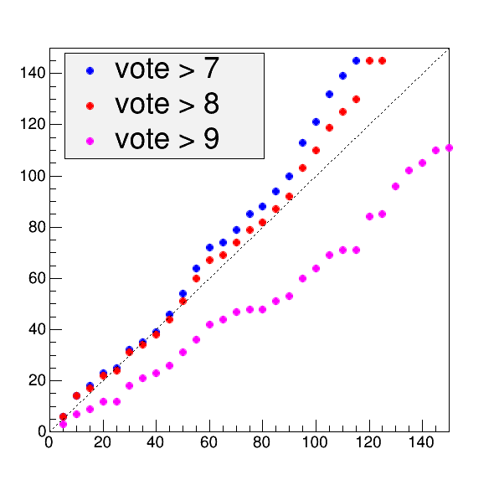
HT algorithm performance
Number of tracks
Number of reconstructed tracks strongly dependent on algorithm parameters:
Hough Matrix Dimension
Vote threshold
Reconstruction slightly overestimated:
A solution could be to add more constraints from other event features
Reconstructed
Generated

Slide 10
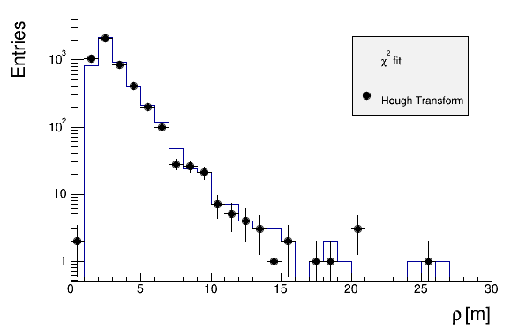
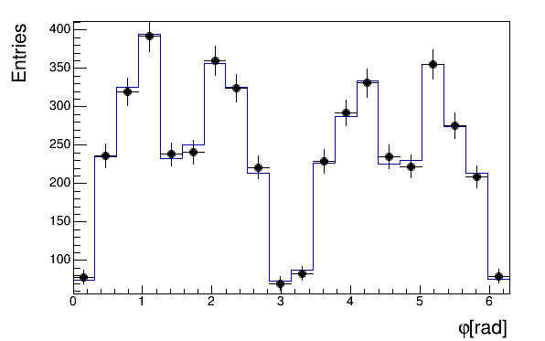
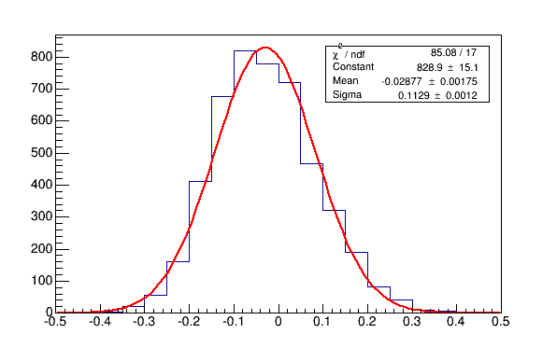
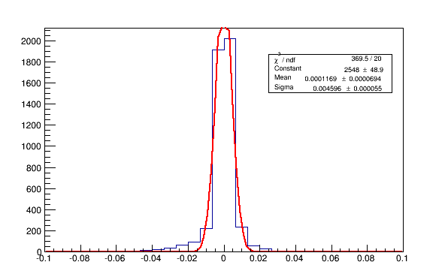
HT vs χ² fit
Track radius ρ spectrum
Track center angle ϕ
ρ resolution
ϕ resolution
σ_{ρ} 11%
σ_{ϕ} 0.5%

Slide 11
CUDA 6.0 coding
Hough Matrix filling (Vote):
  1D grid over hits
  ( grid dimension = number of hits)
  At a given (φ, θ), threadblock over Α .
  For each A, a corresponding B is evaluated
  The M_{H}(φ, θ, A, B) Hough-Matrix element is incremented by a unity with CUDA atomicAdd()
  Matrix initialization once at first iteration with cudaMallocHost (pinned memory) and initialized on device with cudaMemset

Slide 12
CUDA 6.0 coding
Local Maxima search
2D-grid over (φ, θ)
Grid dimension: N_{φ}×(N_{θ}*N_{A}*N_{B}/maxThreadsPerBlock)
2D-threadblock, with dimXBlock= N_{A}, dimYBlock=maxThreadsPerBlock/N_{A}
Each thread compares the M_{H}(φ, θ, A, B) element to neighbours, the bigger is stored in the GPU shared memory and eventually transferred back.
I/O demanding – several kernel may access matrix together

Slide 13
OpenCL 1.1 coding
Translation from CUDA to OpenCL had to be done carefully:
No direct pinning memory API for vote and relative maxima matrices:
  The OpenCL workaround: mapping a device buffer to an already memalloc’ed host buffer
  Ad hoc kernels used for initializing the matrices in the device memory
    Such kernels’ execution times go into initialization time
Memory buffers H2D allocation performed concurrently and asynchronously in OpenCL, saving overall transferring time
Respect to CUDA, working principle of the kernels is unchanged, except for block/thread settings

Slide 14
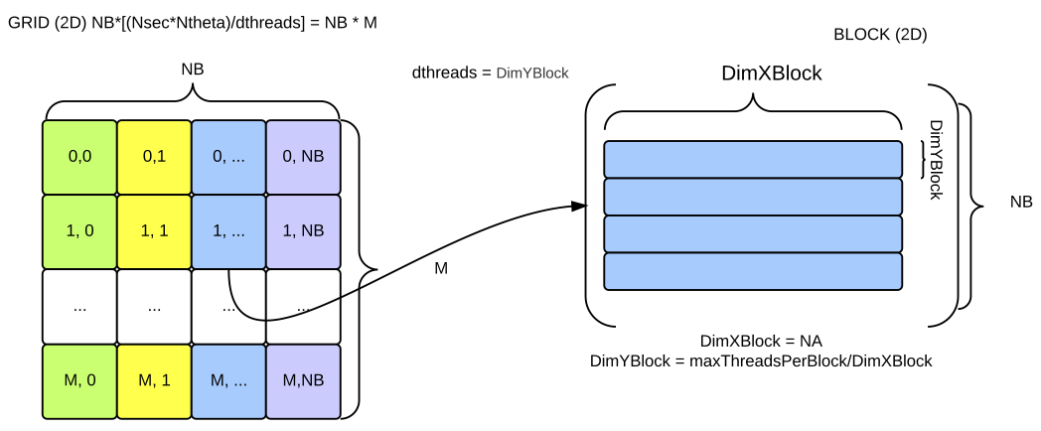
OpenCL 1.1 coding
The block/thread counting OpenCL APIs made such arrangement more useful and easy-to-manage
  Local and global thread (work-items in OpenCL) numbers are considered instead of thread and blocks (work-group in OpenCL)
Indexes have been managed so to have coalesced memory kernels I/O access thus speeding up overall execution
  Useful both in OpenCL and CUDA versions

Slide 15
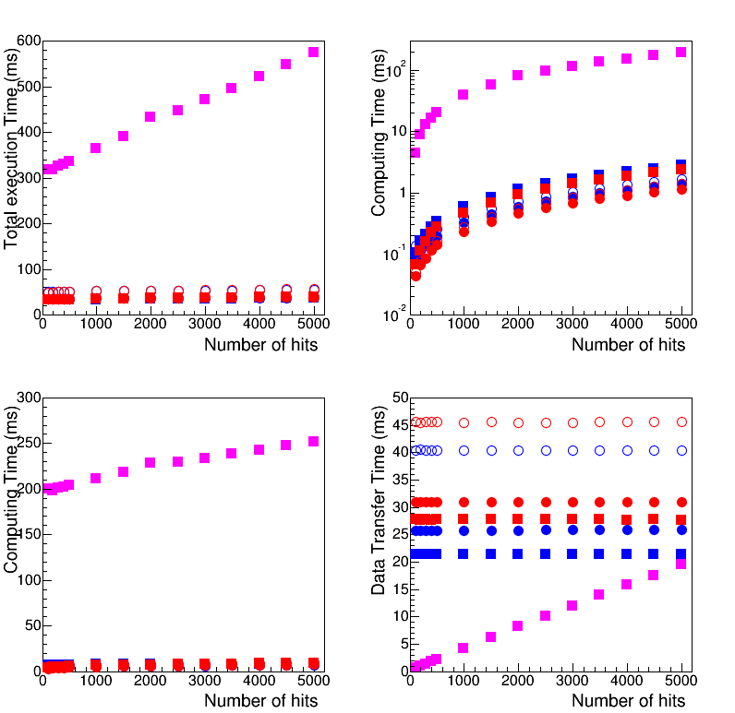
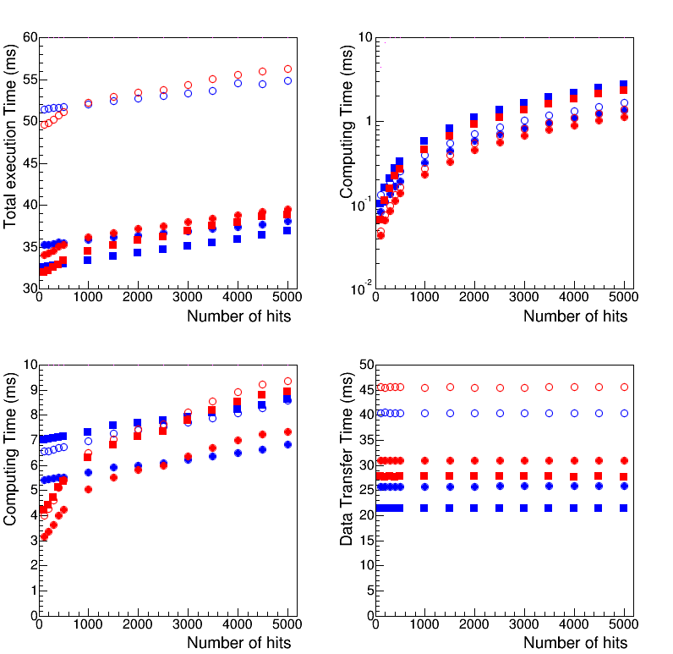
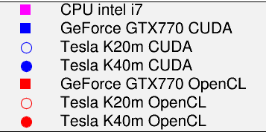
Total execution time vs CPU
GPUs vs CPU
GPUs only
C++
CUDA
OpenCL
GPU%CPU speed up over 15x
CPU timing scales with number of hits
GPU timing almost independent on number of hits

Slide 16
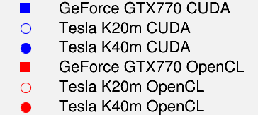
CUDA vs OpenCL
Total execution time
CUDA
OpenCL
Best performance of our code on GTX770, CUDA-coded
For large numbers hits, CUDA performs better on all devices

Slide 17
Kernel: Hough Matrix Filling
GPUs only
C++
CUDA
OpenCL
GPUs vs CPU
Up to GPU%CPU 200x speedup
Linear dependence on number of hits
Good performace of Tesla’s
OpenCL code better optimized on nested loop

Slide 18
Kernel: Relative Maxima
GPUs vs CPU
GPUs only
C++
CUDA
OpenCL
Up to GPU%CPU 60x speedup
Linear dependence on number of hits
Good perfomance on Tesla k40m
CUDA and OpenCL comparable when processing large numbers of hits

Slide 19
Host ← →Device throughput
The bottleneck
CPU I/O much faster than GPUs
Our code transfers data faster
on the GeForce GTX770
CUDA access to memory faster than OpenCL
C++
CUDA
OpenCL

Slide 20
Multi-GPU configuration
Physical motivation:
split the transverse plane in sectors (at detector-readout level).
Each sector processed separately (data independent across sectors)
A single Hough Transform executed for each sector (assigned to a single GPU)
Results merged when each GPU finishes its own process
Benefit:
HT execution per sector overlapped
Lightweight Hough Matrices and output structures per sector

Slide 21
Multi-GPU configuration
Similar workload schema with 4 Hough Matrixes
M_{H}(θ,A,B)
4x(16x1024x1024)
CUDA implementtion only

Slide 22
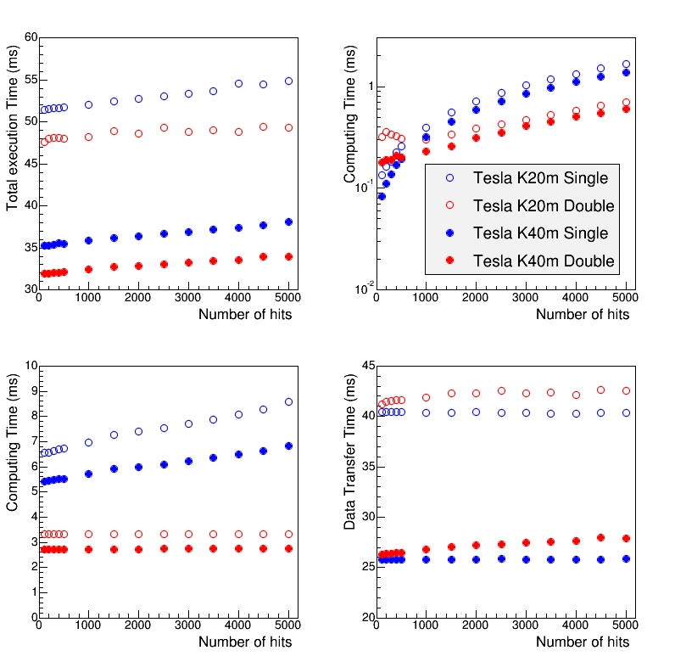
Multi-GPU results
Total execution time
Hough Matrix filling
Test performed separtely with 2 Tesla k20m and 2 k40m (using CUDA)
Multi-GPU faster than single-GPU but not elevate gain
2x Speedup observed on kernels execution (M_{H} filling for large number of hits)
CUDA unified memory NOT used (specified instruction for memory access needed on multiple devices)
Single GPU
Double GPU
Relative Max Search
GPU←→CPU throughput

Slide 23
Summary and lesson learned
Use of GPGPU can dramatically reduce track reconstruction time
  A pattern recognition algorithm based on the Hough Transform has successfully implemented on CUDA and OpenCL, also using multiple devices
Good performance obtained on pure computational algorithms
GPU←→CPU transfers still conditioning total execution time
Many handles for optimizing performance → Dependent on the GPU board specifications

Slide 24
Next steps
Hough Transform method studied on a stand-alone simulation
  Interface to a HEP experiment framework (both software and hardware)
  Test with other accelerators/coprocessors
  Introduce parallel reduction algorithm into RelMax kernel

Slide 25
backup

Slide 26
CUDA && OpenCL
CUDA code ported to OpenCL1.1 (included in CUDA drivers)
Each language has its own advantages, not necessarily unique:
  CUDA and OpenCL rather than CUDA or OpenCL
Advantages (non-exhaustive list) of OCL can be drawn from
  Kernel just-in-time (JIT) compilation, allowing to optimize the kernel execution for the actual employed device
  Easy-to-set asynchronous behavior, thus allowing to fully exploit resources
    Asynchrony can go all the way with GPUs allowing to I/O while computing kernels (not in this talk)
  Etc…
Disadvantages
  Harder learning curve than CUDA
  JIT compilation increases debug time
  Not all the HW features may be taken into account
  Etc…

