Slide 1
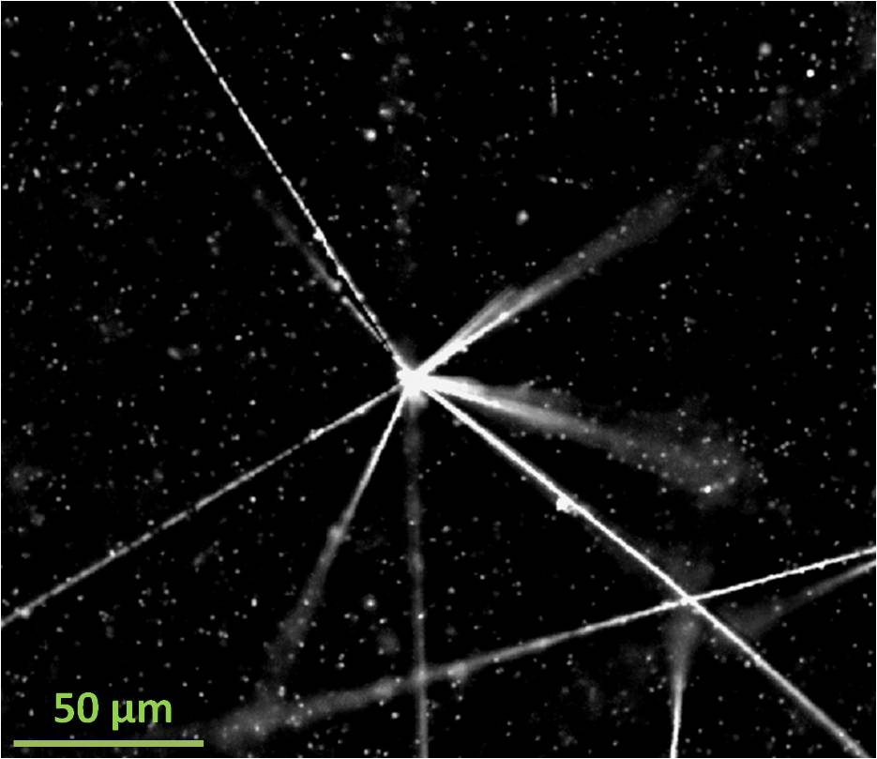


Fast 3D tracking with GPUs for analysis of antiproton annihilation
Akitaka Ariga
Senior staff
Albert Einstein Center for Fundamental physics
Laboratory for High Energy Physics
University of Bern, Switzerland

Slide 2
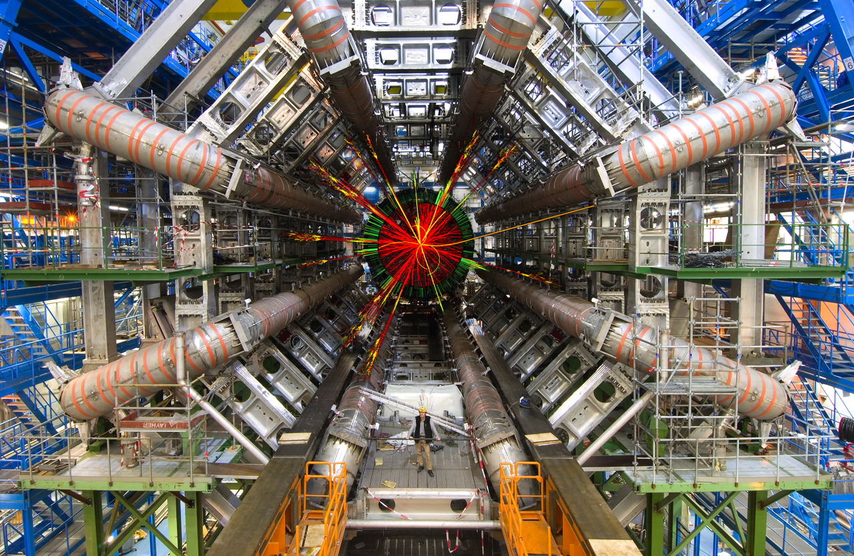
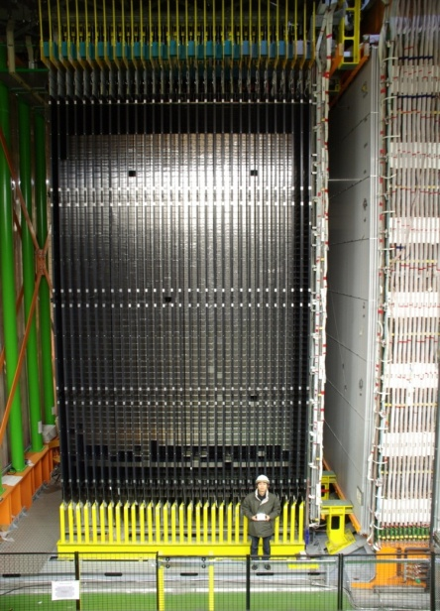
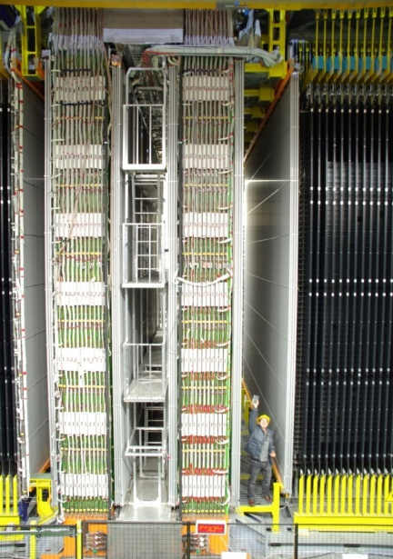
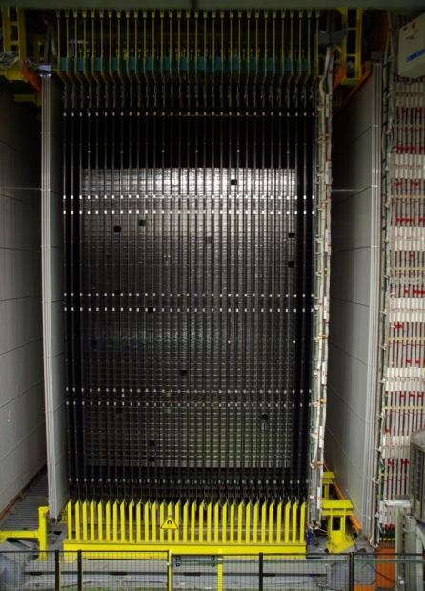
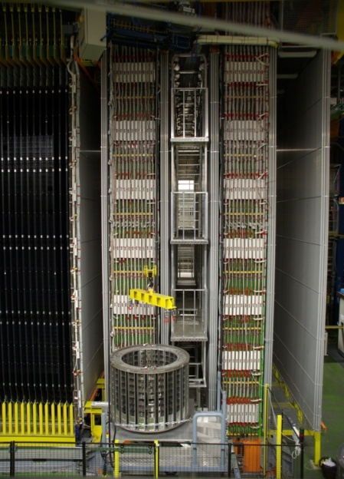
High energy physics needs GPU!
Large facilities and detectors
Huge amount of data from detectors
Reconstruction of data needs GPUs!!
100 M channels x 40 MHz
10²¹ channels 3D detector
ATLAS experiment
OPERA experiment
Photographic emulsion detectors
100 M pixels x 40 MHz
10²¹ pixels 3D camera

Slide 3
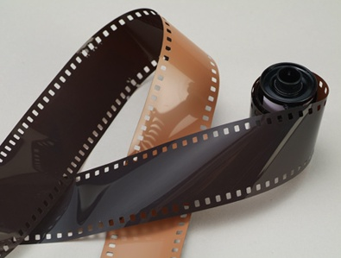
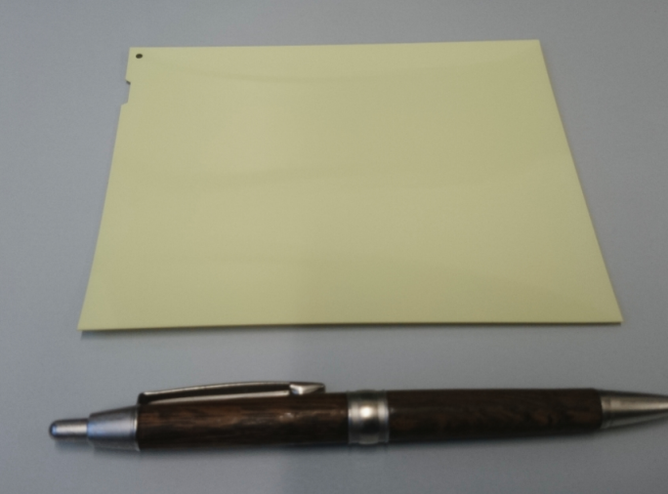
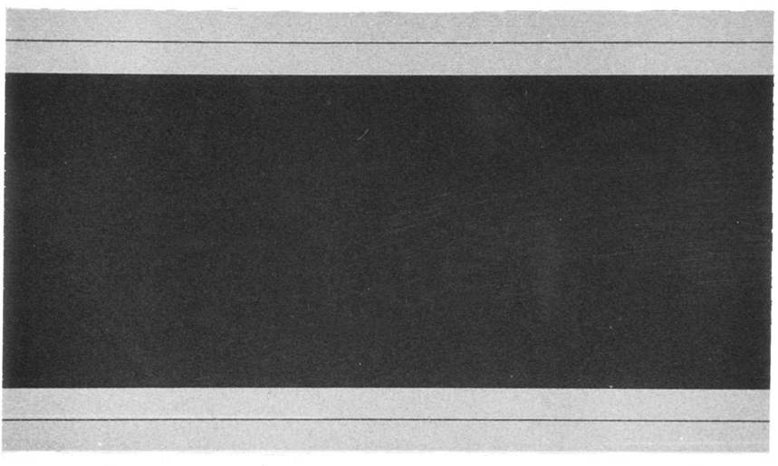
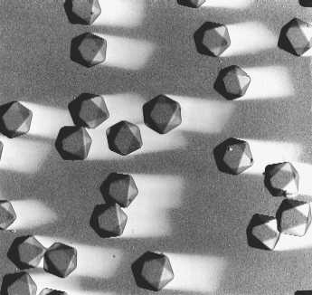
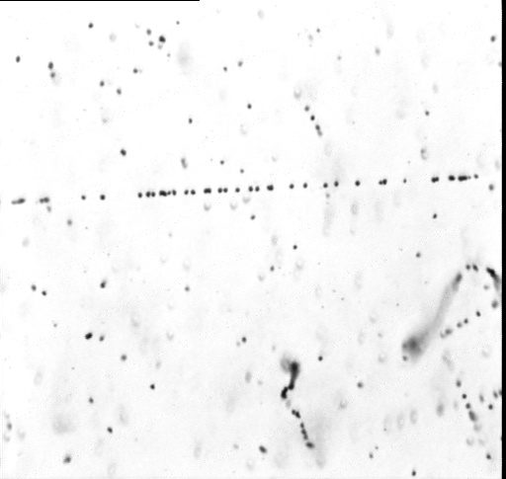
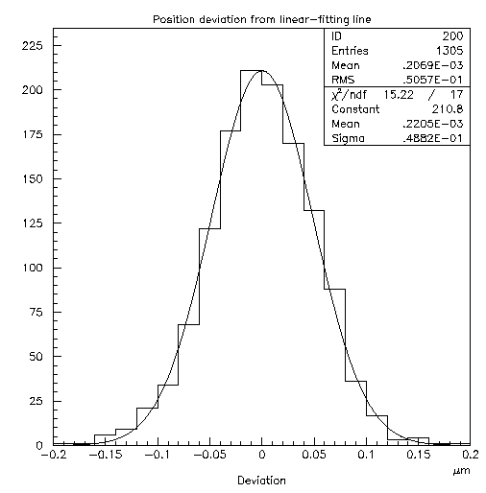
Photographic emulsion detectors (ex. OPERA film by Fuji Film)
Similar to photographic films
Emulsion Layer (44micron)
Plastic Base (200micron)
← minimal detectors
AgBr Cristal,
Size = 0.2micron
10¹⁴ crystals in a film
Emulsion Layer
Cross-sectional view (SEM)
intrinsic resolution 50nm!
The best among the detectors!
sensitivity 36grains/100micron
π-10GeV/c
Electron ～100keV
20μm
3
Notes:
3

Slide 4
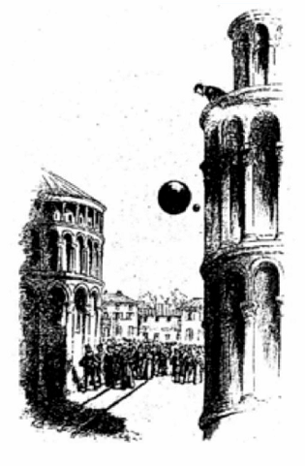

AEgIS experiment aiming at the first measurement of gravitational force on antimatter
9.8m/s²
9.8m/s²?
Principal of equivalence between gravitational
and inertial mass (m_{i}=m_{g}) is measured for matter
with a precision of 10⁻¹³. (10⁻³ by Galileo)
Gravity on antimatter has never measured directly!
AEgIS at CERN is going to measure the gravitational acceleration (g) on a antihydrogen with 1 % accuracy.

Slide 5
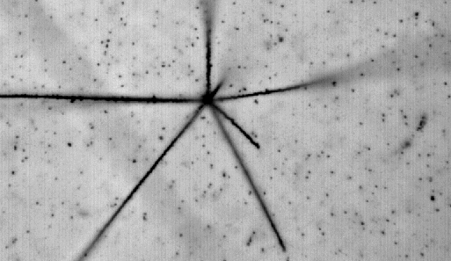

Detection of antiproton annihilation
Atomic nuclei (matter)
Anti-Hydrogen beam
~10 μm
Annihilation!
detector (matter)
antiproton
H
10 cm
antimatter
The scale of free-fall of anti-hydrogen is expected to be ~10 microns
→ Use of high precision particle detector : Photographic emulsion detectors
3D tracking of particles
High position resolution (50 nm)
Emission of many particles

Slide 6
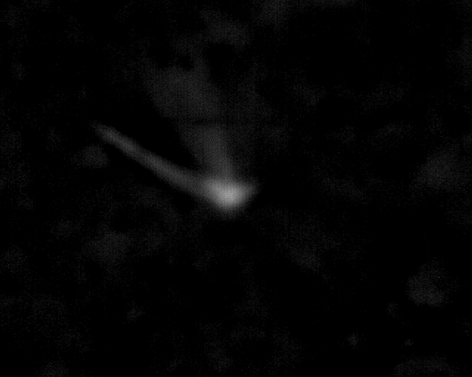
Antiproton annihilation in the emulsion
(AEgIS 2012)
antiproton
Focus
Emulsion layer
(50 μm)
Glass base
1 mm
Emulsion layer
(50 μm)
200 μm
Notes:
C:\Users\ariga\prg\LHEPMic6\work\AEgIS_G1

Slide 7
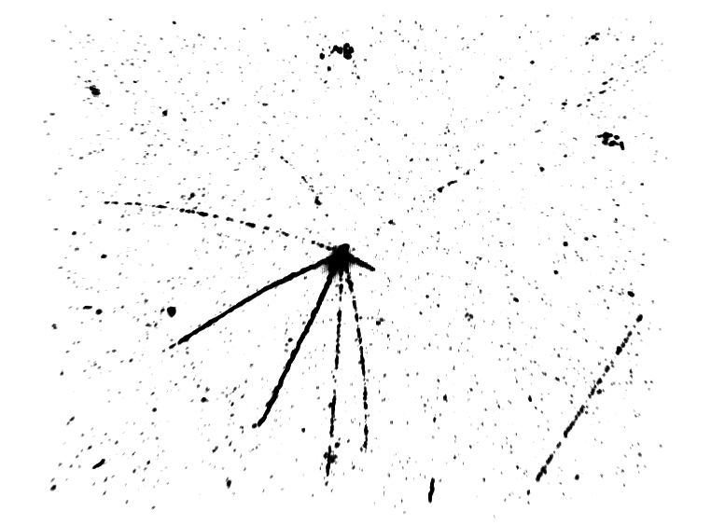
3D view of antiproton annihilation
100 μm

Slide 8
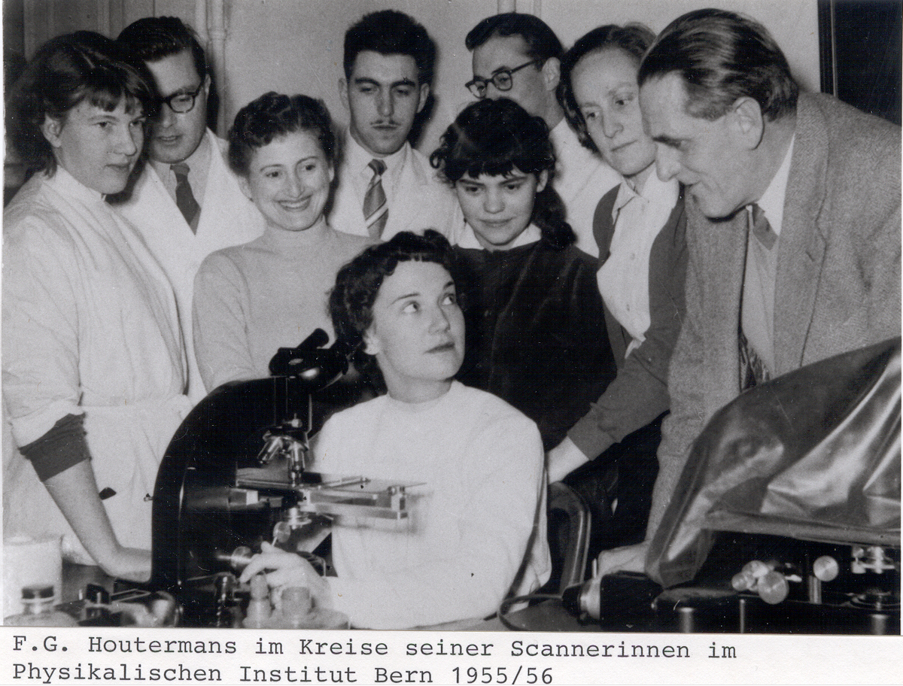
Nice detector… but some drawbacks…
Very high resolution = very large data volume
  10 Tbytes / 10cm x 10cm
In the past, the analysis depends on human work
No way to process it automatically!! … till recently.

Slide 9
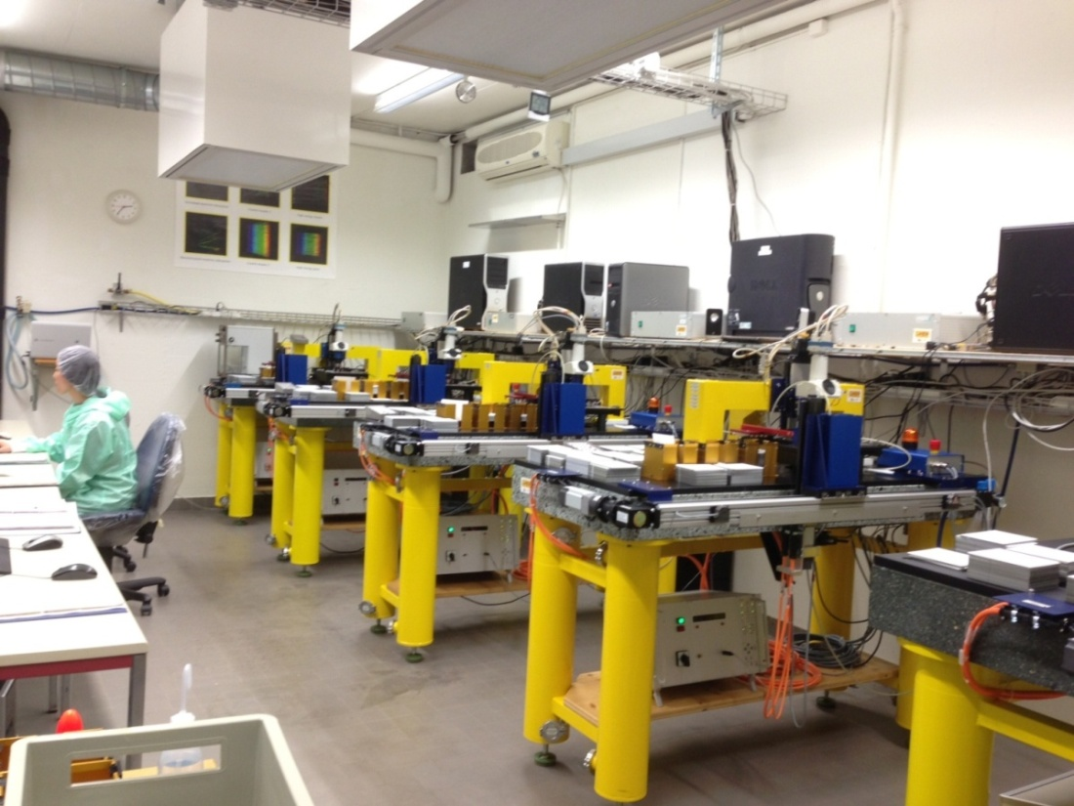
Swiss Scanning Station in Bern
Several hundreds of photographic emulsion sheets analyzed every week
Notes:
9

Slide 10
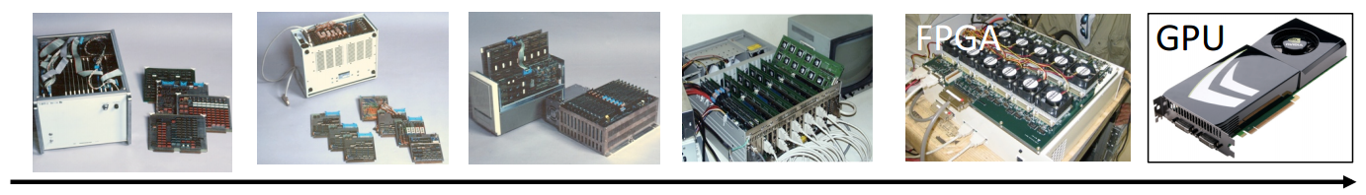
Evolution of automated scanning system
TTL
TTL
CPLD
FPGA
Speed in cm²/ hour (limited angular acceptance 1/8)
10000
100~10000
1000
20
50
100
10
1
1
0.082
0.1
0.01
0.003
0.001
TS (TTL)
1983
NTS (CPLD)
1994
UTS (FPGA)
1998
ESS
(multi-CPU)
2004-
Running
S-UTS
(FPGA)
2006-
Running
Next generation
(GPUs)
Under development

Slide 11
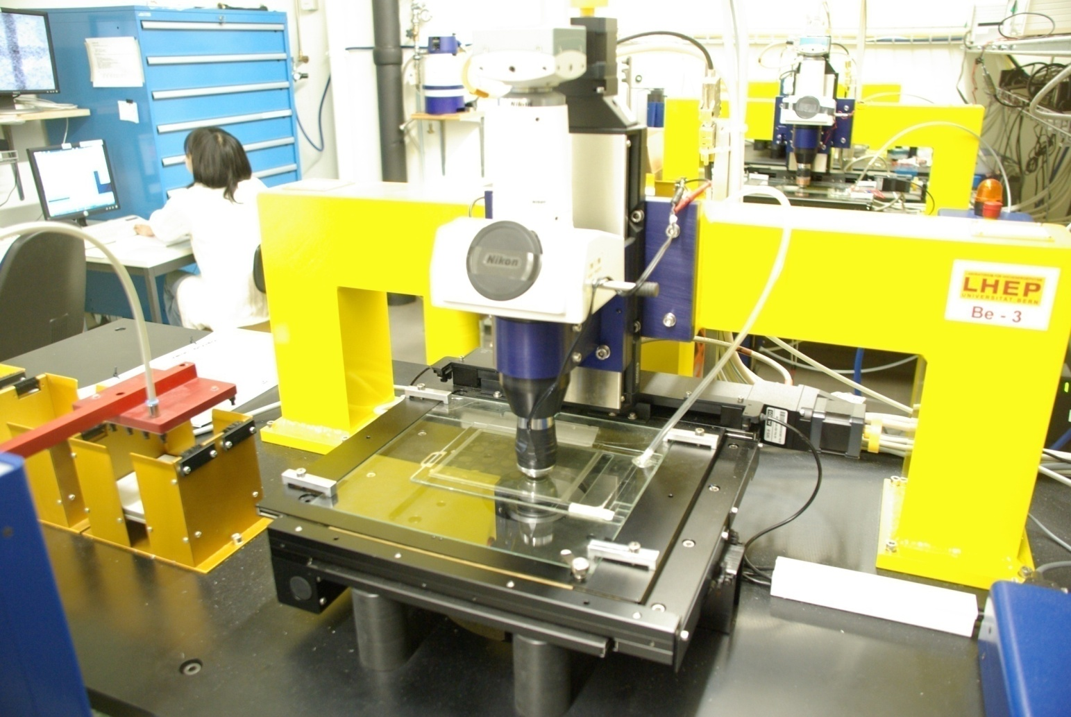
High speed readout system, Recent-Future
Custom-made real-time scanning microscope.
Readout speed ~20 cm² /h
CMOS camera
1.3M pixel x 400 Hz
Camera Link Full
1 view data
= 1.3 M pixel x 40 frames
= 52 MByte/view
x 5 Hz = 210 MByte/s
Emulsion film
Objective lens
Emulsion
(0.1mm)
(Real-time) 3D reconstruction using GPUs
Automatic Plate Changer
XYZ stage (Micos)
0.1 μm nominal
precision
objective (50x)
Glass (~1mm)
refractive index =1.5
Emulsion
(0.1mm)
Current system = 1.3 M pixels x 40 frames x 5 Hz = 210 Mbyte/s
Next generation system = 25 M pixel x 40 frames x 1.6 Hz = 1.6 GByte/s

Slide 12
Track reconstruction
Reconstruction of particle trajectories
3D image filtering
Recognize dots (or grains)
Find any combination of grains
Find sequential grains forming lines
Fit track →5D (3D position, 2D angles)
Millions of such data unit (view) have to be processed within hours.
100 μm

Slide 13
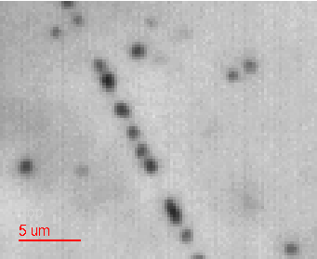
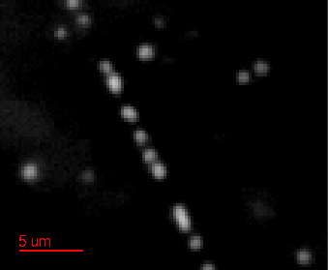
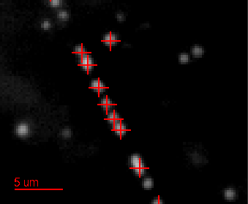
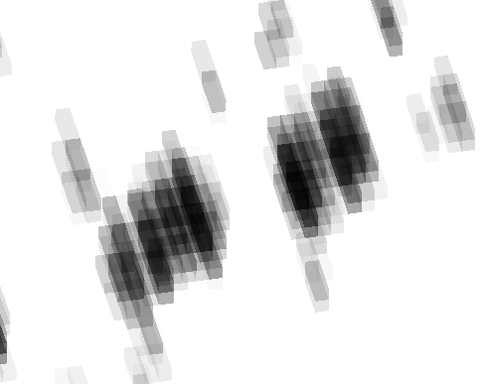
3D image processing and object recognition
Raw image
grains
Host
GPU
GPU
Host
Device
zoom of raw image
3D image filtering
(kind of high pass filter)
3D grain recognition
O(10⁴) grains / view
z
Grains have optical shadow in Z.
Consecutive frames has a strong correlation.
A 3D image processing.

Slide 14
Tracking algorithm
Form “seeds” of tracks = 3D line made of any two combination of grains (4π solid angle)
Count number of grains along the seeds
Number of grains > 5 → “track”
Number of iteration ~O(N_{grain}³)
Form “seeds”
Process seeds
CPU
GPU
Seed1
7 hits
Track
seed0
Seed2
→2 hits
Seed3
→ 3 hits

Slide 15
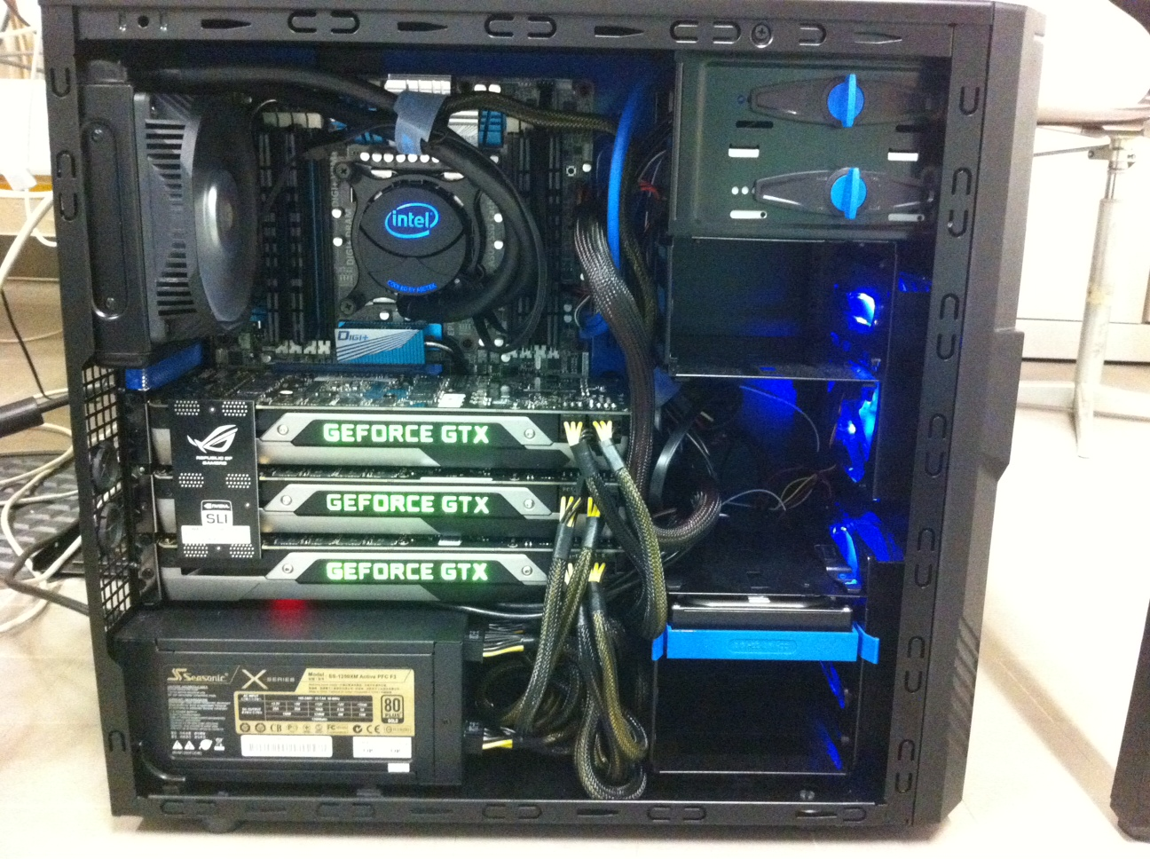
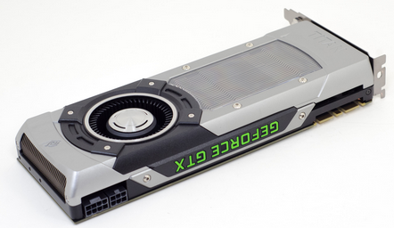
Software and Hardware
C++, CERN ROOT, CUDA (5.5)
  CUDA experience since 2008
  ROOT classes calling CUDA kernels
CPU: i7-3930K (3.2 GHz, 6 cores)
GPU: Geforce GTX TITAN x 3
  Single precision
i7- 3930K
6 cores
12 threads
3.2 GHz
Fast memory
DDR3 2400, 16GB
Water cooling
Geforece GTX TITAN x 3
2688 cores, 6GB memory, 4.5 TFLOPs in each
Strong power supply
1250 W

Slide 16
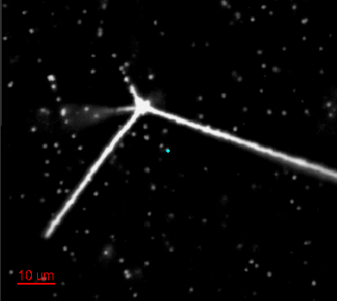
Processing time by single-CPU-thread
Goal: 0.2 sec/view (5Hz), 1 view = 1280x1024x40 voxels.
Same algorithm was implemented on CPU and GPU with minor optimization for them..
Cosmic sample (less grains) | 1 CPU (sec/view) | using 1 GPU (sec/view) | Gain
Image filtering | 3.388 | 0.051 | X66
3D grain reco | 0.157 | 0.012 | X13
3D tracking | 0.274 | 0.033 | X8.3
Antiproton (more grains) | 1 CPU (sec/view) | using 1 GPU (sec/view) | Gain
Image filtering | 3.396 | 0.051 | x67
3D grain reco | 0.181 | 0.023 | X8
3D tracking | 6.999 | 0.330 | x21
Filter image → grain recognition → Track reconstruction
Very good, but not enough…
→ Multi-CPU-thread and multi-GPU solution

Slide 17
Multi-CPU-thread processing
Each CPU-thread is responsible of a view
Each CPU-thread is linked to one of 3 GPUs
CPU-thread 0
0
1
2
3
0
1
2
CPU-thread 1
CPU-thread 2
CPU-thread 3
Each thread uses about 1 Gbyte of onboard memory →

Slide 18
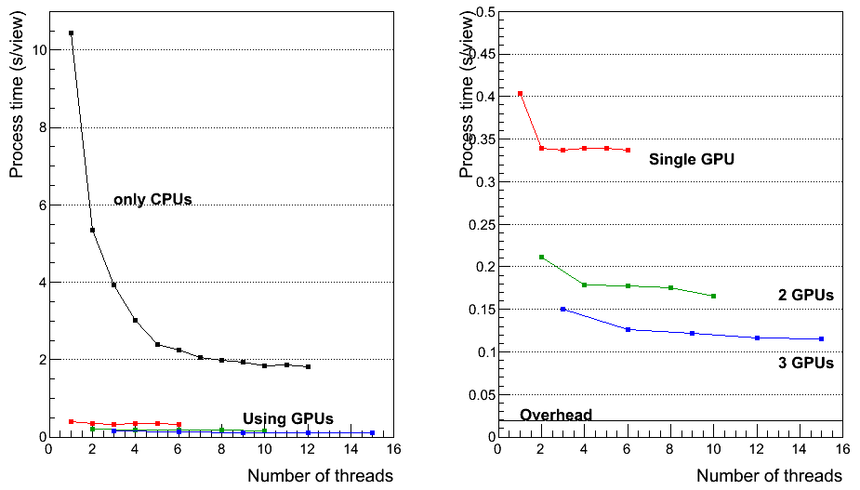
Processing time with “multi-threading” and “multi-GPUs “ (Antiproton sample)
Zoom
Factor 90 faster
CPU :i7- 3930K 6 cores, 12 threads, 3.2 GHz, GPU : Geforce GTX TITAN, 2688 cuda cores

Slide 19
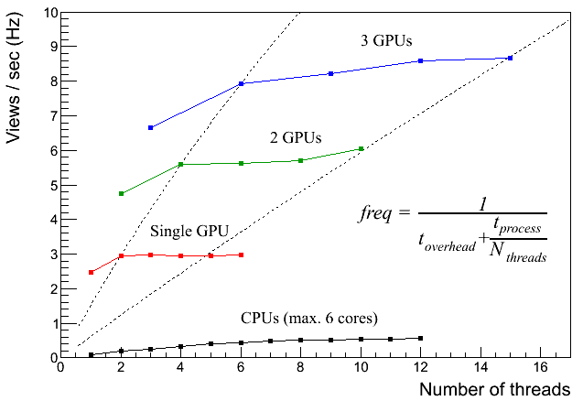
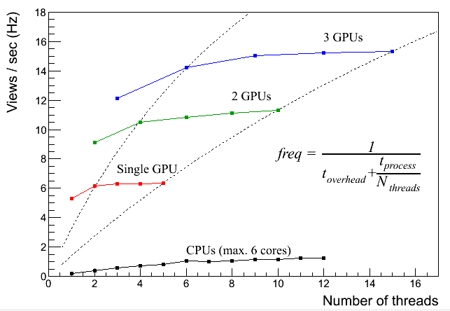
Processing speed
1 Views = 1280x1024 pixels x 40 frames = 52Mbyte
Antiproton sample Few cosmic-rays only
High number of grains Less number of grains
Tracking dominant Image processing dominant

Slide 20
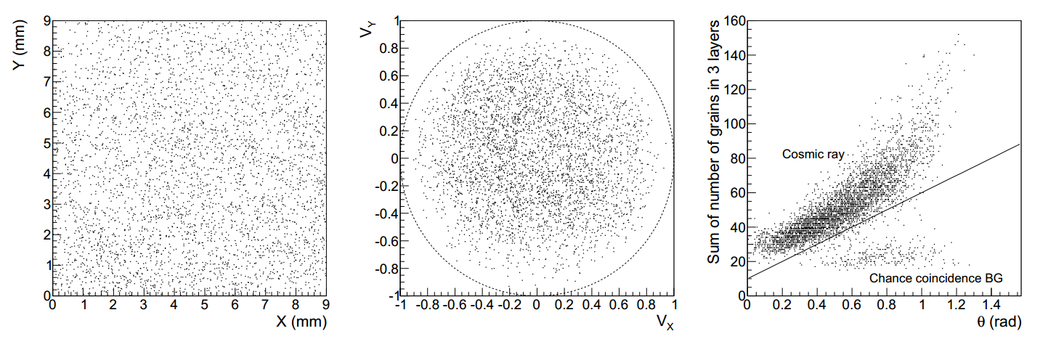
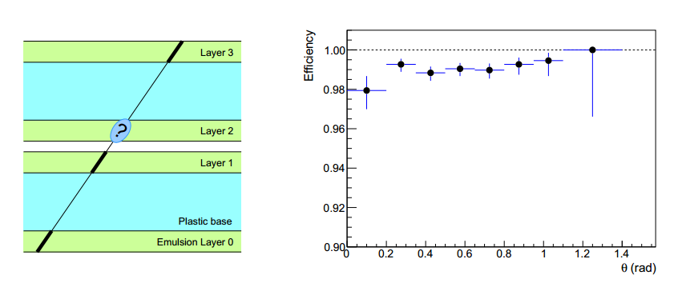
Reconstructed tracks and detection efficiency
Performance test with cosmic-ray tracks
Position
Angle as 3D unit vector
Zenith angle
Track detection efficiency

Slide 21
Summary
Big data from photographic emulsion detectors
Online high speed 3D data processing to find tracks
Successful GPU application to track reconstruction
  Angular acceptance increased by a factor of 10
  Reasonable processing time
  High tracking performance
Further development for faster processing systems

Slide 22
Some publications
  Ariga and T. Ariga, Fast 4π track reconstruction in nuclear emulsion detectors based on GPU technology,
  JINST 9 P04002 (2014), arXiv:1311.5334
AEgIS experiment with photographic emulsions
JINST 8 (2013) P02015
JINST 8 (2013) P08013

Slide 24
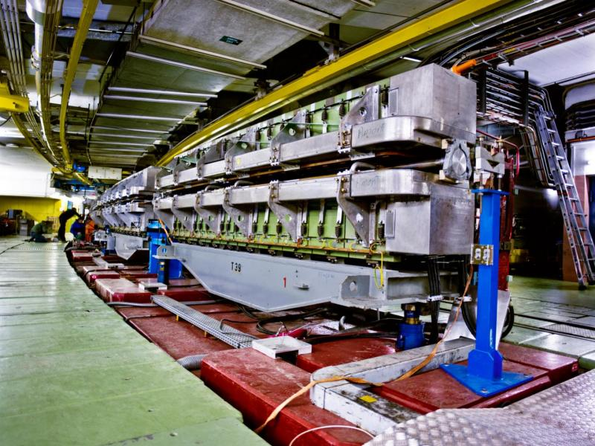
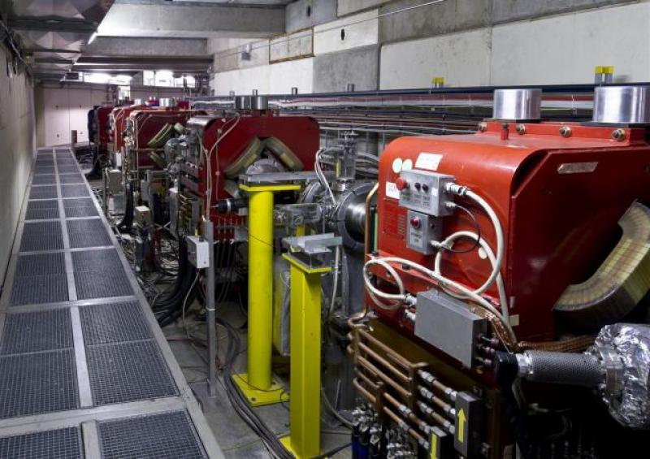
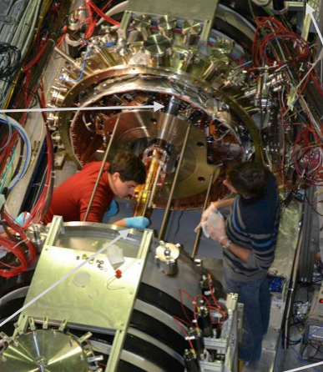
Principle of measurement
Create antiproton
Create anti-electron (positron)
Make anti-Hydrogen
Make a anti-Hydrogen beam
Measure the “free-fall”
(Real life is much more complicated!)
CERN PS
Proton accelerator
e⁺
p
H
CERN AD
(antiproton decelerator)
Anti-Hydrogen beam
Δx = ½ gt²
= ~ 10 μm
H
AEgIS

Slide 25
Detection of antimatter annihilation
Atomic nuclei (matter)
Anti-Hydrogen beam
~10 μm
Annihilation!
detector (matter)
antimatter
H
10 cm
antimatter
The scale of free-fall of anti-Hydorogen is expected to be ~10 microns
→ Use of high precision particle detector : Photographic emulsion detectors
3D tracking of particles
High position resolution (50 nm)
Emission of many particles

Slide 26
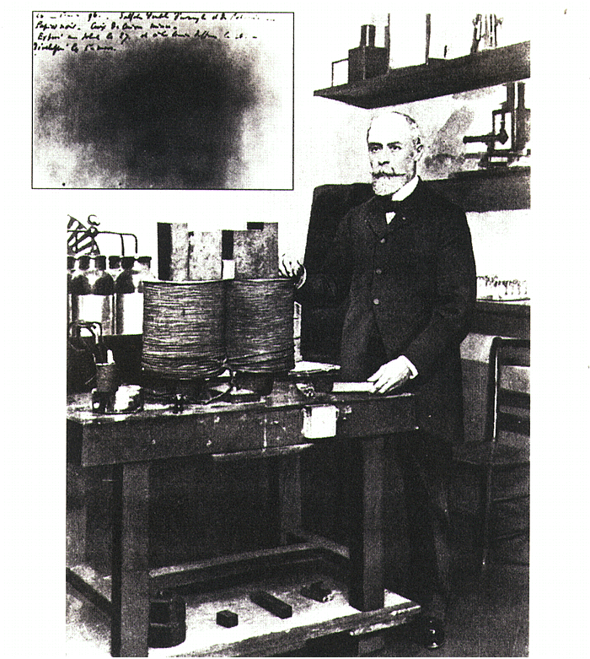
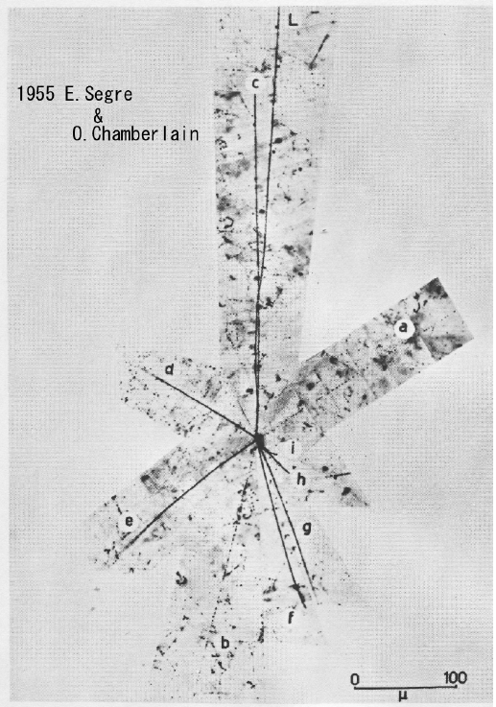
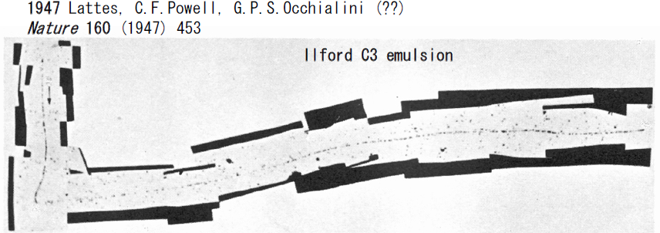
Photographic emulsion detectors
1896
A lot of discovery made by this detector.
1896 H. Becquerel: Discovery of natural radioactivity (Nobel prize)
1947 C.F. Powell: Discovery of π->μ decay (Nobel prize)
1955 E. Segre, O. Chamberain: Discovery of antiproton (Nobel prize)
1971 K. Niu: Discovery of X particle
  the later charm particle
  1974 S.C.C. Ting, B. Richter : Discovery of J/P (Nobel prize)
2014/3 Observation of νμ -> ντ oscillation (OPERA experiment)

Slide 27
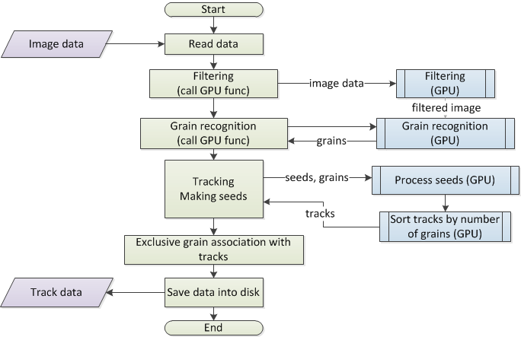

Slide 28
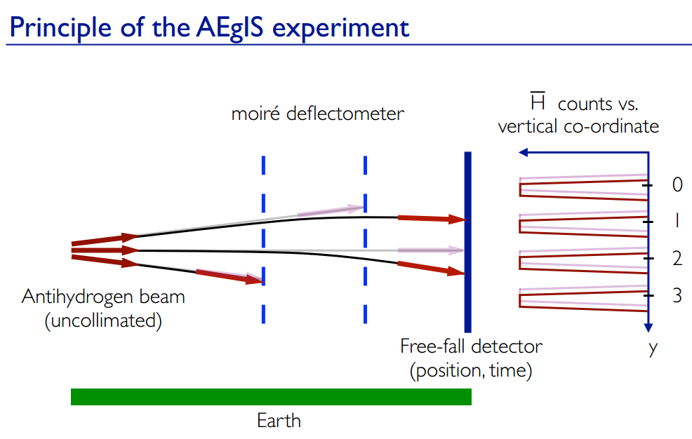
The free-fall is of the order of 10 microns
→ Nuclear emulsion

Slide 29
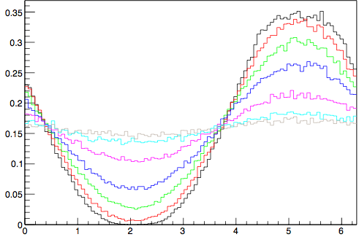
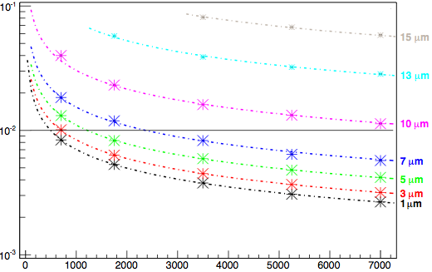







Resolution requirements for a position detector in AEgIS
AEgIS goal: 1% resolution for Δg/g
Emulsion detectors: ~1 µm resolution
velocity = 600 m/s
Δg/g
Relative intensity
phase shift
2π/p* Δx
Phase Φ [rad]
# of detected anti-hydrogen
Emulsions allow to achieve the experiment goal with less than 1000 detected anti-hydrogen atoms

Slide 30
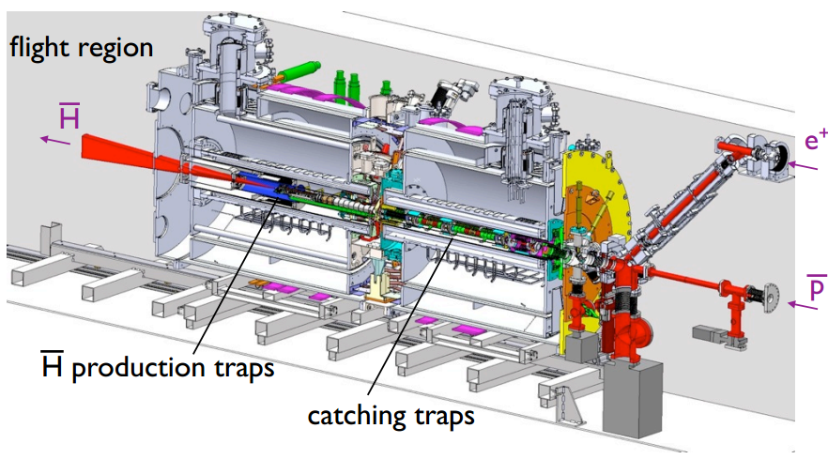
The AEgIS apparatus

Slide 31
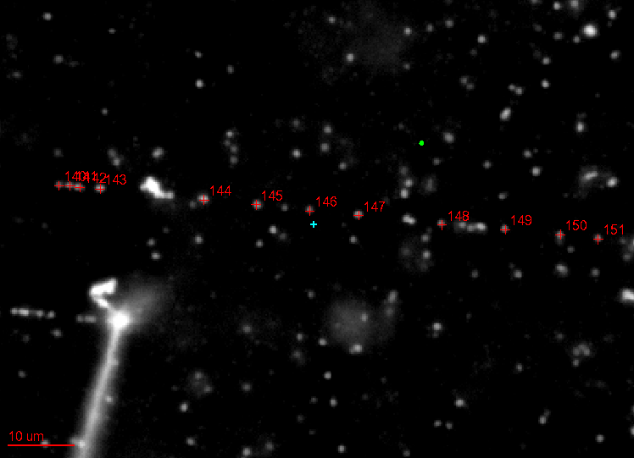
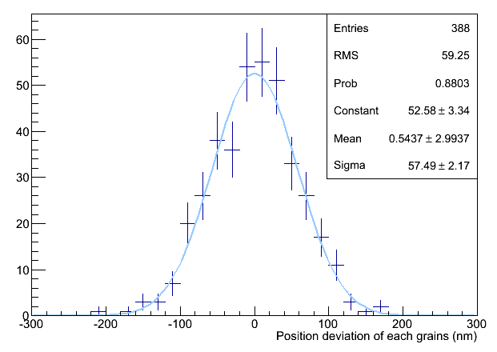
Measurement of intrinsic resolution
Find straight MIP tracks on the display
Click the grains → center of gravity calculation
(Use only grains near to the center of view ← to minimize optical distortion)
(Reject overlapping grains)
Fit a line and evaluate deviation of each grains from the fitted line
Resulting intrinsic resolution = 58nm
This is good, similar to standard film (50nm)
There may be possible contributions
  Measurement error (5nm by x100 objective, 10nm by x50 objective)
  Optical distortion
  Contamination of very short delta-rays (single grain)
  Scattering of the track itself (~ 300 MeV pions)
  Due to glycerin. After glycerin washed away, there might be bigger rooms that silver filaments can grow more freely in the development process

Slide 32
Emulsion in the AEgIS
Use emulsions as position detector
TOF
Emulsion
Moire slits
Antihydrogen
Ideal position resolution down to a few microns.
Emulsion to be placed in OVC
OVC
UHV
TOF
H
Emulsion
Thin window (~0.1mm)
(Metal foil or Si tracker)

Slide 33
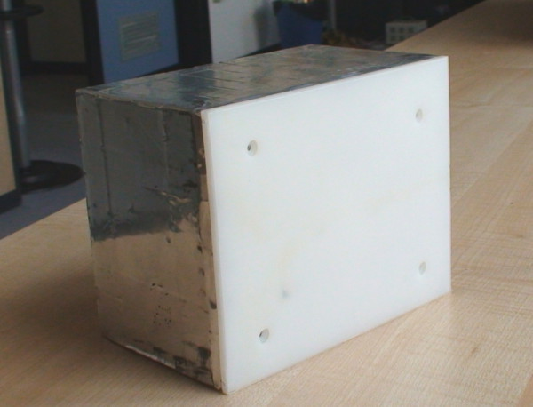
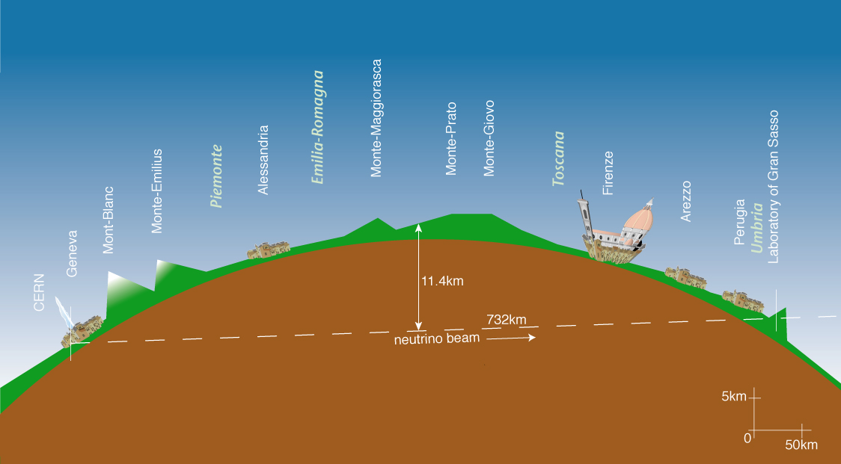
OPERA Experiment
Study neutrino oscillation though appearance of ντ in pure νμ beam
Basic unit : ECC Brick
57 emulsion films interleaved with 1mm read plates
CERN to Gran Sasso (CNGS) neutrino beam
neutrino
10.2 cm
7.5 cm
10 X0
12.5 cm
LNGS
CERN
L = 730 km
OPERA detector 150,000 ECC 1.25kton target
about 10,000,000 emulsion films ~= 110,000 m²
33
Notes:
33

Slide 34
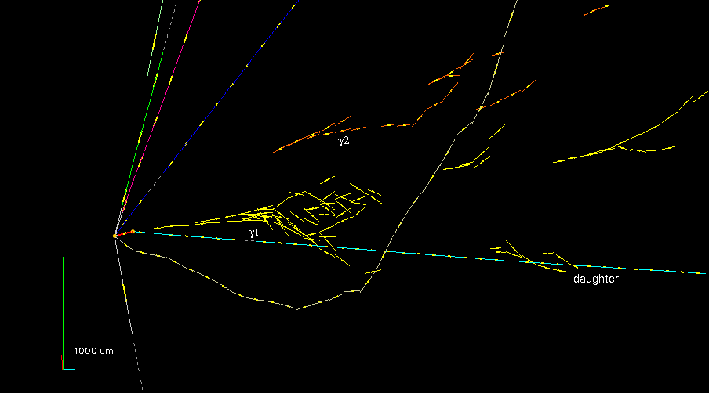
First tau-neutrino candidate in OPERA experiment
High position (1μm) and angular (1mrad) resolution
Topology detection
Electron-magnetic shower reconstruction
Momentum measurement by multiple Coulomb scattering
34

Slide 35
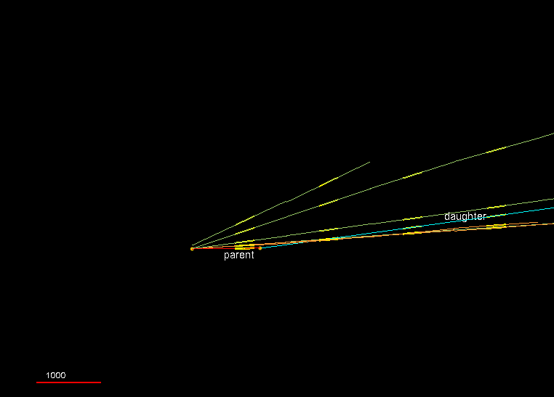
OPERA 4th ντ candidate
Animation
 | Nagoya | Bern | Mean | Selection
Kink angle (mrad) | 134 | 140 | 137 ± 4 | >20
Flight length (μm) | 1116 | 1063 | 1090 ± 30 | -
z_{decay} (μm) | 431 | 381 | 406 ± 30 | <2600
IP of daughter to 1ry (μm) | 150 | 142 | 146 ± 5 | <500
No black track attached to the 2ry vertex

Slide 36
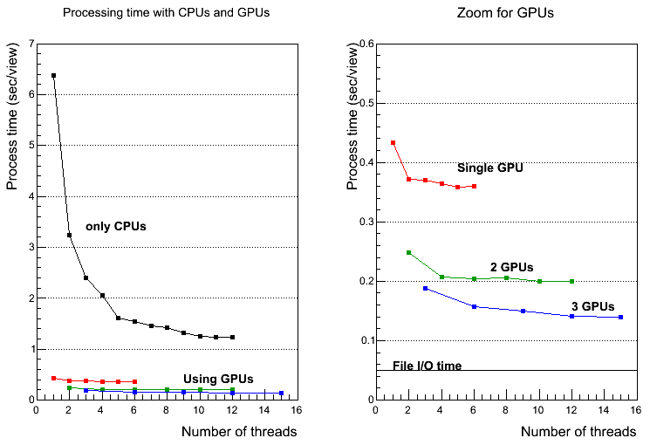
Processing time with “multi-threading” and “multi-GPUs “
arXiv:1311.5334 [physics.ins-det], in press in JINST
Factor 60 faster!
goal
0.2 sec/view
Multi-CPU-threading x multi-GPUs allow to reduce tracking time factor 60.
CPU :i7- 3930K 6 cores, 12 threads, 3.2 GHz, GPU : Geforce GTX TITAN, 2688 cuda cores

Slide 37


Update
Dust filter added.
Tricks in GPU programming
  use of fast memory
Do not use 3D hushing table
  too many “if” branches…
Slower Faster

