Slide 1
XENON100: background and signal modeling and profile likelihood analysis
Brett Cornell and Bárbara Montes
Supervisor: Alfredo Ferella
Gran Sasso Summer Institute 2014

Slide 2
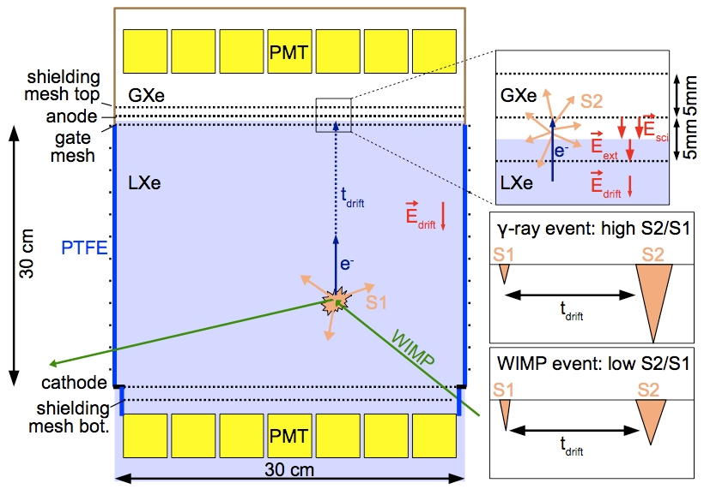
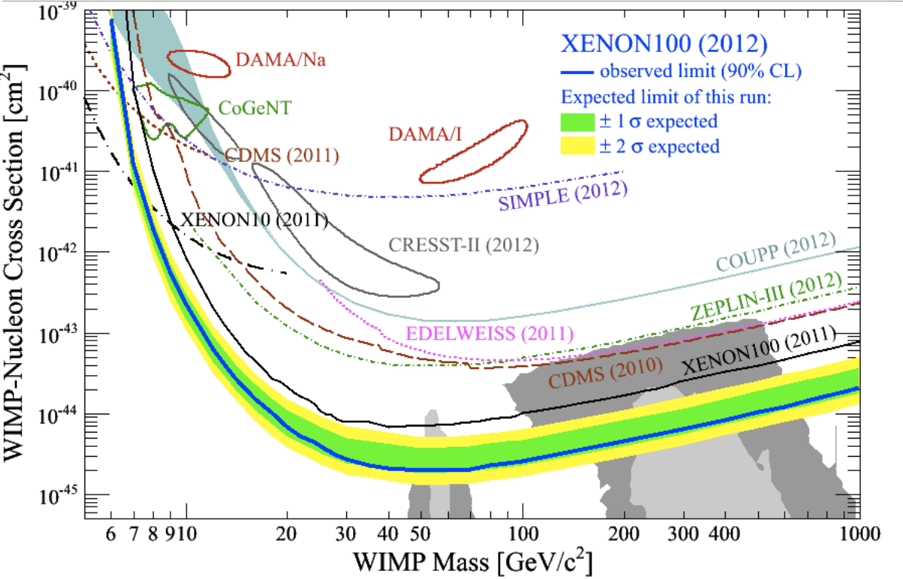
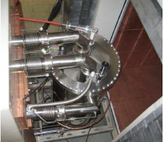

XENON100 experiment
Direct Dark Matter searches.
Operated at LNGS
Detector: cylindrical two-phase Xe (gas/liquid) time projection chamber.
Simultaneous measurement of the ionization and scintillation signals.
Achieved: σ_{SI} ~2.2×10⁻⁴⁵ cm²

Slide 3
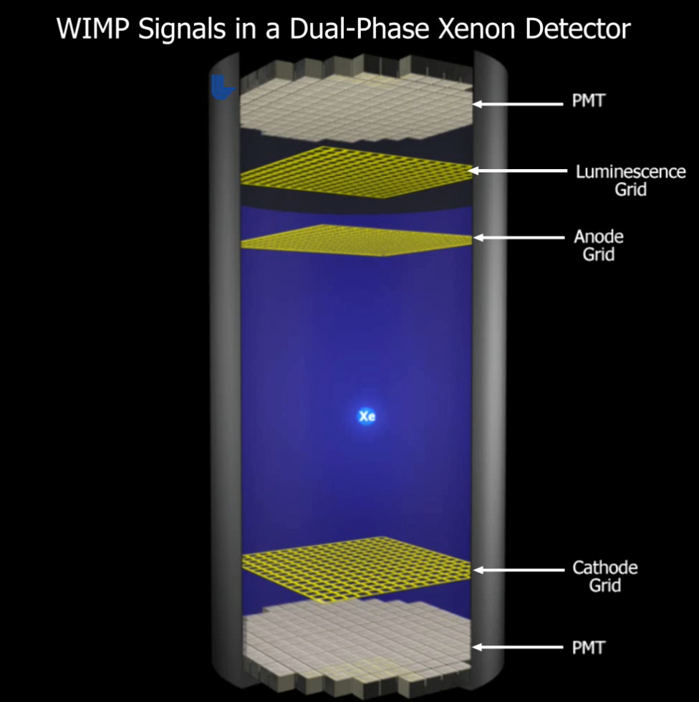

Slide 4
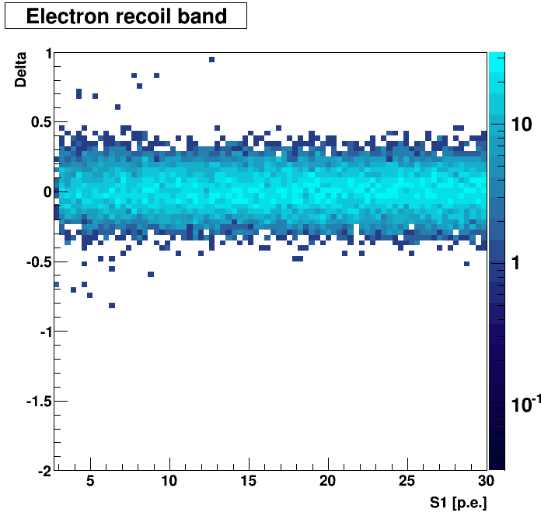
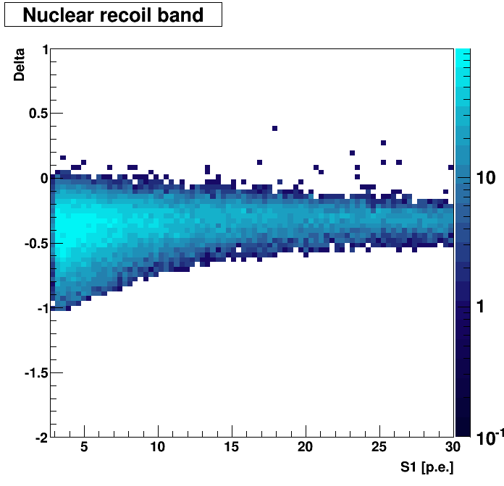
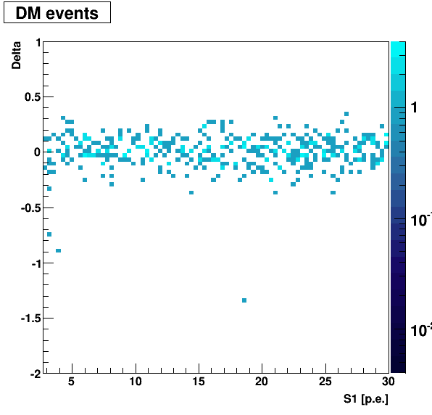
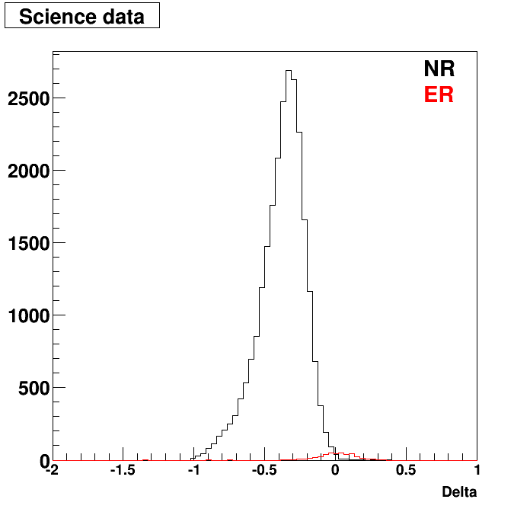
XENON100 calibration data

Slide 5
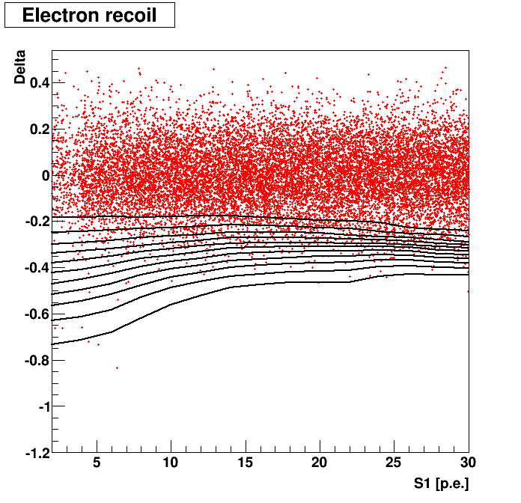
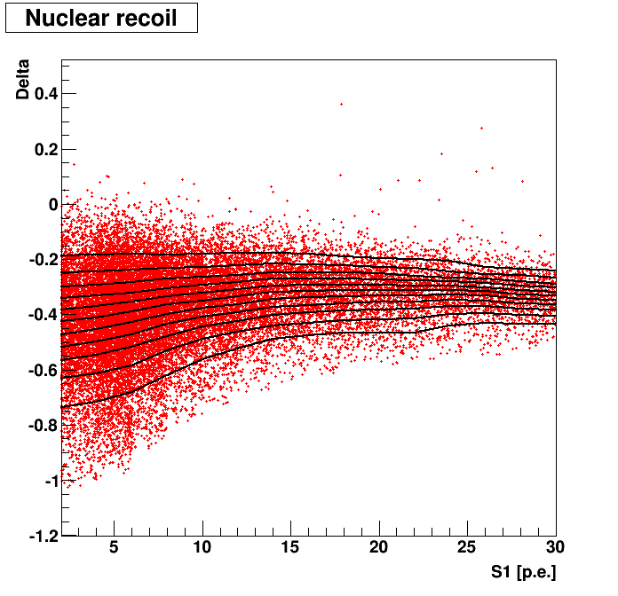
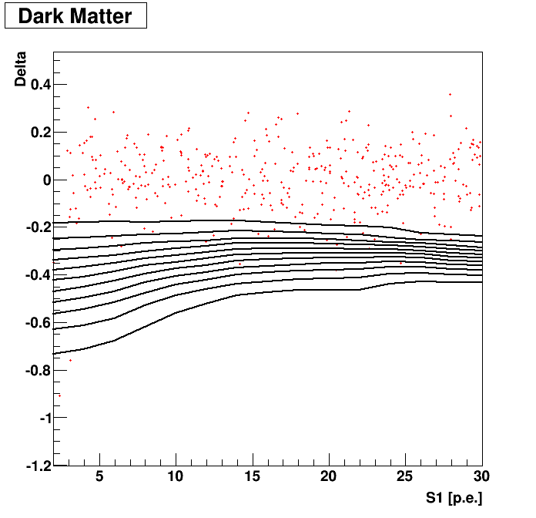
Signal modeling

Slide 6
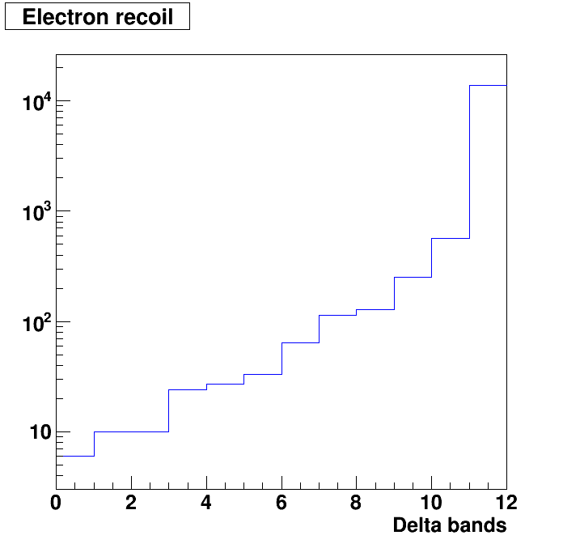
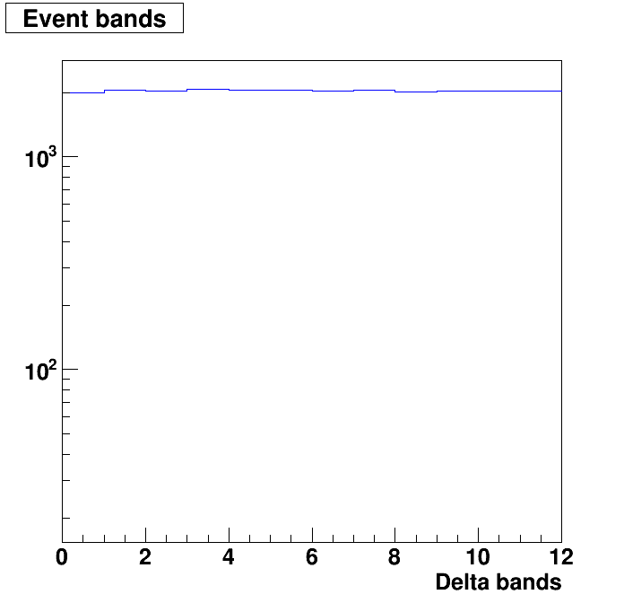
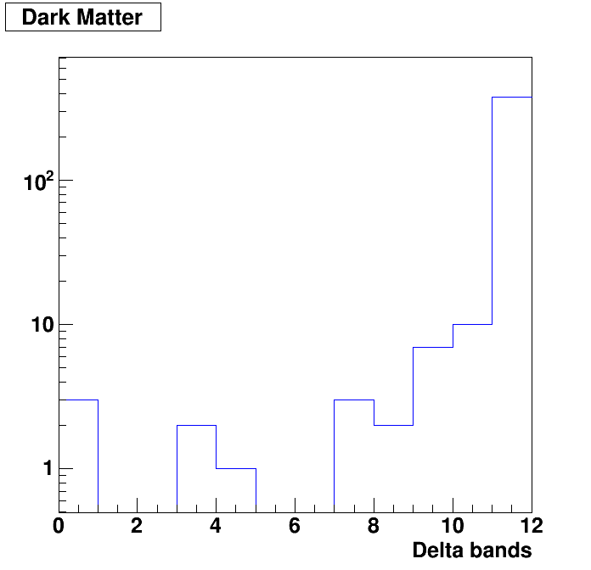
Event distribution

Slide 7
Likelihood
Negative log Likelihood
Expectation value
Signal and background distributions
Number of background events

Slide 8
Profile likelihood
Negative log Likelihood
Nuisance parameters
Expectation value

Slide 10
