Slide 1
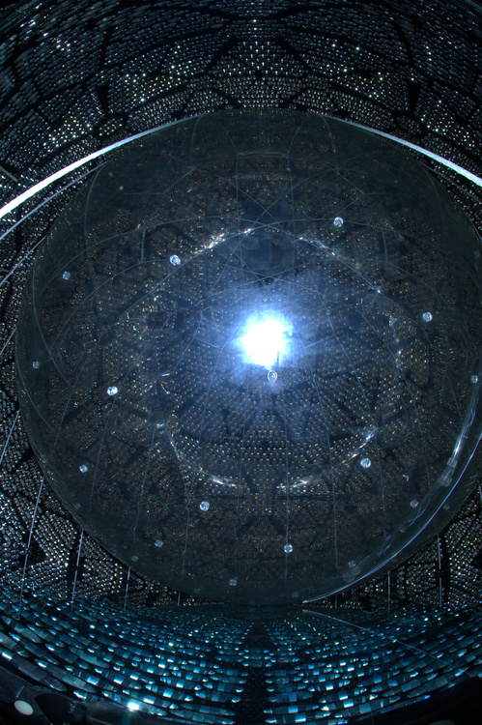
Neutrino Experiments and Detection Methods
Mark Chen
Queen’s University and
Canadian Institute for Advanced Research
Gran Sasso Summer Institute
September 24, 2014

Slide 2
Outline
neutrino interactions
  survey of “all” possible interactions that could be used in detectors
neutrino experiments and their detection methods
  primarily focusing on 0.1-20 MeV neutrinos (solar, reactor, geo, supernova)
  limited discussion of GeV atmospheric neutrinos
  won’t have time to properly discuss GeV accelerator neutrino experiments like T2K, MiniBooNE, OPERA
  won’t have time to discuss TeV (and beyond!) neutrino experiments like IceCube
will talk a little bit about important results from past and current experiments while examining the experiments and their methods

Slide 3
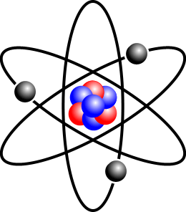
Basics: Neutrino Detectors
neutrinos must interact to produce a detectable charged particle
possible targets in ordinary matter:
  electrons
  atomic nuclei
    composed of nucleons (protons and neutrons)
      composed of quarks
neutrinos only undergo the weak interaction
CC:
NC:
of course, Y has +1 charge wrt X

Slide 4
Electrons as Target in the Detector
neutrino-electron scattering has NC and CC diagrams
is this reaction possible?
it is if the muon neutrino has enough energy to make the outgoing muon
ν_{e,μ,τ}
ν_{e,μ,τ}
ν_{e}
e⁻
Z⁰
W⁺
e⁻
e⁻
e⁻
ν_{e}
Neutral-Current scattering Charged-Current Scattering

Slide 5
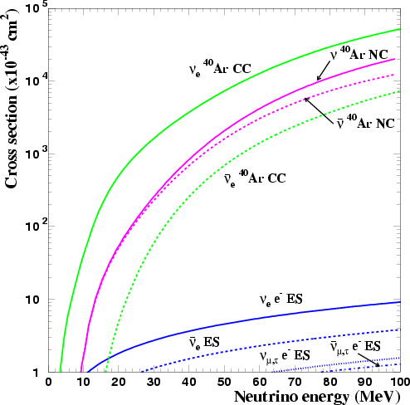
Neutrino-Electron Scattering
objective is to detect the recoiling electrons after CC and NC interactions of neutrinos (CC for ν_{e} only)
  Examples: Borexino liquid scintillator, Super-K water Čerenkov, MUNU TPC
SN ν in LAr TPC
G. Bellini et al. (Borexino), PRD 89 112007 (2014)
I. Gil-Botella and A. Rubbia, JCAP 10 9 (2003)

Slide 6
Nuclei as Target in the Detector
NC neutrino-nucleus scattering (coherent)
  detect the recoiling nucleus, like dark matter experiments
  has not yet been observed
NC excitation of the nucleus
  incoming neutrino excites the nucleus, then detect the gamma rays from nuclear de-excitation
  SNO detected ⁸B solar neutrino NC dissociation of the deuteron; this is essentially the same process
  K2K and T2K have observed neutrino-induced NC interactions with oxygen by detecting the subsequent de-excitation gamma rays; KARMEN has done the same for neutrino-carbon
CC neutrino “absorption”
  detect the outgoing lepton and/or the modified nucleus

Slide 7
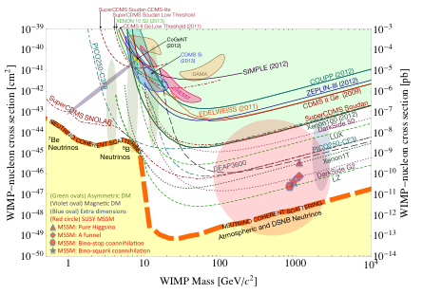
Neutrino-Nucleus Coherent Scattering
background for dark matter searches • CoGeNT ν-nucleus recoil spectrum
cross section goes as A²; kg-sized detectors as opposed to tonne-scale!
Snowmass WIMP Dark Matter Detection, arXiv:1310.8327
P.S. Barbeau, talk at Neutrino 2014 talk

Slide 8
Nuclear Excitation by Neutrinos
original Borex experiment was to search for CC and NC interactions of ⁸B solar neutrinos on ¹¹B in a boron-loaded liquid scintillator
detect 4.45 and 5.02 MeV de-excitation gamma rays
singles events ➔ needs ultra-low background liquid scintillator
200 tonnes natural boron in 1760 tonnes of scintillator would yield 128 events/year
CC:NC cross section related because ¹¹B-¹¹C are mirror nuclei
R.S. Raghavan, S. Pakvasa and B.A. Brown, PRL 57 1801 (1986)

Slide 9
Aside: Dealing with Nuclear Transitions
how to calculate nuclear excitation cross section?
  use ft value from beta decay for CC
  can also extract nuclear matrix elements from charge-exchange reactions (measurements of cross sections), like
  use mirror nuclei properties to relate transition matrix elements for CC and NC
  NC cross sections can also be related to isovector part of radiative decay widths (of the excited states)
  ±10-15% level of precision
detecting NC excitation of nuclei is one thing…knowing the cross section well enough to use this for neutrino physics is another!

Slide 10
Aside: Natural Radioactivity
(naturally-occurring, long-lived isotopes)
highest energy gamma-ray line: 2.614 MeV from ²⁰⁸Tl in the Th decay chain
internal backgrounds (trace contamination) from U and Th can introduce backgrounds up to 5 MeV in a detector
  sum of energy deposited by β-γ from ²⁰⁸Tl decay
alpha energies are 5-8 MeV; however, alphas are easily stopped and alpha backgrounds are suppressed in many detectors
  alpha scintillation is quenched in an organic liquid scintillator
  alpha backgrounds are non-existent in a water Čerenkov detector (way below Čerenkov threshold)

Slide 11
Aside: Natural Radioactivity cont’d
Example: energy spectrum from SNO Phase II
background “wall” visible below 5 MeV

Slide 12
Why Borex Became Borexino (~1992-3)
detecting neutrino NC excitation of ¹¹B is challenging and backgrounds in a ~2 kT boron-loaded liquid scintillator would need to be extremely low
  there was excellent progress toward achieving ultra-low backgrounds in liquid scintillator
when backgrounds reached these ultra-low levels, it was noted that these backgrounds would also be low enough that ⁷Be solar neutrinos could be the detected
  with only 100 tonnes of scintillator (fiducial volume), with good statistics
  using neutrino-electron scattering with precisely known cross section
  ⁷Be solar neutrinos were the key to the solar neutrino problem if the solution was MSW SMA (Small Mixing Angle)

Slide 13
NC Dissociation of the Deuteron
as an example of NC “excitation” of nuclei by neutrinos
binding energy 2.22 MeV; cross section increases as E²
can calculate accurately using “standard nuclear physics approach” or effective field theory
more later when discussing Sudbury Neutrino Observatory…
M. Butler, J.-W. Chen and X. Kong, PRC 63 035501 (2001)

Slide 14

Charged-Current Neutrino Reactions
detect the outgoing lepton
  Examples: CCQE in accelerator neutrino experiments and SNO CC signal from ⁸B solar neutrinos on deuterons
detect the transformed target nucleus
  radiochemical solar neutrino experiments (Chlorine, SAGE, Gallex and GNO)
detect both
  experiments like LENS had the objective to detect both the outgoing electron and the transformed nucleus (via tagged gamma ray decays)
  inverse beta decay for for reactor antineutrino experiments

Slide 15
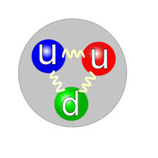
Are Neutrinos Majorana Fermions?
they carry no electromagnetic charge, no QCD colour, no moments, no other quantum number
other than lepton number
but, what exactly is that?
ν_{e}

Slide 16

Are Neutrinos Majorana Fermions?
they carry no electromagnetic charge, no QCD colour, no moments, no other quantum number
other than lepton number
but, what exactly is that?
ν_{e}
e⁺
Why does this reaction only happen for the
“antineutrino”? Does the proton
know an anti-lepton is incident?

Slide 17
Chirality and the Weak Interaction
the weak interaction distinguishes between left and right chirality and that’s why only
does the weak interaction also need to distinguish between lepton number L = 1 and L = –1, in addition? Or is that simply redundant?
if one discards lepton number as a meaningful quantity then neutrinos are Majorana fermions…FACT!

Slide 18
nuebar-proton Cross Section
inverse beta decay
  delayed coincidence distinguishes signal
first neutrino detection by Reines and Cowan (56) used this reaction
neutrino threshold 1.8 MeV = (m_{n} – m_{p} + m_{e})
σ = (9.4 × 10⁻⁴⁴) p_{e} E_{e} cm² quadratic with energy
at E_{ν} = 6 MeV, σ = 2 × 10⁻⁴² cm²
cross section related to free neutron decay lifetime; systematic uncertainty is small
compare to nuebar-deuteron
  threshold energy 4.0 MeV
  lower cross section than nuebar-proton
  for nuebar are there any other good CC target?
  (is a low threshold important?)

Slide 19
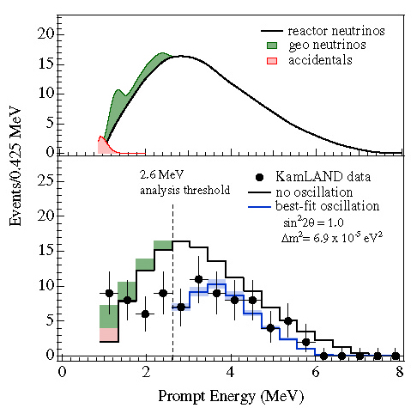
KamLAND Reactor Antineutrino Oscillations
K. Eguchi et al., PRL 90, 021802 (2003)
KamLAND observed disappearance of reactor
antineutrinos – θ₁₂
(61 ± 9)% expected flux
announced 2002-12-06
reactor oscillations
consistent with solar ν
LMA solution
neutron capture on H in scintillator
2.2 MeV γ with lifetime ~200 μs

Slide 20
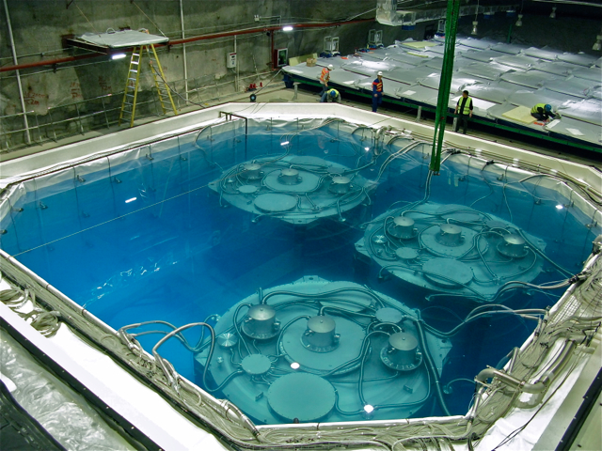
Daya Bay Reactor θ₁₃ Measurement
F.P. An et al., PRL 108, 171803 (2012)
Daya Bay observed reactor antineutrinos disappearing after short distances – θ₁₃
announced 2012-03-08
(also Double CHOOZ and RENO)
Gd-loaded liquid scintillator
neutron capture on Gd gives ~8 MeV of γ’s
~30 μs capture time

Slide 21
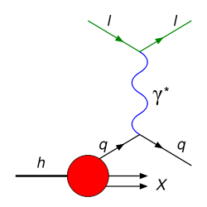
Neutrino Interactions at GeV Energies
DIS, modified from Wikipedia
note: figure to the right does not necessarily have up-to-date data (it’s just for illustration purposes)

Slide 22
Neutrino Interactions at GeV Energies
from 100’s of MeV to several GeV and beyond
CC and NC neutrino interactions on nuclei, nucleons, and deep-inelastic scattering on quarks at progressively higher energies (examples below)
neutrinos detected by observing any of the products in the final state, including the outgoing lepton (or its decay)
Examples
CC NC

Slide 23
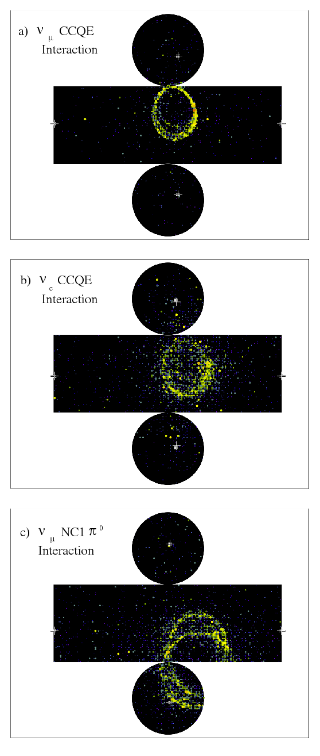
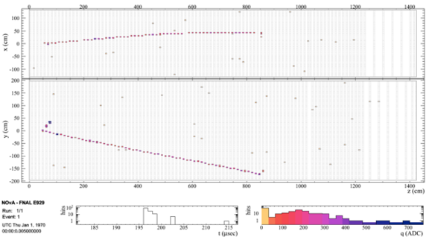
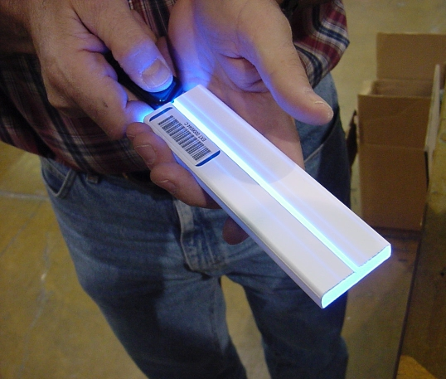
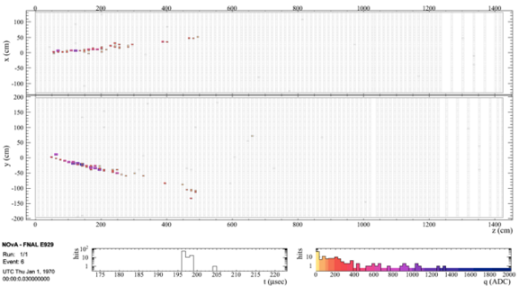
GeV Neutrino Detector Technology
calorimetry: liquid scintillator and water Čerenkov
particle ID: water Čerenkov and mineral oil Čerenkov
  Example: Super-K NC π⁰ and MiniBooNE
tracking: fine grained detector to see the lepton and X
  scintillating fibers
  plastic scintillator bars (Examples: T2K near detector, MINOS)
  segmented liquid scintillator (NOνA)
  “conventional” layers of iron-tracking (Examples: Soudan, INO)
TPC: LAr (ICARUS, LBNE)
nuclear emulsion plus tracking (OPERA)
  to detect short range tau decay “kink”
note: tau neutrino detection in IceCube is very different from OPERA…detector methods are very much dependent on the energy scale

Slide 24
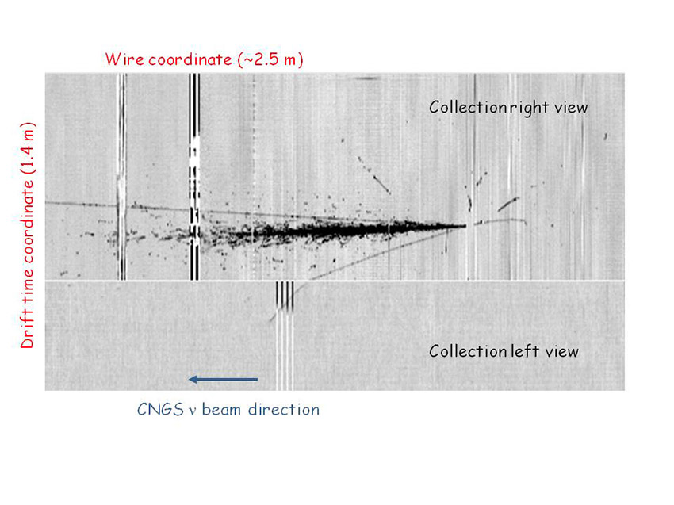
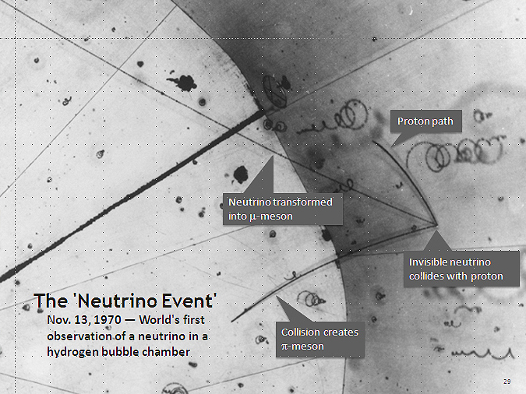
Bubble Chambers and LAr TPCs
Argonne hydrogen bubble chamber
ICARUS

Slide 25
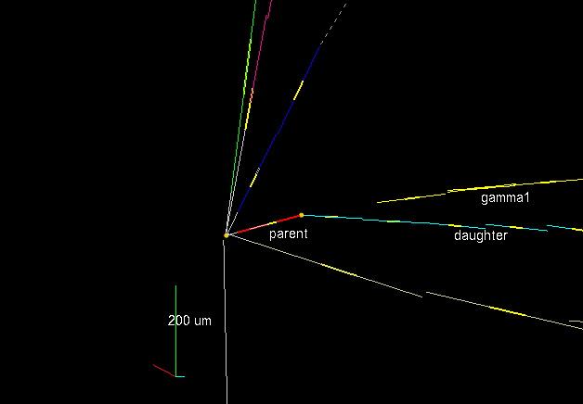
OPERA Tau Neutrino Event

Slide 26
Outline
neutrino interactions
  survey of “all” possible interactions that could be used in detectors
neutrino experiments and their detection methods
  primarily focusing on 0.1-20 MeV neutrinos (solar, reactor, geo, supernova)
  limited discussion of GeV atmospheric neutrinos
  won’t have time to properly discuss GeV accelerator neutrino experiments like T2K, MiniBooNE, OPERA
  won’t have time to discuss TeV (and beyond!) neutrino experiments like IceCube
will talk a little bit about important results from past and current experiments while examining the experiments and their methods

Slide 27
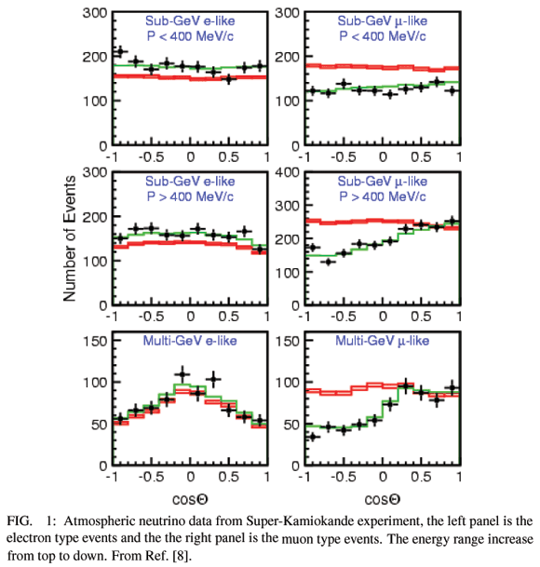
Evidence for Neutrino Oscillations
atmospheric neutrinos (Super-K, +others)
solar neutrinos (SNO, +others)
reactor antineutrino disappearance (KamLAND)
short-baseline θ₁₃ reactor (Daya Bay, RENO, Double CHOOZ)
accelerator neutrino beams (K2K, MINOS, T2K, OPERA)
  include both disappearance and appearance experiments
  LSND?

Slide 28
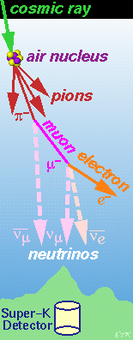
Atmospheric Neutrinos
produced by cosmic ray interactions in the upper atmosphere
the flux of muon neutrinos and electron neutrinos can be reasonably-well calculated
  better now than 15-20 years ago
the ratio of muon neutrinos and electron neutrinos was considered even more reliable
  2:1 ν_{μ}:ν_{ε}
figure from Boston University SK webpage

Slide 29
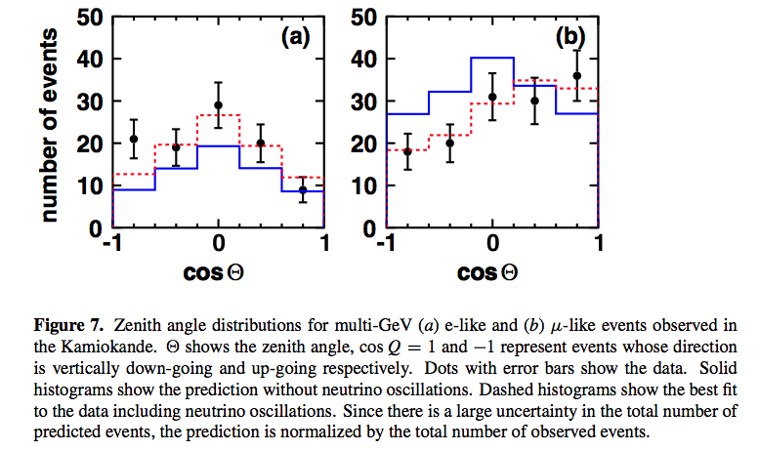
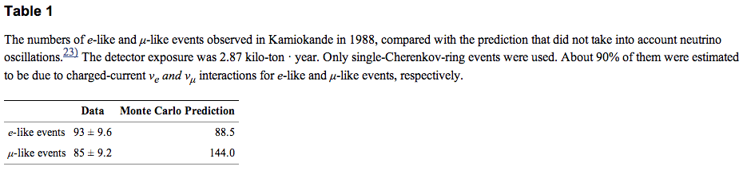
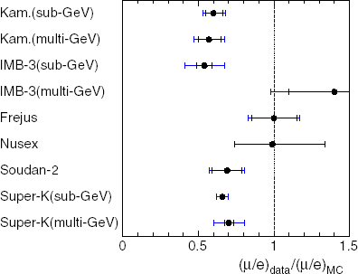
Atmospheric Neutrino Anomaly
from T. Kajita
in the late 80’s and early 90’s underground neutrino detectors noted an anomaly
muon neutrino flux was lower than expected
double ratio
most detectors can’t tell neutrino from antineutrino, so sum

Slide 30
Historical Aside #1
atmospheric neutrinos provided some motivation for 1 km baseline reactor neutrino experiments
  CHOOZ, Palo Verde
if ν_{μ} oscillated to ν_{ε} then reactor antineutrinos should disappear
hence the baseline is appropriate for θ₁₃ experiments
we now know the dominant mode is ν_{μ} oscillates to ν_{τ}
E
X
C
L
U
D
E
D

Slide 31
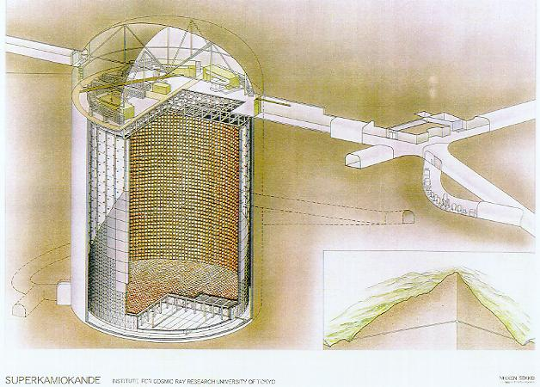

Super-Kamiokande
Electronics hut
Control room
Atotsu
entrance
ID
OD
Ikeno-yama
Kamioka-cho, Gifu
Japan
3km
2km
39.3m
Mozumi
SK
Atotsu
50 kilotons water; cylinder 39.3 m diameter and 41.4 m high; 11,146 PMT’s (20-inch) for 40% photocathode coverage
location: Kamioka mine, near Mozumi, Japan

Slide 32
Smoking Gun – Zenith Angle Distributions
Super-K found that upward-going muon neutrinos have oscillated to ν_{τ}

Slide 33
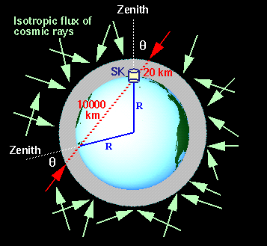
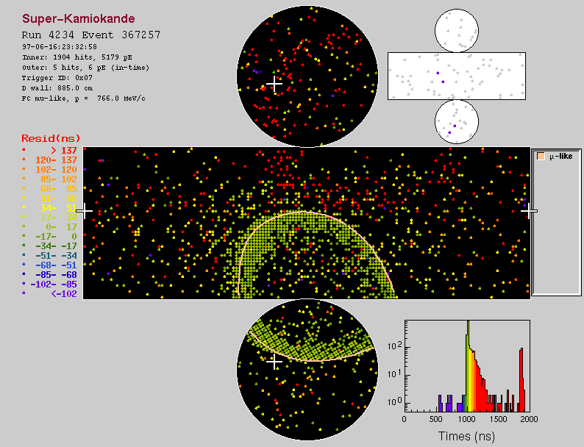
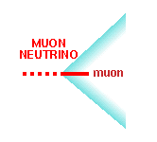
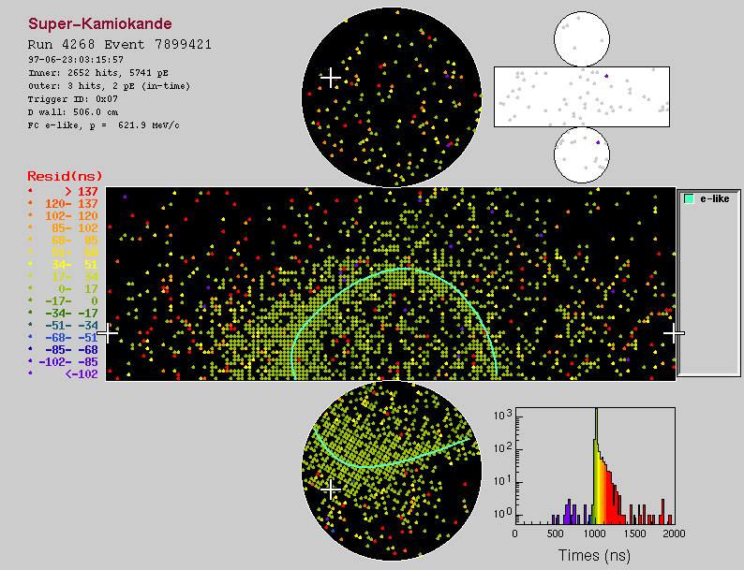
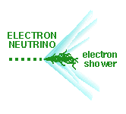
Expect Up-Down Symmetric Distributions ν_{μ} and ν_{ε}
figures from Boston University SK webpage

Slide 34
Most Recent Super-K Atmospheric Results
all SK atmospheric slides from R. Wendell talk at Neutrino 2014

Slide 35
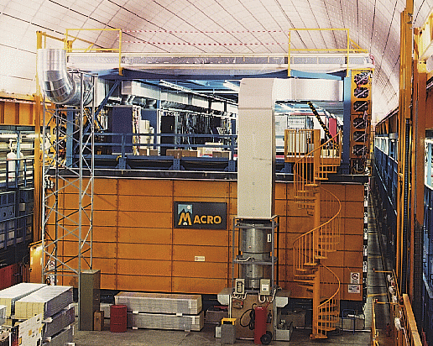
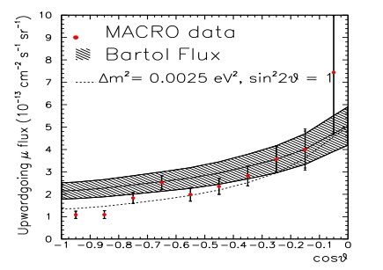
Historical Aside #2 on Upgoing Muons

Slide 36
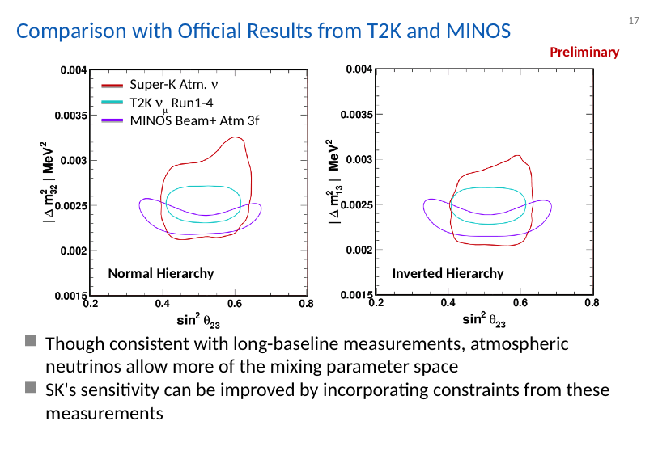
Atmospheric Neutrino Oscillations in the Precision Era

Slide 37
Can Study More Subtle Effects
ν_{τ} appearance

Slide 38
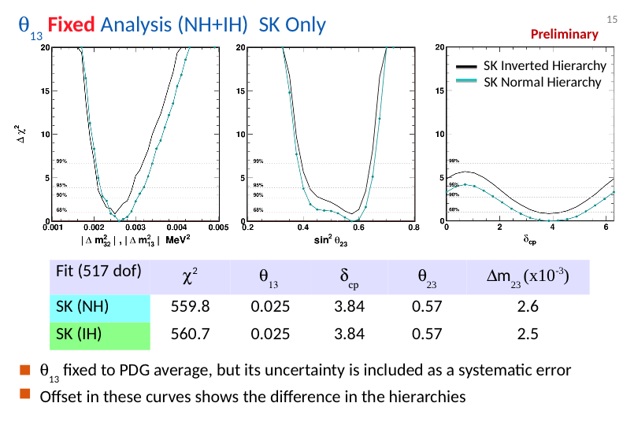
Can Study More Subtle Effects
search for ν_{ε} appearance and 3-flavour effects (hierarchy, octant, CP-phase), matter effects going through the Earth

Slide 39
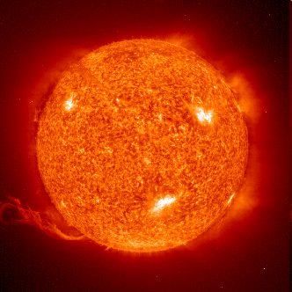
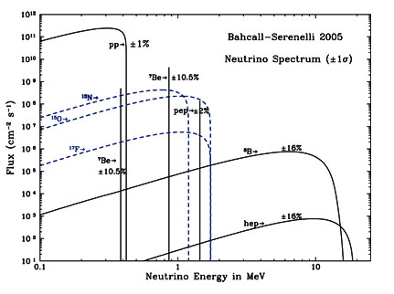
Solar Neutrinos
pp Solar Fusion Chain
p + p → ²H + e⁺ + ν_{e}
p + e⁻ + p → ²H + ν_{e}
²H + p → ³He + γ
³He + ³He → ⁴He + 2 p
³He + p → ⁴He + e⁺ + ν_{e}
CNO Cycle
³He + ⁴He → ⁷Be + γ
¹²C + p → ¹³N + γ ¹³N → ¹³C + e⁺ + ν_{e}
¹³C + p → ¹⁴N + γ
¹⁴N + p → ¹⁵O + γ ¹⁵O → ¹⁵N + e⁺ + ν_{e}
¹⁵N + p → ¹²C + α
⁷Be + e⁻ → ⁷Li + γ + ν_{e}
⁷Be + p → ⁸B + γ
⁷Li + p → α + α
⁸B → 2 α + e⁺ + ν_{e}

Slide 40
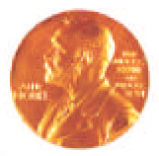
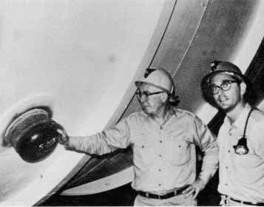
Solar Neutrino Pioneers
Ray Davis built the Chlorine Experiment in the 1965-67
John Bahcall produces the “Standard Solar Model” neutrino calculations
“…to see into the interior of a star and thus verify directly the hypothesis of nuclear energy generation in stars…”

Slide 41
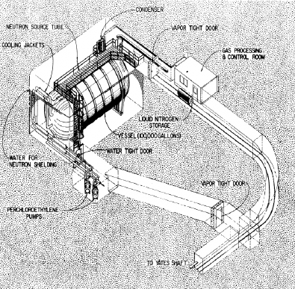
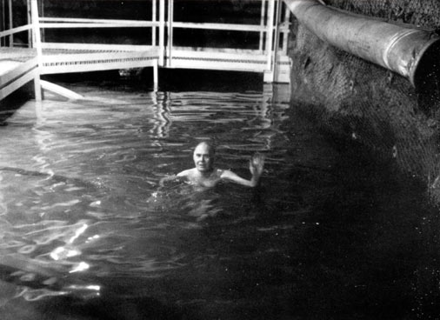
Ray Davis’ Chlorine Experiment
neutrino capture reaction:
E_{threshold} = 0.814 MeV
³⁷Ar half-life is 35 days
“expose” chlorine to solar neutrino flux for ~2 t_{1/2}
bubble helium to collect/purify ~10 atoms of argon produced in the tank
count ³⁷Ar EC decays in a low-background proportional counter
615 tons of C₂Cl₄
location: Homestake Mine in South Dakota, USA

Slide 42
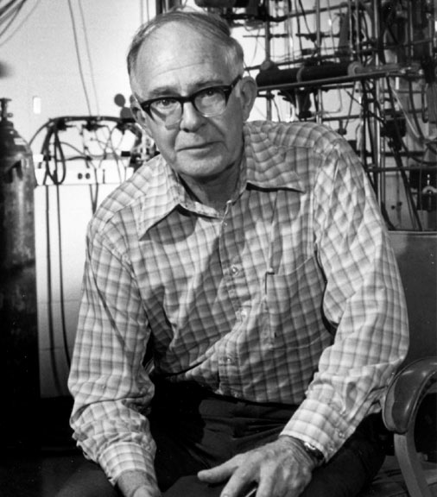
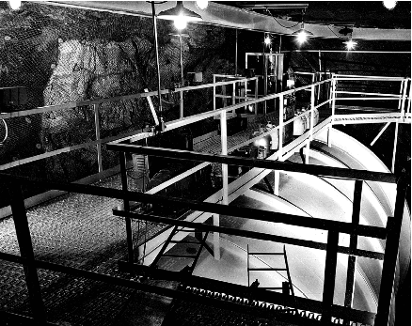

Slide 43
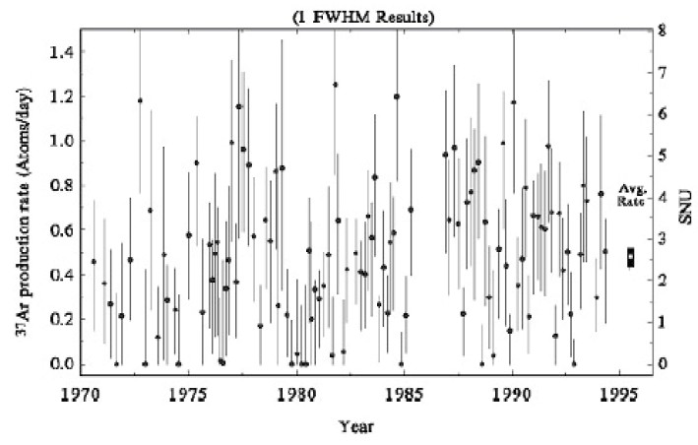
Chlorine Results: 1970-1994 (Final)
average: 2.56 ± 0.23 SNU (Solar Neutrino Unit)
solar model predicted rate: 7-8 SNU
1 SNU = 1 neutrino capture per second per 10³⁶ target atoms

Slide 44
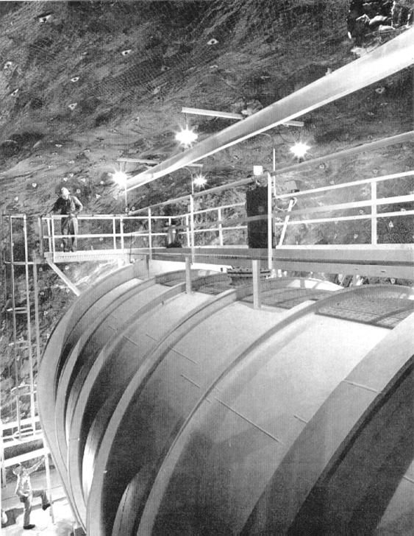
Solar Neutrino Problem
deficit of solar neutrinos detected by experiments compared to solar models is due to:
  experiment(s) are wrong
    is Ray Davis wrong?
  incorrect model/physics of the solar interior
    is John Bahcall wrong?
  incorrect understanding of nuclear reactions?
  new properties of massive neutrinos produce an apparent deficit?

Slide 45
What Experiments Followed?
radiochemical experiments with gallium
water Čerenkov detector
heavy water Čerenkov detector
liquid scintillator detector
other ideas that were proposed or attempted:
  boron-loaded scintillator CC and NC reactions
  iodine-to-xenon radiochemical experiment
  lithium-to-beryllium radiochemical; now lithium-loaded WBLS
  bromine-to-krypton radiochemical
  indium experiment (very low threshold) – tagged
  CC on Yb (or Gd) loaded in liquid scintillator
  fluorine neutrino capture (with coincidence tag)
I will describe the final status of these efforts rather than the chronological contributions to our understanding of solar neutrinos, as the results came to be.

Slide 46
SAGE – Soviet American Gallium Experiment
radiochemical Ga experiment at Baksan Neutrino Observatory with 50 tons of metallic gallium
running since 1990-present
measures pp solar flux in agreement with SSM when oscillations are
included – the predicted signal is

Slide 47
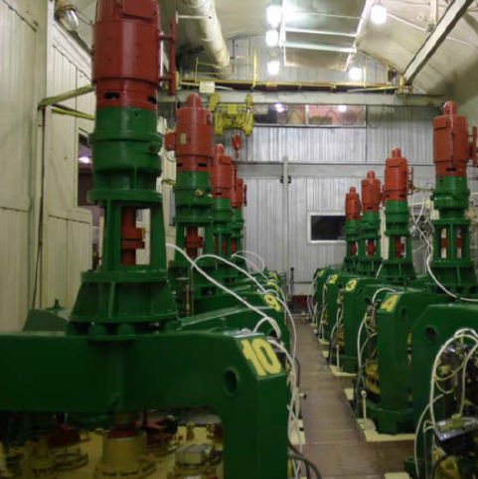
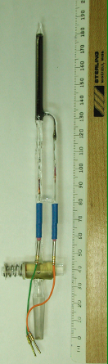
SAGE Experiment
neutrino capture reaction:
E_{threshold} = 0.233 MeV
sensitive to pp solar ν
t_{1/2} is 11.43 days
germanium atoms are extracted with sensitivity: 1 germanium atom extracted from 5×10²⁹ atoms of gallium, with 90% efficiency
50 tons of metallic gallium
location: Baksan Underground Lab,
northern Caucasus

Slide 48
SAGE Results: 1990-2011
solar model predicted rate:
120-130 SNU
from V. Gorbachev talk at NANPino-2013: “SAGE continues measurements”

Slide 49
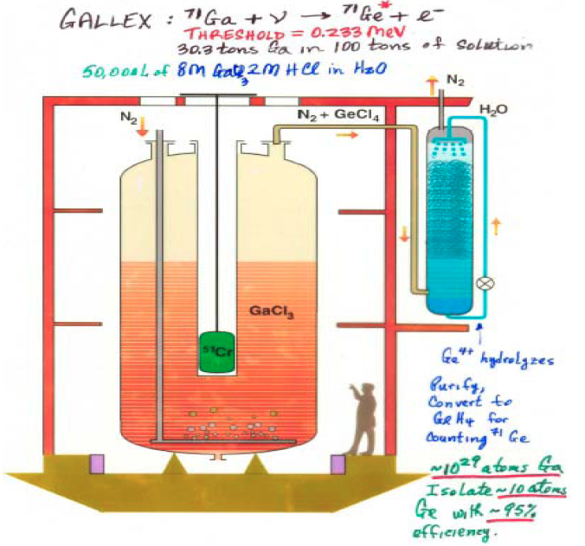
Gallex/GNO Experiment
similar to SAGE except with gallium chloride
ran as Gallex (1991-97)
then as GNO (1998-2003)
Gallex recently reanalyzed all their data
re-calibrated all low-background counters with large Ge spike
used pulse-shape analysis like for GNO analysis
improved Rn cut efficiency and background determination
100 tons of gallium chloride solution (30 tons ⁷¹Ga)
location: Gran Sasso National Lab in
Abruzzo, Italy

Slide 50
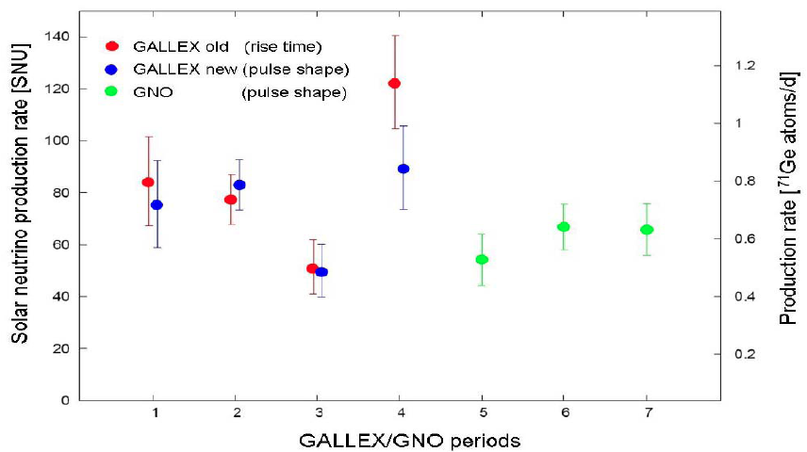
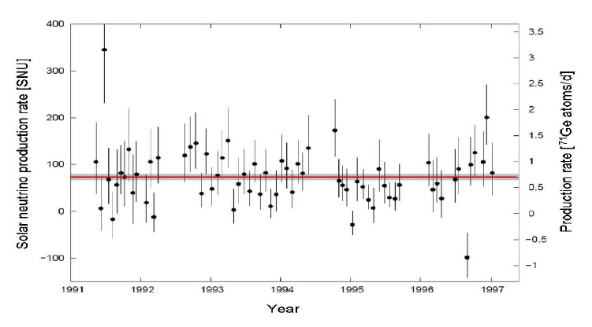
Gallex/GNO Results

Slide 51
Summary of Radiochemical Gallium Solar Neutrino Results
updated Gallex combined: SNU
GNO combined: SNU
Gallex+GNO combined: 67.6 ± 4.0_{stat} ± 3.2_{syst} SNU
average all Ga experiment: 66.1 ± 3.1 SNU
both experiments calibrated with neutrino sources; and measured hot chemical extraction efficiency
they see a clear deficit of the fundamental pp fusion solar neutrinos; results in agreement with each other and with solar model predictions when oscillations are included

Slide 52
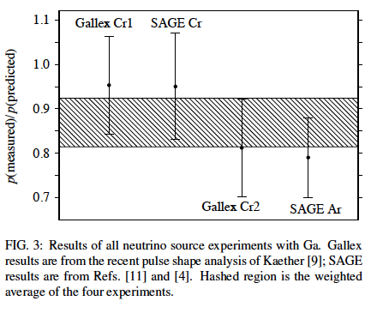
Gallex and SAGE Calibrations
all are low?
  just statistics?
  efficiency of extraction is incorrect?
  oscillations to sterile neutrinos cause disappearance?
  production rate from source (i.e. cross section for ν_{e} absorption) not as large as assumed in calculation?

Slide 53
Outstanding Issues with Gallium?
calibrations are low?
time dependence?
  Gallex (1991-97) runs higher than GNO (1998-2003)
  same is observed by SAGE
…or, is all of this just fine and within experimental errors? Probably!

Slide 54
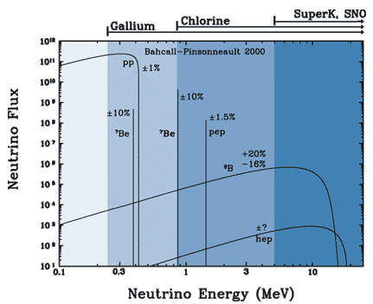
Energy Dependence of Solar ν Deficit
measured / no oscillation expectation
Chlorine 0.34 ± 0.03
Gallium 0.52 ± 0.03
Super-K 0.46 ± 0.02
The “Solar Neutrino Problem”

Slide 55
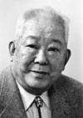
Imaging Water Čerenkov Detectors
Kamiokande and IMB built in the 80’s
  large water Čerenkov detectors that searched for proton decay
Kamiokande was then upgraded, beginning in 1985, to detect ⁸B solar neutrinos (1st solar ν results in 1988)
Super-Kamiokande (larger and improved) was built and became operational on April 1, 1996
SNO – a heavy water Čerenkov detector was built and started taking production data on November 1, 1999
Masatoshi
Koshiba shared
2002 Nobel Prize
with Ray Davis
(and Giacconi)

Slide 56
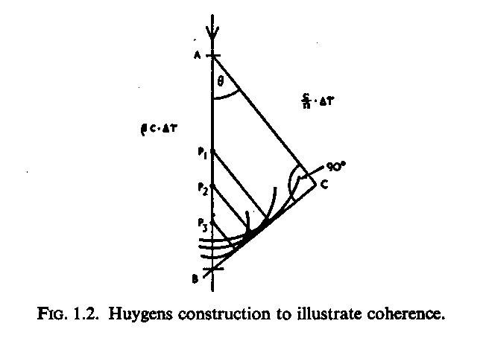

Čerenkov Light
emitted by charged particles whose velocity exceed c/n
for electrons in water, threshold:
  E > 0.768 MeV
cone of light, half angle given by:
  cos θ = 1 / (βn); 41° in water for β ≈ 1
spectrum of photons emitted:
in water: 390 photons per cm, between 300 nm and 700 nm
5 MeV e⁻ travels ~2 cm in water; ~800 photons produced; 20% average PMT efficiency; 33% photocathode coverage → ~50 photoelectrons or 10 p.e./MeV

Slide 57
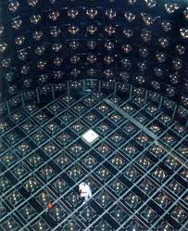


Kamiokande

Slide 58

Kamiokande ⁸B Solar Neutrinos
confirmed Chlorine Experiment deficit of ⁸B solar νευτρινοσ
flux measured by Kamiokande of 2.67×10⁶ cm⁻² s⁻¹ compared to solar model calculated flux of ~5-6×10⁶ cm⁻² s⁻¹
Bahcall and Bethe made the following inference: from the Kamiokande measured flux (of ν_{e}), this would result in at least 3 SNU in the Chlorine experiment
at that time, the Cl result was 2.2 ± 0.2 SNU (in 1993)
  so what about the ⁷Be solar neutrinos that should also contribute to the rate in Cl?
  can’t be explained by solar physics (e.g. core T)
two conclusions: ⁷Be neutrinos missing and/or ⁸B spectrum is distorted by neutrino oscillations
LMA
SMA

Slide 59
Interesting to Note…
it turns out that today we know that neither of these two possibilities are correct!
  spectrum is pretty “flat” and not distorted
  ⁷Be solar neutrinos are not completely suppressed
Bahcall-Bethe was a test case hypothesis that refuted a conventional astrophysical solution to the solar neutrino problem
  they scaled the whole Kamiokande signal as ν_{e}
  but, today we know how to calculate the actual ⁸B ν_{e} contribution to the Chlorine experiment…by using the SNO charged-current result (more on this later)

Slide 60
SNO and Chlorine Revisited
Chlorine rate [SNU]:
⁸B 5.76
⁷Be 1.15
pep 0.22
CNO 0.42
hep 0.04
total 7.82
SNO measures ν_{e} flux:
Φ(⁸Β) = 0.33 SSM
better predictor of ⁸B in Cl
1.92 ± 0.17 SNU
Cl experimental rate:
2.56 ± 0.23 SNU
there is room for ⁷Be!

Slide 61

Super-K Solar Neutrino Detection
neutrino-electron scattering
  ν_{x} + e⁻ → ν_{x} + e⁻ (ES)
~6 times higher cross section than
find ring in pattern of hit PMTs
reconstruct direction of incoming neutrino and correlate to the Sun direction
kinematics of ES gives forward-peaked distribution
1,496 day data
22,400 events (max likelihood)
2.35 ± 0.02 (stat.) ± 0.08 (sys.)
× 10⁶ cm⁻² s⁻¹

Slide 62

Typical Low Energy Event in SK

Slide 63





History of Super-Kamiokande
1996 | 1997 | 1998 | 1999 | 2000 | 2001 | 2002 | 2003 | 2004 | 2005 | 2006 | 2007 | 2008 | 2009 | 2010
SK-I
SK-II
SK-III
SK-IV
SK-I
Acrylic (front)
+ FRP (back)
SK-II
SK-III
SK-IV
11146 ID PMTs
(40% coverage)
5182 ID PMTs
(19% coverage)
11129 ID PMTs
(40% coverage)
Electronics
Upgrade
Energy
Threshold
(Total energy)
(Kinetic energy)
7.0 MeV
~6.5 MeV
5.0 MeV
~4.5 MeV
~4.5 MeV
~4.0 MeV
Current
< 4.0 MeV
<~3.5 MeV
Target
5.0 MeV
~4.5 MeV

Slide 64
Recent Results Super-K Solar
slide from Y. Koshio talk at Neutrino 2014

Slide 65


SK-I Solar Neutrino Results

Slide 66


Slide 67
Example of Recent SK Solar Results
results slides from Y. Koshio talk at Neutrino 2014

Slide 70



Sudbury Neutrino Observatory
1000 tonnes D₂O
12 m diameter Acrylic Vessel
18 m diameter support structure; 9500 PMTs (~55% photocathode coverage)
1700 tonnes inner shielding H₂O
5300 tonnes outer shielding H₂O
Urylon liner radon seal
depth: 2092 m (~6010 m.w.e.) ~70 muons/day

Slide 71


Photos
SNO detector

Slide 72

Neutrino Reactions in SNO
CC
ν
+
d
→
p
+
p
+
e⁻
e
only detects ν_{e} flavor
good measure of neutrino energy spectrum
Q-value 1.44 MeV
directionality
NC
ν
+
d
→
p
+
n
+
ν
x
x
measures total ⁸B ν flux from the Sun
equal cross section for all active ν flavors
Q-value 2.22 MeV
ν
+
e⁻
→
ν
+
e⁻
ES
x
x
lower statistics
points to the Sun

Slide 73



SNO
Pioneers
Herb Chen
George Ewan

Slide 74


Neutrino Current Trilogy
NCD
Pure D₂O
Nov 99 – May 01
n + d → t + γ
(E_{γ} = 6.25 MeV)
PRL 87, 071301 (2001)
PRL 89, 011301 (2002)
PRL 89, 011302 (2002)
PRC 75, 045502 (2007)
Salt
Jul 01 – Sep 03
n + ³⁵Cl → ³⁶Cl + Σγ
(E_{Σγ} = 8.6 MeV)
enhanced NC rate and separation
PRL 92, 181301 (2004)
PRC 72, 055502 (2005)
³He Counters
Nov 04 – Nov 06
n + ³He → t + p
proportional counters
σ = 5330 b
event-by-event separation
PRL 101, 111301 (2008)
PRC 87, 015502 (2013)
“long” archival papers with complete details
PRC 81, 055504 (2010)
PRC 88, 025501 (2013)
combined analysis with
lower energy threshold
combined analysis of
all three phases

Slide 75

A Neutrino Event
Event Information: PMT hits – position, time, charge
Event Reconstruction: vertex, direction, energy, isotropy

Slide 76
Fitting CC, NC, ES in SNO

Slide 77
Example of Fitting Distributions
for SNO Salt Phase (Phase II)
maximum likelihood fit: energy, Sun direction, isotropy, radial

Slide 78
Solar Neutrino Flavour Content
Φ_{CC} = Φ_{e}
Φ_{NC} = Φ_{e} + Φ_{μτ}
Φ_{ES} = Φ_{e} + 0.155 Φ_{μτ}

Slide 79




Summary of Main SNO Solar ν Results
direct measure of the averaged survival probability of ⁸B solar ν
total active flux of ⁸B solar ν agrees with solar model calculations
global fit of oscillation parameters including KamLAND and all solar neutrino data
ν_{e} day-night asymmetry
Phase II
Phase III
Phase II
Phase III
BS05(OP) (5.69 ± 0.91) × 10⁶ cm⁻² s⁻¹
combined Phase I+II
expected value is ~0.03

Slide 80
SNO Spectrum
Phase I – summed
Phase II – CC extracted

Slide 81
Final SNO Results
Φ_{CC}(ν_{e}) = (1.68 ± 0.10) × 10⁶ cm⁻² s⁻¹ [Salt Phase]
Φ_{NC}(ν_{x}) = (5.25 ± 0.20) × 10⁶ cm⁻² s⁻¹ [Final Combined]
coming from:
  2176 CC events, 2010 NC events, 279 ES events (Salt Phase)
  128 external-source neutron backgrounds,125 internal neutron backgrounds (e.g. Salt Phase)
  3 internal Cherenkov backgrounds (e.g. Salt Phase)
  1867 CC events, 927 NC neutrons, 171 ES events, 188 background neutrons (in ³He Phase)
  1968 CC events, 577 NC events, 264 ES events (Pure D2O Phase)
BS05(OP) Solar Model Flux Calculation:
(5.69 ± 0.91) × 10⁶ cm⁻² s⁻¹
We see the Sun is producing all of the ⁸B neutrinos that solar models predict it should.
The SNO NC measurement confirms that solar models are correct and that we understand how energy generation by nuclear fusion works in stars.
About 2/3 of solar neutrinos transform to muon and tau flavours on their way to Earth; we see that in the difference between NC and CC rates.
A global analysis of all solar neutrino results determines neutrino oscillation parameters.

Slide 82
Liquid Scintillator Solar ν Detection
typical light yield: ~10,000 photons/MeV
  compare to Čerenkov 390 photons/cm in water [between 300-700 nm]
scintillation light is isotropic – no correlation with Sun direction (also kinematics at lower energy also makes this less feasible)
energy spectral feature are thus very important
  Example: for ⁷Be ν detection
typical liquid scintillator emission time constant: ~1 to 5 ns
  liquid scintillators are fast (typically); can exploit timing cuts to reject backgrounds

Slide 83

⁷Be Solar Neutrino Detection
neutrino-electron scattering
⁷Be ν “Compton” edge

Slide 84
Aside: Bi-Po Coincidences
U chain
Th chain
β-α coincidences easily detected in a liquid scintillator
– allows in-situ assay of U, Th in the scintillator
– very efficient rejection of these specific backgrounds

Slide 85


Borexino at Gran Sasso
300 tons of pseudocumene-based scintillator
100 ton fiducial volume
⁷Be solar ν
  ν-e scattering
2212 8” PMTs
light yield
  ~500 p.e./MeV
detector filled
  May 15, 2007
first results
  Aug 16, 2007

Slide 86
Borexino ⁷Be Solar ν Measurement
PRL 101, 091302 (2008)
PSD removes ²¹⁰Po α
rate of ⁷Be solar neutrinos: 49 ± 3 ± 4 counts/(day·100 tons)
SSM predicted no-osc rate: 74 counts/(day·100 tons)
SSM (high metallicity) predicted rate including
MSW-LMA oscillations: 48 ± 4 counts/(day·100 tons)
Notes:
86

Slide 87
Borexino Low Energy ⁸B Solar Neutrinos
PRD 82, 033006 (2010)
Borexino detects ⁸B solar neutrino ES with lower threshold than SNO or Super-K (albeit with very low statistics)

Slide 88
Borexino pep Detection
PRL 108, 051302 (2012)
analysis tags used to reject ¹¹C by factor ~10, keeping 50% of the signal
98% CL detection or 2.05σ

Slide 89
Borexino pp Solar Neutrino Detection
Nature 512, 383 (2014)
neutrinos from the primary proton-proton fusion reaction detected, in real time
99% of the Sun’s energy generation starts from the pp reaction (and chain of reactions), as verified by the Borexino measurement

Slide 90
Complete (nearly) Solar ν Spectroscopy by Borexino!
A beautiful achievement that caps the very successful Borexino experiment!

Slide 91









Slide 92






Slide 93




Slide 94


Slide 95



