Slide 1



Future evolution of the FTK processing unit
Christos Gentsos
Aristotle University of Thessaloniki
FTK 324318 FP7-PEOPLE-2012-IAPP
TIPP 2014 Amsterdam 3/6/2014

Slide 2
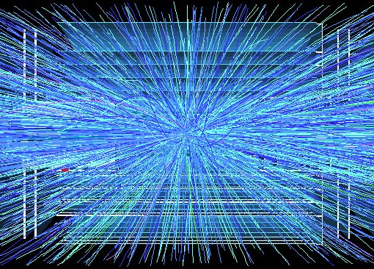
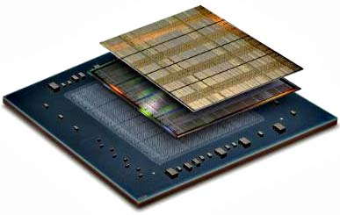
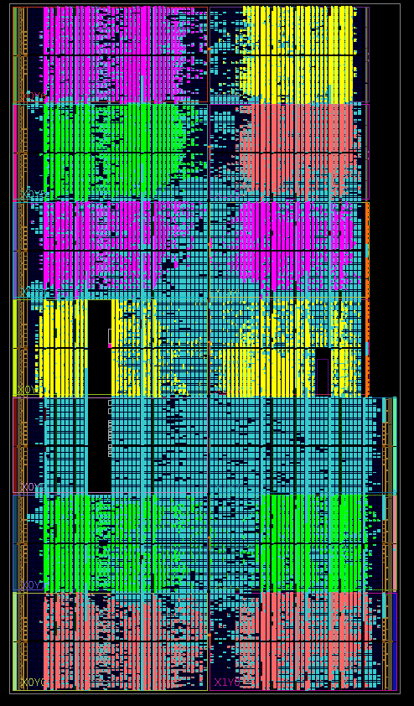
Presentation Overview
Key FTK components
Goal of the project
FPGA firmware
FPGA Device utilization and power
System latency and processing speed

Slide 3
FTK: Full event tracking in 2 steps
  Find Roads first (Pattern Matching with Associative Memory, AM)
  From those Roads extract the Hits
  Combine the Hits to form Tracks, calculate χ² and parameters (Track Fitter)
_{SSIDs}
Data Organizer
(DO)
Pattern matching
(Associative
Memory - AM)
Hits
Roads
Super
Strip (SS)
Roads + hits
Track
Fitter
(TF)
Track fitting
  using full resolution of the detector
Tracks parameters
(d, p_{T}, φ, η, z)

Slide 4
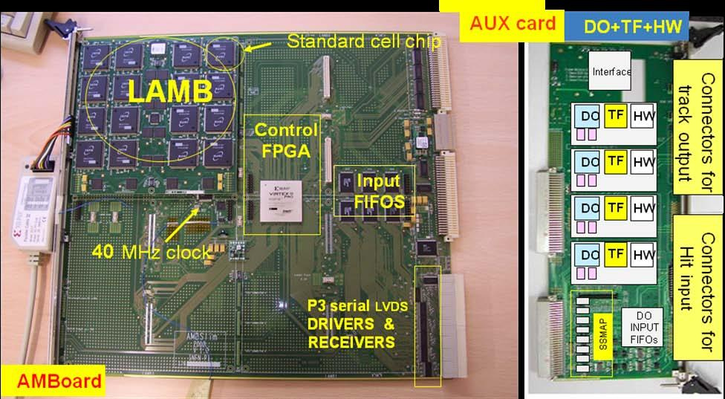
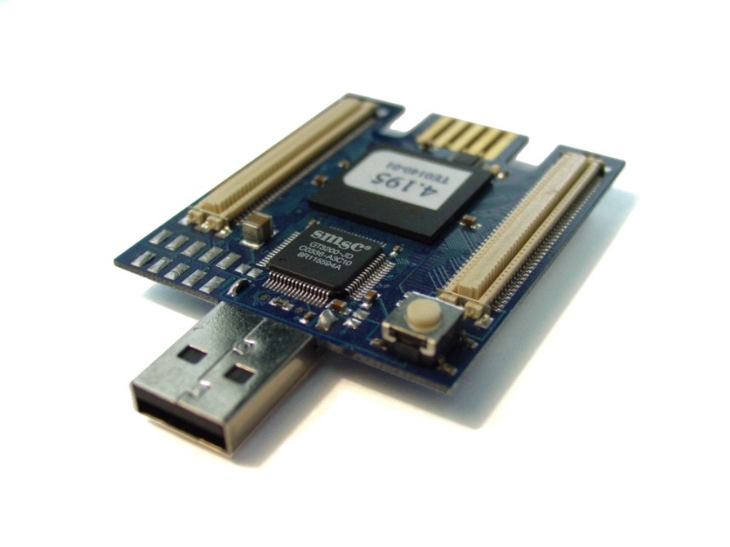
Project goals: integration of many FTK functions in a small form factor
Main goal is to integrate the FTK system in a more compact form
First step will be to connect an AMChip, an FPGA and a RAM in a prototype board
In the future the devices could be merged in a single package
That package will function like a miniature of a whole current FTK Processing Unit (AMB+Aux)

Slide 5
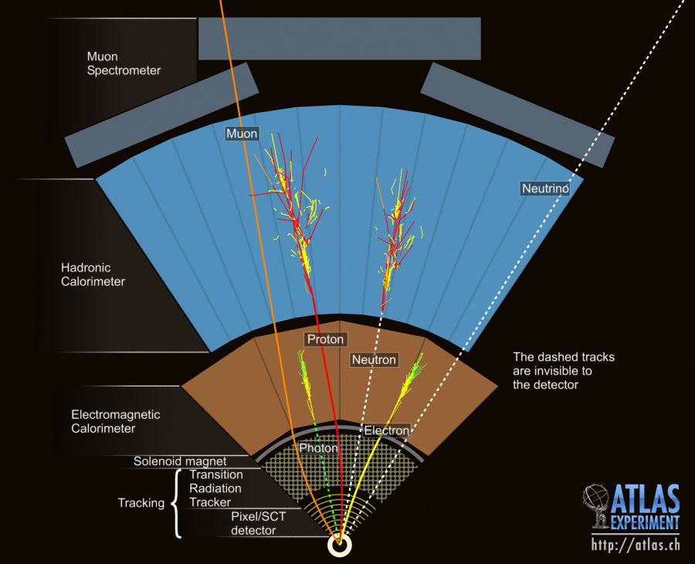
Project goals: flexibility
The main target will be the ATLAS detector L1 trigger (for the PhaseII upgrade), but for that development phase we will keep the FTK detector layout, that is 5 SCT and 3 pixel layers
The end architecture should be flexible, and the resulting system easy to reprogram to target other applications (to be studied in the IAPP project) such as:
  Machine vision for embedded systems: low power edge detection, object detection
  Medical imaging applications
  Coprocessor for various High Performance Computing applications

Slide 6
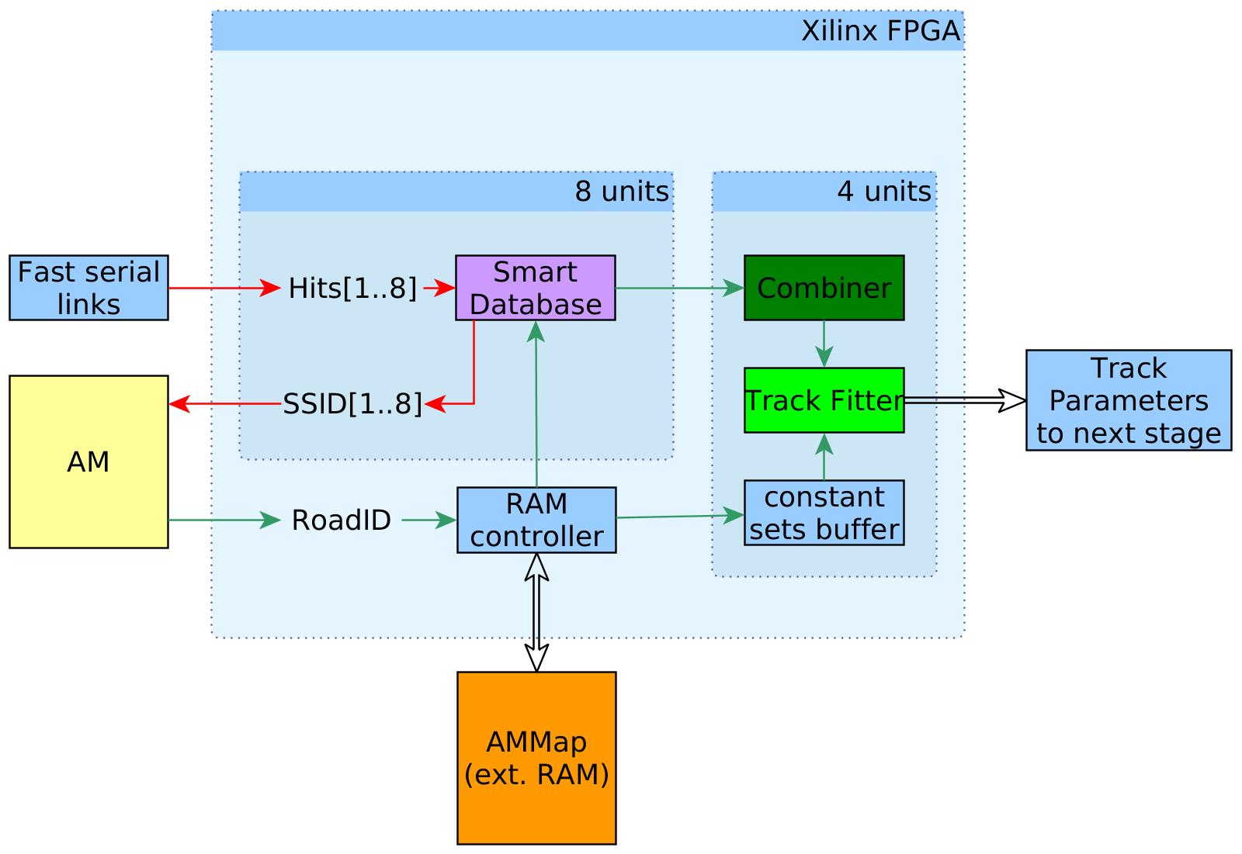
FPGA firmware - overview
Full resolution stored in a smart DB, while SSID of each hit is sent to the AM
Database retreives all hits for each SSID of the detected Roads
A very fast full resolution fit it is done for each possible track, fits are accepted or rejected according to x² value
AM performs pattern recognition and an ID value for each road (RoadID)
Combiner unit computes all possible permutations of the hits to form tracks
The RoadIDs get decoded in SSIDs for each layer, using an external RAM

Slide 7
Data Organizer
Data Organizer

Slide 8
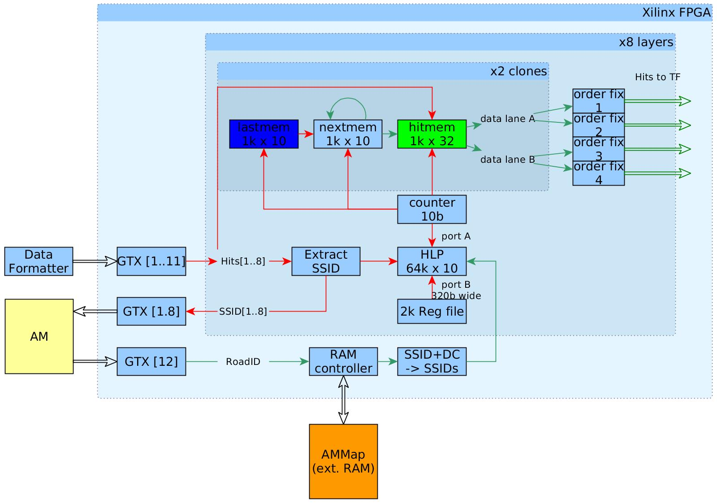
Data Organizer
The hits are stored, in the order in which they arrive, in the hitmem
The HLP keeps track of the address of the first hit of each SSID
The nextmem holds, for each hit address, the location of the next hit of the same SSID
Hits are cloned in two dual-port memories, reading uses 4 memory ports

Slide 9
Track Fitting
Track Fitting

Slide 10
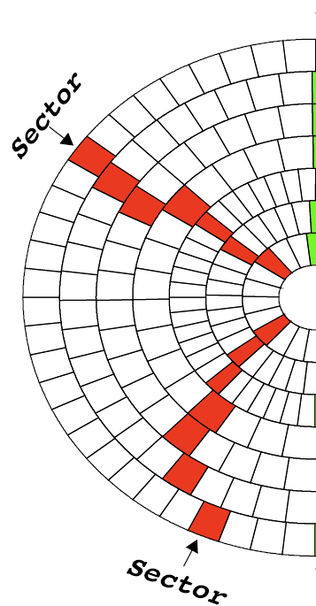
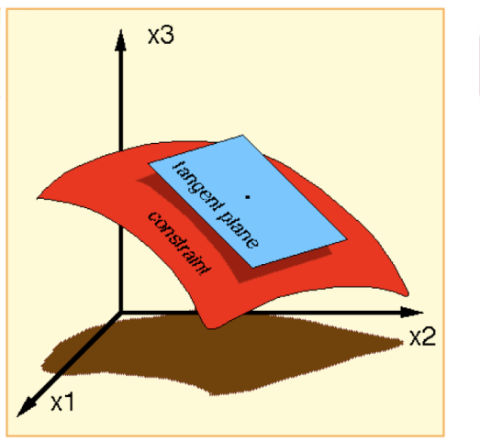
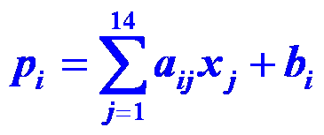
Track Fitting
    High quality helix parameters and χ²: Over a narrow region in the detector, equations linear in the local silicon hit coordinates give resolution nearly as good as a time-consuming helical fit.
    p_{i}’s are the helix parameters and χ² components.
    x_{j}’s are the hit coordinates in the silicon layers.
    a_{ij} & b_{i} are prestored constants from full simulation or real data tracks.
    The range of the linear fit is a “sector” which consists of a single silicon module in each detector layer.
    This is VERY fast in FPGA DSPs.
11D coord. space
5D surface

Slide 11
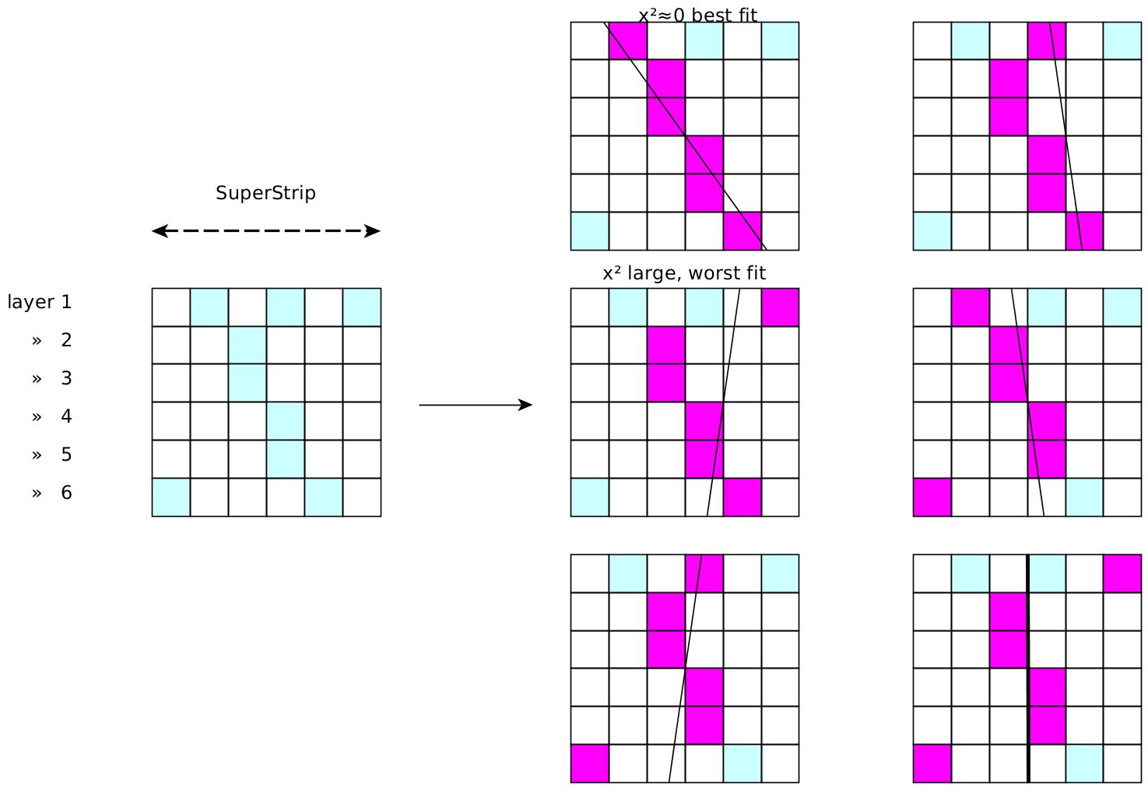
Track Fitting - Combiner
Best fit is selected, others are discarded
Visualization of the combiner function on an example Road

Slide 12
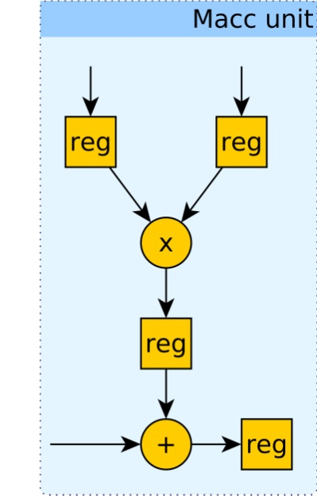
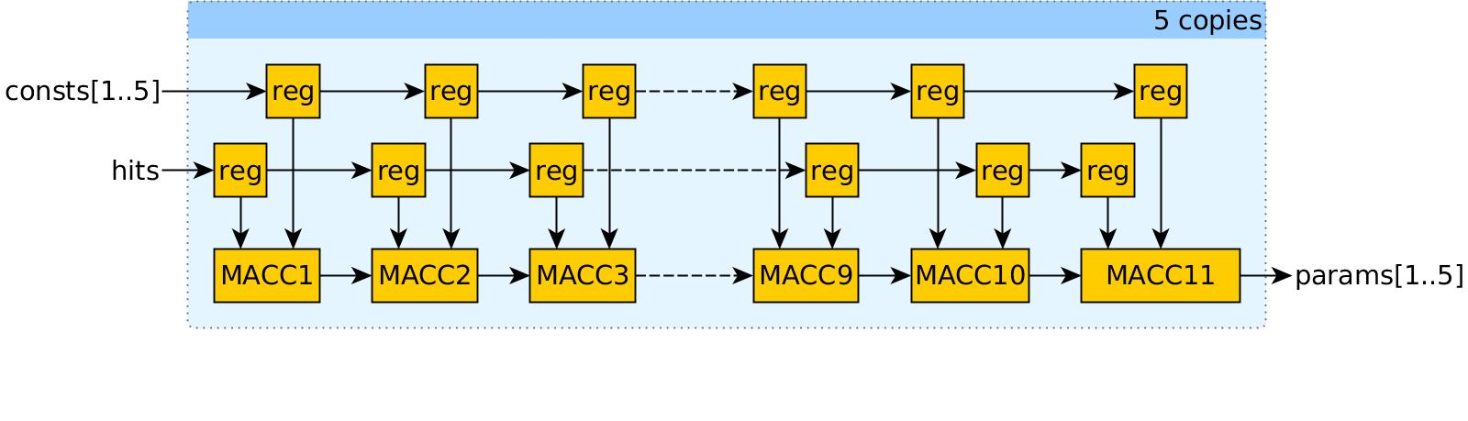
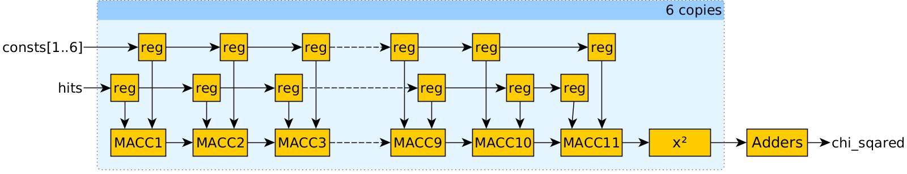
Track Fitting - Core
Very fast FPGA implementation was developed for the fitter
All multiplications are executed in parallel, giving 1 fit per clock
Using dedicated DSP resources, the frequency of the fitter is 550MHz
4 fitters run in parallel in the device

Slide 13
FPGA implementation
The main components of the design are already implemented
Placement on the device was made for estimating true achievable clock rates and the power dissipation
Target device is XC7K325T-900ffg-3
To achieve high clock rates, careful RTL coding and advanced design techniques must be followed
  Pipelining of control signals and memory buses
  Careful fan-out control for many signals
  Manual CLB resource instantiation
  Manual floorplanning of key components
  Utilization of dedicated routing wherever possible
  Local clock buffers for 550MHz areas

Slide 14
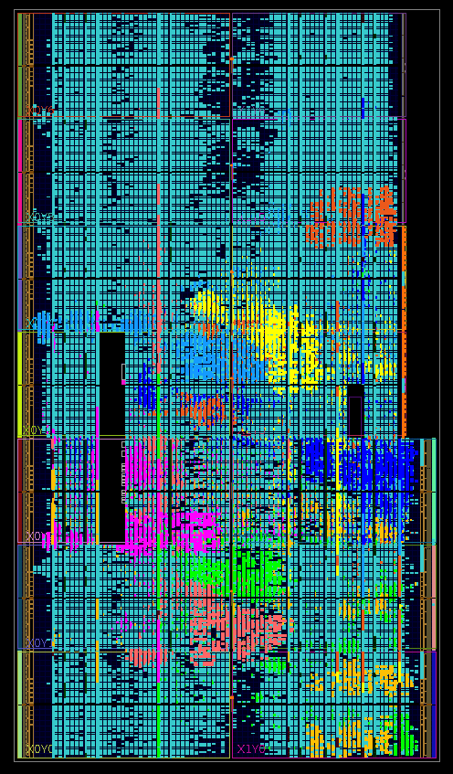
FPGA implementation
Track Fitter instances
Data Organizer instances

Slide 15
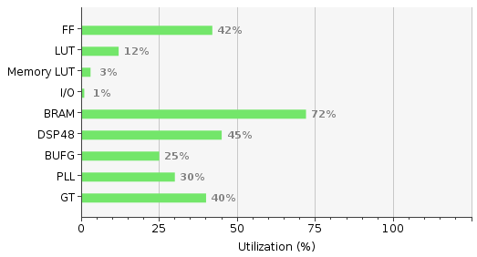
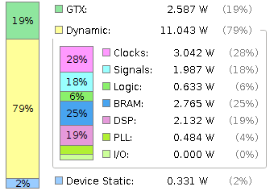
Device utilization & power
Power estimation of 16W is the absolute worst-case figure
Simple improvements to the design are expected to reduce this by 15%
If the design is migrated to a newer Xilinx UltraScale device another 10-15% reduction is expected

Slide 16
Speed and latency
450-1800 Mhits
@550MHz
@450MHz
225MHits
2200Mfits
50MRoads
Units are per second, and per layer where it applies

Slide 17
Speed and latency
~10ns
~70ns
~50ns
Total latency <0.3us
~40ns
Speed and latency are data dependent, further system simulation needed for precision
There are ideas to further improve performance, if needed

Slide 18
Thank you!

Slide 19
Backup
Backup slides, way more to be added

Slide 20
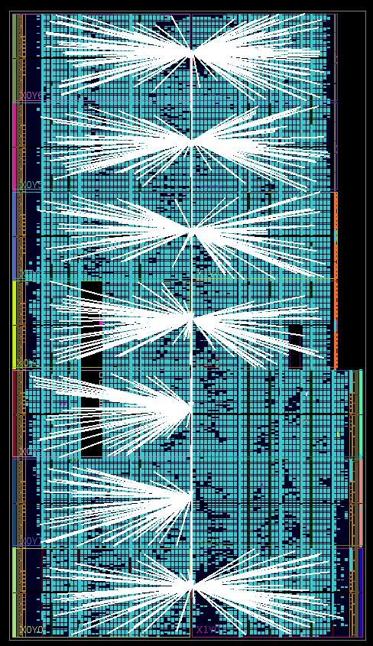
FPGA implementation
Local clock buffers for the Track Fitters

Slide 21
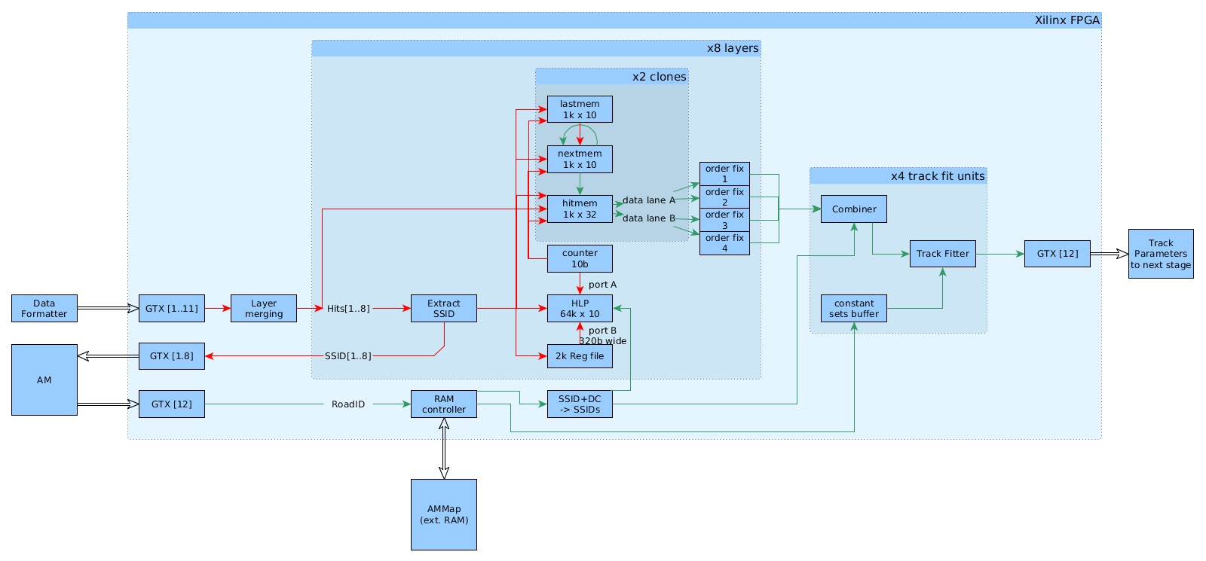
FPGA firmware – DO
Overview of the architecture

Slide 22
Latency, processing speed
To write 1k hits to the DO, 4.5us is needed
To forward 100 roads worth of hits to the Track Fitter another ~0.5-1.5us is necessary (data dependent)
The TF itself because of its high operating frequency does not have any noticeable latency, the maximum processing speed would be close to 2.4Gfits/sec if it was utilized 100% of the event time
There are ideas on how to increase all those numbers if there is need
Simulations will be done to show if the current performance is enough

Slide 23
Latency, processing speed
There are ideas on how to increase all those numbers if there is need
Just migrating to an UltraScale device can increase the performance, by utilizing even more parallelism and clock rate capabilities
Simulations have to be done to show if the current performance is enough, but the figures seem good for now

Slide 24
FPGA firmware
More detailed overview of the design, showing serial transceivers and more details of the DO

Slide 25
FPGA firmware
Data Organizer

Slide 26
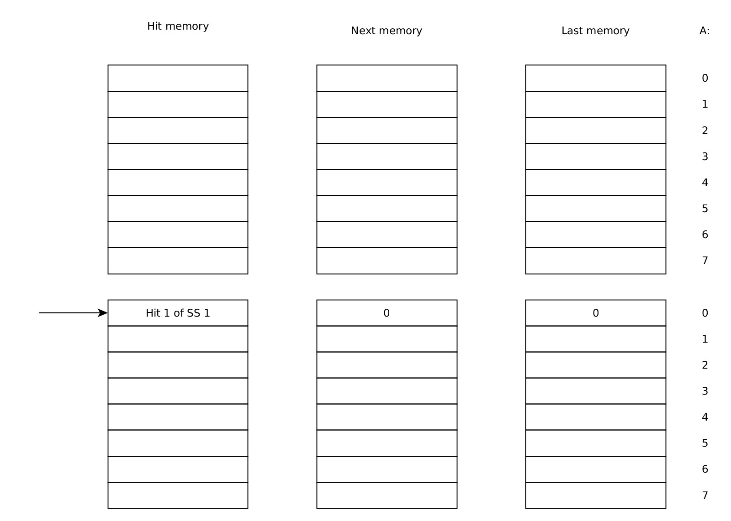
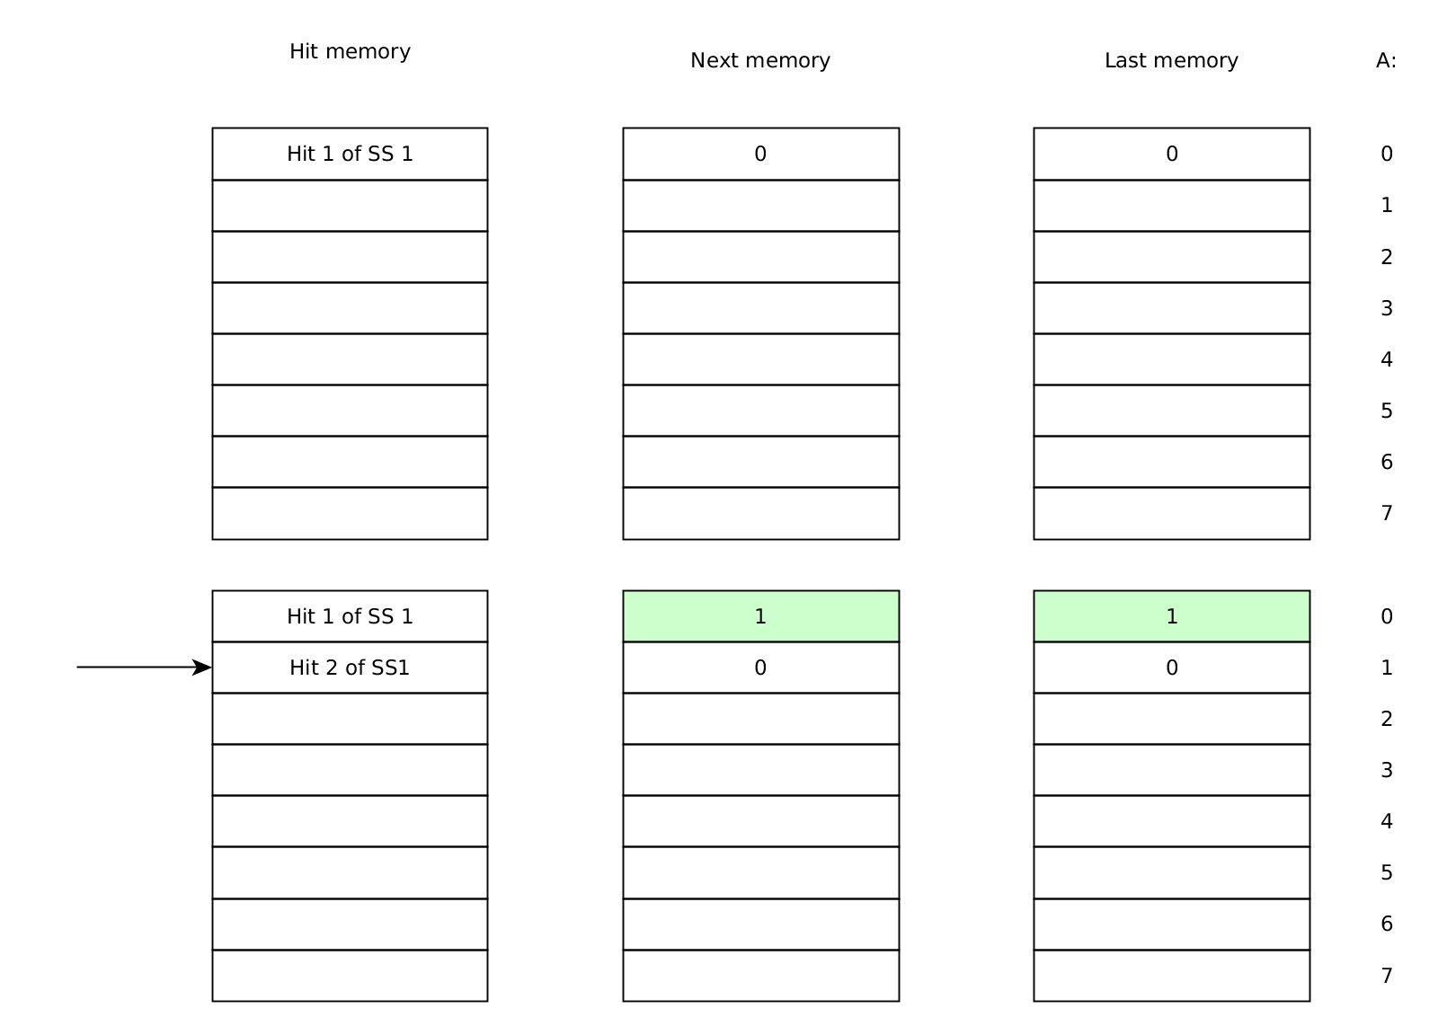
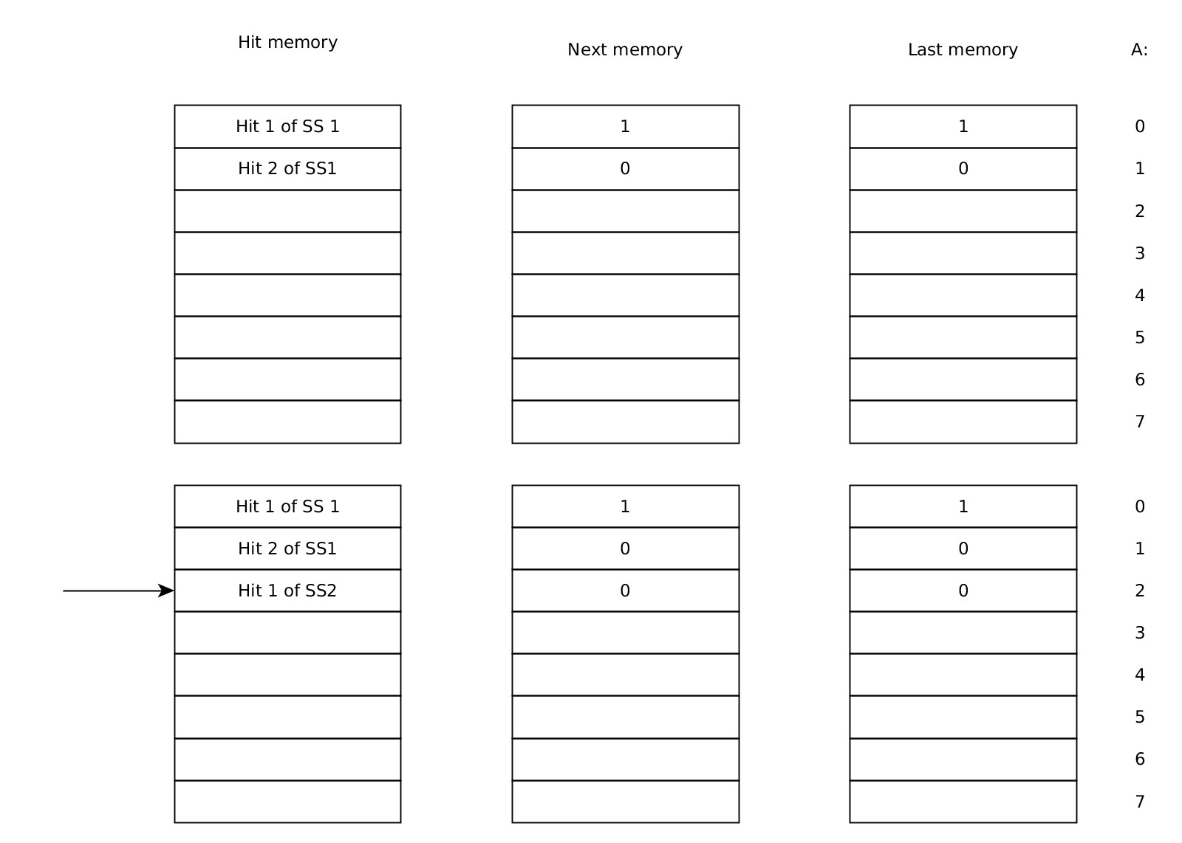
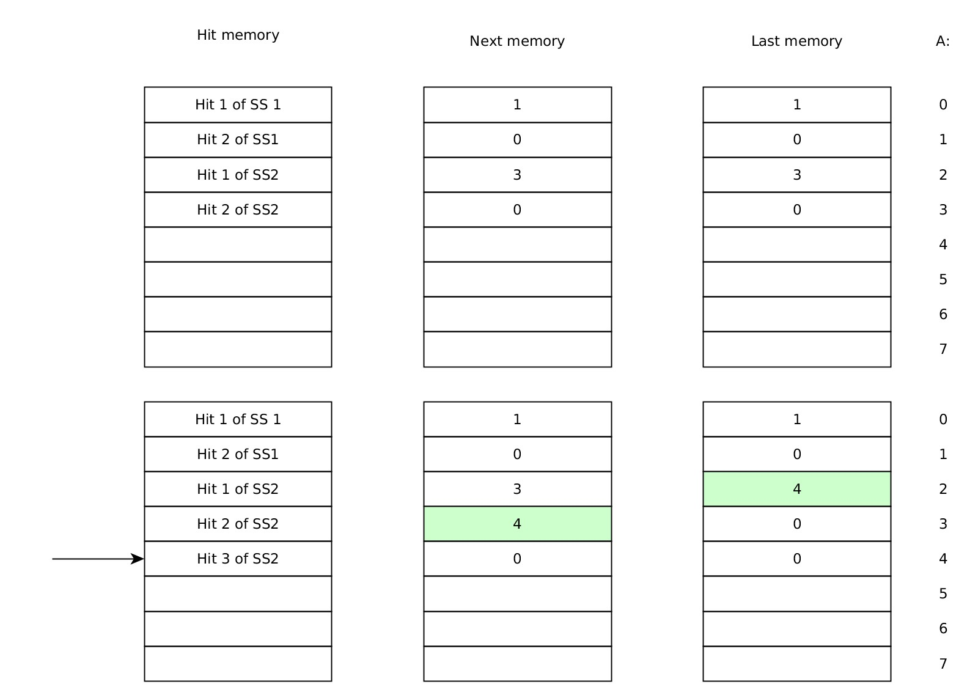
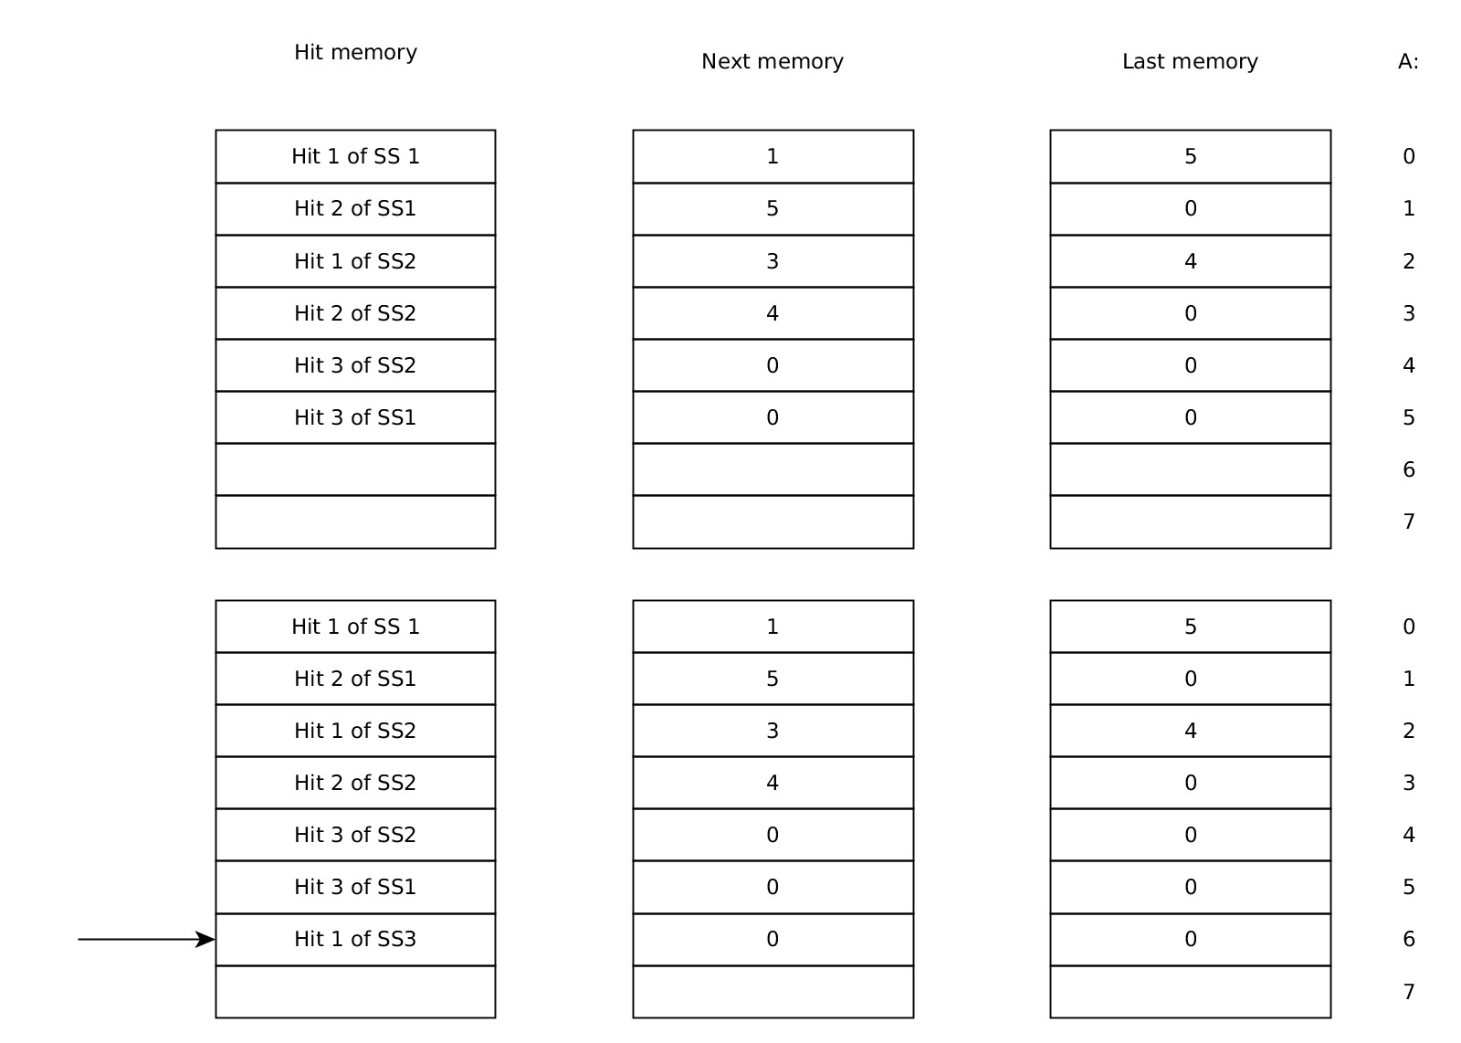
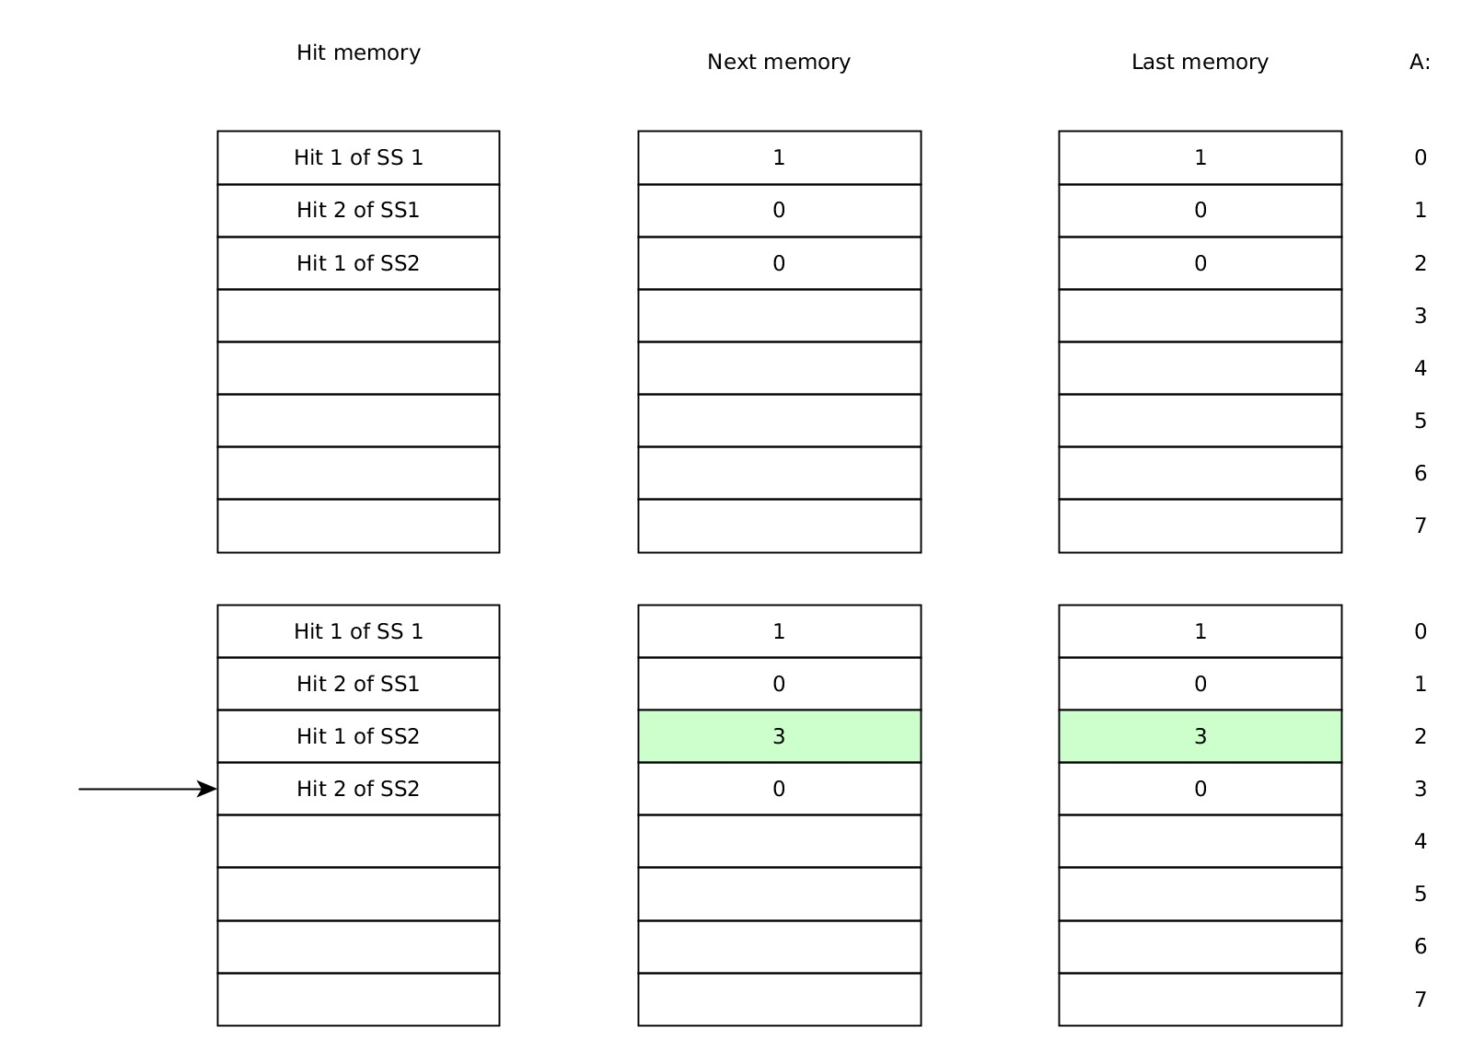
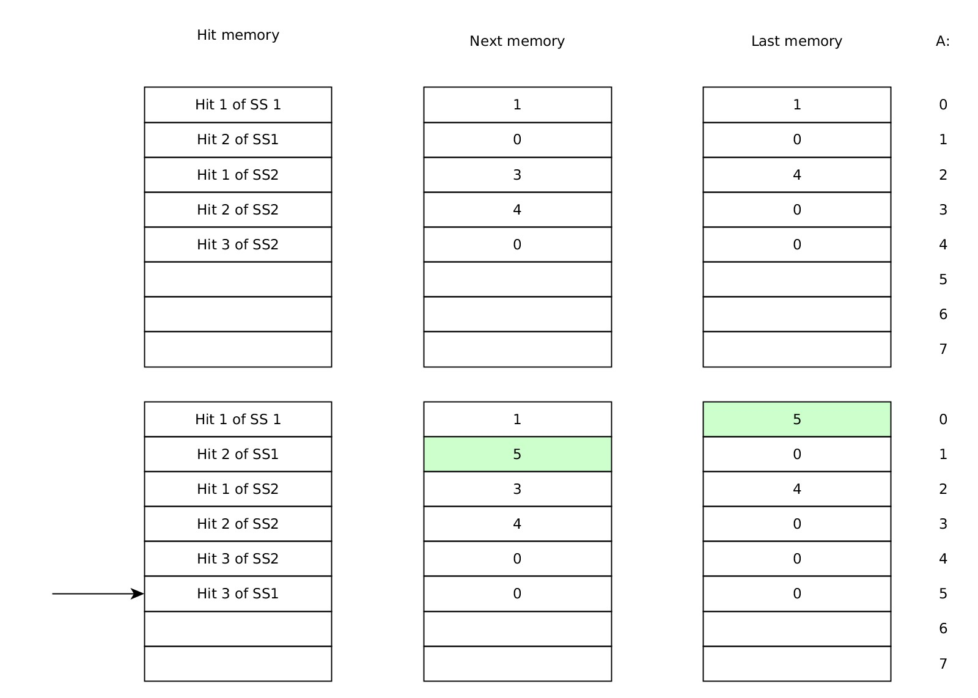
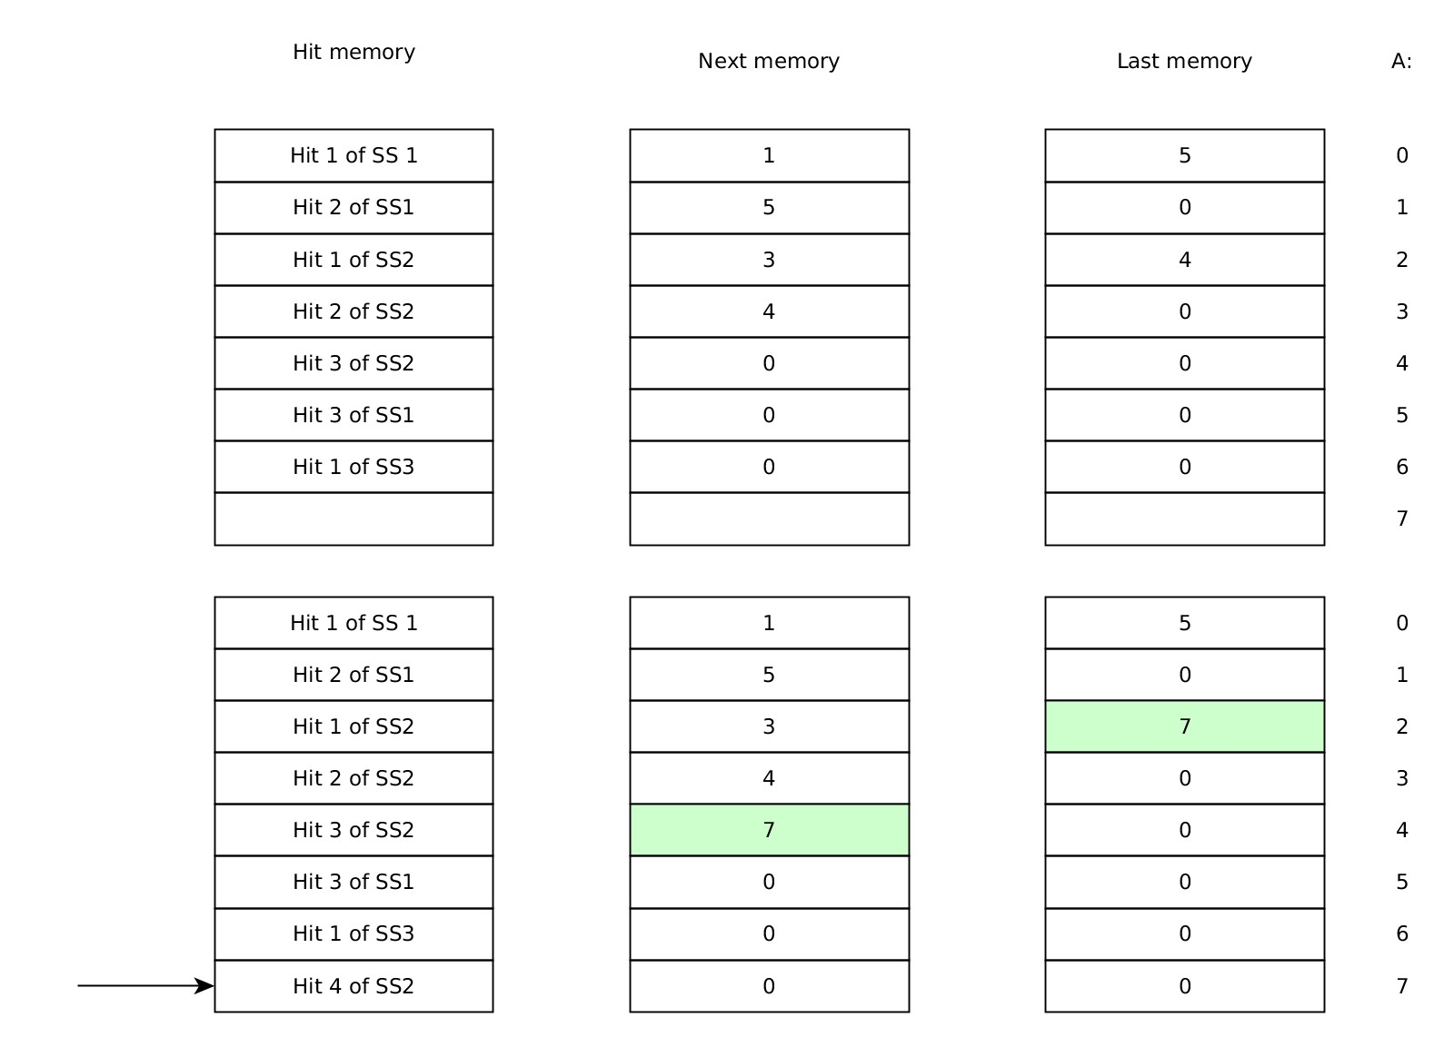
FPGA firmware structure – DO function

