Slide 1
Beta-delayed neutron
spectroscopy at SPES

Slide 2
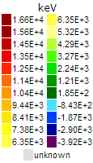
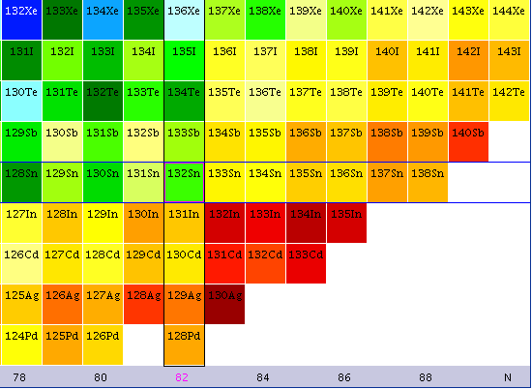
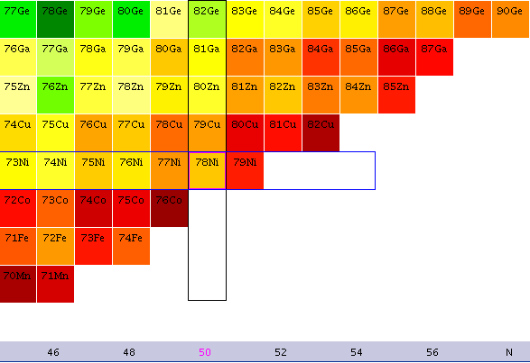
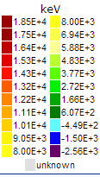
Why β-delayed neutron spectroscopy?
In neutron-rich nuclei the beta-decay Q value increases to values well above 10 MeV

Slide 3
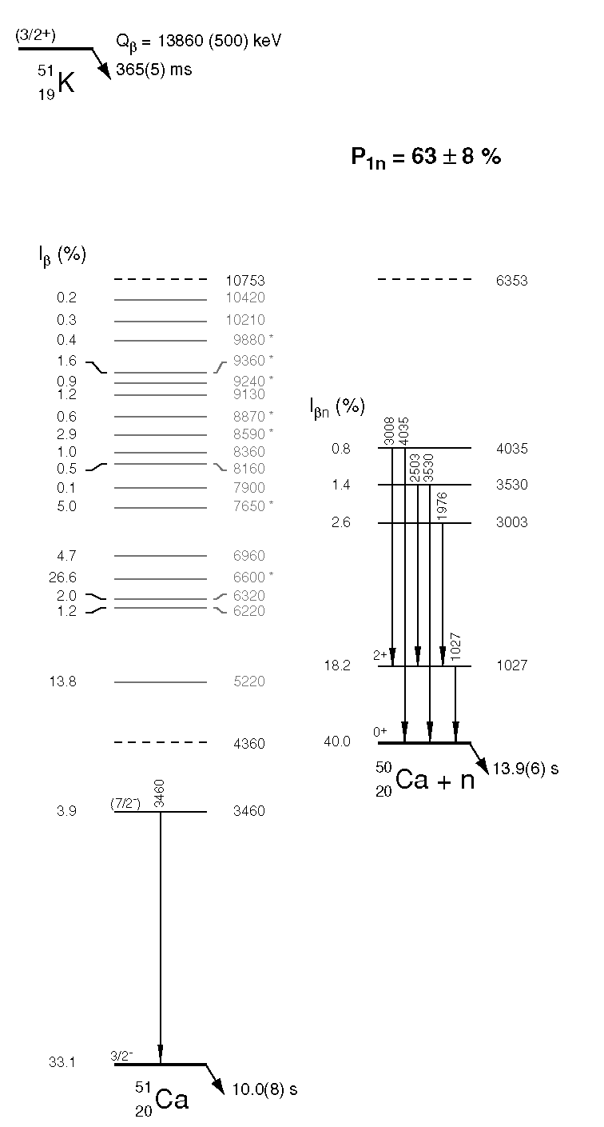
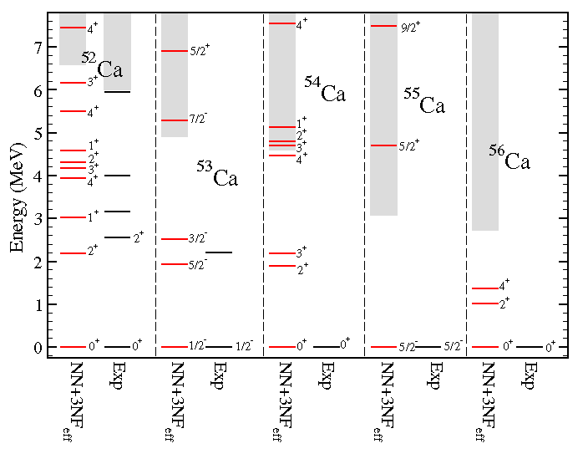
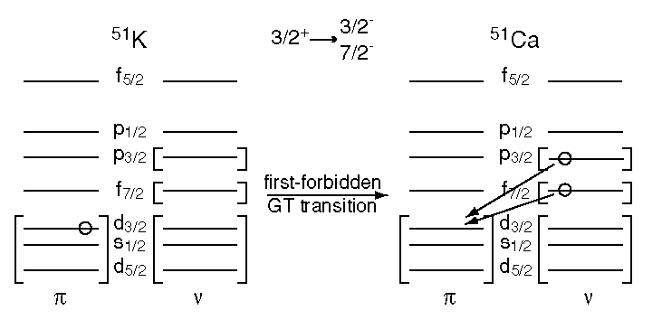
Discrete nuclear structure: ex. of ⁵¹Ca
Example of Ca isotopes: many intersting states above the neutron separation threshold
G. Hagen et al., Phys. Rev. Lett. 109, 032502 (2012)
One state well populated: what is it? Larger statistics, better energy resolution and gamma/n discrimination
F. Perrot et al., Phys. Rev. C 74, 014313 (2006)

Slide 4
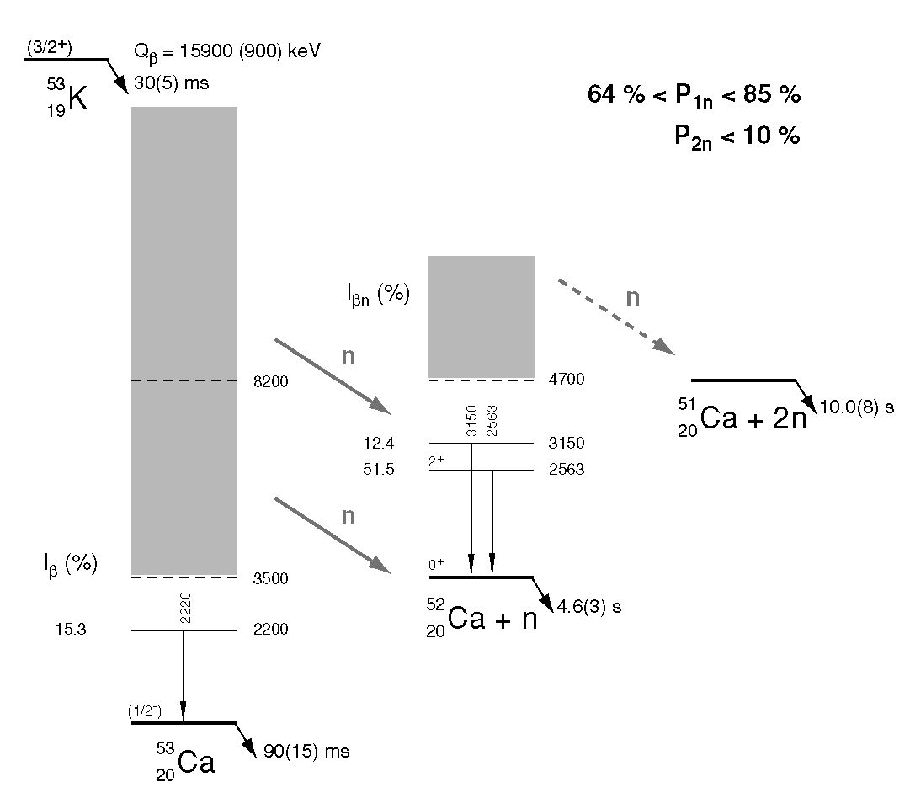
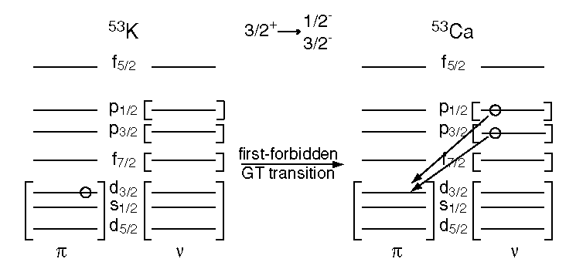
⁵³Ca β-delayed neutron spectroscopy
The GT decay should populate the p_{3/2}, p_{1/2} proton shells. FF could also populate the 2d_{5/2}
F. Perrot et al., Phys. Rev. C 74, 014313 (2006)
Not enough statistics to reconstruct the level scheme

Slide 5
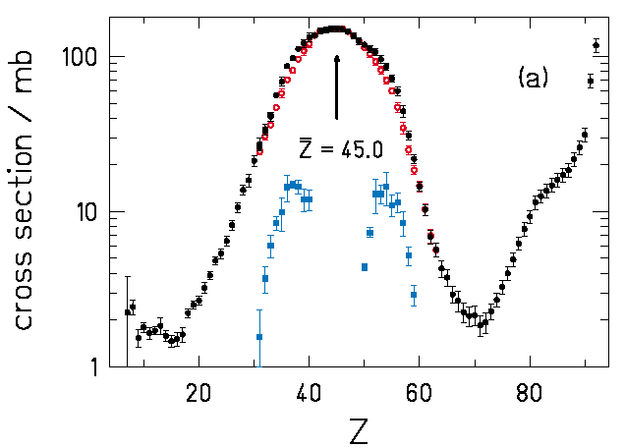
^{53,54,(55)}K β-decay at SPES
Nuclei produced via asymmetric fission -> feasible at SPES?
P. Armbruster et al., Phys .Rev. Lett. 93 (2004) 212701
Fission
Spallation evaporation residues (Z>77)
ISOLDE rates:
⁵¹K (365 ms): > 5000 pps
⁵³K(30 ms): 50 pps at least, up to 200 pps
⁵⁴K(10 ms): some pps (maybe 10 pps) ?
With SPES gain in intensity and extraction time ?

Slide 6
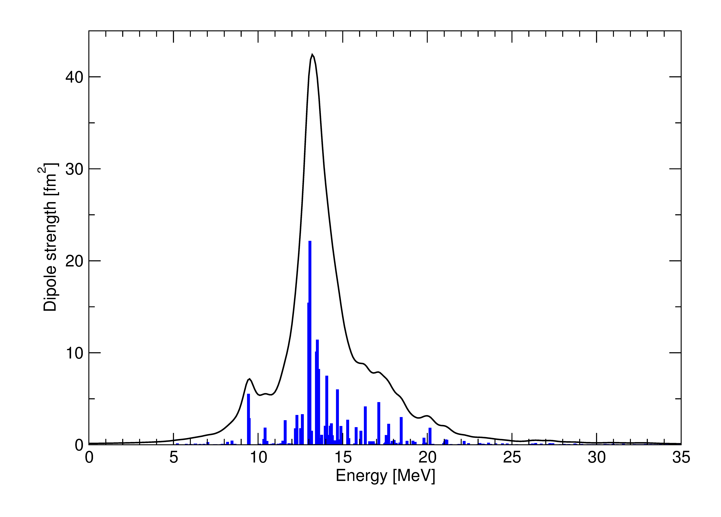
Resonances populated via β decay
The large Q_{β}-value window (> 12 MeV) allows populating at least the PDR
The β decay could populate states which are the PDR on the IAS(R) of the mother nucleus
Example: ¹³⁴In -> ¹³⁴Sn (Q_{β}= 14.7 MeV)
νf_{7/2} -> πg_{9/2}
β decay: ν2f_{7/2} -> π2f_{7/2}, π2f_{5/2} ;
2f_{7/2}
¹³⁴Sn SkI3
2f_{7/2}
E1
1g_{9/2}
PDR
π
ν
QRPA calculations with the SkI3 interaction: PDR at 10 MeV
^{133,134}In rates @ ALTO: 1000 pps ; 25 pps (100 times higher at SPES)

Slide 7
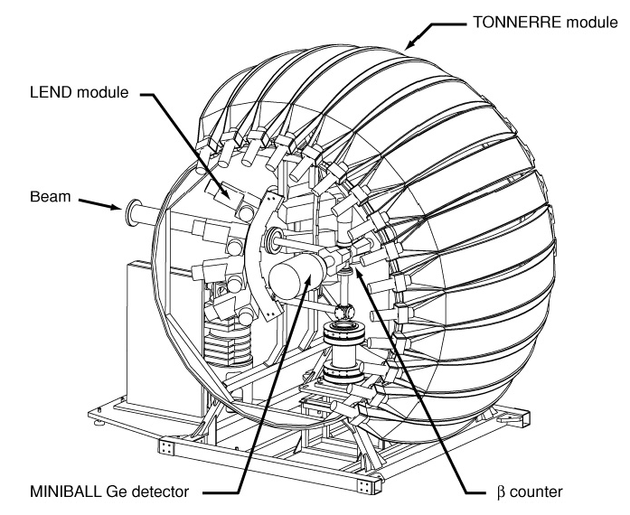
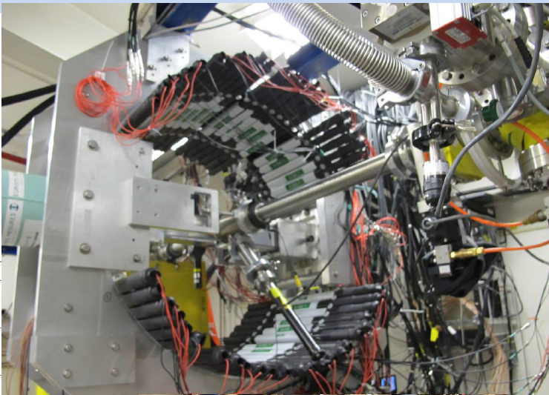
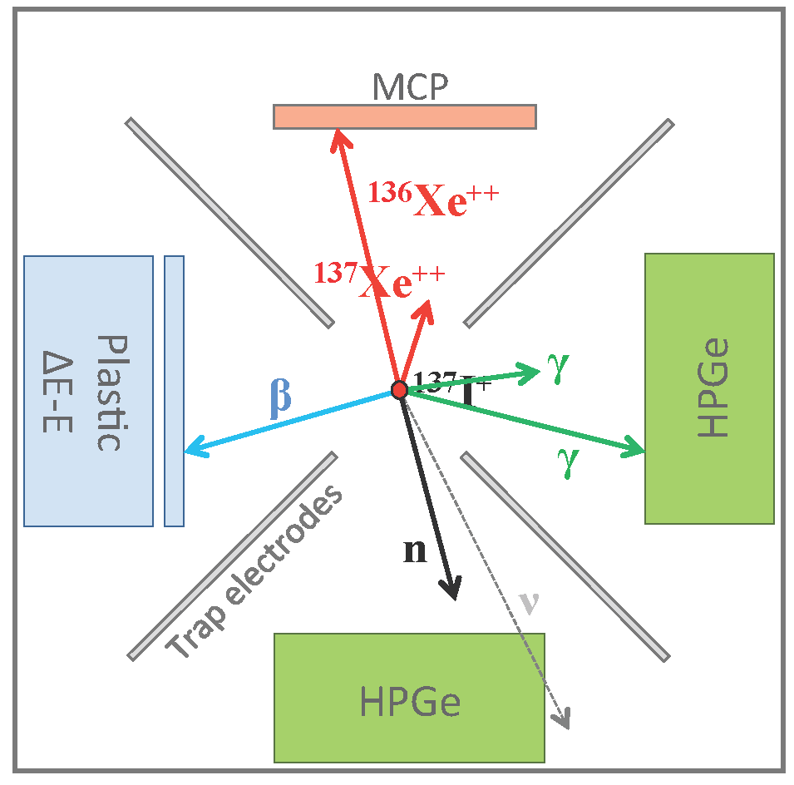
Experimental setup
Tonnere, VANDLE neutron arrays
ε: 12 %; σ: 120 keV (1 MeV)
Ion trap for neutron spectroscopy?
ε: > 60 %; σ: 30 keV (1 MeV)
R.M. Yee et al., Phys. Rev. Lett.110 (2013) 092501
Polarized radioactive beams: spin of states via the neutron angular distribution

Slide 8
Collaboration
A. Gottardo¹, D. Verney¹, M. N. Harakeh², G. Colò³, G. Benzoni³ , M. Vandebrouck⁴, D.Mengoni⁵, G. de Angelis⁶, F. Azaiez¹, D. Bazzacco⁵, S. Bottoni³, A. Bracco³, F. Camera³, F. Crespi³, M.C. Delattre¹, A. Etilé⁷, D. T. Yordanov¹, S. Franchoo¹, C. Gaulard⁷, G. Georgiev⁷, A. Goasduff⁷, Gramegna⁶, S. Grévy⁸,J. Jaworski⁶, P.R. John⁵, S. Lenzi⁵, S. Leoni³, J. Ljungvall⁷, R. Li¹,S. Lunardi⁵, I. Matea¹, T. Marchi⁶, V. Modamio⁶, A. I. Morales³, P. Morfouace¹, D. Napoli⁶, B. Roussière¹, F. Recchia⁵, S. Roccia⁷ , I. Stefan¹, D. Testov¹, J.J. Valiente-Dobón⁶, A. Vitturi⁵ , O. Wieland³
¹Institut de Physique Nucléaire d’Orsay, F-91406 Orsay, France ²Kernfysisch Versneller Instituut, University of Groningen, NL-9747 AA Groningen, The Netherlands ³Dipartimento di Fisica, Università di Milano e Istituto Nazionale di Fisica Nucleare, Sezione di Milano, I20100 Milano, Italy ⁴GANIL, CEA/DSM-CNRS/IN2P3, F-14076 Caen, France ⁵Istituto Nazionale di Fisica Nucleare, Sezione di Padova, I-35100 Padova, Italy ⁶Laboratori Nazionali di Legnaro, I-35020 Legnaro, Italy ⁷CSNSM, UMR 8609, IN2P3-CNRS, Université Paris-Sud 11, F-91405 Orsay Cedex, France ⁸CENBG—Université Bordeaux 1—UMR 5797 CNRS/IN2P3, F- 33175 Gradignan, France

