Slide 1

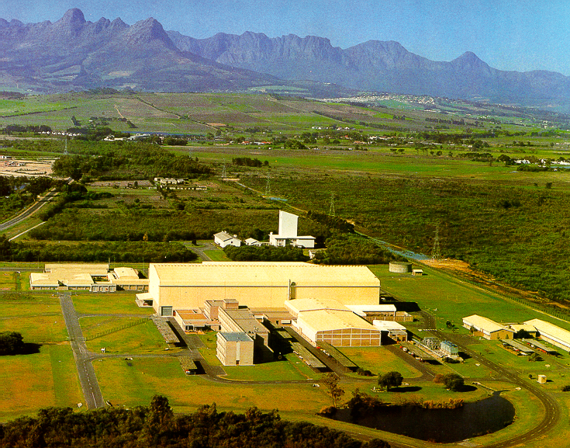
The iThemba LABS Radioactive Beam Project
R A Bark

Slide 2
Outline of Talk
A little bit about iThemba LABS
A little bit about Science & Energy in South Africa
Need for a new accelerator
Plans for a RIB facility

Slide 3
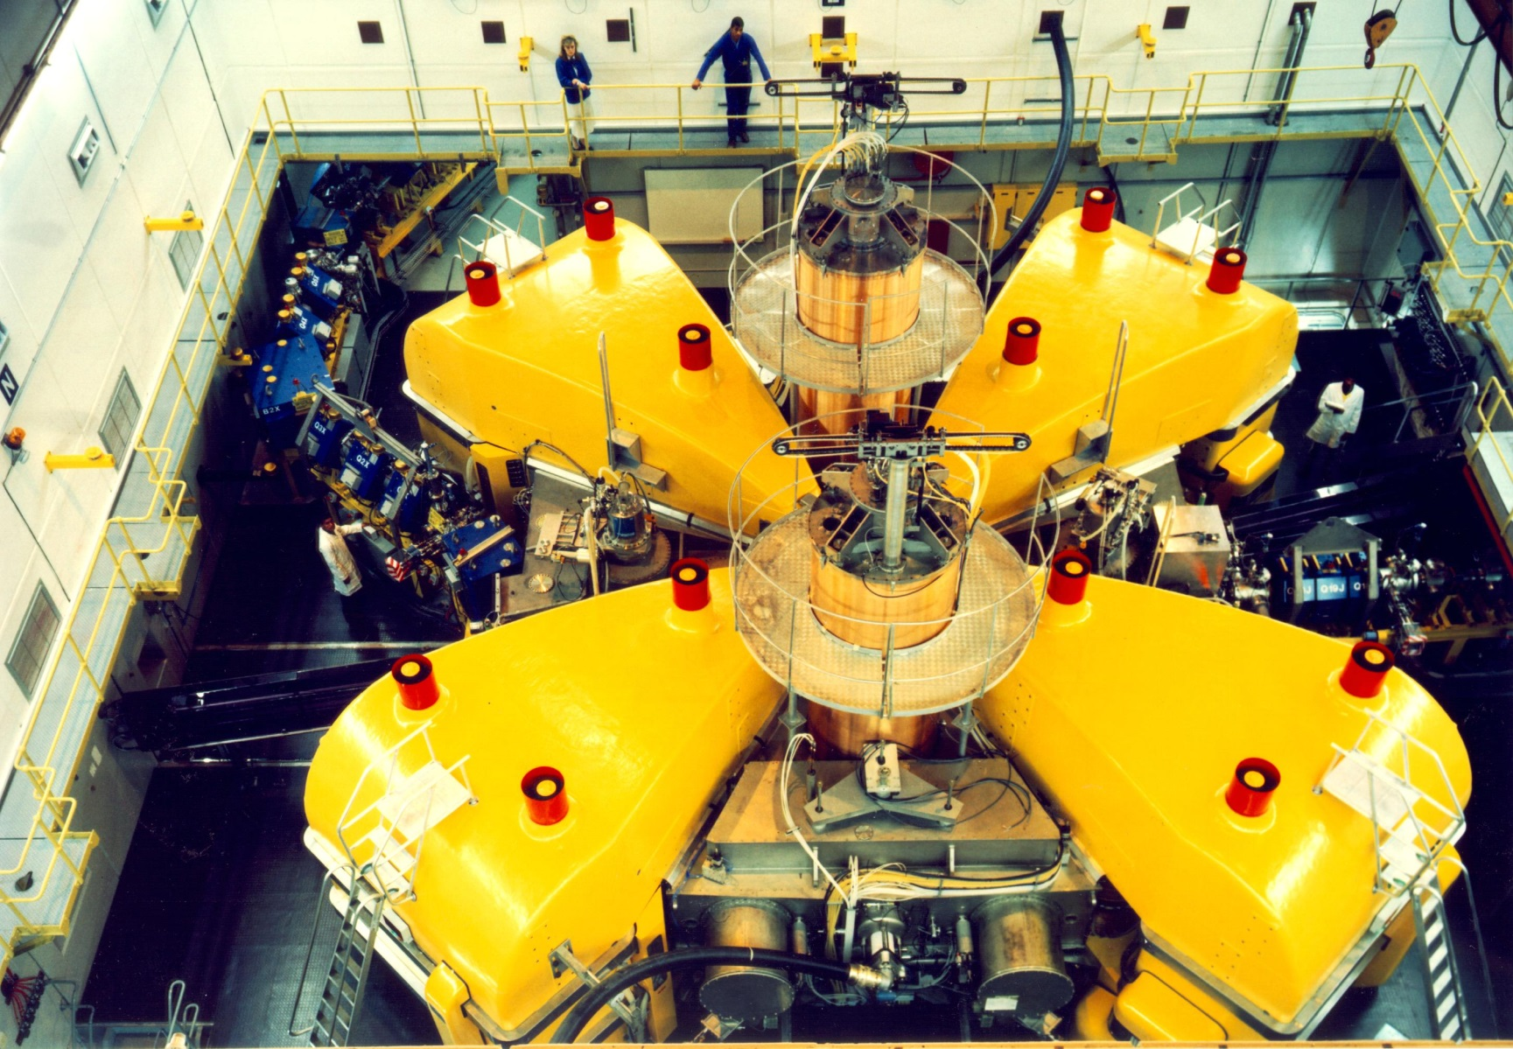
Separated-Sector Cyclotron (SSC)
Rf-system
High Energy Out
Low Energy In
Rf-system
Sector Magnet
Most Powerful Particle Accelerator in Southern Hemisphere (K200)
Notes:
This shows the separated-sector cyclotron. It has four separate magnet sectors with a diameter of 13 m. The RF-system consists of two lambda-half resonators that can operate in the frequency range 7 to 26 MHz. The dee voltage is 220 kV at a power level of 80 kW per resonator. Although it has been designed for a maximum proton energy of 200 MeV but has delivered proton beams of 227 MeV. The beam is inflected with two bending magnets and a magnetic channel and extracted with two septum magnets. Typically the cyclotron delivers a 85 µA beam of 66 MeV protons for radioisotope production with 100% transmission through the machine. Higher beam currents are available but better production target cooling is required for reliable operation at higher intensities.

Slide 4
iThemba LABS: Multi-User Facility
Proton Therapy: 200 MeV p
Neutron Therapy: 66 MeV p, ~ 40μA
Isotope Production: 66 MeV p, up to 350μA
Nuclear Physics: various beams
Notes:
4
This slide shows the layout of our facilities. Beams from the variable separated-sector cylotron, that has a maximum energy of 200 MeV for protons, are directed to vaults for the production of radioisotopes, proton- and neutrontherapy and nuclear physics experiments. Light ions, pre-accelerated in the first solid-pole injector cyclotron with a K-value of 8 are used for therapy and radioisotope production. For radioisotope production and neutrontherapy a 66 MeV proton beam is used and for protontherapy a 200 MeV beam. The second solid-pole injector cyclotron with a K-value of 10 (which you see here) is used for pre-acceleration of heavy ions and polarized protons from these two external sources

Slide 5
SSC Beam Schedule
◊ Nuclear Physics
© Neutron Therapy
© Proton Therapy
© Energy Change
© Isotope Production
SSC Weekly Beam Schedule
Notes:
5
Beam is delivered to the different users for 24 hours per day and seven days per week. Radionuclide production and neutron therapy run from 16h00 on Mondays until 5h00 on Fridays. Patients are treated during day time and between treatments the beam is switched to the radionuclide production vault and the intensity is increased to 85μA. On Mondays and Fridays a 200 MeV beam is used for proton therapy and over the weekend beams of light and heavy ions as well as polarized protons, pre-accelerated in a second solid-pole injector cyclotron. In spite of this very tight schedule it remains difficult to satisfy the beam requirements of the different users. We are therefore in the process of increasing the beam intensity for the production of radioisotopes as well as installing and planning additional beam lines for the same purpose. It is planned to produce radioisotopes on two different targets simultaneously.

Slide 6
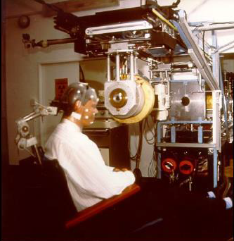
Proton Therapy

Slide 7
Proton Therapy
Present Schedule Restricted to 2 “Fractions” / week
Brain tumours
If schedule allowed 5 “Fractions” / week
Paediatric tumours
Tumours close to critical structures
Brain tumours
Gastro-intestinal tumours (rectum, liver, pancreas)
Prostate tumours
Lung tumours
Recurrent tumours

Slide 8
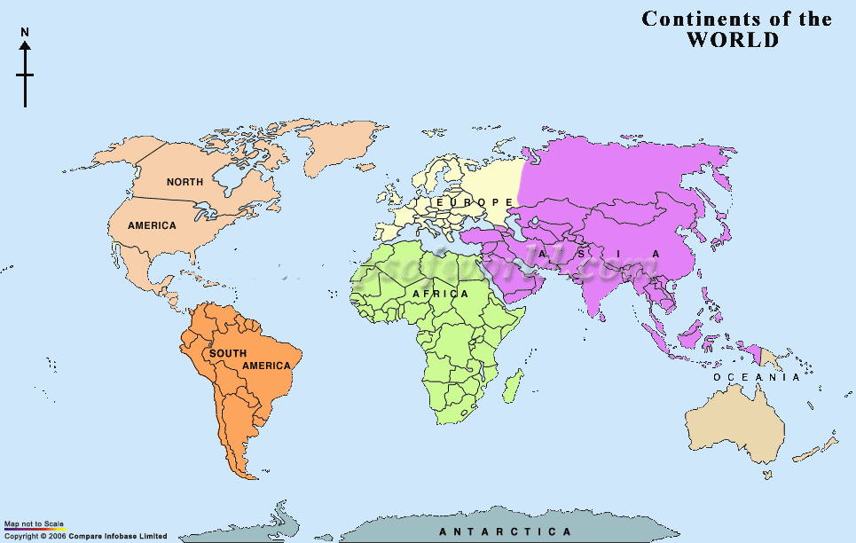

Radionuclide Distribution Network
Africa 3
Australia 2
Asia 19
Canada 2
Europe 31
USA 12
Sr-82, Ge-68, Na-22…..

Slide 9
Radionuclide Production
Made Possible by Flat-topping in SPC1 and SSC and splitting 350µA of 66 MeV protons over two target stations

Slide 10
Nuclear Physics Research
Nuclear Structure
  Pairing Isomers
  Nuclear Clusters
  Tetrahedral Shapes
  Chirality
  Giant Resonances
  Strength Functions
Nuclear Reactions
  Fusion Barrier Distributions
  Incomplete Fusion
  Astrophysical reactions
  Production of intermediate mass fragments
  Reaction Mechanisms

Slide 11
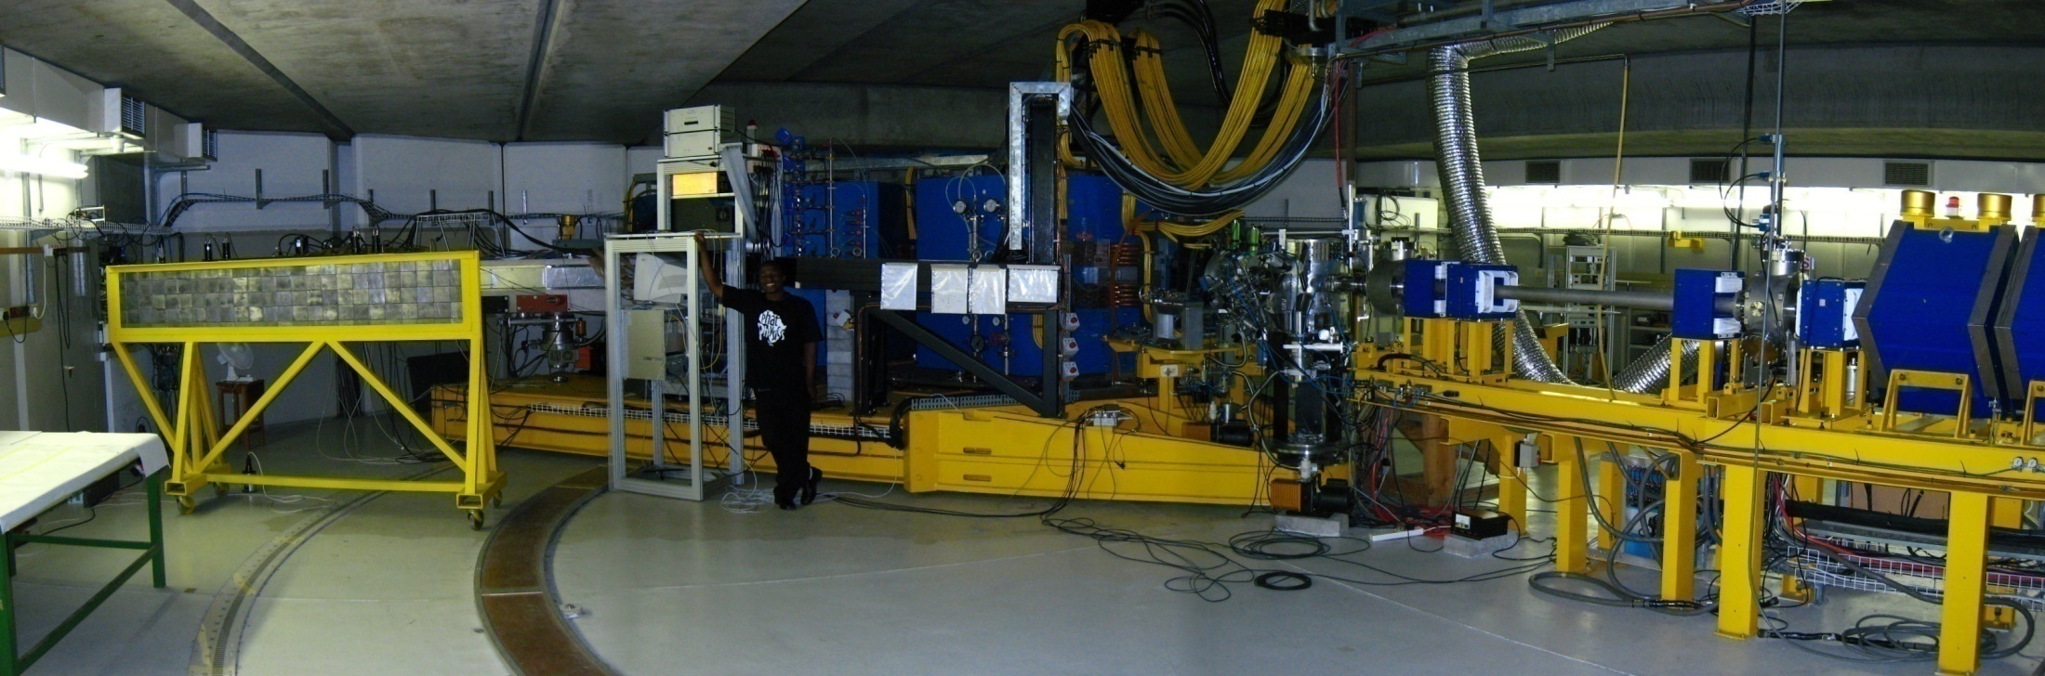
K600 Spectrometer

Slide 12
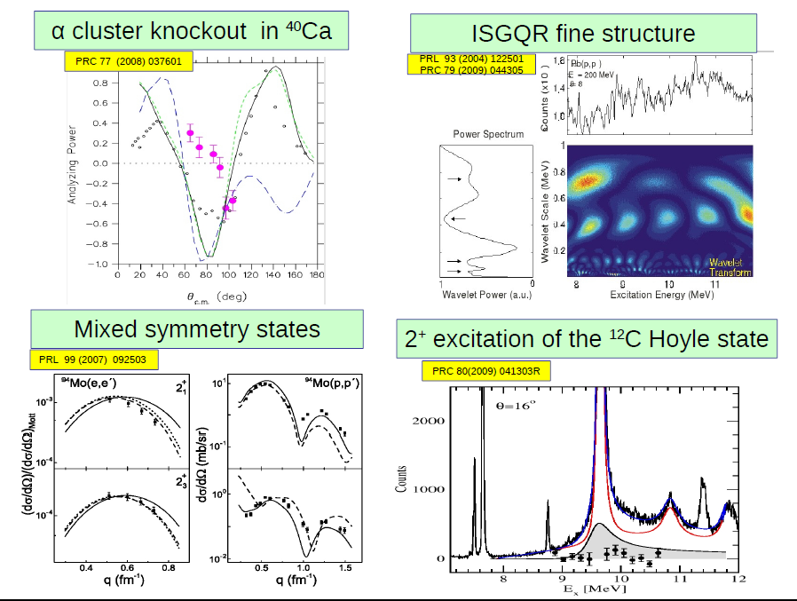
Physics with the K600

Slide 13

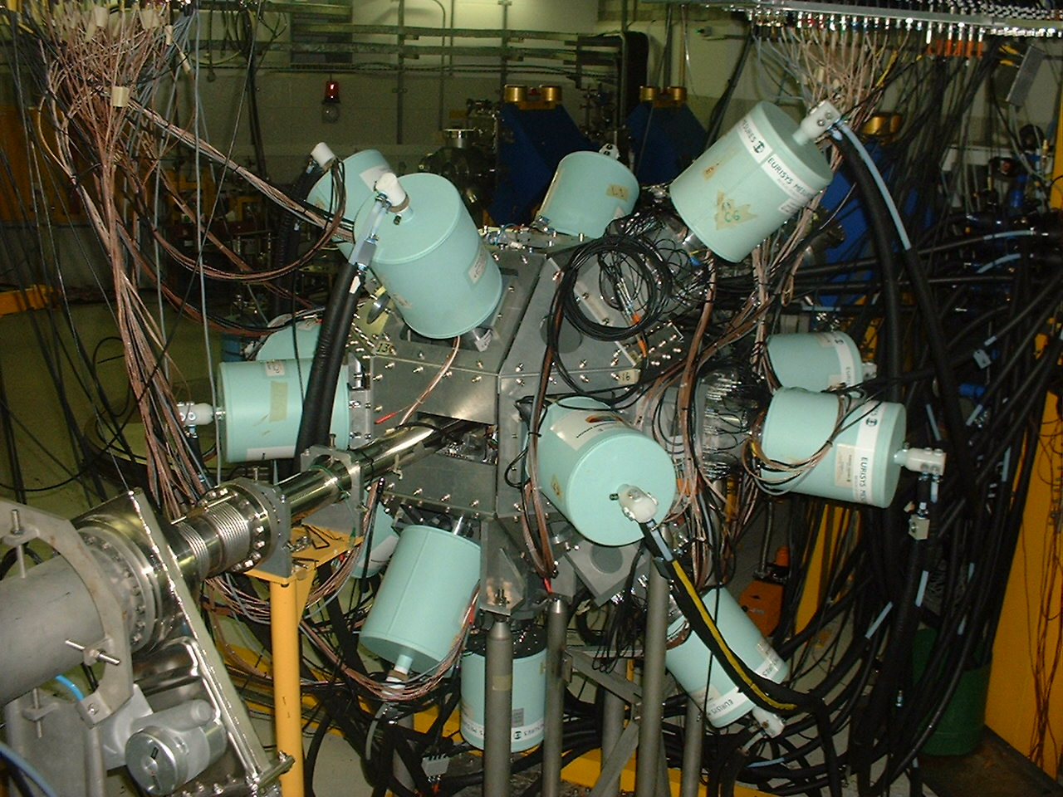
AFRODITE: γ-ray spectroscopy
9 Compton Suppressed
Clover detectors
8 LEPS detectors

Slide 14
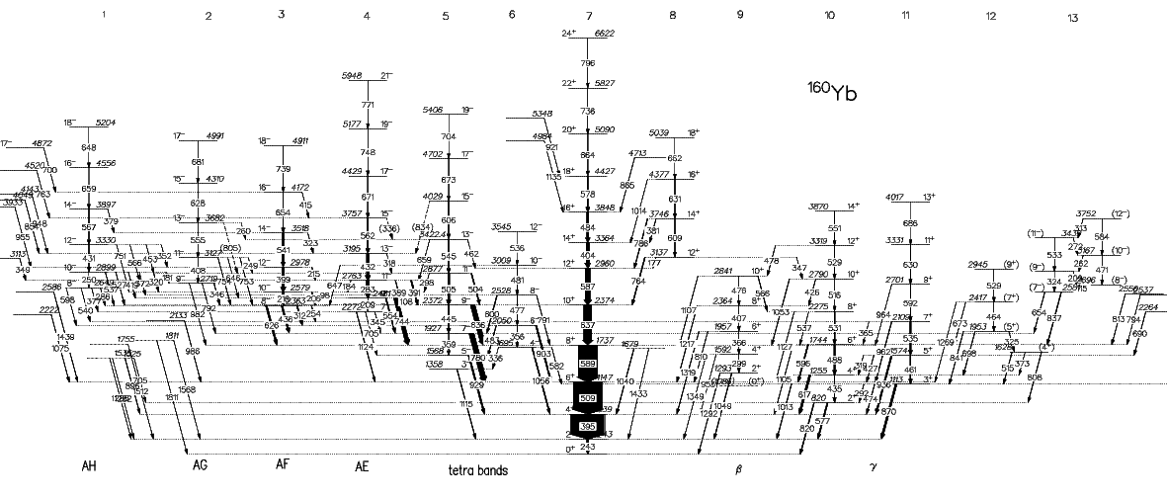
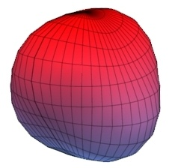
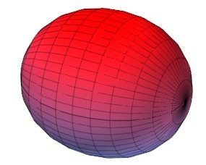
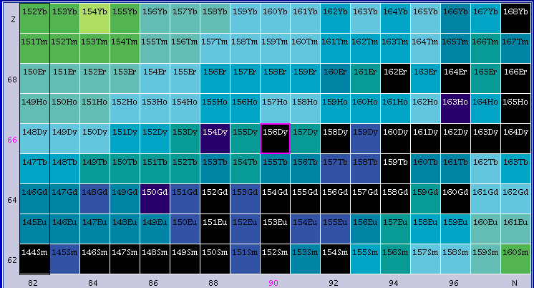
AFRODITE: “Double Vacuum”
“search for a tetrahedral nucleus”
?

Slide 15
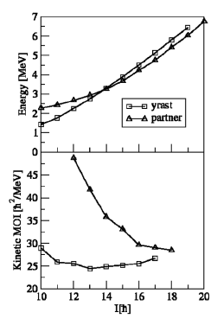
Some results from AFRODITE:
Nuclear Chirality
Best example of chiral doublet
¹⁹⁴Tl
Solving Chiral Conundrum
in ¹⁰⁶Ag
P.L. Masiteng et al Phys. Lett. B719, 83 (20130
E. Lieder et al PRL 112, 202502(2014)

Slide 16
Applications of SSC beams
Long standing with collaboration with PTB
Neutron Metrology
Calibration of detectors for International Space Station
“Radiation Assessment Detector” calibrated at iThemba LABS.
Presently touring Mars on the rover Curiosity

Slide 17
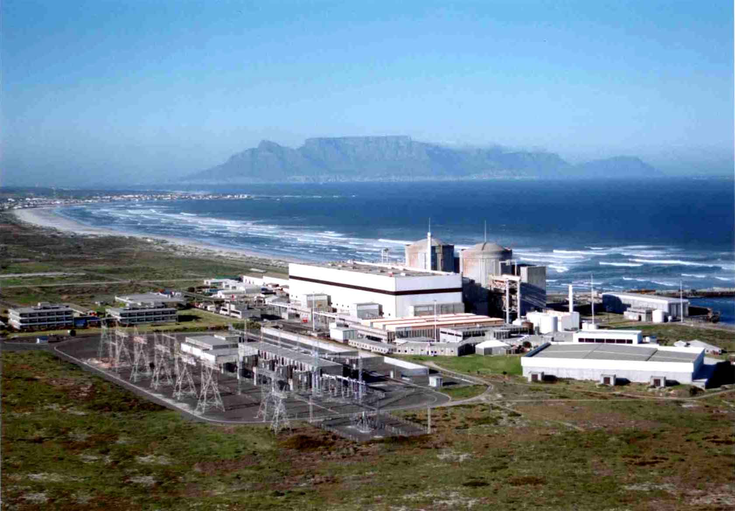
A Nuclear Future
Cabinet approved 20-year Integrated Resource Plan
9.6 GW Nuclear Power
~ 6 ×1600MW Pressurized Water Reactors
Up to R1 000 000 000 000 (Dipuo Peters, Energy Minister)
Human capacity development

Slide 18
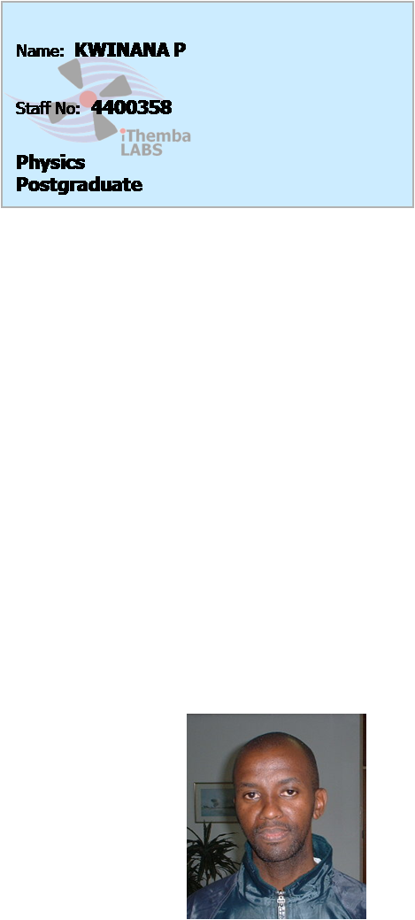
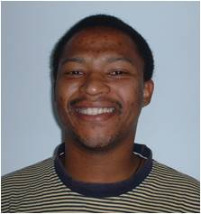
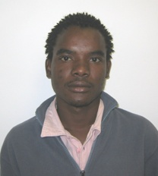
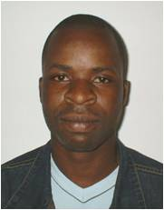
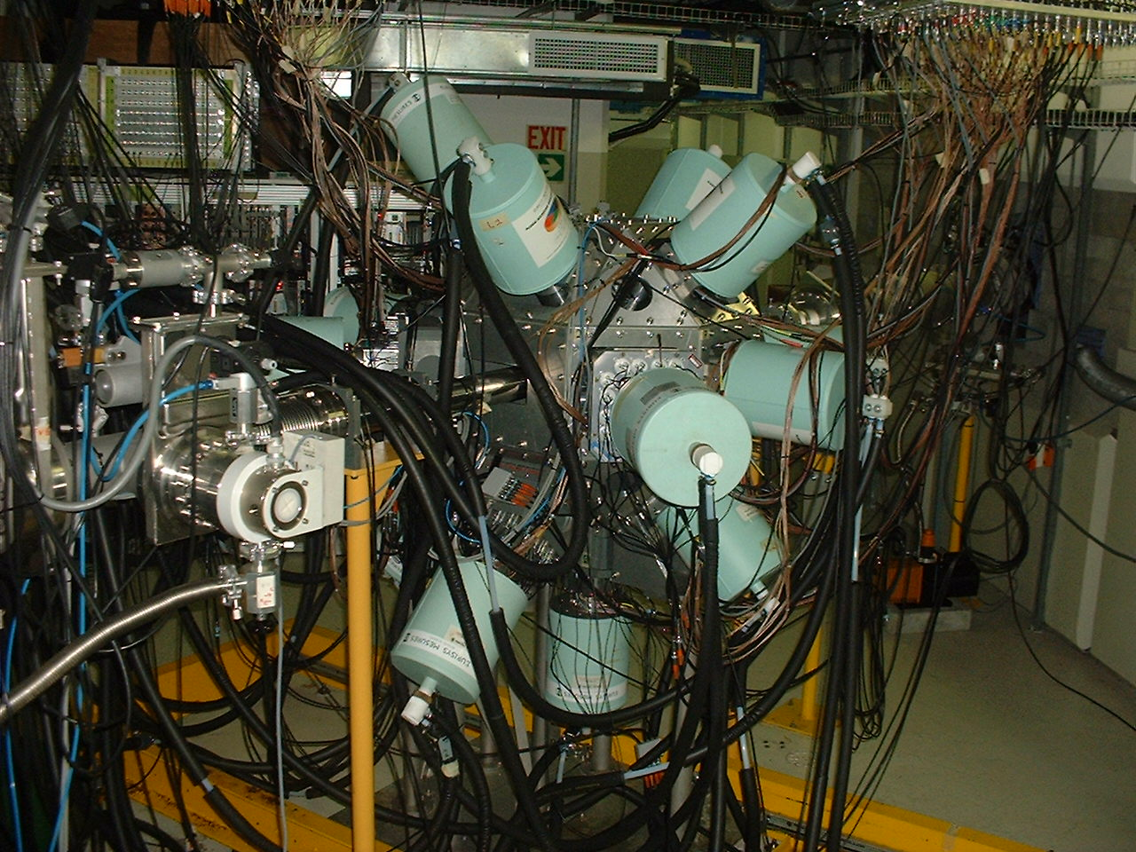
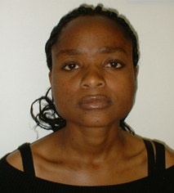
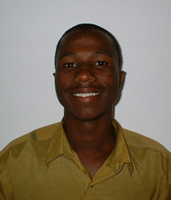
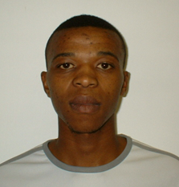
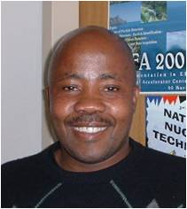
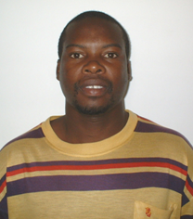
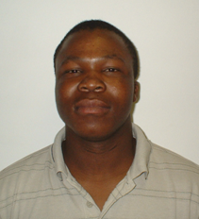
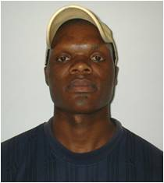
Weekend Beamtime Only (< 80 days/yr)
  Restricts International Collaborations
  Restricts longer (but very interesting) experiments
Stable Beams only
  Latest Physics not accessible at iThemba LABS
Restricts Human Capacity Development

Slide 19
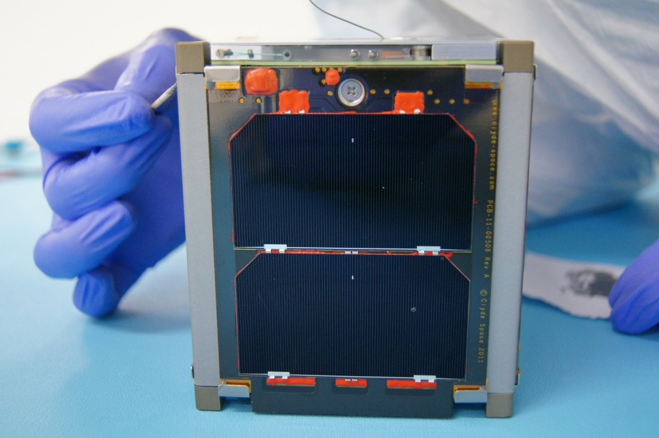
Applications of SSC beams
Radiation hardness testing
Critical for Space Sciences (SANSA)
South Africas 2nd satellite - Sumbandila Satellite was damaged beyond repair by solar storm
Cosmic rays peak energy distribution around 300 MeV
Proton & neutron beams up to 200 MeV available at iThemba LABS
Tshepiso Sat
Launched from Yasny, Russia
on RS-20B Dnepr rocket

Slide 20
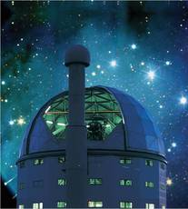
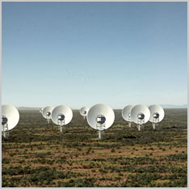
Astronomy in South Africa
SALT - Southern African Large Telescope
(largest in Southern Hemisphere 11m)
Square Kilometer Array
Largest in World
11 countries involved (including Italy)

Slide 21
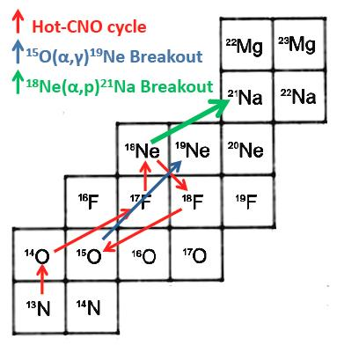
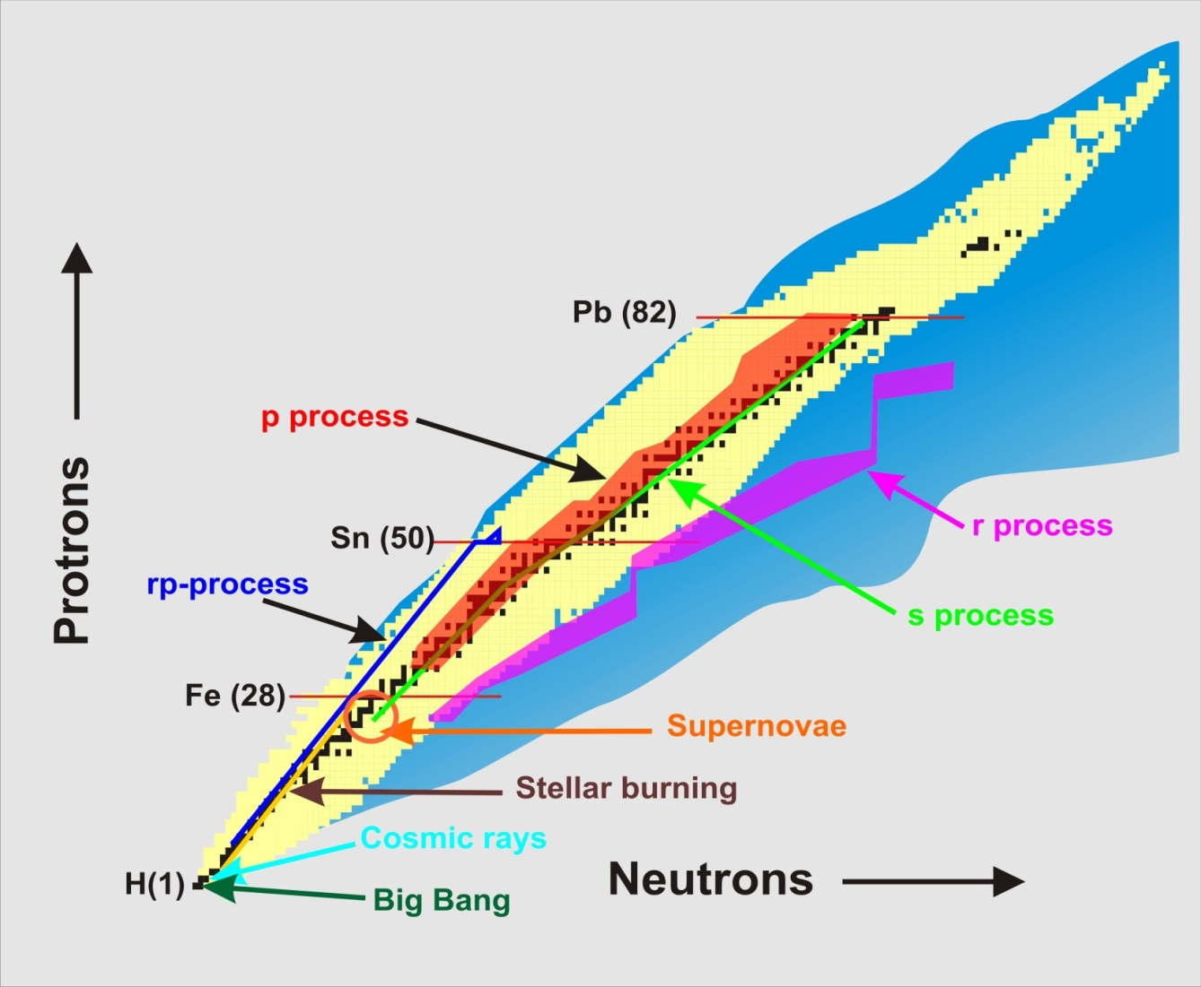
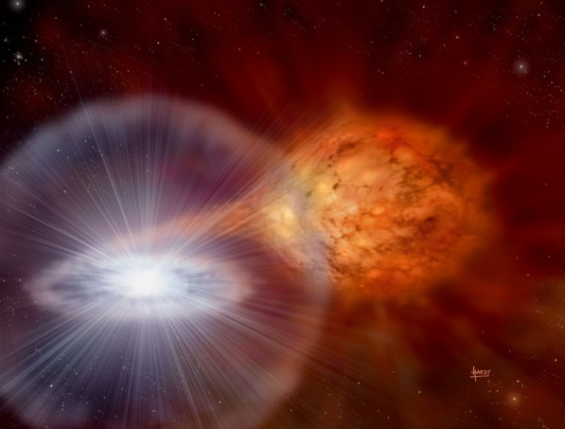
Synthesis of the elements
rp-process
N = 126
N = 82
Pictures:
Univ. of York

Slide 22
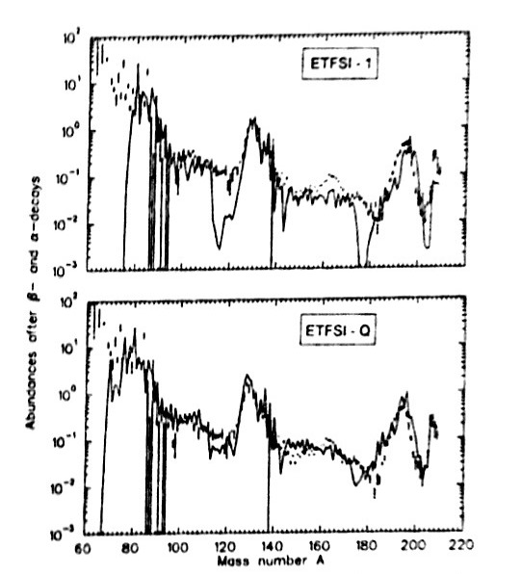
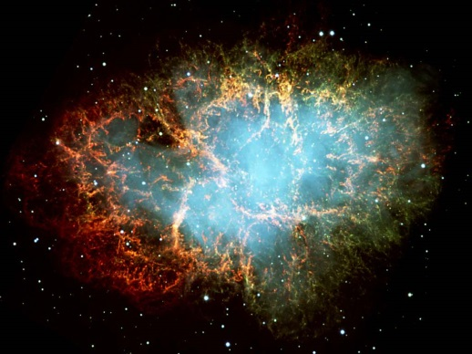
Synthesis of the elements
Astrophysical r-process
Massive neutron bombardment in
Supernova (Giusseppe Lorusso talk)
N = 126
N = 82
Pfeifer et al,
Z.Phys.A 357, 235(97)

Slide 23
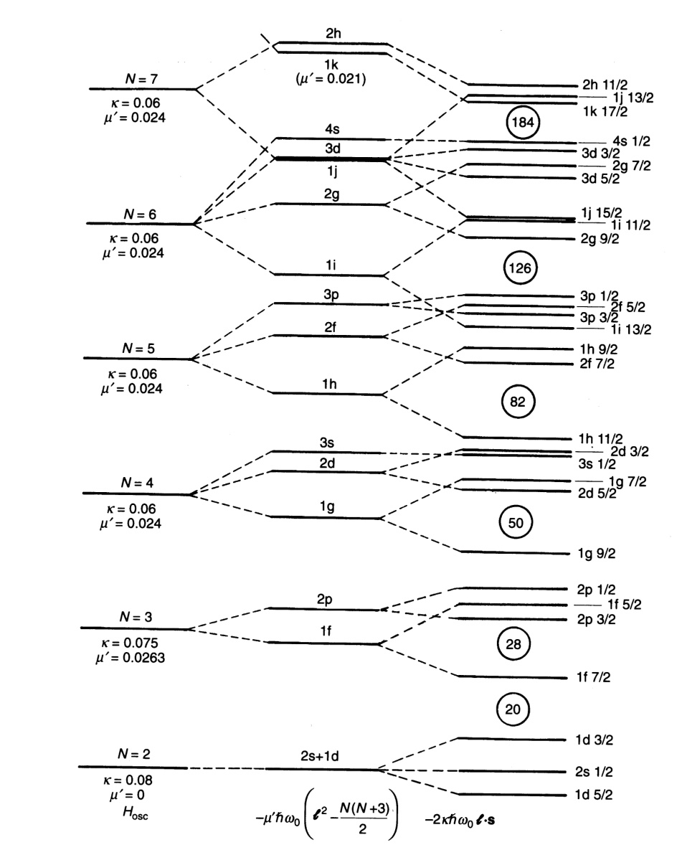
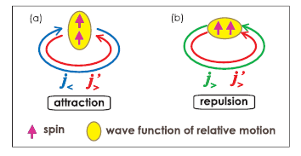
Shell Model of 1949 needs fixing
3 body forces
Importance of Tensor Force in the n-rich!
Takaharu Otsuka et al PRL 87, 082502 (2001); PRL 95, 232502 (2005)
Neutron Skin

Slide 24
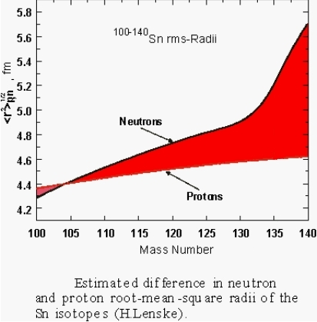
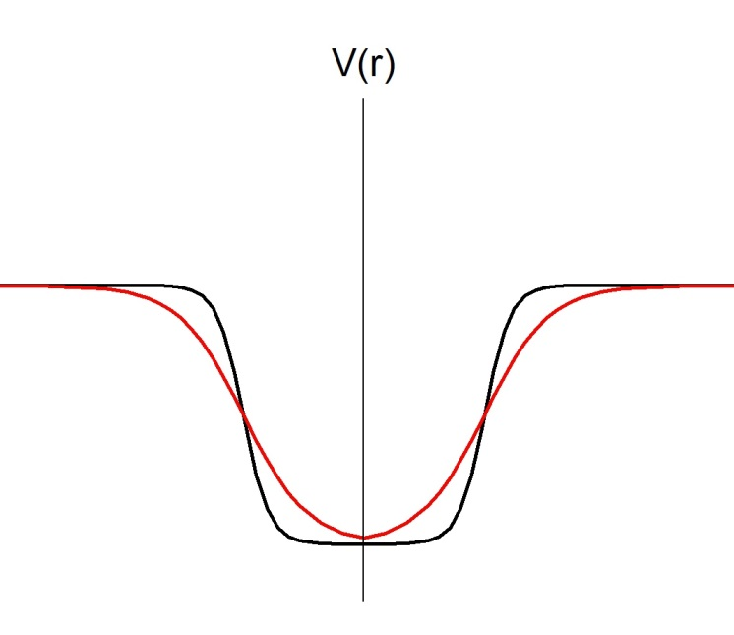
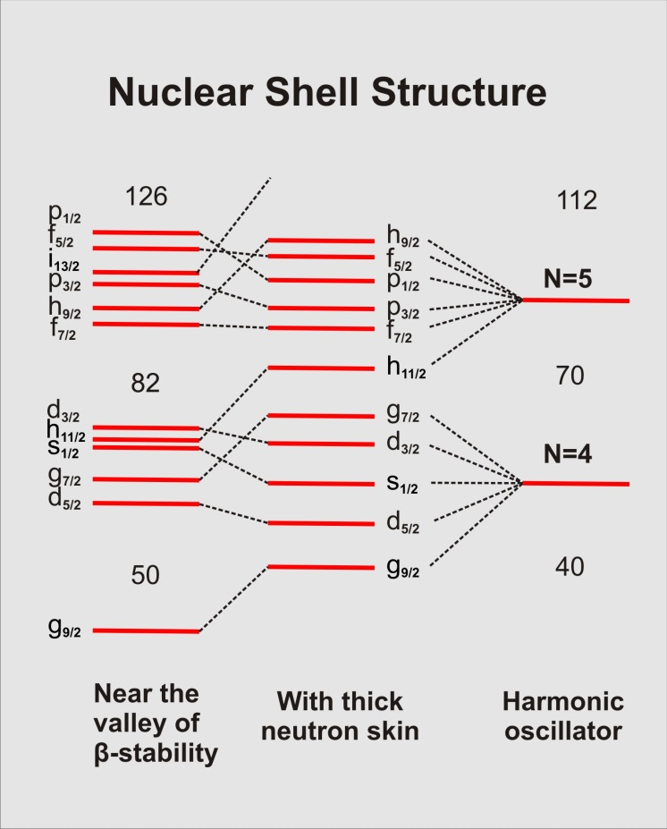
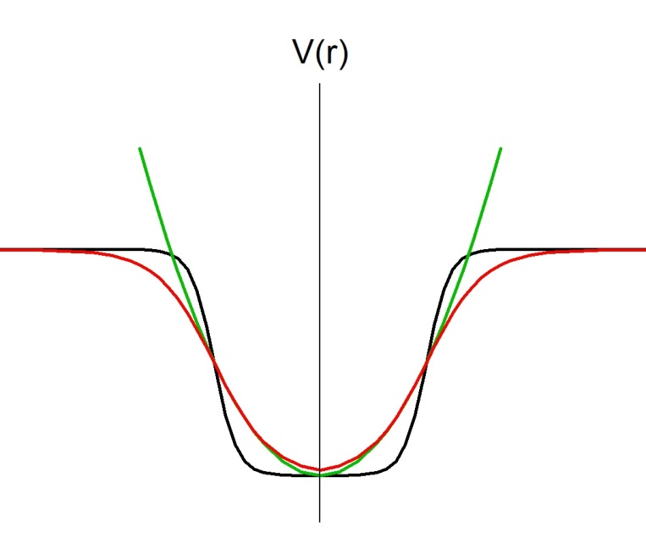
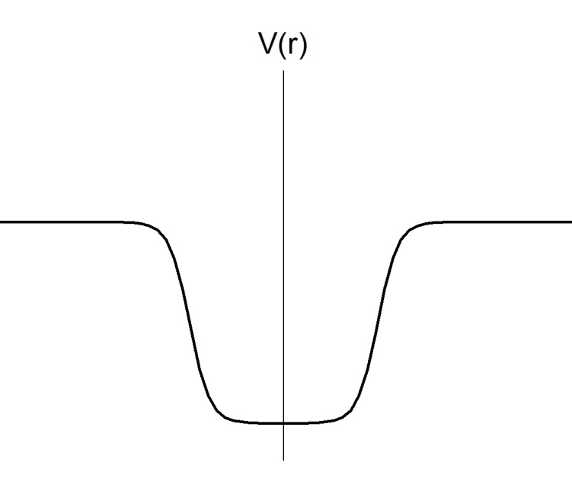
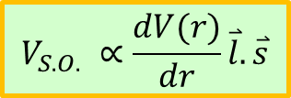
Neutron Rich: Neutron Skin!
Drastic Changes of Shell Structure far off stability!
Softening of the nuclear potential:
High-l pushed upward and
Spin-Orbit splitting reduced
$$V_{S.O.} ∝\frac{dV(r)}{dr}\overset{⃑}{l}.\overset{⃑}{s}$$
(Giusseppe Lorusso talk)

Slide 25
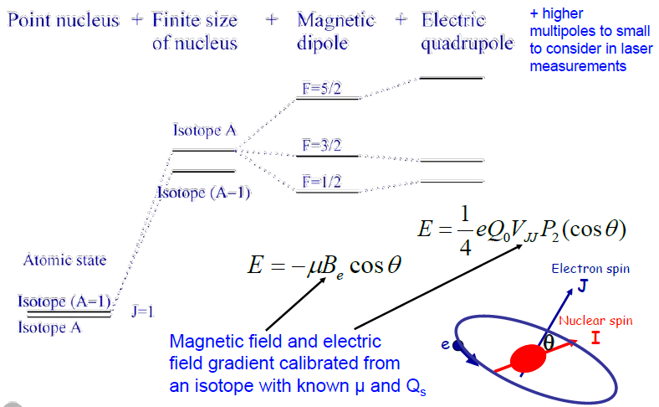
Materials Analysis with RIBs
Hyperfine Structure

Slide 26
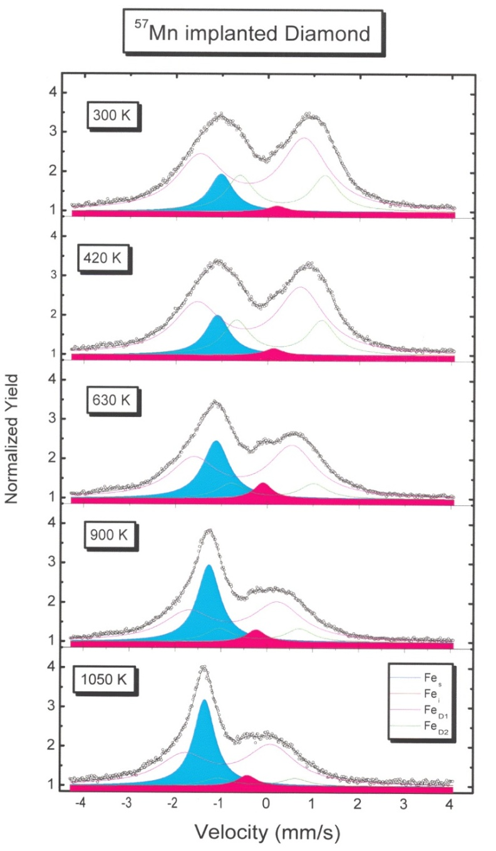
Mössbauer Spectroscopy at CERN
K. Bharuth-Ram et al
⁵⁷Mn implanted into diamond
decays to ⁵⁷Fe
Spectral components correspond
to Fe atoms occupying substitutional
and interstitial sites

Slide 27
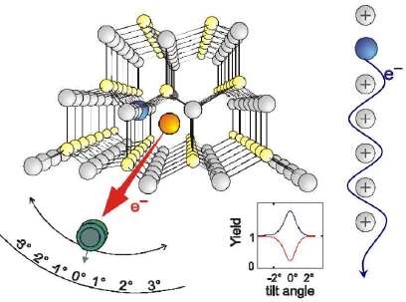
Electron Emission Channeling

Slide 28
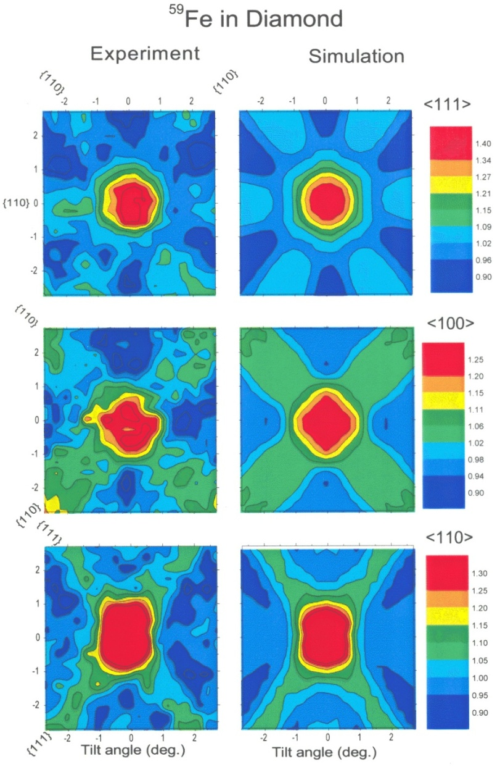
Solid State Physics at ISOLDE, CERN
Lattice location of Fe in Diamond
K. Bharuth-Ram et al
⁵⁹Mn (t_{1/2} = 4.6s) implanted into
Diamond, decays to ⁵⁹Fe which
β-decays with t_{1/2} = 45 days
Electron emission channeling
Measurements indicate that
65% of Fe atoms lie within 0.2 Å
From a substitutional site

Slide 29
A New Cyclotron at iThemba LABS
Isotope Production off SSC and onto new cyclotron
Free SSC for use by Physics and neutron therapy
More than doubles physics beamtime (including stable beams)
Production of radioactive beams using the ISOL method
In-flight production of RIBs (with SSC upgrade)
Proton Therapy to iTHPTC (probably to a hospital)

Slide 30
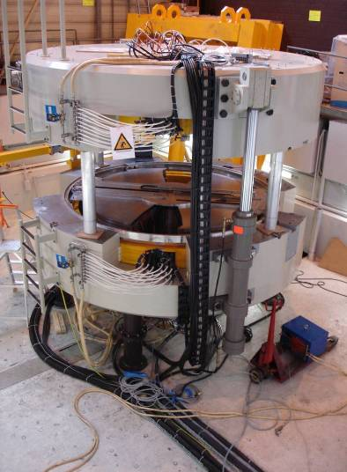

C70 General Description
Diameter < 4m
Weight > 120t
Magnetic field: 1.55T
Magnetic Gap: 30mm
Extraction Radius: 1.2m
2 exit ports
Particles: H⁻ / D⁻ / He²⁺/ HH⁺
Variable Energy : 15 MeV → 70 MeV
extraction Systems:
    Stripper → H⁻ / D⁻
    Deflector → He²⁺/ HH⁺
Performances:
    750µA H⁻ → 70MeV Current upgrade up to 1.5mA
    35µA He²⁺ → 70MeV
Notes:
POSTER → William Beeckman, TUPRA08 Machining & Assembly
Advantage of a commercial solution: fixed time for delivery, performances already tested.

Slide 31
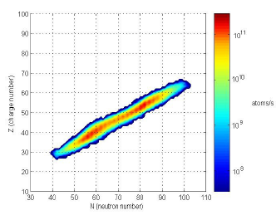
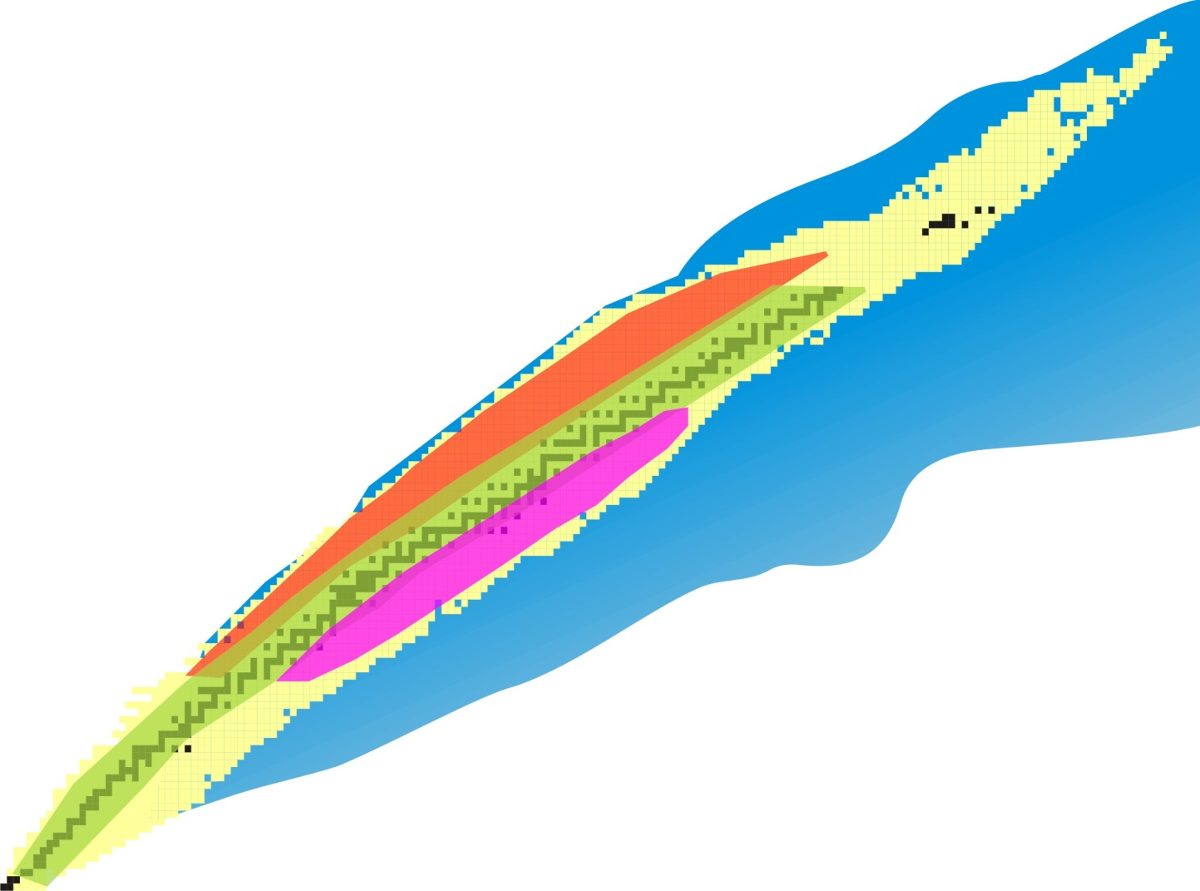
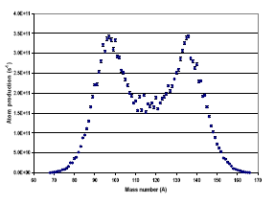
Making Radioactive Beams at iTL
H.I. Fusion-Evaporation
In-Flight
Inverse Kinematics
(p,xn), (p,yp,xn), (p, za, xn) ……
Proton induced Fission of Uranium

Slide 32
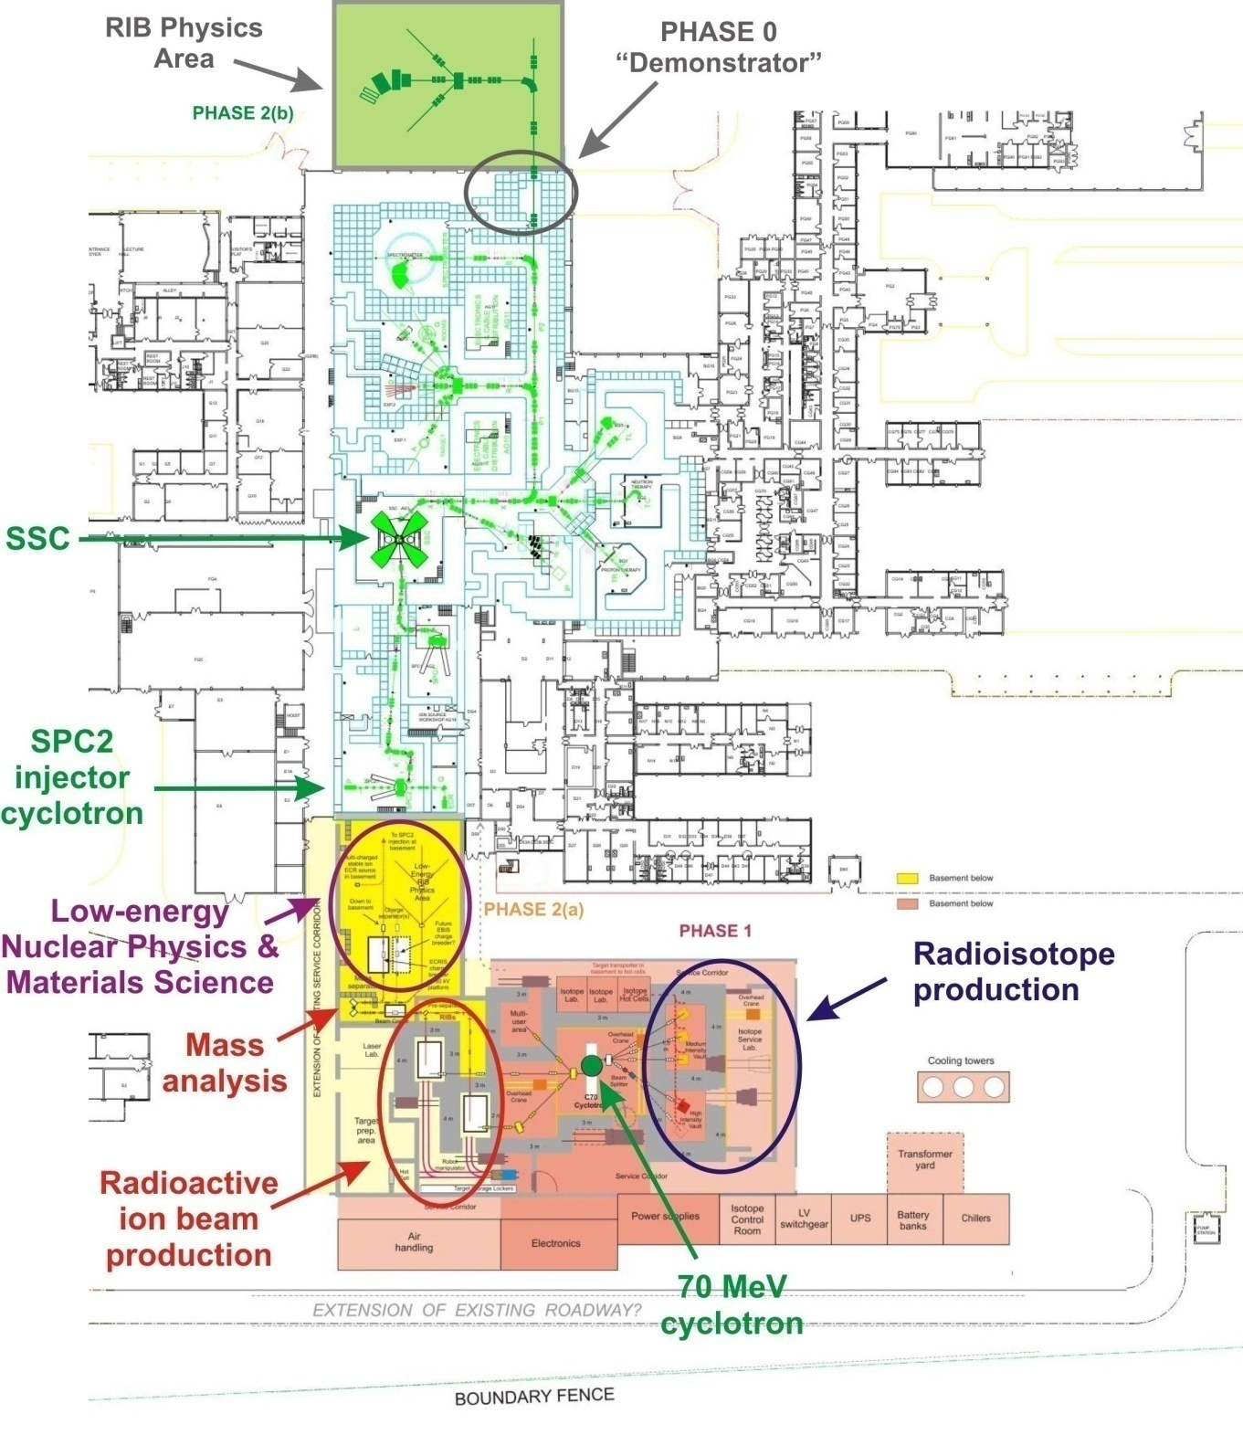
Additions to the existing facility

Slide 33

RIB Production
To injector/SSC
Low-energy
beamlines
Charge breeder
Mass analyser
Beam cooler
RIB production
stations
Target / ion-
source
maintenance
Robot
Target storage

Slide 34
A New Cyclotron at iThemba LABS
iThemba LABS
Flagship Project
National Research Foundation
RIB Project Strongly Supported
R32M Technical Design Study & Low Energy Facility
Department of Science & Technology
Developing South African Research Infrastructure Roadmap
iThemba LABS upgrade Ranked Highly

Slide 35

RIB Target/Ion-SourceTest Facility & Technical Design Study
Technical Design Study R7M
Test Facility R25M
Funded by NRF
Later to be used for
β-decay studies
Materials sciences
Testing fundamental symmetries

Slide 36

SPES Target/Ion-source
Collaboration with INFN Legnaro, Italy
High-power tests of SPES targets

Slide 37

Direct Target:
Collaboration with Legnaro INFN
Upgrade SPES direct target from 40 MeV beam to 70 MeV beam (Alberto Monetti)
More than doubles the fission yield (2 x 10¹³)
Power in this design
limited to
P = MeV x µA
= 70 x 150
= 7.5 kW

Slide 38




High – Power Test of SiC Target
60 µA, 66MeV = 4 kW
(designed byAlberto Monetti)

Slide 39

High – Power Test of SiC Target

Slide 40

High – Power Test of SiC Target
Target Temperature
External Safety Beam Dump Temperature
Vacuum
Beam Power Increase
Heater Power Off

Slide 41

High – Power Test of SiC Target

Slide 42

ISOL Beam Intensities

Slide 43
Technical Design Studies
Putting more beam on target
Without using more beam....
Lifetimes
Efficiencies
New
Accelerator
RIB
Production
target
1⁺ ion – source &
mass selector
Charge
Breeder
injector
SSC
Experiment
I(target) = N × ε₁₊ × ε_{M.S.} × ε_{C.B.} × ε_{SPC2} × ε_{SSC} × ε_{EXP} × e^{-t/τ}

Slide 44


Upgrade SPC2 and SSC:
Present SPC2 inflector unsuitable for heavy-ions
Double-drift buncher in injection line before SPC2
  Puts 80% of beam within phase acceptance
Presently have Variable Frequency Flat-Topping on SPC1
  Introduce the same to SPC2
Variable frequency flat-topping on SSC
Upgrade Vacuum
Overall transmission to reach up to 30%

Slide 45

N-rich intensities ultimately limited by
half lives and diffusion times
Limit due to target diffusion/effusion
Time ~ 1.2s

Slide 46

Charge breeding with 14 GHz ECRIS

Slide 47
Charge Breeding EBIS ?
Status report on physics research and technology developments of Electron String Ion Sources of multicharged ions
Evgeny E. DONETS
Joint Institute for Nuclear Research, Dubna, 141980, Russia
edonets@jinr.ru
iThemba Laboratory, Cape Town, South Africa
January 30, 2012

Slide 48
ESIS - type of EBIS
Element Xe M=129.0
Charge state q | Binding energy E_b; Optimal e-beam energy ≥2.0KeV E_e≈2.5xE_b | Relative abudance in charge state spectrum | Ionization time at J= 300 A/cm² | Ionization time at J= 500 A/cm² | Ionization time at J= 1000 A/cm²
Xe26+ q/M≈0.201 | E_b=0.86 KeV; E_e=2.0 KeV; | 30% | 24 ms | 14 ms | 7 ms
Xe42+ q/M≈0.326 | E_b=3.07 KeV; E_e=7.5 KeV; | 33% | 528 ms | 317 ms | 160 ms
Xe43+ q/M≈0.333 | E_b=3.25 KeV; E_e=7.5 KeV; | 40% | 840 ms | 500 ms | 250 ms
Xe44+ q/M≈0.341 | E_b=3.34 KeV; E_e=7.5 KeV; | 60% | 1.0 s | 630 ms | 315 ms
 |  | 70% | 1.3 s | 800 ms | 400 ms
 |  | 80% | 1.7 s | 1.0 s | 500 ms
Beam
Energy
8M
8 MeV/U
20 MeV/U

Slide 49
Major Instrumentation:
β-decay
Coulomb Excitation
Transfer Reactions
Deep Inelastic
High-efficiency γ-ray array
  ability to Doppler correct -“track”
Large Acceptance Spectrometer
Active Target

Slide 50



Upgrade of experimental facilities
n-rich ISOL beams (p,f)
p-rich ISOL beams (p,xn) (p,ypxn) (p,za,xn)….
Transfer reactions on light-ion targets e.g. (d,p)
Concept: HELIOS Argonne National Lab.
Lighthall et al NIMA622(2010)97

Slide 51


Upgrade of experimental facilities
n-rich ISOL Beams (fission fragments)
Transfer reactions on heavy-ion targets (Deep-inelastics)

Slide 52


Upgrade of experimental facilities
In-flight production of n-deficient beams
Fusion-evaporation; inverse kinematics
In-flight
Beam A ~ 120
1 pµA; 6 MeV/A
A ~ 20
Products A ~ 140
~ 4MeV/A 10⁷ pps
Coulex

Slide 53
Cost Estimates
Probably can be done for:
€44M New Accelerator & Isotope Production (pink)
+€33M RIB ISOL facility (RIBS) (yellow)
+€12M Instrumentation
~ €90 M Total
Over 8 – 10 years

Slide 54
Thank You

