Slide 1
The Medium and High resolution mass separators for SPES facility
State-of-art and perspectives
Antonio Domenico Russo
Legnaro 26/05/2014

Slide 2
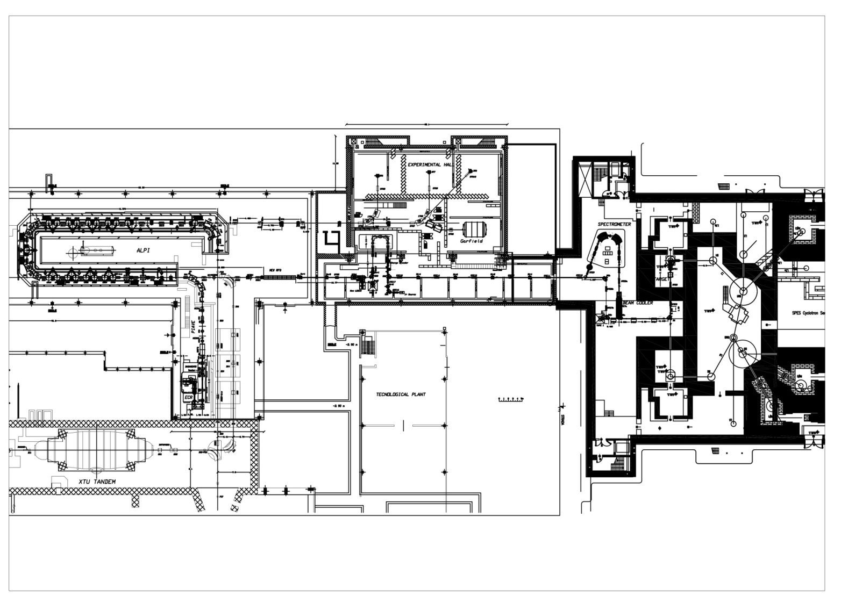
Overview
HRMS preliminary design;
New line to bypass the HRMS;
MRMS design and dipole simulation.
MRMS
HRMS
By-pass

Slide 3
Foreword
The list of possible SPES element is available on the SPES web site
https://web2.infn.it/spes/index.php/characteristics/spes-beams-7037/spesbeamstable
To obtain the ions of interest it is necessary :
To remove isobar ions coming from the source with high resolving power mass separator (HRMS);
Clean up the beam from contaminants introduced by the charge breeder with medium resolving power mass separator (MRMS)
Source
Charge breeder
HRMS
MRMS

Slide 4
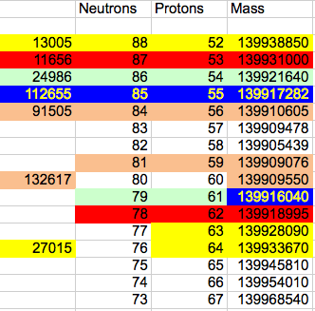
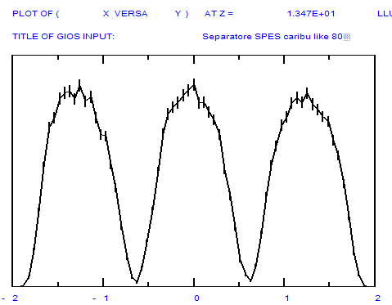
Isobaric nuclei table
Isobars A=140
Stable
Ba and La are not resolved
A/∆A =348 000
The difference of relative mass goes from 11500 up to 38500
−M/M 1/40.000
+ΔM/M 1/40.000
FWtM/R₁₆=1/40000
Isobars with similar intensities are well resolved
FWtM

Slide 5
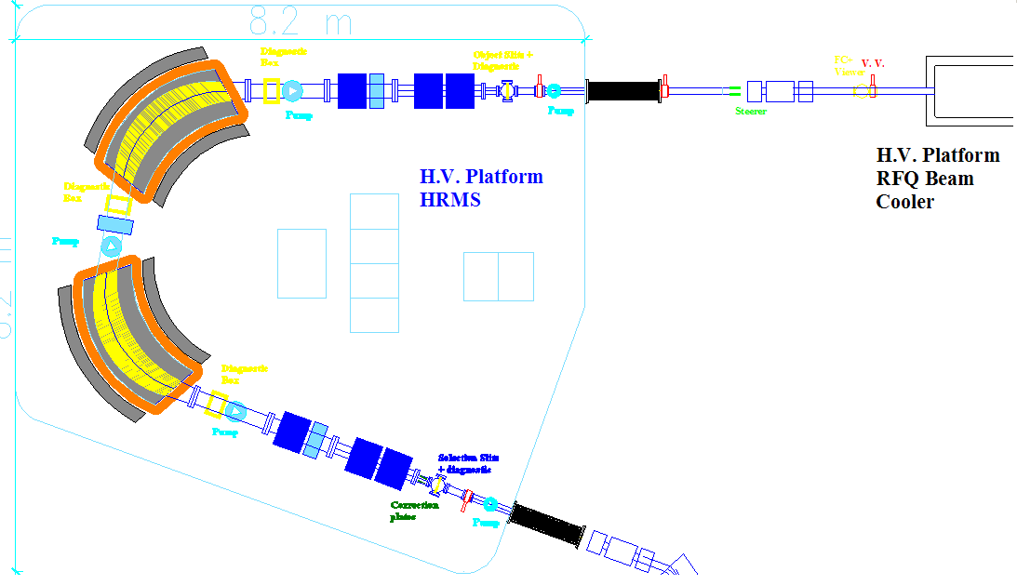
High Resolution Mass Separator
Quadrupoles
Dipoles
A Scaled up version of the separator designed by Cary Davids for CARIBU project, Argonne
Beam entry
Multipole
Sextupoles
Parameters | CARIBU | SPES-LNL
Bending radius | 500 mm | 1500 mm
Beam Energy | 50 keV | 260 keV
Magnetic field A=20 | 2.9 kGauss | 2.2 kGauss
Magnetic field A=200 | 9.1 kGauss | 6.9 kGauss
Bending angle | 60° | 80°
Entrance/exit angle | 23 | 28.4°
Pole gap | 80 mm | <80 mm
Pole width | 620 mm | <640 mm
Selection slits
5

Slide 6
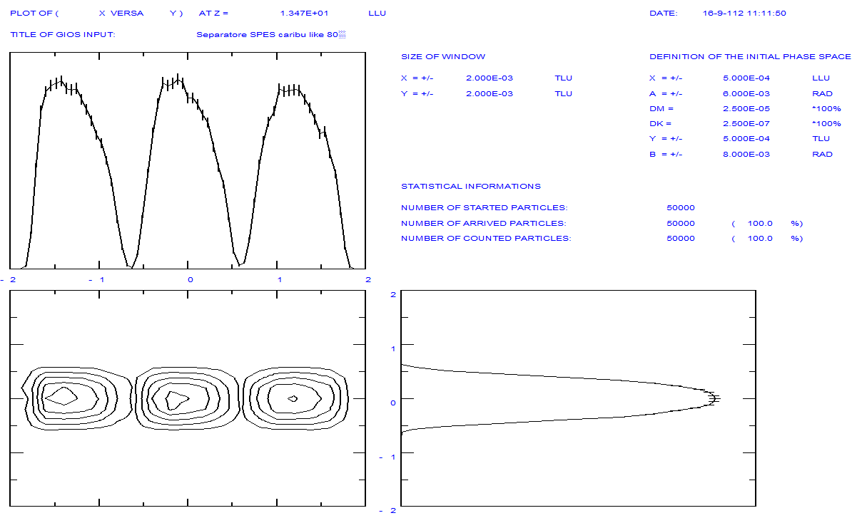
Gios simulations
Mass ΔM/M= 2.5 10⁻⁵ →1/40000 ΔΕ=0
I
x
I
y

Slide 7
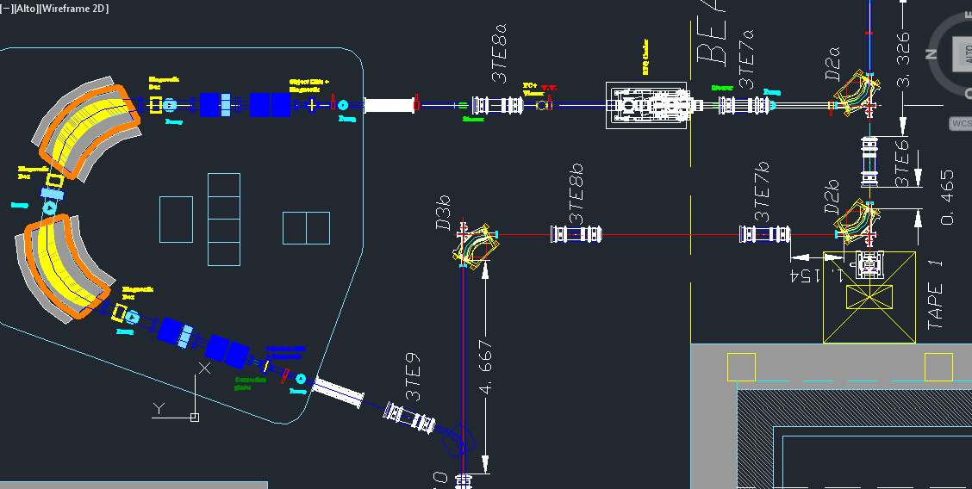
By-Pass
The installation of the bypass line is necessary because :
The system can operate even if the installation of the HRMS is not complete;
The line can be used to transport the low energy beam into another experimental hall;
The line bypasses the HRMS when it is not needed.
HRMS

Slide 8
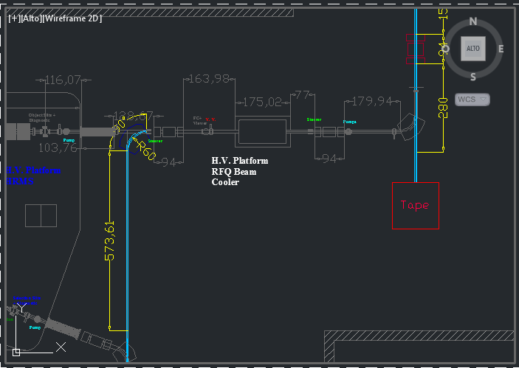
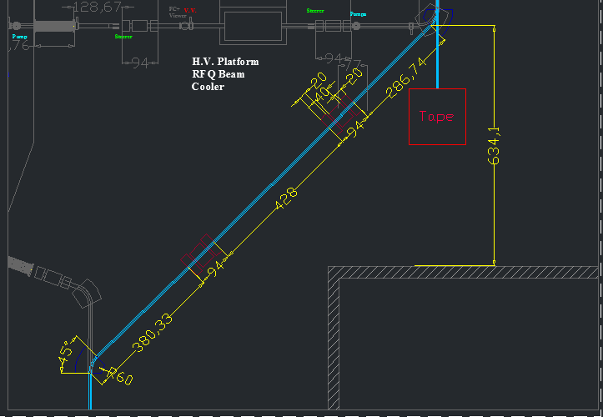
By-Pass
the beam cooler capabilities are maintained
Only two bending magnets are required

Slide 9
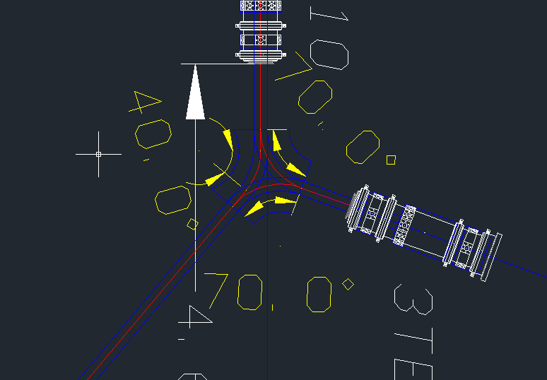
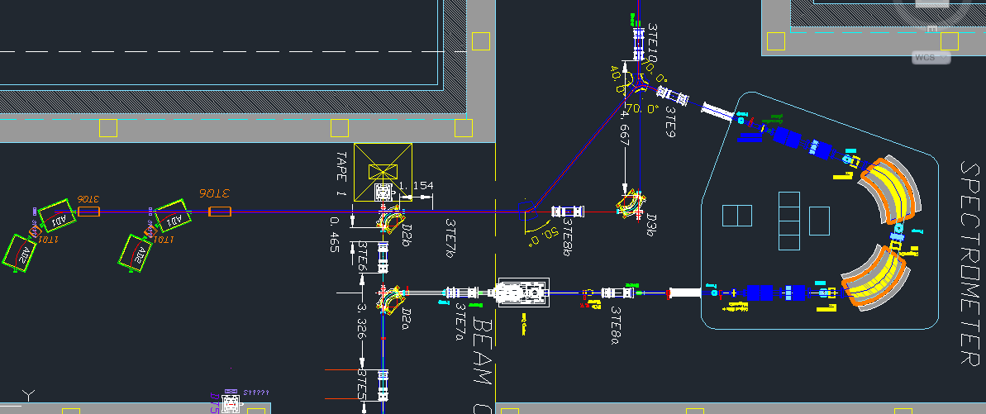
By-Pass
This setup shows how it is possible to use the bypass
line to transfer low energy beam to another experimental hall.
Red lines => Low energy beam

Slide 10
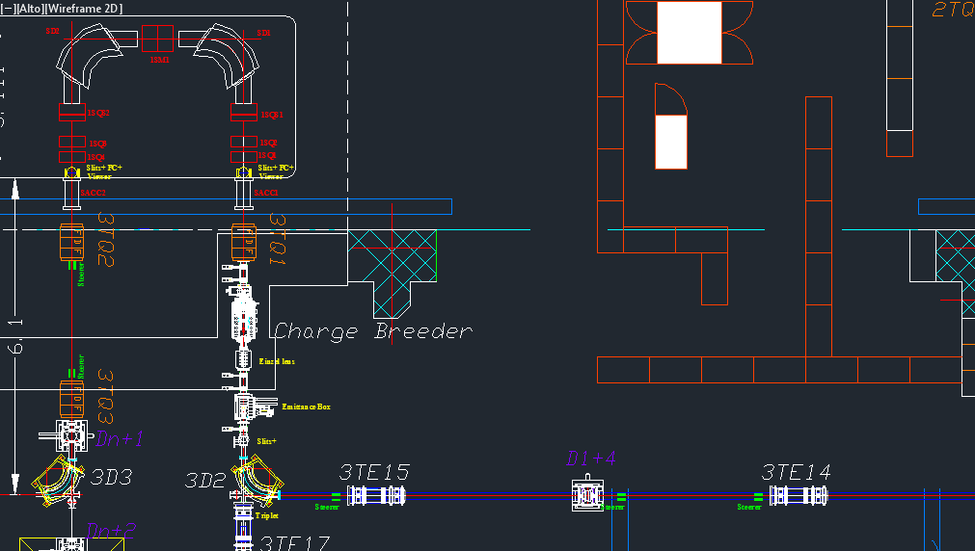
Medium Resolution Mass Separator
The beam exit the HRMS is injected in the charge breeder
It increases the beam charge state even if some contaminants are introduced.
The MRMS is required to clean up the beam.

Slide 11
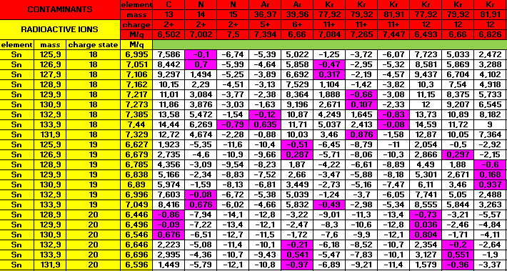
Medium Resolution Mass Separator
Analysis of contaminants introduced by the charge Breeder. Purple cells show the critical resolution value. A resolution of 0.1 % is sufficient.
Resolution (%)
Courtesy of Alessio Galatà

Slide 12
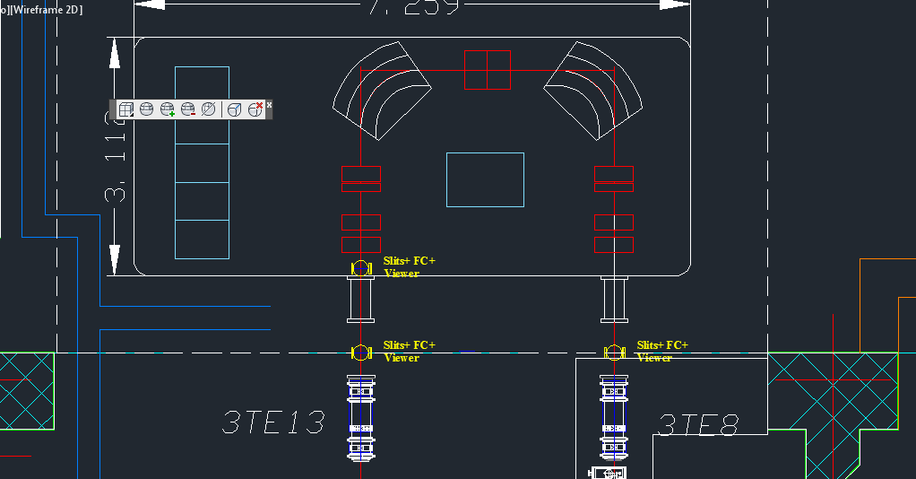
Medium Resolution Mass Separator
Characteristics of the beam at the entrance of the platform
Energy Sn19+@3.04 MeV (40KV+120KV extraction +platform voltage);
Normalized emittance in x-xp=0.1 p*mm*mrad;
Normalized emittance in y-yp=0.1 p*mm*mrad;
Twiss Parameter =0.5 =0
MRMS Project requirement
Dipoles
Mass resolution 0.1%
Multipole
Parameters
Bending radius | 750 mm
Beam Energy | 3.04 MeV
Magnetic field A=132 | 0.2 Tesla
Bending angle | 90°
Entrance/exit angle | 35°
Pole gap | 70 mm
Pole width | 400 mm
Multipole Eff. Length | 60 cm
Multipole diameter | 30 cm
Sextupoles
Quadrupoles
Designed by M. Comunian
Beam input

Slide 13
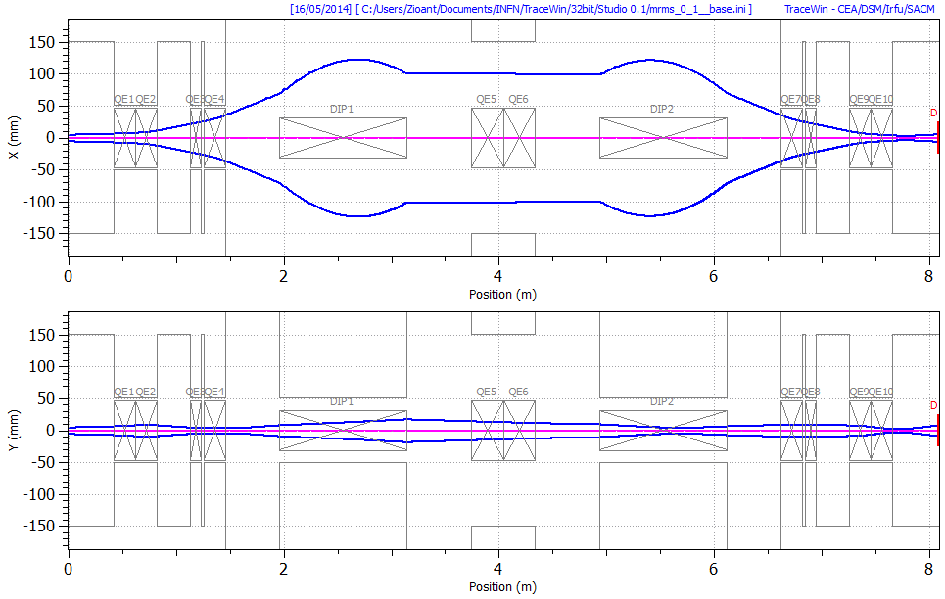
Medium Resolution Mass Separator
First order simulation: Resolution and beam envelope

Slide 14
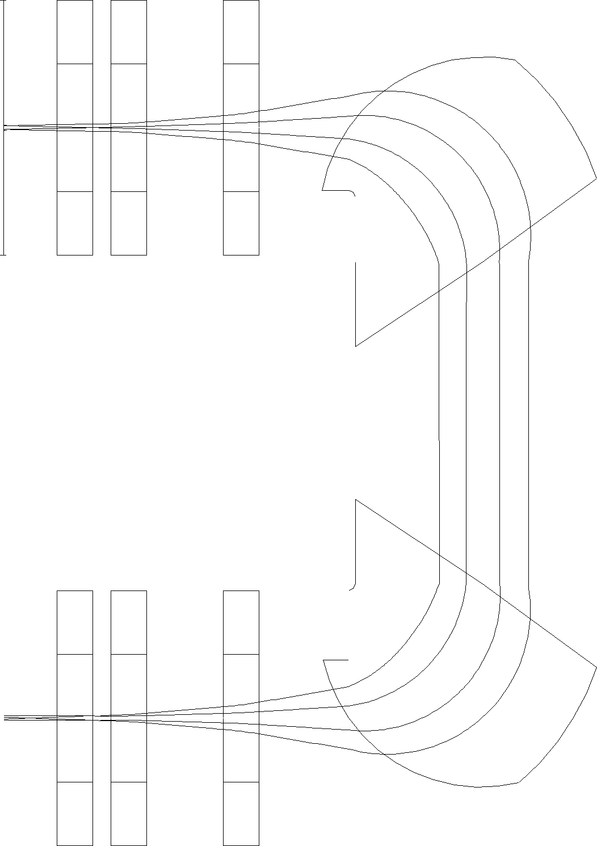
Optimization
A proper shaped dipole face can optimize the available space on the platform.
The corrective sextpole is no longer required.
1
2
Curvature 1
Rin1= 0.93 m
Curvature 2
Rout2=0.9 m
Beam entrance
14

Slide 15
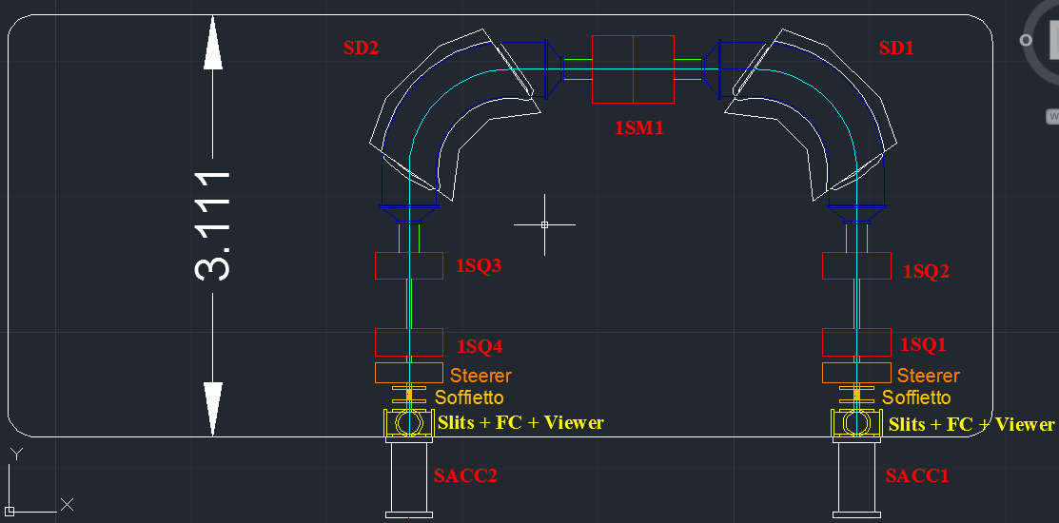
Further space optimization
The new design reduces the total number of quadrupoles from 6 to 4

Slide 16
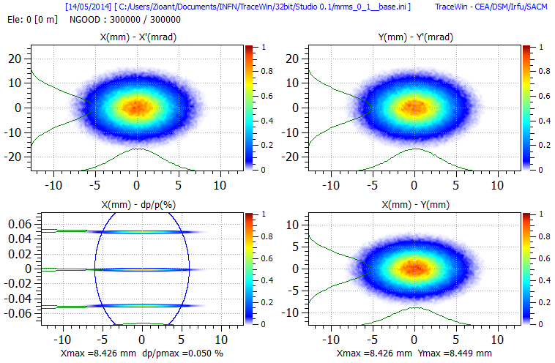
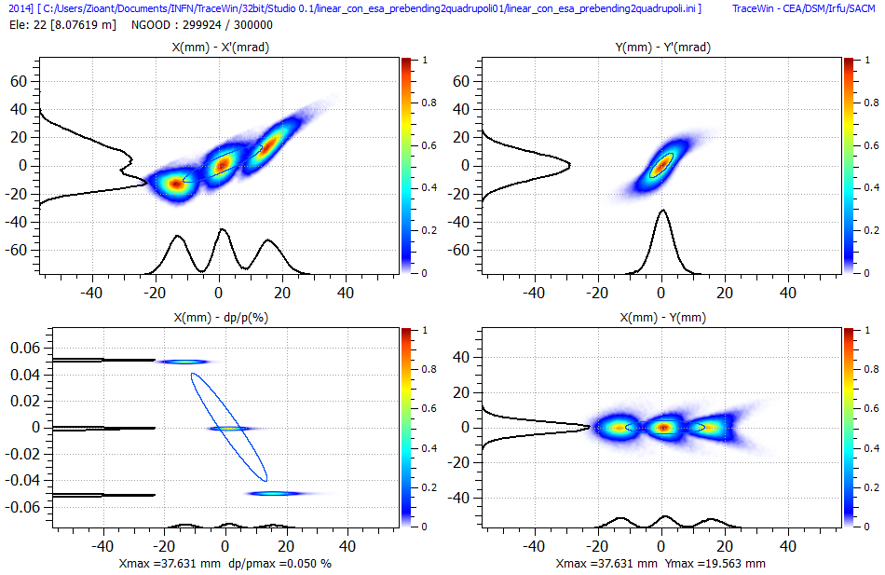
Resolving power
Simulation of a beam with ΔM/M= 0.1%
Tracewin input
output
Resolving power  1/1000

Slide 17
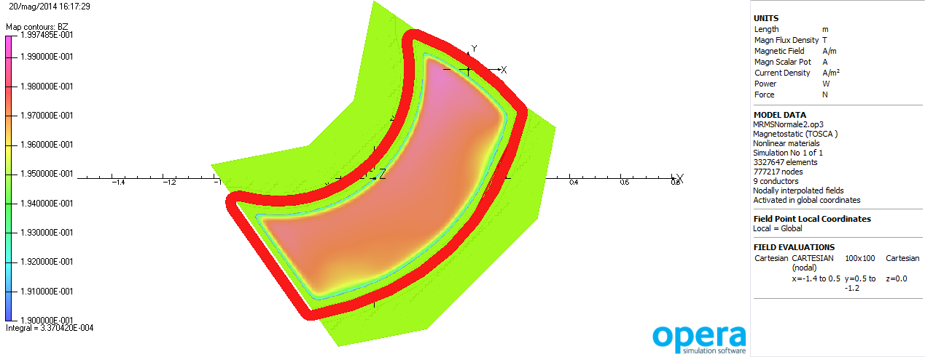
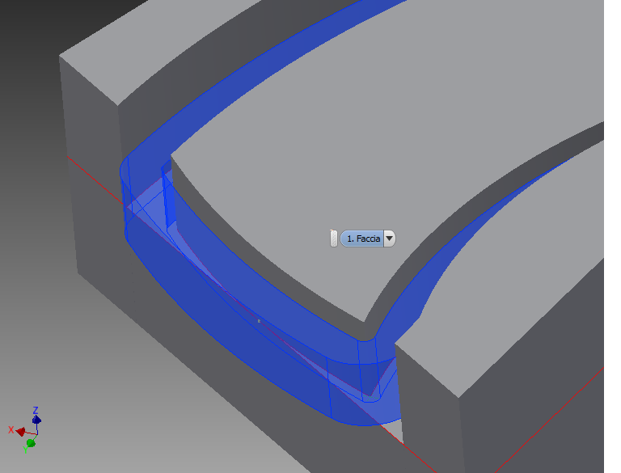
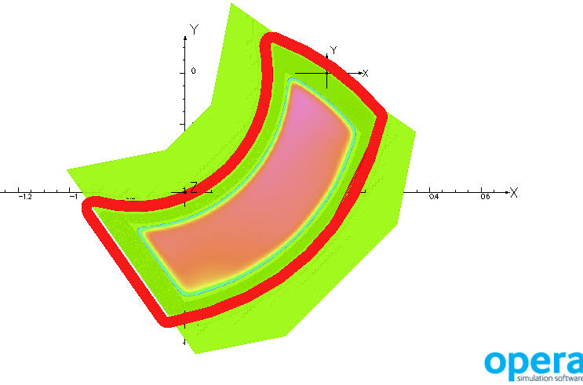
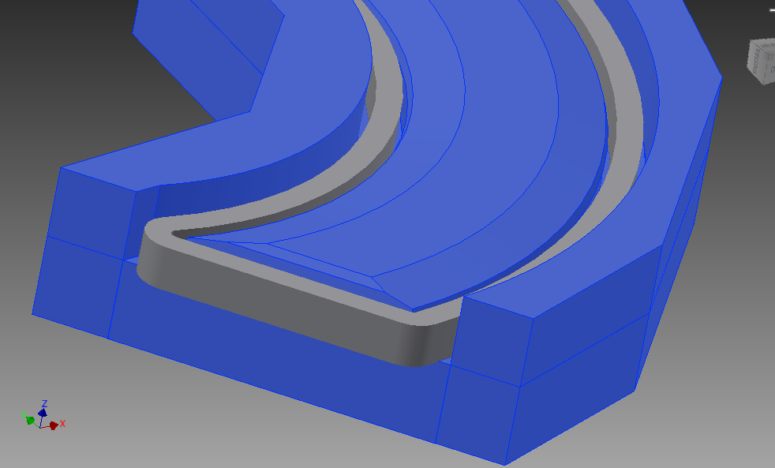
Preliminary Dipole design
Rogoswki shape

Slide 18
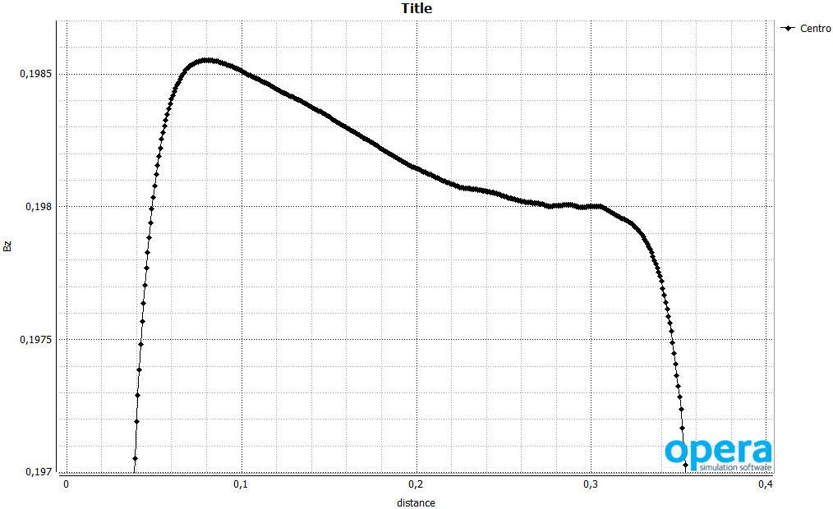
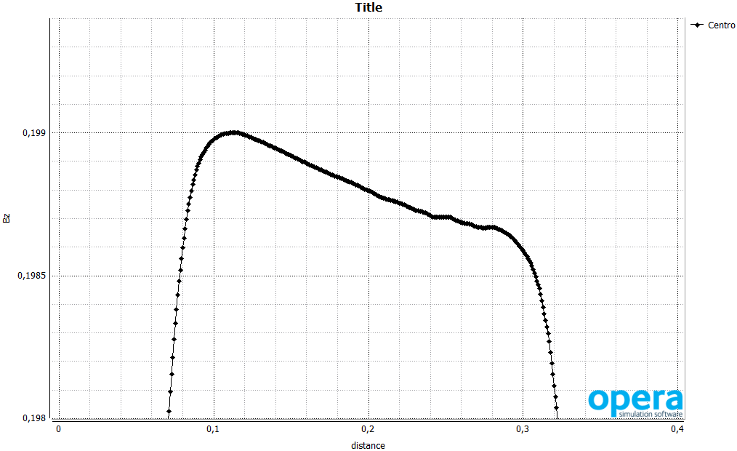
Preliminary Dipole design
Radial field profile
Sharp edges
Optimization 0.25% => 0.2%
Bz
This decreasing index field could be useful to the vertical focusing of the beam
Rogoswki shape solution
Bz

Slide 19
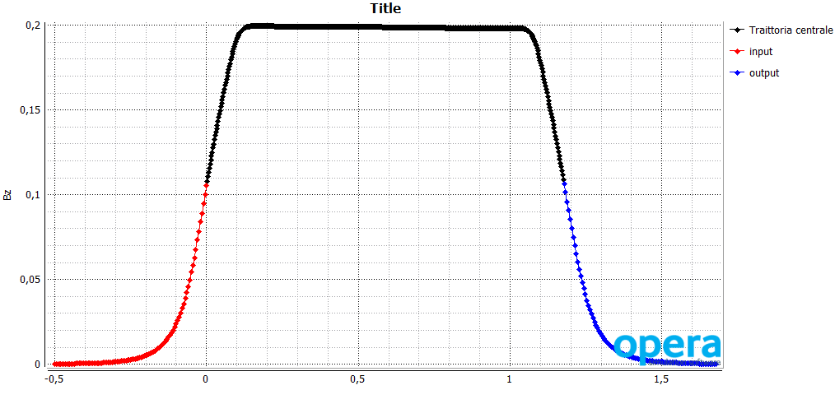
Preliminary Dipole design
Beam Input
Longitudinal field profile:
THE UNIFORMITY OF THE FIELD IS GOOD
m

Slide 20
Conclusions
3 optics studies of bypass line have been studied. One of these will be chosen in the next future;
MRMS study and design are preparatory to the HRMS;
The magnetic simulation of the dipole needs to be improved. Next studies on the errors of the system will determine the level of field uniformity we have to look for

